Slide 1




n_TOF
Report, Week 42-43
26/10 – 02/11/2021
On behalf of the n_TOF Collaboration
Javier Praena
Prof. Titular, Universidad de Granada (Spain)
CERN Scientific Associate (EP/SME) n_TOF Physics Coordinator
1

Slide 2



Summary of the week
Issue on Module fault from Monday to Tuesday, BE team was able to provide beam with this issue →Thank you very much to Frank Tecker and all the PS and BE team.
Sunday 31/10 a problem was solved. No beam few hours. Frank Tecker , thanks.
MD dedicated to n_TOF not affecting other experiments on Thursday 04 afternoon. Timing issue of the proton beam detected only with “fast” detectors.
EAR1: physics program ¹⁷⁶Yb(n,γ)¹⁷⁷Yb→¹⁷⁷Lu, for production of ¹⁷⁷Lu for cancer therapy.
EAR2: physics program ^{94,95,96}Mo(n,γ) for astrophysics.
NEAR: commissioning of the neutron flux (outside the bunker)
    R2E irradiations (outside the bunker)
    R2M irradiations (inside the bunker)
Javier Praena – U. Granada – CERN (EP/SME)
FOM Meeting, 02/11/2021

Slide 3
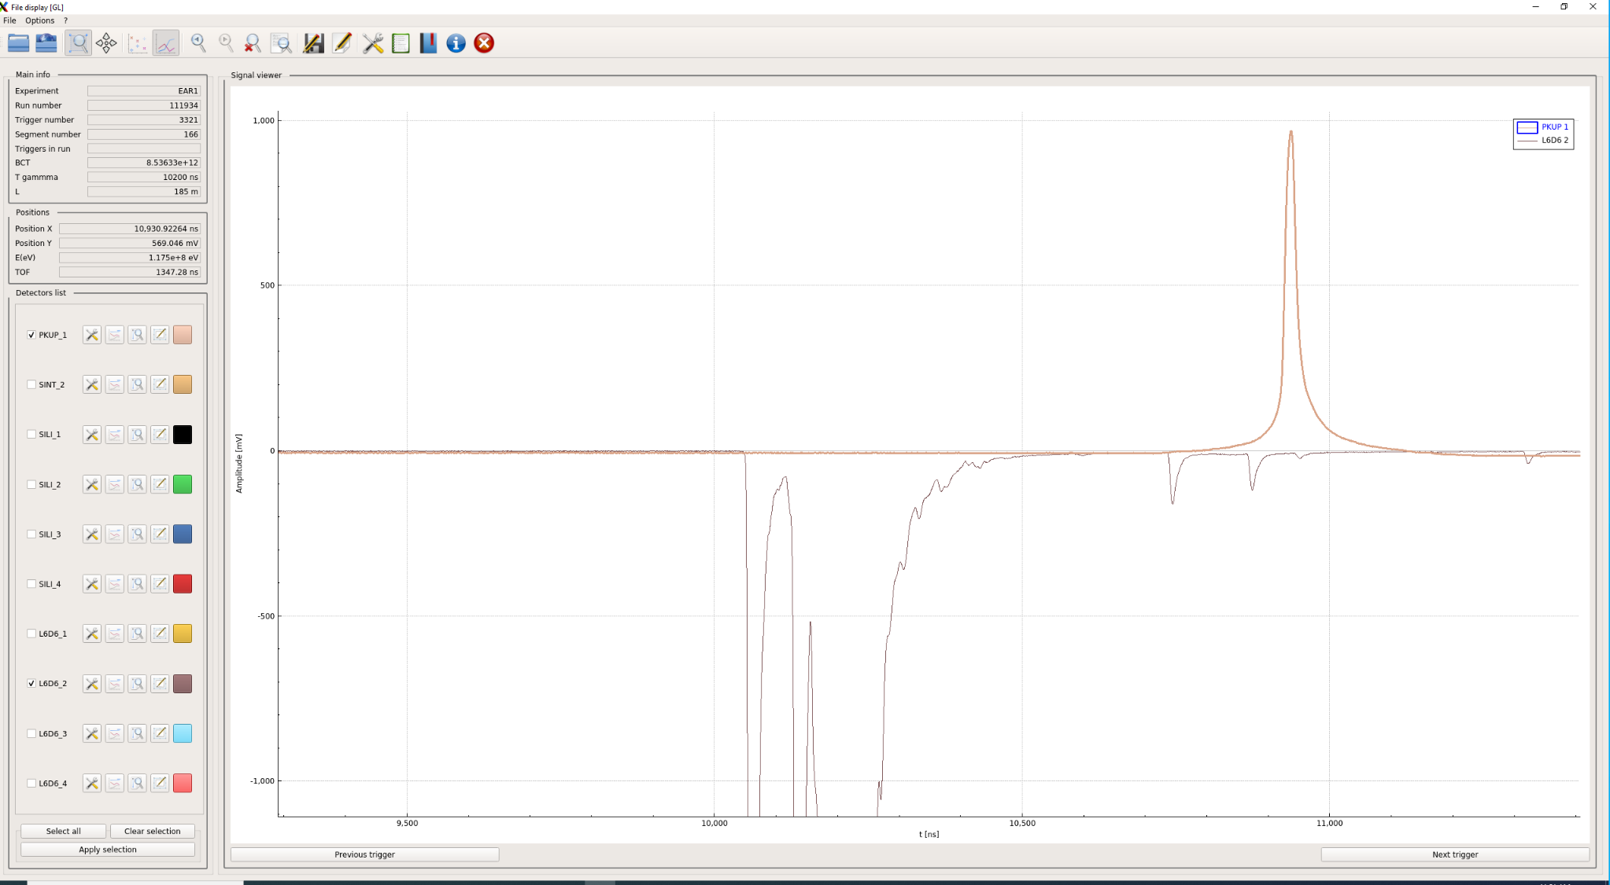
“Bad” proton pulse for timing (high intensity 8.5e12ppp)
Time cero provided by gammas from the target in our experiments is crucial since we measure with the time-of-flight technique…
Pickup signal has not a “sharp” rising
Time Zero of our TOF has “uncertainties”
Signals from fast detectors
“Real” Time Zero
Javier Praena – U. Granada – CERN (EP/SME)
FOM Meeting, 02/11/2021

Slide 4
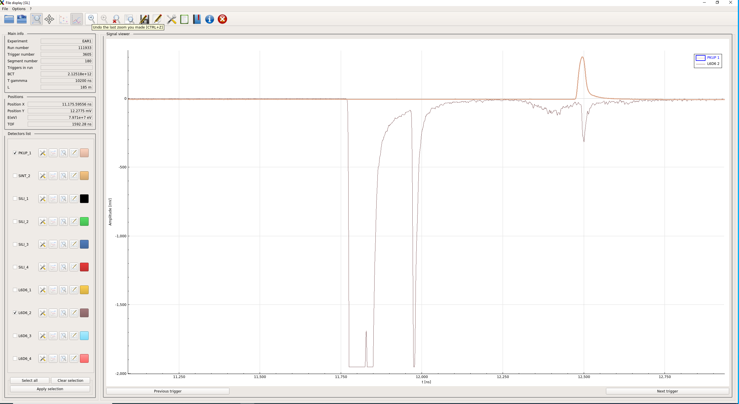
“Good” proton pulse for timing (low intensity 2e12ppp)
Pickup signal with excellent and “sharp” rising
Real and very good Time Zero
Signals from fast detectors
Javier Praena – U. Granada – CERN (EP/SME)
FOM Meeting, 02/11/2021

Slide 5
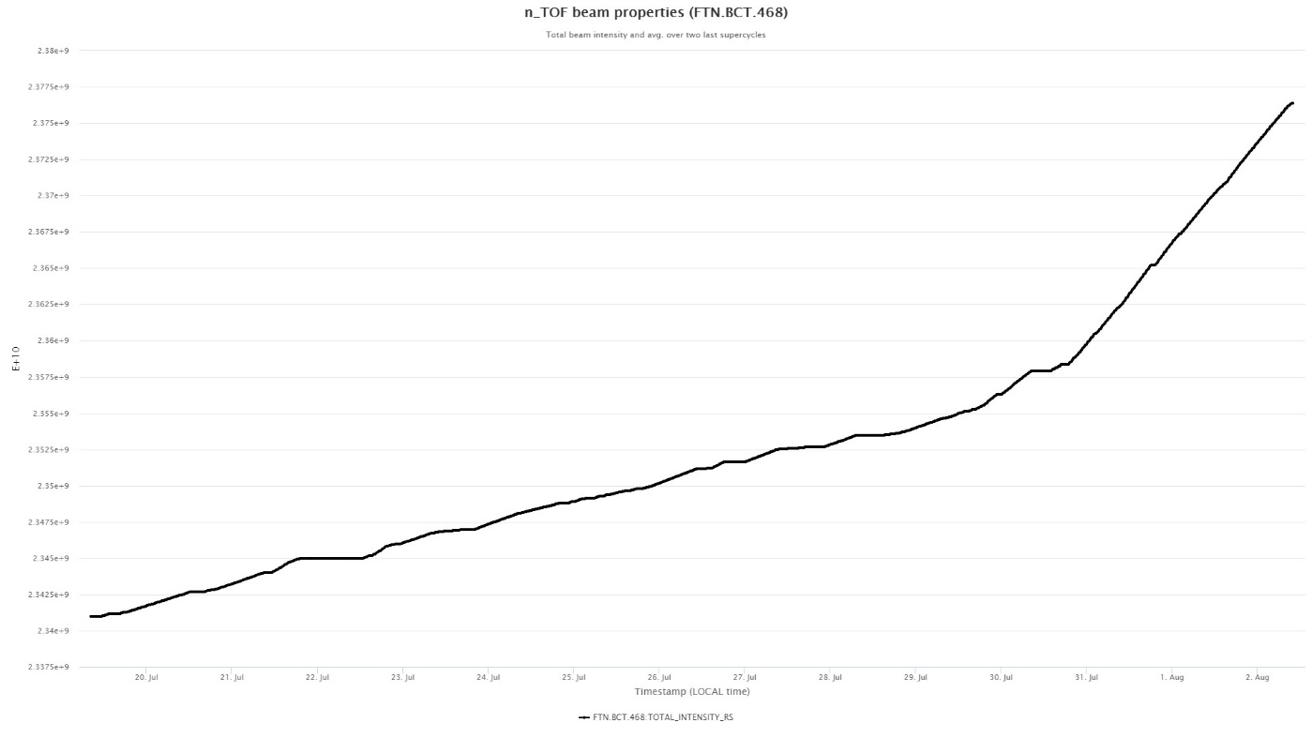
Number of protons up to now
Total number = 70e17
In the campaigns previous to the LS2 the average is 1.06e17 protons/day (including only days with beam, beam stops….).
The present year 2021:
  25e17 protons for the target commissioning, up to 13/09/2021.
  13/09/2021-02/11/2021 = 41 days
  We expected 69e17 protons and we have received 70e17 (“one day more”). Specially because the present we could get more beam than previous weeks.
Javier Praena – U. Granada – CERN (EP/SME)
FOM Meeting, 02/11/2021

Slide 6

Javier Praena
Universidad de Granada (Spain)
CERN Scientific Associate (EP/SME) n_TOF Physics Coordinator
Thank you
6

Slide 7
Beam stops
Beam stops:
  Monday 01/11/2021, from 5:00 to 12:30.
    Changing setup in EAR2
    Changing setup in NEAR (cooling time)
  Depending on the result of the new setup in EAR2 we could need another stop on Tuesday 02/11/2021. I will report to PS coordinator and BE.
Javier Praena – U. Granada – CERN (EP/SME)
PS/SPS Meeting, 28/10/2021

Slide 8
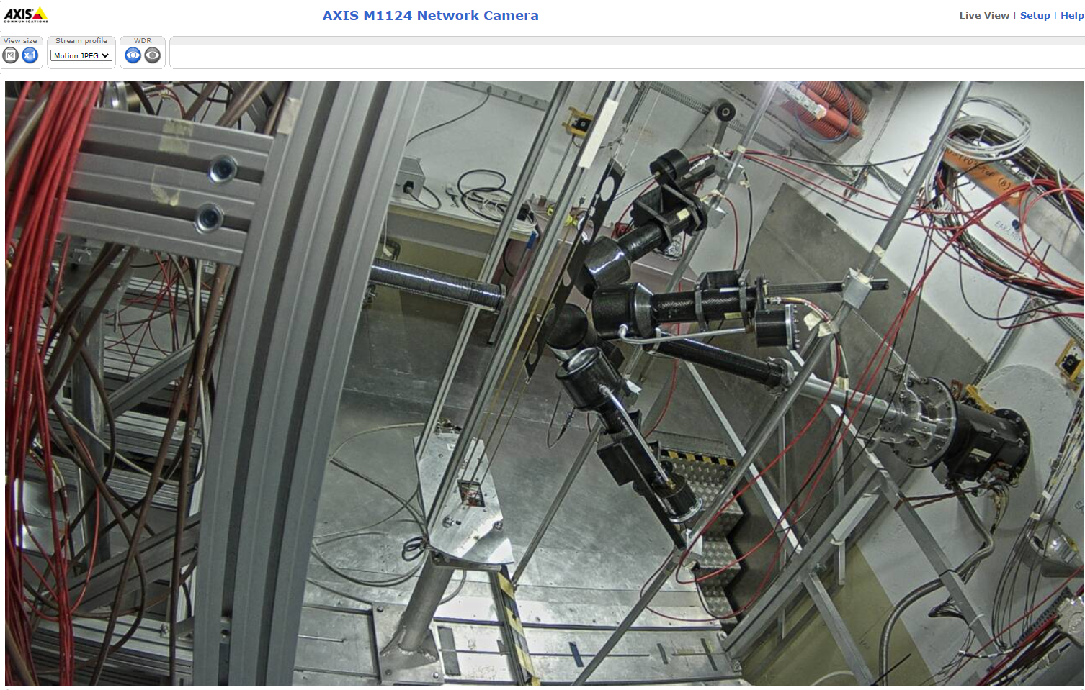
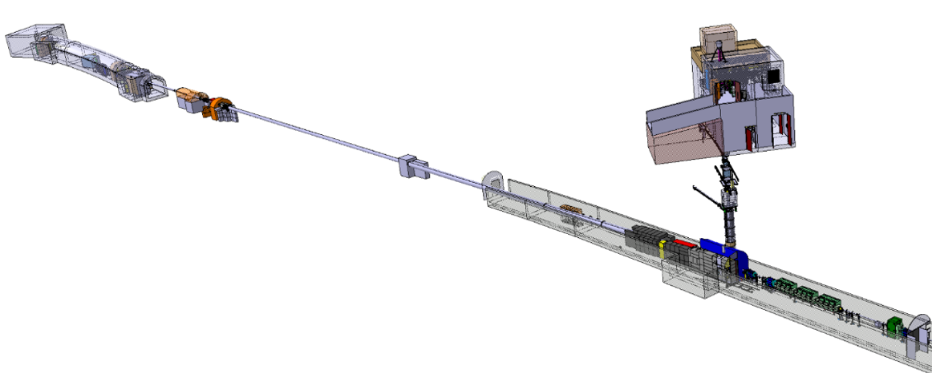

EAR1: continue commissioning time-to-energy conversion.
EAR1
@ 185 m
Neutrons
20 GeV
PS Protons
8
Javier Praena – U. Granada – CERN (EP/SME)
PS/SPS Meeting, 14/10/2021

Slide 9
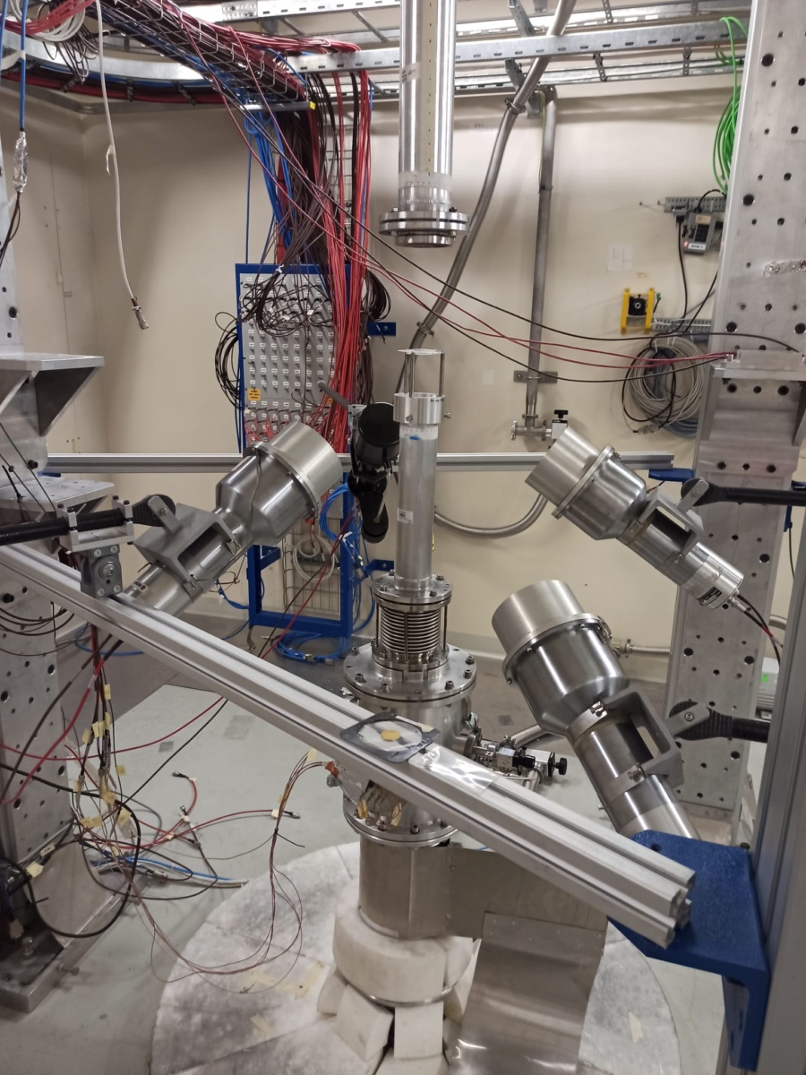
EAR2: start of Physics Measurements before expected
^{94,95,96}Mo(n,γ) with application to astrophysics
EAR2
@ 20 m
Neutrons
Neutrons
Neutrons
20 GeV
PS Protons
9
Javier Praena – U. Granada – CERN (EP/SME)
PS/SPS Meeting, 21/10/2021

Slide 10
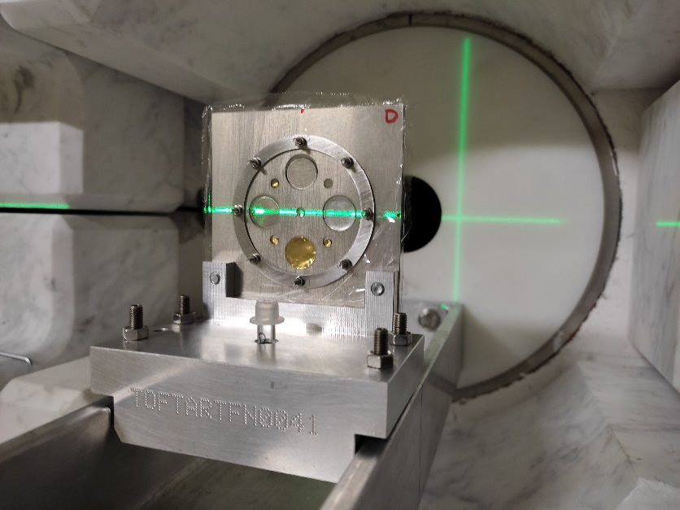
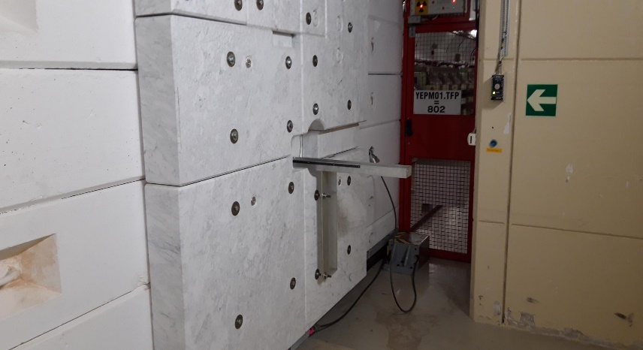
NEAR: multiactivation characterization of the neutron flux
EAR1
@ 185 m
NEAR:
N_TOF
R2M
R2E
20 GeV
PS Protons
10
Javier Praena – U. Granada – CERN (EP/SME)
FOM Meeting, 12/10/2021

Slide 11
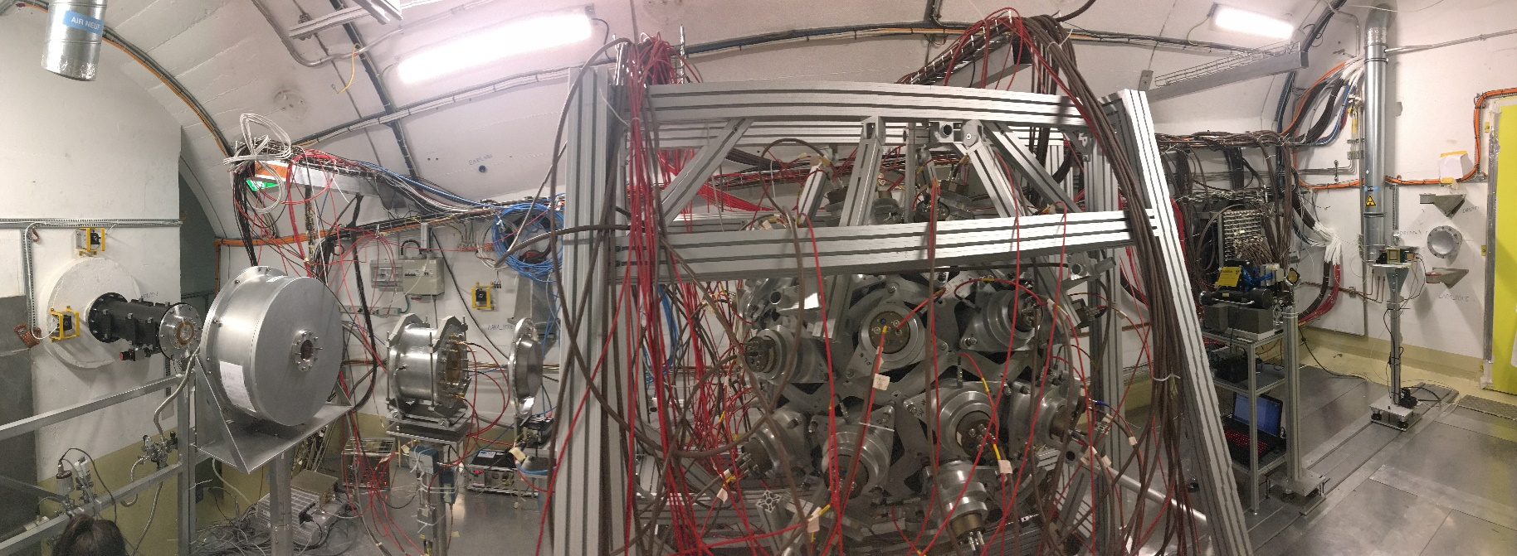
EAR1: previous setup.
EAR1
@ 185 m
PPAC1
(2x²³⁵U, gas
On-beam)
C₆D₆ and iTED
Neutrons
PTB (10x²³⁵U,gas
on-beam)
Simon1
(4 Si detectors off-beam)
Timepix1.2
(Si detector
On-beam)
MGAS1 (²³⁵U and 2x¹⁰B
(Gas Ionization on-beam)
20 GeV
PS Protons
11
Javier Praena – U. Granada – CERN (EP/SME)
PS/SPS Meeting, 30/09/2021

Slide 12
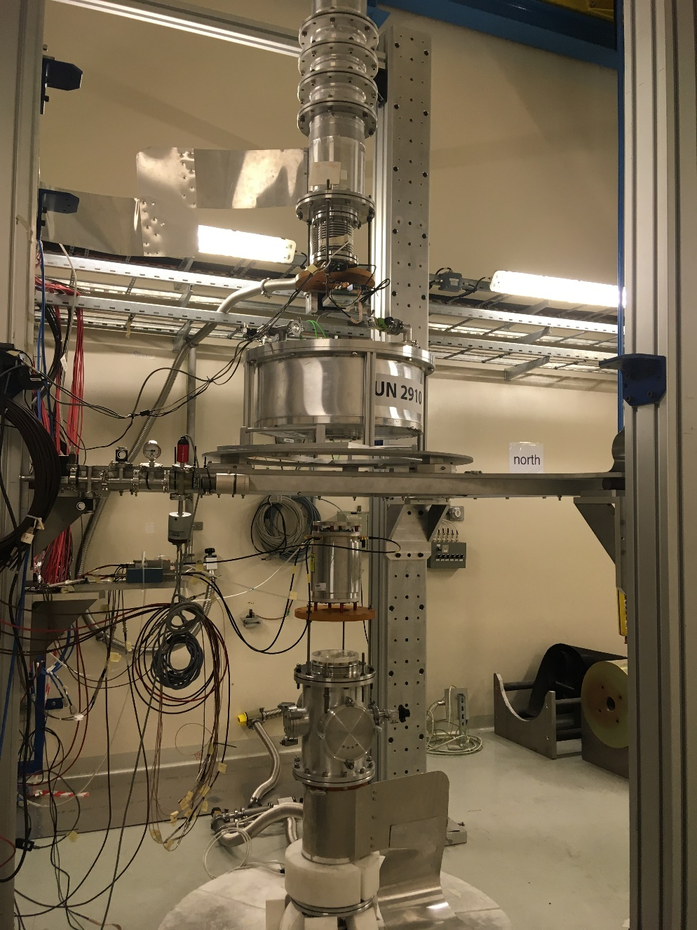
EAR2: previous setup
Neutrons
PPAC1
(²³⁸U, ²³⁷Np gas, on-beam)
EAR2
@ 20 m
Neutrons
MGAS2 (²³⁵U, ¹⁰B, gas on-beam)
Simon2
(4 Si detectors off-beam)
20 GeV
PS Protons
Neutrons
12
Javier Praena – U. Granada – CERN (EP/SME)
PS/SPS Meeting, 30/09/2021

Slide 13
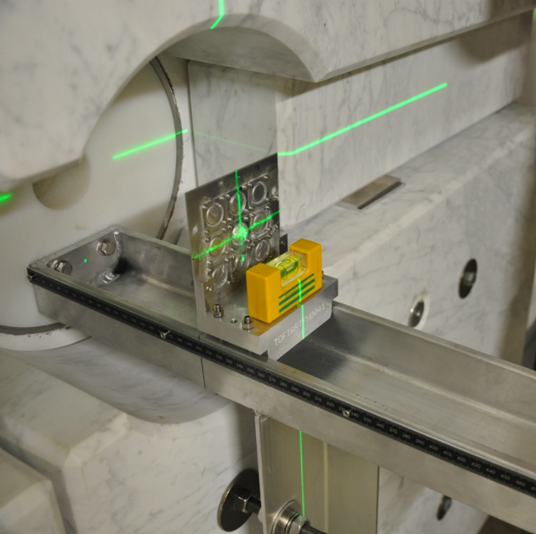
NEAR: change of the setup for multiactivation
EAR1
@ 185 m
EAR2
@ 20 m
NEAR:
N_TOF
R2M
R2E
20 GeV
PS Protons
13
Javier Praena – U. Granada – CERN (EP/SME)
PS/SPS Meeting, 30/09/2021

