Slide 1
WLCG Prolonged Site Downtimes
Towards A Common Strategy?
Jamie.Shiers@cern.ch

Slide 2
Prolonged Site Downtimes
Can we agree on common timelines based on those proposed by CMS and EGI?
EGI talks of:
Up to 24 hours;
Up to 72 hours;
Up to 30 days.
CMS timelines “similar” (next):

Slide 3
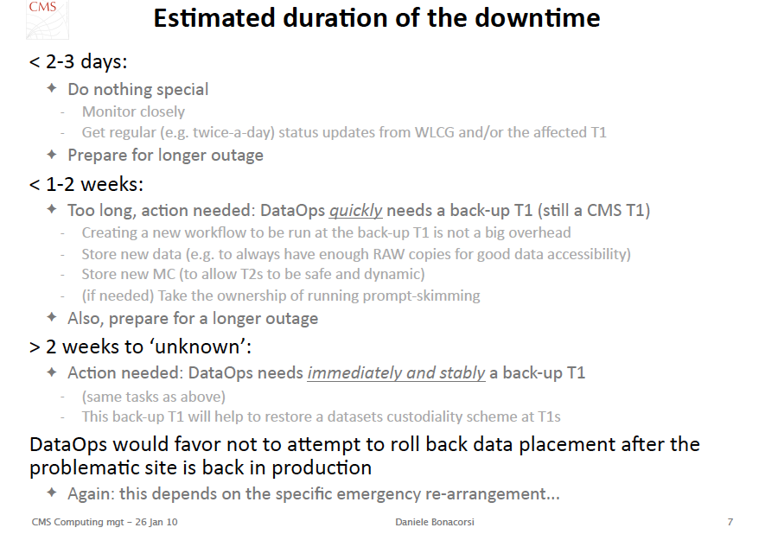

Slide 4
WLCG Timelines (proposal)
1st 24 hours: site internal
Following 48 hours: 1st level escalation
Updates reported to WLCG operations meeting & GGUS tickets;
Formal notification to WLCG MB(?) [ IMHO yes ]
Up to 2 weeks: 2nd level escalation
“Recovery” (if appropriate) may still be an option (cf NL-T1 case)
N.B. 3rd level escalation may be triggered earlier if felt appropriate (e.g. if all reasonable options exhausted)
WLCG helps mediate choice of backup sites (inter-VO issues)
Beyond: 3rd level escalation
Recovery no longer appropriate(?)
Restoration of service is now top priority but may take a long time – e.g. in case of disaster
Incident reported to WLCG OB and CB

Slide 5
Incidents Affecting Multiple Sites
They happen…
Need to agree action beforehand
Goal: minimize impact
A preventative downtime – even if it impacts data taking – may be strongly preferred to the alternatives (which could involve lengthy site re-installs and/or uncertainty about data security/integrity
Proposal: top priority upgrades not counted as site downtime
To be confirmed on a case-by-case basis

Slide 6
Summary
We have had numerous prolonged and disruptive site downtimes
We need a strategy for handling them
The proposed timelines are suggestions – they can be adjusted as necessary but not too much!
We should start handling such downtimes systematically now…

