Slide 1
Comparison between magnet configurations for C-ions gantry
A first proposal
E. Felcini
21/09/2021

Slide 2
The Gantry magnet’s tree
70 mm Ø
90 mm Ø
Fixed gradient
< 5 T/m (mechanical)
+ bolted quads
30 degrees
70 mm Ø
Dipole Field, B0 = 4T
45 degrees
90 mm Ø
Variable gradient
< 5 T/m ± 0.5 T/m
(separate circuits)
30 degrees
70 mm Ø
Ramp rate:
0.35 T/s at B0_{min} (2T)
0.10 T/s at B0_{max} (4T)
90 mm Ø
45 degrees
90 mm Ø
90 mm Ø

Slide 3
The Gantry magnet’s tree
70 mm Ø
90 mm Ø
Fixed gradient
< 5 T/m (mechanical)
+ bolted quads
30 degrees
70 mm Ø
Dipole Field, B0 = 4T
45 degrees
90 mm Ø
Variable gradient
< 5 T/m ± 0.5 T/m
(separate circuits)
30 degrees
70 mm Ø
Ramp rate:
0.35 T/s at B0_{min} (2T)
0.10 T/s at B0_{max} (4T)
90 mm Ø
45 degrees
90 mm Ø
90 mm Ø

Slide 4
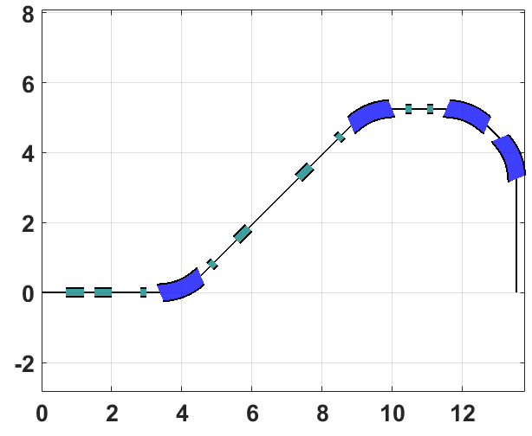
70 mm Ø
The Gantry magnet’s tree
90 mm Ø
Fixed gradient
< 5 T/m (mechanical)
+ bolted quads
30 degrees
70 mm Ø
Dipole Field, B0 = 4T
45 degrees
90 mm Ø
Variable gradient
< 5 T/m ± 0.5 T/m
(separate circuits)
30 degrees
70 mm Ø
Ramp rate:
0.35 T/s at B0_{min} (2T)
0.10 T/s at B0_{max} (4T)
90 mm Ø
45 degrees
90 mm Ø
90 mm Ø
5.25 m
3.0 m
13.5 m

Slide 5
The Gantry magnet’s tree
70 mm Ø
90 mm Ø
Fixed gradient
< 5 T/m (mechanical)
+ bolted quads
30 degrees
70 mm Ø
Dipole Field, B0 = 4T
45 degrees
90 mm Ø
Variable gradient
< 5 T/m ± 0.5 T/m
(separate circuits)
30 degrees
70 mm Ø
Ramp rate:
0.35 T/s at B0_{min} (2T)
0.10 T/s at B0_{max} (4T)
90 mm Ø
45 degrees
90 mm Ø
90 mm Ø

Slide 6
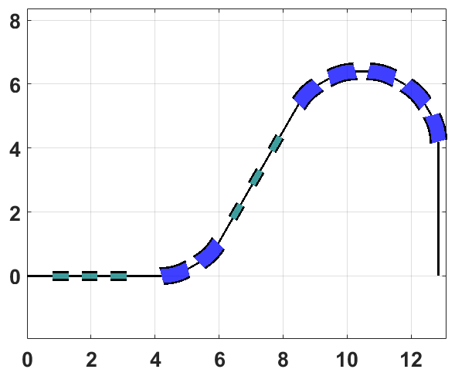
70 mm Ø
The Gantry magnet’s tree
90 mm Ø
Fixed gradient
< 5 T/m (mechanical)
+ bolted quads
30 degrees
70 mm Ø
Dipole Field, B0 = 4T
45 degrees
90 mm Ø
Variable gradient
< 5 T/m ± 0.5 T/m
(separate circuits)
30 degrees
70 mm Ø
Ramp rate:
0.35 T/s at B0_{min} (2T)
0.10 T/s at B0_{max} (4T)
90 mm Ø
45 degrees
90 mm Ø
90 mm Ø
6.4 m
4.0 m
12. 9m

Slide 7
Comparison criteria
Different configurations must be evaluated with common and objective criteria.
The cost estimation would provide a solid and easy parameter for the comparison*
The same work is ongoing for all the main aspects, i.e. mechanics, magnet design,
beam optics solutions, building costs, etc.
*(so that we can compare apples with apples)

Slide 8
Comparison criteria
Different configurations must be evaluated with common and objective criteria.
The cost estimation would provide a solid and easy parameter for the comparison*
We propose to use the following parameters:
Estimated cost of the magnets
Required R&D: cost and time
Design feasibility in 3 years
(estimated probability of success)
The SC magnets probably represents the main contribution to the gantry cost. We should evaluate the cost in terms of:
Fixed costs (e.g. find machines and tools)
Variable costs (e.g. amount of superconductors)
Number of required magnets (small series, spares, etc.)
*(so that we can compare apples with apples)

Slide 9
Comparison criteria
Different configurations must be evaluated with common and objective criteria.
The cost estimation would provide a solid and easy parameter for the comparison*
We propose to use the following parameters:
Estimated cost of the magnets
Required R&D: cost and time
Design feasibility in 3 years
(estimated probability of success)
A too ambitious and aggressive design could be a major threat for the project
*(so that we can compare apples with apples)

