Slide 1
Options for ion operational scenarios with increased performance
R. Bruce
Acknowledgement: H. Bartosik, G. Iadarola, J.M. Jowett
WP2 meeting, 28/09/2021

Slide 2
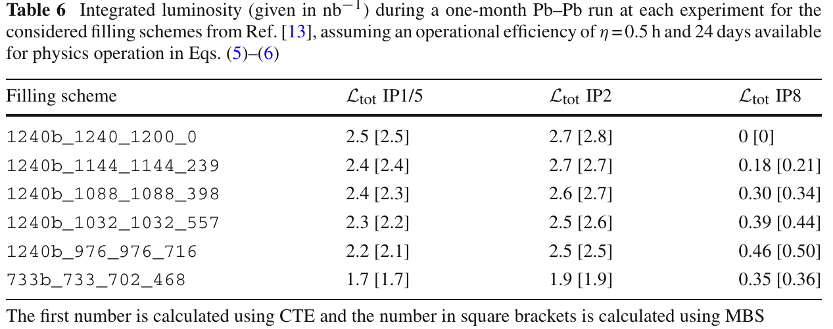
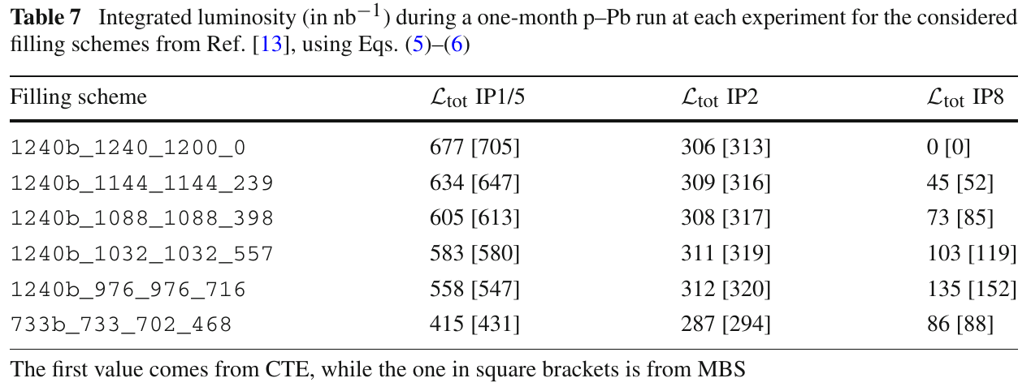
Introduction
Pb-Pb
Recently updated operational scenario for Pb-Pb and p-Pb in Runs 3-4
  Improved filling schemes and modelling
  See CERN report and EPJ Plus paper; WP2 talk, TCC talk
Range of filling schemes with varying number of collisions at LHCb
  Motivated by recent request from LHCb for significant luminosity - comes at the expense of the other experiments
  Updated performance estimates for typical one-month run
    Only studied one-month performance due to large uncertainties in detailed planning
From EPJ Plus paper
p-Pb

Slide 3
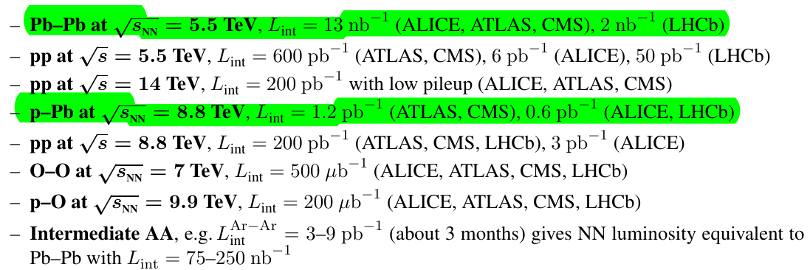
Requests from experiments
WG5 in the 2018 HL-LHC / HE-LHC physics workshop dealt with heavy-ion physics
Yellow report with proposal for extended heavy-ion running: CERN-LPCC-2018-07
Request up to the end of Run 4:
In Run 3 + Run 4
after Run 4: topic of next presentation

Slide 4
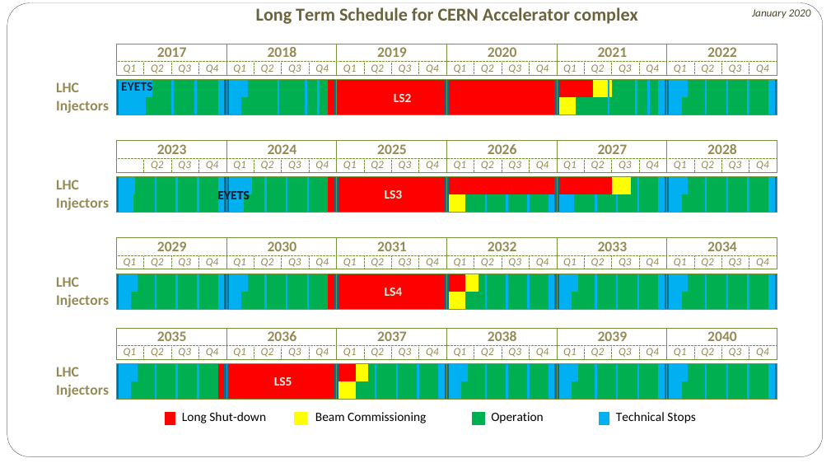
Future heavy-ion runs
Tentative schedule, could well change
(Jan 2020 schedule updated with LS2 extension)
Present planning: Would have four Pb-Pb runs (one two-month run in 2024) and two p-Pb runs until the end of Run 4
  In addition, have to fit pp reference runs
Allows to calculate approximate luminosity requirement for one-month run
Run 3
Run 3
HL-LHC installation
Run 4
Run 4
Run 5
Run 6
Guess on future heavy-ion runs – detailed schedule still to be defined
Oxygen pilot run?

Slide 5
Estimated vs required performance
Pb-Pb
Approximate requirements from experiments for one month:
  Pb-Pb
    2.6 nb⁻¹ at IP1/2/5
    0.4 nb⁻¹ at IP8
  p-Pb
    600 nb⁻¹ at IP1/5
    300 nb⁻¹ at IP2/8
Estimated performance
  For Pb-Pb: expect in the range of 2.2-2.7 nb⁻¹ for IP1/2/5, 0.2-0.5 nb⁻¹ at IP8 in a one-month run
  For p-Pb: expect in the range of 550-700 nb-1 for IP1/5, ~300 nb⁻¹ at IP2, 50-150 nb⁻¹ at IP8 in a one-month run
We’re in the right ballpark, but with present schedule assumptions, no filling scheme simultaneously fulfills requirements at all IPs
  For p-Pb, miss at least a factor 2 at IP8
  Note: approximate figures for p-Pb without detailed filling schemes
From EPJ Plus paper
p-Pb

Slide 6
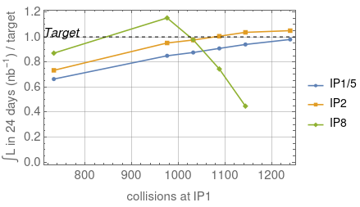
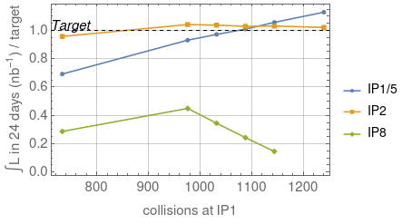
One-month performance vs target
In Pb-Pb, lower luminosity at IP1/5 than IP2 due to crossing angle
  Spectrometer bump at IP2 makes net angle smaller; external angle is the same
  Up to about 10% missing at worst IP for the best filling scheme
In p-Pb, LHCb is the main problem
Targets not reached simultaneously for any filling scheme
Possibly no reason for panic – applying the same assumptions for 2018, get significantly lower luminosity than achieved in the machine
  Operational efficiency >50% achieved

Slide 7
Improvements?
Need to study improvements to find a scenario that reaches targets with present assumptions
  For now, exploring different paths of improvement, i.e. trying to answer “what would have to be done to reach target on paper”
  For now, not exploring the feasibility of each path – possibly need beam tests
Assuming for now that Pb bunch intensities from injectors and LHC operational efficiency are fixed
  Might be conservative, but cannot know now
Ways to improve LHC performance (Pb-Pb)
  Improving further the filling schemes
    Work out detailed filling schemes in p-Pb with realistic 50 ns proton beam
  Skip levelling at IP1/5
  Smaller crossing angle : present baseline is 170 μrad half external angle at each IP
    Gives net half angles of 170 μrad / 100 μrad / -305 μrad
  Smaller β* : present baseline assumes 0.5m / 0.5 m / 1.5 m
    Possibly more aperture and strength margin in IR8
  Change levelling assumptions at IP2/8
    Presently assumed levelling is 6.4E27 cm⁻²s⁻¹at IP1/2/5 (ALICE detector saturation and “fair sharing”) , 1E27 cm⁻²s⁻¹ at IP8 (avoid quenches from BFPP)
Performance improvements for p-Pb
  Similar methods as for Pb-Pb (filling schemes, β*, crossing angle)
  In addition, increase proton bunch intensities (weak bunches of 3E10 p assumed so far)
Following slides: Checking each option, re-running luminosity studies with CTE using the same assumptions as in baseline scenario, unless stated otherwise

Slide 8
Pb-Pb filling schemes
Best scheme (i.e. best compromise) so far seems to be 1240b_1088_1088_398
Does a “better” scheme exist, with more collisions at each experiment?
  “Brute-force” scan of collisions – checked more than 5×10¹⁰ permutations of longer gap between trains and the position of shorter trains
  Found many equivalent permutations, but no better schemes
  Cannot exclude that a better scheme exists – almost infinite parameter space. But maybe not so likely, and not evident to find
Possible route forward: take longer trains from SPS with 8*8 bunches or more, instead of presently assumed 7*8 bunches
  Would result in more beam degradation in the SPS =>
  not obvious that we actually gain
  See Hannes’ talk at Chamonix 2017

Slide 9
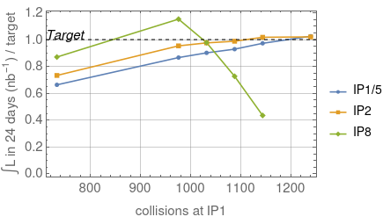
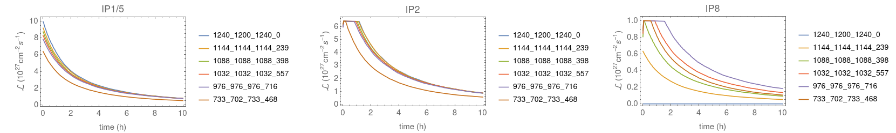
Skip levelling at IP1/5
Levelling at IP1/5 probably not needed to avoid BFPP quenches – FLUKA studies indicate significant margin
Redoing beam evolution study with CTE, for the range of filling schemes, followed by calculation of 1-month luminosity using standard method (re-calculating optimal fill time, 50% OP efficiency)
Only very minor improvement at IP1/5 (gives slightly more equal sharing of luminosity between IP1/2/5)

Slide 10
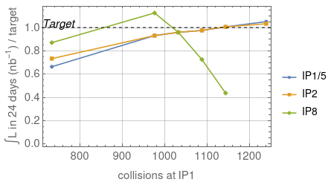
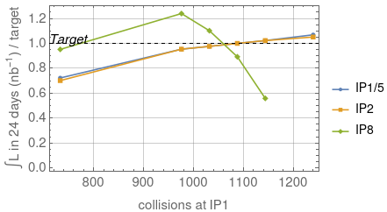
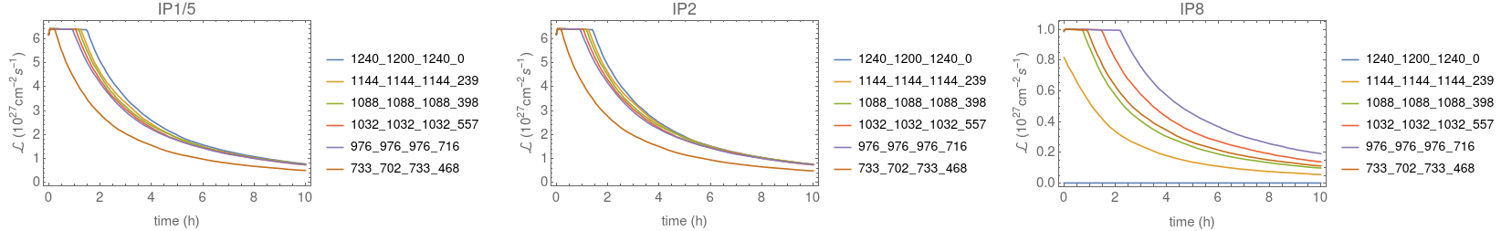
Decreased crossing angles
Net crossing 100/100/100/305
Smaller crossing angle limited by beam-beam and parasitic collisions
  Good hope that decrease is possible (see talk by Sofia)
  At IP2, have UPPER 100 urad limit from ZDC acceptance
At IP8: no preference from LHCb on spectrometer polarity.
  Could use opposite polarity of spectrometer to crossing bump, e.g. half external angle = -235 μrad, spectrometer = +135 μrad
First try: using 100 μrad net half angle at IP1/5, as already in baseline for IP2 – better, but not enough
Second try: using 70 urad net half angle at all IPs, as studied by Sofia – almost there, still miss 2% in best case
Net crossing 70/70/70/70

Slide 11
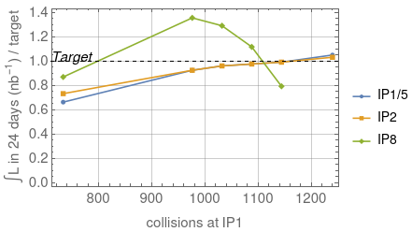
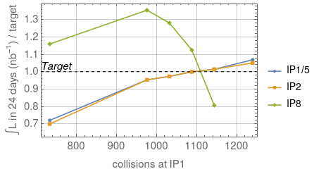
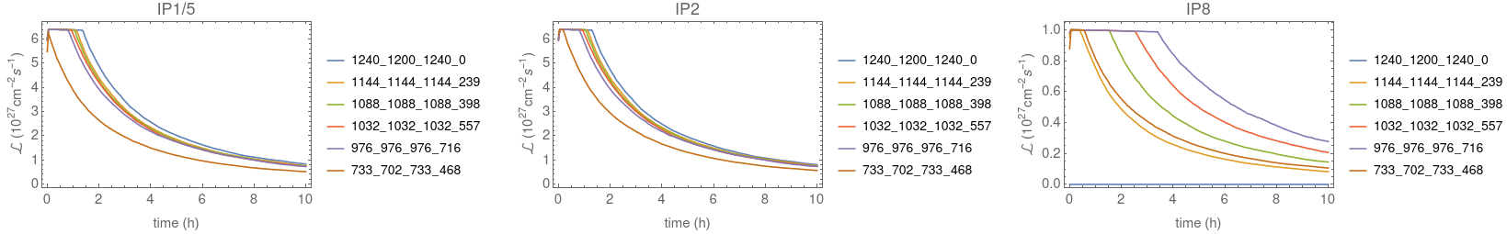
Smaller crossing, smaller IP8 β*
100 urad net at all IPs; β*=1m @ IP8
Assuming 100 μrad net half angle at all IPs, β*=1m at IP8: very close to targets: miss by 2% in best scheme
Assuming 70 μrad net angle at all IPs, β*=1m at IP8: reach target exactly at IP1/2/5, get more at IP8
  Could consider switching between filling schemes during the run to distribute more to IP1/2/5
70 urad net at all IPs; β*=1m @ IP8

Slide 12
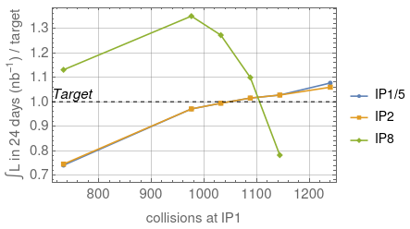
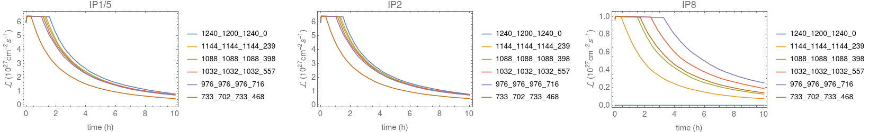
Decreased β* at all IPs
β*=45/45/100cm, 100 urad
Decreasing β* only, even to 40 cm at IP1/2/5 and 50 cm at IP8, keeping nominal crossing: still no scheme satisfying all – IP1/5 limiting
100 urad crossing at all IPs, β*=0.45 m at IP1/2/5, β*=1m at IP8 => Reach targets at all IPs with one scheme, with quite some margin at IP8
  Could consider switching filling schemes throughout the run to get more margin also at IP1/2/5 – to be discussed and agreed with the experiments

Slide 13
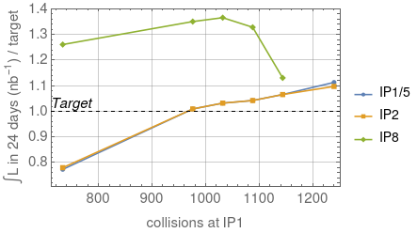
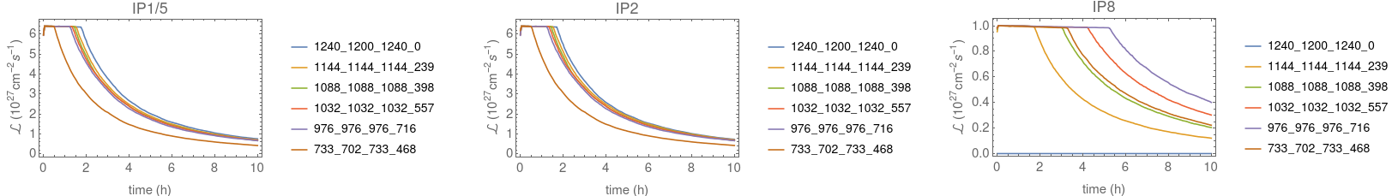
Pushed configuration
Assuming aggressively β*=40 cm at IP1/2/5, β*=50 cm at IP8, 100 urad net angle at all Ips => comfortably reach targets with some margins for several filling schemes
This configuration might not be feasible – further studies required

Slide 14
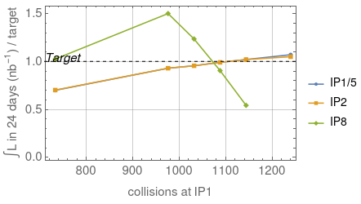
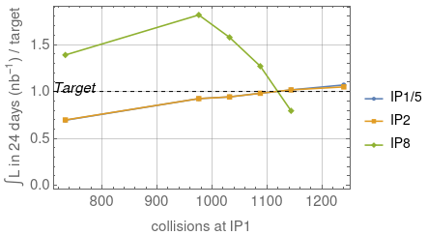
Increased leveling targets
Higher levelling targets, otherwise basline
Increasing IP8 levelling target L=to 1.5E27
  Note: in 2015 quench test, quenched at L=2.3E27
  Don’t know if we can do this in IP8 – limiting luminosity might be different. Needs further study
Increasing IP1/2/5 levelling to L=7E27
  Will be slightly above limiting 50 kHz rate at ALICE in the beginning of the fill – possibly OK, to be seen
  Used as tentative levelling value in previous iteration at Chamonix 2017
Result: Increasing levelling targets to these values alone is not enough
In combination with 100 urad net half crossing at all IPs and β*=1m at IP8:
  2% short for any single scheme
  Can reach targets if we combine two filling schemes, running half of the time with each
Higher levelling targets, 100 urad, β*=1m at IP8

Slide 15
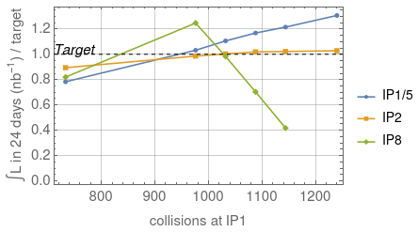
p-Pb
Baseline scenario
Missing a factor 2 at LHCb – not easy…. Need significant improvement
Even with very pushed machine configuration (β*=40 cm at IP1/2/5, β*=50 cm at IP8, 100 urad net angle at all IPs), almost at target
Other option: work on proton beams
  Increase proton bunch intensity
  Work out detailed filling schemes – should be done anyway
Pushed scenario

Slide 16
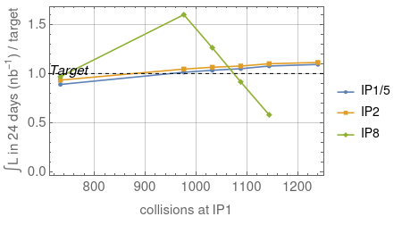
Increasing proton intensity
Present baseline assumed so far: 3E10 p/bunch
  With higher p intensities, beam burns off quickly, which is bad for ALICE (levelled at 5E29)
Alternative approach:
  increase to 1.3E11 p/bunch (already had this with 50 ns beams – higher is only better)
  level IP1/5 at 1E30
  don’t level IP8
  => can reach targets, without any change of optics or crossing angle!
Caveats: Using approximate approach with Pb filling schemes and overall 5% penalty on integrated luminosity
  Clearly need to check realistic schemes before concluding
  Possibly check beam-beam : any consequences of running in this weak-strong scenario?
  Some studies done in thesis by Marc

Slide 17
Proton filling schemes
Goal: match a 50 ns proton beam that matches as well as possible the
50 ns Pb beam. not evident:
  SPS Pb batches have 8 bunches, 100 ns batch spacing, typically 7 trains = 56 Pb bunches
  Proton schemes based on 6*n bunches, 200 ns gap between batches
With Gianni: one potential solution seems to be proton 30 bunches per train
  Two proton trains almost fit the 7 Pb trains
  Direct overlap shows collisions at IP1/5 – but we need to have many collisions at all IPs
Pb
p

Slide 18
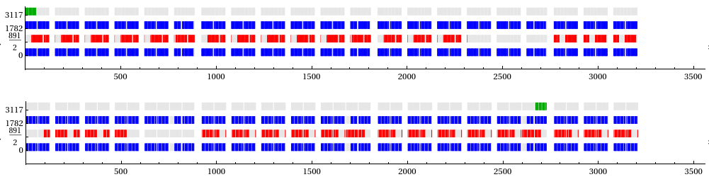
Developing candidate filling schemes
First try: basic scheme with quadrant symmetry
  Adjusting abort gap keeper to longest train
  Can fit 5 Pb/p trains per quadrant
  To fill up the rest of the quadrant: make last train longer, or inject shorter train
  Seems most efficient to make p train longer (4*30 instead of 2*30) and add a shorter Pb train
Scheme gives decent amount of collisions at IP1/5, but less at IP2/8
  1152 Pb, 1260 protons
  1083 / 714 / 26 collisions at IP1/2/8
IP8
Pb
IP5
IP2
IP1
IP8
p
IP5
IP2
IP1

Slide 19
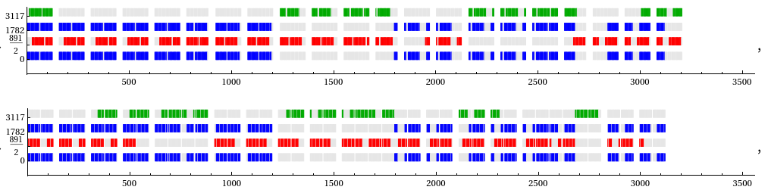
Optimizing p-Pb filling schemes (1)
Trying to move around trains to displace collisions to LHCb – gives large penalty at IP1/2/5, larger than for Pb-Pb
  Brute-force scan of all permutations within each quadrant (displacing single trains to get collisions at LHCb) =>
  if >800 collisions at IP1/2/5, max 137 collisions at IP8 => not good
  Example with more IP8 collisions: 724 / 724 / 427 collisions =>
  not enough at IP1/2/5, not really efficient use of bunches
  Similar to what was done in 2016 with fewer bunches
IP8
IP5
IP2
IP1
IP8
IP5
IP2
IP1

Slide 20
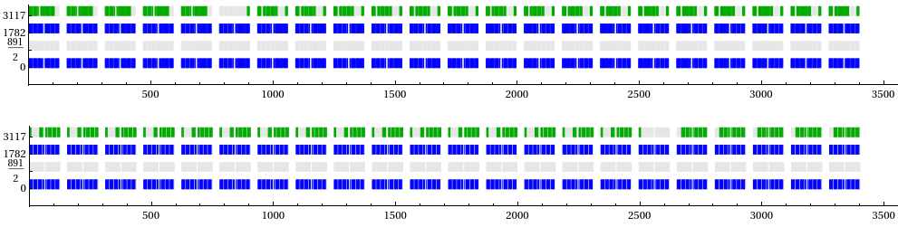
Optimizing p-Pb filling schemes (2)
50 ns
Second approach: neglecting quadrant symmetry, fill up both rings as much as possible
  22 trains each for p (2*30) and Pb (7*8)
    Longer kicker gaps between Pb trains to match p structure
  “Default scheme”: many collisions at IP1/5/8, no collisions at IP2
  Brute-force scan with 0-3 longer gaps between trains in each beam, all permutations checked
  Found range of candidate filling schemes - still a bit worse than assumed when scaling the Pb schemes
Pb bunches | p bunches | IP1/5 coll. | IP2 coll. | IP8 coll.
1232 | 1320 | 1166 | 0 | 870
1232 | 1320 | 901 | 843 | 432
1232 | 1320 | 848 | 820 | 553
1232 | 1320 | 795 | 843 | 602
1232 | 1320 | 795 | 724 | 735
1232 | 1320 | 765 | 762 | 733
IP8
IP5
IP2
IP1
IP8
IP5
IP2
IP1

Slide 21
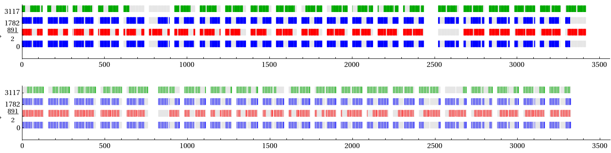
Using 25 ns proton scheme
25ns
So far tried to match the Pb beam as closely as possible, using 50 ns protons
  With 50 ns, no “natural” collisions at LHCb if quadrant symmetry is respected
  With 25 ns, collisions do occur naturally at LHCb
  Try to collide 50 ns Pb beam with 25 ns p beam – obviously many p bunches would be “wasted”, but the aim is to have as many collisions as possible
  Possibly need to think about beam-beam – will get many parasitic encounters. Some studies done in thesis by Marc
  First try: similar length as 2*30 b 50-ns scheme: take 2*60b at 25 ns
With a little fiddling, could get about 900 collisions in all IPs
Could possibly find even better scheme with brute-force scan, and checking other train lengths for protons
Pb bunches | p bunches | IP1/5 coll. | IP2 coll. | IP8 coll.
1232 | 2520 | 1092 | 793 | 755
1232 | 2520 | 918 | 838 | 904
1232 | 2520 | 906 | 912 | 896
1232 | 2520 | 902 | 878 | 935
1232 | 2520 | 900 | 926 | 897
IP8
IP5
IP2
IP1
IP8
IP5
IP2
IP1

Slide 22
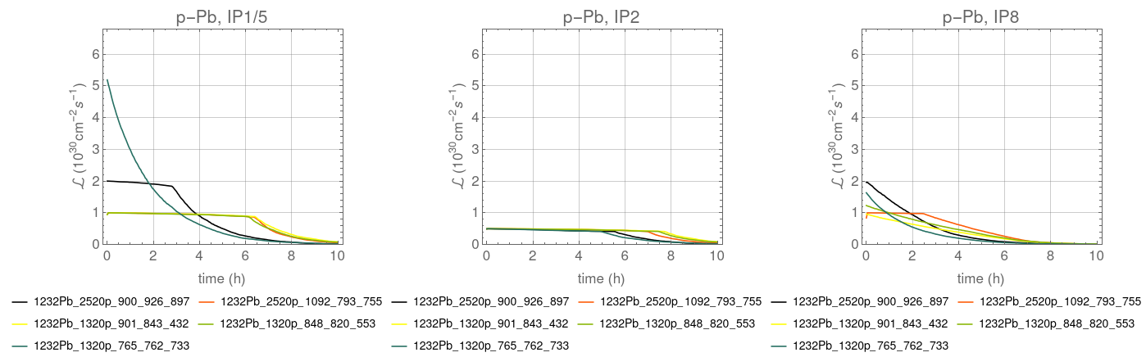
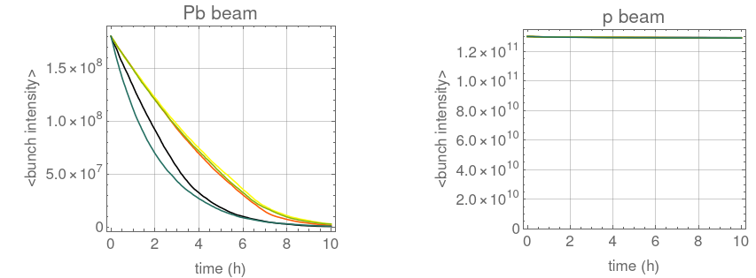
Simulated beam evolution with new p-Pb schemes
Assuming 1.3E11 p/bunch – proton beam intensity is almost unchanged
Assuming baseline machine configuration without changes in crossing or β*
Exploring different levelling scenarios at all IPs – here are some examples. Could still be optimized to find the best compromise

Slide 23
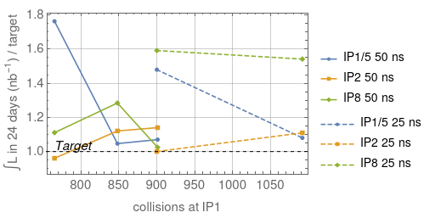
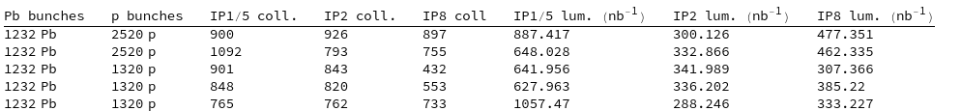
Integrated luminosity in 1-month run
Several of the new filling schemes, both 50 ns and 25 ns, satisfy all experiments simultaneously (relies on 1.3E11 p/bunch)
The levelling scenarios can still be optimized to have a more equal share, or one could switch between filling schemes during a run
Estimated 1-month luminosity

Slide 24
Summary
Assuming baseline parameters, and 50% OP efficiency
  We’re 10% short of the luminosity target in Pb-Pb,
  We miss factor 2 at LHCb for p-Pb
For both Pb-Pb and p-Pb, there are ways to reach the targets, acting on machine configuration and beams. Still need some checks to verify feasibility
For Pb-Pb, could reach the target in several ways. Examples:
  70 μrad net angle at all IPs, β*=1m at IP8
  100 urad crossing at all IPs, β*=0.45 m at IP1/2/5, β*=1m at IP8
  Higher levelling (7E27 / 1.5E27), β*=1m at IP8, 100 urad net half angle at all IPs
  Of course, any combination or more pushed configuration would only improve
  Feasibility of decreased β*, crossings, and levelling targets has not been verified – need further studies, ideally with beam
  Could also increase luminosity through higher operational efficiency and/or higher than nominal intensity, but cannot count on this
For p-Pb, improvements of machine configuration are possibly not enough to gain factor >2 at LHCb
  A very pushed machine configuration with β*=0.4 m at IP1/2/5 and β*=0.5 m at IP8, combined with smaller crossing angles, gives luminosity very close to targets – might not be feasible in operation
  Increasing proton bunch intensities to 1.3E11 gives needed improvement – but think about possible constraints
  New realistic filling schemes developed for p-Pb with 50 ns and 25 ns proton beams – for both beam types, schemes found where all experiments reach their respective targets from WG5 with p intensity of 1.3E11
    Constraints for using 25 ns proton beams? Beam-beam to be checked? Beam instrumentation with very asymmetric beams?
  Leveling targets and filling schemes still to be further optimized

Slide 25
Thanks for the attention

