Slide 1
Update on ions - Vertical crossing angle in both IP1 and 5
& lower crossing angles in IP1/2/5/8
R. Bruce, S. Kostoglou, G. Sterbini
WP2, 28th September 2021
Notes:
1

Slide 2
Motivation
Ion beam-beam studies needed to investigate parameters space for ions for Run3 & Run4:
  Upgrade of ZDC detectors in ATLAS & CMS for Run4: constraint on maximum crossing angle in H-plane→ investigate feasibility of vertical crossing angle both in IP1 & 5.
  Define lower limit of crossing angles (from BBLR) for β*_{IP1/IP5/IP2}=50 cm in Run3.
Opportunity to validate our tools with different species → performed several sanity checks before production.
Considering Run3/Run4 as identical configurations for ions.
2

Slide 3
Limitations
DA_{min}≥6σ criterion based on lifetime-DA correlations from MDs for protons*:
  DA was compared with burn-off corrected lifetime:
    4σ comparable to burn-off (~25 h).
    5σ → 100 h.
    6σ guarantees additional margin.
Threshold of 6σ might not be best approach for ions:
  Luminosity burn-off much stronger for heavy ions than protons (3 h vs 25 h)→might be able to tolerate more tune diffusion, thus ↓ DA.
  Similar MDs with ions needed to derive absolute DA metric. At the moment, focusing on relative DA reduction.
* D. Pellegrini, 8th Evian Workshop
3

Slide 4
Simulation parameters
General parameters for Pb A=208, Z=82
7 Z TeV | C⁻=10⁻³ | V_{RF}=14 MV | Δp/p=24×10⁻⁵ |  | RMS bunch length= 8.24 cm
ε_{N}=1.65 μm | N_{IP1}, N_{IP2}, N_{IP5},N_{IP8} = 1088,1088,1088,398 |  | Q’=10 | I_{oct}= 250 or 50 A | 50 ns bunch spacing
E₀=193.69 GeV | L_{IP1/IP2/IP5/IP8} =6.4/6.4/6.4/1 (10²⁷ Hz/cm2) |  | N_{b}=1.8e8 ions/bunch | γ=2963.54 | β*_{IP1/IP2/IP5/IP8} =0.5/0.5/0.5/1.5 m*
All parameters are listed in: HL-LHC operational scenarios for Pb-Pb, R. Bruce et al
2018 optics: /afs/cern.ch/eng/lhc/optics/runII/2018/ION/opticsfile.21
4

Slide 5
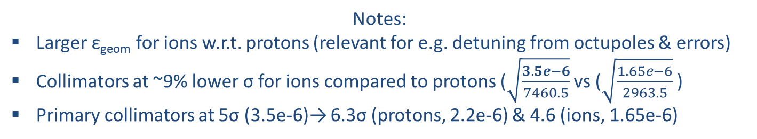
Simulation parameters
General parameters for Pb A=208, Z=82
7 Z TeV | C⁻=10⁻³ | V_{RF}=14 MV | Δp/p=24×10⁻⁵ |  | RMS bunch length= 8.24 cm
ε_{N}=1.65 μm | N_{IP1}, N_{IP2}, N_{IP8} = 1088,1088,1088,398 |  | Q’=10 | I_{oct}= 250 or 50 A | 50 ns bunch spacing
E₀=193.69 GeV | L_{IP1/IP2/IP5/IP8} =6.4/6.4/6.4/1 (10²⁷ Hz/cm2) |  | N_{b}=1.8e8 ions/bunch | γ=2963.54 | β*_{IP1/IP2/IP5/IP8} =0.5/0.5/0.5/1.5 m
2.2 μm for protons
All using offset leveling
7460.5 for protons
Notes:
Larger ε_{geom} for ions w.r.t. protons (relevant for e.g. detuning from octupoles & errors)
Collimators at ~9% lower σ for ions compared to protons ($\sqrt{\frac{3.5e−6}{7460.5}}$ vs ($\sqrt{\frac{1.65e−6}{2963.5}}$ )
Primary collimators at 5σ (3.5e-6)→ 6.3σ (protons, 2.2e-6) & 4.6 (ions, 1.65e-6)
5

Slide 6
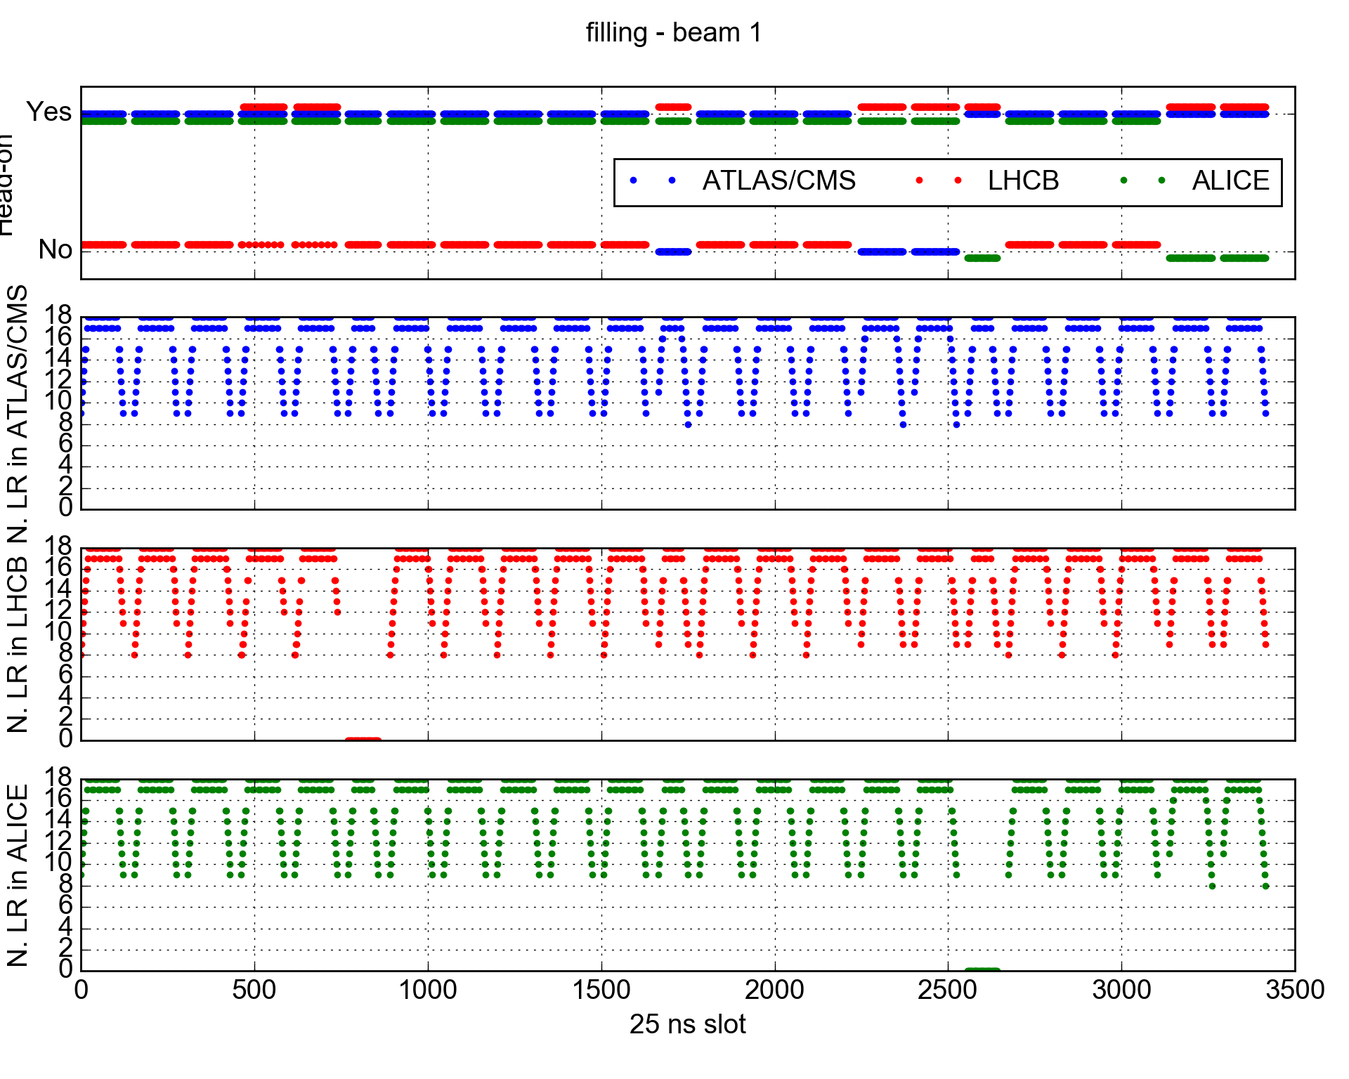
Filling scheme
Filling scheme with 50 ns bunch spacing.
6

Slide 7
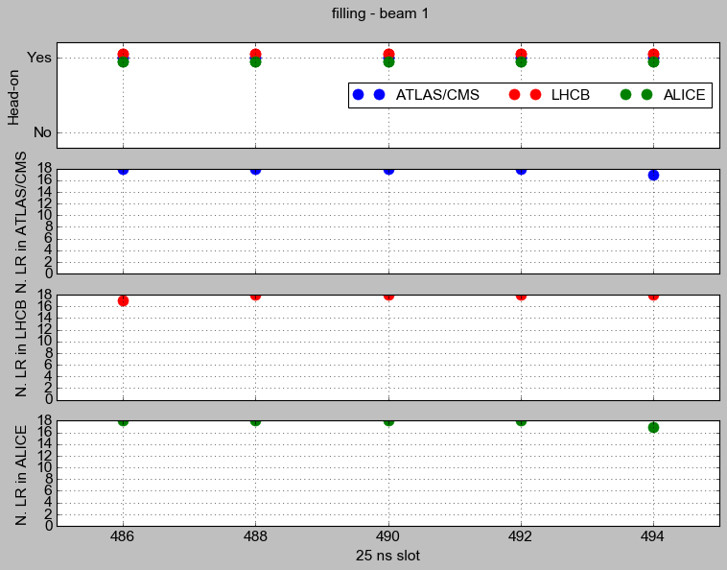
Filling scheme
Filling scheme with 50 ns bunch spacing.
Simulating bunch with maximum number of head-on & long-range BB interactions in all IPs (bunch #488)
7

Slide 8
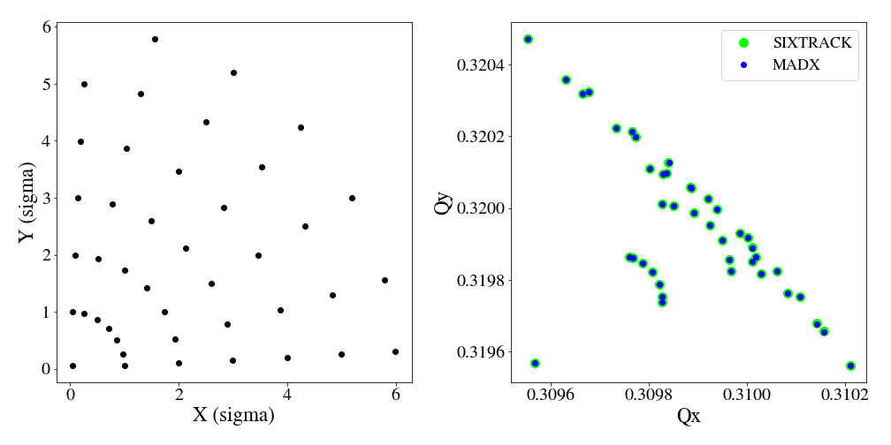
Sanity checks
Very good agreement between SixTrack and MAD-X footprints (only IP1, octupoles & crossing angle →0).
Head-on tune shift 4.34×10⁻⁴ (vs e.g. 6.35×10⁻³ for protons, 1.3e11 ppb, 2.5e-6 μm)
8

Slide 9
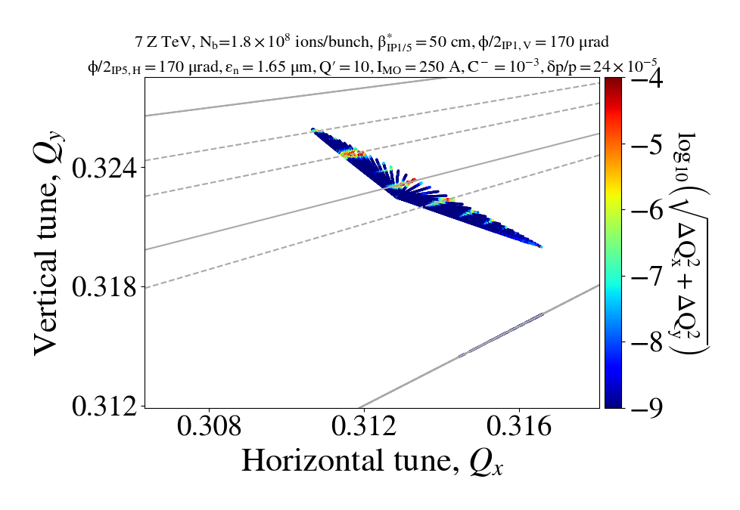
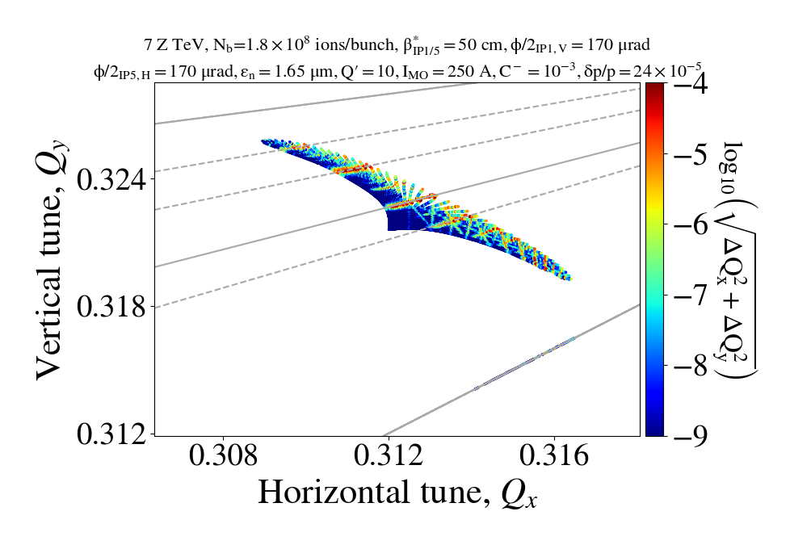
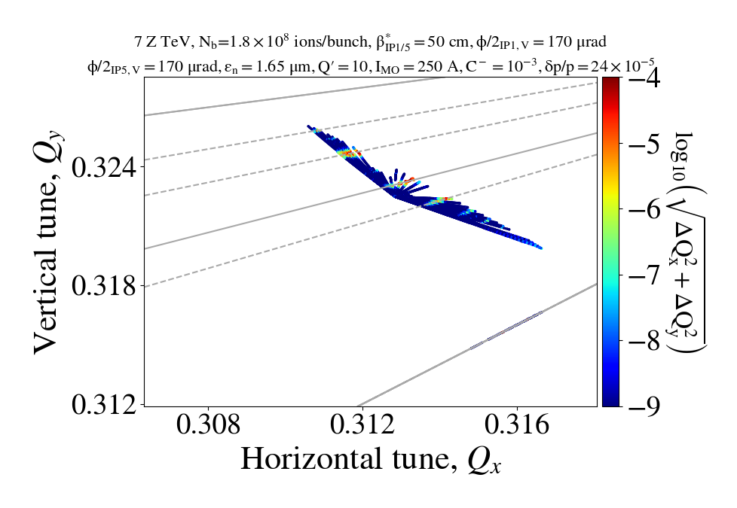
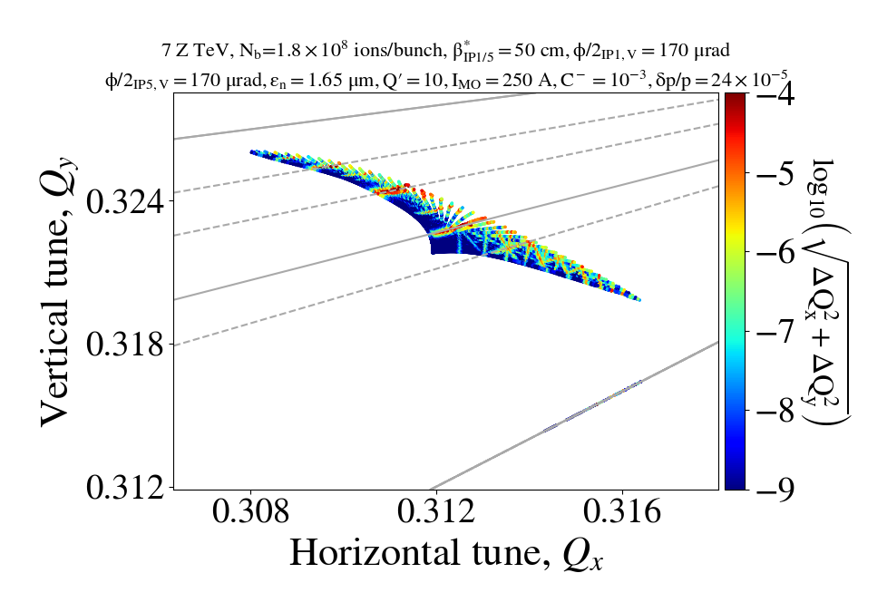
FMAs with nominal configuration, without errors
Without BB
With BB
IP1 V, IP5 H
IP1 V, IP5 V
V-H & V-V configurations similar in terms of tune diffusion
9

Slide 10
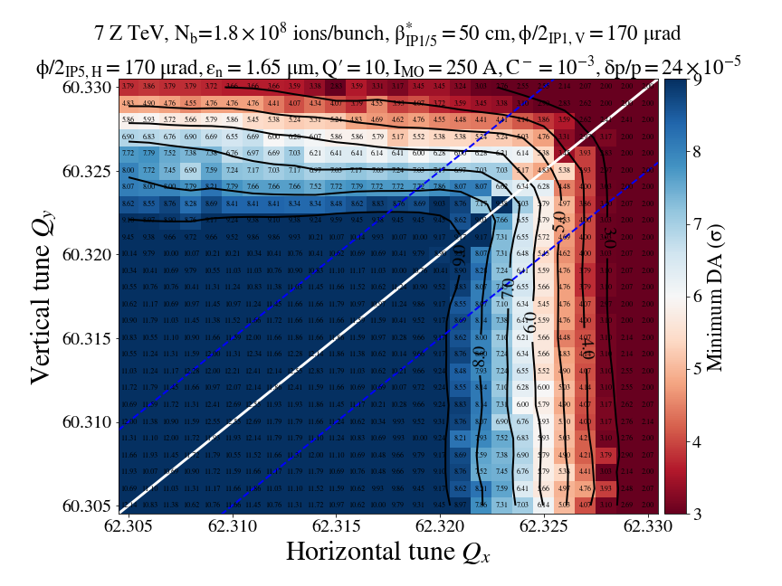
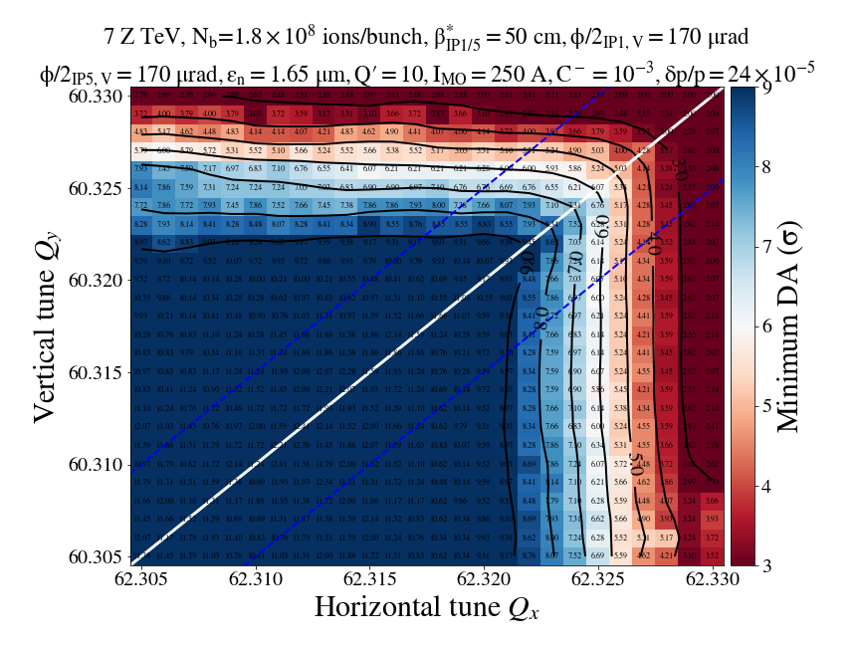
DA with nominal configuration, without errors
φ/2 | Nominal (μrad)
IP1, V | 170
IP5, H or V | 170
IP2 (external) | 170(-)
IP8 (external) | -170
Equivalent V-H & V-V configurations in terms of DA.
Tune scans with nominal configuration indicate very mild impact from beam-beam.
Margin to reduce crossing angles.
Total: 100
Total: -305(-)
or -35(+)
IP1 V, IP5 H
IP1 V, IP5 V
10

Slide 11

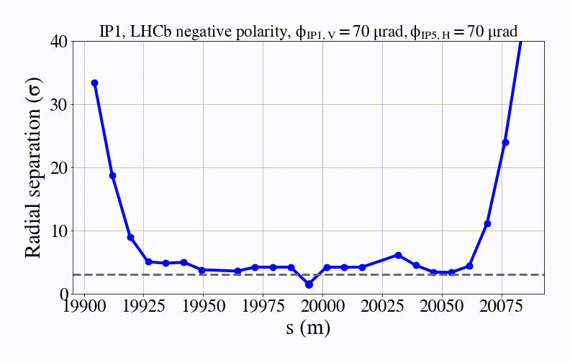
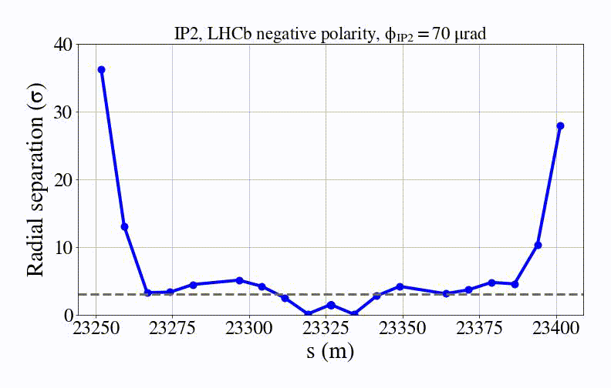
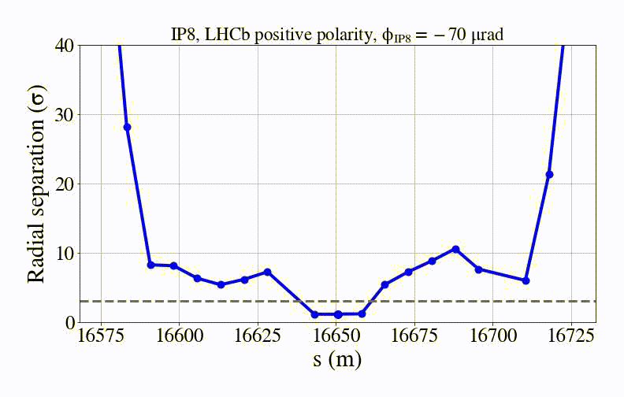
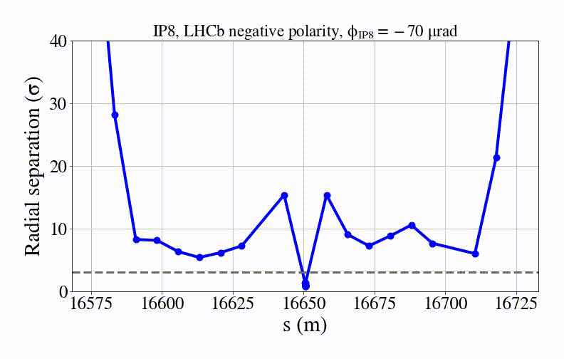
Beam-beam separation
Scan from φ/2=70 to 170 μrad
IP1
IP2
3σ full separation
IP8, positive internal
IP8, negative internal
Internal-external compensating
Internal-external accumulating
11

Slide 12
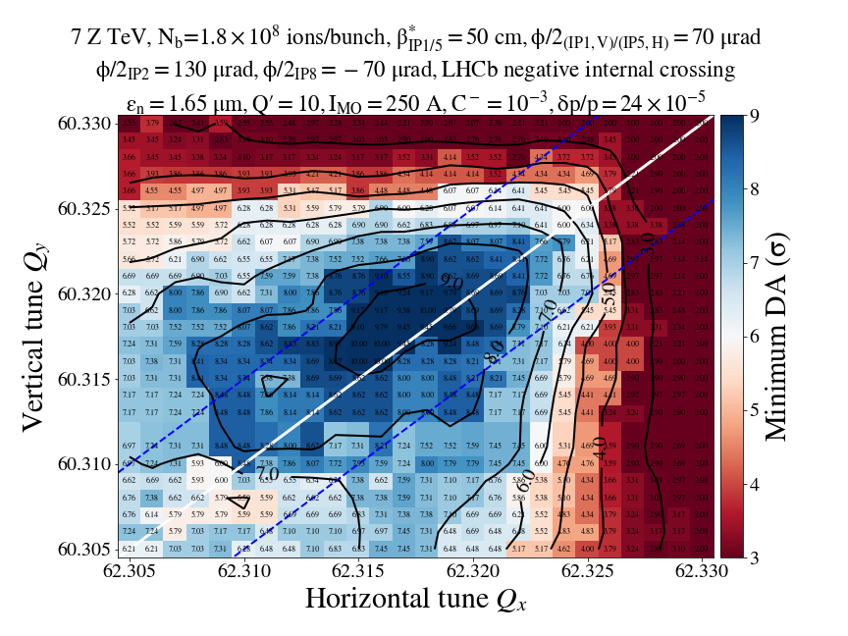
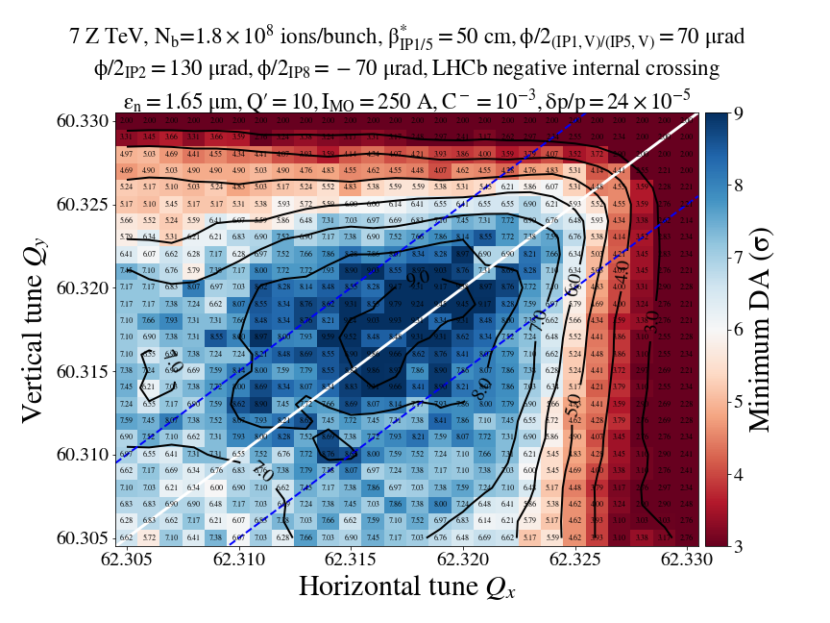
DA with reduced crossing angles
φ/2 | Nominal (μrad) | Reduced (μrad)
IP1, V | 170 | 70
IP5, H or V | 170 | 70
IP2 (external) | 170 | 130 (-)
IP8 (external) | -170 | -70(-) or -120(+)
Total: 69
Total: -205
or 15
IP1 V, IP5 H
IP1 V, IP5 V
12

Slide 13
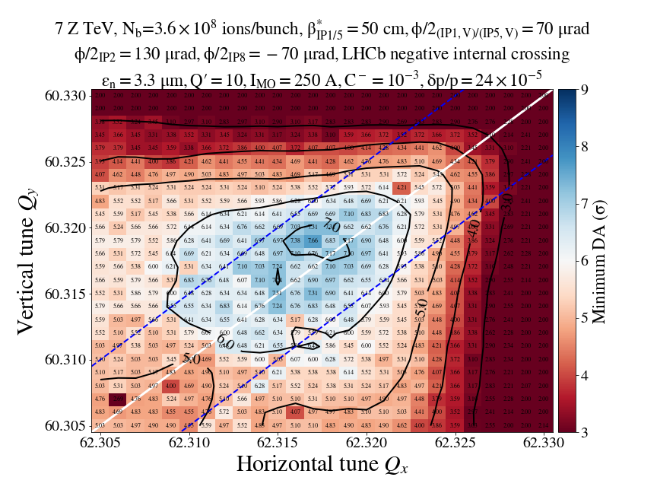
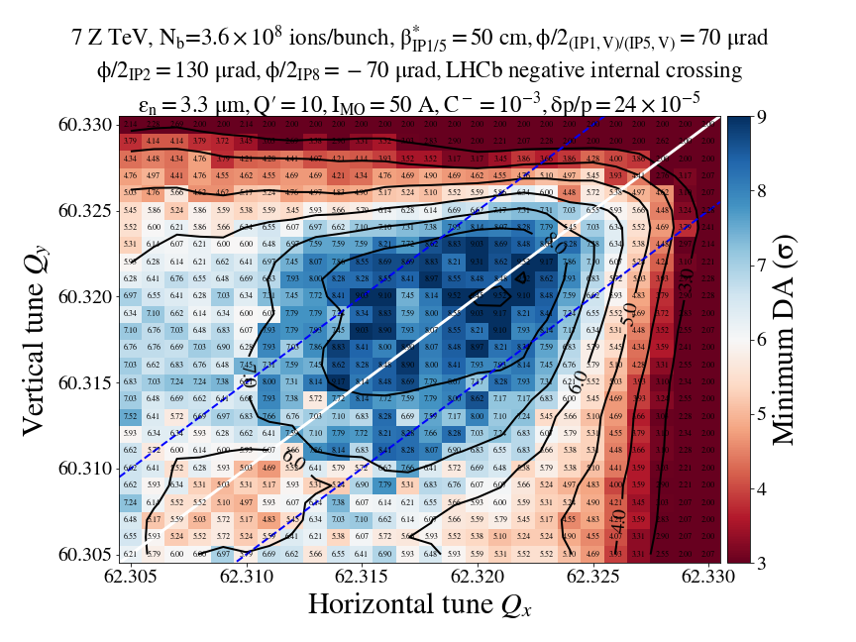
DA with reduced crossing angles
Aggressive scenario: Doubling the intensity and emittance with reduced crossing angles
IP1 V, IP5 V, 250 A
IP1 V, IP5 V, 50 A
Main conclusions without errors:
V-H & V-V configurations yield similar results.
Considering 6σ limit (to be validated), DA at acceptable levels with reduced crossing angles and even double intensity & emittance.
13

Slide 14
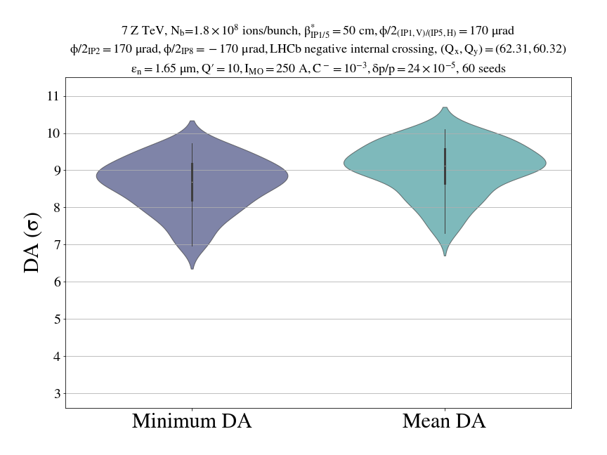
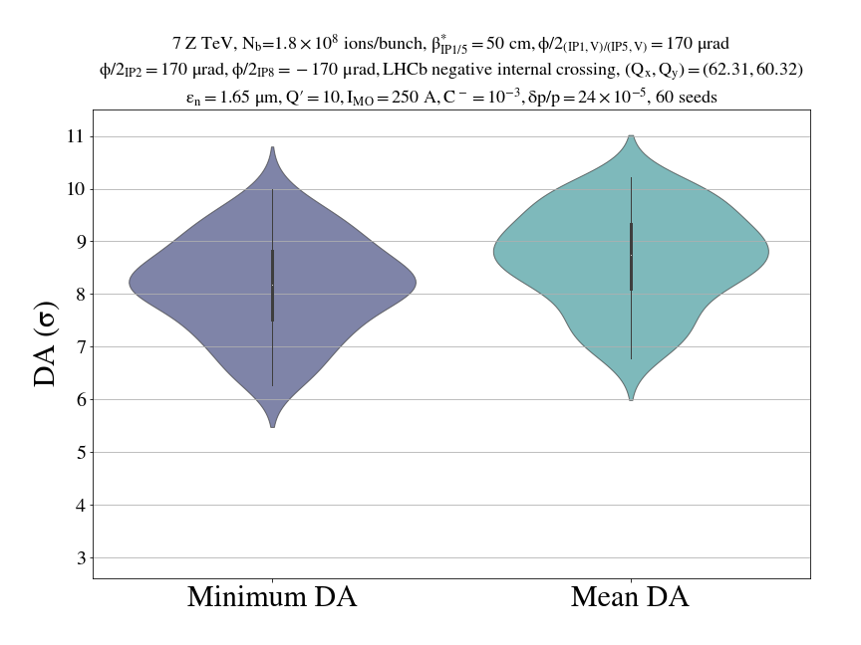
Including errors
Nominal N_{b}, ε_{N}, φ
I_{oct}=250 A
IP1 V, IP5 H
IP1 V, IP5 V
Important variation of DA depending on the seed (from ~6 to ~10 σ) → errors not in the shadow of beam-beam effects, but dominating effect.
Differences between V-H & V-V configurations in terms of DA. DA_{min} below 6σ for V-V and worst seed.
14

Slide 15
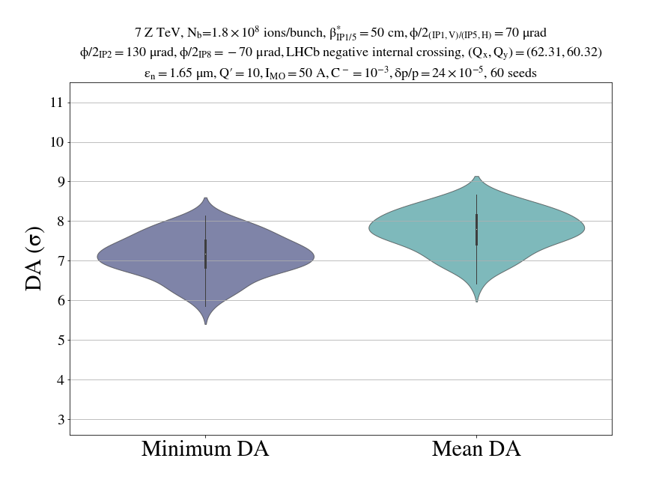
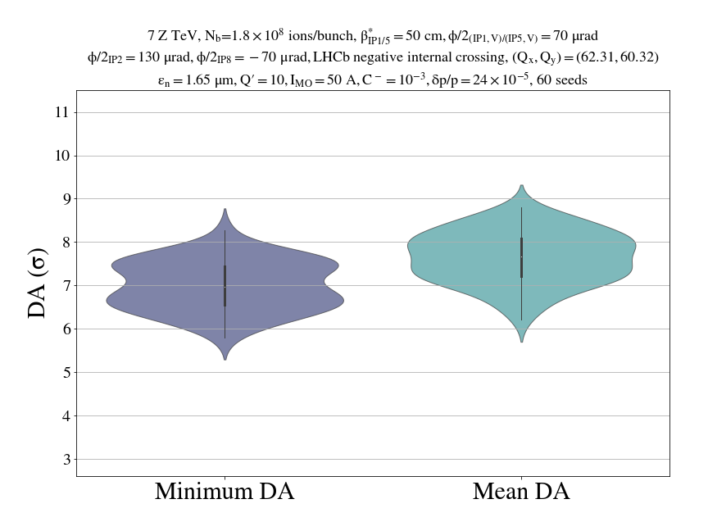
Including errors
Nominal N_{b} & ε_{N}, Reduced φ
I_{oct}=50 A
IP1 V, IP5 H
IP1 V, IP5 V
Both configurations below 6σ for worst seed
15

Slide 16
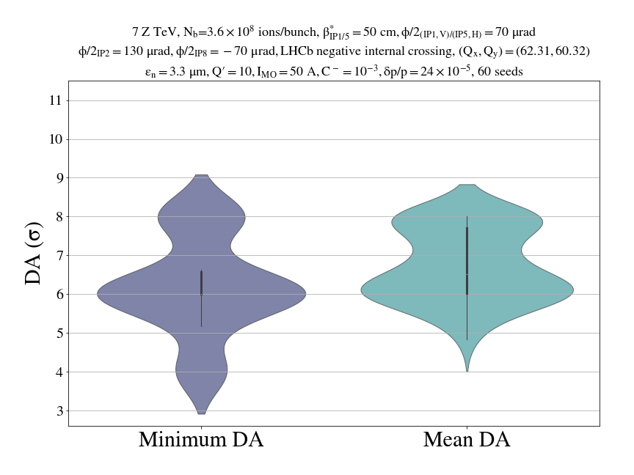
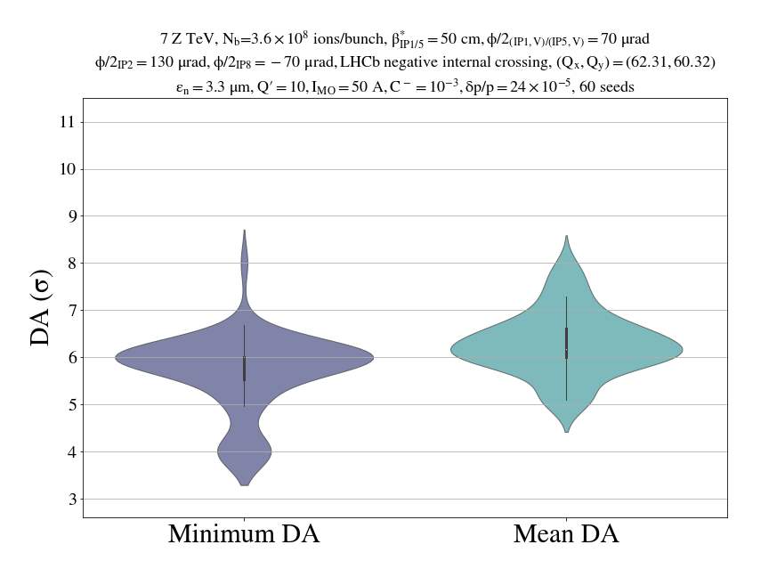
Including errors
Double N_{b} & ε_{N}, Reduced φ
I_{oct}=50 A
IP1 V, IP5 H
IP1 V, IP5 V
DA_{min} spans from ~3 to 9σ depending on the seed.
DA_{min} below 6σ for V-H and worst seed.
16

Slide 17
Summary
With beam-beam
V crossing angle in both IP1/5: V-H and V-V configuration results in equivalent relative DA.
  No showstopper found for V-V crossing.
  Any limit in the horizontal crossing from new ATLAS/CMS ZDC can be alleviated by vertical crossings.
Reduction of crossing angles:
  Reduced crossing angles proposed, based on 3σ full beam-beam separation in closest parasitic encounter → acceptable DA even with double intensity & emittance when considering 6σ criterion as in protons.
  However, absolute metric is missing and threshold of 6σ might be too pessimistic for ions.
17

Slide 18
Summary
With beam-beam & errors
On the contrary to collisions with protons, errors are not in the shadow of beam-beam but rather dominant effect for DA.
Very large variation of DA depending on the seed.
Even with nominal configuration, V-V crossing below 6σ for worst seed.
Open points
Missing important components:
DA-lifetime correlation for ions is needed.
Crossing angle reduction must be validated with MD.
Considering the worst seed might be pessimistic: must identify which seed represents best the machine operation.
18

Slide 19
Backup

Slide 20
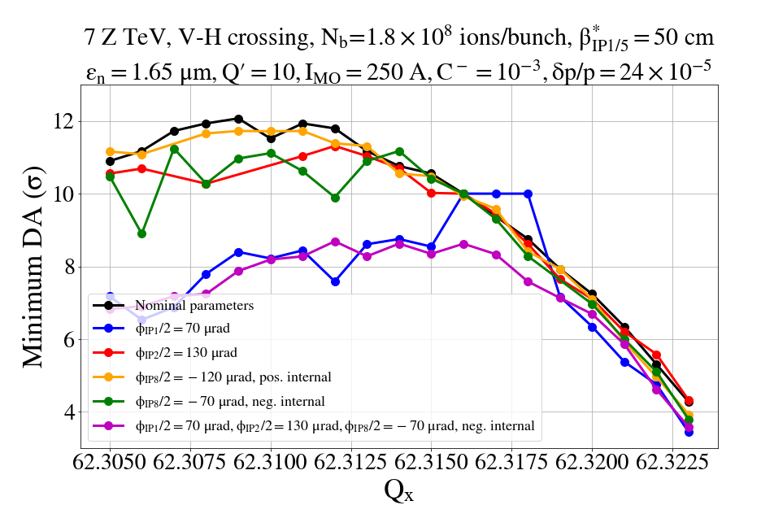
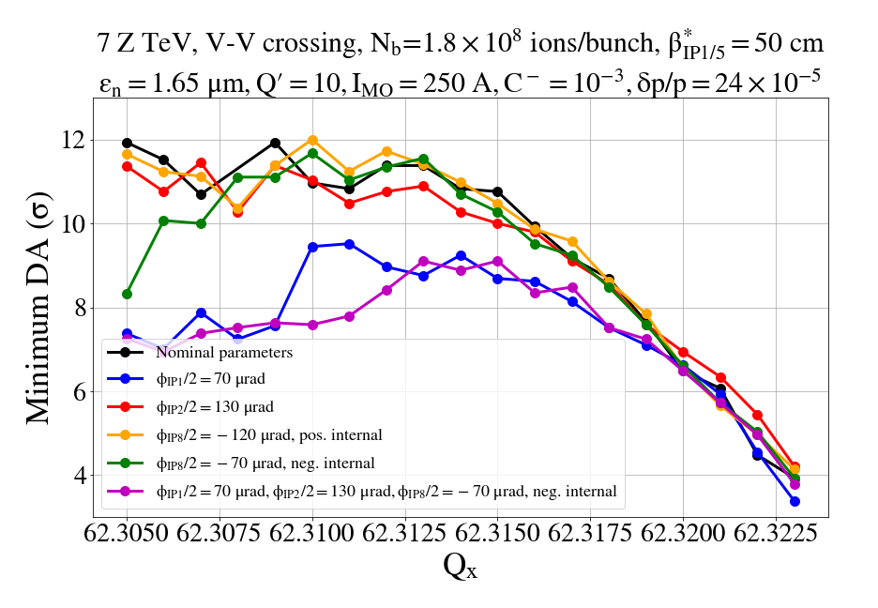
DA with reduced crossing angles
φ/2 | Nominal (μrad) | Reduced (μrad)
IP1, V | 170 | 70
IP5, H or V | 170 | 70
IP2 (external) | 170 | 130 (-)
IP8 (external) | -170 | -70(-) or -120(+)
Equivalent V-H & V-V configurations in terms of DA even with reduced crossing angles.
Total: 53
Total: -205
or 15
Scan parallel to the diagonal with Q_{x}=Q_{y} + 5e-3
IP1 V, IP5 H
IP1 V, IP5 V
20

