Slide 1
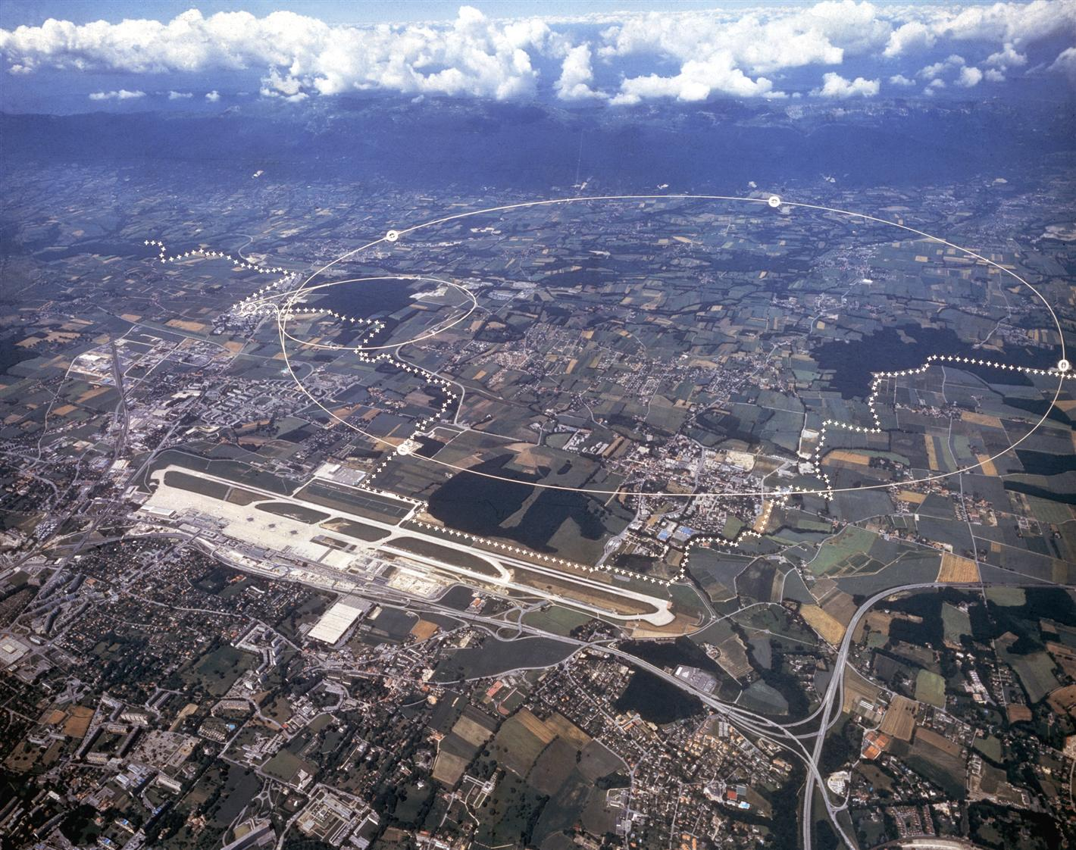
Preliminary LHC light-ion scenarios for Run 5 and beyond
R. Bruce, R. Alemany Fernandez, H. Bartosik, J.M. Jowett
Acknowledgements:
N. Biancacci, F. Boattini, H. Damerau, V. Di Capua, F. Kroeger, Q. King, D. Kuchler, T. Stoehlker, G. Weber

Slide 2
Outline
Introduction: why study light ions in the LHC?
Studied ion species and assumed parameters
Calculated bunch intensitities from injectors
  Limitations from space charge in LEIR and SPS
  Paths for pushing the limitations
Simulated LHC performance in different scenarios
Work in progress!

Slide 3
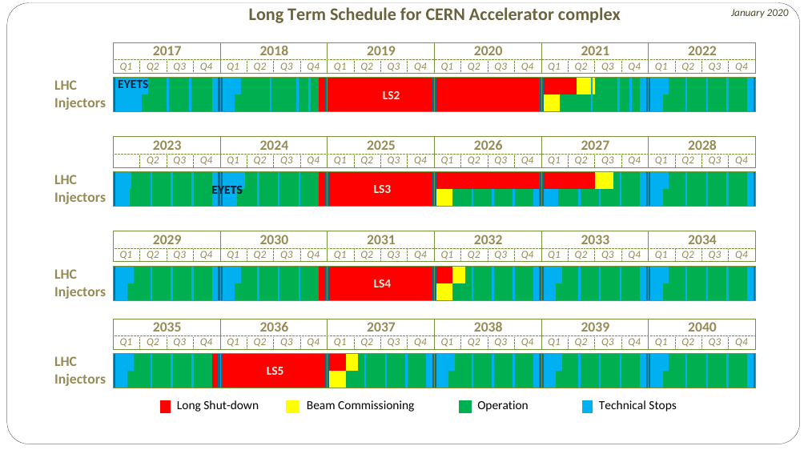
Overview of future heavy-ion operation
In present planning, heavy-ion operation ends with Run 4
  Annual runs with Pb-Pb or p-Pb are
  Pilot run with oxygen beams foreseen for Run 3 (2024?)
2018 HL-LHC / HE-LHC physics workshop, working group 5: Proposal to extend ion program to Run 5 and beyond
  See yellow report
  Would impact time available for p-p physics – see previous talks by Rogelio
Tentative schedule, could well change
(Jan 2020 schedule updated with LS2 extension)
Run 3
Run 3
HL-LHC installation
Run 4
Run 4
Run 5
Run 6
Guess on future heavy-ion runs – detailed schedule still to be defined
Oxygen pilot run?

Slide 4
Ion operation beyond Run 4
In proposed ion runs beyond Run 4, aim at significantly higher nucleon-nucleon luminosity than with Pb-Pb in Run 3/HL-LHC
New ALICE3 detector under study, and letter of intent under final preparation
  To be installed in LS4, aiming at digesting much higher ion luminosities in Run 5 and beyond
Not easy to gain significant factors in Pb-Pb luminosity
  Many optimizations done in the injectors in previous runs resulting in factor ~3 higher bunch intensities in 2018 than the LHC than in the design report
  Only remaining upgrade for HL-LHC performance is SPS slipstacking – to be implemented in Run 3
  No obvious lever arms are left for large future luminosity gains
Could potentially achieve higher nucleon-nucleon luminosities with other (lighter) ion species
  Potential to achieve higher bunch intensities from the injectors, and higher NN luminosity
  Electromagnetic cross sections in the LHC collisions scale with powers of the charge – will be less limiting

Slide 5

Performance with lighter ions: WG5
  Initial study of potential LHC performance done in the WG5 yellow report
  LHC bunch intensity for lighter species based on simple empiric scaling with the ion charge
  Exponent p fitted to data from a few species used for SPS fixed target experiments => p=1.9
    Experience with Xe beams => p=0.75
    Yellow report gave estimated bunch populations for a range of ions for a range of p-values
  LHC performance based on analytic model for luminosity, not accounting for the realistic beam evolution
  Yellow report indicated a large gain in bunch intensity, and LHC integrated luminosity, for the lightest ion species

Slide 6
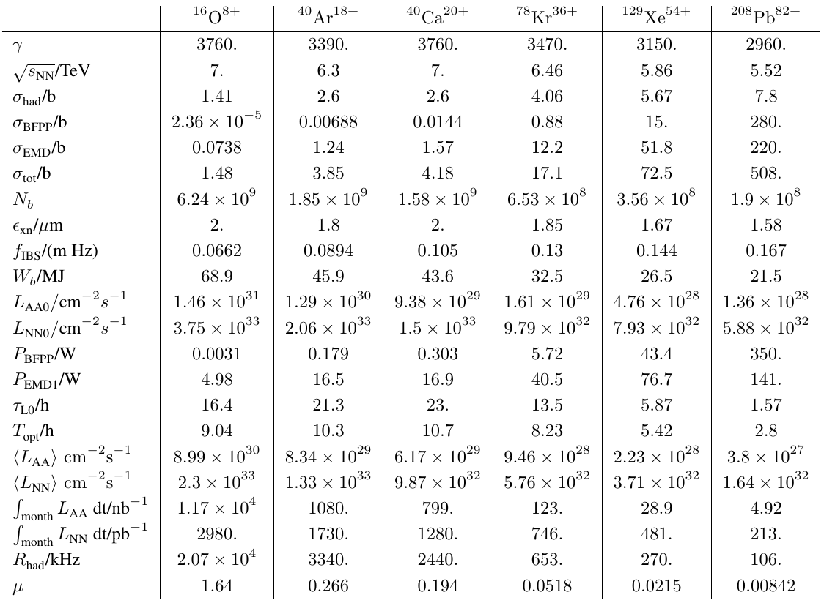
Previous numbers – WG5
P=1.5
  From WG5 yellow report

Slide 7
Reviewing the WG5 scenarios
For ALICE3 letter of intent (and also for the other experiments), need luminosity estimates that are as reliable as possible
  Obviously, large uncertainties apply in any case for operation with new species that has not been demonstrated
Preparation work for Run 3 oxygen pilot run (R. Alemany, H. Bartosik), accounting for the SPS space charge limit, showed much more conservative O bunch intensities from the injectors than the yellow report
  Explanation: WG5 scaling does not account for the real limitations in the injectors
Needed to revise the performance estimates for lighter ions, including realistic limitations in the injectors

Slide 8
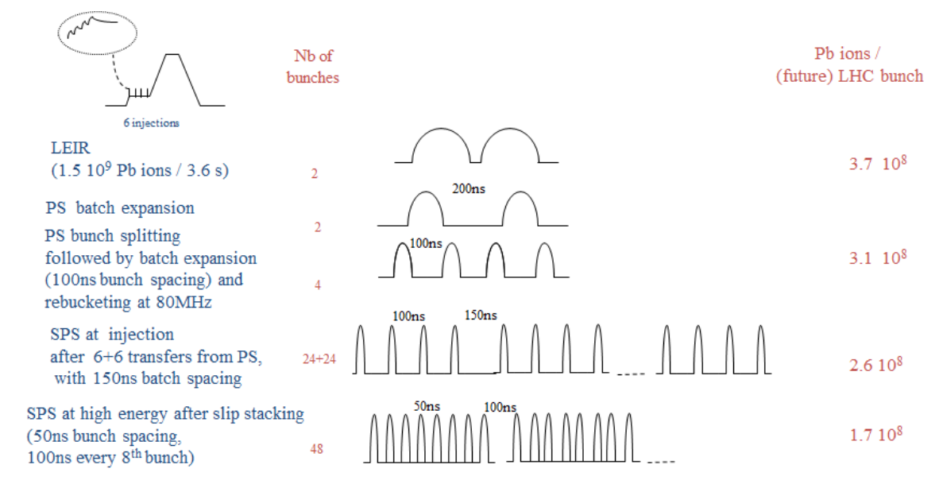
HL-LHC production scheme for Pb in the injectors
LIU baseline production scheme for Pb beams
from LIU Technical Design Report Vol. II: Ions, CERN-ACC-2016-0041
Pb²⁹⁺
Linac3
Stripping
LEIR
Pb⁵⁴⁺
4.2 MeV/A →72 MeV/A
PS
72 MeV/A →5.9 GeV/A
Pb⁵⁴⁺
Stripping
Pb⁸²⁺
SPS
5.9 GeV/A → 177 GeV/A
Assume as default similar production scheme for lighter ions
Typically use 5-7 slip-stacked batches per injection in LHC,
i.e. up to 56 bunches per train

Slide 9
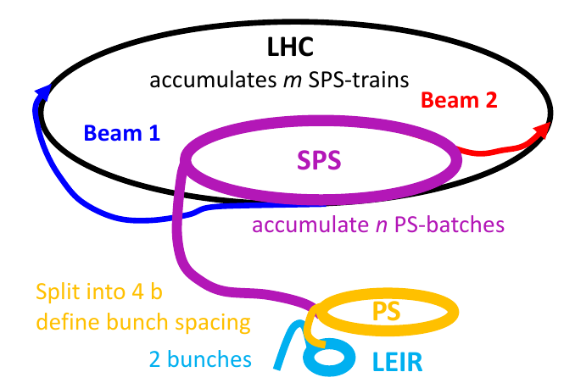
Limitations in the injectors
After significant developments and optimizations in Run 1-2, remaining main limitations on intensity are
  Space charge at LEIR injection
  Space charge and IBS at SPS injection
Prepared a computer program that, given input data on a certain ion, calculates intensity and γ at entrance and exit of each machine (LEIR, PS, SPS), accounting for
  Current in LINAC3 and number of injections
  Injection and transmission efficiencies
  splitting in LEIR and PS
  charge states and stripping efficiencies
  γ, depending on the charge state
  constraints from space charge in LEIR and SPS, depending on γ, charge and mass: If intensity exceeds space charge limit, take space charge limit
    Today, can’t disentangle Pb the limits from IBS and space charge at SPS injection. Assuming conservatively the that space charge dominates
  The bunch intensity at LHC injection, accounting for all of this
  Emittances assumed to be the same as for Pb – presently no easy way to estimate them for different species

Slide 10
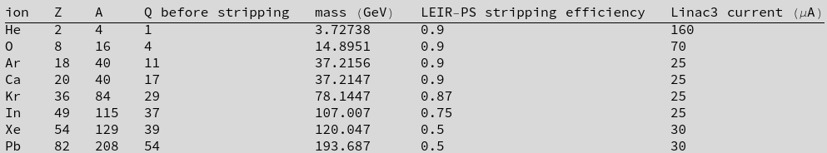
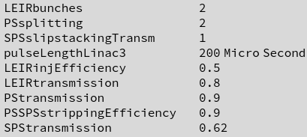
Considered ions, charge states, masses, parameters….
Max allowed LEIR intensity for space charge before capture: 1.85E9 Pb ions
Max allowed SPS bunch intensity at injection for space charge: 3.56E8 Pb ions
Note: In WG5 we had previously Kr78 (rare isotope). Using Kr84 (most common isotope) gives higher achieved LHC intensity
Assuming initially first stripping in LINAC3, second stripping between PS and SPS. “Q before stripping” refers to charge in LEIR (and in PS if we don’t strip between LEIR and PS)
Linac3 current taken from operational experience where available
  For non-operational species (Ca, Kr) assume the lowest current among the operational species – conservative guess
  In any case, if we can take up to 7 injections in LEIR, this is likely not limiting

Slide 11
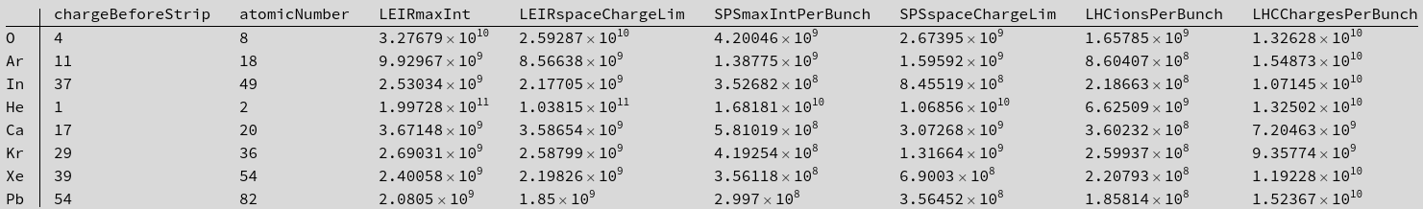
Results: Standard case, including also LEIR
Max that we can inject in SPS,
regardless of space charge
Charge in
LEIR & PS
Max 7 injections, min
to surpass SC limit
Compare to see if limit is in SPS
In this configuration, the limit is in LEIR rather than SPS for most ions
  It is built into the model that we assume we are on the space charge limit in LEIR for Pb. Multiplying by the transmissions, we get intensity injected into the SPS that is slightly below the space charge limit in SPS.

Slide 12
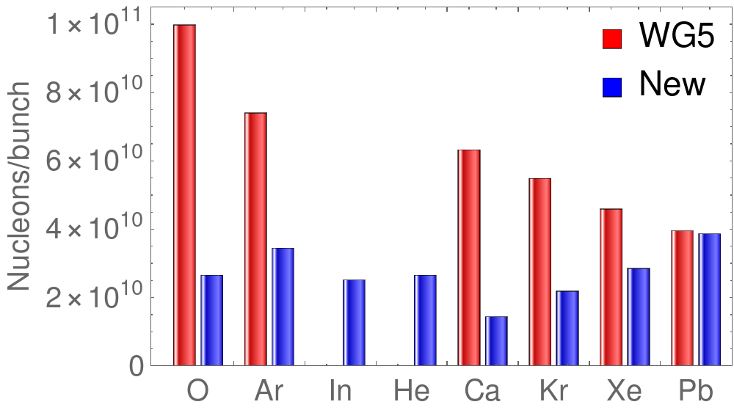
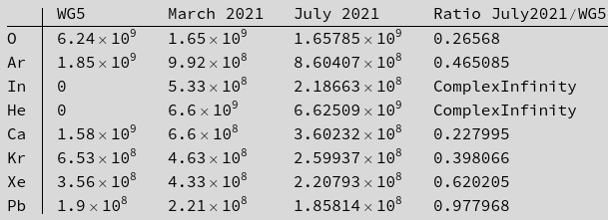
Comparison with WG5 – LHC bunch intensity
Bunch intensities injected in LHC (ions)
For all ions, the new intensities are significantly lower than in WG5 => Much lower LHC luminosity can be expected
Can we do anything to improve?

Slide 13
Paths for improvement
Change SPS optics to improve lattice integral for space charge → not much can be done
Increase bunch length → not much can be done. Even with new RF in SPS we still need to fit the LHC bunch structure
Disentangle limitations from IBS and space charge in the SPS → requires further detailed studies, will take a lot of time. Future work
Omit splitting in PS (gives higher intensity to SPS if LEIR is limiting)
Introduce new stripping stage between LEIR and PS
Vary charge states after stripping in LINAC3 (to optimize charge-to-mass ratio)
Explore the use of different isotopes (to optimize charge-to-mass ratio)
Could give improvement, but feasibility still to be shown through further studies

Slide 14
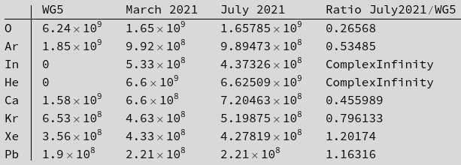
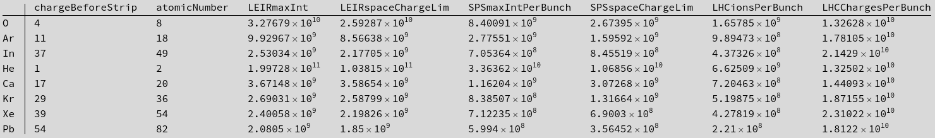
Results – if we in addition don’t split in the PS
If the limit is in LEIR, we can get a higher bunch intensity through to the SPS if we don’t split in the PS
Different train structure: do slip-stacking with 4 bunches per train instead of 8, and do more injections into the LHC
  Detailed filling scheme to be worked out. Rough guess: 15% penalty on number of LHC bunches in the 50 ns Pb scheme.
Without PS splitting, the limit moves to SPS
Observations
  For Ca and Kr, we get more in LHC, because of
  higher charge state in LEIR/PS
  For In, the limitation is in LEIR, i.e. we can
  only inject intensities into the SPS which are
  below the space charge limit
  For Xe, we're 20% above the WG5 intensity

Slide 15
What if we strip between LEIR and PS?
Conflicting space charge requirements: LEIR (low Z) vs SPS (high Z)
Idea: introduce additional stripping between LEIR and PS. Stripper foil potentially installed at existing BTV
  Allows increased γ at PS extraction, and hence pushes the SPS space charge limit
  Additional intensity loss in stripping – approximate stripping efficiencies calculated by GSI colleagues
    Stripping to bare nuclei seems most efficient
  Studying this only for the case where we don’t split in the PS – with splitting, the limit was mainly in LEIR, so we don’t gain much
Caveats
  Stripping to bare nuclei likely exposes potential limitation of space charge in the PS – to be checked
  Stripping introduces spread in angle and energy → capture and beam degradation to be checked
  Need lower B-field in the PS at injection → Checked with PS experts; fine for all except O
  We might need different RF harmonics in the PS. Can the PS RF system cope? → Checked with PS experts
  These limits to be followed up before we can conclude on the feasibility of this scheme
  Under discussion: experimental tests in Run 3

Slide 16
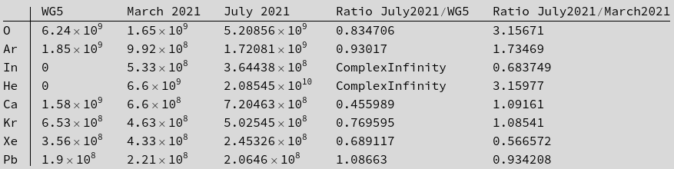
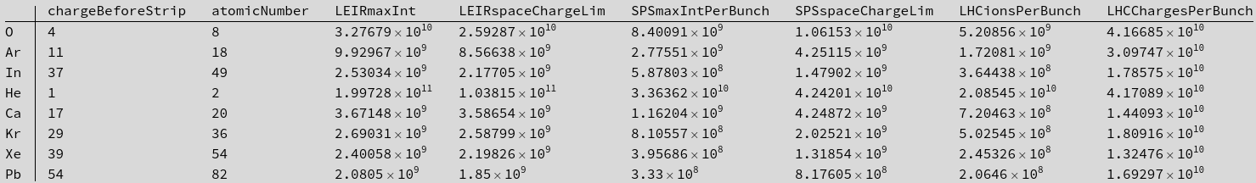
Results – if we strip between LEIR/PS, no split in PS
For many ion species, there’s a significant gain.
We’re now close to the WG5 intensity for O and Ar!
This method doesn’t seem to pay off for Xe, where we lose a lot in the stripping

Slide 17
Scan of charge state in LEIR
Instead of using the charge states in LEIR on slide 13, vary charge state out of LINAC3 to see if we can get a higher intensity to the LHC
  Obviously stripping efficiency in LINAC3 could be lower for other charge states, and many charge states would have too low yield for meaningful operation
  Assuming for now that even for charge states away from the optimum LINAC3 stripping efficiency, we can take more pulses from LINAC3 to fill the LEIR, so that we can still work on the LEIR space charge limit
  This would have to be verified with dedicated studies.
Scanning now all charge states – clearly not all are possible due to charge state out of the source, then stripping efficiency after LINAC3 with electron binding energies, but scanning all gives a good overview of parameter space
Calculating LHC bunch intensity for four cases:
  standard (black line): Split in 2 bunches in LEIR, split in 2 bunches in PS
  As 1, but with additional stripping to bare nuclei between LEIR and PS. Using stripping efficiencies from GSI
  As 1, but without splitting in the PS
  As 3, but with additional stripping to bare nuclei between LEIR and PS.

Slide 18
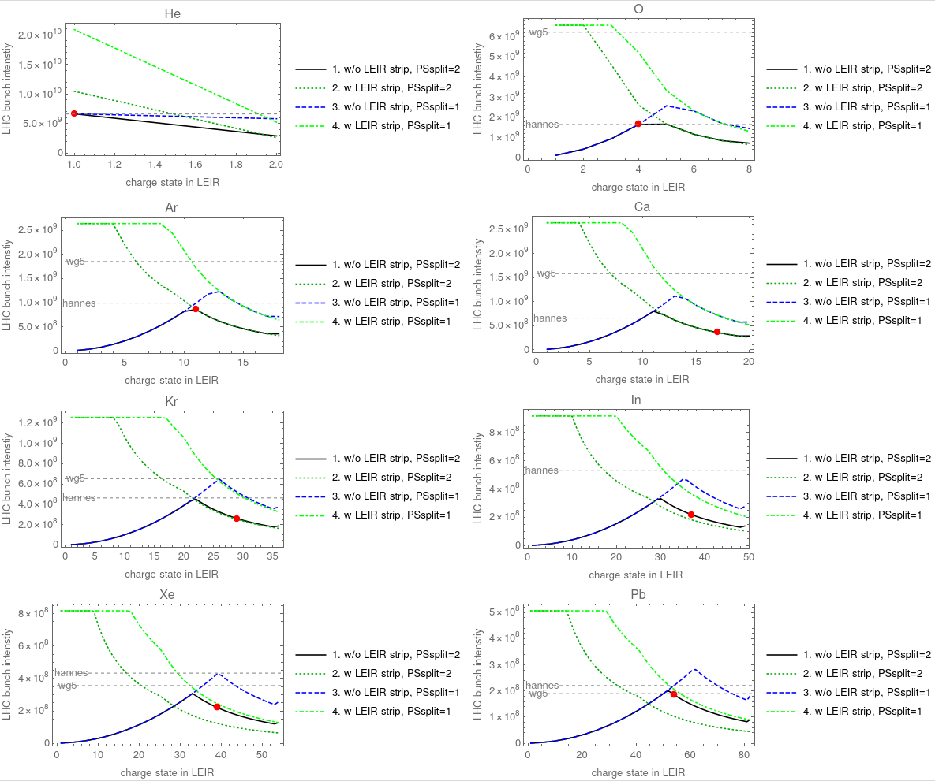
“Baseline scenario” slide 15

Slide 19
Observations: varying charge state
Different “branches” depending on splitting and stripping
  Crossover between limits in LEIR and SPS
For Pb we’re pretty close to the optimum at the LEIR/SPS crossover
  Possibly we should by construction be at the optimum, since we assume for the scaling that in operation we’re exactly at the limit in both machines
For most ions we could get higher bunch intensities if we can move away from the presently assumed charge state in LEIR,
  True in particular if we combine with LEIR/PS stripping and/or no splitting in PS, however, possibly not realistic

Slide 20
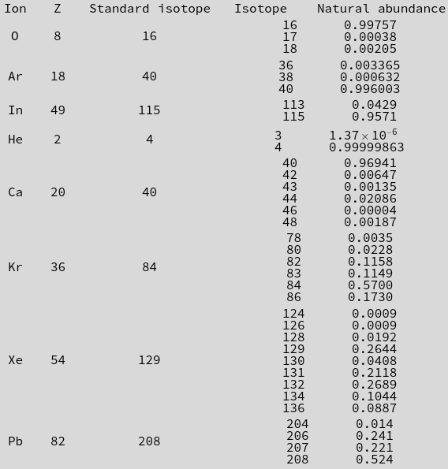
Scan over stable isotopes
Checked isotopes
(stable isotopes and abundances from Mathematica built-in database):
Idea: varying charge/mass ratio can be done by choosing a different isotope, instead of varying the LEIR charge state
  Caveat: need to check which isotopes can actually be acquired at reasonable cost and used in the source – not done yet
For each ion, scanned all stable isotopes for the following scenarios
  Standard case: split in PS, no additional stripping
  Without PS splitting
  Without PS splitting and with additional stripping between LEIR and PS
20

Slide 21
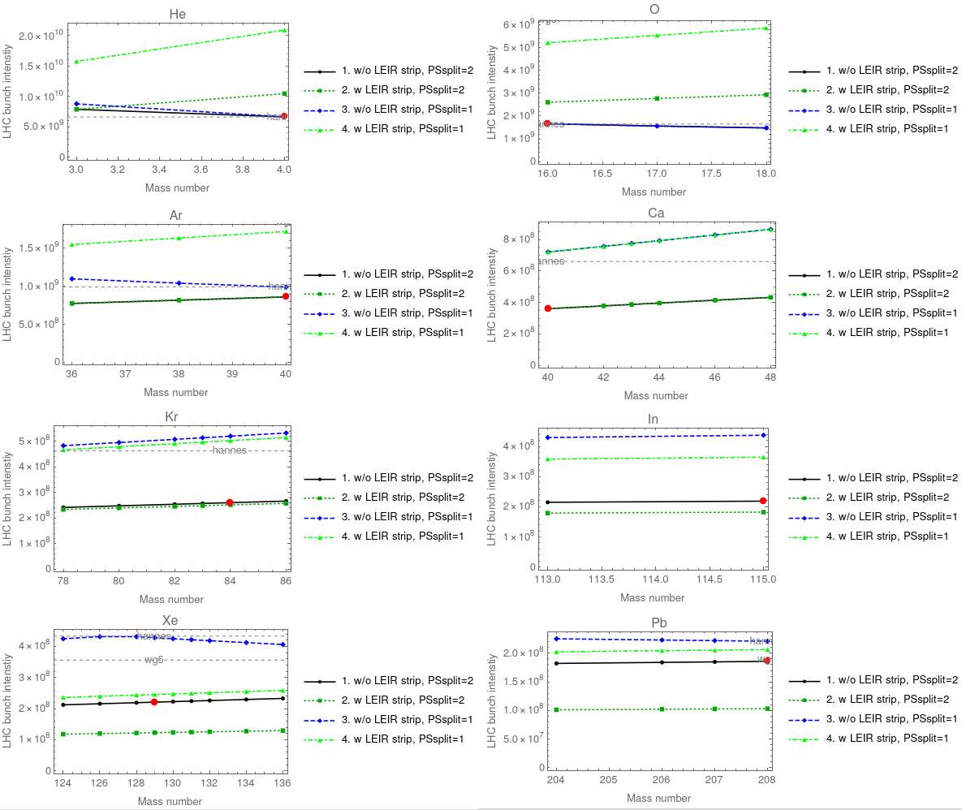
Combined limit from LEIR and SPS – all scenarios
Dots = stable isotopes
Red dot = standard scenario, standard isotope
A limited gain can sometimes be obtained by selecting a different stable isotope, also in the other scenarios

Slide 22
Observations: changing isotope
Depending on scenario, we could achieve interesting gains
  For the case without splitting in PS, could gain ~10% by using Ar36 instead of Ar40
    Natural abundance 3 permille
  All scenarios: Ca48 gives 20% higher bunch charge than Ca40
    Natural abundance is only 1.9 permille
  Kr86 gives 2% gain compared to Kr84 and 10% gain compared to Kr78 (considered in WG5)
    Natural abundance 17%
  Xe136 gives sometimes 5% gain compared to Xe129
    Natural abundance 9%
  For the case without splitting in PS, could gain ~2% by using Pb204 instead of Pb208
    Natural abundance 1.4%

Slide 23
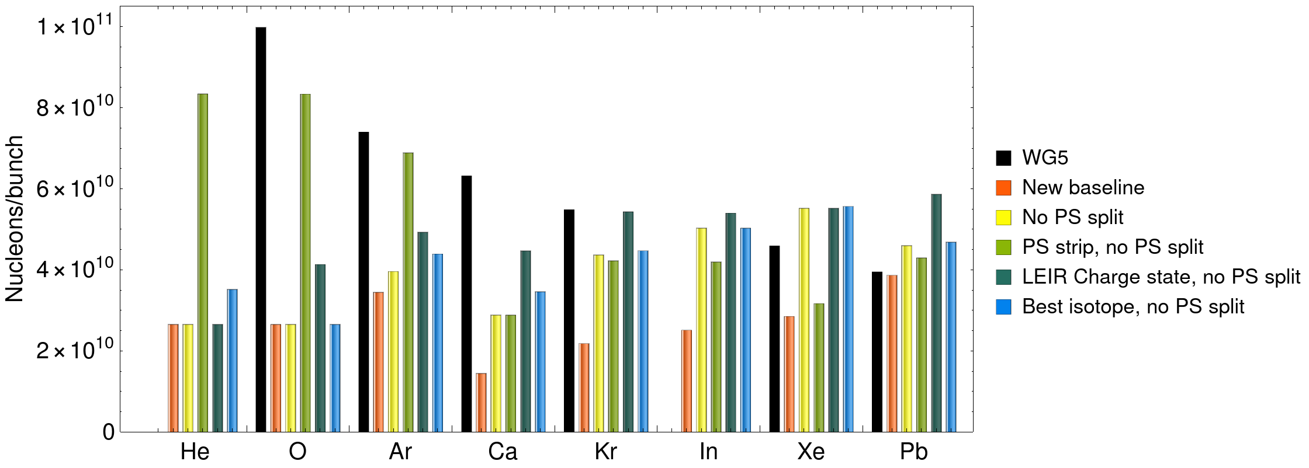
Comparison of gain in bunch intensity (nucleons/bunch)
Not including the scenario with varying charge state AND PS stripping
  shows very high intensities, but likely not realistic
For lighter ions, we’re still far from the WG5 values
For the heaviest ions, the WG5 intensities might be within reach or even surpassed
  Propose beam tests in the injectors for Pb

Slide 24
LHC studies
Selecting two scenarios for performance studies in the LHC
  Goal: get a range in achievable luminosity between what we could possibly achieve with the knowledge we have today, and what might be achieved in Run 5 with some optimism
Conservative scenario
  take the “baseline case”, i.e. orange bars on previous slides, and table on p13
Optimistic scenario
  assume a variation in LEIR charge state and no PS splitting, i.e. dark green bars on previous slide
  Has some optimism, clearly relies on assumptions that have not been proven yet

Slide 25
LHC studies
Using CTE to simulate luminosity in typical LHC fill in both scenarios
Estimating full 1-month luminosity using similar method as for Pb-Pb (get optimal fill time, assume given operational efficiency)
Additional LHC assumptions for each scenario
  Conservative scenario
    Identical assumptions as in previous Pb studies: 93% transmission in LHC, beta*=0.5m, 50% OP efficiency, 3.33 h turnaround
    Filling scheme 1240b_1088_1088_398 seems to be reasonable compromise
  Optimistic scenario
    Need to account for fewer bunches in LHC due to shorter SPS trains without PS splitting – decreasing tentatively number of bunches and number of collisions at each experiment by 15%
      Detailed filling scheme to be studied, but preliminarily changing Pb scheme 1240b_1088_1088_398 to new scheme 1054b_925_925_338 (only approximate guess)
    Adding some optimism on LHC side: beta*=40 cm with 100 urad crossing angle, 65% OP efficiency, keeping turnaround at 3.33 h
      In principle filling will be longer with more injections from SPS, but assuming that we will also be more efficient in the future
    Has some optimism, clearly relies on assumptions that have not been proven yet
  No leveling at any IP both scenarios

Slide 26
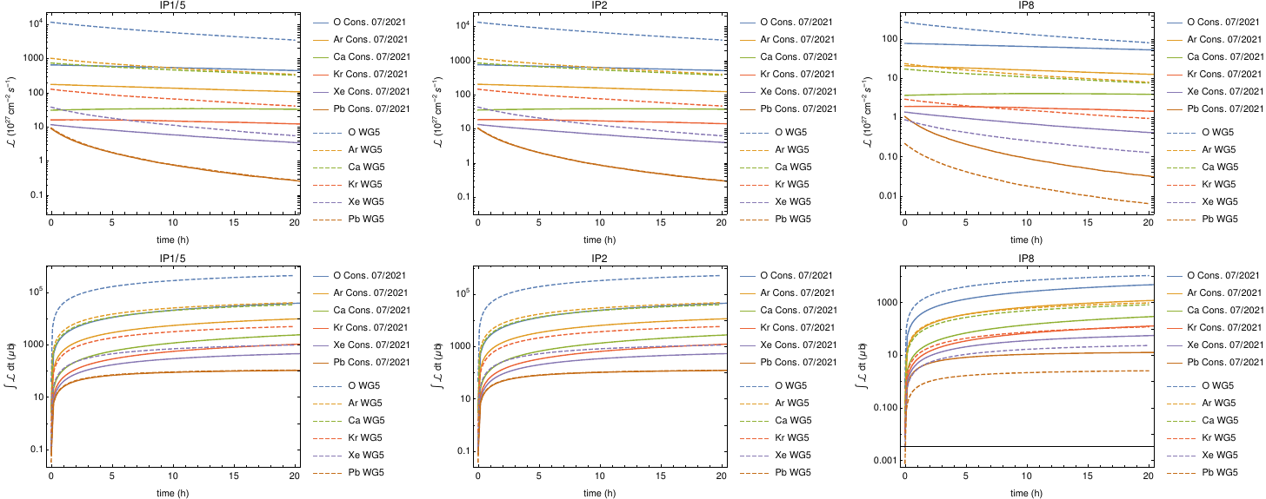
Result – conservative vs WG5
Instantaneous and integrated luminosity in single fill

Slide 27
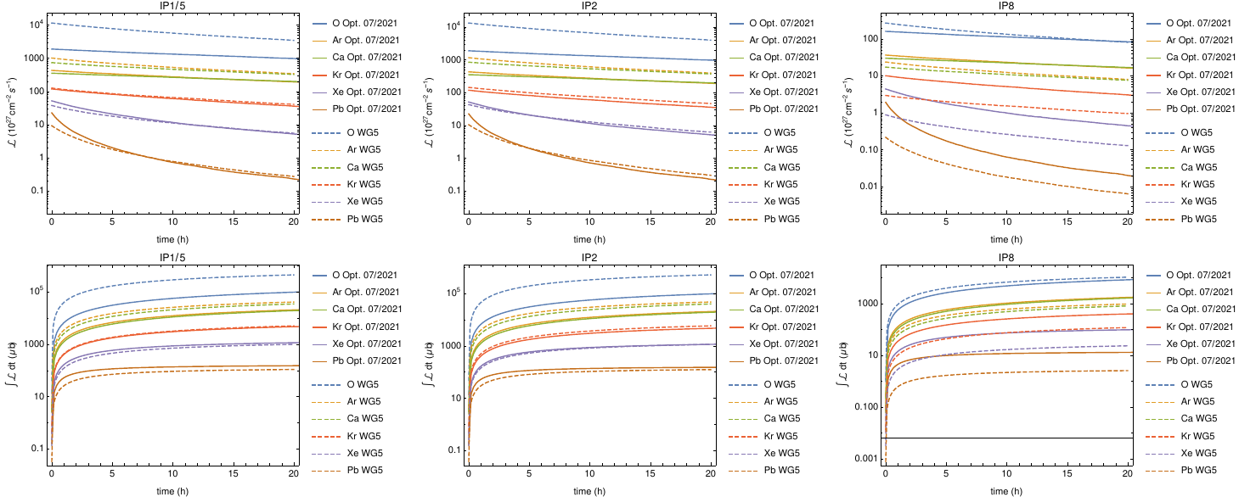
Result – optimistic vs WG5
Instantaneous and integrated luminosity in single fill

Slide 28
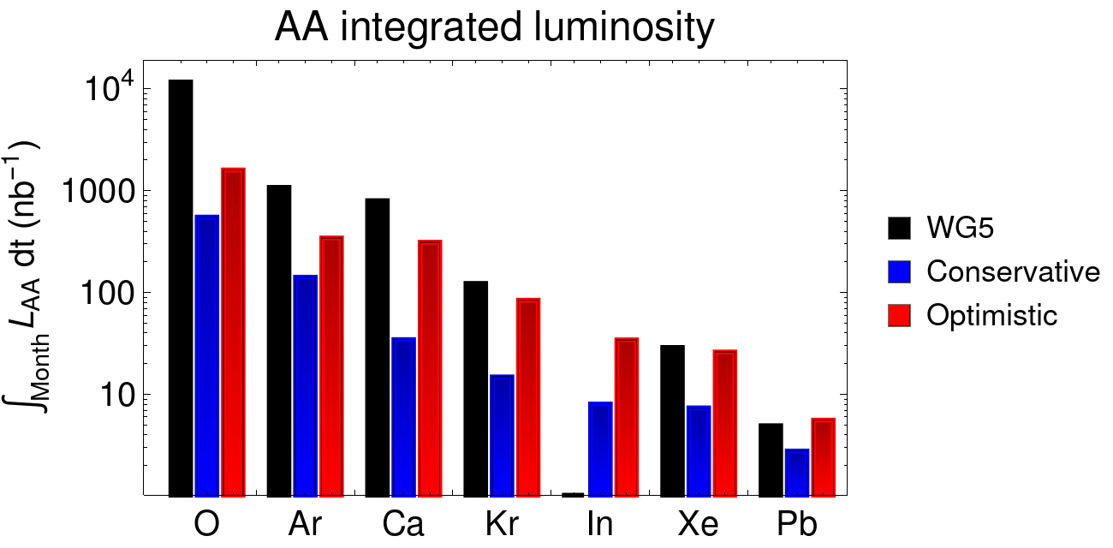
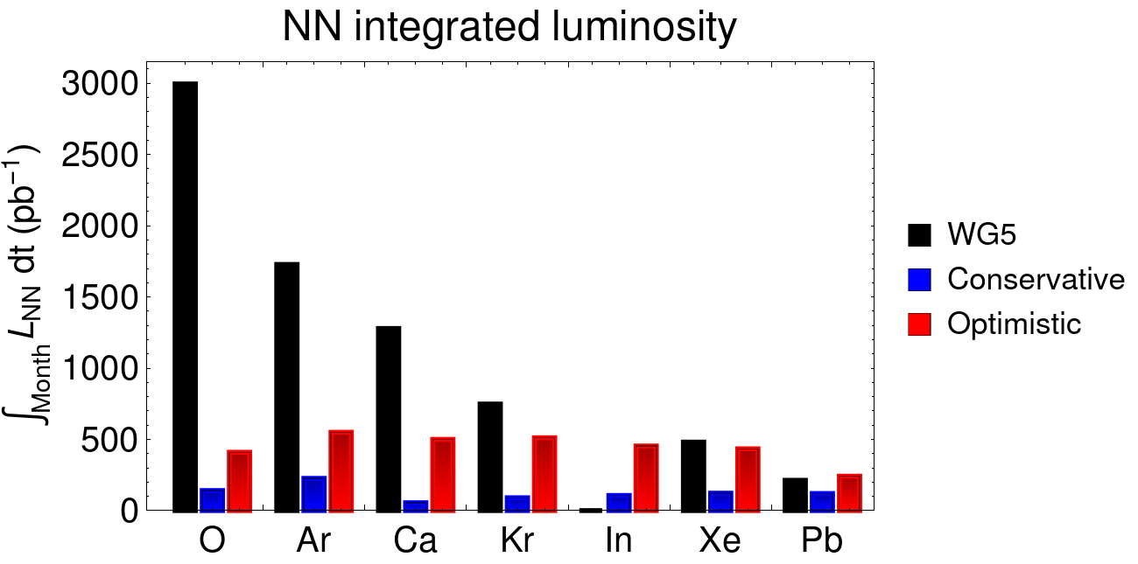
1-month integrated luminosity
Even in optimistic scenario, we get significantly lower luminosity than in WG5 for most considered ions
  The lighter the ion, the larger difference
  Even for the case with higher bunch population than WG5 (Xe, Pb optimistic), we get slightly lower luminosity than in WG5
    Full simulation of beam evolution not performed for WG5
For optimistic scenario, we get up to a factor 4.5 gain (Ar) compared to the HL-LHC Pb-Pb scenario
  WG5 had gain ratio of 25 compared to Pb-Pb (for O)
No clear “winner ion” in new study (Ar is in the lead)
  several intermediate ion species give integrated NN luminosities of 400-550 pb⁻¹ in optimistic scenario
  In conservative scenario, highest luminosity (Ar) is factor 2.5 less
28
R. Bruce, 2021.09.28

Slide 29
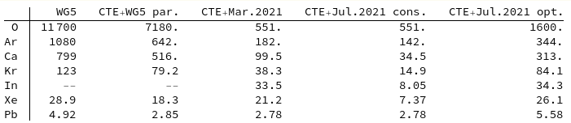
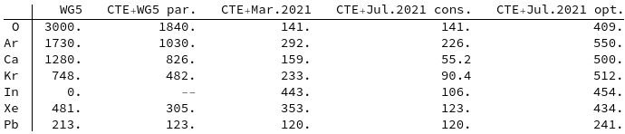
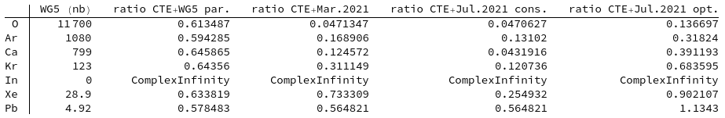
Integrated AA luminosity per 1-month run in 1/nb
Results – integrated 1-month luminosity
Integrated nucleon-nucleon luminosity per 1-month run in 1/pb
Ratio to WG5 of integrated luminosity per 1-month run

Slide 30
Summary
Serious studies for LHC operation with lighter ion species beyond Run 4 are ramping up within the experiments
  ALICE 3 letter of intent under finalization
Revised and updated WG5 estimates of achievable bunch intensities from injectors, and LHC integrated luminosity, for a range of different ion species
  Including detailed considerations of the beam production and limitations in the injectors
  Default production scheme gives large reduction in achievable bunch intensity and LHC luminosity compared to WG5
  The discrepancy with WG5 is the largest for the lightest ions, i.e. O (5% of WG5 lumi), and smaller for heavier ions (Xe 25%)
  For intermediate ions, we’re between 30-90% of WG5, with Xe at 90%
Studied various possible improvements upon conservative default scenario: Omit splitting in PS, stripping after LEIR, varying LEIR charge state, choosing different isotope, more optimistic LHC assumptions
  Could gain a factor ~2.5 on top of the conservative with varying Z/A ratio (charge state in LEIR; expect similar improvements from changing isotopes) combined with omitted PS splitting
    Could potentially get 400-550/pb NN luminosity per month for intermediate ions
  Important inputs for the ALICE3 study
  Potentially larger gain if combined with intermediate stripping
    Would likely cause space charge limitations in PS. To be investigated
This is work in progress – many assumptions still need to be checked, and we have a rich list of future studies
(see next slide)

Slide 31
Potential future studies
We have to understand which alternative charge states are actually feasible into LEIR, and the cost and feasibility of non-standard isotopes
Work out detailed filling schemes to see how many bunches and collisions we could get into the LHC if we don’t split in the PS
MDs in injectors on schemes without splitting in the PS, potentially starting with Pb
Stripping between LEIR and PS seems potentially very promising
  But we must think about various limitations in the PS that could come if we strip between LEIR and PS, in particular PS space charge limit - might need experimental studies with beam in the PS to be fully addressed so not for the near future
  Demonstrate experimentally that we can insert a stripper in the BTV between LEIR and PS?
Launch studies on combined effect of IBS and space charge in the SPS, to see if pure space charge scaling of intensity limit is pessimistic
  Not an easy study that can be done quickly. Student project?
Could think of reviewing and optimizing all assumptions for transmission efficiencies based on Run 3 experience
  Could potentially learn a lot from the O pilot run
Need to study possible new LHC limitations with lighter ions
  Collimation efficiency with nuclear beams at higher stored beam energies
  Collisional losses (BFPP not important for light ions though)
  O beam transmutation effect (applies to any ion with Z=2A, e.g. Ca)

Slide 32
Backup

Slide 33

Calculation of bunch intensities in the LHC
Scaling of space charge tune shift:
In LEIR, we have always the same γ at injection from LINAC3
  The space charge tune shift can be influenced mainly by the charge state
  Lower charge state is better, since it gives lower tune shift
Will then get different γ during acceleration in LEIR, PS and SPS depending on the charge-to-mass ratio
We’re stripping before injection into SPS to bare nuclei, but depending on charge state before the stripping, the γ at SPS injection will be different
  Space charge tune shift in SPS is essentially given by the γ for a given ion, but this γ depends on the upstream charge state before stripping
  Higher LEIR charge state is better, since it gives higher γ
Program accounts for all this and propagates a given ion with given charge state from LEIR and onwards, including transmission efficiencies, splitting, and stripping efficiencies

Slide 34
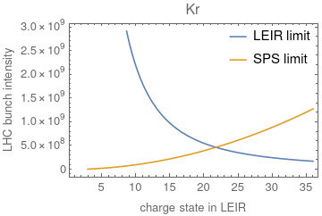
Scanning charge state: LEIR vs SPS limits
Compare limits from LEIR and SPS as function of charge state
  To get LEIR limit: calculate LEIR space charge limit, split in 4 bunches (LEIR and PS), multiply by transmission efficiencies in each machine, but neglecting space charge limit in SPS
  To get SPS limit: Calculate SPS space charge limit, multiply by SPS-LHC transmission, assuming we can always get beam up to the space charge limit from the PS
As expected, LEIR and SPS limits go in different directions (For LEIR, better with low charge state, for SPS better with high charge state)
  Same gamma into LEIR
  Same charge into SPS
There’s an optimum charge state where the two limitations cross – at this optimum, we can get the highest bunch intensity to the LHC
Example: Kr
Scaling factor for space charge tune shift:

Slide 35
Scan for all species, different scenarios
Calculating LHC bunch intensity for four cases:
  standard (black line): Split in 2 bunches in LEIR, split in 2 bunches in PS
  As 1, but with additional stripping to bare nuclei between LEIR and PS. Using stripping efficiencies from GSI
  As 1, but without splitting in the PS
  As 3, but with additional stripping to bare nuclei between LEIR and PS.

Slide 36
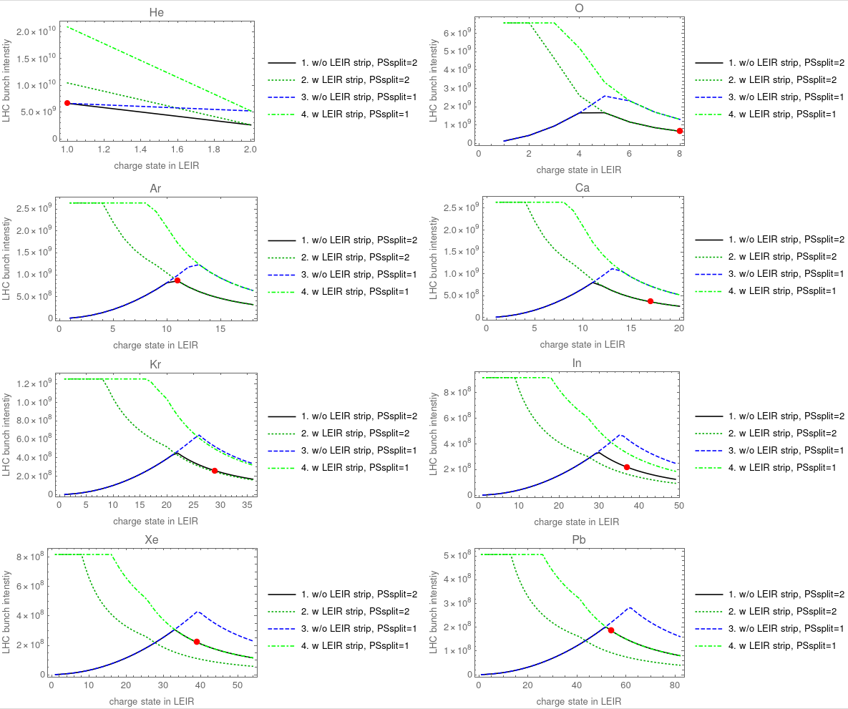
Example result: Kr
Example result: Krypton
For case 1 (black line), use present setup (split in PS, no LEIR/PS stripping). two regimes:
  Limited by LEIR (RHS) => decreasing charge state helps
  Limited by SPS (LHS) => increasing charge state helps
  Optimum at the crossover
  Red dot: previously assumed “baseline” point from slides 9-10
SPS limiting
LEIR limiting
optimum

Slide 37
Example result: Kr
Example result: Krypton
Going to case 2 (introduce stripping in LEIR, dark green) => regardless of LEIR charge state, bare nuclei arrive at SPS => SPS space charge limit is independent of LEIR charge state
“Plateau” where SPS becomes limiting (but with much higher LHC bunch intensity than before, hence much further to the left!)
Slightly lower intensity than black line to the right due to intensity loss in stripping between LEIR and PS
SPS limiting
LEIR limiting

Slide 38
Example result: Kr
Example result: Krypton
Going to case 3 from 1 (no PS splitting, blue) => For the RHS part where LEIR is limiting, we can get a higher bunch intensity into the SPS, since we don’t divide by two in PS
To the left, where SPS is limiting, we don’t gain anything
Crossover between SPS and LEIR limits moving to the right, since we get higher intensity out of LEIR/PS
SPS limiting
LEIR limiting
optimum

Slide 39
Example result: Kr
Example result: Krypton
Going to case 4 (LEIR/PS stripping AND no PS splitting, light green) => For the RHS part where LEIR is limiting, we can get a higher bunch intensity into the SPS than in case 2, since we don’t divide by two in PS
“Plateau” where SPS becomes limiting (but with much higher LHC bunch intensity than before, hence much further to the left!)
Slightly lower intensity than blue line to the right due to intensity loss in stripping between LEIR and PS
SPS limiting
LEIR limiting

Slide 40
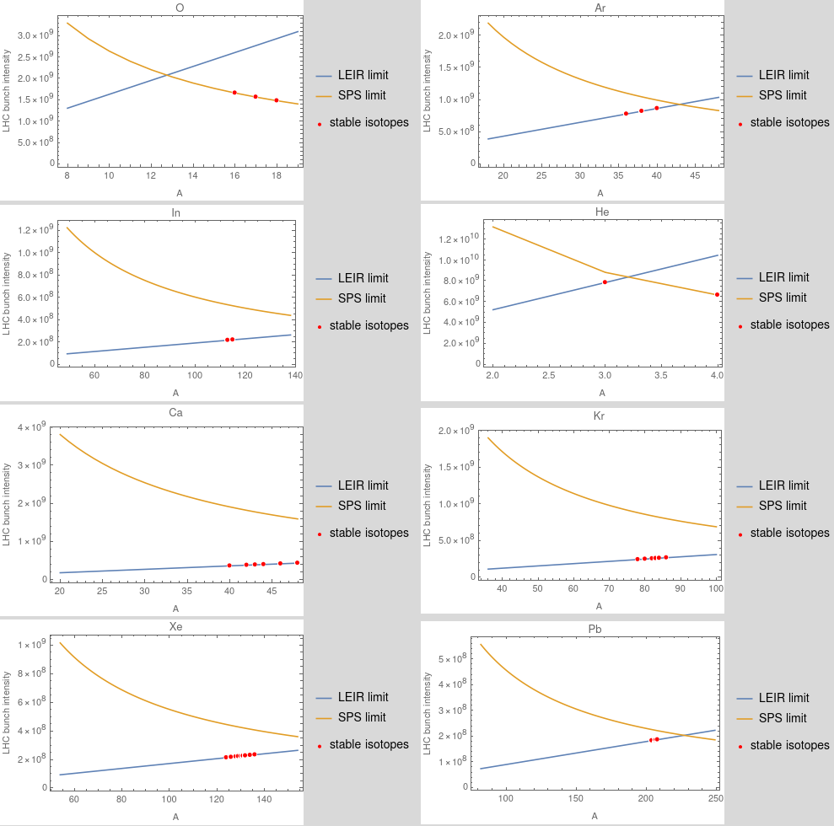
Isotope scan
Limits from LEIR and SPS – standard case with splitting and without LEIR/PS stripping
Conflicting requirements from LEIR and SPS seen similarly as for the charge state variation
Most ions are limited in LEIR
A limited gain can sometimes be obtained by selecting a different stable isotope (red dots)

Slide 41
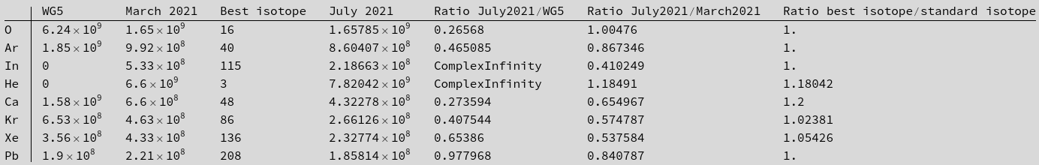
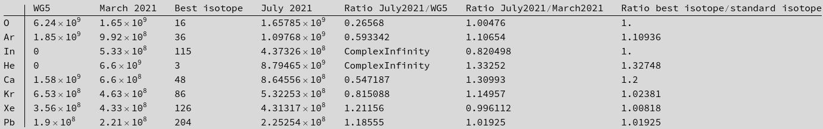
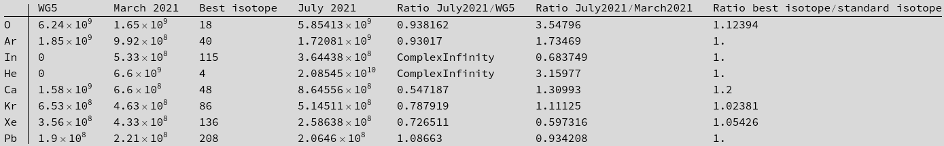
LHC bunch intensity comparisons; isotope scan
Standard case: with PS splitting, no LEIR/PS stripping
Without PS splitting, no LEIR/PS stripping
Without PS splitting, with LEIR/PS stripping

Slide 42
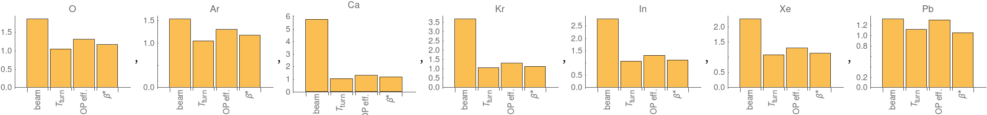
Understanding luminosity gains
Which are the most important factors in the luminosity gain when going from conservative to optimistic?
  Performed intermediate studies, adding one effect at a time
    First putting new optimistic bunch intensities, maintaining b*=0.5 m and op efficiency=0.5. Need then to increase turnaround time
      John used 45 min filling time (see Cham17, slide 18). For shorter SPS trains, double this (i.e. add 45 min.), going to from 200 min to 245 min = 4.08 h
    Then decrease b* to 40 cm
    Then increase OP efficiency to 0.65
    Then decrease turnaround time back to 3.33h as used initially
Resulting 1-month integrated luminosity improvement factors for each ion species

Slide 43

Summary of gain factors
Mean improvement factor for each change, averaged over all ions, in order of importance
The main gain clearly comes from the beam parameters, and the turnaround time is the least important one
  But there are quite some differences between different ion species – see previous slide
Multiplied together, the LHC assumptions give 1.55 – still significantly smaller than the beam assumptions
Changing the order in which the effects are added doesn’t change the conclusions (percent level changes seen)

Slide 44
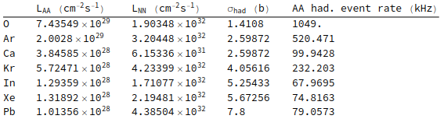
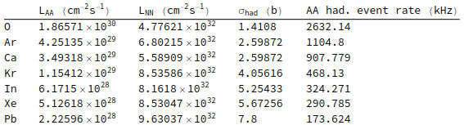
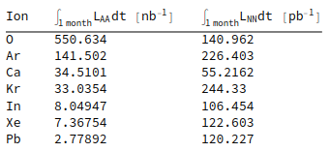
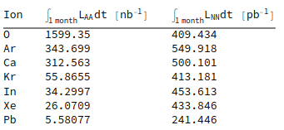
Luminosities if using Kr86 instead of Kr78
Peak rates, conservative
Peak rates, optimistic
Integrated 1-month luminosity, conservative
Integrated 1-month luminosity, optimistic

