Slide 1







Truncated Marginal Neural Ratio Estimation
Empirically testable, simulation efficient & simulation-based posterior approximation.
Benjamin Kurt Miller
Alex Cole
Patrick Forré
Gilles Louppe
Christoph Weniger
5th Inter-experiment Machine Learning Workshop, CERN 2022
Notes:
This method which is aimed at practitioners who care about complex simulators with many nuisance parameters.
Try to explain motivation, show a visual description, then the details.

Slide 2
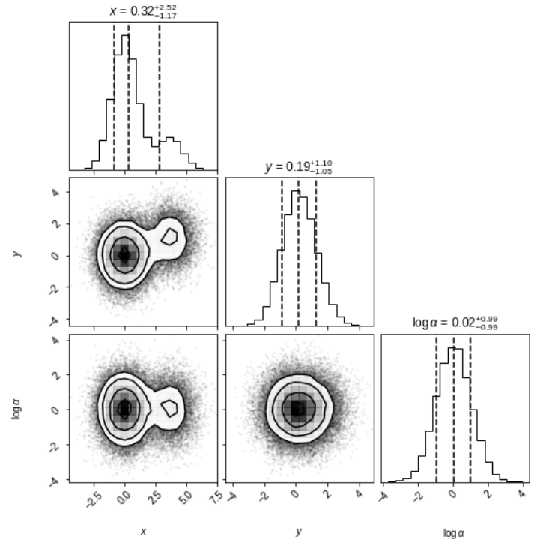

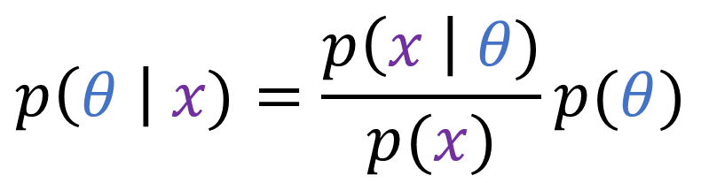
Marginal Inference
The posterior quantifies the uncertainty about parameters $θ$ given data $x$.
$$p\left(θ \right| x)=\frac{p\left(x \right| θ)}{p(x)}p(θ)$$
Foreman-Mackey, D. (2016). corner.py: Scatterplot matrices in Python. The Journal of Open Source Software, 1(2), 24. https://doi.org/10.21105/joss.00024
Notes:
We quantify the uncertainty in the parameters in a Bayesian setting using the posterior.
We can compute moments, credible intervals, or the posterior predictive…
A visual representation of the high-dimensional posterior by a corner plot.

Slide 3
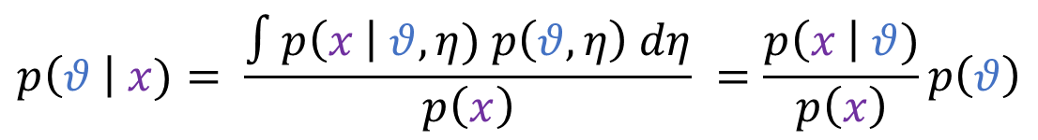
Marginal Inference
Marginalizations of the full 3-dimensional joint posterior!
Marginal Inference: Estimate the marginal posteriors of interest directly.
$$p\left(θ \right| x)= \frac{∫p\left(x \right| θ, η) p\left(θ, η\right) dη}{p\left(x\right)} =\frac{p\left(x \right| θ)}{p\left(x\right)}p\left(θ\right)$$
Also see: Justin Alsing and Benjamin Wandelt. Nuisance hardened data compression for fast likelihood-free inference. arXiv:1903.01473
Niall Jeffrey and Benjamin Wandelt. Solving high-dimensional parameter inference: . arXiv: 2011.05991
Foreman-Mackey, D. (2016). corner.py: Scatterplot matrices in Python. The Journal of Open Source Software, 1(2), 24. https://doi.org/10.21105/joss.00024
Notes:
Notice the corner plot shows 1d and 2d marginals
With likelihood-based methods one must evaluate partially marginalized likelihood or sample in high dimension
we want to estimate them directly with neural ratio estimation
We find that it is more simulation efficient to do it this way when there are many (nuisance) parameters.
Estimating posteriors marginalized by nuisance parameters is available in pydelfi

Slide 4
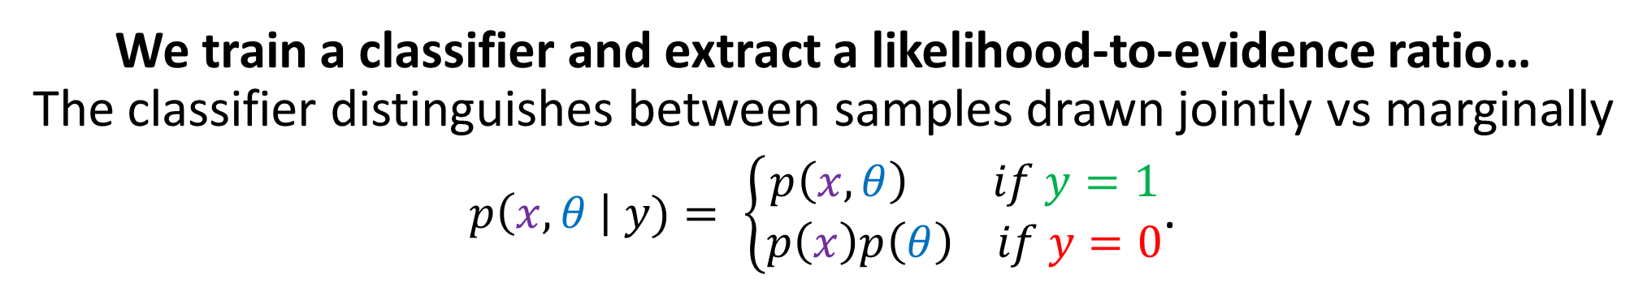
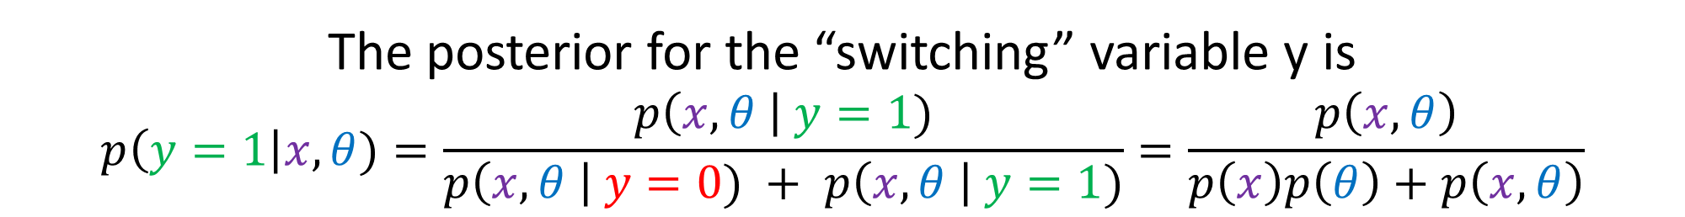
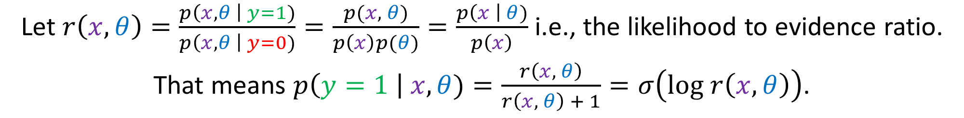
Neural Ratio Estimation
We train a classifier and extract a likelihood-to-evidence ratio…
The classifier distinguishes between samples drawn jointly vs marginally
$p\left(x, θ \right| y)= \left\{\begin{aligned}p\left(x, θ\right) if y=1 \\ p\left(x\right)p\left(θ\right) if y=0\end{aligned}\right.$.
The posterior for the “switching” variable y is
$$p\left(y=1\right|x,θ)=\frac{p\left(x, θ \right| y=1)}{p\left(x, θ \right| y=0) + p\left(x, θ \right| y=1)}=\frac{p\left(x, θ\right)}{p\left(x\right)p\left(θ\right)+p\left(x, θ\right)}$$
Let $r\left(x,θ\right)=\frac{p\left(x, θ \right| y=1)}{p\left(x, θ \right| y=0)}=\frac{p(x, θ)}{p\left(x\right)p(θ)}=\frac{p\left(x \right| θ)}{p\left(x\right)}$ i.e., the likelihood to evidence ratio.
That means $p\left(y=1 \right| x,θ)=\frac{r\left(x, θ\right)}{r\left(x, θ\right) + 1}=σ\left(log r\left(x, θ\right)\right)$.
Notes:
…
By inferring the tractable posterior over the switching variable, the likelihood-to-evidence ratio is recovered.
Replace with vartheta for a marginal prediction.

Slide 5
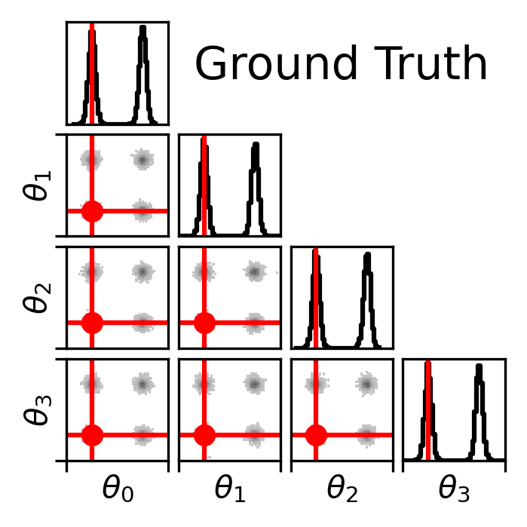
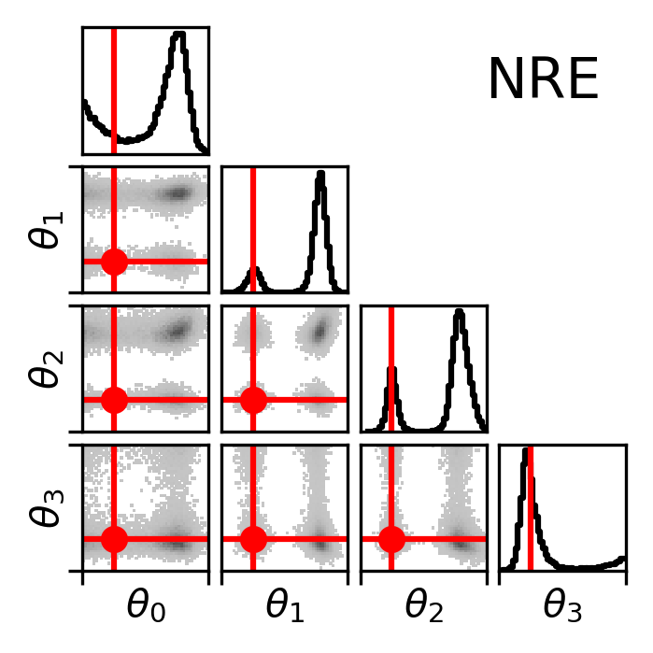
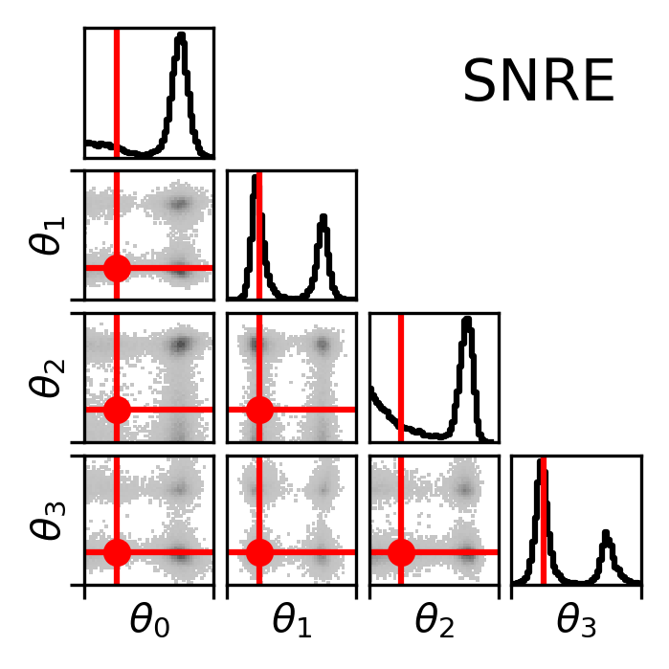
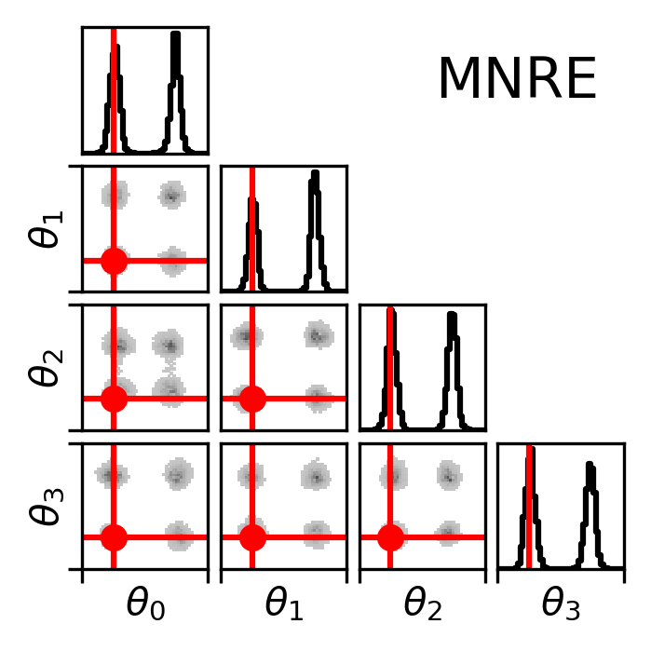
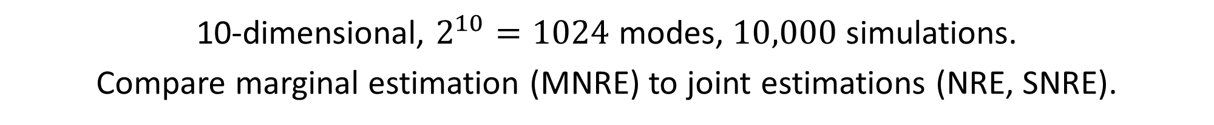
Eggbox: Is marginal ratio estimation simulation efficient?
10-dimensional, $2^{10}=1024$ modes, $10,000$ simulations.
Compare marginal estimation (MNRE) to joint estimations (NRE, SNRE).
Ours
Notes:
We test simulation efficiency with marginal NRE against joint methods.
Eggbox problem with 10 dimensions and over 1k modes. (6 dimensions are safely omitted for space / due to symmetry)
Simulation budget of 10k simulations.
Left ground truth.
Middle left NRE, joint estimation method
Middle right sequential NRE, joint estimation method
Right, ours marginal NRE. Only accurate estimate at this budget.
We target the 1 and 2 dimensional marginals. Each cell in the corner plot is another ratio estimator.

Slide 6
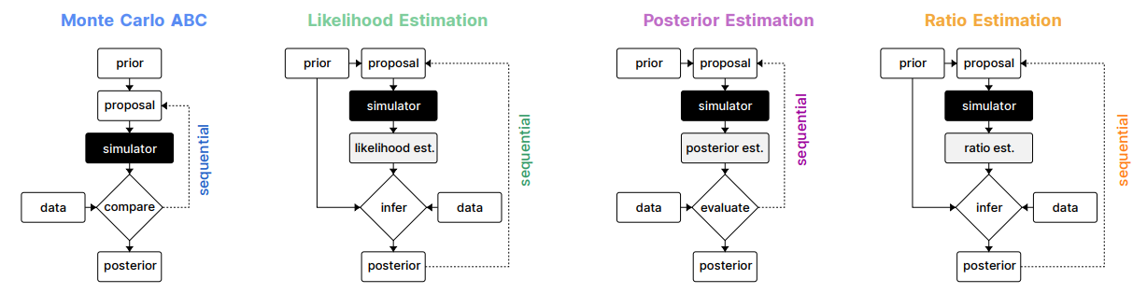
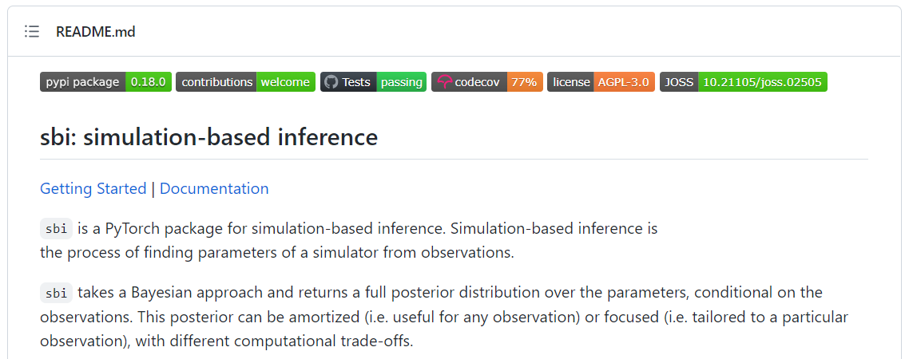
Sidenote: what are amortized vs. sequential methods?
Jan-Matthis Lueckmann, et. al. Benchmarking Simulation-Based Inference.
https://arxiv.org/abs/2101.04653
https://github.com/mackelab/sbi

Slide 7
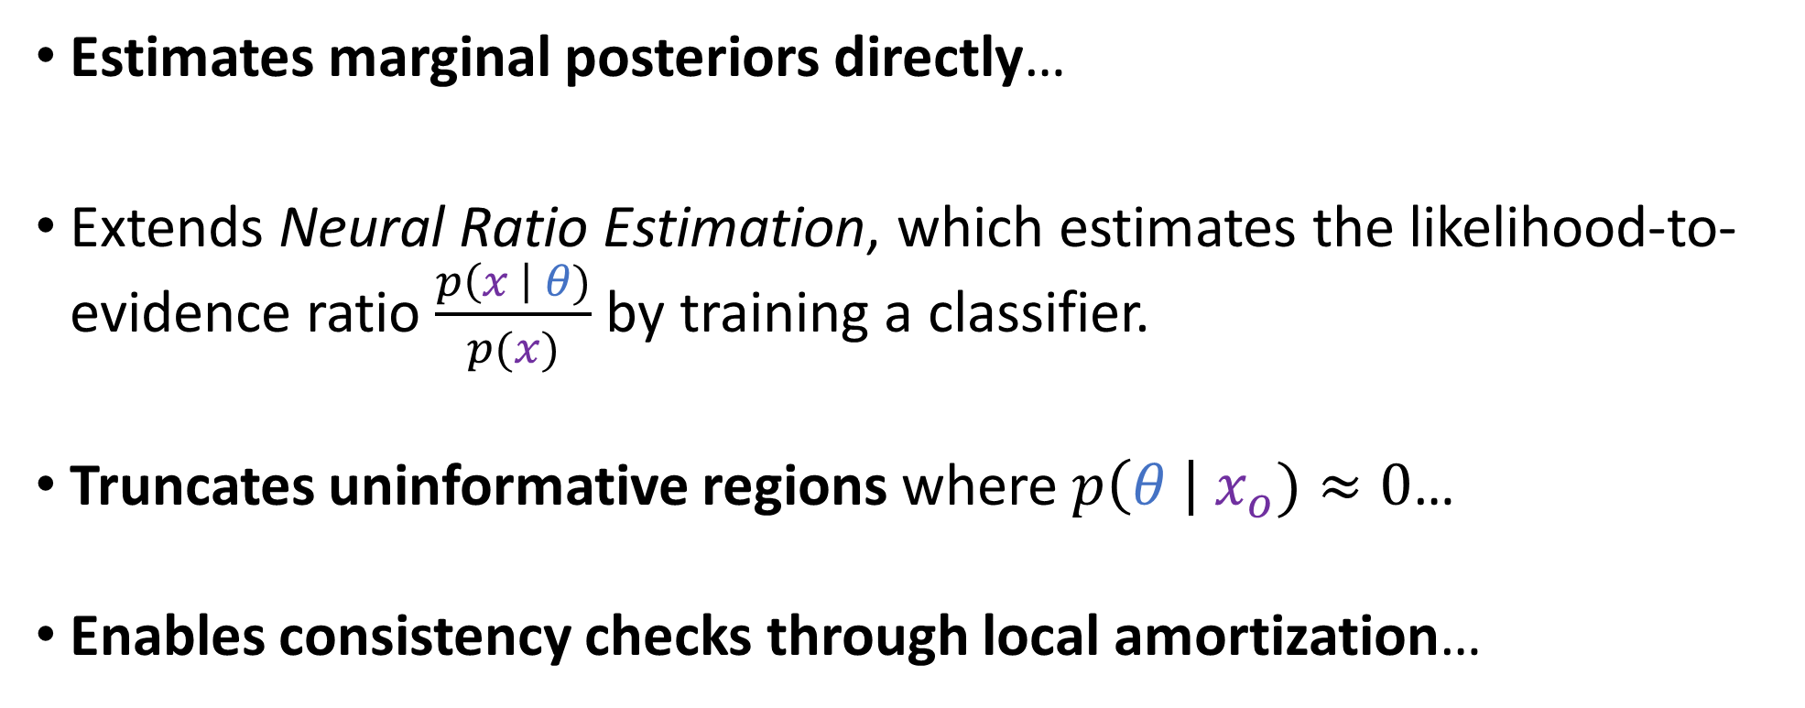
Truncated Marginal Neural Ratio Estimation
Estimates marginal posteriors directly…
Extends Neural Ratio Estimation, which estimates the likelihood-to-evidence ratio $\frac{p\left(x \right| θ)}{p(x)}$ by training a classifier.
Truncates uninformative regions where $p\left(θ \right| x_{o})≈0$…
Enables consistency checks through local amortization…
Hermans, et. al. 2019. Likelihood-free MCMC with Amortized Approximate Ratio Estimators. arXiv: 1903.04057.
Hermans and Delaunoy, et. al. 2021. Averting A Crisis In Simulation-Based Inference. arXiv: 2110.06581.
Notes:
We target the marginal posterior directly which
simplifies finding parameter bounds for scientific inverse problems
avoids the curse of dimensionality
Extends NRE, which estimates LtoR and multiplies to approximate the posterior
Our method truncates the prior in regions where the posterior is nearly zero.
Improves simulation efficiency since those regions are uninformative
Focuses our analysis on a single piece of data.
Truncation doesn’t bias the prior like sequential methods do… which means
Our method can estimate the posterior of “nearby” data, we’re calling local amortization.
Ours amortizes over a subset of the truncated prior using simulations from the region
estimator accurate as if you had a indicator / step fn and original prior in the region
This enables a calibration check of our estimator comparing nominal credible intervals to empirical ones.

Slide 8
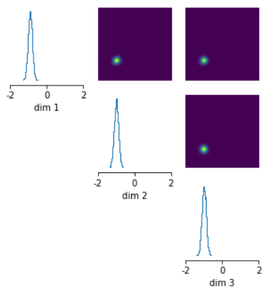
Truncated Bayesian Inference
Posteriors can be quite narrow compared to priors.
Truncated Inference: Sample only regions near the posterior mass.
“Ideal” truncated region?
$$Γ ≔\{θ∈supp p\left(θ\right) | p\left(θ \left| x_{o}\right)>ε\right\}$$
Our component-wise marginal estimate.
$$Γ_{rec, i} ≔\left\{θ_{i}∈supp p_{i}\left(θ_{i}\right) \right| \hat{p}{\left(θ_{i} \left| x_{o}\right)>\tilde{ε}\right\}}_{i}$$
Tejero-Cantero, A., Boelts, J., Deistler, M., Lueckmann, J.-M., Durkan, C., Gonçalves, P. J., Greenberg, D. S., & Macke, J. H. (2020). sbi: A toolkit for simulation-based inference. Journal of Open Source Software, 5(52), 2505. https://doi.org/10.21105/joss.02505
Notes:
Posteriors can be much more informative than the prior.
This means there’s a lot of information in the data—nice for science, expensive for sbi
Most prior draws will be irrelevant. Draw relevant prior samples by avoiding draws far from mass.
We then estimate the likelihood-to-evidence ratio only on truncated region.
Learn a locally amortized estimator
What’s an ideal region? What do we actually learn.
Increases efficiency AND allows for expected coverage testing

Slide 9
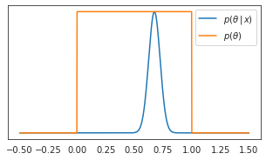
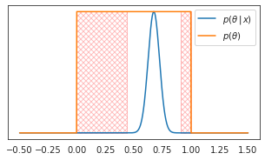
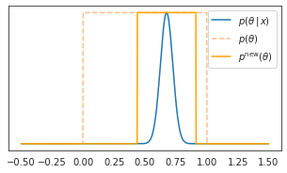
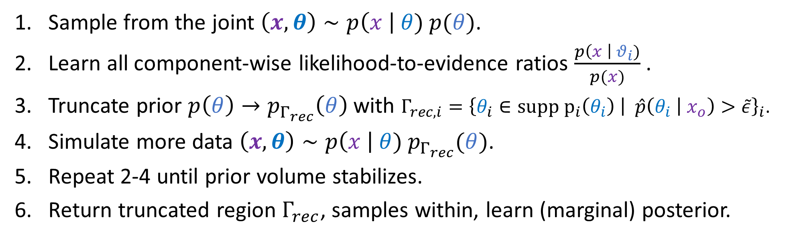

Sketch of truncation scheme
Sample from the joint $\left(x,θ\right)∼p\left(x \right| θ) p(θ)$.
Learn all component-wise likelihood-to-evidence ratios $\frac{p\left(x \right| θ_{i})}{p(x)}$.
Truncate prior $p\left(θ\right)→p_{Γ_{rec}}\left(θ\right)$ with $Γ_{rec, i}=\left\{θ_{i}∈supp p_{i}\left(θ_{i}\right) \right| \hat{p}{\left(θ_{i} \left| x_{o}\right)>\tilde{ε}\right\}}_{i}$.
Simulate more data $\left(x,θ\right)∼p\left(x \right| θ) p_{Γ_{rec}}(θ)$.
Repeat 2-4 until prior volume stabilizes.
Return truncated region $Γ_{rec}$, samples within, learn (marginal) posterior.
Truncation Visualization
In the image, $p^{new}\left(θ\right)$ is not normalized
Notes:
First, sample from the joint to create a dataset.
next truncate the prior based on the component posterior estimates for the observation.
Then simulate more in the region.
The loop ends when the truncated region stabilizes.
Now you have a dataset which can estimate any marginal of interest on the truncated region, including joint.

Slide 10
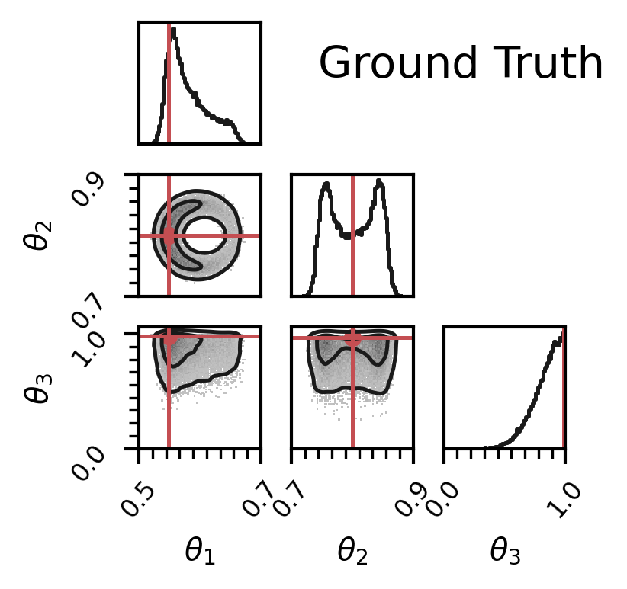
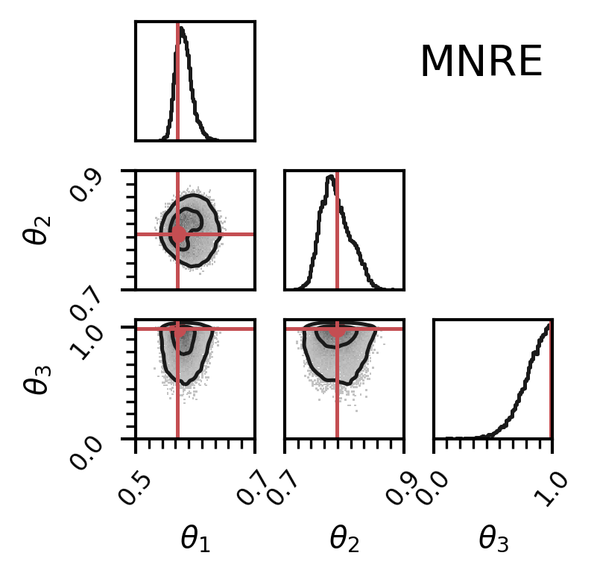
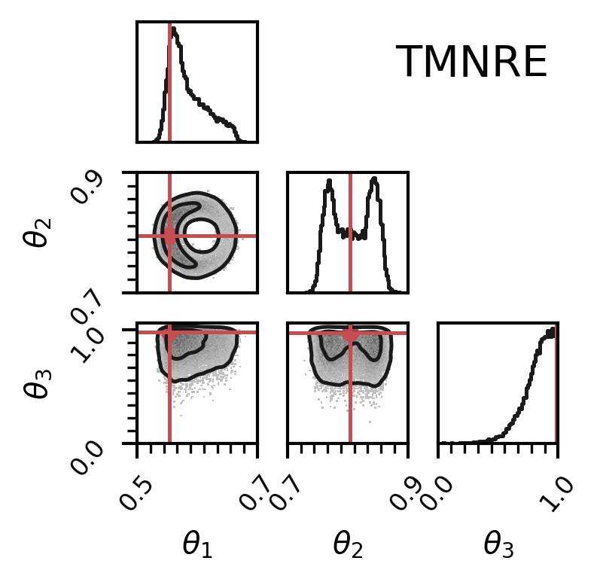
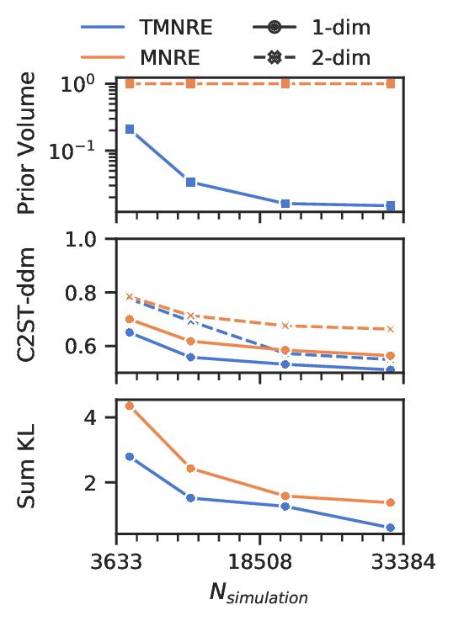
Torus: Is truncation with marginals efficient?
Marginal
Truncated Marginal
Classifier 2-Sample Test (C2ST)
Kullback-Leibler (KL) divergence.
Prior volume reduction
Notes:
We compare the efficiency of our marginal NRE to the truncated version.
The posterior is torus shaped and very narrow compared to the unit-cube prior.
Left: GT. Middle: Marginal NRE. Right: Truncated Marginal NRE.
Marginal inaccurate because most simulations were uninformative, wrong region.
Truncation accurate, it focuses the simulations on the relevant parameters.
Prior volume decreases with rounds by a lot, much less space to simulate in.
Metrics show that truncation is more accurate for all budgets.

Slide 11
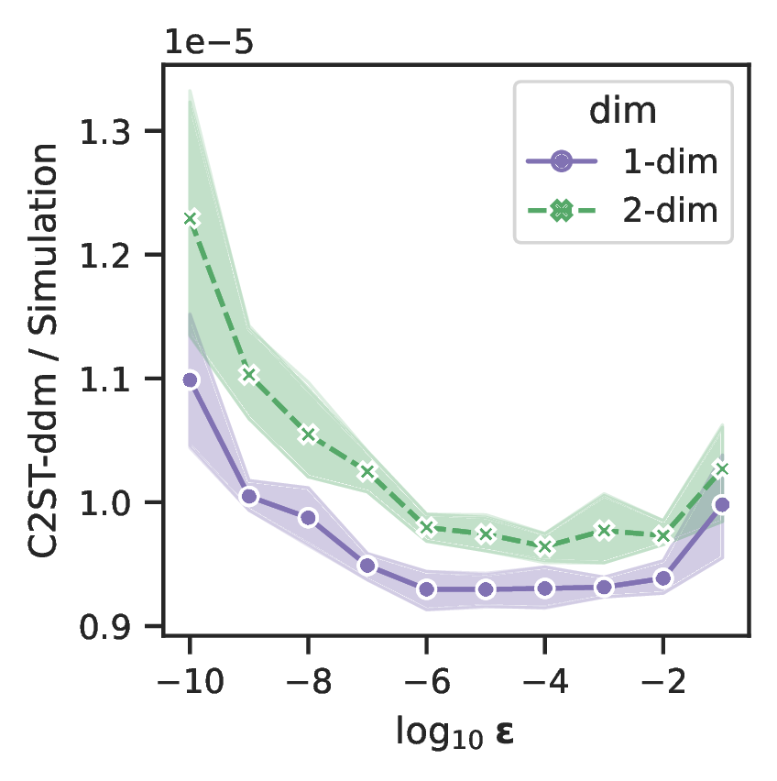
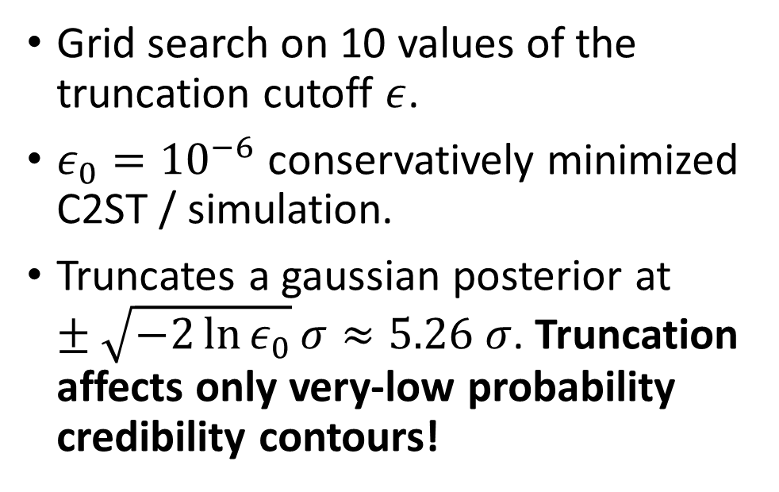
Torus: How did we select our cutoff?
Grid search on 10 values of the truncation cutoff $ε$.
${ε_{0}=10}^{−6}$ conservatively minimized C2ST / simulation.
Truncates a gaussian posterior at $±\sqrt{−2\ln{ε_{0}}}σ≈5.26 σ$. Truncation affects only very-low probability credibility contours!
Notes:
Truncation introduces a new hyperparameter, how did we set it?
We selected the cutoff by grid search on the torus
Repeated runs to estimate uncertainty.
We want a low c2st / simulation, there is a nearly flat region, we choose the conservative threshold.
In a gaussian posterior, this translates to the 5.25 sigma region, i.e., a very low probability region.

Slide 12
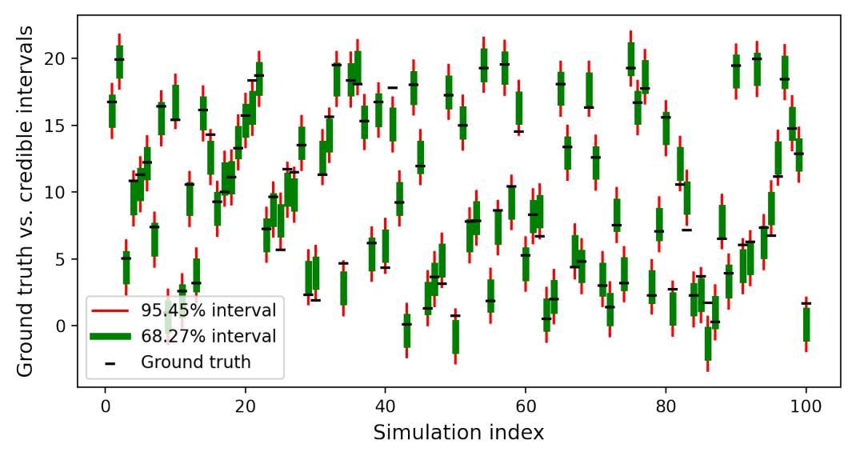

Empirical tests with local amortization
How do we know we got the inference right
(when we don’t have the truth)?
Check $p\left(θ\right)=E_{x∼p\left(x\right)}[ p\left(θ ∣ x\right)]$!
Notes:
How do we know we got it right? Domain scientists cannot access the ground truth. They rely on tests of the CI calibration to trust estimator.
Check estimator’s calibration to prior
Does not comparing the information content of our approximant to the truth
Simulate data, check if the parameter lies within the reported contour with correct frequency
It’s like an expected coverage test
The only methods which can perform this test are amortized and locally amortized because they need to draw from posteriors for many data
Sequential methods cannot perform this test since they cannot estimate other posteriors than the targeted one!
TMNRE relaxes the restriction to estimate posteriors “nearby” targeted observation data and do the check

Slide 13
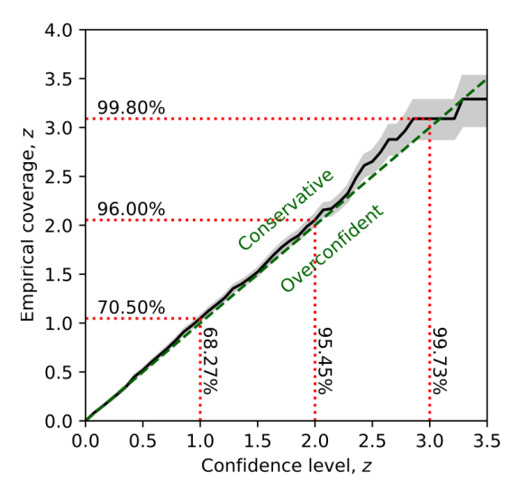

Empirical tests with local amortization
Simulation-based inference constrains parameters
within compact regions using credible intervals.
(Local) amortization enables us to check whether nominal credibility is calibrated.
Notes:
scientists want conservative nominal credible intervals, i.e. diagonal or above.
Our method is unique in offering focused, simulation efficient posterior estimation AND empirical credible interval testing.

Slide 14
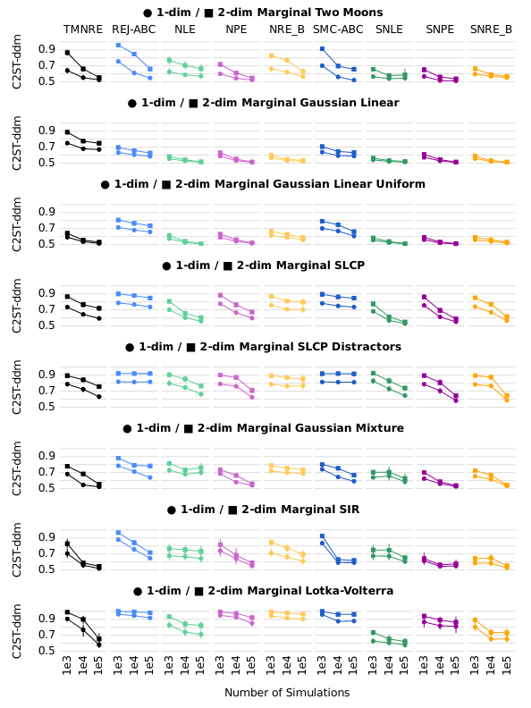
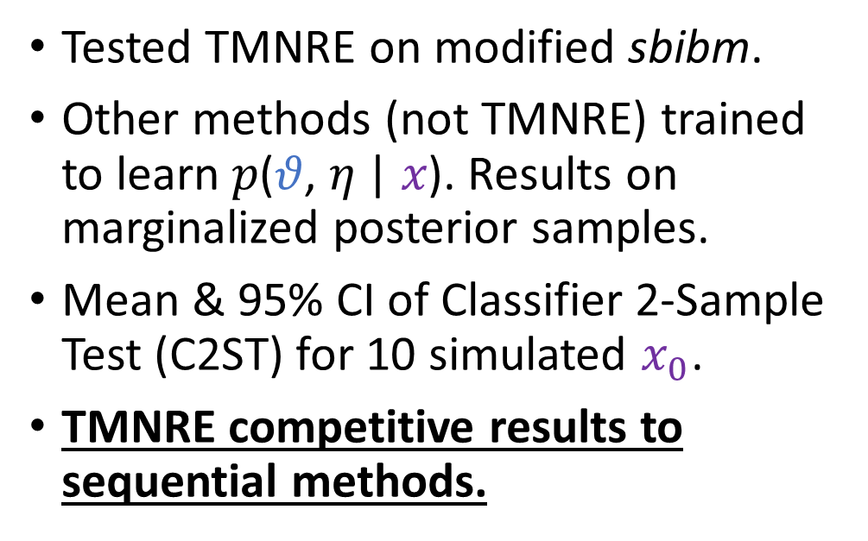
Simulation-based Inference Benchmark​
Tested TMNRE on modified sbibm.
Other methods (not TMNRE) trained to learn 𝑝(𝜗, 𝜂 | 𝑥). Results on marginalized posterior samples.
Mean & 95% CI of Classifier 2-Sample Test (C2ST) for 10 simulated $x_{0}$.
TMNRE competitive results to sequential methods.
Plot style and benchmark from:
Jan-Matthis Lueckmann, et. al. 2021. Benchmarking Simulation-Based Inference.” arXiv: 2101.04653.
Notes:
We ran our method against a modified version of the sbi benchmark where we learned the marginals.
Other methods learned the joint, then we compared their marginalized estimates to the marginalized ground truth.
Our method is competitive with sequential ones in accuracy.

Slide 15
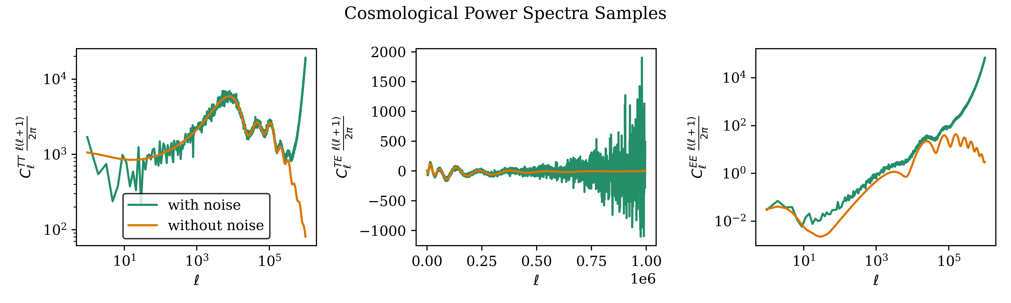
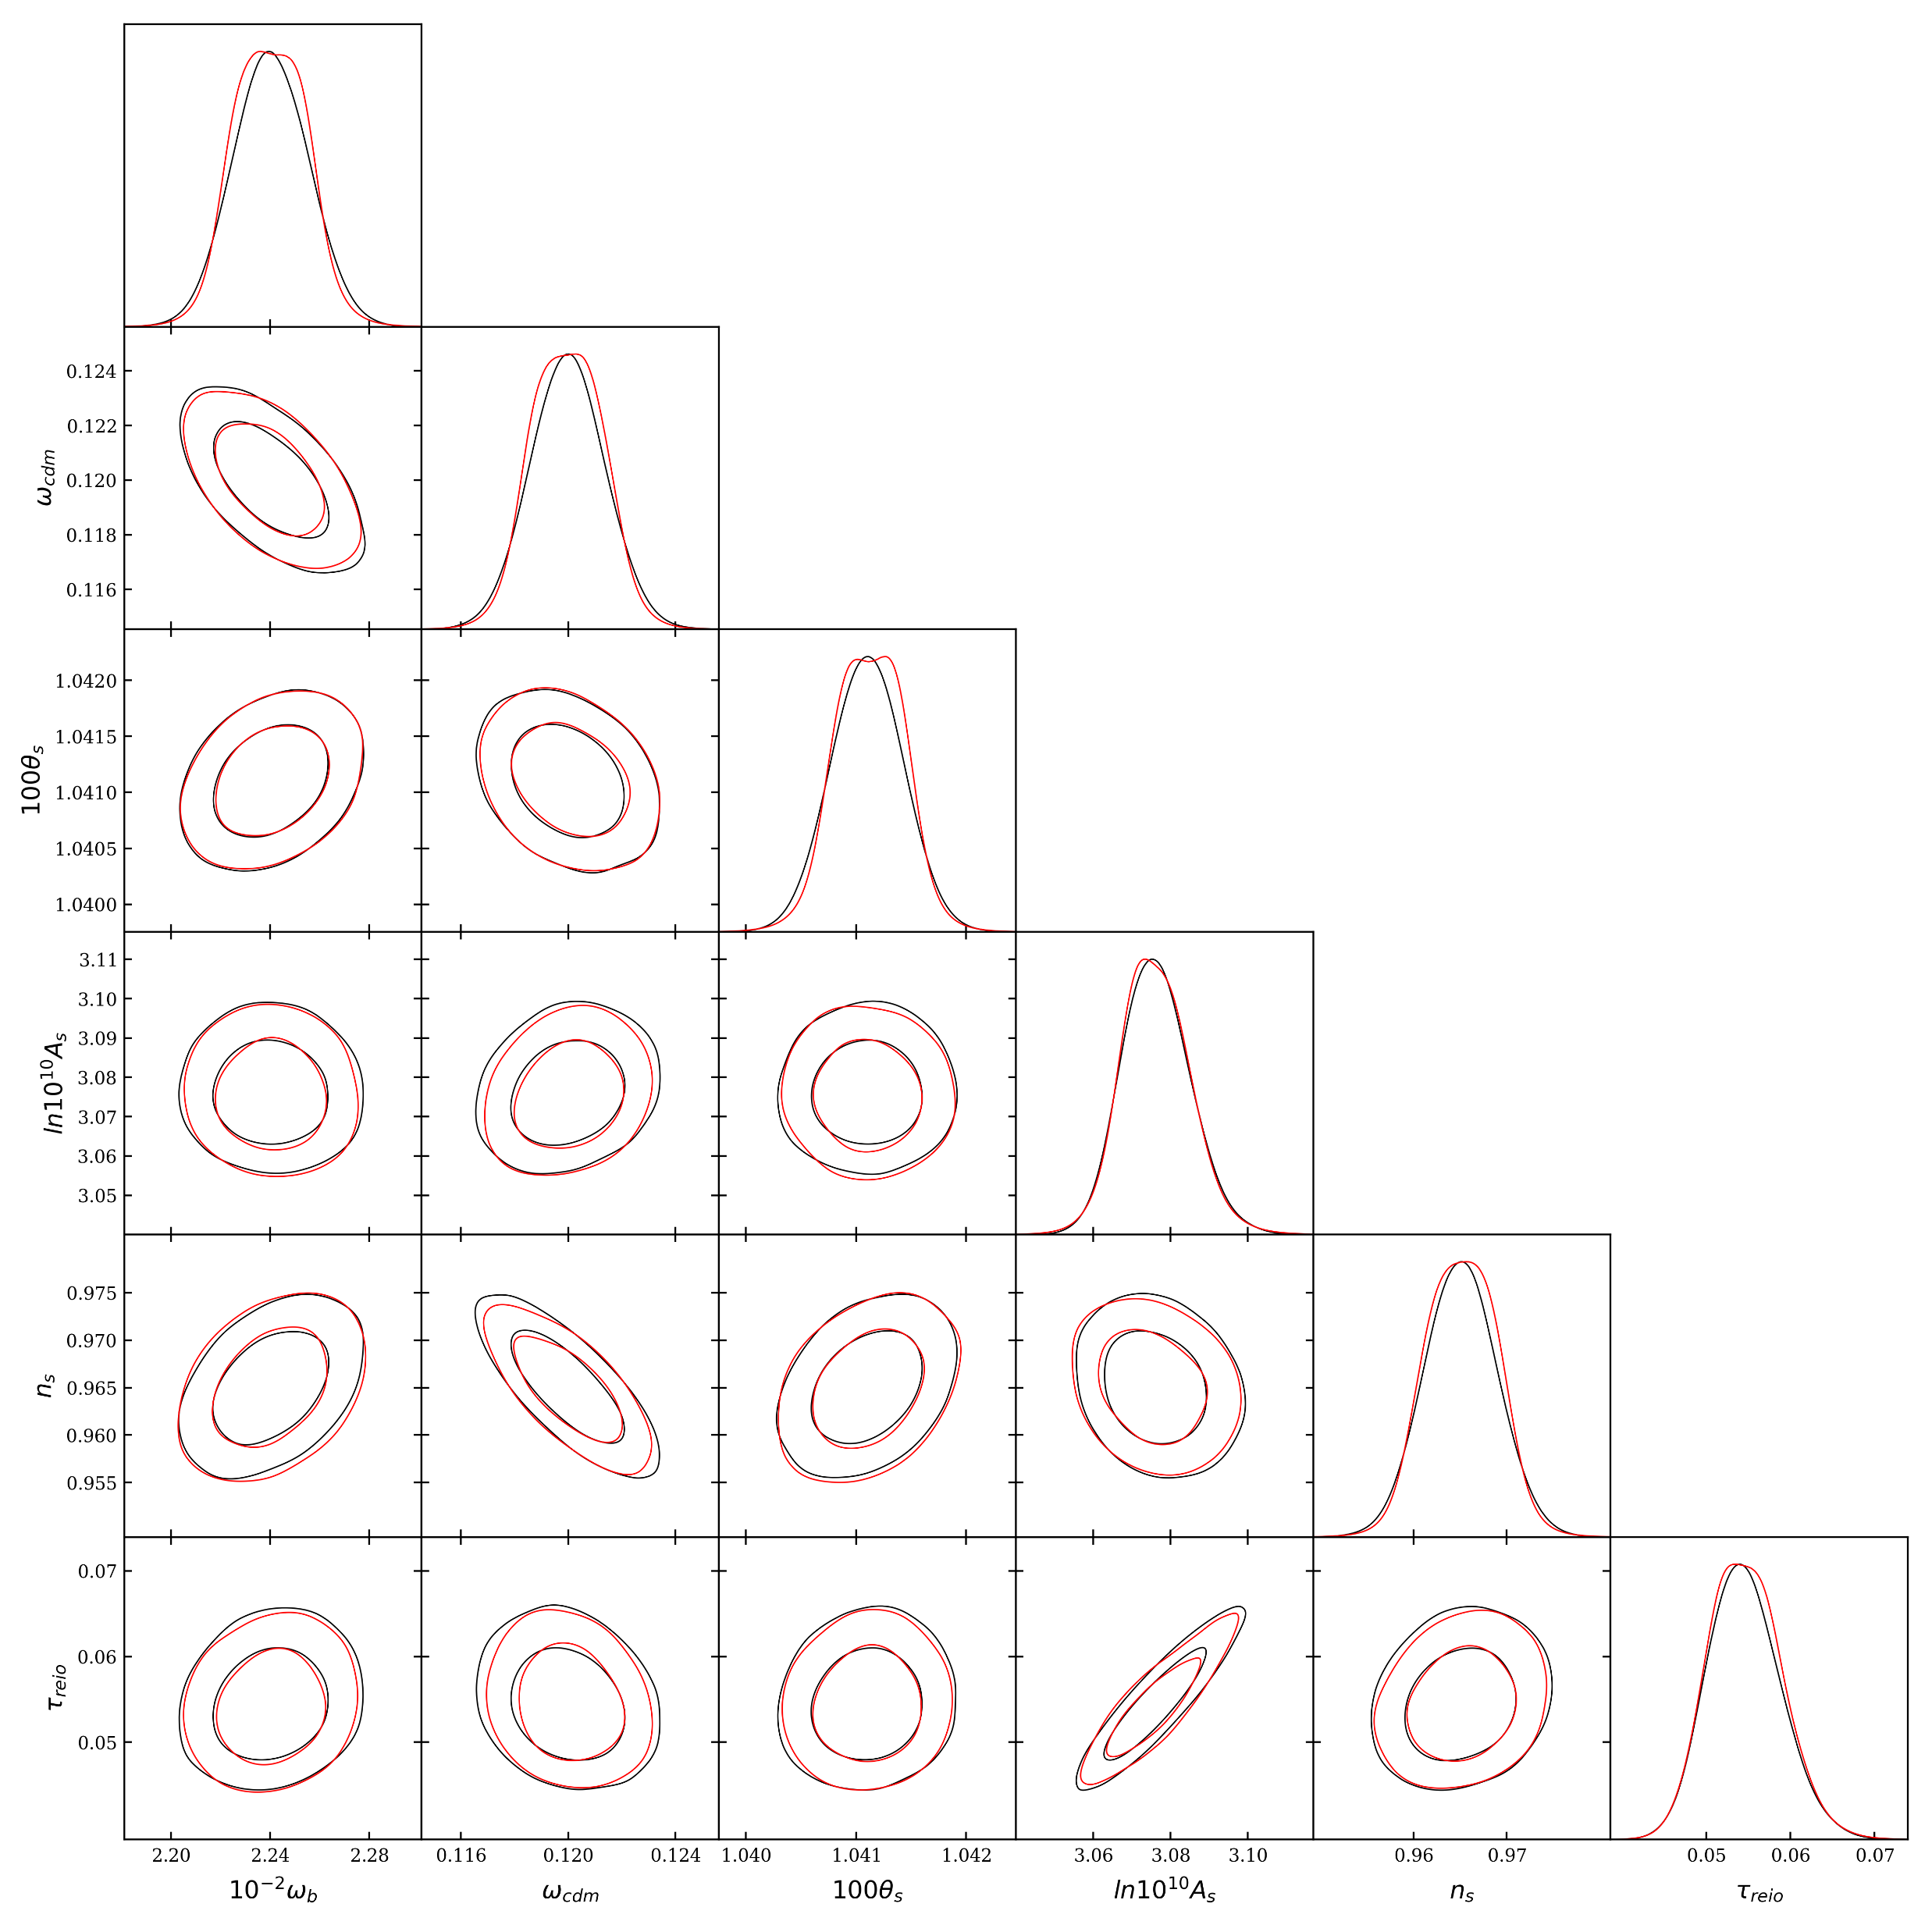

Cosmology
Six parameters specify the lambda-CDM model.
Data are power spectra (left) from the CMB.
Simulator utilized to forecast the expected constraining power of future experiments.
Budget of 5,000 simulations.
MNRE
NRE
See Alex Cole’s presentation at 16:30!
Notes:
Example domain problem.
Cosmological simulators generate a power spectrum from a hypothetical cosmic microwave background.
This can be useful to estimate the discovery value of future experiments and telescopes.
Our method can accurately represent the marginal posteriors at the budget while joint methods cannot.

Slide 16
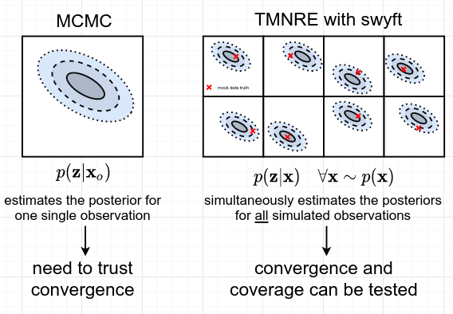
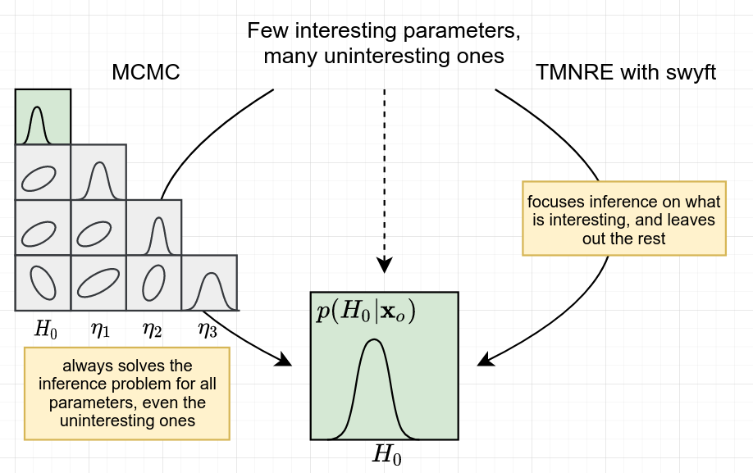
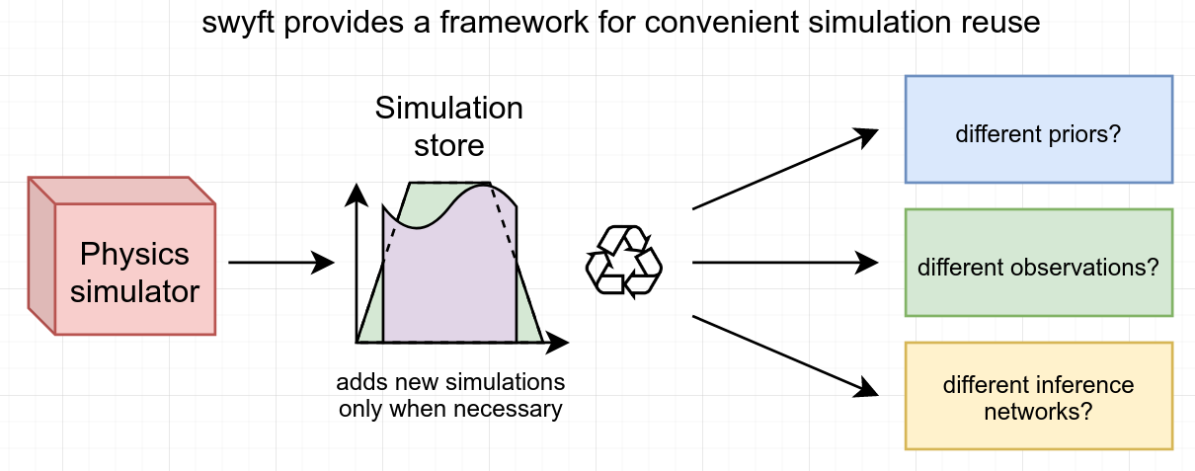
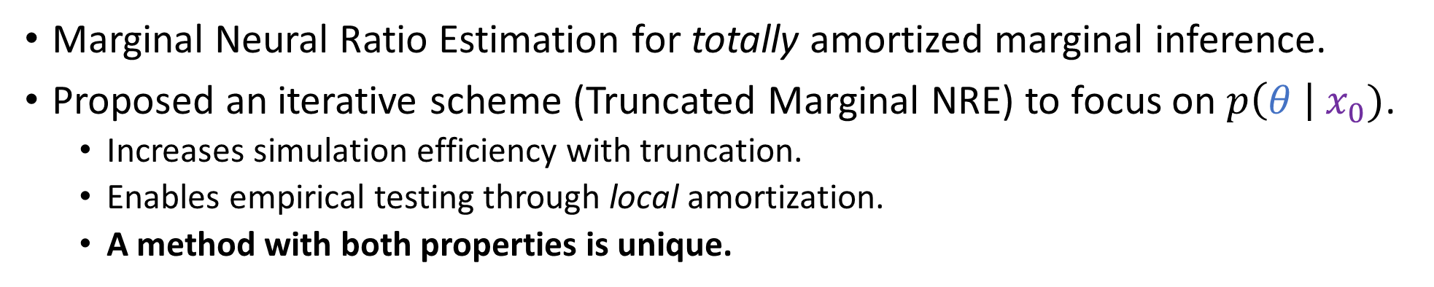
Conclusions
Marginal Neural Ratio Estimation for totally amortized marginal inference.
Proposed an iterative scheme (Truncated Marginal NRE) to focus on $p\left(θ \right| x_{0})$.
  Increases simulation efficiency with truncation.
  Enables empirical testing through local amortization.
  A method with both properties is unique.
swyft – implementation of method – https://github.com/undark-lab/swyft
tmnre – experimental results – https://github.com/bkmi/tmnre
Packages:

Slide 17
Extra Slides
Hopefully, the answer to your question can be found in the next few slides…

Slide 18
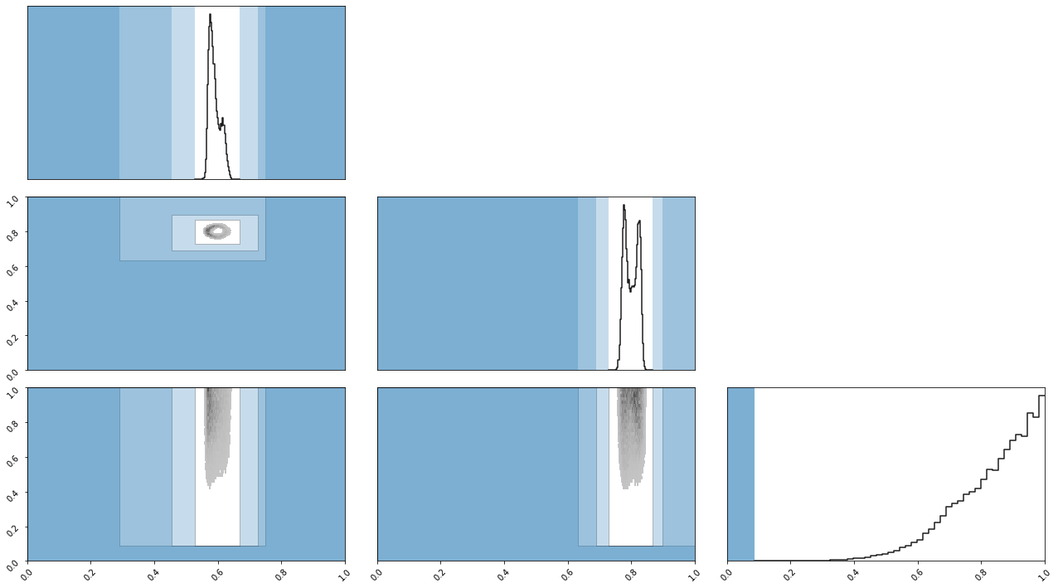
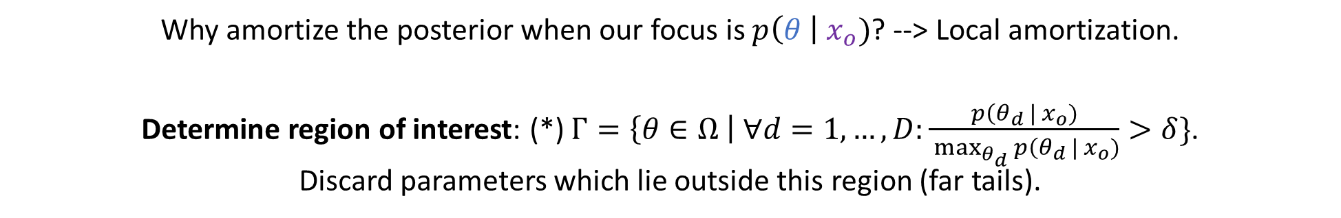
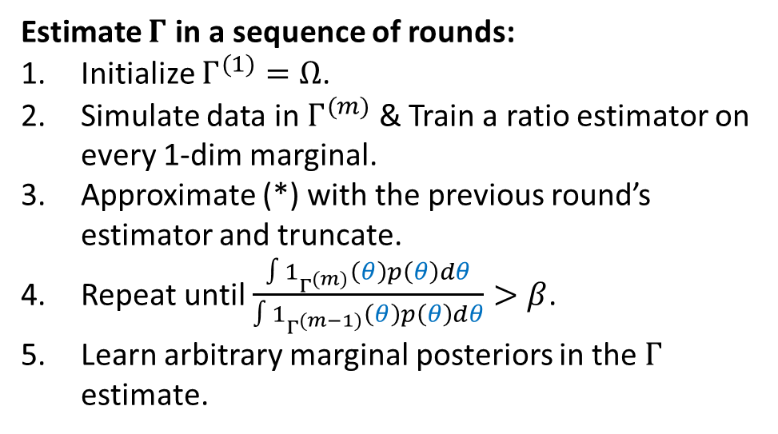
Truncating the prior, based on the estimate posterior
Why amortize the posterior when our focus is $p\left(θ \right| x_{o})$? --> Local amortization.
Determine region of interest: (*) $Γ=\left\{θ∈Ω \right| ∀d=1,…, D:\frac{p\left(θ_{d} \right| x_{o})}{ \max_{θ_{d}}{p\left(θ_{d} \right| x_{o})}}>δ\}$.
Discard parameters which lie outside this region (far tails).
Estimate $Γ$ in a sequence of rounds:
Initialize $Γ^{(1)}=Ω$.
Simulate data in $Γ^{(m)}$ & Train a ratio estimator on every 1-dim marginal.
Approximate (*) with the previous round’s estimator and truncate.
Repeat until $\frac{∫1_{Γ^{(m)}}\left(θ\right)p\left(θ\right)dθ}{∫1_{Γ^{(m−1)}}\left(θ\right)p\left(θ\right)dθ}>β$.
Learn arbitrary marginal posteriors in the $Γ$ estimate.
Visualize truncation at each of 3 rounds. Truncation occurs along 1-dim marginals. All posteriors are from the
last round.
We use $ε_{0}={10}^{−6}$, for a gaussian joint posterior this truncates at $±\sqrt{−2\ln{ε_{0}}}σ$.
Truncation affects only very-low probability credibility contours.
Notes:
NRE normally learns all possible posteriors (amortization), that’s expensive, it’s cheaper to focus on posteriors within a region.
We determine a compact region, Gamma, on which to learn posteriors in an iterative regime.
Gamma is truncated as the product of 1 dimensional truncations, so a rectangle.
We sketched this before…
We loop over generating data within our region and approximating the equation with a star using all 1d likelihood-to-evidence ratios
We truncate and repeat the last two steps.
We stop when the ratio of the truncated masses stabilizes.
Now we have data in this region which we can use to train arbitrary marginals.
Visual on the right of 3 rounds.
This only affects very very-low probability contours.

Slide 19
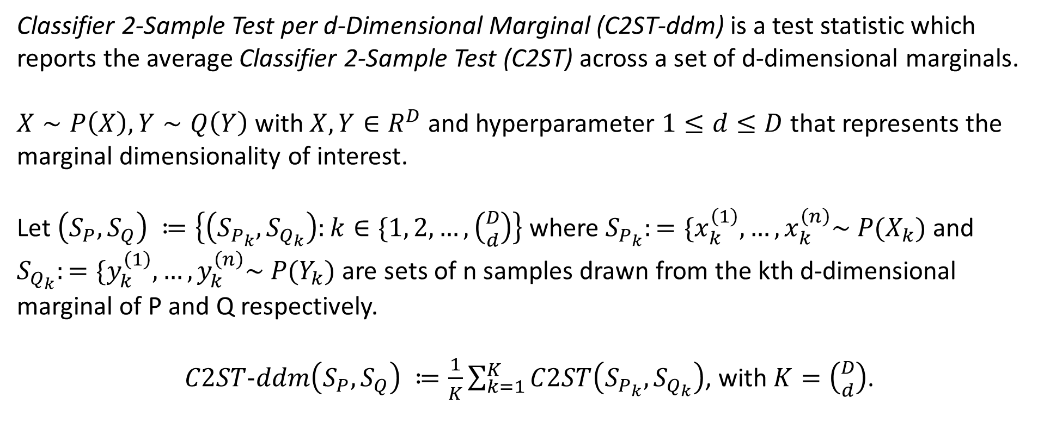
C2ST-ddm
Classifier 2-Sample Test per d-Dimensional Marginal (C2ST-ddm) is a test statistic which reports the average Classifier 2-Sample Test (C2ST) across a set of d-dimensional marginals.
$X∼P\left(X\right), Y∼Q\left(Y\right)$ with $X, Y∈R^{D}$ and hyperparameter $1≤d≤D$ that represents the marginal dimensionality of interest.
Let $\left(S_{P}, S_{Q}\right) ≔\left\{\left(S_{P_{k}}, S_{Q_{k}}\right):k∈\{1, 2,…, \left({D \atop d}\right)\right\}$ where $S_{P_{k}}:=\{x_{k}^{\left(1\right)},…, x_{k}^{\left(n\right)}\sim P(X_{k})$ and $S_{Q_{k}}:=\{y_{k}^{\left(1\right)},…, y_{k}^{\left(n\right)}\sim P(Y_{k})$ are sets of n samples drawn from the kth d-dimensional marginal of P and Q respectively.
$C2ST−ddm\left(S_{P}, S_{Q}\right) ≔\frac{1}{K}\sum_{k=1}^{K}{C2ST\left(S_{P_{k}}, S_{Q_{k}}\right)}$, with $K=\left({D \atop d}\right)$.

