Slide 1
Status of nested correctors in CIEMAT
Ó. Durán, J. García-Matos, C. Martins, F. Toral (CIEMAT)
J. C. Pérez, E. Todesco (CERN)
11th HL-LHC Collaboration meeting – 19th October 2021

Slide 2
Index
MCBXFB01: First short magnet of the series
Series production follow-up
MCBXFAP1: Long magnet prototype
Conclusions
F. Toral - 11th HL-LHC Collaboration meeting – 19th October 2021

Slide 3
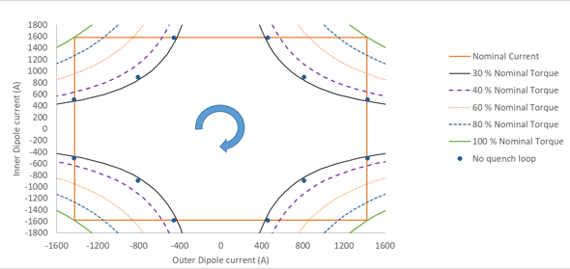
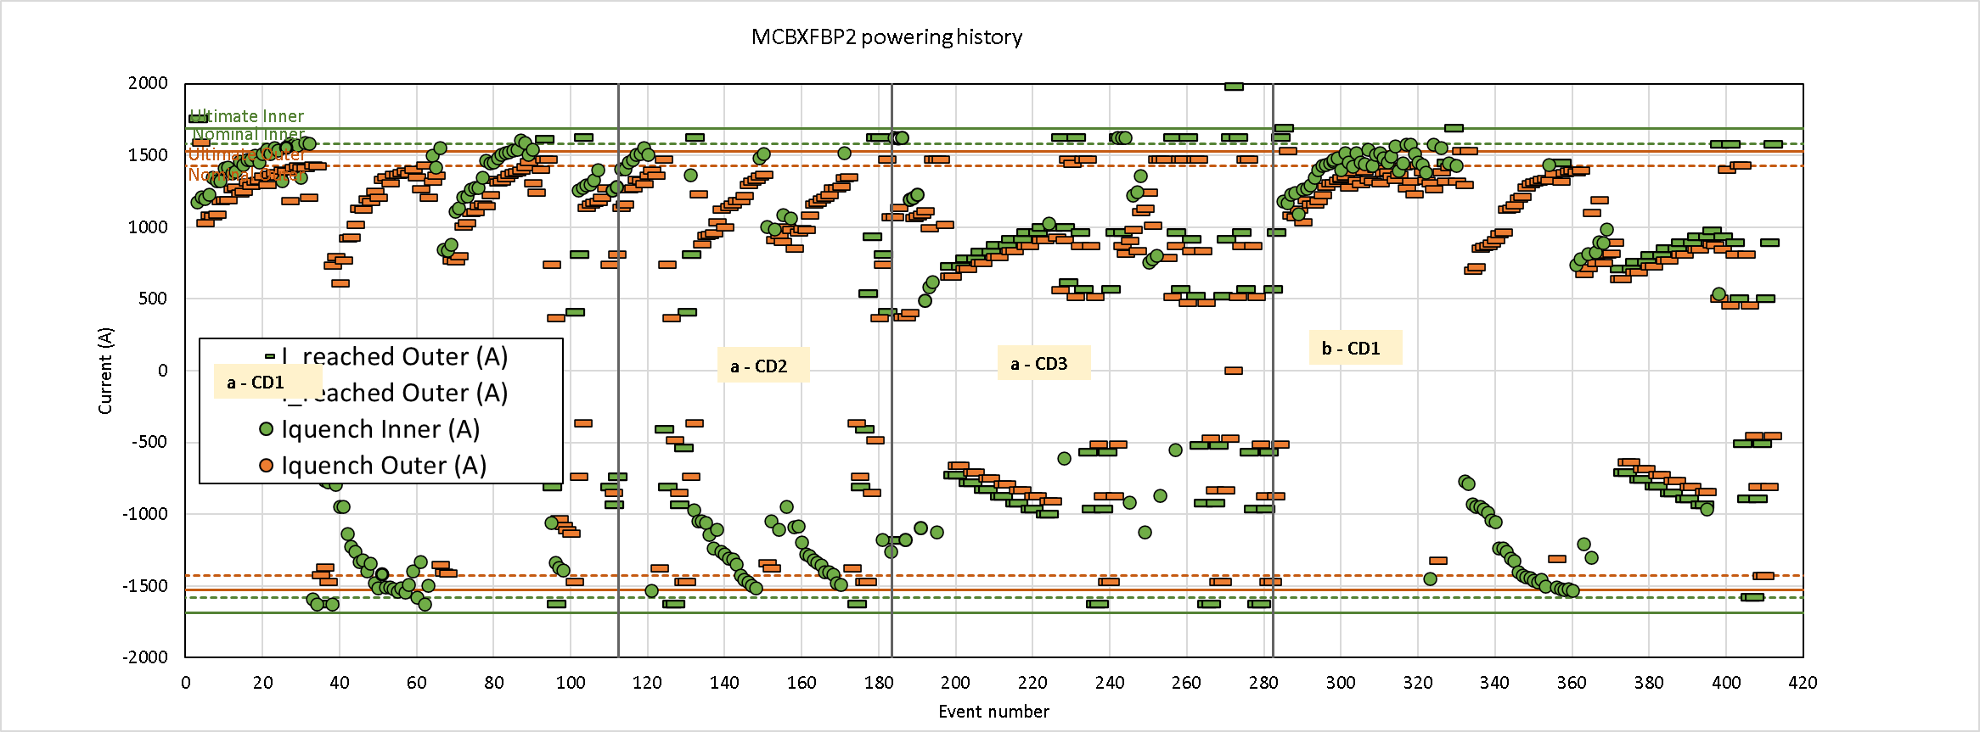
Second test results of the second prototype
Similar to first test:
  Good margin in standalone configuration
    No quench inner nor outer
  ~ same number of training quenches in both torque directions
  Quench free region:
    Around 32% of nominal torque on all quadrants
Different from first test:
  Coil IC5 quenching 90% of the time
Conclusion:
  The performance of the second prototype in combined operation is similar to the first one.
F. Toral - 11th HL-LHC Collaboration meeting – 19th October 2021

Slide 4
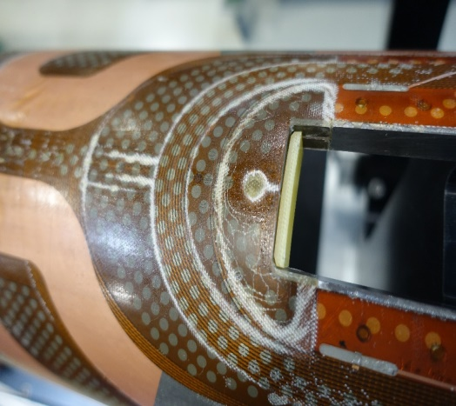
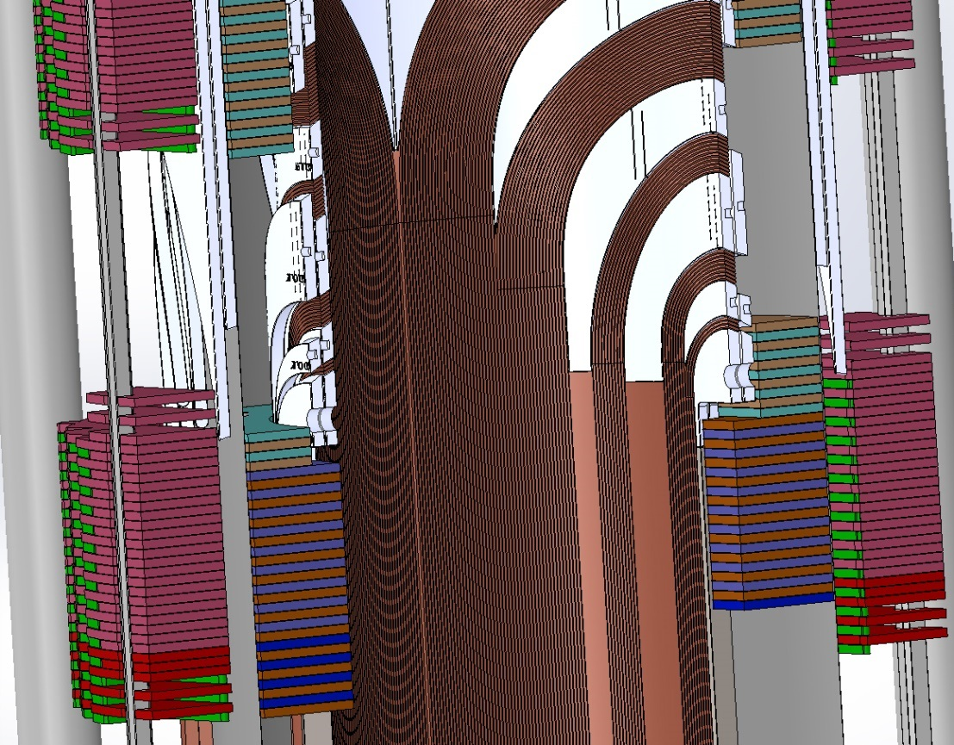
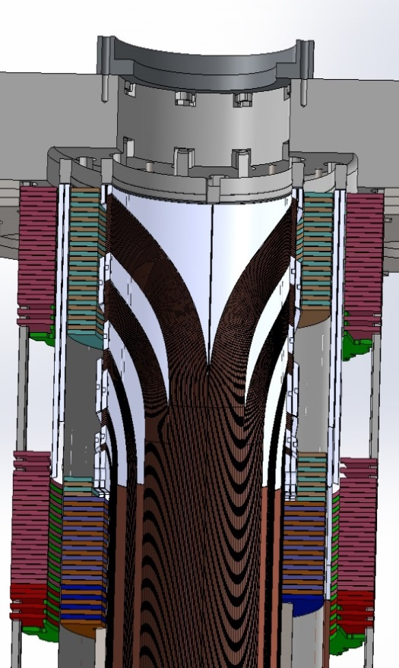
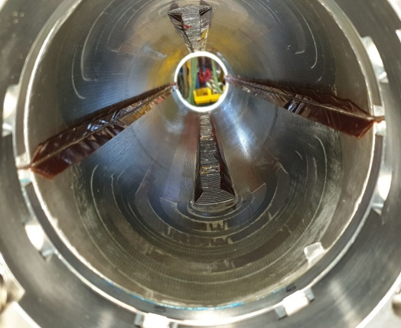
Analysis of training in combined operation
Assumption: coils do not slide with respect to collars.
A gap between coil ends could explain that the coils cannot learn beyond a given torque: discarded by the results of the second prototype.
Shear stress between the cable blocks, wedges and end-spacers: it could explain fracture lines and long training.
F. Toral - 11th HL-LHC Collaboration meeting – 19th October 2021

Slide 5
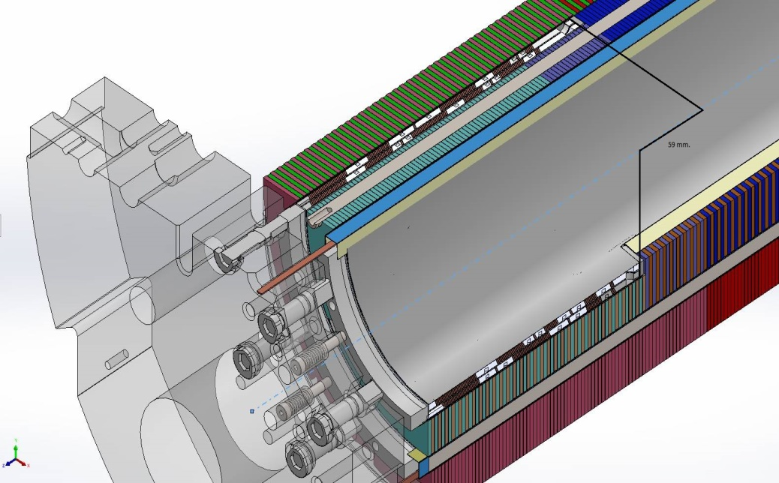
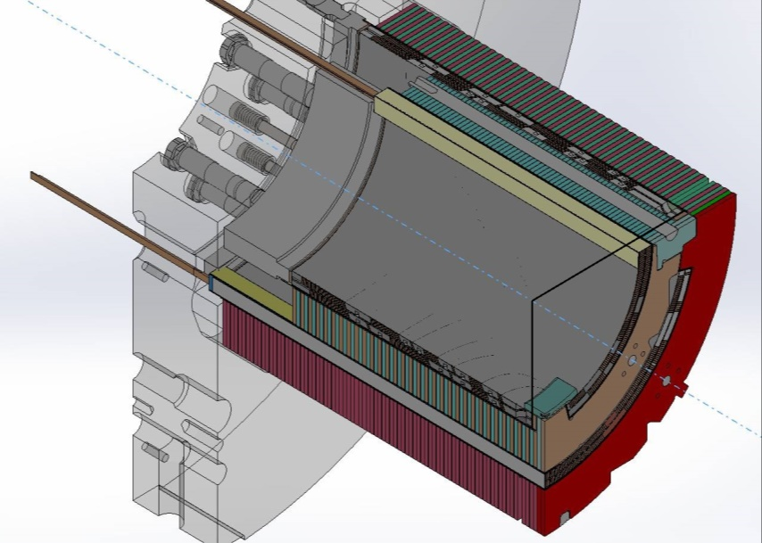
Fine tuning of MCBXFB01 design (I)
Modification of the inner dipole coil length
The inner coil length was reduced by 118 mm.
The cantilever length of the inner coils was reduced by 59 mm at each coil extremity.
The inner coil nominal current was increased from 1625 A to 1755 A to keep the same integrated field.
In consequence, 5% more torque generated in the coil straight section.
F. Toral - 11th HL-LHC Collaboration meeting – 19th October 2021

Slide 6
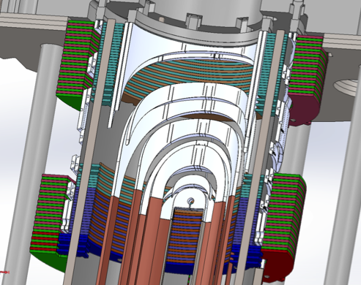
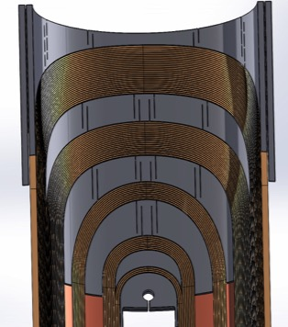
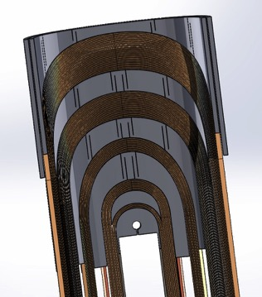
Fine tuning of MCBXFB01 design (II)
Modification of the end-spacers geometry
Some of the end-spacers were modified to increase the rigidity at coil extremity
MCBXFBP2 end-spacer configuration
MCBXFB01 end-spacer configuration
F. Toral - 11th HL-LHC Collaboration meeting – 19th October 2021

Slide 7
Fine tuning of MCBXFB01 design (III)
Calculations
The azimuthal deformation of coil ends is reduced by one third
Shear stress at end spacers tips is much lower
More details in parallel session next Friday

Slide 8
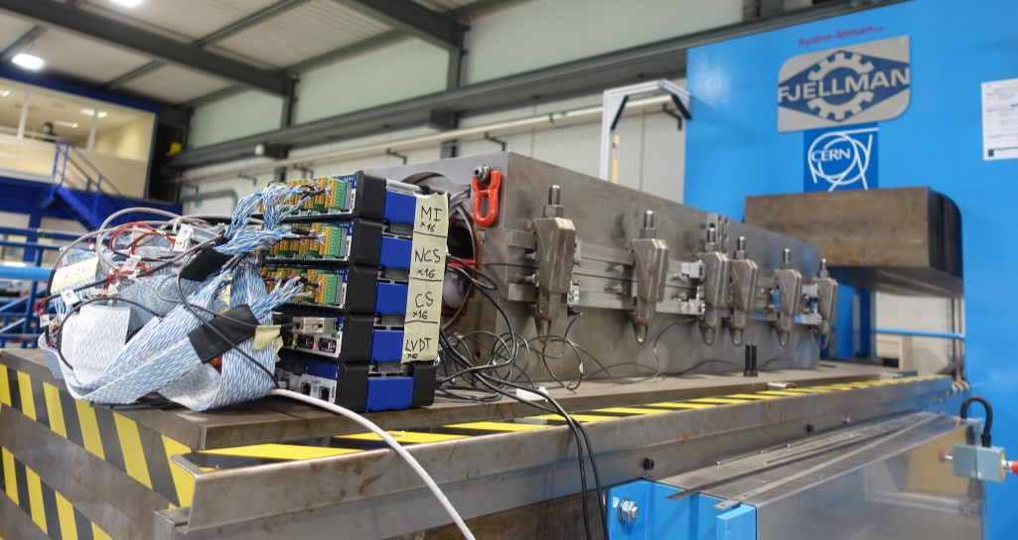
MCBXFB01 production
  Coils were finished in time (early April).
  Fine blanking of collars (also for series magnets): made at INECFI
    Several iterations on some tool parts were necessary to achieve the required tolerances.
    Full fine blanking of edges was difficult to achieve.
    Very exhaustive monitoring by CIEMAT was required.
    Production end expected by March, but finished by mid-June.
  Magnet assembly was made with the help of 927 crew in June. Some problems with collar and iron assembly to be solved for the series.
F. Toral - 11th HL-LHC Collaboration meeting – 19th October 2021

Slide 9
MCBXFB01 power tests: training
Reached ultimate current in both dipoles in standalone
Combined powering Q1&Q3
MCBXFB01:
3 quenches to reach nominal in Q1
No quench in Q3
Combined powering Q2&Q4
MCBXFB01:
1 quench to reach nominal in Q2
1 quench while verification in Q4
Combined powering Q1
MCBXFB01:
1 quench at 96 % of N_{torque} while retraining in Q1
No more ramps foreseen in the test plan
Training quenches
ICSB01 | ICSB02 | OC3
1 | 2 | -
Training quenches
ICSB01 | ICSB02 | OCBS01
1 | - | 1
Training quenches
ICSB01 | ICSB02 | OCBS01
- | 1 | -
MCBXFBP2a:
32 quenches to nominal
MCBXFBP2a:
31 quenches to nominal in Q2
First quench at 23% of N_{torque}
MCBXFBP2a:
22 quenches to nominal in Q2
First quench at 27% of N_{torque}
Reached 97% of N_{torque} in event #87
Training quenches
IC4 | IC5 | OC3
20 | 11 | 1
Training quenches
IC4 | IC5 | OC3
11 | 18 | 2
Training quenches
IC4 | IC5 | OC3
12 | 10 | 0
F. Toral - 11th HL-LHC Collaboration meeting – 19th October 2021

Slide 10
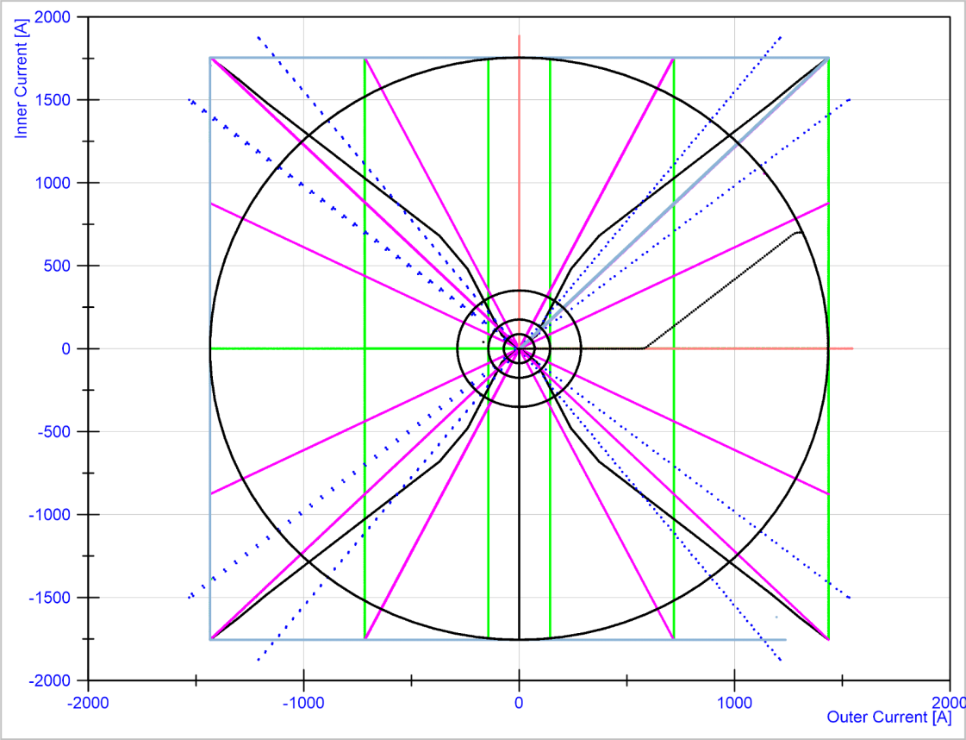
MCBXFB01 power tests: quench free region
12 point square cycle
Full requested range of operation!!!
Standalone
2.14/2.64 Tm
MM Diagonals
MM Grid
MM Roxie benchmark
Powering in the perimeter
*Training ramps and RR hidden under the rest of the cycles
Courtesy S. Ferradas (CERN)
MCBXFBP2a:
Quenches between 20 and 30 % of nominal torque in Q2 after being fully trained in Q1
Quench free region around 38-41% of nominal torque
Thermal cycle:
Good memory: few quenches during the tests, very close to nominal torque in combined operation.
Complete set of magnetic measurements: test results very close to calculations.
F. Toral - 11th HL-LHC Collaboration meeting – 19th October 2021

Slide 11
Index
MCBXFB01: First short magnet of the series
Series production follow-up
MCBXFAP1: Long magnet prototype
Conclusions
F. Toral - 11th HL-LHC Collaboration meeting – 19th October 2021

Slide 12
Tendering for the series
  Contract signed with Elytt Energy 15th March.
  Scope: delivery of 6 long (A) and 11 short (B) MCBXF magnets.
  Technical specification and acceptance criteria agreed with CERN.
  Manufacturing and inspection plan agreed with CERN: quality documentation, tests and hold points.
  Quality documentation will guarantee traceability. It will be uploaded at CERN servers: MTF and EDMS. Templates have been agreed with CERN.
  Drawings will be stored at EDMS (CERN), both of prototypes, series magnets and tooling (about 2000 drawings).
F. Toral - 11th HL-LHC Collaboration meeting – 19th October 2021

Slide 13
Technological transfer
An Elytt engineer was learning at CIEMAT for three months.
Two Elytt technicians came to CIEMAT to be trained with the most delicate tasks: binder, impregnation mould...
During the production of the first magnet at Elytt premises, one technician from CIEMAT is always present. During the most critical tasks (binder, impregnation) one engineer from CIEMAT provides in-situ technical support.
CIEMAT has prepared detailed procedures for each step of production: coil winding, binder, impregnation, assembly, parts production (ground insulation, collar packages, collaring shoes). They are uploaded to EDMS. There are thousands of photos to help know-how transfer.
CIEMAT is supporting Elytt to contact suppliers for components, tooling and materials.
F. Toral - 11th HL-LHC Collaboration meeting – 19th October 2021

Slide 14
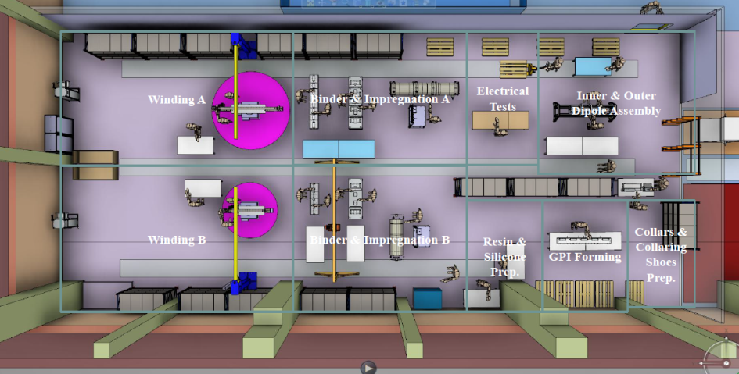
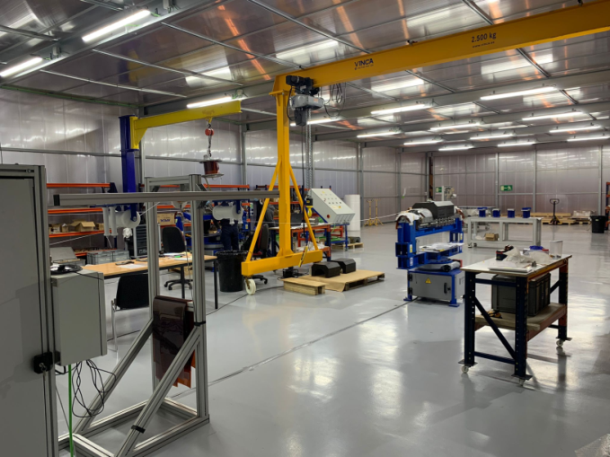
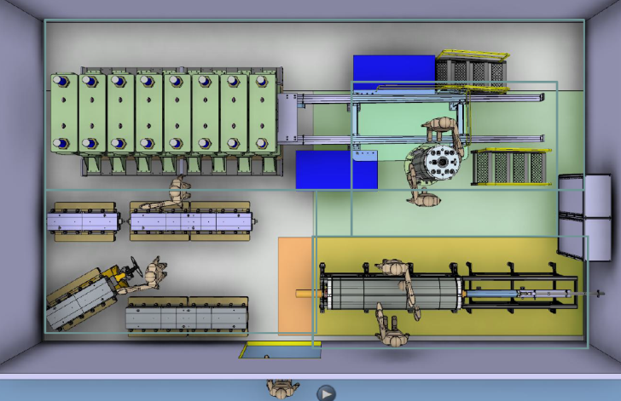
Elytt Energy premises
  A clean area has been prepared for coil production (two lines) and assembly of collared coils.
  Another clean area is under preparation for the magnet assembly.
F. Toral - 11th HL-LHC Collaboration meeting – 19th October 2021

Slide 15
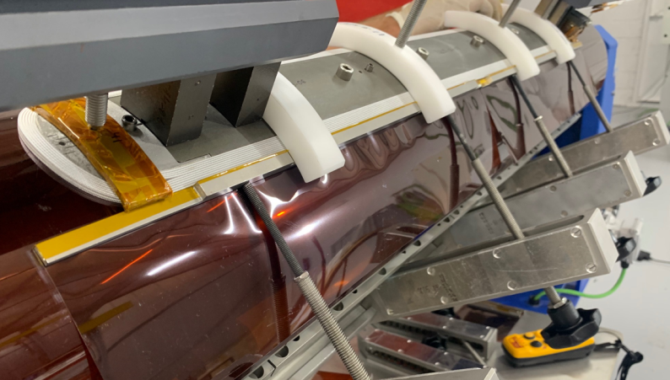
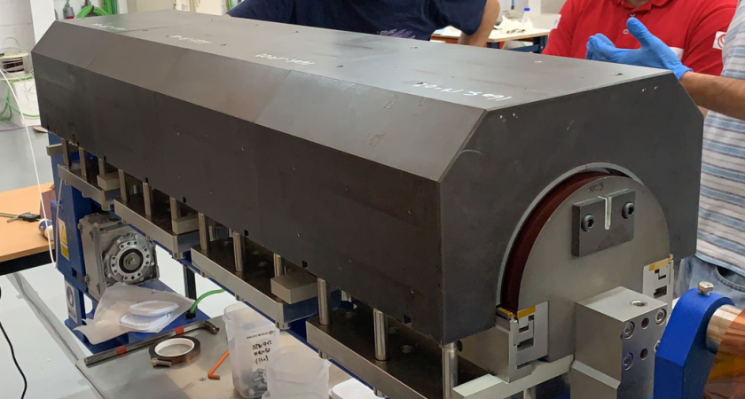
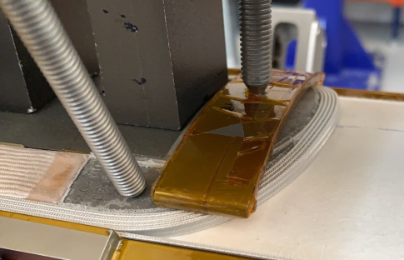
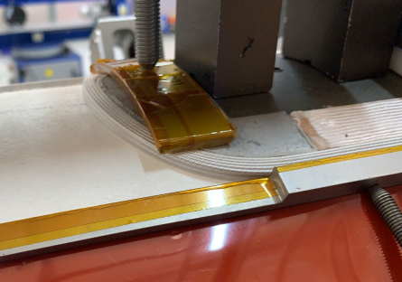
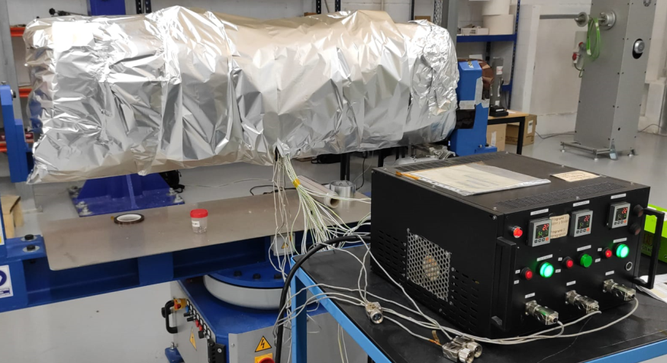
Series coil production (I)
  Winding of the first outer coil (OCBS04) started by the end of June.
IL Winding
IL Binding
OL Winding
OL Binding
F. Toral - 11th HL-LHC Collaboration meeting – 19th October 2021

Slide 16
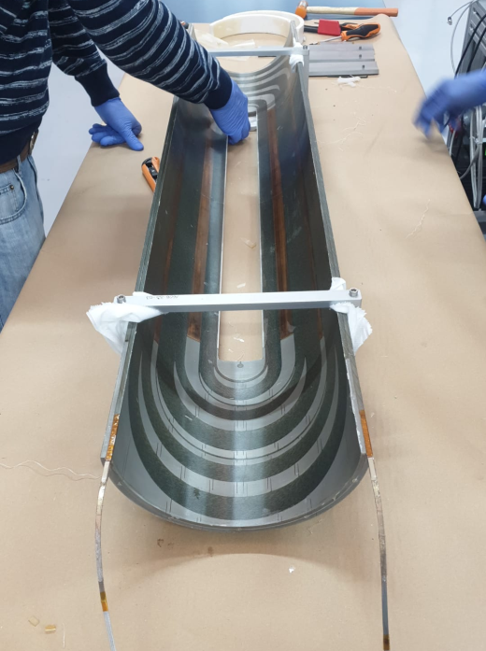
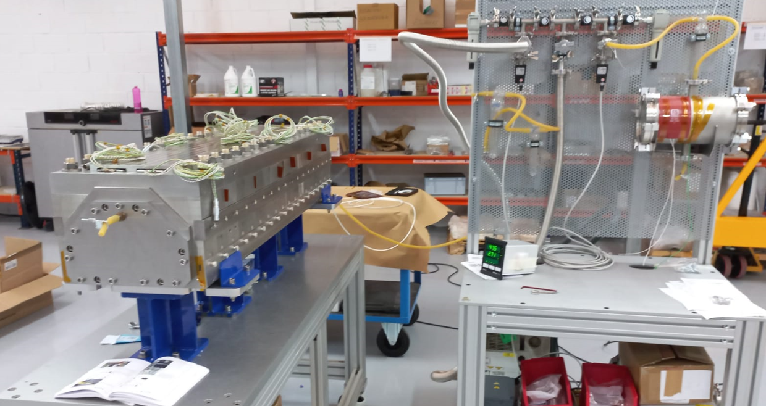
Series coil production (II)
  OCBS04 was finished in September.
OCBS04 impregnation mould assembly
F. Toral - 11th HL-LHC Collaboration meeting – 19th October 2021

Slide 17
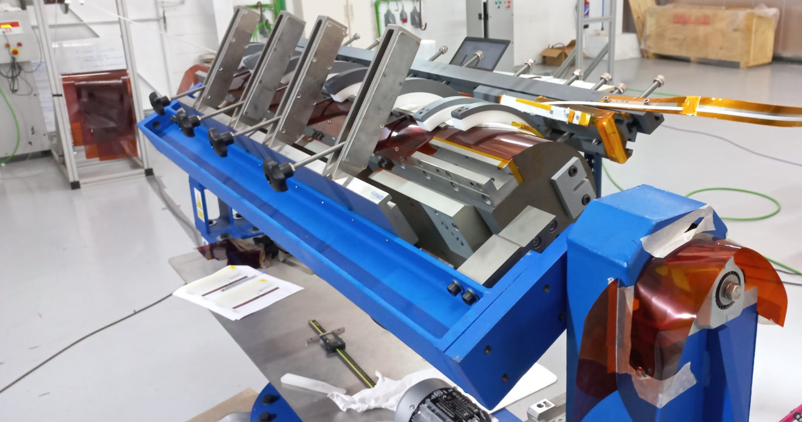
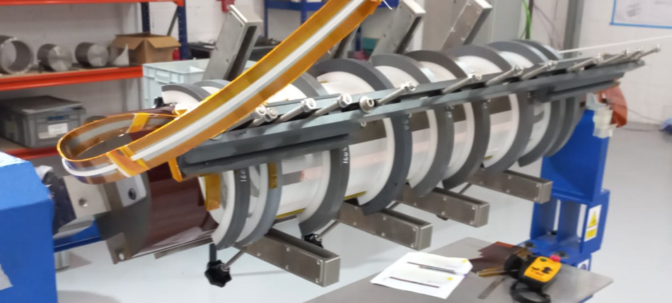
Series coil production (III)
  Winding of the second outer coil (OCBS05) is ongoing.
IL Winding
F. Toral - 11th HL-LHC Collaboration meeting – 19th October 2021

Slide 18
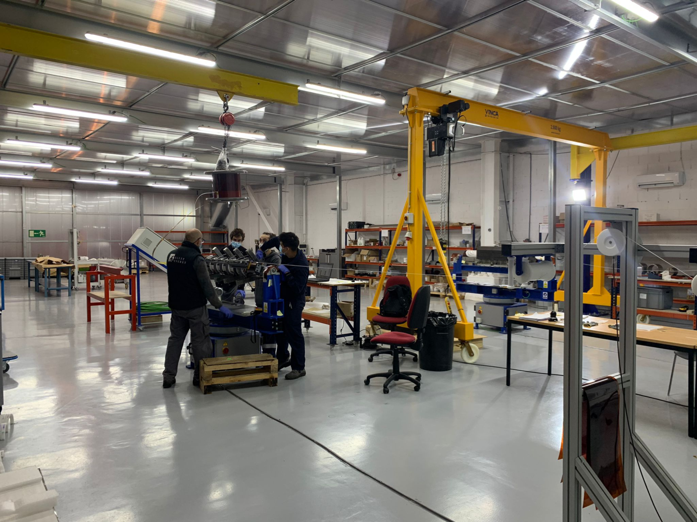
Series coil production (IV)
  First inner coil (ICBS03) is being wound in the second production line.
F. Toral - 11th HL-LHC Collaboration meeting – 19th October 2021

Slide 19
Index
MCBXFB01: First short magnet of the series
Series production follow-up
MCBXFAP1: Long magnet prototype
Conclusions

Slide 20
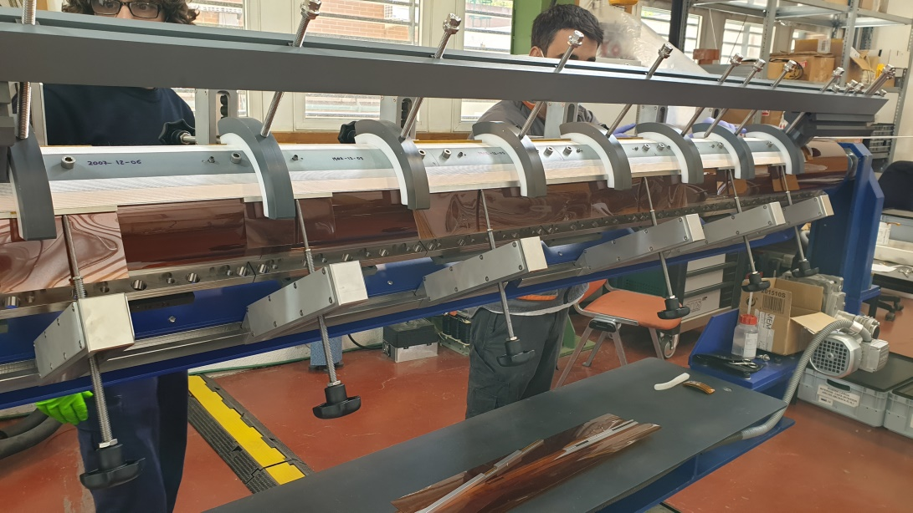
MCBXFAP1 production (at CIEMAT)
  The tooling for the inner dipole coils is being modified to shorten the length like MCBXFB.
  Inner dipole coil winding is ongoing.
  Drawings for outer dipole tooling are under revision.
  Iron laminations are under production.
  Collar package and iron assembly designs are under revision to solve the problems detected in MCBXFB01 assembly.
F. Toral - 11th HL-LHC Collaboration meeting – 19th October 2021

Slide 21
Conclusions
MCBXFB01 was finished and successfully trained at CERN. It reached the whole requested range of operation.
Series magnet contract was signed by Elytt on March 15th. Technical specification, acceptance criteria and MIP agreed with CERN.
Technological transfer from CIEMAT to Elytt to speed-up the learning curve is ongoing.
Great effort to follow-up the production tasks at Elytt premises, while training the technicians and engineers.
Production of inner dipole coils for the long prototype MCBXFAP1 has just started at CIEMAT.
Schedule is very tight for the production of the first magnet at Elytt and the long prototype at CIEMAT.
F. Toral - 11th HL-LHC Collaboration meeting – 19th October 2021

Slide 22
Acknowledgements to:
Pablo Abramian, Cristóbal Alcázar, Jesús Calero, Manuel Domínguez, Óscar Durán, Jesus Angel García Matos, Luis Garcia-Tabarés, Luis González, Pablo Gómez, Jesús Jiménez, Teresa Martínez, Carla Martins, Javier Munilla, José Antonio Pardo, José Manuel Pérez, Víctor Sanz, Sebastián Soto, Pablo Sobrino, Fernando Toral from CIEMAT
Beatriz Almeida, Marta Bajko, Isabel Bejar, Nicolas Bourcey, Raphael Bouvier, Cristina Castro, Hugues Dupont, Nicolas Eyraud, Elena Fernandez, Salvador Ferradas, Paolo Fessia, Bertrand Fornes, Jean-Luc Guyon, Hector Garcia, Michael Guinchard, Lucio Fiscarelli. Gregory Maury, Jacky Mazet, Sylvain Mugnier, Francois-Olivier Pincot, Ezio Todesco, Gerard Willering from CERN

Slide 23
Thanks for your attention

