Slide 1

IPv6 & WLCG update from the IPv6 working group
https://indico.cern.ch/event/1012420/ HEPiX IPv6 WG meeting (29/30 June 2021)
David Kelsey (STFC, UKRI), Andrea Sciabà (CERN)
on behalf of the HEPiX IPv6 Working Group
WLCG GDB meeting
8 Sep 2021

Slide 2
Dual-stack IPv4/IPv6 - reminder
WLCG MB approved plan for Dual-stack IPv4/IPv6 storage by end LHC Run 2
Main driver was and still is: “support IPv6-only CPU”
  Ongoing concern of lack of IPv4 addresses (at some sites)
Other (more recent) drivers
  Support packet marking in TCP for monitoring by RNTWG
    Research Networking Technical Working Group
      See WLCG GDB May 2021 – LHCOPN/ONE (E. Martelli) slide 15
  US Federal Government - 80% of services to be IPv6-only by 2025-26
    come back to this

Slide 3
IPv4/IPv6 and Tier-1 storage
FTS servers at BNL, CERN, Fermilab and RAL all now work in dual stack
FTS transfers do happen via IPv6 at most Tier-1s (but not all transfers)
IPv6 transfers do not (yet) happen at RRC-KI but IPv6 is enabled
Experiment | Fraction of T1 storage accessible via IPv6
ALICE | 78%
ATLAS | 96%
CMS | 100%
LHCb | 94%
Overall | 96%

Slide 4
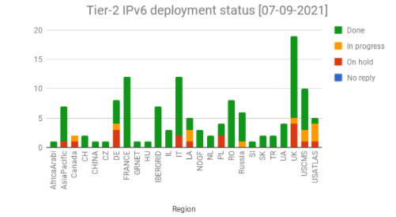
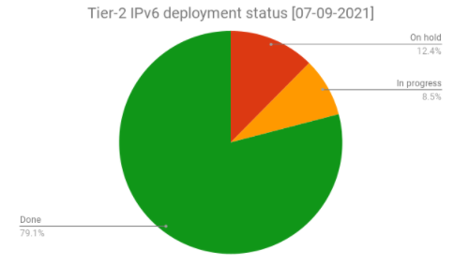
IPv4/IPv6 deployment at Tier-2 sites
The deployment campaign was launched in November 2017
Steady progress (status)
  ~79% of Tier-2 sites have storage on dual stack
Experiment | Fraction of T2 storage accessible via IPv6
ALICE | 87%
ATLAS | 62%
CMS | 94%
LHCb | 75%
Overall | 77%

Slide 5
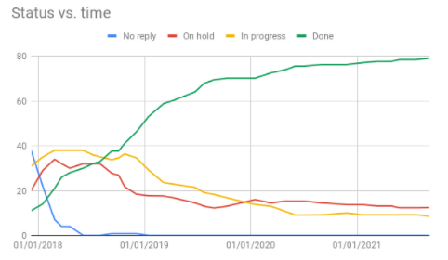
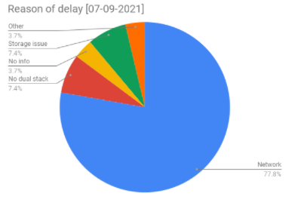
Tier-2 status (cont’d)
Progress is slower and slower
  The cause is that remaining sites are the ones having the most difficulties
    Typical example: IPv6 not a priority for the campus
Plans are in place for US ATLAS to complete dual-stack storage in coming months.

Slide 6
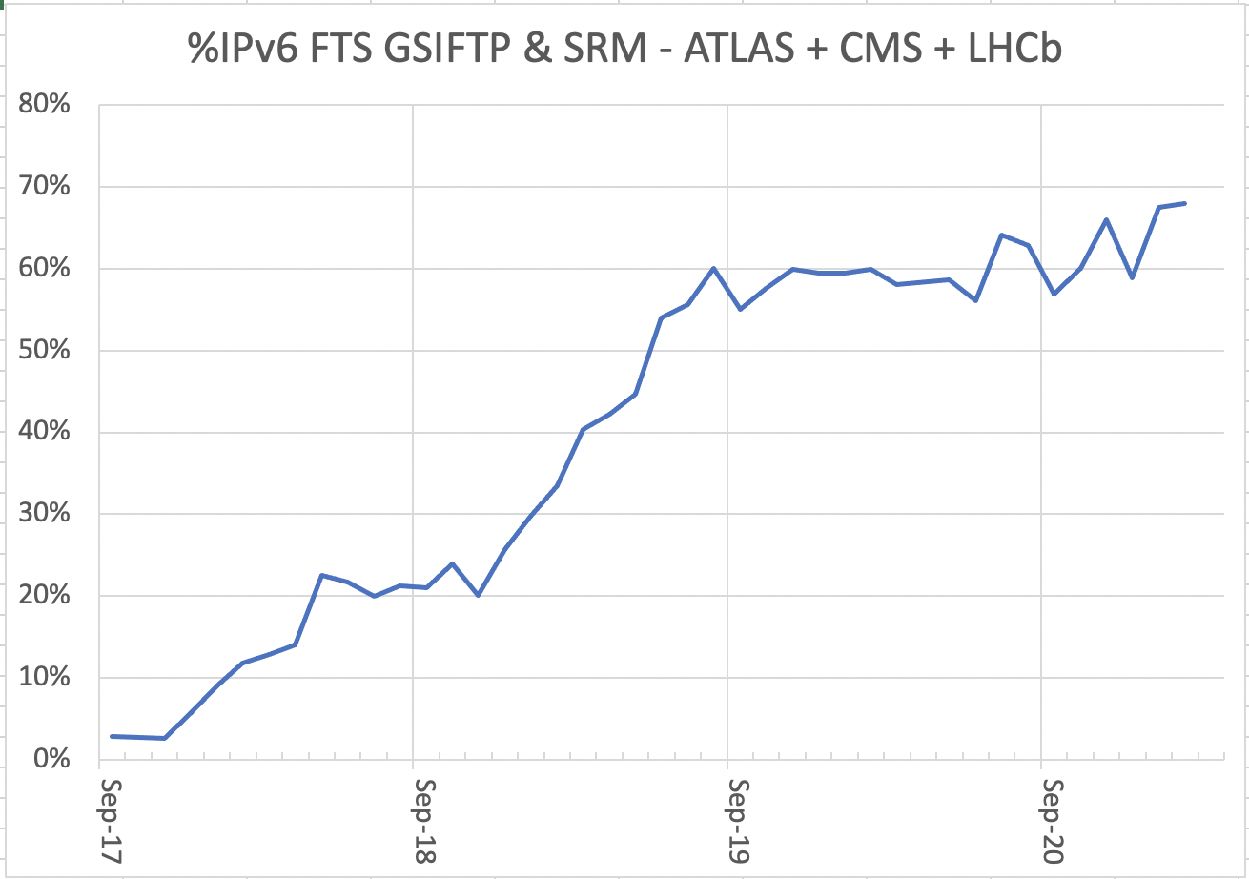
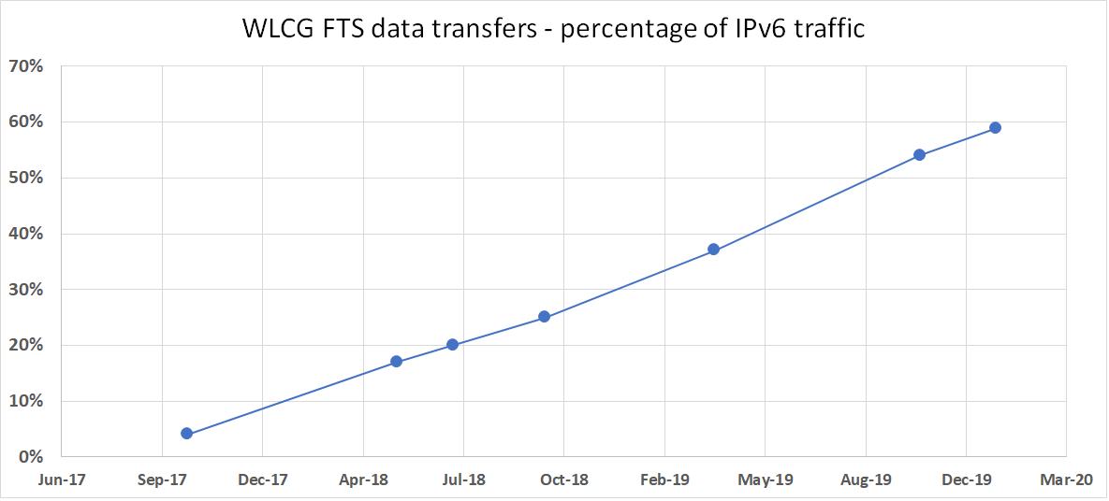
Fraction of SRM/GridFTP FTS traffic over IPv6
Some FTS protocols, e.g. DAVS, not yet instrumented to monitor IPv6
these are excluded from this plot

Slide 7
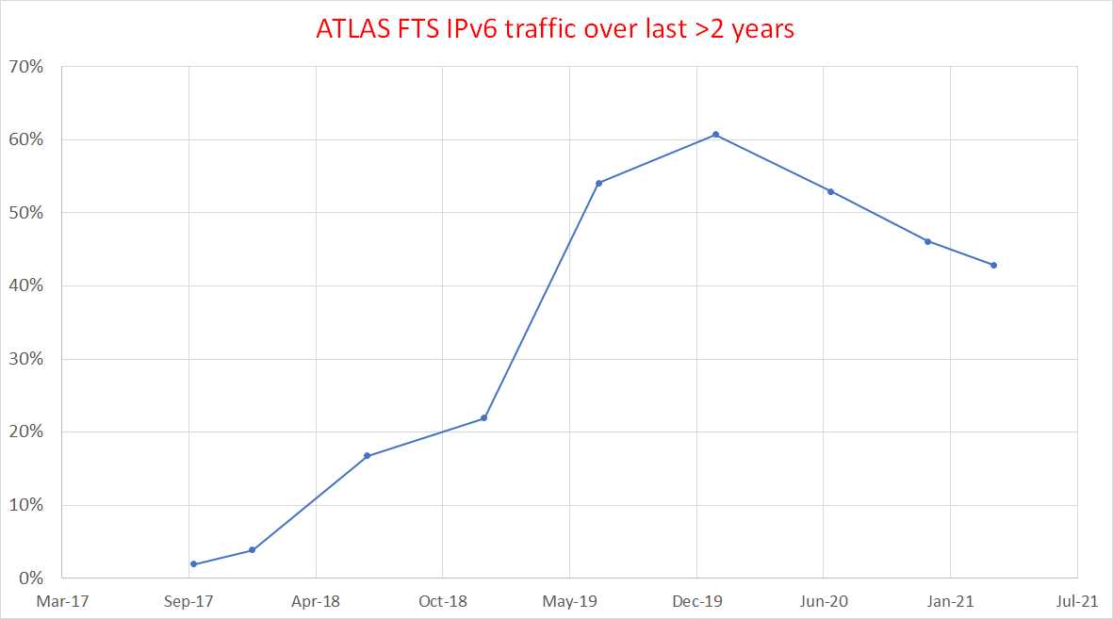
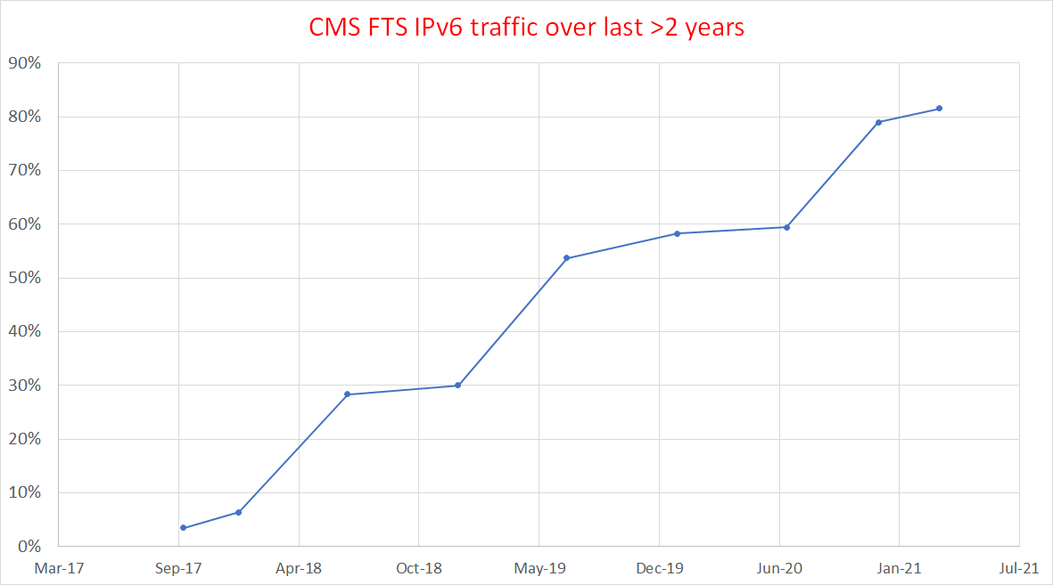
ATLAS and CMS FTS IPv6 traffic
- all protocols
Drop in IPv6 is because of move away from GridFTP – and other protocols not yet monitored (all assumed to be IPv4)

Slide 8
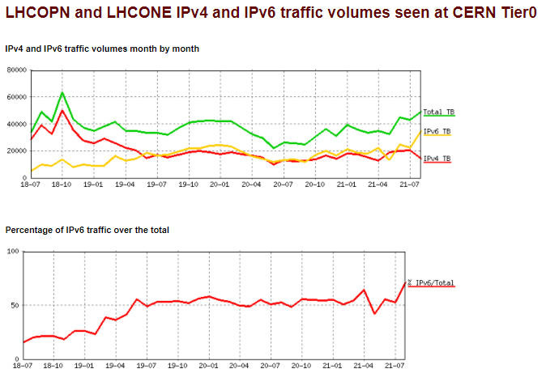
IPv6 traffic on LHCOPN/LHCONE at CERN
IPv6 traffic on LHCOPN/ONE as seen at CERN
~70% of all traffic is IPv6
> 50% from June 2019 onwards
LINK to these plots

Slide 9
IPv4 transfers on LHCOPN/ONE?
Tier1s are dual-stack, but IPv4 can still be used for transfers
  Site/experiment issues - some storage end-points not yet dual-stack
    Old software stacks (legacy deployments) are still deployed
  both ends are dual-stack but configuration or request prefers IPv4
    Investigation of ATLAS/CMS IPv6 traffic has been proposed in UK
  transfers are to/from WN's and the WNs are still IPv4-only
    Difficult to monitor WN IPv6 traffic centrally – can sites monitor?
encourage all sites to deploy all WNs and all services as dual-stack
encourage all sites and all experiments to "prefer" IPv6 transfers

Slide 10
DOE Labs and US IPv6-only directive
https://www.whitehouse.gov/wp-content/uploads/2020/11/M-21-07.pdf
Required to develop plans by end of FY2021, for
At least (20%, 50%, 80%) of IP-enabled assets on Federal networks are operating in IPv6-only environments by the end of FY (2023, 2024, 2025)
Was discussed at WLCG MB in July 2021
  USA DOE/HEP initially pushing for full dual-stack deployment
  IPv6-only will be difficult/expensive

Slide 11
From dual-stack to IPv6-only (CHEP2019) https://doi.org/10.1051/epjconf/202024507045
Planning for an IPv6-only WLCG
To simplify operations
  dual-stack infrastructure is the most complex!
Large infrastructures (e.g. Facebook, EE/BT) use IPv6-only internally
The plan - the goal we are working towards
  IPv6-only for the majority of WLCG services and clients
  With ongoing support for IPv4-only clients where needed
    e..g. via use of RFC 7755/7756
      Stateless IP/ICMP Translation for IPv6-only Data Centres
Timetable to be defined

Slide 12
Preparing for an IPv6-only WLCG
Need to test IPv6-only clusters/worker nodes
  IPv6-only testing at CERN (Ben Jones,Luis Fernandez Alvarez)
  IPv6-only testing being planned for DUNE
FTS monitoring changes will happen soon
  to monitor IPv6 share on all FTS protocols
Analyse samples of WN traffic to identify protocols and services using IPv4
  Applications that store, handle or signal literal IPv4 addresses will be broken by protocol translation
  Work with experiments and developers to “fix” whatever is broken
Need to test tools to allow IPv4-only clients (volunteers?)

Slide 13
IPv6-only timetable?
WLCG can already support use of IPv6-only CPU resources
During 2021 & 2022
  Sites
    deploy dual-stack WN’s and other services
    check that configurations “prefer” IPv6
    investigate data transfers that happen over IPv4
  Experiments
    check data transfer configurations - always prefer IPv6

Slide 14
IPv6-only timetable (2)
A possible first place to turn-off IPv4?
  LHCOPN (Tier0 and all Tier1’s are all dual-stack)
  When the amount of IPv4 traffic becomes very small
    make LHCOPN IPv6-only
    IPv4 traffic will flow via general internet links
  WLCG Management Board – “must not happen too early”
WLCG IPv6-only plan (is during LS3 and before start of Run 4 possible?)
  MB still to agree date for end of “full support” for IPv4 on WLCG Clients
  Core services at that point can become IPv6-only

Slide 15
WLCG MB Conclusions (July 2021)
Deployment of dual stack storage remains the priority
  this is a prerequisite to fully supporting IPv6-only WNs
All sites and regions should plan accordingly and as soon as possible
The final goal is agreed to be IPv6-only
  But the timetable to be agreed later!

Slide 16
Questions, Discussion?

