Slide 1
Connecting the DOTS
E. Mosselmans & P. Berset
13.07.21

Slide 2
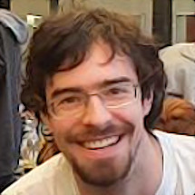
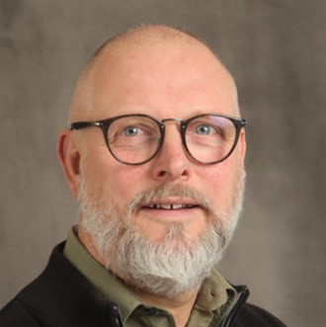
About us
Welcome
Bienvenue
Erwin
MOSSELMANS
HR Department
Learning Specialist
Philippe
BERSET
HR Department
Learning Specialist

Slide 3
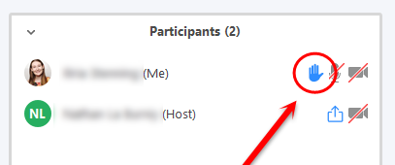




Logistics
During presentations
During Q&A sessions
Notes:
During presentations – switch off your microphone to avoid parasitic noise
During the Q&A session :
Please switch on your cameras and microphone
To ask a question:
raise hand (you can lower)
write in the chat
You can ask your question in English or in French

Slide 4

Agenda, slides & Videos
Available on Indico

Slide 5

Poll
Notes:
From where do you assist to this event?

Slide 6

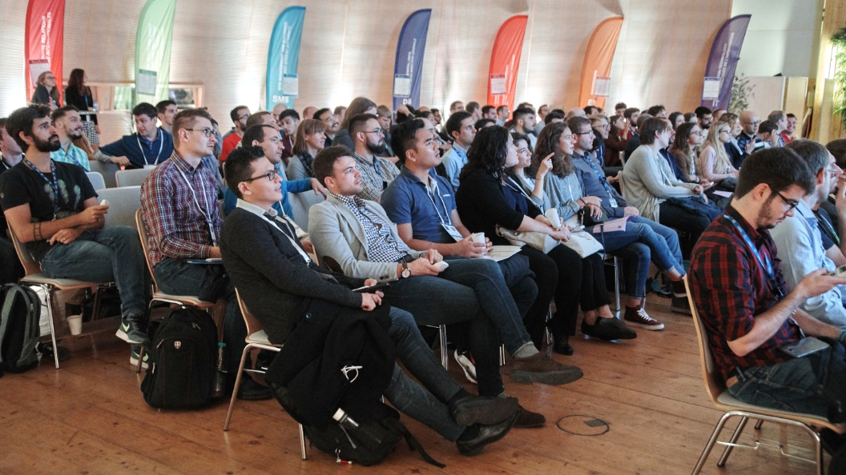

Your first day at CERN

Slide 7
Poll
Notes:
Have you been on CERN site?

Slide 8
Today - Goals
Integration
Interactions

Slide 9
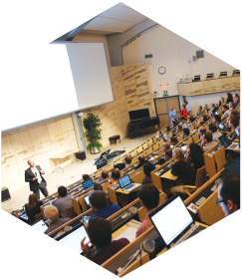
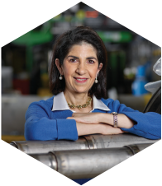
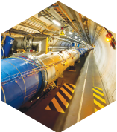
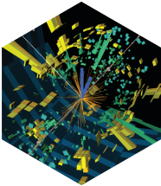
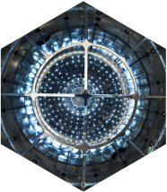
Any Questions ?

Slide 10
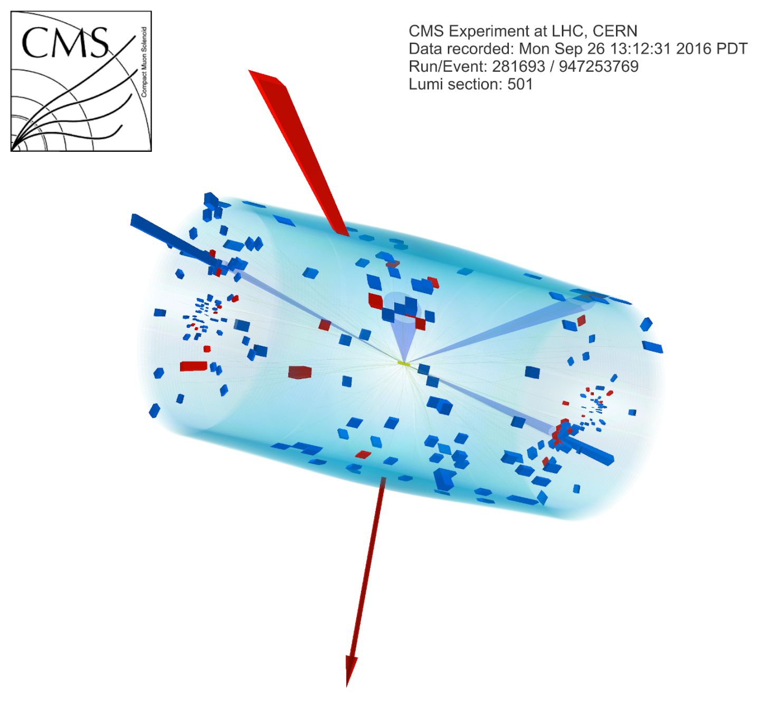
Ice-breaker 10’
In small groups, discuss:
What is my role at CERN and how does my job contribute to CERN’s mission?
En petits groupes, discutez:
Quel est mon rôle au CERN, et comment mon travail contribue à la mission du CERN ?
Notes:
Participants placés en breakout rooms aléatoires

Slide 11
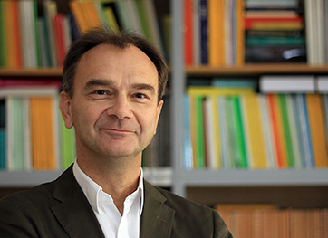
Scientific activities
Manfred Krammer
EP Department Head

Slide 12
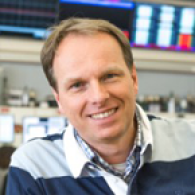
CERN’s accelerator complex
Rende Steerenberg
BE Operation Group Leader

Slide 13
Stands and/or Break
CERN Services
CERN Clubs
Free chat
Coffee/drinks

Slide 14
Introduction to CERN departments
Video Presentation

Slide 15
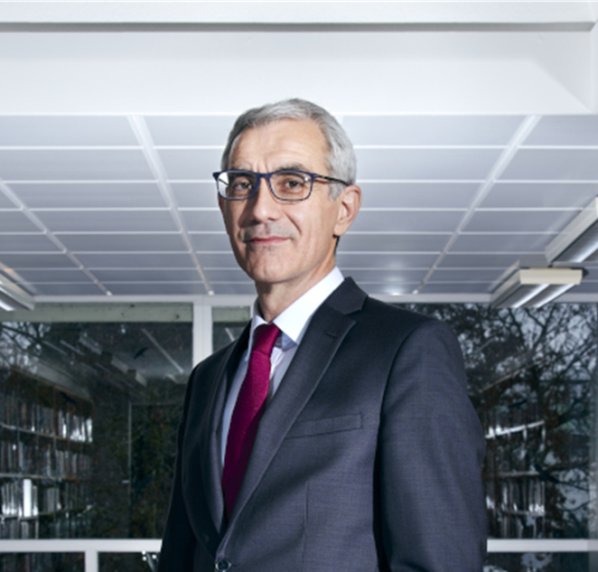
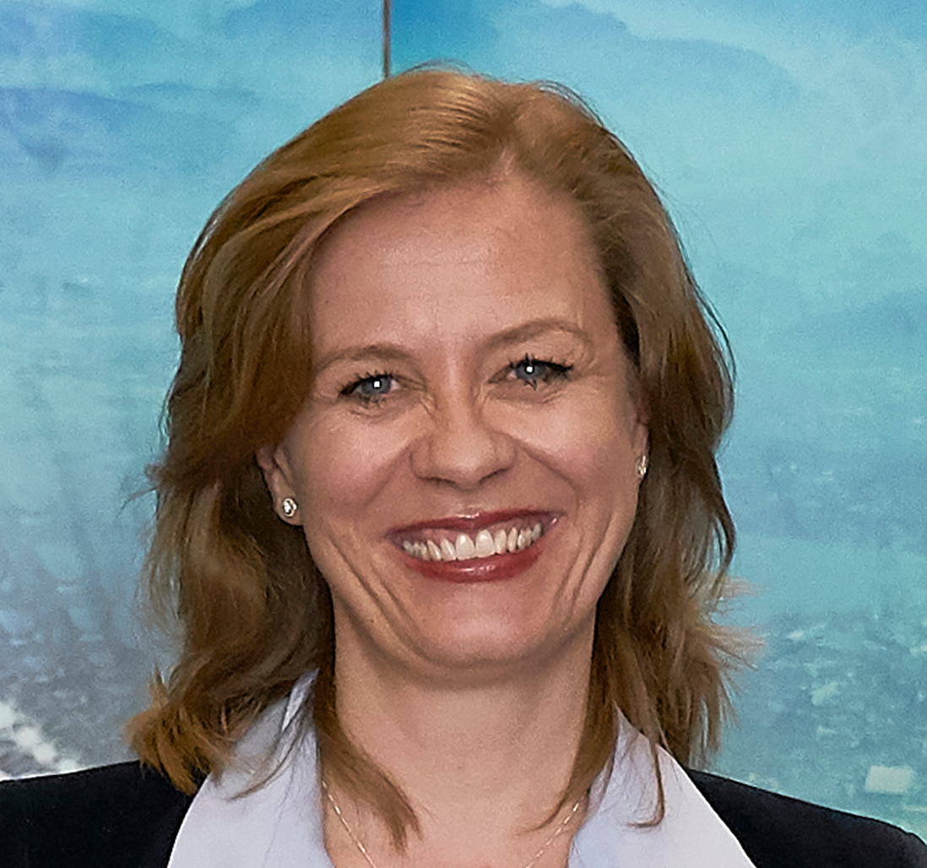
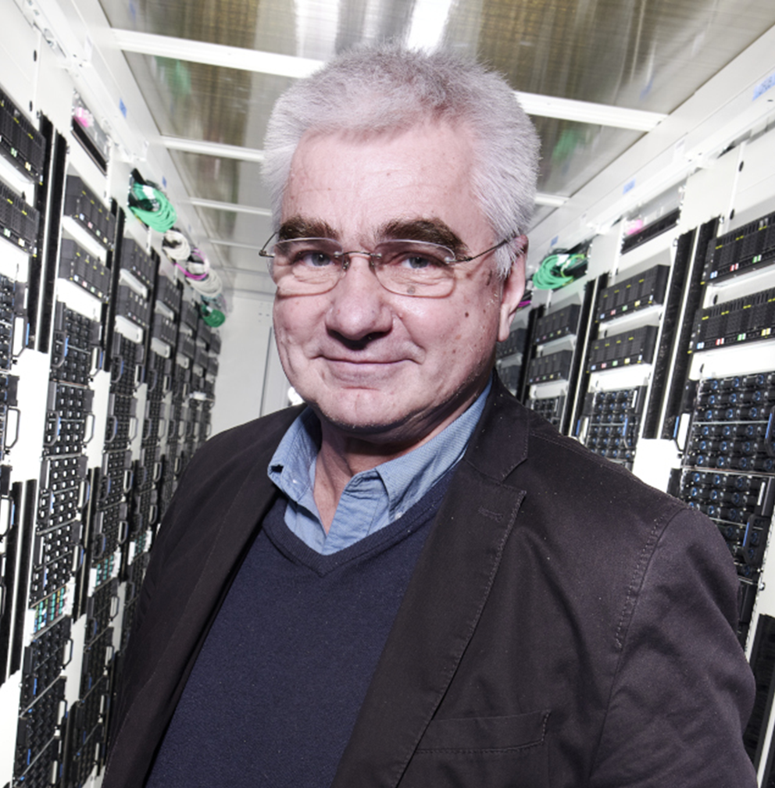
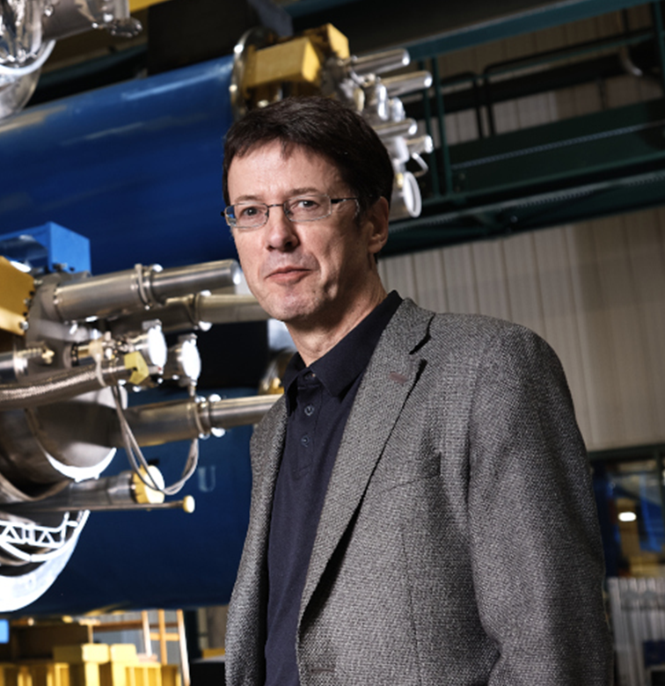
Q&A with the directorate
Raphaël Bello
Director for Finance and Human Resources
Charlotte Lindberg Warakaulle
Director for International Relations
Joachim Mnich
Director for Research and Computing
Mike Lamont
Director for Accelerators and Technology
Fabiola Gianotti, Director General

Slide 16
Networking in small groups
In small groups, discuss:
What is my role at CERN and how does my job contribute to CERN’s mission?
En petits groupes, discutez:
Quel est mon rôle au CERN, et comment mon travail contribue à la mission du CERN ?
Notes:
Participants placés en breakout rooms aléatoires

