Slide 1
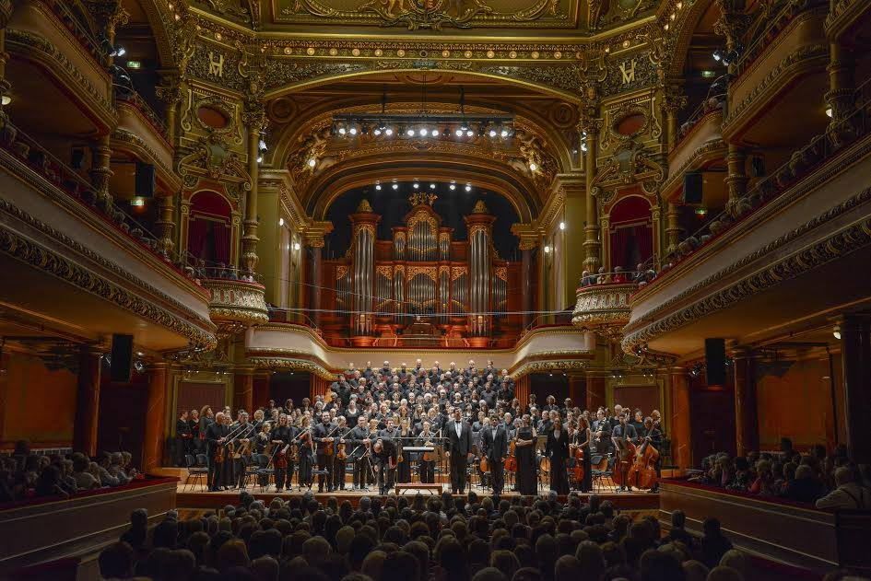

CERN Choir
The CERN Choir performs classical music concerts
  Different eras
  Known and less known composers
  With orchestral, or piano accompaniment and some “a capella”
  We have an experienced professional director
  Excellent professional soloists and musicians work with us
Concerts take place in prestigious places in France and Switzerland
We rehearse on Wednesdays in the CERN Main Auditorium
We provide a good Club Life too…
https://club-choir.web.cern
https://club-choir.web.cern.ch/form/contact

Slide 2
A bit of history
The CERN choir was created in autumn 1974 with the CERN Orchestra, as one of the numerous clubs of the Staff Association, by a group of enthusiastic music lovers among whom were Colin Taylor, Mervyn Hyne and Hildred Blewett. Renée Adam and CERN Woman's Club as well as the members of the Geneva Amateur Operatic Society contributed actively in this creation. CERN Choir will have its 50th birthday 2024 !
Colin Taylor was our first director, then the direction of the Choir was entrusted to several professional directors and since 1989, to Gonzalo Martinez who also works for the Choir Pro Musca Of Annecy, the Vocal ensemble Heinrich Schütz of Annecy, and the Vocal Chapel of Lausanne.

Slide 3
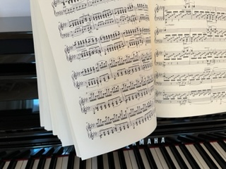
Join us !
Do you like classical music and want to sing under the direction of a professional choir director at concerts in which professional soloists and musicians participate?
If the answer is yes, there's a place for you in the CERN Choir!
For more information, please come join us at one of our rehearsals. You will be very welcome!
Who are we ?
… people working on the CERN site
… CERN retirees, external people from the Geneva area, France and Switzerland, who like to sing with us

Slide 4
Rehearsals and info
Rehearsals
Every Wednesday, from 8 pm to 10 pm, in CERN’s Amphitheater in bldg. 500.
We also rehearse during a few week-ends per year to prepare our concerts
N.B. For more information, please fill in our contact form that you can fins on our our website https://club-choir.web.cern.ch
Membership fees
From January to June: 150 CHF
From September to December: 100 CHF
Students get a reduction of 50 %
In addition to the membership fee, there will be additional costs for some of
the required scores.

Slide 5
Future
Verdi’s Requiem will be set up in Victoria Hall, Geneva, within a cross-border collaboration between 3 choirs and an orchestra from both Switzerland and neighboring France.
The concert is planned for the 14th of September 2023, with the CERN and the “Pro Musica” choirs as organizers. The “Saleve choir will” also join !
In addition to rehearsing the Verdi Requiem, the choir is now also working on the Stabat Mater by Dvorak, in collaboration with the “Ensemble Vocal Schütz”, from Annecy. This concert is planned for November 19th and 20th , 2022.

Slide 6

Concerts, a few examples

Slide 7
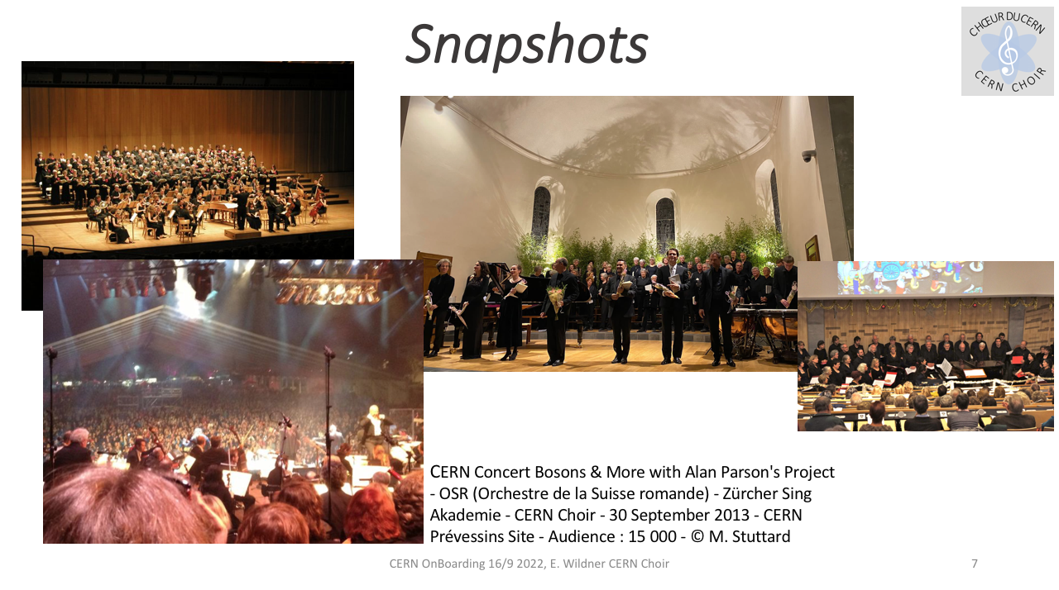

Slide 8



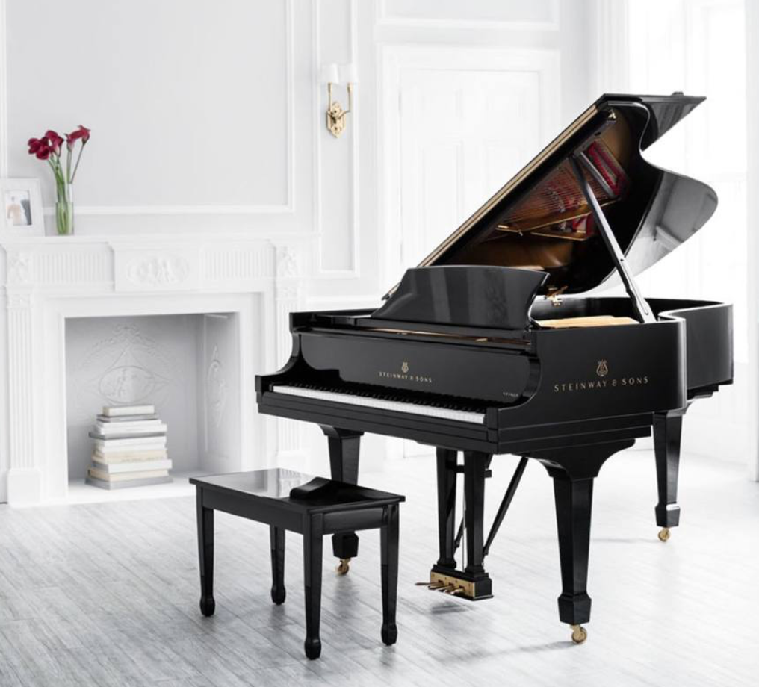

Support, donations and invitations …
Thank !
We are one of the recognized oratorio choirs of Geneva
CERN Amphitheatre for rehearsals and concerts
Steinway 221 B lent to us by the Staff Association
…and others

Slide 9
Thank you for your attention !
Choeur du CERN - L'Orchestre de Chambre de Genève - Zürcher Sing-Akademie / Beethoven - Missa Solemnis / Victoria Hall, Geneva - 30 septembre 2014 / 60 ans du CERN - 40 ans du Choeur du CERN photo © F.Bevilacqua
😊

