Slide 1
FCC-EE Multipole Kicker Injection Studies
Sept. 21, 2021 – FCC-ee Injection #3
Patrick Hunchak
Patrick Hunchak and Michael Hofer
Thanks to Masamitsu Aiba

Slide 2
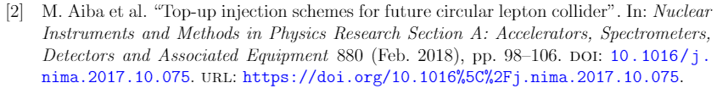
Injection Into FCC-ee
Top-up injection is necessary to maximize the integrated luminosity of the collider.
Four options have been proposed:
 | On Momentum | Off Momentum
Conventional Orbit Bump
Multipole Kicker Injection (MKI) | Focus of this Work
Wienands, U. “Lepton Collider Operation with Constant Currents”. Proceedings of the 2005 Particle Accelerator Conference. doi:10.1109/pac.2005.1590385

Slide 3
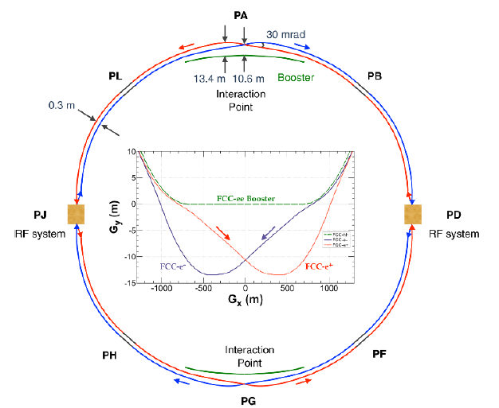
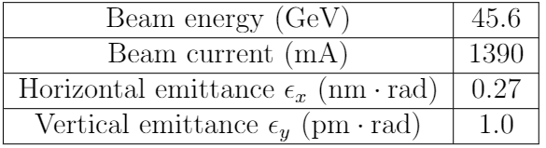


The FCC-ee Ring
Injection at Point PB
Four operation modes ( Z, WW, ZH, & $t\overline{t}$ ) ranging in beam energy from 45.6 to 182.5 GeV.
Z-mode examined first for machine protection aspect (high stored beam energy).
Z-mode operation Parameters
Layout has been updated recently. Shorter Circumference, longer injection straight.

Slide 4
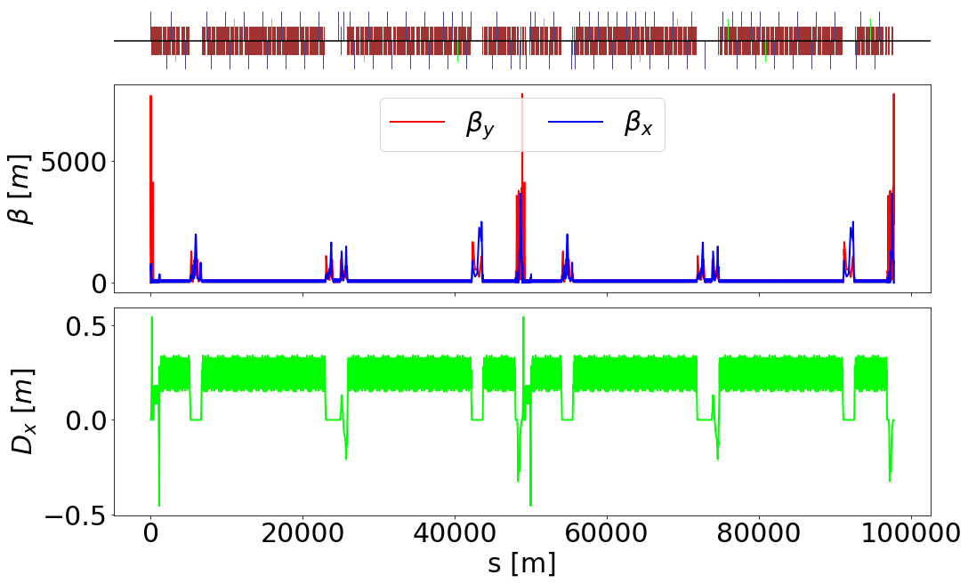
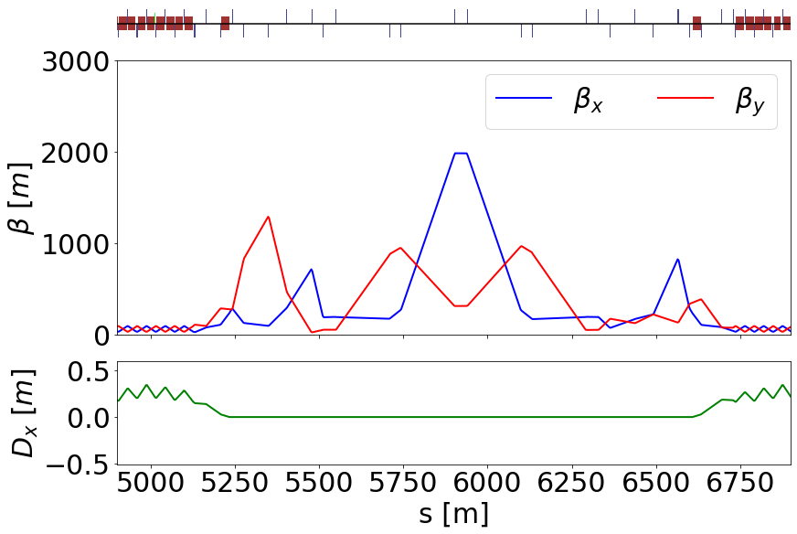
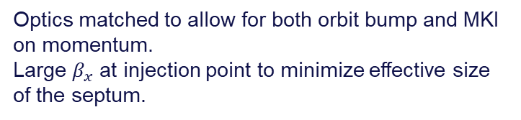
Machine Parameters
Full Machine
PB Injection Section
Optics matched to allow for both orbit bump and MKI on momentum.
Large $β_{x}$ at injection point to minimize effective size of the septum.

Slide 5
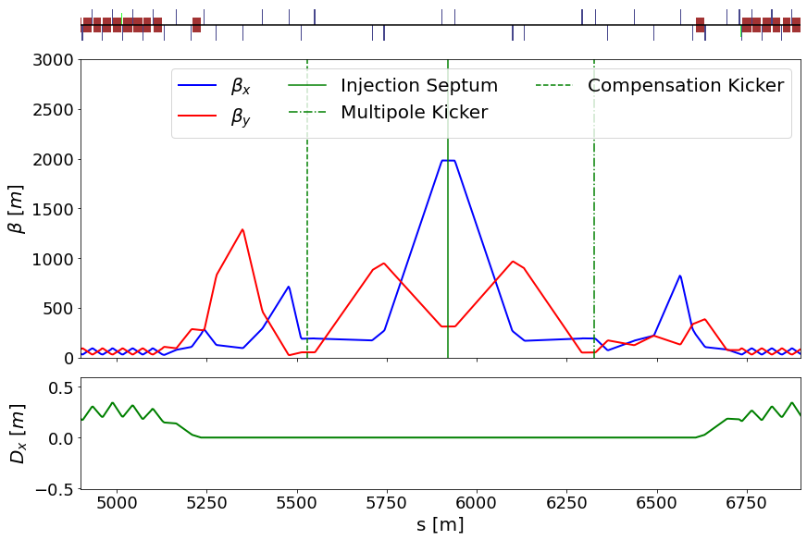
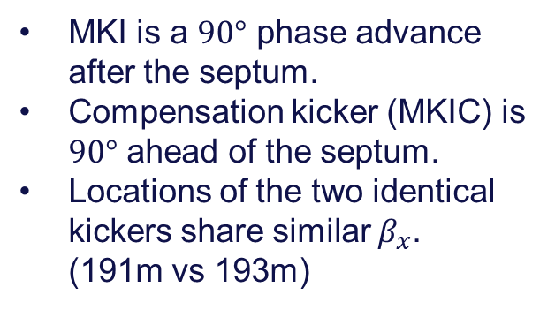
Placement of Injection Magnets
MKI is a $90°$ phase advance after the septum.
Compensation kicker (MKIC) is $90°$ ahead of the septum.
Locations of the two identical kickers share similar $β_{x}$. (191m vs 193m)

Slide 6
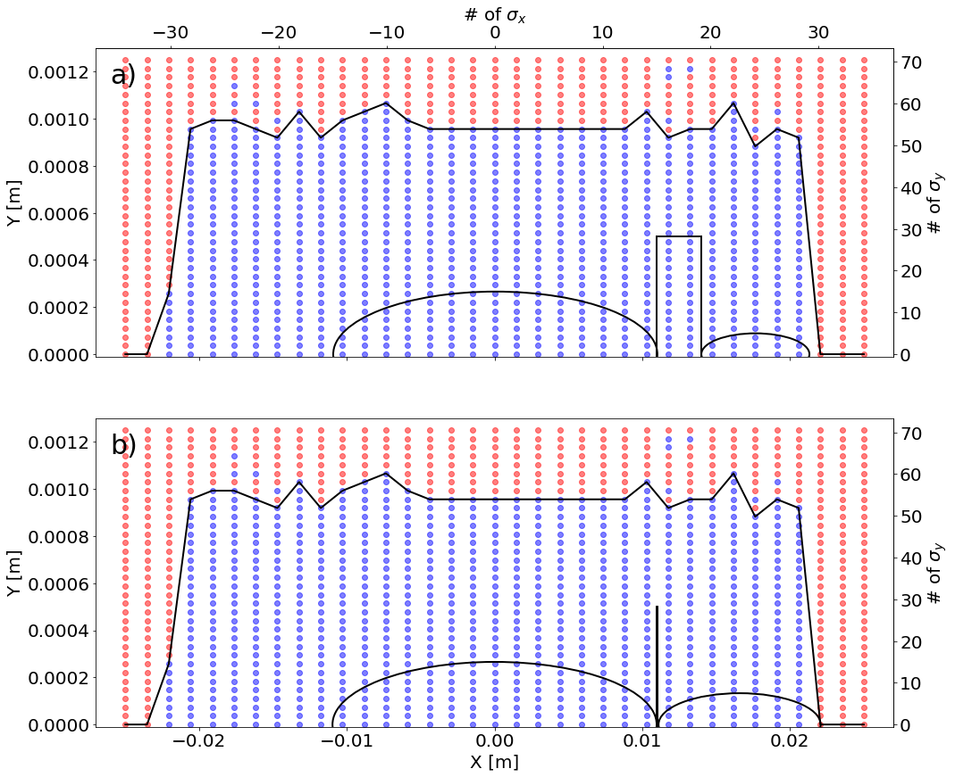
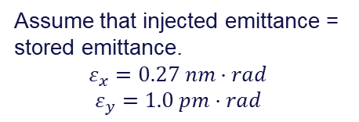
Dynamic Aperture
Assume that injected emittance = stored emittance.
$$ε_{x}=0.27 nm·rad$$
$$ε_{y}=1.0 pm·rad$$
3 mm eddy current septum
0.1 mm electro-static wire septum
The thinner septum reduces dynamic aperture req. but not previously used.*
Our simulations show plenty of DA for either septum.
* M. Aiba “Top-up Injection Status and Next Steps” FCC Week 2021 https://indico.cern.ch/event/995850/contributions/4419415/attachments/2271652/3858072/FCC-ee_Injection_aiba.pdf

Slide 7
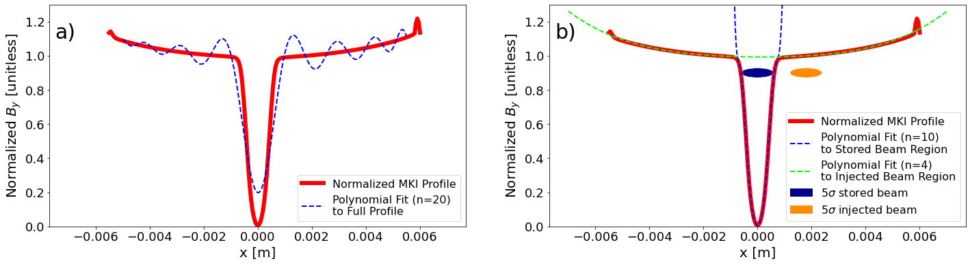
Modelling the Multipole Kicker
MKI has zero on-axis field to minimize disturbance of stored beam, large off-axis field to kick the injected beam.
MADX does not currently support arbitrary field elements.
Maximum of 20th order polynomial not a good fit.
Split into two fits, for interaction with stored/injected beam.

Slide 8
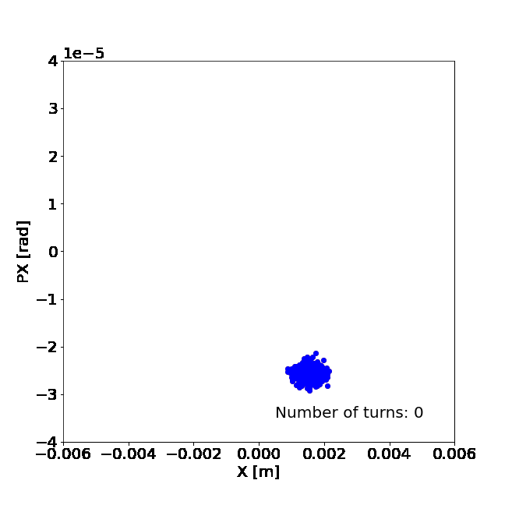
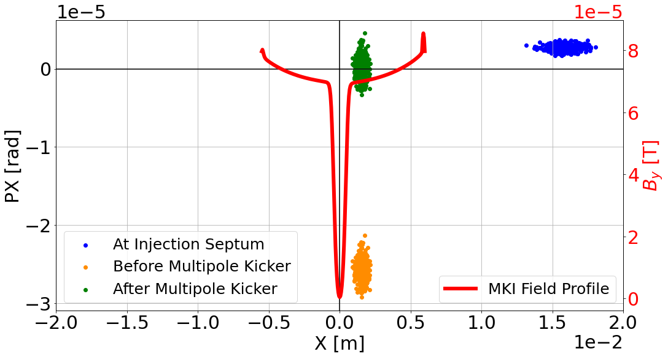
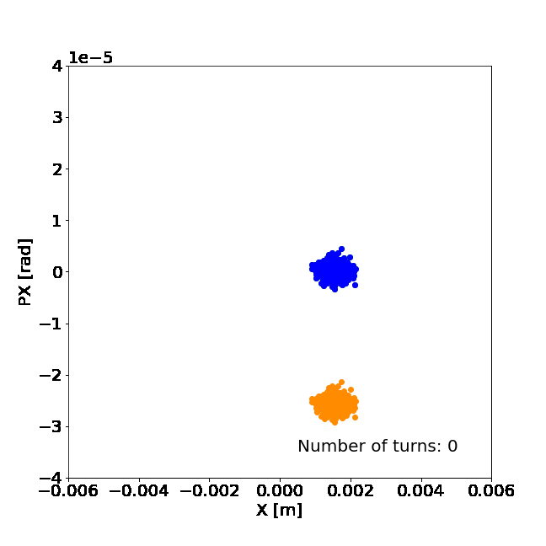
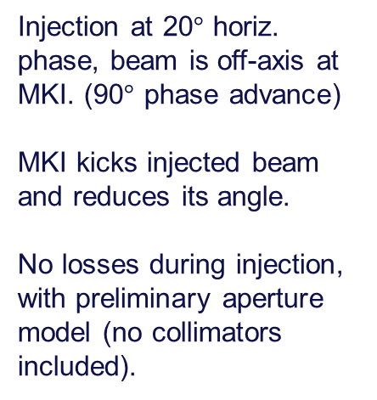
Simulating Injection
Injection at 20$°$ horiz. phase, beam is off-axis at MKI. (90$°$ phase advance)
MKI kicks injected beam and reduces its angle.
No losses during injection, with preliminary aperture model (no collimators included).

Slide 9
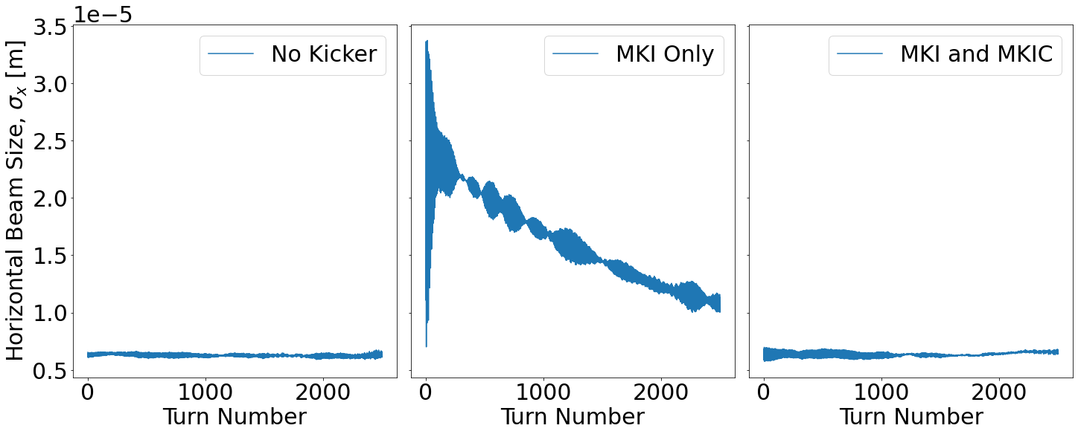
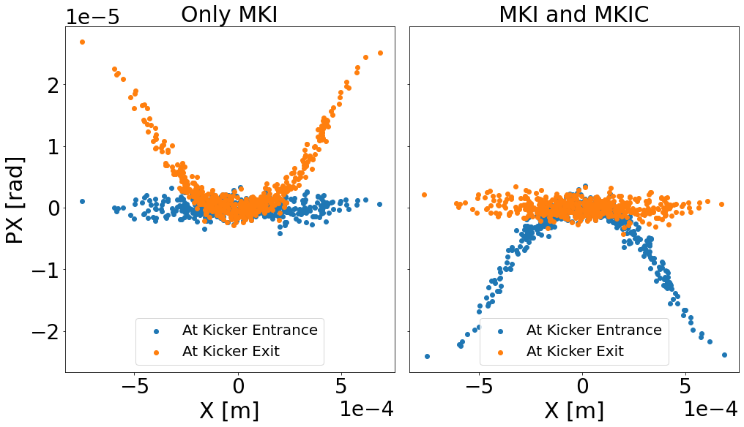
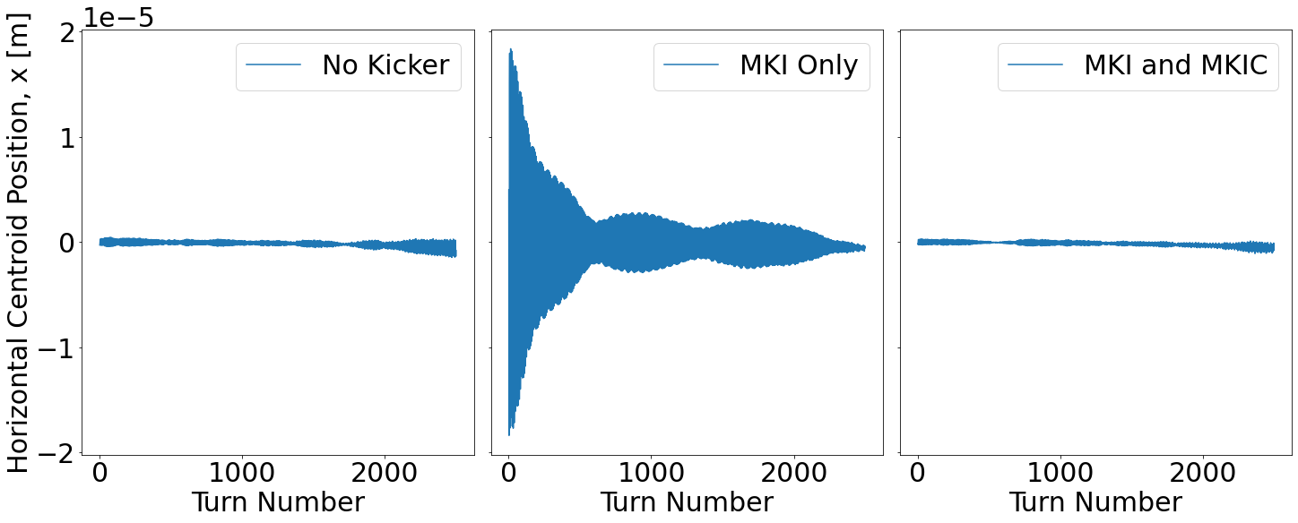
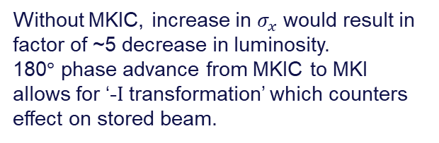
Injection Effect on Stored Beam at Interaction Point
Stored beam at IP
Without MKIC, increase in $σ_{x}$ would result in factor of ~5 decrease in luminosity.
180$°$ phase advance from MKIC to MKI allows for ‘-I transformation’ which counters effect on stored beam.
Stored beam at MKI location

Slide 10
Injection Effect on Stored Beam at Interaction Point
Stored beam at IP
Without MKIC, increase in $σ_{x}$ would result in factor of ~5 decrease in luminosity.
180$°$ phase advance from MKIC to MKI allows for ‘-I transformation’ which counters effect on stored beam.
Stored beam at MKI location

Slide 11
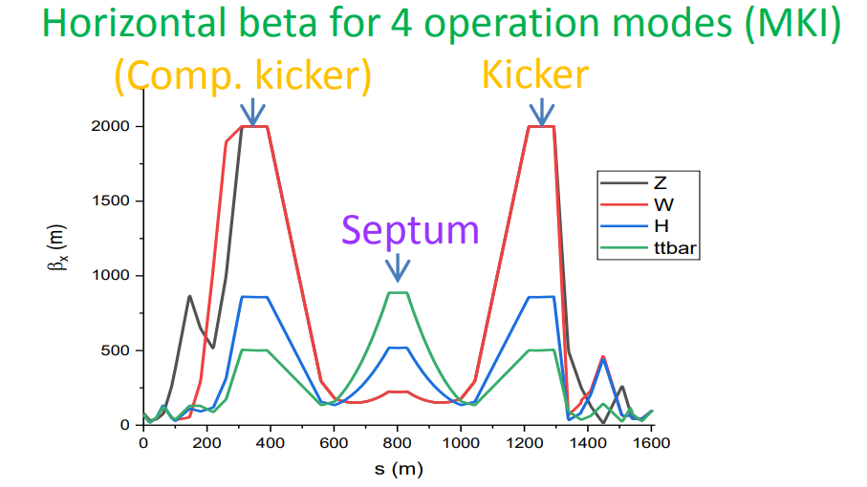
Next Steps
Short Term
Other optics (tuned for MKI or off-momentum)
Other operation modes
Other injection approaches (conventional orbit bump)
Long term
Error studies – Misalignments, Kicker Misfires, etc.
Beam-beam effects
* M. Aiba “Top-up Injection Status and Next Steps” FCC Week 2021 https://indico.cern.ch/event/995850/contributions/4419415/attachments/2271652/3858072/FCC-ee_Injection_aiba.pdf

Slide 12
Thank you for your attention.
Sept. 21, 2021 – FCC-ee Injection #3
Patrick Hunchak
Gitlab Repository of Project Work:
https://gitlab.cern.ch/phunchak/fccee-injection-studies

Slide 13
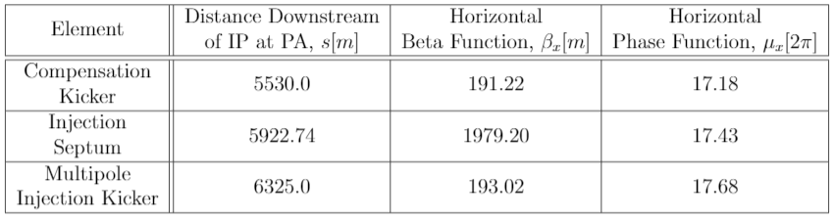
Placement of kickers
FCCee_z_216_nosol_1.seq

Slide 14
Colors
Backgrounds
Background Blue
Background Purple
Background Yellow
Background Grey
Use for Layout
Radiant Blue
Flash
Energy
Green
Red
Deep
Blue

Slide 15
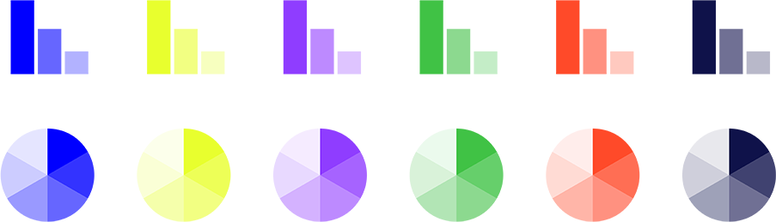
Graphical Elements
Badges
This information is a badge because it is important!
This information is a badge because it is important!
Separation lines 1.5 pt
Arrows
Use blue badges on light backgrounds
Infographics
This information is a badge because it is important!
This information is a badge because it is important!
Use light badges on dark backgrounds

