Slide 1
CERN-KEK Collaborative Activities for
Linear Colliders
Steinar Stapnes – with information/slides from Shinichiro Michizono and Akira Yamamoto
2019-20 – a few examples:
X-band facility and industrial studies, HiEff klystron (superconducting solenoid, for high-efficiency klystrons), Nano-beam technology (using ATF-2)
2020-21:
New basis for common work established: CERN LC planning after the ESPP and the ILC IDT startup
  CERN – KEK new addendum for ILC-IDT
  Active work in IDT, WG1 and 2
High efficiency klystrons
X-band facility back in operation

Slide 2
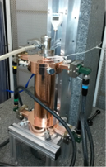
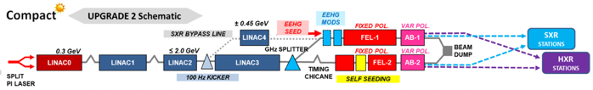
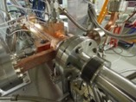
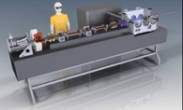
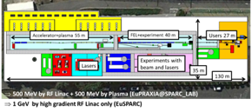
LC studies CERN 2021-26
CLIC and High Gradient technology:
Design and manufacturing of X-band structures and components, system interfaces
Study structures breakdown limits and optimization, operation and conditioning
Beam-dynamics and parameters: Nanobeams (focus on beam-delivery), pushing multi-TeV region (parameters and beam structure vs energy efficiency)
Tests in CLEAR (wakefields, instrumentation) and other facilities (e.g. ATF2)
See talks by Phil Burrows (CLIC), Nuria Catalan (Nanobeams), Chetan Gohil (Luminosity Performance)
Application of X-band technology (examples):
1 GeV X-band linac at LNF
A compact FEL (CompactLight: EU Design Study 2018-21)
Compact Medical linacs (proton and electrons)
Inverse Compton Scattering Source (Smart-Light)
Linearizers and deflectors in FELs (PSI, DESY, more)
See talk by Walter Wuensch (Applications of High Gradient Technologies)
ILC related R&D and Pre-lab Planning
Positron flux concentrator, ATF2/3, Hi-klystrons, various SRF topics, cryo, dumps, beam-dynamics, DR, etc
IDT participation and Common Fund contributions.
Numerous ILC and/or KEK collaborative R&Ds, linking to CLIC, generic R&D or SRF for HL LHC and FCC and other CERN activities.
See talks by Joachim Mnich and Steinar Stapnes (CERN and European reports)

Slide 3
MTP text and goals 2022
The design and implementation studies for the CLIC e⁺/e⁻ multi-TeV linear collider are at an advanced stage. The main feasibility issues, cost and project timelines have been developed, demonstrated and documented in a comprehensive project implementation plan for the accelerator, and a summary report covering the physics, detector and accelerator status, including future plans. An initial stage at 380 GeV was presented in detail for the European Strategy update (ESPP), together with upgrade paths to higher energy stages, 1.5 and 3 TeV. During 2019-20 further potential improvements in luminosity performance and components designs were introduced and will be a focus of further studied. On the design side the parameters for running at multi-TeV energies, with X-band or other RF technologies, will be studied further, in particular with energy efficiency guiding the designs. The work-programme, technical R&D and design studies, are carried out by a collaboration of 53 institutes providing the overall (M&P) resources for the activities. The CLIC accelerator studies are closely connected with associated physics and detector studies with 30 institutes involved.
During the coming years the focus will remain on core technology development and spread making use of existing facilities (High Gradient Test Stand and the CLEAR beam facility), optimising X-band components for performance and manufacturability towards full modules, and efficient use of the abovementioned collaborations with the many laboratories and universities now using the technology in linac systems. This allows CLIC to remain a future accelerator option for CERN, and increases the overall availability and knowledge of the technology, with modest investments. The use of the CLIC technology - primarily X-band RF, associated components and nano-beams - in compact medical, industrial and research accelerators in many of the CERN Member States has become increasingly important development and test grounds for CLIC, and is destined to grow further. An EC supported design study with 24 partners pursue the use of the technology in future FELs facilities (CompactLight).
The International Linear Collider (ILC) studies are progressing rapidly lead by an International Development Team (IDT) where CERN participates. The CERN linear collider studies support this effort through combined activities with CLIC, co-operation with KEK for specific technology developments where CERN has expertise, and studies using ATF2 facility. The future of the ILC focused part of linear collider activities will depend on the progress of the ILC project in Japan, building on the commonalities between CLIC and ILC, common R&D interests between CERN and KEK, and extensive European activities and capabilities related to ILC studies and technologies, inside and outside CERN.
Development of X-band technology with industry and collaboration partners; structures, RF networks and high efficiency power units, as needed for CLIC R&D, the high gradient test-stands and applications in compact linacs in general
Continue studies of the luminosity performance at 380 GeV and multi-TeV energies, including nanobeam hardware developments as needed for these, and power efficiency studies.
Conclude the most central collaboration agreements for the period 2022-2025, including collaborations for applications of the core technologies in research and medical linacs
Participate in relevant working groups for ILC and organize collaborative R&D efforts with KEK for ILC and CLIC
Continue to play a coordinating and facilitating role for European planning and contributions to the ILC as the project evolves
For reference

Slide 4
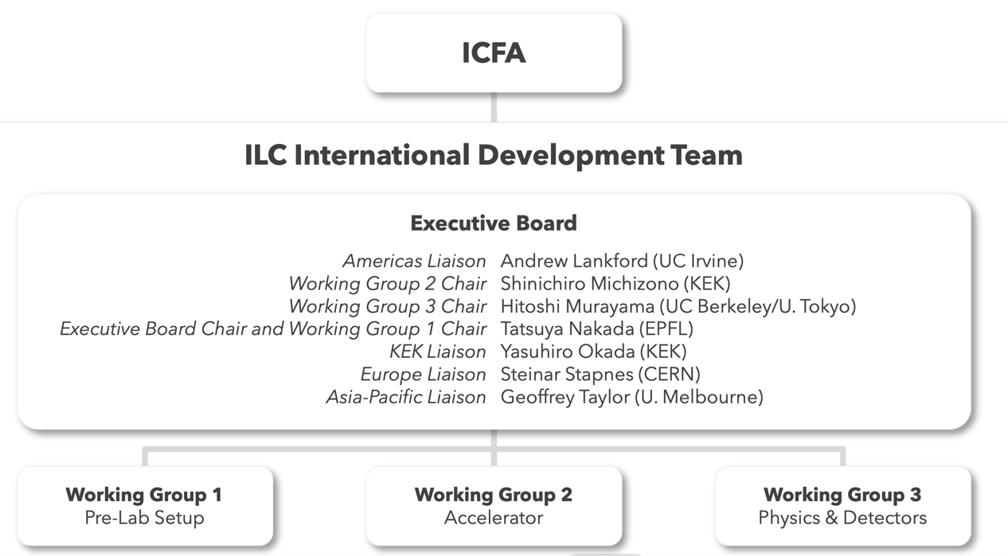
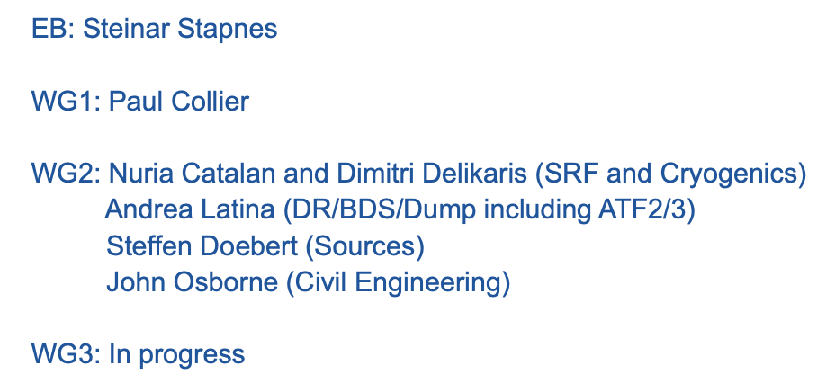
IDT structure from Summer 2020

Slide 5
CERN – KEK agreement for the ILC IDT in 2020
Add annexes for specific common studies, positrons, possibly klystrons, dumps, etc
In some areas we have other appendixes ..

Slide 6
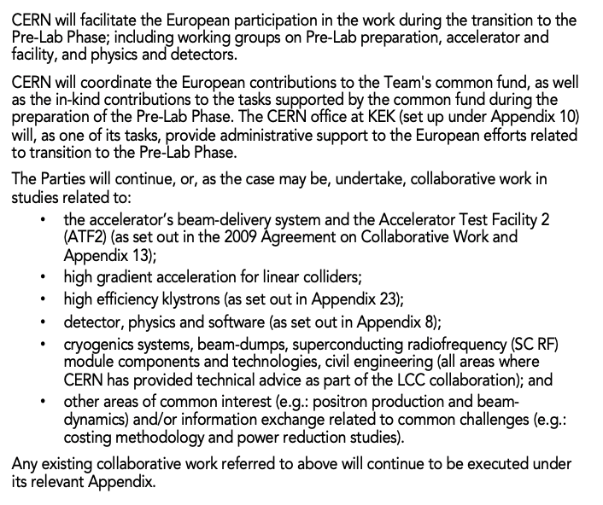
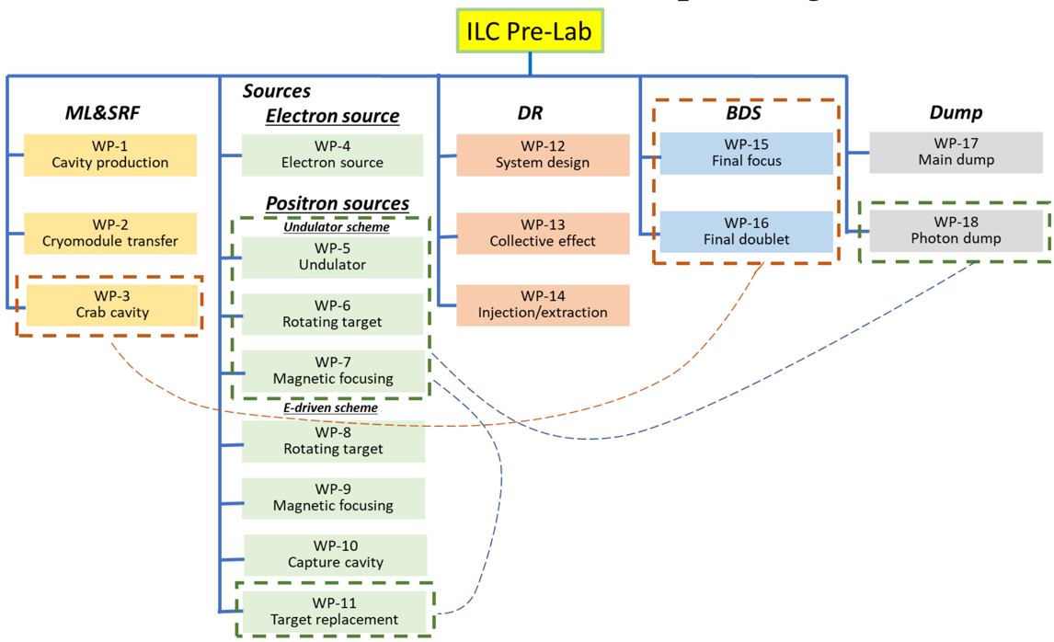
ILC overall timeline
IDT (~1.5 years)
  Prepare the work and deliverables of the ILC Pre-Laboratory and work out, with national and regional laboratories, a scenario for their contributions
  Prepare a proposal for the organisation and governance
  of the ILC Pre-Laboratory
ILC Pre-Laboratory (~4 years)
  Complete all the technical preparation necessary to start the ILC project (infrastructure, environmental impact
  and accelerator facility)
  Prepare scenarios for the regional contributions to and organisation for the ILC.
ILC laboratory
  Construction and commissioning of the ILC (~9-10 years)
  Followed by the operation of the ILC
  Managing the scientific programme of the ILC
R&D and common work with ILC/KEK – already accounted for. Expect to run 2021-23
Planning, except to start in 2022 at the earliest
Later

Slide 7
Pre-lab work-packages
Engineering Design working group being set up
Also in WG2, but related to Civil Engineering
John Osborne CERN
Accelerator WP reviewers:
Erk Jensen CERN
Deepa Angal Kalinin STFC
Nick Walker DESY
Dumps
CERN, Spain, CERN
DR/BDS
Karsten Buesser and Jenny List DESY
Philip Burrows UK
Angeles Faus-Golfe IJClab (France)
Andrea Latina CERN
Ivan Podadera CIEMAT (Spain)
Mikhail Zobov INFN LNF
ATF3 interests UK, Germany, France, CERN, Spain
Other light-sources labs possible (DR)
ML & SRF
Nuria Catalan and Dimitri Delikaris CERN
Enrico Cenni and Olivier Napoly CEA
Luis Garcia-Tabares CIEMAT
Peter McIntosh UK
Laura Monaco INFN Milano
Hans Weise DESY
Not all European SRF labs represented
Additionally:
Long term cryo collaboration with CERN. HiEff RF another relevant activity
SRF “basic” R&D for fabrication improvements or long term performance improvements (i.e. for upgrades)
Sources
Jim Clarke UK
Steffen Doebert, CERN and Peter Sievers, CERN retired
Benno List, Jenny List, Sabine Riemann, Gudrid Moortgat-Pick DESY
IJCLab also, other groups also possible (FCC-ee, Dafne)

Slide 8
ILC IDT EB – news
The Proposal for the ILC Preparatory Laboratory is now published: https://arxiv.org/abs/2106.00602
“This proposal is intended to provide information to the laboratories and governmental authorities interested in the ILC project to allow them to consider participation”
Several announcements, e.g http://newsline.linearcollider.org/2021/06/01/ilc-preparatory-laboratory-proposal-released/
Endorsed by IFCA, (being) sent to IDT WGs, ICFA, ECFA and Lab directors
The Technical Preparation Document describing the 18 WPs is at: (https://zenodo.org/record/4742019#.YLfkLi0RrqY)
And a document (in Japanese) addressing, “key issues related to the ILC project”, as identified in various reviews, is also sent
Further information about Japanese funding needs also provided
Ongoing:
MEXT review panel meetings 14 and 18.10, presentations and background slides include information about CERNs recent work related to ILC and its key technologies, and indicate capabilities for the ILC Prelab (next slides)

Slide 9
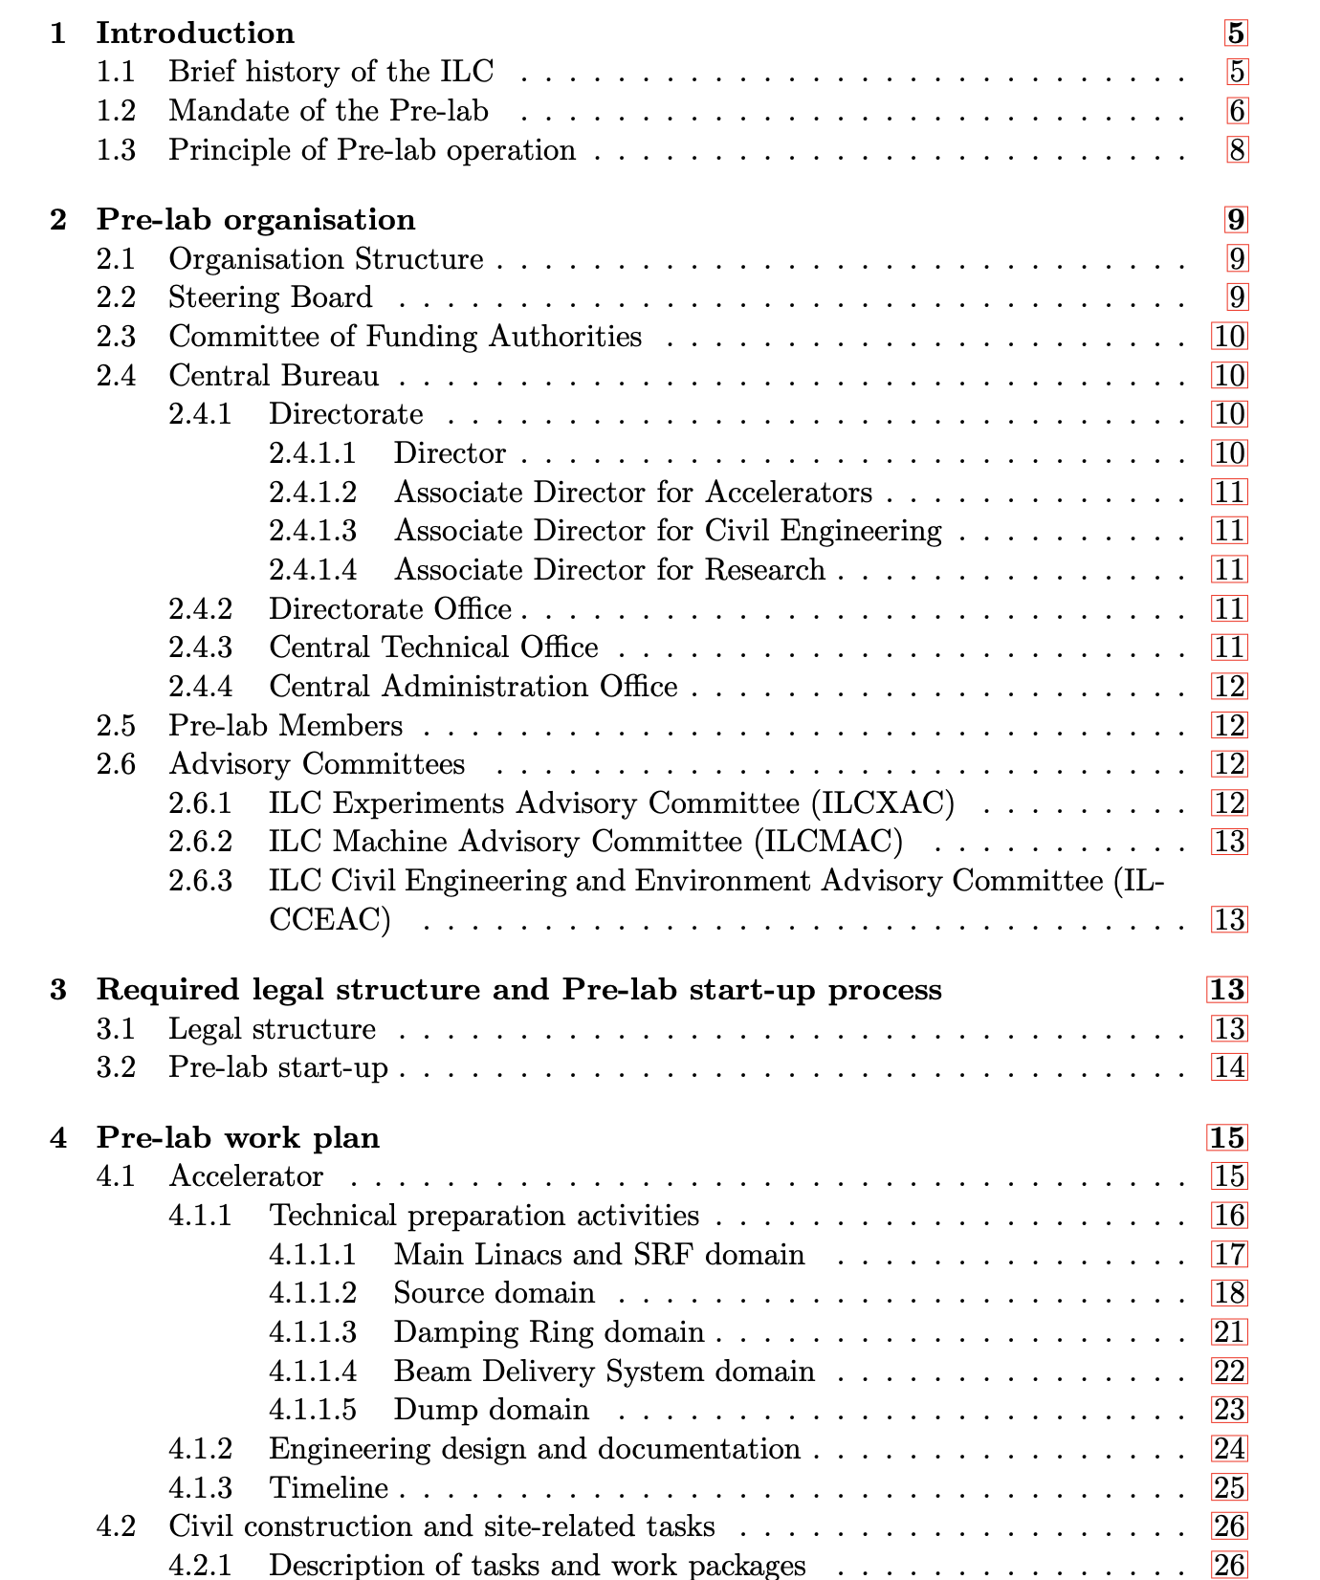
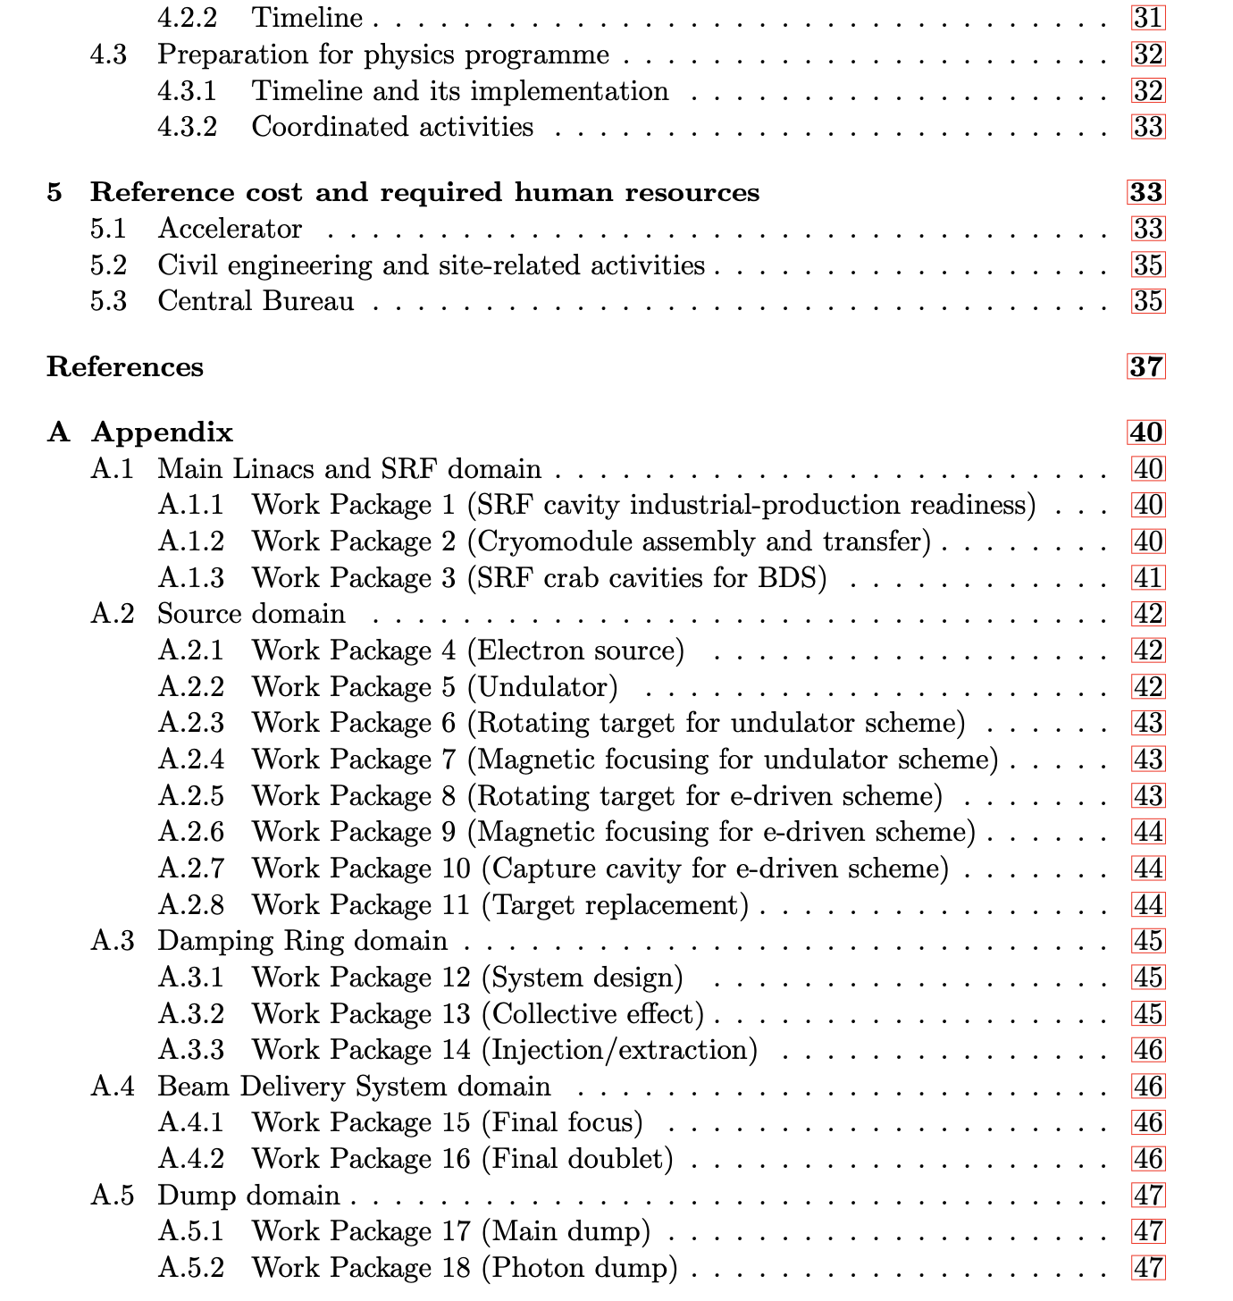

Slide 10
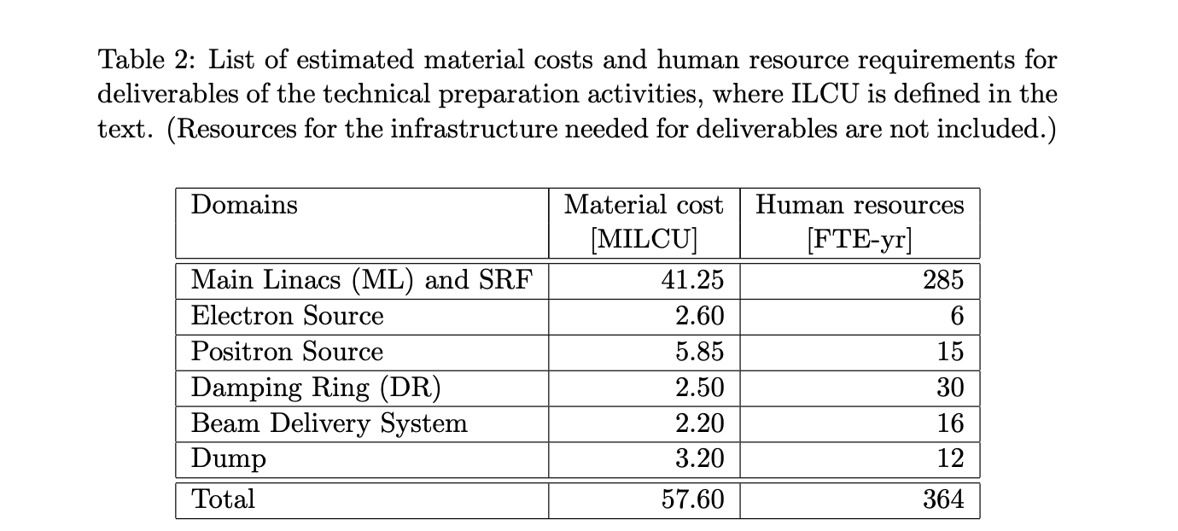
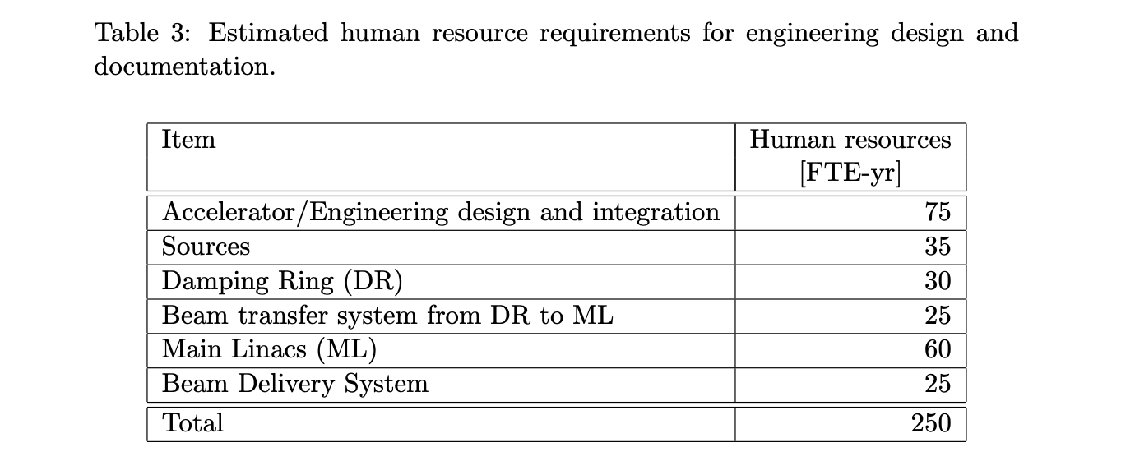
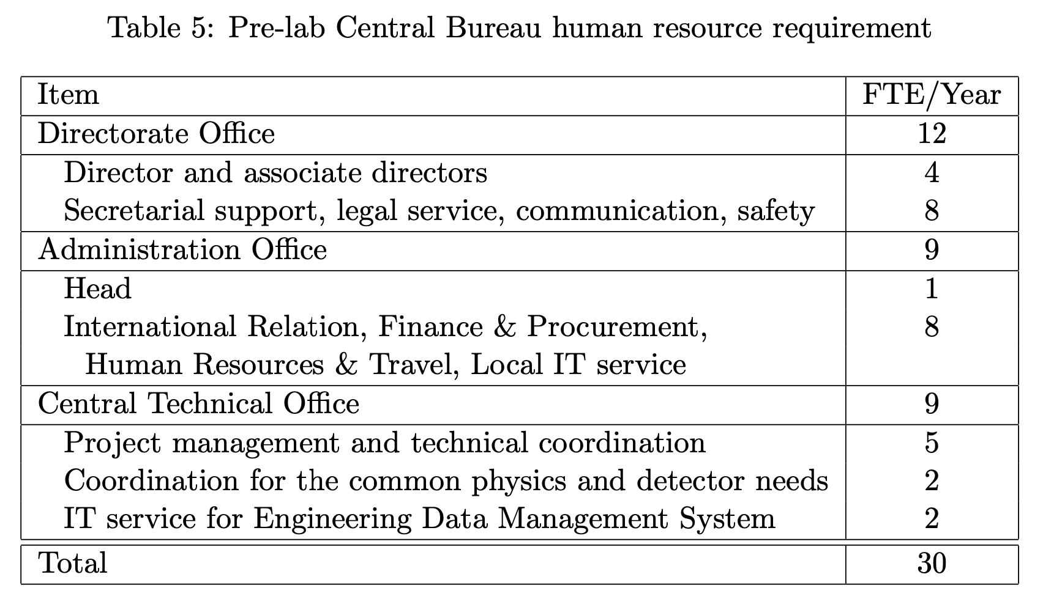
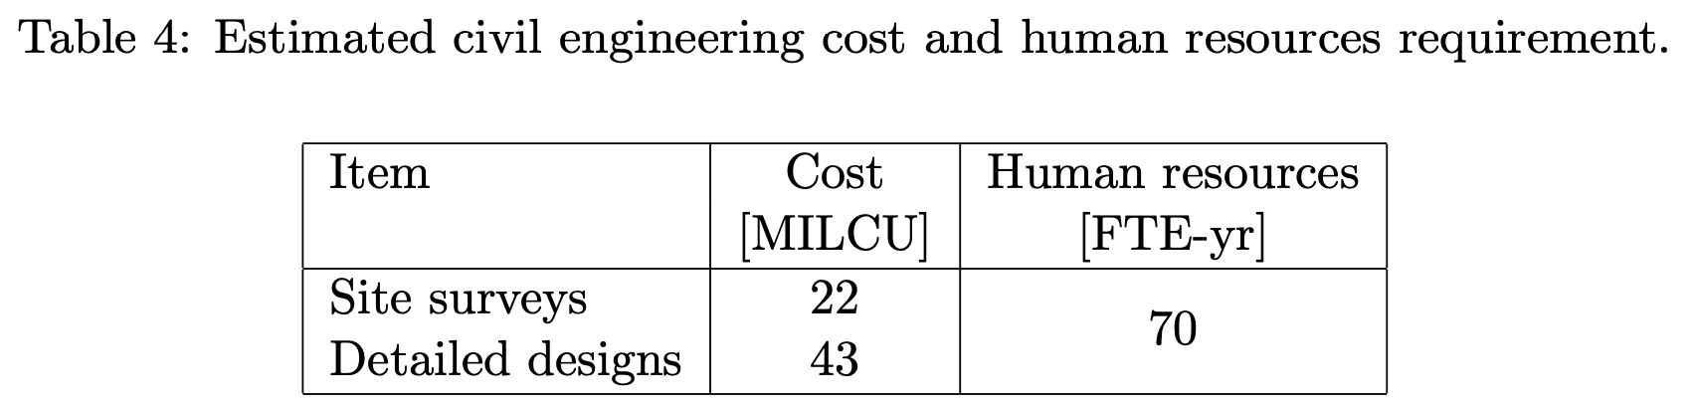
With the IDT proposal numbers (integrated over 4 years):
Personnel from Europe ~200-250 FTEy
Material around 35-40 MEURO (including – very uncertain – 15-20 M for infrastructure)
Possible qualification of companies not included

Slide 11
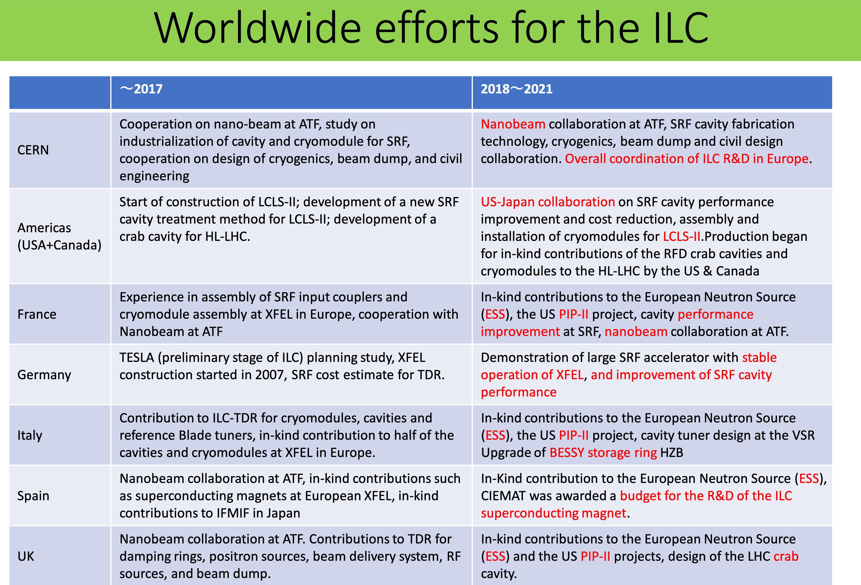

Slide 12
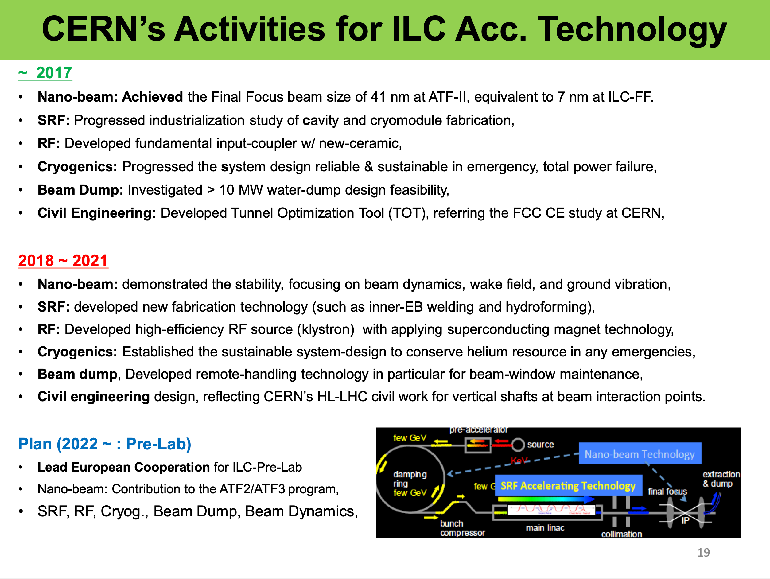
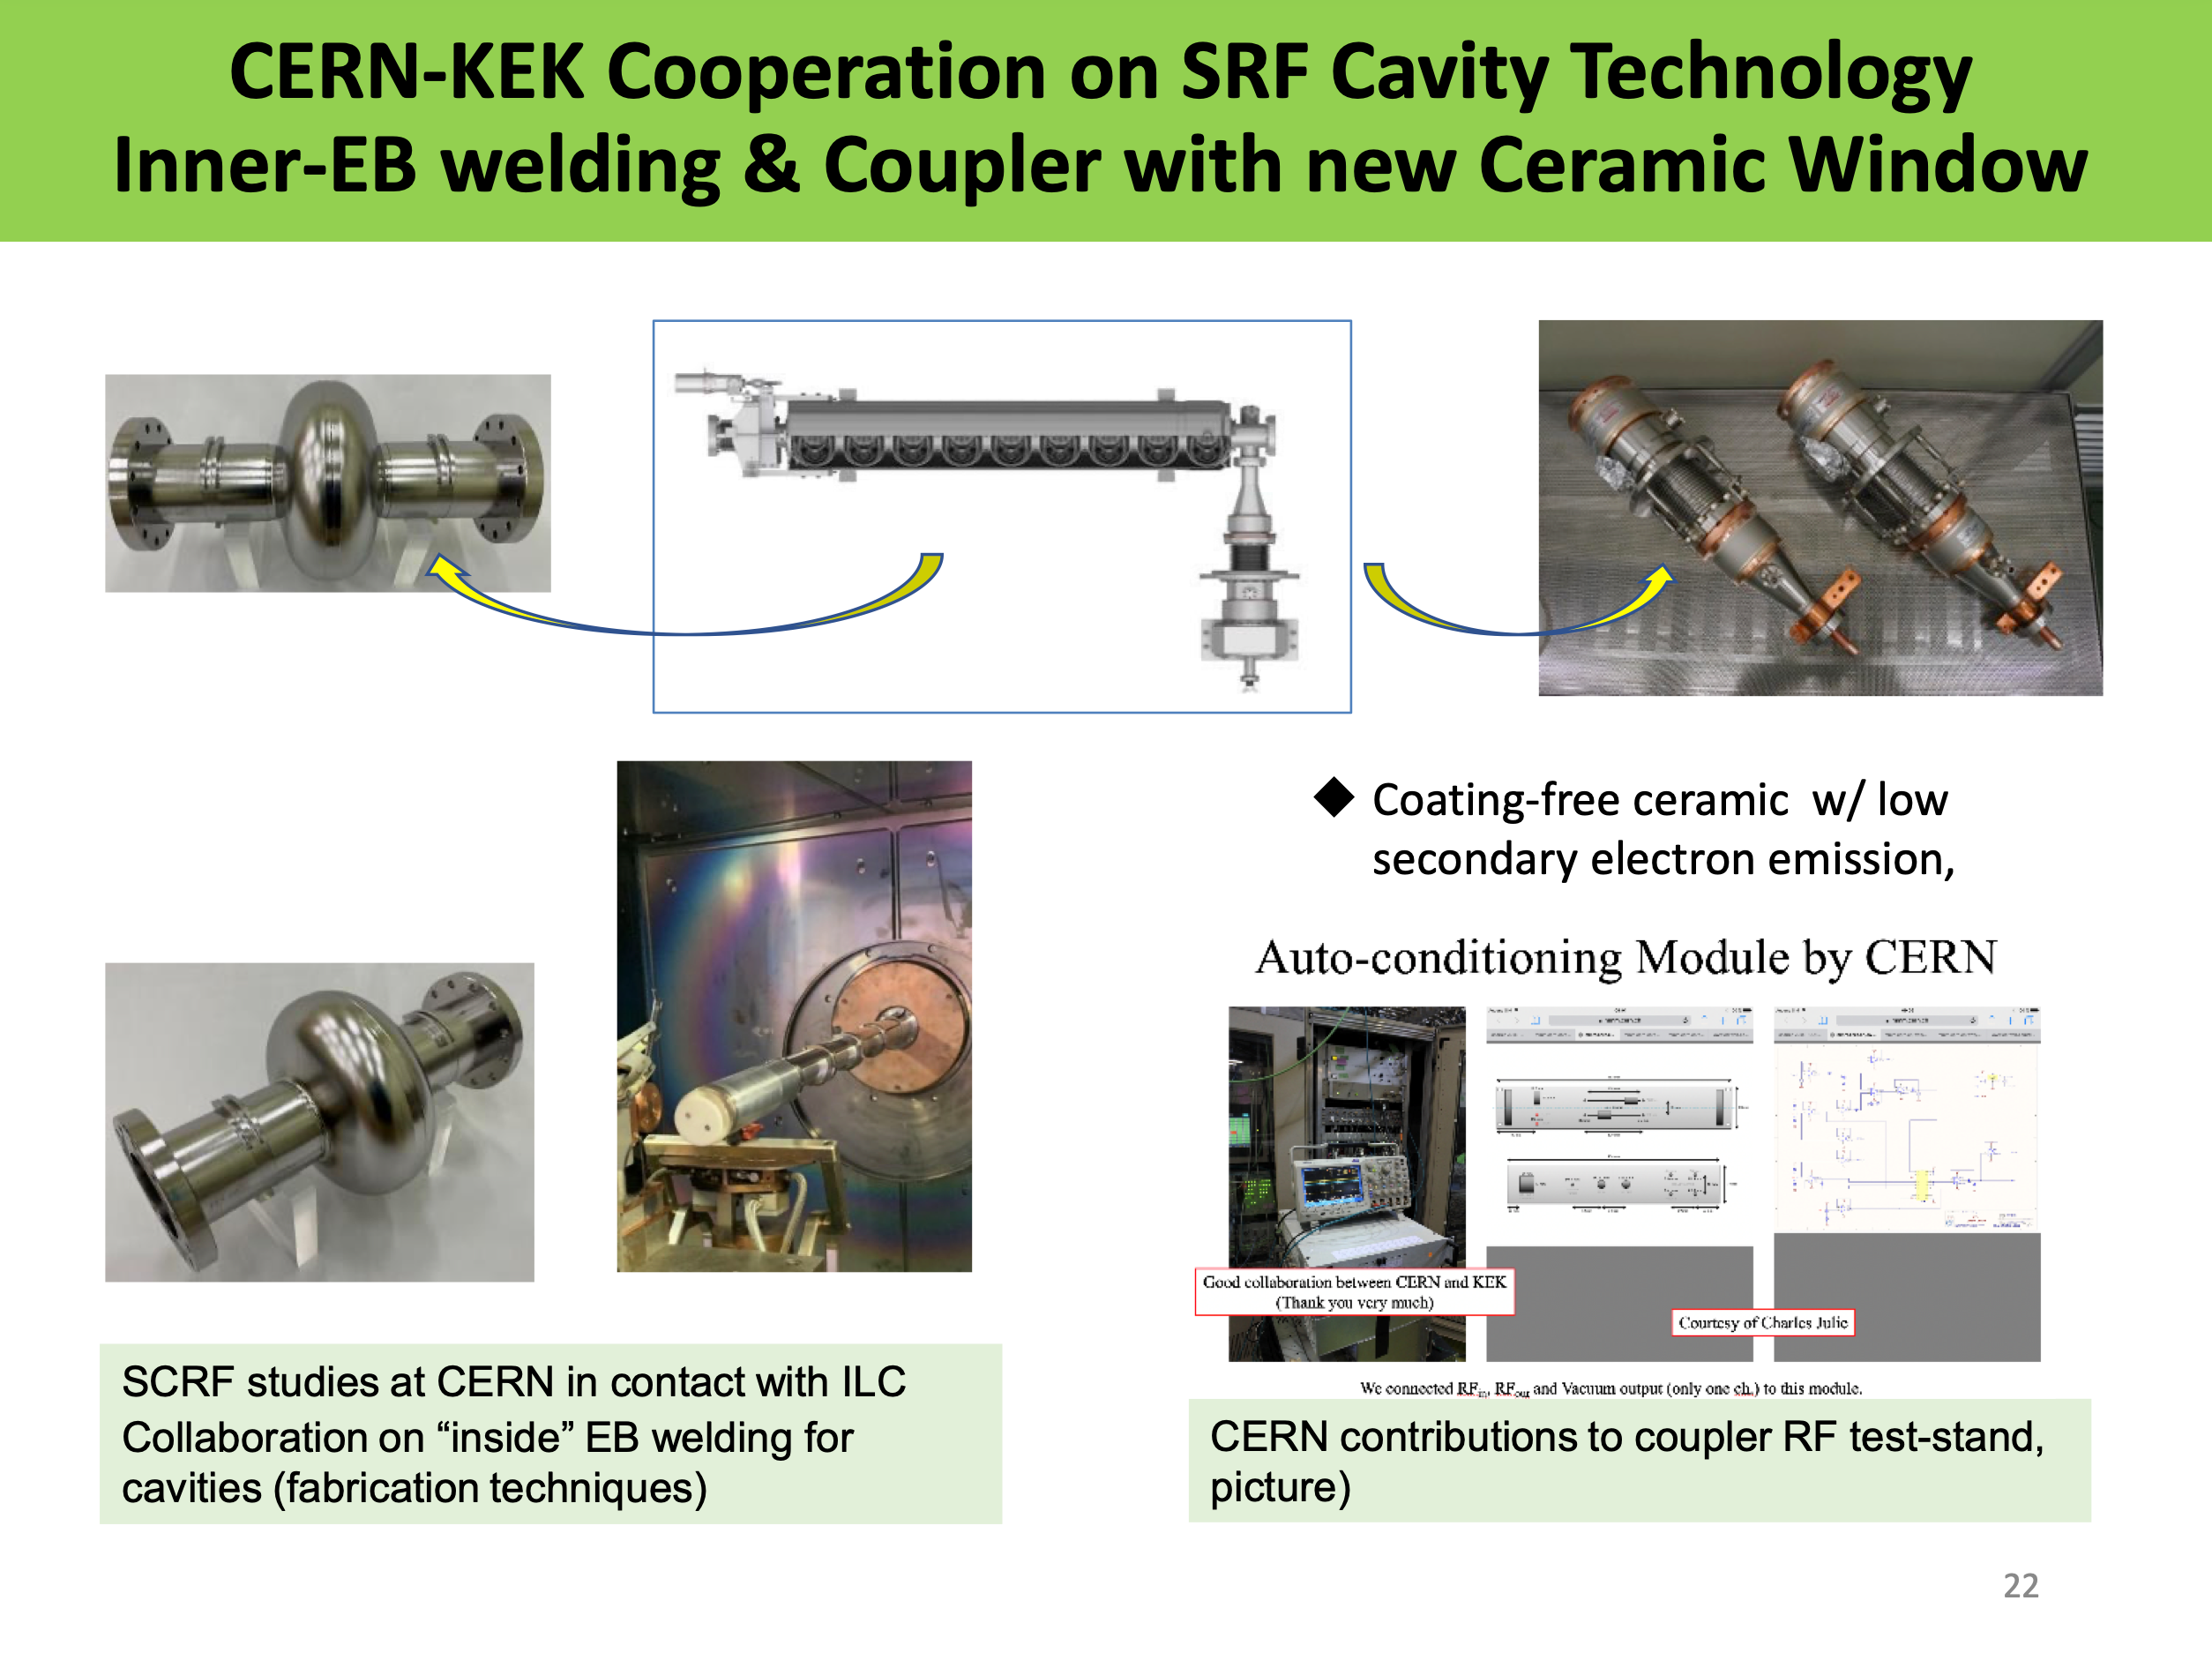
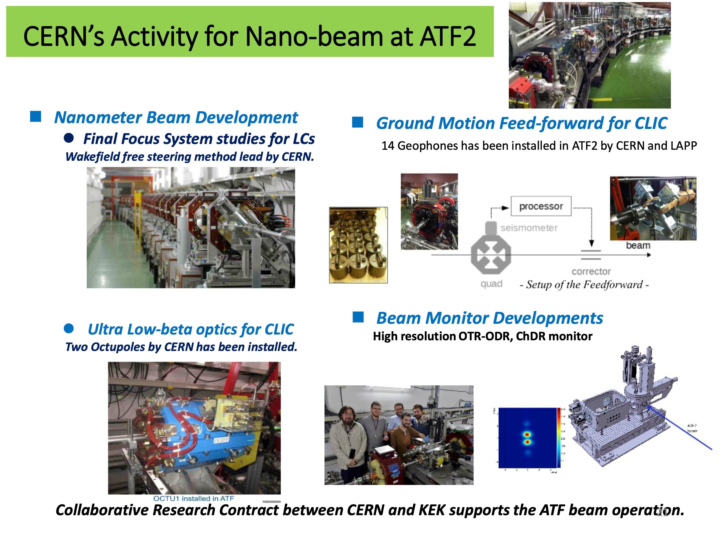
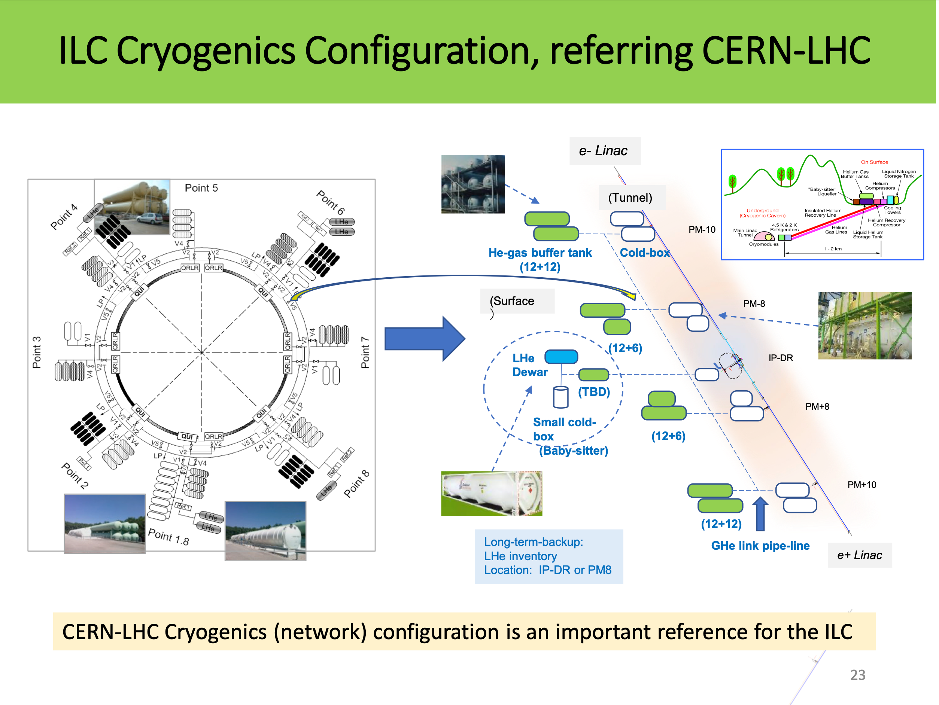
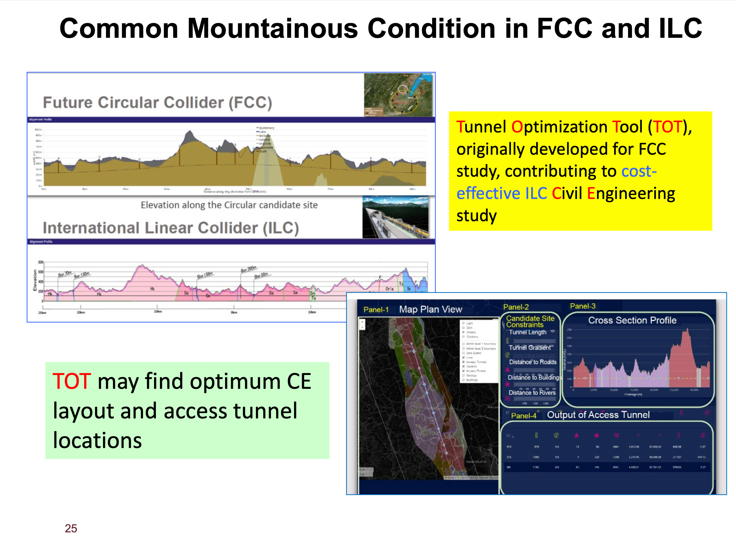
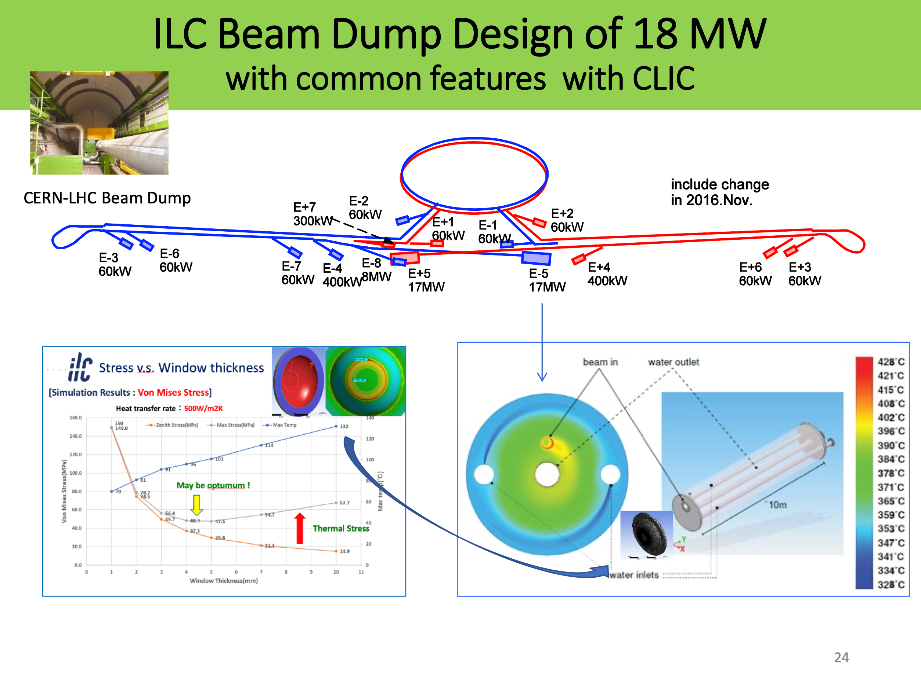

Slide 13
R&D areas with common interests
Topics | CLIC – ILC communality | Other | Status wrt ILC and KEK
CE and Cryo | CE common | LHC, all future project | WG2 reps from CERN
ATF2(3), BDS, beamdynamics, instrumentation and related beam-elements | Common | Other nanobeam projects | Participate in ATF3 study – BDS optimization, WG2 rep. from CERN
Positrons | Common for e-driven | All e+e- colliders | WG2 rep. from CERN, target, AMD, pulsed magnet for undulator version
Damping Rings | Common | All low emittance rings | Possible effort (performance studies, design and also kicker for CLIC relevant) – only partly in current LC studies, WG2 rep. from CERN
Hi-Eff klystron | Common (L-band) | FCC, CEPC etc | Designed (also ongoing SC solenoid work with KEK), now in Hi-Eff klystron project
SCRF cavities | For ILC | SCRF generally | Common manufacture studies, e.g. internal EB welding studies/hydro-forming, long term Nb3Sn studies, surface treatment, crab-cavities, WG2 rep. from CERN, recent APT first attempt to include limited personnel in this area
Couplers | For ILC | SCRF generally | Possible design effort, also common work in the past
Beam dumps | Common | (HL)LHC/FCC/muons .. | Advisory, visits and common studies to be considered
Physics and Detectors | Common | Higgs factories | Some common tools, not defined longer term
CERN – KEK office, agreements, WEB pages, LCWS | Partly common | NA | LC project office at CERN working with KEK communication and international office

Slide 14
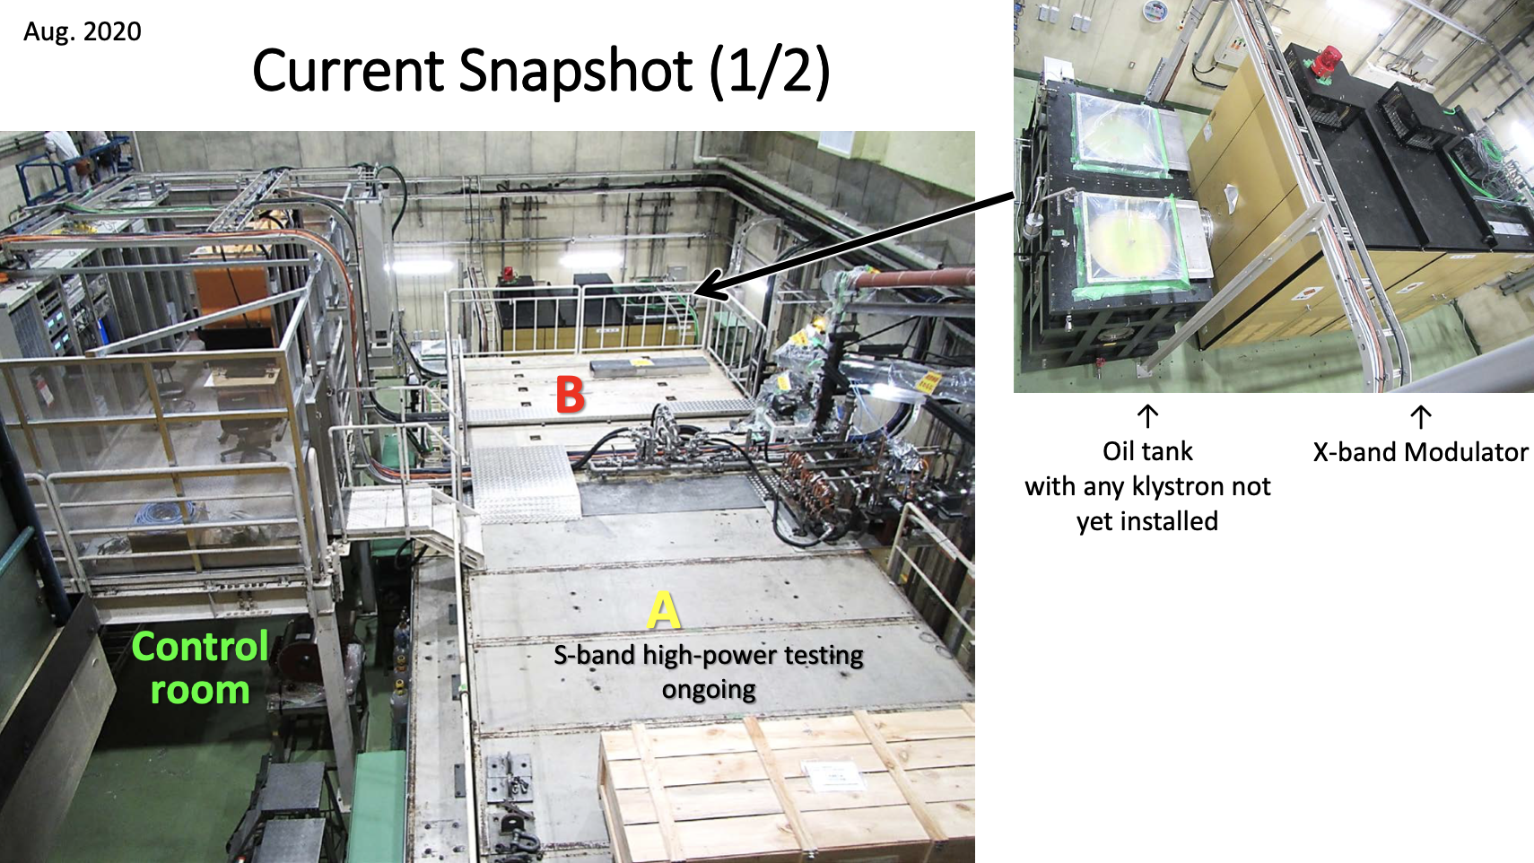
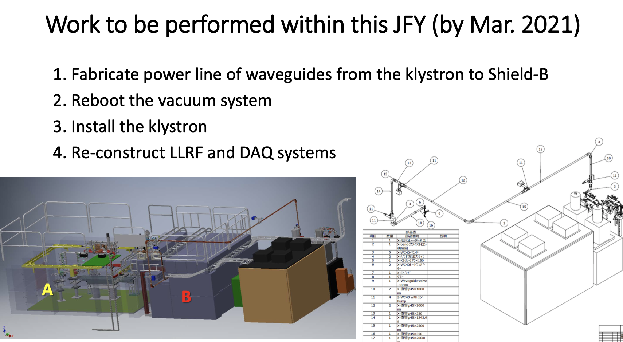
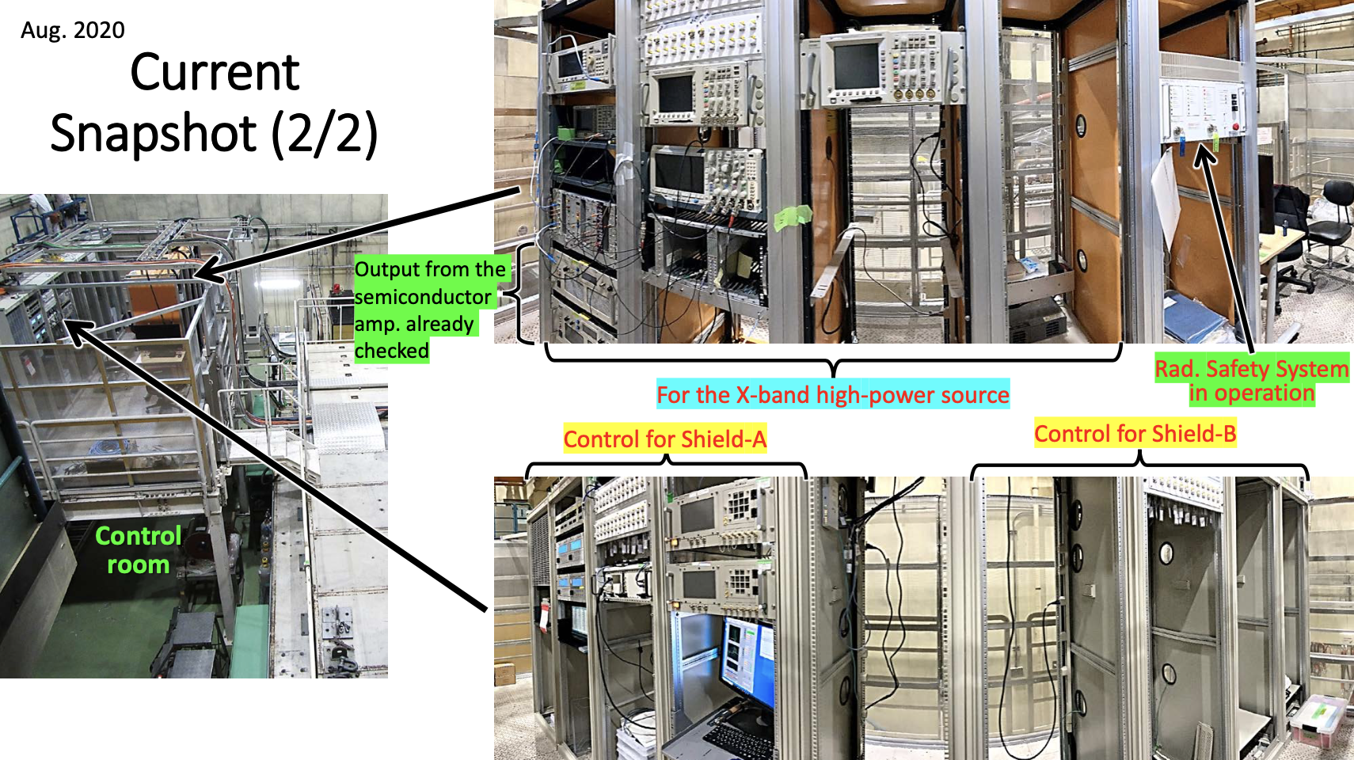
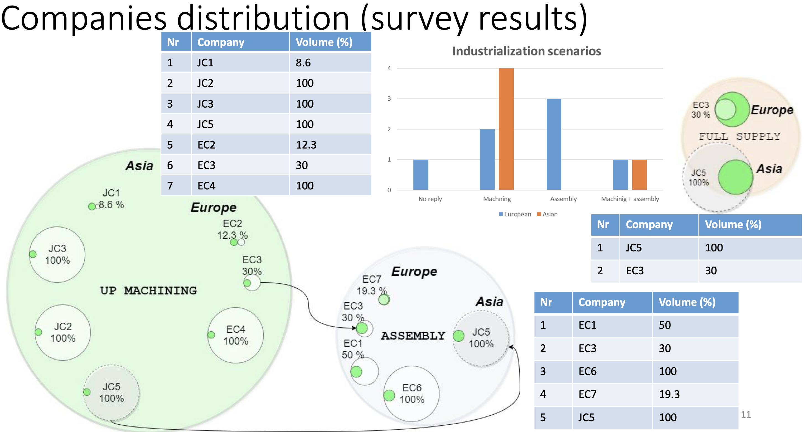

Slide 15
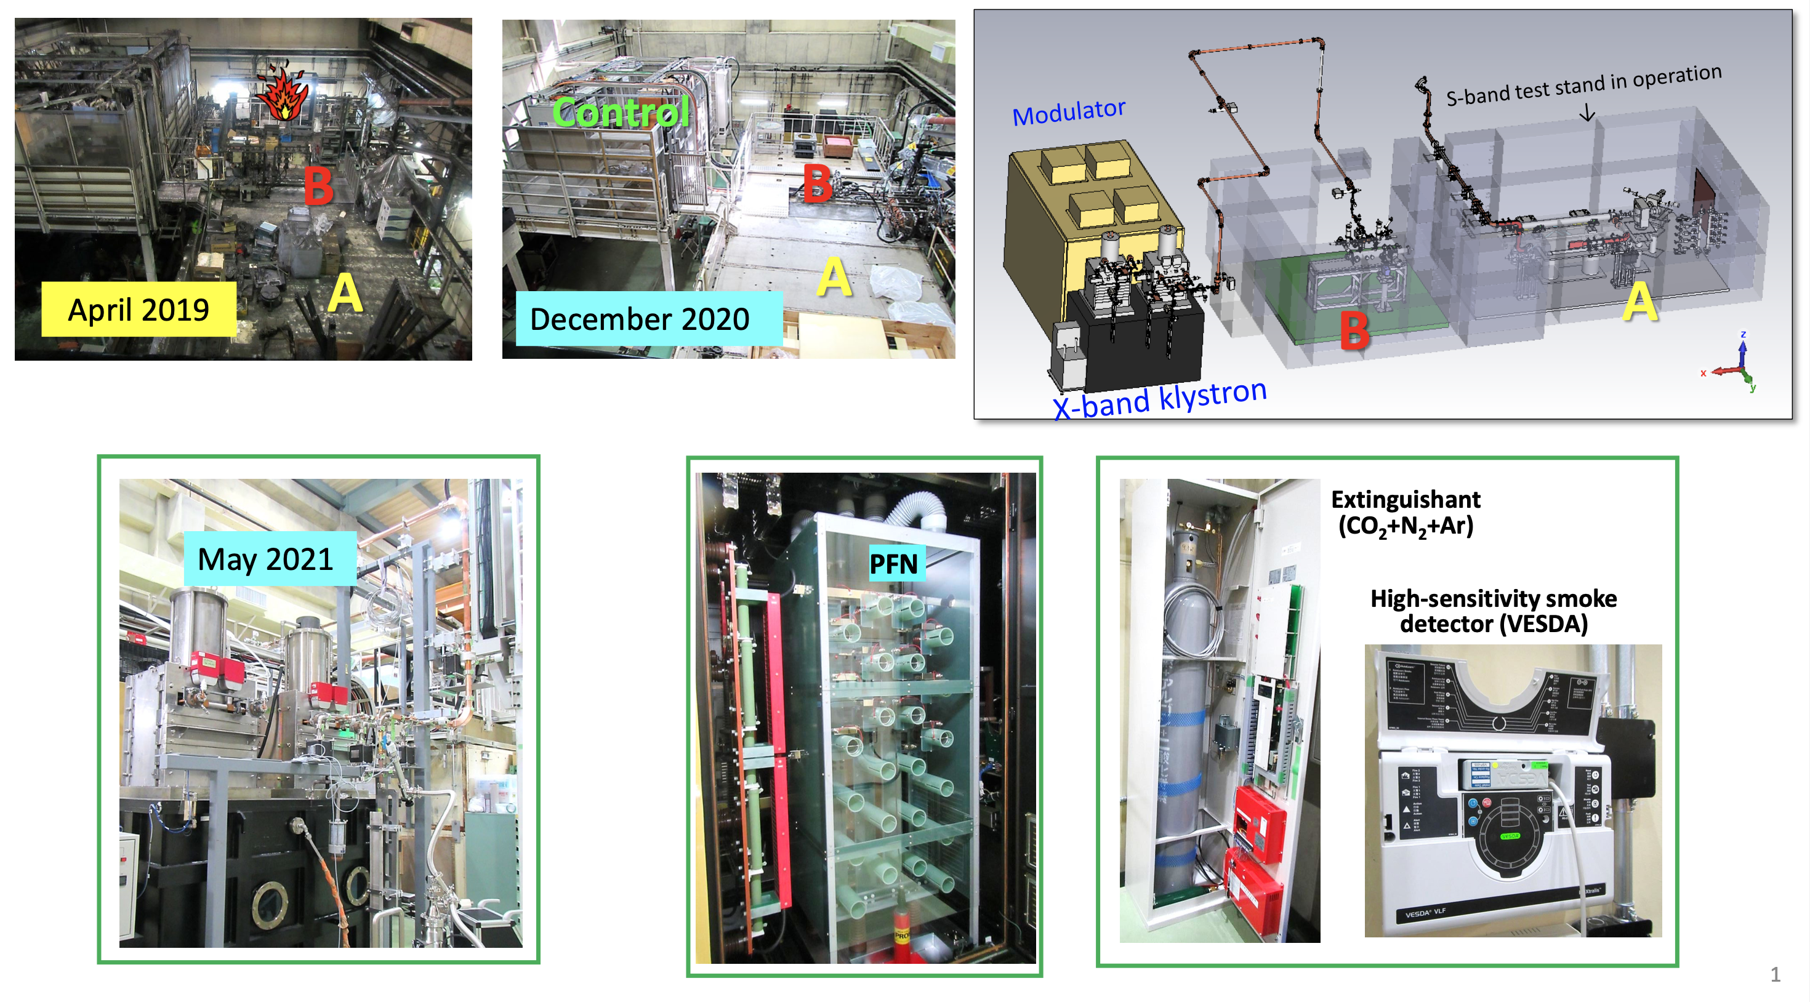
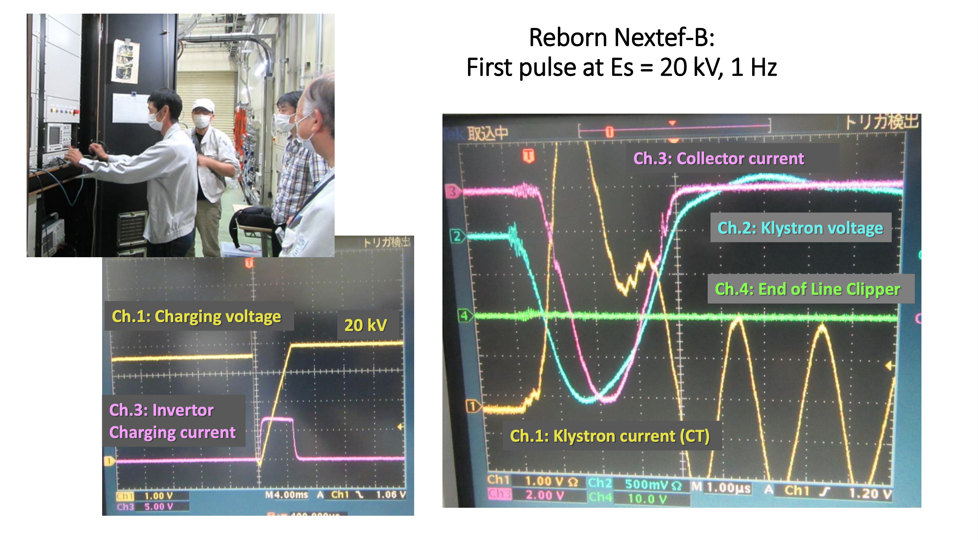
Today
Pictures from T.Higo

Slide 16
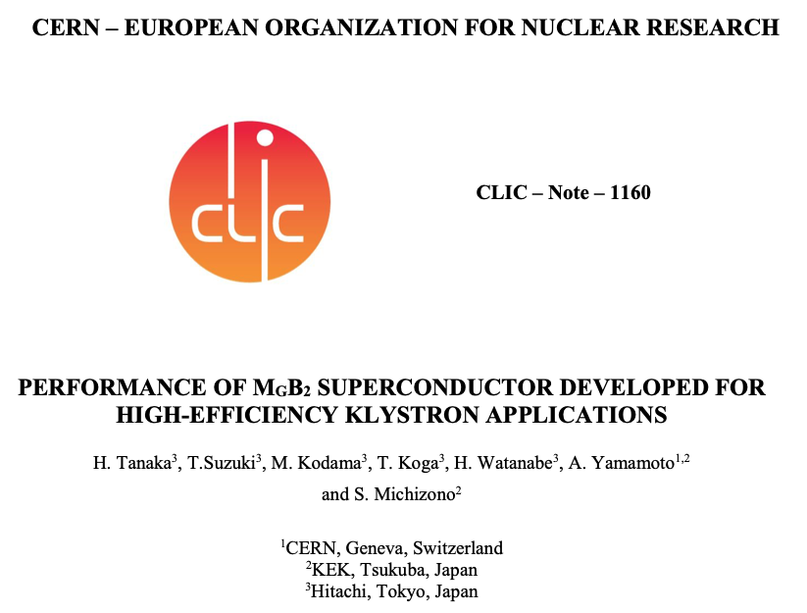
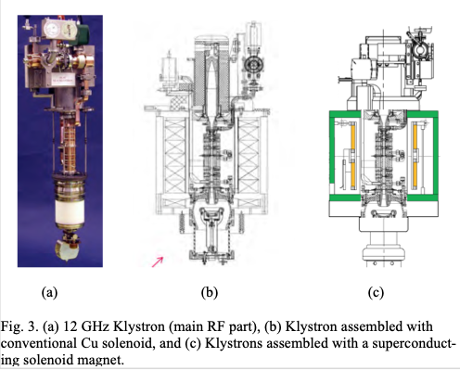
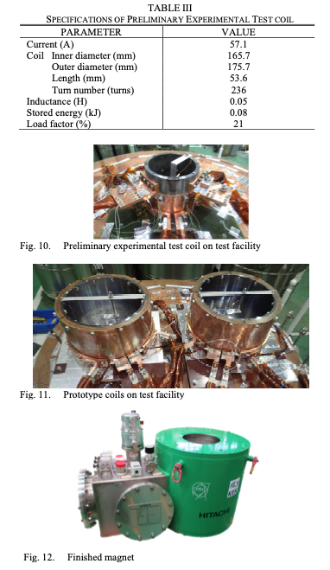
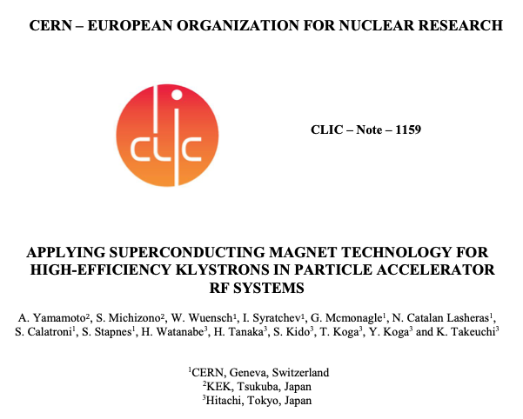
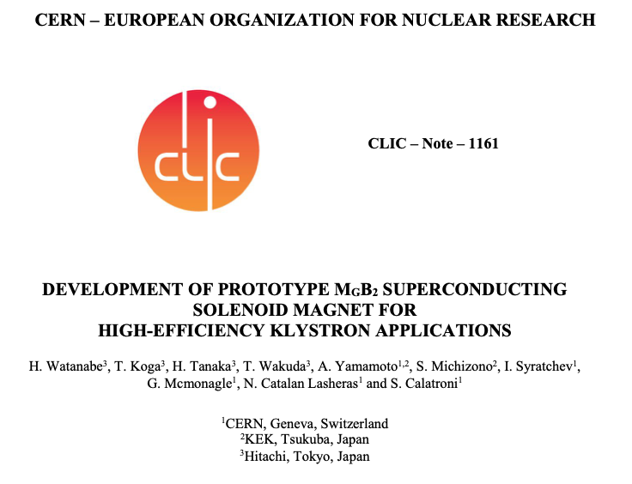
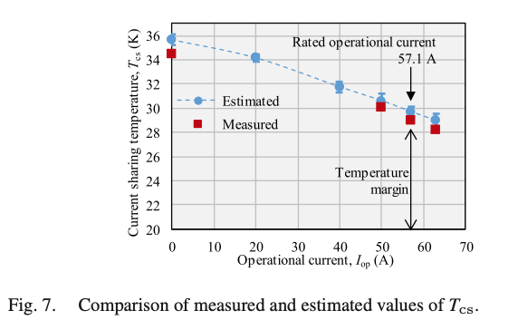
SC solenoid for HiEff klystrons
Final integrated tests at CERN
to be done (this was status in November last year)

Slide 17
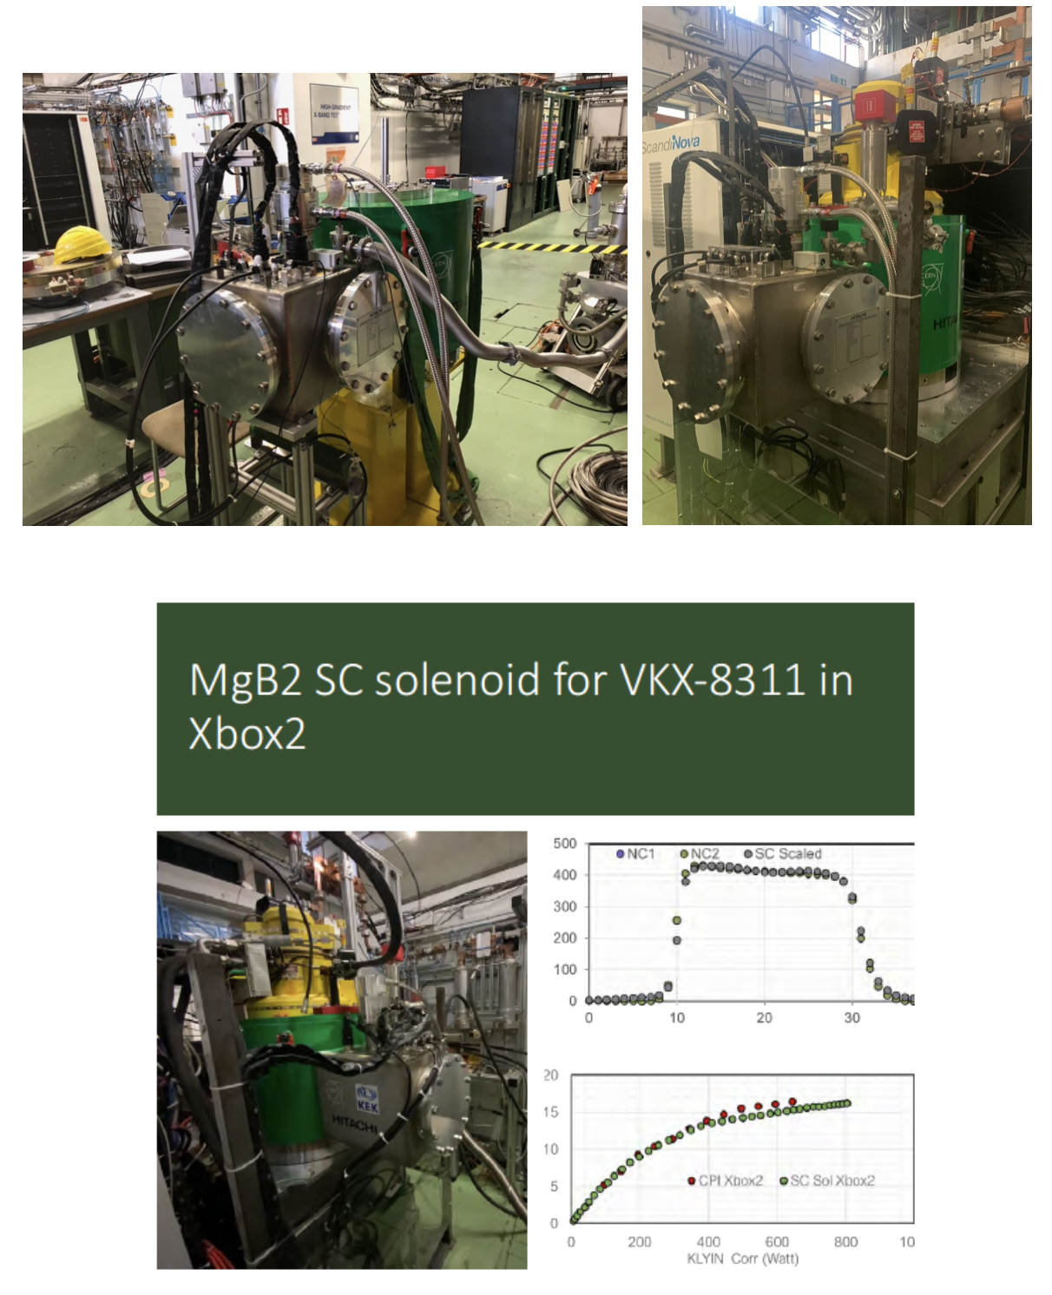
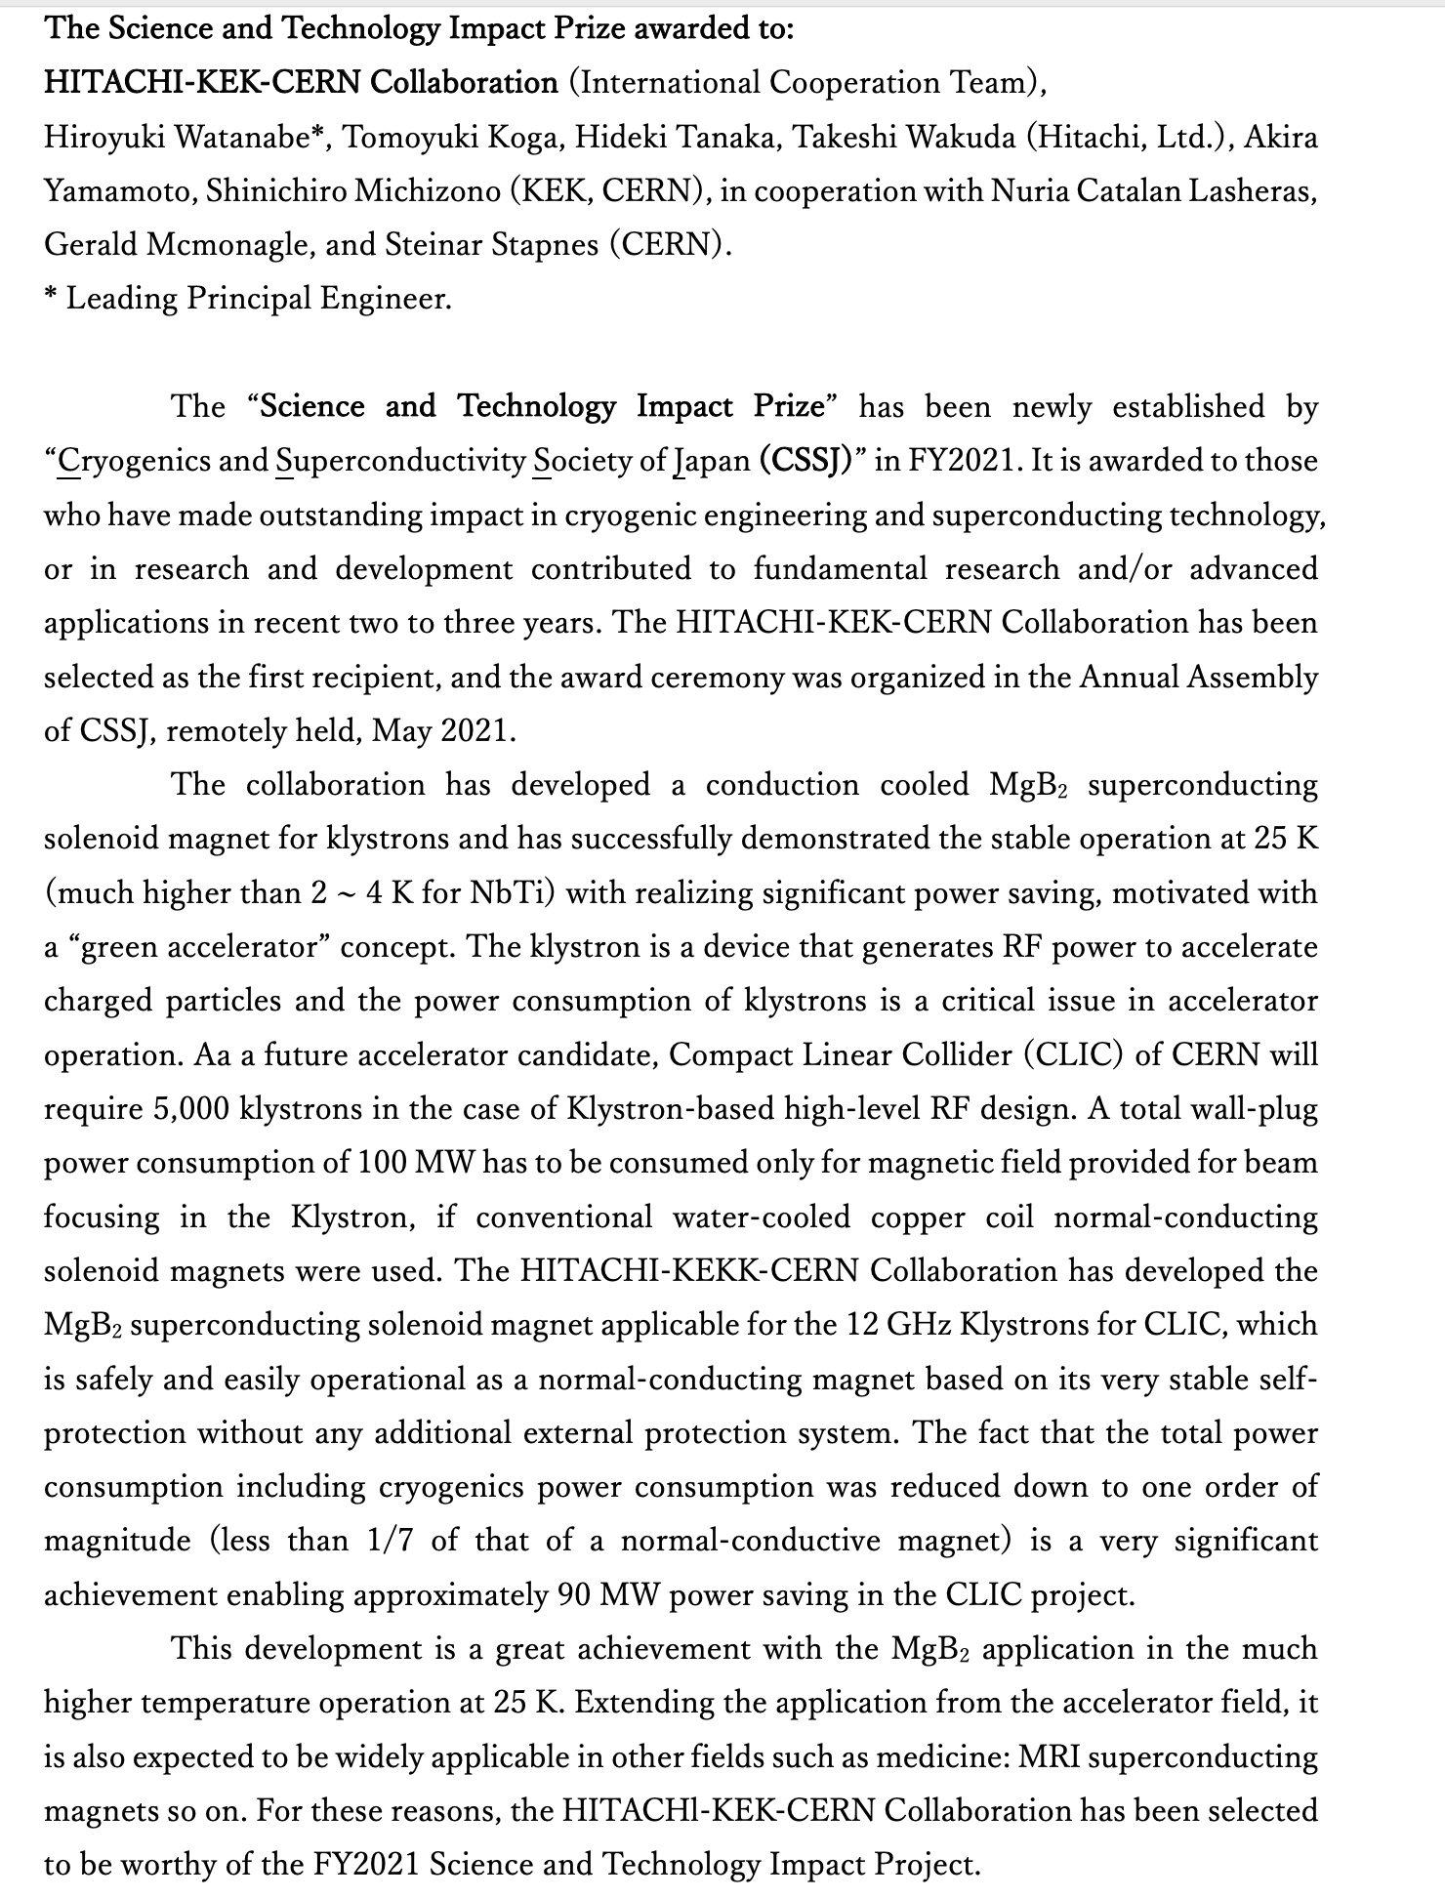

Slide 18
Conclusion
Collaborative work has continued as much as allowed by the Covid situation
A lot of progress in the area of ILC prelab planning – including work between KEK-CERN, still unclear if/when one can get into implementation
Hi-efficiency klystron testing done successfully – and a price awarded
X-band facility becoming operational again at KEK, potentially important also for other groups as Tsinghua, Shanghai and Melbourne
The hope is that in 2022 more personnel exchange, as needed for ATF, positrons, beamdumps etc., can actually take place (this we have funding for)
A possible implementation of the ILC prelab would imply a change of gear, expect this to become clearer during 2022
Slides/plots and pictures from many colleagues in CLIC and ILC – many thanks

Slide 20
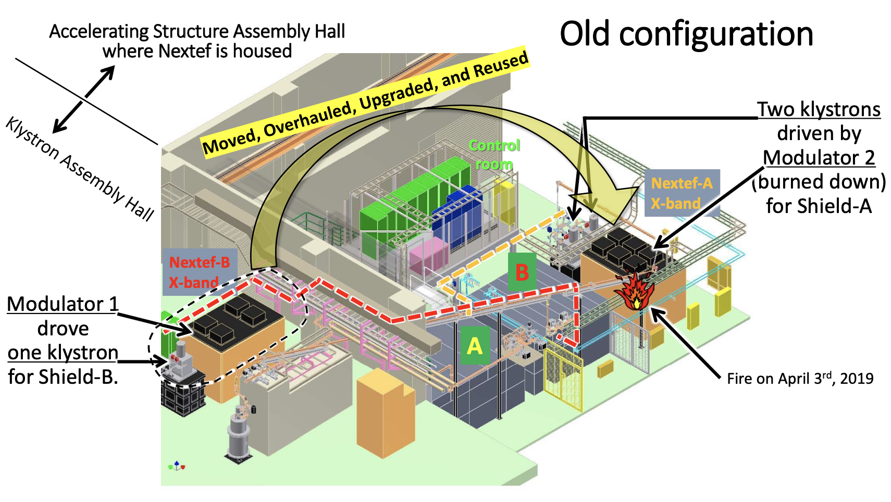
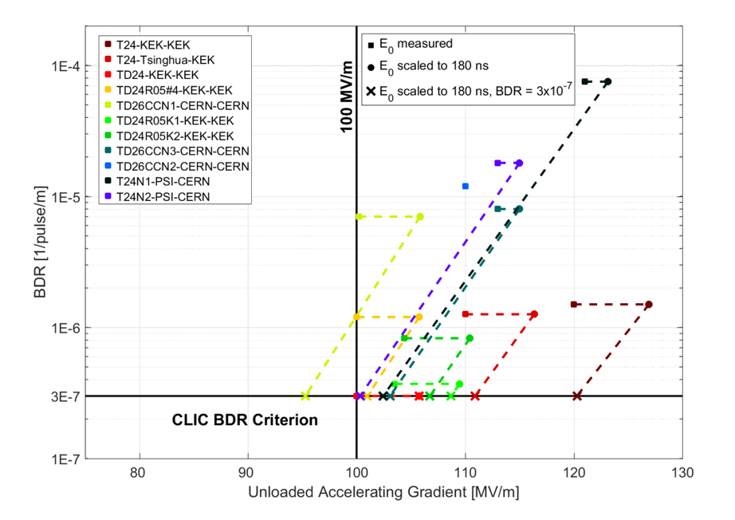
X-band at KEK
NEXTEF: New X-band Test Facility (11.4 GHz)

Slide 21
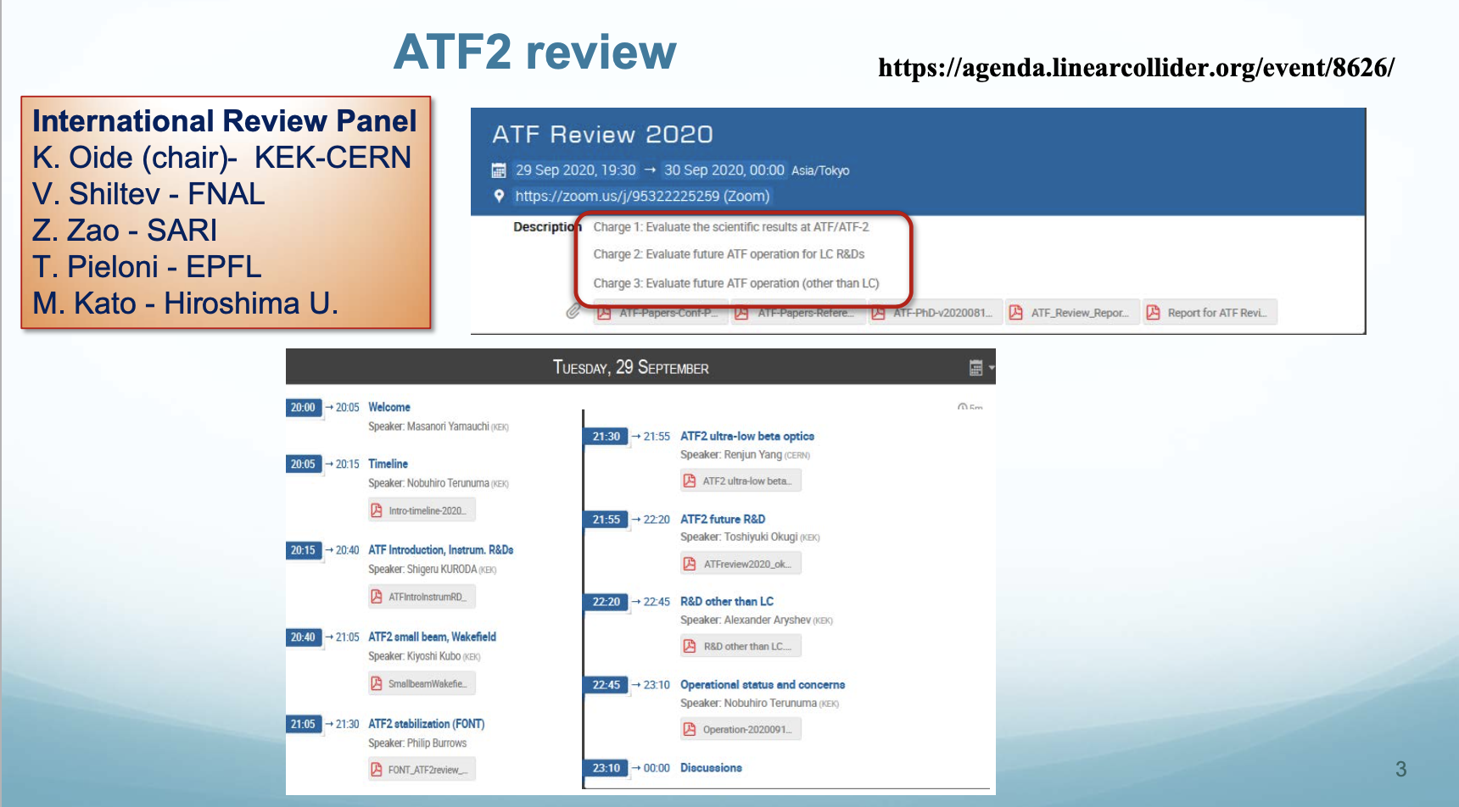
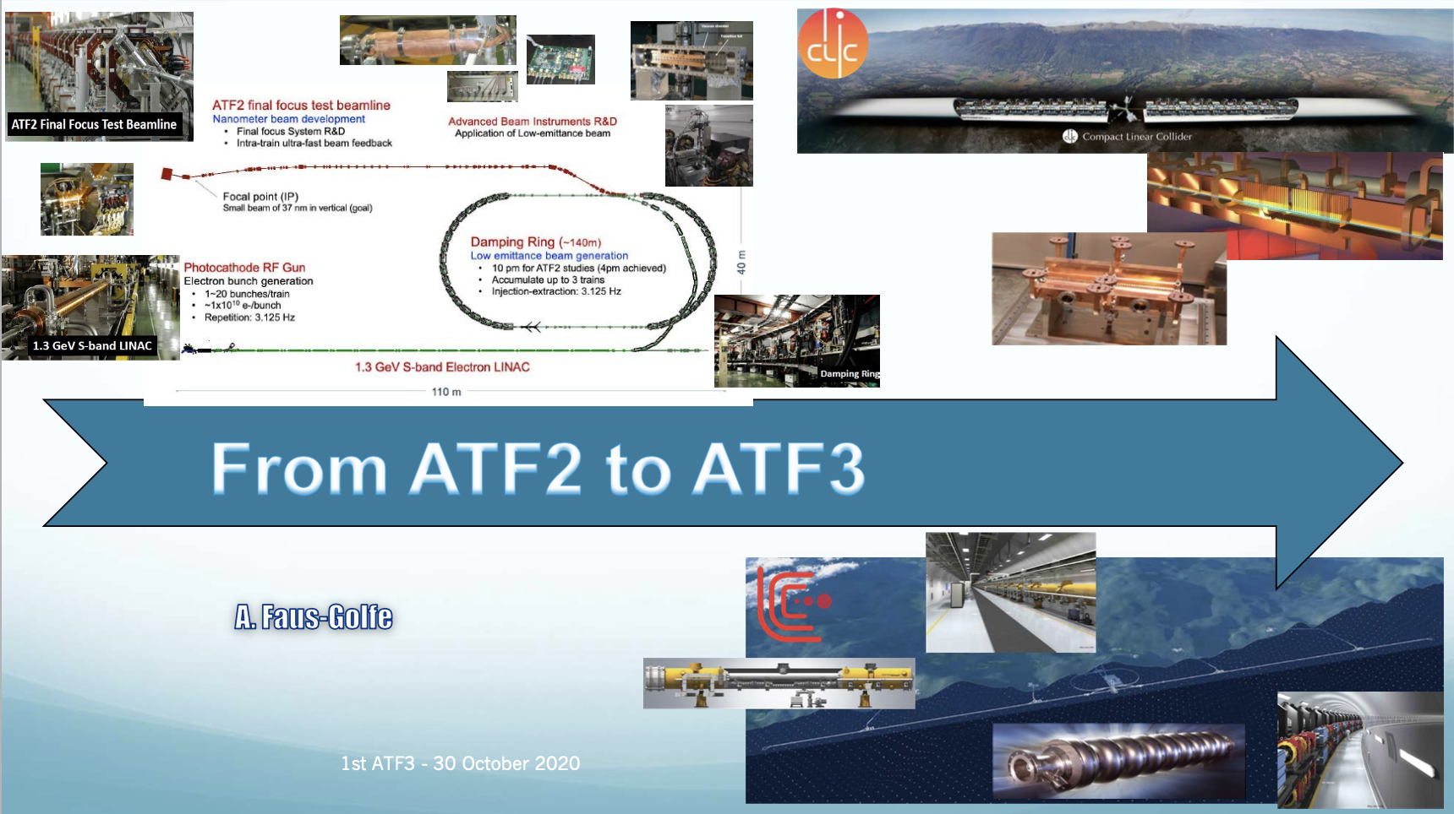
ATF2-3 for nanobeams
ATF2 work has continued (affected by Covid)
AFT2 analysis – PhD students, some at CERN – also
AFT2 review in September (extract from draft report on the left)
ATF3 planning started
In all cases with CERN involvement
Scientific results at ATF/ATF2
The committee has been impressed on outstanding and unique results achieved in ATF/ATF2:
● The smallest spot size, 40 nm, in any accelerators.
● Intra-train bunch orbit feedback (FONT).
● Vertical emittance in the ring, 4 pm, smallest at the beginning of the century.
The committee also applauds pioneering developments on various accelerator components:
● Fast extraction kickers with rise/fall time less than 3 ns
● Laser wires measuring 1 μm beam size
● Cavity BPMs with 20 nm resolution
● Single- and multi- OTR/ODR beam profile monitors
Some of these devices have been spread to other accelerators including CERN PS and light sources.
Educating graduate students and young scientists under international collaboration was another achievement of ATF, which is the best project at KEK in this aspect.
Future ATF operation for LC R&Ds
The committee recognizes that the achievements at ATF/ATF2 have already verified the minimum technical feasibility on the beam focusing and control for the ILC. However there will be a number of possibilities for further extensions to investigate:
● intensity dependent effects on the spot size
● optical aberrations, esp. with smaller horizontal β*
● beam halo and collimation
● even smaller spot sizes with higher chromaticities
Besides the studies on the beam spot, the committee notices some possibilities of ATF to explore other components which will benefit the ILC preparation:
● polarized electron source, transport, and storage in the damping ring.
● beam collimation study using fancy devices such as using a laser or another beam.
● beam feedback within one turn of the ring circulation to simulate a fast feedback at the extraction of the ILC DR

Slide 22
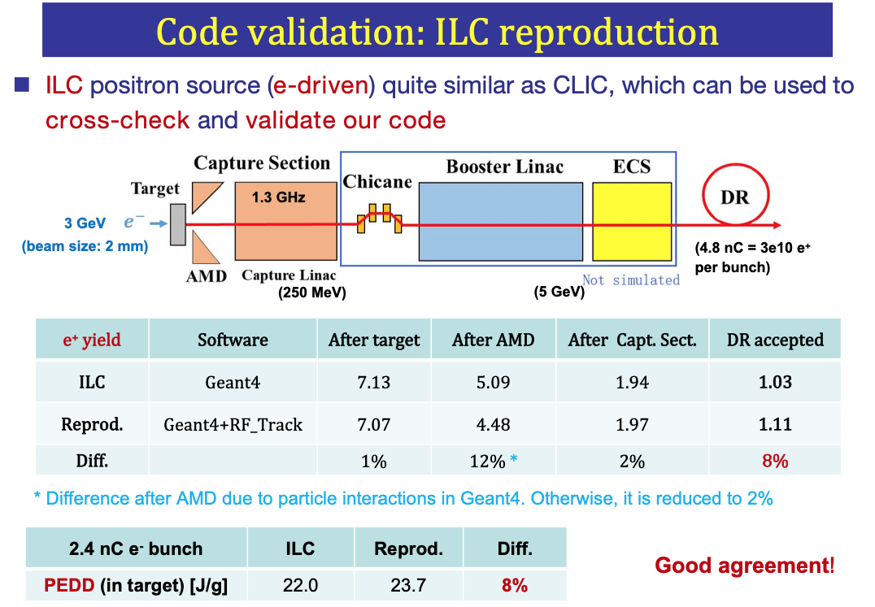
Positrons
Positron production modelling and target, AMD optimization
Common Project with Shandung University
Evaluating next stages with KEK (SuperKEKb and ILC) and Orsay and PSI (FCC-ee)
--------
Target studies and simulation studies for CLIC are very relevant – and visa versa, example on the left where ILC studies are used as code validation for CLIC

