Slide 1


FCC-ee injection studies:
Septa technologies
R. Ramjiawan, Y. Dutheil
Tuesday 19th October
FCC-ee injection meeting

Slide 2
Outline
Considering different technology options for septa
Key parameters for the septa designs and a discussion of the dependencies.
Multipole kicker injection, on-energy, off-axis, Z-mode optics
Conventional orbit bump, on-energy, off-axis, Z-mode optics

Slide 3
MKI : on energy : off-axis

Slide 4
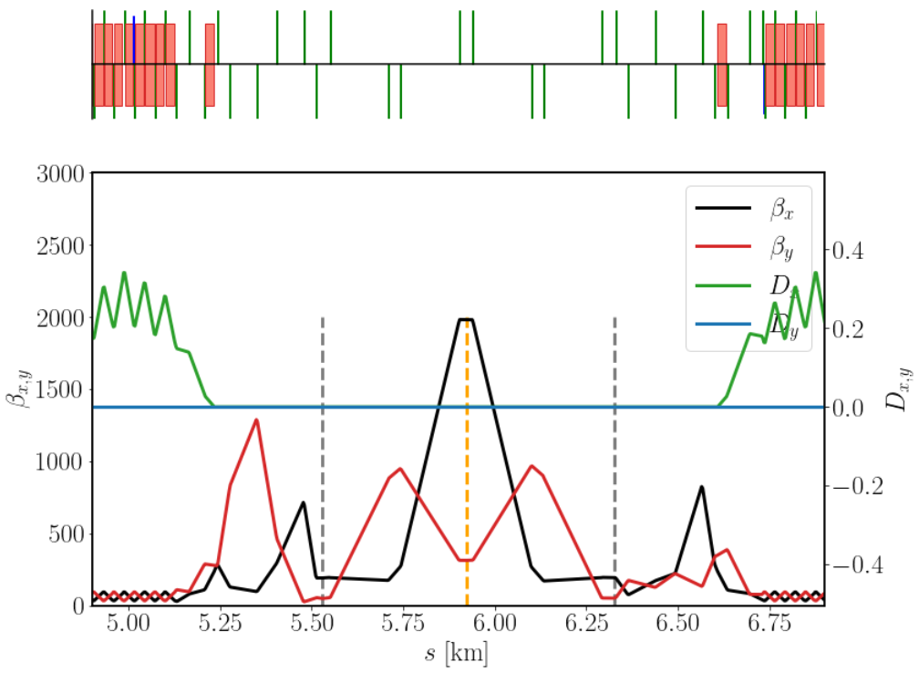
Injection optics Z-energy
Compensation kicker
Septum
Multipole kicker
Z-mode optics for the CBI and MKI injection:
FCCee_z_216_nosol_1.seq

Slide 5
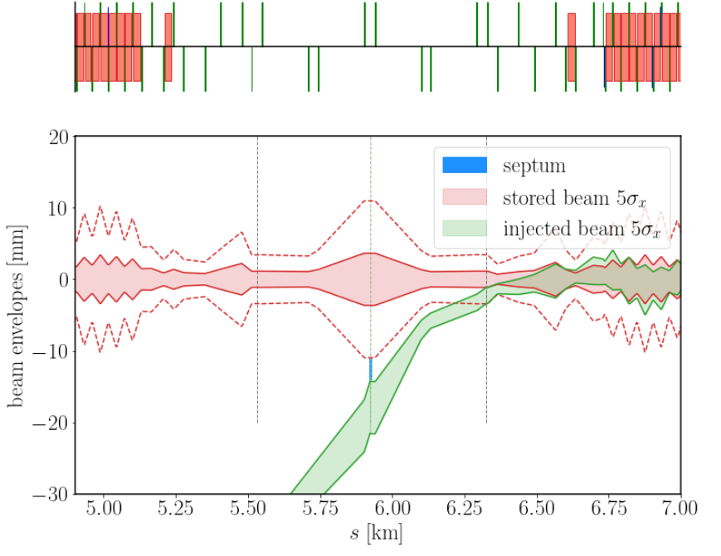
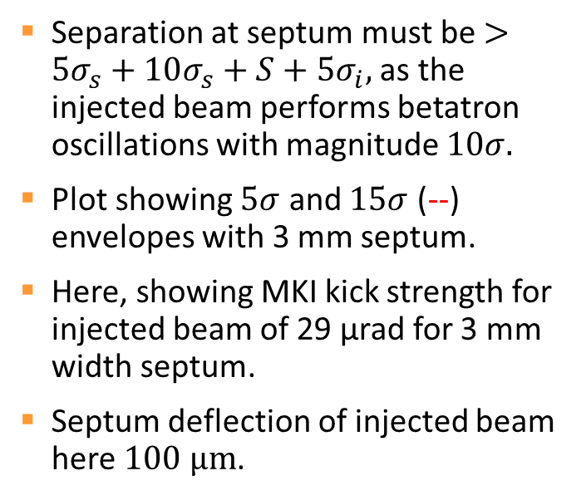
MKI configuration
Separation at septum must be $>5σ_{s}+10σ_{s}+S+5σ_{i},$as the injected beam performs betatron oscillations with magnitude $10σ.$
Plot showing $5σ$ and $15σ$ (--) envelopes with 3 mm septum.
Here, showing MKI kick strength for injected beam of 29 µrad for 3 mm width septum.
Septum deflection of injected beam here $100 μm$.
Compensation kicker
Septum
Multipole kicker

Slide 6
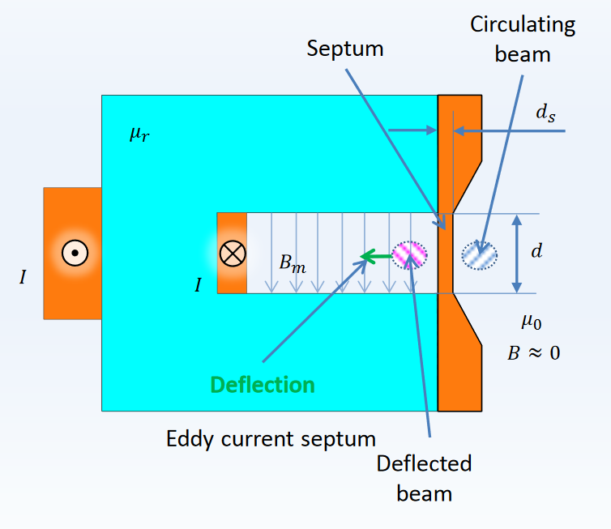
Magnetic eddy septa
Premise: if the magnetic field changes inside of a solid conductor, eddy currents will be induced to oppose the magnetic field change.
These septa use eddy currents to shield the leakage field.
Eddy currents induced by pulsing the magnet, their magnitude depend on this frequency.
Leakage fields can be down to 0.01%, requiring additional magnetic shielding (e.g. mu-metal) and a box for the return magnetic field lines.
The coil is often single-turn, to minimize inductance, with the coil around the back leg of the C-shaped yoke [1].
[2]

Slide 7
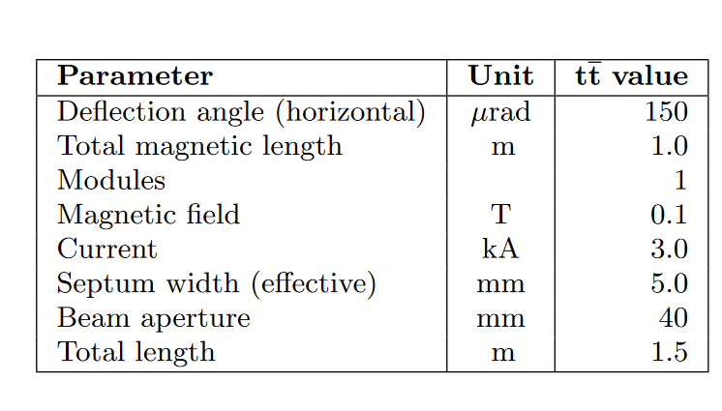
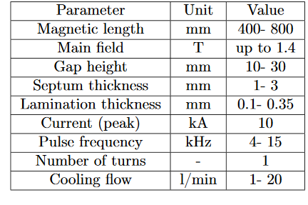
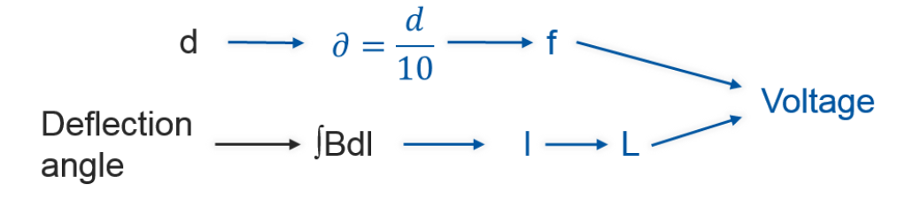
CDR magnetic septum parameters
CDR magnetic septum “tentative” parameters
Typical parameters for an eddy septum
[3]
[4]
Here are some additional information on typical ranges for parameters of magnetic and electrostatic septa.
Rough flow of design process

Slide 8
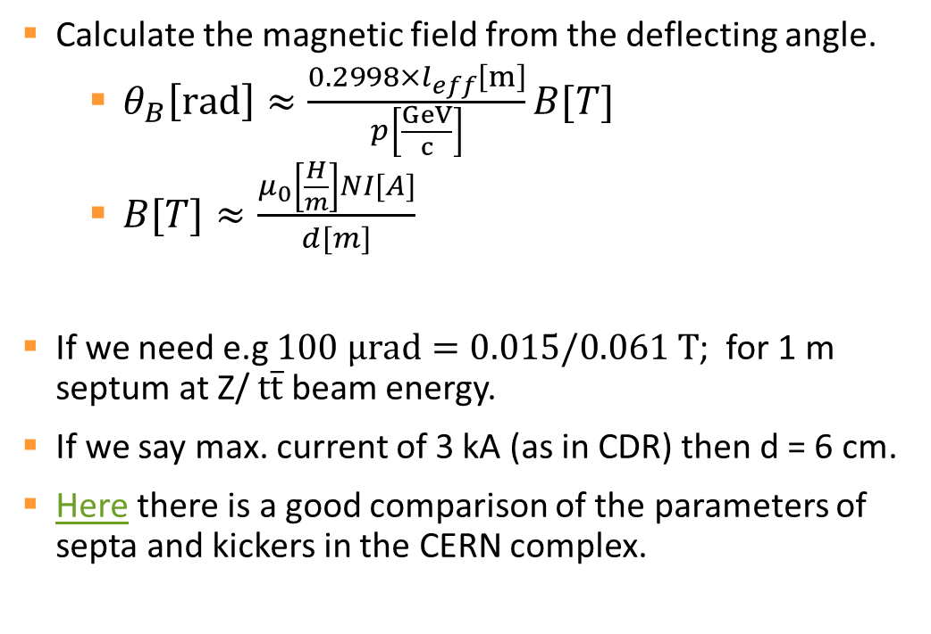
Magnetic field
Calculate the magnetic field from the deflecting angle.
  $θ_{B}\left[rad\right]≈\frac{0.2998×l_{eff}\left[m\right]}{p\left[\frac{GeV}{c}\right]}B[T]$
  $B[T]≈\frac{μ_{0}\left[\frac{H}{m}\right]NI[A]}{d[m]}$
If we need e.g $100 μrad=0.015/0.061 T$; for 1 m septum at Z/ $t\overline{t}$ beam energy.
If we say max. current of 3 kA (as in CDR) then d = 6 cm.
Here there is a good comparison of the parameters of septa and kickers in the CERN complex.

Slide 9
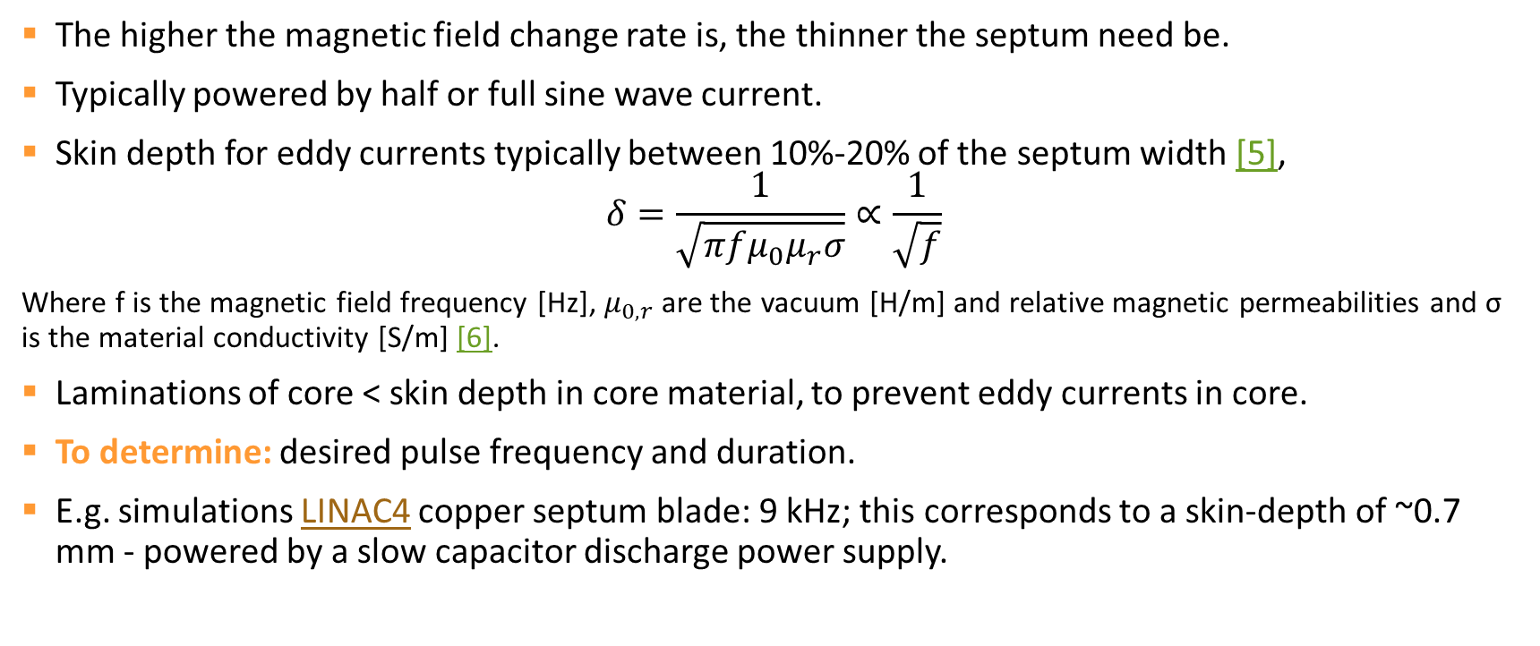
Frequency of magnetic field change
The higher the magnetic field change rate is, the thinner the septum need be.
Typically powered by half or full sine wave current.
Skin depth for eddy currents typically between 10%-20% of the septum width [5],
$$δ=\frac{1}{\sqrt{πfμ_{0}μ_{r}σ}}∝\frac{1}{\sqrt{f}}$$
Where f is the magnetic field frequency [Hz], $μ_{0,r}$ are the vacuum [H/m] and relative magnetic permeabilities and σ is the material conductivity [S/m] [6].
Laminations of core < skin depth in core material, to prevent eddy currents in core.
To determine: desired pulse frequency and duration.
E.g. simulations LINAC4 copper septum blade: 9 kHz; this corresponds to a skin-depth of ~0.7 mm - powered by a slow capacitor discharge power supply.

Slide 10
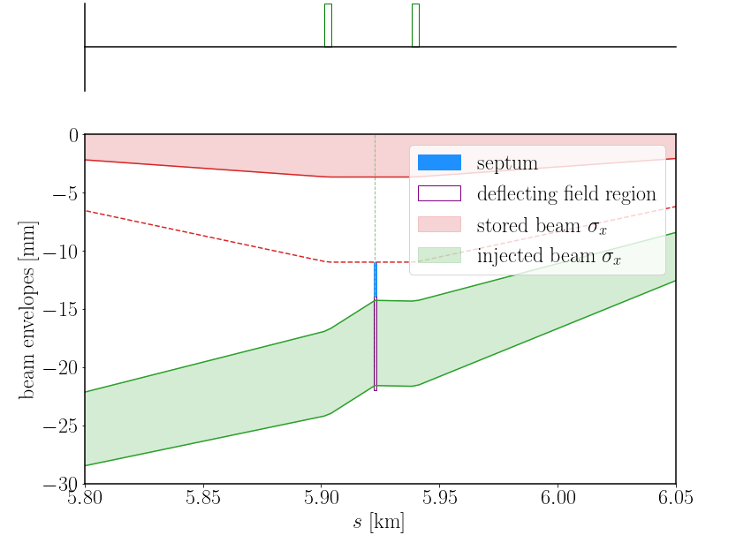




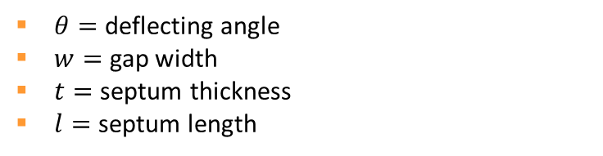
Gap width & deflecting field region
Must include beam envelopes and start and end of septum and beam trajectory from bending.
stored beam
$$t$$
$$θ$$
injected beam
$$w$$
deflecting field region
$$l$$
$θ=$ deflecting angle
$w=$ gap width
$t=$septum thickness
$l=$ septum length
> 8 mm
Gap width 10-30 mm is common for Eddy Septa.
→ What field homogeneity can be achieved over this region?
[7]

Slide 11
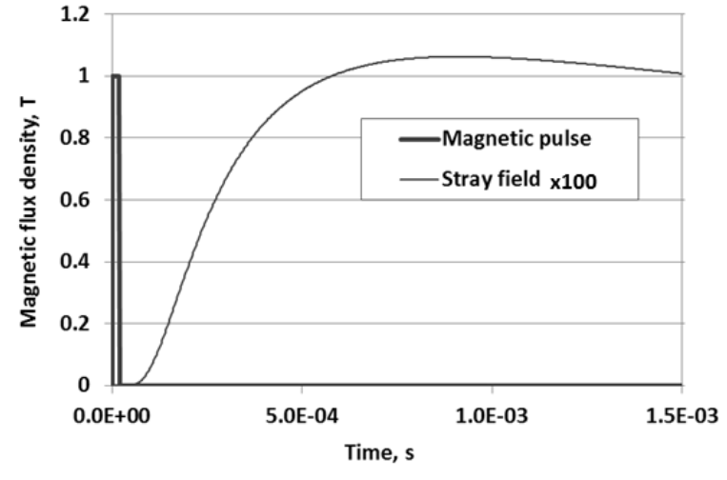
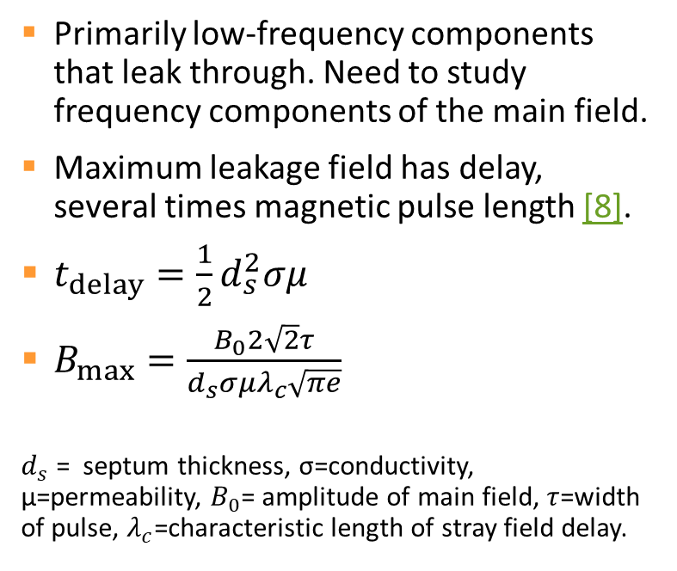


Leakage field
Example stray field time structure
Primarily low-frequency components that leak through. Need to study frequency components of the main field.
Maximum leakage field has delay, several times magnetic pulse length [8].
$t_{delay}=\frac{1}{2}d_{s}^{2}σμ$
$B_{max}=\frac{B_{0}2\sqrt{2}τ}{d_{s}σμλ_{c}\sqrt{πe}}$
$d_{s}$ = septum thickness, σ=conductivity, µ=permeability, $B_{0}$= amplitude of main field, $τ$=width of pulse, $λ_{c}$=characteristic length of stray field delay.
$$B_{max}$$
$$t_{delay}$$

Slide 12
Additional considerations
Need to determine if there are any key parameters likely to be show-stoppers.
Pulsed power supply design.
Additional magnetic shielding, e.g mu-metal?, study saturation of the material. Shield thickness in addition to septum thickness.
Pole geometry to be designed to optimise field homogeneity.
Beam impedance.
Vacuum level.
Edge cooling may be needed.
Septum mechanical and thermal stress - pressure on the coil in the aperture.

Slide 13
Conventional : on-energy : off-axis

Slide 14
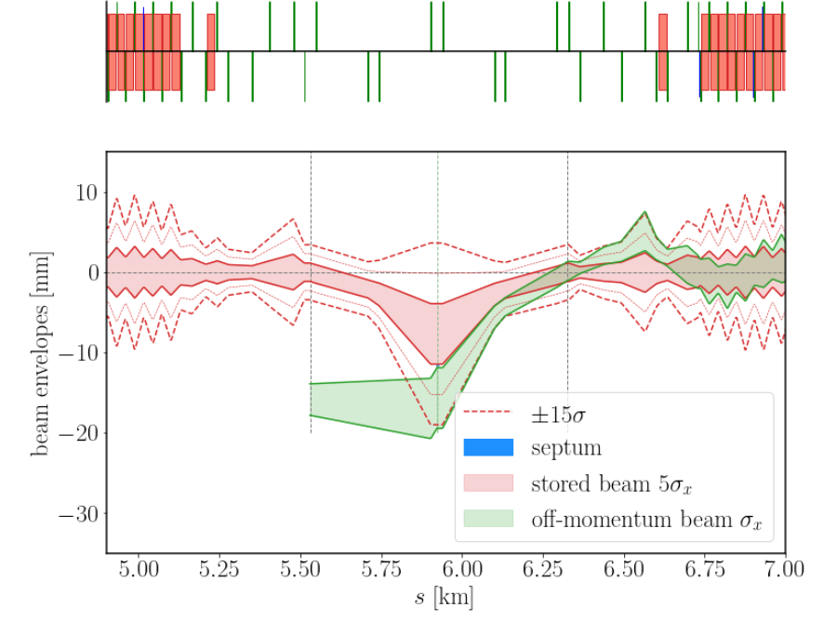
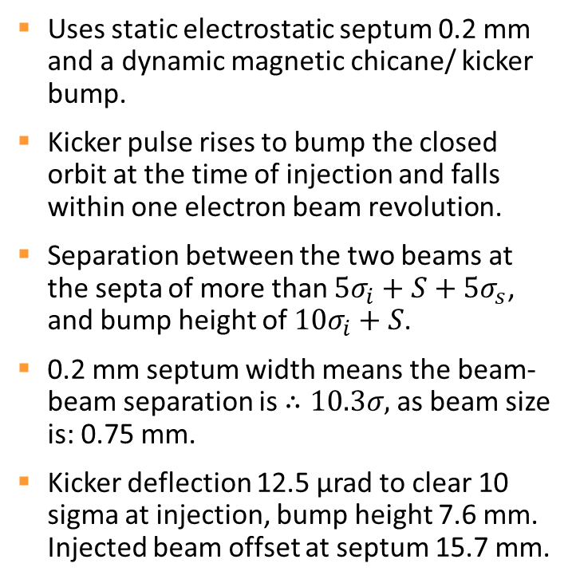
Conventional bump orbit
Uses static electrostatic septum 0.2 mm and a dynamic magnetic chicane/ kicker bump.
Kicker pulse rises to bump the closed orbit at the time of injection and falls within one electron beam revolution.
Separation between the two beams at the septa of more than $5σ_{i}+S+5σ_{s}$, and bump height of $10σ_{i}+S$.
0.2 mm septum width means the beam-beam separation is $∴10.3σ,$as beam size is: 0.75 mm.
Kicker deflection 12.5 µrad to clear 10 sigma at injection, bump height 7.6 mm. Injected beam offset at septum 15.7 mm.
Kicker
Septum
Kicker

Slide 15
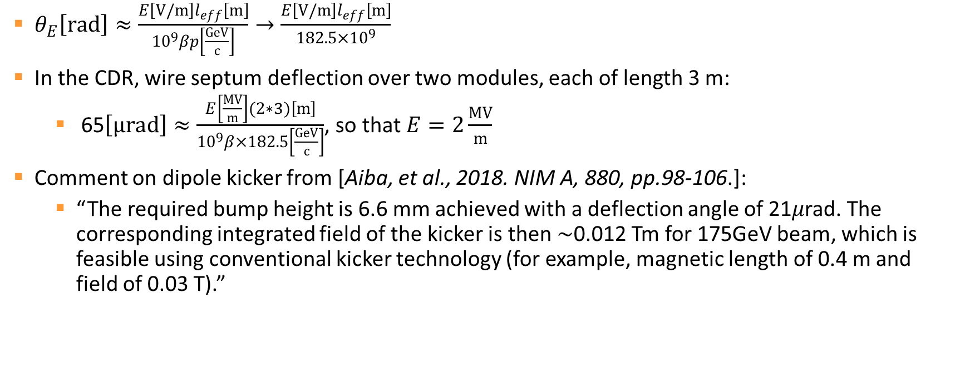
Wire septa, dipole kicker
$θ_{E}\left[rad\right]≈\frac{E\left[V/m\right]l_{eff}\left[m\right]}{{10}^{9}βp\left[\frac{GeV}{c}\right]}→\frac{E\left[V/m\right]l_{eff}\left[m\right]}{{182.5×10}^{9}}$
In the CDR, wire septum deflection over two modules, each of length 3 m:
  65$\left[μrad\right]≈\frac{E\left[\frac{MV}{m}\right](2∗3)\left[m\right]}{{10}^{9}β×182.5\left[\frac{GeV}{c}\right]}$, so that $E=2\frac{MV}{m}$
Comment on dipole kicker from [Aiba, et al., 2018. NIM A, 880, pp.98-106.]:
  “The required bump height is 6.6 mm achieved with a deflection angle of 21𝜇rad. The corresponding integrated field of the kicker is then ∼0.012 Tm for 175GeV beam, which is feasible using conventional kicker technology (for example, magnetic length of 0.4 m and field of 0.03 T).”

Slide 16
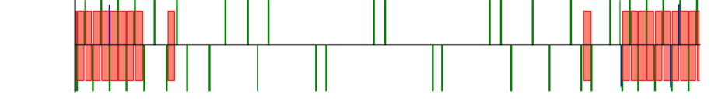
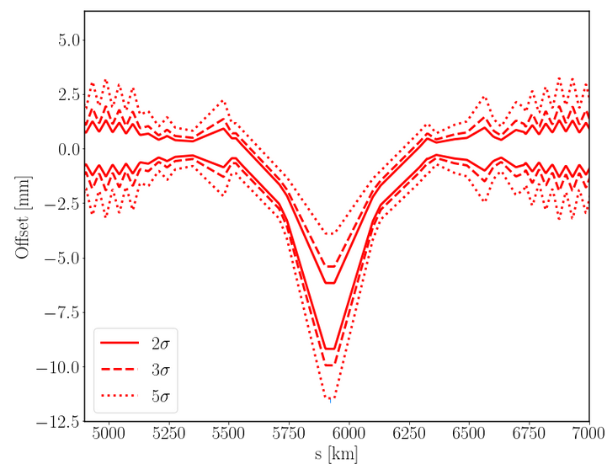
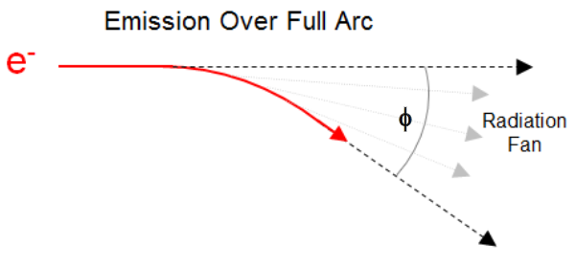
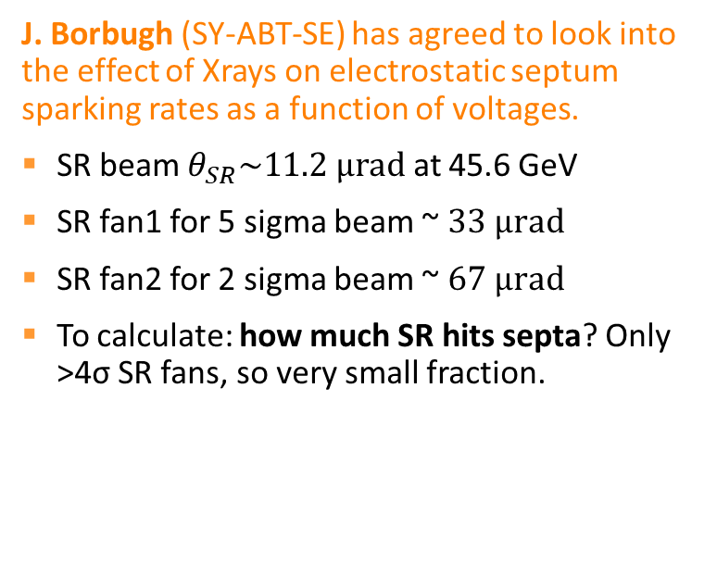
Synchrotron radiation
J. Borbugh (SY-ABT-SE) has agreed to look into the effect of Xrays on electrostatic septum sparking rates as a function of voltages.
SR beam $θ_{SR}\sim 11.2 μrad$ at 45.6 GeV
SR fan1 for 5 sigma beam ~ $33 μrad$
SR fan2 for 2 sigma beam ~ $67 μrad$
To calculate: how much SR hits septa? Only >4σ SR fans, so very small fraction.
5 sigma
fans 1, 2, 3

Slide 17
Additional considerations
Study energy deposition from wakefields to the wire, what are the limits?
Field homogeneity for the deflected bunch.
Alignment requirements and alignment method.
Surface coating.
Activation.
Wire material.
Leakage fields.
Vacuum requirements.

Slide 18
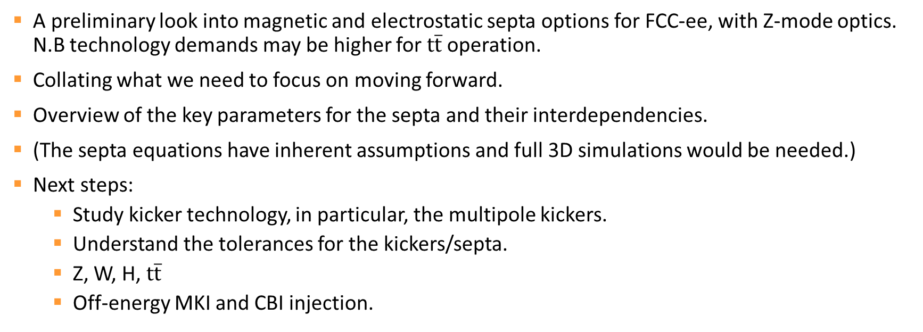
Conclusion
A preliminary look into magnetic and electrostatic septa options for FCC-ee, with Z-mode optics. N.B technology demands may be higher for $t\overline{t}$ operation.
Collating what we need to focus on moving forward.
Overview of the key parameters for the septa and their interdependencies.
(The septa equations have inherent assumptions and full 3D simulations would be needed.)
Next steps:
  Study kicker technology, in particular, the multipole kickers.
  Understand the tolerances for the kickers/septa.
  Z, W, H, $t\overline{t}$
  Off-energy MKI and CBI injection.

Slide 19
Extra slides

Slide 20
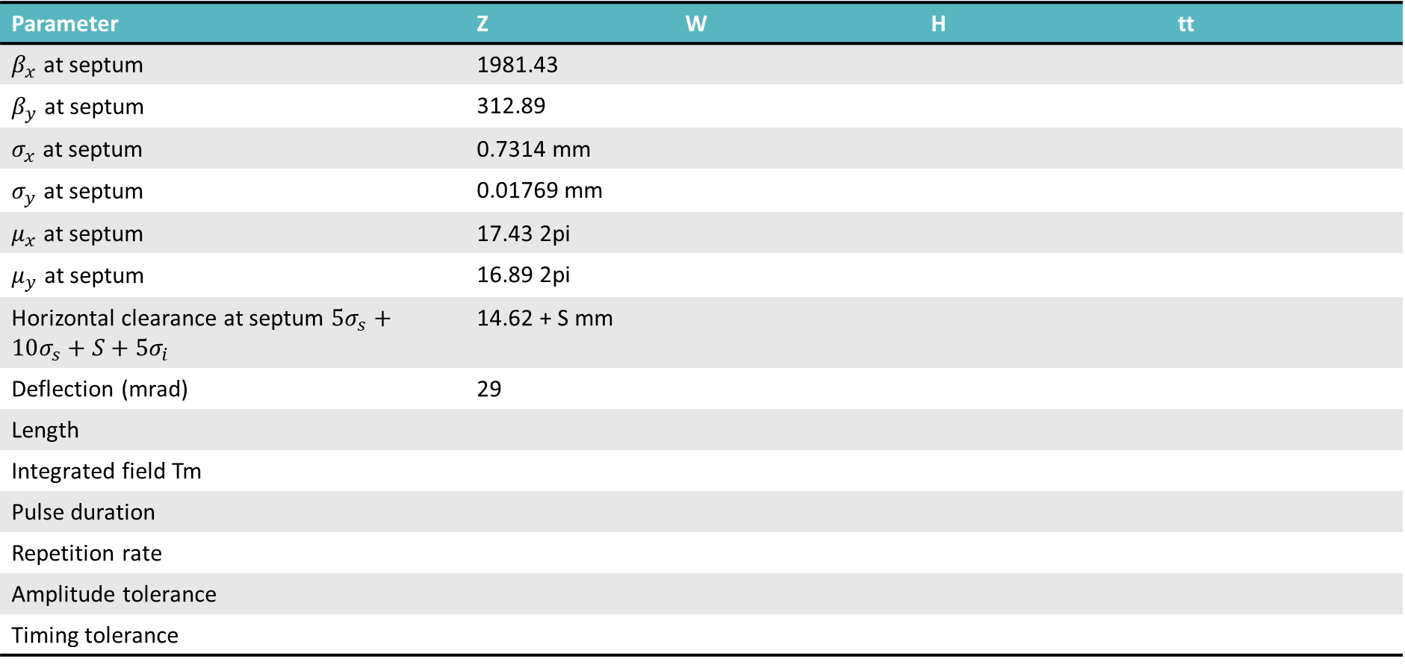
MKI on-momentum add
Parameter | Z | W | H | tt
$β_{x}$ at septum | 1981.43
$β_{y}$ at septum | 312.89
$σ_{x}$ at septum | 0.7314 mm
$σ_{y}$ at septum | 0.01769 mm
$μ_{x}$ at septum | 17.43 2pi
$μ_{y}$ at septum | 16.89 2pi
Horizontal clearance at septum $5σ_{s}+10σ_{s}+S+5σ_{i}$ | 14.62 + S mm
Deflection (mrad) | 29
Length
Integrated field Tm
Pulse duration
Repetition rate
Amplitude tolerance
Timing tolerance

Slide 21
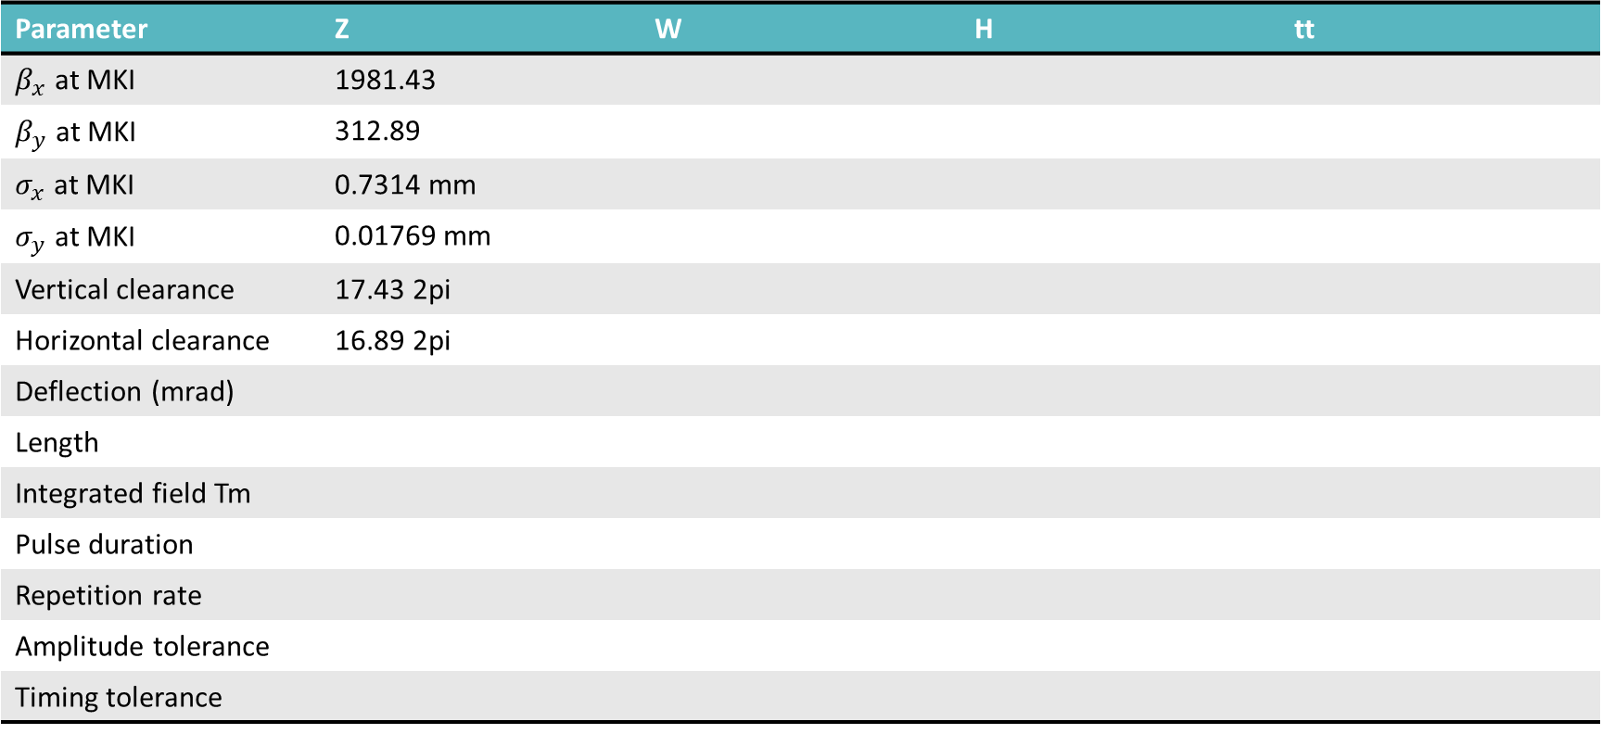
MKI off-momentum
Parameter | Z | W | H | tt
$β_{x}$ at MKI | 1981.43
$β_{y}$ at MKI | 312.89
$σ_{x}$ at MKI | 0.7314 mm
$σ_{y}$ at MKI | 0.01769 mm
Vertical clearance | 17.43 2pi
Horizontal clearance | 16.89 2pi
Deflection (mrad)
Length
Integrated field Tm
Pulse duration
Repetition rate
Amplitude tolerance
Timing tolerance

Slide 22
MKI - off energy

Slide 23
MKI off-energy (still to do)
The injection orbit is designed so as to cross the corresponding off-momentum closed orbit at the position of the multipole kicker.
The kick brings the injected bunch onto the off-momentum closed orbit, which then merges into the circulating beam as the momentum offset is damped.
Dispersion at the kicker of 0.3 m to widen off-momentum orbit.
Beam injected into off-momentum closed orbit in dispersive region. Merge as momentum deviation is damped.
2% momentum offset, used dispersion to calculate offset.

Slide 24
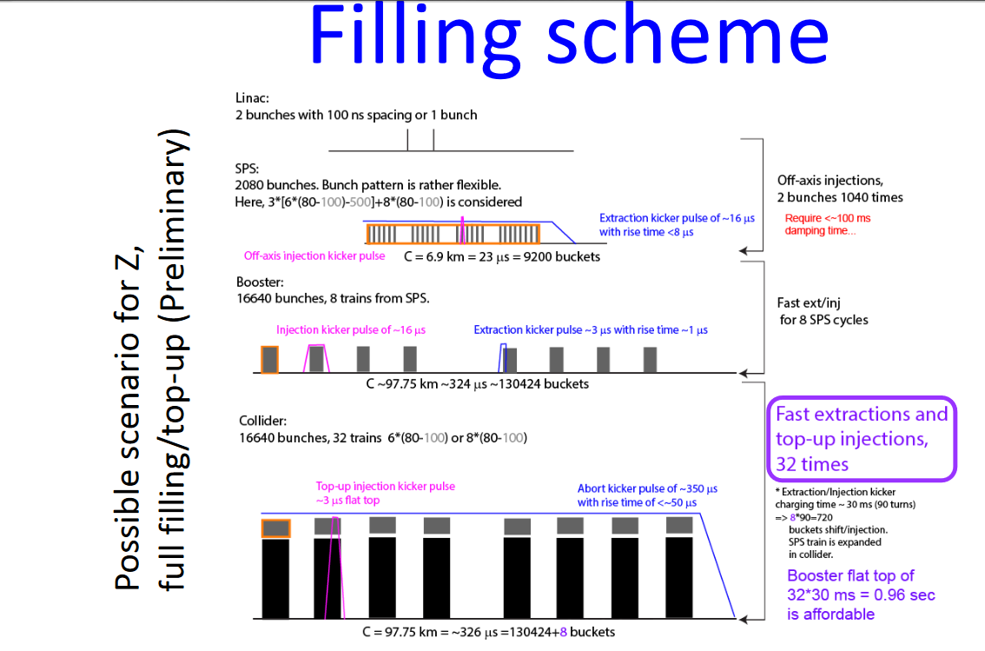
Pulse magnetic multipole kicker technologies
How many injections per pulse?
Rise time?
Flat-top time?
Impedance
Tolerance?
With the multipole kicker an integrated field of about 0.03 Tm CDR
Multipole kicker alignment tolerance and beam-based alignment methods.
Kicker technology: needs r&d
Injection kicker: 3 us flat top,
Abort kicker pulse 350 us, rise time 50 us

