Slide 1
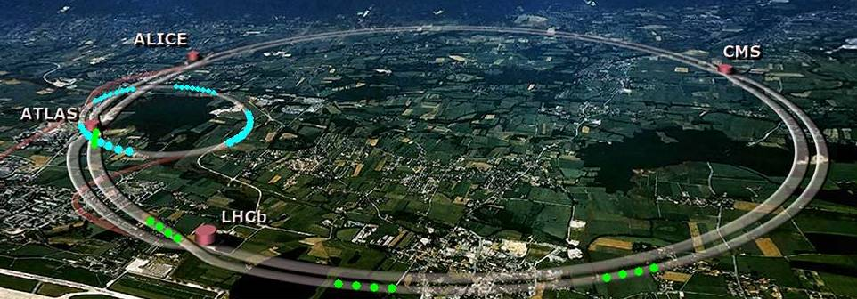
Hadron Accelerators
R.W. Aßmann
2011 CERN-Fermilab HCP Summer School Accelerator Beam Physics Group
Beams Department - CERN

Slide 2
Acknowledgements
W. Fischer (RHIC)
T. Roser (RHIC)
R. Schmidt (LHC)
V. Shiltsev (Tevatron)

Slide 3
Contents – Lecture 1
Introduction
  Scope of lecture. What is an accelerator? Tevatron, RHIC, LHC. Limits and high tech solutions
What are beams?
Collider goals: Energy, event rate and luminosity
Generating beams
Proton bending
Beam acceleration
Collimation
Beam dump
Colliding beams

Slide 4
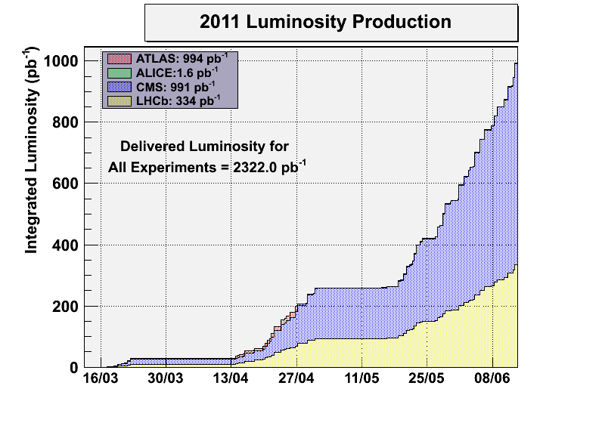
LHC Latest News: 1 fb⁻¹ Produced
Goal for year 2011

Slide 5
LHC Latest News: 1 fb⁻¹ Produced
Goal for year 2011
LHC performance discussed in lecture 2!
First: Let’s get an idea of hadron accelerators!

Slide 6
Introduction – Scope of Lecture
There are many hadron accelerators around the world:
  Hadron synchrotron colliders (Tevatron, RHIC, LHC)
  Hadron synchrotrons without collisions (SIS, …)
  Hadron linacs (SNS, UNILAC, medical applications, …)
  Hadron cyclotrons (PSI, medical applications, …)
Very broad field. Here focus on hadron colliders.
As we are at CERN: Particular focus on LHC, including latest news from the control room.

Slide 7
What is an Accelerator?
The accelerator (“atom smasher”)
A scientific instrument that increases the kinetic energy of charged particles!

Slide 8
Particle beams find many usages
Use particle beams:
  for scattering experiments (Transmission Electron Microscopy)
  to destroy cancer (medical accelerators).
  to produce high temperature, high density plasmas (plasma physics).
  to produce diamonds (high temperature – high pressure).
  to build a fusion reactor (high temperature – high pressure)
  to initiate a nuclear chain reaction or to get rid of nuclear waste (transmutation).
  to produce neutrons (neutron spallation sources – material science).
  to produce neutrinos (neutrino physics).
  to produce new particles in colliding beam experiments (high energy physics).
Use emitted light:
  for applied research (synchrotron light facilities).
  for lithography (microchip production).

Slide 9
Accelerators
Beams of charged particles are a very powerful tool for science.
Many applications exist with new ideas coming up regularly.
Different types of accelerators:
Protons, anti-protons, electrons, positrons, ions!
Hundreds of accelerators support scientific advance around the globe.
The future of accelerators will be very active and diverse.
RHIC – Collider for ion physics and polarized protons.
Tevatron – Discovery of the top. To be switched off in 2011.
LHC is the new flagship accelerator for high energy physics!

Slide 10


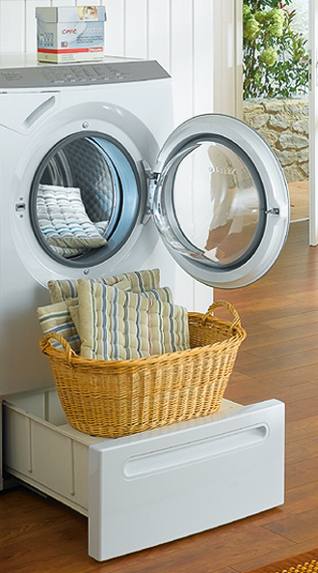


Technology as Base for Innovation or: The Connection Between a
Washing Machine and an iPhone
Steve Jobs:
  “We ended up opting for these Miele appliances, made in Germany... These guys really thought the process through. They did such a great job designing these washers and dryers. I got more thrill out of them than I have out of any piece of high tech in years. ” (1996)
  “We're both busy and we both don't have a lot of time to learn how to use a washing machine or to use a phone - you get one of the phones now and you're never going to learn more than 5 per cent of the features.” (Oct 2005)
Let’s look at the washing machines (accelerators) to make an iPhone (new territory in physics)!
2007

Slide 11
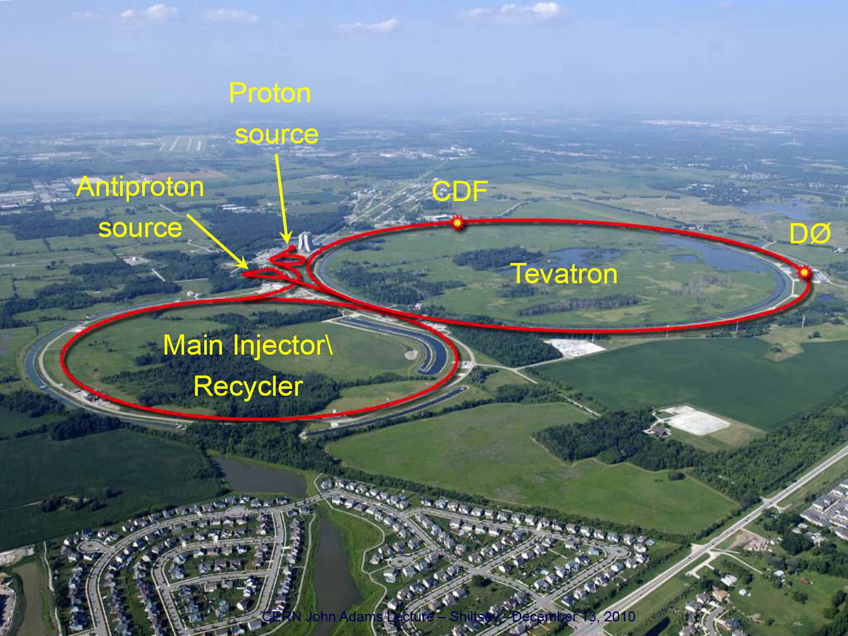
Tevatron
V. Shiltsev

Slide 12
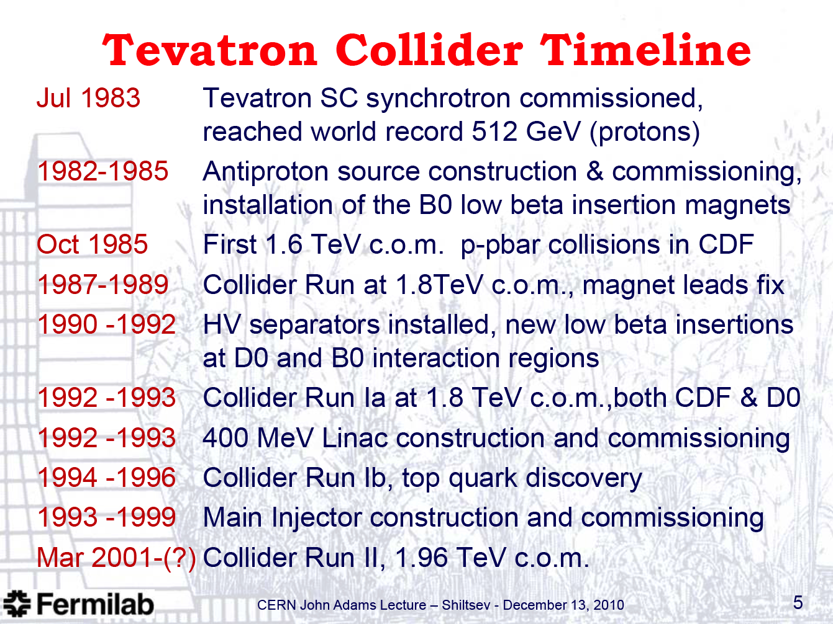
Tevatron

Slide 13
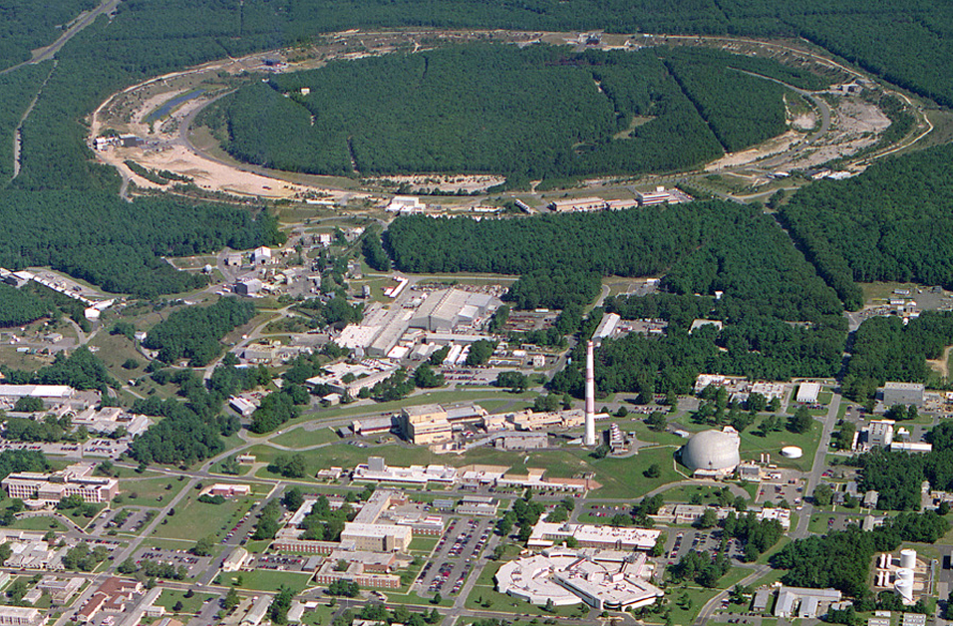
RHIC – a High Luminosity (Polarized) Hadron Collider
2 superconducting 3.8 km rings
2 large experiments
10:00 o’clock
Jet Target
12:00 o’clock
RHIC
2:00 o’clock
PHENIX
8:00 o’clock
RF
4:00 o’clock
STAR
6:00 o’clock
LINAC
NSRL
EBIS
Booster
AGS
Operated modes (beam energies):
Au–Au 3.8, 4.6, 5.8, 10, 32, 65, 100 GeV/n
d–Au* 100 GeV/n
Cu–Cu 11, 31, 100 GeV/n
p↑–p↑ 11, 31, 100, 250 GeV
Planned or possible future modes:
U – U 100 GeV/n
Au – Au 2.5 GeV/n (~ SPS cm energy)
p↑ – Au* 100 GeV/n (*asymmetric rigidity)
Achieved peak luminosities (100 GeV, nucl.-pair):
Au–Au 155×10³⁰ cm⁻² s ⁻¹
p↑–p↑ 50×10³⁰ cm⁻² s ⁻¹
Other large hadron colliders (scaled to 100 GeV):
Tevatron (p – pbar) 35×10³⁰ cm⁻² s ⁻¹
LHC (p – p, design) 140×10³⁰ cm⁻² s ⁻¹
Tandems

Slide 14
LHC: The Biggest Machine on Earth
Diameter: 27 km
Depth: ~ 100 m below ground surface
LHC: “collider”

Slide 15
Limit: The Dipole Magnets
Hadron (p) circular collider
Limited by available bending field strength (even SC):
(increase momentum by increasing radius times bending field)
LHC: 8.3 T bending field from 1232 magnets!
56 mm holes for beams.

Slide 16
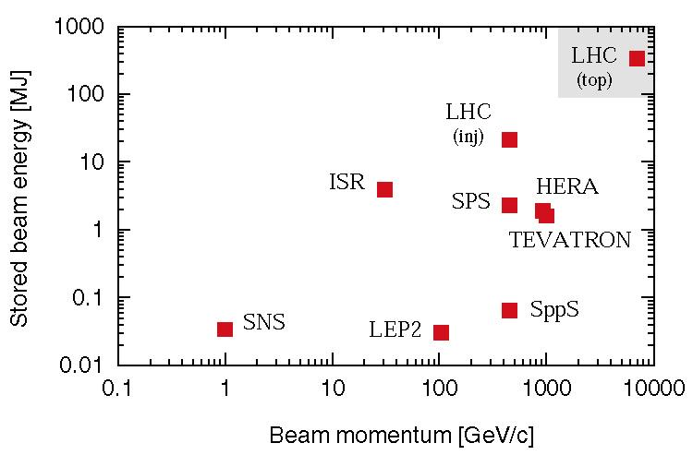
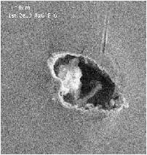
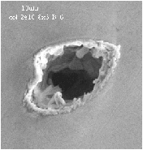
Limit: Power of the Beams
Entry and exit holes of an electron beam impacting on a spoiler
(courtesy P. Tenenbaum)
At less than 1% of nominal intensity LHC enters new territory.
Collimators must survive expected beam loss…

Slide 17
High Tech Solutions
These and other challenges are addressed with high tech solutions.
Fundamental research as a driver for technology…

Slide 18
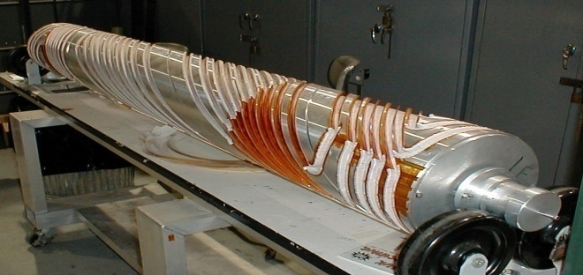
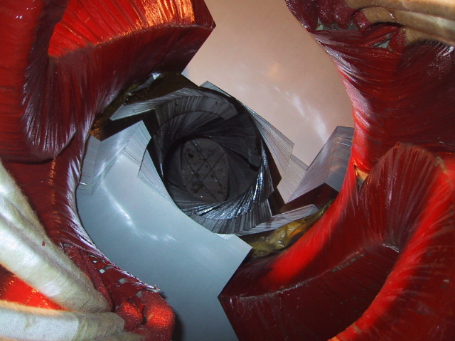
RHIC: Siberian Snakes

Slide 19
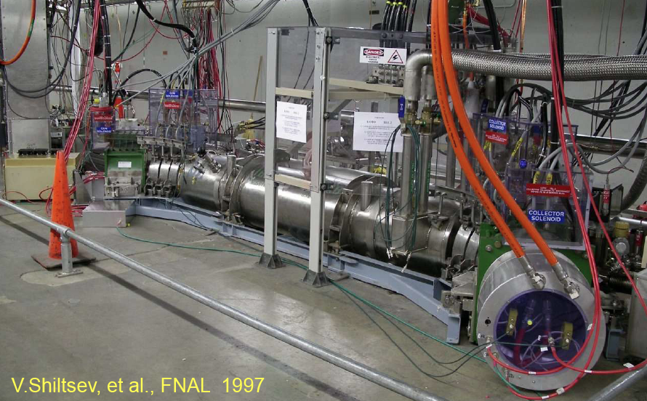
Tevatron: Electron Beam Lens

Slide 20
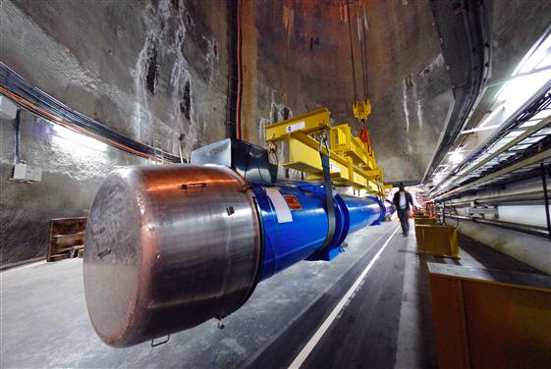
LHC: SC Magnets

Slide 21
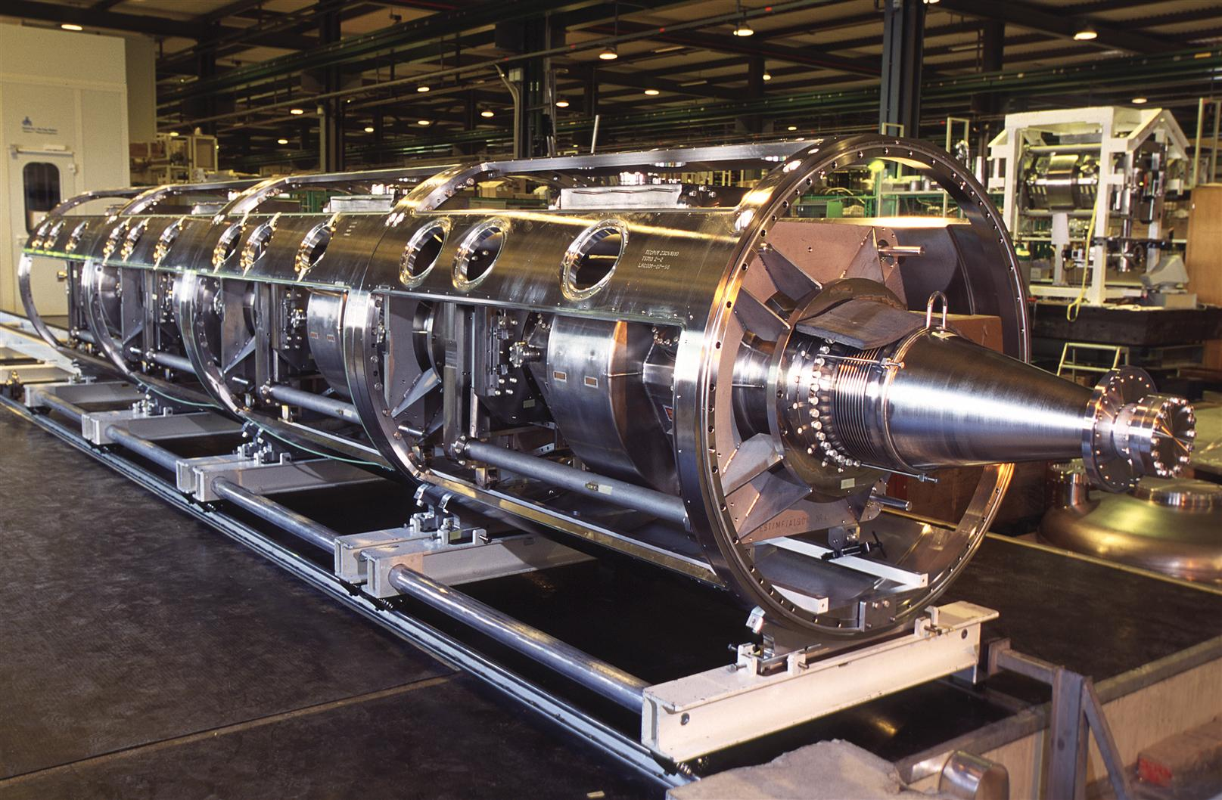
LHC: Super-Conducting RF Cavities

Slide 22
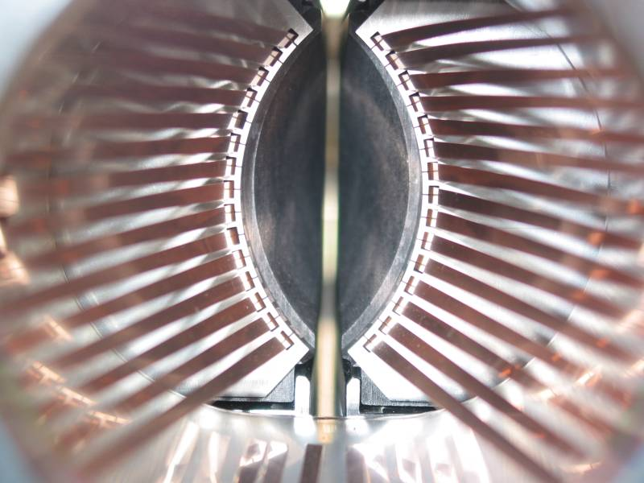
LHC: Collimators

Slide 23
What Are Beams?

Slide 24
The Charged Particle Beam
The accelerator generates, accelerates, transports and delivers beams to the user (e.g. HEP exp).
Beam are transported in ultra-high vacuum.
A beam can consist of individual bunches.
Each “bunch” is an ensemble of charged particles that are grouped together in space and carry the same (very similar) energy.
Radio-frequency fields are used to accelerate particles coherently and to group them together longitudinally.
Magnetic fields are used to guide the beam particles on well defined paths and to focus them into a small transverse area.

Slide 25
Purpose of accelerators
Length of bunch
(packet)
Transverse area
➔ Increase kinetic energy of particles
More particles per bunch
Smaller transverse areas
Shorter bunches
➔ More bunches

Slide 26
The choice of particle type
Hadron colliders
(p-pbar or pp or ions)
“Discovery” machines
LHC 2009
p-p: 2 × 7 TeV
Pb-Pb: 2 × 2.76 TeV
VLHC study
p-p: 2 × 20 TeV
2 ×100 TeV
Lepton colliders
(e⁻e⁺ or γγ)
“Precision” studies
B factory upgrade studies
Linear collider study
e⁺e⁻: 0.5-1.5 TeV
(eγ, γγ, e-e- options)
μμ collider study
2 × 0.15/4.0 TeV
Plasma accelerators

Slide 27
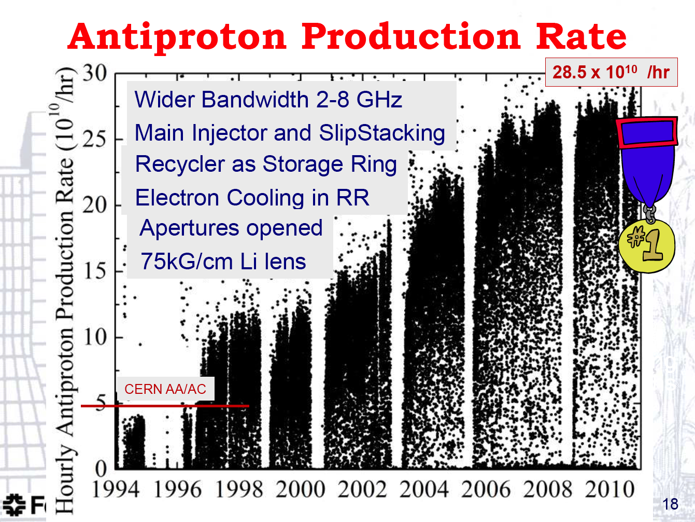
Tevatron: Anti-Proton Beam

Slide 28
The LHC Beam
Length of bunch
(packet)
Transverse area
➔ Increase kinetic energy of particles (3.5 – 7 TeV)
➔ More protons per bunch (150,000 – 300,000 billion)
Smaller transverse areas (~ 30 μm – width of hair)
Shorter bunches (~ 7 cm)
➔ More bunches (~ 400 – 2808)

Slide 29
RHIC: Polarized Proton Beams
Proton Spin
Goal: Fully polarized beam, e.g. all spins UP.
Manipulation of polarization vector needed!
UP
DOWN
Length of bunch
(packet)
Transverse area

Slide 30
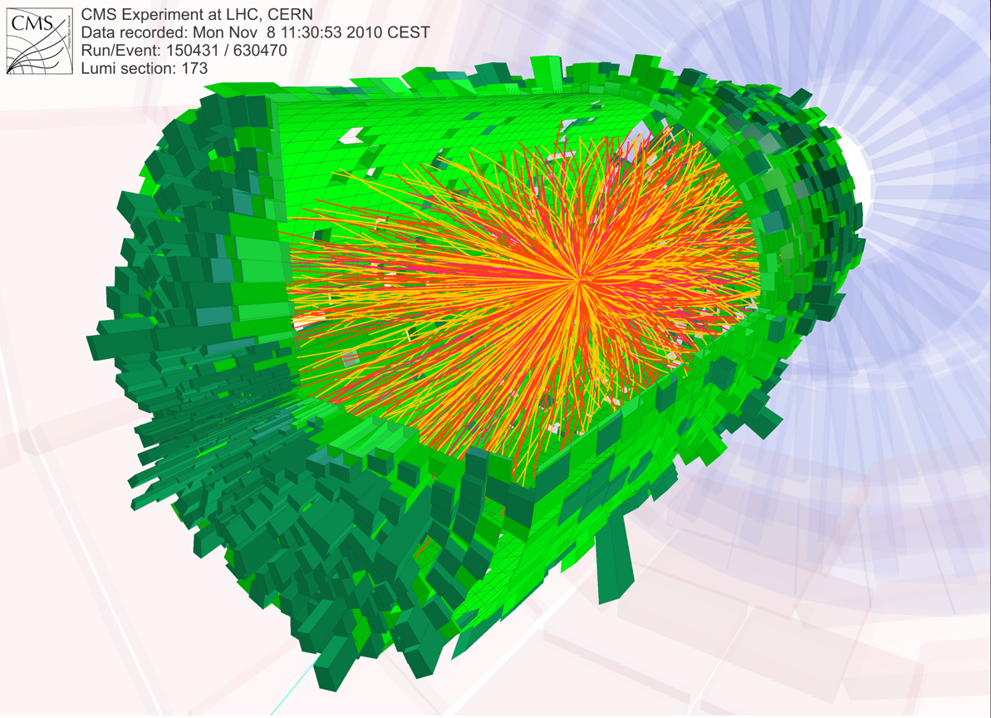
Collider Goals

Slide 31
High & well-defined beam energies
Einstein’s famous formula:
Mass can be converted into energy!
Collide electrons (matter) and positrons (anti-matter):
electrons
positrons
If energy is high enough new particles can be produced…
Maximum beam energy
for
highest discovery potential!

Slide 32
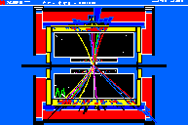
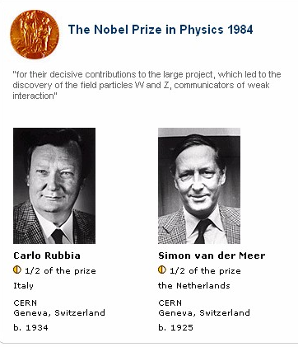
Example: Producing the Z-boson
The Z boson:
Discovered in the SppS with proton and anti-protons (nobel prize C. Rubbia and S. van de Meer 1984) → accelerator innovation!
Detailed studies at the LEP collider with electrons and positrons.
Example from the LEP-ALEPH detector

Slide 33
The need for high event rate
p⁺p⁺
Luminosity L
proton
proton
p⁺p⁺
→ Determines how long the PhD student has to wait for his data…

Slide 34
Luminosity
Gaussian transverse distributions (neglecting effect of self-focusing of beams):
Neglecting geometric factor F…

Slide 35
Generating Beams

Slide 36
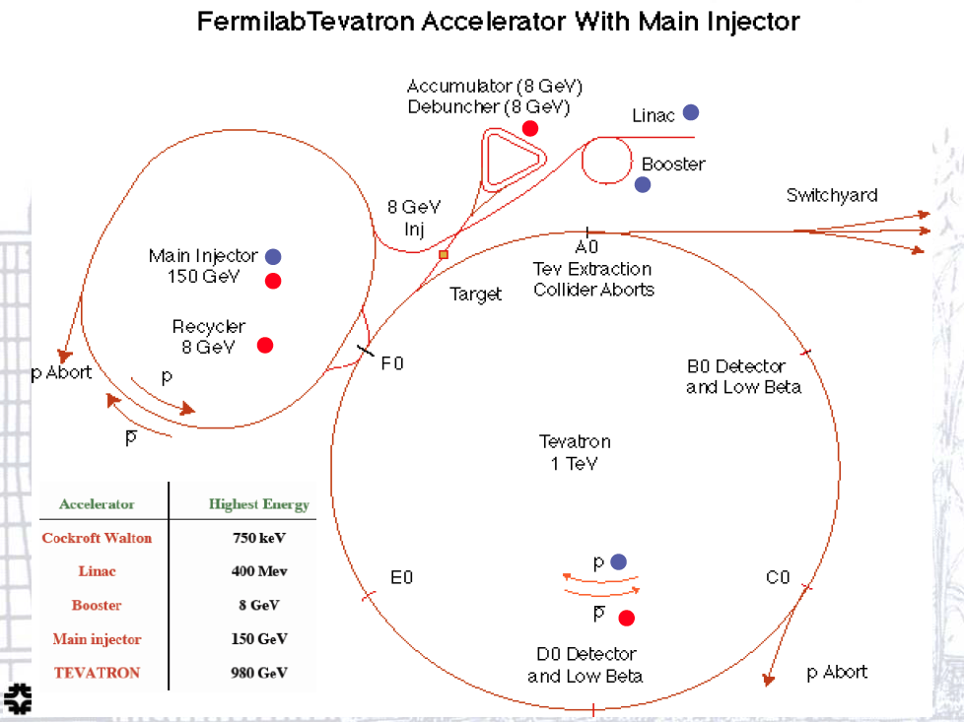
Fermilab Example

Slide 37
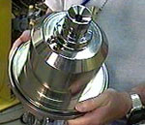
Producing the LHC beams
H gas

Slide 38
Proton bending (circular)

Slide 39
Governed by Maxwell’s Equations
Very few acceleration issues require quantum mechanics (e.g. spin polarization).

Slide 40
Lorentz Force F
Longitudinal electrical field to accelerate a particle
Transverse magnetic field to guide a particle

Slide 41

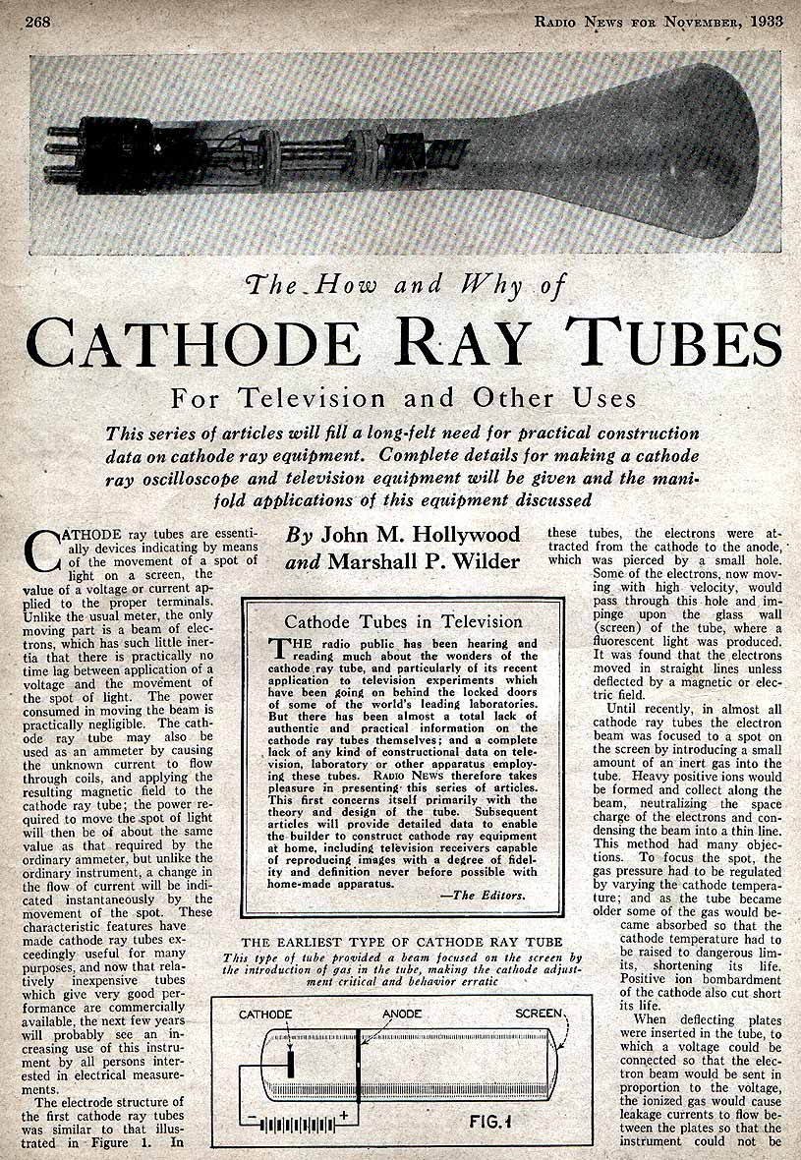
The electron accelerator in your (past) living room
(1938)
(1931)

Slide 42
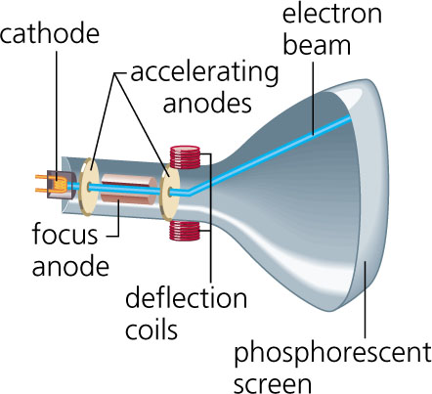
Cathode Ray Tube (CRT) has the basic ingredients of a scientific accelerator:
Particle source
Acceleration scheme
Focusing scheme
Beam steering
Beam observation
Particle momentum p given by Lorentz Force:
dp / dt =

Slide 43
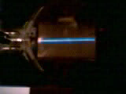
Transverse deflections:
Transverse magnetic fields are used for beam deflections!
y
Depends on particle energy and transverse field
x
Proton
z
Transverse fields used for:
Focusing lattice
Bending (esp. circular)
De-magnifying
Steering

Slide 44
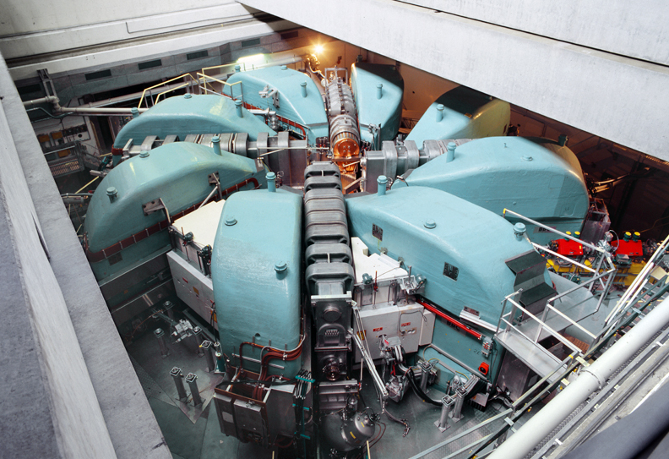
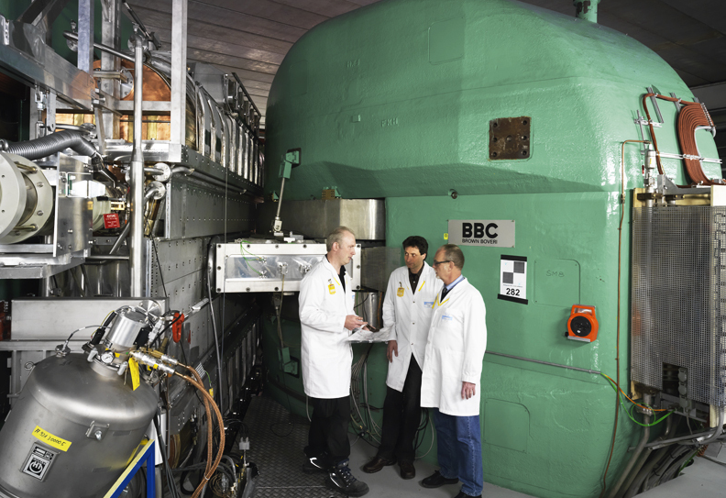
The PSI Cyclotron
590 MeV protons, 1.3 MW
Fixed target physics
neutrons, muons

Slide 45
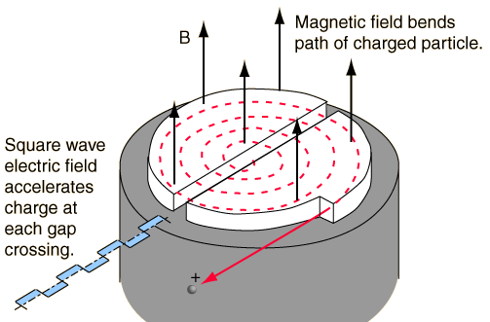
Cyclotron Principle

Slide 46
Limited in Energy Reach
Constant bending field B with time → Radius R will change during acceleration (increase of momentum p):
p = R e B
Solution: Increase bending field synchronous with momentum gain → constant radius → large rings with a vacuum pipe become possible.
See also: Large accelerators (big R) are required to reach high momentum if bend fields are limited!
Large synchrotrons (LHC, …).

Slide 47
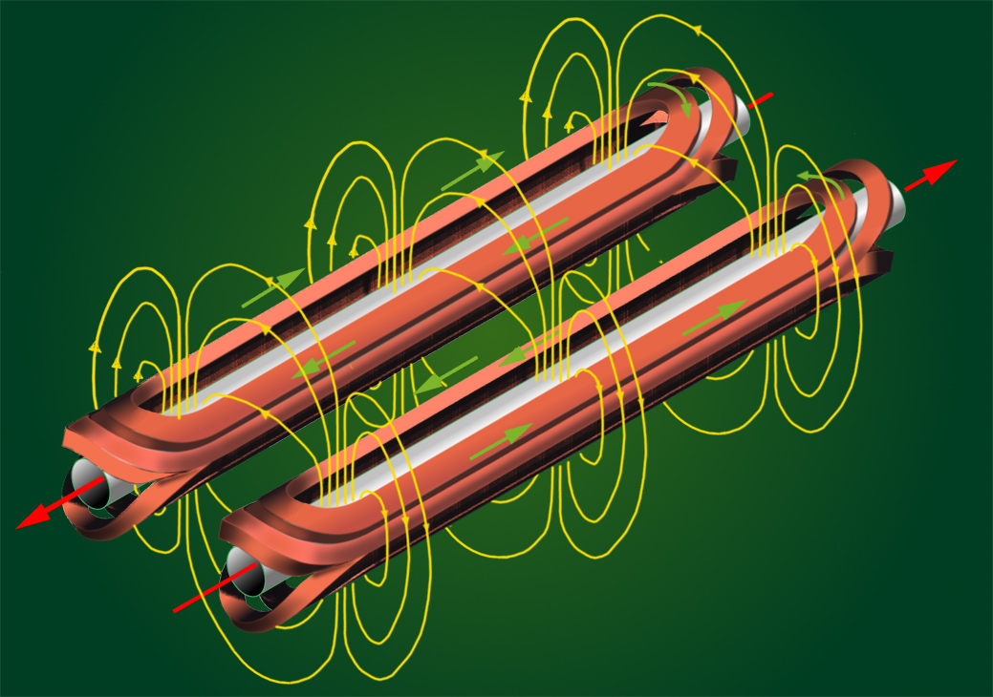
Dipolmagnet Coils in Synchrotrons

Slide 48
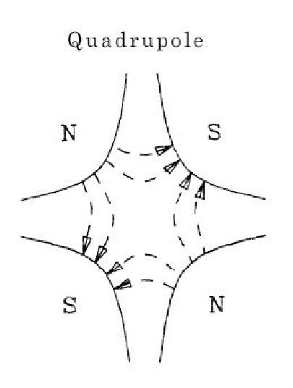
Strong focusing lattice → Quadrupoles
Built with quadrupole magnets…
y
x
Force is restoring in one, anti-restoring in the other plane.
More focusing (beam size larger) than defocusing!
Quadrupoles
Beam
Equation of particle motion:
γ

Slide 49
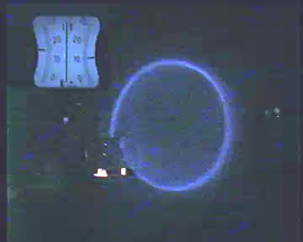
LHC
Fit the LHC ring into the LEP tunnel
8.3 T bending field from 1232 magnets!
56 mm holes for beams.

Slide 50
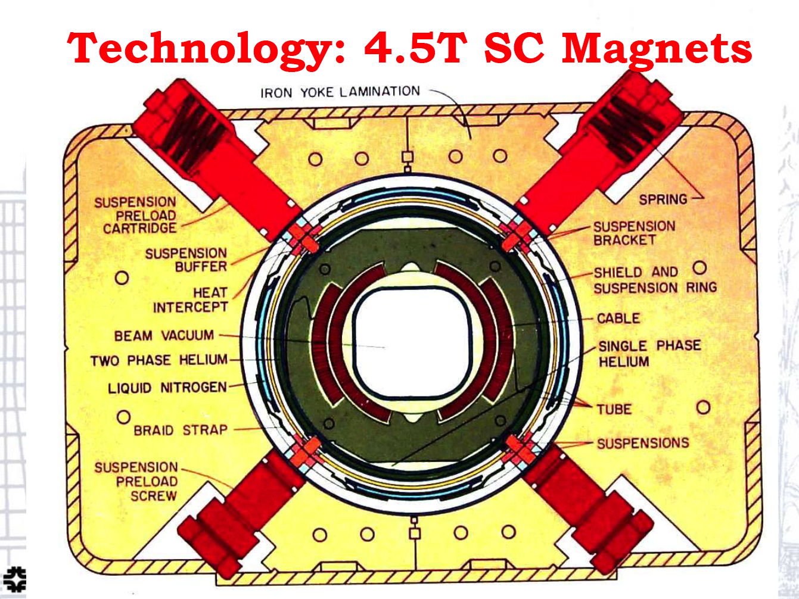
Tevatron Magnet Technology
Two colliding beams in the same vacuum pipe!
V. Shiltsev

Slide 51
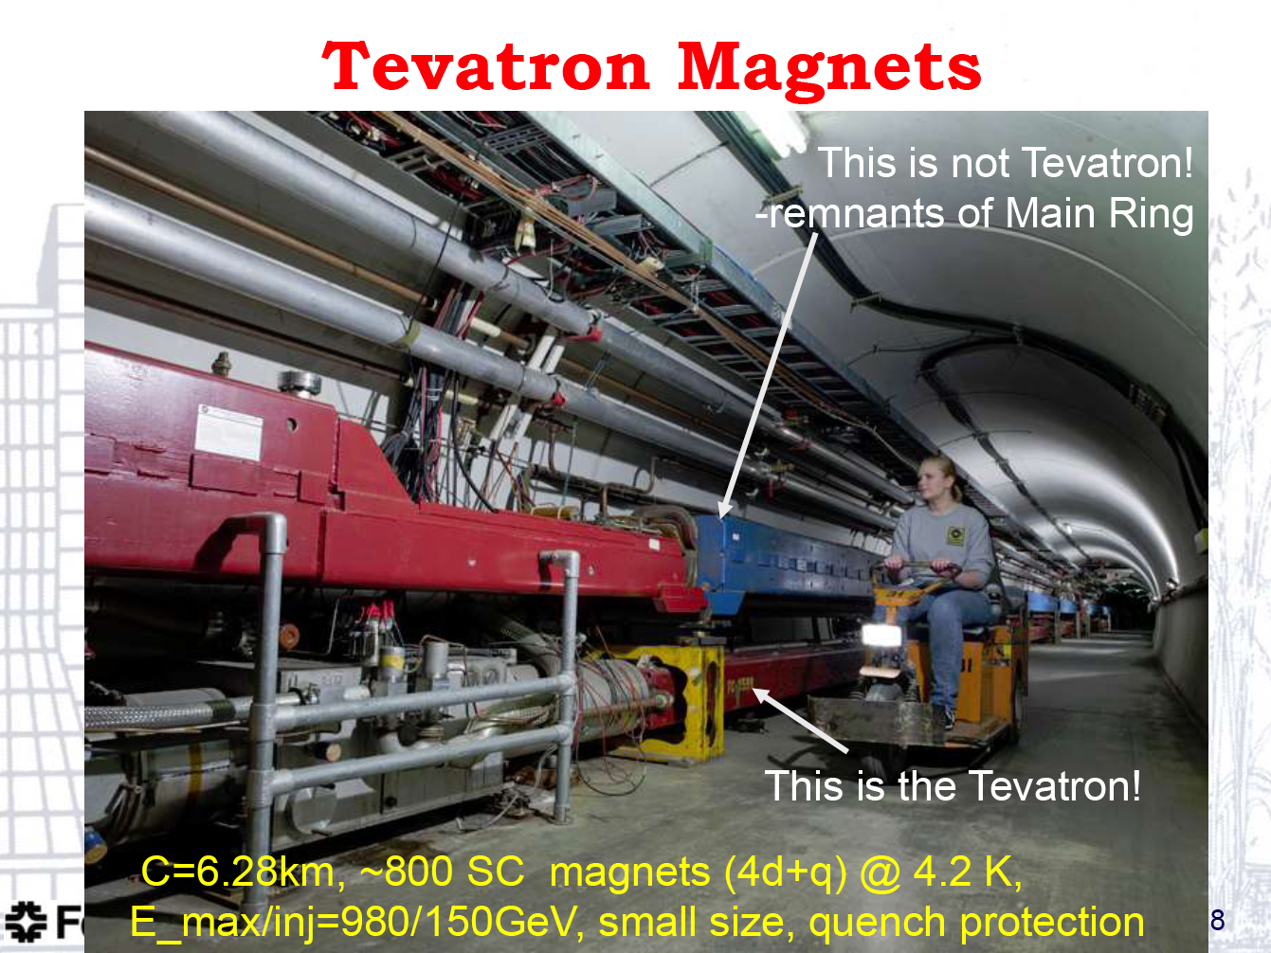
Tevatron Ring
V. Shiltsev

Slide 52
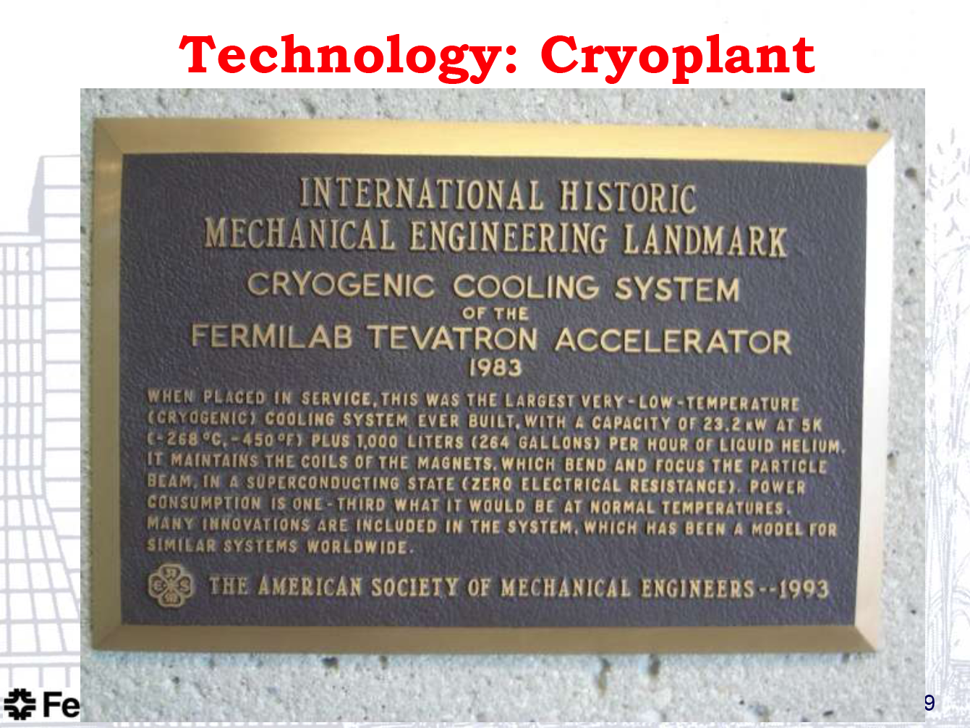
Tevatron Cooling System
V. Shiltsev

Slide 53
Why Super-Conducting?
For LHC we need 12,000 A current to generate the bending fields required for 7 TeV protons!
A resistive magnet would just over-heat and melt.
We need to build super-conducting magnets: no resistance → high currents and fields are possible.
Magnets cooled to 1.9 K and some to 4.5 K → biggest refrigerator on earth (Helium).
CERN is the coldest place on earth (inside the magnets).

Slide 54
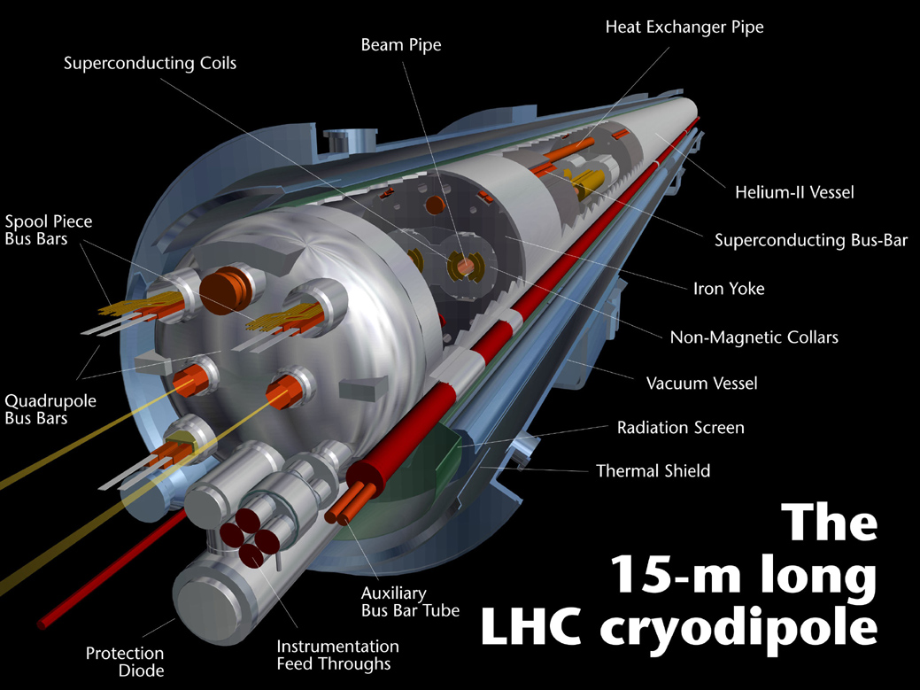
High Beam Energy with Super-Conducting
Magnets: Handle High Currents and Large Stored Energy
Each beam in a separate vacuum pipe!
54
Notes:
54

Slide 55
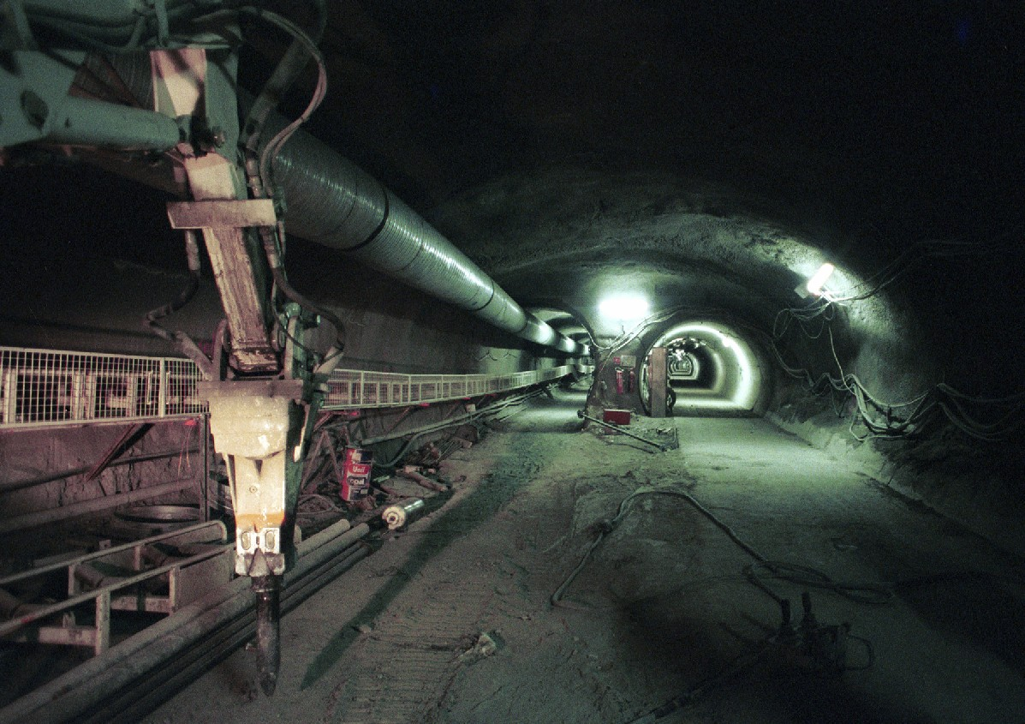

Slide 56
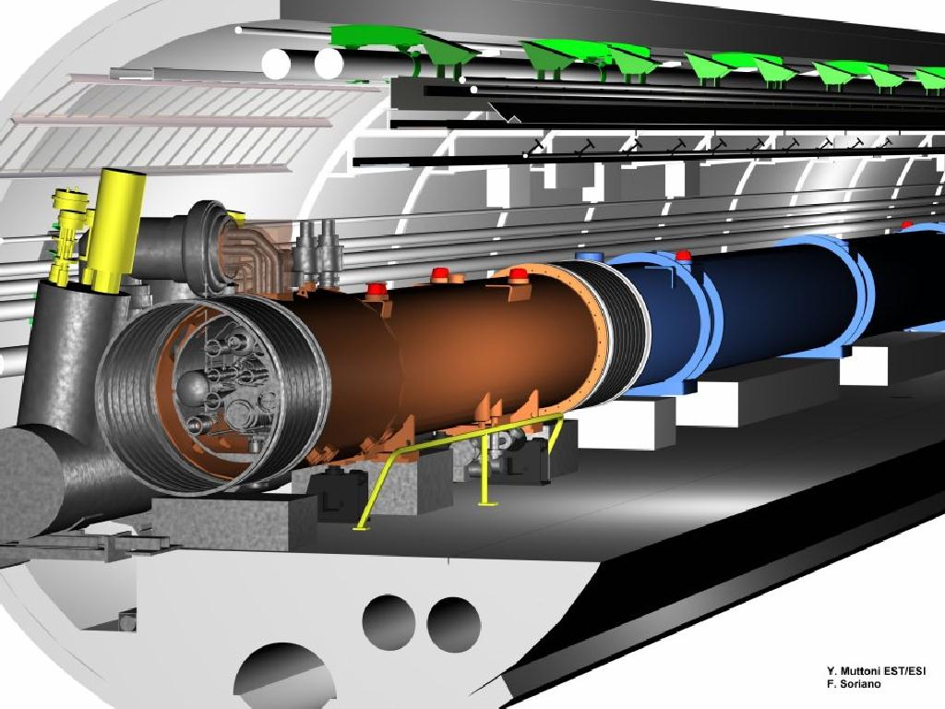
Regular arc:
Magnets
1232 main dipoles +
3700 multipole corrector magnets
392 main quadrupoles +
2500 corrector magnets
R. Schmidt

Slide 57
R. Schmidt
Regular arc:
Cryogenics
Connection via service module and jumper
Static bath of superfluid helium at 1.9 K in cooling loops of 110 m length
Supply and recovery of helium with 26 km long cryogenic distribution line

Slide 58
Regular arc:
Vacuum
Beam vacuum for
Beam 1 + Beam 2
Insulation vacuum for the magnet cryostats
Insulation vacuum for the cryogenic distribution line
R. Schmidt

Slide 59
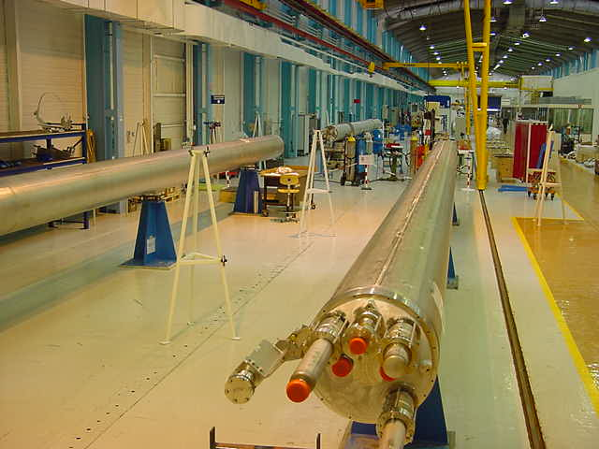

Slide 60
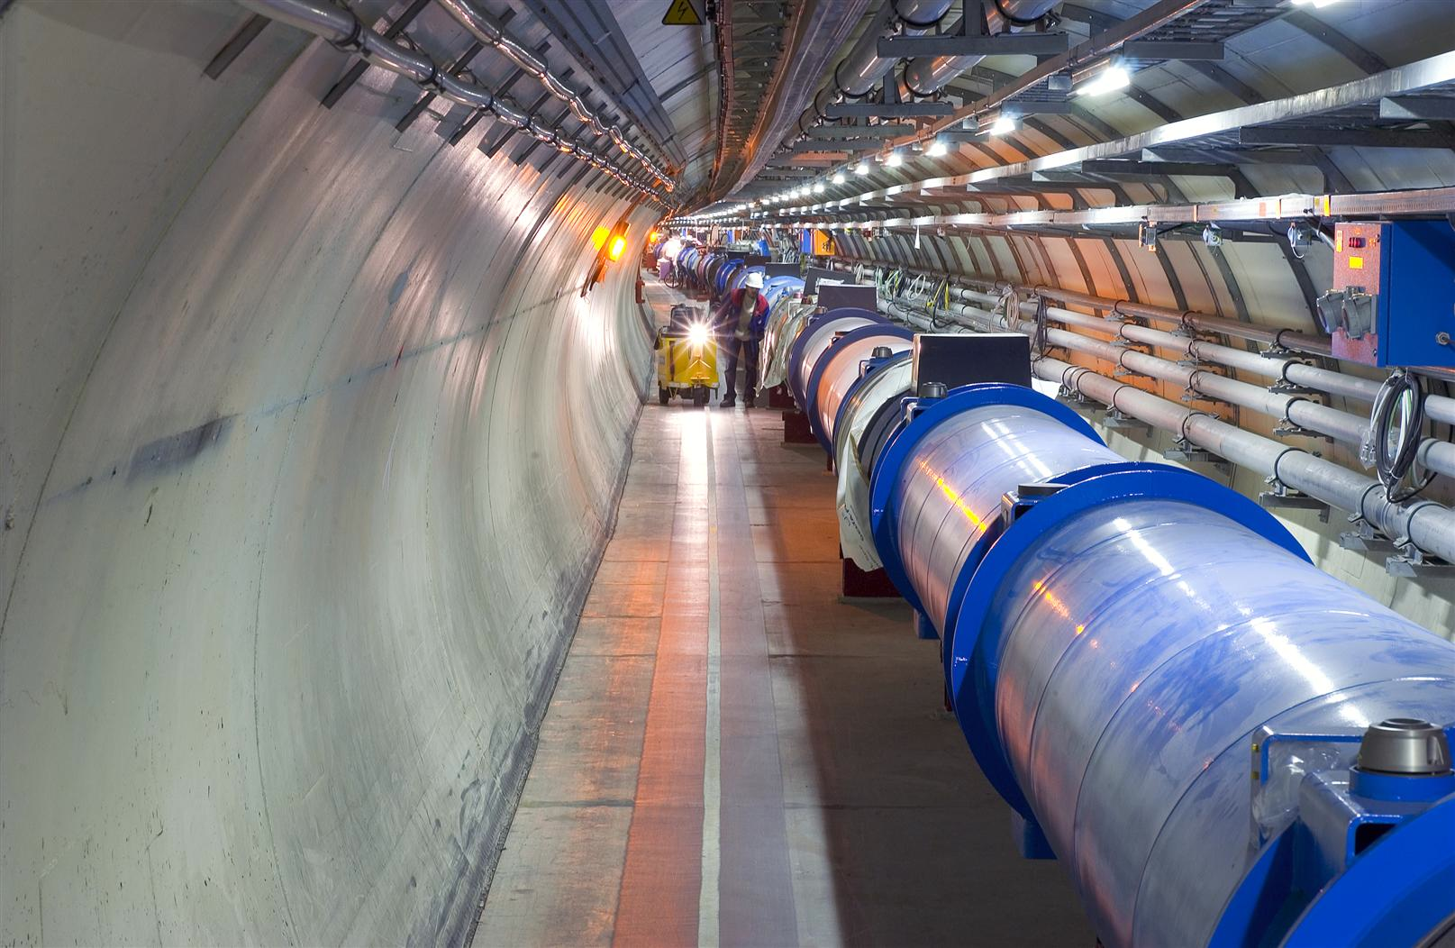
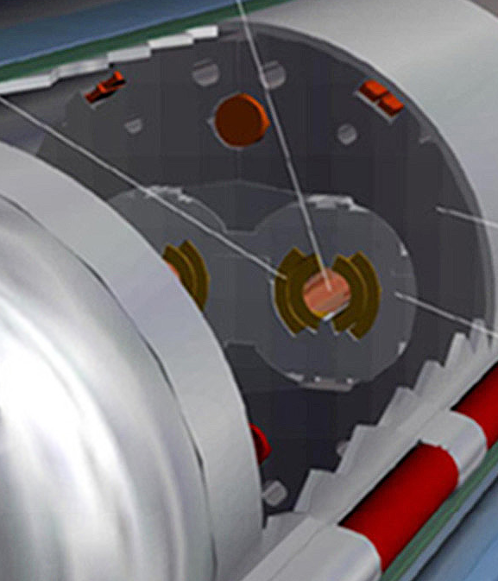
Quench Limit of LHC Super-Conducting Magnets
Beam
362 MJ
56 mm
SC Coil:
quench limit
12 - 41 mJ/cm³

Slide 61

If Resistance Develops…
61
Notes:
61

Slide 62
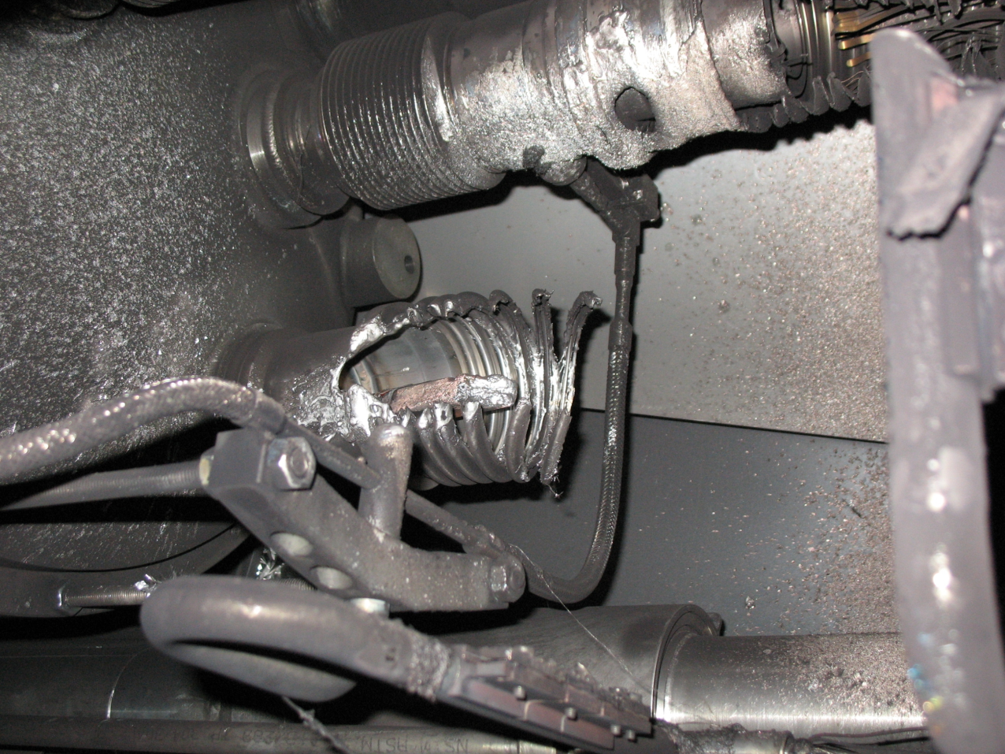
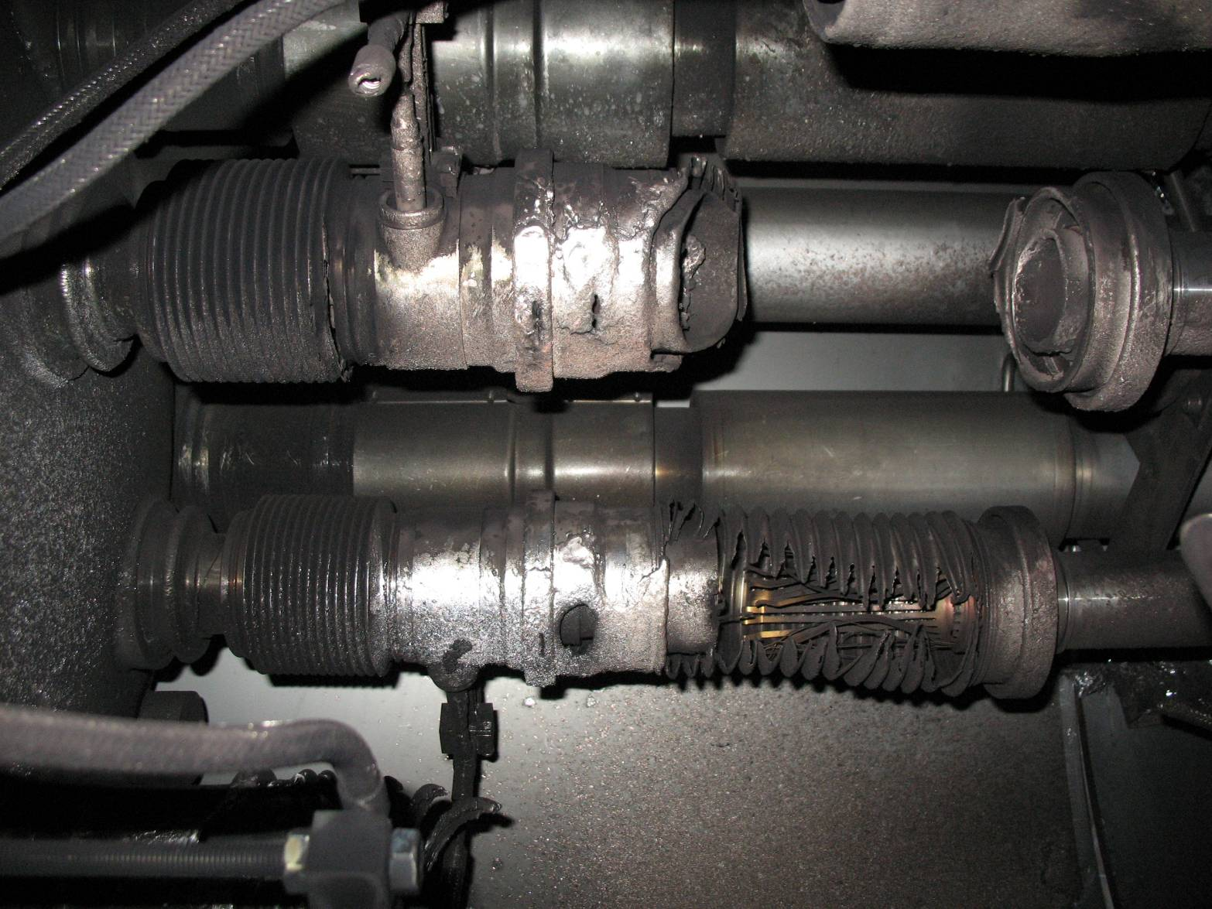
Electrical arc between C24 and Q24
Resistance ➔ current cannot flow as foreseen ➔ electrical arc!
Local material is destroyed by electrical arc.
Liquid Helium escapes and inflates.
M3 line
What is not taken out by safety valves runs as pressure wave along the accelerator!
Pressure waves hit the vacuum barriers that are located every two cells.
V lines

Slide 63
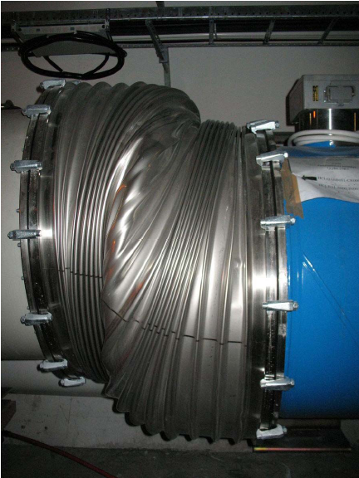
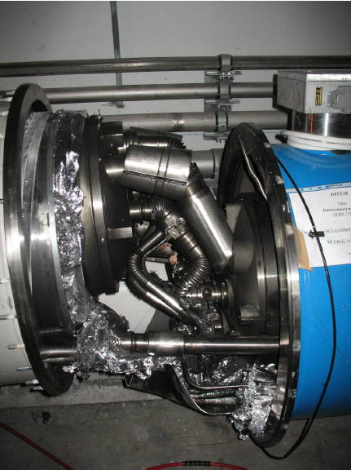
Consequences
All fixed
Magnet supports cannot handle pressure wave and buckle…
63
Notes:
63

Slide 64
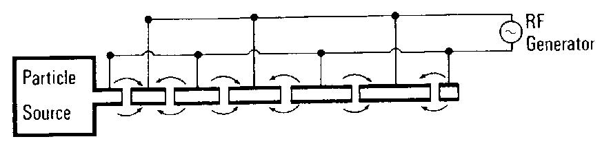
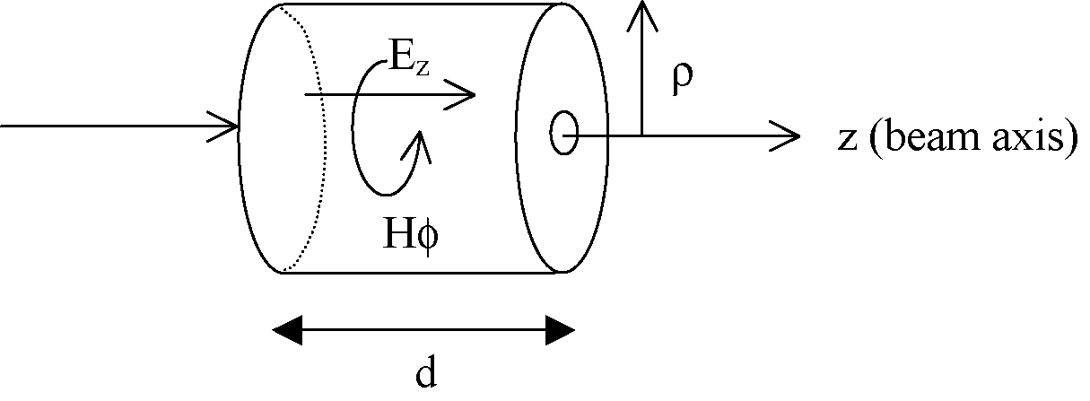
Beam Acceleration: RF System
Wideroe accelerator
Cylindrical cavity
E.g. d = λ_{RF}/2: λ_{RF} is the RF wavelength →
f_{RF} = 400 MHz

Slide 65
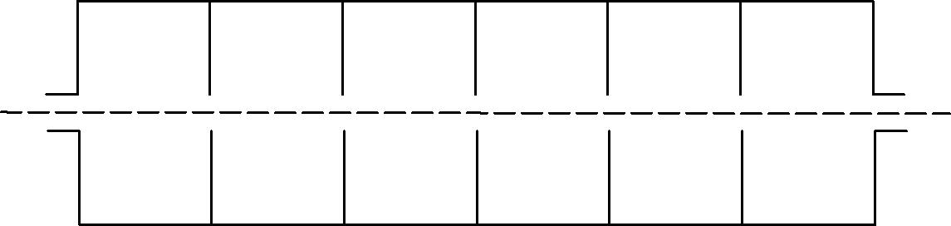
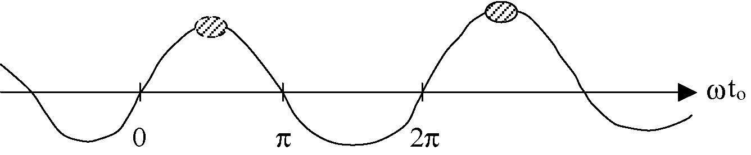
Multiple cavity structure
Smooth waveguide: v_{ph} > c
Obstacles (irises) to slow down accelerating wave for synchronous acceleration:
Iris
Bunch length shorter than λ_{RF}

Slide 66
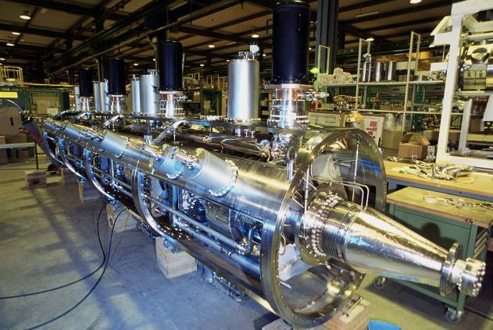
LHC RF systems: 400 MHz
400 MHz system:
16 sc cavities (copper sputtered with niobium) for 16 MV/beam were built and assembled in four modules

Slide 67
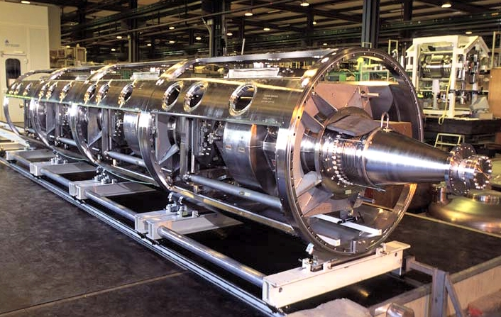
Fitting Beam in RF Buckets
RF bucket
time
2.5 ns
450 GeV 7 TeV
RMS bunch length 11.2 cm 7.6 cm
RMS energy spread 0.031% 0.011%

Slide 68
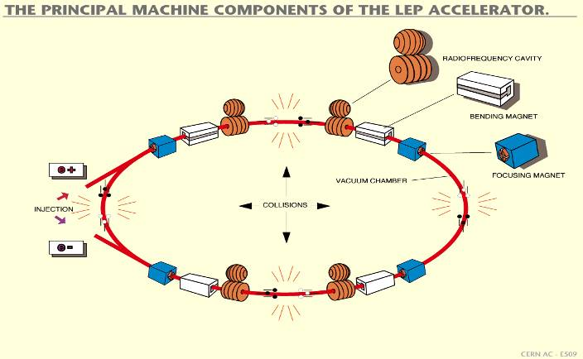
To get to 7 TeV: Synchrotron – circular accelerator and many passages in RF cavities
LINAC (planned for several hundred GeV - but not above 1 TeV, e.g ILC)
LHC circular machine with energy gain per turn ~0.5 MeV
acceleration from 450 GeV to 7 TeV takes about 20 minutes
....requires deflecting magnets (dipoles)

Slide 69

Collimation
Shock beam impact: 2 MJ/mm² in 200 ns (0.5 kg TNT)
Maximum beam loss at 7 TeV: 0.1% of beam (360 MJ) per second
(assumed lower than Tevatron/HERA)
360 kW
Quench limit of
SC LHC magnet:
~ 5 mW/cm³
➔ proportional to stored energy

Slide 70
Limit: Power of the LHC beams
Entry and exit holes of an electron beam impacting on a spoiler
(courtesy P. Tenenbaum)
At less than 1% of nominal intensity LHC enters new territory.
Collimators must survive expected beam loss…

Slide 71



Examples of damage from beams
Tungsten collimator
in the SPS
Entry and exit holes of an electron beam impacting on a spoiler
(courtesy P. Tenenbaum)
Lead block accidentally put into a p beam
Damage of coating of a SLC collimator
(courtesy G. Stevenson)

Slide 72



Examples of damage from beams
TEVATRON Dec 2003 Photographs courtesy D. Still

Slide 73

Hearing Proton Beam…
Microphone
Proton beam…
Collimator
450 GeV
3 10¹³ p in the beam
2 MJ
0.7 x 1.2 mm²
Beam Dump
~ Tevatron beam
~ ½ kg TNT

Slide 74

LHC Collimators: Dilute and Stop
Quench limit: ~ 5 mJ/mm² (any SC magnet)
Jaw 1
Required “filter” factor:
1 × 10⁻¹⁰ = Leakage / Dilution
Leakage factor (inefficiency): 10⁻⁴
Dilution factor: 10⁶
Cannot be achieved with single collimator ➔ therefore multi-stage collimation for betatron cleaning (x, y, skew) and momentum cleaning.
Jaw 2
Incoming: up to ~ 50 MJ/mm² (primary collimator)

Slide 75

Multi-Stage Cleaning & Protection
3-4 Stages
CFC collimator
Beam propagation
Core
Unavoidable losses
Primary
halo (p)
Secondary
halo
π
p
Shower
Impact
parameter
≤ 1 μm
π
Tertiary halo
p
Primary
collimator
e
p
Shower
Secondary
collimator
e
Super-conducting magnets
High Z coll
SC magnets and particle physics exp.
High Z coll
CFC
CFC
W/Cu
W/Cu

Slide 76


System Design
“Phase I”
Momentum
Cleaning
Betatron
Cleaning
108 collimators and absorbers in phase I (only movable shown in sketch)
Gaps: ± 6/7 σ
2-3 mm

Slide 77

Tunnel: Cleaning Insertion IR7
RADIATION-HARD CABLE PATH
WATER FEEDS
COLLIMATOR
COLLIMATOR CABLE TRAYS
PHASE I/II
WATER
DISTRIBUTION
BEAM PIPES
TRANSPORT ZONE

Slide 78

Beam Dump: Disposing the Beam
∅ 0.7m × 7.7 m C cylinder

Slide 79
Dilution with spiral sweep
Dilution kicker
108 cm sweep length
400 cm sweep length
  At 7 TeV would allow currents of ~4 A in distributed bunches

Slide 80

Colliding the Beams

Slide 81

Crossing Angles

Slide 82
To be continued tomorrow…

