Slide 1
Heavy Ion Physics
Lecture 1
Thomas K Hemmick
Stony Brook University

Slide 2
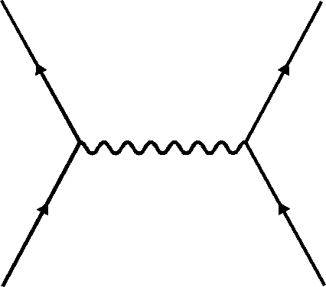
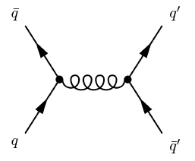
Physics beyond the diagram!
The water droplets on the window demonstrate a principle.
Truly beautiful physics is expressed in systems whose underlying physics is QED.
Does QCD exhibit equally beautiful properties as a bulk medium.
ANSWER: YES!

Slide 3
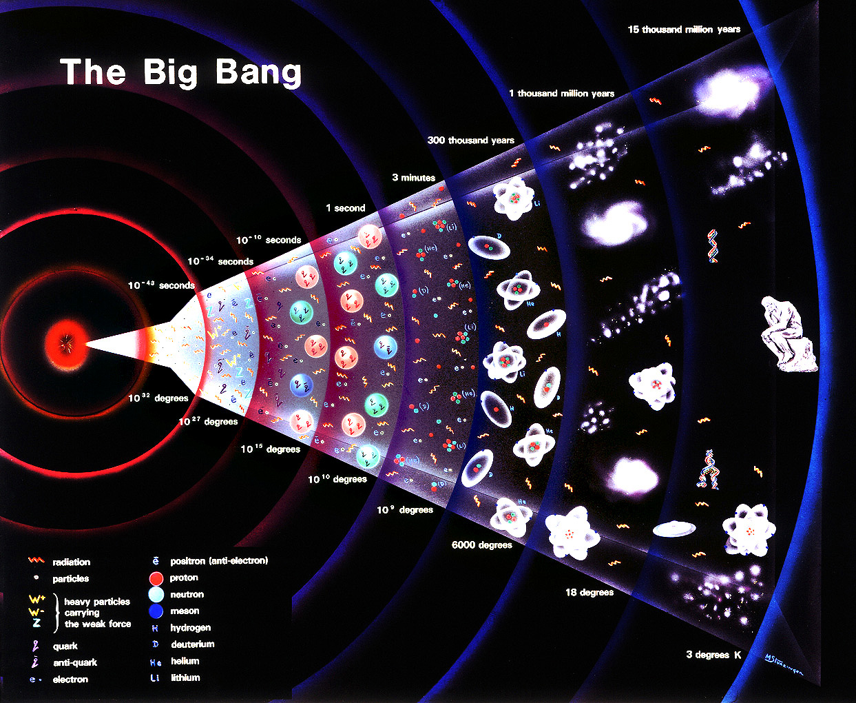
~ 10 μs after Big Bang
Hadron Synthesis
strong force binds
quarks and gluons in massive objects:
protons, neutrons mass ~ 1 GeV/c²
~ 100 s after Big Bang
Nucleon Synthesis
strong force binds protons and neutrons bind in nuclei

Slide 4
~ 10 μs after Big Bang T ~ 200 MeV
Hadron Synthesis
strong force binds
quarks and gluons in massive objects:
protons, neutrons mass ~ 1 GeV/c²
Planck scale T ~ 10¹⁹ GeV
End of Grand Unification
inflation
~ 100 ps after Big Bang T ~ 10¹⁴ GeV
Electroweak Transition explicit breaking of chiral symmetry

Slide 5
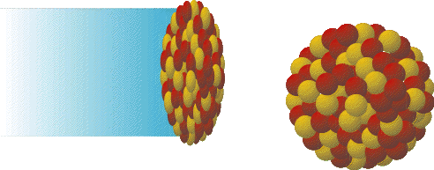
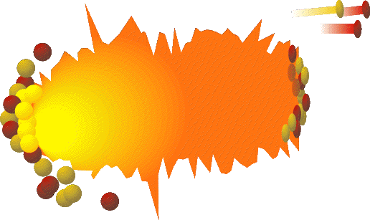
“Travel” Back in Time
QGP in Astrophysics
  early universe after ~ 10 μs
  possibly in neutron stars
early universe
T
RHIC
& LHC
Quark Matter
SPS
T_{C}~170 MeV
AGS
Quest of heavy ion collisions
  create QGP as transient state in heavy ion collisions
  verify existence of QGP
  Study properties of QGP
  study QCD confinement and how hadrons get their masses
Hadron
Resonance Gas
SIS
temperature
Nuclear
Matter
neutron stars
baryon chemical potential
940 MeV
1200-1700 MeV
μ_{B}
Thomas K Hemmick

Slide 6
Estimating the Critical Energy Density
nuclear matter
p, n
Quark-Gluon Plasma
q, g
distance of two nucleons:
2 r₀ ~ 2.3 fm
size of nucleon
r_{n} ~ 0.8 fm
density or temperature
normal nuclear matter ρ₀
critical density:
naïve estimation
nucleons overlap R ~ r_{n}
Thomas K Hemmick

Slide 7
Critical Temperature and Degrees of Freedom
Noninteracting system of 8 gluons with 2 polarizations
and 2 flavor’s of quarks (m=0, s=1/2) with 3 colors
In thermal equilibrium relation of pressure P and temperature T
Assume deconfinement at mechanical equilibrium
  Internal pressure equal to vacuum pressure B = (200 MeV)⁴
Energy density in QGP at critical temperature T_{c}
Thomas K Hemmick

Slide 8
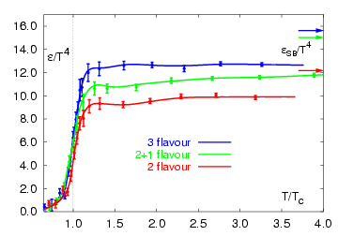
Lattice Calculations
The onset of QGP is far from the perturbative regime (α_{s}~1)
Lattice QCD is the only 1st principles calculation of phase transition and QGP.
Lattice Calculations indicate:
  T_{C}~170 MeV
  ε_{C}~1 GeV/fm⁴

Slide 9
Outline of Lectures
}
What have we done?
  Energy Density
  Initial Temperature
  Chemical & Kinetic Equilibrium
  System Size
Is There a There There?
  The Medium & The Probe
  High Pt Suppression
  Control Experiments: γ_{direct}, W, Z
What is It Like?
  Azimuthally Anisotropic Flow
  Hydrodynamic Limit
  Heavy Flavor Modification
  Recombination Scaling
Is the matter exotic?
  Quarkonia, Jet Asymmetry,
  Color Glass Condensate
Lecture 1
}
Lecture 2

Slide 10
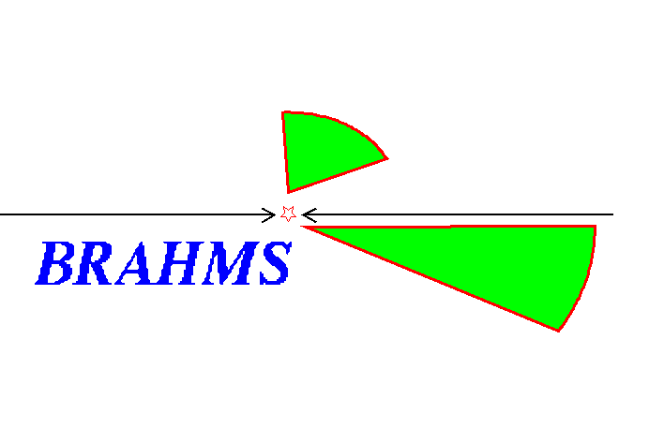
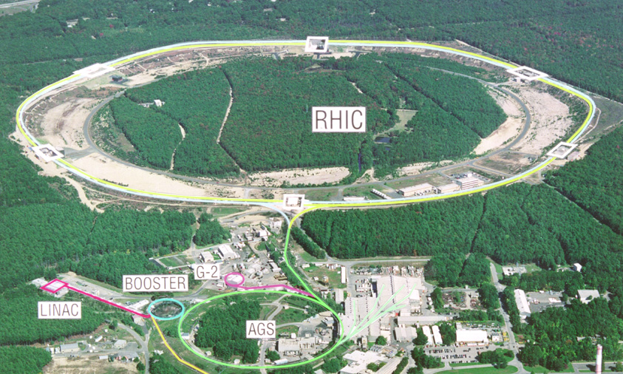
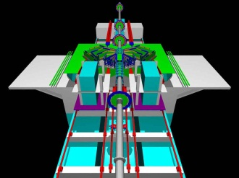

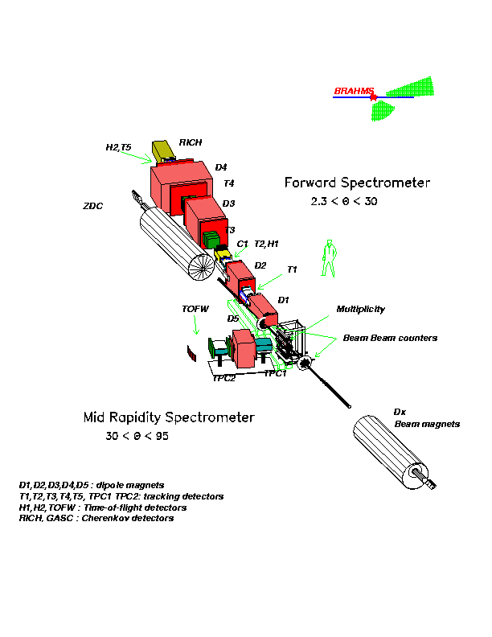
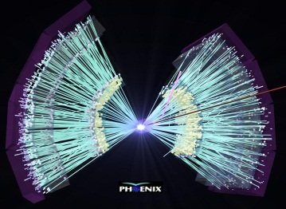
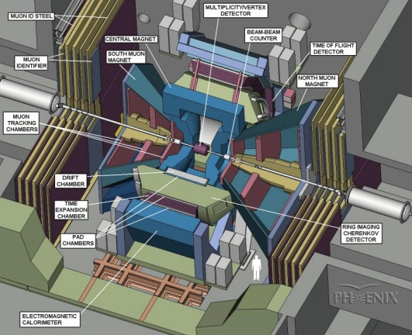
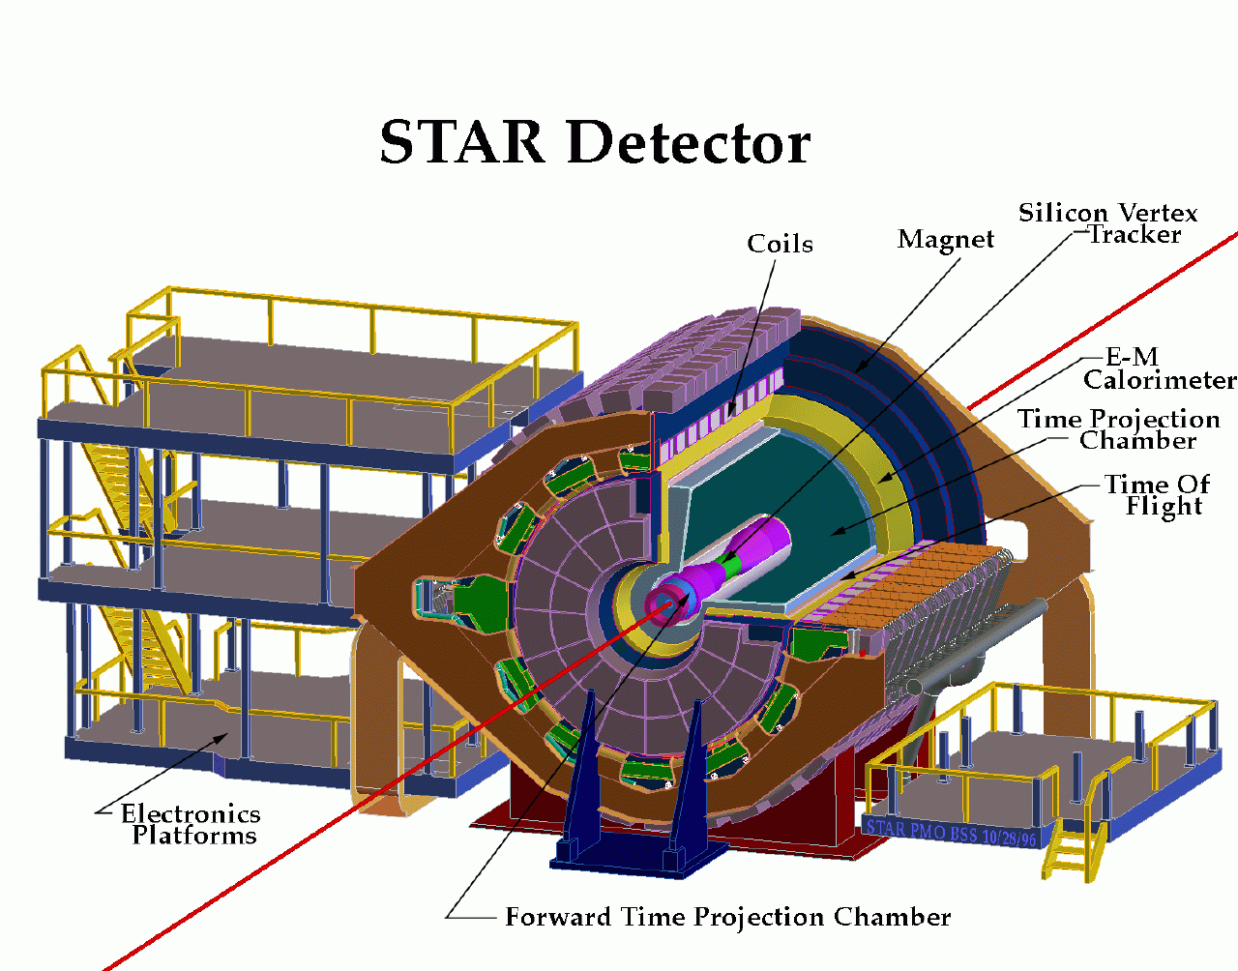

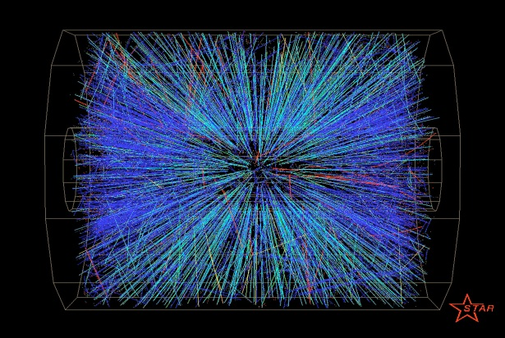
RHIC Experiments
STAR

Slide 11
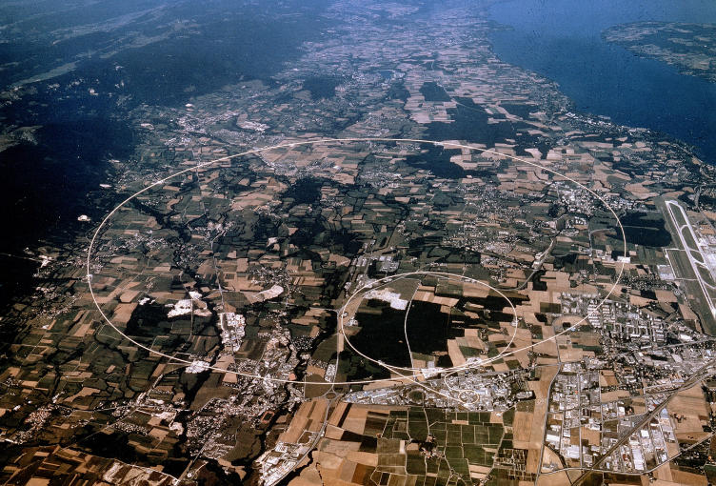
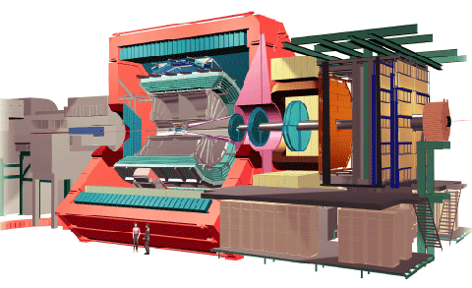
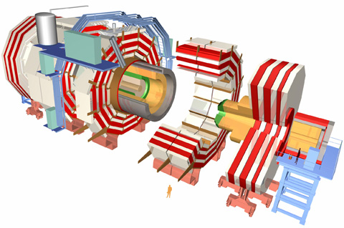
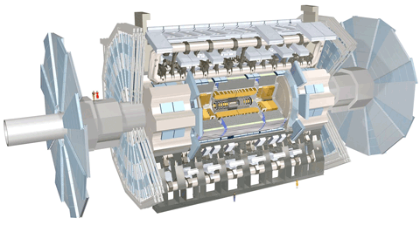
LHC Experiments
ALICE
CMS
ATLAS

Slide 12
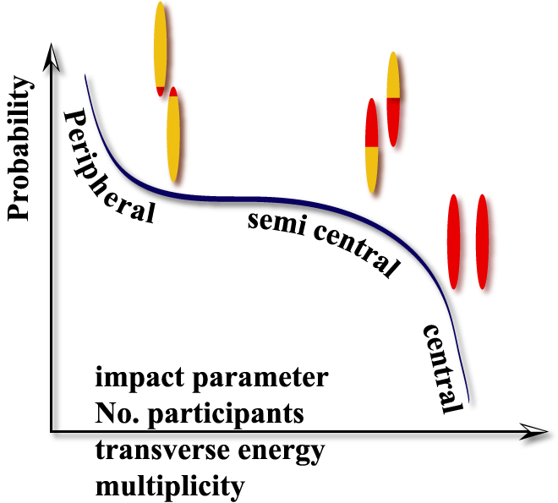
Collisions are not all the same
Spectators
Impact parameter b
Participants
Spectators
Small impact parameter (b~0)
  High energy density
  Large volume
  Large number of produced particles
Measured as:
  Fraction of cross section “centrality”
  Number of participants
  Number of nucleon-nucleon collisions
100% 0 %

Slide 13
Terminology
Peripheral Collision
Semi-Central Collision
Central Collision
100% Centrality 0%
Centrality and Reaction Plane determined on an Event-by-Event basis.
N_{part}= Number of Participants
  2 → 394
φ
Reaction Plane
Fourier decompose azimuthal yield:

Slide 14
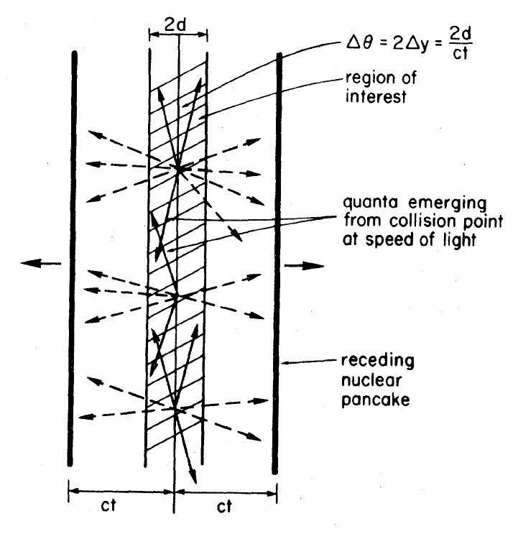
What have we done? Energy Density
Overly Simplified: Particles don’t even have to interact!
Let’s calculate the Mass overlap Energy:
Bjorken Energy Density Formula:
RHIC: ετ = 5.4 +/- 0.6 GeV/fm²c
LHC: ετ = 16 GeV/fm²c
Assumed
Measured

Slide 15
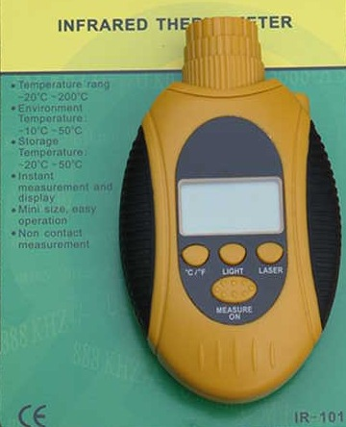



Remote Temperature Sensing
Red Hot
White Hot
Hot Objects produce thermal spectrum of EM radiation.
Red clothes are NOT red hot, reflected light is not thermal.
Photon measurements must distinguish
thermal radiation from other sources: HADRONS!!!
Not Red Hot!

Slide 16
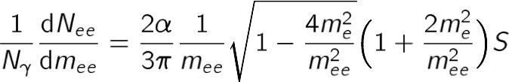


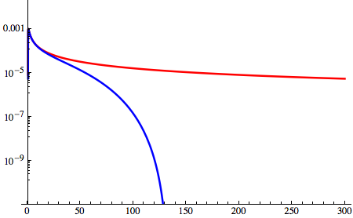
Real versus Virtual Photons
Direct photons γ_{direct}/γ_{decay} ~ 0.1 at low p_{T}, and thus systematics dominate.
Number of virtual photons
per real photon:
Hadron
decay:
Point-like
process:
form factor
1/Nγ dN_{ee}/dm_{ee} (MeV⁻¹)
About 0.001 virtual photons
with m_{ee} > M_{pion} for every
real photon
Direct photon
π⁰
Avoid the π⁰ background
at the expense of a factor
1000 in statistics
m_{ee} (MeV)

Slide 17
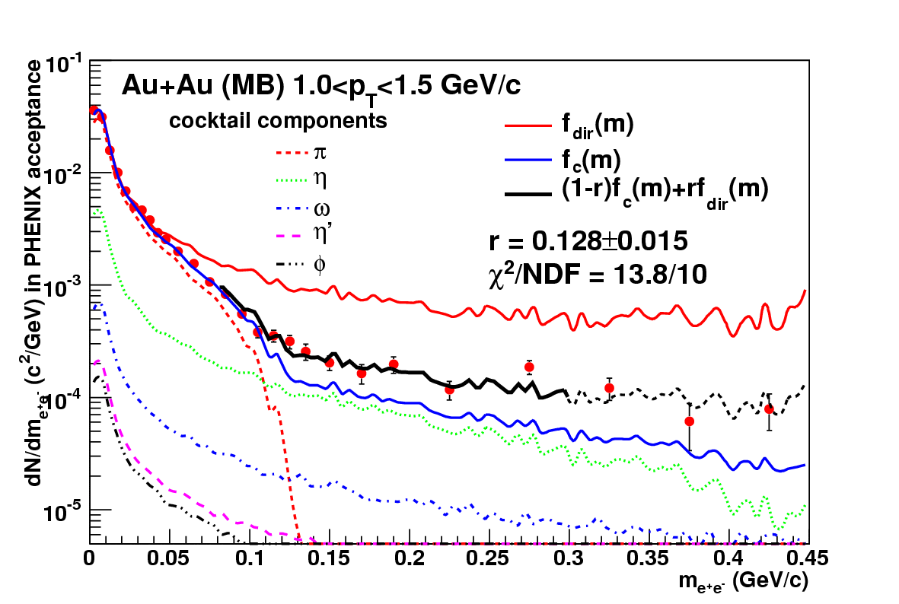
Observation of Direct Virtual Photons

Slide 18
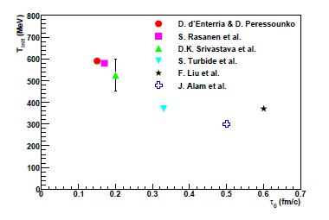
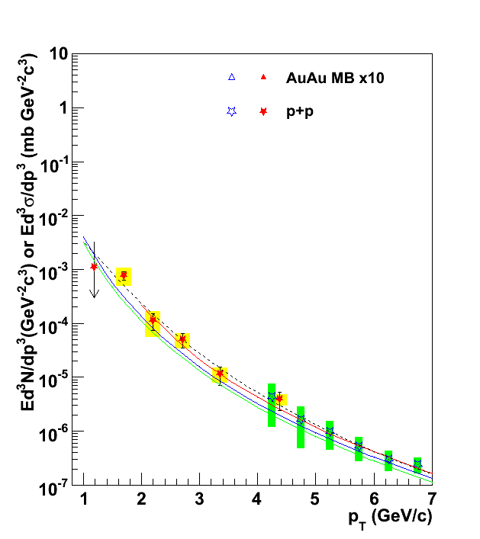
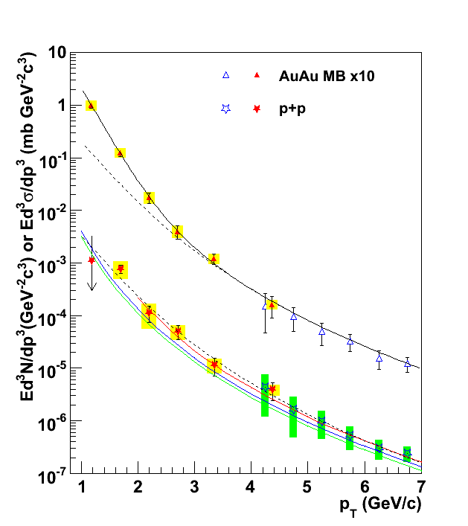
Experimental Result
T_{i} = 4-8 trillion Kelvin
Gold-Gold
Photons
Number of Photons
Emission rate and distribution consistent with
equilibrated matter
T~300-600 MeV
Proton-Proton
Photons
2 x 10⁻¹⁵ m
0.5 x 10⁻¹⁵ m
Photon Wavelength

Slide 19
Thermal Equilibrium
We’ll consider two aspects of thermal predictions:
  Chemical Equilibrium
    Are all particle species produced at the right relative abundances?
  Kinetic Equilibrium
    Energetic sconsistent with common temperature plus flow velocity?
Choose appropriate statistical ensemble:
  Grand Canonical Ensemble: In a large system with many produced particles we can implement conservation laws in an averaged sense via appropriate chemical potentials.
  Canonical Ensemble: in a small system, conservation laws must be implemented on an EVENT-BY-EVENT basis. This makes for a severe restriction of available phase space resulting in the so-called “Canonical Suppression.”
  Where is canonical required:
    low energy HI collisions.
    high energy e+e- or hh collisions
    Peripheral high energy HI collisions

Slide 20
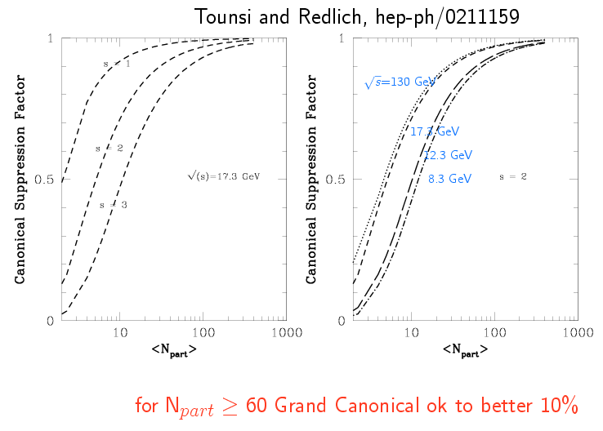
Chem Eql: Canonical Suppression
Canonical Suppression is likely the driving force behind “strangeness enhancement”

Slide 21
Thermal or Chemical yields
As you know the formula for the number density of all species:
here g_{i} is the degeneracy
E²=p²+m²
μ_{B}, μ_{S}, μ₃ are baryon, strangeness, and isospin
chemical potentials respectively.
Given the temperature and all m, on determines the equilibruim number densities of all various species.
The ratios of produced particle yields between various species can be fitted to determine T, μ.

Slide 22
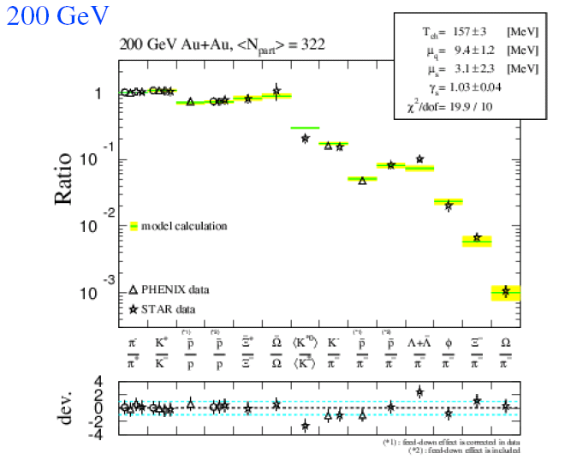
Chemical Equilibrium Fantastic
Simple 2-parameter fits to chemical equilibrium are excellent.
Description good from AGS energy and upward.
Necessary, but not sufficient for QGP

Slide 23
Kinetic Equil: Radial Flow
As you know for any interacting system of particles expanding into vacuum, radial flow is a natural consequence.
  During the cascade process, one naturally develops an ordering of particles with the highest common underlying velocity at the outer edge.
This motion complicates the interpretation of the momentum of particles as compared to their temperature and should be subtracted.
  Although 1st principles calculations of fluid dynamics are the higher goal, simple parameterizations are nonetheless instructive.
Hadrons are released in the final stage and therefore measure “FREEZE-OUT” Temp.

Slide 24
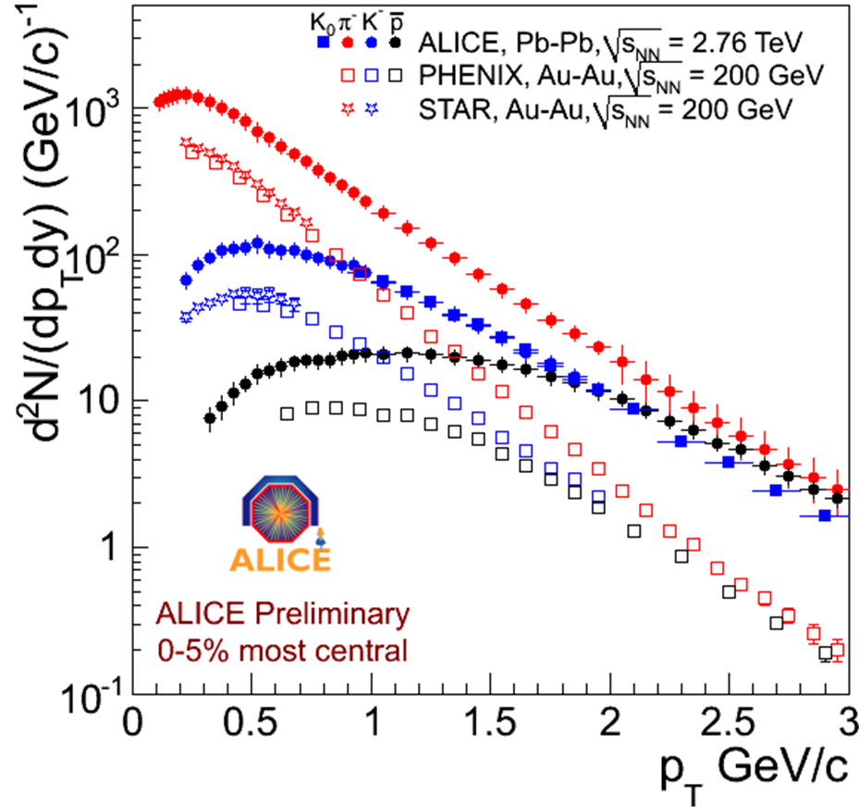
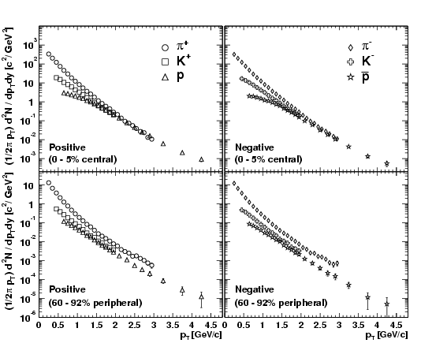
Radial Flow in Singles Spectra
Peripheral:
  Pions are concave due to feeddown.
  K,p are exponential.
  Yields are MASS ORDERED.
Central:
  Pions still concave.
  K exponential.
  p flattened at left
  Mass ordered wrong (p passes pi !!!)
Central
Peripheral
Underlying collective VELOCITIES impart more momentum to heavier species consistent with the trends

Slide 25
Decoupling Motion: Blast Wave
Let’s consider a Thermal Boltzmann Source:
If this source is boosted radially with a velocity β_{boost} and evaluated at y=0:
where
Simple assumption: uniform sphere of radius R and boost velocity varies linearly w/ r:

Slide 26
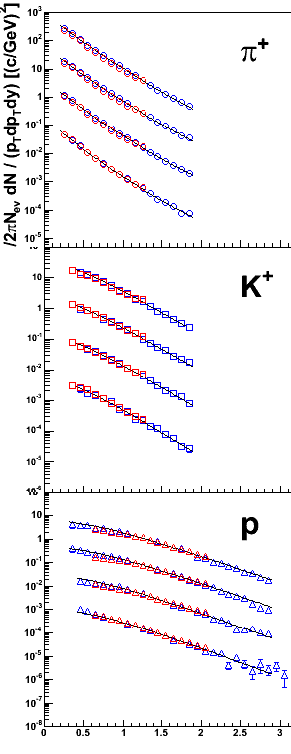
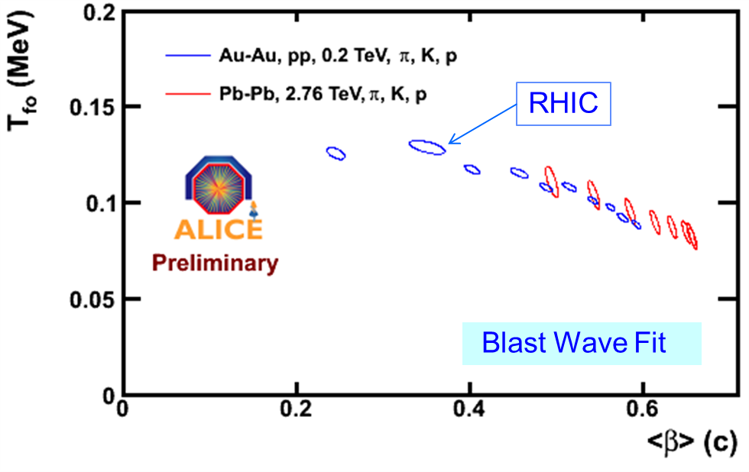
Blast Wave Fits
Fit AuAu spectra to blast wave model:
β_{S} (surface velocity) drops with dN/dη
T (temperature) almost constant.
p_{T} (GeV/c)
Notes:
Get better plot from Eun-Joo, put equqtion down.

Slide 27
Intensity Interferometry
All physics students are taught the principles of amplitude interferometry:
  The probability wave of a single particle interferes with itself when, for example, passing through two slits.
Less well known is the principle of intensity interferometry:
  Two particles whose origin or propagation are correlated in any way can be measured as a pair and exhibit wave properties in their relative measures (e.g. momentum difference).
  Correlation sources range from actual physical interactions (coulomb, strong; attractive or repulsive) to quantum statistics of identical bosons or fermions.
Measurement of two-particle correlations allows access space-time characteristics of the source.

Slide 28
Boson Correlations
a
Consider two particles emitted from two locations (a,b) within a single source.
Assume that these two are detected by detector elements (1,2).
b
The two paths (a→1,b→2) and (a→2,b→1) are indistinguishable and form the source of the correlation:
The intensity interference between the two point sources is an oscillator depending upon the relative momentum q=k₂-k₁, and the relative emission position!

Slide 29

Integrate over Source
The source density function can be written as
We define the 2-particle correlation as:
To sum sources incoherently, we integrate the intensities over all pairs of source points:
Here q,K are the 4-momentum differences and sums, respectively of the two particles.

Slide 30
Famous Naïve Mistakes
If S(x,K) = ρ(x)Π(K), the momentum dependence cancels!
  No. If the source contains any collective motions (like expansion), then there is a strong position-momentum correlation .
Gee…the correlation function is simply the Fourier Transform of S(x,K). All we need do is inverse transform the C(q,K) observable!!
  Um…no. Particles are ON SHELL.
Must use parameterized source.

Slide 31
Building Intuition
The “under-measure” of the source size for a flowing source depends upon the flow velocity:
  Higher flow velocity, smaller source.
We expect that the measured Radius parameters from HBT would drop with increasing K (or K_{T}).

Slide 32
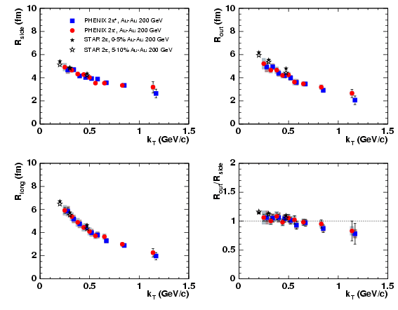
Some Results
R(Au) ~ 7 fm, R(HBT)<6 fm
  No problem, its only a homogeneity length…
R(k_{T}) drops with increasing k_{T}
  Just as one expects for flowing source…
R_{out}~R_{side}
  Surprising!
  Vanishing emission time?

Slide 33
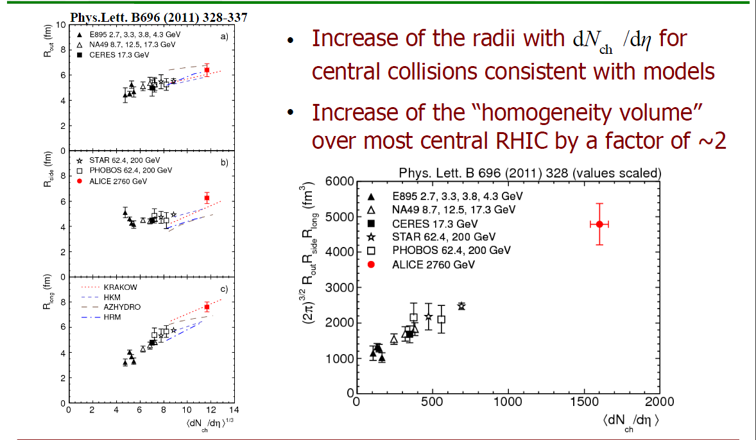
Scaling with Multiplicity

Slide 34
Is There a There There?
We accelerate nuclei to high energies with the hope and intent of utilizing the beam energy to drive a phase transition to QGP.
The collision must not only utilize the energy effectively, but generate the signatures of the new phase for us.
I will make an artificial distinction as follows:
  Medium: The bulk of the particles; dominantly soft production and possibly exhibiting some phase.
  Probe: Particles whose production is calculable, measurable, and thermally incompatible with (distinct from) the medium.
The medium & probe paradigm will establish whether there is a there there.

Slide 35
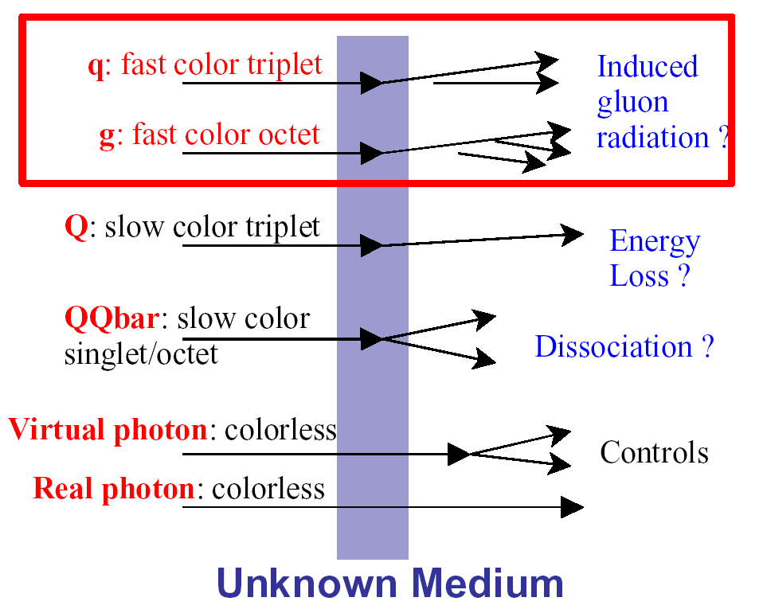
The Probes Gallery:
Jet Suppression
charm/bottom dynamics
J/Ψ & Υ
Colorless particles
CONTROL

Slide 36
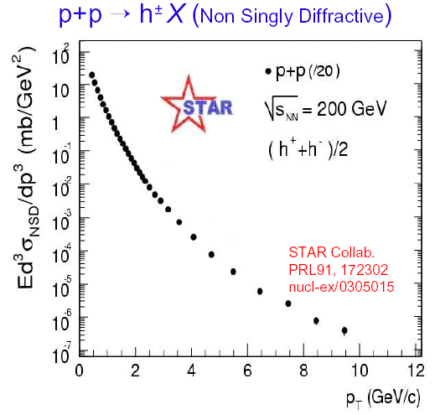
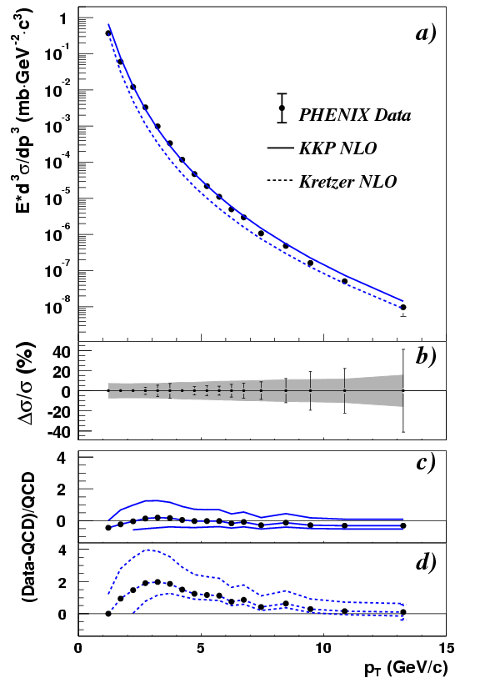
Calibrating the Probe(s)
p+p->π⁰ + X
Thermally-shaped Soft Production
“Well Calibrated”
Hard
Scattering
Measurement from elementary collisions.
“The tail that wags the dog”
(M. Gyulassy)
hep-ex/0305013 S.S. Adler et al.

Slide 37
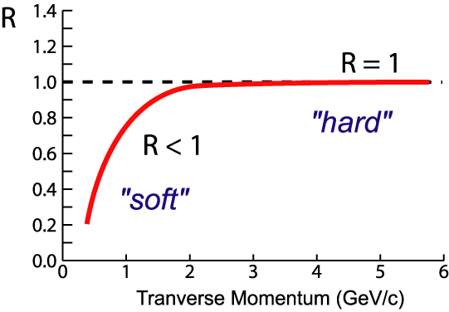
R_{AA} Normalization
1. Compare Au+Au to nucleon-nucleon cross sections
2. Compare Au+Au central/peripheral
Nuclear
Modification
Factor:
nucleon-nucleon
cross section
AA
<N_{binary}>/σ_{inel}^{p+p}
AA
If no “effects”:
R_{AA} < 1 in regime of soft physics
R_{AA} = 1 at high-p_{T} where hard
scattering dominates
Suppression:
R_{AA} < 1 at high-p_{T}
AA

Slide 38
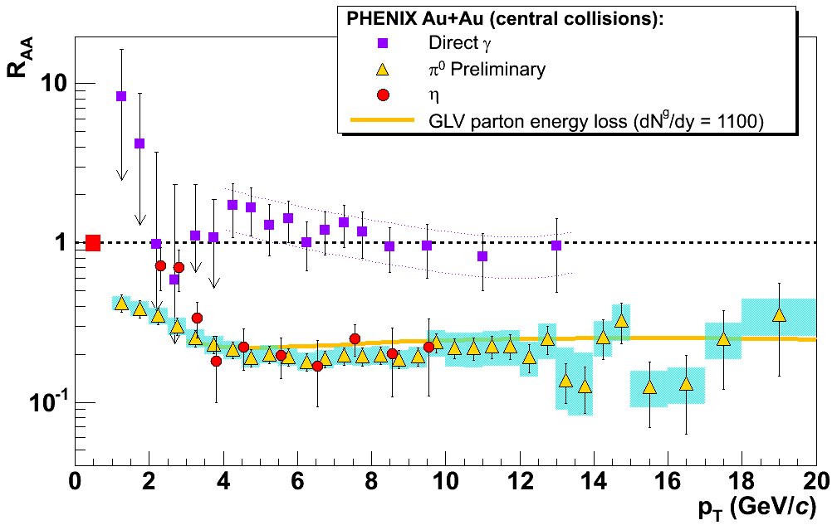
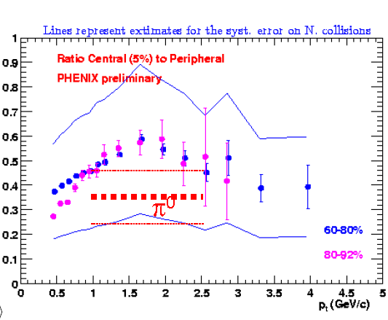
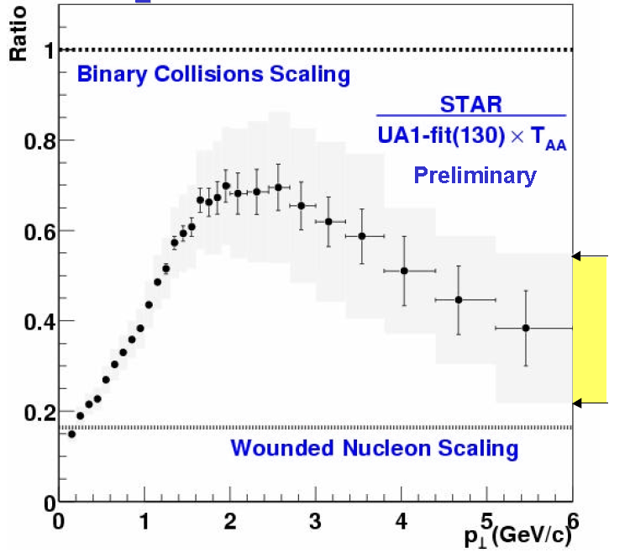
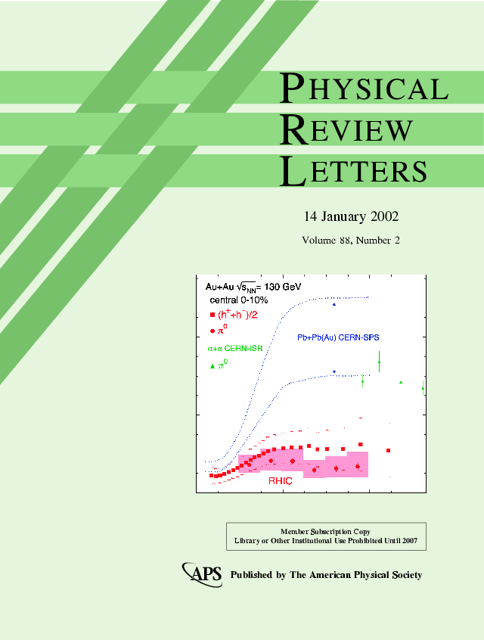

Discovered in RHIC-Year One
QM2001
QM2001
Quark-containing particles suppressed.
Photons Escape!
Gluon Density = dN_{g}/dy ~ 1100

Slide 39
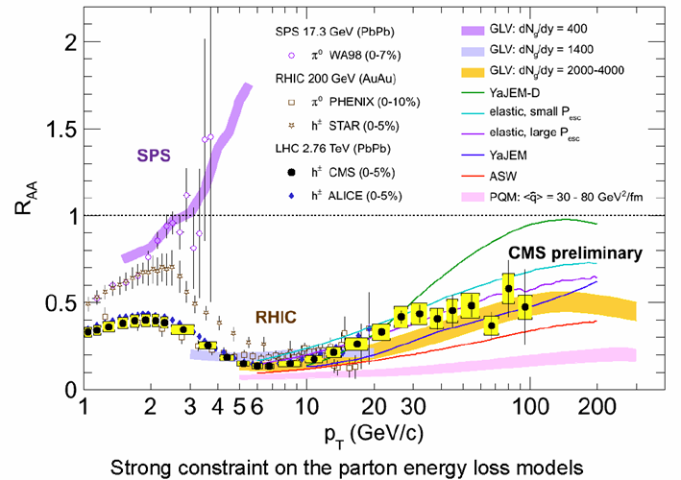
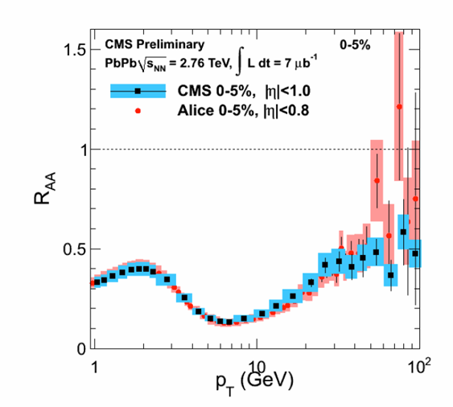
Suppression Similar @LHC
Suppression of high momentum particles similar at RHIC and LHC.
Both are well beyond the phase transition.

Slide 40
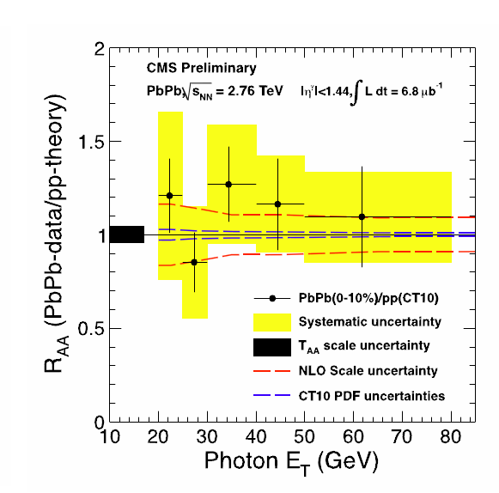
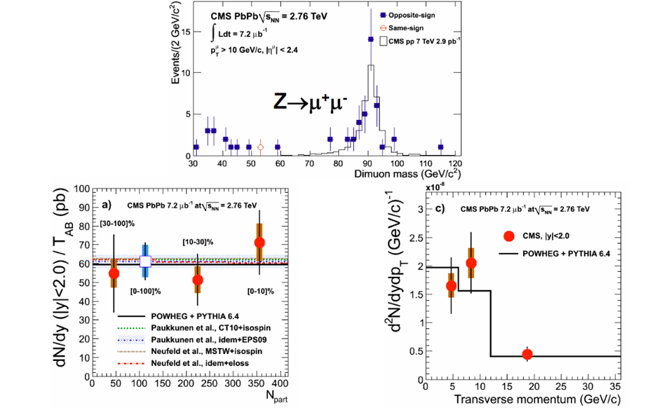
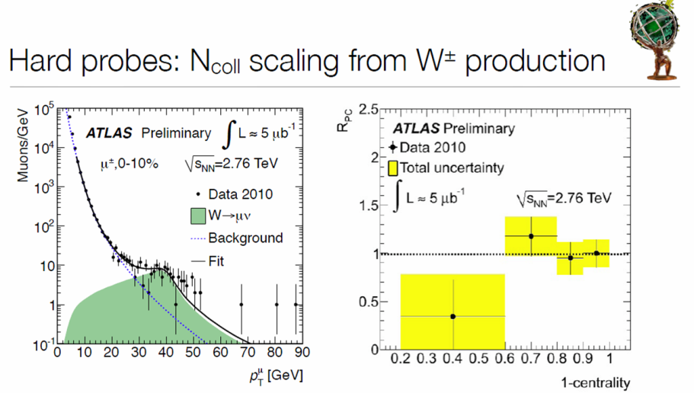
Control Measures for R_{AA}
R_{AA} intrinsically scales the pp reference by <N_{coll}> as the denominator.
Validity of this for colorless probes should be established.
At RHIC was use direct photons at large p_{T}.
At LHC, there are more:
  γ_{direct}
  W
  Z

Slide 41
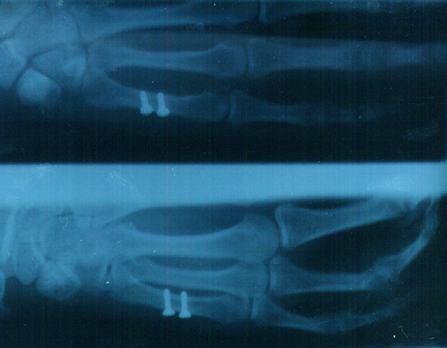
Jet Tomography
Escaping Jet
“Near Side”
Tomography, a fancy word for a shadow!
Jets are produced as back-to-back pairs.
One jet escapes, the other is shadowed.
Expectation:
  “Opaque” in head-on collisions.
  “Translucent” in partial overlap collisions.
Lost Jet
“Far Side”
Out-plane
X-ray pictures are
shadows of bones
In-plane
Can Jet Absorption be Used to
“Take an X-ray” of our Medium?

Slide 42
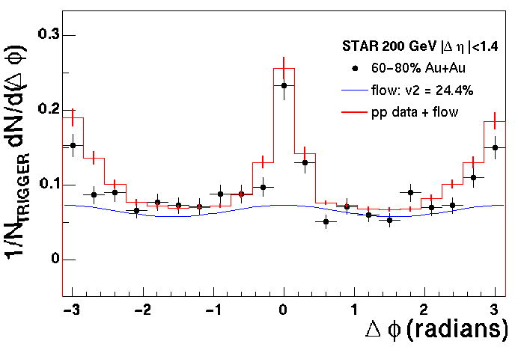



Back-to-back jets
Peripheral Au + Au
Out-plane
STAR
In-plane
Central Au + Au
Given one “jet” particle, where are it’s friends:
  Members of the “same jet” are in nearly the same direction.
  Members of the “partner jet” are off by 180º
Away-side jet gone (NOTE: where did the energy go?)

Slide 43

Singles to Jets
Parton pairs are created
at the expected rate
(control measure).
Parton pairs have a “k_{T}” due
to initial state motion.
Partons interact with medium
(E-loss,scattering?)
Fragment into Jets either within or outside the medium.
To be Learned:
  E-loss will created R_{AA}{Jets} < 1.
  Scattering will make back-to-back correl worse (higher “k_{T}”)
  Fragmentation function modification possible.

Slide 44



Moving from Singles to Jets…
LHC shows loss of Jets
similar to loss of hadrons.
Huge Asymmetry signal in ATLAS and CMS.
Must understand the nature of this loss…

Slide 45


Jet Direction
Overwhelmingly, the direction of the Jets seems preserved.
This is a shock…
How can you lose a HUGE amount of longitudinal momentum and not have a “random walk” that smears back-to-back.
Top Puzzle from LHC.

Slide 46
Summary Lecture 1
Heavy Ion collisions provide access to the thermal and hydrodynamic state of QCD.
RHIC and LHC both provide sufficient energy to create the form of matter in the “plateau” region.
The matter is opaque to the propagation of color charge while transparent to colorless objects.
Coming in Lecture #2:
  The medium behaves as a “perfect fluid”.
  Fluid is capable of altering motion of heavy quarks (c/b).
  Descriptions from string theory (AdS/CFT duality) are appropriate.
  Indications of yet another new phase of matter (Color Glass Condensate) are beginning to emerge.

