Slide 1

Statistics In HEP
How do we understand/interpret our measurements

Slide 2
Outline
What is Probability : frequentist / Bayesian
  review PDFs and some of their properties
Hypothesis testing
  test statistic
  power and size of a test
  error types
  Neyman-Pearson → What is the best test statistic
  concept of confidence level/p-value
Maximum Likelihood fit
strict frequentist Neyman – confidence intervals
  what “bothers” people with them
Feldmans/Cousins confidence belts/intervals
Yes, but what about systematic uncertainties?

Slide 3
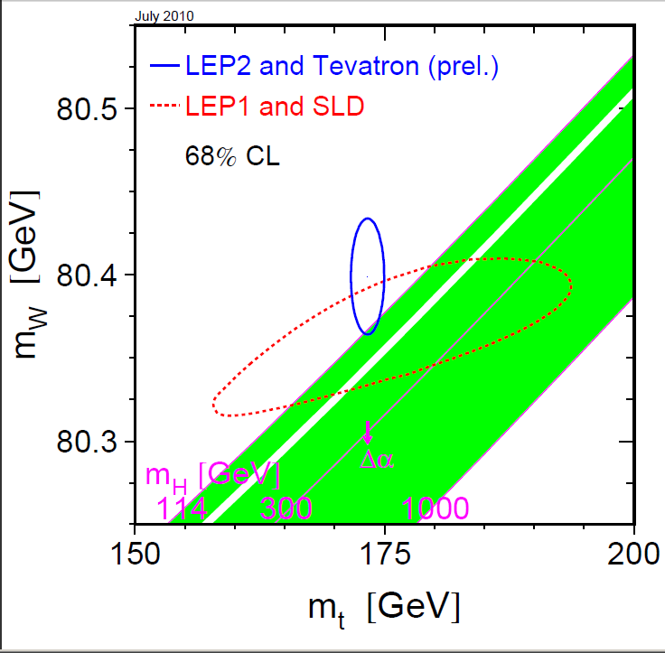
Interpreting your measurement
What do we REALLY mean by:
  m_{W} = 80.399+/- 0.023 ;
  M_{Higgs}< 114.4GeV/c² @95%CL
these things are results of:
  involved measurements
  many “assumptions”
correct statistical interpretation:
most ‘honest’ presentation of the result
  unless: provide all details/assumptions that went into obtaining the results
needed to correctly “combine” with others (unless we do a fully combined analysis)

Slide 4
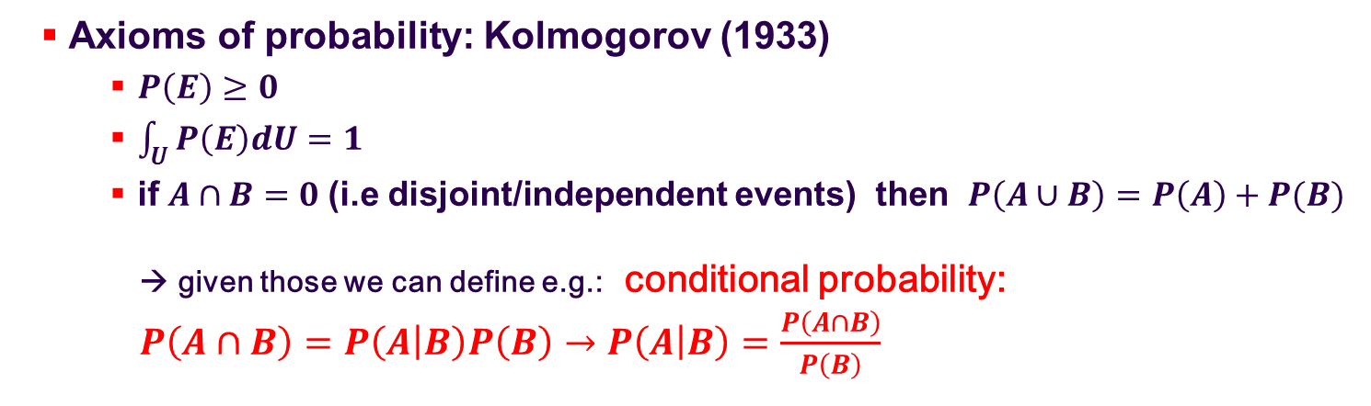
What is Probability
Axioms of probability: Kolmogorov (1933)
    $P\left(E\right)≥0$
    $\int_{U}{P\left(E\right)dU=1}$
    if $A∩B=0$(i.e disjoint/independent events) then $P\left(A∪B\right)=P\left(A\right)+P(B)$
  → given those we can define e.g.: conditional probability:
  $P\left(A∩B\right)=P\left(A | B\right)P\left(B\right)→P\left(A | B\right)=\frac{P\left(A∩B\right)}{P\left(B\right)}$
Universe
A
Universe
B
B
A
A∩B
A
Venn-Diagram
Venn-Diagram

Slide 5

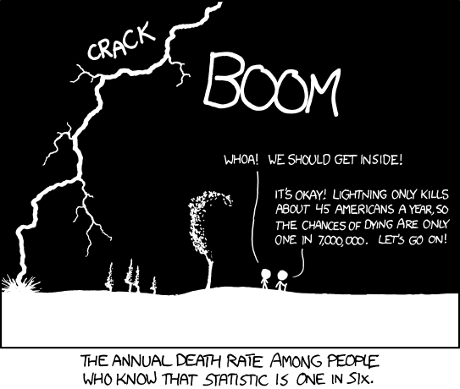
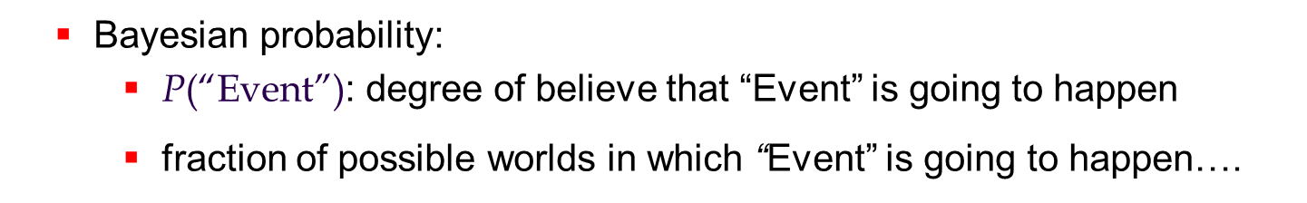
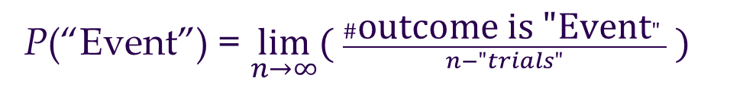
What is Probability
Axioms of probability: → pure “set-theory”
a measure of how likely it is that some event will occur;
  a number expressing the ratio of favorable – to – all cases
Frequentist probability
P(“Event”) = $\lim_{n→∞}\text{( }\frac{\#\text{outcome} \text{is}\text{ "}\text{Event}"}{n−"trials"}\text{ )}$
the quality of being probable; a probable event or the most probable event (WordNet® Princeton)
Bayesian probability:
    $\text{P}\text{(“}\text{Event}\text{”)}$: degree of believe that “Event” is going to happen
    fraction of possible worlds in which “Event” is going to happen….

Slide 6

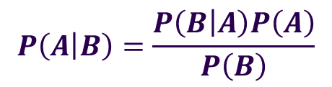
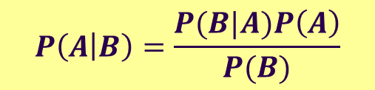


Frequentist vs. Bayesian
$$P\left(A | B\right)=\frac{P(B|A)P\left(A\right)}{P(B)}$$
=$P\left(B | A\right) \frac{P\left(B\right)}{P\left(A\right)}$
Bayes’ Theorem
This follows simply from the “conditional probabilities”:
$$P\left(A | B\right)P\left(B\right)=P\left(A∩B)=P(B∩A\right)=P\left(B | A\right)P(A)$$
$$P\left(A∩B)=P(B∩A\right)$$
$$P\left(A | B\right)P\left(B\right)=P\left(B | A\right)P(A)$$
$$P\left(A | B\right)=\frac{P\left(B | A\right)P\left(A\right)}{P\left(B\right)}$$

Slide 7
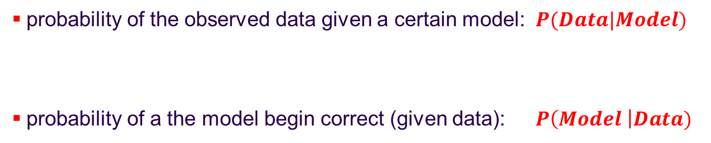
Frequentist vs. Bayesian
$$P\left(A | B\right)=\frac{P(B|A)P\left(A\right)}{P(B)}$$
=$P\left(B | A\right) \frac{P\left(B\right)}{P\left(A\right)}$
Bayes’ Theorem
Some people like to spend hours talking about this…
B.t.w.: Nobody doubts Bayes’ Theorem:
  discussion starts ONLY if it is used to turn
  frequentist statements:
into Bayesian probability statements:
probability of the observed data given a certain model: $P(Data|Model)$
probability of a the model begin correct (given data): $P\left(Model \right|Data)$
Notes:
I will not talk TOO much about Bayesian approaches in HEP. Perhaps because I don’t know enough about to REALLY judge the different approaches to “trying to be an objective Bayesian”, Jeffreys prior, uninformative priors, reference priors, Marcov-chain Monte Carlo methods to evaluate different prios etc. And: rushing through all these different ideas in the limited time of a 2h lecture (whose subject is not Bayesian vs Frequentist) will any not result into something that you’ll learns of. Hence, I’d rather try to simply make you aware of what IS Bayesian and/or frequentist in order to KNOW what you are doing! There are many so called “Hybrid-methods” around.. that use a bit of both!

Slide 8
Frequentist vs. Bayesian
Certainly: both have their “right-to-exist”
  Some “probably” reasonable and interesting questions cannot even be ASKED in a frequentist framework :
    “How much do I trust the simulation”
    “How likely is it that it is raining tomorrow?”
    “How likely is it that the LHC/Tevatron will also be operated next year?”
  after all.. the “Bayesian” answer sounds much more like what you really want to know: i.e.
  “How likely is the “parameter value” to be correct/true ?”
BUT:
  NO Bayesian interpretation w/o “prior probability” of the parameter
    where do we get that from?
    all the actual measurement can provide is “frequentist”!

Slide 9
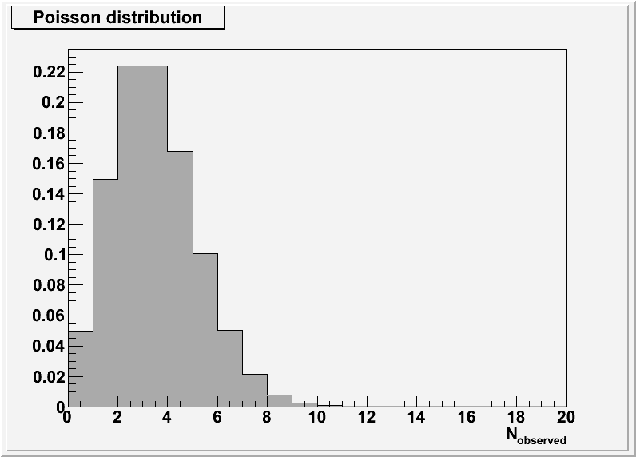
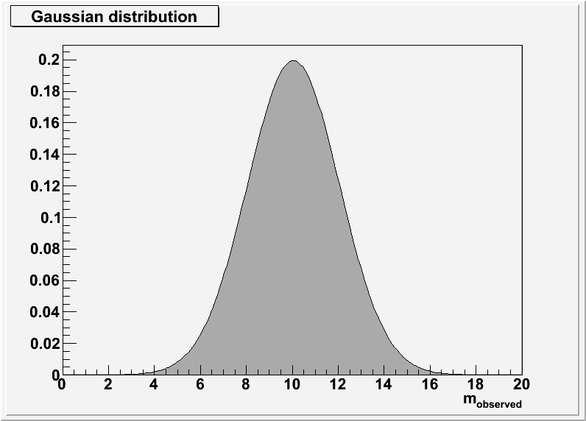






Probability Distribution/Density of a Random Variable
random variable x : characteristic quantity of point in sample space
discrete variables
continuous variables
$$P\left(x_{i}\right)=p_{i}$$
$$P\left(x ∊\left[x,x+dx\right]\right)=f\left(x\right)dx$$
normalisation (It has to be ‘somewhere’)
$$\sum_{i}{P\left(x_{i}\right)}=1$$
$$\int_{−∞}^{∞}{f\left(x\right)dx}=1$$
$$x_{i}=N_{obs.}$$
$$x=m_{obs.}$$

Slide 10
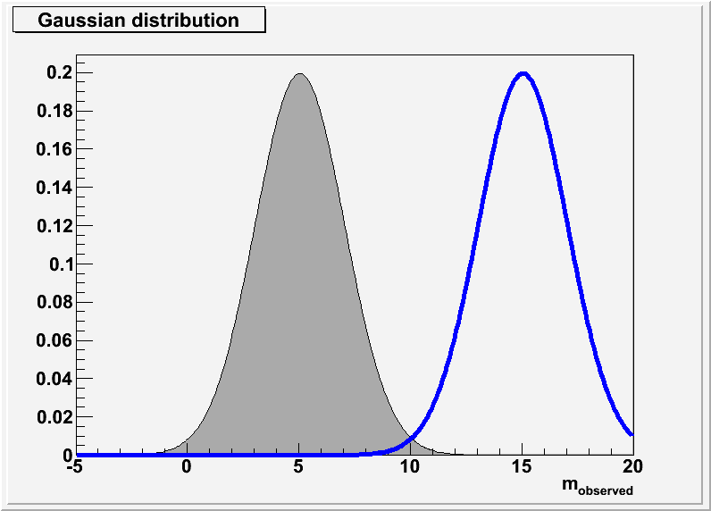
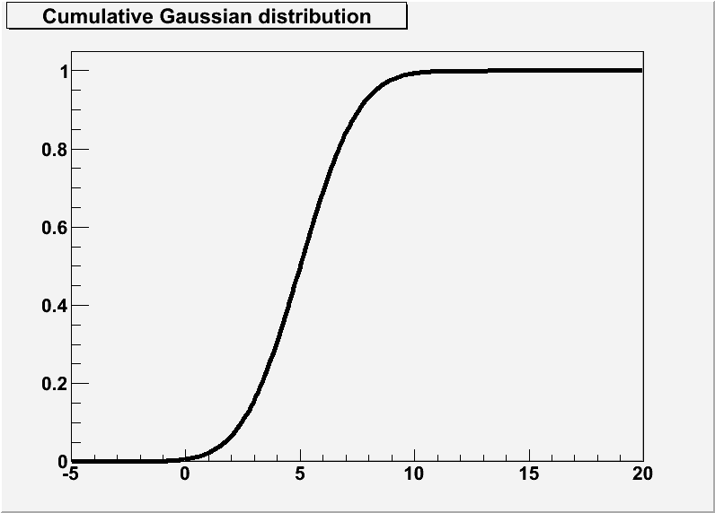
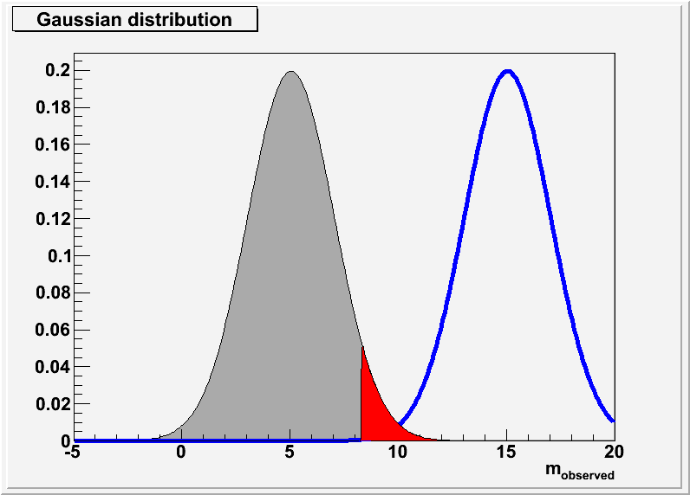
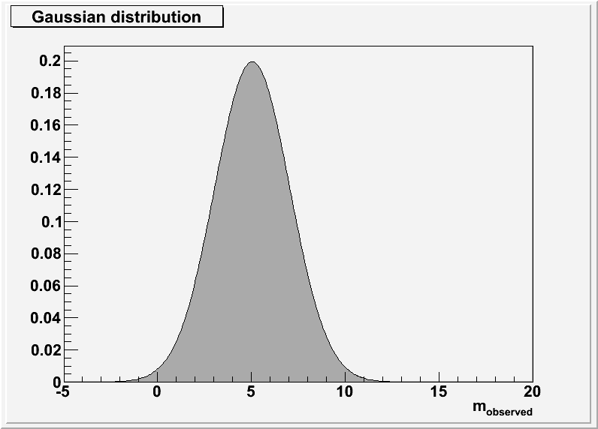

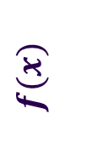

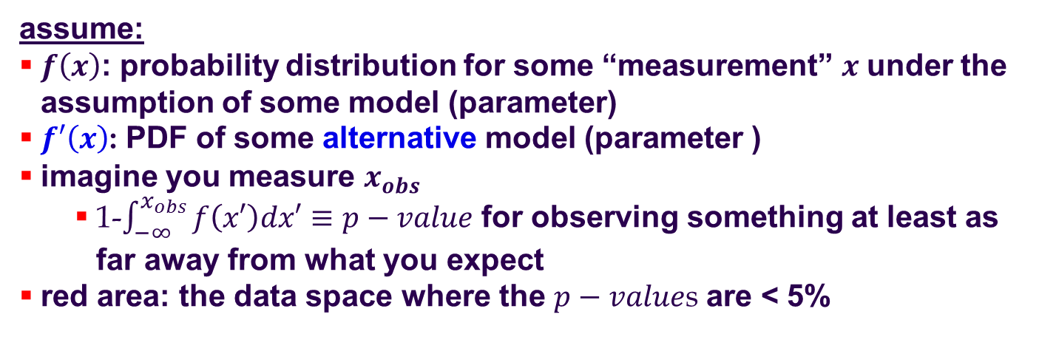



Cumulative Distribution
$$f(x)$$
PDF (probability density function)
$$F(x)$$
Cumulative PDF distribution:
$$\int_{−∞}^{x}{f\left(x′\right)dx′}≡F(x)$$
$$x$$
$$x$$
$$→f\left(x\right)=dF(x)/dx$$
assume:
$f\left(x\right)$: probability distribution for some “measurement” $x$ under the assumption of some model (parameter)
$f′\left(x\right)$: PDF of some alternative model (parameter )
imagine you measure $x_{obs}$
  1-$\int_{−∞}^{x_{obs}}{f\left(x′\right)dx′}≡p−value$ for observing something at least as far away from what you expect
red area: the data space where the $p−value$s are < 5%
we will come back to this..

Slide 11
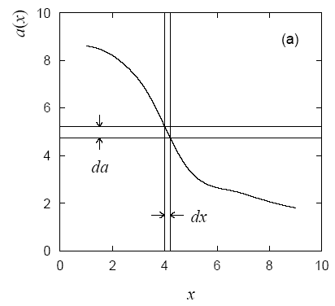
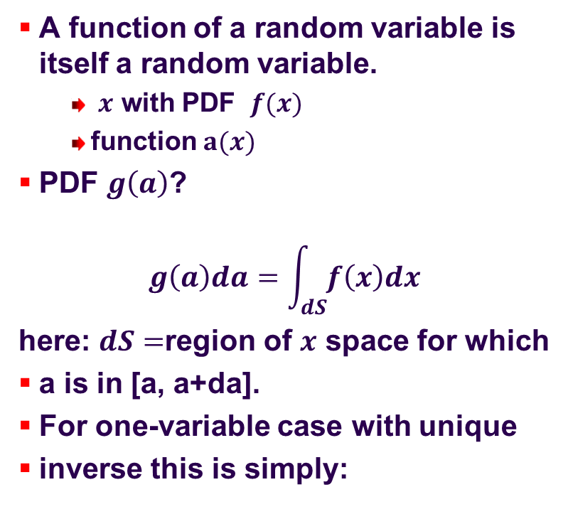
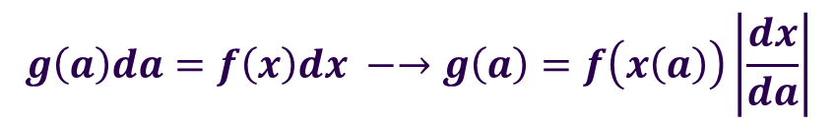
Functions of Random Variables
A function of a random variable is itself a random variable.
  $x$ with PDF $f(x)$
  function $a(x)$
PDF $g\left(a\right)$?
$$g\left(a\right)da=\int_{dS}{f\left(x\right)dx}$$
here: $dS=$region of $x$ space for which
a is in [a, a+da].
For one-variable case with unique
inverse this is simply:
Glen Cowan: Statistical data analysis
$$g\left(a\right)da=f\left(x\right)dx −→g\left(a\right)=f\left(x\left(a\right)\right)\left|\frac{dx}{da}\right|$$

Slide 12
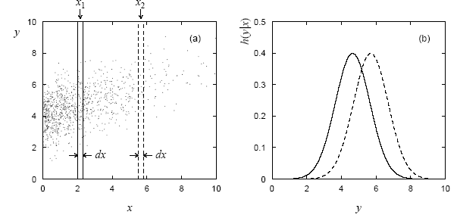
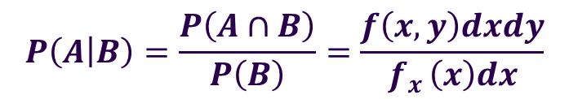
Conditioning and Marginalisation
$$P\left(A | B\right)=\frac{P\left(A∩B\right)}{P\left(B\right)}=\frac{f\left(x,y\right)dxdy}{f_{x }\left(x\right)dx}$$
conditional probability:
↔ consider some variable in the joint PDF(x,y) as constant (given):
Glen Cowan: Statistical data analysis
marginalisation: If you are not interested in the dependence on “x”
→ project onto “y” (integrate “x out”)

Slide 13
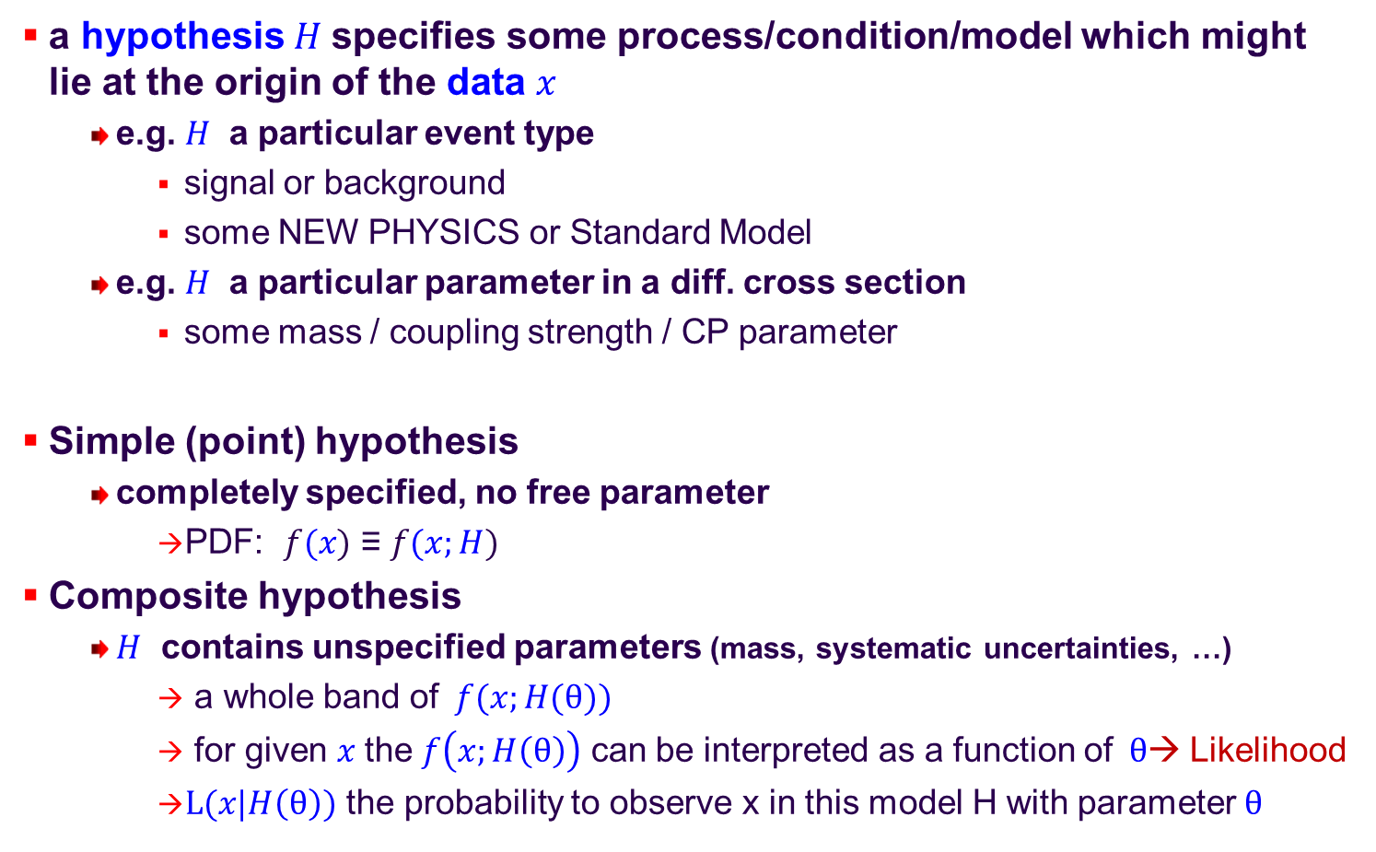
Hypothesis Testing
a hypothesis $H$specifies some process/condition/model which might lie at the origin of the data $x$
  e.g. $H$ a particular event type
    signal or background
    some NEW PHYSICS or Standard Model
  e.g. $H$ a particular parameter in a diff. cross section
    some mass / coupling strength / CP parameter
Simple (point) hypothesis
  completely specified, no free parameter
    PDF: $f(x)$ ≡ $f(x;H)$
Composite hypothesis
  $H$ contains unspecified parameters (mass, systematic uncertainties, …)
    a whole band of $f(x;H(θ))$
    for given $x$the $f\left(x;H\left(θ\right)\right)$ can be interpreted as a function of$θ$→ Likelihood
    $L(x|H\left(θ\right))$ the probability to observe x in this model H with parameter $θ$

Slide 14
Why talking about “NULL Hypothesis”
Statistical tests are most often formulated using a
  “null”-hypothesis and its
  “alternative”-hypotheisis
Why?
  it is much easier to “exclude” something rather than to prove that something is true.
    excluding: I need only ONE detail that clearly contradicts
  assume you search for the “unknown” new physics.
  “null”-hypothesis : Standard Model (background) only
  “alternative”: everything else

Slide 15
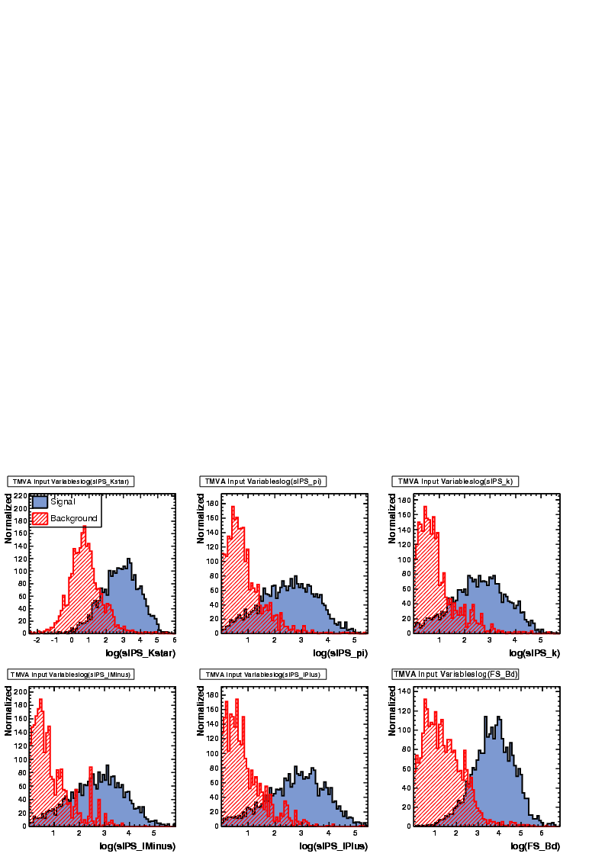
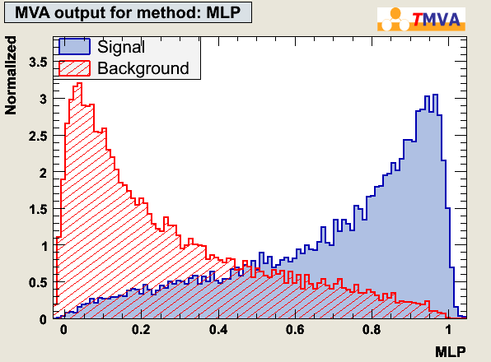

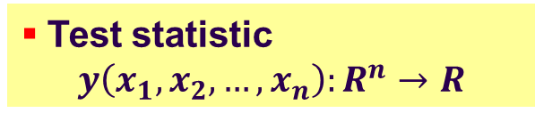
Hypothesis Testing
Example: event classification Signal(H₁) or Background(H₀)
Test statistic
$$y\left(x_{1},x_{2},…,x_{n}\right):R^{n}→R$$
y(B) → 0, y(S) → 1
PDF$\left(y | Signal\right)$ and PDF$\left(y | Bkg\right)$
^{n}
“feature space”
choose cut value:
i.e. a region where you “reject” the null- (background-) hypothesis
(“size” of the region based on signal purity or efficiency needs)
y
> cut: signal
= cut: decision boundary
< cut: background
y(x):
You are bound to making the wrong decision, too…

Slide 16
Hypothesis Testing
Type-1 error: (false positive)
  → accept as signal although it is background
Trying to select signal events:
(i.e. try to disprove the null-hypothesis stating it were “only” a background event)
 | Signal | Back-ground
Signal | ☺ | Type-2 error
Back-ground | Type-1 error | ☺
accept as:
truly is:
Type-2 error: (false negative)
  → reject as background although it is signal

Slide 17
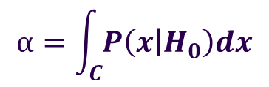
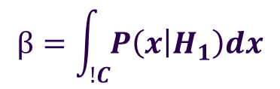
Hypothesis Testing
Type-1 error: (false positive)
  reject the null-hypothesis although it would have been the correct one
  → accept alternative hypothesis although it is false
Try to exclude the null-hypothesis (as being unlikely to be at the basis of the observation):
 | H₁ | H₀
H₁ | ☺ | Type-2 error
H₀ | Type-1 error | ☺
accept as:
truly is:
Type-2 error: (false negative)
  fail to reject the null-hypothesis/accept null hypothesis although it is false
  → reject alternative hypothesis although it would have been the correct/true one
“C”: “critical” region: if data fall in there → REJECT the null-hypothesis
Significance α: Type-1 error rate:
$$α=\int_{C}{P\left(x | H_{0}\right)dx}$$
should be small
Size β: Type-2 error rate:
Power: 1− β
$$β=\int_{!C}{P\left(x | H_{1}\right)dx}$$
should be small

Slide 18
Type 1 versus Type 2 Errors
Signal(H₁) /Background(H₀)
discrimination:
“limit” in ROC curve
given by likelihood ratio
1
y(B) → 0, y(S) → 1
y’(x)
1- ε_{backgr.}
y’’(x)
Type-1 error small
Type-2 error large
which one of those
two is the better??
Type-1 error large
Type-2 error small
y(x)
0
ε_{signal}
0
1
Signal(H₁) /Background(H₀) :
Type 1 error: reject H₀ although true → background contamination
  Significance α: background sel. efficiency 1− α: background rejection
Type 2 error: accept H₀ although false → loss of efficiency
  Power: 1− β signal selection efficiency

Slide 19
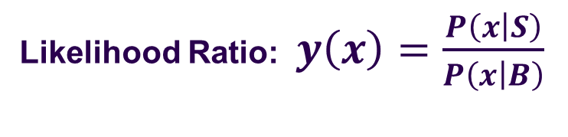
Neyman Pearson Lemma
Likelihood Ratio: $y\left(x\right)=\frac{P\left(x | S\right)}{P\left(x | B\right)}$
“limit” in ROC curve
given by likelihood ratio
1
Neyman-Peason:
The Likelihood ratio used as “selection criterium” y(x) gives for each selection efficiency the best possible background rejection.
i.e. it maximises the area under the “Receiver Operation Characteristics” (ROC) curve
1- α.
Type-1 error small
Type-2 error large
Type-1 error large
Type-2 error small
0
1−β
0
1

Slide 20
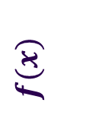
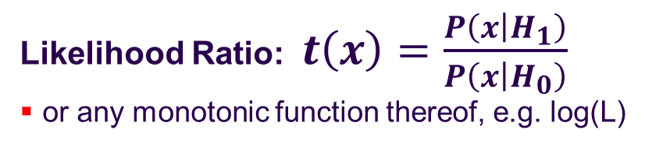

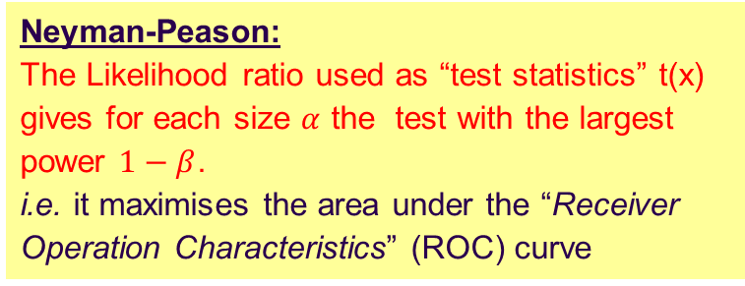
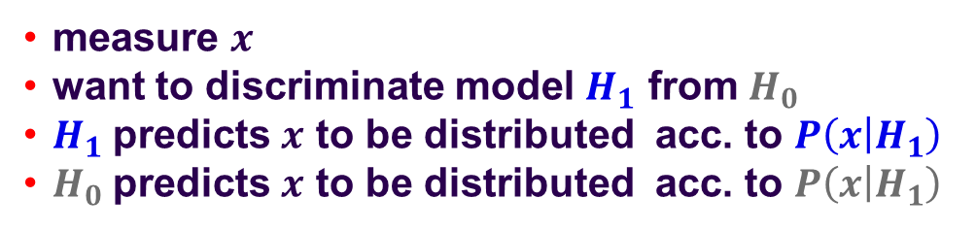
Neyman Pearson Lemma
Likelihood Ratio: $t\left(x\right)=\frac{P\left(x | H_{1}\right)}{P\left(x | H_{0}\right)}$
or any monotonic function thereof, e.g. log(L)
“limit” in ROC curve
given by likelihood ratio
1
Neyman-Peason:
The Likelihood ratio used as “test statistics” t(x) gives for each size $α$ the test with the largest power $1−β$.
i.e. it maximises the area under the “Receiver Operation Characteristics” (ROC) curve
1- α.
Type-1 error small
Type-2 error large
Type-1 error large
Type-2 error small
0
1−β
$$f(x)$$
0
1
measure $x$
want to discriminate model $H_{1}$ from $H_{0}$
$H_{1}$predicts $x$ to be distributed acc. to $P\left(x | H_{1}\right)$
$H_{0}$predicts $x$ to be distributed acc. to $P\left(x | H_{1}\right)$
$$x$$

Slide 21
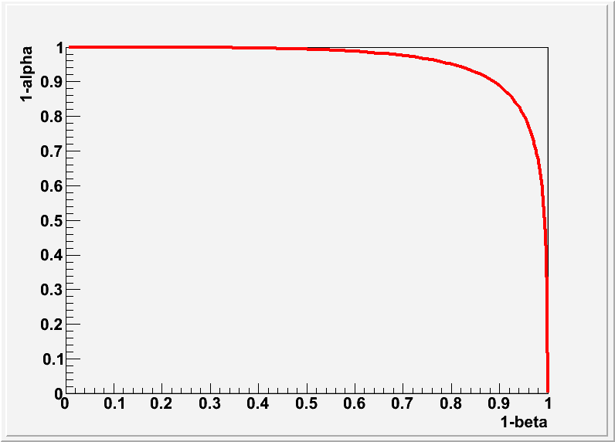
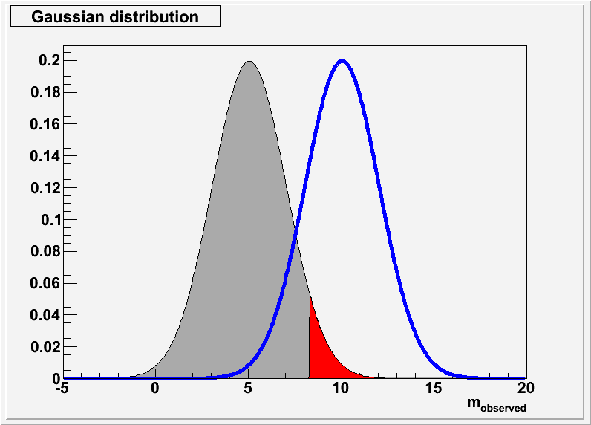
Neyman Pearson Lemma
Likelihood Ratio: $t\left(x\right)=\frac{P\left(x | H_{1}\right)}{P\left(x | H_{0}\right)}$
or any monotonic function thereof, e.g. log(L)
Note: it is probably better to plot 1/α rather than 1- α as:
α →α/2 means
“HALF the background”
Neyman-Peason:
The Likelihood ratio used as “test statistics” t(x) gives for each size $α$ the test with the largest power $1−β$.
i.e. it maximises the area under the “Receiver Operation Characteristics” (ROC) curve
$$f(x)$$
measure $x$
want to discriminate model $H_{1}$ from $H_{0}$
$H_{1}$predicts $x$ to be distributed acc. to $P\left(x | H_{1}\right)$
$H_{0}$predicts $x$ to be distributed acc. to $P\left(x | H_{1}\right)$
$$x$$

Slide 22
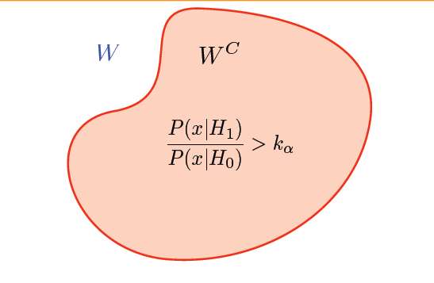

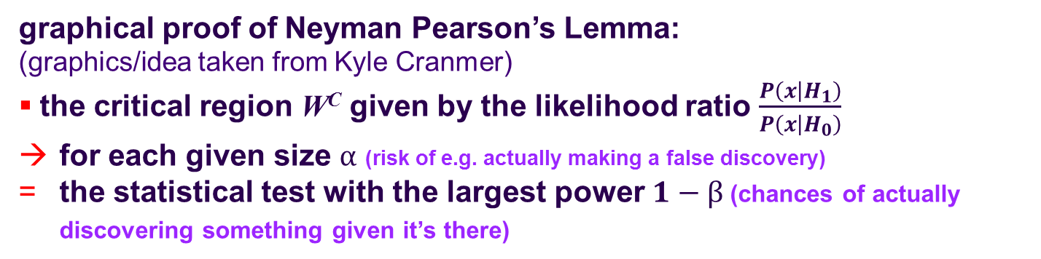
Neyman Pearson Lemma
Kyle Cranmer
$$\frac{P\left(x | H_{1}\right)}{P\left(x | H_{0}\right)}<k_{α}$$
graphical proof of Neyman Pearson’s Lemma:
(graphics/idea taken from Kyle Cranmer)
the critical region W^{C} given by the likelihood ratio $\frac{P\left(x | H_{1}\right)}{P\left(x | H_{0}\right)}$
for each given size $α$ (risk of e.g. actually making a false discovery)
the statistical test with the largest power $1−β$(chances of actually discovering something given it’s there)

Slide 23
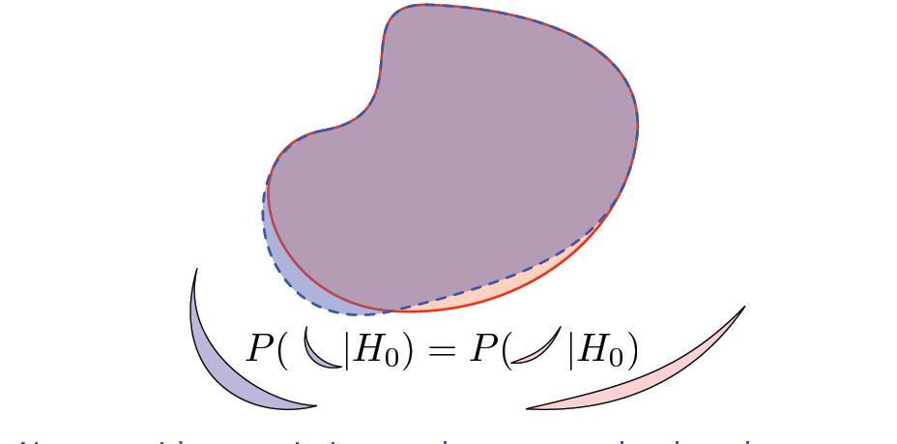
Neyman Pearson Lemma
Kyle Cranmer
assume we want to modify/find another “critical” region with same size (α) i.e. same probability under H₀

Slide 24
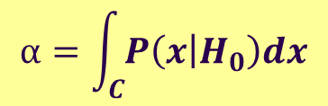
Neyman Pearson Lemma
Kyle Cranmer
$$α=\int_{C}{P\left(x | H_{0}\right)dx}$$
… as size (α) is fixed

Slide 25
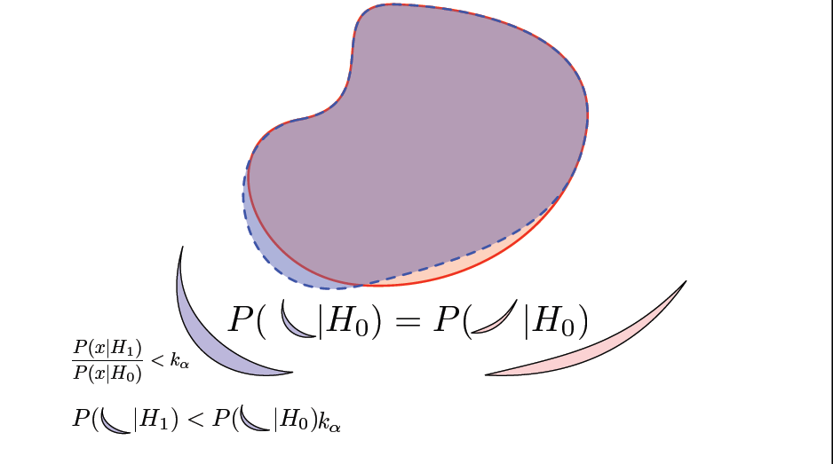
Neyman Pearson Lemma
Kyle Cranmer
outside “critical region” given by LL-ratio

Slide 26
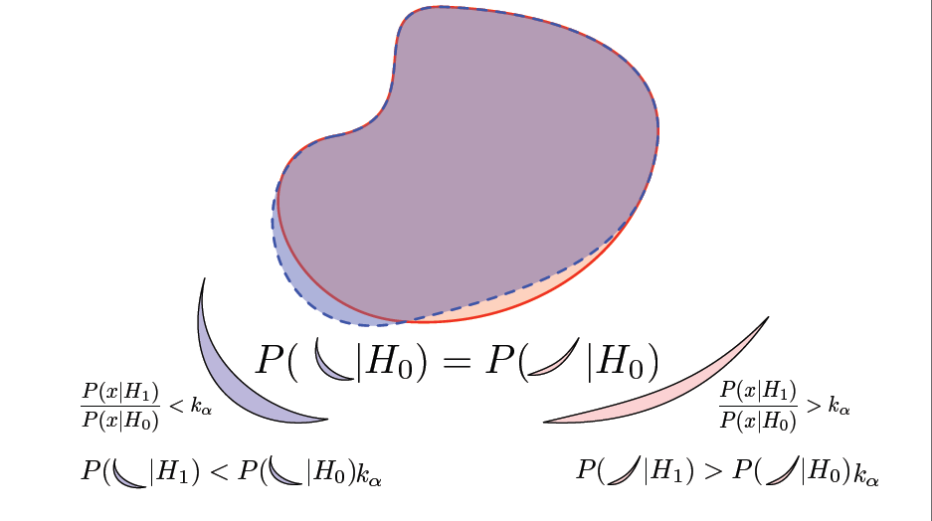
Neyman Pearson Lemma
Kyle Cranmer
outside “critical region” given by LL-ratio
inside “critical region” given by LL-ratio

Slide 27
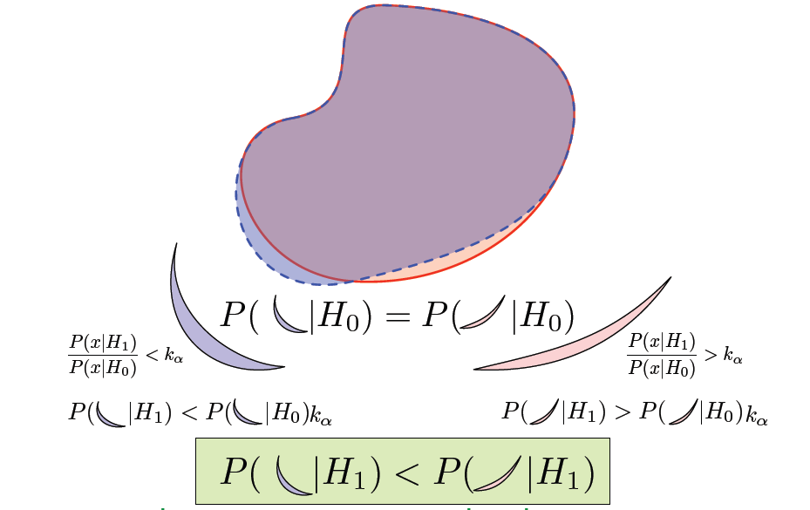
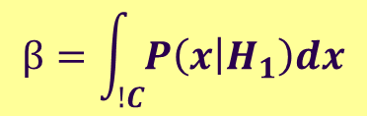
Neyman Pearson Lemma
Kyle Cranmer
$$β=\int_{!C}{P\left(x | H_{1}\right)dx}$$

Slide 28
Neyman Pearson Lemma
Kyle Cranmer
“acceptance” region
(accept H₀ (reject H₁)
“critical” region
(reject H₀)
The NEW “acceptance” region has less power! (i.e. probability under H₁ ) q.e.d

Slide 29
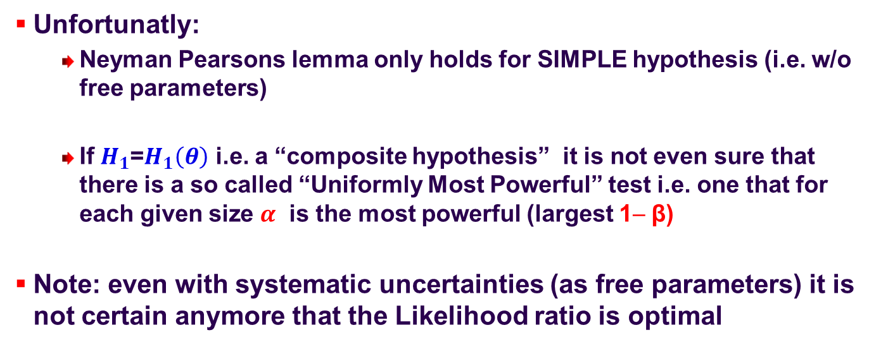
Neyman Pearson Lemma
Unfortunatly:
  Neyman Pearsons lemma only holds for SIMPLE hypothesis (i.e. w/o free parameters)
  If $H_{1}$=$H_{1}\left(θ\right)$ i.e. a “composite hypothesis” it is not even sure that there is a so called “Uniformly Most Powerful” test i.e. one that for each given size $α$ is the most powerful (largest 1− β)
Note: even with systematic uncertainties (as free parameters) it is not certain anymore that the Likelihood ratio is optimal

Slide 30
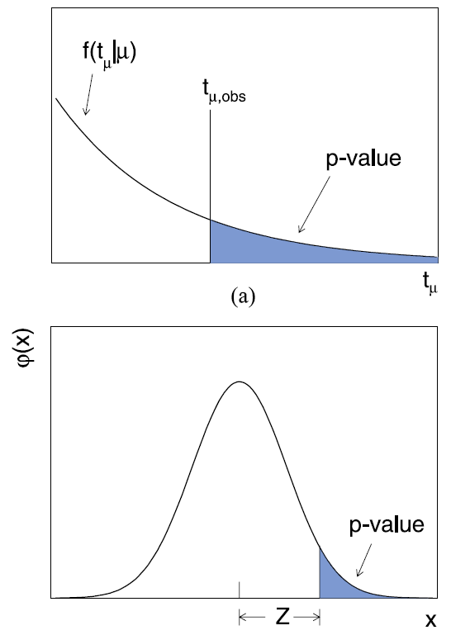
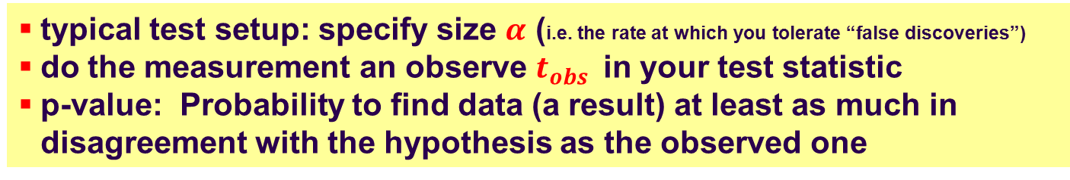
P-Value
typical test setup: specify size $α$ (i.e. the rate at which you tolerate “false discoveries”)
do the measurement an observe $t_{obs }$ in your test statistic
p-value: Probability to find data (a result) at least as much in disagreement with the hypothesis as the observed one
Note:
p-value is property of the actual measurement
p-value is NOT a measure of how probably the hypothesis is
translate to the common “sigma”
how many standard deviations “Z” for same p-value on one sided Gaussian
5σ = p-value of 2.87∙10⁻⁷

Slide 31

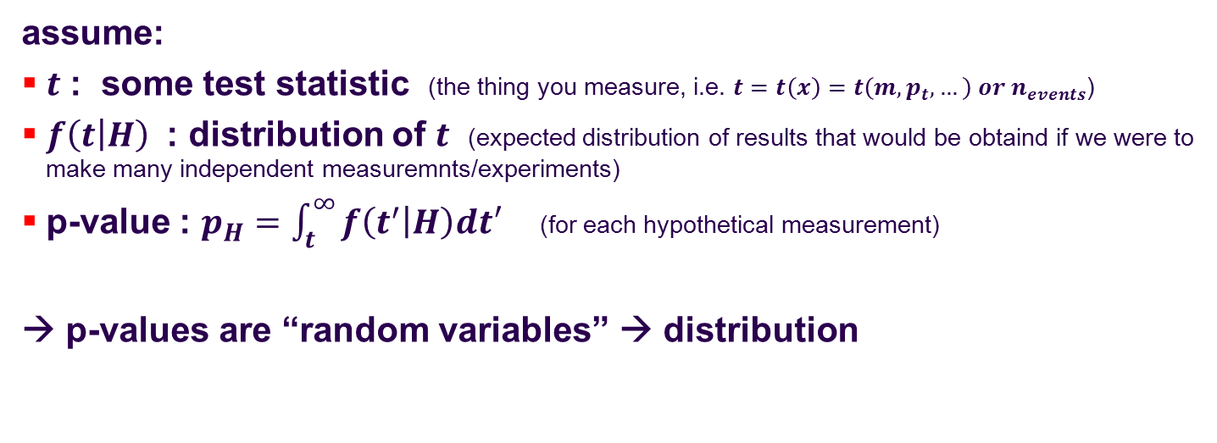


Distribution of P-Values
assume:
$t$ : some test statistic (the thing you measure, i.e. $t=t\left(x\right)=t\left(m,p_{t},…\right) or n_{events}$)
$f\left(t | H\right)$ : distribution of $t$ (expected distribution of results that would be obtaind if we were to make many independent measuremnts/experiments)
p-value : $p_{H}=\int_{t}^{∞}{f\left(t^{′} | H\right)dt′}$ (for each hypothetical measurement)
→ p-values are “random variables” → distribution
remember: $χ^{2}$ and e.g. straight line fit
  $χ^{2}$probability is flat
  value tell you “how unlucky” you were with your “goodness-of-fit” ($χ^{2}$ at the best fit)
  up to you to decide if you still trust the model
0
1
$$p_{H}$$

Slide 32

Summary
Hypothesis testing
  for simple hypothesis:
    Likleihood Ration as teststatistic gives the most powerful test
      for each given $size=α$ (probability of “false discoveries”, accidnetally rejecting $H_{0} (background only)$ hypothesis
      the largest power power$=1−β$ (chance to actually SEE the effect given it’s there)
  concept of confidence level / p-value
    specify you test to “reject” if outcome falls in “rejection/critical” region (typically some 95% CL or higher for discoveries)
    p-value (probability to observes s.th. even less in agreement with the (null) hypothesis as my measurement

