Slide 1
Direct Digitisation for the Power and Amplitude Measurement of Broadband Pulses: Sampling and Quantisation Effects on Resolution
BI Seminar
Irene Degl’Innocenti - CERN / SY-BI-BP
08/10/2021
Notes:
Hello everyone, I’m Irene Degl’Innocenti. For those of you who don’t know me, I’m currently a fellow in the Beam Position section in the Beam Instrumentation Group. I am developing digital signal processing and acquisition electronics for the new LHC Beam Position Monitor systems.
Today I’m presenting my PhD work, in collaboration with the University of Pisa, that mainly refers to the LHC Beam Extraction Interlock BPM system. More generally speaking, my research activity has been into understanding how the Analog to Digital conversion stage defines the performance of an instrumentation system that wants to measure the power or the amplitude of broadband pulses after direct digitisation.

Slide 2

Outline
Introduction
Analog to Digital Conversion: definitions and limits
Analysis of the sampling effects on the average power measurement of direct digitally acquired pulses
Study of the effects of digitisation in the LHC beam extraction interlock BPM prototype
Conclusions
Notes:
After a short introduction to provide the context, I’ll provide some reference about analog to digital conversions and undersampling.
Then I will present the main core of my reserach work, that are the general analytic results I have obtained and how they were applied to a specific beam position systems, in synergy with numeric simulations and experimental measurements.
I’ll finally draw the conclusions.

Slide 3
Introduction

Slide 4
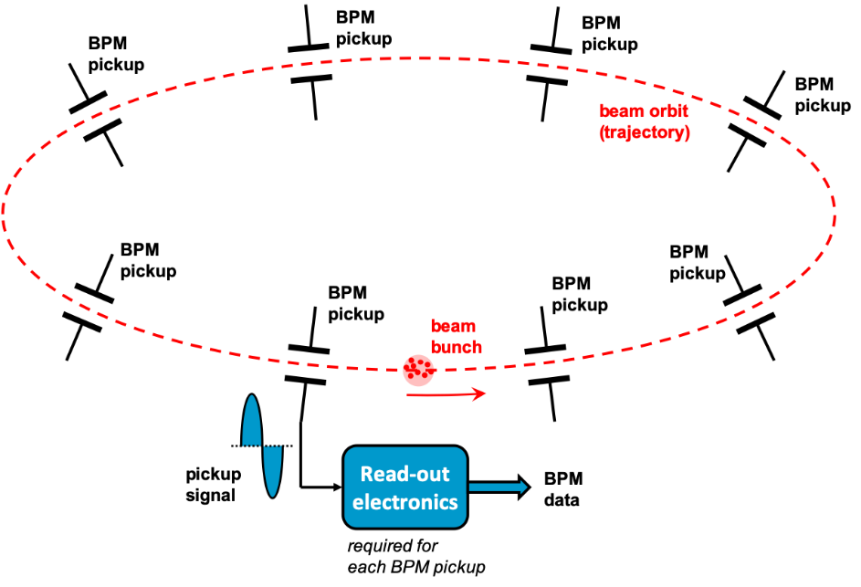
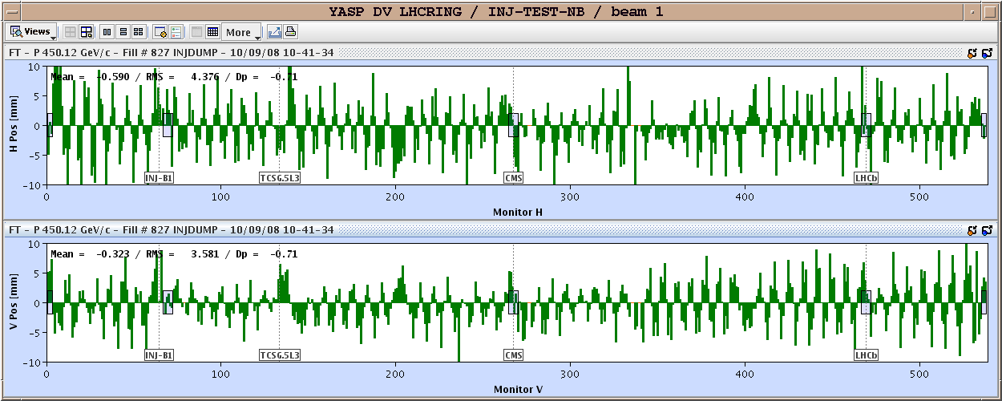
Introduction
Direct digitisation in instrumentation
ANALOG
DIGITAL
ELECTROMAGNETIC TRANSDUCER
SIGNAL PROCESSING
SIGNAL PROCESSING
MEASUREMENT
ADC
Tendency towards direct-digitisation based architecture
Notes:
Direct digitization, What does it mean? The transducers interact with the physical system under observation, generating electric signals. For example, in a beam position monitor system, the bunched beam generate broadband pulses in the analogue domain.
The instrument must provide a digital information about the measured parameter, at the required bandwidth and resolution. In our example it is the beam orbit at various locations of the accelerator.
The signal processing electronics must calculate this information combining analogue conditioning and digital signal processing, with a digitization stage in between.
We talk about direct digitization if the digitization is performed at an early stage of the processing chain, after minimal conditioning.

Slide 5
Introduction
Direct digitisation in instrumentation
Less analogue components
  Less parameter spread
  Less parameter drifts effects
Flexibility of the digital signal processing
  Programmable filters and algorithms
BUT demanding requirements in terms of resolution and sampling rate on the digitisation stage
Notes:
Why is it interesting? First of all it allows to minimise the number of analog components, meaning less parameter spread and less parameter drift. This is valuable when building, operating and mantaining hundreds of monitors for more than a decade.
Then having most of the signal processing in the digital domain maximises the system flexibility, with reprogrammable filters and algorithms.
The downside are the high requirements for the digitisation, in terms resolution and sampling rate, the ADC must digest fast broadband signals with high dynamic range.
There are intrinsic technologic limits on the achievable performance of an ADC and a trade off between high sampling rate and high resolution: the faster you go, the worse is the resolution.

Slide 6
Introduction
Objective and methodology
Analyse the impact of the characteristics of the ADC on the system resolution performance.
GOAL
Analytical model of the error induced by limited sampling rate and sampling resolution to the power measurement of a digitally acquired pulse.
METHODOLOGY
Study case: the LHC extraction interlock Beam Position Monitor
Beam Measurements
Comparison of the results and validation of the model
Numeric Simulation
Notes:
So, the main goal of my research activity was to analyse the impact of the characteristics of the ADC on the system resolution perfomance,
To do so, on one side I studied the generic problem of describing the error induced by a limited sampling rate and sampling resolution to the power measurement of a digitally acquired pulse.
On the other side I applied my studies to a specific system, the Large Hadron Collider extraction interlock Beam Position Monitor. A prototype of the system was used to perform beam measurement. The system was also replicated in numeric simulation In order to cross-check the results of the analytic model, the simulations and the measurements.

Slide 7
Analog to Digital Conversion
Definitions and limits

Slide 8
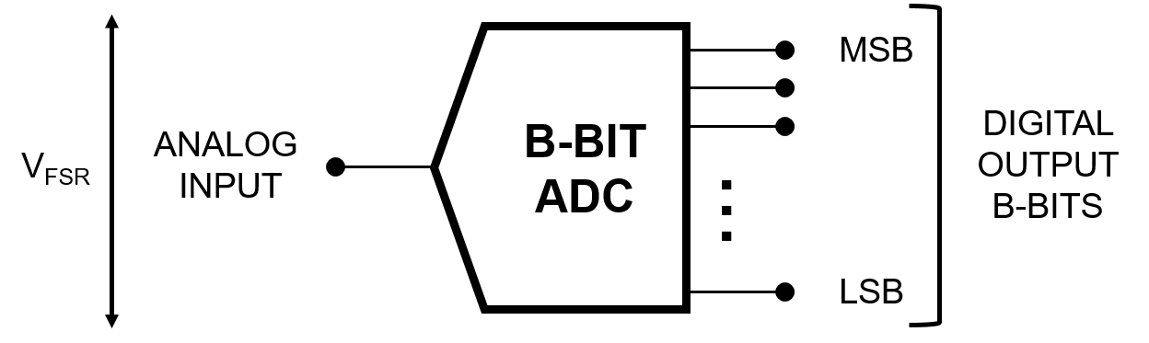
Analog to Digital Conversion
Main Definitions
An analog-to-digital converter converts an analog input (electric signal) into a digital output, discrete in time and amplitude.
Here we consider only uniform sampling and binary digit converters.
Notes:
As we all probably know, an ADC is a device converting an analog input, usually an electric signal, into a digital output that is DISCRETE in time and amplitude. Here I am considering only uniform sampling, so with an ideally constant sampling period, and binary digit converters.

Slide 9
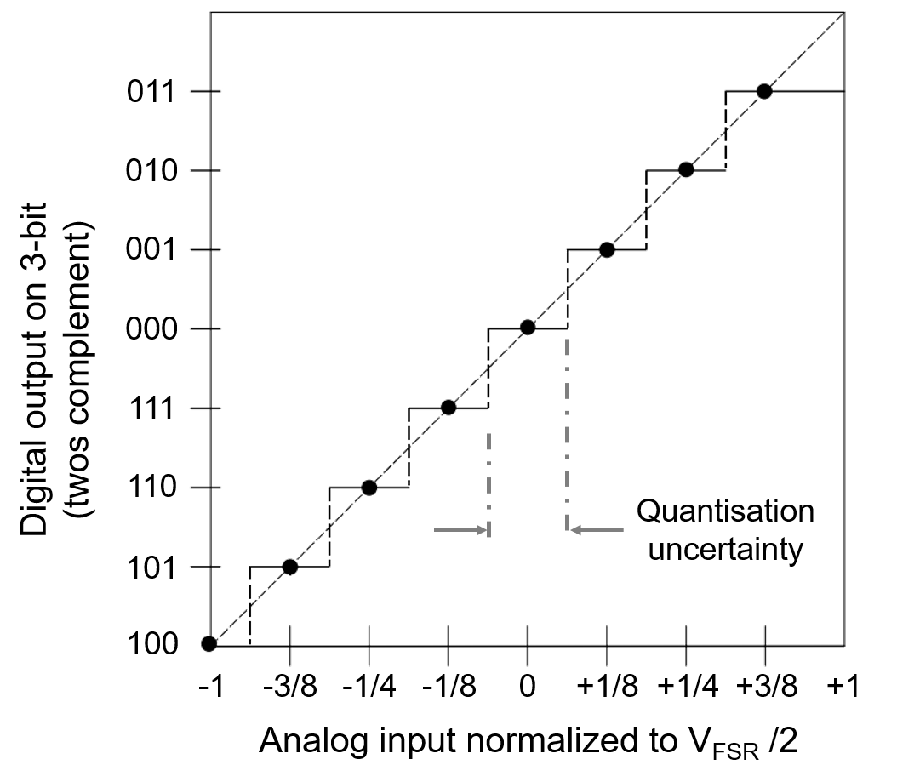
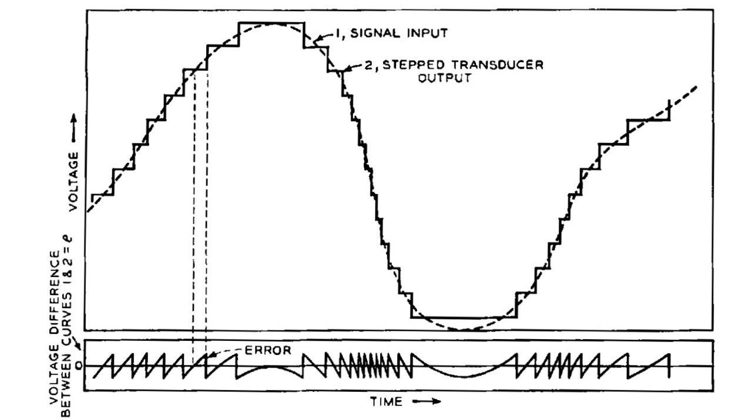
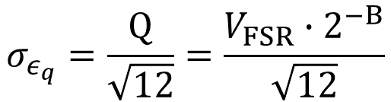
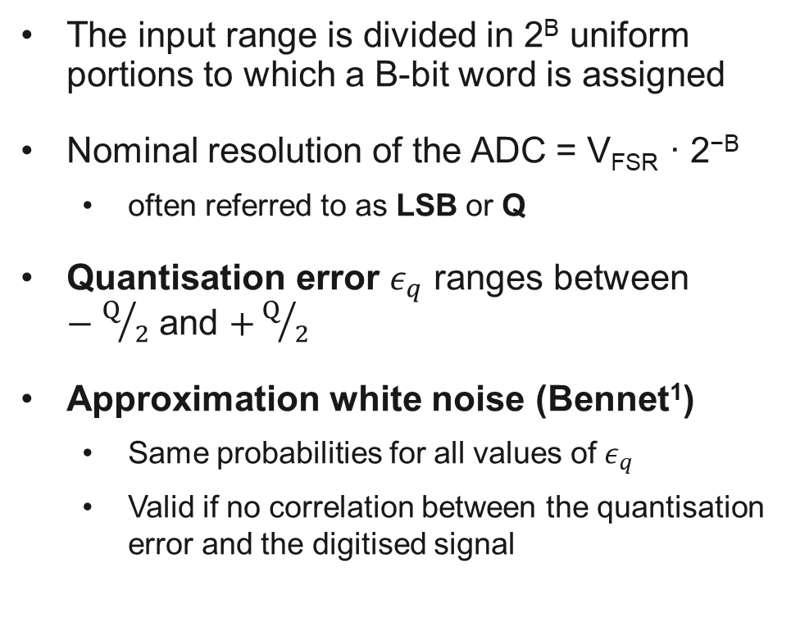
Analog to Digital Conversion
Main Definitions
The input range is divided in 2^{B} uniform portions to which a B-bit word is assigned
Nominal resolution of the ADC = V_{FSR} · 2^{−B}
  often referred to as LSB or Q
Quantisation error $ε_{q}$ ranges between $−Q/2$ and $+Q/2$
Approximation white noise (Bennet¹)
  Same probabilities for all values of $ε_{q}$
  Valid if no correlation between the quantisation error and the digitised signal
$$σ_{ε_{q}}=\frac{Q}{\sqrt{12}}=\frac{V_{FSR}∙2^{−B}}{\sqrt{12}}$$
[1] W. R. Bennett, “Spectra of quantized signals,” The Bell System Technical Journal, vol. 27, no. 3, pp. 446–472, 1948. doi
Notes:
This means that the output is encoded by words of a fixed number of bits, defining the quantity of uniform portions in which the input range is divided. On the right we are looking at the input output characteristics for an ideal ADC of 3 bits.
This means that the device has a nominal amplitude resolution, that we usually refer to as LSB or Q, and there is an intrinsic error, the quantisation error.
The popular approximation of this error as white noise was introduced in the late forties by Bennet. It is valid when there is no correlation between the input signal and the quantisation noise and it allows to describe the error with its standard deviation, function of the number of bits.

Slide 10
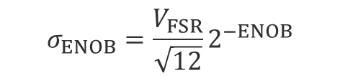
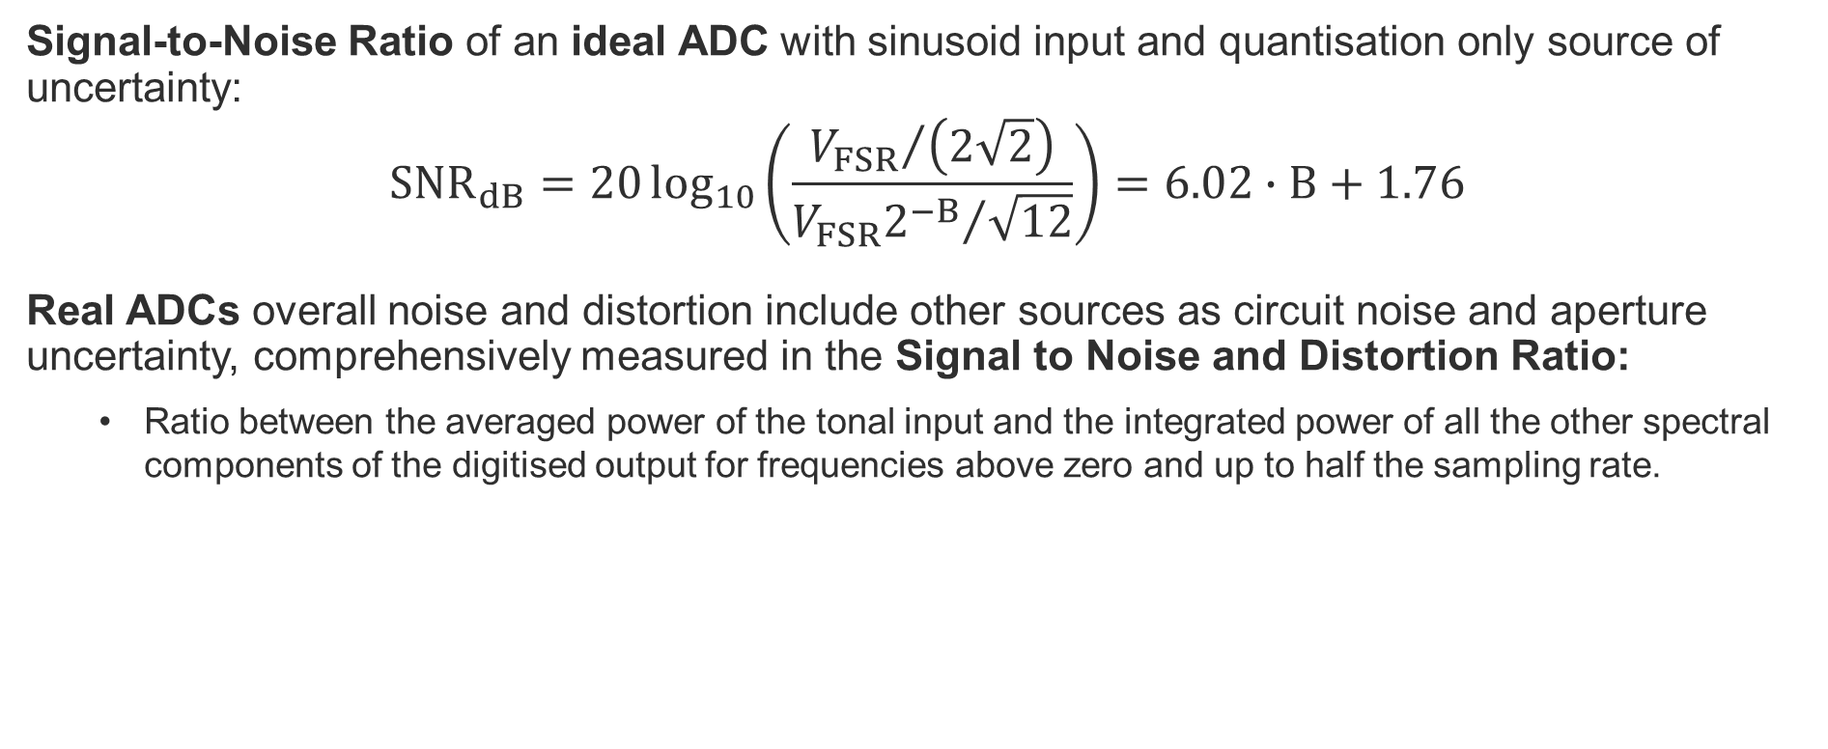
Analog to Digital Conversion
Main Definitions
Signal-to-Noise Ratio of an ideal ADC with sinusoid input and quantisation only source of uncertainty:
$${SNR}_{dB}=20\log_{10}\left(\frac{{V_{FSR}}/{\left(2\sqrt{2}\right)}}{{V_{FSR}2^{−B}}/{\sqrt{12}}}\right)=6.02∙B+1.76$$
Real ADCs overall noise and distortion include other sources as circuit noise and aperture uncertainty, comprehensively measured in the Signal to Noise and Distortion Ratio:
  Ratio between the averaged power of the tonal input and the integrated power of all the other spectral components of the digitised output for frequencies above zero and up to half the sampling rate.
Total noise modelled as Gaussian white noise
  $ENOB= \frac{{SINAD}_{dB}−1.76}{6.02}$
$$σ_{ENOB}=\frac{V_{FSR}}{\sqrt{12}}2^{−ENOB}$$
Notes:
Knowing the error power, we get the common expression of the Signal to Noise Ratio for a sinusoid input for an IDEAL ADC with quantisation as only source of uncertainty.
For a REAL ADC there are obviously other sources of dynamic error and noise, such as circuit noise and aperture uncertainty and they can be comprehensively measured by the Signal to Noise and Distortion Ratio.
Another way to quantify the performance of the converter is by the Effective number of Bits, that is the number of bits an ideal ADC would have to have its SNR (caused only by quantisation) equal to the SINAD of the real ADC.
Assuming to describe the whole noise of the real ADC as Gaussian White noise, then it would be described by its standard deviation in function of the ENOB.

Slide 11
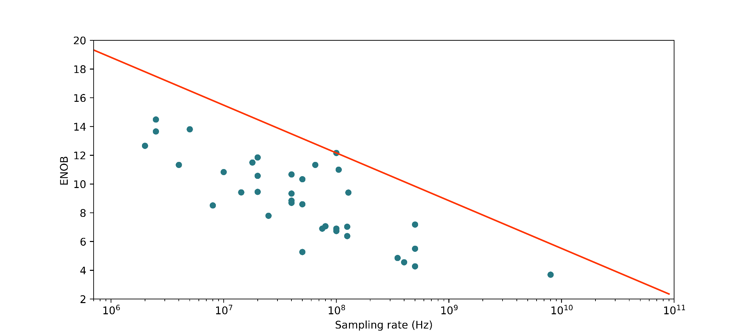
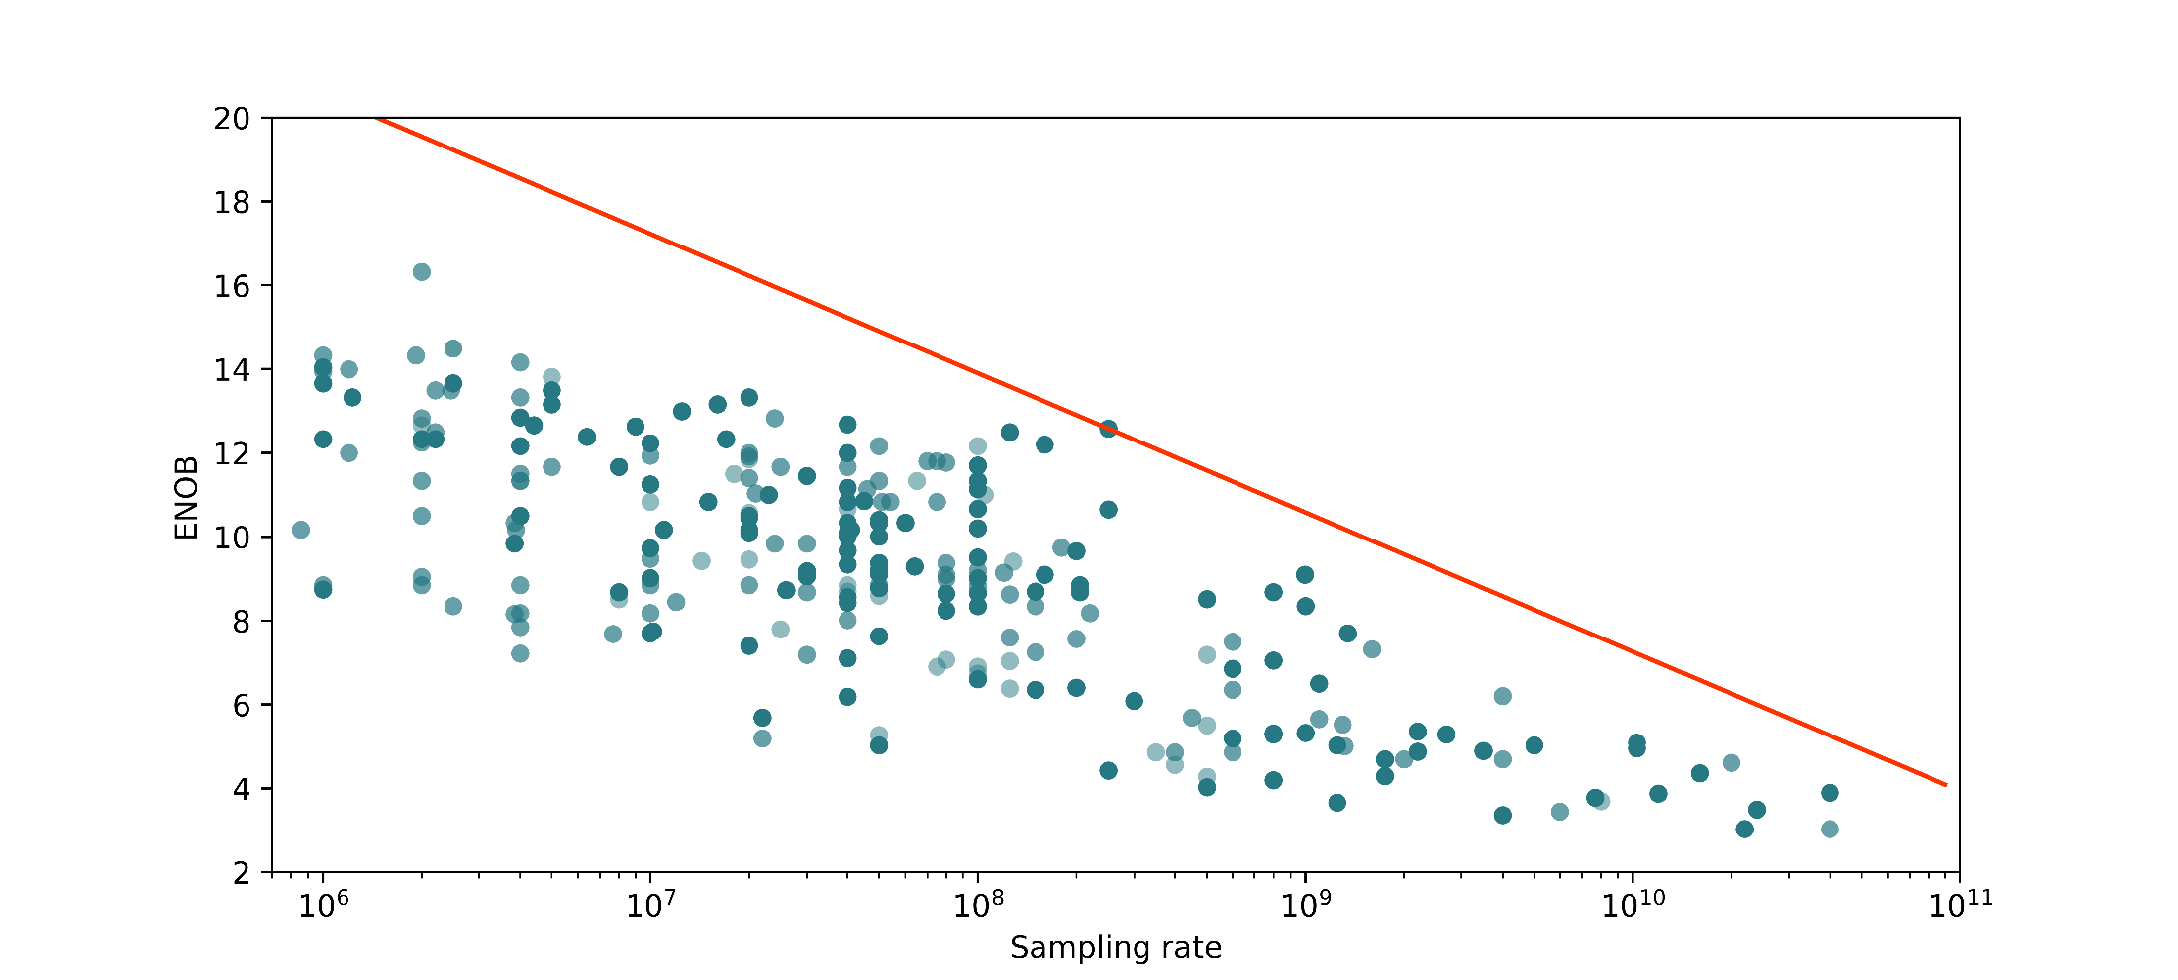
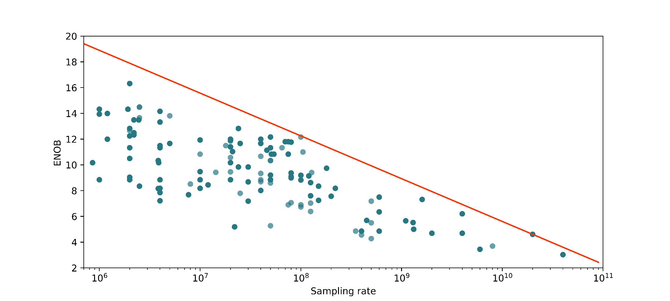
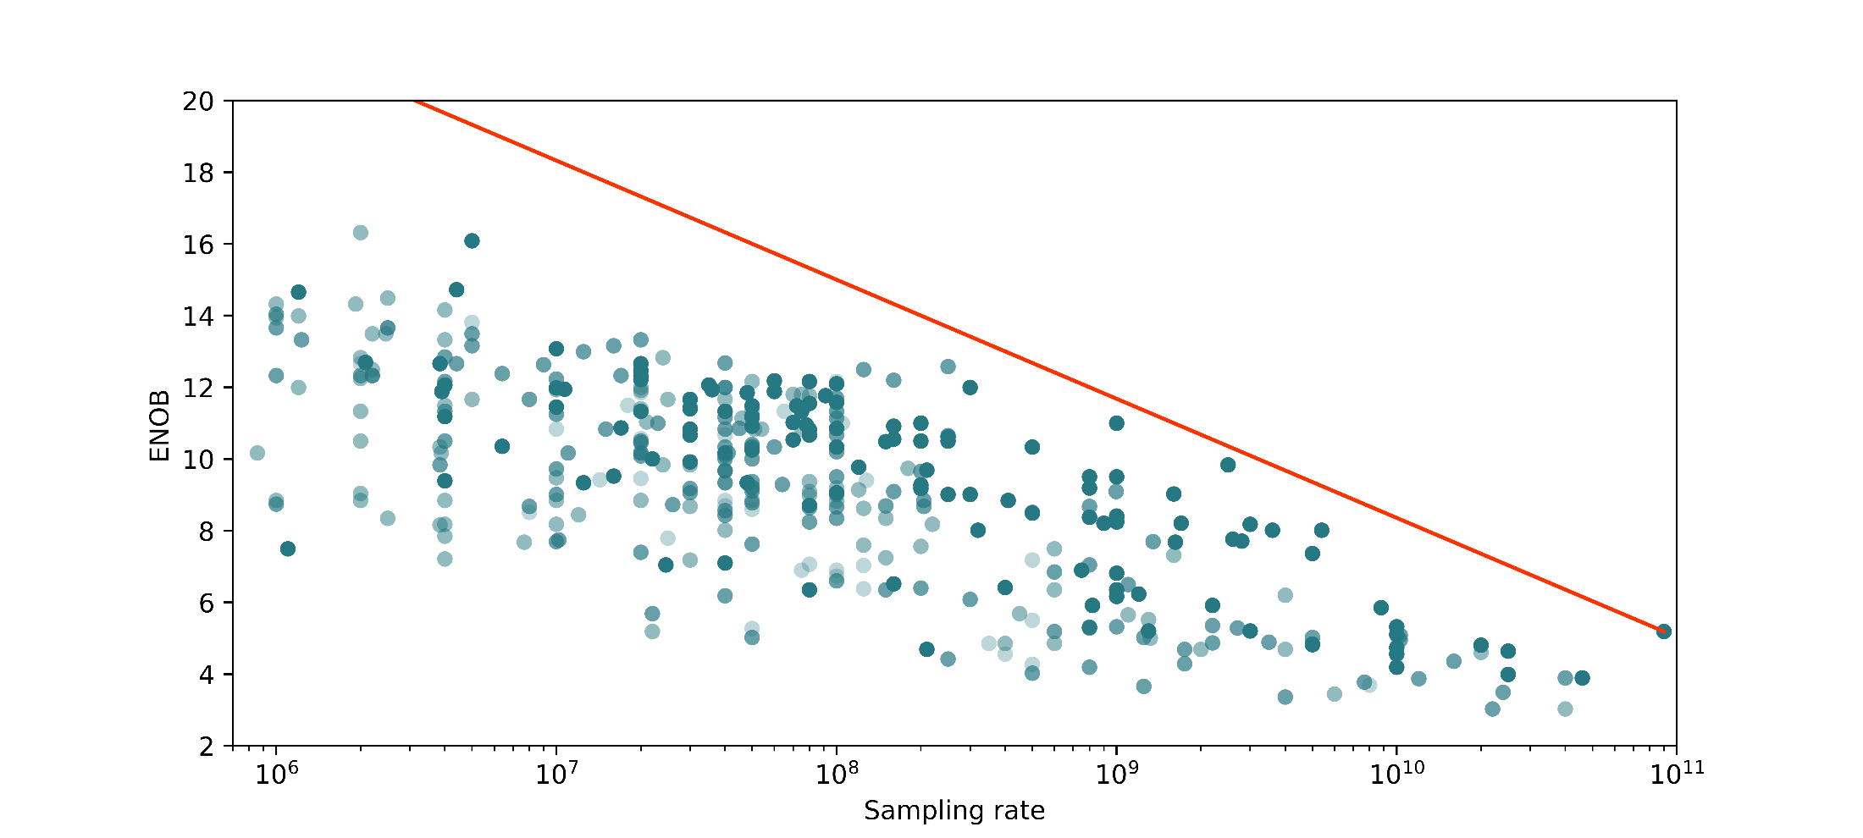
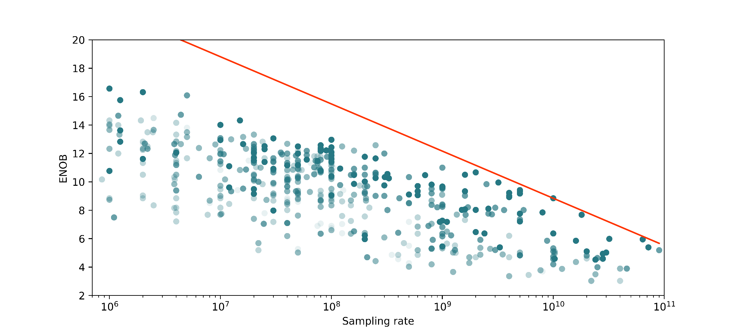

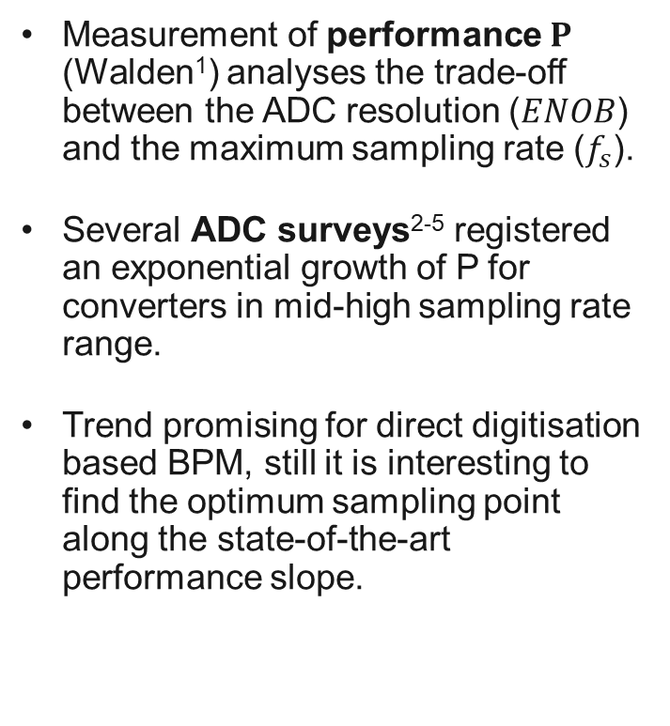
Analog to Digital Conversion
State of the art: Sampling Rate vs. Resolution
Measurement of performance $P$ (Walden¹) analyses the trade-off between the ADC resolution ($ENOB$) and the maximum sampling rate ($f_{s}$).
Several ADC surveys²⁻⁵ registered an exponential growth of P for converters in mid-high sampling rate range.
Trend promising for direct digitisation based BPM, still it is interesting to find the optimum sampling point along the state-of-the-art performance slope.
$$P=2^{ENOB}∙f_{s}$$
?
year < 2005
year < 2000
year < 2015
year < 2010
year < 2020
[2] R. H. Walden, “Analog-to-digital converter survey and analysis,” IEEE Journal on Selected Areas in Communications, vol. 17, no. 4, pp. 539–550, 1999. doi
[3] Bin Le, T. W. Rondeau, J. H. Reed, and C. W. Bostian, “Analog-to-digital converters,” IEEE Signal Processing Magazine, vol. 22, no. 6, pp. 69–77, 2005. doi
[4] M. Keller, B. Murmann, and Y. Manoli, Analog-Digital Interfaces—Review and Current Trends, pp. 93–116. Cham: Springer International Publishing, 2016. doi
[5] B. Murmann, “ADC performance survey 1997-2020,.” website
Notes:
There are intrinsic technologic limits on the achievable performance of an ADC and a trade off between high sampling rate and high resolution. Here we are looking at the performance distribution of ADC before the year 2000 showing the resolution of the chip (expressed in effective number of bits) versus their maximum sampling rate. It is evident that the faster you go, the worse is the resolution. A way to model this trade-off is the performance figure of merit P , defined as the product between the number of resolved levels and the speed of the chip. Here we see it as the red line, setting the envelope of the chip performance distribution.
As registered by several ADC surveys, in the last 20 years we had an exponential performance improvement, especially driven by converters in the mid-high sampling rate range.
This trend is promising for direct digitisation based beam instrumentation,
But, the question stays, how resolution and sampling rate affect the performance of my system based on direct digitization?
Where along this line should I pick the ADC for my application?

Slide 12
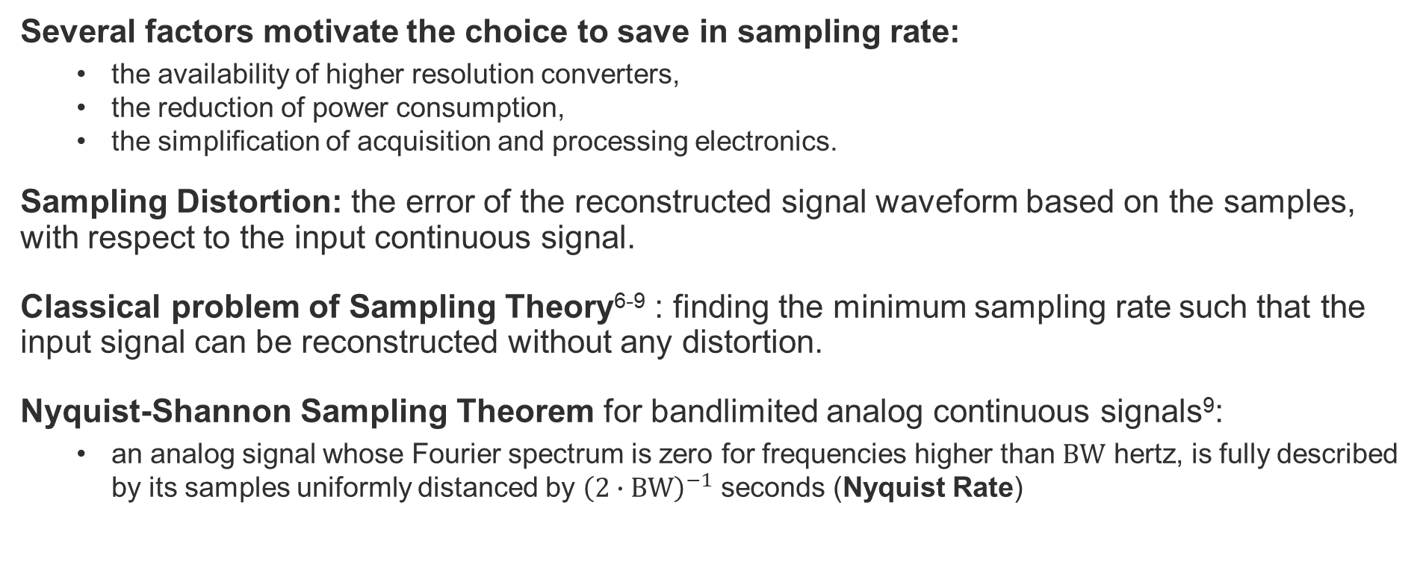
Analog to Digital Conversion
Undersampling and Sampling Distortion
Several factors motivate the choice to save in sampling rate:
  the availability of higher resolution converters,
  the reduction of power consumption,
  the simpliﬁcation of acquisition and processing electronics.
Sampling Distortion: the error of the reconstructed signal waveform based on the samples, with respect to the input continuous signal.
Classical problem of Sampling Theory⁶⁻⁹ : finding the minimum sampling rate such that the input signal can be reconstructed without any distortion.
Nyquist-Shannon Sampling Theorem for bandlimited analog continuous signals⁹:
  an analog signal whose Fourier spectrum is zero for frequencies higher than $BW$ hertz, is fully described by its samples uniformly distanced by ${\left(2∙BW\right)}^{−1}$ seconds (Nyquist Rate)
[6] E. T. Whittaker, “On the functions which are represented by the expansions of the interpolation-theory,” Proc. of the Royal Society of Edinburgh, vol. 35, p. 181–194, 1915. doi
[7] V. A. Kotel’nikov, On the Transmission Capacity of the “Ether” and Wire in Electrocommunications, pp. 27–45. Boston, MA: Birkhäuser Boston, 2001, (transl. of the 1933). doi
[8] H. Nyquist, “Certain topics in telegraph transmission theory,” Transactions of the American Institute of Electrical Engineers, vol. 47, no. 2, pp. 617–644, 1928. doi
[9] C. E. Shannon, “Communication in the presence of noise,” Proc. of the IRE, vol. 37, no. 1, pp. 10–21, 1949. doi
Notes:
So we have several factors motivating the choice to save in sampling rate. Not only we can find more converters with high resolution, but also we can reduce power consumption and simplify acquisition and processing electronics.
The cost of a low sampling rate is the introduction of sampling distortion, that is the amount of information we lose about the signal because we take too few samples of it.
Finding the minimum sampling rate such that the input signal can be reconstructed without any distortion is a classic problem of sampling theory.
Nyquist-Shannon sampling theorem gives the answer for a bandlimited analog continuous signal, with such minimum sampling rate, named Nyquist Rate, being twice the signal bandwidth.

Slide 13
Analog to Digital Conversion
Undersampling and Sampling Distortion
No Infinite Resolution Sampler → It is impossible to guarantee zero distortion
Problem of Information Theory¹⁰⁻¹⁴: finding the relation between the bitrate used to encode a source and the minimum distortion of the reconstructed signal.
Hybrid problem between Sampling Theory and Information Theory¹⁵⁻¹⁶: encoding a source by scalar quantisation (ADC) and with limited bitrate
  Rate and distortion are coupled, introducing the trade-off between sampling rate and bit-precision
  Conclusion: optimal rate is for most cases below the Nyquist rate
[10] C. E. Shannon, “A mathematical theory of communication,” The Bell System Technical Journal, vol. 27, no. 4, pp. 623–656, 1948. doi
[11] T. Berger and J. D. Gibson, “Lossy source coding,” IEEE Transactions on Information Theory, vol. 44, no. 6, pp. 2693–2723, 1998. doi
[12] M. B. Matthews, “On the linear minimum-mean-squared-error estimation of an undersampled wide-sense stationary random process,” IEEE Trans. on Sign. Proc., vol. 48, no. 1, pp. 272–275, 2000. doi
[13] A. Kipnis, A. J. Goldsmith, Y. C. Eldar, and T. Weissman, “Distortion Rate Function of Sub-Nyquist Sampled Gaussian Sources,” IEEE Trans. on Inf. Theory, vol. 62, no. 1, pp. 401–429, 2016. doi
[14] E. Mohammadi and F. Marvasti, “Sampling and distortion tradeoffs for bandlimited periodic signals,” IEEE Trans. on Inf. Theory, vol. 64, no. 3, pp. 1706–1724, 2018. doi
[15] A. Kipnis, Y. C. Eldar, and A. J. Goldsmith, “Fundamental distortion limits of analog-to-digital compression,” IEEE Trans. on Inf. Theory, vol. 64, no. 9, pp. 6013–6033, 2018. doi
[16] A. Kipnis, Y. C. Eldar, and A. J. Goldsmith, “Analog-to-digital compression: A new paradigm for converting signals to bits,” IEEE Signal Processing Magazine, vol. 35, no. 3, pp. 16–39, 2018. doi
Notes:
But this assuming a perfect sampler.
Admitting the presence of noise and distortion, a very much studied problem in Information Theory is finding the relation between the bitrate used to encode a source, typically a stationary process, and the minimum distortion of the reconstructed signal.
Closer to our measurement application, is the hybrid problem studied by Kiplin and his collegues: what is the optimum rate to encode a source by SCALAR quantisation assuming a limited bitrate. This way they introduced the tradeoff between sampling rate and bit-precision in the equation, reaching the conclusion that the optimal rate is for most cases below the Nyquist rate.

Slide 14
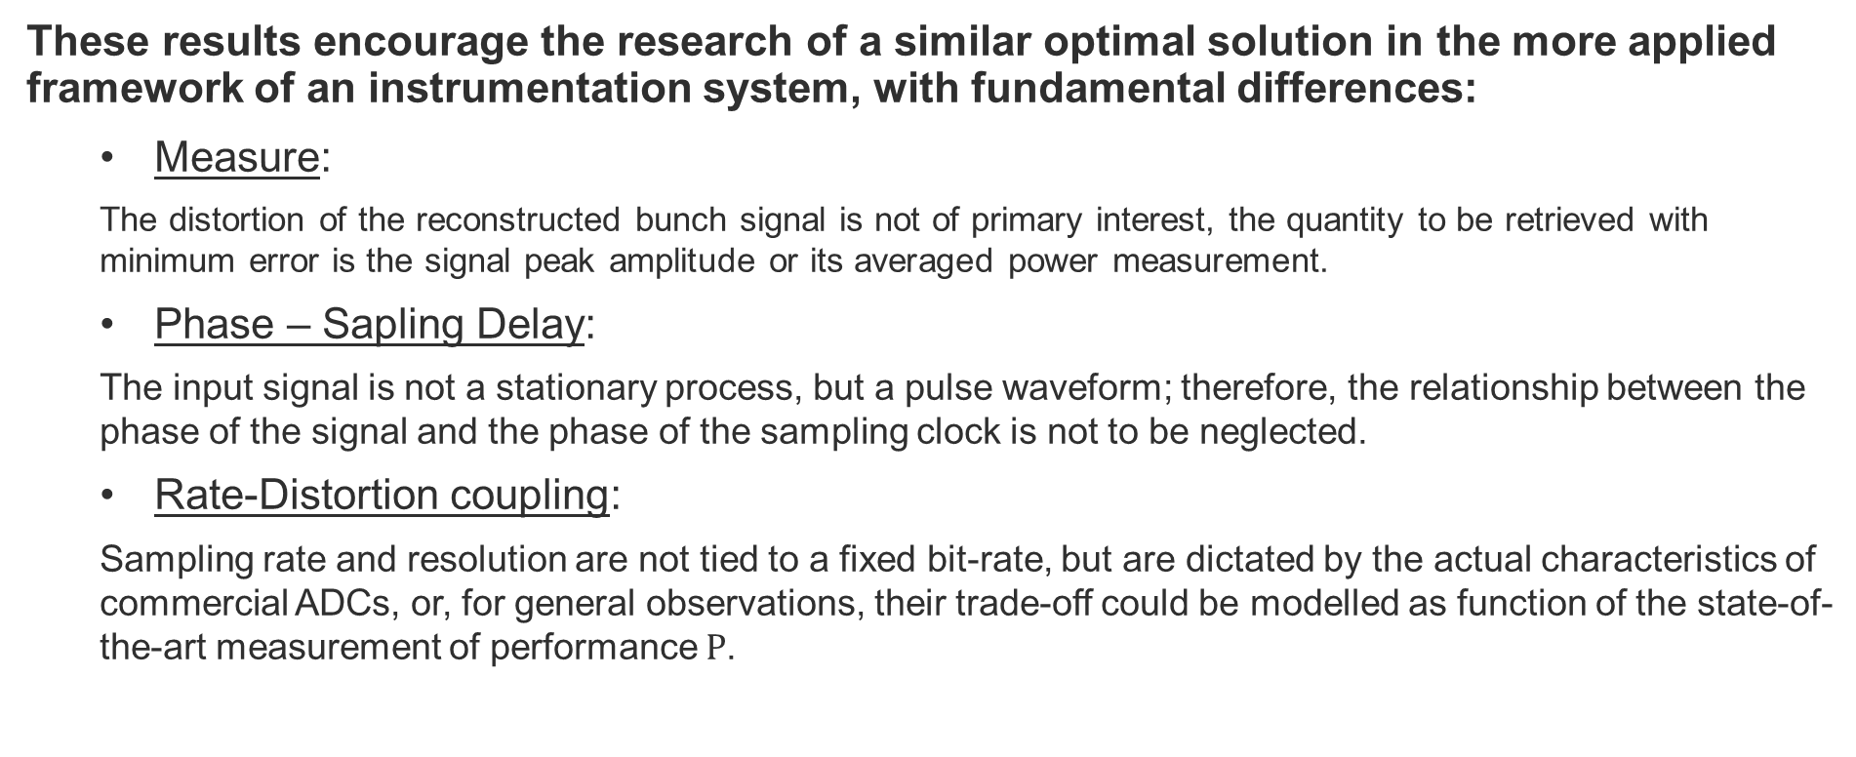
Analog to Digital Conversion
Undersampling and Sampling Distortion
These results encourage the research of a similar optimal solution in the more applied framework of an instrumentation system, with fundamental differences:
  Measure:
  The distortion of the reconstructed bunch signal is not of primary interest, the quantity to be retrieved with minimum error is the signal peak amplitude or its averaged power measurement.
  Phase – Sapling Delay:
  The input signal is not a stationary process, but a pulse waveform; therefore, the relationship between the phase of the signal and the phase of the sampling clock is not to be neglected.
  Rate-Distortion coupling:
  Sampling rate and resolution are not tied to a fixed bit-rate, but are dictated by the actual characteristics of commercial ADCs, or, for general observations, their trade-off could be modelled as function of the state-of-the-art measurement of performance $P$.
Notes:
These results encourage the research of a similar optimal solution in the more applied framework of an instrumentation system with fundamental differences:
First of all how we measure the optimum. We are not necessarily interested into reconstructing the bunch signal, instead we want to retrieve certain properties as the amplitude modulation or its averaged power.
Then, our input signal is not a stationary process, but a pulse waveform; therefore the sampling delay, the relationship between the sampling clock phase and the phase of the signal, is not to be neglected.
Finally, the way we couple Sampling rate and bit precision is not described by a fixed bit-rate, but more by the properties of the available analog to digital converters or the general state-of-the-art as described by the measurement of performance.

Slide 15
Analysis of the sampling effects
In particular on the average power measurement of direct digitally acquired pulses

Slide 16
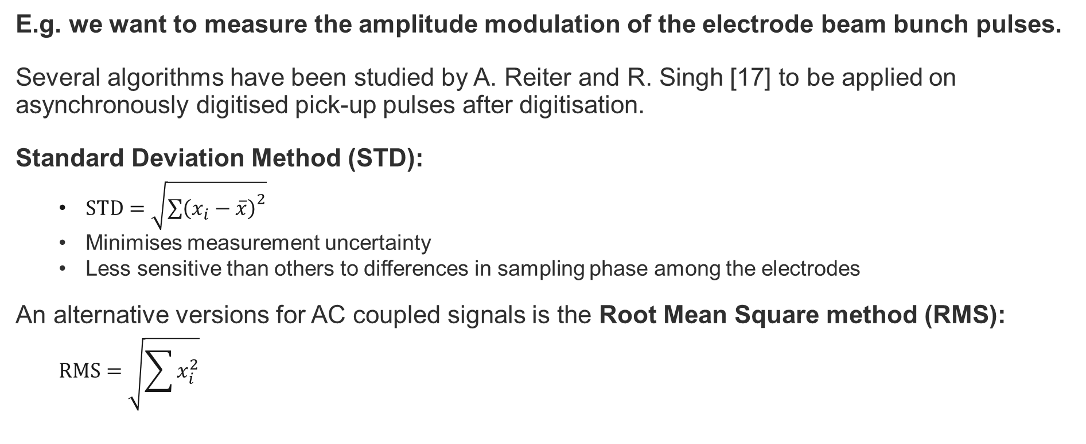
Problem Definition
Power measurement of a pulse signal
E.g. we want to measure the amplitude modulation of the electrode beam bunch pulses.
Several algorithms have been studied by A. Reiter and R. Singh [17] to be applied on asynchronously digitised pick-up pulses after digitisation.
Standard Deviation Method (STD):
  $STD=\sqrt{{\sum{\left(x_{i}−\overline{x}\right)}}^{2}}$
  Minimises measurement uncertainty
  Less sensitive than others to differences in sampling phase among the electrodes
An alternative versions for AC coupled signals is the Root Mean Square method (RMS):
  $$RMS=\sqrt{\sum{x_{i}^{2}}}$$
LHC Interlock BPM system prototype
Related to the average power of the continuous pulse signal
[17] A. Reiter and R. Singh, “Comparison of beam position calculation methods for application in digital acquisition systems,” Nuclear Instruments and Methods in Physics Research Section A: Accelerators, Spectrometers, Detectors and Associated Equipment, vol. 890, pp. 18 – 27, 2018. doi
Notes:
Why the power measurement of a pulse signal? We want to measure the amplitude modulation of the pik-up beam bunch pulses.
There are several algorithms being commonly used on digitised pick-up pulses, Reiter and Singh recently published a systematic comparative study about the topic.
The algorithm that stands out is the standard deviation method, it is among those that minimise the measurement uncertainty, but at the same is less sensitive than others to differences in sampling phase among the electrodes.
An alternative version to be used for AC coupled signals, as those of interest in this work, is the root mean square method.
This algorithm is the one used for the Large Hadron Collider extraction interlock beam position monitor and it is related to the average power measurement of the continous pulse.

Slide 17
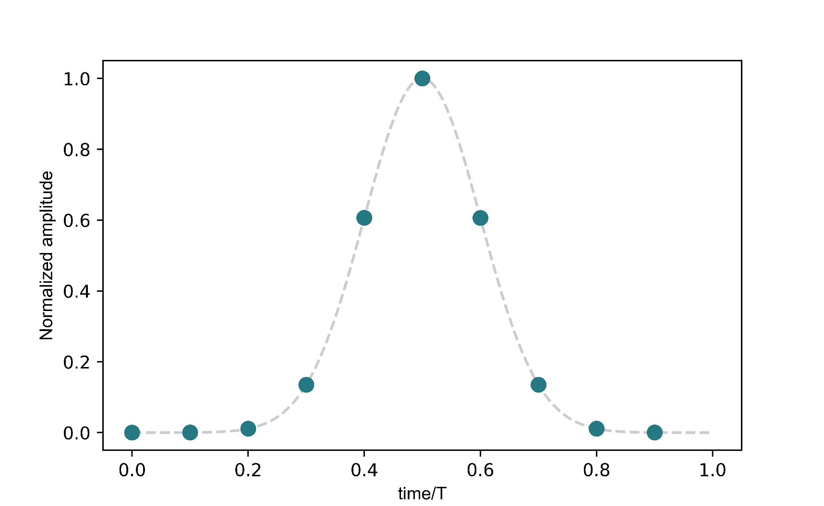
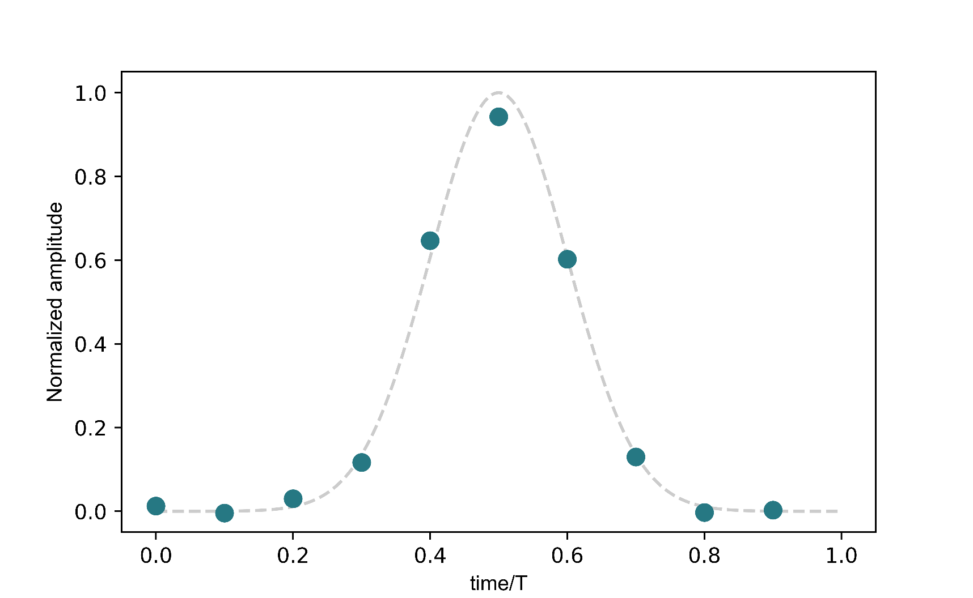
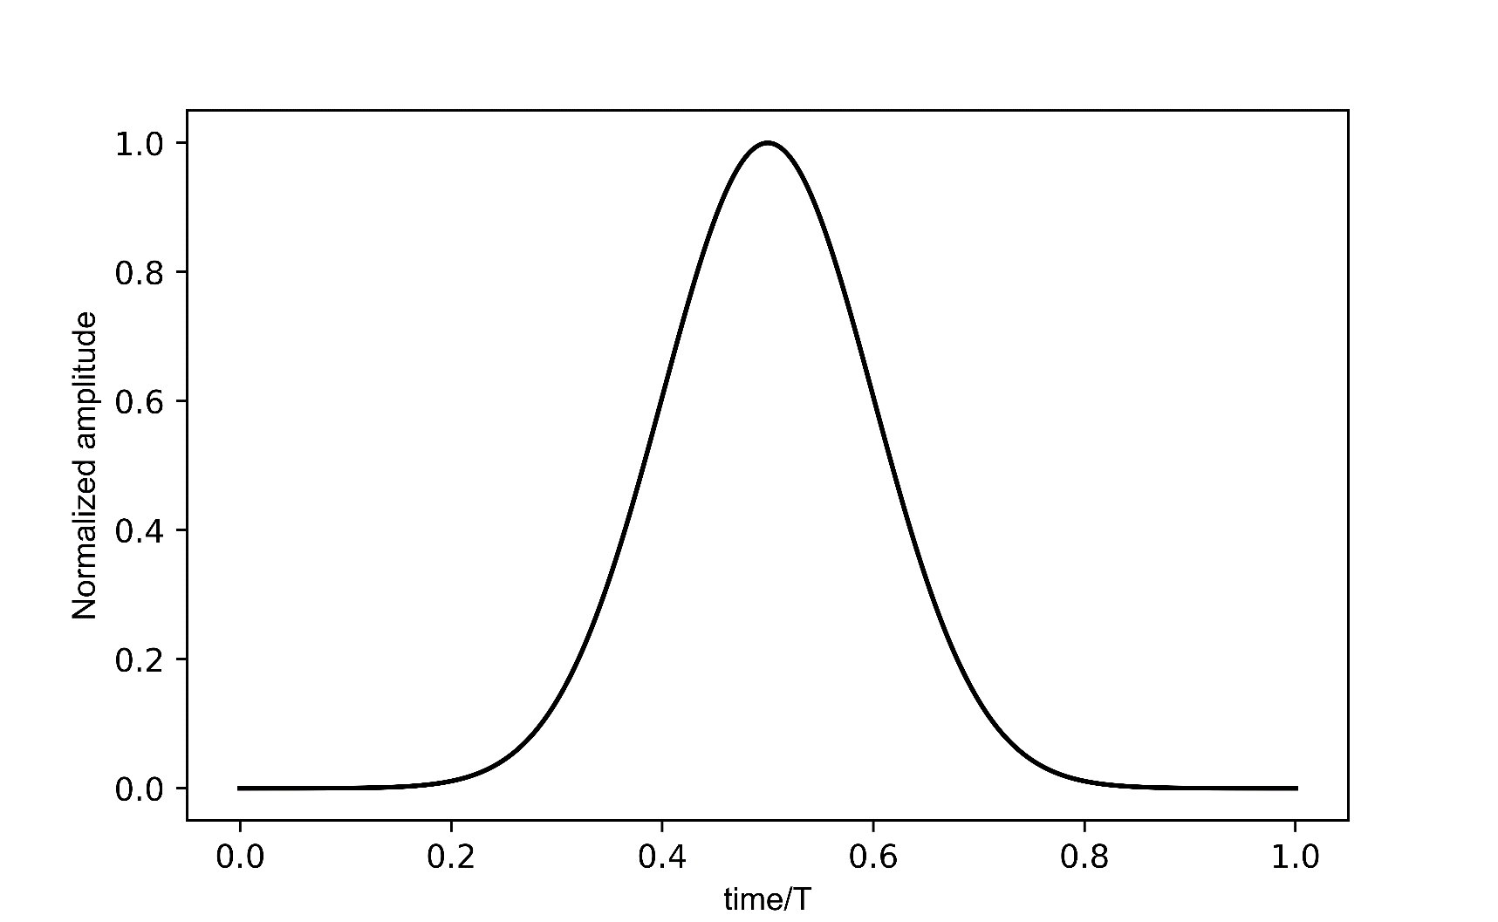
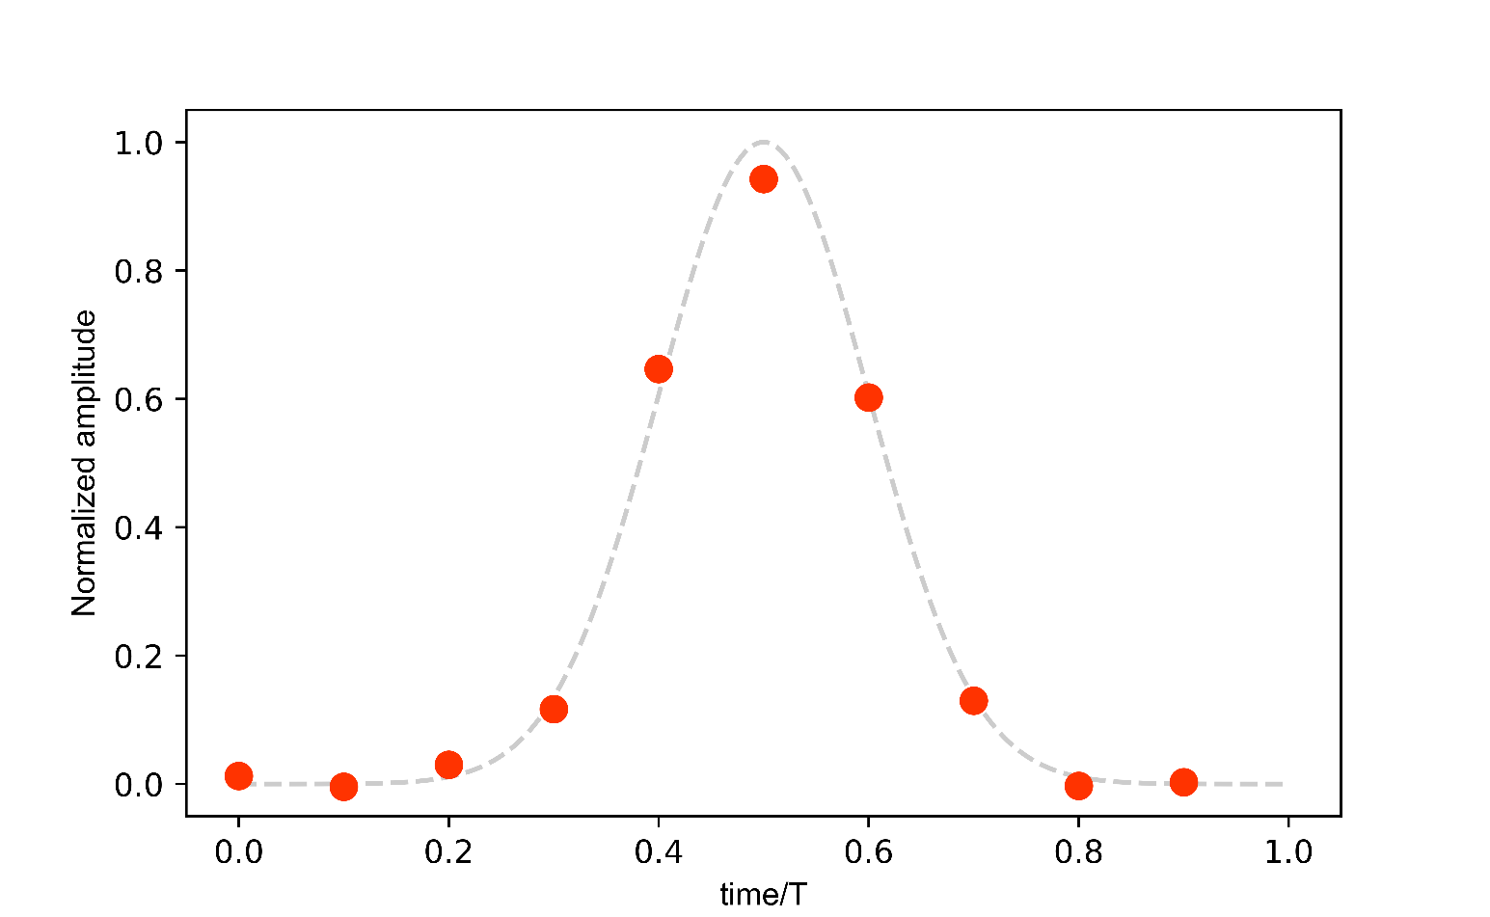

Problem Definition
Power measurement of a pulse signal
Continuous pulse (ex. Gaussian) $x\left(t\right)$
Averaged power over window $T$:
$$P_{T}=\frac{1}{T}\int_{0}^{T}{{\left|x\left(t\right)\right|}^{2}dt}$$
Limited number $N$of samples ${\hat{x}}_{n}$
Affected by noise $ν_{n}$
$$\overline{P_{T}}=\frac{1}{N}\sum_{n=0}^{N−1}{{\left({\hat{x}}_{n,τ}+ν_{n}\right)}^{2}}={RMS}^{2}$$
Notes:
How are they related? We have our continous pulse, for example a Gaussian pulse, and we can comput its averaged power over a window of observation T.
When we have a limited number of samples,
that are noisy samples.
The correspondent quantity in the digital domain is the mean value of the squared samples, that is the square of the RMS.

Slide 18
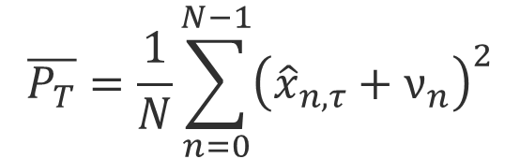
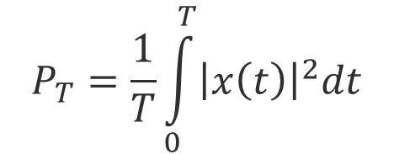
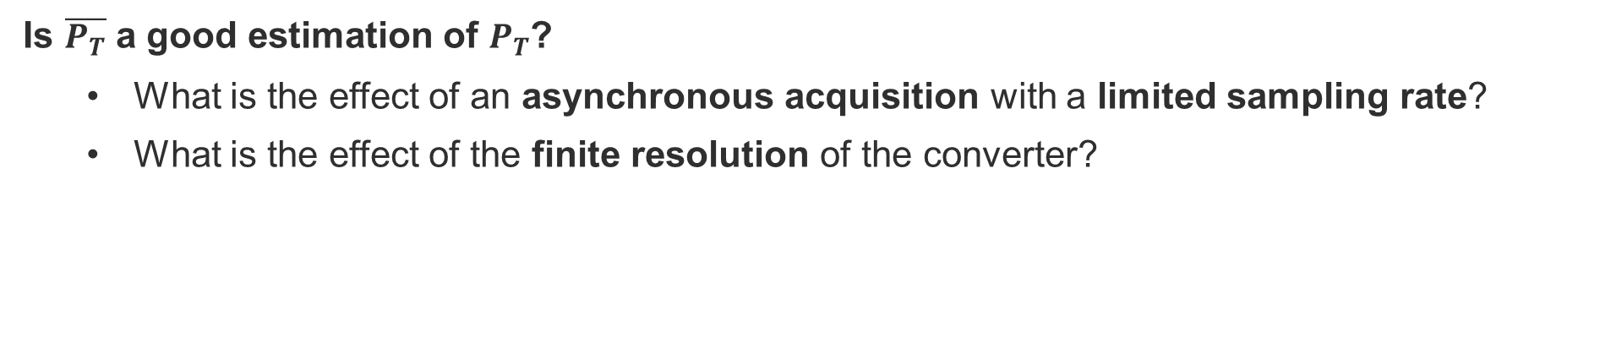
Problem Definition
Power measurement of a pulse signal
$$P_{T}=\frac{1}{T}\int_{0}^{T}{{\left|x\left(t\right)\right|}^{2}dt}$$
$$\overline{P_{T}}=\frac{1}{N}\sum_{n=0}^{N−1}{{\left({\hat{x}}_{n,τ}+ν_{n}\right)}^{2}}$$
Is $\overline{P_{T}}$ a good estimation of $P_{T}$?
  What is the effect of an asynchronous acquisition with a limited sampling rate?
  What is the effect of the finite resolution of the converter?
Notes:
So, I wanted to understand in which conditions the averaged power on the sequence of samples is a good estimator of the average power of the original continous pulse signal.
In particular my questions were: What is the effect of an asynchronous acquisition with a limited sampling rate? And what is the effect of the finite resolution of the converter?

Slide 19
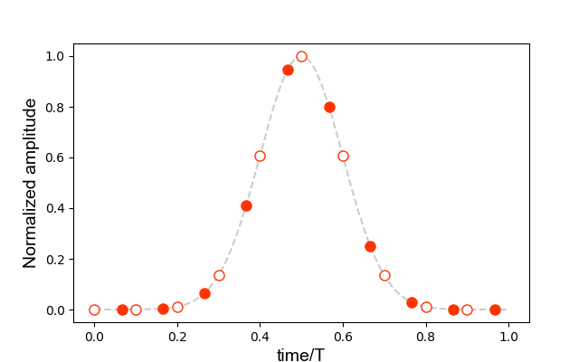

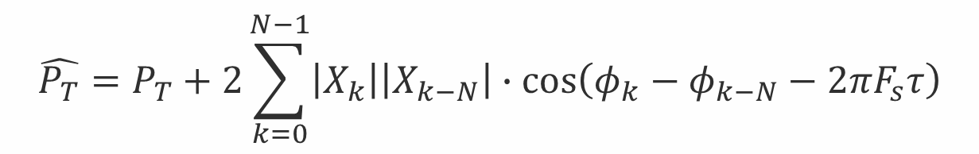
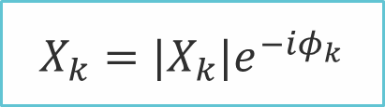
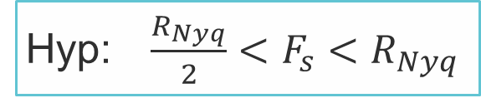
Limited Sampling Rate
Impact on the power estimation
Sampling rate
Hyp: $\frac{R_{Nyq}}{2}<F_{s}<R_{Nyq}$
Input signal spectrum
$$X_{k}=|X_{k}|e^{−iφ_{k}}$$
$$τ$$
Sampling delay
$$\hat{P_{T}}=P_{T}+2\sum_{k=0}^{N−1}{\left|X_{k}\right|\left|X_{k−N}\right|∙\cos\left(φ_{k}−φ_{k−N}−2πF_{s}τ\right)}$$
Quantity to estimate
Error term
Notes:
It is immediate to demonstrate that if the signal is bandlimited, for sampling rates above the Nyquist rate the estimator is a perfect estimator.
It is then interesting what happens for sampling rates below the Nyquist rate.
Under this hypothesis about the sampling rate
and expressing the input signal Fourier coefficients in their modulus and phase
And considering the variable sampling delay tau with respect to a reference sampling time
The power estimation expression result is
Where the Averaged power that we want to measure appears explicitly
Together with an error term
Which depends on the signal spectrum
On The sampling rate (here N is the number of samples over the window)
And on the variable delay tau that takes in account the variation of the sampling phase
This error term can be expressed more clearly

Slide 20
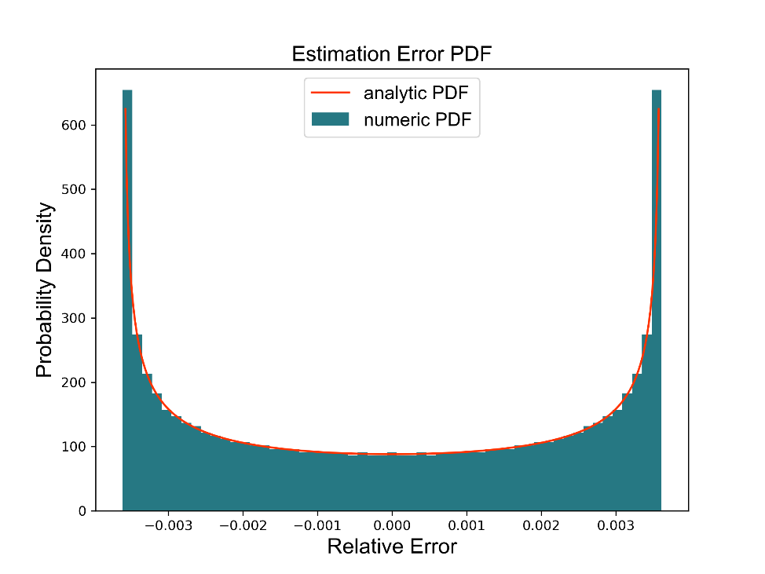
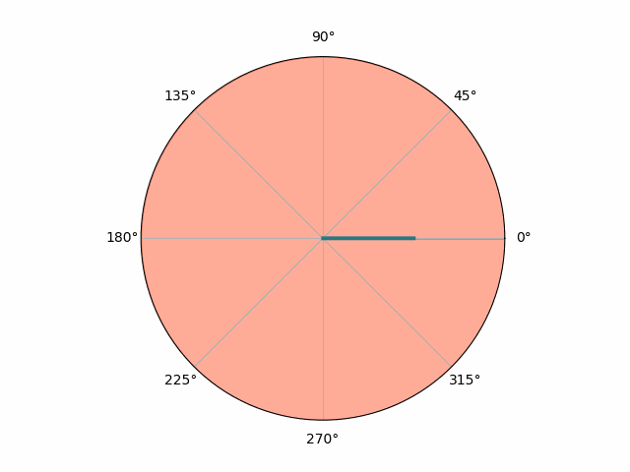
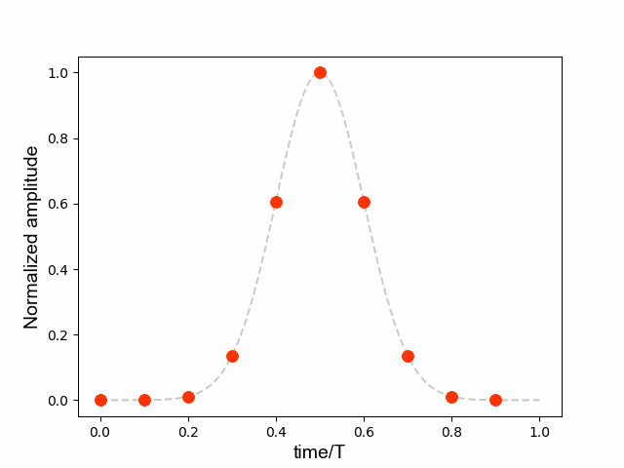


Limited Sampling Rate
The estimation error
$$ε\left(X_{k},F_{s},τ\right)≜\hat{P_{T}}−P_{T}=A_{X_{k},N}∙2\cos\left(2πF_{s}τ\right)+B_{X_{k},N}∙2\sin\left(2πF_{s}τ\right)$$
$$A_{X_{k},N}≜\sum_{k=0}^{N−1}{\left|X_{k}\right|\left|X_{k−N}\right|∙\cos\left(φ_{k}−φ_{k−N}\right) }$$
$$B_{X_{k},N}≜\sum_{k=0}^{N−1}{\left|X_{k}\right|\left|X_{k−N}\right|∙\sin\left(φ_{k}−φ_{k−N}\right)}$$
Hyp: $τ=U\left[0,\frac{1}{F_{s}}\right]$
$μ_{ε}=0;$
$σ_{ε}^{2}=2\left({\left(A_{X_{k},N}\right)}^{2}+{\left(B_{X_{k},N}\right)}^{2}\right)$
Notes:
We define it epsilon
and we can rewrite it as the combination of two harmonics
With the coefficients A and B depending on the signal spectrum and on the sampling rate
When the sampling delay varies, the error changes magnitude and sign as the real part of a rotating phasor.
For a uniformly distributed sampling delay between zero and one sampling period, the mean value of the error is zero, while its variance depends on the coefficients A and B.
From the point of view of an instrument, the mean value of the error is of interest for averaged measurements on long time intervals, like the orbit for BPM.
The standard deviation instead is important to estimate the performance for single shot, single bunch measurements.
Also the probability density function can be computed analytically, here it is compared with numeric simulation results for a Gaussian pulse. It shows how the error has more occurrences for the bigger values in absolute module.

Slide 21
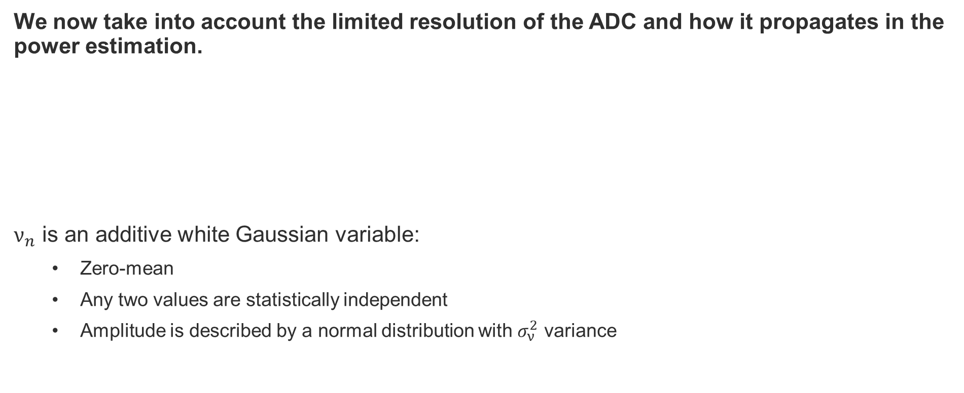


Limited Sampling Resolution
Impact on the power estimation
We now take into account the limited resolution of the ADC and how it propagates in the power estimation.
$ν_{n}$ is an additive white Gaussian variable:
  Zero-mean
  Any two values are statistically independent
  Amplitude is described by a normal distribution with $σ_{ν}^{2}$ variance
$$\hat{P_{T}}=\frac{1}{N}\sum_{n=0}^{N−1}{{\hat{x}}_{n}^{2}}$$
$$\overline{P_{T}}=\frac{1}{N}\sum_{n=0}^{N−1}{{\left({\hat{x}}_{n}+ν_{n}\right)}^{2}}$$
Notes:
So far we have neglected the limited resolution of the analog to digital converter and now it is time to take it into account.
The question is how the noise on each sample propagates in the estimator and effects the final measurement?
Here we model the converter noise as an additive with Gaussian variable, with zero mean value, any two values are statistically independent and the amplitude is described by a normal distribution with sigma nu squared variance.

Slide 22

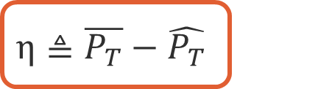
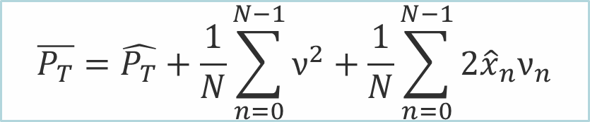

Limited Sampling Resolution
Impact on the power estimation
We now take into account the limited resolution of the ADC and how it propagates in the power estimation.
$ν_{n}$ is an additive white Gaussian variable:
  Zero-mean
  Any two values are statistically independent
  Amplitude is described by a normal distribution with $σ_{ν}^{2}$ variance
$$\overline{P_{T}}=\hat{P_{T}}+\frac{1}{N}\sum_{n=0}^{N−1}{ν^{2}+\frac{1}{N}\sum_{n=0}^{N−1}{2{\hat{x}}_{n}ν_{n}}}$$
$$η≜\overline{P_{T}}−\hat{P_{T}}$$
$$μ_{η}=σ_{ν}^{2}$$
$$σ_{η}^{2}=\frac{σ_{ν}^{4}}{N}+4P_{T}\frac{σ_{ν}^{2}}{N}$$
Notes:
The estimator results to be the previous estimator affected by the limited sampling rate, plus a new error term that can be isolated
We define this error etha.
Also this error term is a random variable and we can calculate its mean value and variance.
The mean value of the error is equal to the variance of the converter noise and The variance of the error is also dependent on the converter noise variance,
But also on the sampling rate (N is the number of samples over the window)
And on the pulse averaged power.

Slide 23
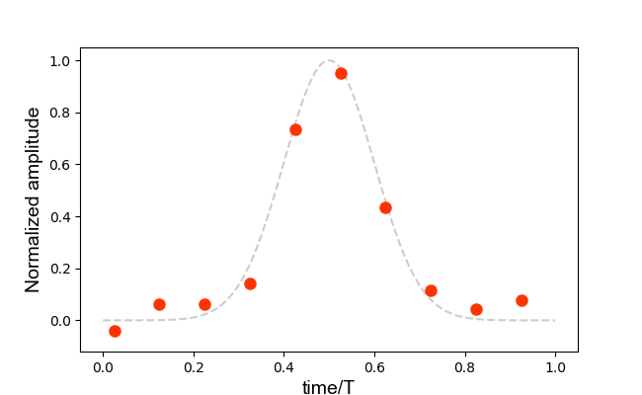
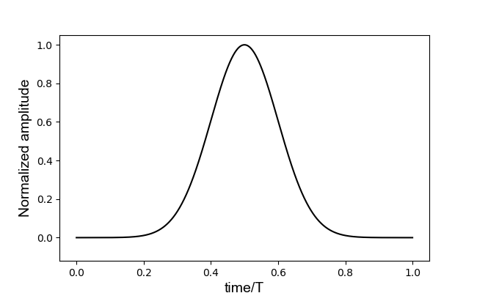
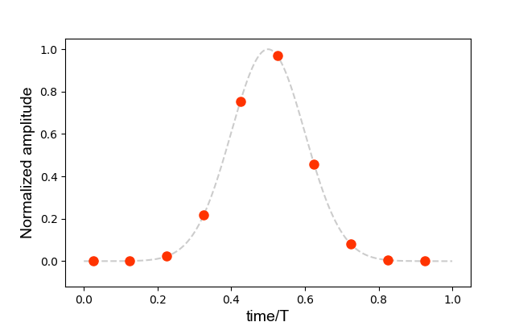
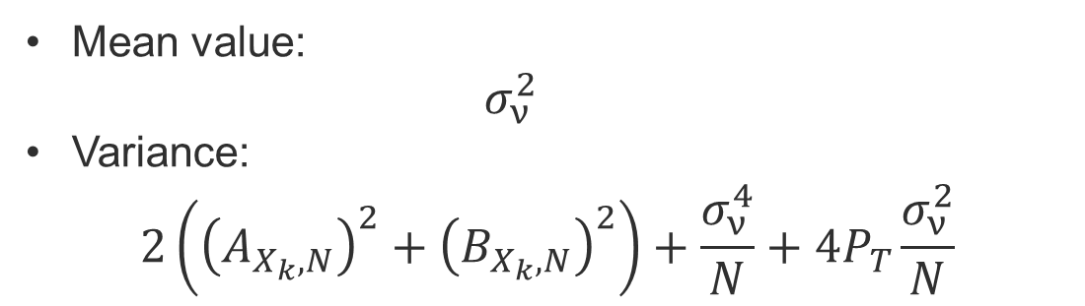
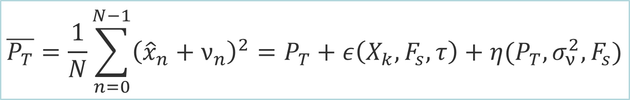
The combined SNR expression
Total error
$$\overline{P_{T}}=\frac{1}{N}\sum_{n=0}^{N−1}{{\left({\hat{x}}_{n}+ν_{n}\right)}^{2}}=P_{T}+ε\left(X_{k},F_{s},τ\right)+η(P_{T},σ_{ν}^{2},F_{s})$$
Mean value:
  $$σ_{ν}^{2}$$
Variance:
$$2\left({\left(A_{X_{k},N}\right)}^{2}+{\left(B_{X_{k},N}\right)}^{2}\right)+\frac{σ_{ν}^{4}}{N}+4P_{T}\frac{σ_{ν}^{2}}{N}$$
Notes:
So, summarizing our results.
We have found out that out estimator is equal to the averaged power of the continuous pulse under measurement
Plus an error term epsilon defined by the asynchronous limited sampling rate
Plus an error etha caused by the limited resolution of the ADC
The resulting total error mean value is the sum of the two mean values, so it is equal to the converter noise variance
The resulting total error variance is the sum of the two variances, the one of epsilon and the one of etha

Slide 24
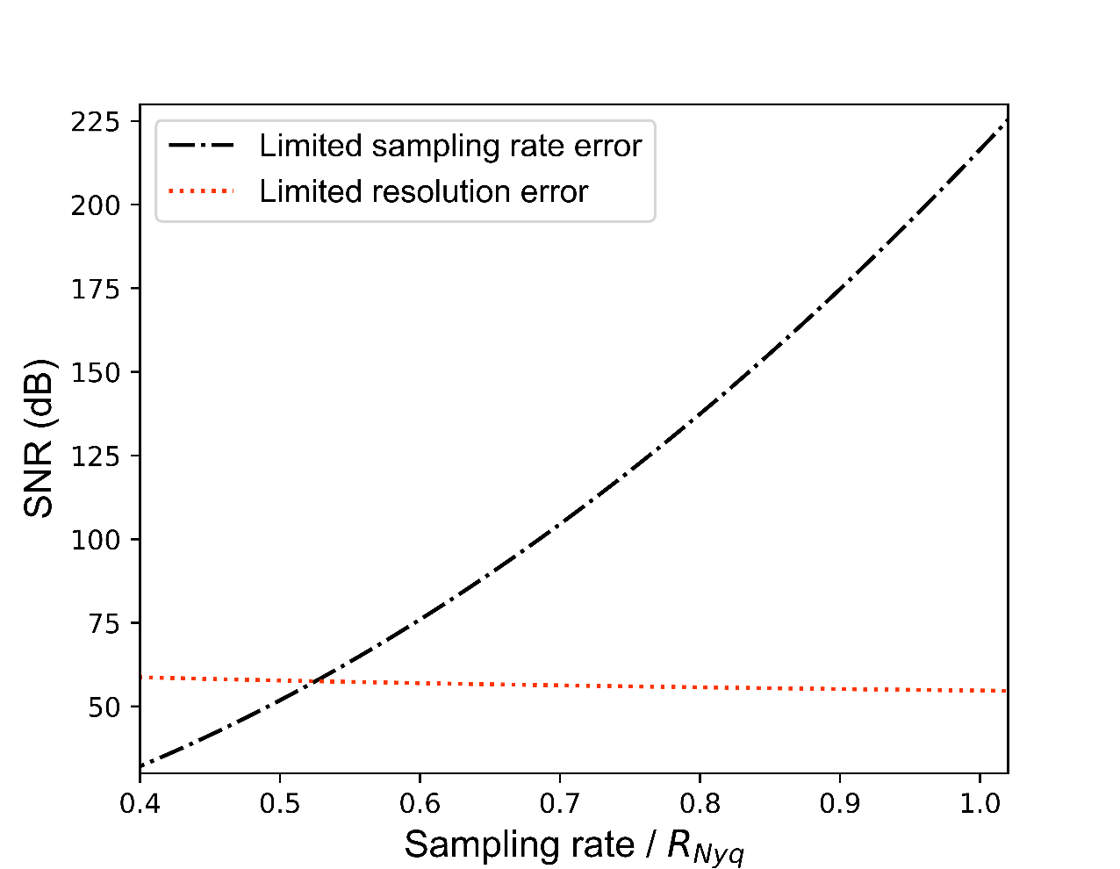
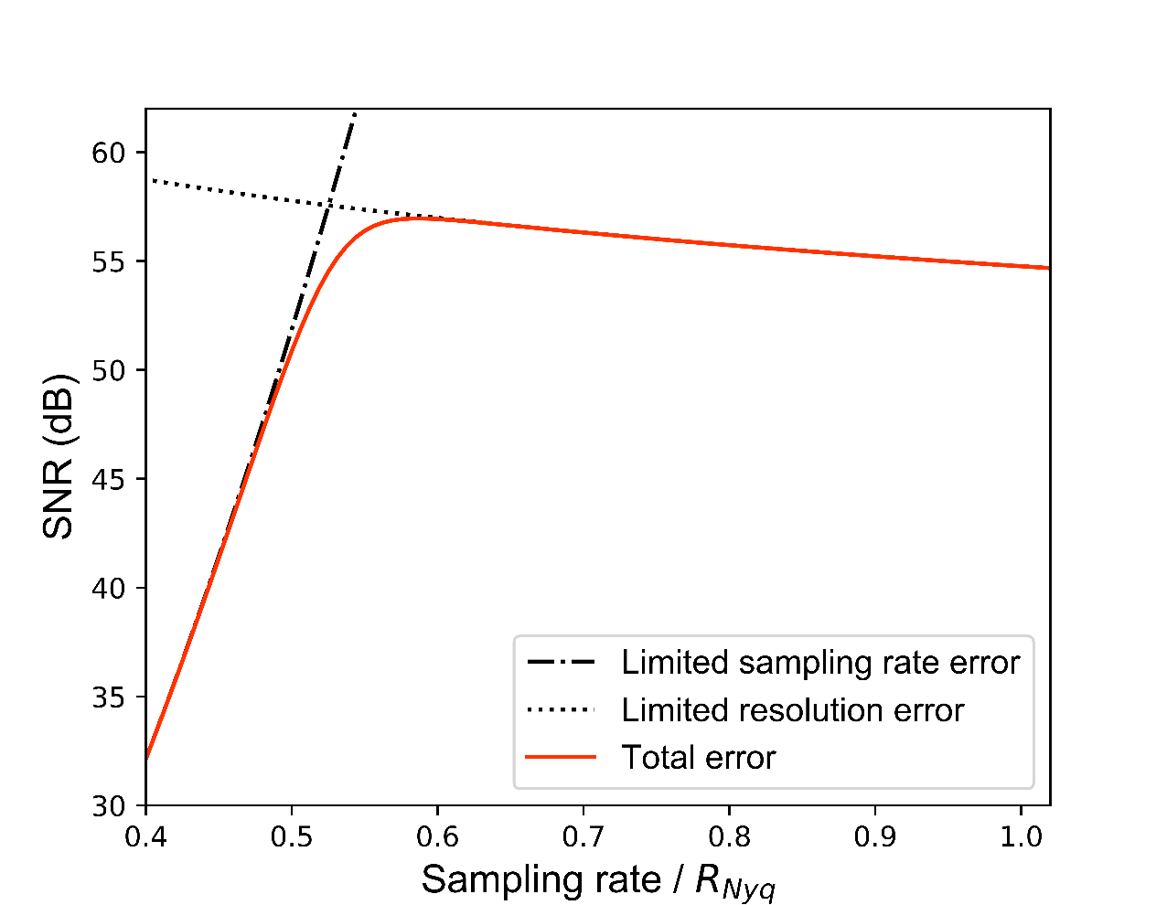
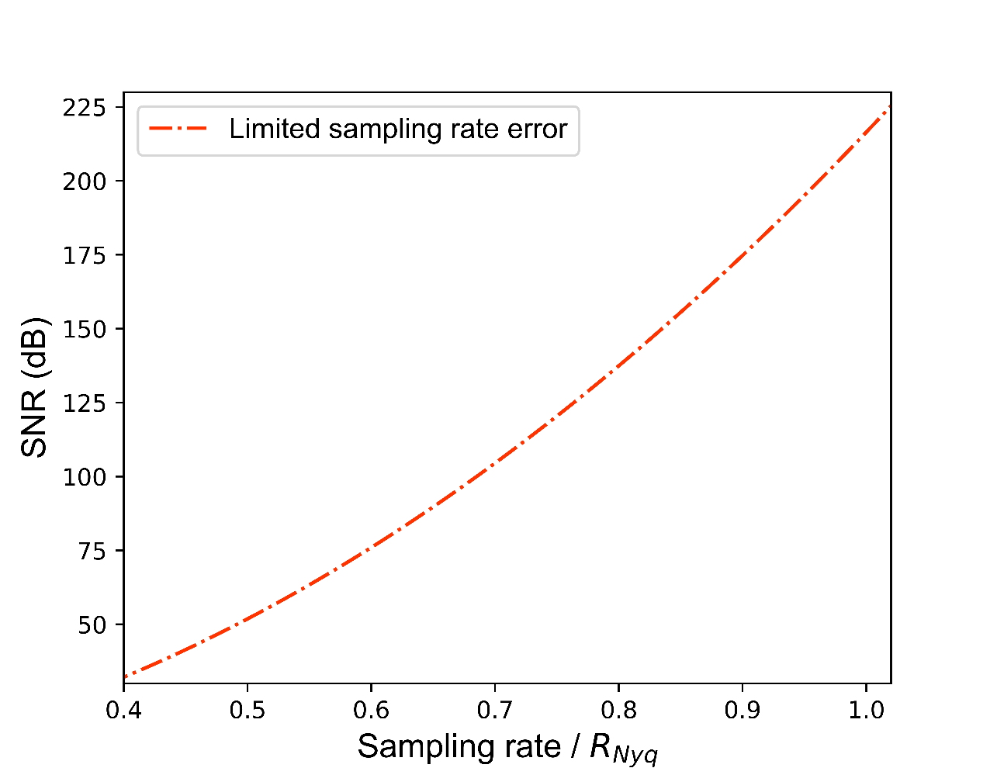



The combined SNR expression
Total error
$$SNR_{dB}=10\log_{10}\left(\frac{P_{T}^{2}}{2\left({\left(A_{X_{k},N}\right)}^{2}+{\left(B_{X_{k},N}\right)}^{2}\right)+\frac{σ_{ν}^{4}}{N}+4P_{T}\frac{σ_{ν}^{2}}{N}}\right)$$
ADC resolution in function of the sampling rate
$$σ_{ν}=\frac{V_{FSR}}{\sqrt{12}}2^{−ENOB}$$
$$P=2^{ENOB}∙f_{s}$$
Notes:
Knowing the total error variance, we can finally express the signal to noise ratio for the measurement of the averaged power of the pulse signal.
We can see how this applies to our example Gaussian pulse plotting the SNR in function of the sampling rate, looking at the frequencies in the range between half of the Nyquist rate and the Nyquist rate.
We first see the only effect of the limited sampling rate, with an ideal ADC with infinite resolution. The higher the sampling rate, the higher the SNR.
We now look at the only effect of the limited resolution of the chip. The variance of the noise is here a function of the Effective number of bits and a function of the sampling rate, since we assume a constant measure of performance P to describe the ADC trade-off. This means that the higher the sampling rate is , the higher the ADC noise variance is.
We finally combine the two effect using the whole SNR expression
We see how the SNR expression indicates two regions of operation, one where the sampling rate limits the performance, one where the ADC resolution limits the performance.
It is in the transition area between these regions that the optimal sampling point sits, and it can be at lower frequencies than the Nyquist rate

Slide 25





Validation with numeric simulations
Gaussian pulse
Notes:
These results were validated with numeric simulations on various examples of pulse signals.
A generic Gaussian pulse, here plotted in the time and frequency domain.
The probability density function was computed for different sampling rate
And the SNR was plotted as a function of the sampling rate and for two fixed values of ADC noise variance.
It was also computed varying the ADC noise variance in function of the sampling rate to keep a constant measurement of performance P.

Slide 26




Validation with numeric simulations
Derivative of a Gaussian pulse
Notes:
Same was performed on the derivative of the Gaussian pulse, differential signal more similar to the signals generated by beam position monito pick-ups. Also here the probability density function and the SNR were accurately matched between the analytical model and the numeric simulation.

Slide 27





Validation with numeric simulations
Stripline pick-up signal: analytic expression and beam measurement
Analytic Signal
Measured Signal
Notes:
As more practical cases, the model was validated also with examples of actual stripline BPM pick-up signals, the analytic expression and an actual acquisition from oversampled beam measurement.
Also in this case it was found good agreement between the analytic model and the numeric simulations.

Slide 28
Effects of digitization on an example system
The LHC beam extraction interlock BPM prototype

Slide 29


LHC Extraction Interlock BPM
Functionality of the System
Part of the machine protection system that guarantees a safe beam extraction.
Notes:
The LHC extraction interlock BPM is part of the machine protection system that guarantees a safe beam exctraction. It monitors the beam position before and after the kicker magnets that deviate the beam from the accelerator pipe into the dump line. On the left you see a picture of the Large Hadron Collider dump line.

Slide 30

LHC Extraction Interlock BPM
Architecture of the Prototype System
Single Processing Chain: mitigation of asymmetries and drift effects.
Direct Digitisation: high sampling rate digitiser after minimalistic analog filtering.
No Gain Adjustments: all beam cases should be covered without changing settings.
Independent from Accelerator RF Clock: asynchronous acquisition for reliability.
[18] J. Pospisil, O. Bjorkqvist, A. Boccardi, and M. Wendt, “Digital Signal Processing Techniques to Monitor Bunch-by-Bunch Beam Positions in the LHC for Machine Protection Purposes,” in 6th International Beam Instrumentation Conference, p. TU3AB3, 2018. doi
Notes:
The new system architecture is based on few principles:
First, Single processing chain, the signals from the two electrodes are combined in a single signal, for mitigation of asymmetries and drift effects
Then, Direct digitisation: after a minimalistic filtering stage the signal is sampled ah high sampling rate
Also, gain settings are fixed during operation for reliability reasons, so, given the changes in beam intensity, the system does not always use all the input dynamic of the sampler.
Finally, always for reliability reasons, the system must be independent from the accelerator RF clock distribution, so the acquisition is asynchronous.

Slide 31




LHC Extraction Interlock BPM
Architecture of the Prototype System: Analog Stage
2
3
1
Calculation of the position x
Beam(x,I)
ADC
1
2
3
Notes:
This is how the signal is conditioned along the analog stage,
here we see the response of a single electrode to beam bunch,
the two signal are time-multiplexed together,
The comb filter then extend the pulses, by adding four replicas distanced by 2 ns each.
By comparing the RMS value of these two pulses the system computes the beam transverse position.

Slide 32


LHC Extraction Interlock BPM
Architecture of the Prototype System: Digital Stage
Digitisation: ADC Mezzanine Card
Acquisition Control, Data Processing and Communication: FPGA based FMC carrier board
High Sampling Rate ADC Mezzanine Card
Vadatech FMC225¹⁹
TI ADC12J4000, 12-bit, up to 4.0 GSps²¹
8.8 ENOB, used at 3.2 GSps
High Resolution ADC Mezzanine Card
HTG Dual 14-bit ADC (3 GSPS) FMC Module²⁰
AD9208, 14-bit, up to 3.0 GSps²²
9.6 ENOB, used at 2.6 GSps
[19] FMC225 Datasheet. VadaTech Incorporated, 2016.
[20] HTG Dual 14-bit ADC (3 GSPS)/ Dual 16-bit DAC (12.6 GSPS) FMC Module webpage. HiTech Global , LLC.
[21] ADC12J4000 Datasheet. Texas Instruments Incorporated, 2014.
[22] AD9208 Datasheet. Analog Devices, Inc., 2017.
Notes:
The digital stage uses and ADC mezzanine card for digitisation and an FPGA based FMC carrier board for acquisition and data processing.
Two commercial adc mezzanine were tested, one with an higher sampling rate ADC, used at 3.2 GSps and with 8.8 ENOB resolution
The other with an high resolution ADC, 9.6 ENOB, but sampling only at 2.6 GSps.

Slide 33

LHC Extraction Interlock BPM
Measurement Set-up
Use of a single electrode split in two as signal source to decouple the acquisition from the beam movement.
Use of attenuators to emulate changes in beam intensity and displacement.
Position calculation and data analyses performed offline.
Notes:
The system prototype was used to acquire beam signals.
In the measurement set-up a single electrode signal was split in two to serve the two inputs of the system, this way the acquisition was decoupled from the beam movement.
A set of attenuators was used to emulate changes in beam intensity and position.
The position of each raw acquisition was calculated offline as part of the data analysis.

Slide 34
LHC Extraction Interlock BPM
Measurement Set-up
Measurement Set-up A: button pickup with high-sampling rate ADC
Measurement Set-up B: stripline pickup with high-sampling rate ADC
Measurement Set-up C: stripline pickup with high-resolution ADC
Notes:
I collected the results of three measurement set-ups, one using a button pick-up as signal source, with the high sampling rate digitisers.
The other two measurement set-ups used a stripline pick-up as input, one set-up always with the high sampling rate digitiser, the other with the high resolution digitiser.

Slide 35
LHC Extraction Interlock BPM
Simulation Framework
PICKUP
ANALOG CONDITIONING
ADC
DIGITAL SIGNAL PROCESSING
Modular
Parametric
Beam Test function configures the chain:
  Input: position and intensity
  Output: distribution of the error of the position measurement
Python
Intensity modulation
Coaxial cable
Random delay and sampling
Bunch detection
Position modulation
Time multiplexing
Amplitude calculation
Noise introduction and
quantisation
Waveform generation
Comb-filter
Position calculation
Notes:
I also developed a modular and parametric simulation framework, to simulate the waveforms and the results produced by direct digitisation based BPM. It models the system in its main stages: the pick-up, analog conditioning elements as cables and filters, the sampling stage with random sampling delay and noise, and finally the digital signal processing. The whole chain can be configured in its elements, it takes the beam position and intensity as inputs, and generates as output the distribution of the error of the position measurement.

Slide 36

LHC Extraction Interlock BPM
Simulation of Measurement Set-ups
The simulation framework was set to emulate the three different measurement set-ups.
Same bunch detection and position calculation algorithms are used both for the measured sampled waveforms and the simulated sampled waveforms to calculate the position error standard deviation.
In the simulations, the beam intensity is sweeped in the range of interest in order to interpolate the measurement results.
Notes:
This simulation framework was used to emulate the three measurement set-ups with their different characteristics.
On the right we see for set-up C, the black continuous line that is the simulated waveform of the two combined and filtered pulses before digitisation, the black dots are the sample after the ADC, the green squares are an actual beam acquisition with the measurement set-up.
The same bunch detection and position calculation algorithms were used for both the measured and simulated sample sequences.
In the simulations I could sweep the beam intensity, in order to interpolate the measurement results.

Slide 37

LHC Extraction Interlock BPM
Application of the Analytic Model
The simulation framework provides the waveforms to be used as input for the analysis.
Bandwidth threshold at -60 dB:
Button (A): 1.6 GHz
Stripline (B,C): 2.1 GHz
Nyquist Rate:
Button (A): 3.2 GHz
Stripline (B,C): 4.2 GHz
Notes:
The simulation framework could also provide the waveforms to be used as input for the analysis.
We see on the left the pulse signals in the time domain, the red from the button pickup (for setup A), the blue from the stripline pickup (for setup B and C).
On the right the respective spectral amplitude, where we see also the bandwidth threshold at -60 dB, from which we can set the Nyquist Rate for each pulse. It is above 3 Gsps for the button, above 4 Gsps for the stripline.

Slide 38


LHC Extraction Interlock BPM
Application of the Analytic Model
For both pulses, analytical expression of the SNR of the averaged power estimation, as a function of the sampling rate and of the resolution of the used converter.
To take into account how the signal level changes with respect to input full scale range, with a safety margin for changes in intensity and position and scaling with the beam intensity, the Gaussian noise standard deviation $σ_{ν}$ for each ADC is expressed as:
We can therefore estimate for each measurement set-up which characteristic of the ADC is limiting the performance and which system should provide better resolution.
Notes:
We have all the elements to express the signal to noise ration of the averaged power measurement for both pulses, as a function of the sampling rate and of the resolution of each converter.
To take into account also how the signal level changes with the beam intensity and with respect to the input full scale range, the Gaussian noise standard deviation is expressed as a function also of the beam intensity, the number Nb of particles per bunch.
We can then estimate for each measurement set-up which characteristic of the ADC is limiting the performance.

Slide 39


LHC Extraction Interlock BPM
Power Estimation SNR for High Intensity Beams
B: limited by ADC resolution
C: limited by sampling rate
A: limited by ADC resolution
Notes:
On the left, set-up A, on the right set-ups B and C. In both cases it is shown the SNR in function of the sampling rate for high intensity bunches, separating the different contributions.
We see for set-up A the dotted line defining the limit to the SNR given by the sampling rate. The dashed.dot line is the limit of the ADC resolution, for the high sampling rate ADC. The continuous line combines both contributions and the star points at which sampling rate we.
It is evident that the system is limited by the ADC resolution.
Set-up B and C share the same input, so the same dependency on the limited sampling rate, here the black dotted line. But the have different ADCs with different ENOB, the two bit-resolution limits.
It is then clear that for set-up C we used an higher resolution ADC, in fact the blue line limits less the SNR, but also the sampling point is located at lower frequency and set C is actually limited by sampling distortion, differently from set-up B, that reaches a better SNR.

Slide 40


LHC Extraction Interlock BPM
Power Estimation SNR for Low Intensity Beams
Notes:
The result change lowering the beam intensity and so the impact of the ADC noise. The SNR drops for all the measurement set-ups, dragged by the limited resolution, but now set up C wins the comparison with set-up B.

Slide 41




LHC Extraction Interlock BPM
Propagation in the position computation
Passage from the pulse’s averaged power to its RMS amplitude:
Mean Value and Variance of the error:
Position error variance in a simple case: central position ($A_{RMS}=B_{RMS}$)
$$σ_{position}^{2}=\frac{k_{BPM}^{2}}{4{\left(A_{RMS}+μ_{A}\right)}^{2}}\left(2σ_{A}^{2}±\frac{σ_{ε}^{2}}{4A_{RMS}^{2}}\right)$$
Term depending on the covariance between the two electrode’s errors
Notes:
To be more informative about the final beam position resolution, I extended the analytical model to the calculation of the RMS amplitude, finding a linearised approximation of the error and of its mean value and variance, always in function of the ADC noise and of the limited sampling rate.
For the simple case of centered beam, with the two pulses having same RMS amplitude, I found a compact expression of the position error variance,
With this final term, here expressed in its maximum (plus) or minimum (minus) values, that depends on the covariance between the two electrode’s errors and is significant only when the variance of the error caused by limited sampling rate is high.

Slide 42

LHC Extraction Interlock BPM
Comparison of the Position Resolution results
A | B | C
Button | Stripline | Stripline
High Sampling | High Sampling | High Resolution
Validation of the model and of the simulation framework as solutions to estimate the one-sigma resolution performance of the single-bunch position measurement for the three measurement set-ups of the LHC Extraction Interlock BPM.
Notes:
So, here I finally show the comparison between measurement, simulations and analytic models.
First of all we can use the measurements to validate the simulations and the analytic model estimations of the one-sigma position resolution for the three measurement set-ups.
Here for set-up A, the position resolution is plotted versus the change in beam intensity. The stars are the one sigma resolutions of the measurement for each position and intensity combination, the big xs show the averaged for each of the 3 intensity settings.
The dashed line is the simulated position resolution, the continuous line is the result of the analytic model.

Slide 43

LHC Extraction Interlock BPM
Comparison of the Position Resolution results
A | B | C
Button | Stripline | Stripline
High Sampling | High Sampling | High Resolution
Validation of the model and of the simulation framework as solutions to estimate the one-sigma resolution performance of the single-bunch position measurement for the three measurement set-ups of the LHC Extraction Interlock BPM.
Notes:
Same for set-up B

Slide 44

LHC Extraction Interlock BPM
Comparison of the Position Resolution results
A | B | C
Button | Stripline | Stripline
High Sampling | High Sampling | High Resolution
Validation of the model and of the simulation framework as solutions to estimate the one-sigma resolution performance of the single-bunch position measurement for the three measurement set-ups of the LHC Extraction Interlock BPM.
Notes:
And for set-up C, which is the only one in which we can observe the rising of the effects caused by the limited sampling rate, with the covariance term becoming significant.

Slide 45


LHC Extraction Interlock BPM
Comparison of the Position Resolution results
A | B | C
Button | Stripline | Stripline
High Sampling | High Sampling | High Resolution
Comparison of ADCs for same input pulse:
  $N_{b}>{1.2∙10}^{11}→$ High Sampling
  $N_{b}<{1.2∙10}^{11}→$ High Resolution
  ADC noise limits the performance for low intensity beams
  High-Resolution ADC limited by sampling distortion for high intensity bunches
Notes:
After validation, the analytic model was used for comparison of ADCs for a same input signal, here for the set-ups B and C. We can clearly identify that for intensity higher than approximately 1.2 10 to 11 charges per bunch the higher sampling rate ADC provides a better position resolution. On the other hand the Higher resolution ADC is to be preferred for lower intensity bunches where the ADC noise defines the performance.
For the high resolution ADC, seeing that is sampling distortion that limits the position resolution for high intensity bunches, we also conclude that more filtering potentially should improve the performance.

Slide 46


LHC Extraction Interlock BPM
Comparison of the Position Resolution results
A | B | C
Button | Stripline | Stripline
High Sampling | High Sampling | High Resolution
Investigation of the sampling effects on the position error distribution
SIMULATION ($N_{b}={3∙10}^{11}$)
Notes:
The combination of measurements, simulations and analytic model results for the understanding of the effect of the two error sources on the position distribution.
Here we are looking at the position distribution resulting by simulating high intensity bunches with the configuration of set-up B and C. On the left how 2000 repetition result are distributed in the vertical and horizontal plane, on the right the horizontal position error distribution. While set-up B error (green) is defined by the Gaussian ADC noise, set-up C error is dominated by sampling distortion and has a very different distribution.

Slide 47


LHC Extraction Interlock BPM
Comparison of the Position Resolution results
A | B | C
Button | Stripline | Stripline
High Sampling | High Sampling | High Resolution
Investigation of the sampling effects on the position error distribution
Observable oscillation in the measurements
MEASUREMENT ($N_{b}={1.1∙10}^{11}$)
Notes:
Such distribution is observable as an oscillation in the position measurement of a high intensity bunch turn by turn with set-up C.

Slide 48


LHC Extraction Interlock BPM
Comparison of the Position Resolution results
A | B | C
Button | Stripline | Stripline
High Sampling | High Sampling | High Resolution
Investigation of the sampling effects on the position error distribution
Observable oscillation in the measurements
Error sources and final distributions can be separated in the simulations
SIMULATION ($N_{b}={1.1∙10}^{11}$)
Notes:
The error distribution can be further dissected by means of the simulation framework, with the same beam intensity conditions, but isolating the two error sources. So here we can see how the two error sources generate different error distributions but with comparable standard deviation.

Slide 49


LHC Extraction Interlock BPM
Comparison of the Position Resolution results
A | B | C
Button | Stripline | Stripline
High Sampling | High Sampling | High Resolution
Investigation of the sampling effects on the position error distribution
Observable oscillation in the measurements
Error sources and final distributions can be separated in the simulations
The analytical tool gives a more powerful picture of the error sources and their trends
SNR ANALYSIS ($N_{b}={1.1∙10}^{11}$)
Notes:
Finally the analytical model is the tool that provides a more complete picture of the error sources and their trend. In this SNR plot we can confirm how at the selected sampling rate, with ADC noise adjusted to the beam intensity, the two errors have the same variance.

Slide 50
Conclusions

Slide 51
Conclusions
Summary
Direct digitization based systems are of growing interest for Instrumentation applications.
ADC state-of-the-art imposes a trade-off between sampling rate and resolution.
It is possible to estimate the error introduced in the averaged power estimation of a digitised pulse as a function of the sampling rate and resolution.
This analytic tool can facilitate the analysis of the performance of a system, but also assist in the design of a new system, especially in the selection of the ADC, as seen in the study case of the LHC beam extraction interlock BPM.

Slide 52
Conclusions
Further reading
Model description and demonstration:
I. Degl’Innocenti, A. Boccardi, L. Fanucci, and M. Wendt, “Analysis of sampling and noise error on the energy measurement of direct digitally acquired pulsed signals,” Nuclear Instruments and Methods in Physics Research Section A: Accelerators, Spectrometers, Detectors and Associated Equipment, vol. 984, p. 164571, 2020. doi
Application to LHC BPM systems:
I. Degl’Innocenti, A. Boccardi, L. Fanucci, and M. Wendt, “Direct Digitization and ADC Parameter Trade-off for Bunch-by-Bunch Signal Processing,” in Proc. IBIC’20, no. 9 in International Beam Instrumentation Conference, pp. 288–294, JACoW Publishing, Geneva, Switzerland, 10 2020. doi
PhD Thesis:
I. Degl’Innocenti, “Direct Digitisation for Position Measurement of Charged Particle Beams: Sampling and Quantisation Effects on Resolution,” Doctoral thesis under the supervision of Prof. Luca Fanucci and Andrea Boccardi, presented at University of Pisa on 23 June 2021 CDS

Slide 53
Conclusions
Acknowledgements
Thank you for your attention!
Special thanks to:
Andrea Boccardi, Luca Fanucci
Paolo Bruschi, Michele Dei
Jan Pospisil, Michele Bozzolan, Oskar Bjorkqvist
Manfred Wendt, Rhodri Jones and all the colleagues of the BP and IQ sections

Slide 55



Beam Position Measurement
Input
Position characteristic
Beam displacement $x$ is detected by a pair of symmetrical arranged electrodes
$$i_{A}∝i_{b}\left(1+\frac{1}{k_{BPM}}x\right)$$
$$i_{B}∝i_{b}\left(1−\frac{1}{k_{BPM}}x\right)$$
$$x≈k_{BPM}\frac{i_{A}−i_{B}}{i_{A}+i_{B}}$$
details
Notes:
The signal intensity is much higher the closer is the beam to the sensor.
The beam displacement can be measured by comparing the change in signal amplitude detected by a pair of simmetrically arranged electrodes.

Slide 56



Beam Position Measurement
Broadband Pickup
Button Pickup
Capacitive high-pass ﬁlter like response generating differential pulses
Stripline Pickup
Set of transmission lines, exploiting signal propagation effects to generate differential responses, sensitive to beam direction.
Notes:
The monitors, called pickup, treated in this thesis the button pick-up (on the left) and the stripline pick-up (on the right).
Both are broadband pick-up.

Slide 57


Beam Position Measurement
Broadband Pickup
Button Pickup
Stripline Pickup
VA
y
HB
x
HA
VB
Notes:
..and generate short differential pulses at the passage of the bunched beam.
With proper signal processing, they allow the measurement of the position of each single bunch at each passage.

Slide 58























Limited Sampling Rate
Energy and power in time and frequency domain
Continuous pulse energy $E$
Window $T$
Periodization $x_{T}(t)$
Averaged power $P_{T}$
Bandwidth limit $N_{0}$
Approximation of $P_{T}$
$$E=\int_{0}^{T}{{\left|x\left(t\right)\right|}^{2}dt}$$
$$P_{T}=\frac{1}{T}\int_{0}^{T}{{\left|x\left(t\right)\right|}^{2}dt}$$
$$E=\int_{−∞}^{+∞}{{\left|X\left(f\right)\right|}^{2}df}$$
$$E=\int_{−∞}^{+∞}{{\left|x\left(t\right)\right|}^{2}dt}$$
$$P_{T}=\sum_{k=−N_{0}}^{+N_{0}}{{\left|X_{k}\right|}^{2}}$$
$$P_{T}=\sum_{k=−∞}^{+∞}{{\left|X_{k}\right|}^{2}}$$
$$X_{0}$$
$$X_{1}$$
$$X_{2}$$
…
$${\left|X_{k}\right|}^{2}≈0$$
$$∀ \left|k\right|>N_{0}$$
$${E=T∙P}_{T}$$
$$X_{k}=\frac{1}{T}X\left(\frac{k}{T}\right)$$
$$X_{N_{0}}$$
$$x(t)$$
$$x_{T}(t)$$
$$X(f)$$
Notes:
First of all, let’s refresh our knowledge about the relation between energy and power in time and frequency domain.
Let’s start from our continuous signal, here a Gaussian pulse, with a Gaussian continuous Fourier transform. The energy is an infinite integral and it can be calculated both in the time and in the frequency domain, as stated by the Parseval identit..
The signal is limited in time, I can limit the Energy calculation to the wind of observation T.
Since it is limited, I can make the signal periodic without affecting it. The correspondent Fourier spectrum is the previous spectrum sampled at multiples of the inverse of the window T.
Since the signal is periodic, we can not talk about Energy anymore, but about the averaged power P_T. In the frequency domain it is calculated now as an infinite sum of the Fourier coefficients Xk.
Energy and P_T are immediately related, they are proportional.
Looking at the frequency domain, we observe that in most cases of interest the spectrum becomes negligible after a certain coefficient N0, the signal has a limited bandwidth, and it is possible to truncate the sum without significative loss of information.
The final result is that the energy of our continuous pulse can be calculated as the sum of a finite number of coefficients without significative error.

Slide 59



























Limited Sampling Rate
What happens when sampling the pulse
Periodic → Discrete
Discrete → Periodic
Nyquist Rate $R_{Nyq}$
Notes:
What happens when we sample our pulse? We have a sample sequence in the time domain and its discrete fourier transform in the frequency domain is also a sequence of samples defined between baseband and the sampling frequency.
We have defined a bandwidth limit, and Nyquist-Shannon theorem tells us that if we sample at twice that bandwidth limit we do not introduce any distortion in the signal. Such sampling rate is called Nyquist Rate and this spectrum plot has the frequency axis normalized to it.
Nyquist Shannon theorem come from the fact that sampling in the time domain corresponds in the frequency domain to a periodization of the signal, where the replica of the spectrum are shifted by multiples of the sampling frequency and added.
When we are sampling at Nyquist rate the replicas have no significative overlapping, there is no aliasing and the signal will be reconstructed with no error.
Decreasing the sampling frequency, we get less samples and the replicas are closer, the overlapping areas generating distortion, here in red, become significative and if we look at the resulting spectrum coefficients hat Xk of the discrete Fourier transform of our sequence, they resent of the aliasing. Information is lost.

Slide 60




Limited Sampling Rate
Impact on the power estimation
Estimator $\hat{P_{T}}$ is a function of the samples in time
Parseval Identity for periodic sequence
${\hat{X}}_{k}$ are functions of the input signal spectrum and of the sampling rate
$$\hat{P_{T}}=\frac{1}{N}\sum_{n=0}^{N−1}{{\hat{x}}_{n}^{2}}$$
$$\hat{P_{T}}=\sum_{k=0}^{N−1}{{\left|{\hat{X}}_{k}\right|}^{2}}$$
Notes:
What are the effects on the energy estimation?
Our estimator PT with an hat is defined on the sampled sequence.
Given the Parseval identity for the Discrete Fourier transform, I can express this value also in the frequency domain as a function of the Spectrum DFT coefficients Xk with an hat.
Those coefficients, as we have seen, are a combination of the spectrum of our input signal and a function of the sampling frequency.

Slide 61


Limited Sampling Rate
Impact on the power estimation
If the Nyquist-Shannon criterion is met ($F_{s}≥R_{Nyq}$)
what if $F_{s}<R_{Nyq}$?
$$\hat{P_{T}}=P_{T}=E/T$$
$$\hat{P_{T}}=\frac{1}{N}\sum_{n=0}^{N−1}{{\hat{x}}_{n}^{2}}$$
$$\hat{P_{T}}=\sum_{k=0}^{N−1}{{\left|{\hat{X}}_{k}\right|}^{2}}$$
Notes:
It is easy to verify that if the converter has infinite resolution and the Nyquist_Shannon criterion is met, our PT is a perfect estimator with no error.
But in the real world the converter does introduce noise and if we want high resolution ADCs we have to look among slower ADCs. So we are interested into understanding what happens when we have to sample below the Nyquist rate.

Slide 62


Limited Sampling Rate
Impact on the power estimation
Range of interest:
$$\frac{R_{Nyq}}{2}<F_{s}<R_{Nyq}$$
Only the first replica:
$$\hat{X_{k}}=X_{k−N}+X_{k}$$
$$\hat{P_{T}}=\frac{1}{N}\sum_{n=0}^{N−1}{{\hat{x}}_{n}^{2}}$$
$$\hat{P_{T}}=\sum_{k=0}^{N−1}{{\left|{\hat{X}}_{k}\right|}^{2}}$$
Notes:
How much below? An interesting case is when the sampling rate is below the Nyquist Rate, but above half of the Nyquist Rate.
Given this condition only the first replica of the spectrum affects the signal and it is immediate to express the DFT coefficients of the sampled.
The resulting average power estimator can then be expressed as a function of the input signal spectrum and of the sampling rate, here indicated as N, the number of sample over the window T.

Slide 63


LHC Extraction Interlock BPM
Propagation in the position computation
… and for the LHC Extraction Interlock BPM the electrodes’ errors caused by the limited sampling rate are correlated, since the two signals are time multiplexed together and there is a fixed relationship between the sampling phase of the two.
Extreme cases:
  Same sampling phase:
  maximum positive correlation → minimum position error variance
  Opposite sampling phase:
  maximum negative correlation → maximum position error variance

