Slide 1
Updates on structures for CEPC and HEPS
Jingru Zhang
On behalf of linac group
Institute of High Energy Physics, CAS
2022.5.17

Slide 2
Outline
1
Update of CEPC injector linac
2
Progress of the CEPC structures
3
Status of HEPS and its structures
4
Summary

Slide 3
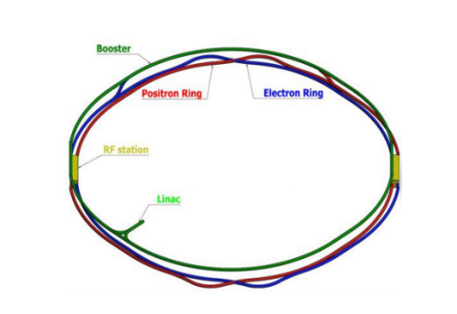
CEPC layout
CEPC (Circular electron positron collider) consists of Linac, Booster and Collider
  The energy electron and positron of the collider is 120 GeV
  The booster and collider circumference is about 100 km
  Linac

Slide 4
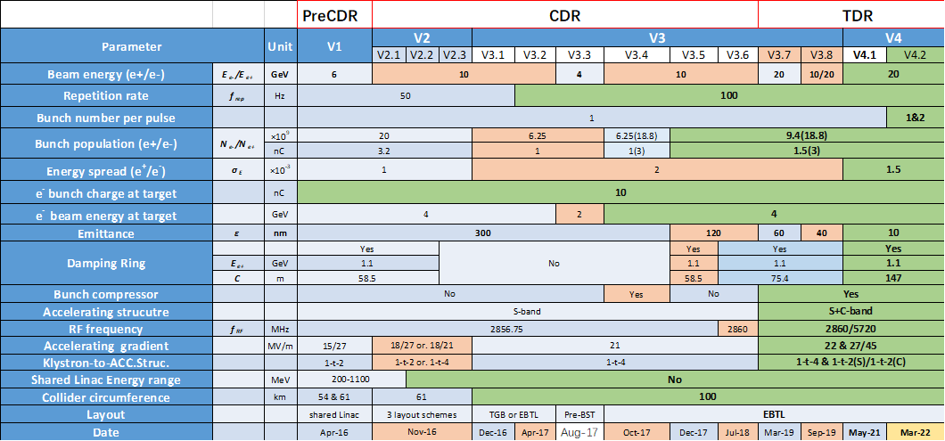
Linac version evolution
Meet the design requirements of Booster: Energy/Emittance
Baseline (CDR: v3.5，2017): 10GeV, 100Hz, one bunch, S-band structures
New baseline (TDR：V4.2, 2021): 20GeV, 100Hz, two bunches per pulse, S+C band structures

Slide 5
LINAC New baseline
Increase the energy of the Linac from 10 GeV to 20GeV
  Booster magnet: Low magnetic field & large magnetic field range
  Linac：S+C-band accelerating structures
Decrease the emittance of the Linac from 40nm to 10nm
  Low emittance damping ring
    Nor. RMS. Emittance: 200mm-mrad
Two bunch per pulse
  To meet the high luminosity for Z
Parameter | Symbol | Unit | Baseline
e⁻ /e⁺ beam energy | E_{e-}/E_{e+} | GeV | 20
Repetition rate | f_{rep} | Hz | 100
e⁻ /e⁺ bunch population | Ne-/Ne+ | ×10¹⁰ | 0.94(1.88)
 |  | nC | 1.5 (3)
Energy spread (e⁻ /e⁺ ) | σ_{E} |  | 1.5×10⁻³
Emittance (e⁻ /e⁺ ) | ε_{r} | nm | 10
Parameter | Unit | S-band | C-band
Frequency | MHz | 2860 | 5720
Length | m | 3.1 | 1.8
Cavity mode |  | 2π/3 | 3π/4
Aperture diameter | mm | 20~24 | 11.8~16
Gradient | MV/m | 21 | 45

Slide 6
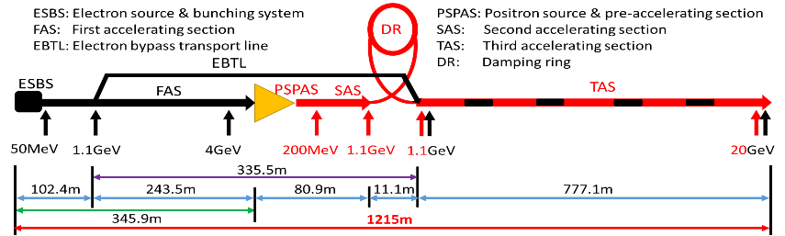
LINAC New baseline
  Layout
  Vertical electron by-pass transport line (EBTL): 1.2 m separation
S-band Linac
  FAS: 4GeV + PSPAS: 200MeV + SAS: 1.1GeV
C-band Linac
  TAS：1.1GeV→20GeV
  Because the emittance of damping ring is decreased, the C-band accelerating structure could be used from 1.1 GeV

Slide 7
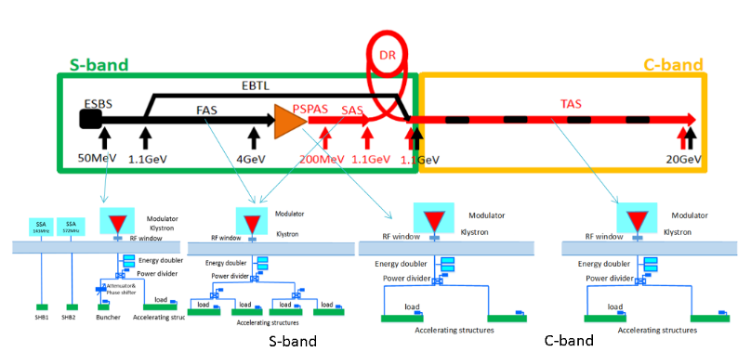
RF distribution of the linac
RF distribution of the linac
  S-band
    80 MW klystron, the number of S-band Acc. Structure is 95, big hole s-band structure after the positron source is 16. the number of pulse compressor is 30
  C-band accelerating structures
    50 MW klystron, C-band structures: 292, pulse compressor 146

Slide 8



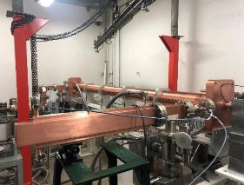



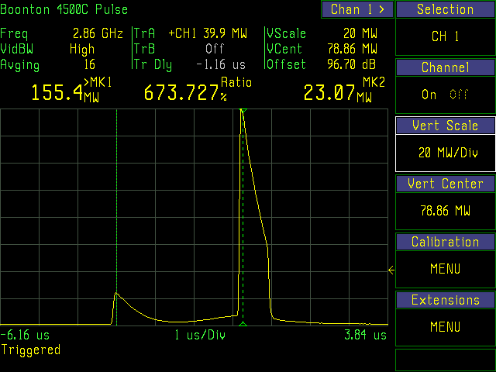
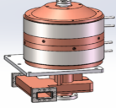
HG 2021 review for CEPC linac
Last year, the S-band accelerating structure high power test result and the pulse compressor design have been introduced .
The AS tested gradient has reached 33 MV/m, and it meets the requirement of CEPC linac. The pulse compressor finished design
Next, I will introduce the progress of S-band pulse compressor and the design and manufacture of C-band accelerating structure
The input power with SLED
Electric field distribution of the twoTE₁₁₃ polarized degenerate mode
S-band High power test bench

Slide 9
Pulse compressor
Design results
  The input power is 80 MW, the repetition rate is 100Hz
  TE ₁₁₃ mode has been selected
Parameter name | Value | Unit
Frequency | 2856 | MHz
Input Power | 80 | MW
Repetition Rate | 100 | Hz
Pulse Width | 4 | μs
Mode | TE₁₁₃（two polarized degenerate mode） | -
Filling Time of Accelerating Structure | 728 | ns
Group Velocity Gradient g of Accelerating Structure | 0.56 | -
Vacuum Leak Rate | ＜2×10⁻¹⁰ | Torr.L/s
Vacuum level | ＜5×10⁻⁸ | Torr
Water Temperature | 30±0.1 | ºC
VSWR | ＜1.1 | -

Slide 10
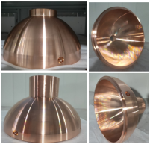
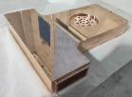
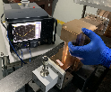
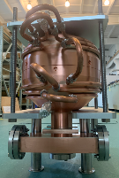


Pulse compressor
Machining in progress
  For the diameter (365 mm) is large, in order to reduce cost, Sheet Forming process has used
Cold test result before brazing of the prototype
  Q₀ =127934 (87% of the theoretical Value)
  β=6.5（83% of the theoretical Value）
High power test will be conducted in October
  The S-band 80MW klystron high power test bench is ready
After fine machining

Slide 11
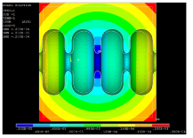
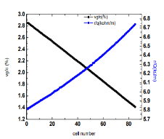
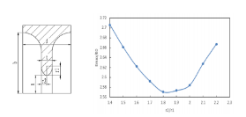
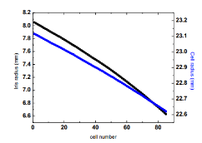
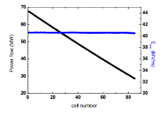
C-band accelerating structure
The preliminary design of the C-band structure for CEPC
  Finished in May 2018 with the support of fund
  Design goal 40 MV /m at that time
  Constant gradient
  3π/4 mode, 1.8 meters long
    Round cavity
    Ellipticity iris
    Dual feed racetrack magnetic coupling
The deformation caused by temperature variation
Emax/E0 as a function of the iris ellipticity

Slide 12
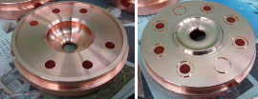
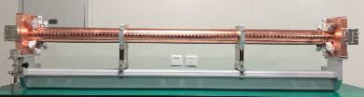
C-band accelerating structure
The beam dynamics of CEPC injector linac based on this design
Frequency: f（MHz） | 5712
No. of Cells | 85+2*0.5
Phase advance | 3π/4
Total length | 1.8m
Length of cell : d | 19.675mm
Disk thickness: t | 4.5mm
Average aperture: 2a | 14.8mm
Average diameter : 2b | 45.7mm
Shunt impedance : Rs (MΩ/m) | 66.0 ~ 75.7
Quality factor : Q | 11232~11359
Group velocity: Vg/c (%) | 2.8% ~ 1.4%
Filling time : t_{f} (ns) | 271
Attenuation factor : τ | 0.432

Slide 13
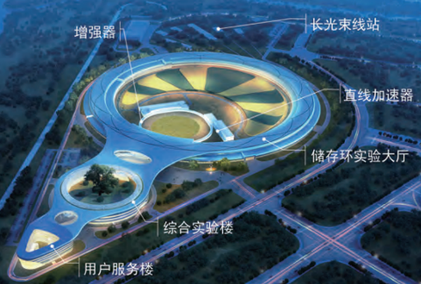
Status of HEPS linac and its structures
High Energy Photon Source (HEPS)
  It is a fourth-generation synchrotron light source with an ultrahigh brightness and under construction in Beijing, China
  Its accelerator system is comprised of a 6-GeV storage ring, a full energy booster, a 500 MeV Linac and three transport lines
Booster
LINAC
storage ring

Slide 14
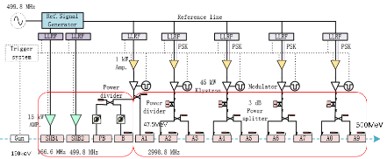
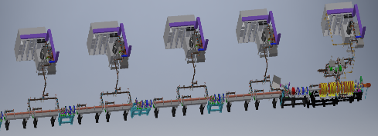
Status of HEPS linac structures
Microwave system of the linac
  SHBs, 2（166.6MHz，499.8MHz）
  Prebuncher, 1（2998.8MHz）
  Buncher, 1（2998.8MHz）
  Accelerating structure, 9（2998.8MHz）
  Pulse compressor, 4（2998.8MHz）
  Waveguides, loads, directional couplers etc.
K1
K3
K2
K5
K4

Slide 15
Bunching system
Requirements of bunching system
  There are solenoid coils outside the two SHBs and hope the electromagnetic field improve rapidly, so there are requirements for mechanical dimensions
  The cavity voltage of SHB1, SHB2, PB, B is 100, 120, 100, 1200 kV respectively
Parameters | value |  |  |  | unit
 | SHB1 | SHB2 | PB | B
Frequency | 166.6 | 499.8 | 2998.8 | 2998.8 | MHz
Type | SW | SW | SW | TW | -
Max. cavity voltage | 100 | 120 | 100 | 1200 | kV
Pulse repetition | 50 | 50 | 50 | 50 | Hz
Drift tube aperture | 30 | 30 | 24 | 24 | mm
Longitudinal mechanical length | 750 | 450 | 243.5 | 235 | mm
Short drift tube length | ≤120 | ≤120 | - | - | mm
RF parameters
Mechanical dimensions

Slide 16
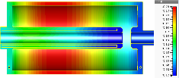
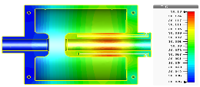
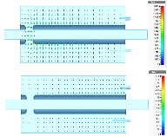

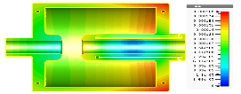
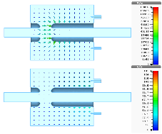
SHBs
Cavity type： Capacitance loaded coaxial line resonator
Material ： Oxygen free copper
SHB1
SHBs temperature and deformation distribution
Parameters | SHB1 | SHB2 | Unit
Frequency | 166.6 | 499.8 | MHz
Shunt impedance | 1.52 | 2.68 | MΩ
Q₀ | 8813 | 13135 | -
Esmax@100kV | 6.44 | 7.36 | MV/m
Kilpatrick factor | 0.47 | 0.35 | -
Transit time factor | 0.997 | 0.971 | -
SHB2
Electromagnetic field

Slide 17
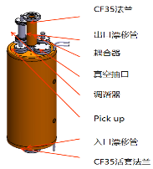
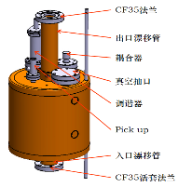
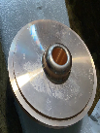

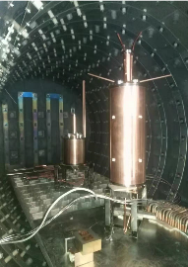
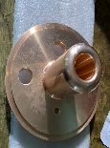
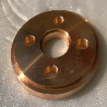
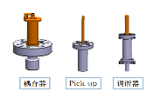

SHBs
Machine design and processing
  Coupling loop
  SHB1 pick up is coupling ring, SHB2 pickup is probe
  Both cavities have tuners. Vacuum pumping port are all on end plate
Cavity welding
SHB1
SHB2

Slide 18
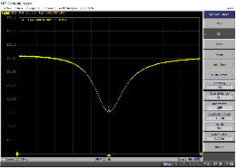
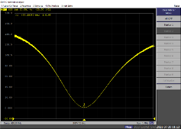
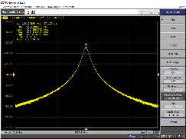
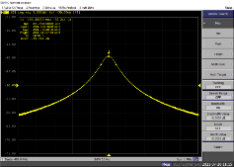
SHBs
Cold test result（SHB1）
  VSWR： 1.03
  Q₀=8038（ Theoretical value with coupler and tuner: 8083, 99.4% ）
  The coupling and the adjustment range of the tuner can meet the requirements
Cold test result (SHB2)
  VSWR： 1.02
  Q₀=12076（ Theoretical value with coupler and tuner: 12100，99.8%）
  The coupling and the adjustment range of the tuner can meet the requirements

Slide 19
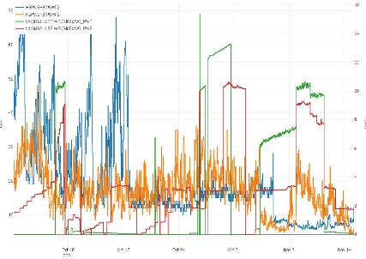
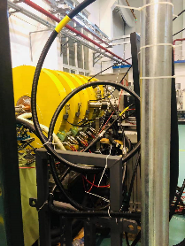
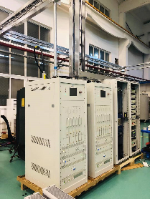
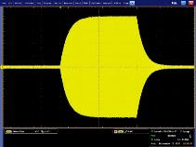
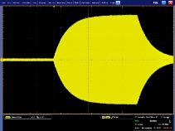
SHBs
High power test
  46 days (2021.9.30-11.15)
  The waveform is stable
High power test facility
15kW SSA

Slide 20
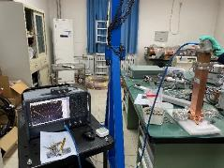
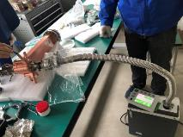
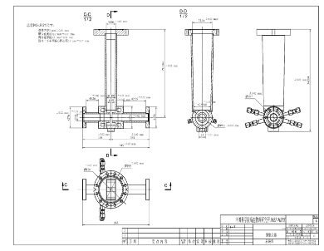
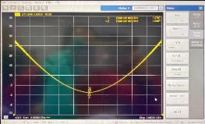
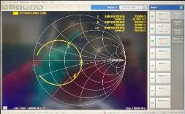
Prebuncher
One cavity, waveguide magnetic coupling
The main body of the cylinder is made of stainless steel, which reduces Q₀ and temperature sensitivity
  VSWR: 1.08
  Q₀: 1600

Slide 21
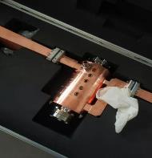
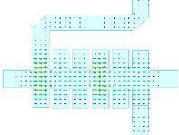
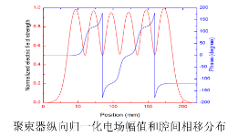

Buncher
Traveling wave constant impedance disk loaded waveguide accelerating structure, including 6 cavities
β=0.75
The output coupler design needs to consider the diameter size of solenoid coil S2
parameters | value | unit
Frequency | 2998.8 | MHz
Mode | 2π/3 | -
Cavity number | 6 | -
β | 0.75 | -
v_{g} | 0.0193 | -
α | 0.147 | Np/m
Rs | 33.2 | MΩ/m
Q₀ | 11083 | -
VSWR | 1.01 | -
Input power | 8 | MW
Type | TW | -

Slide 22


Buncher
High power test on test bench
  The power was started in the afternoon of March 11 and shut down on March 20, lasted 9 days
  High power goal: 2uS/10MW（1uS、1.5uS，2uS）

Slide 23




Pulse compressor
The working mode is TE₀₁₅
Two-hole narrow-wall coupled SLED type is adopted
The energy contribution will be 1.6 times compared to the situation without the pulse compressor
Before installation, all the 4 compressors have been practiced in the high power test bench
It is about 10 days need to the input power of 40 MW
腔内电场分布TE_{0,1,5}
Item | Designed value | Measured value
Frequency | 2998.8 MHz | 2998.8MHz
Mode | TE_{0,1,5} | TE_{0,1,5}
Unloaded quality factor | 100,000±5,000 | 99980
Coupling coefficient | ~5 | 4.6
Insertion loss | ≤0.2 dB | 0.19dB
Frequency tuning range | ＞±500 kHz | ＞±500 kHz
VSWR | ＜1.1 | 1.09
Peak power gain | 7dB | 7.16dB
High power test

Slide 24

Accelerating structures
The total number of Accelerating structures is 9
Main parameters
Parameters | value | unit
Frequency | 2998.8 | MHz
type | Constant gradient, travaling wave | -
Work mode | 2π/3 | rad
Cell number | 88+2 | -
Total length | 3.101 | m
Vg/vc | 1.89~0.87 | %
Attenuation | 0.46 | NP
impedance | 65.2～73 | MΩ/m
Average shunt impedance | 69.8 | MΩ/m
Filling time | 740 | ns
Power requirement @Eacc=20MV/m | 28.5 | MW
Espeak/Eacc 1st cavity | 2.84 | -
Hspeak 1st cavity @Eacc=20MV/m | 70 | kA/m
 | 11 | -
Output power/input power | 0.4 | -

Slide 25




Accelerating structures
All of them have high power test and to the gradient 20MV/m

Slide 26
Accelerating structures
High power test duration
  This statistics includes the equipment failure time
  It takes a long time to AS1 and AS2 because of the waveguides and loads are all new one

Slide 27





Accelerating structures
Straightness adjustment
  Required straightness ± 0.15mm
  Using laser tracker to adjust the straightness of the 3 meters long structure
After

Slide 28





Waveguide components
3dB power hybrid
  Test results
    Coupling ：-3.06dB，-3.10dB
    VSWR：1.03
    Isolation ：-46.7dB
    Balance ：90.03°

Slide 29





Waveguide components
6.3dB power divider
  Narrow side double row slotting , 6 slots in each row
  Test results
    VSWR：1.05
    Coupling：-6.45dB
    Isolation ：-41.2dB

Slide 30






Waveguide components
18dB power divider
  Narrow side 6-holes coupling
  Test results
    VSWR：1.02
    Coupling ：-18.05dB
    Isolation ：-48.4dB

Slide 31





Waveguide components
Directional coupler
  The vacuum sealing position is moved upward, which can withstand higher power
  The inverted T-shaped coupling piece is easy to process and adjust, and can obtain high directivity
    Coupling: -60±0.5dB
    Directivity: ~40dB

Slide 32




Waveguide components
Waveguides
Straight waveguide
Bent waveguide
Extraction waveguide
Dummy loads

Slide 33





Installation
All microwave devices have been installed
PB&B
AS1
SHB1&SHB2
AS2-AS9
Pulse compressor

Slide 34
Summary
The CEPC linac baseline design is changed from 10 to 20 GeV S+C-band AS in TDR phase
The key components of the linac baseline are being developed
According to CPM plan, TDR will be complete before 2023
HEPS linac is a 500MeV S-band normal conducting pre-injector
Before installation, accelerating structure, pulse compressor, loads etc. have been high power tested
Now microwave components have been installed at Huairou Science City linac tunnel and waiting for Commissioning

Slide 35
Thank you for your attention!

