Slide 1
Monte Carlo Model of High-Gradient Conditioning and Operation
Lee Millar¹, Walter Wuensch¹, Graeme Burt²
¹CERN SY-RF-MKS
²Cockcroft Institute, Lancaster University, Lancaster, United Kingdom
International Workshop on Breakdown Science and High Gradient Technology (HG2022), 18th May 2022

Slide 2


Contents
Introduction.
Simulation Setup.
A Visual Example.
Results of the Model.
Conclusion.

Slide 3
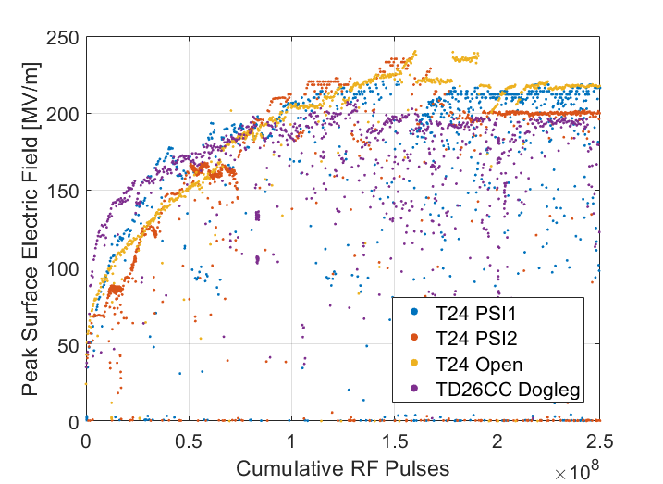
High-Voltage Conditioning
“Typical” Behaviour
Well known that high-gradient structures (and high-power RF components) are often limited by breakdown.
To achieve stable high-power operation, they must first be conditioned.
At CERN a conditioning algorithm has now been developed to automate the process and offers a consistent and reproducible method of component testing [1,2].
Figure: Preliminary conditioning of several X-band structures tested at CERN.

Slide 4
So Why Model Conditioning?
The Physics Motivation:
Many attempts have been made to connect theory to the measurements (e.g. probabilistic behaviour of BDs, BDR dependency on gradient), but they generally only address a single facet of the problem. Real operation is more complex, the model is an attempt to combine theoretical explanations and connect them to results.
The Pragmatic Motivation:
Conditioning procedures are largely anecdotal. Despite being essential the conditioning process has yet to be optimised (tests require a long timeframe/significant expense, difficult to do experimentally).
The first attempt at a comprehensive integration of HG operation to address these issues.
Notes:
Mention: Very nice study on the LES was also previously carried out however with some different objectives pertaining to field emitters.

Slide 5
Contents
Introduction.
Simulation Setup.
A Visual Example.
Results of the Model.
Conclusion.

Slide 6
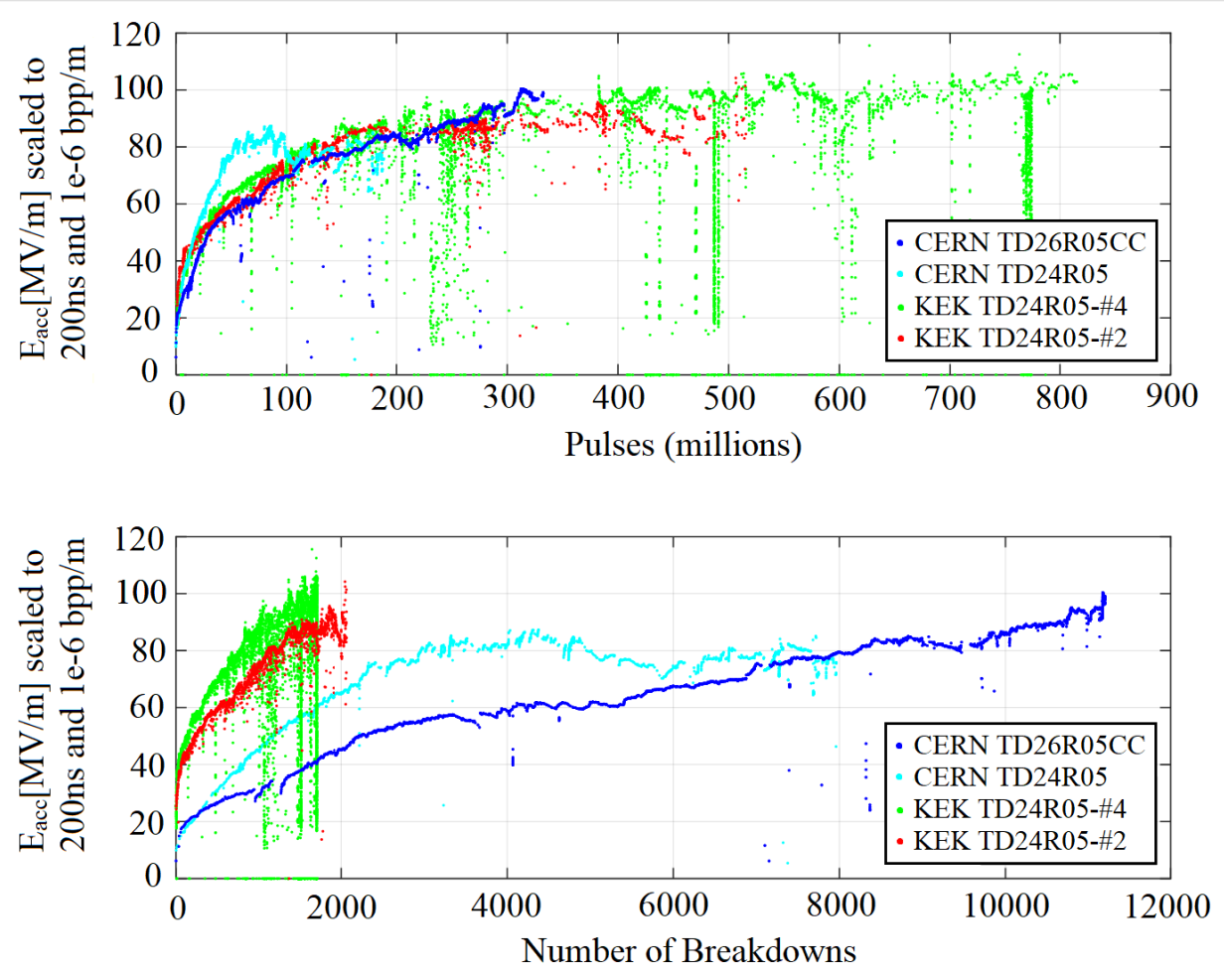
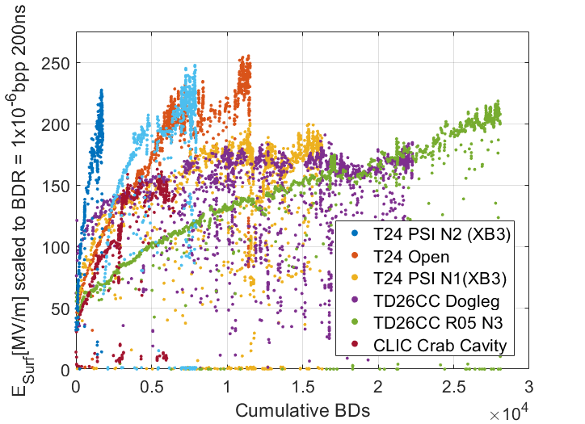
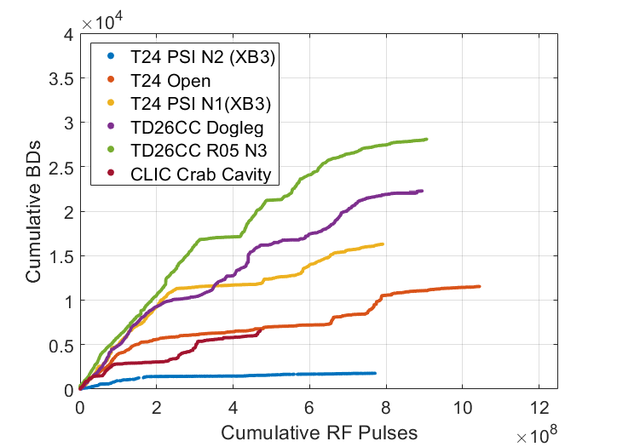
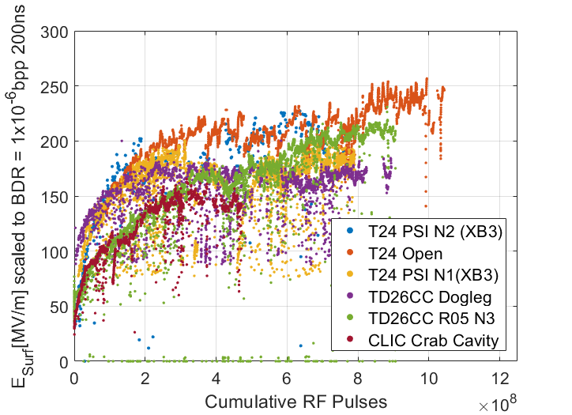
Simulation Setup: Assumptions of the Model
No. 1:
Asymptotic behaviour
(no indefinite conditioning)
No. 2:
Structures condition on pulses (pulse count usually more comparable than BDs).
Figure: Scaled gradient vs. cumulative no. pulses (top) and scaled gradient vs. cumulative no. breakdowns (bottom) for four different structures [3].

Slide 7
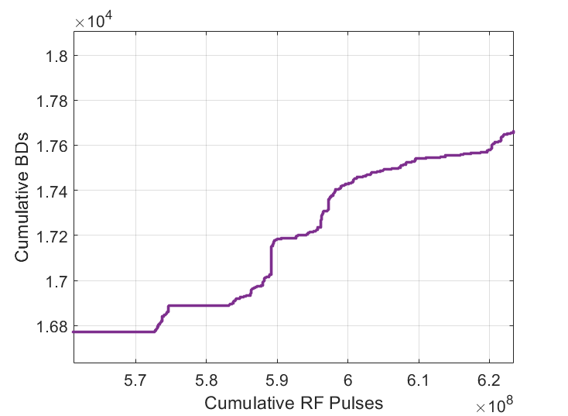
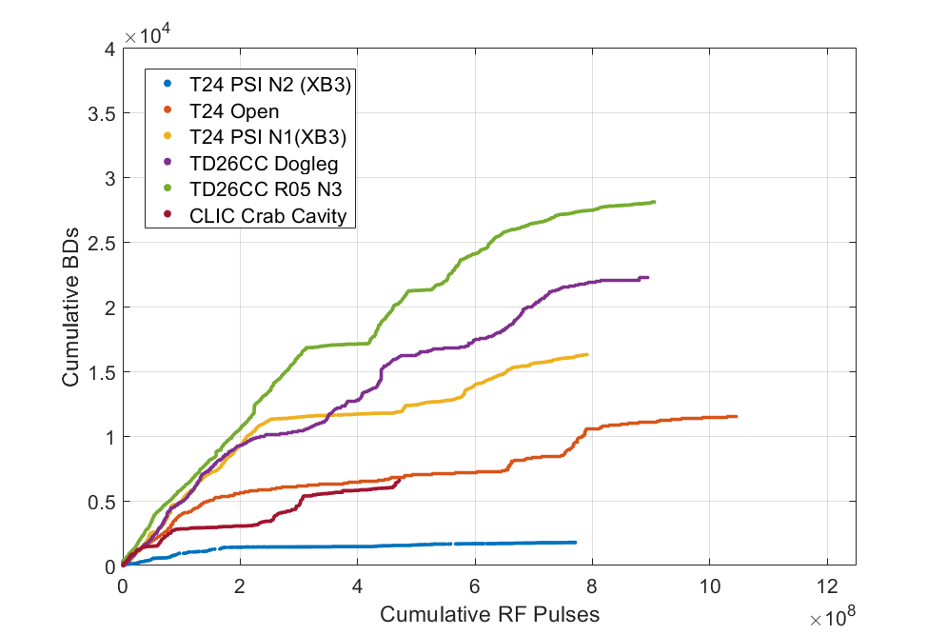
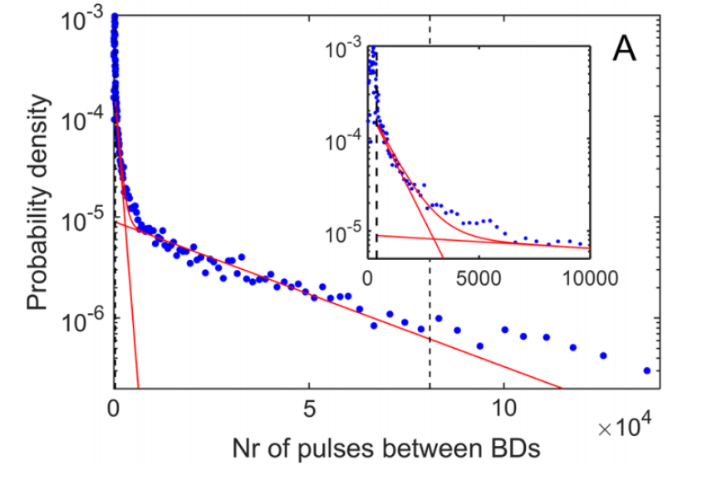
Simulation Setup: Assumptions of the Model
No. 3:
Breakdowns can improve or worsen the surface
(occur both individually or in groups).
Figures: Cumulative breakdowns vs pulses for a TD26CC tested at CERN showing “staircasing”.
Figure: Probability distribution of the pulses between BDs for a structure tested at CERN and a two-exponential fit [4].

Slide 8
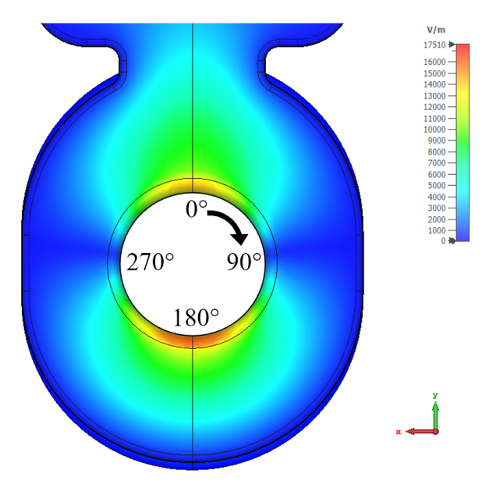
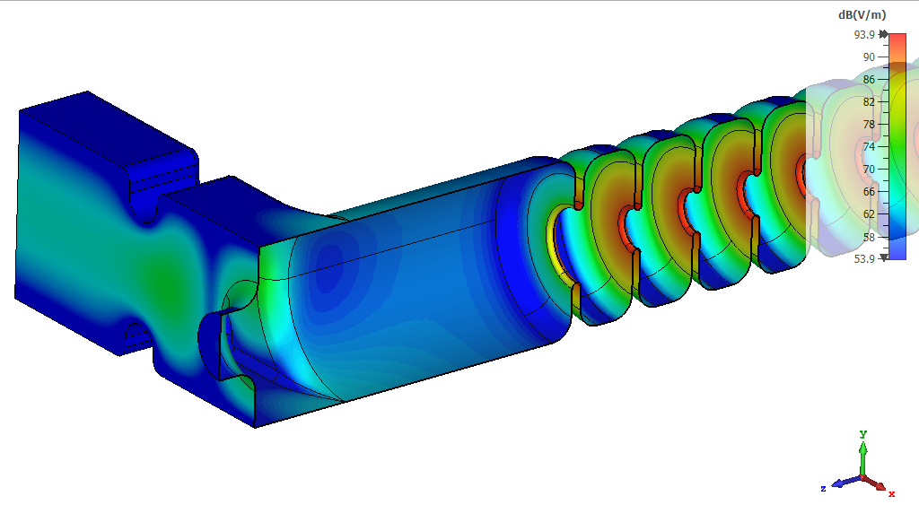
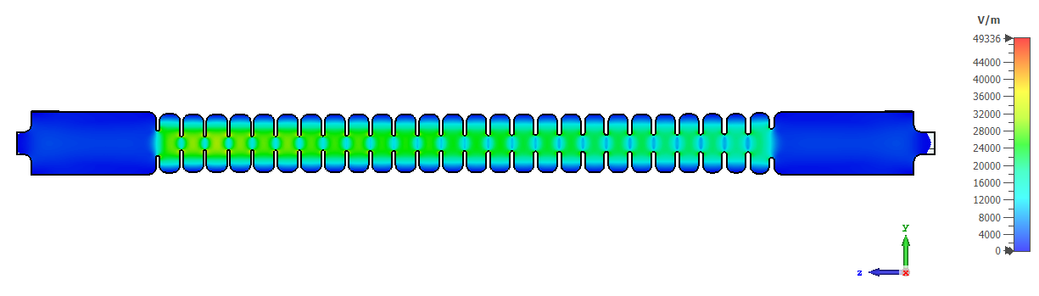


Simulation Setup: Assumptions of the Model
Field distributions often vary spatially, and the effect of breakdown is a local one, making a grid/mesh-based approach appropriate. We can then monitor each element individually.
Surface electric field in an dipole-mode RF cavity.
E [V/m]

Slide 9
Simulation Setup: Assumptions of the Model
I have condensed the process into three key characteristics, although many other facets of operation exist. To summarise:
Each pulse improves (conditions) the surface elements.
Elements asymptotically approach a limit, above which no improvement takes place.
Breakdowns may worsen or improve a given surface element.
The model is built around the idea of progressive modification of the surface on a pulse-to-pulse basis. To do so, we have used a few terms…
Notes:
Next, lets define a few terms…

Slide 10
Simulation Setup: A Reminder
“Typical” Behaviour
Figure: Preliminary conditioning of several X-band structures tested at CERN.

Slide 11
Simulation Setup: A Few Terms
There is a saturation point for E_{State} for a given material (E_{Sat}).
We have an operating field (E_{Operate}).
E_{Sat}
E_{State}
E_{operate}
Electric Field [MV/m]
BDR [bpp]
The field level to which the device has been conditioned (E_{State}).
There is a probability of breakdown for a given level of conditioning (P_{Reference}). Applies to the whole device i.e. all grid elements.
Cumulative RF Pulses
Figure: Visualisation of proposed quantities during conditioning. For illustrative purposes only.

Slide 12
Simulation Setup
Using these quantities, we have then derived appropriate equations to capture and quantify:
The conditioning effect.
The probability of breakdown for each element.
How breakdowns affect the grid elements.
Today I’d rather focus on the model’s capabilities and some results, so I have left the equations employed and the relevant justifications in the bonus slides. For now, I’ll show only a broad overview of the model.

Slide 13
Summary: A (very) Simple Model Outline
Modify BD Element
BD
Input Values
Run
Increment Pulse Count
Check Grid Elements for Arc
Condition Surface
No BD
Calculate BDR
Pulse goal not met
Append
Data
Conditioning Algorithm
(Determine characteristics of next pulse)
End Simulation
Pulse goal met
Figure: Simplified block diagram of the model showing the equations implemented.

Slide 14

Summary: A (very) Simple Model Outline
Modify BD Element (Assign new ψ from Gaussian dist.).
PLACE YOUR MODEL HERE
BD
Input Values
Run
Increment Pulse Count
Check Grid Elements for Arc
Condition Surface
No BD
$${RNG>P_{Grid}∙\left(\frac{E_{Operate}}{E_{State}∙ψ}\right)}^{30}?$$
Calculate BDR
Pulse goal not met
Append
Data
Conditioning Algorithm
(Determine characteristics of next pulse)
End Simulation
Pulse goal met
Figure: Simplified block diagram of the model showing the equations implemented.

Slide 15
Contents
Introduction.
Simulation Setup.
A Visual Example.
Results of the Model.
Conclusion.

Slide 16
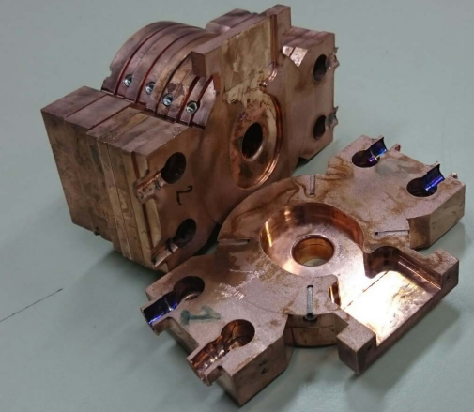
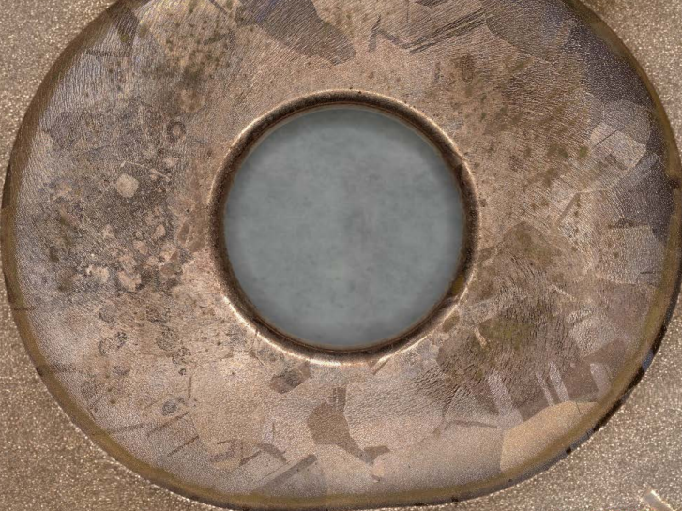
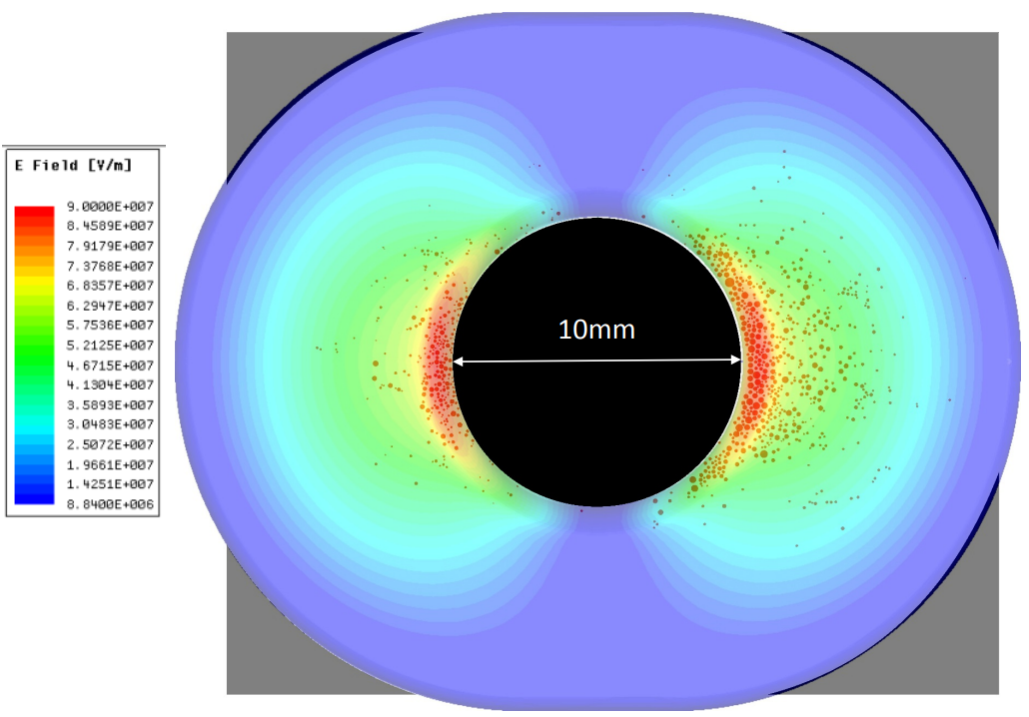
A Visual Example: The CLIC Crab Cavity
Breakdown locations superimposed on electric field distribution.
Cavity after high-power test and cutting.
Face of a single cell.
Figure: Images from the post-mortem examination of the CLIC crab cavity [5].

Slide 17
A Visual Example: The CLIC Crab Cavity
Select Surface
Apply grid/mesh.
Relative Field Values are assigned.
E [V/m]
Breakdown locations.

Slide 18
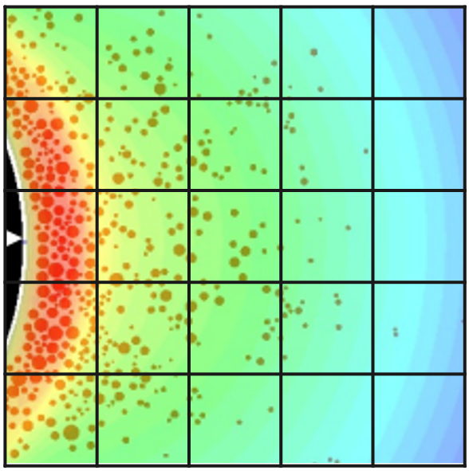
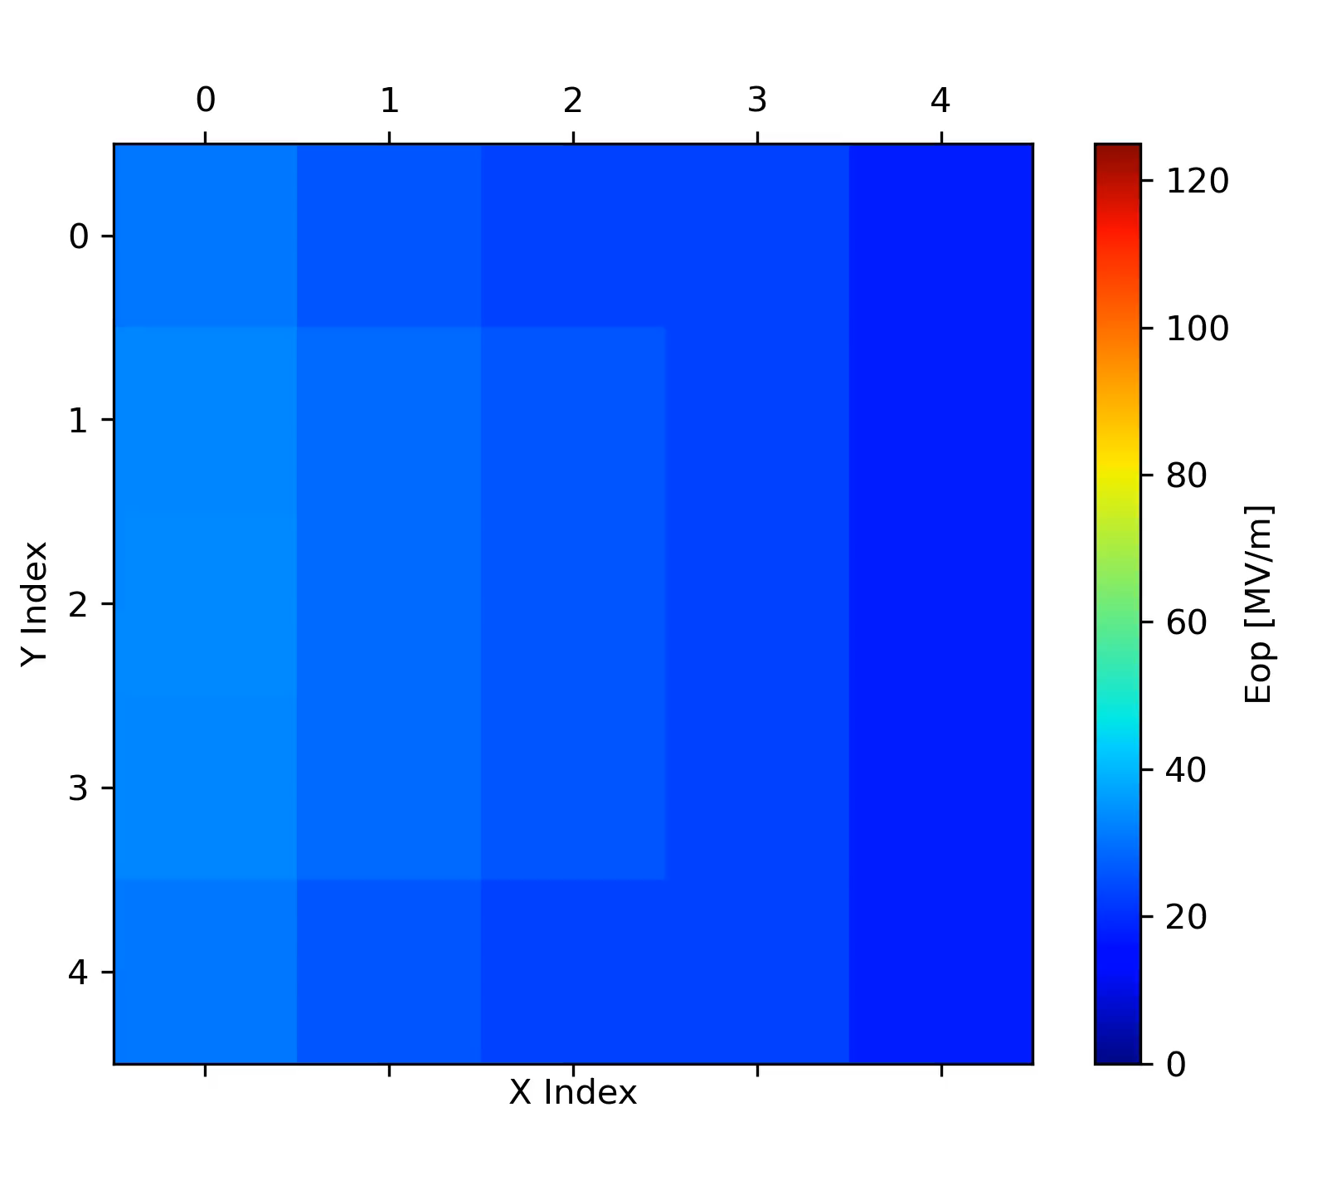
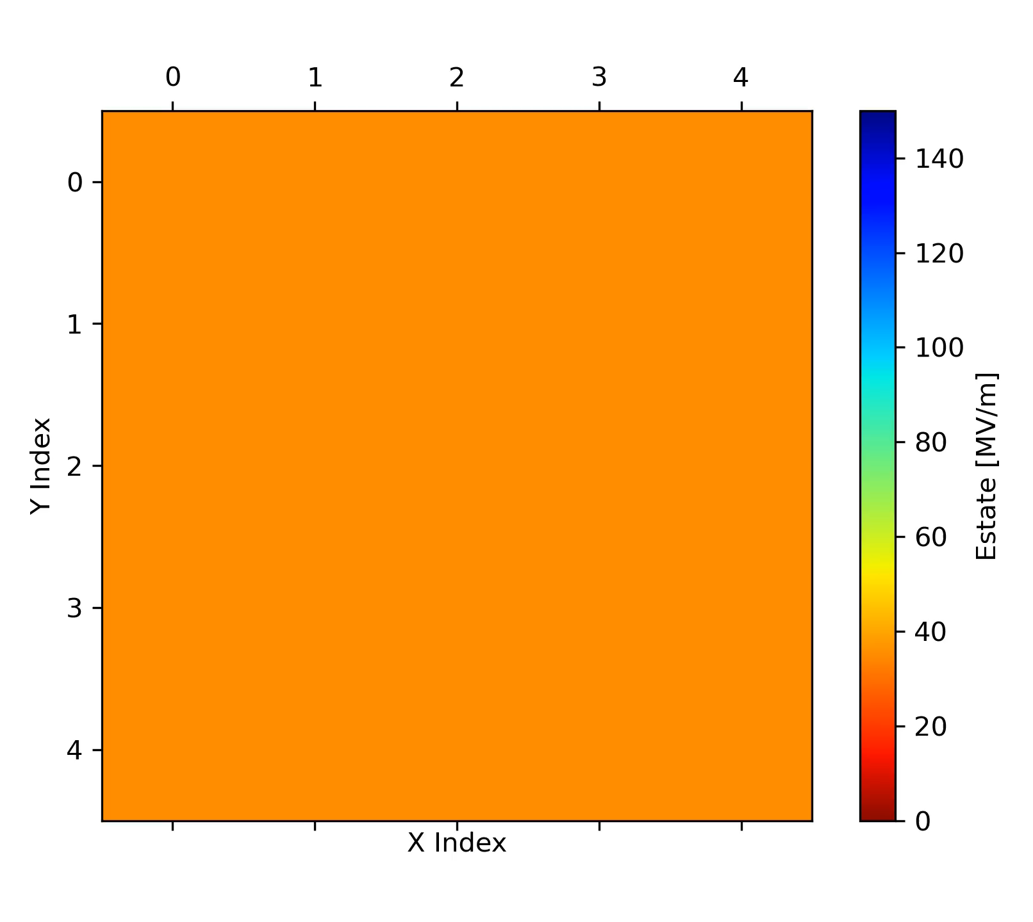
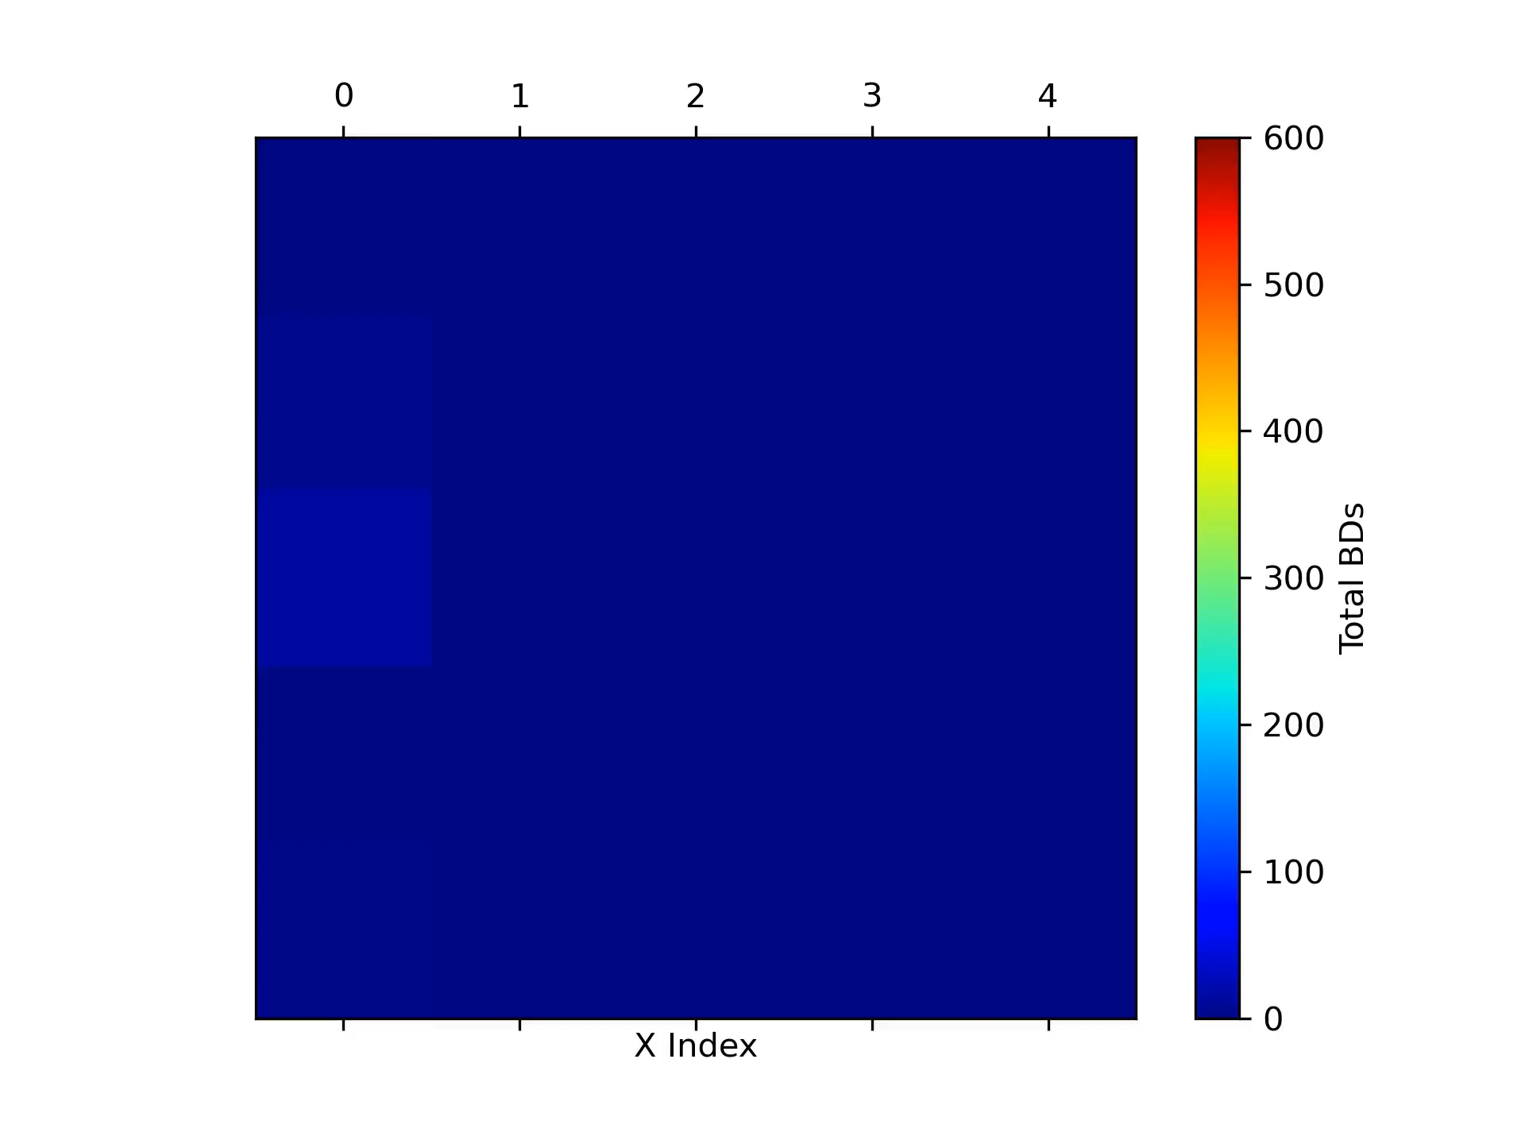
A Visual Example: The CLIC Crab Cavity
Can then monitor quantities accessible in experiments (E_{Op}, global BDR) and others which cannot be directly measured (E_{state}, effect of breakdowns, etc.).
E_{op} Values (Applied Electric Field)
E_{state} Values
Cumulative BDs

Slide 19
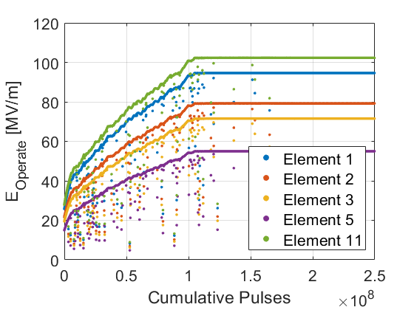
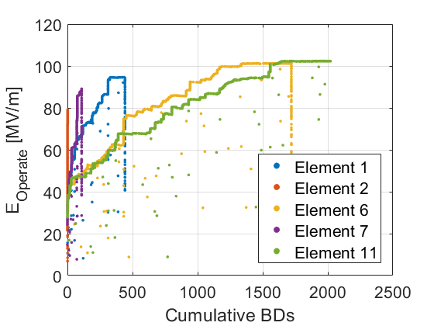
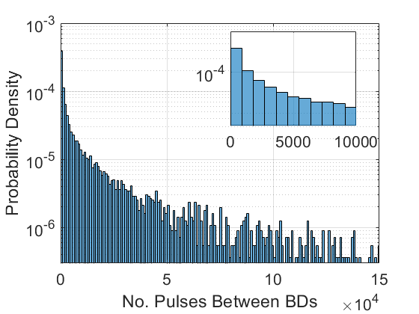
A Visual Example: The CLIC Crab Cavity
And generate the more familiar plots…..
E_{op} Values (Applied Electric Field)
BD Accumulation
Probability Distributions

Slide 20
Contents
Introduction.
Simulation Setup.
A Visual Example.
Results of the Model.
Conclusion.

Slide 21
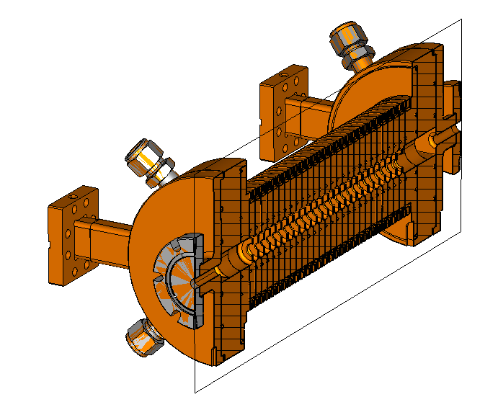
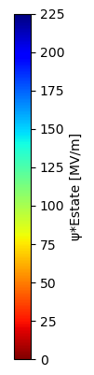
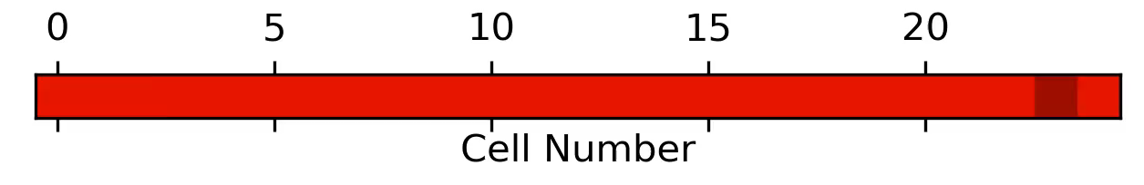
Result 1: CLIC Prototype Structure
Modelling each cell as an identical grid element (real structures vary in field and cell surface area).
Constant impedance example in the bonus slides.
Conditioned state for each cell.

Slide 22
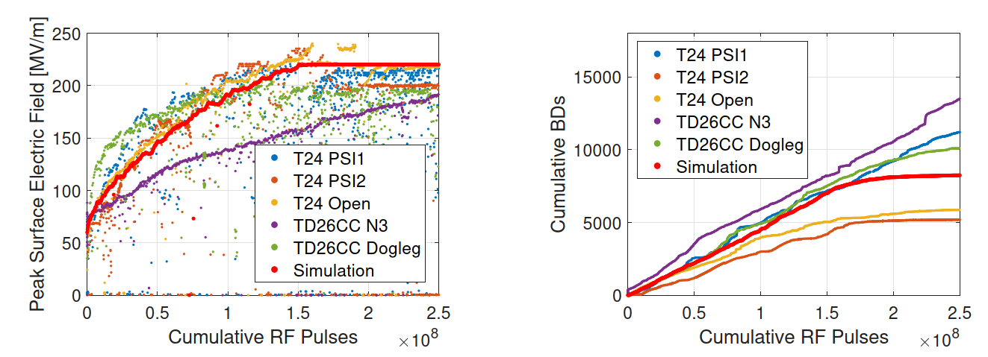
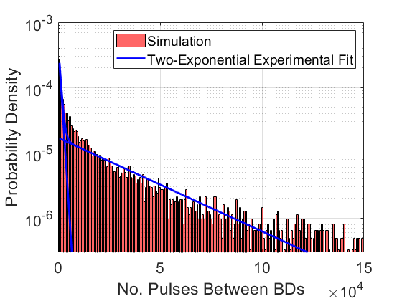
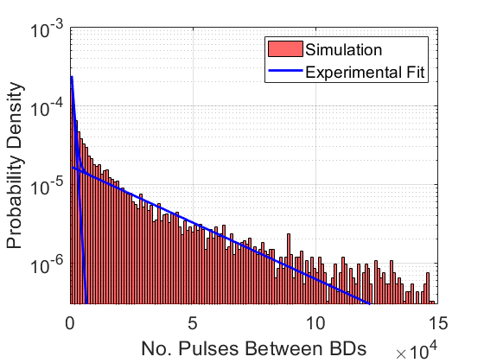
Result 1: CLIC Prototype Structure
Simulated conditioning in red (25 grid elements).
Notes:
Probabilistic behaviour.

Slide 23
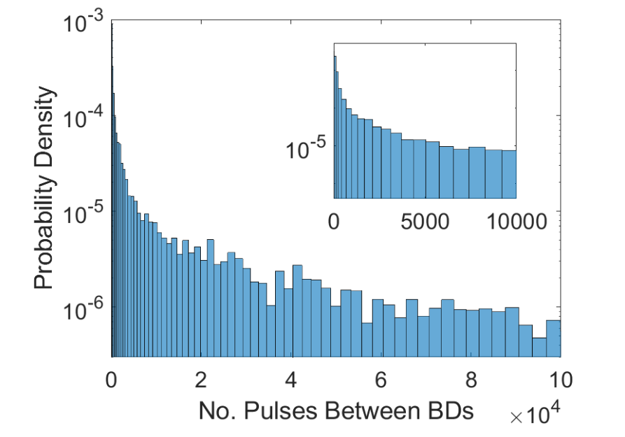
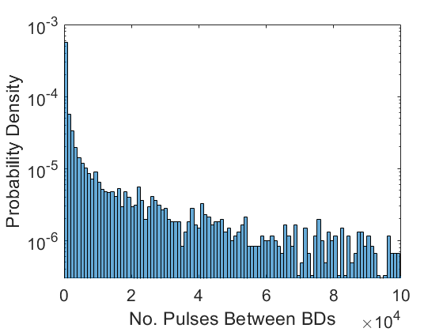
Result 1: CLIC Prototype Structure
Previously described as a “double Poisson” or having a “two-exponential” fit (referring to primary and secondary breakdowns). Similar behaviour emerges in simulation using only a standard gaussian distribution.
Experimental Data
Simulation
More in the bonus slides!

Slide 24
Contents
Introduction.
Simulation Setup.
A Visual Example.
Results of the Model.
Conclusion.

Slide 25
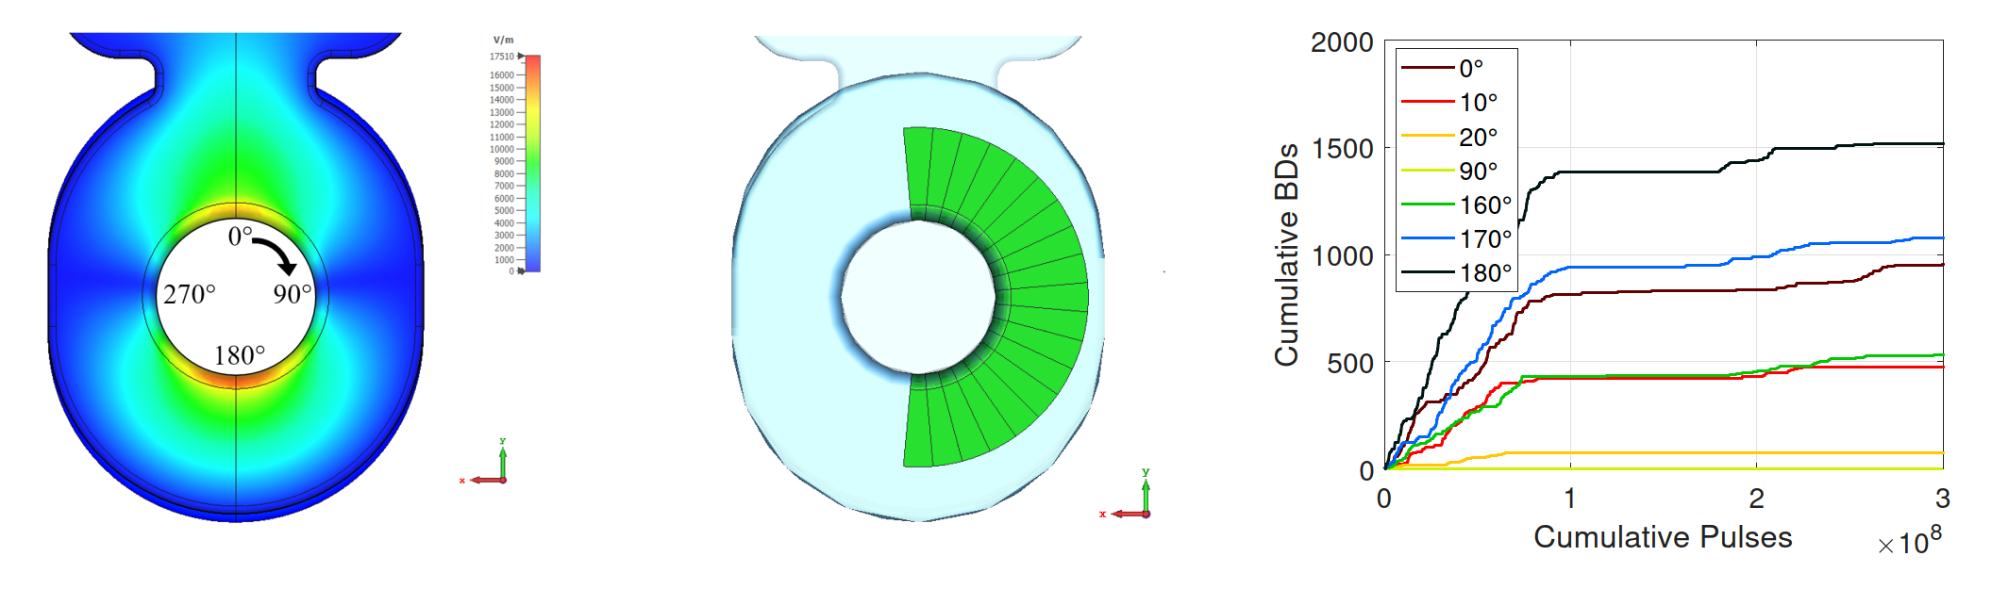
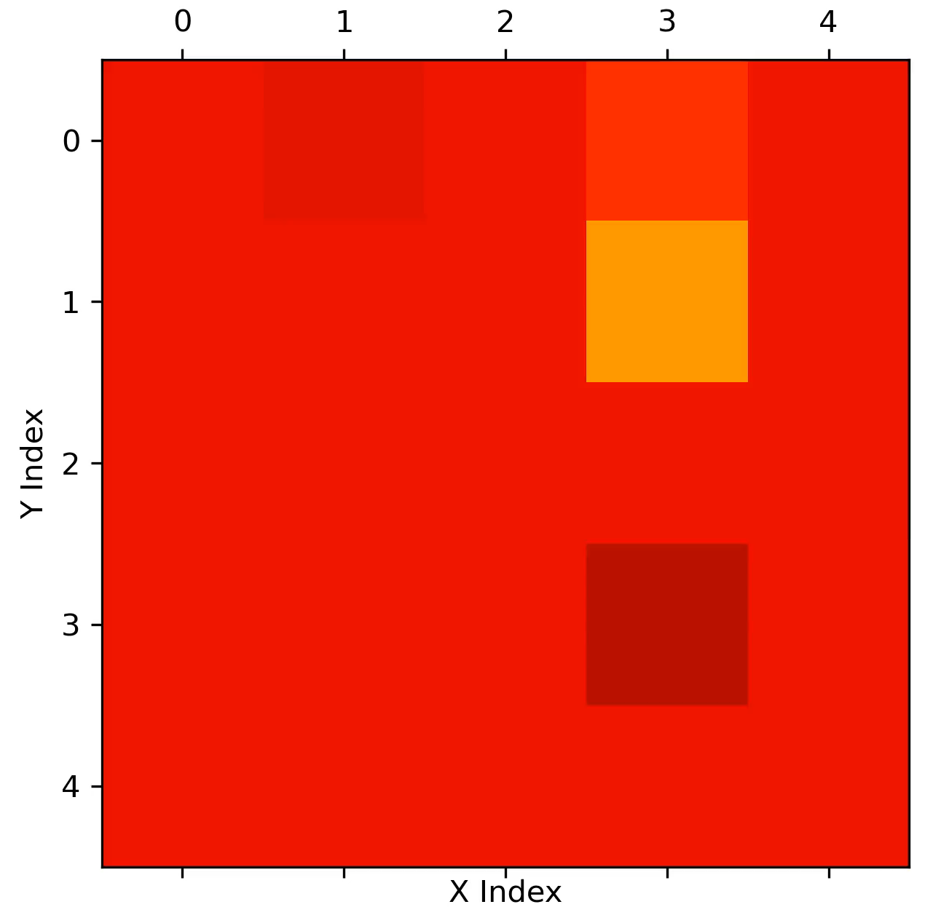
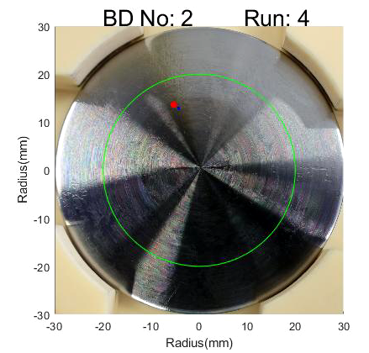
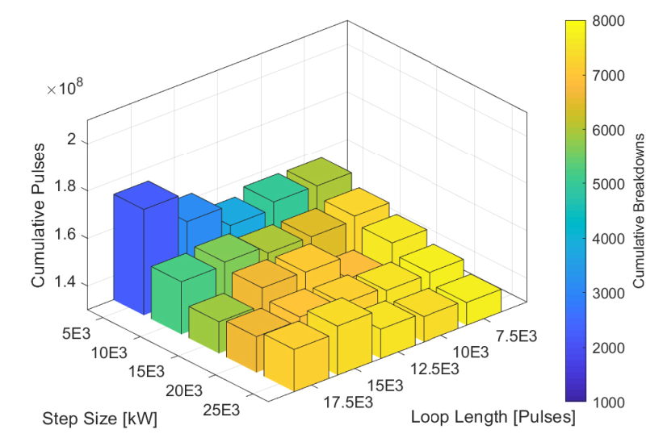
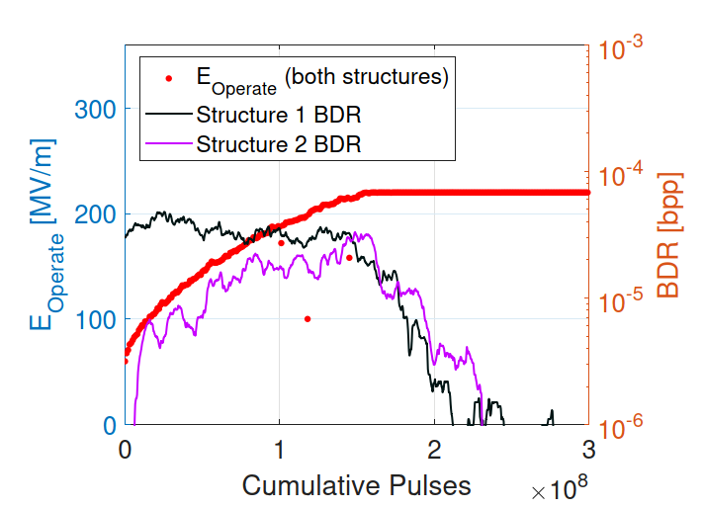
Conclusion & Future Work
A discretised model of conditioning has been created and the results align well with HG test data. Ongoing studies include:
Spatially Resolved Conditioning.
Conditioning algorithm optimisation.
Multi-Structure arrangements.
Simulation of DC electrodes (to be compared with CERN Large Electrode System data).
Trialing alternative models/conditioning theories.
Currently being prepared for publication!
Simulation
Real Data
Figure: Additional ongoing Monte Carlo studies. DC Electrode clip courtesy of Ruth Peacock

Slide 26
Thank you. Questions?

Slide 27
References
[1] – B. Woolley, “High Power X-band RF Test Stand Development and High Power Testing of the CLIC Crab Cavity,” Lancaster University, United Kingdom, 2015.
[2] – L. Millar, “Conditioning and Operational Algorithms”, Presentation, Available online: https://indico.cern.ch/event/719535/
[3] – J. Giner Navarro, Breakdown Studies for High Gradient Rf Warm Technology in: CLIC and Hadron Therapy Linacs, University of Valencia, 2016.
[4] – Statistics of vacuum breakdown in the high-gradient and low-rate regime. Wuensch, W. et al. 10, s.l. : American Physical Society, 2009, Phys. Rev. Accel. Beams 20, 011007 – Published 25 January 2017, Available online: https://journals.aps.org/prab/pdf/10.1103/PhysRevAccelBeams.20.011007
[5] – Enrique Castro, “CLIC Crab CavityPost-Mortem analysis” (presentation), Available online: https://indico.cern.ch/event/449801/contributions/1945273/
[6] – W. Wuensch, “The CLIC accelerating structure development program” (presentation),Available online: https://indico.cern.ch/event/106300/contributions/1306888/
[7] – T. Lucas et al., “HIGH POWER TESTING OF A PROTOTYPE CLIC STRUCTURE: TD26CC R05 N3”, Available online: http://cds.cern.ch/record/002642425

Slide 28
Bonus Slides: Extra Results

Slide 29
Result 1: CLIC Prototype Structure
Previously described as a “double Poisson” or having a “two-exponential” fit (referring to primary and secondary breakdowns). Similar behaviour emerges in simulation using a standard gaussian distribution.
Experimental Data
Simulation

Slide 30
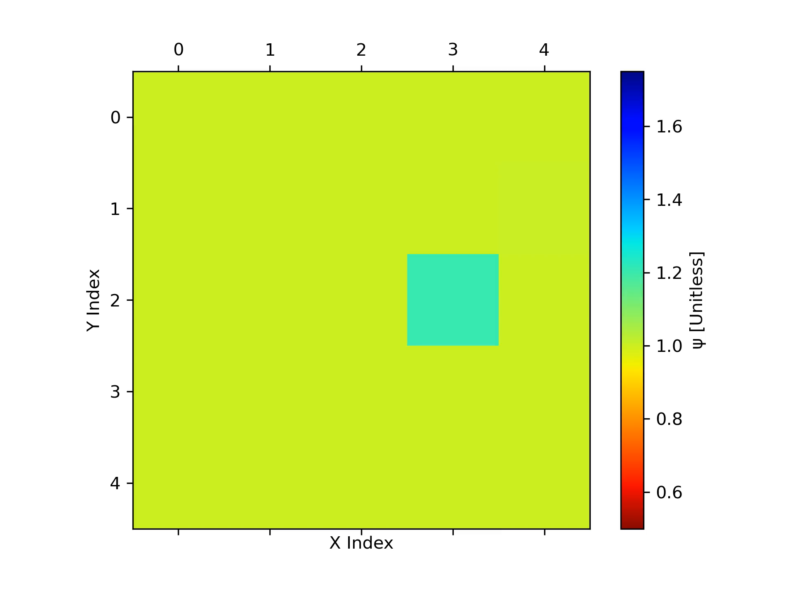
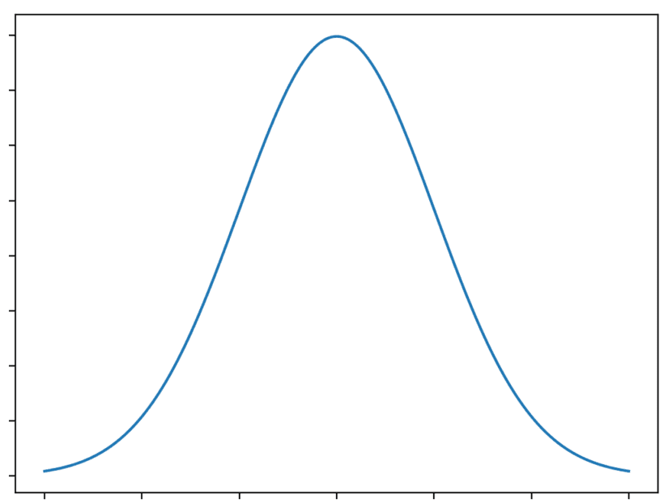
Result 1: CLIC Prototype Structure
Previously described as a “double Poisson” or having a “two-exponential” fit (referring to primary and secondary breakdowns), emerges naturally in simulation using an enhancement factor taken from a standard gaussian distribution.
Values tend towards stability.

Slide 31
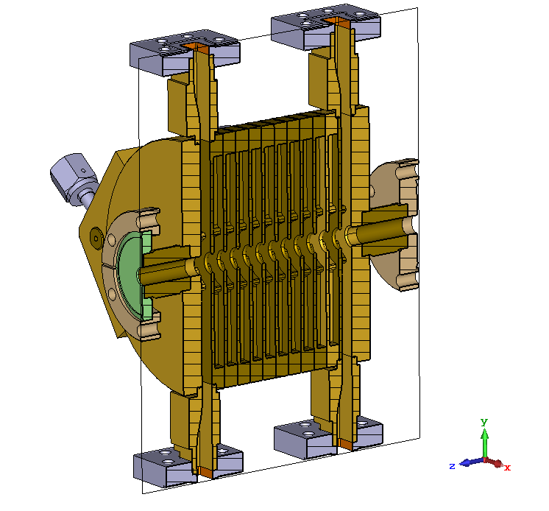
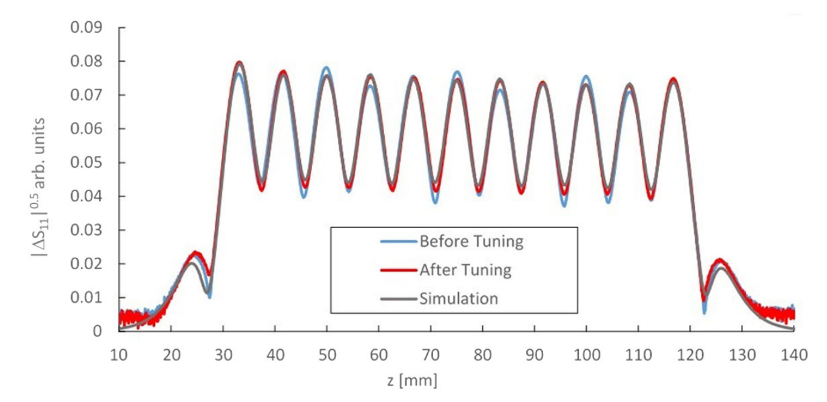
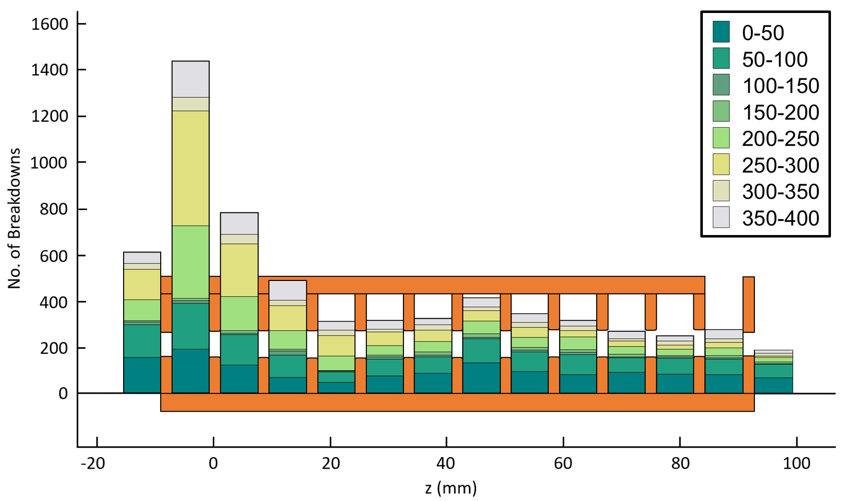
Result 2: A Constant Impedance Structure
Different cells in the CLIC crab cavity (shown left) accumulated different numbers of BDs.
Cells identical, E-field decreases.
Different BD accumulation.
Figure: Field profile of the CLIC crab cavity.
Figure: Number of breakdowns accrued in each cell for different windows of pulses (millions) during the test of the CLIC crab cavity.

Slide 32
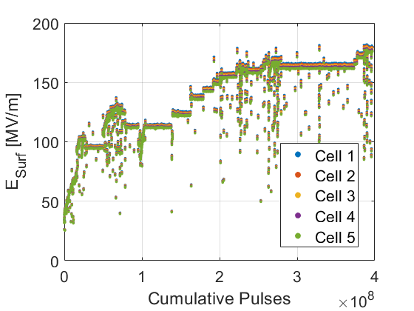
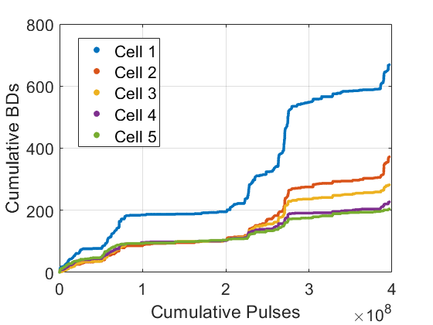
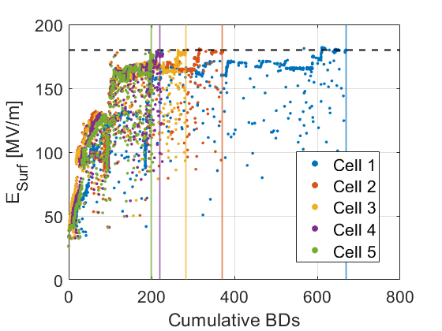
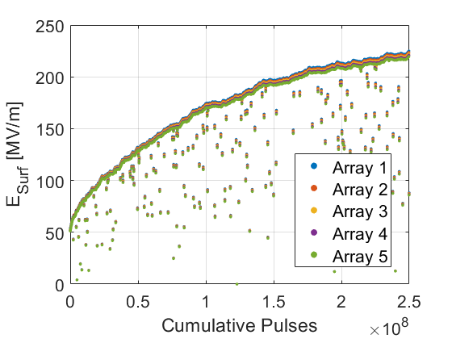
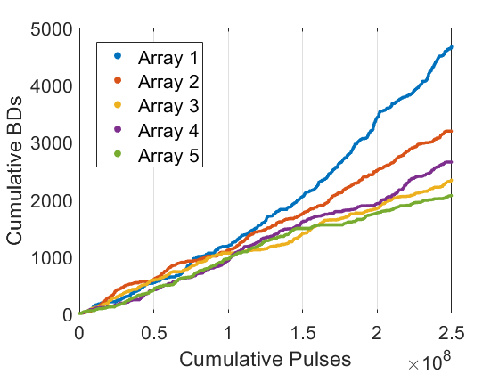
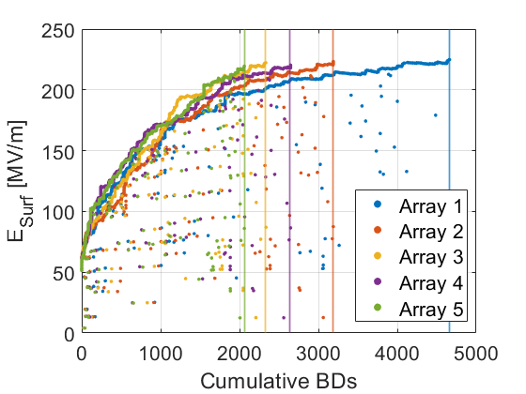
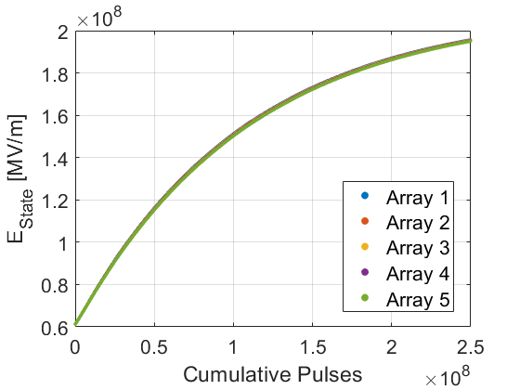
Result 2: A Constant Impedance Structure
Experiment
Experimental and simulation data shows cells reach virtually the same field (~97%) but accrue different numbers of breakdowns.
Simulations agree!
Simulation

Slide 33
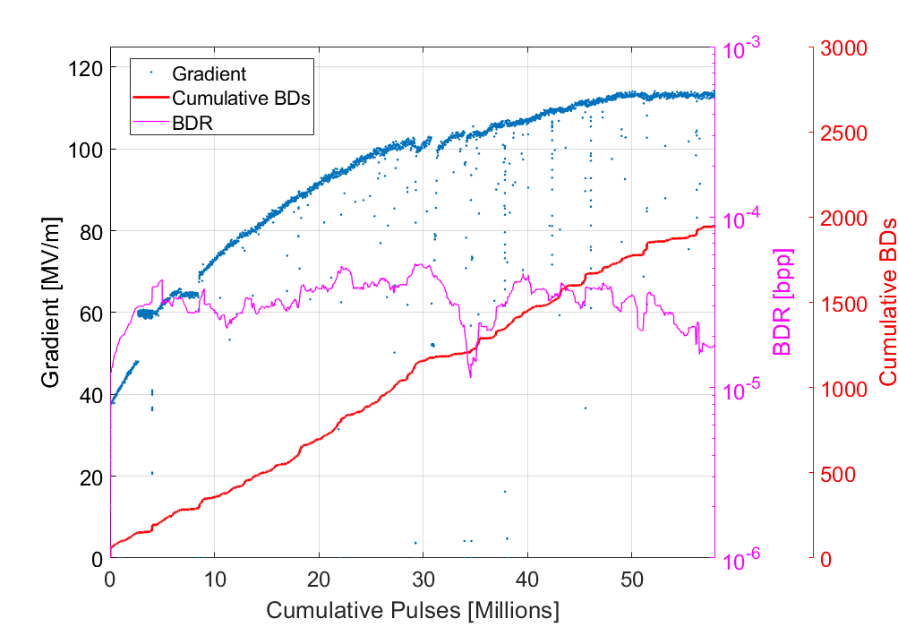

Result 3: Adjusting CERN’s Conditioning Algorithm
One of the goals was to examine changing the parameters in our conditioning algorithm.
In the test stands, we track an operator-selected BDR. Little data exists on changing this value.

Slide 34
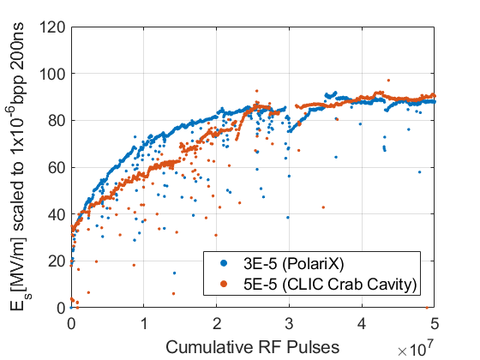
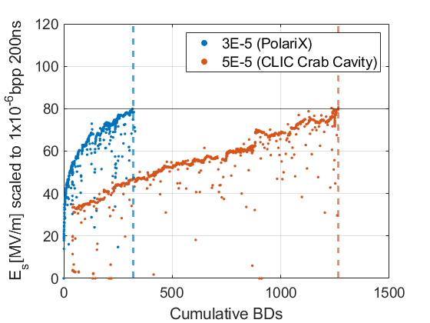
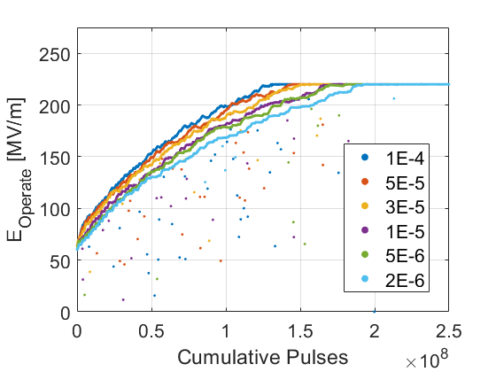

Result 3: Adjusting CERN’s Conditioning Algorithm
Simulation predicts that reducing the BDR setpoint can reduce the BDs accrued without significantly prolonging conditioning. Results agree with an existing experimental example.
Fewer BDs at lower setpoints.
Offers an explanation for the results✔.
Experimental Data
Simulation

Slide 35
Bonus Slides: Model Details

Slide 36
BONUS SLIDE - Definition of Model Terms
P_{Reference} = The instantaneous probability of breakdown for a given device operating at the level to which it has been conditioned. 5E-5 bpp selected as it is generally the max permissible BDR chosen in CERN structure tests.
E_{Operate} = The electric field level in MV/m at which the device operates.
E_{State} = The surface electric field level to which the device has been conditioned in MV/m. Operation at this field level results in a probability of breakdown which is equal to P_{Baseline}.
E_{Sat} = The saturation point for a given material in MV/m. Operation above this level does not result in any further improvement in E_{State} and thus, this is the maximum surface field attainable at the reference breakdown rate (5E-5 bpp) after the device has been fully conditioned. Typically ≈ 250 MV/m in our structures.

Slide 37
Simulation Setup: Assumptions of the Model
E_{Operate} = The electric field at which the device operates.
E_{State} = The surface electric field level to which the device has been conditioned.
E_{Sat} = The maximum achievable value for E_{state}. The saturation point for a given material in MV/m.
E_{Sat}
E_{State}
E_{operate}
Electric Field [MV/m]
BDR [bpp]
Cumulative RF Pulses
Figure: Visualisation of proposed quantities during conditioning. For illustrative purposes only.

Slide 38

Simulation Setup: Quantification of Conditioning
Assuming each element has a conditioning rate (CR), the surface state (E_{State}) should asymptotically approach a limit (E_{Sat}):
$$CR∝ \left[1−\frac{E_{State}}{E_{Sat}}\right]$$
However, to produce a significant conditioning effect the operating field (E_{Operate}) must be close to the level to which the surface is conditioned (E_{State}):
$$CR∝\frac{E_{Operate}}{E_{State}}\left[1−\frac{E_{State}}{E_{Sat}}\right]$$
E_{Sat}
E_{State}
E_{operate}
Electric Field [MV/m]
Cumulative RF Pulses
Figure: Visualisation of proposed quantities during conditioning.

Slide 39

Simulation Setup: Quantification of Conditioning
Adding a constant to facilitate tuning ($γ$), we can then modify the state of the surface every pulse i.e.
$$\text{CR}\text{ [}\text{per} \text{pulse}\text{]} \text{=} γ∙\frac{E_{Operate}}{E_{State}}\left[1−\frac{E_{State}}{E_{Sat}}\right]$$
The surface state after N pulses is then given:
$$E_{State} \text{=}\sum_{i=0}^{N}{CR(i)} i=1,2,3…N$$
E_{Sat}
E_{State}
E_{operate}
Electric Field [MV/m]
Cumulative RF Pulses
Figure: Visualisation of proposed quantities during conditioning.

Slide 40



Simulation Setup: Probability of Breakdown
In the CLIC structures the BDR scales strongly with the electric field. Some variance is present, but 30 is the frequently quoted exponent. Values measured in structure tests generally lie around this.
Figures: E³⁰ fit to various HG structure test results [6,7].

Slide 41


Simulation Setup: Probability of Breakdown
For the time being, it is assumed that changes in the operating field strongly affect the probability of breakdown (P_{BD}) as:
$$P_{BD} ∝{E_{Operate}}^{30}$$
However, the probability of BD decreases as we condition, hence:
$$P_{BD} ∝{\left(\frac{E_{Operate}}{E_{State}}\right)}^{30}$$
Figure: Conditioning curve of a CERN structure.

Slide 42

Simulation Setup: Probability of Breakdown
A reference probability is added to provide a reasonable BDR:
$$P_{BD}= {\left(\frac{E_{Operate}}{E_{State}}\right)}^{30}\text{∙ }P_{Reference}$$
However, P_{reference} applies to a whole device, not individual grid elements. The probability corresponding to each element in a grid of n elements is then:
$$P_{Grid}=\sqrt[n]{{1−P}_{Reference}}$$

Slide 43

Simulation Setup: Probability of Breakdown
The probability of a BD occurring for each grid element is then:
$$P_{BD}= {\left(\frac{E_{Operate}}{E_{State}}\right)}^{30}\text{∙ }P_{Grid}$$
Given that breakdown randomly improves or worsens the surface, a quasi-enhancement factor in the BD calculation for each element taken from a gaussian distribution as:
$$P_{BD}= {\left(\frac{E_{Operate}}{ψ∙E_{State}}\right)}^{30}\text{∙ }P_{Grid}$$

Slide 44

Simulation Setup: Probability of Breakdown
On every pulse, each element is checked for the occurrence of a breakdown. If a breakdown occurs the relevant grid element is assigned a new ψ value.

