Slide 1

Power Combination of Magnetrons as compact X-band RF source
Jiayang Liu on behalf of VED team in THU
May 19, 2022
International Workshop on Breakdown Science and High Gradient Technology (HG2022), May 16-19

Slide 2
Outline
Background
Power combination of conventional magnetrons
Power combination of magnetrons with dual ports
Power combination of magnetrons with parallel cathodes
Summary
International Workshop on Breakdown Science and High Gradient Technology (HG2022), May 16-19

Slide 3
Outline
Background
Motivations
Locking technologies
Power combination of conventional magnetrons
Power combination of magnetrons with dual ports
Power combination of magnetrons with parallel cathodes
Conclusions
International Workshop on Breakdown Science and High Gradient Technology (HG2022), May 16-19

Slide 4
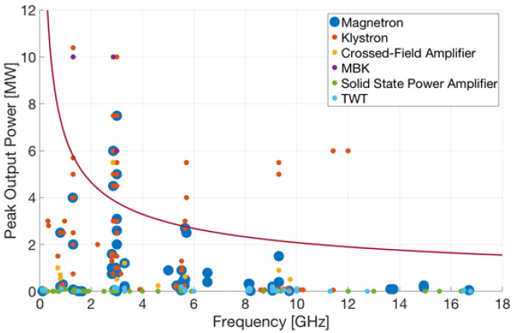
Motivations
Advantages of X-band structures:
Compact size, light weight, high shunt impedance…
Advantages of magnetrons:
Compact size, low cost, high efficiency…
Bottleneck of miniaturization:
Peak power of magnetrons (2MW)
Longer structures
Lower dose rate
Power combination of the magnetrons seems to be a cost-effective solution
Preferred for industrial and medical applications
S-band
IPAC’19, THPMP038
X-band
International Workshop on Breakdown Science and High Gradient Technology (HG2022), May 16-19

Slide 5
Locking Technologies
The frequency- and phase-locking of the magnetrons is critical for the power combination of magnetrons.
Master-to-slave locking
M_{m}
Load
M_{s}
Load
Peer-to-peer locking
M₁
Load
M₂
Load
International Workshop on Breakdown Science and High Gradient Technology (HG2022), May 16-19

Slide 6
Outline
Background
Power combination of conventional magnetrons
Based on master-to-slave locking
Based on peer-to-peer locking
Power combination of magnetrons with dual ports
Power combination of magnetrons with parallel cathodes
Conclusion
International Workshop on Breakdown Science and High Gradient Technology (HG2022), May 16-19

Slide 7
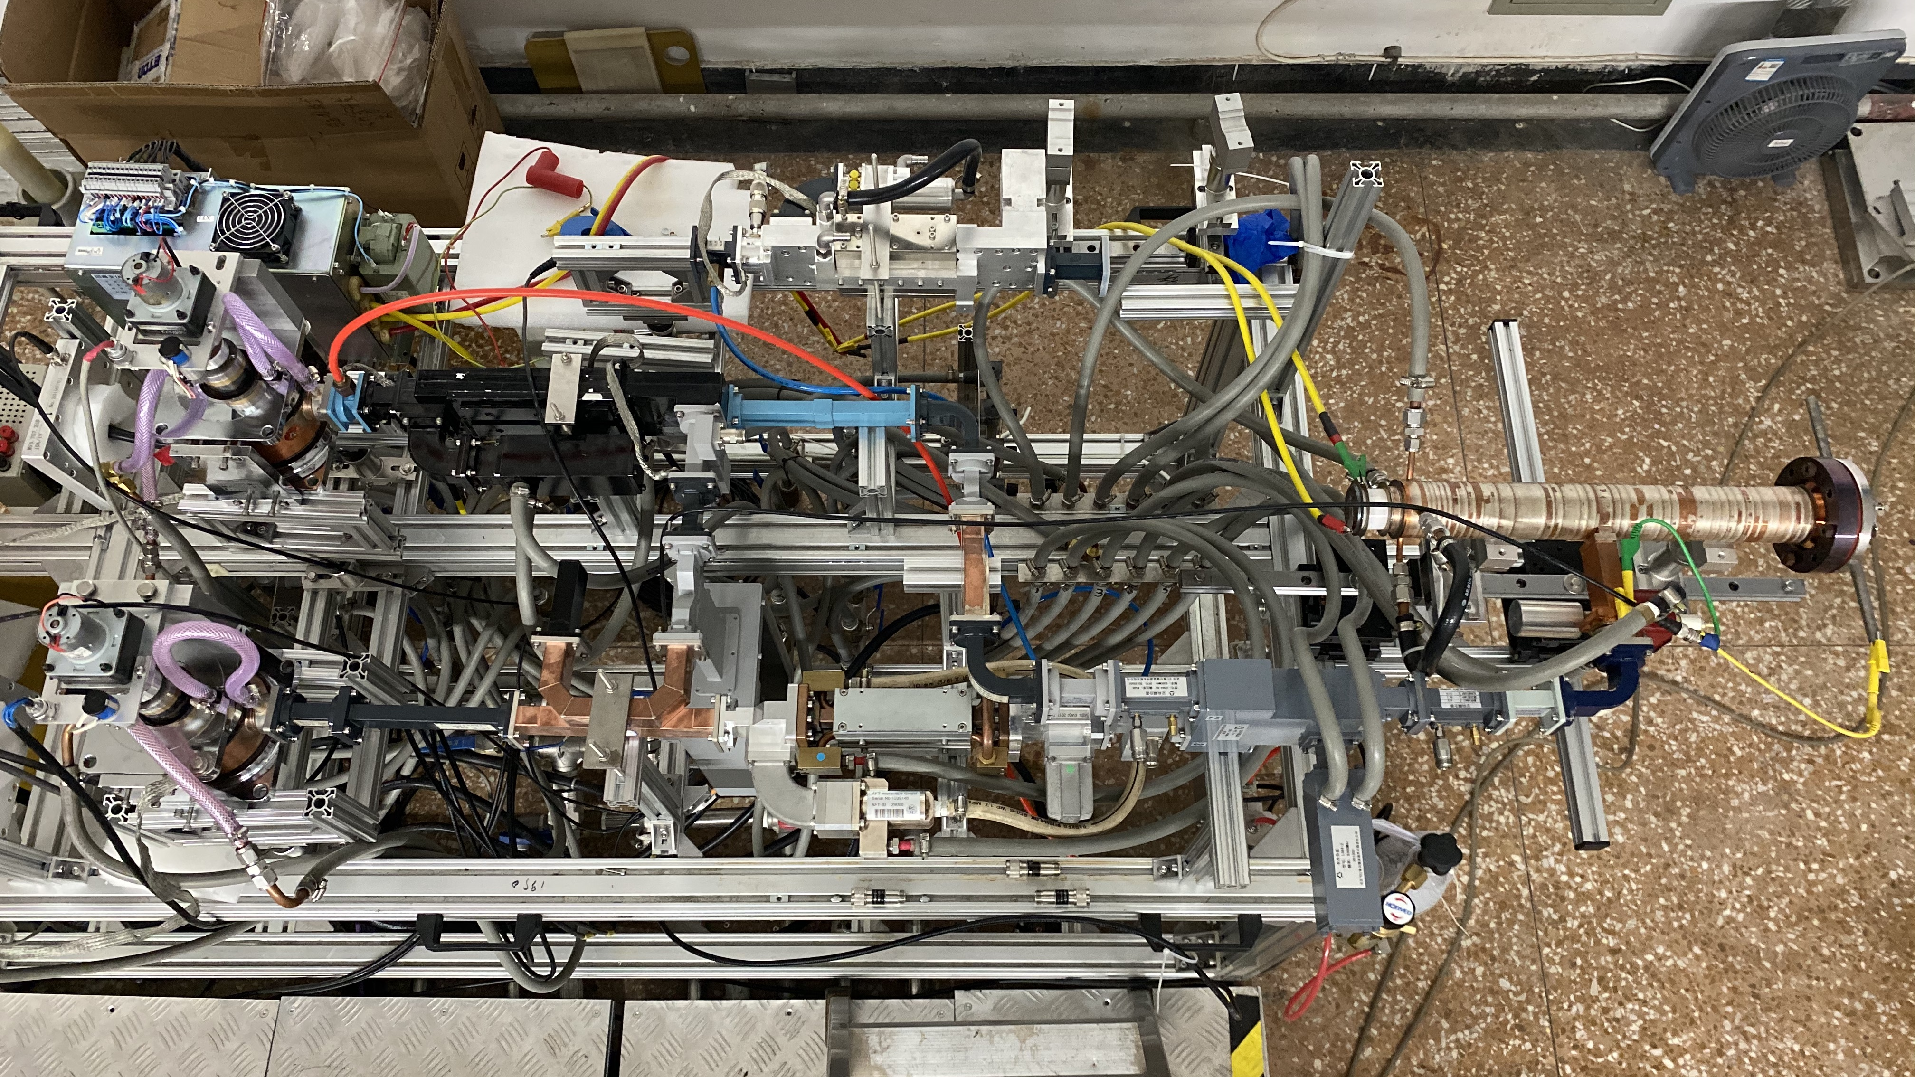
Master-to-Slave Locking
The power for phase locking was extracted from the master magnetron by utilizing a 15-dB coupler, and then fed into the slave magnetron through a 4-port circulator.
A phase shifter was employed in the locking circuit to adjust the phase difference between two magnetrons.
Slave magnetron
4-port circulator
3-dB hybrid
6-MeV accelerator
Phase shifter
Master magnetron
15-dB coupler
Directional couplers
International Workshop on Breakdown Science and High Gradient Technology (HG2022), May 16-19

Slide 8
Master-to-Slave Locking
f (MHz) | U_{m} (kV) | I_{m} (A) | P_{m} (MW) | U_{s} (kV) | I_{s} (A) | P_{s} (MW) | P_{comb} (MW) | η_{comb} (%) | η_{total} (%)
9304.3 | 38.8 | 80.3 | 1.39 | 38.9 | 77.8 | 1.10 | 2.37 | 95 | 39
RF power source | Peak power (MW) | Pulse width (us) | Duty cycle (‰) | Dose rate (cGy/min) | Dose rate@1‰ (cGy/min)
Power combination | 2.37 | 3.5 | 0.070 | 113.3@1m | 1619@1m
2-MW magnetron | 2.0 | 3.8 | 0.076 | 88.8@1m | 1168@1m
International Workshop on Breakdown Science and High Gradient Technology (HG2022), May 16-19
Notes:
46%, 36%

Slide 9
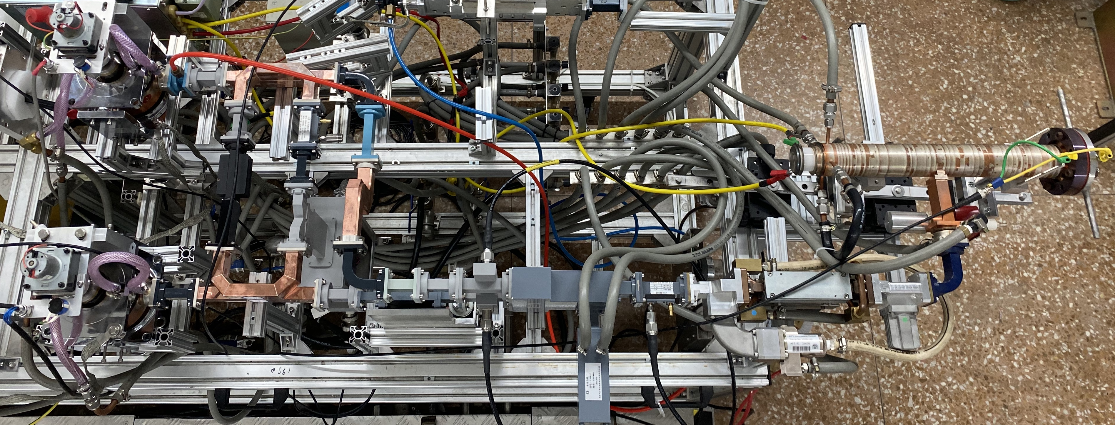
Peer-to-Peer Locking
The power for peer-to-peer locking circuit was picked up by two 10-dB couplers adjacent to the magnetrons.
Magnetron 2#
10-dB coupler
6-MeV accelerator
3-dB hybrid
4-port circulator
Magnetron 1#
Phase shifter
Directional couplers
International Workshop on Breakdown Science and High Gradient Technology (HG2022), May 16-19

Slide 10
Peer-to-Peer Locking
f (MHz) | U₁ (kV) | I₁ (A) | P₁ (MW) | U₂ (kV) | I₂ (A) | P₂ (MW) | P_{comb} (MW) | η_{comb} (%) | η_{total} (%)
9304.4 | 38.6 | 89.0 | 1.66 | 38.9 | 88.1 | 1.61 | 3.09 | 94 | 45
International Workshop on Breakdown Science and High Gradient Technology (HG2022), May 16-19

Slide 11
Outline
Background
Power combination of conventional magnetrons
Power combination of magnetrons with dual ports
Design and assembly
High-power experiments
Power combination of magnetrons with parallel cathodes
Summary
International Workshop on Breakdown Science and High Gradient Technology (HG2022), May 16-19

Slide 12
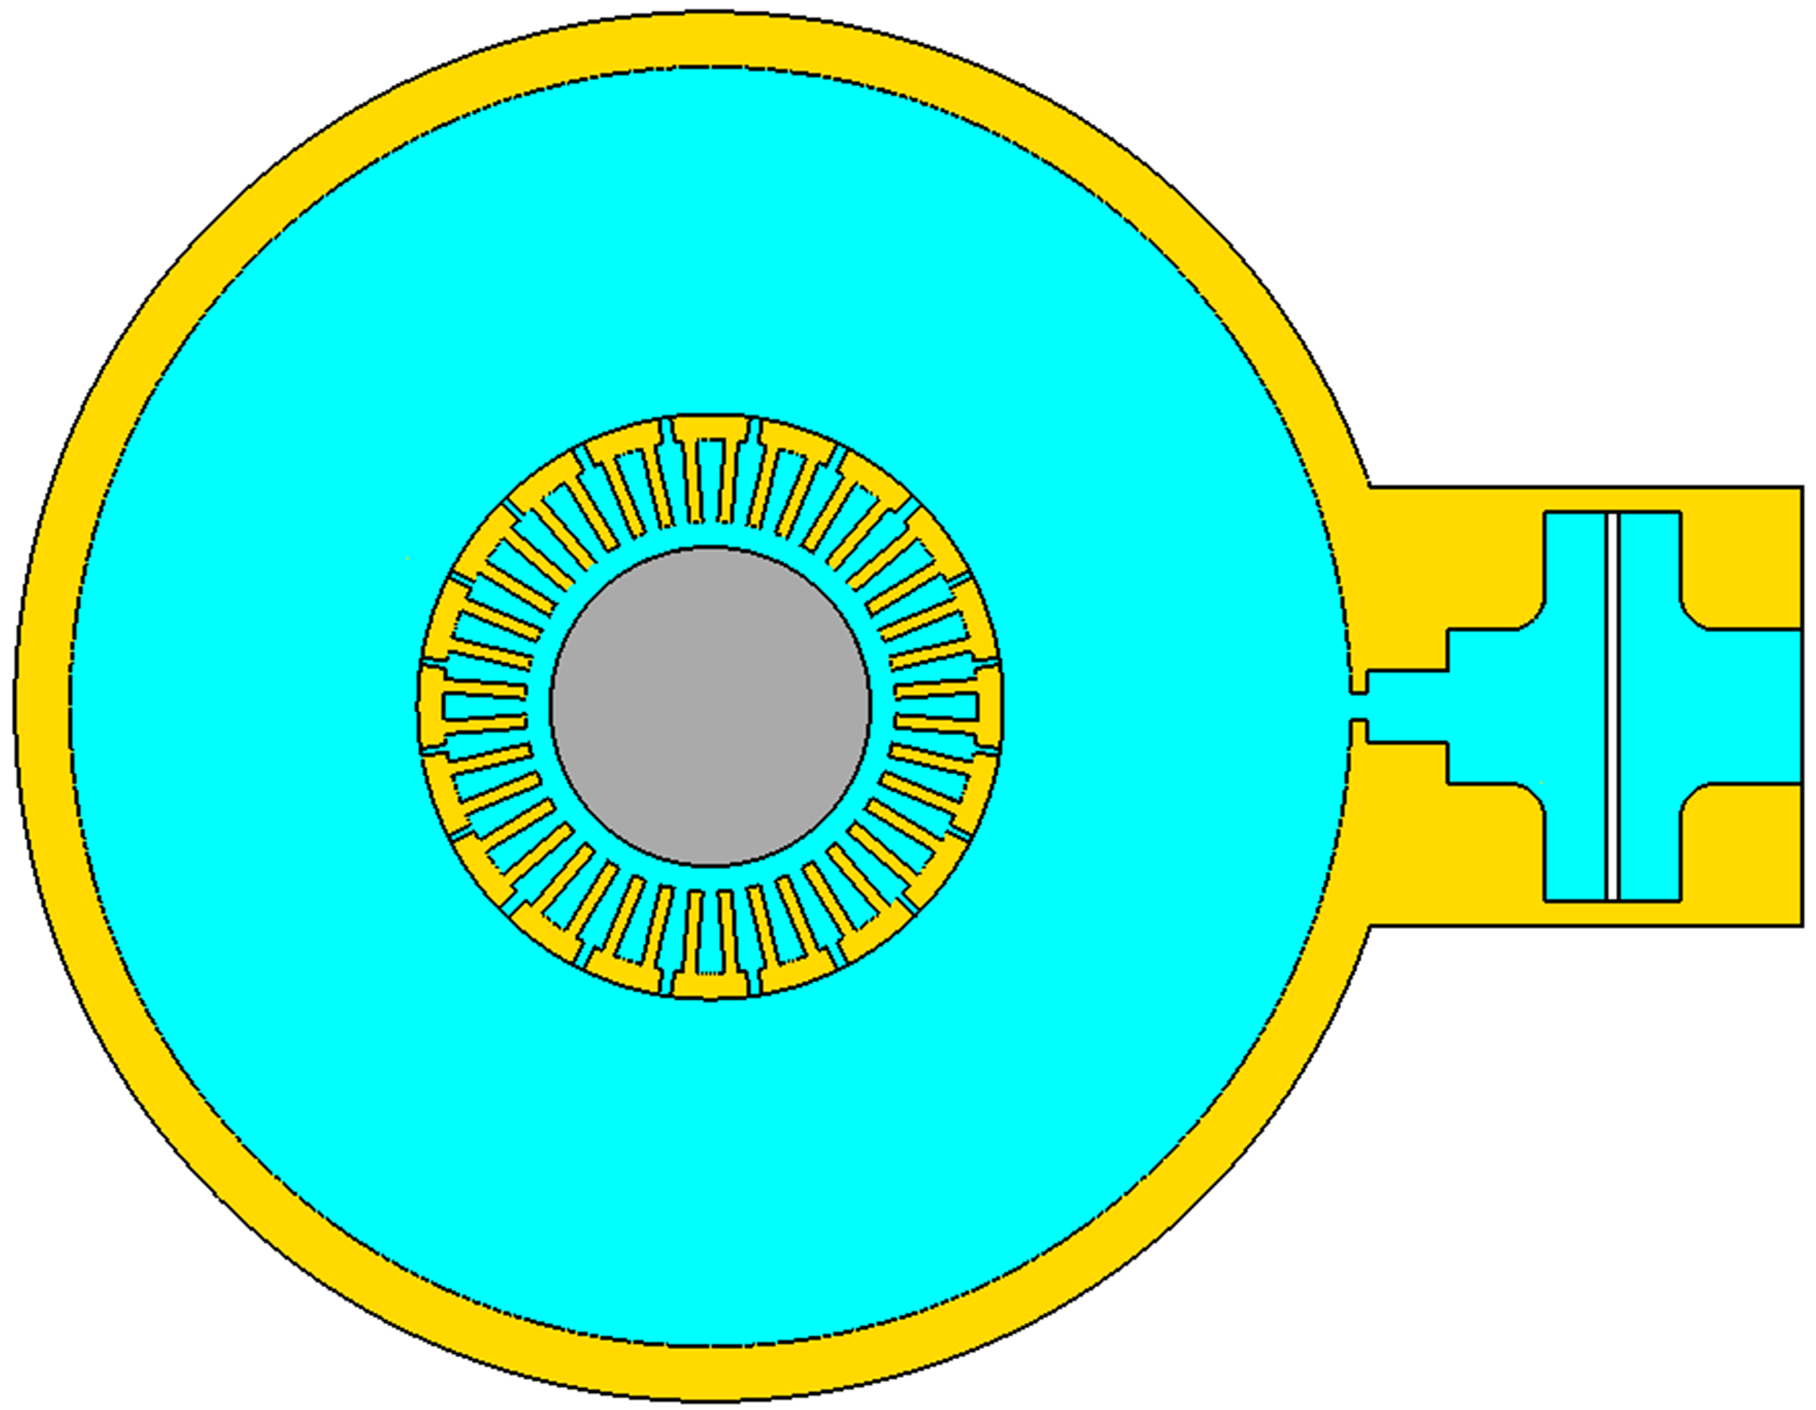
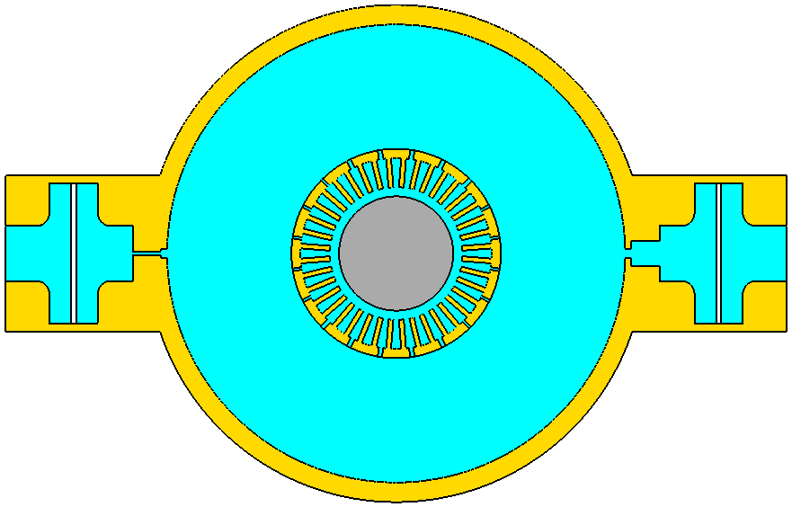
Magnetron with Dual Ports
Design
P_{out}
P_{coupler}
P_{out}
108 A
105 A
2.2 MW
1.8 MW
0.1 MW
International Workshop on Breakdown Science and High Gradient Technology (HG2022), May 16-19

Slide 13
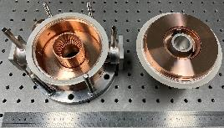
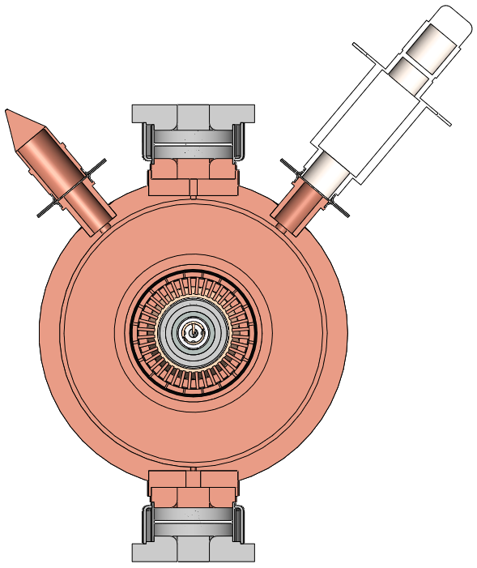
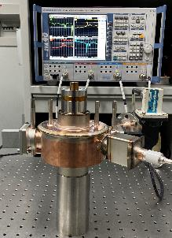
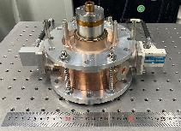
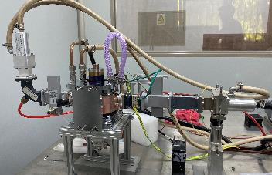
Magnetron with Dual Ports
Assembly
Fabrication
Mechanical design
Cold test
before welding
Cold test
after welding
Conditioning
International Workshop on Breakdown Science and High Gradient Technology (HG2022), May 16-19

Slide 14
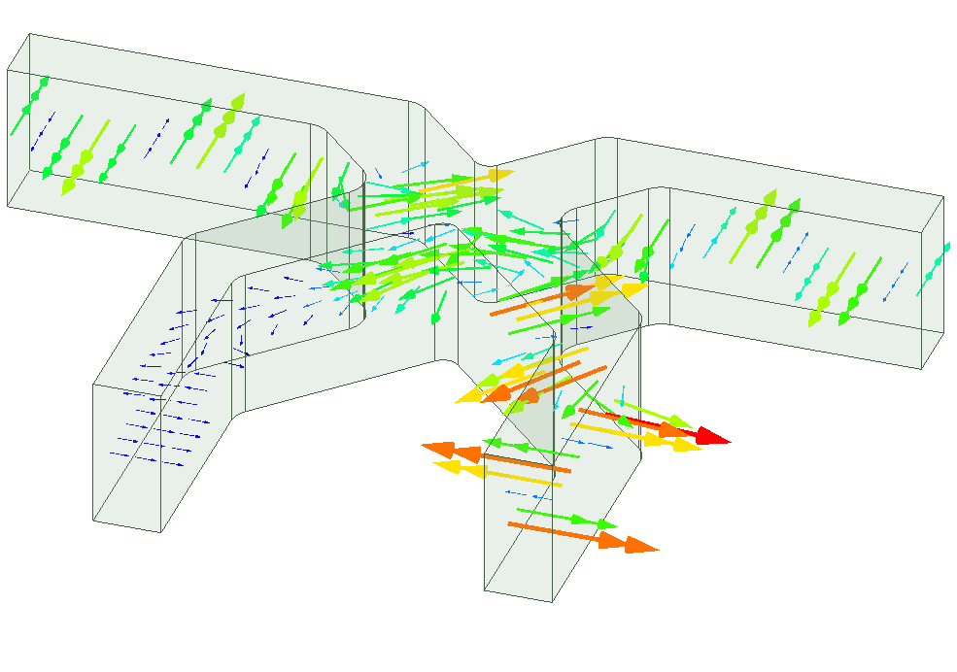
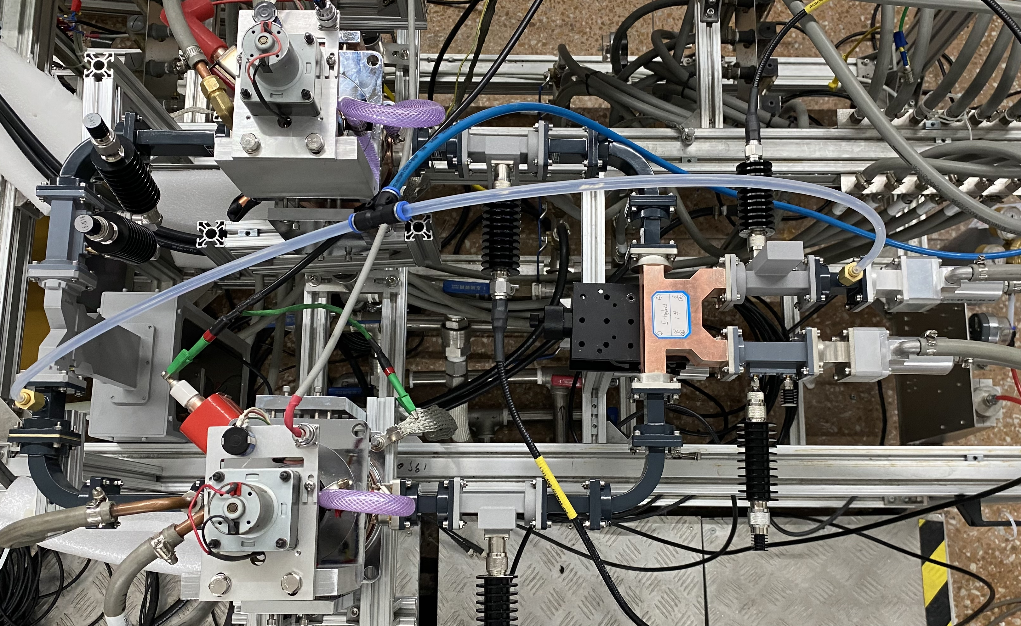
Magnetron with Dual Ports
High-power experiments
Asymmetric 3-dB hybrid with 0 and π phase characteristic was used to combine the power.
Port 1
Port 2
MGDP2
Directional couplers
Port 4
Port 3
Phase shifter
Load
3-dB hybrid
MGDP1
International Workshop on Breakdown Science and High Gradient Technology (HG2022), May 16-19

Slide 15
Magnetron with Dual Ports
Phase | f (MHz) | U₁ (kV) | I₁ (A) | P₁ (MW) | U₂ (kV) | I₂ (A) | P₂ (MW) | P_{comb} (MW) | η_{comb} (%) | η_{total} (%)
0 | 9303.4 | 40.3 | 87.2 | 1.75 | 41.0 | 88.7 | 1.73 | 3.39 | 97 | 47
π | 9303.5 | 40.3 | 86.0 | 1.74 | 41.0 | 87.5 | 1.70 | 3.27 | 95 | 46
~ 0.15 MW
International Workshop on Breakdown Science and High Gradient Technology (HG2022), May 16-19

Slide 16
Outline
Background
Power combination of conventional magnetrons
Power combination of magnetrons with dual ports
Power combination of magnetrons with parallel cathodes
Design and simulations
Fabrication and assembly
High-power experiments
Summary
International Workshop on Breakdown Science and High Gradient Technology (HG2022), May 16-19

Slide 17
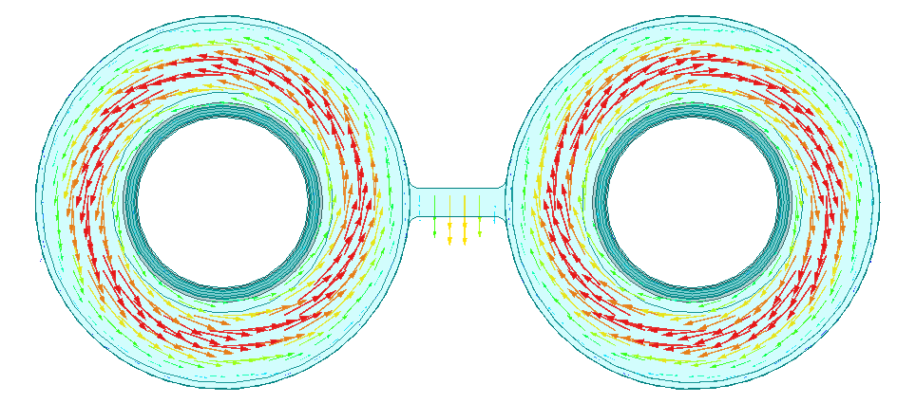
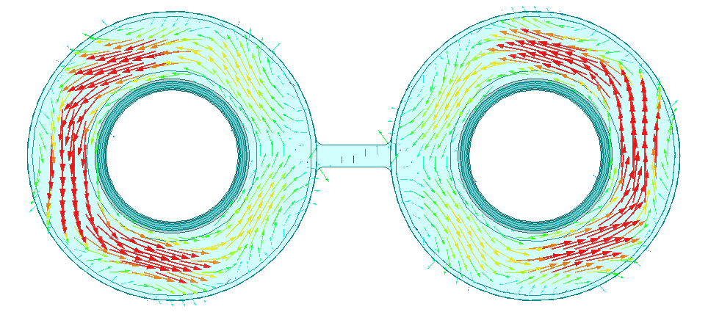
Magnetron with Parallel Cathodes
Eigenmode simulation
Design
Anode
resonators
Cathode 2
Output port 2
Combined
port 1
L = 131.5 mm
Working mode: π-like mode
f = 9.300 GHz, Q₀ ~ 15700
Coaxial
cavities
Coupling
waveguide
Combined
port 2
Output port 1
Anode
resonators
Cathode 1
Parasitic mode: 0-like mode
f = 9.313 GHz, Q₀ ~ 5600
International Workshop on Breakdown Science and High Gradient Technology (HG2022), May 16-19

Slide 18
Magnetron with Parallel Cathodes
Frequency-domain simulation
π-like mode in outer cavity: 9.300 GHz
0-like mode in outer cavity: 9.314 GHz
TE₁₂₁ mode in two coaxial cavities: 9.387 GHz
π-like mode
in outer cavity
0-like mode
in outer cavity
TE₁₂₁ mode in two
coaxial cavities
International Workshop on Breakdown Science and High Gradient Technology (HG2022), May 16-19

Slide 19
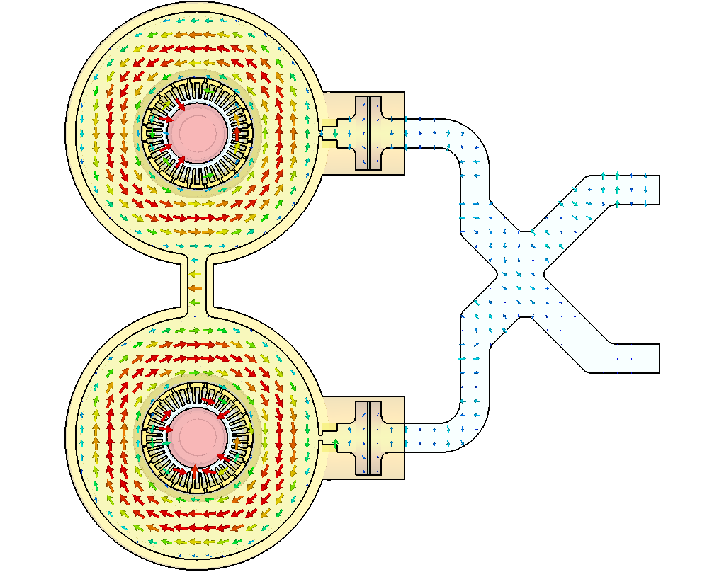
Magnetron with Parallel Cathodes
Particle-in-cell simulation
f = 9296.25 MHz, U₁ = U₂ = 40 kV, I₁ = 110 A, I₂ = 109 A
P₁ = 2.29 MW, P₂ = 2.07 MW, P_{comb} = 4.36 MW, η_{comb} > 99%, η_{total} = 50%
Conventional coaxial magnetron：
f = 9295.00 MHz, U = 40 kV, I = 112 A, P = 2.27 MW, η_{total} = 51%
International Workshop on Breakdown Science and High Gradient Technology (HG2022), May 16-19

Slide 20
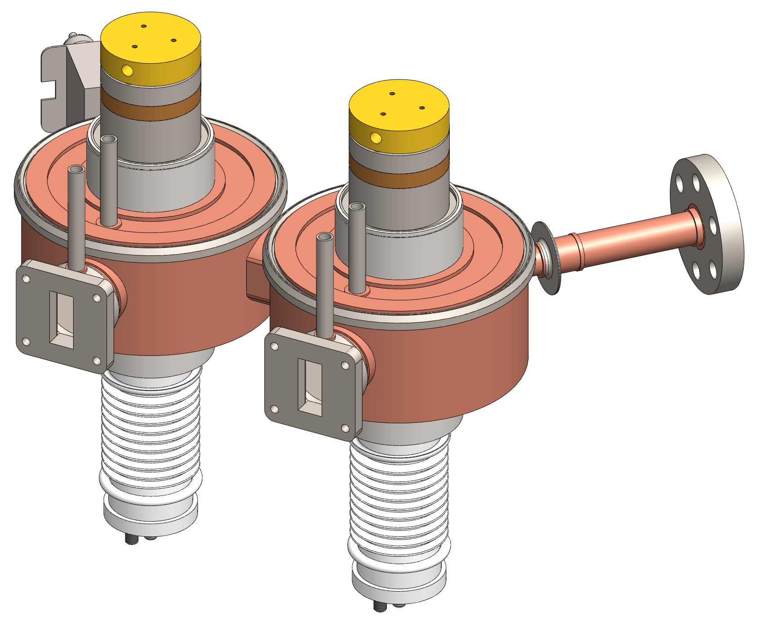
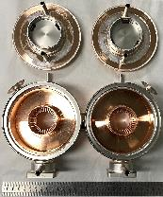
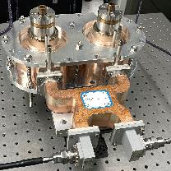
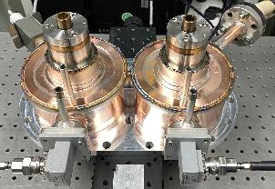
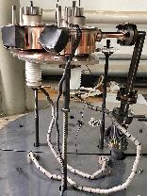
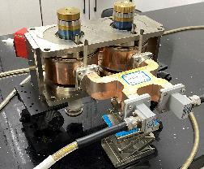
Magnetron with Parallel Cathodes
Fabrication and assembly
Magnetron prototype(12.9 kg) + permanent magnet(12.2 kg) + asymmetric 3-dB hybrid(1.8 kg) ≈ 27 kg
International Workshop on Breakdown Science and High Gradient Technology (HG2022), May 16-19

Slide 21
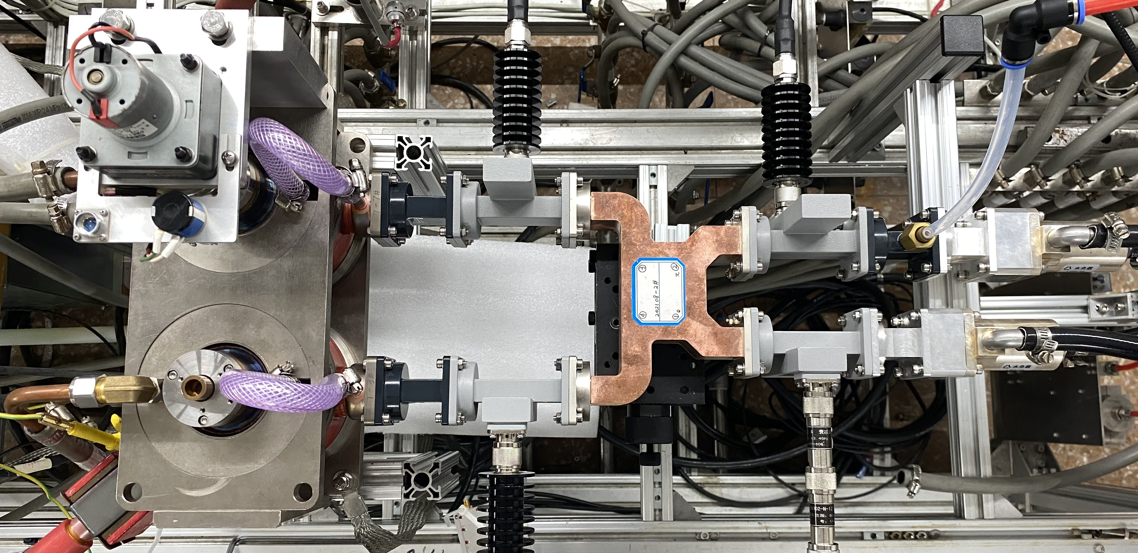
Magnetron with Parallel Cathodes
High-power experiments
Directional coupler
Load
Magnetron prototype
Asymmetric
3-dB hybrid
International Workshop on Breakdown Science and High Gradient Technology (HG2022), May 16-19

Slide 22
Magnetron with Parallel Cathodes
High-power experiments
f (MHz) | U₁ (kV) | I₁ (A) | P₁ (MW) | U₂ (kV) | I₂ (A) | P₂ (MW) | P_{comb} (MW) | η_{comb} (%) | η_{total} (%)
9284.0 | 38.8 | 86.7 | 1.84 | 36.7 | 79.0 | 1.57 | 3.38 | 99 | 54
9286.3 | 38.9 | 85.0 | 1.80 | 36.7 | 79.8 | 1.57 | 3.34 | 99 | 54
9289.2 | 39.0 | 86.1 | 1.88 | 36.6 | 79.6 | 1.57 | 3.43 | 99 | 54
International Workshop on Breakdown Science and High Gradient Technology (HG2022), May 16-19

Slide 23
Magnetron with Parallel Cathodes
High-power experiments
f (MHz) | U₁ (kV) | I₁ (A) | P₁ (MW) | U₂ (kV) | I₂ (A) | P₂ (MW) | P_{comb} (MW) | η_{comb} (%) | η_{total} (%)
9284.0 | 38.8 | 86.7 | 1.84 | 36.7 | 79.0 | 1.57 | 3.38 | 99 | 54
9286.3 | 38.9 | 85.0 | 1.80 | 36.7 | 79.8 | 1.57 | 3.34 | 99 | 54
9289.2 | 39.0 | 86.1 | 1.88 | 36.6 | 79.6 | 1.57 | 3.43 | 99 | 54
International Workshop on Breakdown Science and High Gradient Technology (HG2022), May 16-19

Slide 24
Outline
Background
Power combination of conventional magnetrons
Power combination of magnetrons with dual ports
Power combination of magnetrons with parallel cathodes
Summary
International Workshop on Breakdown Science and High Gradient Technology (HG2022), May 16-19

Slide 25
Summary
The power combination of magnetrons based on conventional coaxial magnetron has been proven effective.
A peak output power greater than 3 MW has been achieved by the power combination of magnetrons.
Magnetron with parallel cathodes is compact and has prominent performance, which can be a possible candidate as the RF power source for the X-band linacs.
International Workshop on Breakdown Science and High Gradient Technology (HG2022), May 16-19

Slide 26
Thanks for your attention！
This work was supported in part by the National Key Research and Development Program of China under Grand 2017YFC0111700 and the National Natural Science Foundation of China under Grant 11922504.
International Workshop on Breakdown Science and High Gradient Technology (HG2022), May 16-19

Slide 27
/
/
/
S₁₁
S₂₂
S₂₁

Slide 28
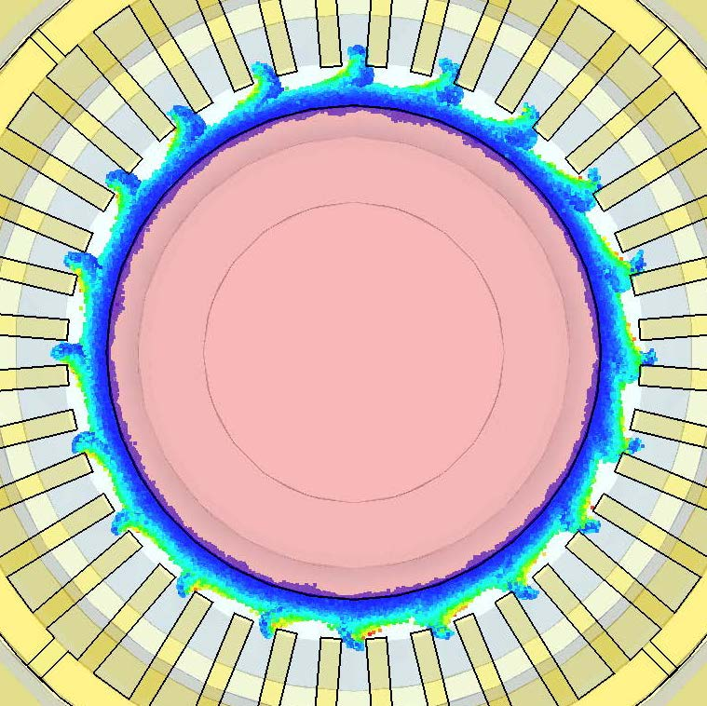
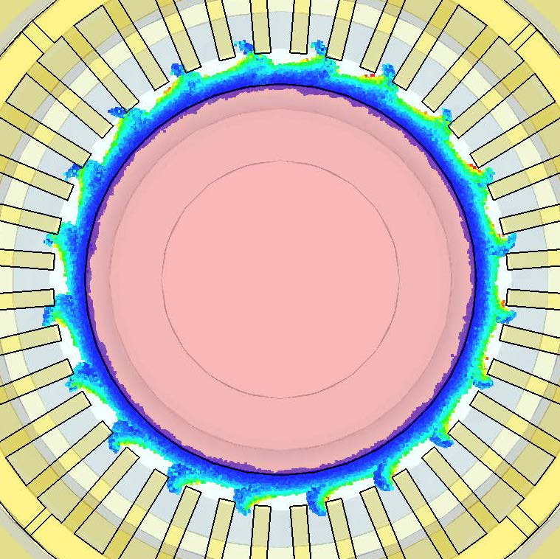

Slide 29
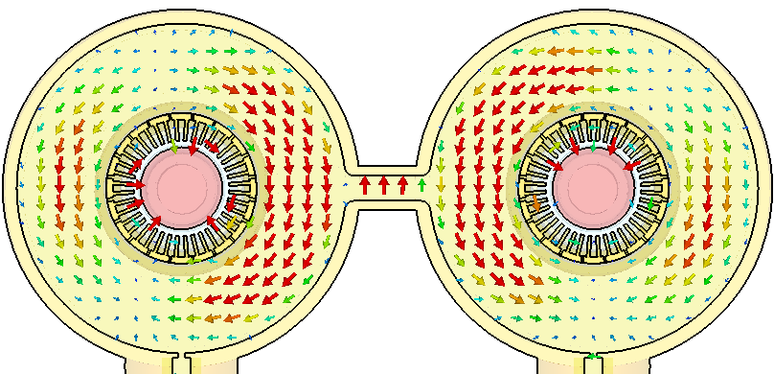
9309MHz, TE₁₂₁
TE₁₂₁ mode
π-like mode

Slide 30
