Slide 1
X-band high efficiency klystrons development.
I. Syratchev, CERN

Slide 2
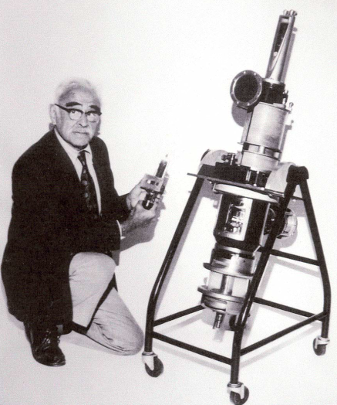
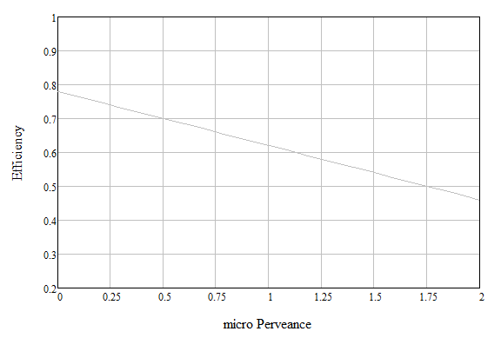
The klystrons have been used in the particle accelerators for more than 7 decades. The experimental results from hundred’s of different devices have shown that higher efficiency is associated with lower perveance. Accounting for technological and cost reasons (µA/V^{1.5}>0.25), the 73% efficiency was predicted to be the utmost limit.
Efficiency performance of few selected commercial klystrons
1948. The first multi-megawatt (33 MW) S-band klystron ITT 2960 Mark III (Stanford, USA)
L-MBK ILC
10 MW
L-MBK CLIC
20 MW
L-ESS
1.5 MW
UHF-LHC
0.3 MW
UHF-B-factory
1.25 MW
industrial empirical limit
X-Canon
6 MW
X-Canon
PPM, 50 MW
X-CPI
50 MW
S-band
Industry, medical
ITT 2960
33 MW
Klystrons for science
M. Chodorow
(µA/V^{1.5})

Slide 3
High efficiency klystrons projects at CERN #1
T1. Development and maintenance of the fast and accurate computer codes (KlyC and CGUN) for massive optimization of the new klystrons, accompanied by mastering the expertise in using commercial simulation suits like CST 3D PIC.
T2. In-depth understanding of the electron beam dynamic and factors that limit klystrons performance. Studying and mitigating phenomena associated with parasitic beam instabilities.
T3. Development of the new klystron bunching methods, new klystron topologies and associated technologies. Dissemination of the obtained advancements and progress to the community (publications, presentations etc.)
T4. Communication of the new klystron design to industrial partners and collaboration with industry during klystron technical design phase, prototype fabrication and testing.
T5. The new klystron acceptance tests and operation at CERN facilities.

Slide 4
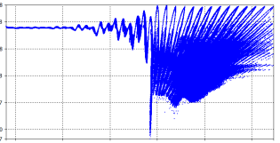
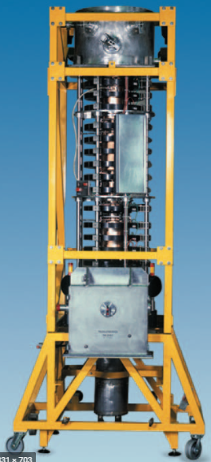
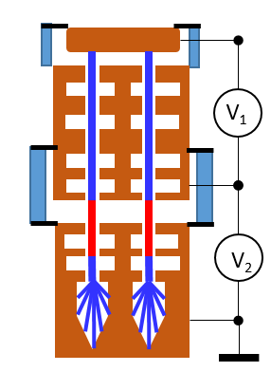
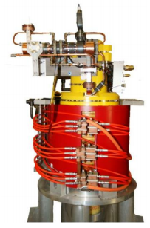
High efficiency klystrons projects at CERN #2
Task 1: HE Design and simulation
  Development and maintenance of the fast and accurate 2D klystron codes.
  Klystron simulation code KlyC version 5 was released in May 2021. About 50 users worldwide.
  New KlyC version 6 will include CGUN tracking module for the beam optics simulation (gun, solenoid and collector). Will be released in January 2021.
Task 2:HE LHC 400 MHz klystron
  Validate the HE klystron technology (~70%) while upgrading and retro-fitting current LHC klystrons
  The klystron design is accepted by Thales. Expected delivery of the prototype to CERN is in March 2023.
  Prepare the acceptance tests at CERN
Task 3: HE-TS MBK L-band klystron
  Demonstrate two-stage multibeam technology with 80%+ RF production efficiency
  Complete design of TS MBK for CW FCC: 400 MHz, 1.2 MW
  built demonstrator -> WP5 of the FCC SRF R&D Program
  Promote this new technology towards CLIC, ILC, CEPC, by means of design and collaboration
Task 4: HE X-band klystrons (8MW and 50MW) with high rep-rate
Built klystrons and demonstrate ~60% efficiency. Collaboration with industry: Canon CETD (Japan) and CPI (USA).
Reinforce synergies with CLIC, FLASH, Compact Light, Compton sources...
great showcase for CERN's technology. Contribution to the worldwide society.

Slide 5
Fast and accurate klystron simulation tools developed at CERN (T1,T2)
Large signal 1/1.5D klystron simulator [6].
CGUN (electron beam tracking)
Klystron optimizer module [1].
Allows versatile optimization of the klystrons within specified condition.
Electrostatics module.
Simulates DC E-field maps and potentials in the 2D system with arbitrary shaped electrodes. Can be used in KlyC (TS MBK for example).
1/1.5D Wave-beam interaction module[1]. Beam dynamic simulation (single beam and MBK).
Parameters scaling module [4].
Allows internal scaling with arbitrary changing the frequency, beam power and perveance.
Electro-Magnetic module [1].
RF eigenmode and eigenfield solver in the arbitrary axisymmetric RF cavities. 2D field maps. Enables E-field maps import from HFSS and CST.
Magnetostatics module.
Simulates DC B-field maps in the 2D system with arbitrary shaped coils and iron shields (saturation etc.)
Bunched beam generator module[5].
Simulation of IOT and output couplers with bunched beam
Coupled cavities module [2].
Special EM simulator of the coupled cavities with or without external loading. Coupled eigen frequencies and 2D field maps.
Design report module.
Generates various tables, graphs and animations to analyze the device performance.
Electron beam tracking module.
Simulates the cathodes with space charge limit.
Electrons tracking (trajectories) in the calculated B field (beam scalloping etc).
Simulates collector in DC mode and RF mode using the spent beam energy spectra simulated in KlyC.
Ultimately, A-Z beam tracking in entire device.
Monotron oscillations module [3].
Simulates the threshold of monotron oscillations in the RF cavities (klystron stability issues)
Service functions. Automatic simulation of the power gain and bandwidth curves, arrival functions, reflected electrons absorber, batch mode and more…
[1] J. Cai, I. Syratchev, ‘KlyC: 1.5-D Large-Signal Simulation Code for Klystrons’, IEEE Transactions on Plasma Science ( Volume: 47 , Issue: 4 , April 2019 )
[2] J. Cai, I. Syratchev ‘Modelling of Coupled Cell Output Structures for the Klystrons’, IEEE Transactions on Electron Devices ( Volume: 66 , Issue: 11 , Nov. 2019 )
[3] J. Cai, I. Syratchev, G. Burt ‘Accurate Modeling of Monotron Oscillations in Small- and Large-Signal Regimes’, IEEE Transactions on Electron Devices ( Volume: 67 , Issue: 4 , April 2020) )
[4] J. Cai, I. Syratchev, ‘Scaling Procedures and Post-Optimization for the Design of High-Efficiency Klystrons’, IEEE Transactions on Electron Devices ( Volume: 66 , Issue: 2 , Feb. 2019 )
[5] Z. Liu, et al, ‘Study on the efficiency of Klystrons’, IEEE Transactions on Plasma Science( Volume: 67 , Issue: 7 , April. 2020 )
[6] J. Cai, I Syratchev, ‘KlyC. The 1D/1.5D large signal computer code for the klystron simulations. User manual’, CERN-ACC-2018-0050 ; CLIC-Note-1137, Link: http://cds.cern.ch/record/2649486?ln=en .

Slide 6
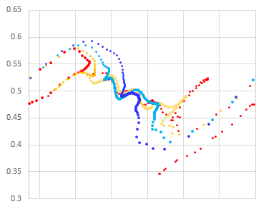
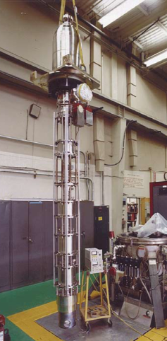
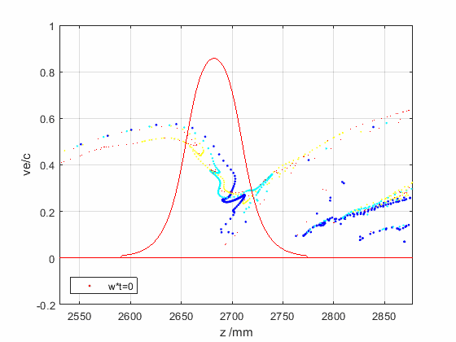
The factors limiting efficient RF power extraction from the bunched beam in RF cavity (T2)
Bunch phase space in the vicinity of the klystron output cavity
Ideal
bunch
E field expansion in the drift tubes causes beam reacceleration when it leaves the output cavity.
Ohmic loses are proportional to the operating frequency.
Space charge depression is a partial conversion of the beam kinetic energy into the potential DC energy of beam traveling in the drift tube.
Bunch saturation is optimal, when all the elections populate only the useful RF phase bucket leaving the anti-bunch empty.
Bunch congregation is a normalized elections velocity spread along the bunch. It has an optimal value for every given bunch length.
Bunch stratification is a radial dependence of the bunch length and congregation. The ideal bunch should not have such a dependency.
Radial bunch expansion happens during beam deceleration in the output cavity in the presence of external solenoidal magnetic field.
Reflected electrons could be generated if some of the above effects are not balanced.
SLAC B-factory CW
0.478GHz, 1.25 MW
Velocity Ve/c
Real bunch
2π
<- arrival time (t/w)
0
Arrival plane
Efficiency 61%
Driven by klystron general parameters.
Driven by RF design and space charge effects.

Slide 7
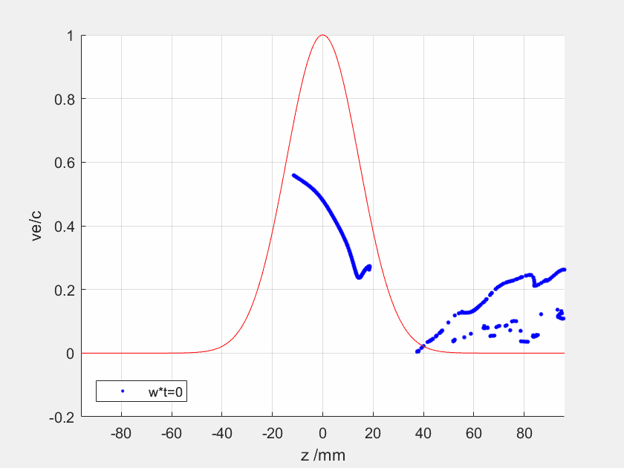
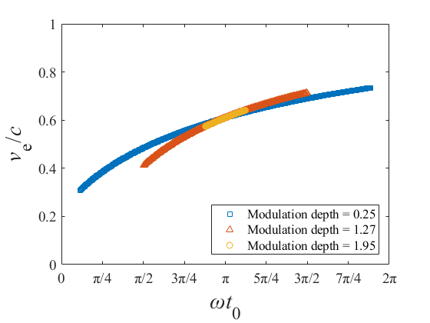
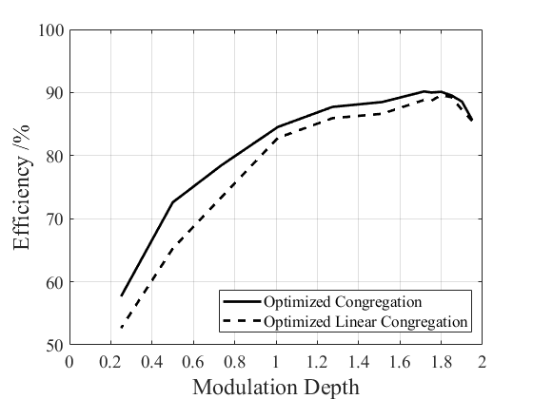
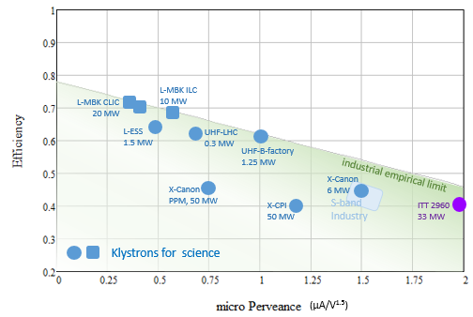
The ultimate power extraction efficiency in the linear beam devices (T2)
Example of 0.8 GHz klystron. Voltage 133 kV, Current 12.6 A (µP=0.26 µA/V^{3/2})
Fully saturated bunch with optimised congregation
Optimised congregation for the different bunch lengths.
Effect of the bunch length
KlyC
90.1 %
Optimum at L _{bunch} ≈ λ_{RF} /3
Ultimate limit
High efficiency Klystrons design objectives
Ultimate limit
E field expansion in the drift tubes
Ohmic Losses
Space charge depression
Bunch saturation
Bunch congregation
Bunch stratification
Radial bunch expansion
Optimised RF bunching circuit

Slide 8
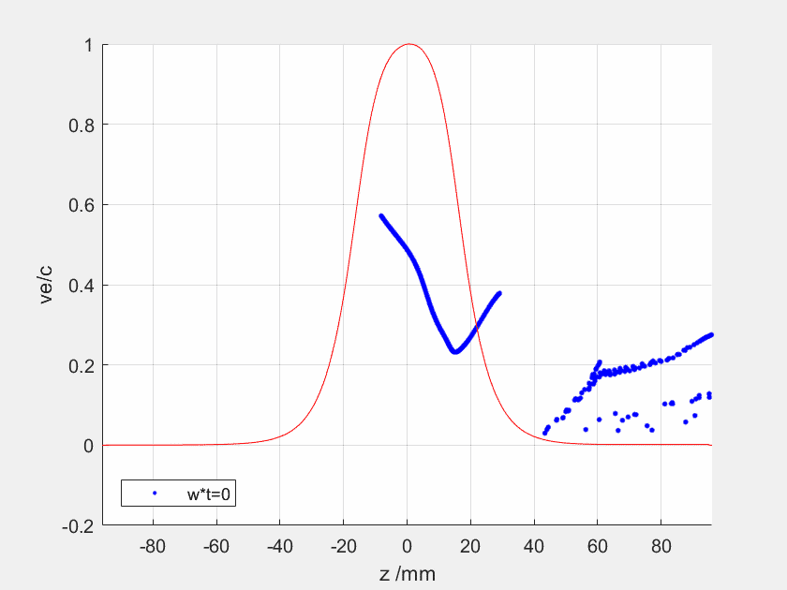
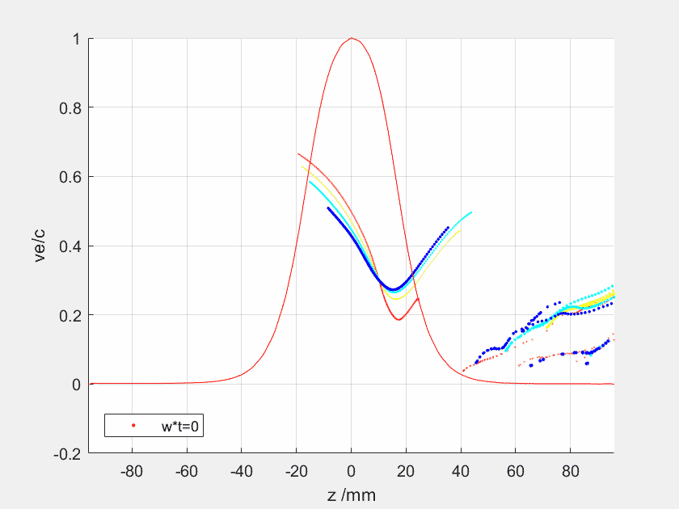
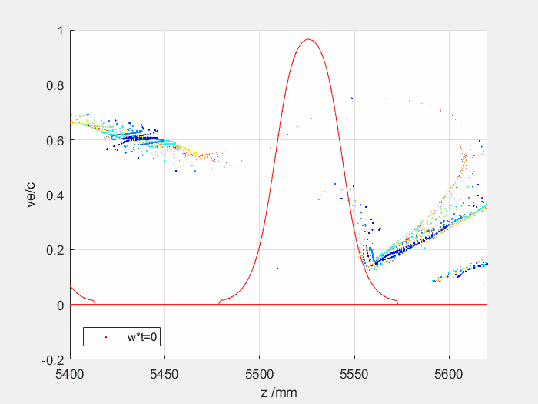
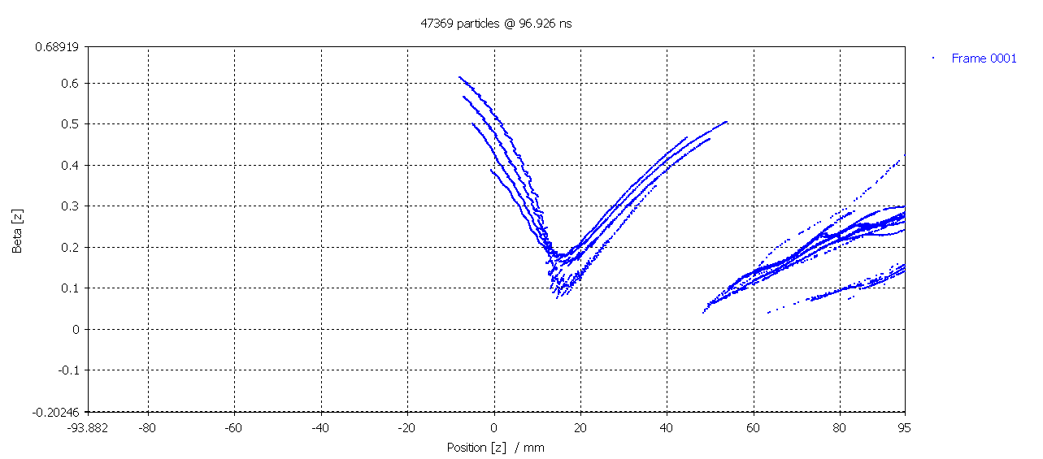
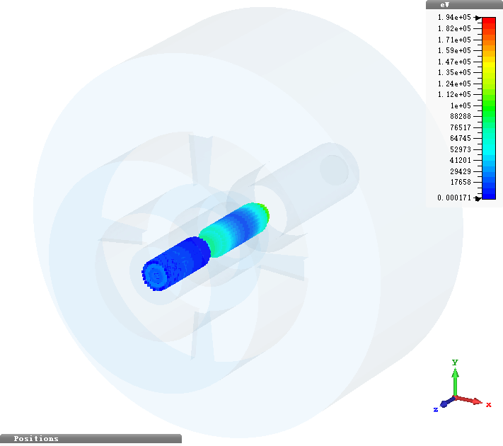
The ultimate power extraction efficiency in the linear beam devices (T2)
Fully saturated bunch
1D bunch Optimised congregation
1D bunch Linear congregation
Stratified 2D bunch with linear congregation
90.1%
88.70%
84.20%
‘Real’ bunch: Saturation, Ohmic losses, Space charge depression.
Benchmark with CST 3D PIC for the same bunch quality
80.1%
CST 3D PIC
82.6%

Slide 9
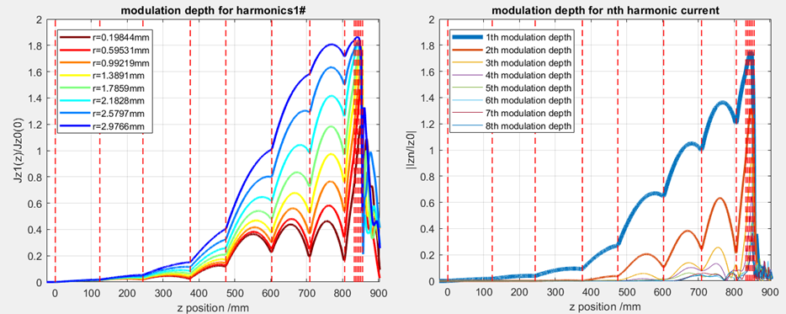
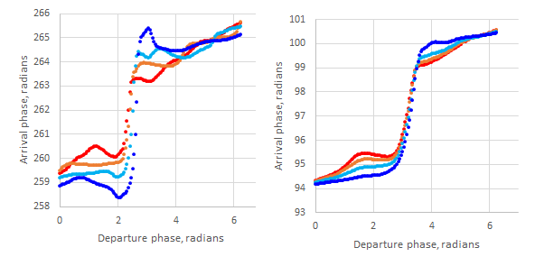
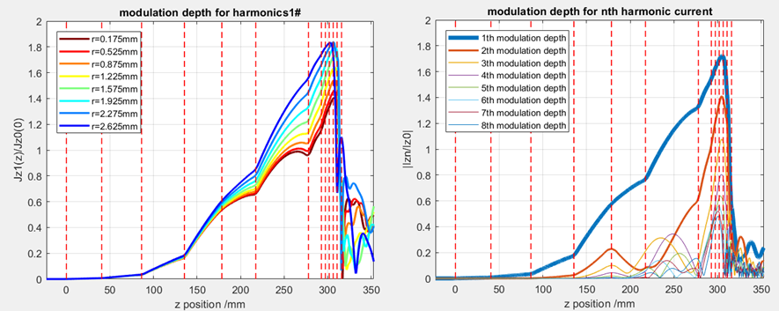
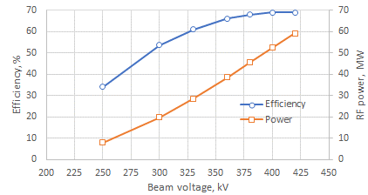
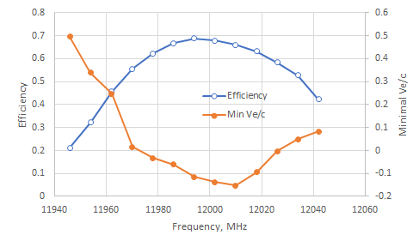
COM RF bunching circuit (0.86m). 70.2%.
X-band 50MW tube
Klystron’s RF circuit optimization (T3)
COM (core oscillation method) provides strong bunch saturation, but it requires long RF circuit.
In klystrons, bunching processes are space charge dominated, thus long circuits increase radial bunch stratification.
Employing 2nd harmonic impedance (and even 3rd harmonic at L-band; CSM tube) allows to bust bunching process and to reduce the circuit length dramatically, providing ‘optimal’ balance between bunch saturation and radial stratification. That also reduces the solenoid cost and power consumption.
Bunch congregation is controlled by the penultimate cavity. With given cavity geometry, it shall be located close possible to the output circuit.
Output multi-cell (6 cells) coupler aperture is optimized to provide highest power extraction efficiency, with surface E-field limited to the design value (100MV/m at 50 MW) and to avoid any reflected electrons.
KlyC
Generic/compact HE-X RF bunching circuit (0.32m). 69.3%
400kV, Pin=60W

Slide 10
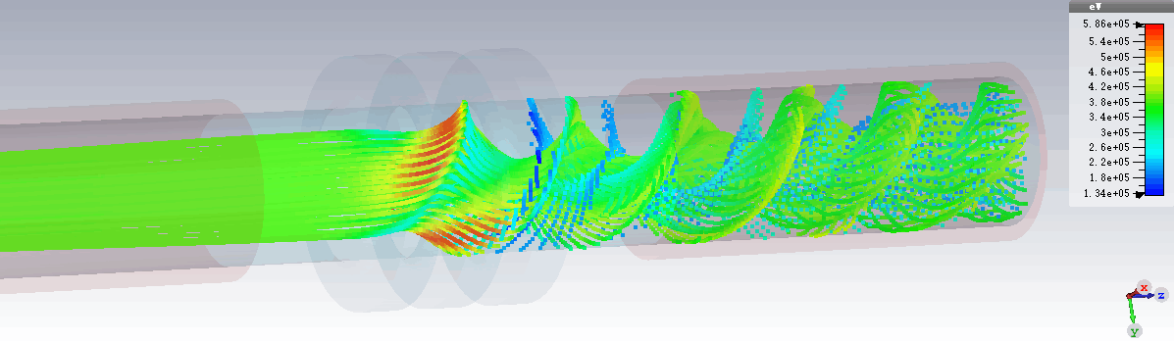
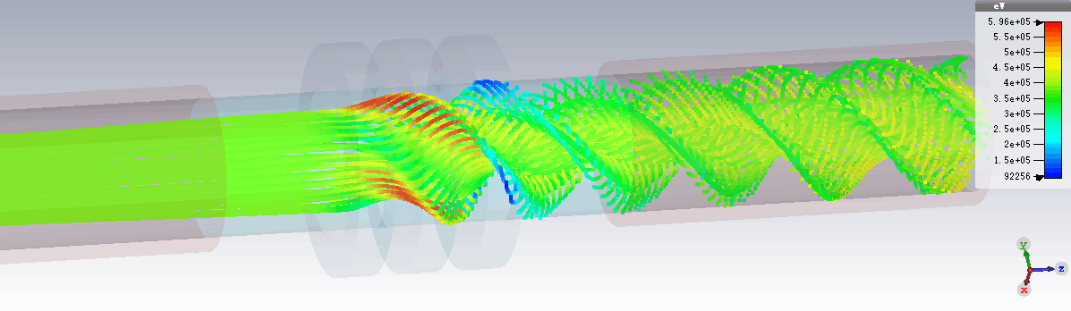
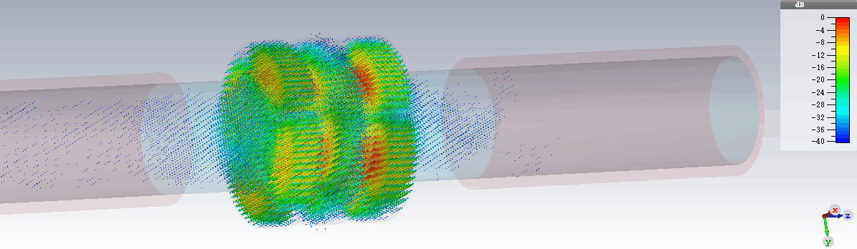
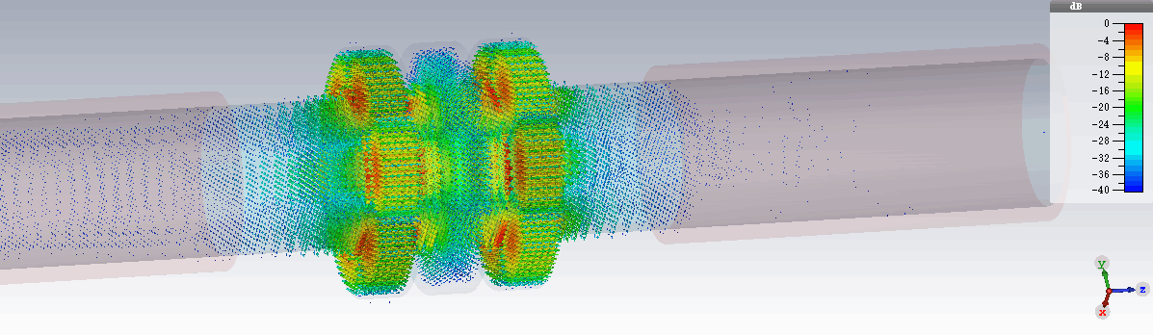
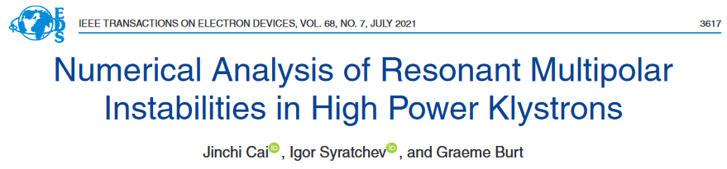
3D PIC simulations are mandatory to justify the klystron operational stability (T1,T2).
One example of uncommon multipolar rotating HE modes instabilities in the 2nd harmonic triplet of 50 MW X band klystron.
DC beam
HE21, 33.4GHz
HE31, 42.7GHz
All possible instabilities sources have to be understood in details and mitigated in the most efficient (cost) way.
https://ieeexplore.ieee.org/document/9447151

Slide 11

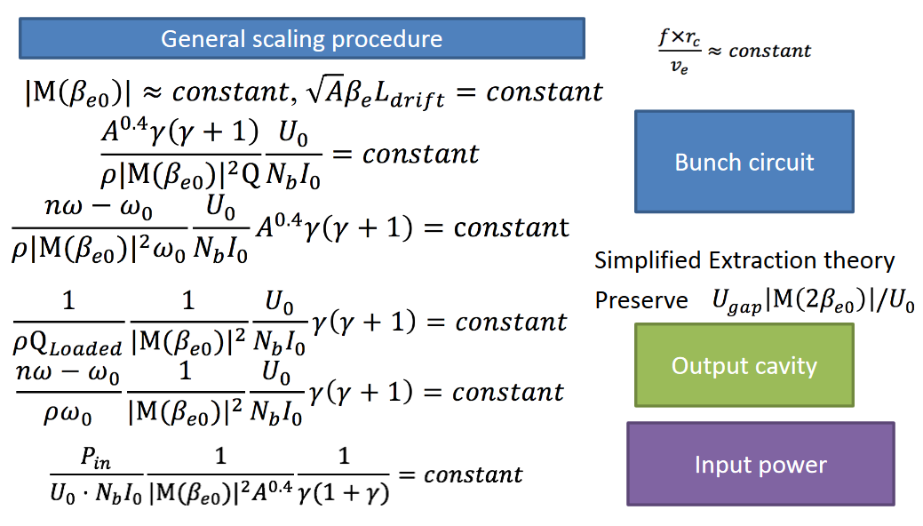
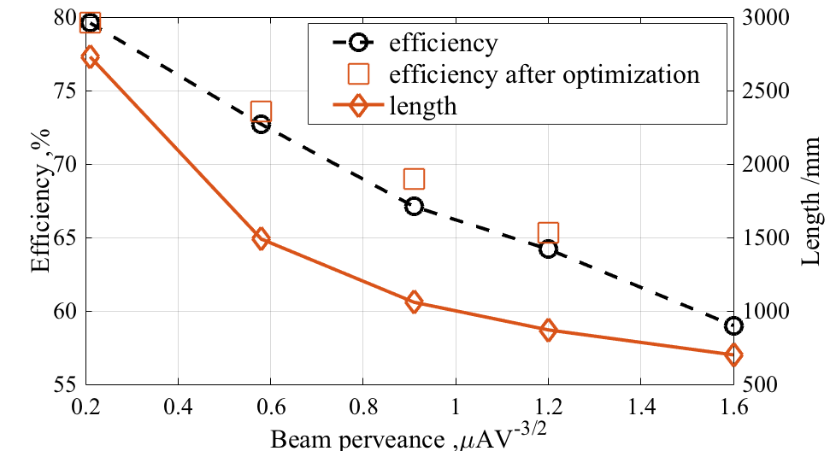
Klystrons’ General Scaling Procedure (GSP) (T3)
GSP is a built-in option in the KlyC v5.
https://ieeexplore.ieee.org/stamp/stamp.jsp?arnumber=8595427
Example of 5 cavities 2MW, 1GHz HE (COM) klystron scaling (constant beam power)
Any optimized klystron design can be scaled using GSP to another frequency, beam power and/or perveance.
If the perveance is not changed, the scaled tube will preserved original RF power efficiency.

Slide 12
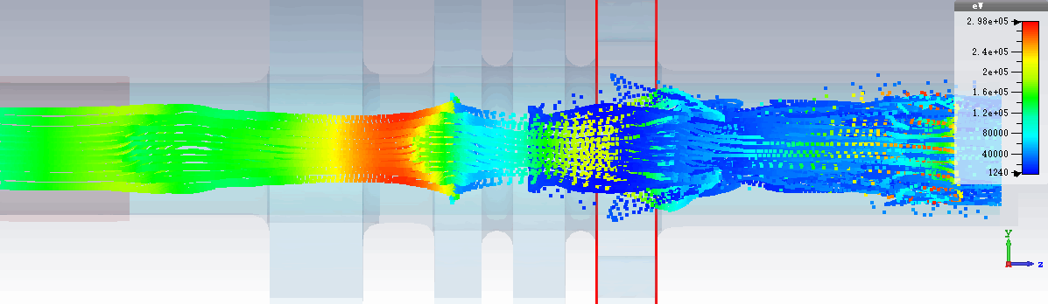
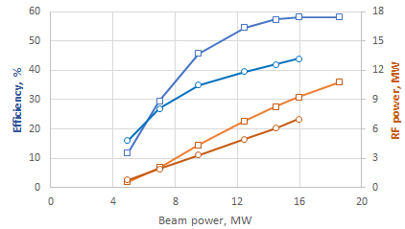

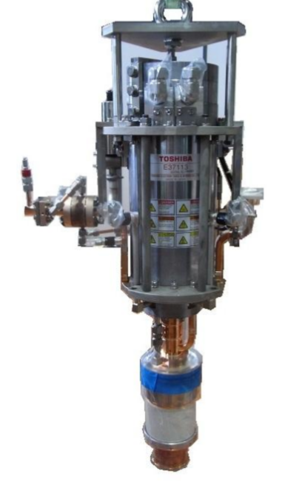
Retro-fit High Efficiency (57%), 8 MW 12 GHz klystron (CERN/Canon) (T4).
E37113
HEX8
HEX8
E37113
Retrofit design
 | E37113 at factory | E37117 design
Voltage, kV | 154 | 154
Current, A | 93 | 94
Frequency, GHz | 11.994 | 11.994
Peak power, MW | 6.2 | 8.16
Sat. gain, dB | 49 | 58
Efficiency, % | 42 | 57/ FCI
Life time, hours | 30 000 | 30 000
Solenoidal magnetic field, T | 0.35 | 0.4
RF circuit length, m | 0.127 | 0.127
Re-used solenoid.
Re-used cathode
Increased power gain (10 dB)
Prototype is in fabrication at Canon
To be tested at factory 07.2022.
VKX-8311A

Slide 13
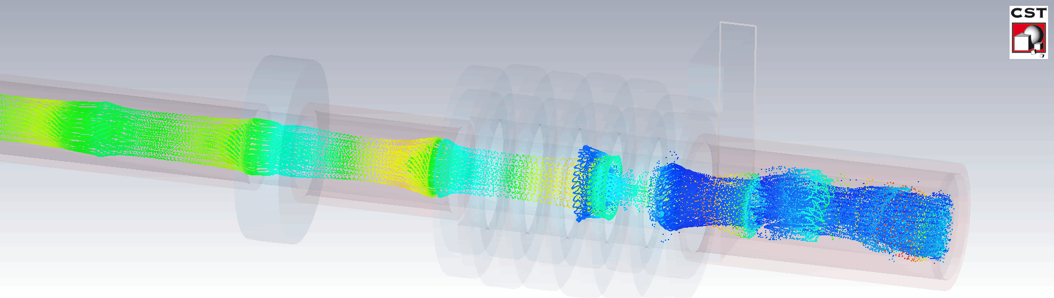
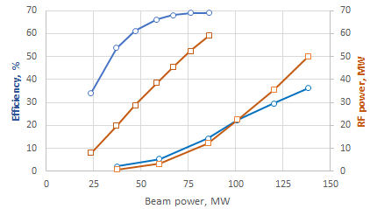
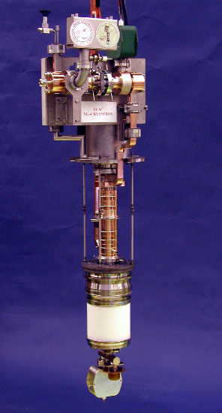

Retro-fit High Efficiency (66%) 50 MW, 12 GHz klystron (CERN/CPI) (T4).
Saturated efficiency & RF power
3D Particle-in-Cell (PIC) simulations
HEX
VKX-8311A
 | VKX-8311A | HEX (CERN/CPI)
Voltage, kV | 420 | 420
Current, A | 322 | 204
Frequency, GHz | 11.994 | 11.994
Peak power, MW | 49 | 58
Sat. gain, dB | 48 | 59
Efficiency, % | 36.2 | 66
Life time, hours | 30 000 | 85 000
Solenoidal magnetic field, T | 0.5 | 0.5
RF circuit length, m | 0.32 | 0.32
Re-used solenoid.
Increased life time (> factor 2)
Reduced modulator power (~ factor 2)
Increased power gain (10 dB)
Prototype fabrication is under negotiation within CPI/INFN/CERN collaboration.
VKX-8311A

Slide 14
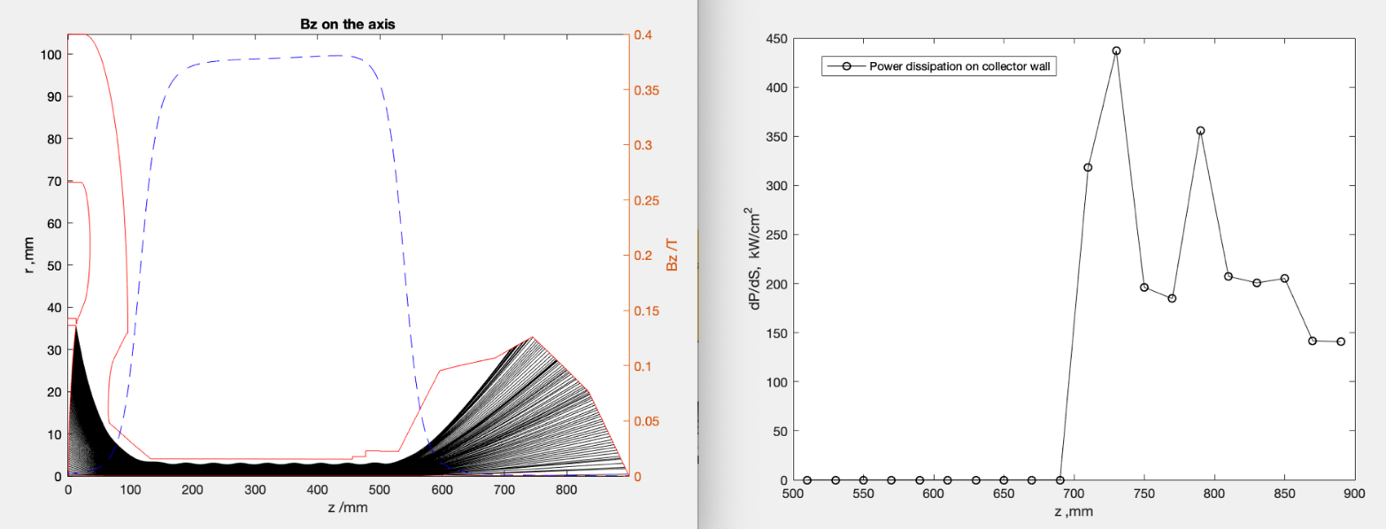
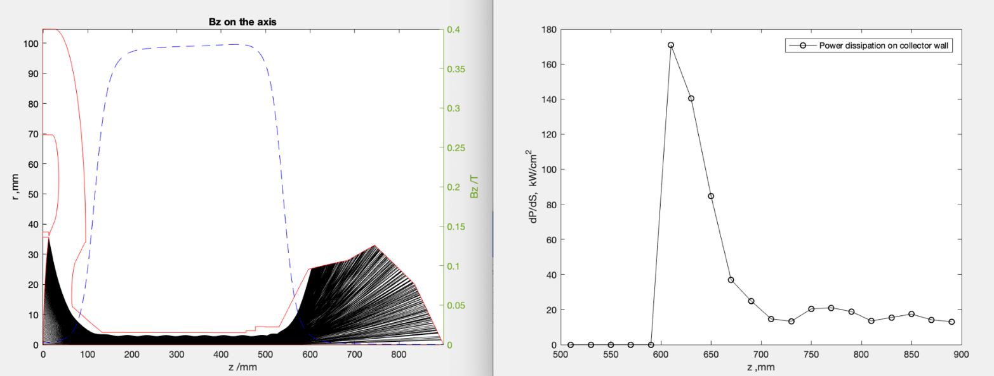
High Efficiency (66%) 50 MW X-band. Collector design for high (1KHz) repetition rate.
Optimization and simulation of the beam optics is done with CERN-made code CGUN.
VKX-8311A
Solenoid
There is a growing demand on the operation of the high RF power tubes at an increased (up to 1 kHz) repetition rate.
The collector profile was optimised in a way, that operated at nominal beam power in DC mode with 1kHz repetition rate and of 1000 ns long pulses, the maximal surface heat load is 440 W/cm². This value is below the recommended limit of 500 W/cm² in the water-cooled collectors.
In RF mode the surface heat load is reduced to 170 W/cm².
DC mode
RF mode
50 MW

Slide 15
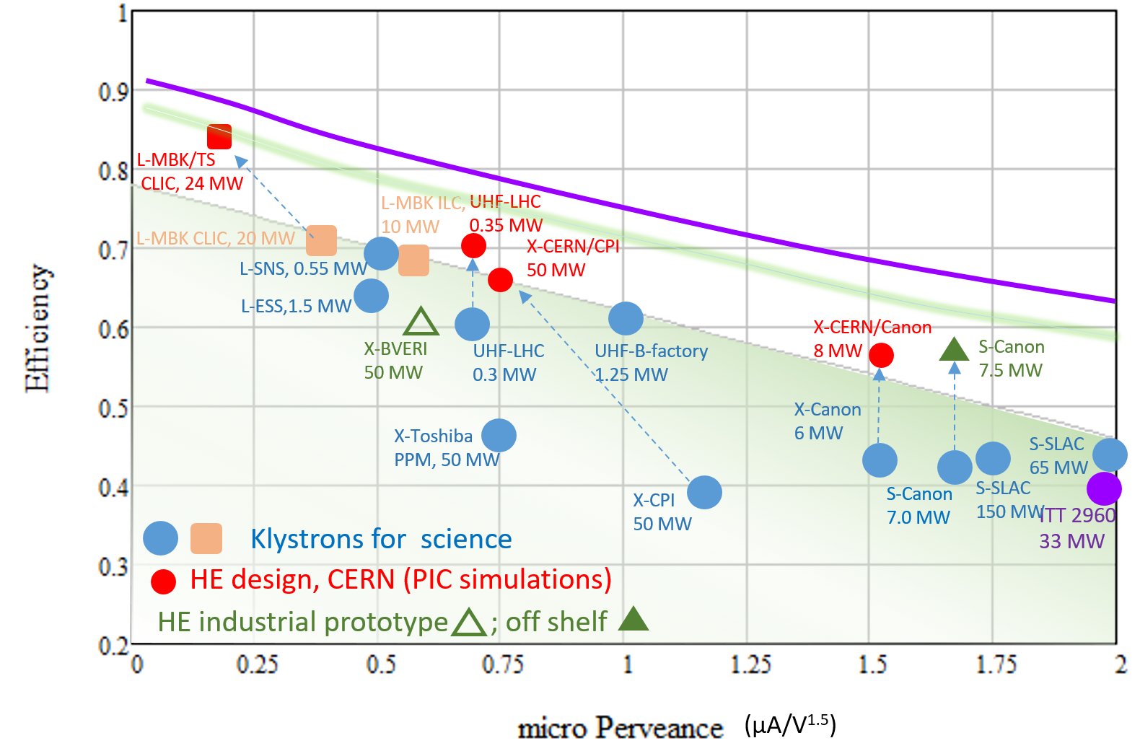
Efficiency performance of the selected commercial klystrons and the new HE klystrons (May 2022).
FCC, 1.2MW

Slide 16
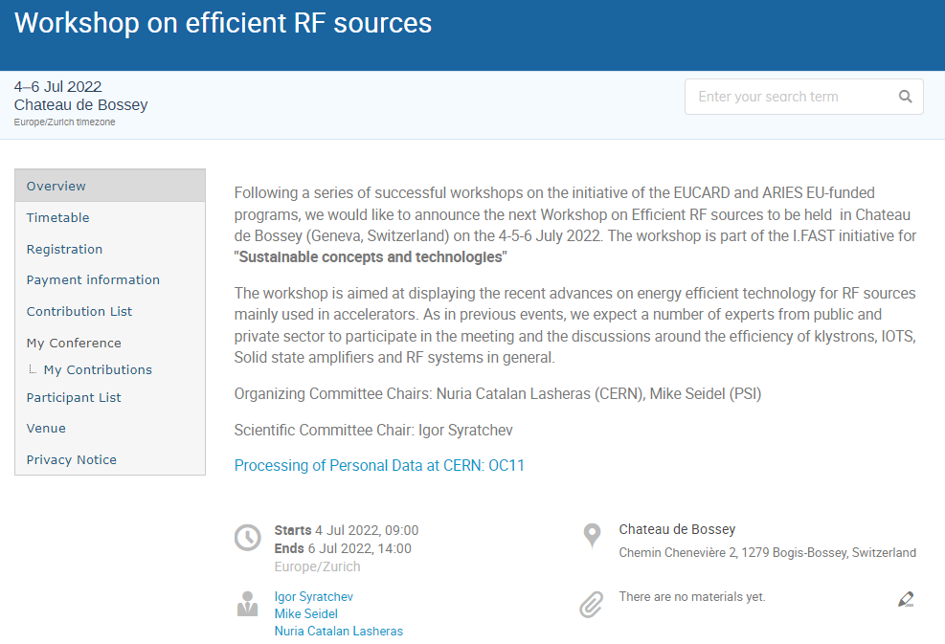
https://indico.cern.ch/event/1138197/

