Slide 1
The CompactLight Project and beyond
Gerardo D’Auria
Elettra – Sincrotrone Trieste
14th International Workshop on Breakdown Science
And High-Gradient Technology,
HG2022 Workshop, 16-19 May 2022

Slide 2
Preamble
CompactLight was a 4-years Design Study funded by the EU (GA 777431) in the context of the Horizon 2020, call INFRADEV-2016-2017, development and long-term sustainability of new pan-European research infrastructures.
The project objective was to demonstrate, through a conceptual design, the feasibility of an innovative, compact and cost effective FEL facility, suited for users demands, using the latest concepts for bright electron photoinjectors, very high gradient accelerating structures and novel short period undulators.

Slide 3
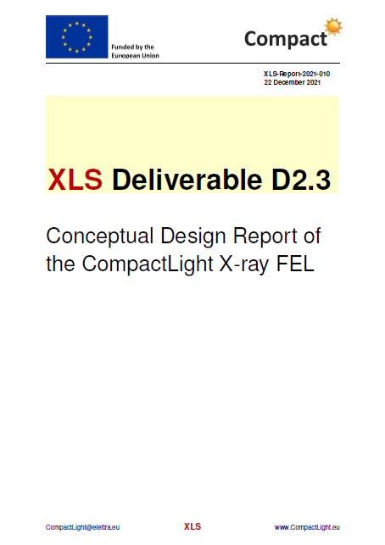
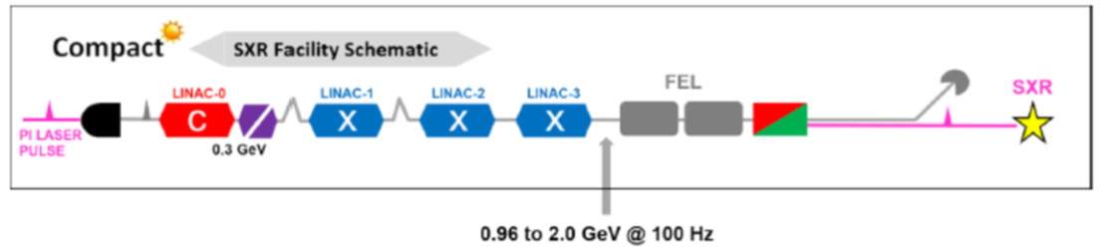
XLS Conceptual Design Report
At the end of 2021 the project has been completed with the submission of its main deliverable, D2.3, the XLS Conceptual Design Report (CDR),
describing in detail the proposed facility.
The CDR also includes preliminary evaluations of a soft X-ray FEL and an extremely compact and relatively inexpensive photon source based on Inverse Compton Scattering (ICS), both using the CompactLight technology.
http://www.compactlight.eu

Slide 4
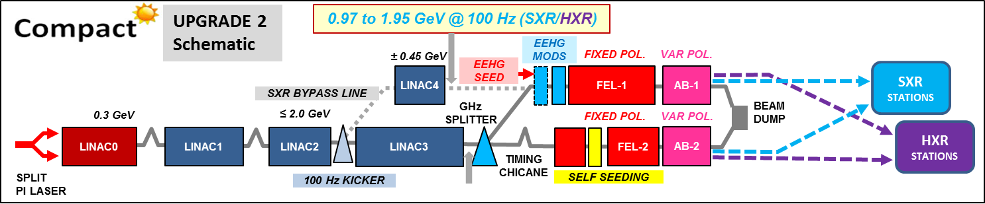
Facility layout and operating modes
CompactLight has been designed as a hard X-ray facility, covering the wavelength range from 0.8 Å up to 5nm (16 keV to 0.25 keV) with two separate FEL beamlines:
a soft X-ray (SXR) FEL able to deliver photons from 5.0 nm to 0.6 nm (0.25 keV to 2 keV) operating up to 1 kHz repetition rate (high rep rate)
a hard X-ray FEL source (HXR) ranging from 6.0 Å to 0.8 Å (2 keV to 16 keV) with maximum 100 Hz repetition rate (low rep rate)
FEL operating modes:
0.97 to 1.95 GeV @ 1000 Hz (SXR/SXR)
2.75 to 5.5 GeV @ 100 Hz (HXR/HXR)
+
2.75 to 5.5 GeV @ 100Hz (SXR/HXR at the same time)

Slide 5
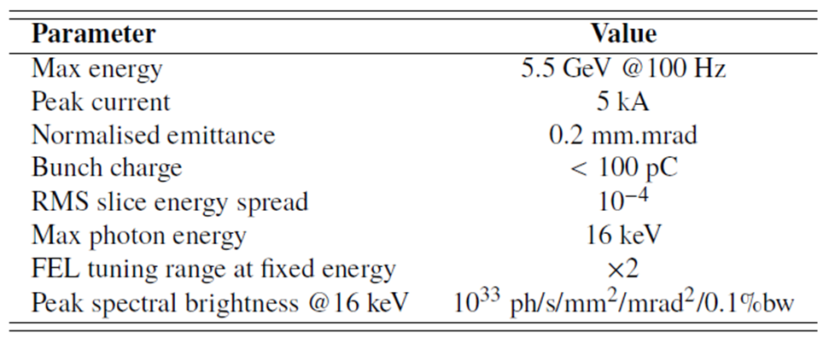
Main operating parameters
e⁻ beam
(HXR)
FEL

Slide 6
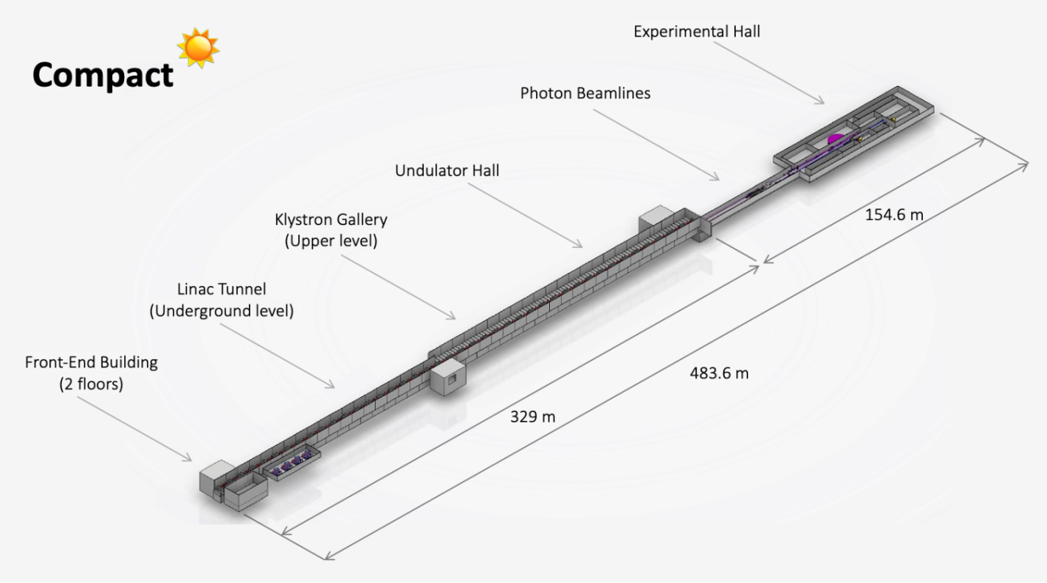
CompactLight footprint
Compared to existing facilities, for the same operating wavelengths, the technical solutions adopted ensure that the CompactLight facility can operate with a lower electron beam energy and has a significant footprint reduction.
≈ 45% reduction on Linac/Undulator overall length

Slide 7
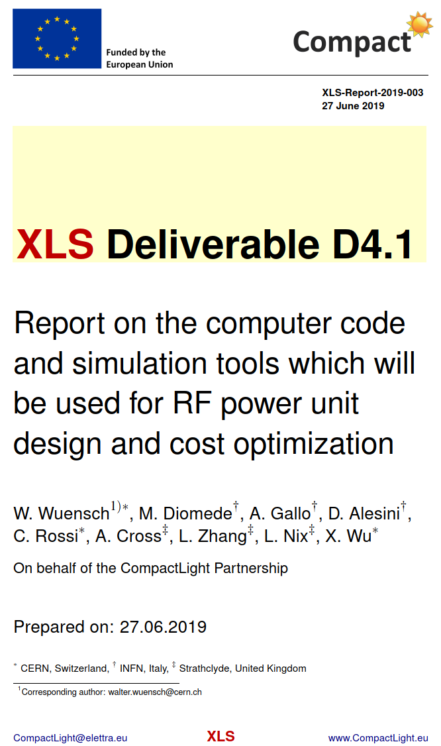
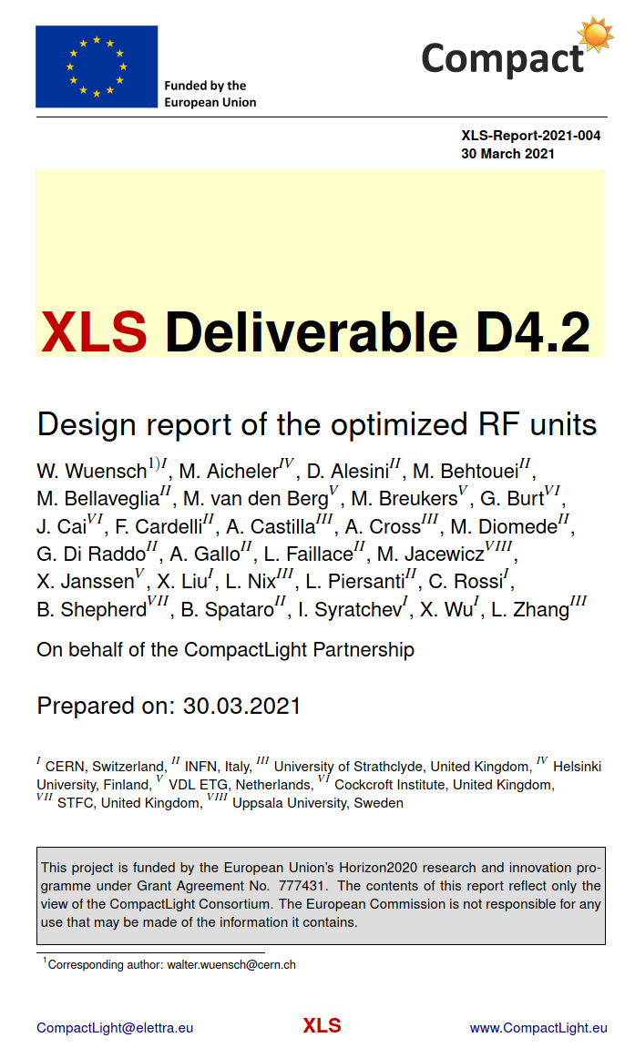
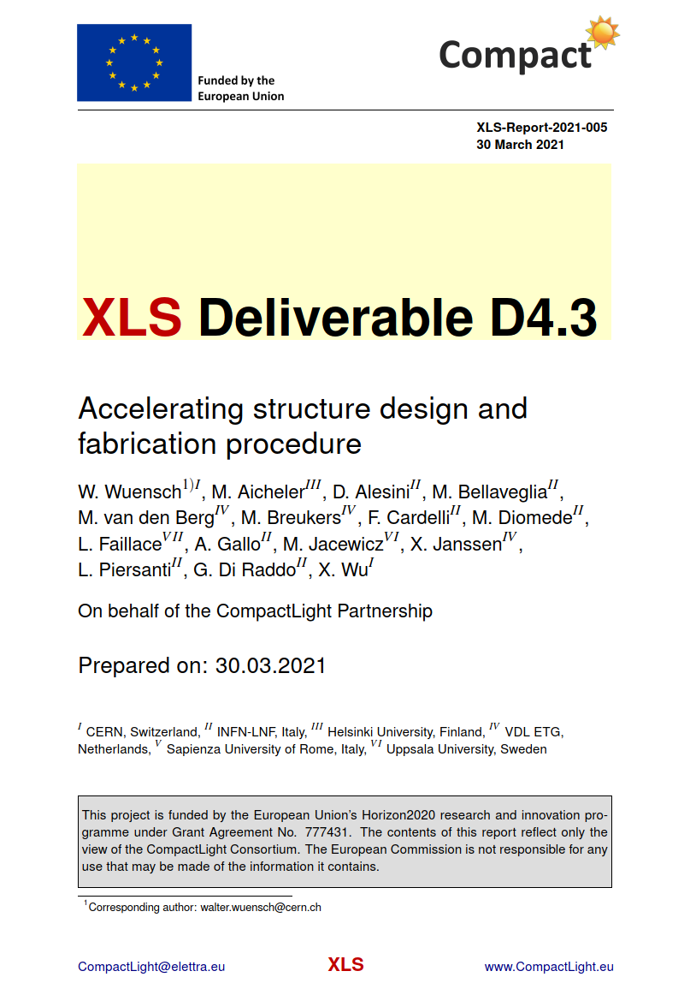
Deliverables
All the deliverables are available at http://www.compactlight.eu

Slide 8
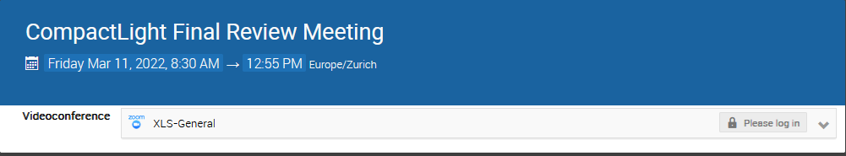
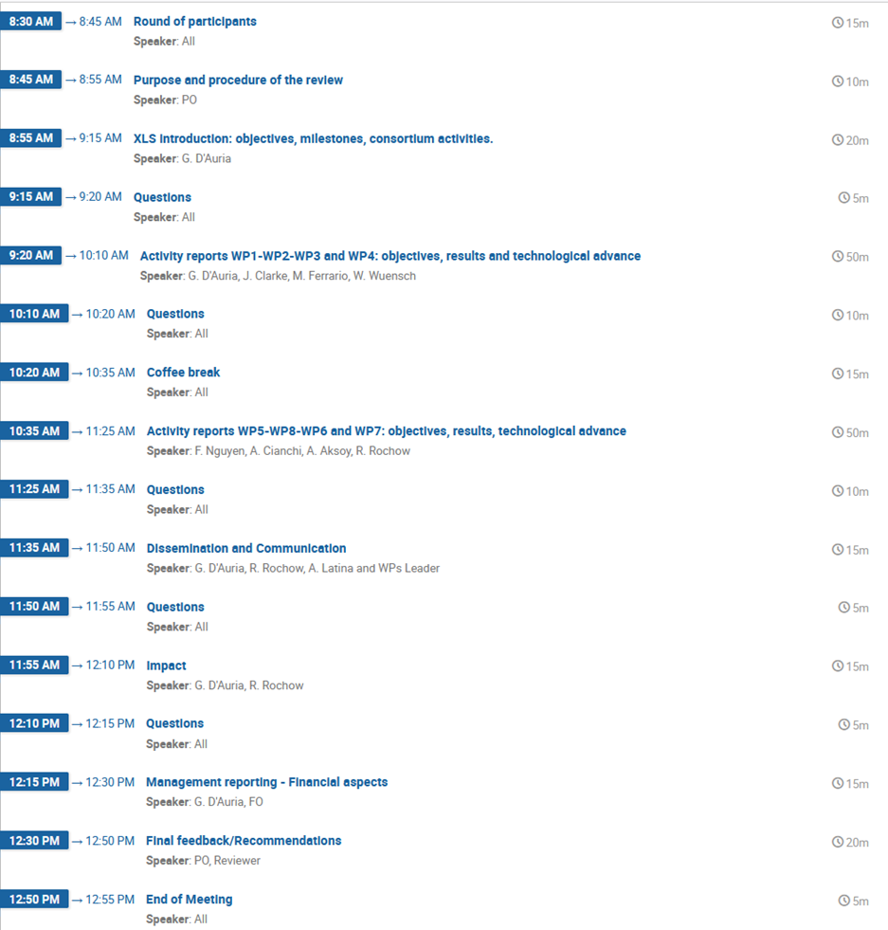
Final review meeting
On March 11, we had the final review of the project, organized by the XLS EU Officer, receiving full approval for the work done and the results achieved
“CompactLight has delivered exceptional results with significant immediate or potential impact………
It constitutes an exceptional contribution to accelerator technologies in terms of the development of a compact and lower-cost FEL facility, with the resulting positive economic, environmental, energy usage, and other socio-economic impacts.………….
The adoption of innovative photoinjector, high-gradient accelerating structures, and short period superconducting undulators, were successfully described in the timely submitted deliverables……..
Specially relevant being D2.3, reporting the CDR of the facility, that presents clear industrialization potentials, part of which are already being investigated with industry”.

Slide 9
Outlook and future plans I
The XLS Collaboration is determined to continue its activities well beyond the end of its H2020 contract, improving the partnership and maintaining its leadership in compact acceleration and light production, strong of the experience gained in the four years of the project.
Periodic workshops and events will be organized to promote exchanges among the members of the Collaboration and the Scientific Community to foster further developments in the field of very compact photon sources.
We have already received internal funding from Elettra (through the internal project Pro-Compact) to continue our activity on XLS, in order to maintain a high level of scientific iteration between the members of the Collaboration.
We also plan to stimulate the next phase of the project for its implementation and possible placement on the next ESFRI roadmap.

Slide 10
Outlook and future plans II
In addition, for the technical point of view, key components proposed by CompactLight (XLS) are already planned to be used/prototyped within different projects:
  The EuPRAXIA@SPARC_LAB project plans to use the same RF module developed by XLS for its X-band linac.
  Prototypes of the C-band Gun and the X-band accelerating structure are under development within the I.FAST project.
  Two XLS Apple-X undulators, designed by ENEA, are being prototyped by Kyma and will be installed at INFN-LNF in the context of Sabina and EuPRAXIA@SPARC_LAB projects.
  Prototypes of a high repetition rate modulator and a high efficiency klystron have been included in a new Horizon Europe proposal, CREATE, submitted for approval on April 20, 2022.

Slide 11

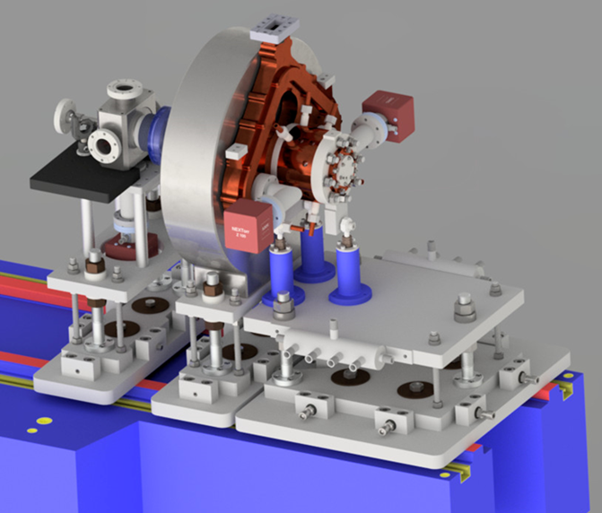
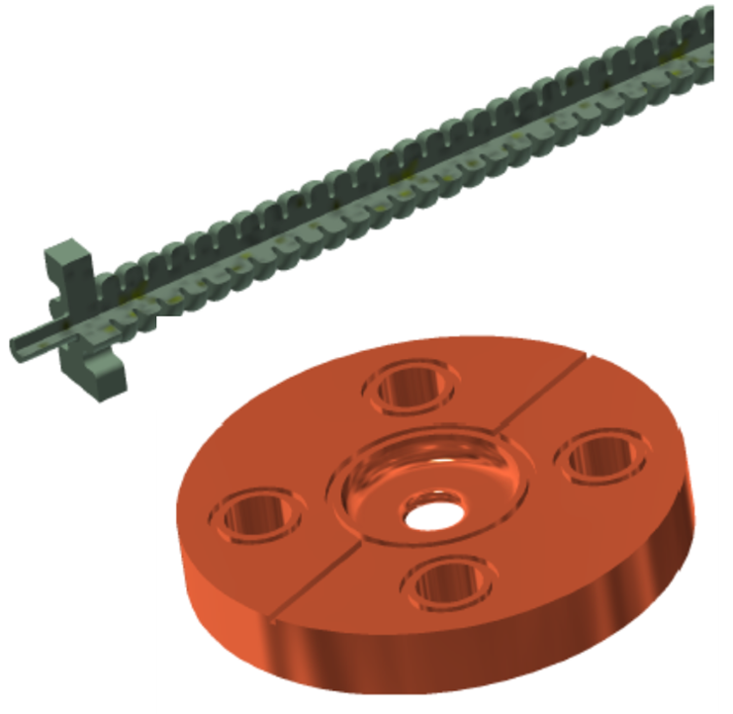
Prototypes under development
Innovation Fostering in Accelerator Science and Technology
I.FAST
WP7, High Brightness Accelerators for Light Sources
Ref. D. Alesini (INFN)
Task 7.4: Very high gradient RF Guns operating in the C-band (April 2025)
Design and realization of two C-band photoinjectors: a SW and a TW gun, with low and high RF power tests.
INFN, PSI
VDL and COMEB
Task 7.5: CompactLight Prototype Accelerating Structures (April 2025)
Build and test, at low and high RF power, two prototypes of the X-band (12 GHz) accelerating structure designed for the CompactLight (XLS) project
Elettra, CERN, INFN,
VDL, TMD and COMEB

Slide 12
XLS accelerating structure prototypes
The two prototypes will be used to get a full validation of the XLS accelerating structure at two RF operating regimes:
high gradient/low pulse repetition rate (60 MV/m @100Hz)
low gradient/high pulse repetition rate (30 MV/m up to 1KHz)
Two deliverables:
D7.5: Construction of the XLS accelerating structure pre-prototype.
  Development of production process and RF tests of the pre-prototype (@TRL 6/7)_M32.
D7.6: Construction of the XLS accelerating structure full prototype.
  Production process analysis and validation, RF tests of the full prototype (@TRL 7)_M48.

Slide 13
Task 7.5 Time schedule
Preparatory
Phase
for structure
fabrication

Slide 14
Undulator prototypes

Slide 15
New EU funding opportunities: CREATE proposal
CREATE:
Compact and Resource-Efficient Accelerator TEchnologies
Horizon Europe Work Programme 2021-2022
INFRA-2022-TECH-01-01
Development of ground-breaking RI Technologies,…..including high tech developments for acceleratos
Aspects addressed in the proposal
Research and development of new scientific instrumentation, tools and methods for research infrastructures taking into due account resource efficiency (e.g. energy consumption) and environmental (incl. climate-related) impacts
Their technology validation and prototyping
Training of RI staff for the operation and use of these new solutions
The innovative potential for industrial exploitation of the solutions and/or for the benefits of the society.
EU contribution requested 10 M€

Slide 16
CREATE scientific areas of interest and WPs
Work package |  | Lead participant |  | Person Months | Month
No. | Title | No | Short Name |  | Start | End
1 | Project coordination and management | 1 | Elettra | 109 | 1 | 48
2 | Scientific and industrial exploitation | 3 | INFN | 56 | 1 | 48
3 | High efficiency RF generator | 2 | CERN | 22 | 1 | 48
4 | High repetition rate modulator | 2 | CERN | 33 | 1 | 36
5 | X-Band RF Pulse Compressor (BOC) | 3 | INFN | 20 | 1 | 48
6 | High repetition rate photoinjector studies | 4 | ULANC | 40 | 1 | 48
7 | Plasma accelerator dynamics and theory | 17 | IST | 102 | 1 | 48
8 | High repetition rate plasma structures | 20 | DESY | 198 | 1 | 42
9 | Diagnostics and instrumentation | 11 | CNRS | 110 | 1 | 48
10 | High power Ti:Sa amplifier | 5 | UKRI | 88 | 1 | 48
11 | High intensity diode pump source | 16 | FBH | 60 | 1 | 48
12 | Development of OPCPA-based laser driver for electron acceleration | 10 | IP-ASCR | 55 | 1 | 48
13 | High average power compressor | 9 | CNR | 42 | 1 | 48
14 | Laser System Architecture, transport and engineering | 11 | CNRS | 60 | 1 | 43
 | Total person-months |  |  | 995
Project coordination
Normal conducting
RF technology
Plasma
acceleration
High power laser technology

Slide 17
CREATE Consortium
Participant No | Participant organisation name | Country
1 - Coordinator | Elettra - Sincrotrone Trieste SCpA | Italy
2 | European Organization for Nuclear Research | Switzerland
3 | Istituto Nazionale Fisica Nucleare | Italy
4 | University of Lancaster | United Kingdom
5 | United Kingdom Research and Innovation | United Kingdom
6 | Uppsala Universitet | Sweden
7 | University of Strathclyde | United Kingdom
8 | Institute of Accelerating Systems and Applications | Greece
9 | Consiglio Nazionale delle Ricerche | Italy
10 | Fyzikalni Ustav AV CR V.V.I (ELI-BeamLines) | Czech Republic
11 | Centre National de la Recherche Scientifique CNRS | France
12 | VDL ETG Technology & Development BV | Netherlands
13 | Thales LASERS France SAS | France
14 | Amplitude | France
15 | Scandinova Systems AB | Sweden
16 | Ferdinand-Braun-Institut gGmbH, Leibniz-Institut für Hoechstfrequenztechnik | Germany
17 | Associacao do instituto superior Tecnico para a Investigacao e Desenvolvimento | Portugal
18 | Universita degli Studi di Roma La Sapienza | Italy
19 | Heinrich-Heine-Universitaet Duesseldorf | Germany
20 | Deutsches Elektronen-Synchrotron DESY | Germany
21 | The Chancellor, Masters and Scholars of the University of Oxford | United Kingdom
22 | Ludwig-Maximilians-Universitaet Muenchen | Germany
23 | DILAS Diodenlaser GmbH | Germany
24 | University of Liverpool | United Kingdom
CREATE is a partnership among 19 Universities and International Research Lab. supported by 5 Industrial partners.
Country | #
Italy | 4
International | 1
United Kingdom | 5
Greece | 1
Sweden | 2
Czech Republic | 1
France | 3
Germany | 5
Portugal | 1
Netherlands | 1
Tot | 24

Slide 18
Conclusions
With 26 Partners and 5 Third Parties, the CompactLight Collaboration brought together world-class expertise to promote the development of innovative breakthrough technologies for future photon sources.
The XLS project represents an important milestone in the development of compact linacs and cost-effective NC FEL sources, extending their capabilities up to the KHz regime, to serve a larger number of users in many scientific fields, including industry and society.
With the XLS CDR we have highlighted the technical concepts and the parameters used for the facility design, with the objective to provide a reference document for future FEL designers. It also represents an effective solution that makes X-ray FELs more affordable to construct and operate, even for small laboratories or academia with limited space and funding capabilities.
The prototyping phase of the key components developed within CompactLight has started within other projects. This represents the second step of our program and is of particular importance for our objectives: the validation of the technology with the possibility of having all the key components for more efficient and less expensive photon sources.

Slide 19
Acknowledgements
I would like to express my sincere gratitude to all members of the XLS collaboration for the work carried out and their important contribution for the success of the project.
Warm thanks also go to my colleagues in the I.FAST and CREATE collaborations.

Slide 20
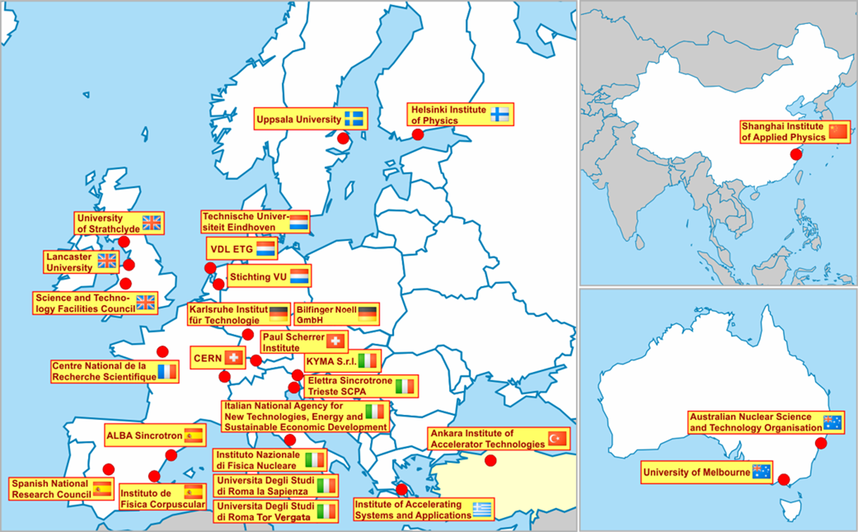
Thank you!
CompactLight@elettra.eu www.CompactLight.eu
CompactLight is funded by the European Union’s Horizon2020 research and innovation programme under Grant Agreement No. 777431.

