Slide 1
High Gradient Linac for High Intensity Positron Production
KEK accelerator division
Yoshinori Enomoto
On behalf of slow positron upgrade working group

Slide 2
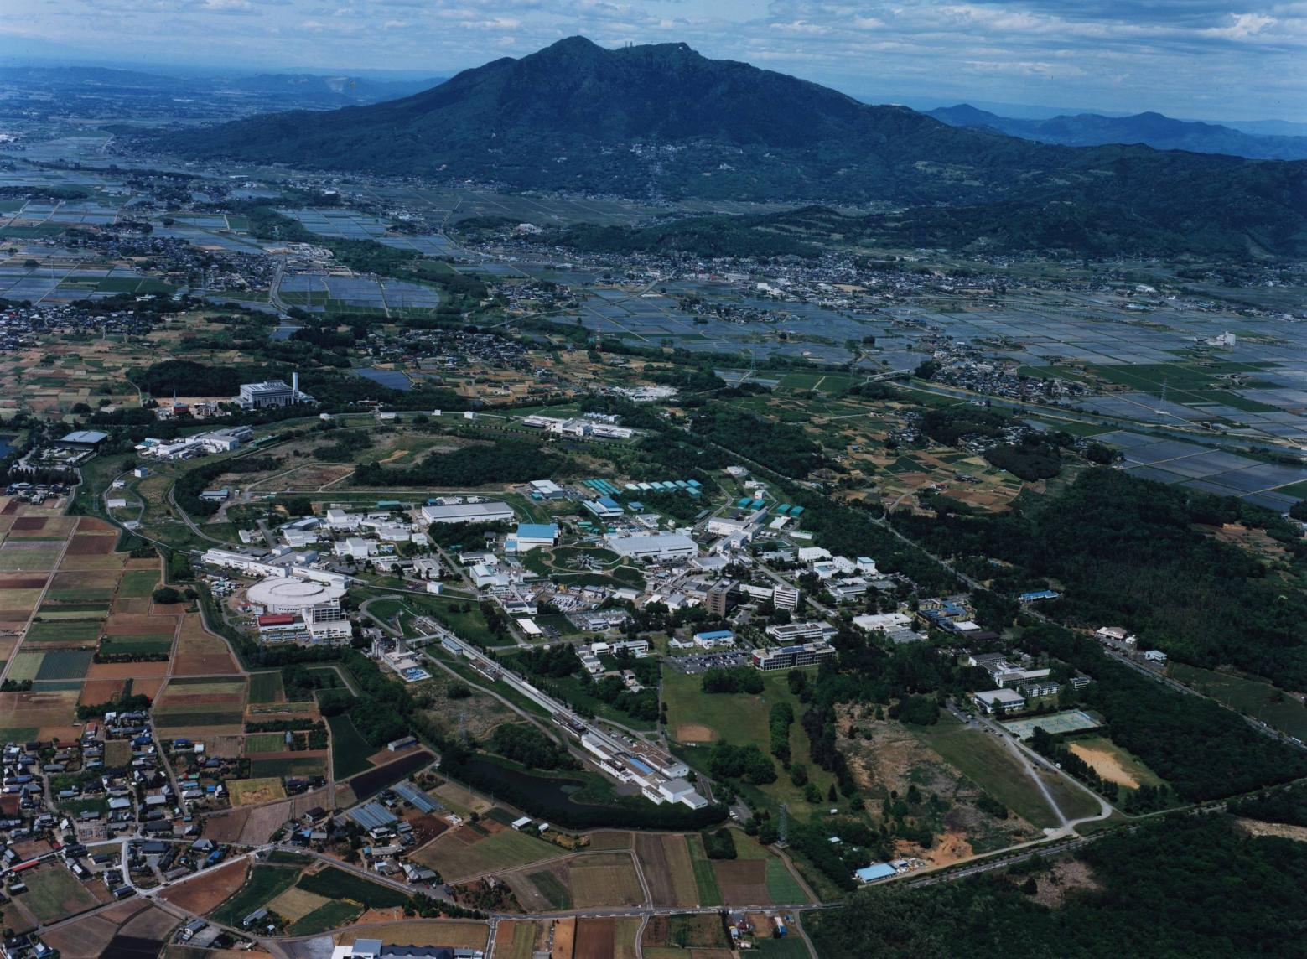
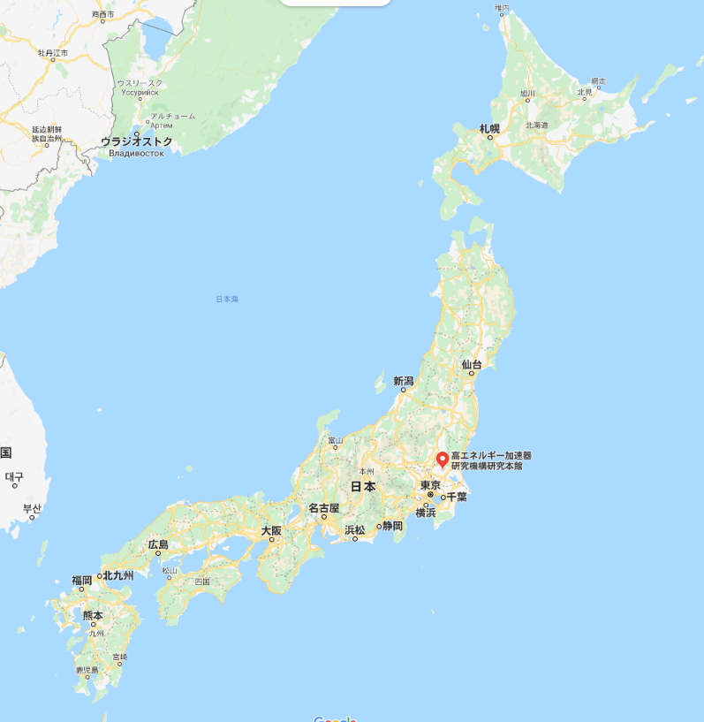
High Energy Accelerator Research Organization （KEK）
Tsukuba Campus
Tsukuba
electron-postiron collider：SuperKEKB
PFｰAR
Main gate
Photon Factory
Electron-positron linac
（electron 7GeV, positron 4GeV ）
（Slow Positron Facility, A dedicated linac, electron 50MeV, 12$μ$A)

Slide 3
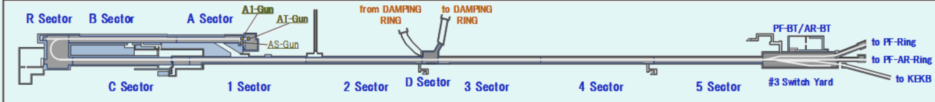
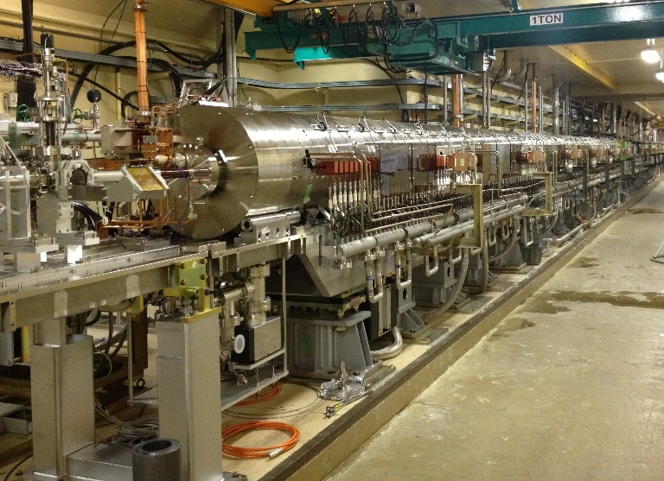
KEK Linac and positron source
500 m
Positron source for SuperKEKB
Slow positron facility
Nextef2
KEK electron positron injector Linac
  build in 1980
  Have been providing electron and positron for more than 35 years for high energy collider experiments
  Slow positron facility is operated for more than 25 years
  Nextef / Nextef2 is next to the Linac

Slide 4
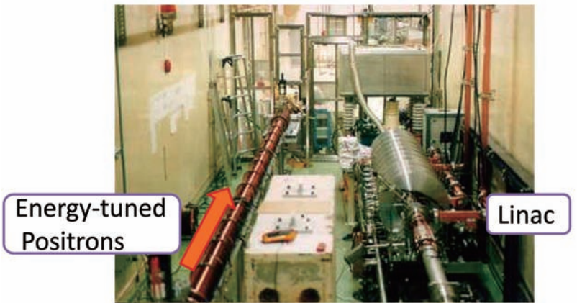
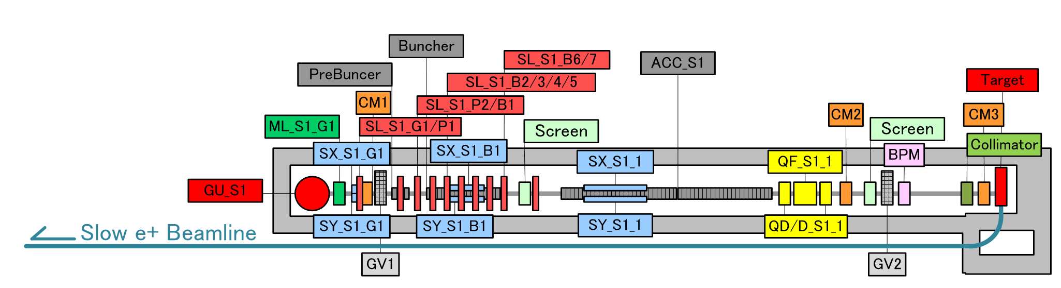
Slow positron facility
Thermionic electron gun
Pre buncher and buncher
2 x 2m S-band accelerator structure
Ta Target and W foil moderator
Primary beamline is covered by
concrete shield during operation

Slide 5
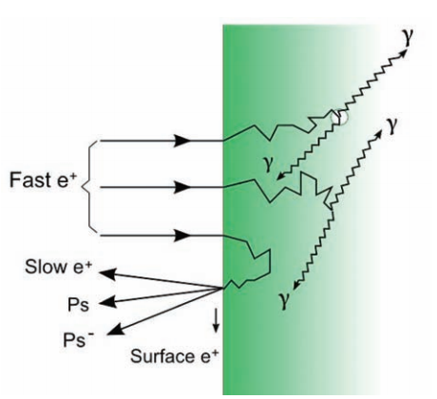
moderator
Absorb positron from target
  Created positron have very wide energy spread (0 ～ MeV)
Thermalize positron energy
  through collisions in the material
Re-emit positron from its surface
  Diffused to surface
  Negative work function
Material of moderator
  Solid Ne
    Highest efficiency, but not used in accelerator based positron source
  W foil, mesh
    Widely used
  There are many research for efficient moderator

Slide 6
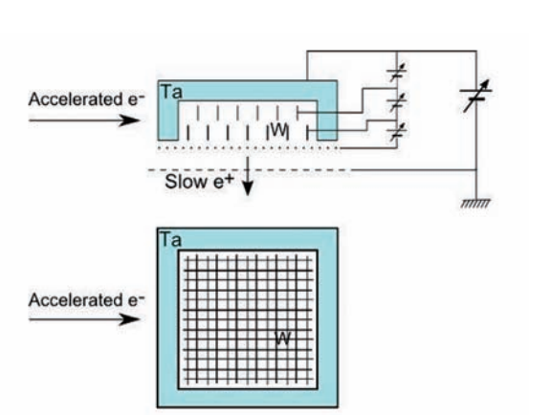
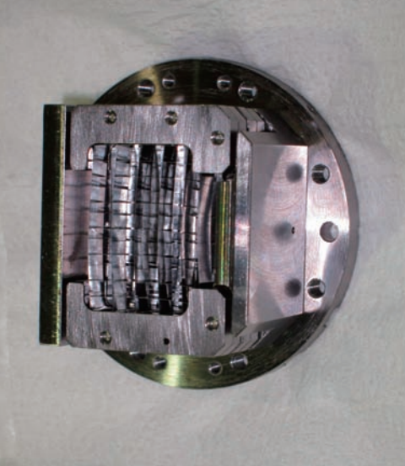
Target and moderator
Target and moderator is floated from GND potential.
Floating voltage = energy of positron
(a few 100 eV ～ a few 10 kV)

Slide 7
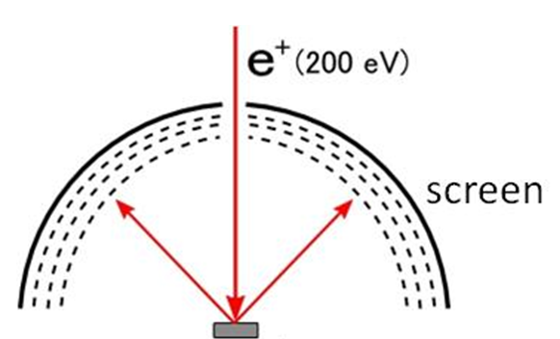
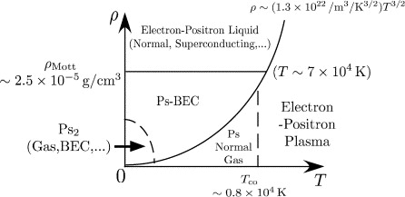
Applications of slow positron
Industrial use
  Defect analysis
Material science
  Surface analysis
Plasma physics
  Electron-positron pair plasma
Atomic physics
  Positronium BEC
Low-energy positron diffraction
(25 eV – 300 eV)
H. Yabu, NIM B 221 (2004) 144-148, “Many positron and positronium interactions”

Slide 8
TRHEPD –total reflection high energy positron diffraction
Positron: TRHEPD
Penetration depths of e⁺ and e⁻
Electron: RHEED
e ⁺
surface
e⁺
Pushed up
Total reflection
e⁻
e ⁻
surface
Probing depth (Å)
atomic layer (unit: Bilayer)
E= 10 keV
eV₀= +12 eV (Si crystal)
Pulled down
bulk
Glancing angle: θ (°)
The critical angle for total reflection θ_{C} (2°-3°) lies in the middle of the TRHEPD measurement region (θ<6 °) (→ unique to the positron),
accidentally, due to the values of $m, e, h, etc.$
(size of atoms (lattice constant) , de-Broglie wave length, crystal potential)
θ_{in}<θ_{C}: positrons are totally reflected and see the topmost surface only.
θ_{in}>θ_{C}: positrons also see the immediate subsurface.
Probing depth is adjustable by varying θ_{in}.
No background from the deeper, bulk part at all.

Slide 9
Present situation in slow positron source
p.459

Slide 10
Parameter consideration 1
Primary Beam power
  Number of positron is proportional to the primary beam power
    Higher power is preferable

Slide 11
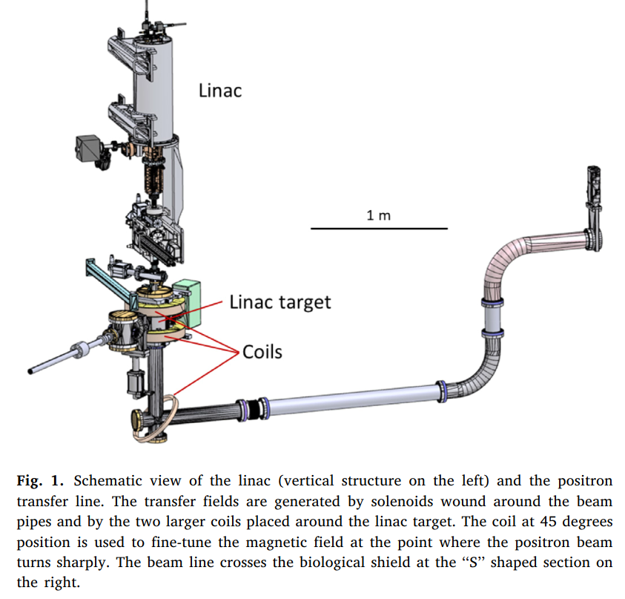
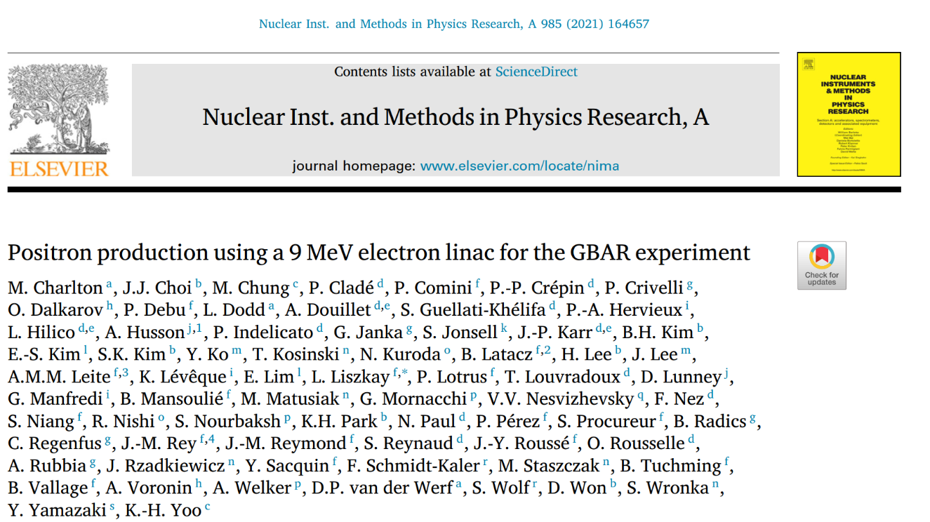
Positron source in GBAR
9 MeV, 300 Hz, 2.5 kW
5 X 10^7 e+/s

Slide 12
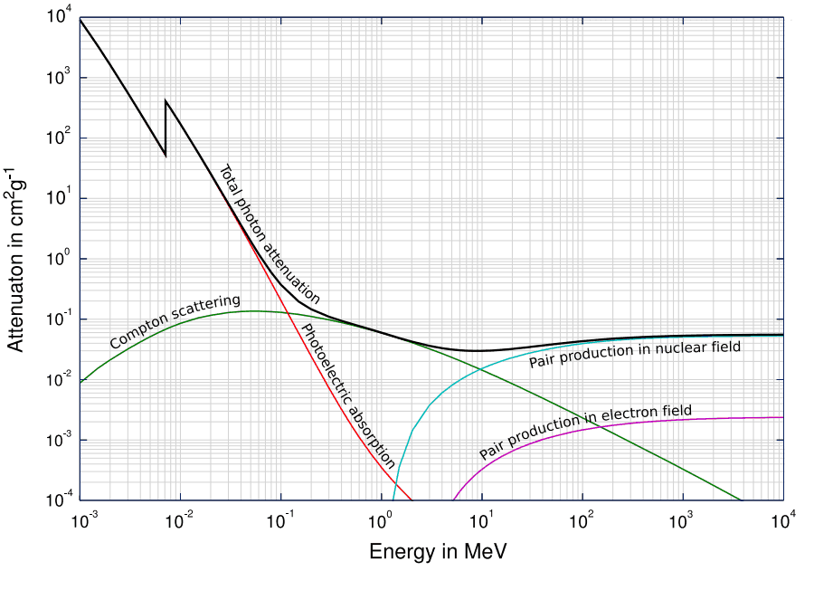
Interaction of photon with matter
A few tens MeV primary electron beam is
Usually used to create electron positron pair
In slow positron facility
https://www.nuclear-power.net/nuclear-power/reactor-physics/interaction-radiation-matter/interaction-gamma-radiation-matter/

Slide 13
Parameter consideration 1
Primary Beam power
  Number of positron is proportional to the primary beam power
    Higher power is preferable
Synergy and Connection to a positron source for high energy physics
  prototype of future high power positron sources for high energy physics (ILC, FCCee, CEPC, CLIC)
    High energy low current short bunch is preferable compared with low energy high current scheme
Limitation
  Available tunnel space < 50 m
Collaboration and environment
  KEK Linac has long history of development on high gradient X-band accelerator structures –Nextef
1 GeV order primary beam by high gradient acceleration (50 MV/m)

Slide 14
Parameter consideration 2
Parameters of this project are similar to that of ILC
project | SPF (achieved) | SuperKEKB (achived) | SLC (achieved) | ILC(e-driven) (design) | LLNL1999 (design) | This project (design)
Primary energy | 0.05 GeV | 3.5 GeV | 33 GeV | 3 GeV | 0.1 GeV | 1 GeV
Beam power | 0.55 kW | 3.5 kW | 27 kW | 74 kW | 45 kW | 50 kW
Repetition | 50 Hz | 50 Hz | 120 Hz | 100 Hz |  | 50 Hz
Pulse width | 4 us | Single x2 | Single | Single x 66 |  | 4 us
Average current | 11 uA | 1 uA | 0.8 uA | 24 uA | 450 uA | 50 uA
Efficiency (e+/e-) | 1.45 x 10⁻⁶ | 0.4 | 1.0 | 1.25 | 3.2 x 10⁻⁶ | 32 x 10⁻⁶
Efficiency (e+/kW) | 1.82 x 10⁸ /kW | 0.71 x 10¹² /kW | 0.19 x 10¹² /kW | 2.7 x 10¹² /kW | 2 x 10⁸ /kW | 2 x 10⁸ /kW
Number of positrons (/s) | 1 x 10⁸ /s | 2.5 x 10¹² /s | 5 x 10¹² /s | 200 x 10¹² /s | 90 x 10⁸ /s | 100 x 10⁸ /s
High energy physics
SLC was the world’s highest power positron source ever build (27 kW)
SuperKEKB is the word’s highest power positron source in operation (3.5 kW)
Future project especially ILC and CLIC require further higher beam power (～74 kW)
A few tens kW (more than 27 kW) positron source will give us new knowledge.

Slide 15



Layout and upgrade scheme
Existing target
Separation wall
New target
$∼$14 m
$∼$36 m
Experimental
hall
S-band linac
50 MeV, 550 W, 50 Hz
high-gradient linac
1 GeV, 50 kW, 50 Hz
After commissioning, it will be extended to the space where the existing linac is.
New accelerator will be installed downstream side of the present Linac
Separation wall will be removed after confirming the new positron source working correctly
Present positron source will be removed and the new Linac will be extended

Slide 16
Efficiency of moderator vs positron energy
10
-1
10
-2
Fraction of positrons stopped
10
-3
10
-4
10
-5
Efficiency of moderator is strongly depends on energy of fast positron
Deceleration of positron from target before impinging into the moderator will increase efficiency greatly.
10
5
6
7
0.1
2
3
4
5
6
7
1
2
3
4
5
6
7
10
Energy (MeV)

Slide 17
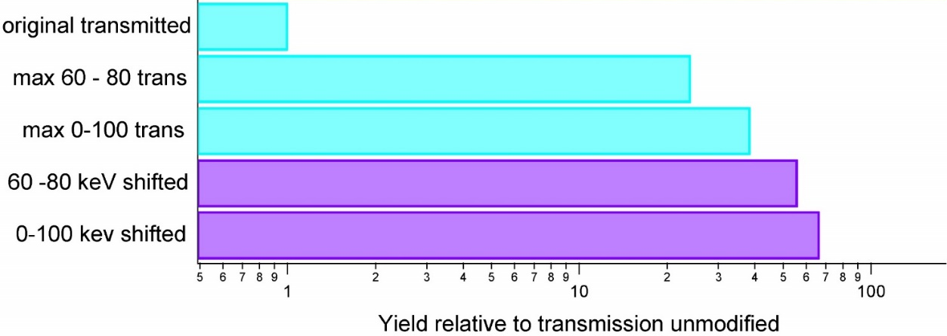
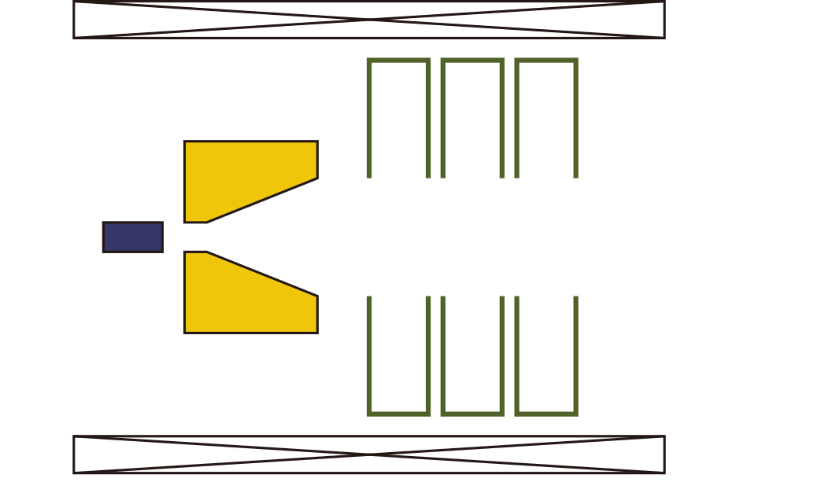
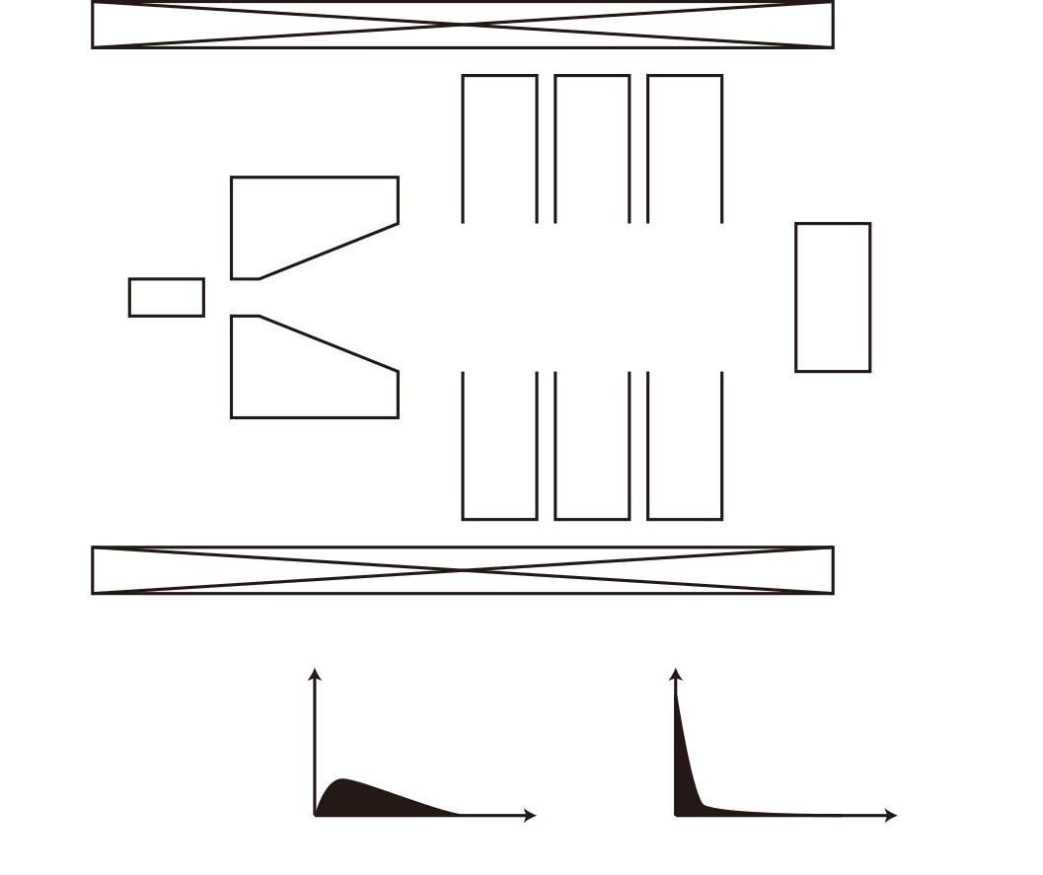





Increase moderator efficiency by deceleration
Reducing the angular spread by a flux concentrator (FC)
C. D. Jonah et al., Appl. Surf. Sci. 225 (2008) 25-28
“Development of the Argonne positron source APosS”
Large
angle spread
Small
angle spread
RF cavities
$${\text{e}}^{−}$$
More than 10 times increase of efficiency by slowing down positrons down less than 100 keV.
Purple bars show the results when the energy is shifted 20 keV. (i.e. 0-100kV shifted = 20-120 keV)
(1 GeV)
ＦＣ
Fast ${\text{e}}^{+}$
Slow${\text{e}}^{+}$
target
0.1－35 keV
Moderator
Solenoid
Count
Count
$$E$$
$$E$$
Slowing down
through the cavity
Notes:
Curr.ent.ly, slow-pos.i.trons are ob.tained by in.jecting pair-cre.ated fast pos.i.trons di.rec.to.ry into the mod.e.ra.tor.
In this project, we will first slow down the fast pos.i.trons in the same way as the SuperKEKB pos.i.trons un.der.go through the flux con.cen.trator and RF cav.i.ties, and then let them go into the mod.e.ra.tor.
It is expected to improve the slow-positron conversion efficiency by a factor of about 50.
This will be a hi.stor.ic break.through in the slow-pos.i.tron beam tech.nol.o.gy.

Slide 18
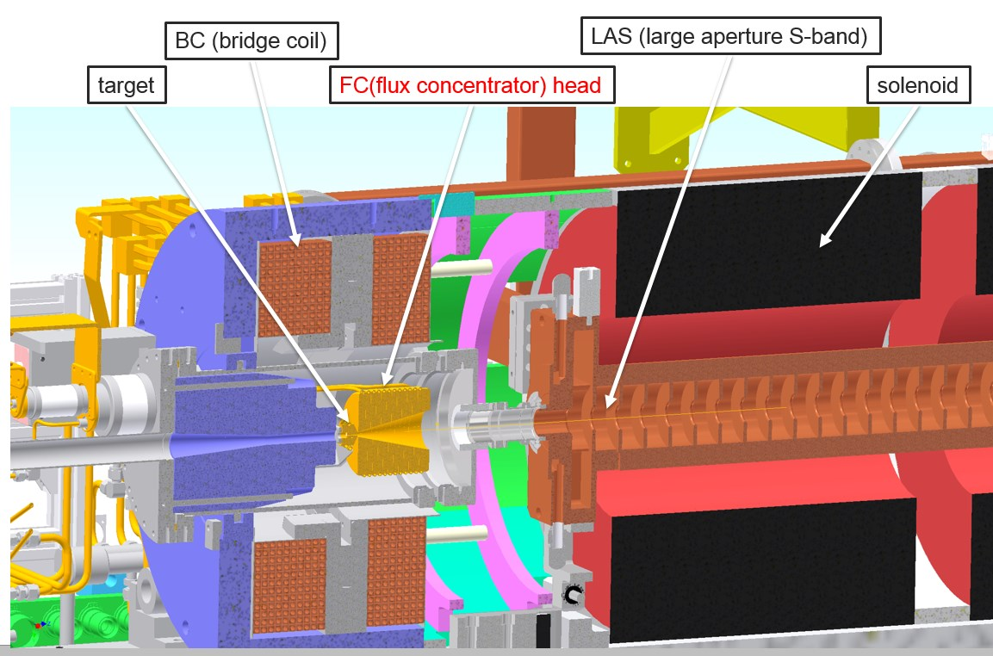
Positron source for SuperKEKB
For capture and bunching, positrons are usually injected into deceleration phase of the accelerator structure at first stage, even in high energy positron source.

Slide 19
Summary
100 times intensity upgrade of the slow positron facility in KEK is proposed
  For material and surface science
  For technical development and prototyping of
    High power positron sources for future collider
    High gradient (X-band) accelerator of a few tens meter
  Using technology developed by Nextef
  Using technology developed by SuperKEKB positron source

Slide 20
Annual plan (original)
Fiscal year | 2022 | 2023 | 2024 | 2025 | 2026 | 2027 | 2028 | 2029 | 2030
User run by the existing linac
Planning
Building renovation
Designing
Fabrication
Construction
Commissioning
User run by the new linac
Removing the old linac
Linac extending
LEPM installation
①
The project is originally proposed to next mid-term Plan of KEK (2022-2028).
②
③
④
⑤
⑥
⑦
⑧
⑨
⑩
⑪
LEPM (Low-energy positron microscope)
Notes:
予算は全体で18億円程度です。
全体のスケジュールは，入射器のマンパワーの状況次第でこの表から前後します。関係学会やユーザーからのサポートも得られます。

