Slide 1

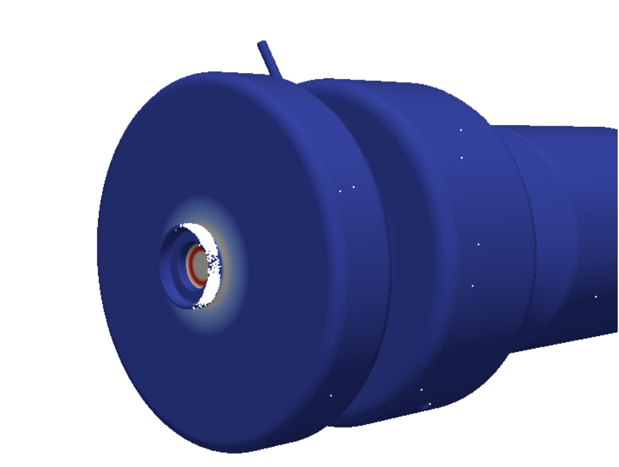

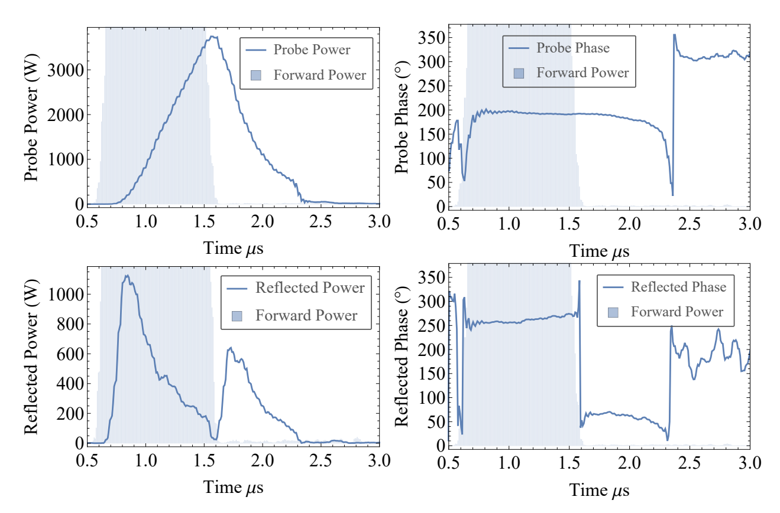
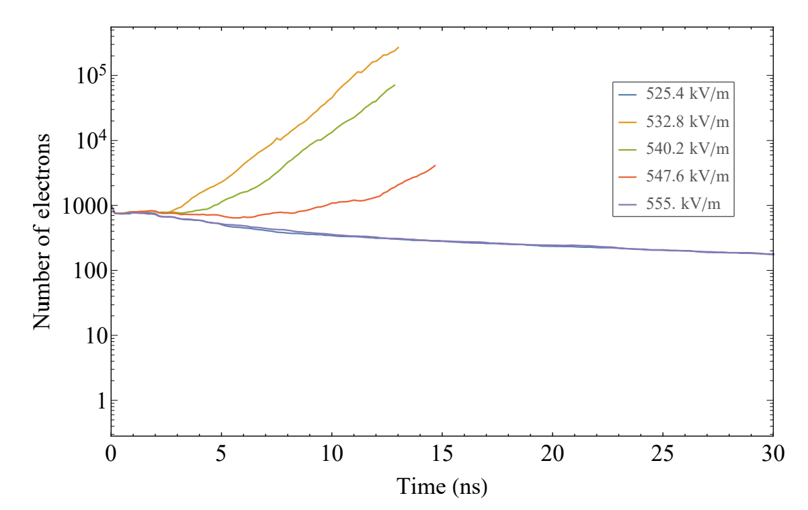
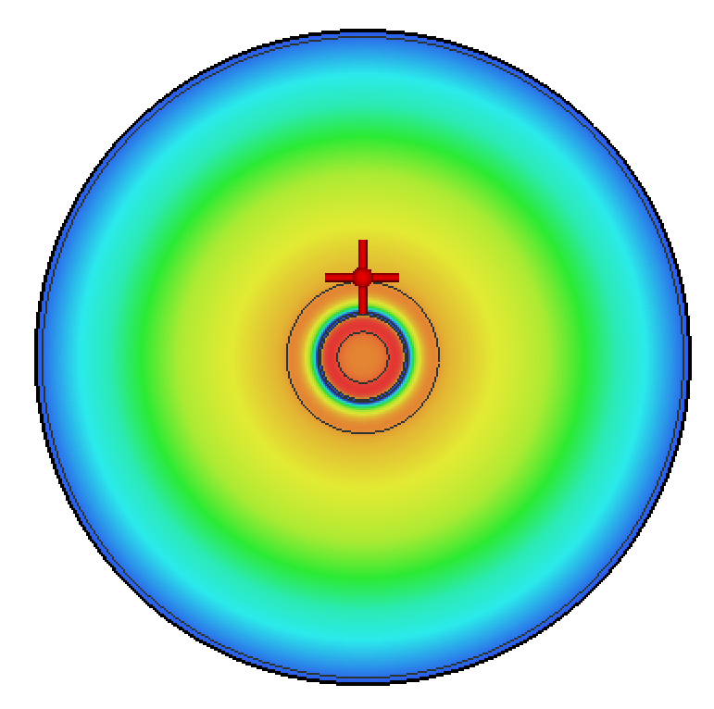
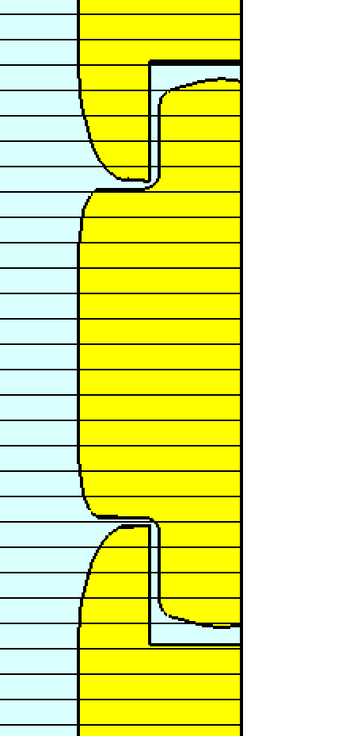
Field emission seeded multipactor
(Or not so high!)
Very early in conditioning of 400 Hz S-band photoinjector we see this:
Hypothesis:
Field emission seeded multipactor
Field emission from earlier into the pulse seeds the multipactor in the decay. Estimating from the exponential growth rate and the power loss, a seed current of 3.88 µA is required.
Next steps: the field in the multipacting region is low, but it is close to the highest field region- the cathode. Can field emitted electrons travel from the cathode to the multipacting region? Must do a tracking simulation to find out.
Multipactor is in the cathode plug region. Ok great. But…
Caught as a breakdown- but occurs on every pulse in certain forward power ranges. Multipactor?
See it here
But why dont
Why not here? It’s the same gradient. Maybe because the time spent in the multipactor band is not long enough?
Also why do we only see it at certain forward power ranges? The structure will always empty, and always pass through this gradient range as it does.
SPARK 3D says yes
Louise Cowie

Slide 2
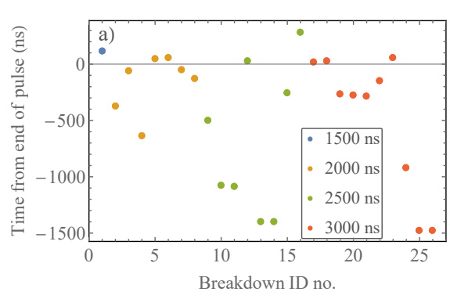
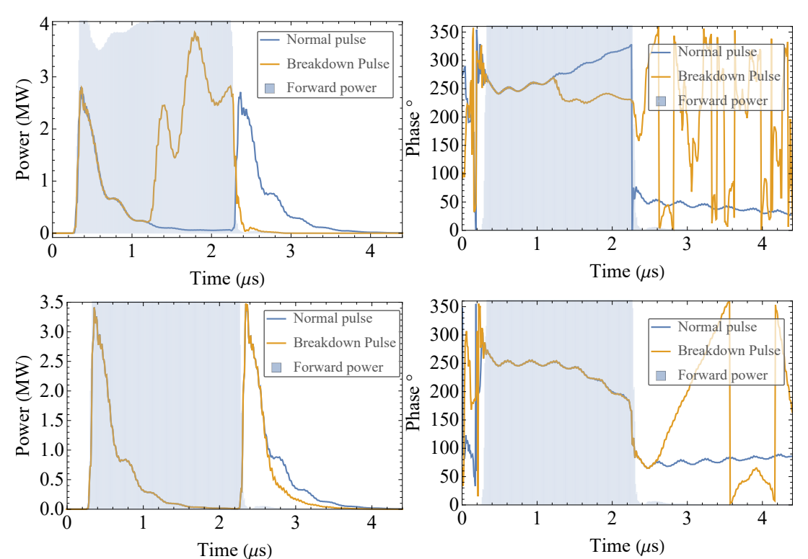
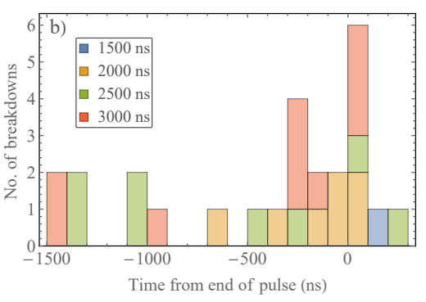
Breakdowns cluster at end of pulse
This was in our previous 70 MV/m S-band photoinjector.
In a standing wave structure we have two time periods:
Filling/steady state - when the forward pulse is on.
Emptying- after the end of the forward pulse.
Louise Cowie
Low statistics, but there seems to be a cluster just after the end of the pulse. Hypothesis: power flow effect.
The gradient in the cavity is high just before the end of the pulse, but there is no/low power flow as tends towards steady state.
Immediately after the end of the forward power pulse the cavity starts to empty and the power flow is high, but so is the gradient.
This is evidence that power flow is an important factor in predicting breakdowns.
Next steps: get more data from 120 MV/m photoinjector conditioning
We see breakdowns that are during the forward power pulse
The time of the breakdown from the end of the forward RF pulse here shown as scatter plot in chronological order and histogram with 100 ns bins.
But also a surprising number of breakdowns that are just after the end of the pulse
Pulse lengths
Louise Cowie

Slide 3
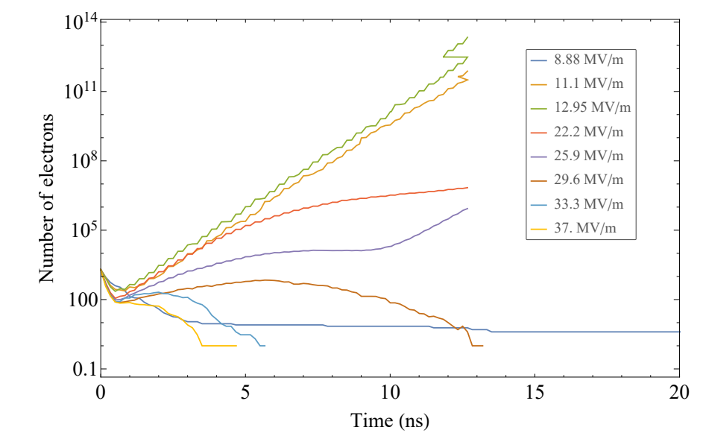
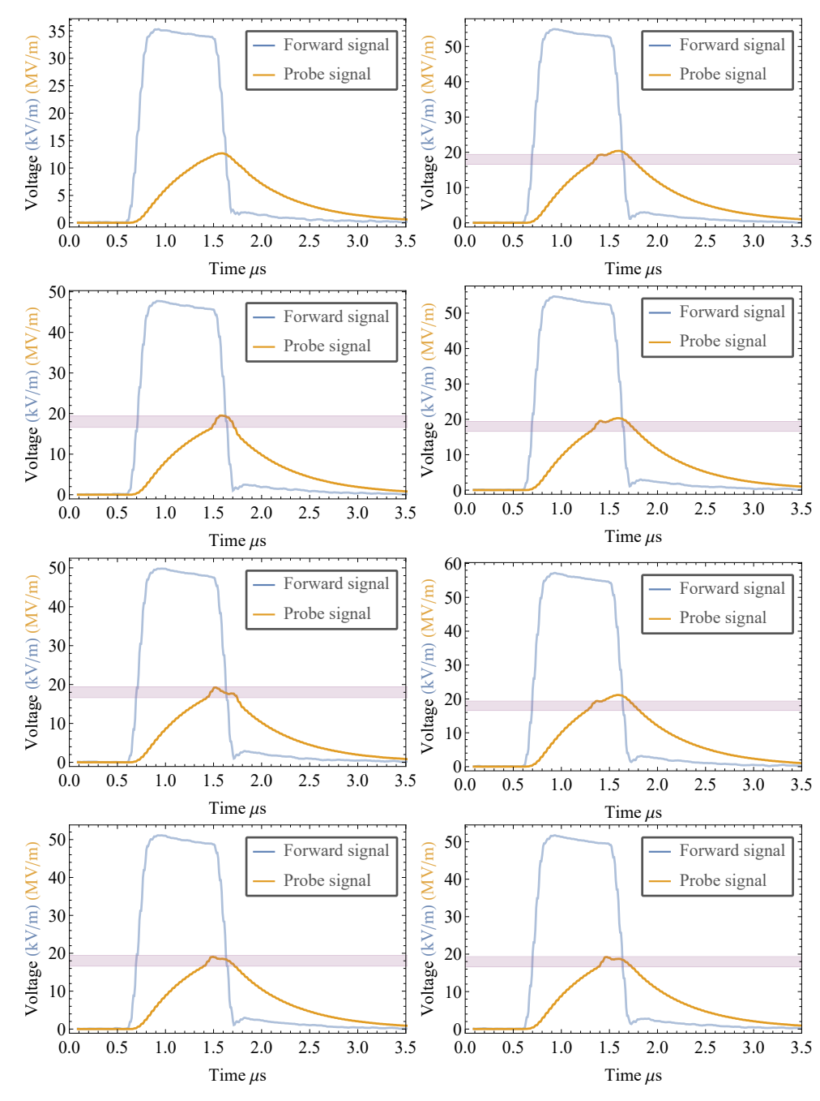
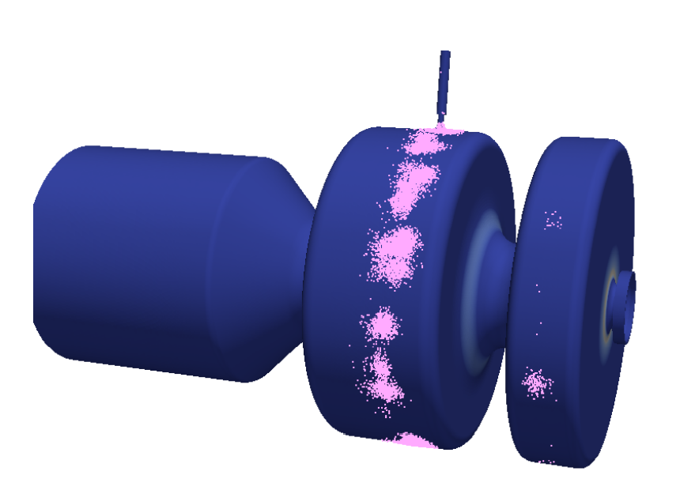
Probe multipactor
Weird signals on the probe measurement. Turned out to be multipactor electrons hitting the probe!
Louise Cowie

