Slide 1
Wakefield Damping of a Distributed Coupling LINAC for CLIC
Evan Ericson, Alexej Grudiev
International Workshop on Breakdown Science and High Gradient Technology (16-19 May, 2022)

Slide 2
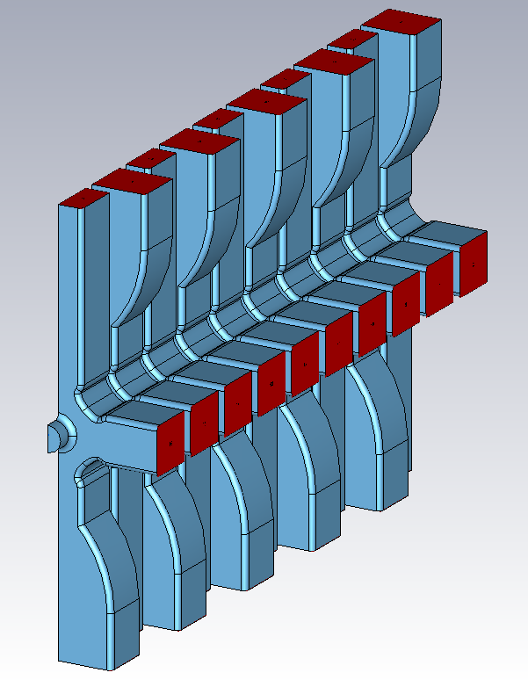
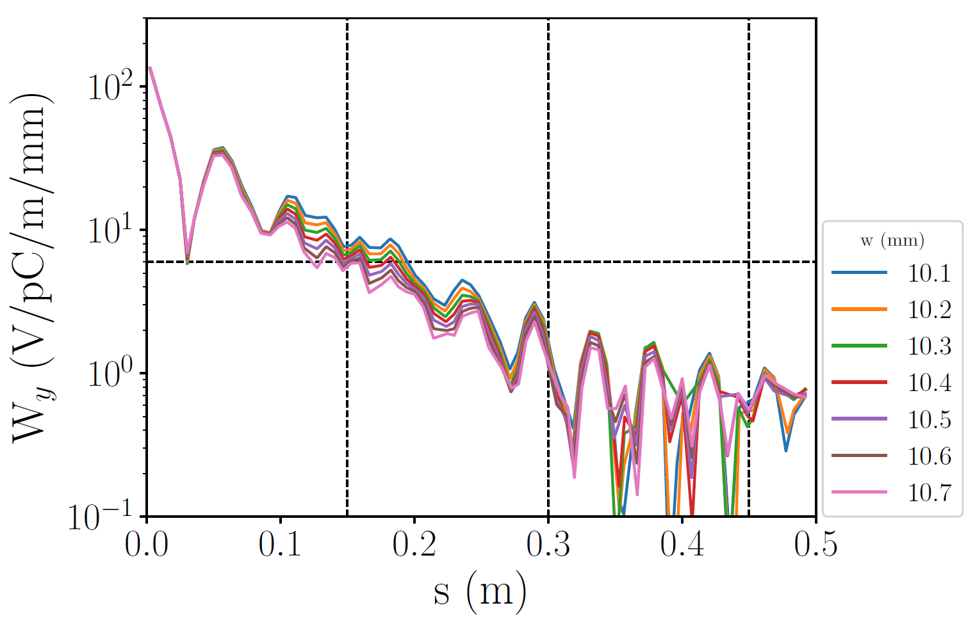
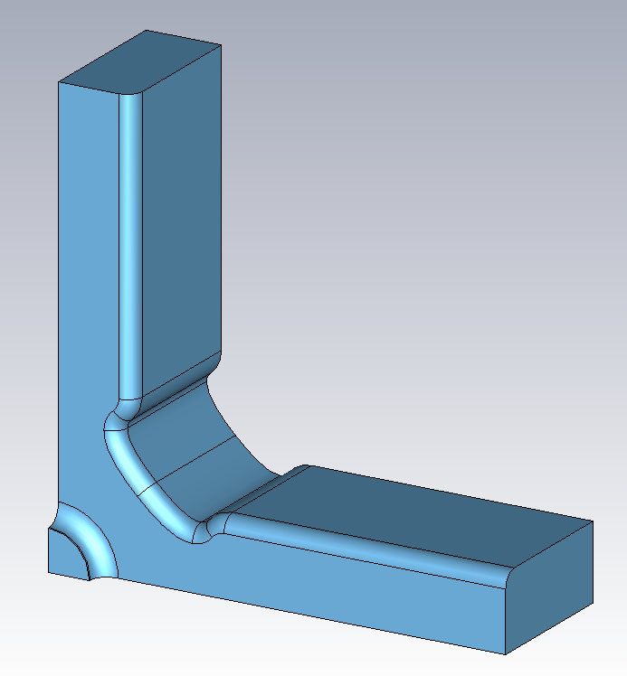
Wakefield Damping of a Distributed Coupling
LINAC for CLIC
Goal: Modify CLIC-G* structure to make a distributed coupling structure that satisfies transverse wakefield damping requirement

Slide 3
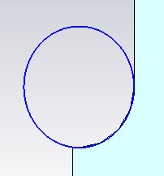
Travelling wave to standing wave cell
Adjusted cell length for π phase advance and outer radius for operating frequency
Optimize iris shape for surface fields and RF performance
4 design options:
Opt0 – non-optimized SW cell
Opt1 – optimize E_{s}/E_{a} for high gradient performance
Opt2 – optimize R for efficiency (same E_{s}/E_{a} as TW)
Opt3 – optimize S_{c}/E_{a}² for high gradient performance

Slide 4
Comparing cell designs I
 | unit | TW | SW – Opt0 | SW – Opt1 | SW – Opt2 | SW – Opt3
Iris thickness | mm | 1.333 | 1.333 | 2.6 | 2.3 | 2.35
Iris ellipticity |  | 1.153 | 1.102 | 2.400 | 1.600 | 1.179
f₀ | GHz | 11.9952 | 11.9947 | 11.9943 | 11.9943 | 11.9939
Q |  | 5,843 | 7,140 | 6,930 | 6,940 | 6,920
R/Q | Ohm/m | 16,515 | 11,219 | 10,980 | 11,208 | 11,368
R | MOhm/m | 96.49 | 80.10 | 76.09 | 77.78 | 78.67
E_{s}/E_{a} |  | 1.98 | 2.486 | 1.79 | 1.98 | 2.11
H_{s}/E_{a} | mA/V | 3.73 | 4.432 | 4.67 | 4.60 | 4.59
S_{c}/E_{a}² | mA/V | 0.33 | 0.296 | 0.34 | 0.33 | 0.33

Slide 5
Comparing cell designs II
 | unit | TW | SW – Opt0 | SW – Opt1 | SW – Opt2 | SW – Opt3 | limit
N |  | 26+2 | 18 | 18 | 18 | 18
L | mm | 230 | 225 | 225 | 225 | 225
E_{acc}^{load} avg | MV/m | 100 | 100 | 100 | 100 | 100
V_{acc} | MV | 23.0 | 22.5 | 22.5 | 22.5 | 22.5
P_{diss} | MW | 33.17 | 28.09 | 29.57 | 28.93 | 28.60
P_{b} | MW | 27.232 | 26.64 | 26.64 | 26.64 | 26.64
P₀ | MW | 60.40 | 54.73 | 56.21 | 55.57 | 55.24
τ | ns |  | 64.27 | 63.40 | 63.05 | 62.65
E_{acc}^{UL} avg | MV/m | 120.00 | 139.58 | 137.87 | 138.60 | 138.98
t_{fill} | ns | 62.60 | 80.99 | 81.92 | 80.61 | 79.65
t_{p} | ns | 218.60 | 236.99 | 237.92 | 236.61 | 235.65
total RF-beam efficiency | % | 27.80 | 32.04 | 31.08 | 31.61 | 31.93
E_{a} in middle cell | MV/m | 105 | 100 | 100 | 100 | 100
E_{s} | MV/m | 232 | 248.60 | 179.00 | 198.00 | 211.00 | 240
H_{s} | MA/m | 0.39 | 0.44 | 0.47 | 0.46 | 0.46
ΔT - pessimistic | K | 49.70 | 42.06 | 46.79 | 45.27 | 44.98 | 40
S_{c} scaled to 200 ns | MW/mm² | 5.67 | 3.13 | 3.60 | 3.49 | 3.49 | 4

Slide 6
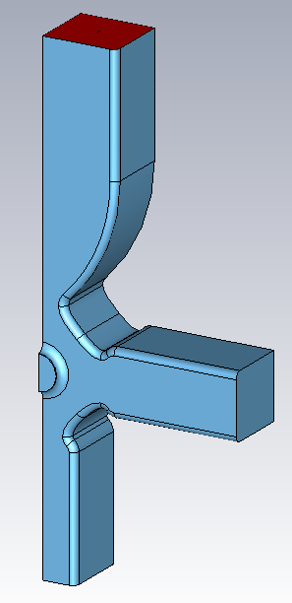
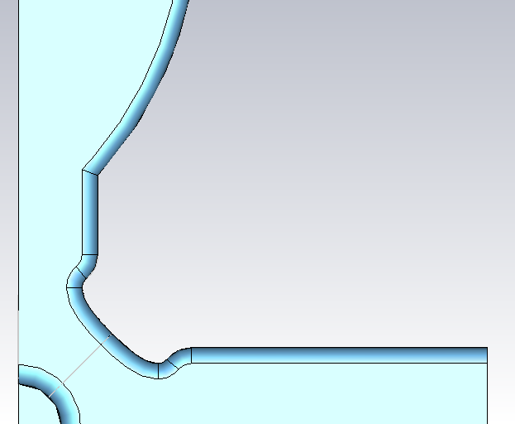
Structures whose wakes were evaluated
No power input
Power input reduces damping
Asymmetric cell
Provides damping and input power
Alternating input couplers mitigates kicks due to asymmetry

Slide 7
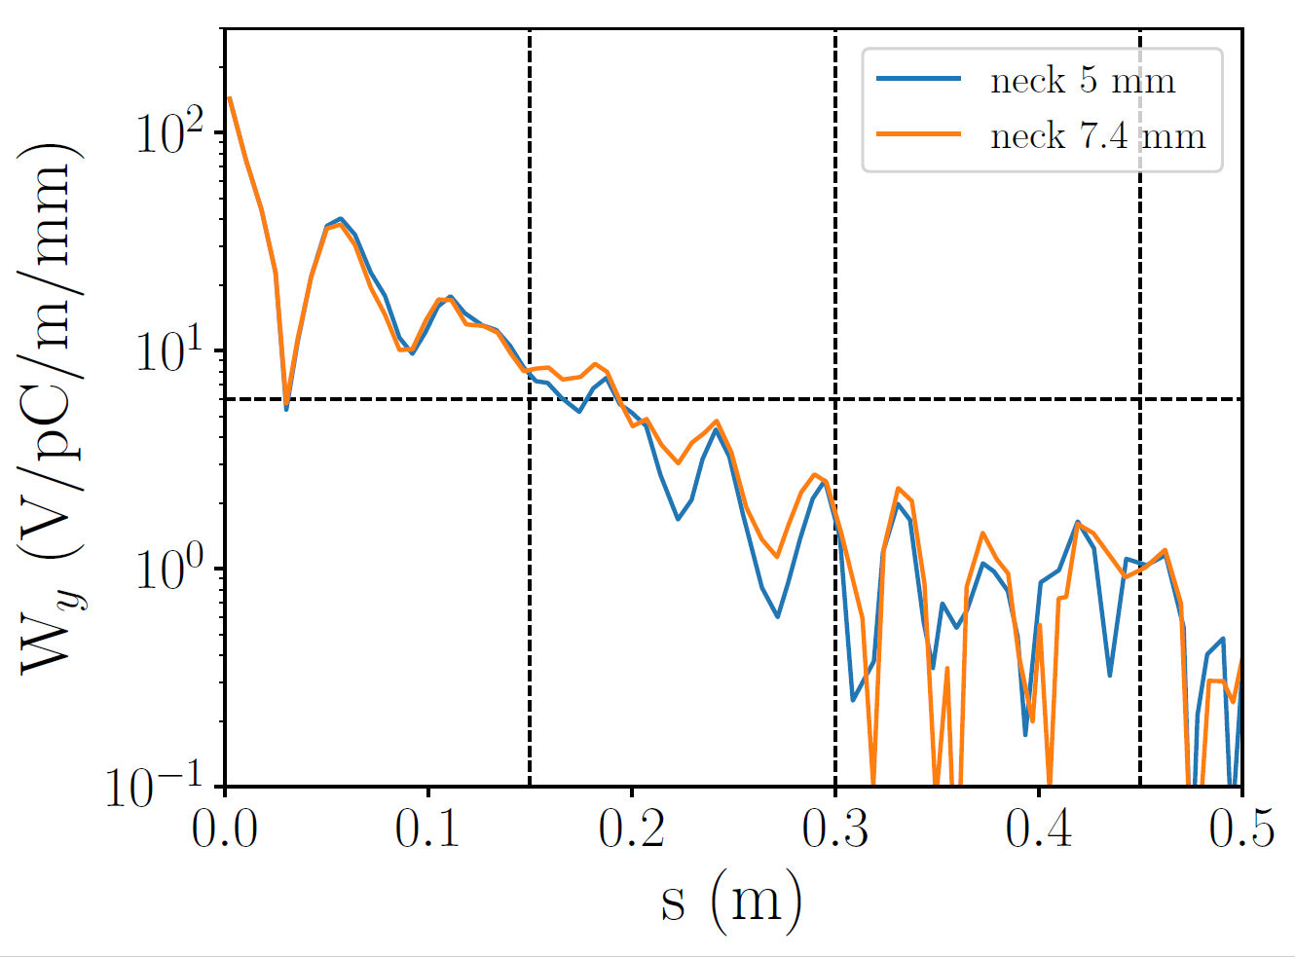
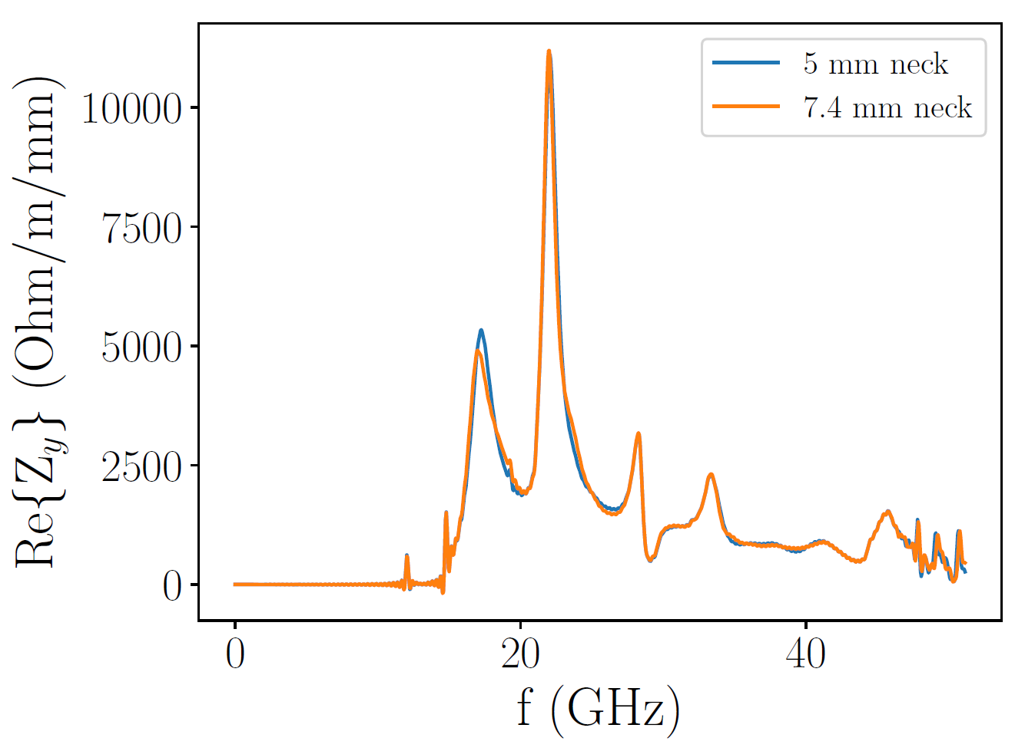
Wakefields of distributed coupling structure
Insufficient damping at 2nd bunch position (0.15 m)
Impedance peaks at 17, 22 GHz

Slide 8
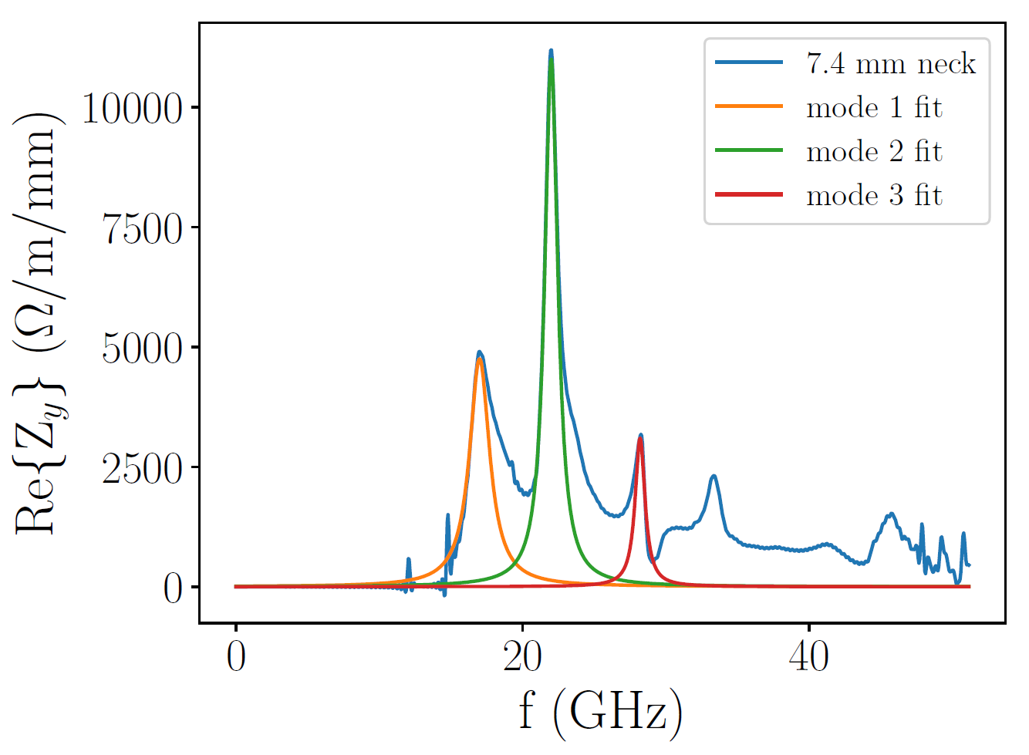
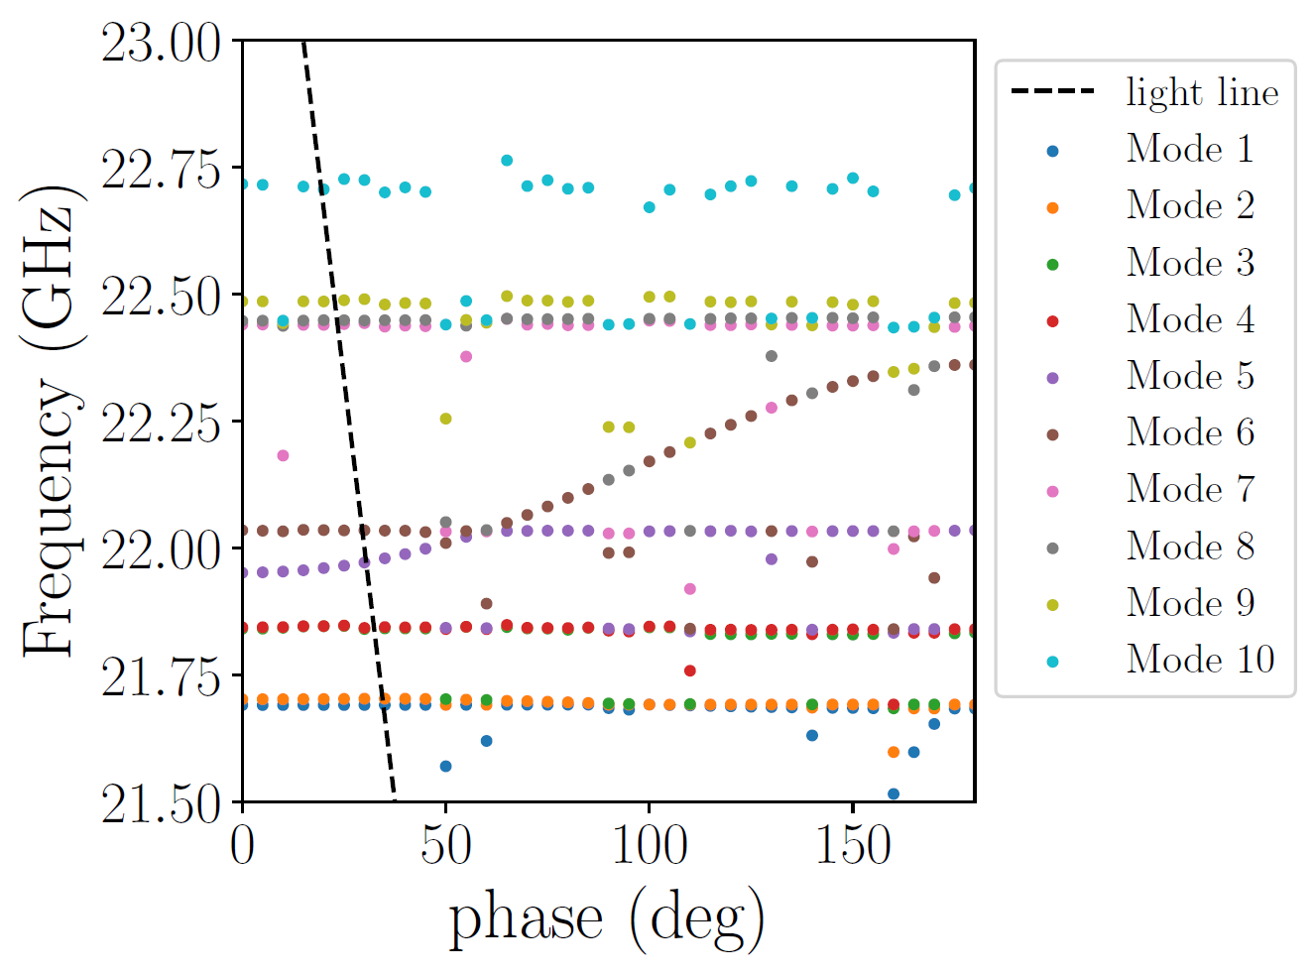
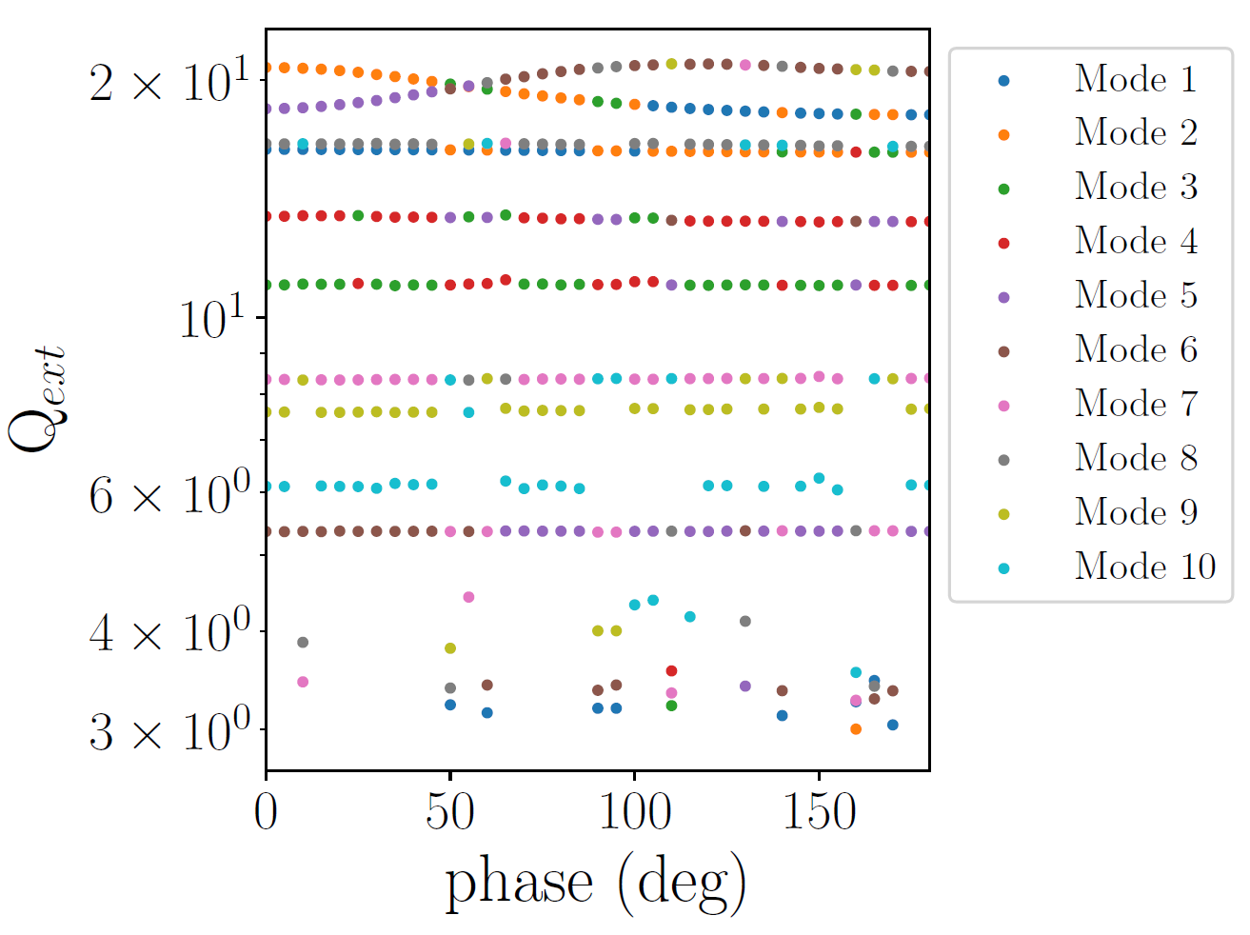
Impedance fitting
 | Mode 1 | Mode 2 | Mode 3
f (GHz) | 17 | 22 | 28.2
Q_ext | 10 | 20 | 34
Z = R/2 | 9,500 | 22,000 | 6,200

Slide 9
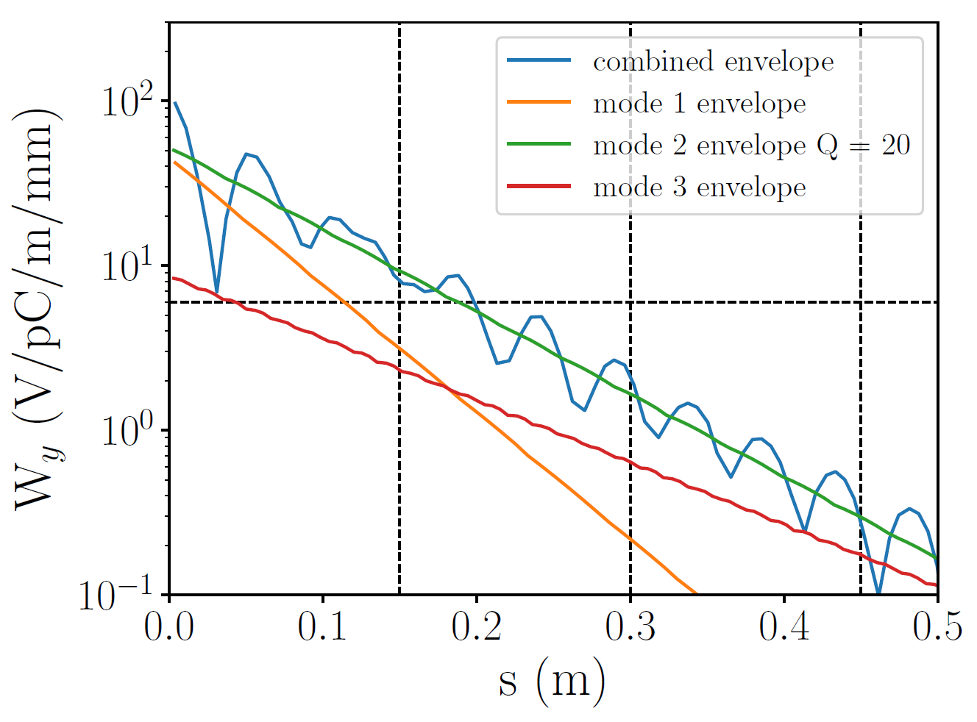
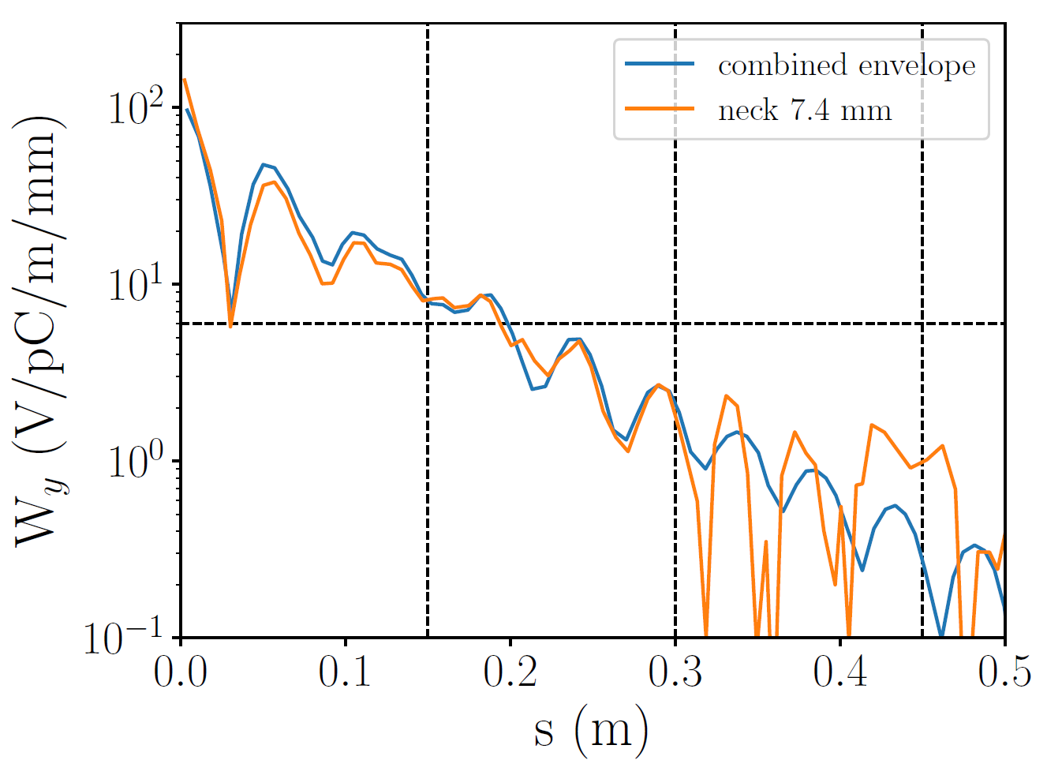
Which mode contributes most to the wakepotential at the 2nd bunch position?
Mode 2 (22 GHz) dominates wakepotential at position of 2nd bunch

Slide 10
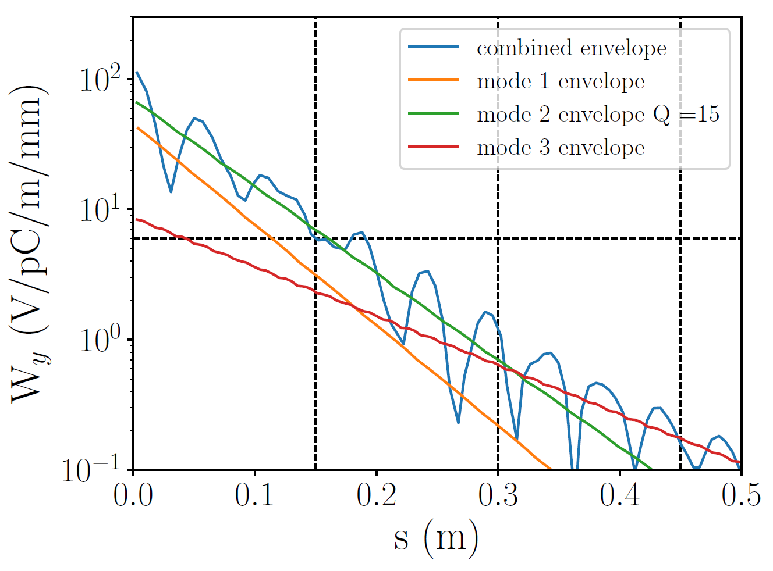
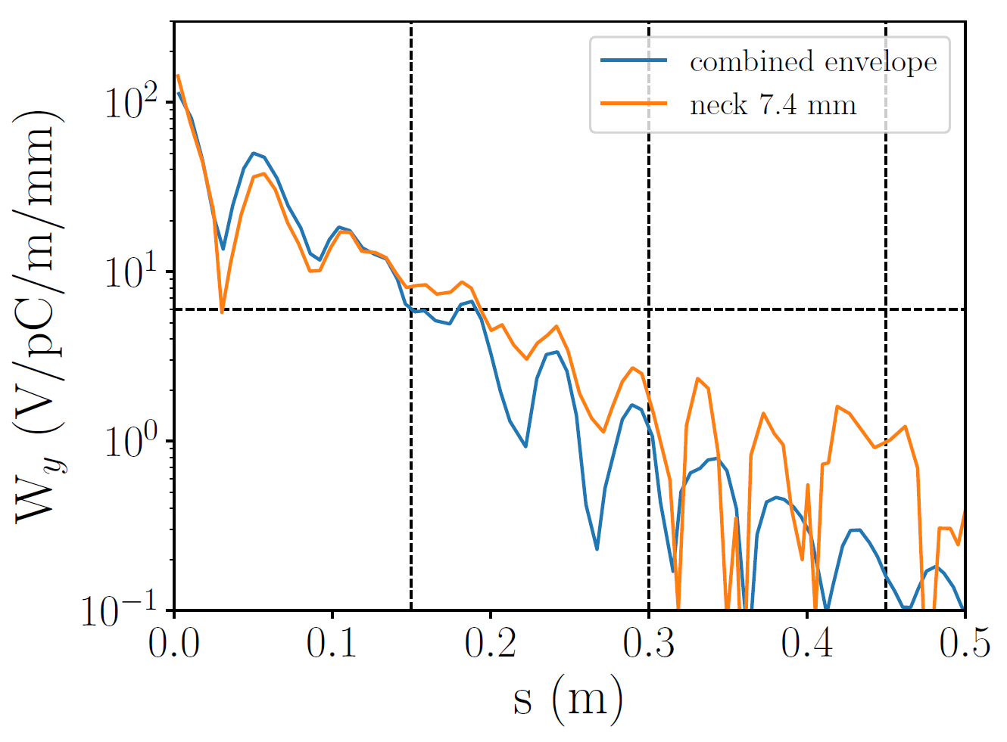
Reducing Q of mode 2 to 15
w
Change HOM waveguide-to-cell aperture or waveguide width to reduce Q
Modifying waveguide width keeps cell symmetric in vicinity of beam

Slide 11
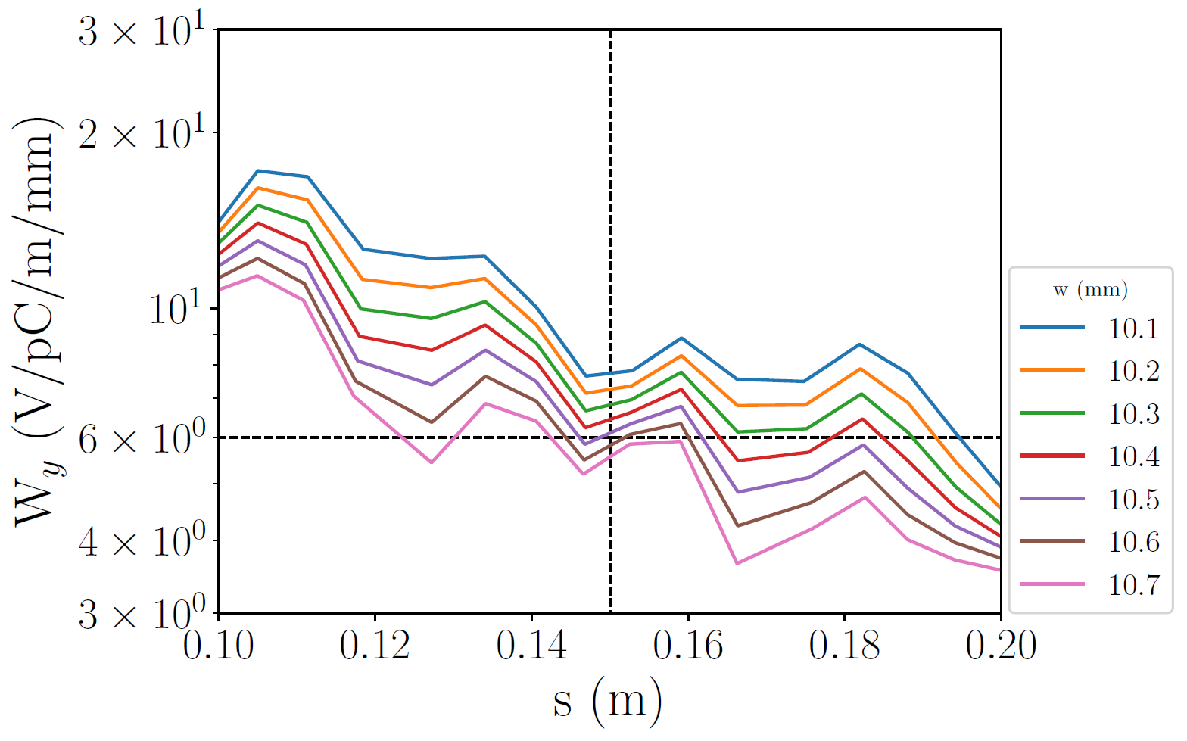
Varying waveguide width to increase damping

