Slide 1
GALI: a gamma-ray burst localizing instrument
Shlomit Tarem, September 2021

Slide 2
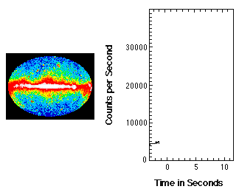
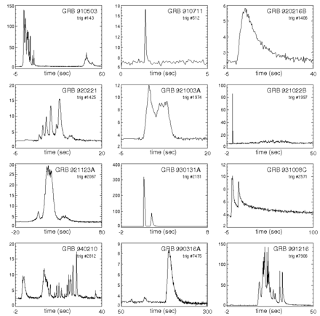
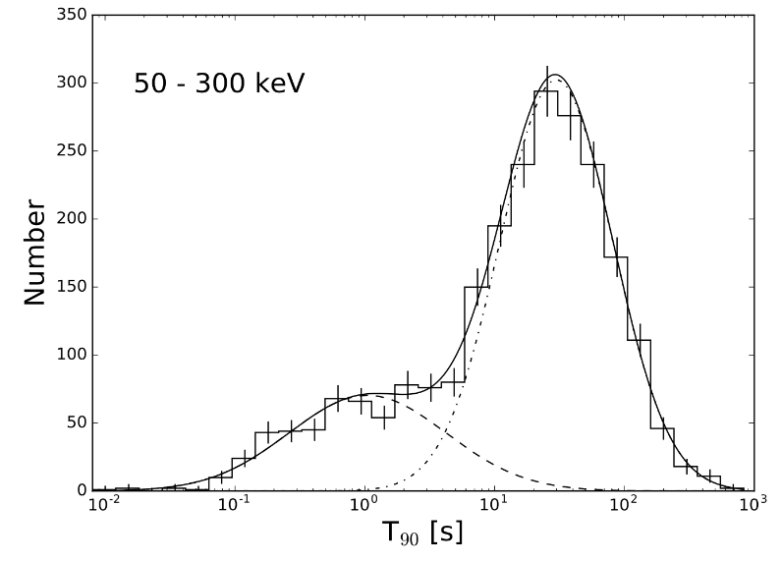
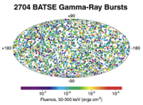
Introduction
γ-ray burst (GRB) are cosmic explosions detected as a short rise above the γ-ray background
Most of the GRB flux is emitted between 1 keV – 1 MeV (photons)
Flux decreasing with energy;
GRB dominates background
above 50 keV
GRB temporal behavior is arbitrary, they last from 0.1 s – 100 s
with two peaks around
0.3 s and 30 s
GRBs occur unexpectedly, anywhere in the sky, a few times a day
GBM T90

Slide 3

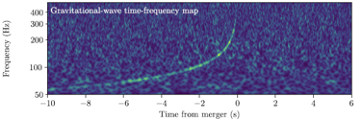
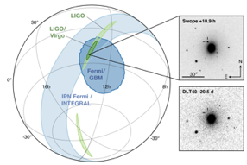
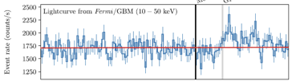
Top Level Science Mission Motivation and Goals
Motivation to detect GRBs associated with gravitational wave (GW) events
Neutron star mergers are allegedly the sources of short GRBs and also produce GWs
One such event detected to date GW170817
LIGO/
VIRGO
t= 0
Fermi/
GBM
t= 2s
Visible
identification
t= 11hr

Slide 4
Top Level Science Mission Motivation and Goals
Top Level goal – TO BE ON TARGET – FASTER and MORE ACCURATE
GW170817 had favorable conditions
  Three LIGO/VIRGO detectors were operating
  It was in a VIRGO blind spot => 30 sq. deg. (and VIRGO was just commissioned)
  It was only 40 Mpc away (LIGO/VIRGO design sensitivity is out to 200 Mpc)
The GRB detection by Fermi/GBM had a 1000 sq. deg. uncertainty
Host galaxy identified only ~11 hours later
GRBs and their X-ray afterglows decay within seconds/minutes
Two astronomical methods for seeking EM counterparts
  Survey galaxies within LIGO/VIRGO uncertainty region (both angle and distance)
  Use wide field imagers to capture that region
Former becomes prohibitive as LIGO/VIRGO sensitivity increases for distant events
Conclusion: Need sensitive, wide-field detector with good angular resolution

Slide 5
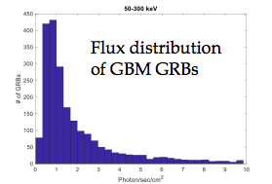
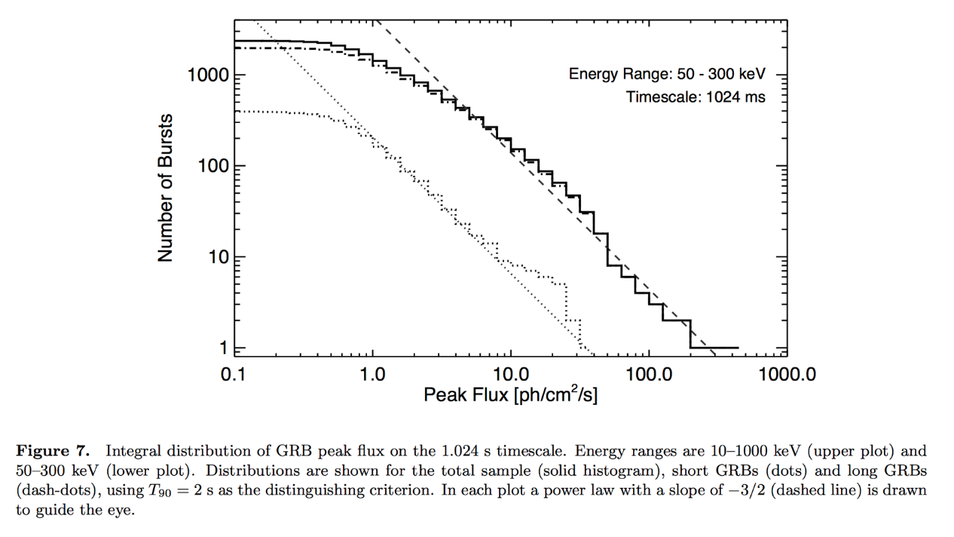
Overview of Science Requirements
Detect as many GRBs as possible,
at least 50/yr
  Wide field instrument, at least half of the sky
  Sensitivity to weak GRBs, reaching peak flux of 1 ph s⁻¹ cm⁻²
Accurately detect direction of GRB
  GALI’s Claim-to-fame
  Goal is to allow standard, ground based telescopes to follow up
  3°x3° FoV of small robotic telescopes
  Reference:
    Fermi/GBM detects 236 GRBs/yr,
    ~ 100 above 1 ph s⁻¹cm⁻²
    ISS/CALET(FoV ~ π str) detects ~43/yr
    (60% duty cycle because SAA)
Notes:
GBM: https://arxiv.org/pdf/2002.11460.pdf
Only 50-300 keV shown
Number scales with flux ^ -5/2
CALET: https://inspirehep.net/files/5c8f967f5e59ad828c33fc6aeea206ff
Two 6.6 cm (dia.) x 12.7 cm cylinders (< 100 cm²)

Slide 6
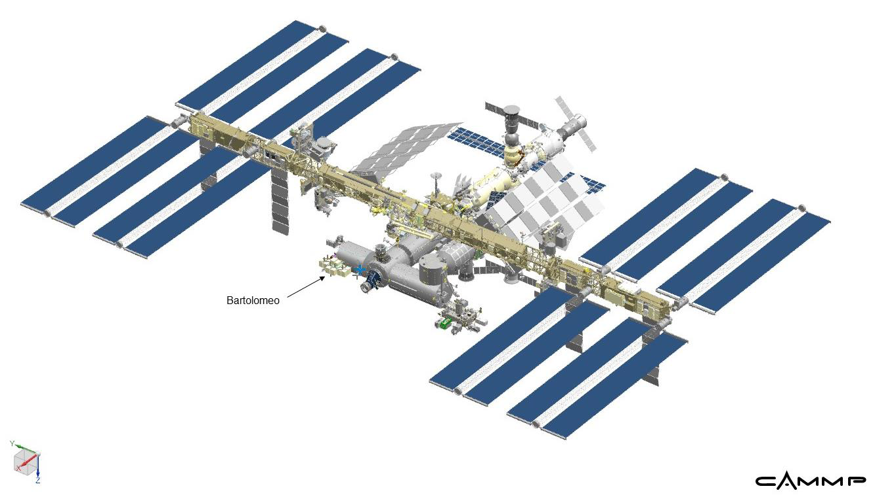
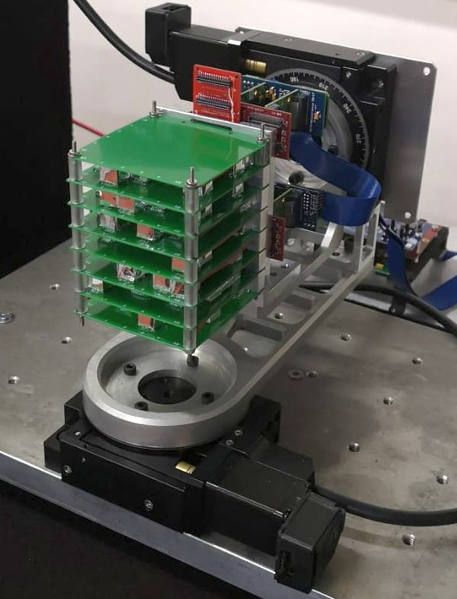
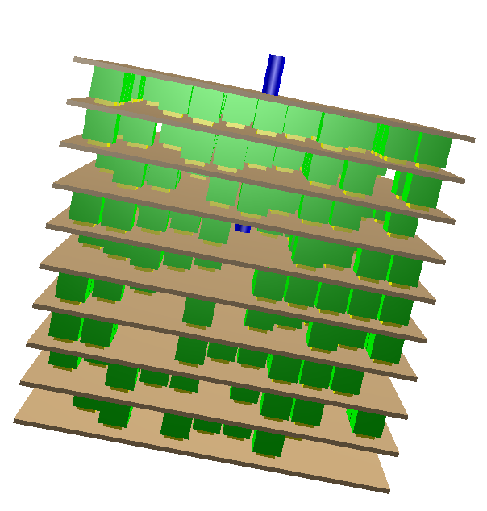
Scientific Mission Overview
GALI is a GRB detector to be mounted on the ISS
Detection based on scintillators
  Low level product is a list of photons with t, E
  (for each scintillator)
GALI’s novelty is the use of an array of small scintillators, obtaining directionality through mutual occultation
Onboard computer will take raw data and
  Identify a GRB above background
  Identify its direction in the sky
Report GRB alert to the ground
Lab prototype
Design

Slide 7
Back Story of GALI
In 2012 my colleague Ehud Behar was invited to join the ISS-TAO proposal by a team of Goddard scientists and build a small Gamma-ray trigger instrument to complement the lobster x-ray telescope.
Prof. Behar has no background in instrumentation – hence suggested I join him
The instrument was to be inspired by Fermi’s GRB but smaller and cheaper
We started thinking about finding the GRBs direction and how to arrange scintillators to do it
In the end – ISS-TAO was not funded by NASA and we continued a research project to optimize configurations for direction finding

Slide 8
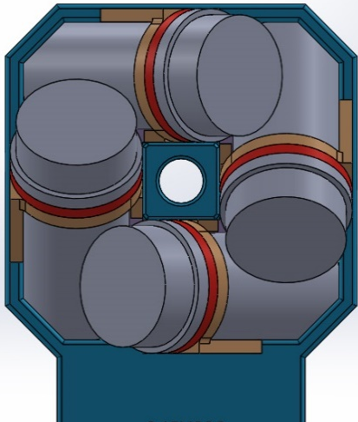
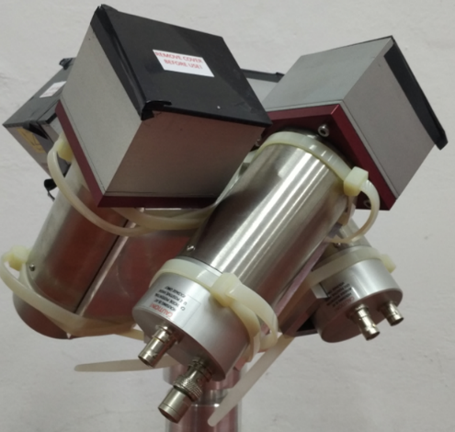
The starting point
Fermi has 12 NaI scintillators of 12.7 cm diameter 1.27 cm depth distributed in different directions over the large volume of the satellite. It has additional BGO scintillators for higher energies.
  Fermi cost a total of $690M, no idea how much of it is the GBM
  but each scintillator cost 100s of $K
Our design for GTM looked like this:
  NaI scintillators have 3” diameter and are 1” thick
The direction is found by comparing shares of photons between
scintillators
We had a lab model that looked like this:
  I will compare it’s performance to GALI later
NaI must be encased in vaccum - hygroscopic

Slide 9
Introducing GALI
Instead of a small number of large scintillators, GALI is a compact arrangement of many small scintillator cubes in a 3 dimensional array
Each scintillator is a 9 mm cube of ScI(Tl)
The cubes obstruct the photons from each other depending strongly on the photon direction
Thus our ability to find the source direction by what combination of cubes was hit – share of photons between cubes
We learned from simulation that ~30% is a good fill factor – the current design has 362 scintillator cubes in a 12 cm cube
The current arrangement inside the 12 cm cube is more or less random, optimizing the arrangement needs further study

Slide 10
Goals and how we’ll meet them
GRB detection: 50 detections per year
Readings summed over detectors and compared to the recent background
  Simulated average sensitivity of ~0.9 ph cm⁻² s⁻¹ in the detection band (50-300 keV)
  Open sky and isotropic GRB distribution yields ~110 GRB/year, based on the Fermi GBM.
  Since the sky on the ISS is partially blocked we can expect ~70-80 GRB/year
GRB localization: 3° average error for 10 ph cm⁻² s⁻¹ total GRB flux
A compact configuration of many detectors causes angle dependent mutual obstruction between detectors
  Each scintillator is a 9 mm cube
  Simulations show configuration with 362 detectors reach average accuracy
  of <5° for a flux of 5 ph cm-2 s-1 in the 10-1000 keV energy band
  The configuration is made possible by using Silicon Photomultipliers (SiPM)
  coupled to scintillator crystals.
Trigger warning - instant message / Spectrum and light-curve as products

Slide 11
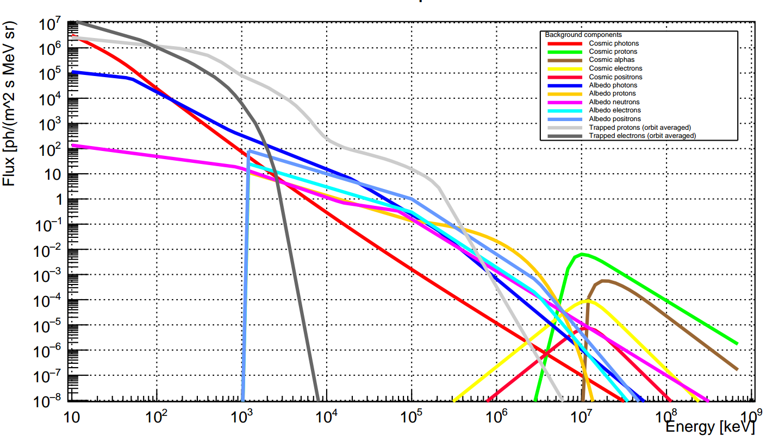
Simulation
Simulations performed using MEGAlib software (based on ROOT and Geant4).
5M gamma ray background events simulated – estimate
expected number of per second on each scintillator
Simulate bursts of 1000 ph cm⁻² from different directions
on the hemisphere, in 5 degree intervals – build sky map
The spectrum is that of a typical GRB (but large variations exist)
Direction estimation is done by comparing the photon shares (between detectors) of a burst to the high statistics sky map – cstat statistic
We simulated multiple detector configurations
The average accuracy of each configuration is only slightly affected by the scintillator placement (~5%).

Slide 12
Comparison to GTM - simulation
A comparison between the simulation-generated GRB direction reconstructed by different detector configurations.
Each dot represents a 1 second burst of 10 ph cm⁻² s⁻¹ at lower earth orbit.
Dots are grouped by color according to the actual burst direction, which is represented by a mark.
Top: GTM
Middle: 90 scintillators GALI
Bottom: 350 scintillators GALI

Slide 13
Comparison to GTM – measurements on prototypes
A comparison between laboratory tests of the GTM (Top) and a 90-scintillator GALI (Bottom).
The reconstructed direction of repeated 0.5 s bursts are plotted where each dot represents a burst.
Dots are grouped by color according to the actual
source direction, which is represented by a x mark.
Confirming the simulations, the superior localization
accuracy of GALI is clear.
Lab prototypes

Slide 14
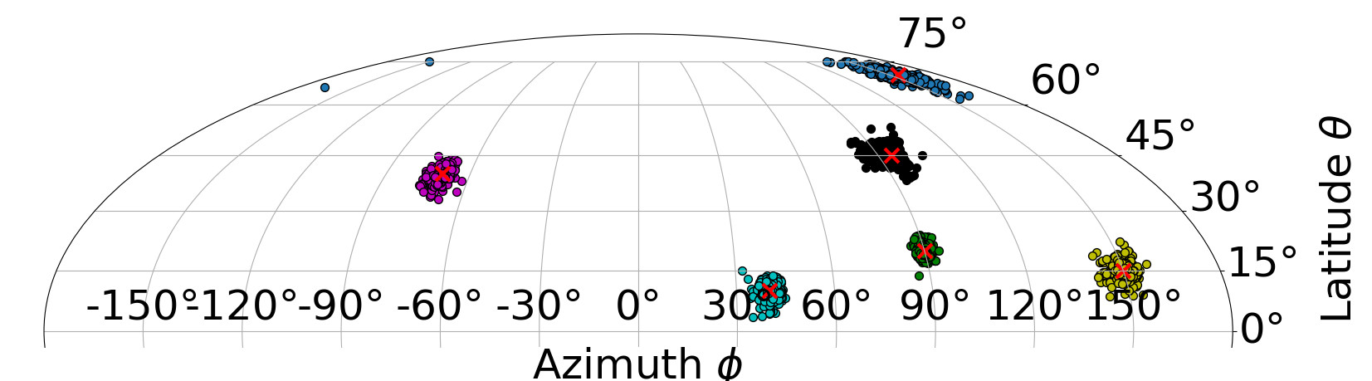
Simulation of Final Version
Flux of 10 ph cm⁻² s⁻¹ 10-1000 keV ( 1 second duration)
Expected average error 4.68° for 5 ph/cm². 50% of the bursts are expected to have an average error between 2.2° and 6.0°

Slide 15
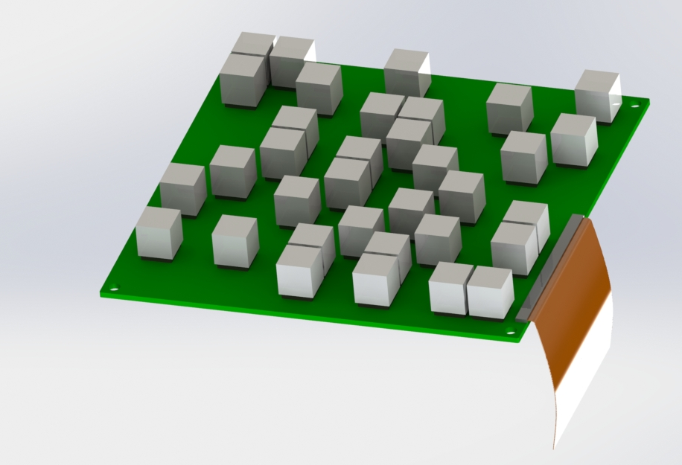
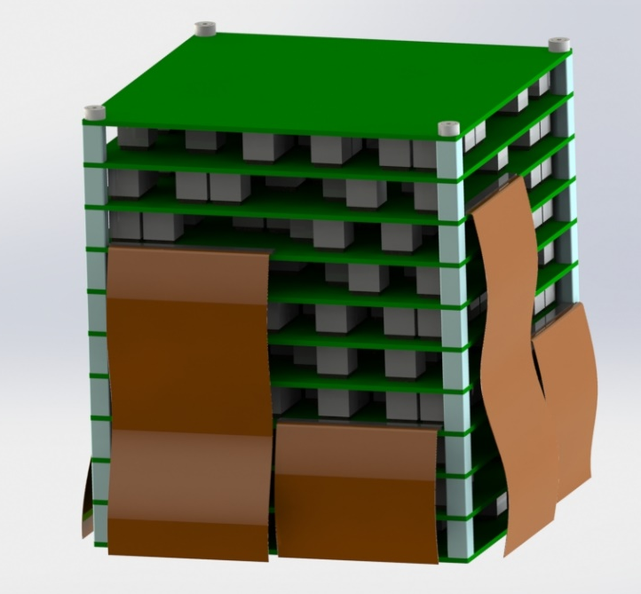
GALI Instrument Design
  One PCB with 2D Array of up to 46 sensors
    Material: Arlon85NT: Polyimide reinforced with non-woven aramid substrate.
Each PCB is a rigid-flex combination PCB: The flexible part is standard polyimide.
Scintillators + silicon PM
  Staggered 3D array of ~400 sensor
    9 stacked PCB’s
    Each interfaced via a flat cable
126 x 126 mm
125 mm

Slide 16
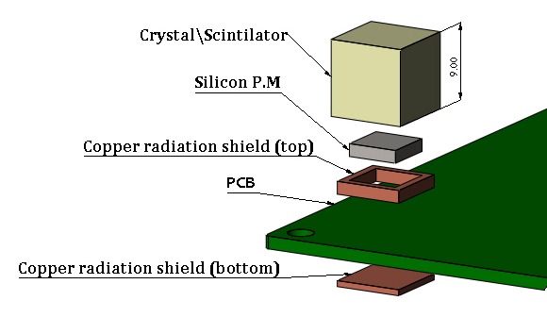
GALI Instrument Design - details
Detection Sub-System
Single sensor
  Crystal scintillator covered with reflective material
  Silicone photomultiplier
  Copper radiation shield (top)
  PCB- Arlon 85
  Copper radiation shield (bottom)
Open issues on Scintillators
  Optical glue, top flex material holders and coating

Slide 17
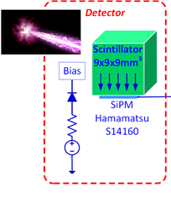
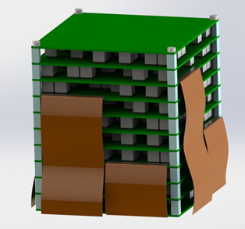
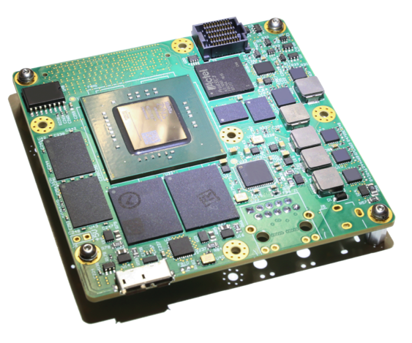
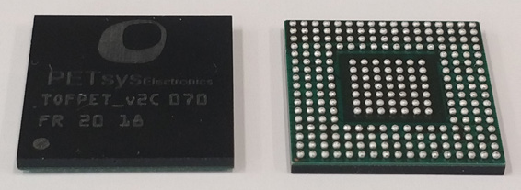
Instrument Outline / Detection Sequence
Scintillator => SiPM => Readout ASIC => FPGA => Computer
Xiphos Q8s
  SOC
  Space qualified
  Includes drivers/FPGA skeleton/coms
  Radiation protection features
  Support
Additional HW
Power supply
LED calibrators
Thermal sensors
Star tracker
Sun sensors

Slide 18
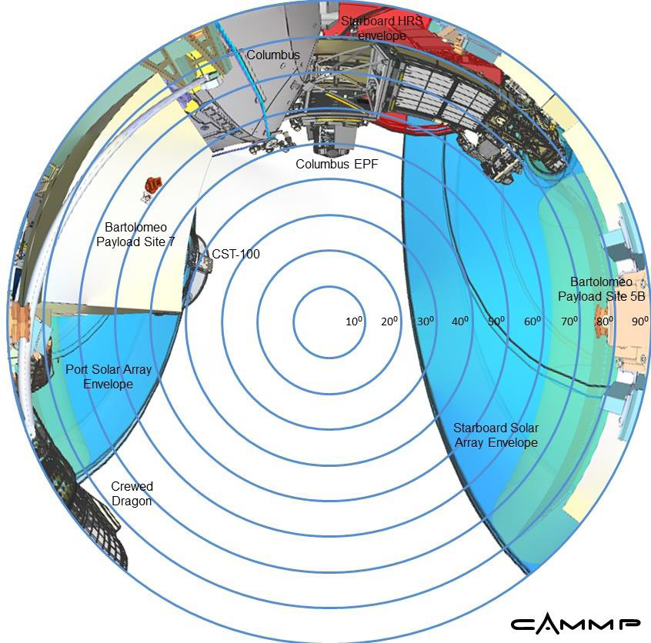
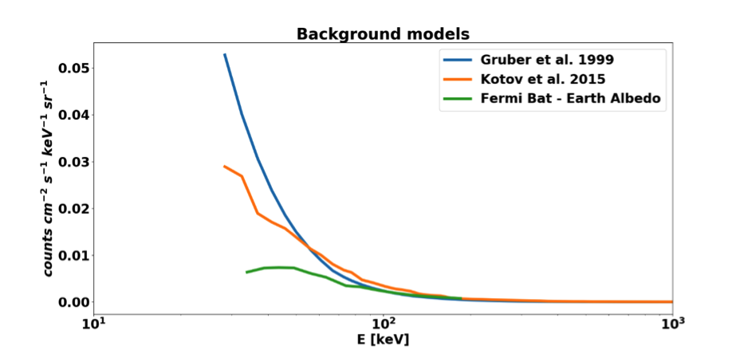
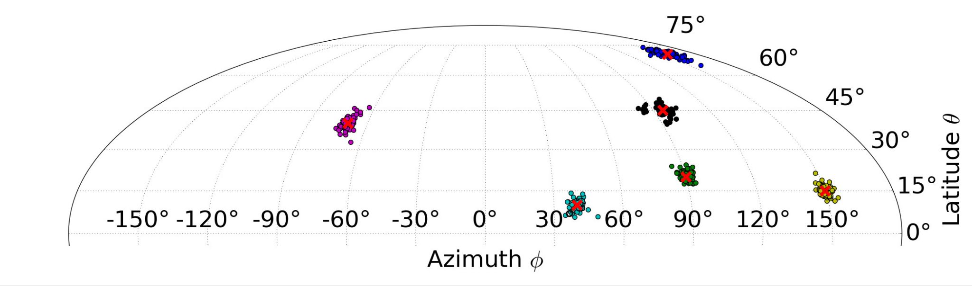
Mission Implementation of Science Goals
Detect as many GRBs as possible,
at least 50/yr
  Wide field instrument,
  at least half of the sky π str
  Sensitivity to weak GRBs,
  reaching peak flux of 1 ph s⁻¹ cm⁻²
  Grasp = A_{eff}*FoV = 300 cm² str
Accurately detect direction of GRB
  GALI’s Claim-to-fame
  Goal is to allow standard, ground based telescopes to follow up
  3°x3° FoV of small robotic telescopes
  Reference:
    Fermi/GBM detects 236 GRBs/yr,
    ~ 100 above 1 ph s⁻¹cm⁻²
    ISS/CALET(FoV ~ π str) detects ~43/yr
    (60% duty cycle because SAA)
Rough GALI features
  FoV ~ 70% of sky, or 4.4 str
  A_{eff} ~ 100 cm²
  Grasp 440 cm² str
Sensitivity (trigger band, 1s bursts)
  Sky background is ~0.5 ph s⁻¹ cm⁻²str⁻¹
  Over entire instrument 400 +/- 20 ph/s
  Sensitivity (5σ) 100 ph/s or 1 ph s⁻¹ cm⁻²
Localization (full band)
  GALI concept of mutual occultation
  Localization depends on peak flux
  Simulations show (1s bursts)
    1.7° uncertainty for 2.7 ph s⁻¹ cm⁻²
    4.5° uncertainty for 1.9 ph s⁻¹ cm⁻²
    10° uncertainty for 1.0 ph s⁻¹ cm⁻²

Slide 19


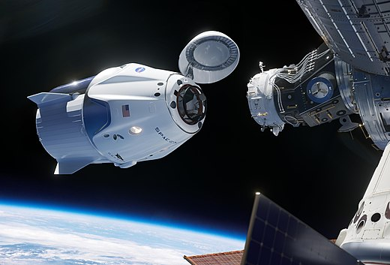

Status
GALI is a Technion developed instrument with help from our collaborators at NRCN
  Joint programs funded by ISA and by Pazy
Development boosted by NASA’s decision to discontinue ISS-TAO and our GTM
Proven laboratory prototype
Schedule expedited by selection for the Rakia mission to the ISS
  To launch in 2022 to an Airbus ISS platform

Slide 20
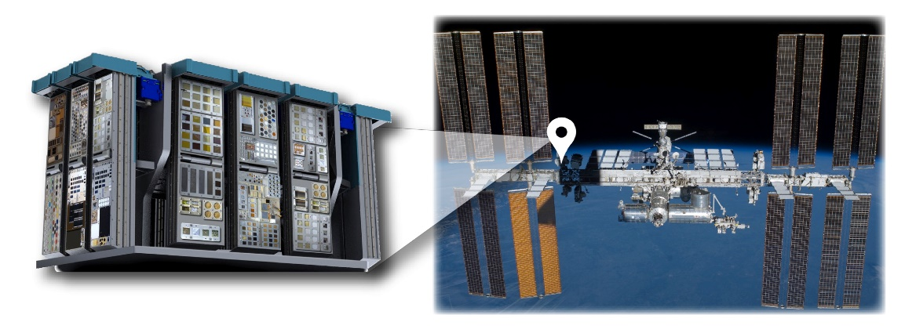
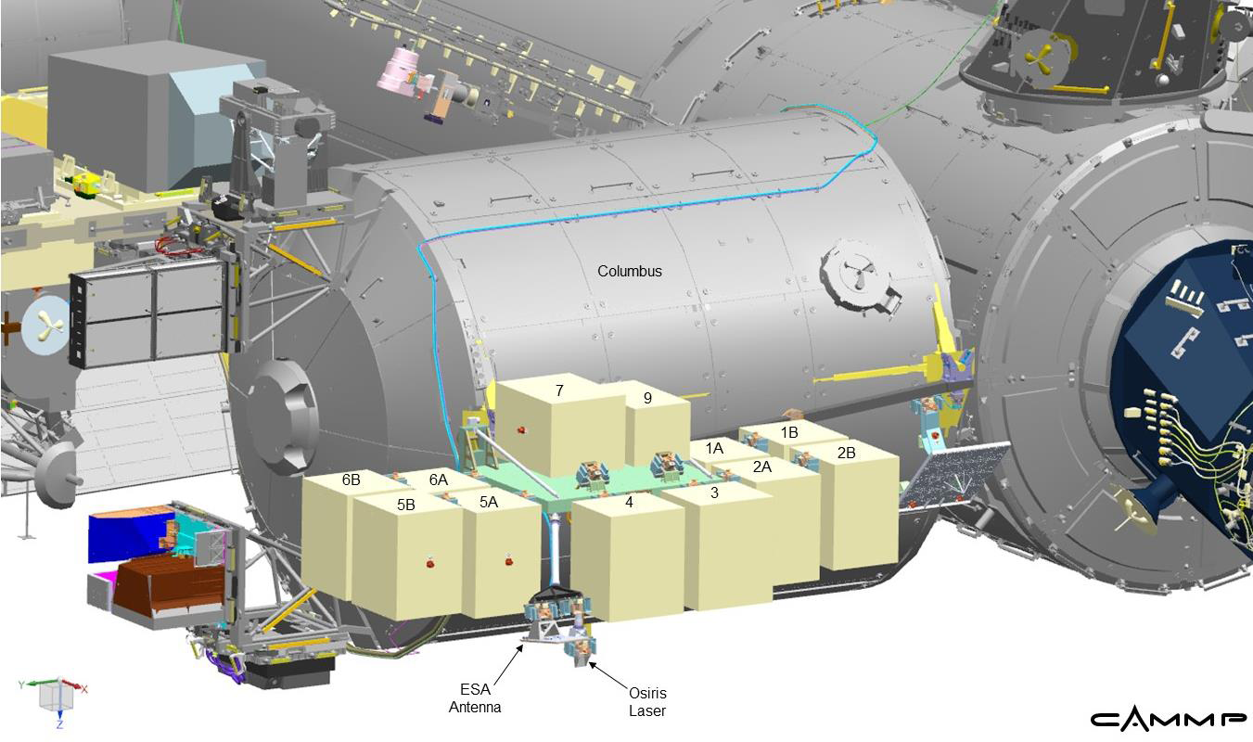
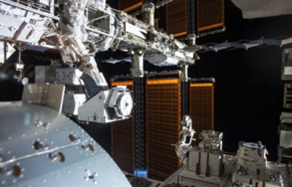
Status, ISS platform
Irrespective of Rakia, we need to find a vendor to place us outside the space station
We have been negotiating with 3 companies
AIRBUS on their Bartolomeo, current leading platform
Alpha Space on their MISSE location – limited platform
Nanoracks on their NADIR-facing external platform (NREP)

Slide 21
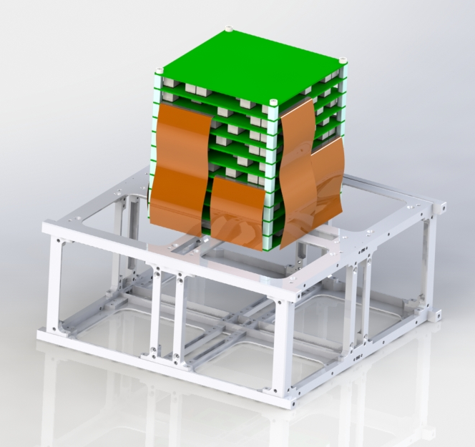
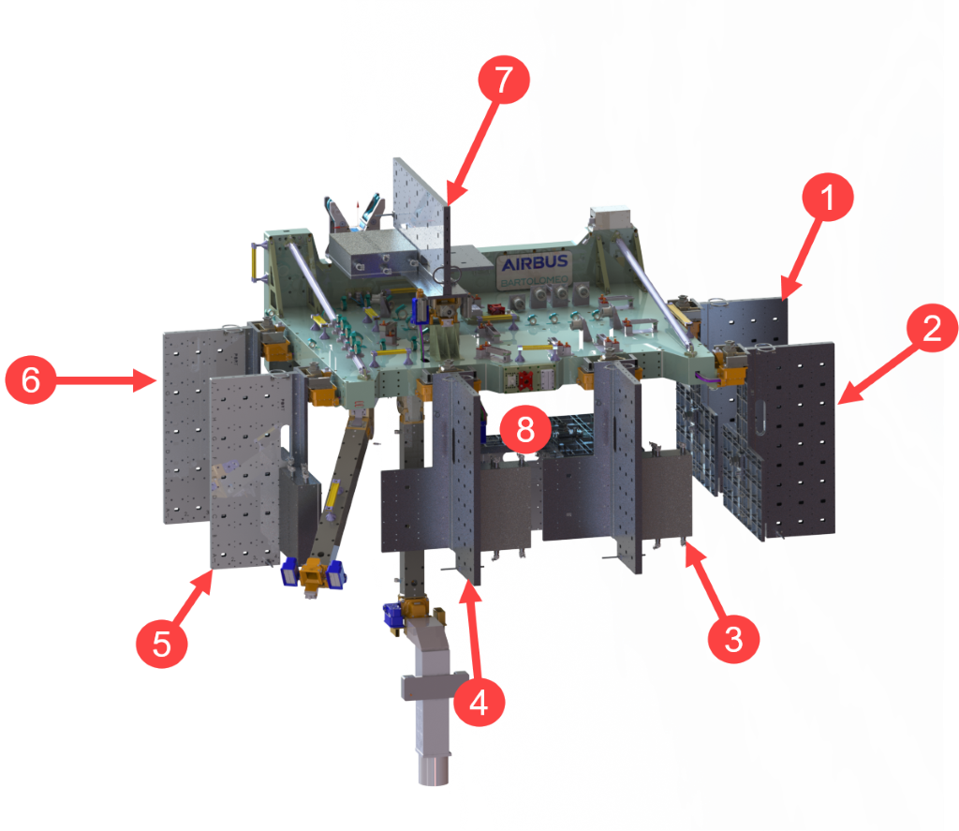
Nice Pictures

Slide 22



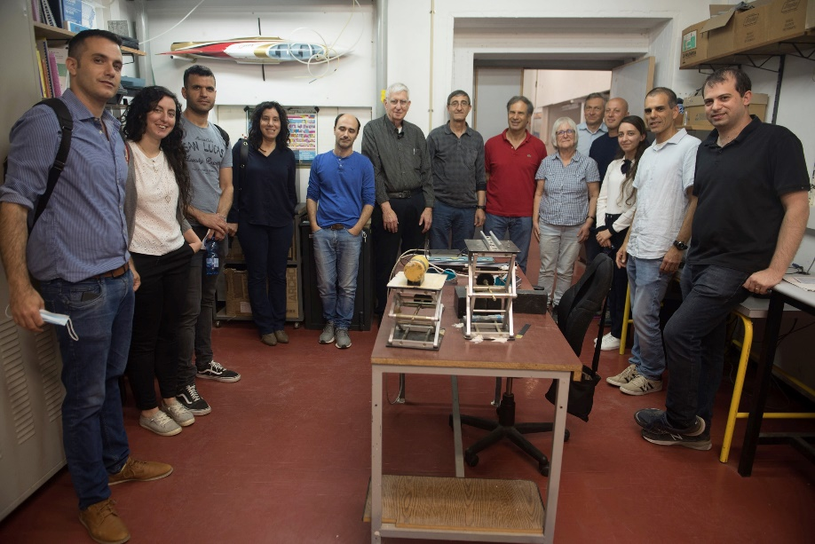
Team
Principle Investigators
  Ehud Behar, Shlomit Tarem
Detectors, simulations
  Roi Rahin
Electronics
  Lucal Moleri, Alex Vdovin,, Julia Salh
Software/firmware
  Zvi Tarem, Ifat Mehalev, Yulia Kuniavsky, Roman Parpialo
Mechanical design
  Amir Figenboim
Project students
  Solomon Margolin,
  Ori Zaberchik
Systems Engineering
  Avner Kaidar
Electronics Engineering
  Hovik Agalarian
Thermal analysis
  Yoel Arcos
Advisory team, NRCN
  Alon Osovizky, Max Ghelman, Eran Vax

