Slide 2
Yellow racks
and their components
TE-MPE Piquet 27.09.2021

Slide 3
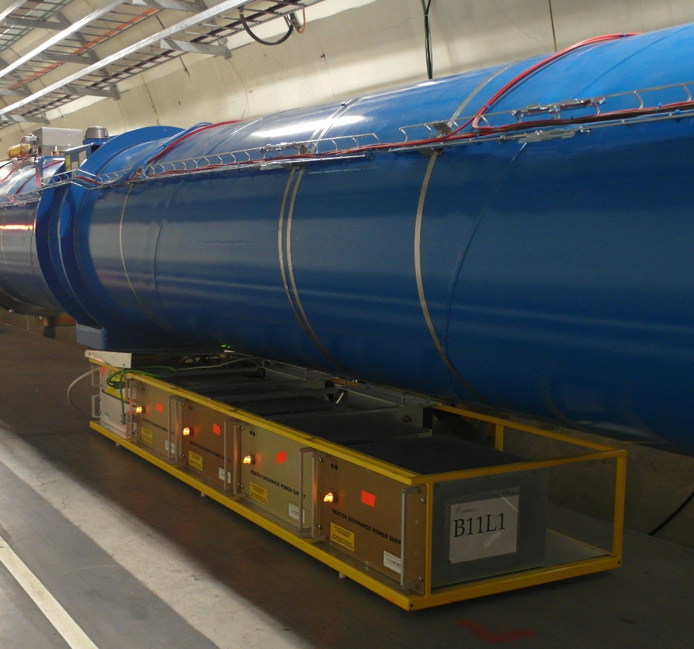
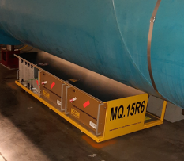
Yellow racks in LHC
DYPB - 1232
4x DQHDS
1x DQLIM001
2x DQLPR001
1x DQLPU001 (type A)
1x DQLPUS (nQPS)
2x DQLPRS
2x DQLPUSPB (supercaps module)
DYPQ - 392
2x DQHDS
1x DQLIM002
2x DQLPR002
1x DQLPU002 (type B)

Slide 4
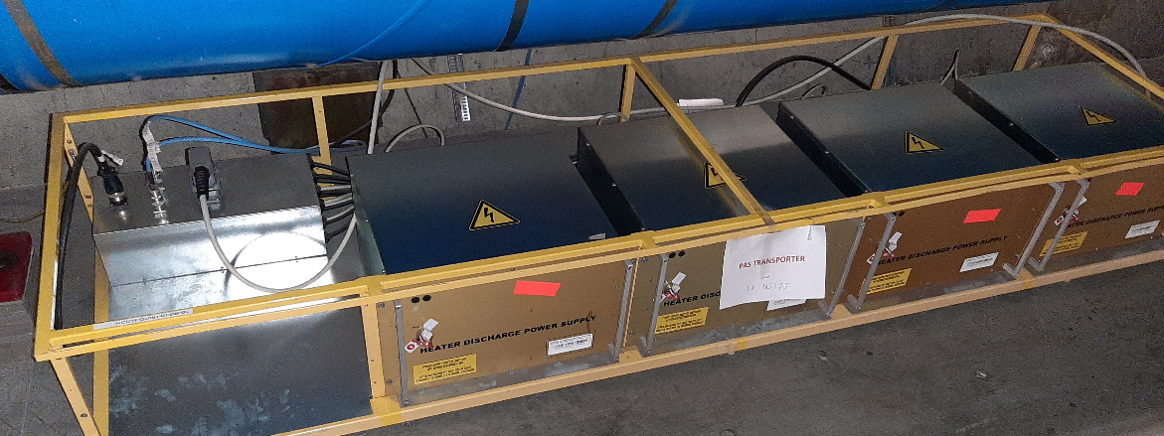
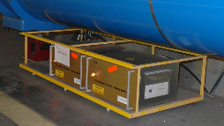
Yellow racks in LHC
DYPQL - 20
4x DQHDS
1x Connection box (Crowford box)
1x F4 UPS distribution box
DYPQS - 26
2x DQHDS
1x Connection box (Crowford box)
1x F4 UPS distribution box

Slide 5
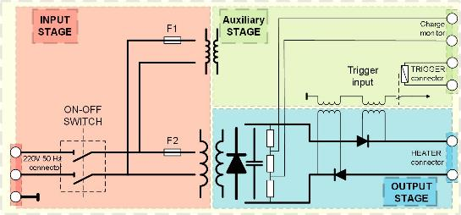
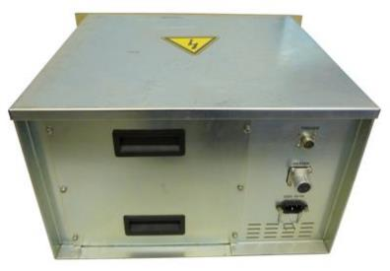
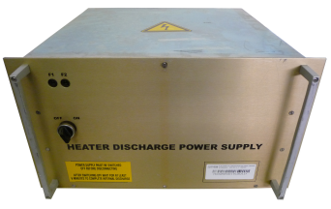
DQHDS
6068 units in LHC
https://wikis.cern.ch/display/TEE/Piquet_DQHDS_diagnose_and_replacement

Slide 6
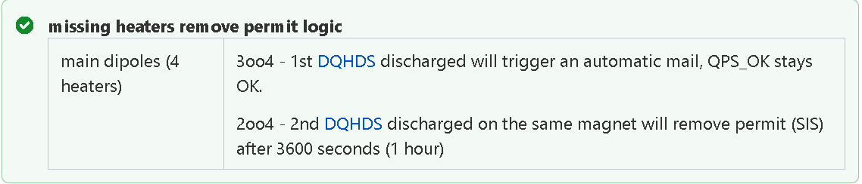

DQHDS - QPS_OK
U_HDS > 810 V
Logic:
  DYPB
  DYPQ

Slide 7
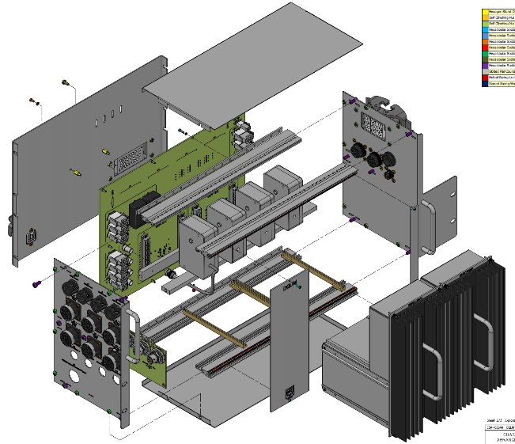
DQLIM001
Dipole

Slide 8
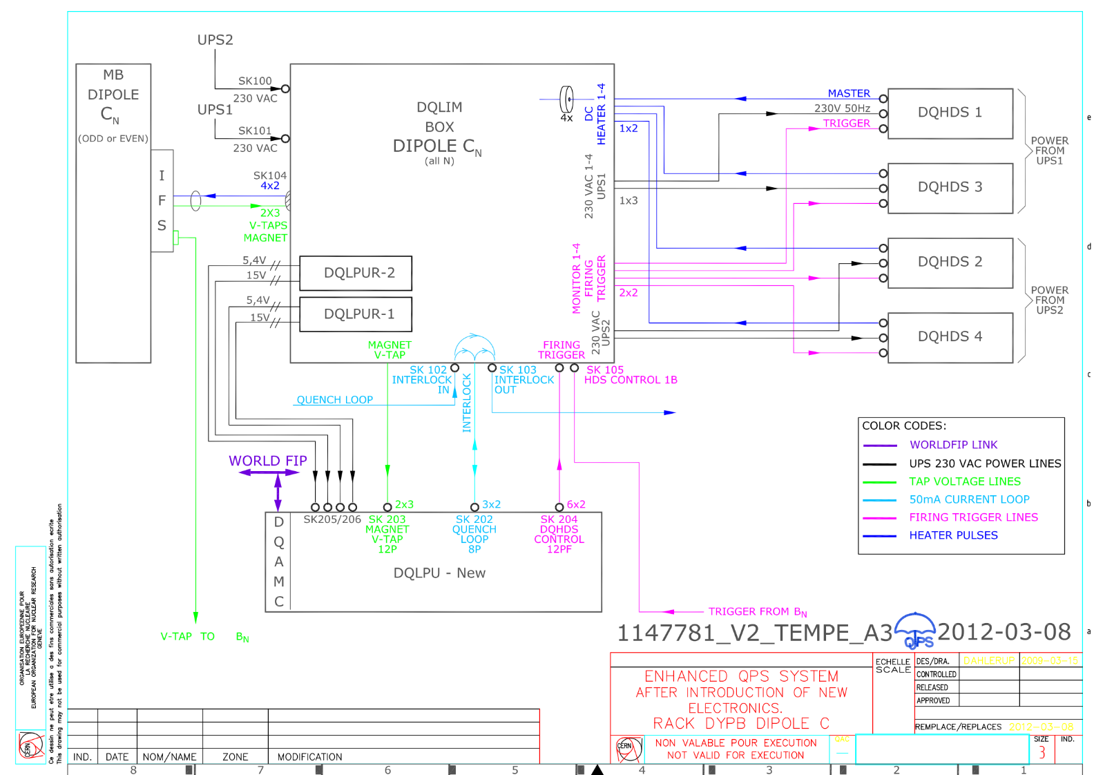
DQLIM001

Slide 9
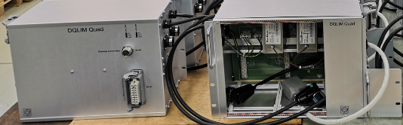
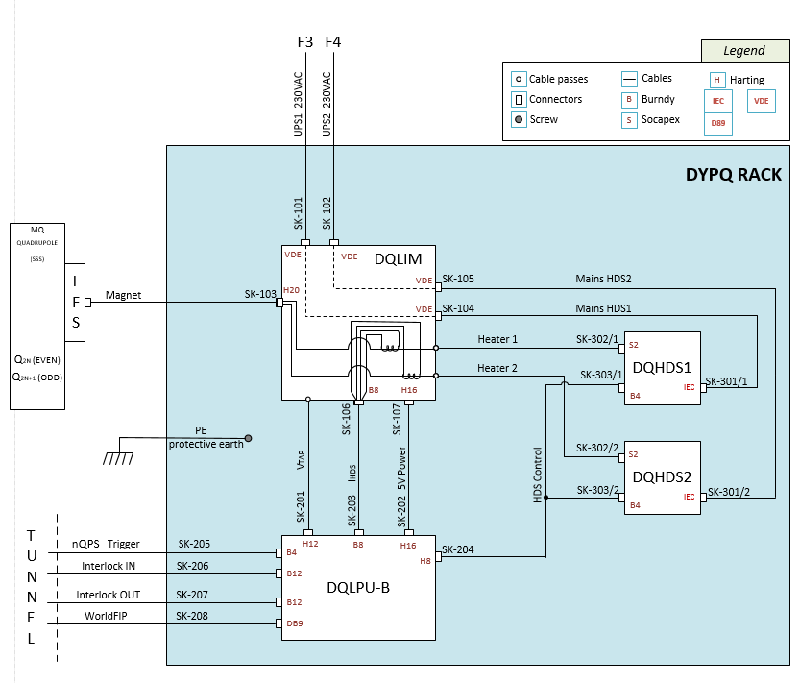
DQLIM002
Quadrupole

Slide 10
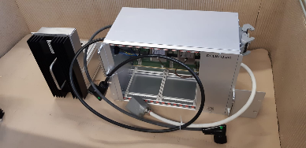
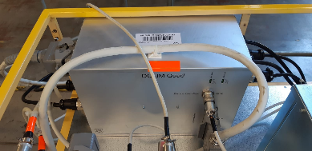
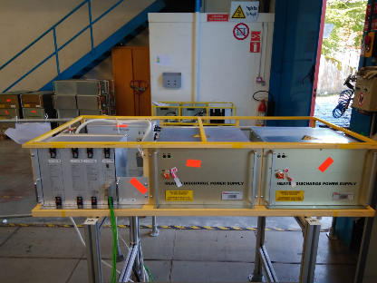
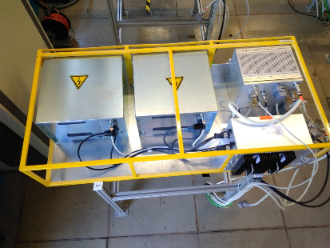
DQLIM002 inside DYPQ

Slide 11
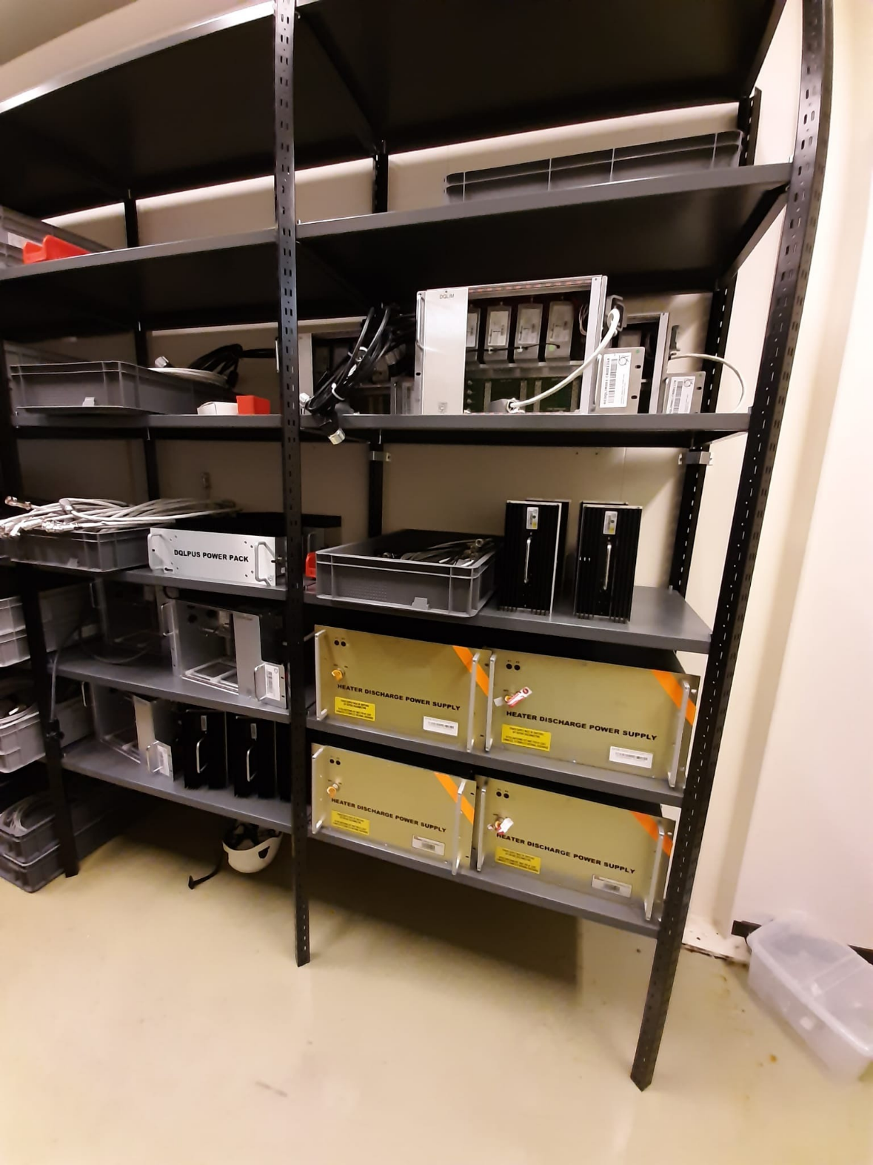
Spares components
DQHDS in LHC
Piquet room b. 112
b. 281
  DQLIM002
  DQLPR002
  DYPQ cables
b. 282
  DQHDS
  DQLIM001
  DQLPR001
  DYPB cables
  Rest of the cables
  Connection boxes (Crowford box)

Slide 12
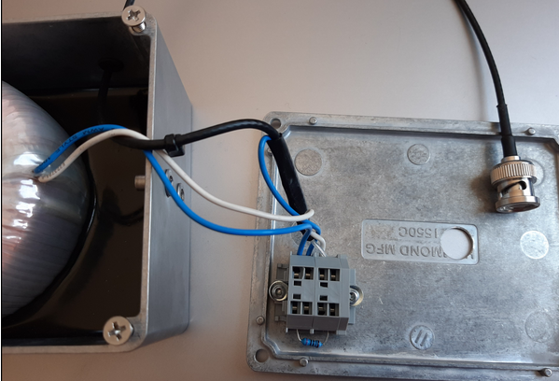
DQLCT - I_HDS – Dipole
https://wikis.cern.ch/display/TEE/Connection+problem+and+repair

Slide 13
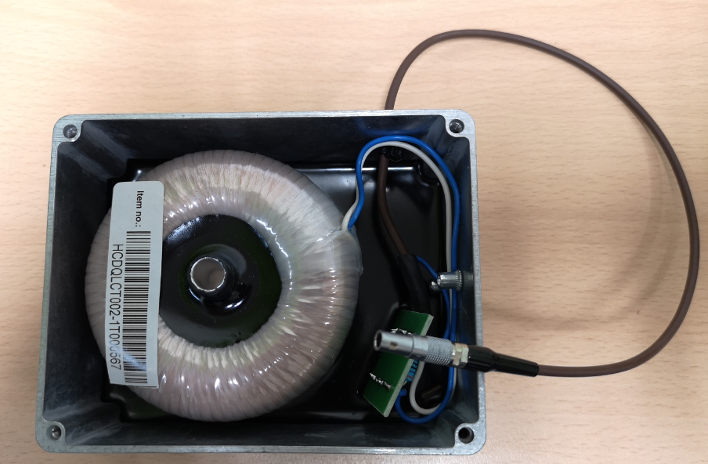
DQLCT002 - Quadrupole

