Slide 1

RFD1 Testing Overview & Observed Vacuum Leaks
Chiara Pasquino and Katarzyna Turaj
with inputs from: A. Harrison, J. Walker, J. Bastard, Ch. Duval, M. Gourragne, N. Valverde, R. Calaga, W. Parma
WP4 Coordination meeting, CERN, 5 October 2021

Slide 2
RFD1 cold test results

Slide 3
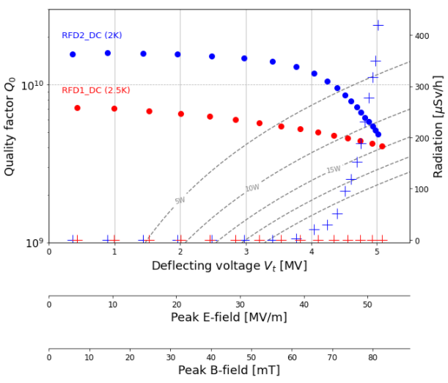
RFD1_DC cold test results
Successfully cold test up to 5MV, but only at 2.5K and with active pumping.
  No quench observed
  No radiation observed
  No heating observed
We were able to repeat the results after a short thermal cycle (~20K)

Slide 4
Observed vacuum leaks

Slide 5
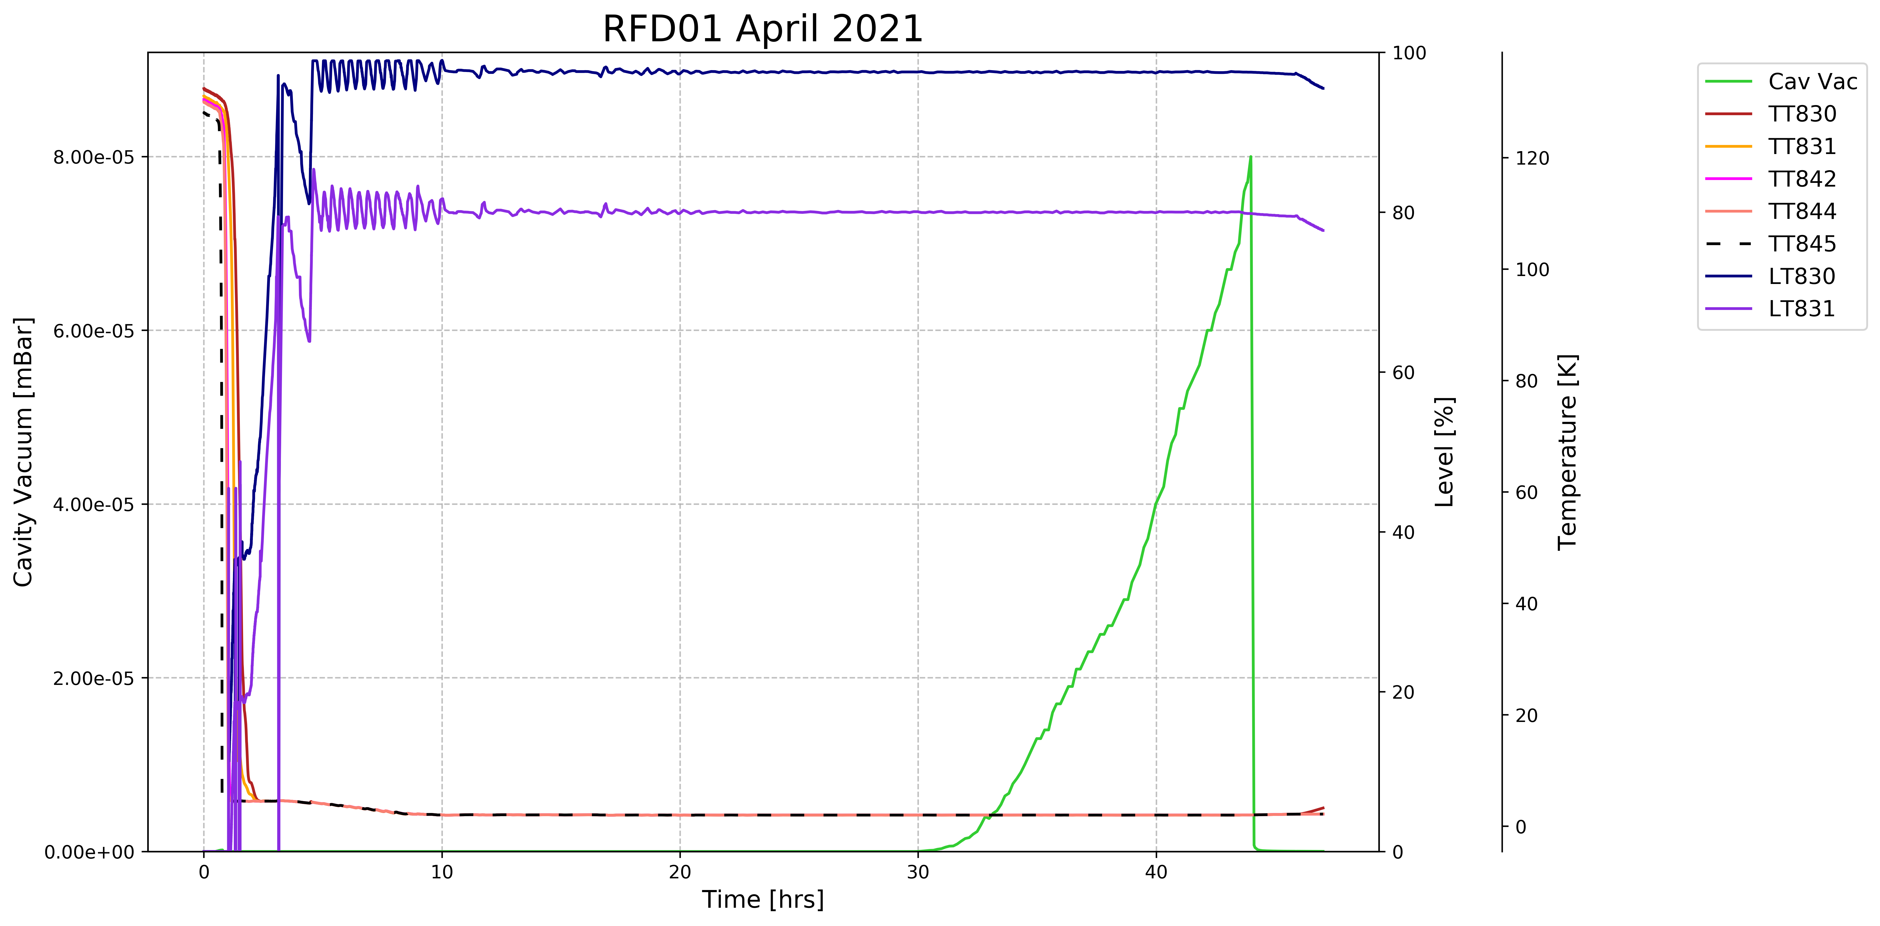
RFD1_DC: 1st leak – April 2021 (1/2)
A leak visible at 2K, after ~20hrs. The vacuum prior to it was 5e-10 mbar and the cavity was pumped by the cryopumping and isolated from the external pumping unit.
During pulse conditioning with an input power of 2 W, a sudden raised of the cavity vacuum up to 8e-5 mbar was observed.
To stop the increase of vacuum, it was decided to open the valve and pump the cavity volume with the turbo molecular pump (level reached 1e-7mbar)
CT was stopped

Slide 6
RFD1_DC: 1st leak – April 2021 (2/2)
The leak was confirmed at warm after CT (leak rate 3e-8mbar*l/s)
  A leak was found in the connection between the cavity flange and the field antenna (FA)
The cavity went back to the CR and the FA was removed and replaced by a blank flange → no leak was detected in the range of 3.2e-9 mbar.
A leak of the field antenna alone in a vacuum chamber →no leak was detected in the range of 1e-10 mbar l/s
Action: inspection → no defect was found neither in the cavity nor in the FA, HPR, new set of HOM’s couplers, retest

Slide 7
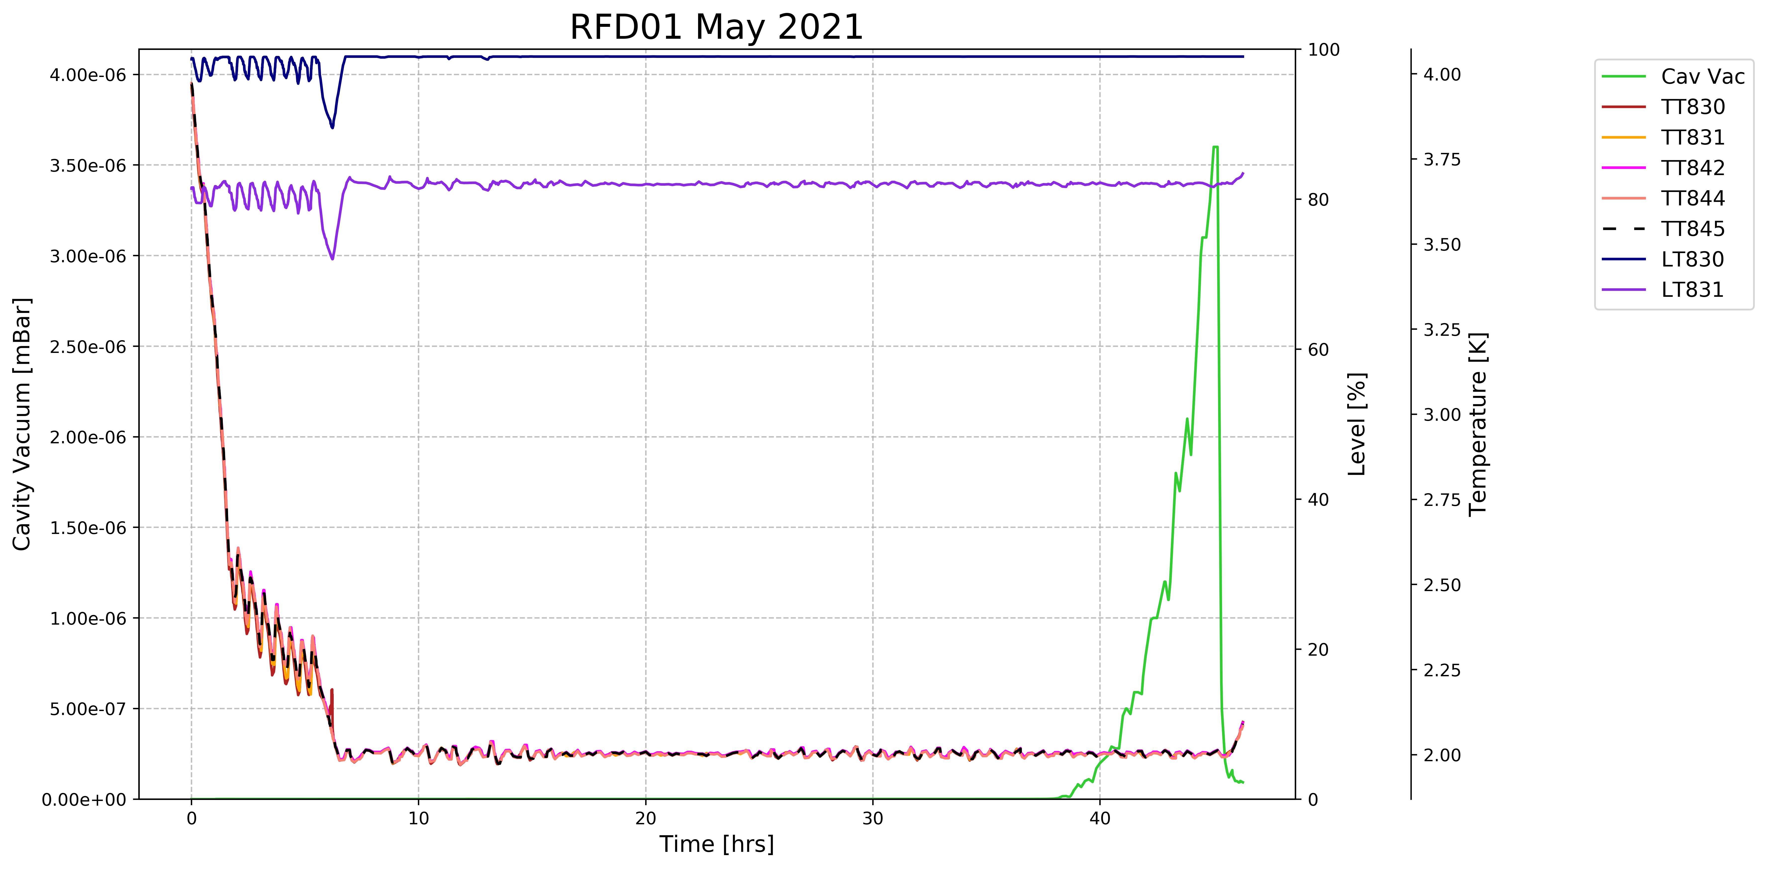
RFD1_DC: 2nd leak – May 2021
Visible at 2K after ~30hrs, the cavity vacuum was in the range of 10-6 mbar.
It was decided to open the valve and start pumping with the turbo pump.
Two other checks were done :
  The cryostat was warmed-up up to 4K the pumping was stopped and the leak was still visible.
  When LHe level inside the cryostat was below the field antenna port the pumping was stopped and the leak was still visible.
No leak was found in the range of 1e-11mbar l/s at warm after CT
Action: inspection, FA flange was polished, HPR, 1st set of HOM’s couplers, retest
Notes:
After inspection of the flanges, the following features were found:
• Bump in the CF knive’s edge of the HHOM port.
• Small scratch and Nb-stains on the beam-pipe flange (FPC side).
• A bump on the CF knive’s edge and three scratches on the field antenna’s port. Once these features were identified, they were carefully buffered and after a second inspection all of them were deemed as corrected (see images here: link).

Slide 8
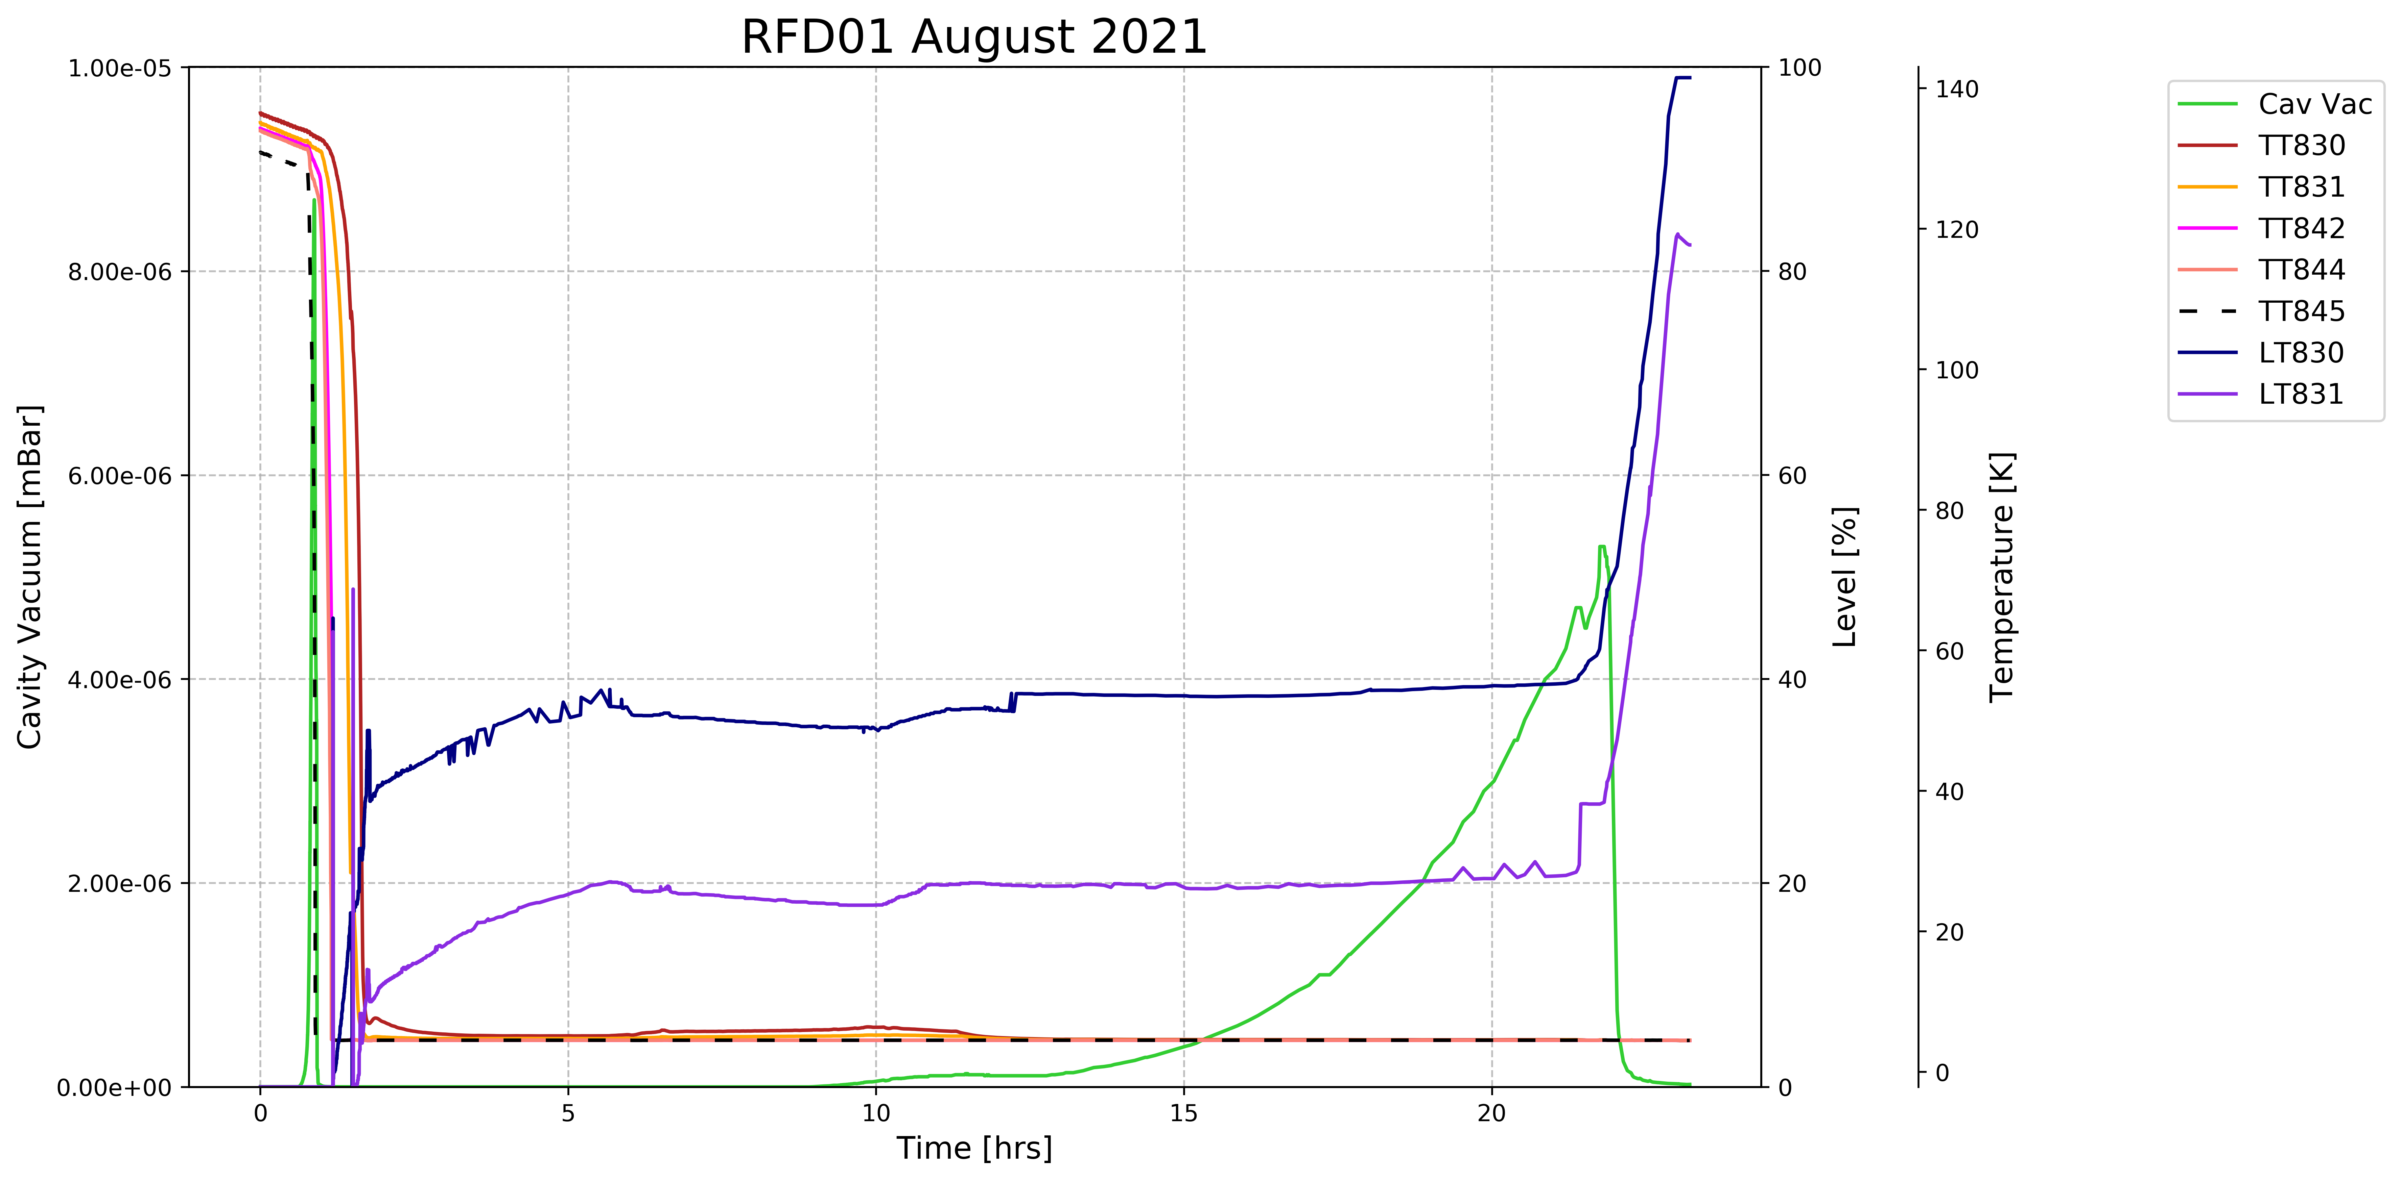
RFD1_DC: 3rd leak – August 2021
Visible immediately at 4K (after ~8hrs), CT was continued but with the active pumping
LD after CT was done and the leak (leak rate 2e-8mbar*l/s) on the CF gasket of VHOM port was found
  The inspection showed that the tightening torque of this flange was below expected (12Nm instead of the 15Nm). Once the correct torque was applied no leak found in the range of 1e-10 mbar l/s
Action: continue with the beam screen assembly

Slide 9
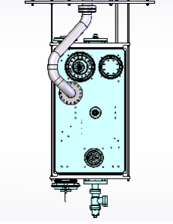
What can we do to avoid this in the future?
Warm LD made with a dedicated pocket (time, additional risk?), now each time we "build" foil pockets
Test HOMs by doing thermal cycles: check the torque evolution and perform leak detections → done
Use a dedicated set-up for dressed cavities CT → studies ongoing
B. Laxdal, Triumf

Slide 10
References:
EVALUATION Recurring leak on RFD_01 dressed cavity, EDMS 2618980
NCR, Cold RF test RFD Dressed Cavity, EDMS 2563751

Slide 11
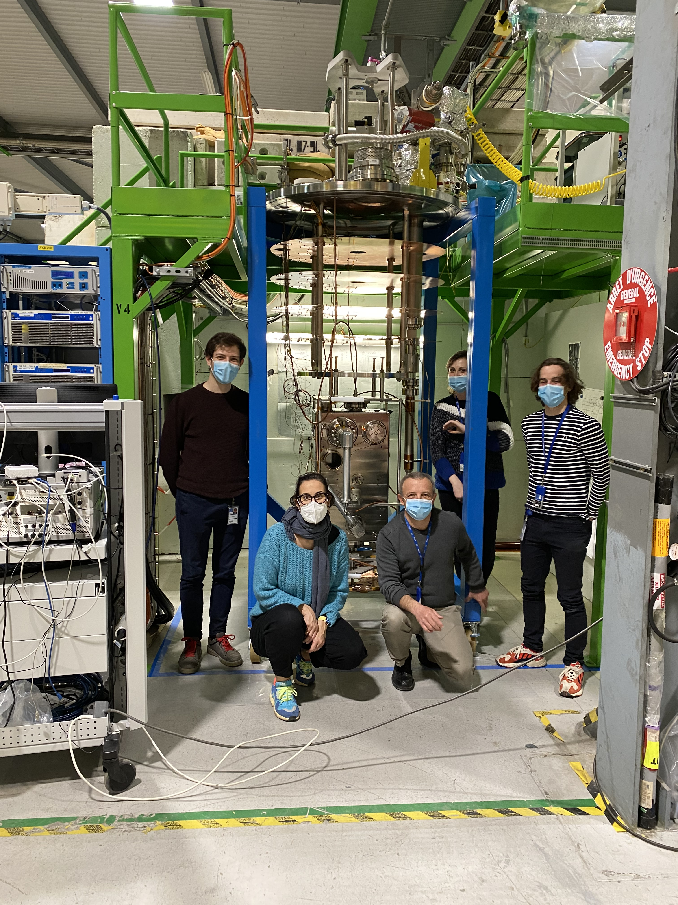
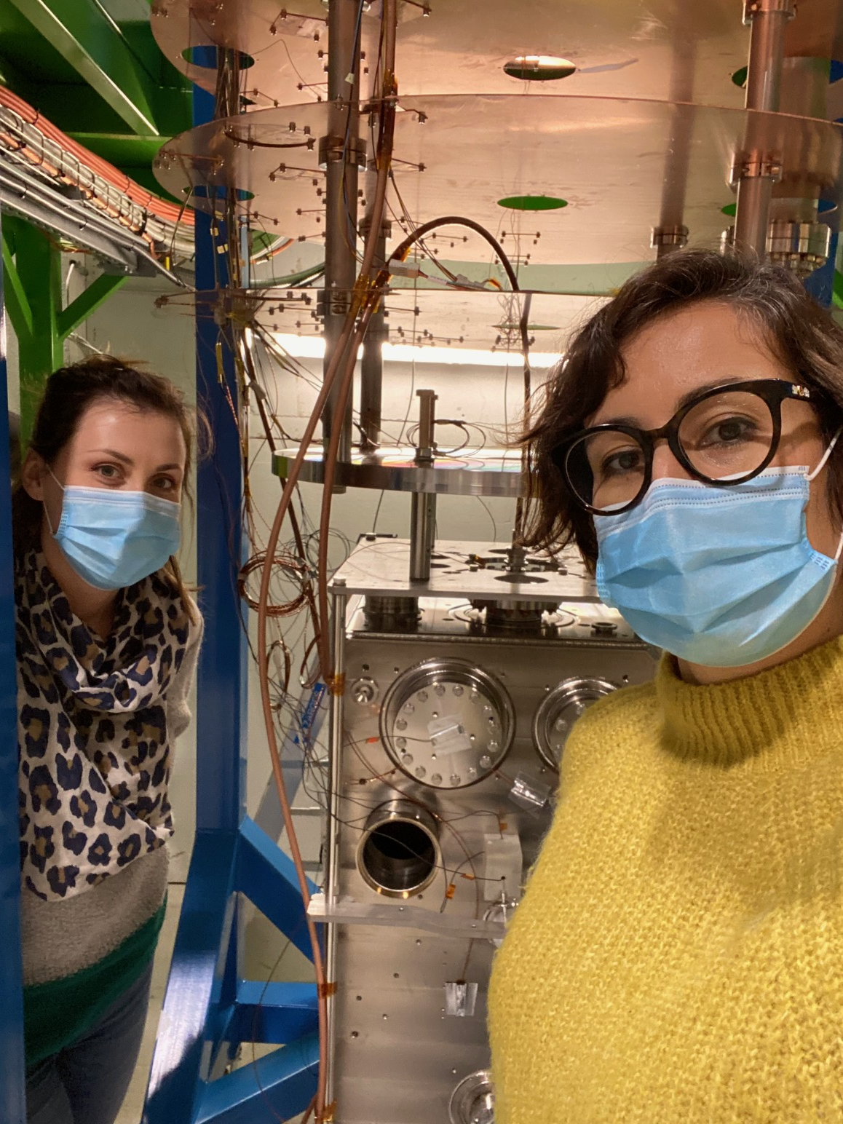
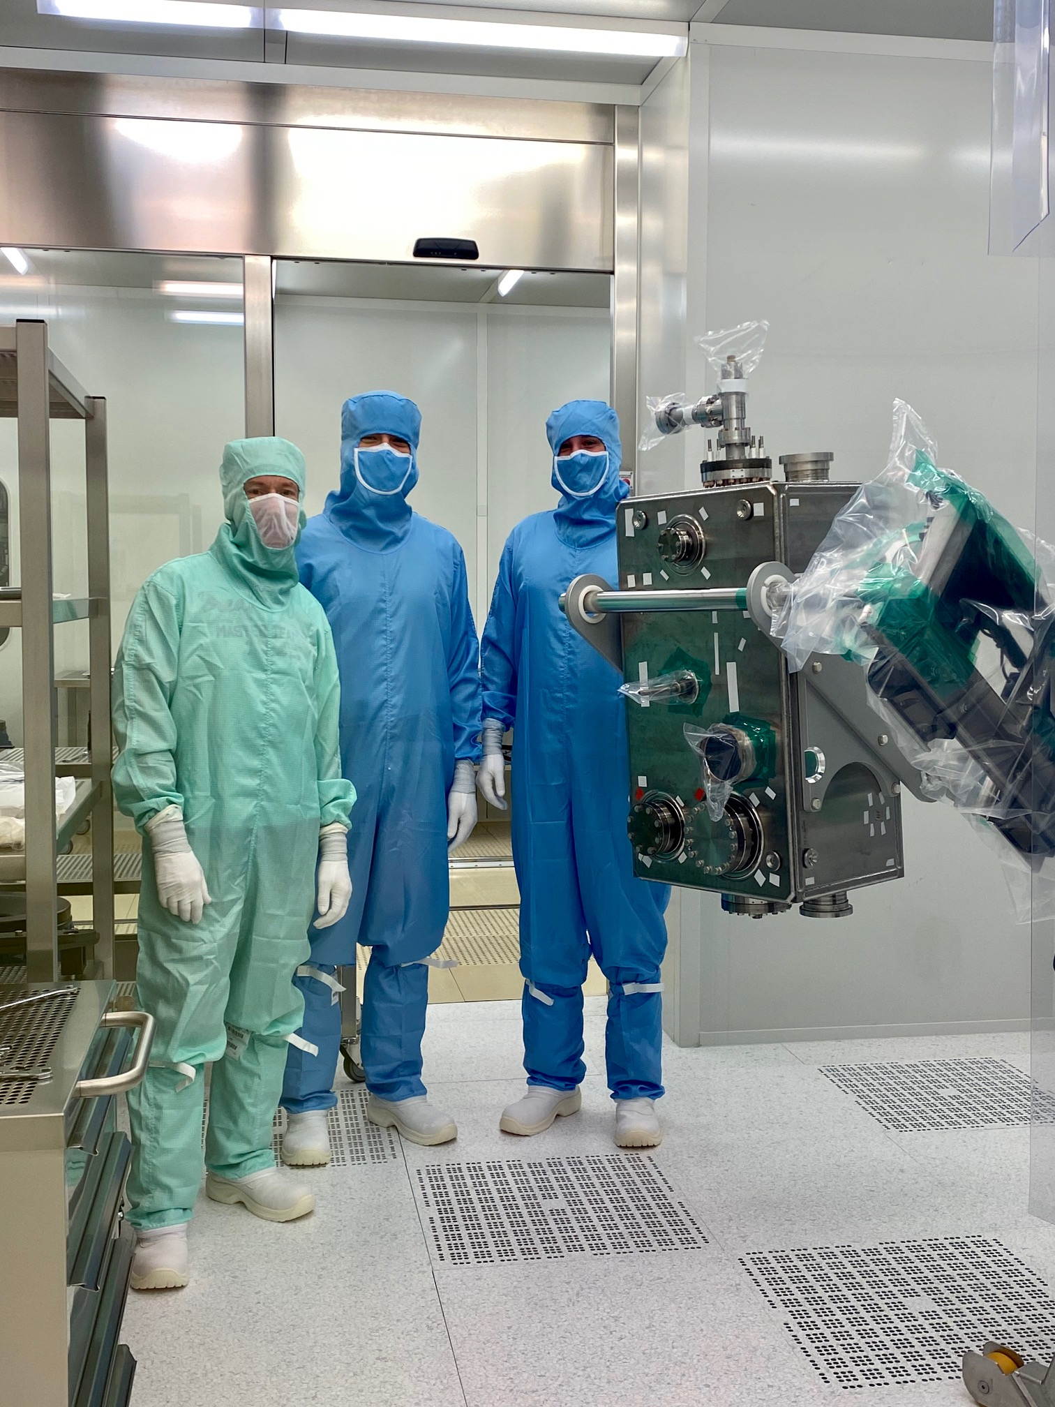
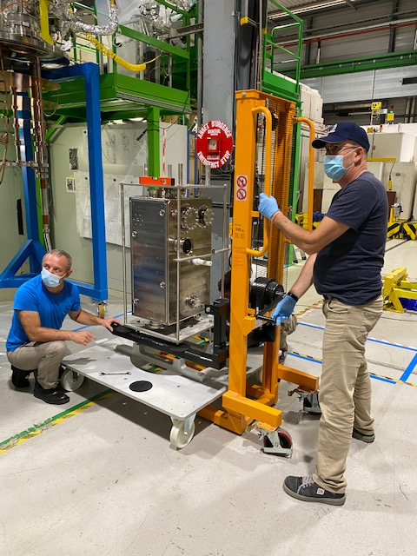
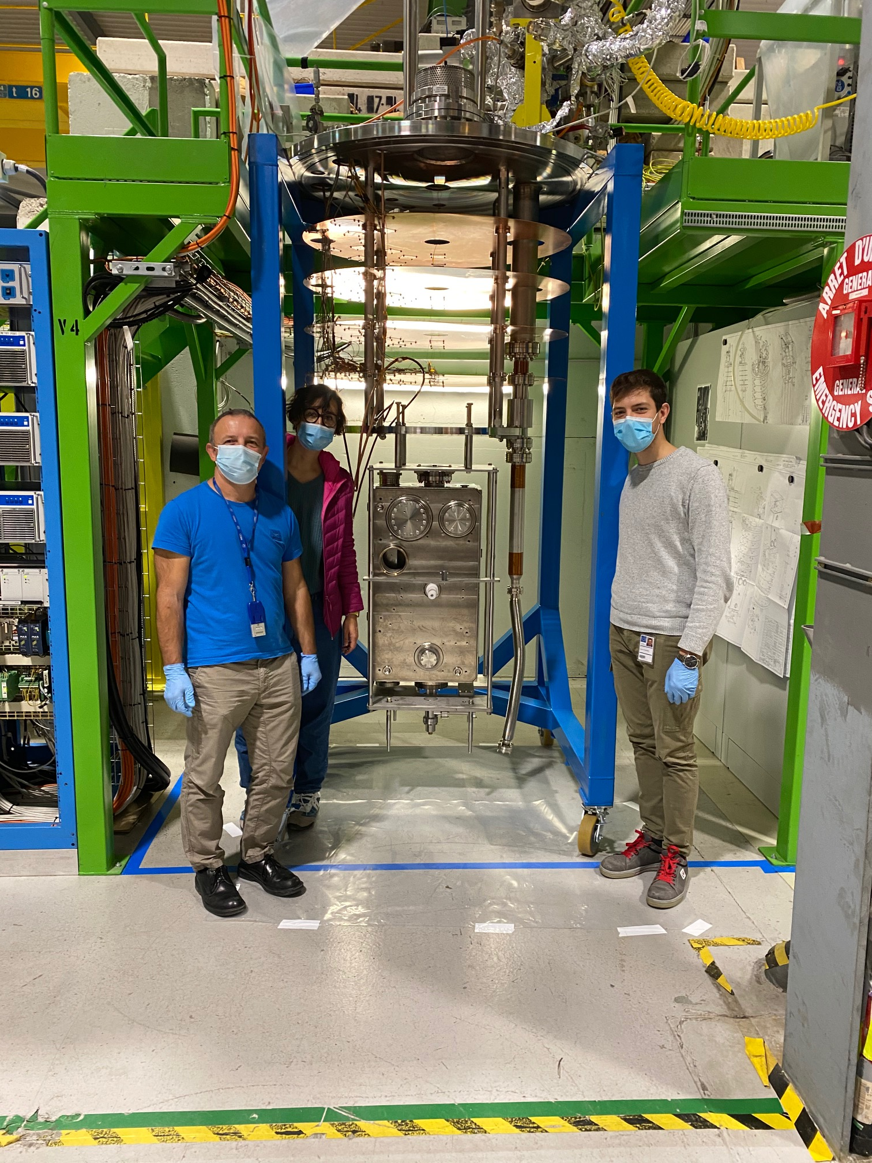
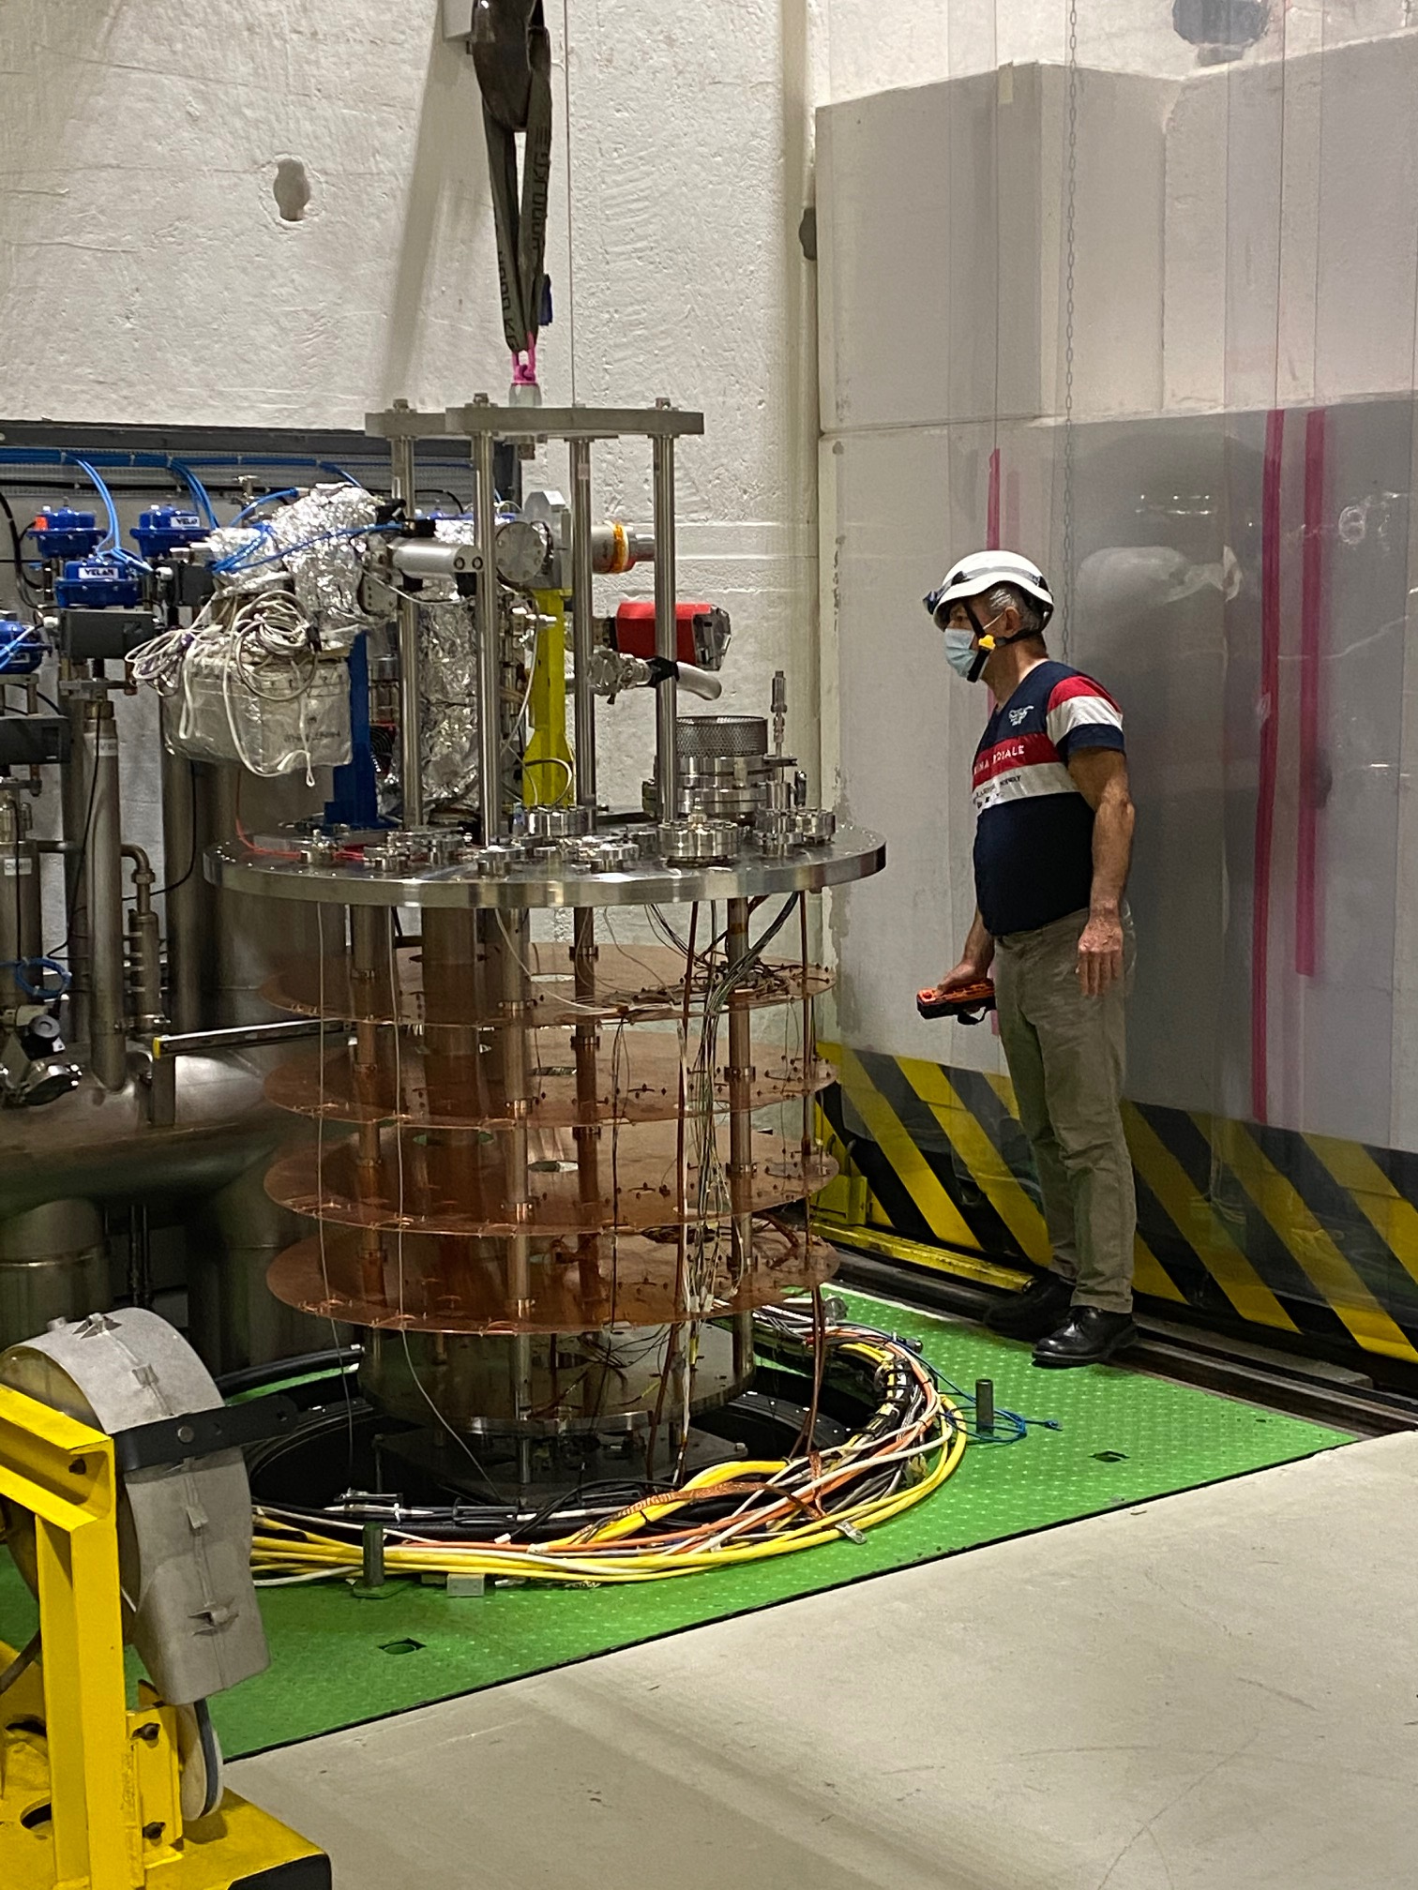
Thank you very much!

Slide 12
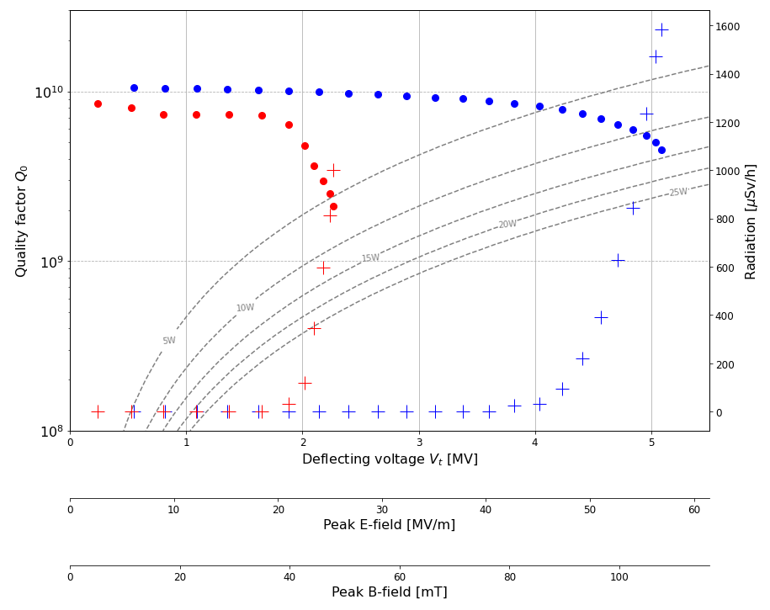
SPARE: DQW RI cold test results
DQW1 and DQW2 bare cavities were tested in SM18
DQW1 will be HPR and retest in November

Slide 13
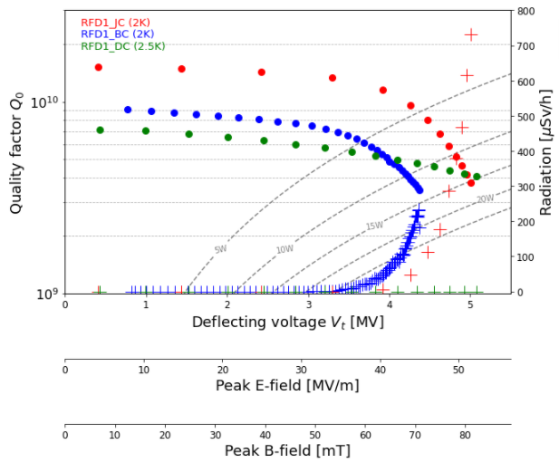
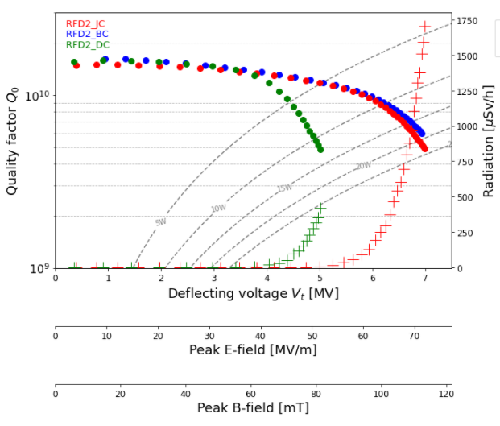
SPARE: RFD1 and RFD2 cold tests results

Slide 14
RF testing of jacketed and dressed RFD cavities
RF tests performed in V4 cryostat in SM18 at CERN
Without 120 degree bake-out for dressed cavities
Cavity Reception
120 degree Bake out
Leak test
RGA
Cavity in storage
HPR
Leak Test
RGA
Transfer to Cryostat
Removal from Insert
Cleanroom Assembly
Connect Pumping Line
Cold Test
Slow venting of N2 to 1bar
Leak Test, RGA
Mount on the insert
Removal from Cryostat
RGA
Notes:
The cavity was high pressure rinsed and assembled for rf testing (input antenna in beam port, pick-up antenna in pick-up port on the VHOM side). Prior to rf test the cavity was baked at low temperature of 120 C.

