Slide 1
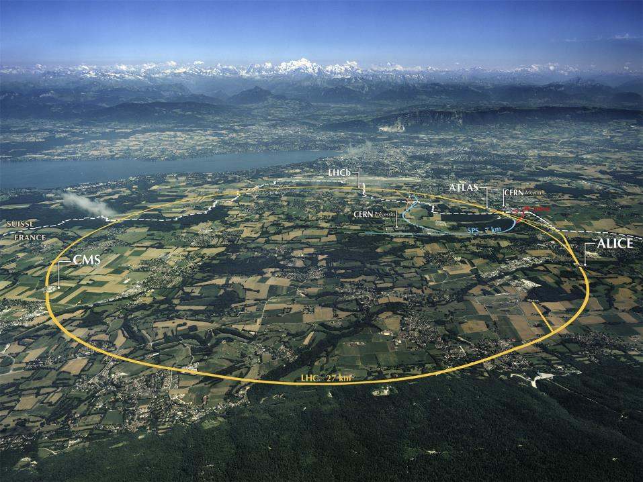
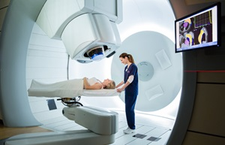

The CERN Next Ion Medical Machine Study: towards a new generation of accelerators for cancer therapy
M. Vretenar CERN
for the NIMMS Collaboration

Slide 2
Outline
The use of particle beams in cancer therapy – challenges and opportunities
Present facilities and new European initiatives for particle therapy
The NIMMS Toolbox: advanced accelerator options for ion therapy
NIMMS-based designs
Review of far-future options
Conclusions

Slide 3
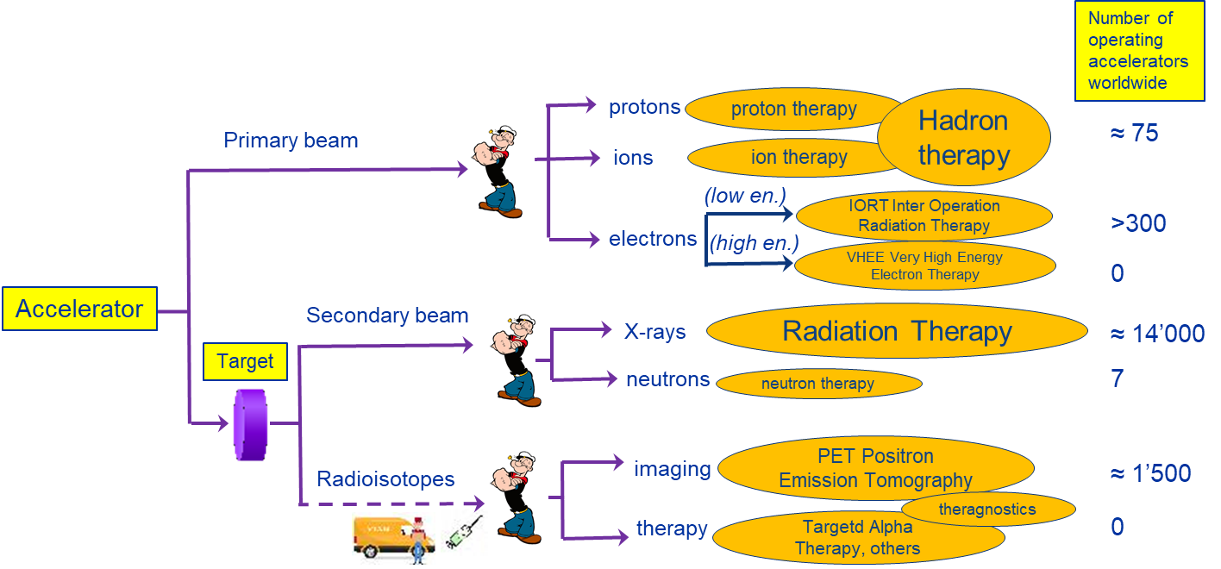
Particle Accelerators for Medicine
Total: ≈ 16’000 particle accelerators operating for medicine

Slide 4
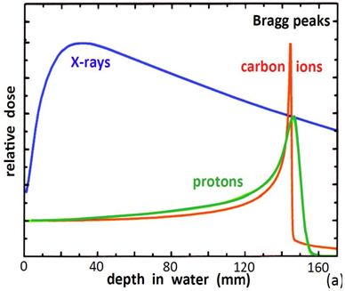
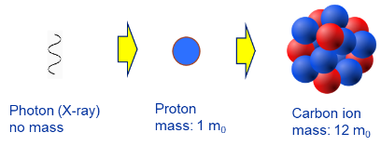
Therapy of cancer with particle beams
Goal: curing deep solid tumours with minimum damage to surrounding organs
Conventional Radiation Therapy makes use of X-rays that deliver most of their dose in healthy tissue before reaching the tumour.
Protons and heavier ions present a characteristic Bragg peak:
A beam of particles starts to deposit energy at a given depth corresponding to its energy.
These techniques aim at “bloodless surgery”: destroy a cancer with minimum damage to the surrounding tissues.
Energy deposition of X-rays, protons, carbon ions
Because of their higher mass and energy loss in the tissues, ions act in a different way than X-rays or protons

Slide 5
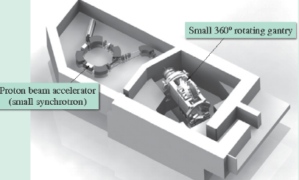
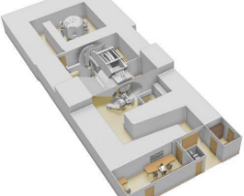
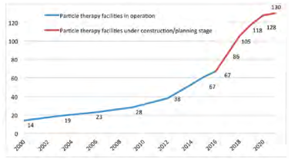
The rise of proton therapy
Protons have a lower energy deposition per length than ions → they need less energy to penetrate the full body → the accelerator is smaller, superconducting cyclotrons or small synchrotrons can be used
4 companies are now selling turn-key proton therapy systems at a starting cost of some 40 M€.
Fast increase in the number of facilities worldwide
The Hitachi synchrotron system (Japan)
ProteusOne from IBA (Belgium)

Slide 6
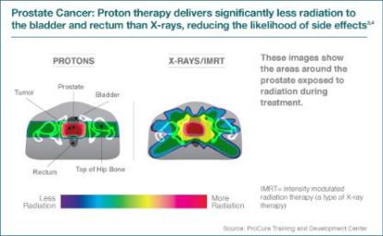
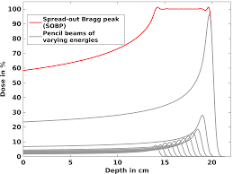
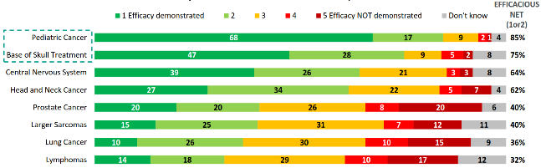
Proton therapy vs. X-ray therapy
Main challenges of proton (and ion) therapy:
Treatment planning (spread-out Bragg peak)
Moving organs and imaging
Quantify quality of life after treatment
New opportunities: FLASH therapy
Proton therapy is now recommended for many types of cancer, in particular for children (lower risk of recurrencies) – covered by health insurance in most EU countries.
Source: IBA proton therapy fact-sheet,

Slide 7
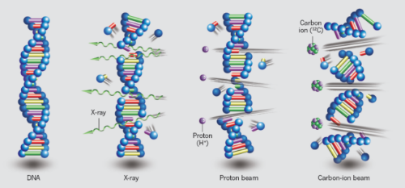
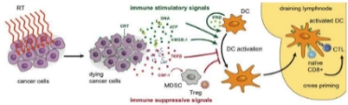
Cancer therapy with heavier ions
Heavy ions are more effective than protons or X-rays in attacking cancer:
Higher energy deposition (and ionisation) per length generates a large number of double-strand DNA breakings that are not reparable by the cell itself.
Energy deposition more precise, with lower straggling and scattering
The different damage mechanism makes ions effective on hypoxic radioresistant tumours – 1 to 3% of all RT cases (200-500 cases/year per 10M people).
Recent studies show that ion therapy combined with immunotherapy may be successful in treating diffused cancers and metastasis.
Long-term goal: the cancer vaccine
Example:
24.06.2021, experiment at GSI Darmstadt combining carbon ion therapy with an mRNA-based cancer immunotherapy drug (vaccine). Combining this powerful systemic drug with localized heavy ion bombardment of the primary mass could be a key to defeat cancers in advanced stage.
Carbon ions are routinuously used to treat patients since 1994, but much research is still needed, in terms of
optimisation of ion type, delivery modality, new techniques (flash), integration of dosimetry, etc.:
Ion treatment is still in its infancy!

Slide 8
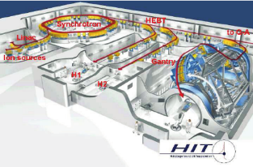
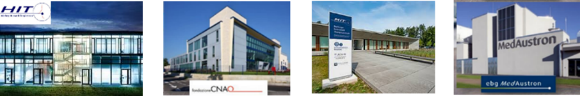
Present and the future of ion therapy accelerators
Ions deliver more energy to the tissues, but need more energy to enter the body → a larger accelerator (430 MeV/u for Carbon compared to 250 MeV/u for protons)
The main limitation to the diffusion of ion therapy is the cost and size of the accelerator
Only 4 ion therapy facilities operating in Europe (+ 6 in Japan, 3 in China, 1 in construction in US)
CNAO and MedAustron based on a design started at CERN in 1996. 1st patient at CNAO in 2011.
HIT and MIT based on a design started at GSI (Germany) in 1998 . 1st patient at HIT in 2009.
Layout of the Heidelberg Ion Therapy facility
All ion facilities worldwide operate with Carbon but there is a strong interest in lighter ions like Helium that could keep the advantages of carbon but require a smaller machine.
Particle accelerator technology has made a huge progress in the last 20 years, in particular towards developing new more compact and less expensive accelerator designs.
We can today explore new accelerator designs profiting of the latest advances in accelerator technologies.

Slide 9
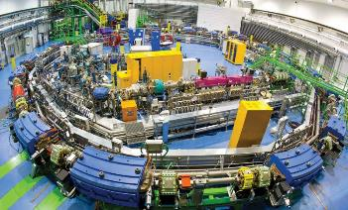
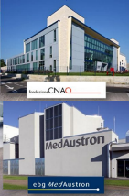
The CERN engagement for particle therapy
1996/2000: CERN hosts PIMMS (Proton-Ion Medical Machine Study), a collaborative study (CERN, TERA Foundation, MedAUSTRON, Onkologie 2000) for the design of a cancer therapy synchrotron. The study has been the foundation for the construction of the CNAO and MedAustron particle therapy centres.
In parallel, GSI develops a similar technology and treats the first patients. This experience goes in the construction of the HIT and MIT therapy centres
Successful technology, but developing slowly because of:
high treatment costs linked to cost and size of the facility
slow acceptance by the medical community
20 years later, and with the experience gained with LHC construction, it is time to explore new technologies to extend to a wider fraction of society the benefits of cancer therapy with particle beams.
June 2017 CERN Council Strategy document on KT for Medical Applications:
A collaborative design study coordinated by CERN would contribute to the development of a new generation of compact and cost-effective light-ion medical accelerators. A new initiative of this type would leverage existing and upcoming CERN technologies and the Laboratory’s expertise in the fields of radiofrequency systems, advanced magnet design, superconducting materials, and beam optics.
NIMMS = Next Ion Medical Machine Study
To be developed at CERN in collaboration with the existing ion therapy centres and with similar programmes in the Member States.

Slide 10
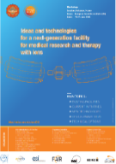

The CERN Next Ion Medical Machine Study (NIMMS)
Requirements of the ion therapy community, expressed at the Archamps Workshop, June 2018
1. Concentrate on heavy ions (Carbon but also Helium, Oxygen, etc.).
2. A next generation ion accelerator must have:
Lower cost and footprint, compared to present;
Faster dose delivery with higher beam intensity or pulse rate, and FLASH delivery
A gantry device to precisely deliver the dose to the tumour.
Operation with multiple ions, for therapy, research, and possibly dosimetry.
Establishment of NIMMS, the
Next Ion Medical Machine Study at CERN (2018):
Building on the experience of the PIMMS (proton-ion medical machine study) of 1996/2000;
Federating a large number of partners to develop designs and technologies for next-generation ion therapy;
Partners can use the NIMMS technologies to assemble their own optimized facility.

Slide 11


The NIMMS Collaboration
Large number of international partners collaborating with NIMMS:
South East European International Institute for Sustainable Technologies
TERA Foundation (Italy)
GSI (Germany)
INFN (Italy)
CIEMAT (Spain)
Cockcroft Institute (UK)
University of Manchester (UK)
CNAO (Italy)
Imperial College (UK)
MedAustron (Austria)
U. Melbourne (Australia)
ESS-Bilbao (Spain)
Riga Technical University (Latvia)
Thessaloniki University (Greece)
Sarajevo University (Bosnia &H.)
NIMMS as a toolbox
in line with CERN mission, build on CERN expertise to develop a portfolio of technologies that can be used in a next generation facility, more than developing a single design
Participation in 2 EC funded projects:
H2020 HITRIplus project (CNAO, SEEIIST, CERN, MedA, INFN, CEA, CIEMAT, PSI, UU, Wigner)
Dedicated WP in H2020 IFAST project (GSI, BI, BT, CERN, HIT, CERN, CEA, INFN, CIEMAT, Wigner, UU, PSI, Scanditronix, Elytt)

Slide 12
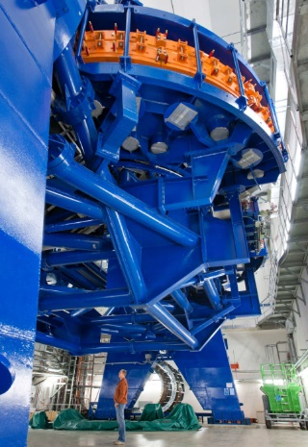
NIMMS Workpackages – inside the toolbox
 | Workpackage | Objectives
1 | Superconducting magnets | Comparison of magnet technologies (CCT, costheta) and cables (NbTi, HTS). Design of prototype magnets (gantry and synchrotron) for the selected option.
2 | High-frequency hadron linacs | End-to-end beam dynamics design, study of 180-degree bend, design of medium-beta accelerating structures (5-20 MeV/u), RF optimisation.
3 | Gantries | Advanced design and comparison of 2 gantry options (optics and mechanical structure): Rotational, Toroidal
Superconductivity, the main avenue to accelerator miniaturisation.
Long-standing CERN expertise, needs high fields, pulsed operation, strong curvature
The “full-linac”, a different approach for fast 3D scanning of tumours
The gantry, a strategic component merging traditional CERN competences: magnets, beam optics, mechanics.
4 | Synchrotron design | Design of Superconducting synchrotron and of a backup normal conducting version with advanced features: multi-turn injection for 10¹⁰ particles per pulse, fast and slow extraction, multiple ion operation, new upgraded linac injector.
Design of synchrotrons, key element of most ion therapy systems, is a core competence of CERN.
Main challenge for ion acceleration is the
magnetic rigidity (Bρ) at treatment energy:
  2.27 Tm for protons (220 MeV)
  6.63 Tm for carbon ions (430 MeV/u)
  → factor 2.9
Gantry=rotating beam line sending the beam to precise positions on the patient
HIT carbon ion gantry (RT magnets):
L=25 m, F = 13 m, 600 tons
Notes:
Ions lose more energy per unit length – need higher energy at entrance point to go to inner organs

Slide 13
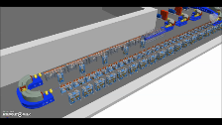
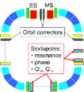
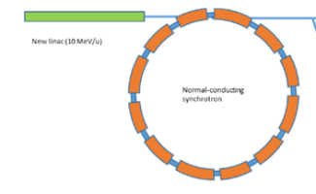
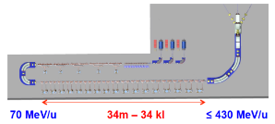
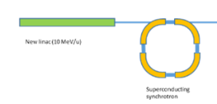
Three alternative accelerator designs
Improved synchrotron (warm)
Equipped with several innovative features: multi-turn injection for higher beam intensity, new injector at higher gradient and energy, multiple extraction schemes, multi-ion.
Circumference ~ 75 m
Improved synchrotron (superconducting)
Equipped with the same innovative features as warm, but additionally 90⁰ superconducting magnets.
Circumference ~ 27 m
Linear accelerator
Linear sequence of accelerating cells, high pulse frequency.
Length ~ 53 m
Other options considered as less interesting because of cost and/or required R&D: RC synchrotron, FFAG, SC cyclotron, PWFA

Slide 14
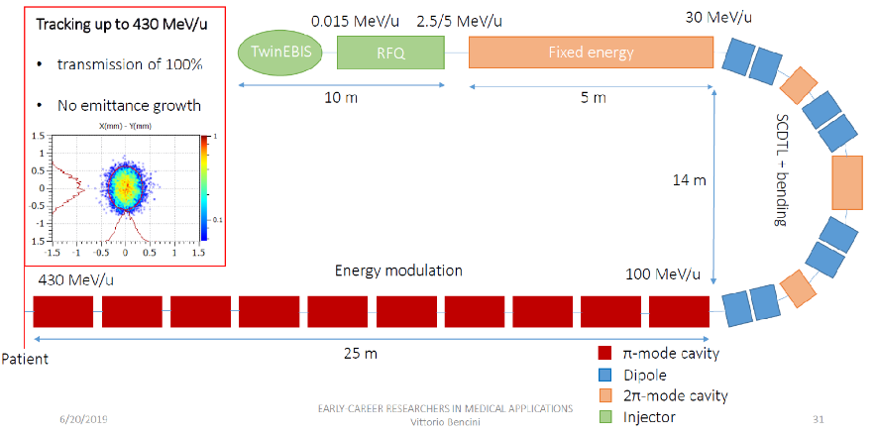
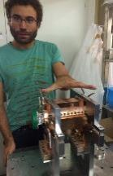
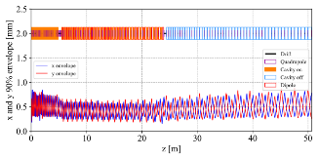
Accelerator option #1: the linac
A. Lombardi, V. Bencini, D. Gibellieri, F. Wenander, BE/ABP
A. Grudiev, H. Pommerenke, S. Ramberger, M. Khalvati, BE/RF J. Navarro, C. Oliver, D. Perez, CIEMAT
High repetition frequency (360 Hz) with pulse-to-pulse energy modulation allow fast and accurate dose delivery to the tumour
Parameter | Value
Frequency | 750 MHz/3 GHz
Species | ¹²C⁶⁺
Final energy | 100-430 MeV/u
Repetition rate | 200 (400) Hz
Pulse length | 5 μs
Acceleration of fully stripped Carbon with 750MHz/3GHz structures
Innovative «folded» version to save space
Particle tracking completed
Prototype EBIS source under commissioning
RFQ designed
Agreement with CIEMAT for construction of pre-injector in collaboration with Spanish industry

Slide 15
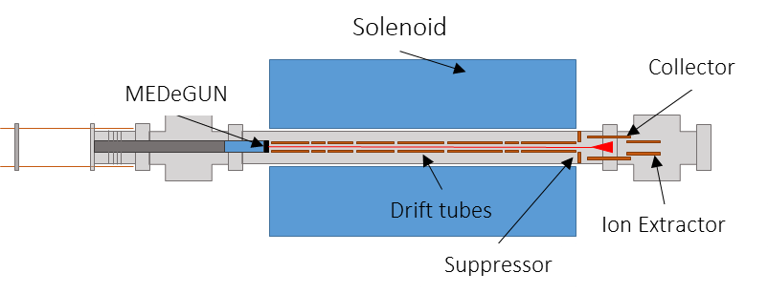

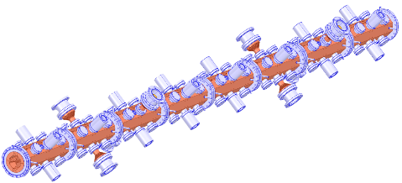
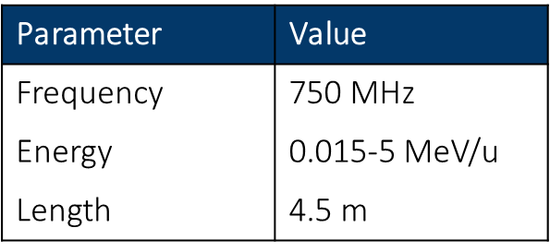
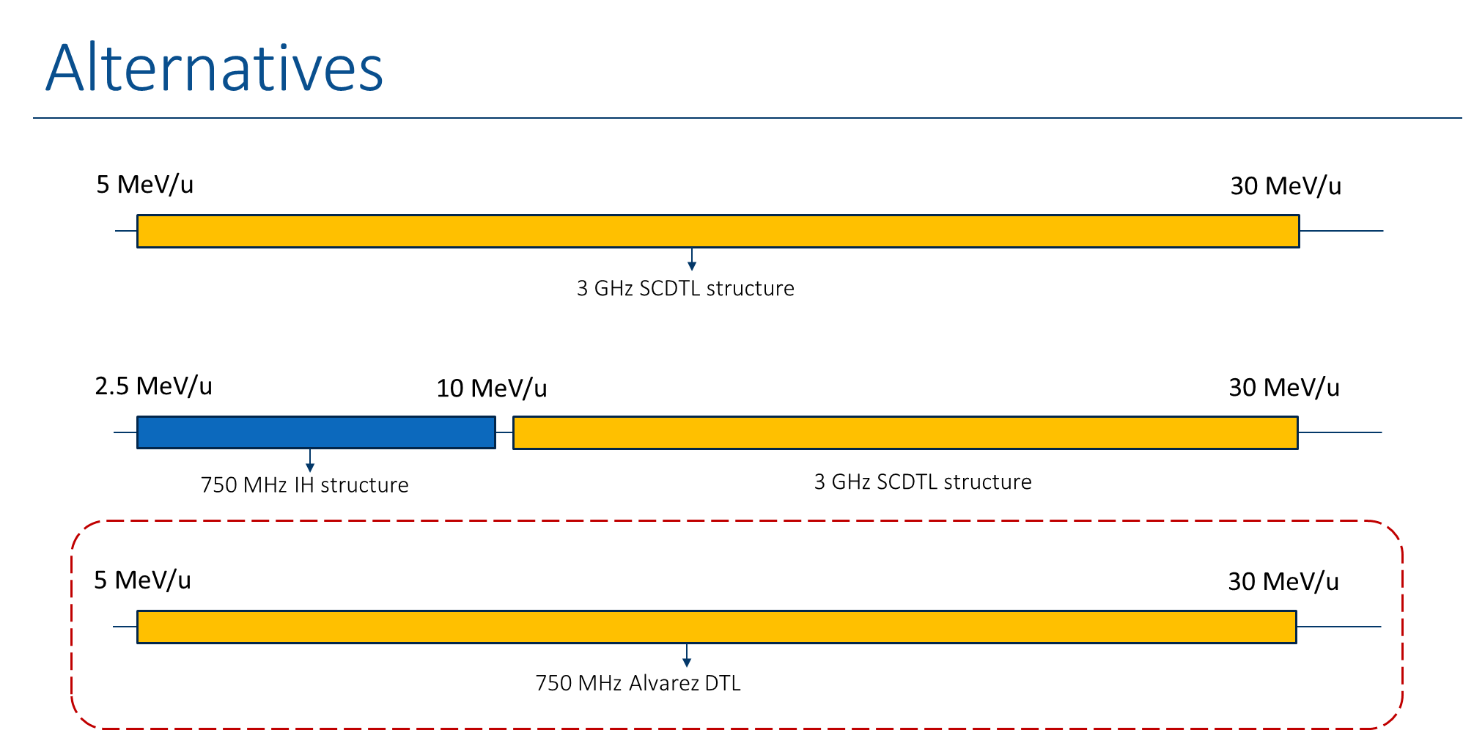
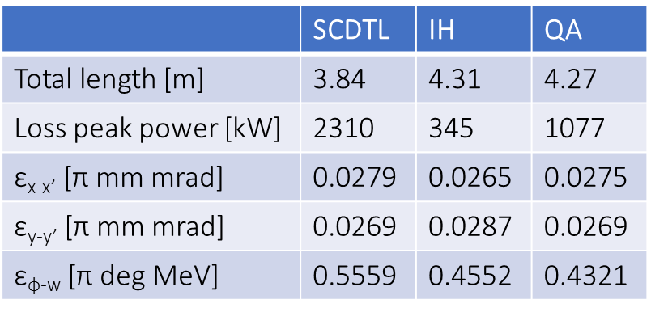
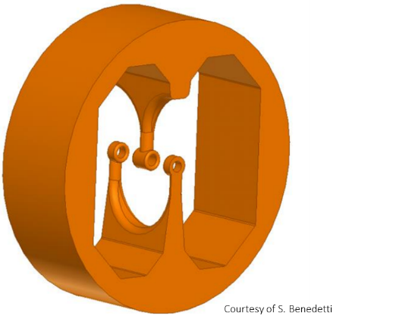
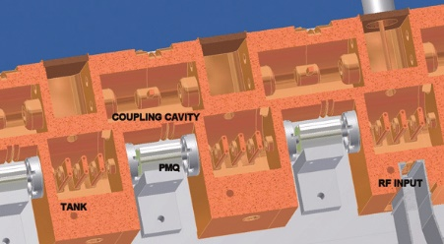

Linac key components: source, RFQ, acc. structures
2019 Commissioning of MEDeGUN
Radio Frequency Quadrupole designed
trapezoidal vanes with sinusoidal step
Stable reproducible operation above nominal current
Energy decreased to the lower theoretical limit
Minimized losses (<1.5 mA)
Calculation of expected ion current
Comparison of alternatives for the fixed energy section 5-10 MeV/u
Interdigital-H
Side-Coupled DTL
QuasiAlvarez
Courtesy S. Benedetti
Courtesy L. Picardi
Courtesy M. Khalvati

Slide 16
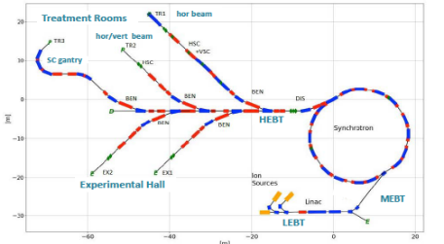
Accelerator option #2: the advanced RT synchrotron
E. Benedetto, M. Sapinski, TERA/SEEIIST
U. Amaldi, TERA
A. Avdic, A. Ibrahimovic, U. Sarajevo
X. Zhang, U. Melbourne
M. Vretenar, CERN
Starting point: the PIMMS design
Improvements:
Higher beam intensity for faster treatment (2x10¹⁰, 20 times higher)
Multiple energy extraction (multiple flat-tops)
Additional fast extraction for FLASH operation
Redesigned linac at higher frequency, for lower cost and parallel isotope production
Multiple particles: p, He, C, O
Optimised layout of beam transport, for both research and therapy

Slide 17
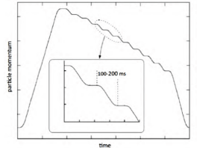
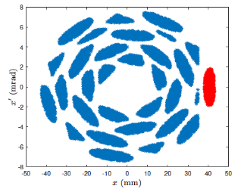
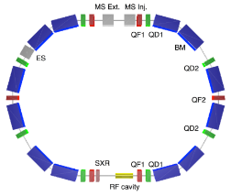
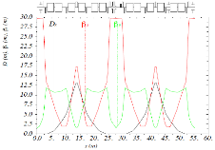
Advanced synchrotron design, key elements
Multiple flat-top operation (from HIMAC, Japan)
Optimisation of multi-turn injection: phase space after 30 turns
(A. Avdic, U. Sarajevo)
FLASH delivery:
The particles are extracted in ultra-short bursts to deliver the dose in very short time (>40 Gy/s).
Tests on animals have demonstrated that the under very short pulses the damage to healthy cells around the tumour is considerably reduced.
Alternative lattice based on Double Bend Achromat cells, with dispersion-free drift sections and only 12 dipoles and 14 quadrupoles (16 dipoles and 24 quadrupoles in PIMMS)
(X. Zhang, U. Melbourne)

Slide 18
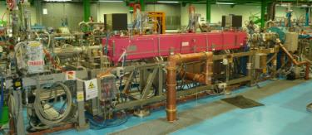
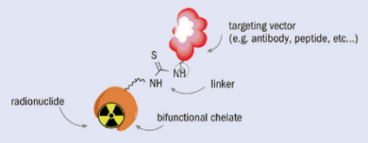
Dual-mode injector linac for production of radioisotopes
The advanced NIMMS synchrotron needs a new injector linear accelerator (linac) designed for higher energy (5-10 MeV/u), with lower cost, higher efficiency and higher intensity.
With a minor additional investment, the linac could have 2 modes of operation: for injection in the synchrotron, and for sending the beam to a target for production of medical radioisotopes.
Main target isotopes for the linac:
211At for Targeted Alpha Therapy
117mSn, for theranostic, artherial plaque and bone malignancies
11C and 18F for PET imaging
Targeted Alpha Therapy (211At)
Alpha-emitting therapeutic isotopes attached to antibodies and injected to the patient: accumulate in cancer tissues and selectively deliver their dose.
Advanced experimentation in several medical centres, very promising for solid or diffused cancers (leukaemia). Potential to become a powerful and selective tool for personalised cancer treatment.
If the radioisotope is also a gamma or beta emitter, can be coupled to diagnostics tools to optimise the dose (theranostics)

Slide 19
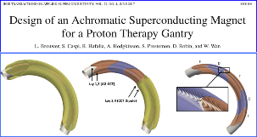
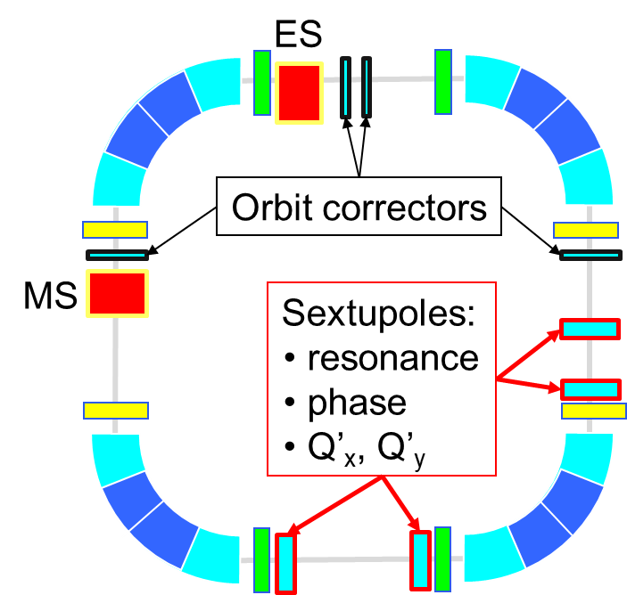

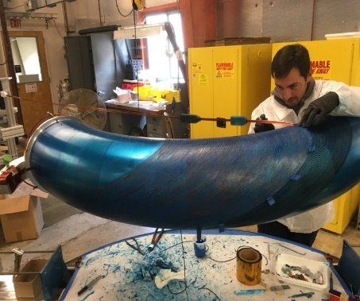
Accelerator option #3: superconducting synchrotron
Advantages:
Smaller dimensions
Lower construction and operation cost
Reduced power consumption
Circumference | 27 m
Injection energy | 7 MeV/u
Extraction energy | 100 → 430 MeV/u
Straight section 1 | 3 m
Straight section 2 | 3.6 m
AG-CCT Max. bending field | 3.5 T
AG-CCT Bending radius | 1.89 m
AG-CCT Magnetic bending angle | 90°
Need: 3 – 5 T magnets ramped at 1 T/s
Magnet options to be explored:
Conventional Nb-Ti
Canted Cosine Theta
High Temperature Superconductivity
A superconducting C-ring at the same scale of CNAO and MedAustron
TERA synchrotron Design: CCT magnets 3.5T
Aperture 60 mm
Total circumference 27 m
Canted Cosine Theta magnets
Proposed by TERA, based on the LBNL experience in the design and prototyping of a proton gantry magnet
Layered construction, can include quadrupole layers

Slide 20
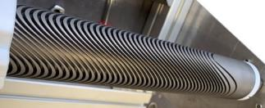
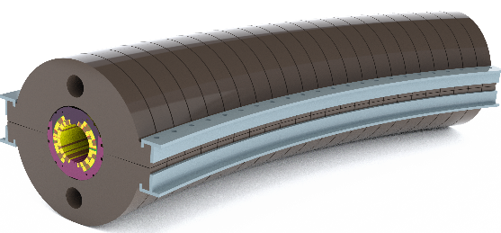
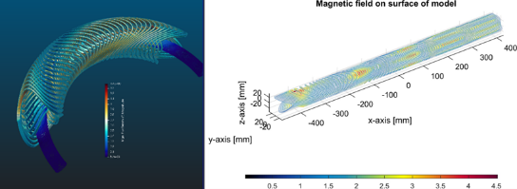
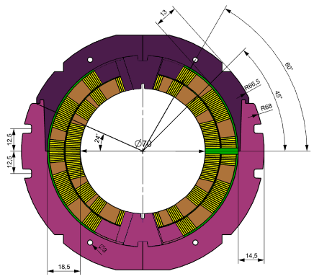
SC magnets for synchrotrons and gantries
High Energy Physics is promoting a wide international effort in the development of conductors, designs and technologies for SC magnets.
NIMMS aims at profiting of this R&D effort for compact synchrotron and gantry magnets.
Some of the challenges are common, other are specific for medical accelerator magnets: ramping field, curved shape, quadrupole integration, use of cryocoolers.
Magnet Parameters for HITRI+ and IFAST
Parameter | Synchrotron magnet | Prototype Magnet
Bρ (Tm) | 6.6 | 6.6
B₀ dipole (T) | 3.0 | 4-5
Coil apert. (mm) | 70-90 | 60 (90)
Curvature radius (m) | 2.2 | 2.2 , ∞
Ramp Rate (T/s) | 1 | 0.15-1
Field Quality (10⁻⁴) | 1-2 | 10-20
Deflecting angle | 90° | 0 - 45°
Alternating-Gradient | yes (triplet) | N/A
Quad gradient (T/m) | 40 | 40
B_{quad} peak (T) | 1.54- 1.98 | 1.2
B_{peak} coil (T) | 4.6 - 5 | 5.6-7
Operating current (kA) | < 6 | < 5
Type of Superconductor | NbTi (Nb₃Sn) | NbTi (curved), HTS (straight)
Operating temperature (K) | 5 (8) | 5 (20)
A few ideas
Solution for curved and straight CCT coils combining dipole and quadrupole in the same winding - Courtesy G. Kirby and J. van Nugteren, CERN
2 proposals submitted to H2020 calls with Workpackages dedicated to SC magnets for medical accelerators – covering 2021/25
HITRIplus – Integrating Activity for Ion Therapy
  WP8 on Magnet Design: overview and assessment of various conductors (LTS, HTS, various types of cables) and magnet layouts (costheta, CCT, racetracks – spit coils or flare ends – etc…). Design construction and test of 1 demontrator 500 mm long (either LTS or HTS)
I.FAST – General innovation programme for accelerator R&D
  WP8 on Innovative Superconducting Magnets: General consensus to go toward CCT, different conductors. Development of a HTS cable suitable for low losses - large size - fast cycling - synchrotrons (led by GSI)
Both WPs coordinated by L. Rossi (INFN, former CERN)
Participants: CEA, CERN, CIEMAT, INFN, PSI, UU, Wigner, SEEIIST, GSI + BNG, Sigmaphi, Elytt (industrial)
Curved cos-theta dipole with H-split yoke with assembly clamps - Courtesy Mikko Karppinen, CERN

Slide 21
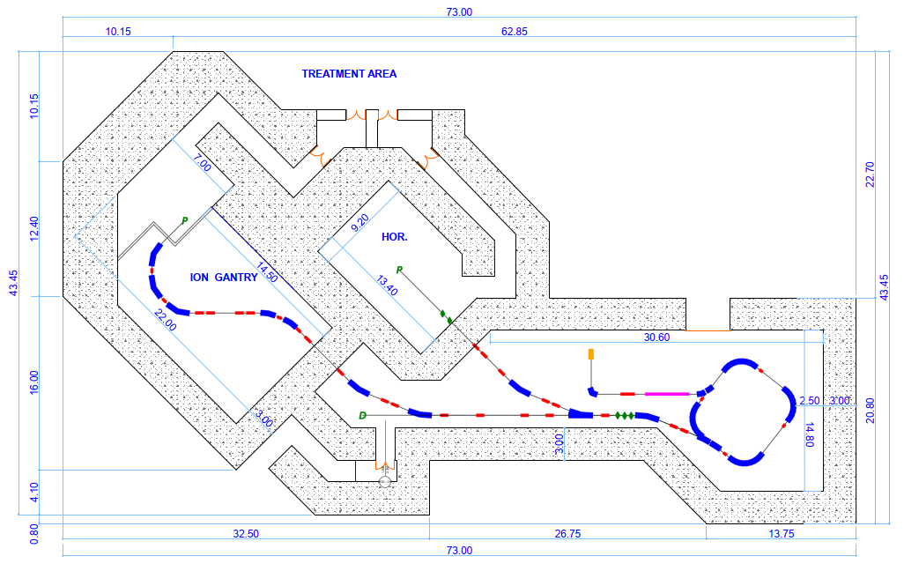
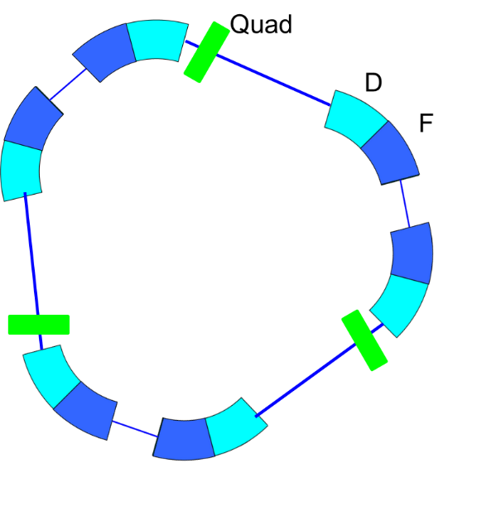



The compact SC synchrotron
E. Benedetto, M. Sapinski, TERA/SEEIIST
P. Foka, GSI
D. Kaprinis, Kaprinis Architects
M. Vretenar, CERN
Alternative lattice with 60⁰ magnets
Compact faciliy with 2 rooms
A compact single-room ion therapy facility in about 1,000 m²
Comparable in size with proton therapy systems – here the single-room proton facility ProteusOne, from IBA)

Slide 22


The Superconducting Ion Gantry
New compact (7m radius) superconducting ion gantry rotating around the patient for ≈±100⁰, equipped with curved superconducting magnets of new design (3-5 T field) to be developed within a collaboration INFN, CERN, CNAO, MedAustron.
Mechanical design (light, without counterweight) and optics being developed within HITRI+ by a collaboration CERN, CNAO, RTU.
“SIGRUM, A Superconducting Ion Gantry with Riboni’s Unconventional Mechanics”
U. Amaldi, N. Alharbi, E. Benedetto, P.L. Riboni and M. Vaziri, TERA Foundation
D. Aguglia, V.Ferrentino, G. Le Godec, M.Karppinen, D. Perini, E.Ravaioli and D. Tommasini,
CERN-ACC-NOTE-2021-0014 ; NIMMS-Note-002

Slide 23

New particle therapy initiatives in Europe
Only 2 areas in Europe without particle therapy facilities:
South East Europe
Baltics
Particle therapy centres in Europe. Courtesy of ENLIGHT, 2020

Slide 24



The SEEIIST initiative
The SEEIIST (South East Europe International Institute for Sustainable Technologies) is a new international partnership aiming at the construction of a new Research Infrastructure for cancer research and therapy in South East Europe (10 member countries).
SEEIIST is supported by the European Commission, to develop the facility design in collaboration with CERN.
Goals are to develop a new advanced design and to build international cooperation and scientific capacity in a region that will join EU but is less develop and still divided, in the line of “science for peace”.
Promoted by H. Schopper, former Director General of CERN, and S. Damjanovic, former Minister of Science of Montenegro.
Accelerator: a large normal-conducting synchrotron
Estimated cost of facility: 240 M€

Slide 25




Comparing the three options for SEEIIST
RT synchrotron:
accelerator 1,200 m², facility 6,500 m²
SC synchrotron:
accelerator 600 m², facility 5,500 m²
Full linac:
accelerator 600 m², facility 5,500 m²
SC synchrotron or linac allow 50% reduction in accelerator dimensions, 15% in overall facility dimensions, and 20% reduction in cost.
R&D on superconducting magnet and linac technology will require about 5 years to be completed
The SEEIIST has selected a room-temperature synchrotron design of PIMMS type with advanced features as baseline design

Slide 26


The unique SEEIIST ion therapy and research facility
Intensive design work in 2019/20 in collaboration between CERN and SEEIIST, with the contribution of NIMMS partners and of the main European ion therapy centres – resulted in the ESFRI application of September 2020
A. Innovative SEEIIST features:
Optimised for 50% research and 50% patient treatment (~400 patients/year);
Providing 20 times higher beam intensity for carbon ions than present facilities;
Equipped with flexible extraction for operation in FLASH mode;
Equipped with dual mode linear injector capable of producing radioisotopes for cancer imaging and therapy.
C. Conservative SEEIIST feature:
  The synchrotron adopts the well-established PIMMS design (known and available components, flexible layout for research);
D. Specific SEEIIST features:
Environmental strategy: minimise energy consumption, strategy for energy generation;
Conceived as a multiple-hub facility, to federate partners in different countries.
B. Advanced SEEIIST features (common to other advanced facilities):
Operation with multiple ions: protons, Helium, Carbon, Oxygen, Argon;
Multiple energy extraction for faster treatment;
Equipped with a compact superconducting gantry of novel design.

Slide 27

Layout of the complete SEEIIST-type facility
Research and Therapy Facility
(50% daily beam time for research, 50% for therapy)
Access for therapy
Total 5,400 m² (shielded area)
The synchrotron can be replaced by an SC version if R&D successful
Equipment room and access to synchrotron
Area for future expansion
Target for isotope production
Access for animal testing
Reconfigurable experimental room
Access to experimental room and linac

Slide 28

The SEEIIST facility
Roof of accelerator building is removed to show accelerator components

Slide 29


Slide 30
Other initiatives
The Baltics (Estonia, Latvia, Lithuania) are developing a common scientific and research infrastructure agenda. They considering ion therapy of cancer as a priority area, coherent with the EU programmes. Population too low to justify a Carbon facility, more interested in proton therapy and experimental work with heavier ions and possibly Helium treatment.
Greece is a recent member of SEEIIST and is planning for a proton therapy centre in Thessaloniki, as initial treatment hub of SEEIIST.
Portugal has started a proton therapy centre in Lisbon, and is planning for an experimental “cyclinac” in Coimbra – isotope production with a 30 MeV cyclotron and post-acceleration of protons with a high-frequency linear accelerator.

Slide 31



New European initiatives in ion therapy - UK
LhARA (Laser-hybrid Accelerator for Radiobiological Applications) collaboration coordinated by Imperial College:
Innovative laser ion source
Gabor lens for beam capture
FFAG accelerator technology
Ion Therapy Research Facility proposal
Innovative and challenging accelerator
No patient treatment, only research programme (no need to licence for medical use, no constraints and risks with patients).

Slide 32

Thank you for your attention
maurizio.vretenar@cern.ch
Image credit: Elwood H. Smith, The New York Times

