Slide 1


Generative Modeling
Generative adversarial networks
Denis Derkach
Laboratory for methods of big data analysis
HSE-Yandex Autumn School 2021, Moscow
November 2021

Slide 2
In this Lecture
Generative Adversarial Networks
  algorithm statement;
  ideal case;
  shortcomings of vanilla algorithm;
  proposed shortcuts.

Slide 3
Idea

Slide 4

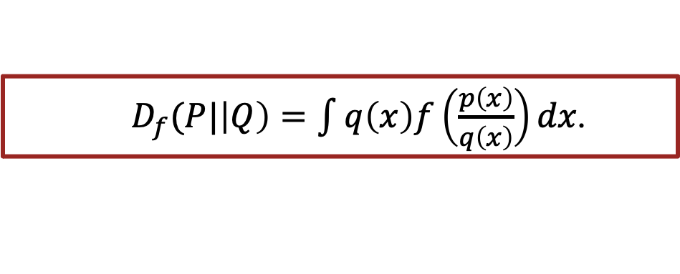
Reminder: $f$-divergence
For convex $f(.)$, $P$ and $Q$ some distributions, we define $f$-divergence:
$D_{f}(P|\left|Q\right)=\int{q\left(x\right)f\left(\frac{p\left(x\right)}{q\left(x\right)}\right)dx}$.

Slide 5
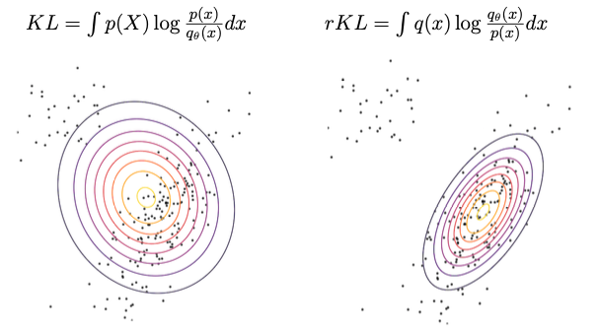
Reminder: $f$-divergence
For convex $f(.)$, $P$ and $Q$ some distributions, we define $f$-divergence:
$D_{f}(P|\left|Q\right)=\int{q\left(x\right)f\left(\frac{p\left(x\right)}{q\left(x\right)}\right)dx}$.

Slide 6

Reminder: $f$-divergence Convergence
For convex $f(.)$, $P$ and $Q$ some distributions, we define $f$-divergence:
$D_{f}(P|\left|Q\right)=\int{q\left(x\right)f\left(\frac{p\left(x\right)}{q\left(x\right)}\right)dx}$.
To optimize $rKL$ properly we need access to true PDF, p(x).

Slide 7
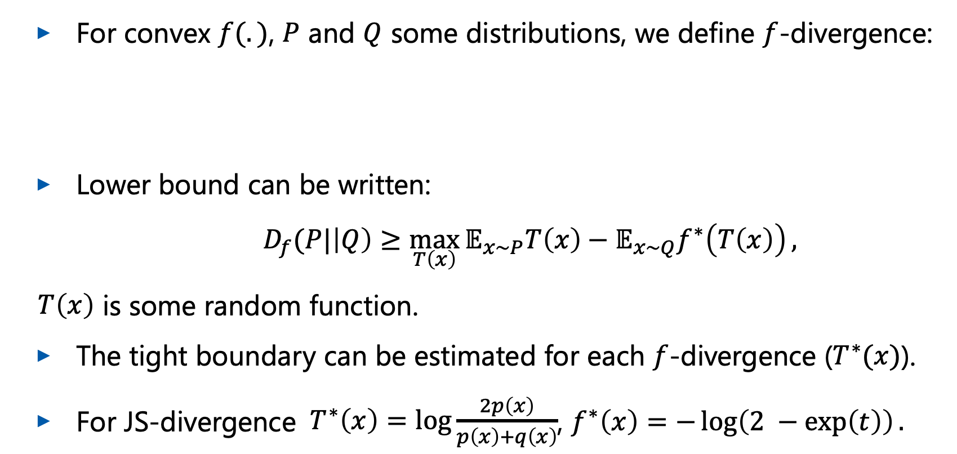
Reminder: Variational Lower Bound
For convex $f(.)$, $P$ and $Q$ some distributions, we define $f$-divergence:
Lower bound can be written:
$D_{f}(P|\left|Q\right)≥\max_{T\left(x\right)}{𝔼_{x\sim P}T\left(x\right)−𝔼_{x\sim Q}f^{∗}\left(T\left(x\right)\right)},$
$T\left(x\right)$ is some random function.
The tight boundary can be estimated for each $f$-divergence ($T^{∗}(x)$).
For JS-divergence $T^{∗}\left(x\right)=\log{\frac{2p\left(x\right)}{p\left(x\right)+q\left(x\right)}}$, $f^{∗}\left(x\right)=−\log\left(2 −\exp\left(t\right)\right).$
$D_{f}(P|\left|Q\right)=\int{q\left(x\right)f\left(\frac{p\left(x\right)}{q\left(x\right)}\right)dx}$.

Slide 8
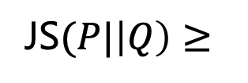

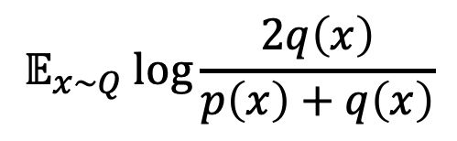
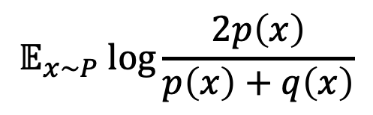
Lower Bound for JS
P(x)
Q(x)
x
x
$$𝔼_{x\sim P} log{\frac{2p\left(x\right)}{p\left(x\right)+q\left(x\right)}}$$
$$𝔼_{x\sim Q} log{\frac{2q\left(x\right)}{p\left(x\right)+q\left(x\right)}}$$
JS$(P|\left|Q\right)≥$
$$+$$
It would be interesting to construct something close.

Slide 9
Adversarial optimization

Slide 10

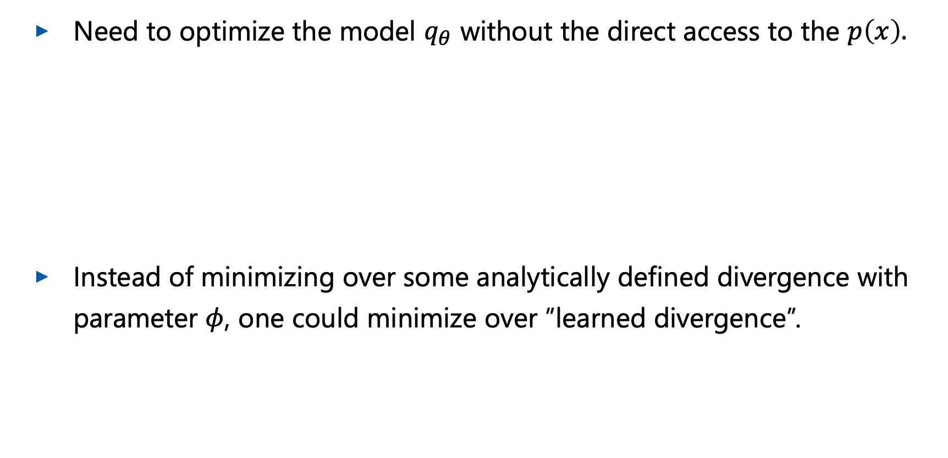
Rationale
Need to optimize the model $q_{θ}$ without the direct access to the $p\left(x\right).$
Instead of minimizing over some analytically defined divergence with parameter $φ$, one could minimize over ”learned divergence”.

Slide 11
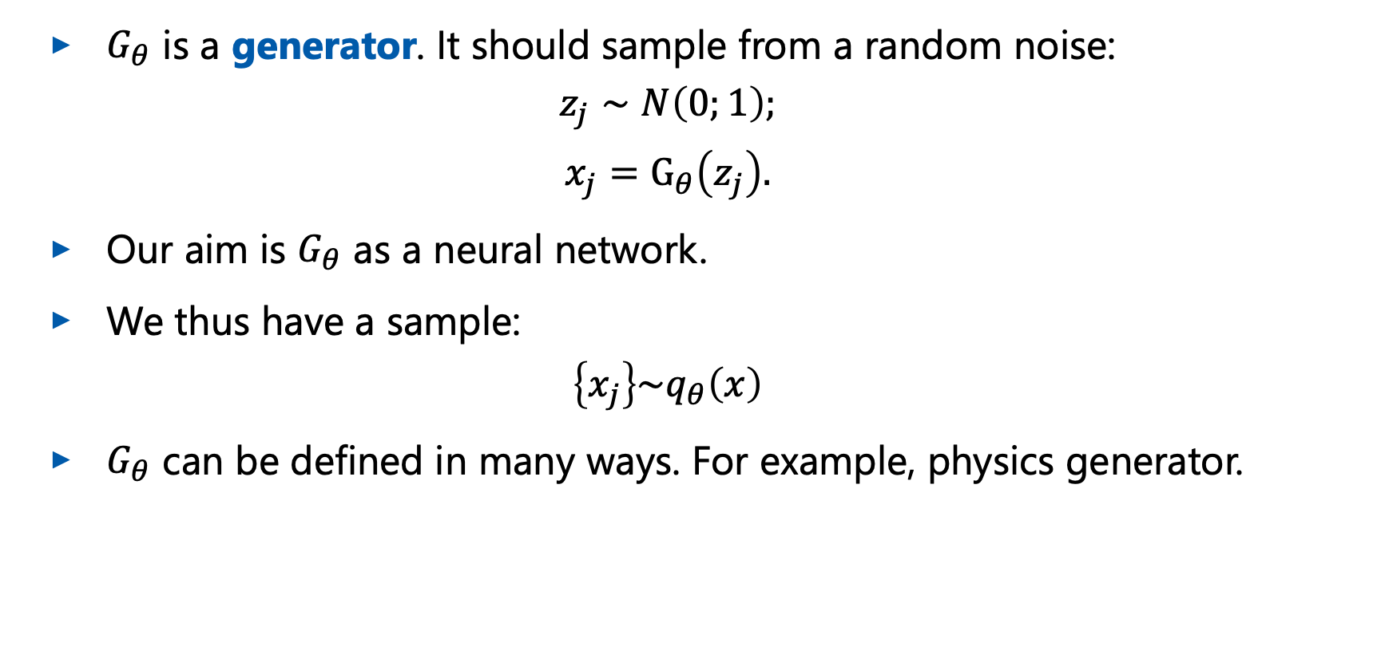
Generator
$G_{θ}$ is a generator. It should sample from a random noise:
$$z_{j}∼N\left(0;1\right);$$
$$x_{j}=G_{θ}\left(z_{j}\right).$$
Our aim is $G_{θ}$ as a neural network.
We thus have a sample:
$$\left\{x_{j}\right\}\sim q_{θ}\left(x\right)$$
$G_{θ}$ can be defined in many ways. For example, physics generator.
Borisyak M et al. Adaptive divergence for rapid adversarial optimization. PeerJ Computer Science 6:e274 (2020)

Slide 12


Discriminator
Add a classifying neural network, discriminator $D_{φ}$, to distinguish between the real and generated samples.
Optimize:
Real samples
Generated samples

Slide 13
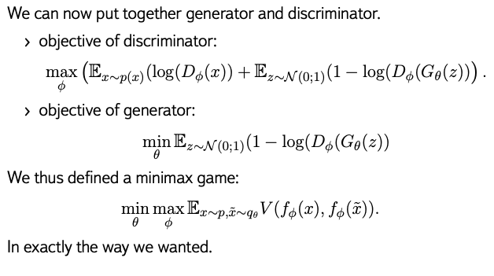
G+D recap

Slide 14
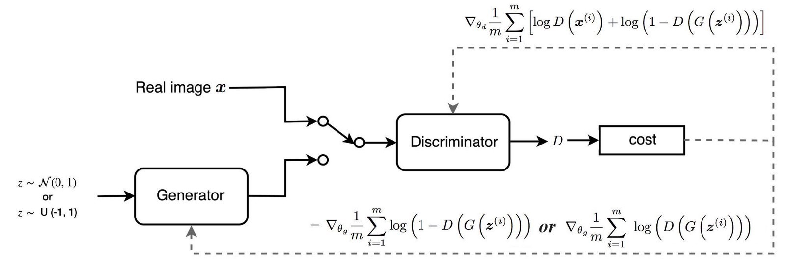
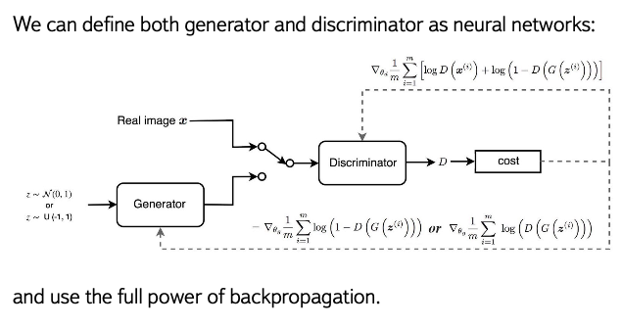
Training at a Glance
For D and G defined as neural networks, we can use backpropagation.

Slide 15
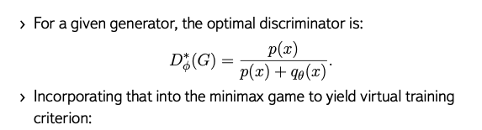
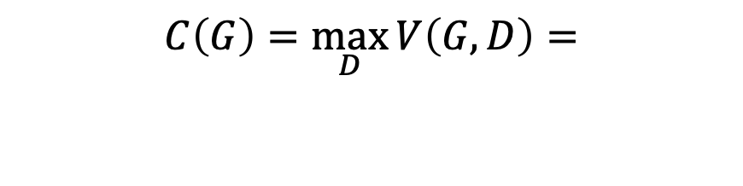
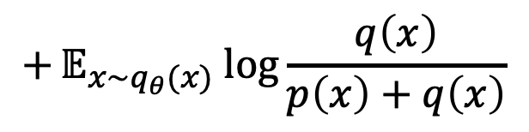
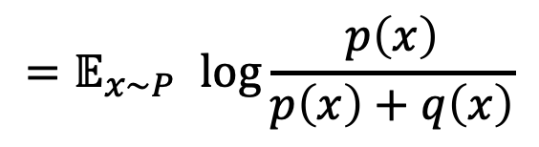
Optimal Solution
$$C\left(G\right)=\max_{D}{V\left(G,D\right)=}$$
$$=𝔼_{x\sim p(x)} log{(D_{φ}^{∗}\left(x\right))}+𝔼_{x\sim q_{θ}(x)} log{(1−log⁡(D_{φ}^{∗}\left(x\right))}=$$
$${=𝔼}_{x\sim P} log{\frac{p\left(x\right)}{p\left(x\right)+q\left(x\right)}}$$
$$+𝔼_{x\sim q_{θ}(x)} log{\frac{q\left(x\right)}{p\left(x\right)+q\left(x\right)}}$$

Slide 16
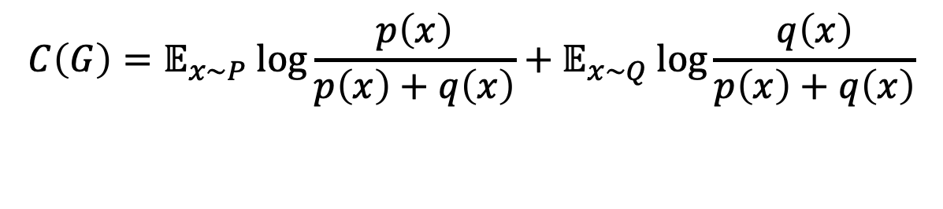

Lower Bound Reminder
In case of ideal discriminator:
This can be compared to variational bound:
Difference is only in $\log{4}$
$$C\left(G\right)=𝔼_{x\sim P} log{\frac{p\left(x\right)}{p\left(x\right)+q\left(x\right)}}+𝔼_{x\sim Q} log{\frac{q\left(x\right)}{p\left(x\right)+q\left(x\right)}}$$
JS$(P|\left|Q\right)≥𝔼_{x\sim p(x)} log{\frac{2p\left(x\right)}{p\left(x\right)+q\left(x\right)}+𝔼_{x\sim q(x)} log{\frac{2q\left(x\right)}{p\left(x\right)+q\left(x\right)}}}$

Slide 17
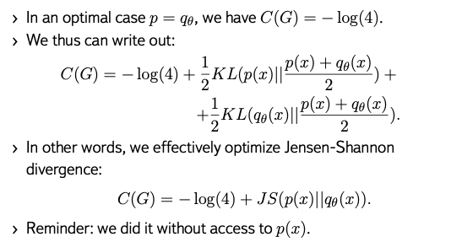
Optimal Solution

Slide 18
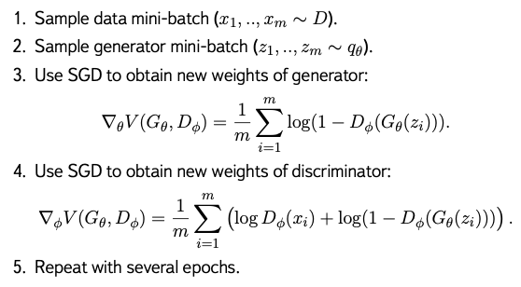
GAN algorithm

Slide 19
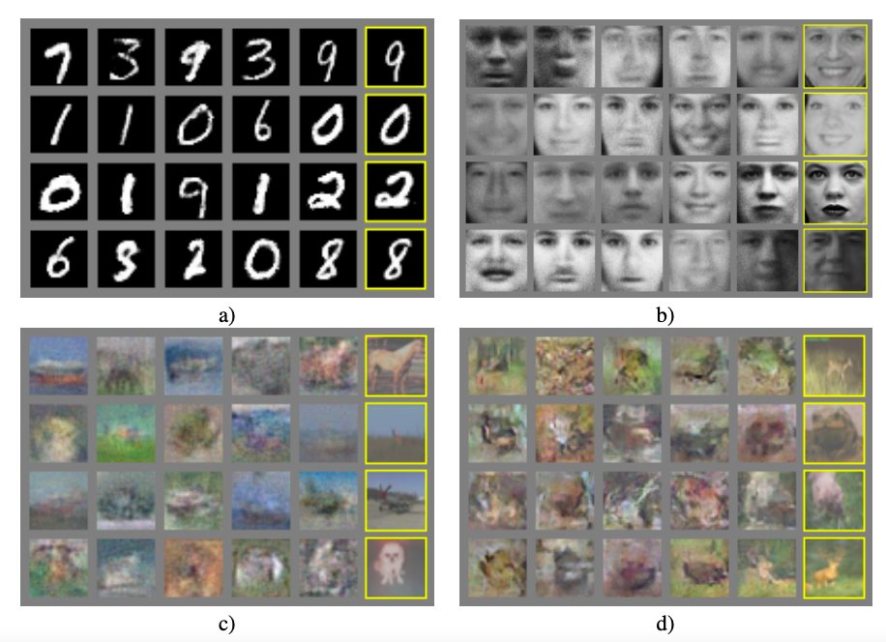
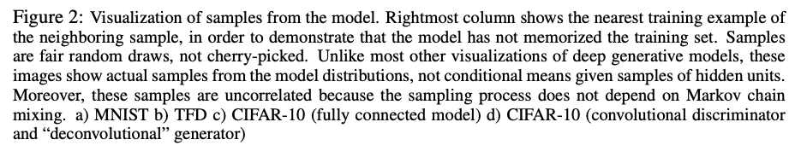
GAN results
I. Goodfellow,et al. Generative Adversarial Networks, NIPS 2014

Slide 20
GAN First Paper Disclaimer
While we make no claim that these samples are better than samples generated by existing methods, we believe that these samples are at least competitive with the better generative models in the literature and highlight the potential of the adversarial framework.
I. Goodfellow, Generative Adversarial Networks, NIPS 2014

Slide 21
GAN problems

Slide 22
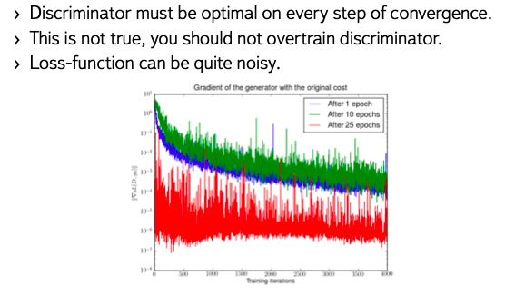
Game Approach Problems
Martin Arjovsky, Towards Principled Methods for Training Generative Adversarial Networks , ICLR17

Slide 23
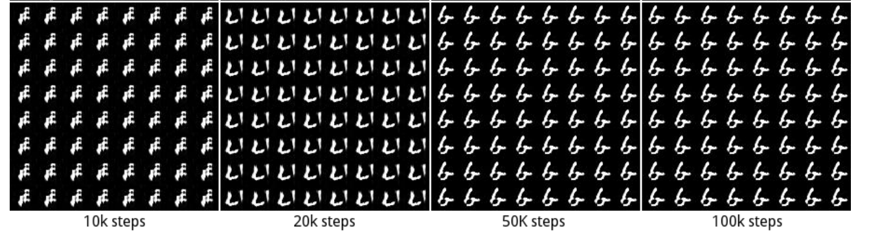
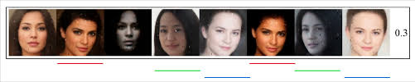
Mode Collapse
GANs choose to generate a small number of modes due to a defect in the training procedure, rather than due to the divergence they aim to minimize.
I. Goodfellow NIPS 2016 Tutorial: Generative Adversarial Network
Luke Metz et al Unrolled Generative Adversarial Networks ICLR 2017

Slide 24
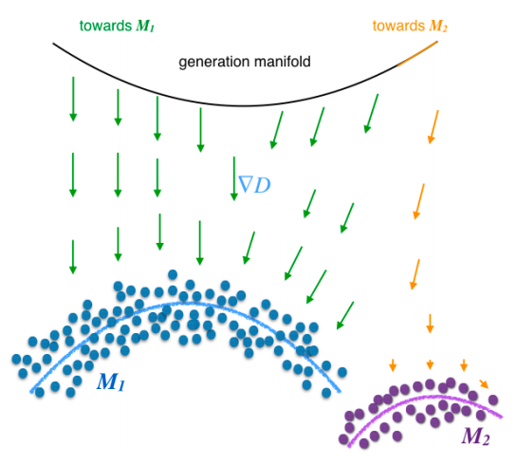
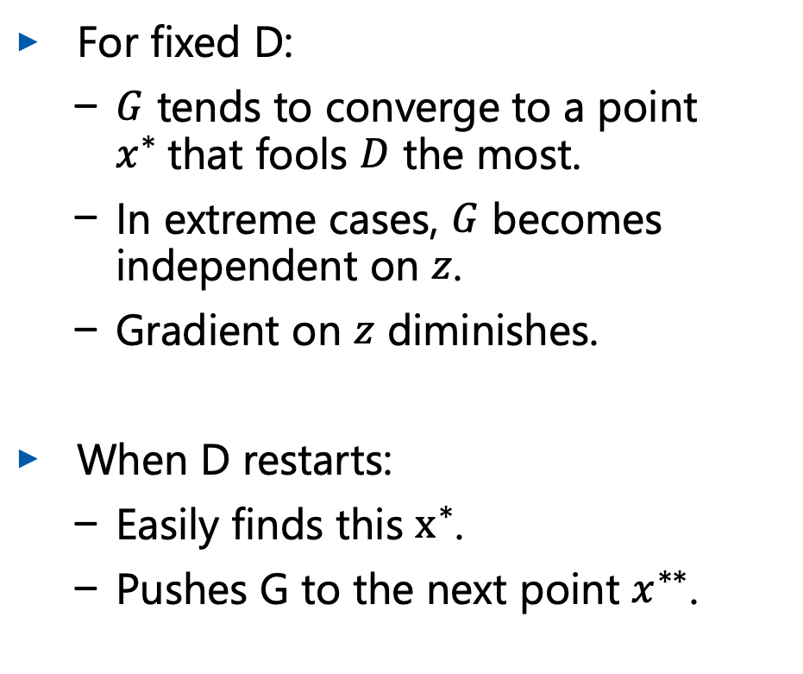
Mode Collapse
For fixed D:
  $G$ tends to converge to a point $x^{∗}$that fools $D$ the most.
  In extreme cases, $G$ becomes independent on $z$.
  Gradient on $z$ diminishes.
When D restarts:
  Easily finds this $x^{∗}$.
  Pushes G to the next point $x^{∗∗}$.
T. Che Mode Regularized Generative Adversarial Networks ICLR 2017

Slide 25
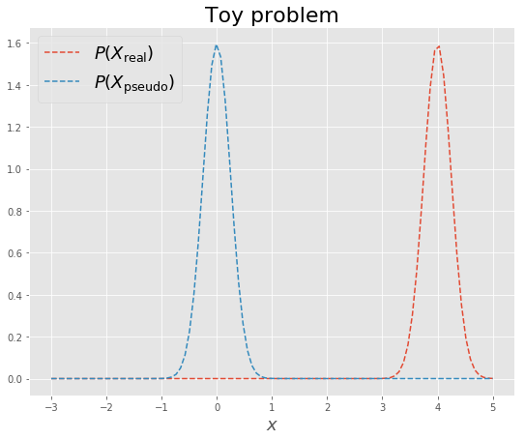
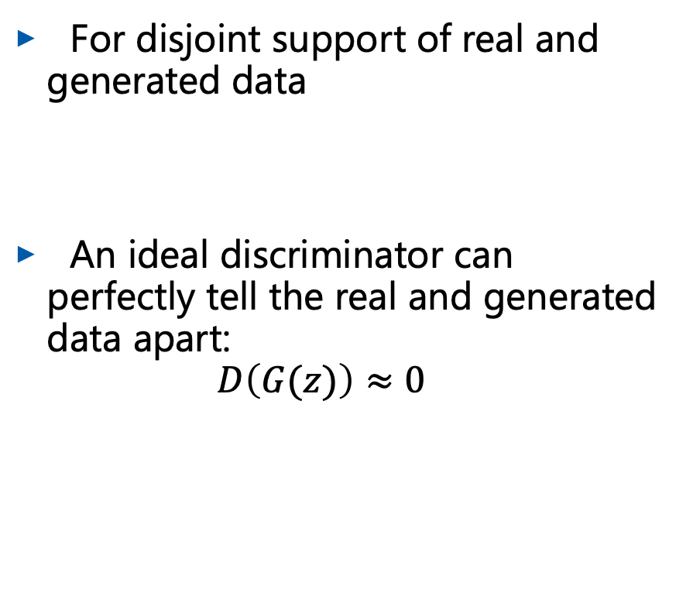
Vanishing Gradients
For disjoint support of real and generated data
An ideal discriminator can perfectly tell the real and generated data apart:
$D\left(G(z)\right)≈0$

Slide 26
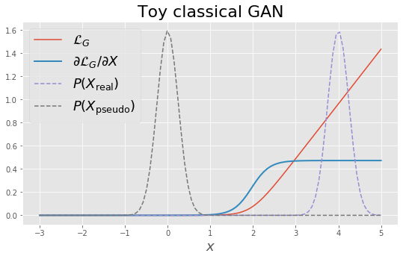
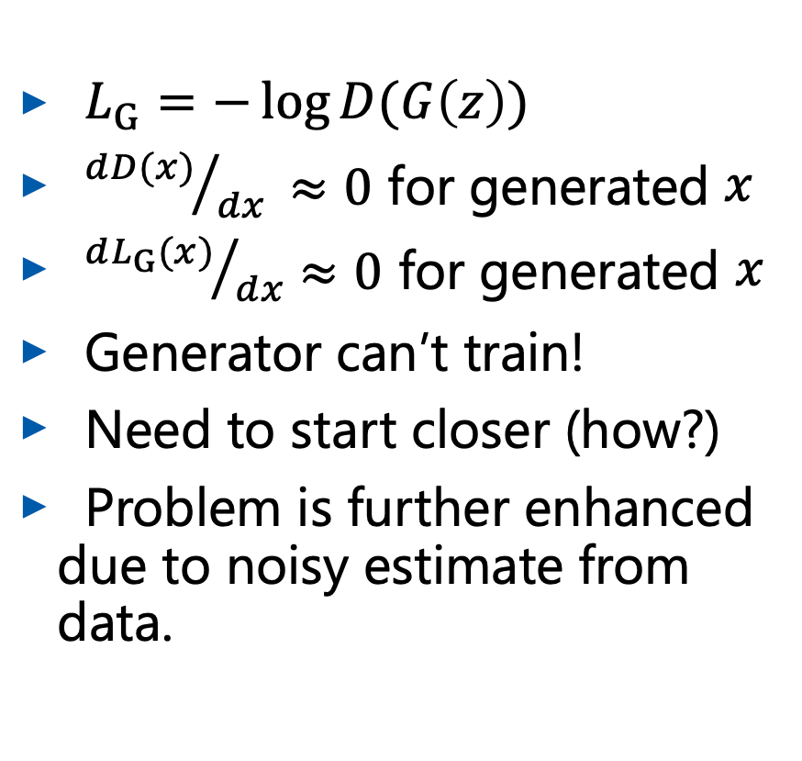
Vanishing Gradients
$L_{G}=−\log{D(G\left(z\right))}$
${dD(x)}/{dx }≈0$ for generated $x$
${dL_{G}(x)}/{dx}≈0$ for generated $x$
Generator can’t train!
Need to start closer (how?)
Problem is further enhanced due to noisy estimate from data.

Slide 27
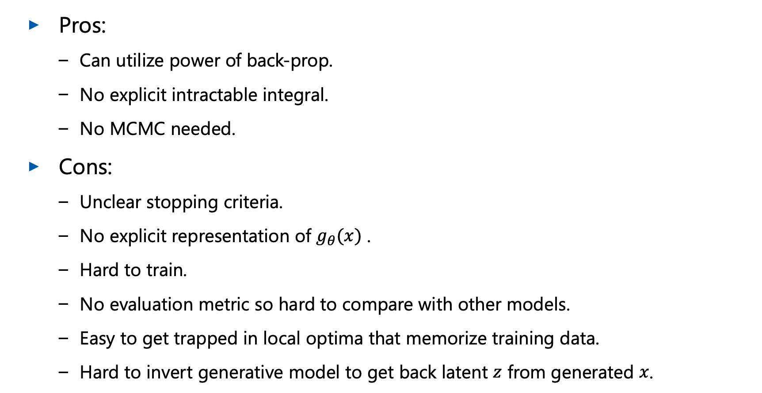
Summary so Far
Pros:
  Can utilize power of back-prop.
  No explicit intractable integral.
  No MCMC needed.
Cons:
  Unclear stopping criteria.
  No explicit representation of $g_{θ}(x)$ .
  Hard to train.
  No evaluation metric so hard to compare with other models.
  Easy to get trapped in local optima that memorize training data.
  Hard to invert generative model to get back latent $z$ from generated $x$.

Slide 28
GAN ways out

Slide 29
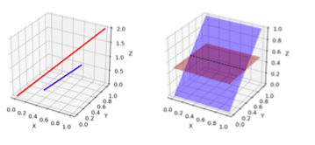
Diminishing Gradients
We have seen already that signal data is located on manifold.
GAN case is in fact more complicated, as we need a discriminator that distinguishes two supports.
This is way too easy, if supports are disjoint.

Slide 30



Diminishing Gradients: Noisy Supports
Let’s make the problem harder: introduce random noise $ε∼N(0;σ^{2}I)$:
$$ℙ_{x+ε(x)} = 𝔼_{y∼P(x)}ℙ_{ε}(x − y).$$
This will make noisy supports, that makes it difficult for discriminator.
Martin Arjovsky, Towards Principled Methods for Training Generative Adversarial Networks , ICLR17

Slide 31
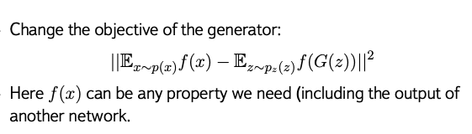
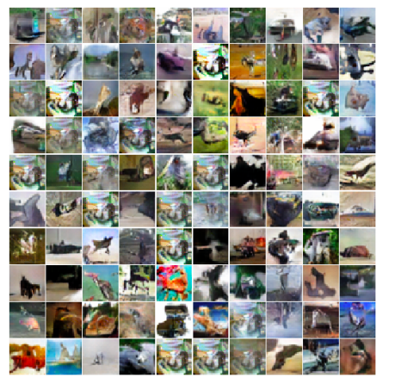
Feature Matching
Danger of overtrain to match known tests!

Slide 32
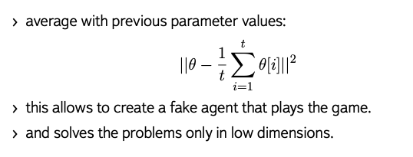
Historical averaging
Salimans et al. Improved Techniques for Training GANs, NIPS16

Slide 33
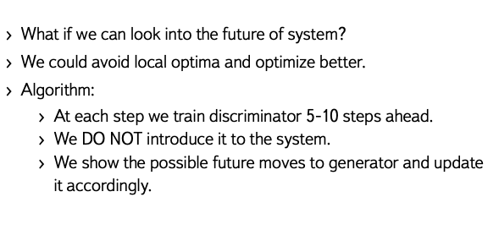
Look into the Future: unrolled GANs

Slide 34
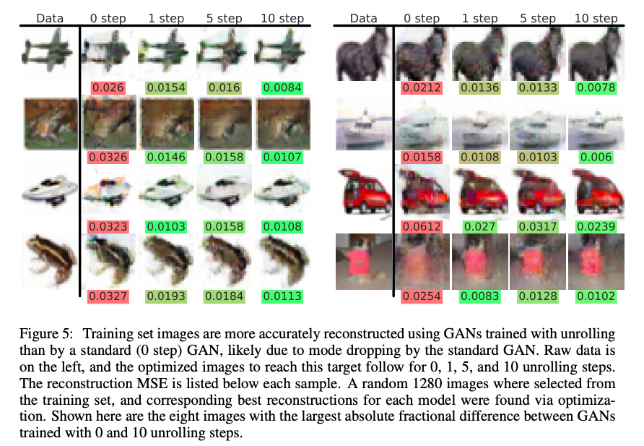
Unrolled GAN: results
Luke Metz et al Unrolled Generative Adversarial Networks ICLR 2017

Slide 35
Conclusions: GANs
use Generator-Discriminator game to estimate the distance from generated distribution to the true one.
produce sharp images.
reconstruct implicit model of target PDF.

Slide 36
Wasserstein Distance

Slide 37
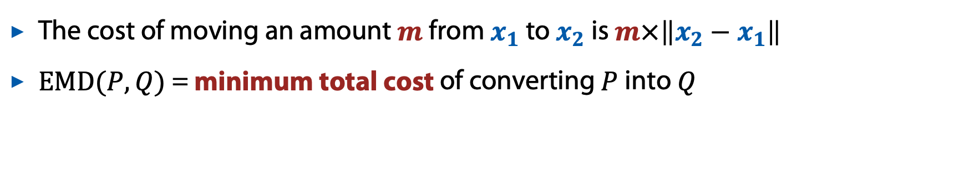

Wasserstein distance
Also called “Earth mover’s distance” (EMD)
Distributions $P\left(x\right)$ and $Q\left(x\right)$ are viewed as describing the amounts of “dirt” at point $x$
We want to convert one distribution into the other by moving around some amounts of dirt
The cost of moving an amount $m$ from $x_{1}$ to $x_{2}$ is $m×\left\|x_{2}−x_{1}\right\|$
$EMD(P,Q)$ = minimum total cost of converting $P$ into $Q$

Slide 38
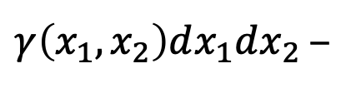
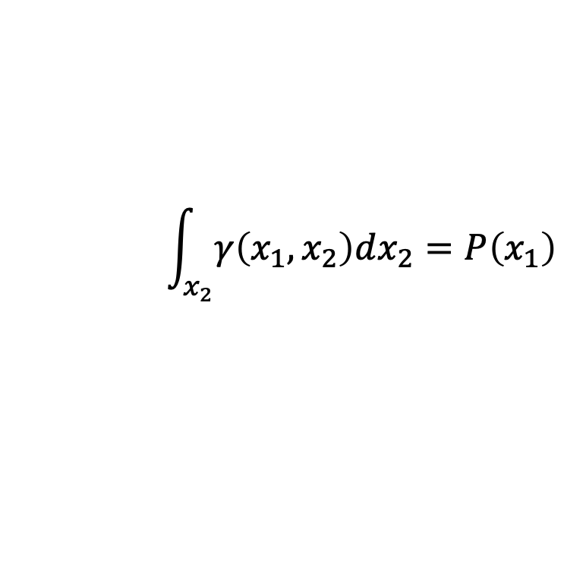
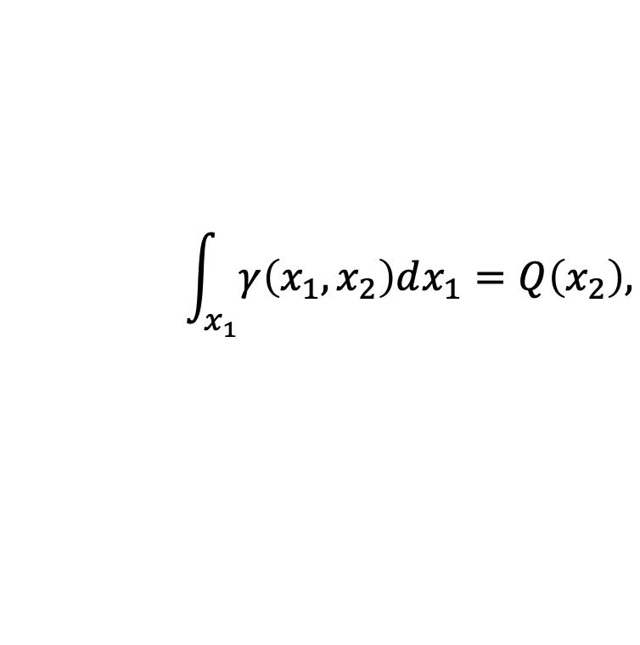
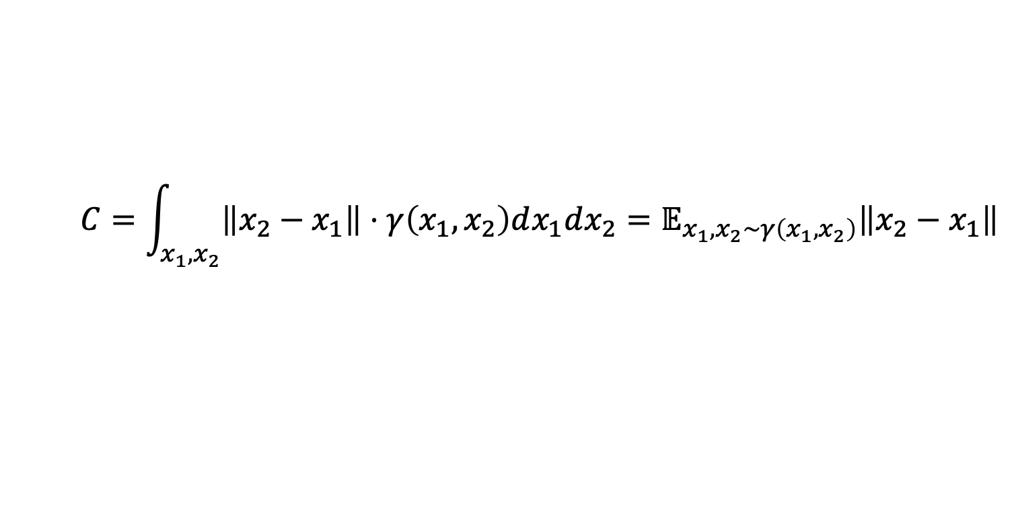
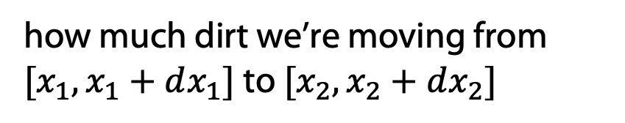

Idea of definition
Say, we have a moving plan $γ\left(x_{1},x_{2}\right)≥0$:
$γ\left(x_{1},x_{2}\right)dx_{1}dx_{2}$ –
how much dirt we’re moving from $[x_{1},x_{1}+dx_{1}]$ to $[x_{2},x_{2}+dx_{2}]$
Then, the cost of moving from $[x_{1},x_{1}+dx_{1}]$ to $[x_{2},x_{2}+dx_{2}]$is:
$$\left\|x_{2}−x_{1}\right\|⋅γ\left(x_{1},x_{2}\right)dx_{1}dx_{2}$$
and the total cost is:
$$C=\int_{x_{1},x_{2}}{\left\|x_{2}−x_{1}\right\|⋅γ\left(x_{1},x_{2}\right)dx_{1}dx_{2}}=𝔼_{x_{1},x_{2}∼γ\left(x_{1},x_{2}\right)}\left\|x_{2}−x_{1}\right\|$$
Since we want to convert $P$ to $Q$, the plan has to satisfy:
$$\int_{x_{1}}{γ\left(x_{1},x_{2}\right)dx_{1}}=Q\left(x_{2}\right),$$
$$\int_{x_{2}}{γ\left(x_{1},x_{2}\right)dx_{2}}=P\left(x_{1}\right)$$

Slide 39



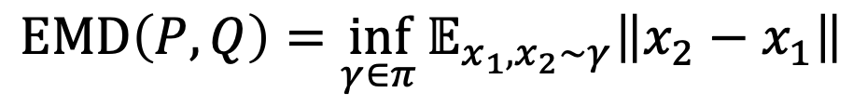

Idea of Definition
Let $π$ be the set of all plans that convert $P$ to $Q$, i.e.:
$$π=\left\{ γ: γ≥0, \int_{x_{1}}{γ\left(x_{1},x_{2}\right)dx_{1}}=Q\left(x_{2}\right), \int_{x_{2}}{γ\left(x_{1},x_{2}\right)dx_{2}}=P\left(x_{1}\right) \right\}$$
Then, the Wasserstein distance between $P$ and $Q$ is:
$$EMD\left(P,Q\right)=\inf_{γ∈π}{𝔼_{x_{1},x_{2}∼γ}\left\|x_{2}−x_{1}\right\|}$$
Optimization over all transport plans – not too friendly

Slide 40

Wasserstein Distance

Slide 41

$W_{1}$distance
Wikimedia

Slide 42



Convergence Example
TV:
KL:
JS:
W:
1
$$∞$$
$$\log{2}$$
$$d_{0}$$
1
$$∞$$
$$\log{2}$$
$$d_{50}$$
0
0
0
0

Slide 43


Mass Attention
$W$ takes into account the distance at which the differences in the distributions are located.
This is exactly what we need to take into account multiple solutions!
Wikimedia

Slide 44

$W$ properties hints
$P$ – true PDF, $Q$ – fitted PDF.
For a sequence of distributions $Q_{n}$:
  $KL(P|\left|Q_{n}\right)→0$ → $JS(P;Q_{n})→0$ → $W\left(P;Q_{n}\right)→0,$ $Q_{n}\underset{→}{D}P$
For $Q_{θ}∼g_{θ}\left(z\right),$ $g_{θ}(z)$ continuos
  $W\left(Q_{θ};Q\right)$ is continuous and can be restricted to differentiable almost everywhere.
  Should we use directly in GAN?

Slide 45



Lipschitz continuity
$f$ is Lipschitz-k continuous if
there exists a constant $k≥0$, such that for all $x_{1}$ and $x_{2}$:
$$\left|f\left(x_{1}\right)−f\left(x_{2}\right)\right|≤k⋅\left\|x_{1}−x_{2}\right\|$$
img from https://en.wikipedia.org/wiki/Lipschitz_continuity

Slide 46

Kantorovich-Rubinstein Duality
$P$ – true PDF, $Q$ – fitted PDF.
$$W(P;Q)=\sup_{f∈Lip_{1}}\left(𝔼_{x∼P }f\left(x\right)−𝔼_{x∼Q}f(x)\right),$$
where $Lip_{1}$ is 1-Lipshitz condition.

Slide 47

Integral Probability Metrics
$p\left(x\right), q(x)$ – PDF.
$$γ_{ℱ}\left(P,Q\right)=\sup\left\{\left|\int{f}dp\left(x\right)−\int{f}dq\left(x\right)\right|:f∈ℱ\right\}$$
$ℱ$ is a class of real-valued bounded measurable functions on $S$.
For $ℱ=\left\{f:\right| \left|f\right|{\left.​\right|}_{L}≤1 \},$ with 1-Lipschitz condition:
$W_{1}$is IPM but not $f$-divergence
B. Sriperumbudur et al. On the empirical estimation of integral probability metrics
S. Nowozin, NIPS2016 workshop talk

Slide 48

Conclusions
Wasserstein-1 is a distance with desired properties.
Kantorovich-Rubinstein duality connects Wasserstein-1 distance to IPM.
Lipschitzeness is needed for above to work.
Wasserstein-1 distance cannot directly be inserted into $f$-GAN style*.
*J. Song et al., Bridging the Gap Between f-GANs and Wasserstein GANs, ICML 2020

Slide 49
Wasserstein GAN

Slide 50






Lipschitz-1 Condition and Neural Networks
$$W(P;Q)=\sup_{f∈Lip_{1}}\left(𝔼_{x∼P }f\left(x\right)−𝔼_{x∼Q}f(x)\right),$$

Slide 51


Lipschitz-1 Condition and Neural Networks
$$W(P;Q)=\sup_{f∈Lip_{1}}\left(𝔼_{x∼P }f\left(x\right)−𝔼_{x∼Q}f(x)\right),$$
$f$ is a neural net – discriminator (‘critic’ in the original paper).
The expectations is estimated from samples.
Lipschitz-1 continuity can be replaced with Lipschitz-k continuity
  estimate $k×W(P,Q)$
  achieved by clipping the weights of the critic: $w→clip(w, −c, c)$ with some constant $c$.
M. Arjovsky et al. Wasserstein GAN

Slide 52
WGAN

Slide 53

WGAN: problems solved
the vanishing gradient problem is solved;
mode collapse problem is addressed;
rom authors: Weight clipping is a clearly terrible way to enforce a Lipschitz constraint. :
https://arxiv.org/abs/1701.07875

Slide 54

WGAN: results

Slide 55





WGAN-GP
Weight clipping makes the critic less expressive and the training harder to converge
Optimal $f$ should satisfy $\left\|∇f\right\|=1$ almost everywhere under $P$ and $Q$
Also: ${\left\|f\right\|}_{L}≤1 ⟺ \left\|∇f\right\|≤1$
Can replace weight clipping with a gradient penalty term:
Largest gradient constrained here
$$ℙ_{\tilde{x}} : \left[\begin{matrix}\tilde{x}=αx_{1}+\left(1−α\right)x_{2} \\ α∼Uniform\left(0, 1\right) \\ x_{1}∼P \\ x_{2}∼Q\end{matrix}\right]$$
$$GP=λ\int{\max\left[{\left(\left\|∇_{\tilde{x}}f\left(\tilde{x}\right)\right\|−1\right)}^{2}\right]}dx$$
$$GP=λ𝔼_{\tilde{x}∼ℙ_{\tilde{x}}}\left[{\left(\left\|∇_{\tilde{x}}f\left(\tilde{x}\right)\right\|−1\right)}^{2}\right]$$
Ishaan GulrajaniImproved Training of Wasserstein GANs

Slide 56

WGAN-GP
Weight clipping makes the critic less expressive and the training harder to converge
Optimal $f$ should satisfy $\left\|∇f\right\|=1$ almost everywhere under $P$ and $Q$
Also: ${\left\|f\right\|}_{L}≤1 ⟺ \left\|∇f\right\|≤1$
Can replace weight clipping with a gradient penalty term:
$$ℙ_{\tilde{x}} : \left[\begin{matrix}\tilde{x}=αx_{1}+\left(1−α\right)x_{2} \\ α∼Uniform\left(0, 1\right) \\ x_{1}∼P \\ x_{2}∼Q\end{matrix}\right]$$
$$GP=λ𝔼_{\tilde{x}∼ℙ_{\tilde{x}}}\left[{\left(\left\|∇_{\tilde{x}}f\left(\tilde{x}\right)\right\|−1\right)}^{2}\right]$$
or alternatively (‘one-sided’ penalty):
$$GP=λ𝔼_{\tilde{x}∼ℙ_{\tilde{x}}}\left[{\max\left(0, \left\|∇_{\tilde{x}}f\left(\tilde{x}\right)\right\|−1\right)}^{2}\right]$$
Ishaan GulrajaniImproved Training of Wasserstein GANs

Slide 57


WGAN: spectral normalization
Miyato et al. Spectral Normalization for Generative Adversarial Networks, ICLR 2018

Slide 58

WGAN: problems
M. Bellemare et al. The Cramer Distance as a Solution to Biased Wasserstein Gradients

Slide 59
Conclusions
WGAN is a power generative model.
Simpler training procedure but need to control Lipschitz continuity
Several ideas how do this.
Still problems:
  Kantorovich-Rubinstein duality only mimicked;
  gradient is stuck near solutions.

