Slide 1



Status of the Gentner Programme
40 Gentner students as of 1 October 2021 (39 students nominal)
+ further 9 German students in regular Doctoral Student Programme
10 new students since last Gentner Day (October 2020)
2 students currently with Covid-19 extension
Covid-19 extensions granted for 13 Gentner students until now
now 35% female students (14/40)
new record, continuous raise since 2018 (only ~13% women in 2018)
175 Gentner students since November 2007
40 active students + 135 former students
Students from 36 German universities (since November 2007)
no new university since last Gentner Day

Slide 2
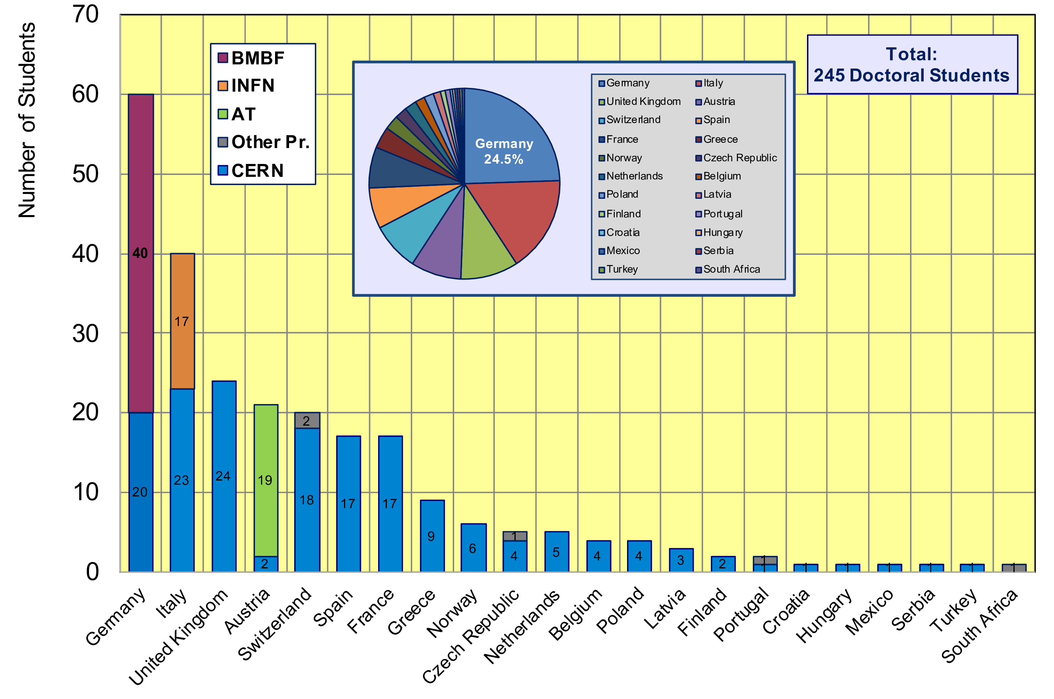
CERN Doctoral Students
Country of Home University of all CERN Doctoral Students
60/245 Students enrolled at German Universities (24.5%)

Slide 3
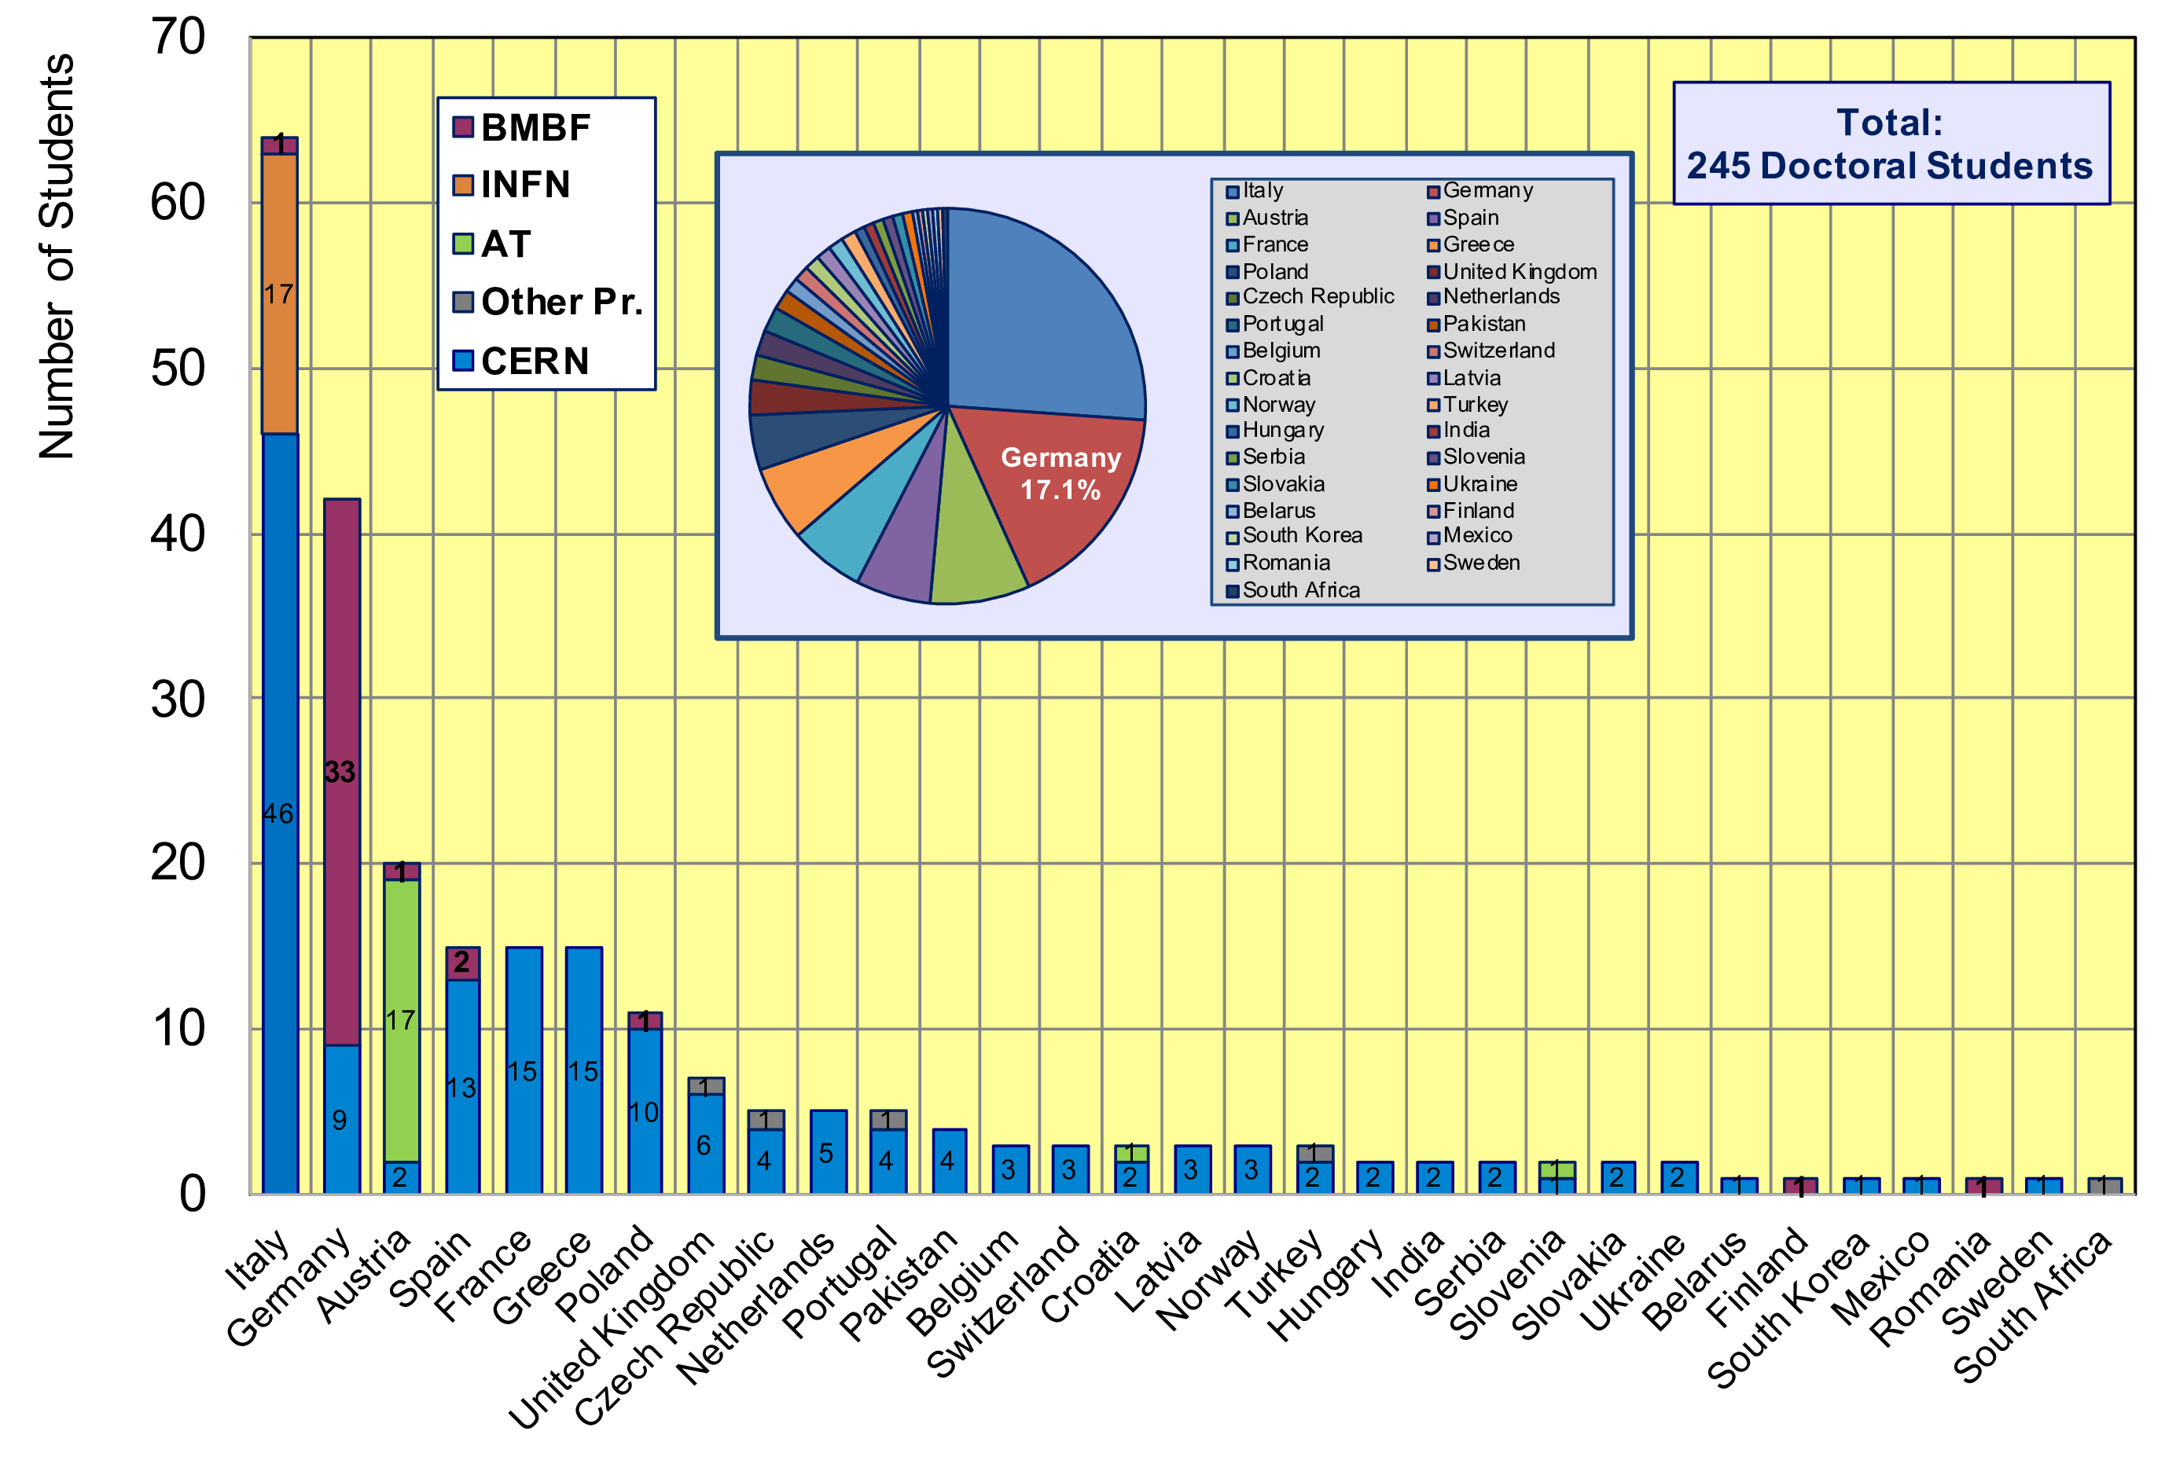
CERN Doctoral Students
Nationalities of all Doctoral Students at CERN
Italians (64 students, 26.1%) and Germans (42 students, 17.1%) leading

Slide 4
Travel I
Duty travel possible again since Covid-19 level-2 (yellow)
Travel supported by the Gentner Programme (reminder)
for Students
travel to home university + to German national symposia
for Supervisors (in Germany and at CERN)
travel from/to Germany
Note
“Gentner travel” bound to general CERN travel rules for duty travel
CERN travel rules changed in January 2020 (just before Covid-19)
tickets need to be booked through traveldoo portal and/or CWT travel agency
no reimbursement of self-booked tickets (possible at old rules)

Slide 5
Travel II
New EDH travel document since May 2021
simplification of travel claim after return, but still complex document...
two separate EDH documents needed before (travel request + travel claim)
now single EDH travel document
Reimbursement according to Gentner Programme travel rules (reminder)
Conference fees (if travel to German national symposia)
Accommodation: real costs
CERN rate for meals: 2 x 25 CHF/day (Hamburg/Berlin: 2 x 34 CHF/day)
Misc expenses: 10 CHF/day (e.g. local public transport, only if costs incurred)
Gentner FAQ was updated according to new EDH travel document
after discussion with + input from FAP travel responsible
see for details:
https://cern.ch/gentner/en/faq.php#Travel

Slide 6


Advertisement
When travelling to your home university
→ think of advertising the Gentner Programme
Brochures + posters available (in German)
CERN Overview
statements and photos of 8 (now) former Gentner students
thesis topics + contact persons
programme information + how to apply
download: https://cern.ch/gentner/de/brochure.php
printed copies available on request

Slide 7
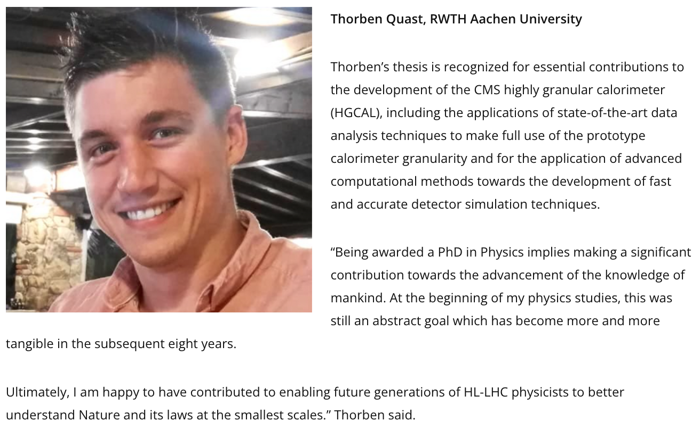
Awards for former Gentner Students I
CMS Thesis Award 2020 for Thorben Quast
The award includes a plaque of recognition and a proposal to have the thesis endorsed by CMS for publication in the Springer Theses series that recognizes exceptional PhD theses in the physical sciences.
https://cms.cern/news/cms-thesis-award-winners-2020

Slide 8
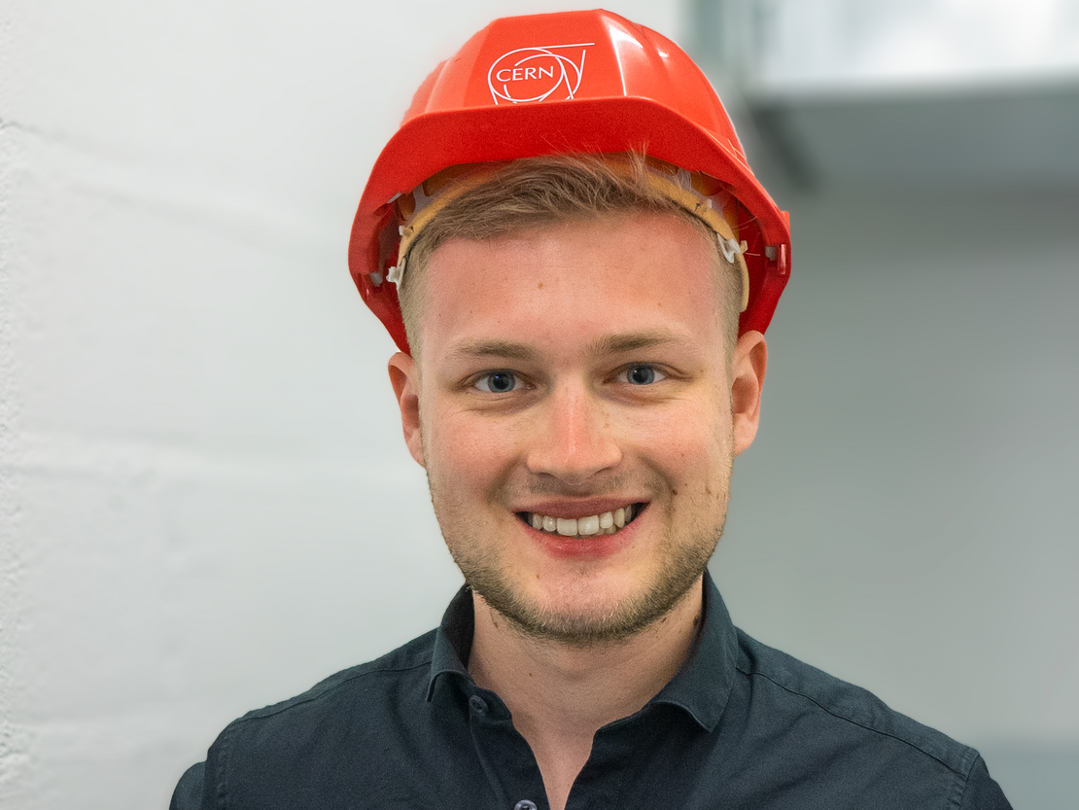
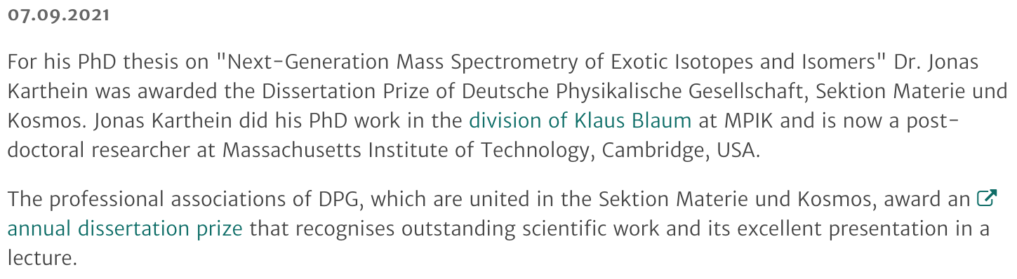
Awards for former Gentner Students II
DPG Dissertation Prize for Jonas Karthein
The dissertation prize is endowed with 1’500 EUR + 500 EUR for travel
https://www.mpi-hd.mpg.de/mpi/en/public-relations/news/news-item/dpg-dissertation-prize-for-jonas-karthein

Slide 9
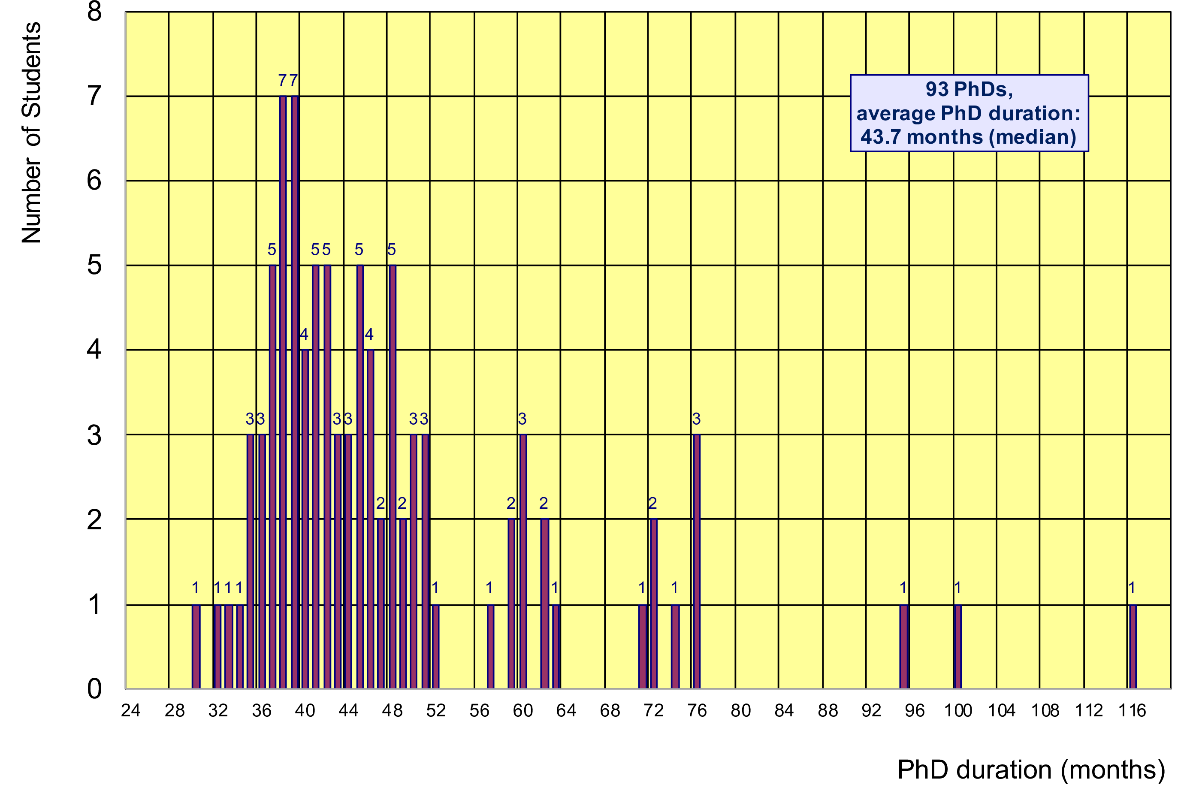
PhD Statistics
93 finished PhDs so far, cancelled PhDs: 12, uncertain: 5 (13% total)
average age at PhD (defence): 30.7 years (median)
average PhD duration: 43.7 months (median) = 7.7 months after end of CERN 3-years contract
Physics PhDs in Germany (2020)
21.4% female PhDs students
31.0 years (median) at PhD defence
53.0 months (median) duration of PhD
10/93 students (11%)
with ≤ 3 years
36 months

Slide 10
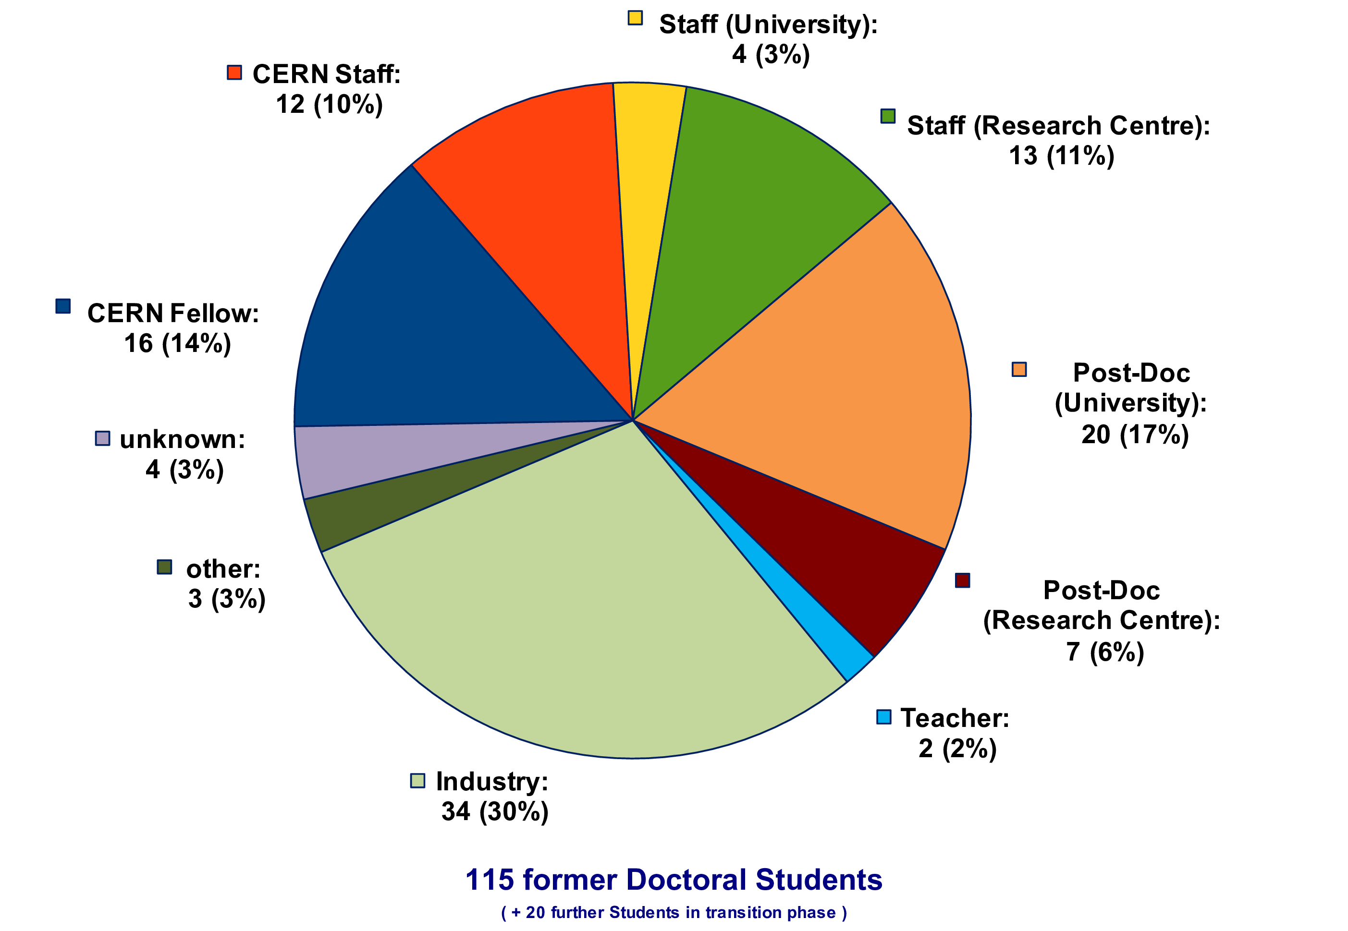
Whereabouts of Gentner Students (present employment)
> 60% of former students still in academic research
academic research (CERN, other Research Centre, University): 62%
industry: 30%
today’s guest speaker:
Pascal Hermes

Slide 11
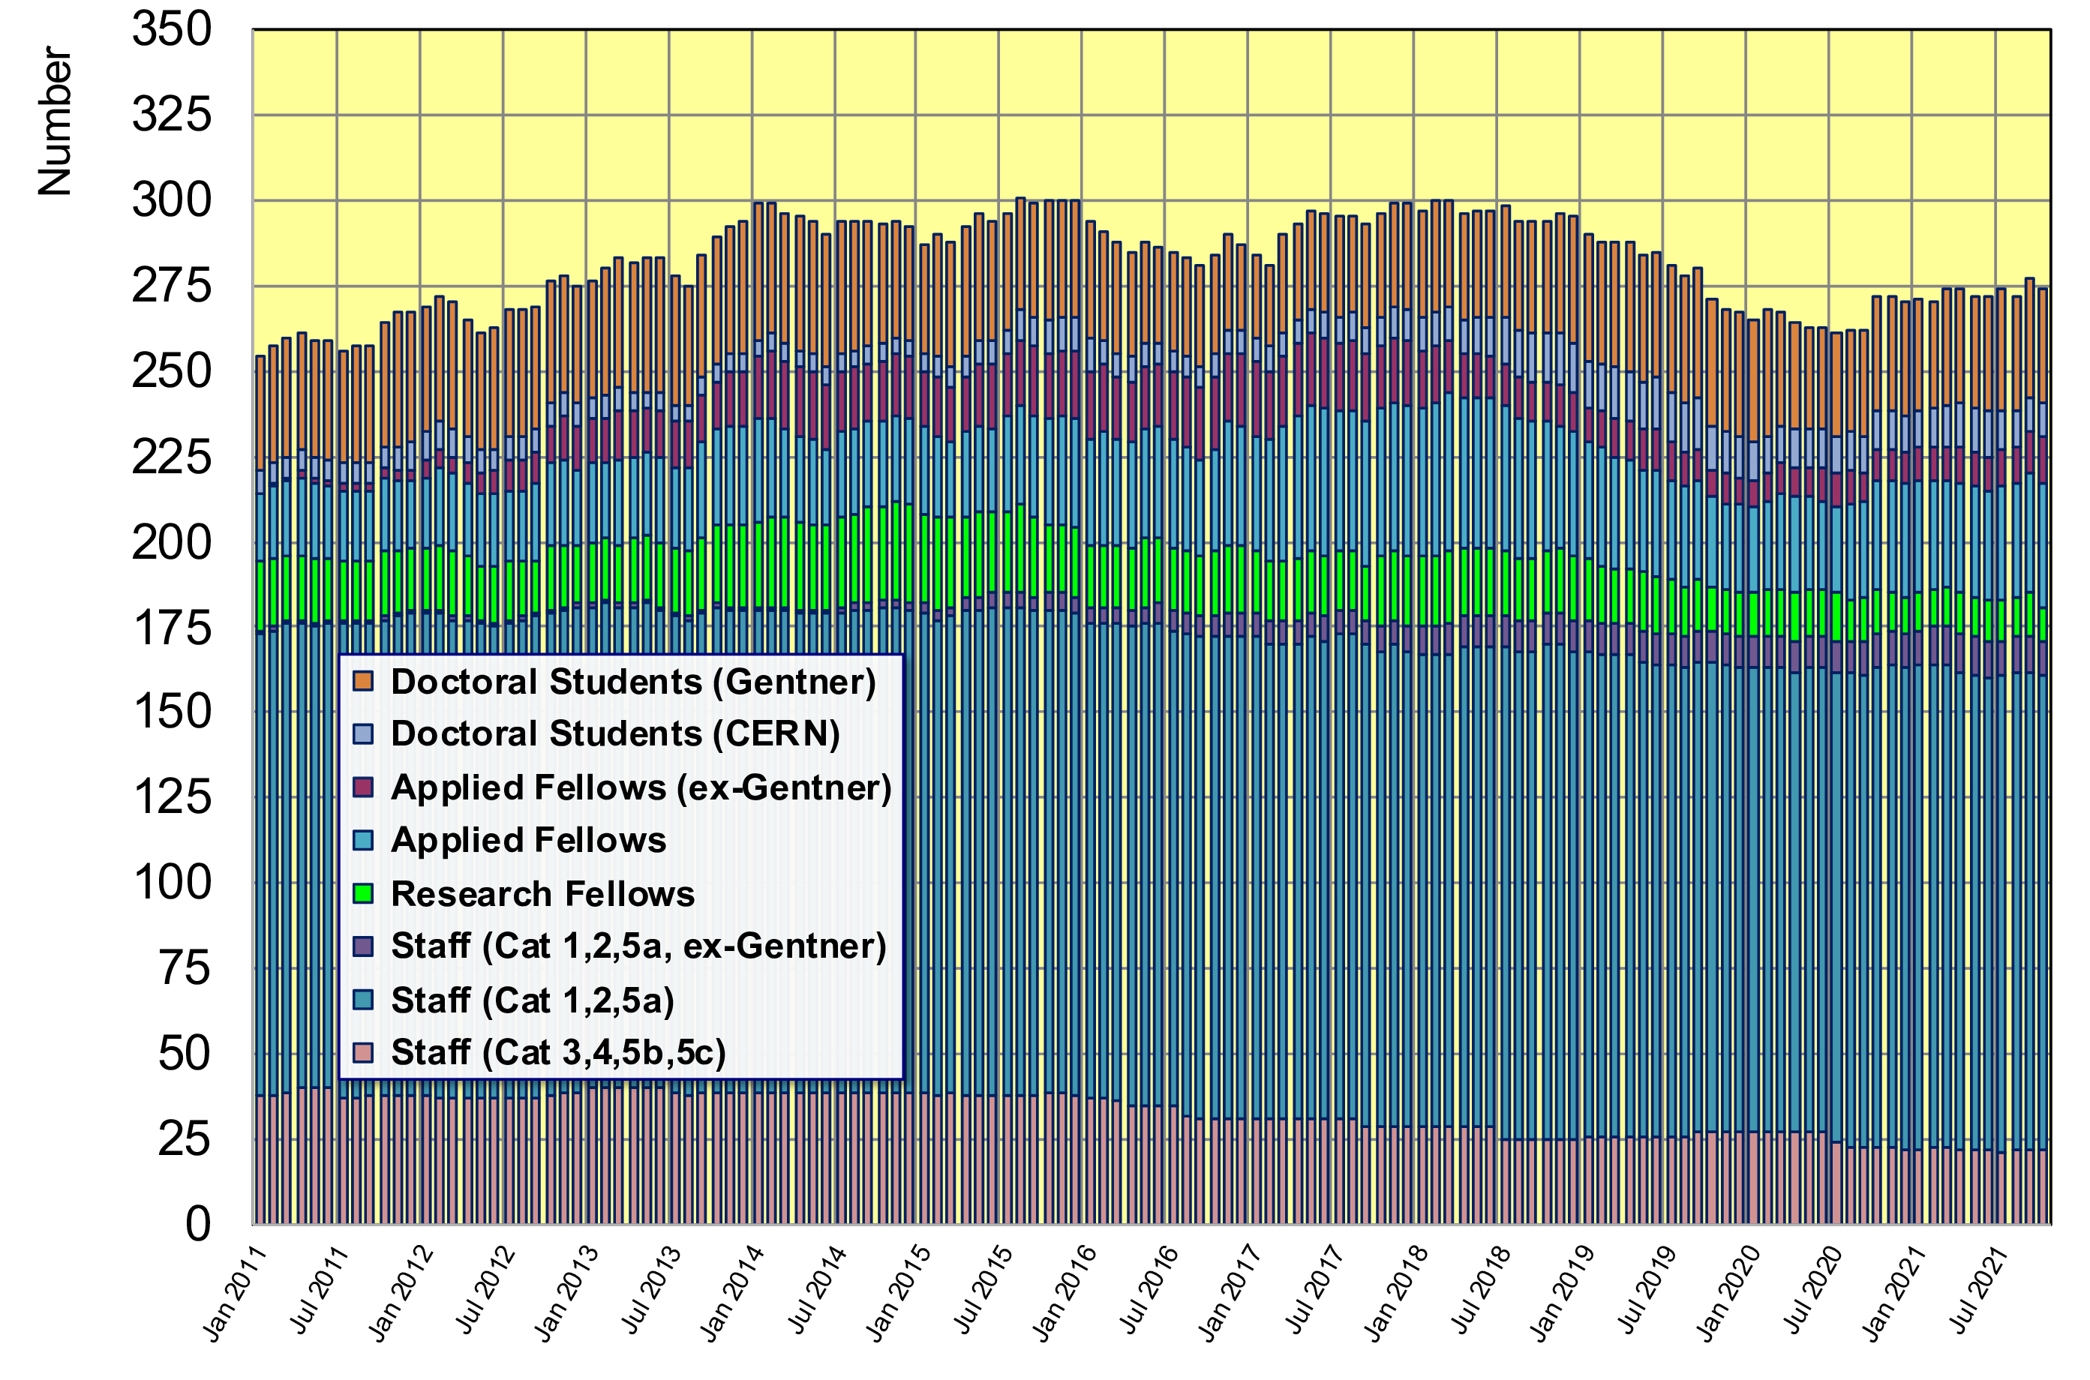
Gentner Students → Fellows, Staff
273 German Doctoral Students, Fellows and Staff at CERN in total
of those: 31 active + 24 former Gentner Students (= 20%)
(ex-)Gentner
DOCT
Fellows
Staff

Slide 12
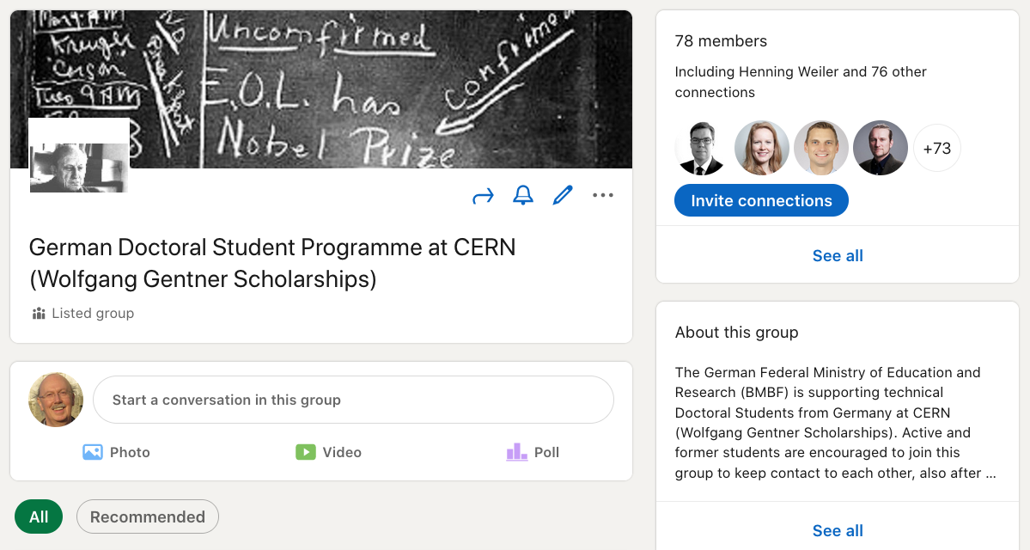
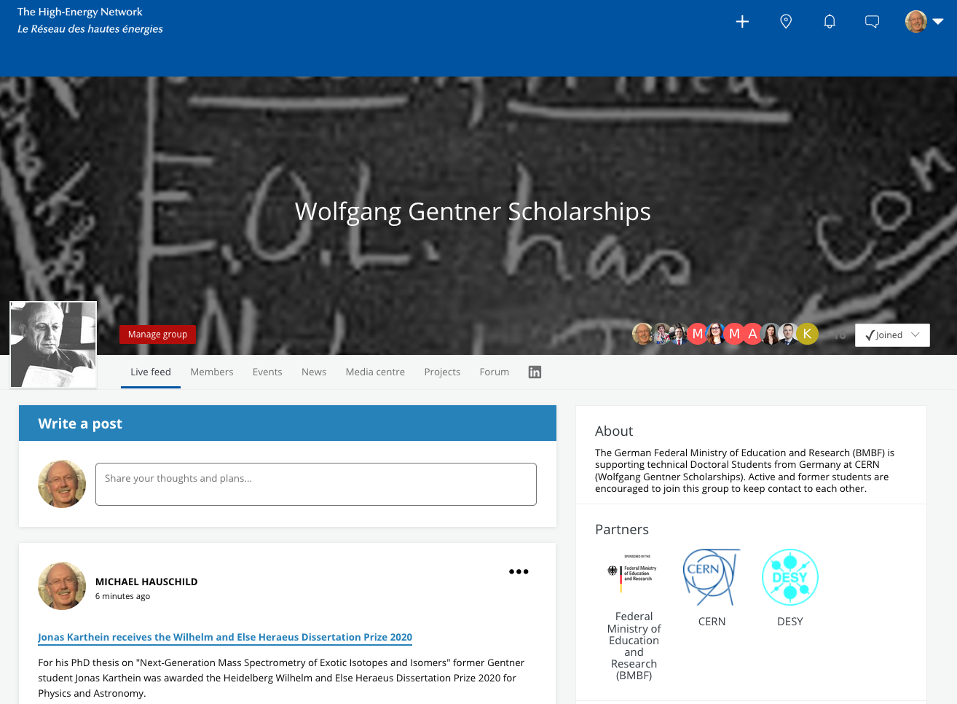
How to Stay Connected
LinkedIn:
https://www.linkedin.com/groups/8511060/
Gentner Groups at LinkedIn
and CERN Alumni Programme
for former AND active Gentner students
CERN Alumni:
https://alumni.cern/topics/597/feed
please join!

Slide 13
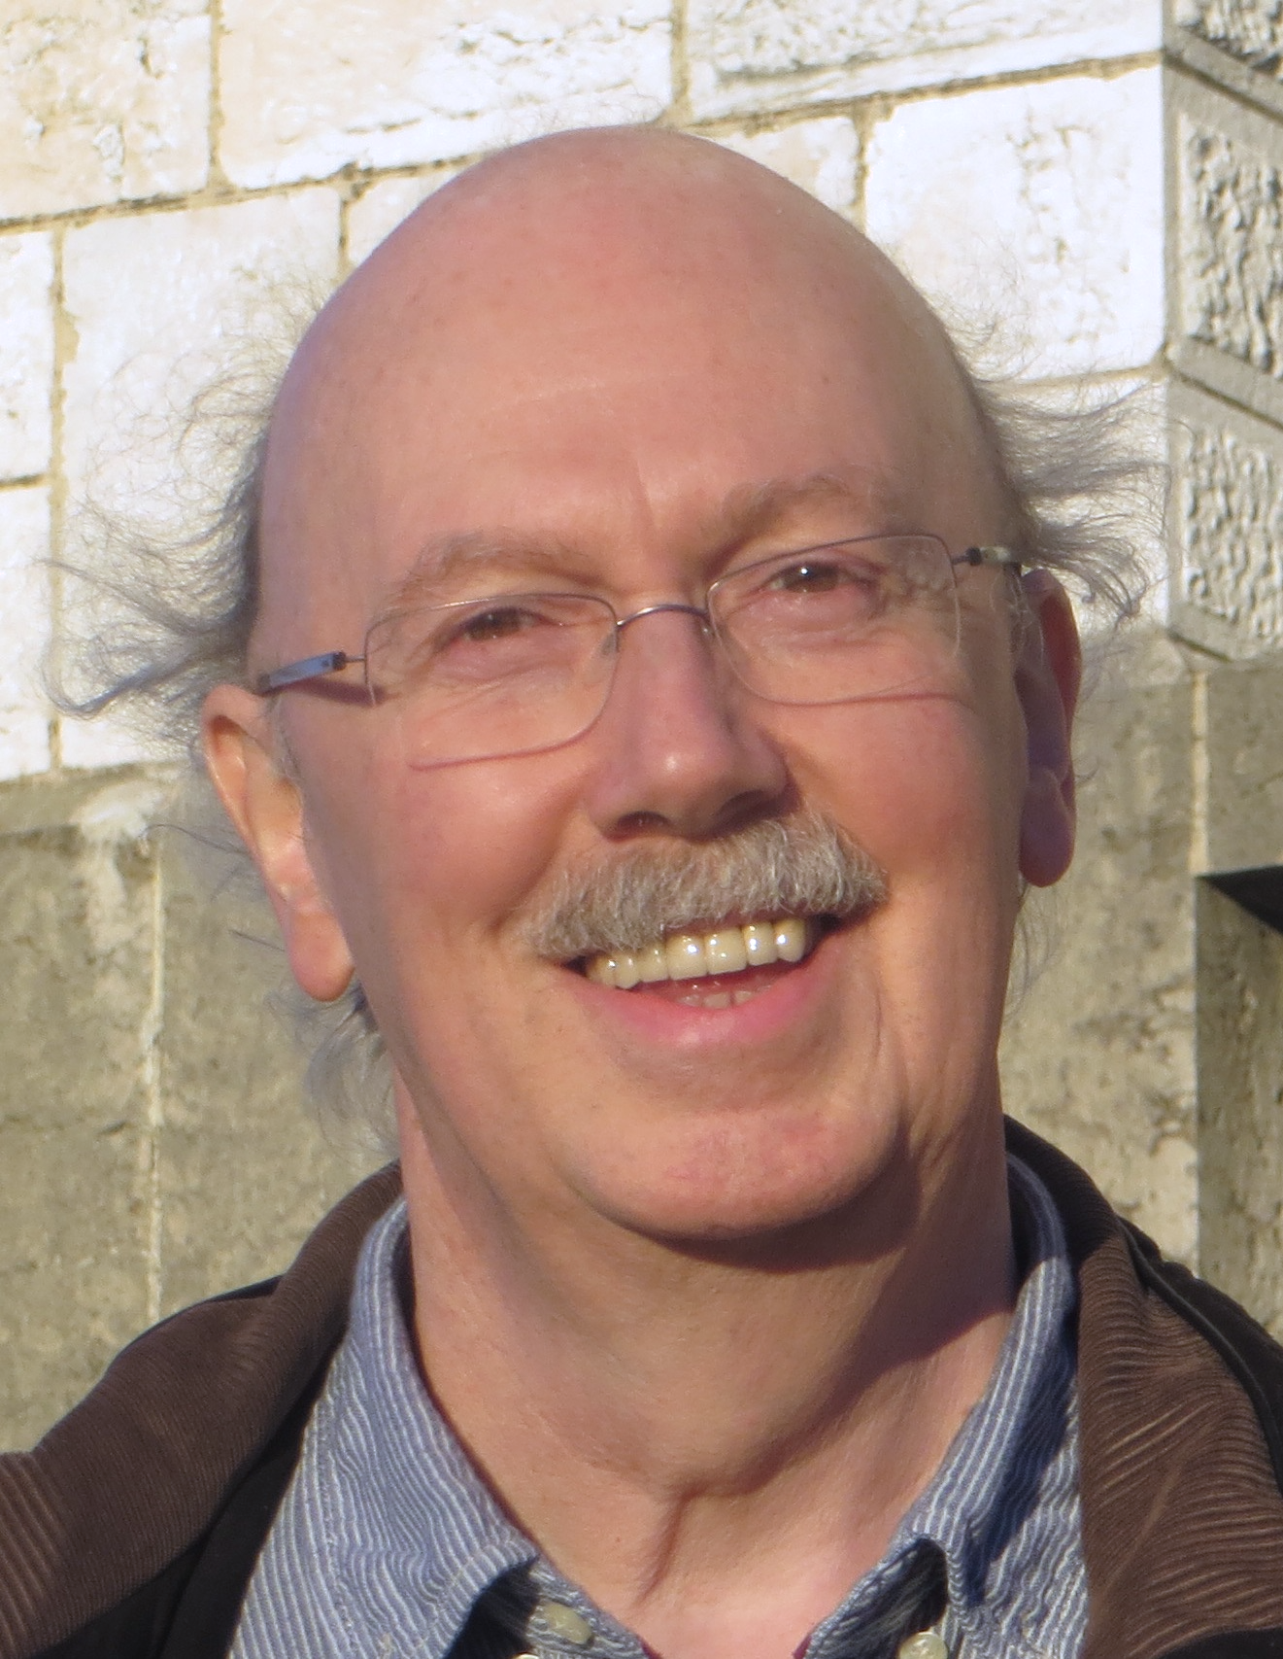
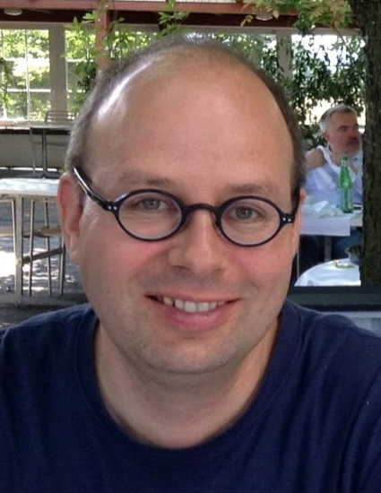
Gentner Coordination
Change of Gentner Coordination as of 1 January 2022
Michael Hauschild Dominik Dannheim
Some personal notes
was a real pleasure to be “your” Gentner Coordinator for 14 years
saw many excellent students and followed their career at CERN or elsewhere
will now retire as staff early 2022
but will continue to be connected with the Gentner Programme in advisory role
will try to follow your whereabouts also over the next years

Slide 14
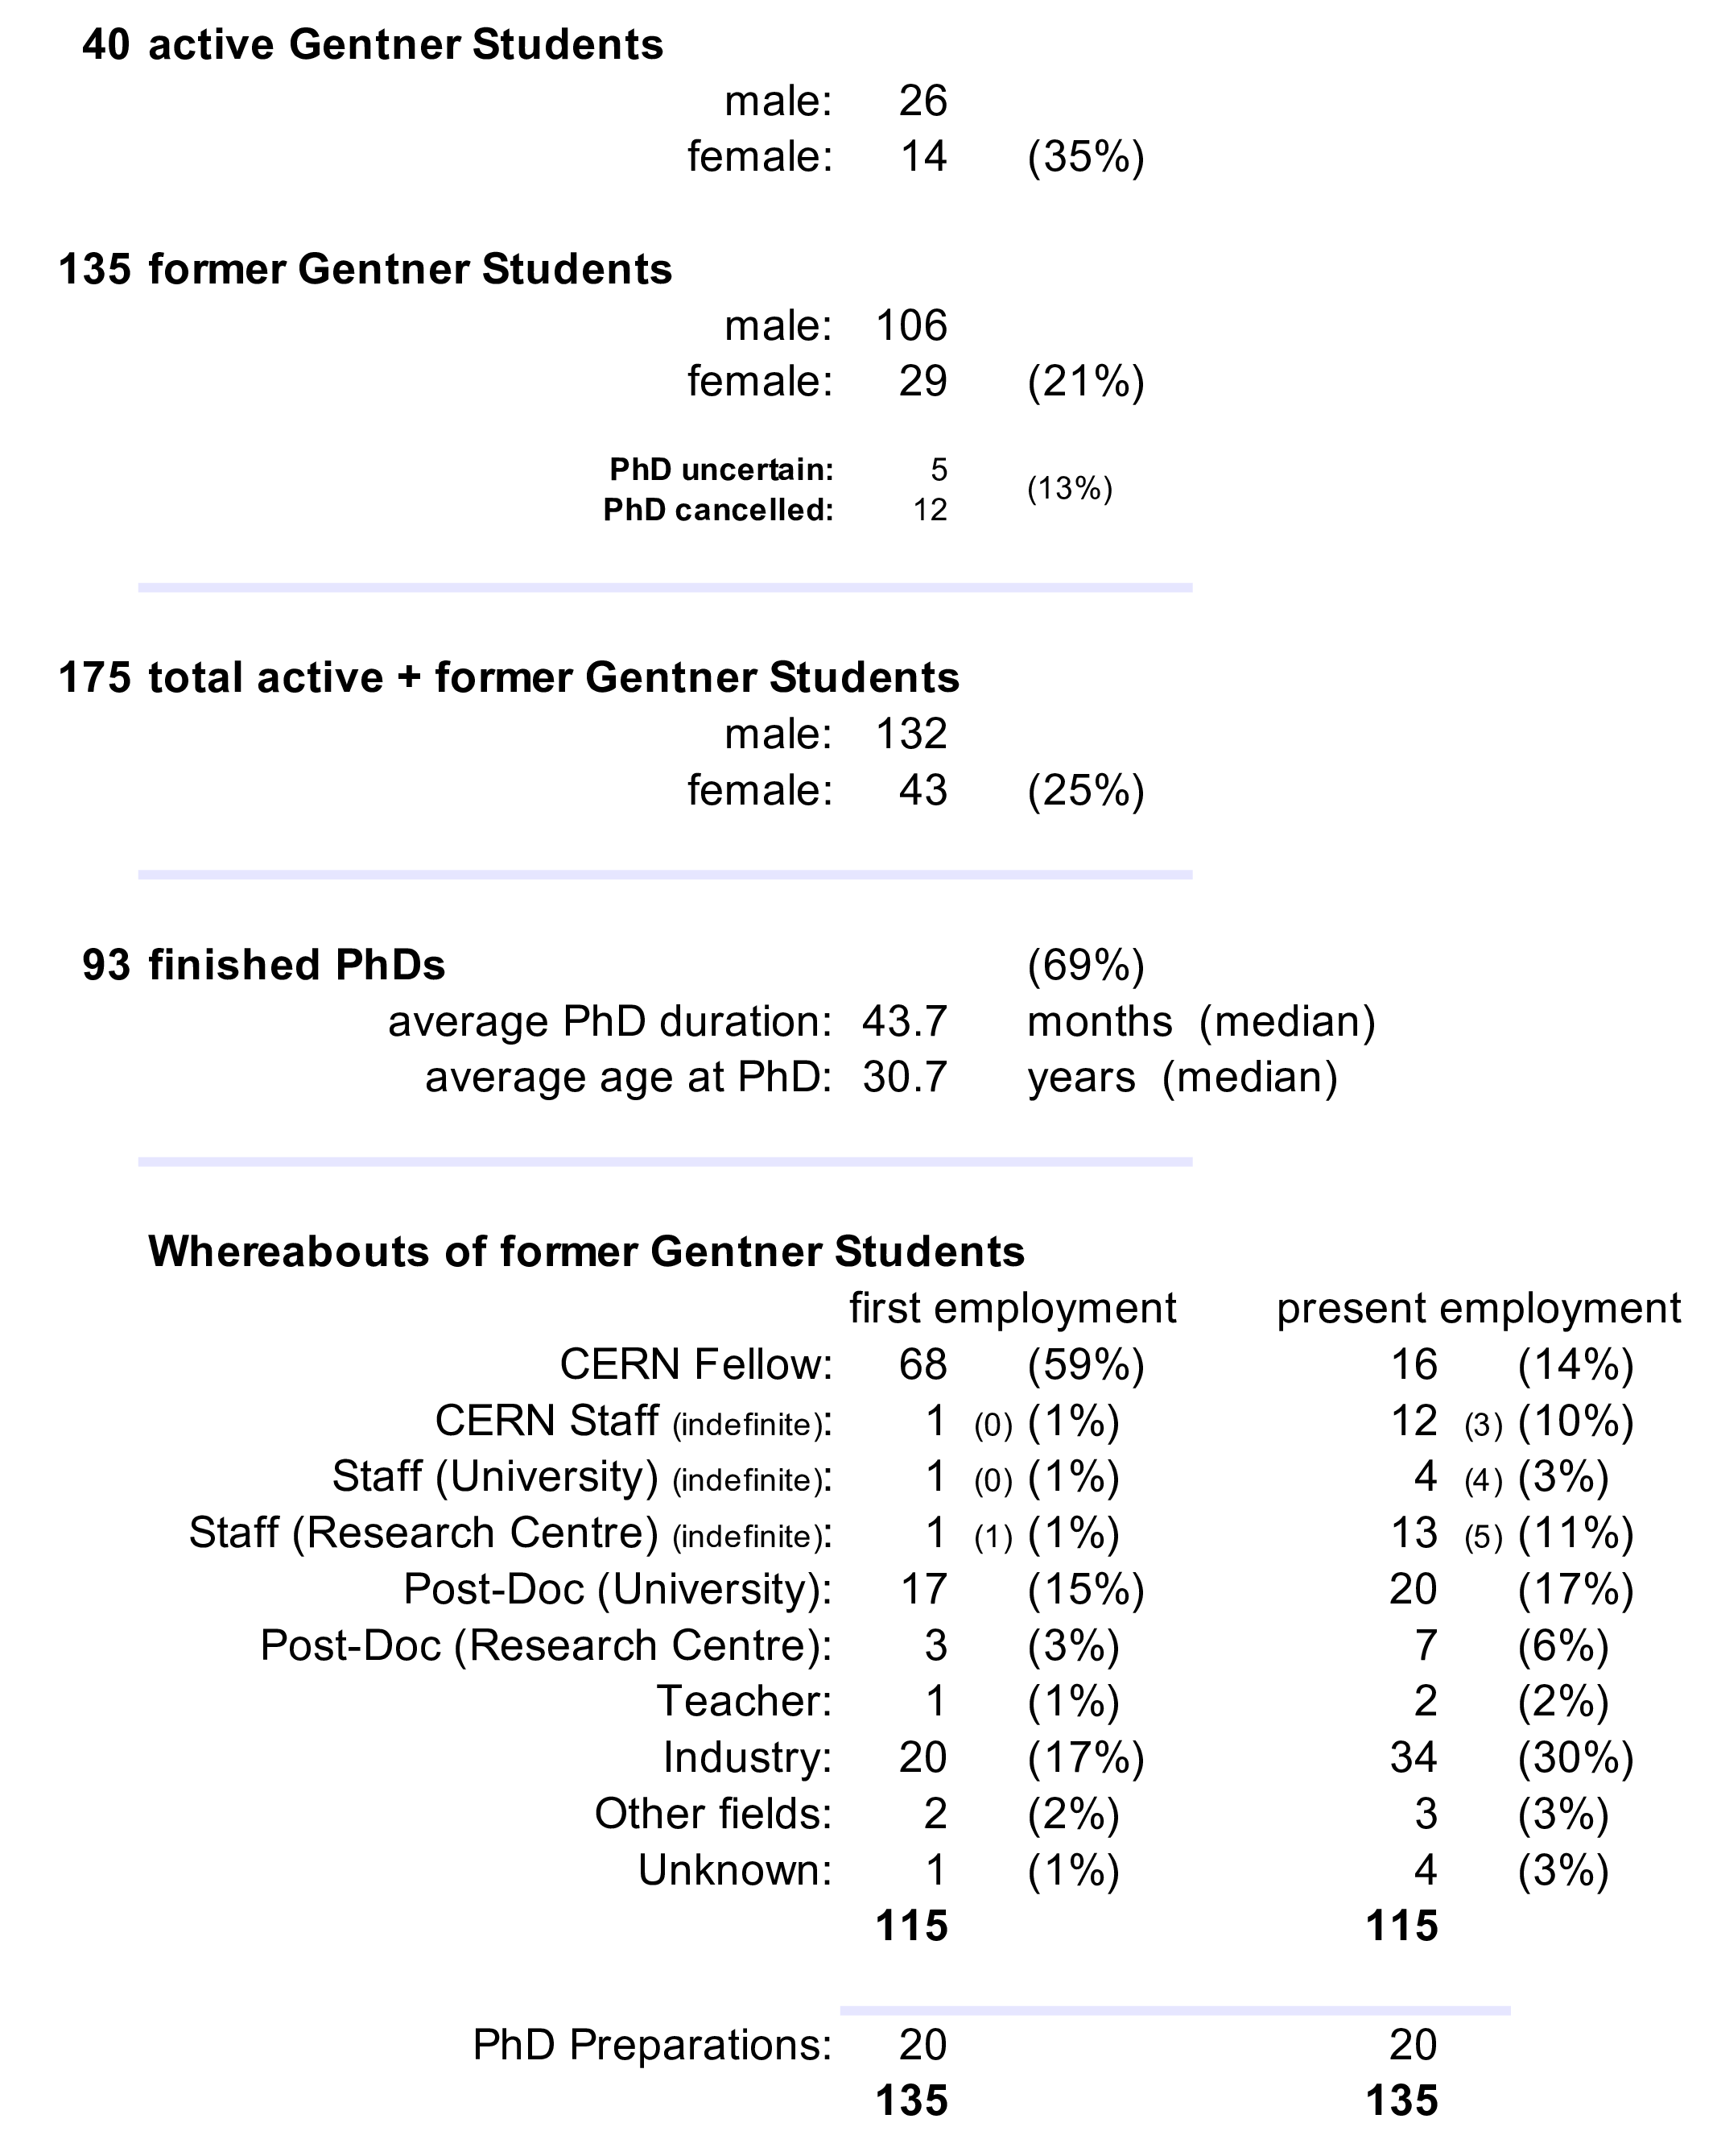
Summary Gentner Programme
number of female students now at 35%
was ~13% in 2018
duty travel possible again
new EDH travel document
change of Gentner coordination (as of 1 January 2022)
Michael Hauschild → Dominik Dannheim
Next Gentner Day:
27 April 2022 (tbc)

