Slide 2

PUMA @ ISOLDE
Status, plans and timeline

Slide 3
Outline:
Present situation
- MIRACLS setup at LA2
- Preparations RC6 zone
New concept MIRACLS/MR-ToF at RC6
- (new) requirements
Timeline
Next steps

Slide 4
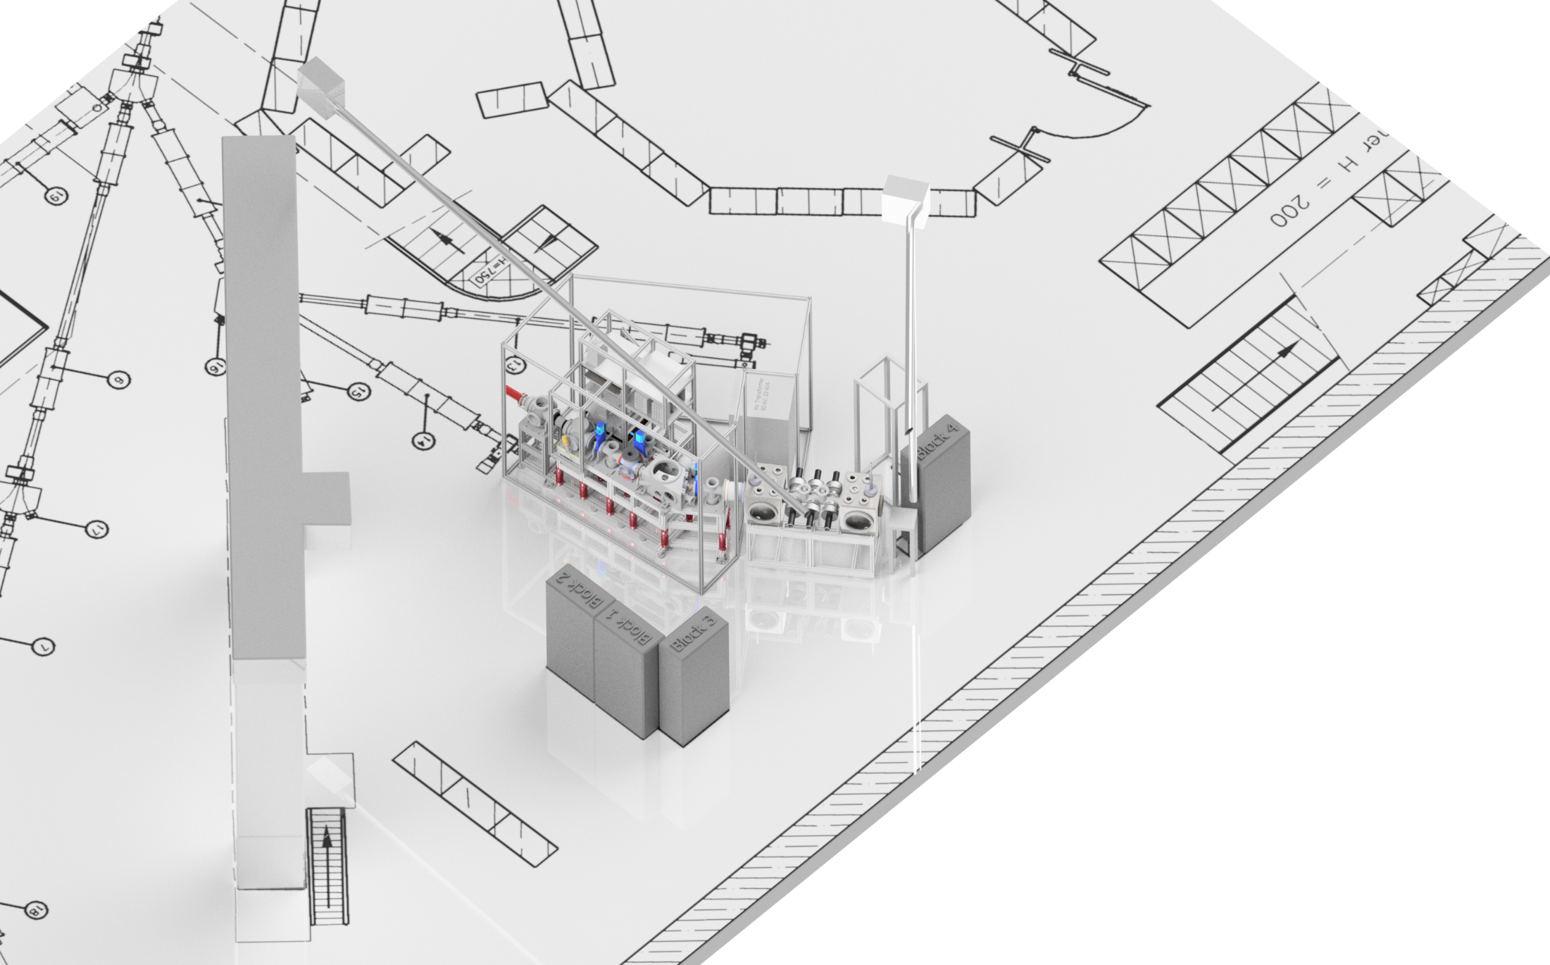
Present situation: MIRACLS at LA2
aaa
To 508
MIRACLS
CRIS
COLLAPS
Courtesy: Markus Vilen

Slide 5
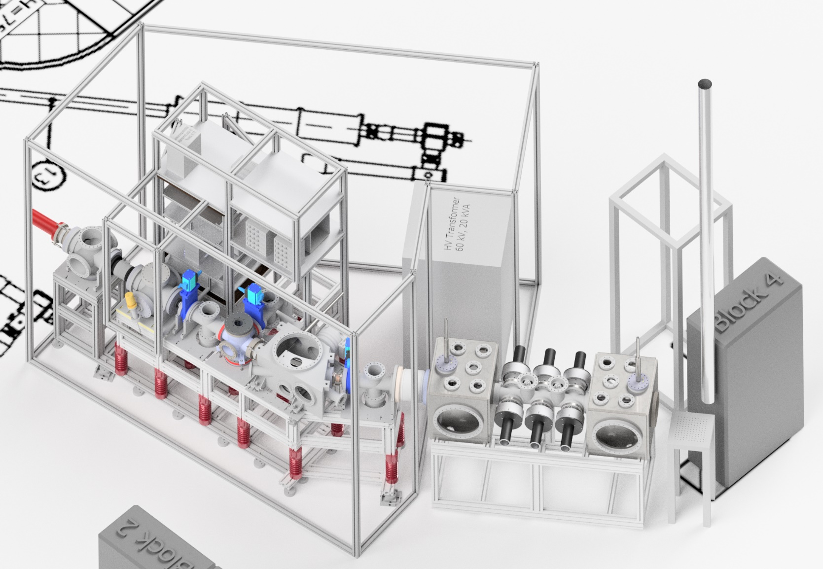
Courtesy:
Markus Vilen
Details: MIRACLS at LA2
Offline ion source
Laser
Injection optics
Paul trap (300K)
2-keV extraction
Quadrupole bender
30 deg bender
Reacceleration
2 keV → 50 keV
MR-ToF mirror
Optical detection region
MR-ToF mirror

Slide 6
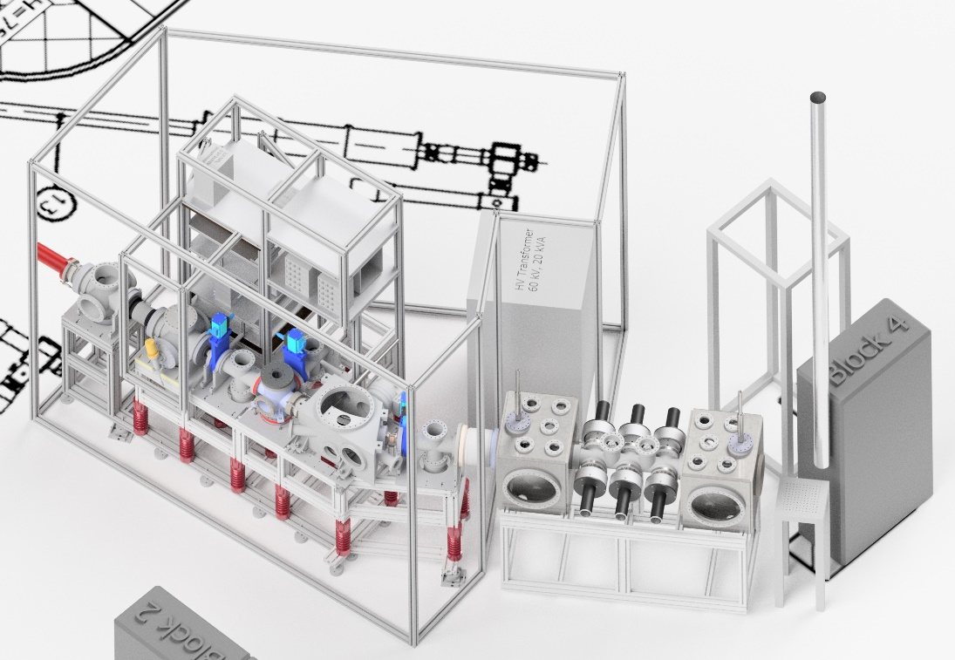
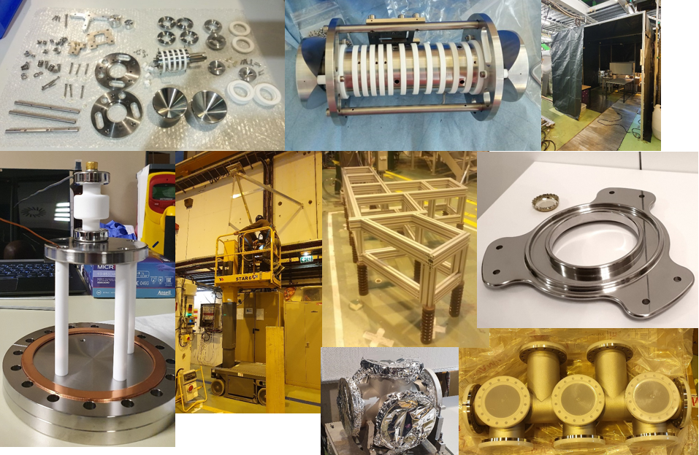
Status: MIRACLS at LA2
PT assembled UHV clean
  Commissioning starting
  Support structure being assembled
Transfer beamline components being manufactured
Offline ion source available
MR-ToF mirrors
  HV testing being finalised
    60+20 kV (max output) during conditioning
    60 kV: 8 days
    40 kV: Almost 7 weeks
    Upgrade to unipolar 100 kV in progress
Optical detection region
  Vacuum chamber ready
  Drift tube being coated (Vantablack)
  First lens system being manufactured
Laser transport
  Mechanical support installed
  Hole drilled to b. 508
Courtesy: Markus Vilen

Slide 7
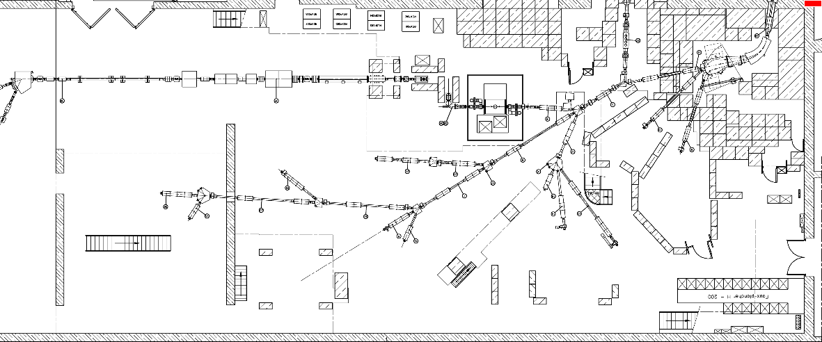
Relocation MIRACLS: 2022 – early 2023
RC6
LA2
Courtesy: Markus Vilen

Slide 8
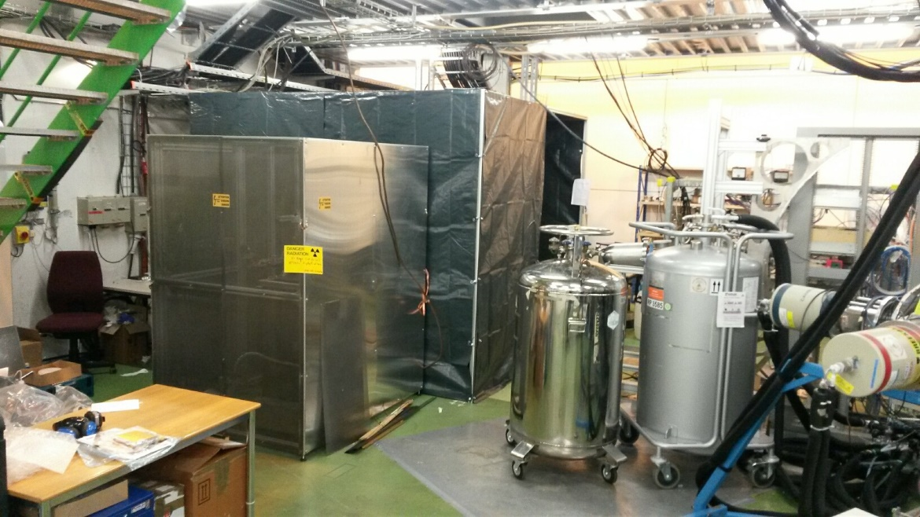
Preparations: RC6 line
RC6
LA2
RC6 line area
  All old NICOLE equipment removed
  Zone in use for UHV cleaning (preparations MIRACLS at LA2)
Courtesy: Markus Vilen

Slide 9
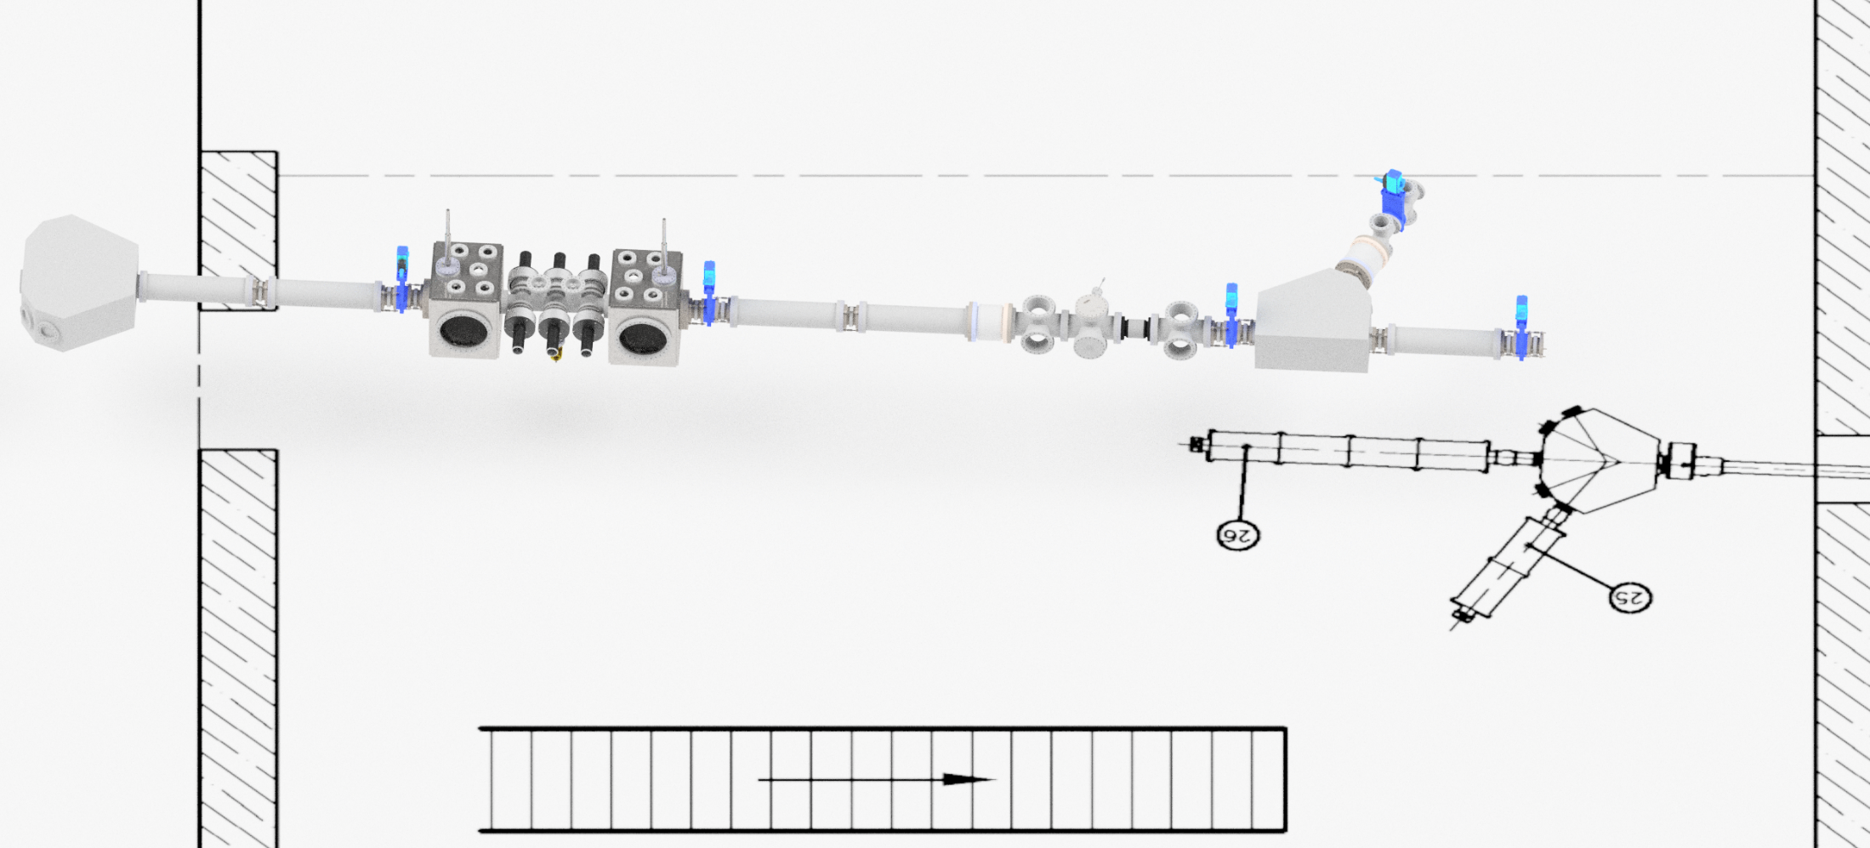
MIRACLS/MR-ToF at RC6
New concept (Markus Vilen, MIRACLS & ISOLDE collaboration)
Components:
From LA2
New
Hard extraction
Offline ion source,
50 kV
Switchyard
Field-free region
Switchyard
Paul trap
MR-ToF mirror
injection
Acceleration to 50 keV
Quad triplet
Quad triplet
Acceleration to 50 keV
Courtesy: Markus Vilen

Slide 10
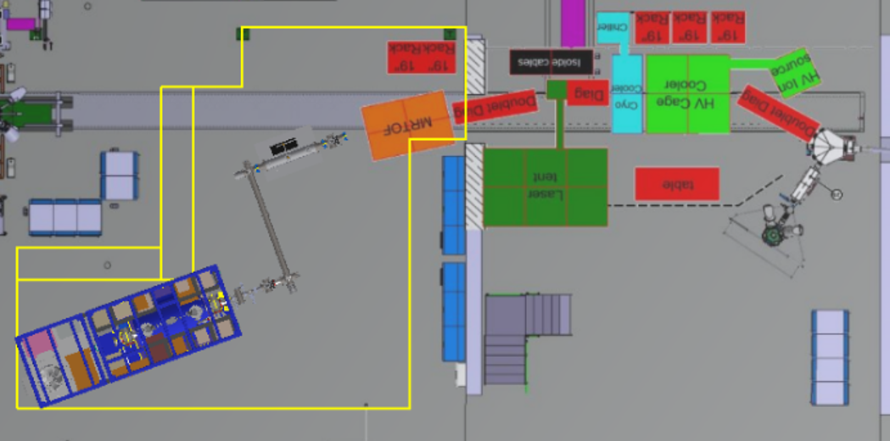
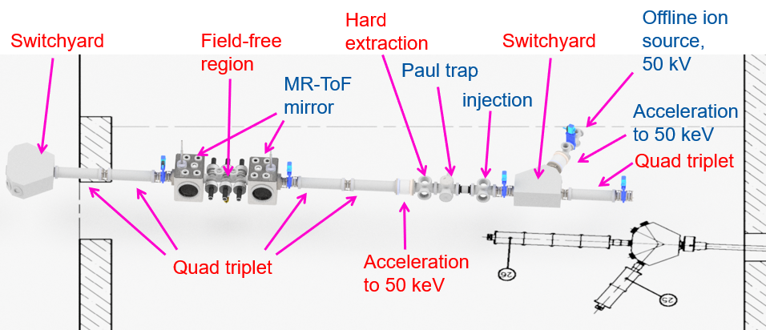
MIRACLS/MR-ToF at RC6
New concept (Markus Vilen, MIRACLS & ISOLDE collaboration)
Components:
Existing
New
ECR
(EDMS 2307820)
UHV chicane
PUMA setup
Exp. station
New concept with additional exp. station to allow use of the MR-ToF purified beams
To PUMA

Slide 11
MIRACLS/MR-ToF at RC6
New concept requirements
New concept Requirements
  Optics model and beam parameters at RC6
    Emittance measurements at RC6 for different beams
    Surface, Plasma targets from HRS/GPS
    Optics model (non-existing)
    Evaluation of the compatibility of ELENA based electrostatic elements
  New components
    ELENA based Quad Triplets
    Which would need new design
    Or ELENA doublets equivalent instead
    Existing design. Optics and compatibility to be evaluated. Space might be issue.
    New Switchyard for Ion source
    Possibly existing Switchyard to experimental station and PUMA
  As per ECR (EDMS 2307820)
    Supports
    Power supplies
    DC/HT cabling
    Vacuum chambers
    Infrastructure (CV, EL)
PUMA Requirements
  Beam instrumentation
    Necessity and type to be defined
    Design (copy/improved from PUMA @ AD if possible)
    SY/BI discussions started
  As per ECR (EDMS 2307820)
    Infrastructure (CV, EL)
    Crane adaptation
    Diesel slab preparation

Slide 12
Timeline
2020-2022
  MIRACLS at LA2 beamline, commissioning the first 30-keV MR-ToF
2022 - early 2023
  MIRACLS relocation to RC6 beamline
Aim:
2022- half 2023
  Design and fabrication of the UHV chicane to PUMA
2023
  MIRACLS/ISOLDE MR-ToF and line elements installation, tests and commissioning
2023
  Installation PUMA infrastructure
  Installation and commissioning UHV line
End 2023
  First transport PUMA to ISOLDE
  First ISOLDE beam to PUMA

Slide 13
Next Steps
Aim End-23 first transport, PUMA @ ISOLDE
  2021 if feasible: Optics model and beam parameters at RC6
    Emittance measurements at RC6 for different beams with the TRIUMF emittance meter. Still ’21? To confirm the concept and provide data for ABT / components design
    Approval / fix final concept RC6 MIRACLS
  Project structure to be defined
    WP’s to be defined
    Optics model and beam parameters (SY/ABT, MIRACLS)
    Quads design (SY/ABT)
    Switchyard design
    Vacuum (RC6 and UHV) (TE/VSC)
    Power supplies (SY/EPC)
    DC/HT Cabling (EN/EL)
    Electrical installation and AC distribution (EN/EL)
    CV infrastructure RC6 and PUMA (EN/CV)
    Etc.
  Update of the ECR
    With regard to the new concept of the RC6 / MIRACLS
    Impact on costs
  Start infrastructure requirements
    YETS 21/22 if feasible:
    Diesel slab preparations
    Overhead crane modifcations (AC power + possible mechanical changes?) (EN/EL, EN/HE)

