Slide 1


AD FACILITY
PUMA Exp area
LNE51 transfer line

Slide 2
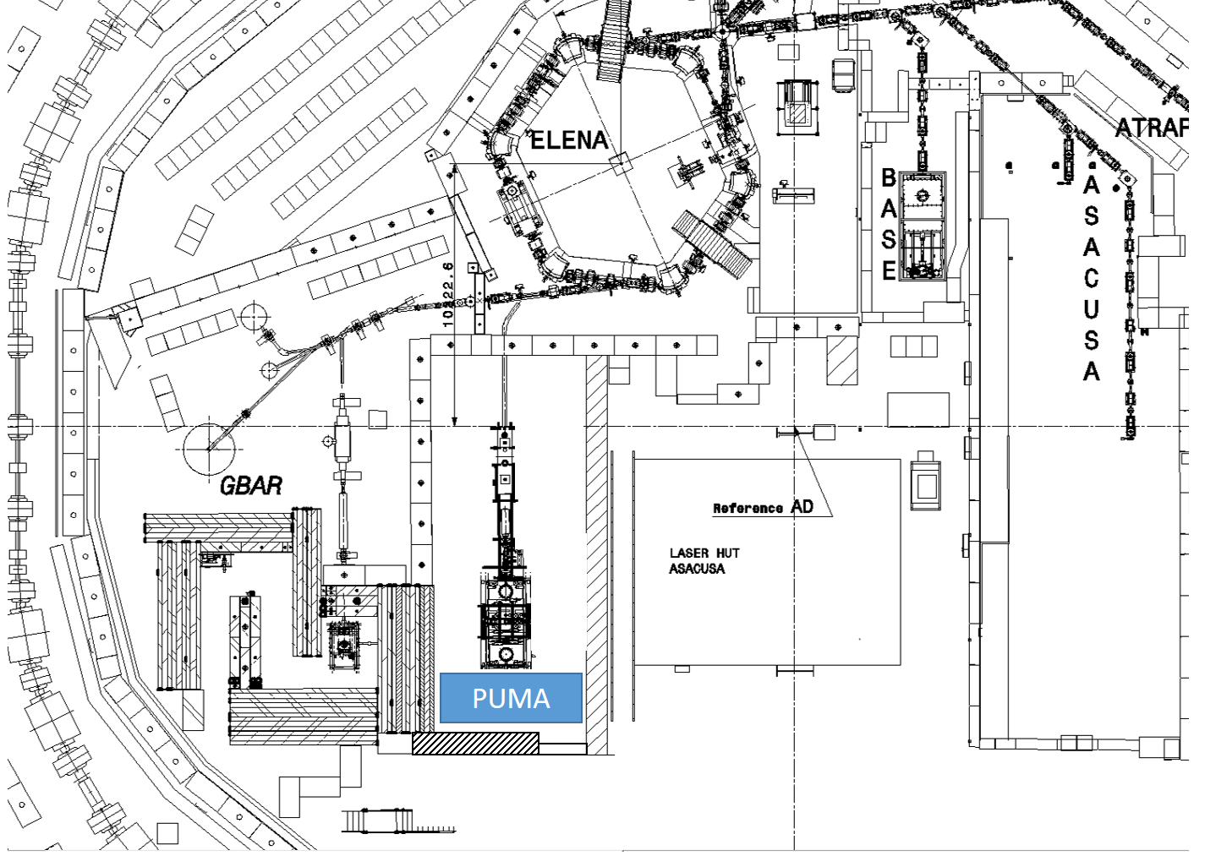
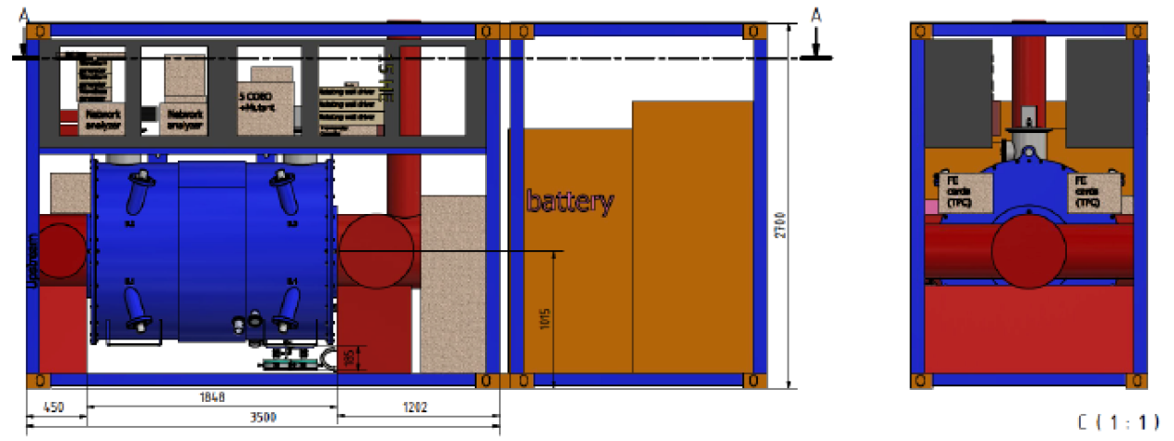
PUMA New Experimental area
80 cm concrete shileding
PPX emergency exit (chicane)
5
2.7 m
5.5m
1.9m
PPE access

Slide 3
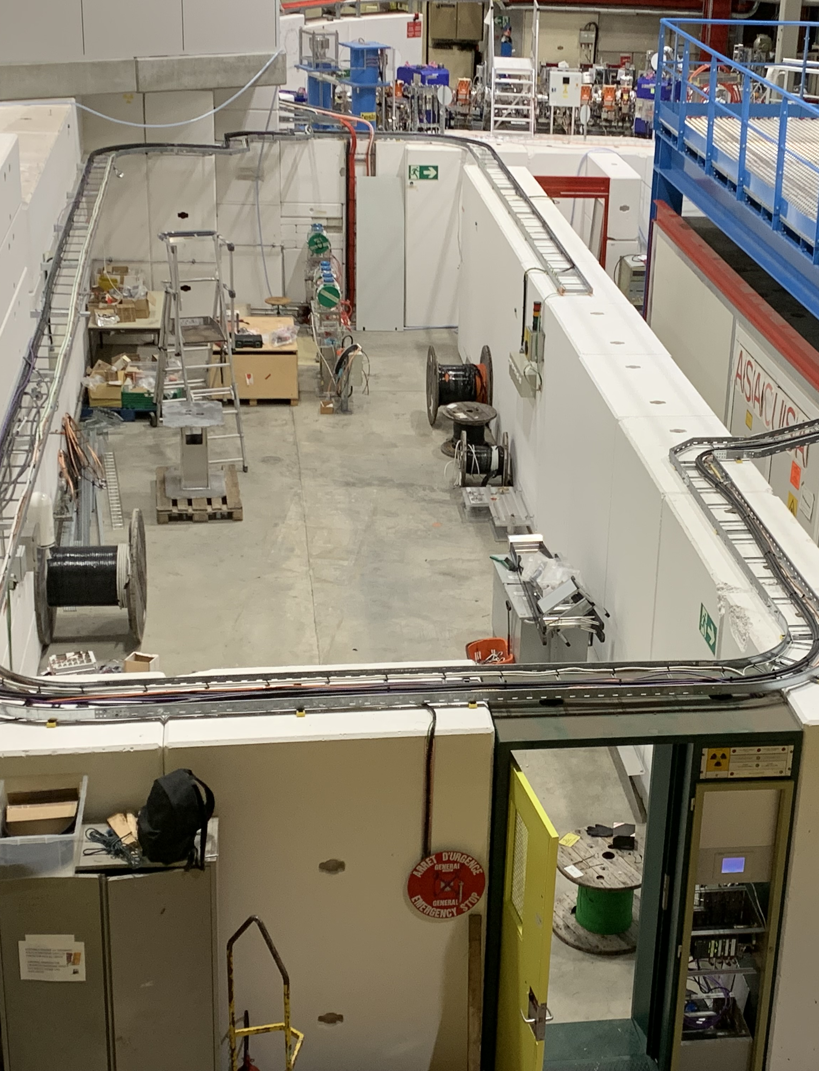
Status of experimental area
Exp area is now complete
Shielding is complete, layout around transfer line passage will be improved during YETS
Cooling water operational
Electrical distribution installed, main switchboard connected
Power from crane to be installed during crane refurbishment planned as of mid April 2022
RP and access safety systems to be connected during YETS
New storage
platform
PUMA
exp area

Slide 4
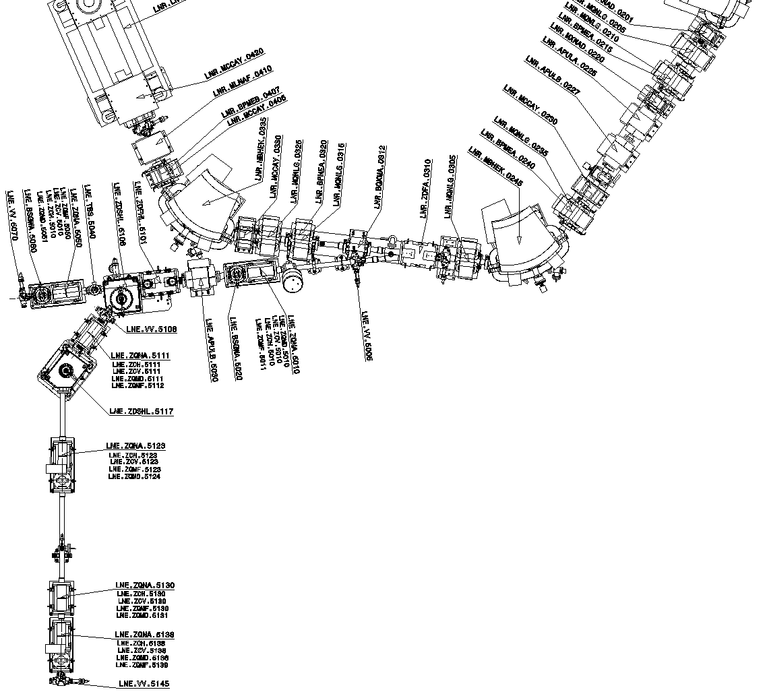
LNE51 transfer line
ELENA ring
To be installed
during YETS
Shielding wall
Installed
(2 SEMs missing)
Interface
gate valve

Slide 5
LNE51 transfer line status
All supports are installed
Cabling is complete, connectors installed
Power converters installed
Electrostatic element (PUMA side) are installed
Electrostatic elements (ELENA side) are ready to be installed -> during YETS (as of 15th Nov)
SEM’s expected, no delivery date yet
Vacuum elements installed (PUMA side, 1 SEM tank missing) and during YETS (ELENA side)
Bake-out of line planned W48-50 (if SEMs are installed)
IST and Commissioning of LNE51 with H⁻ as of Jan 2022

Slide 6
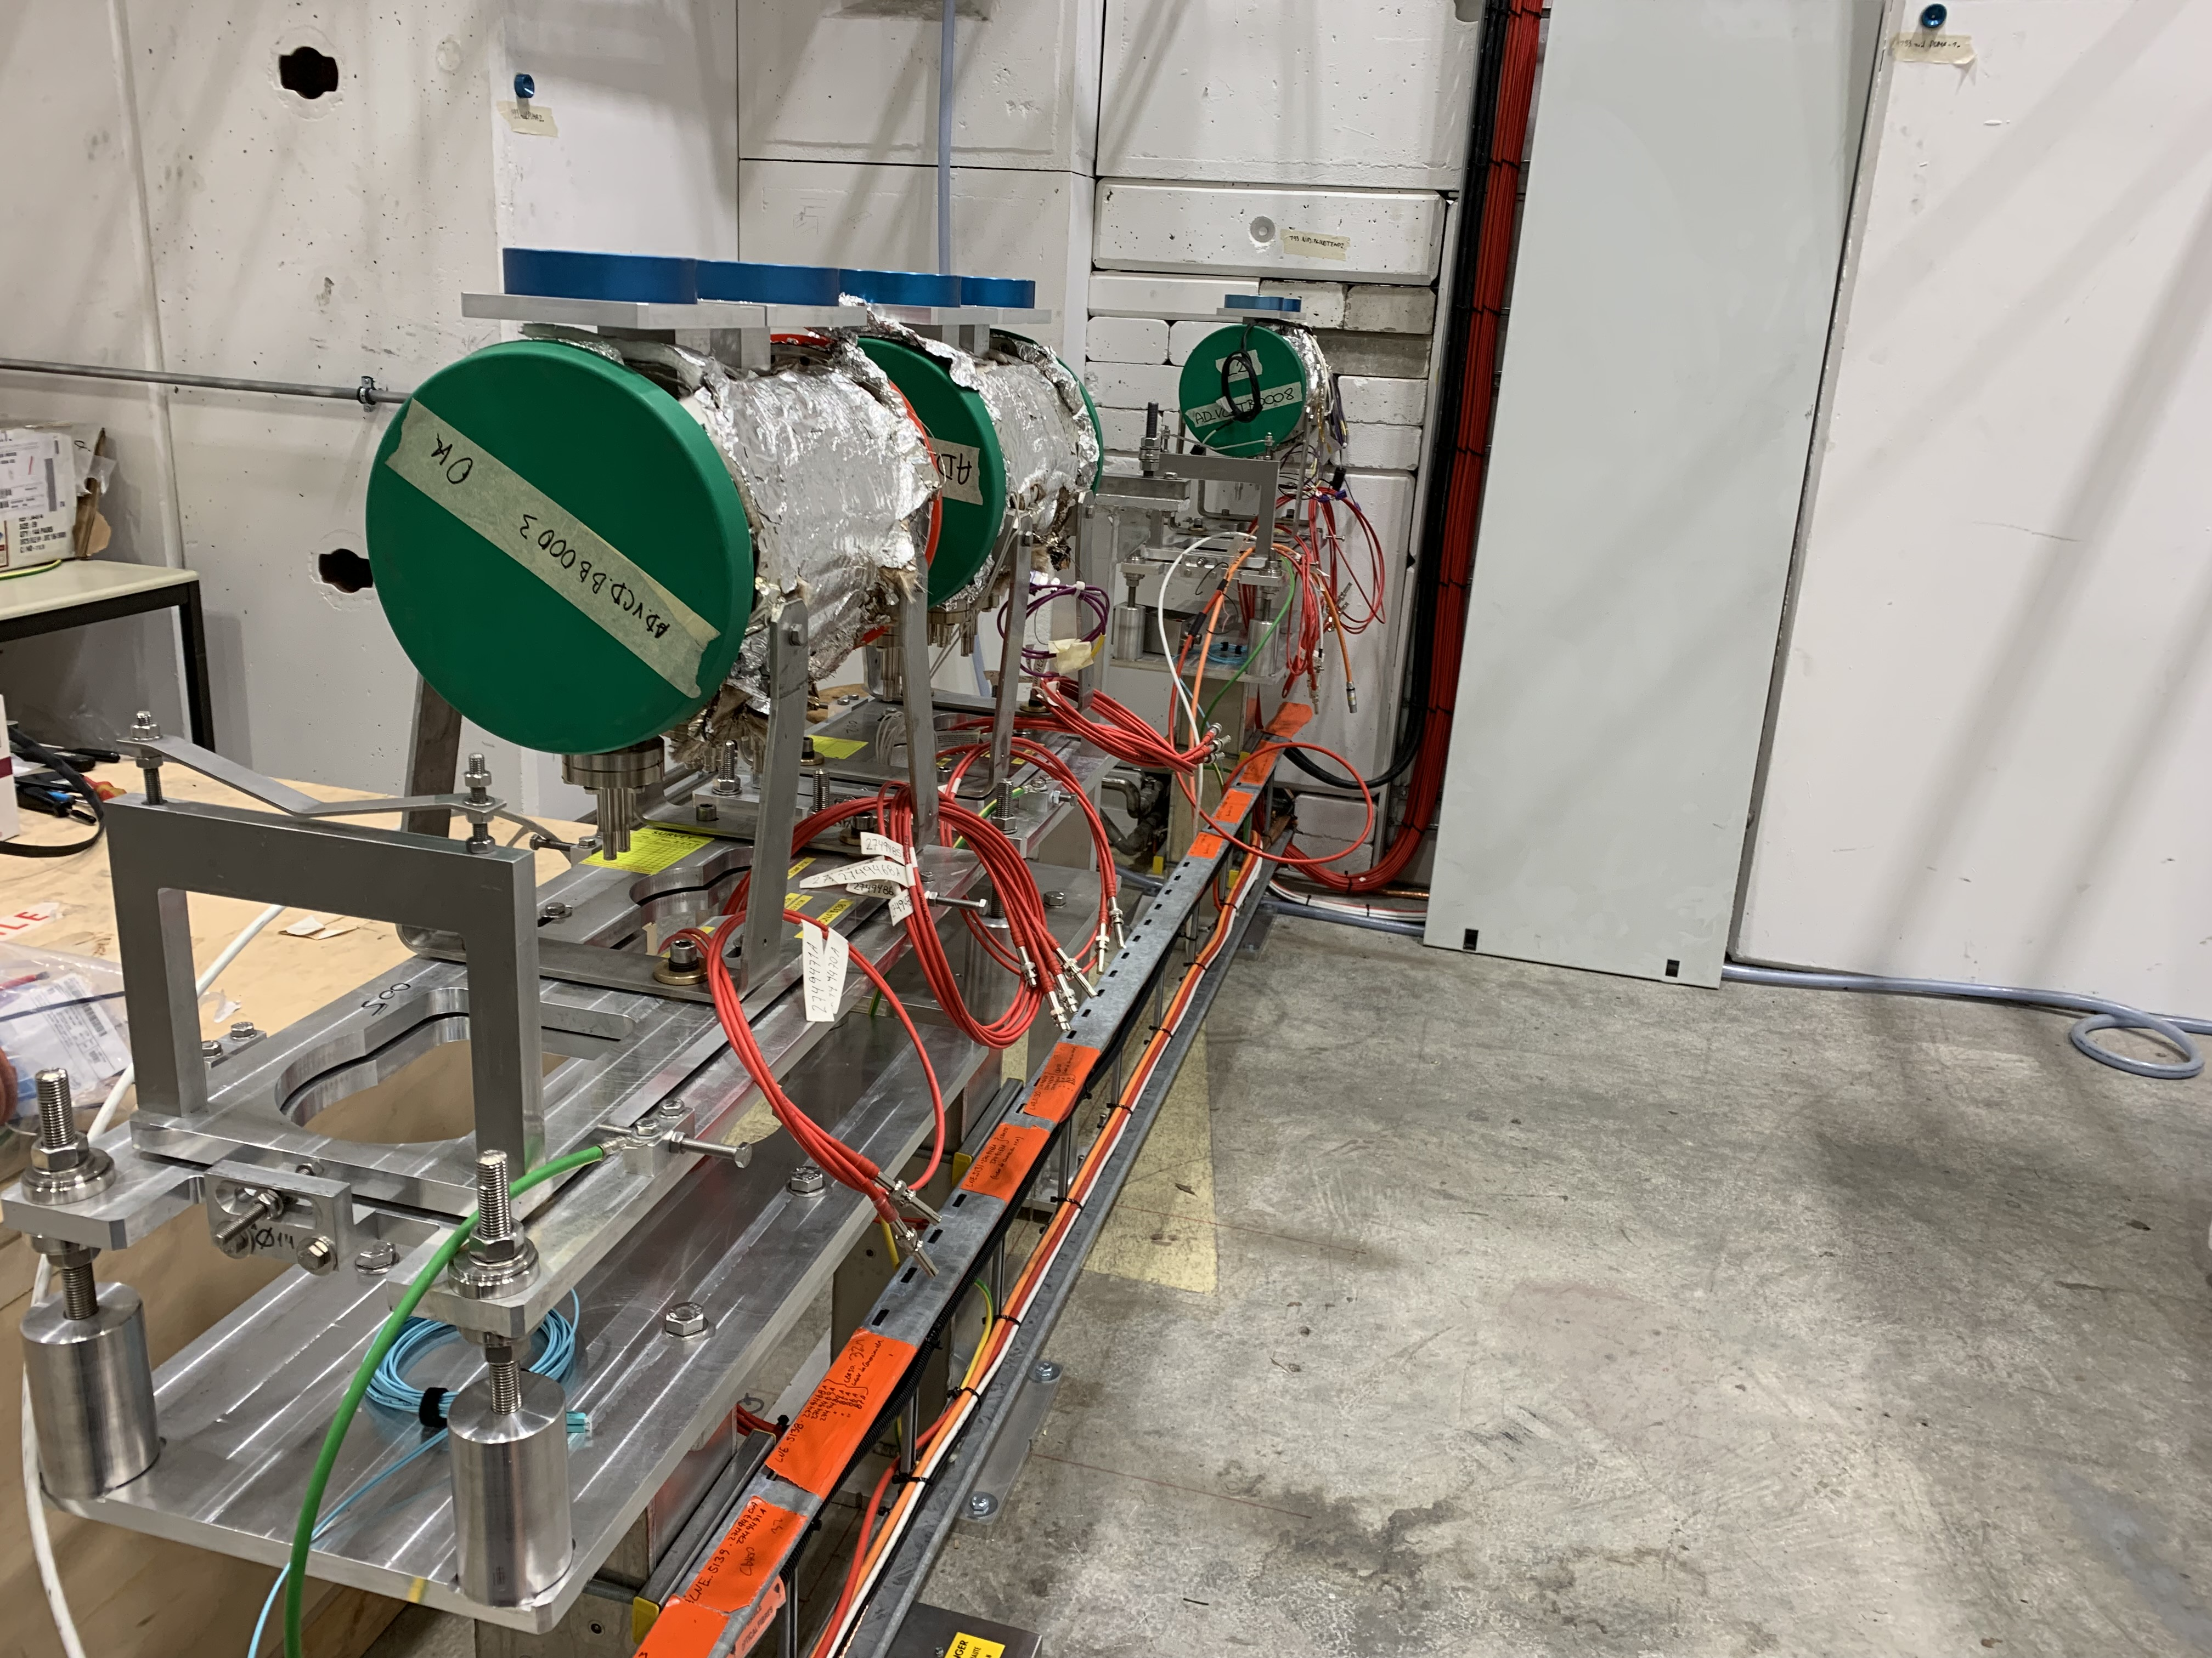
Status of LNE51 transfer line
PUMA side

Slide 7
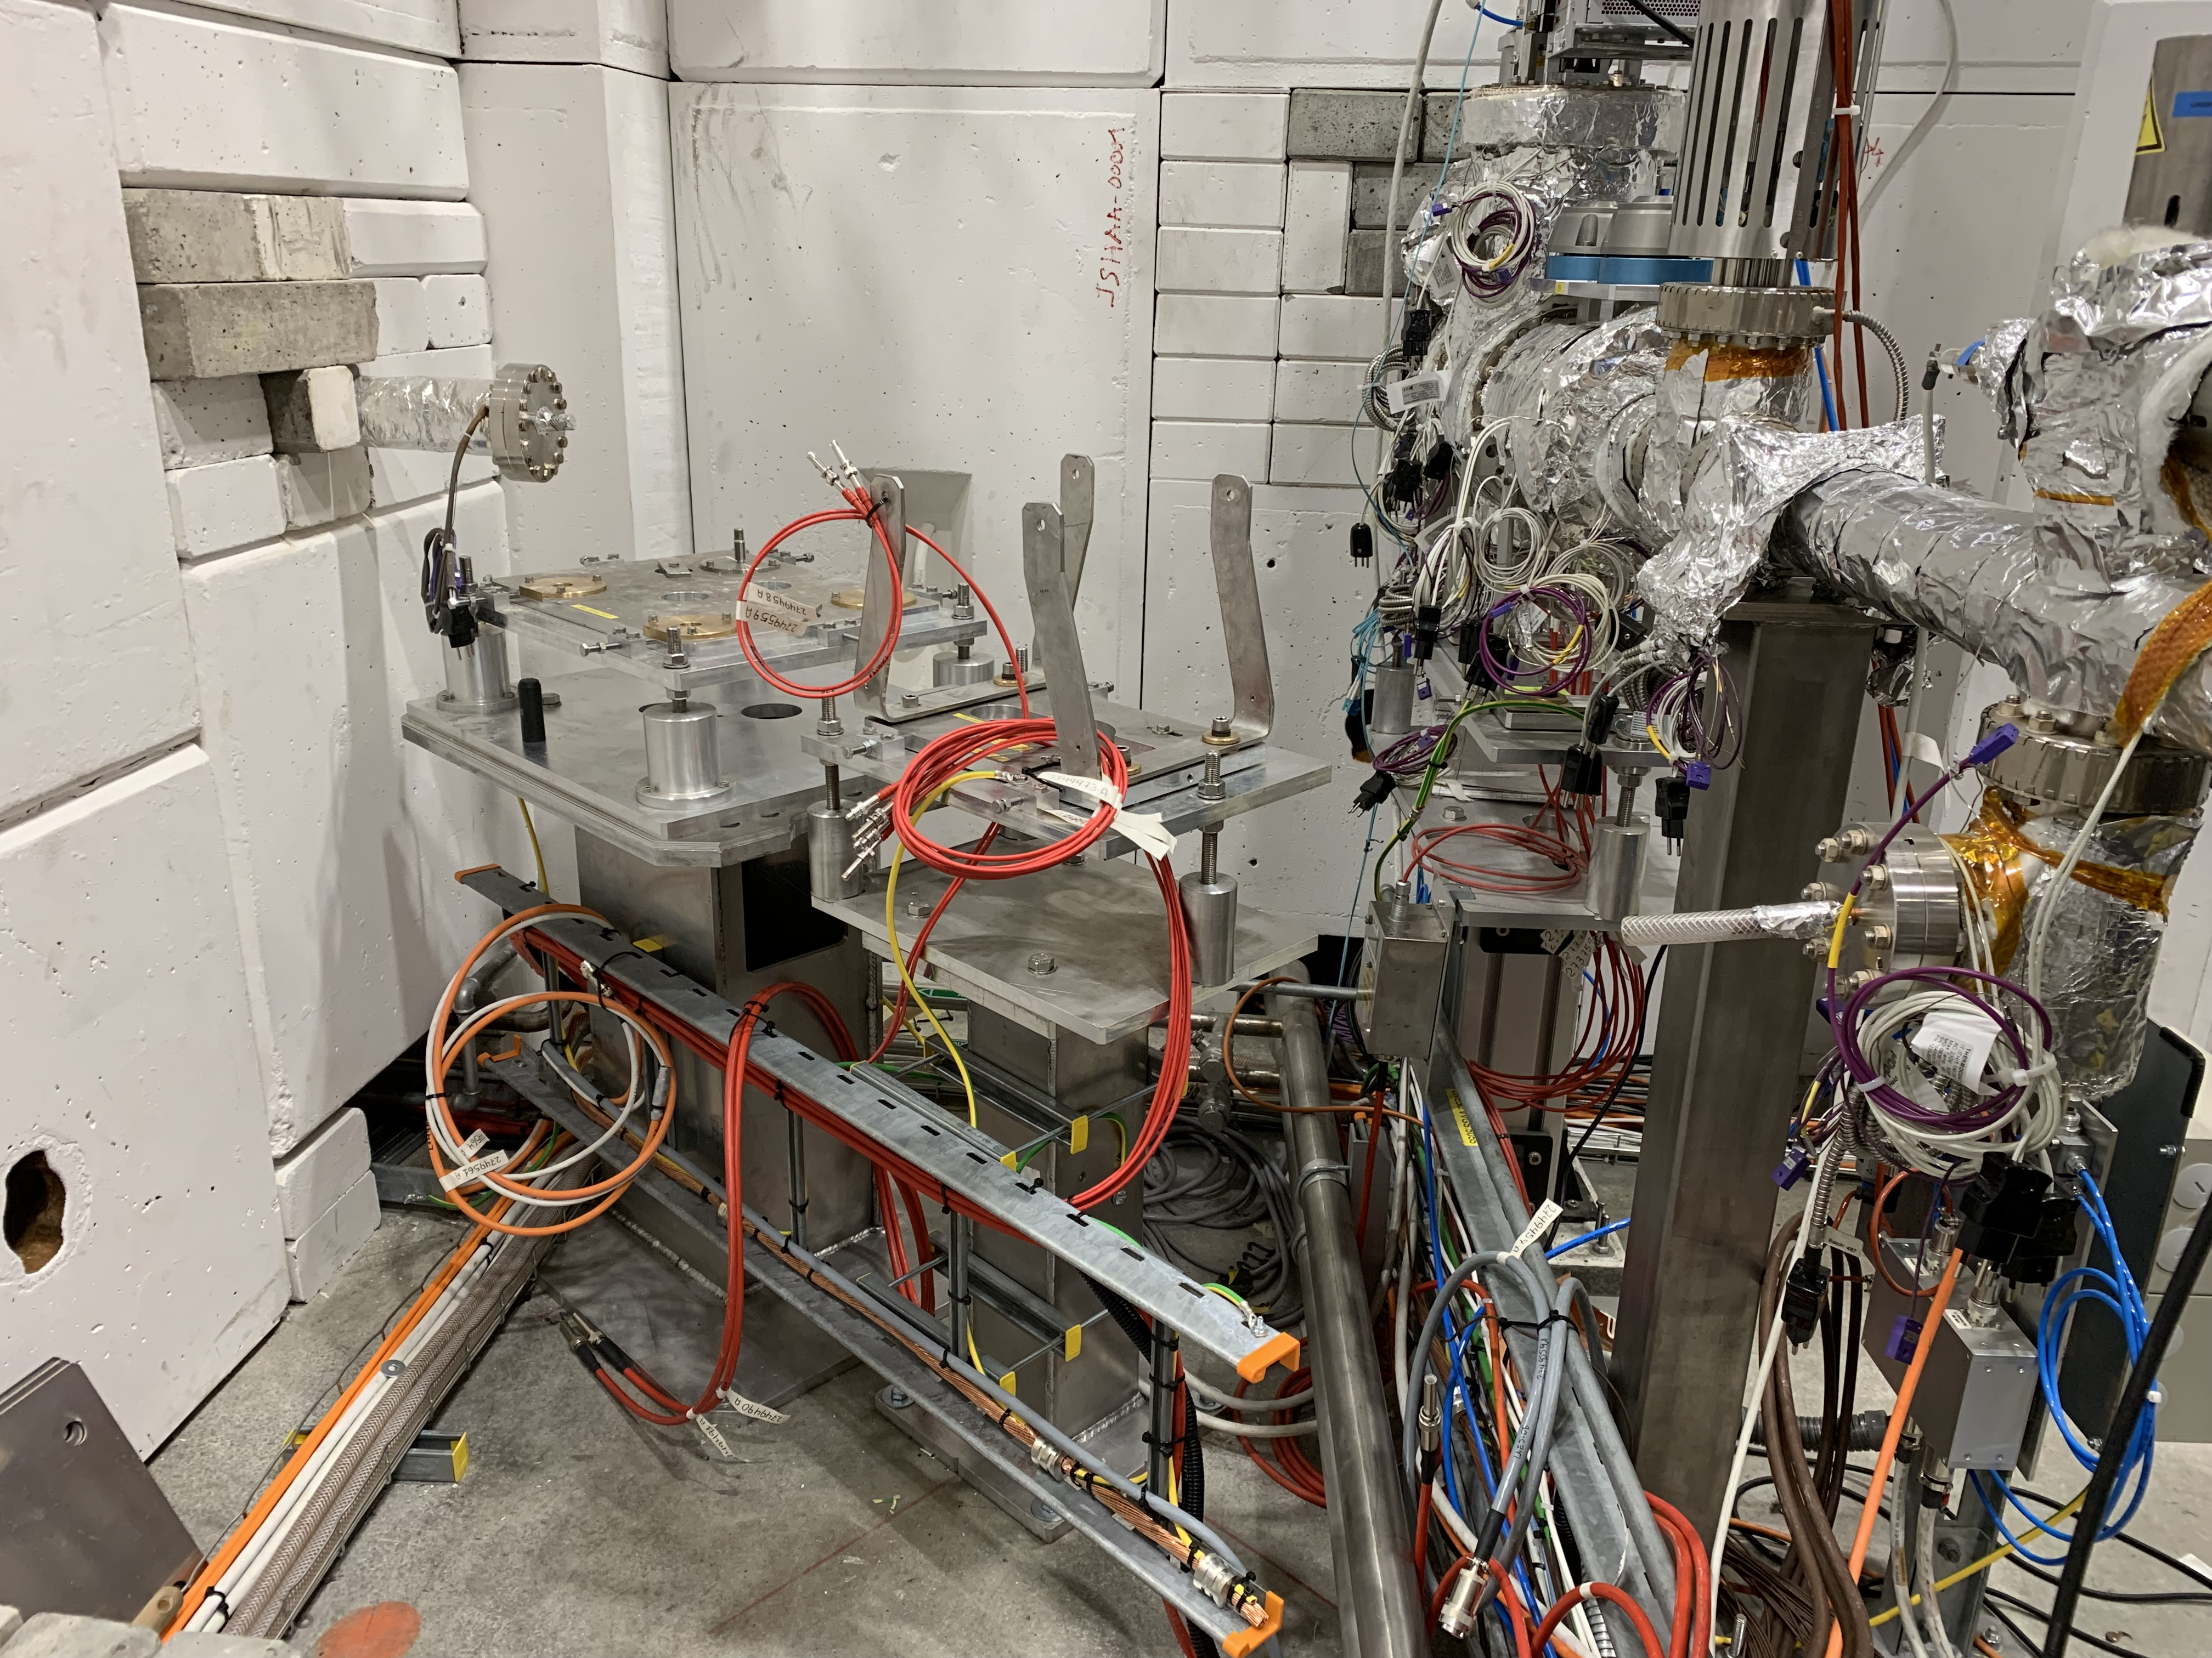
LNE51 status
ELENA
side

Slide 8
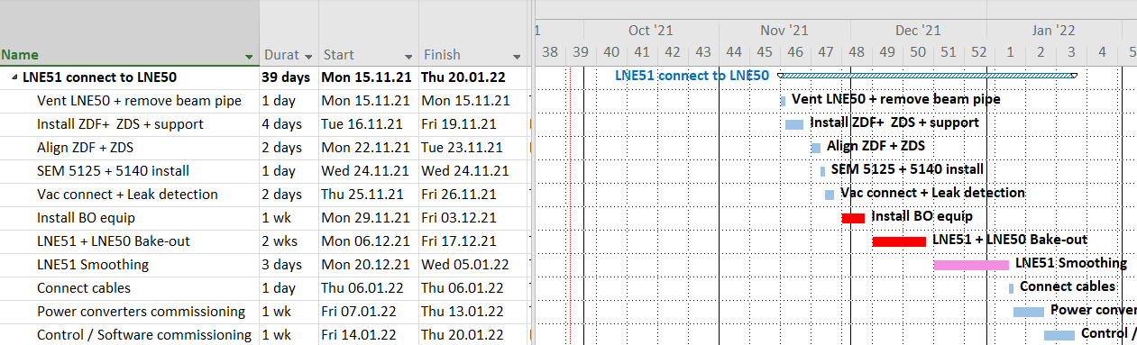
LNE51 schedule
TBC

