Slide 1

Notes:
Perimeter is a leading theoretical physics institute.

Slide 2
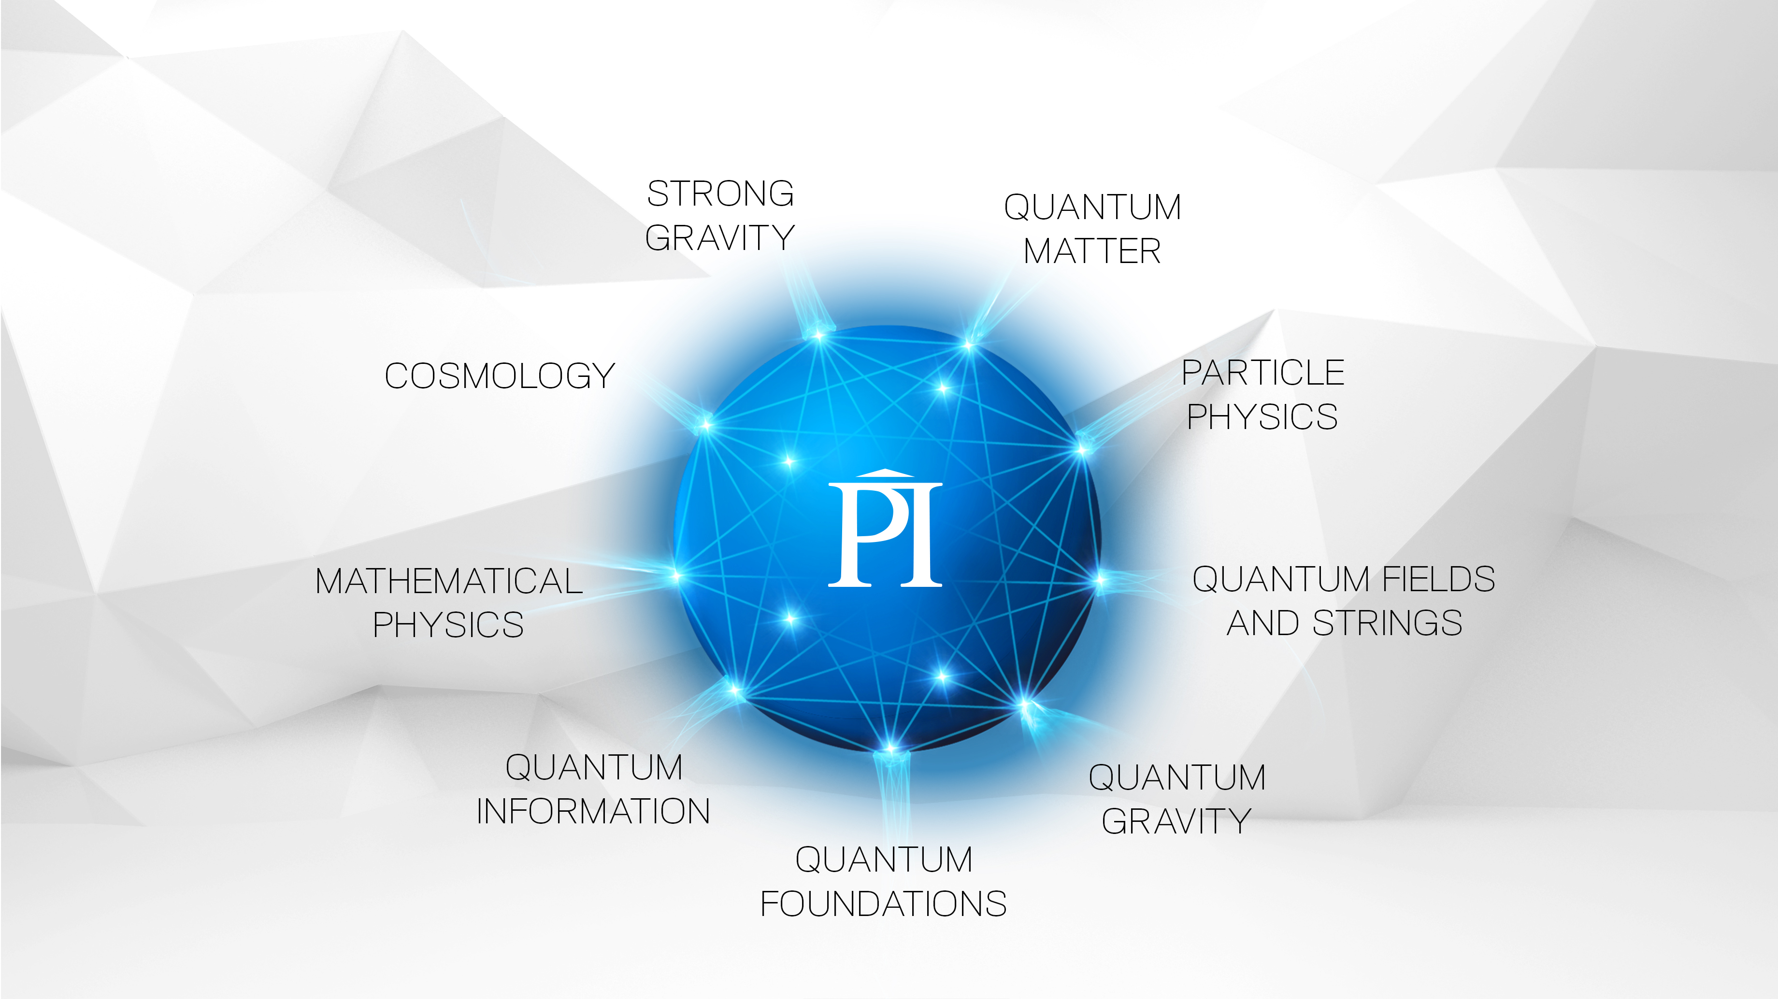
Notes:
Research strategy

Slide 3
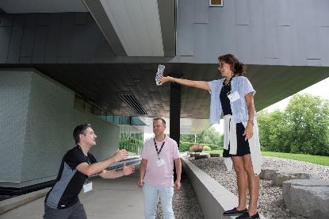
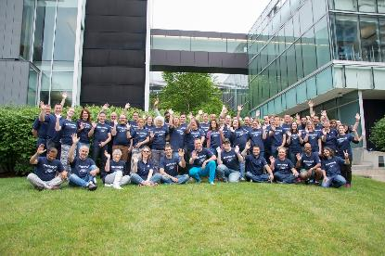

Teacher Programs
www.perimeterinstitute.ca/outreach/teachers
Notes:
Perimeter Institute offers a range of programming for high school physics and science teachers. Visit our website or email outreach@perimeterinstitute.ca for current programs.

Slide 4

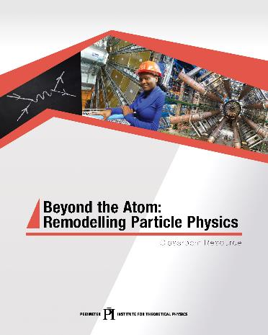

IN-CLASS RESOURCES
Experienced teachers
Perimeter researchers
Pedagogy and teaching strategies
Notes:
We produce about two resources per year, each with a suite of lessons and often with a short video. Our resource centre has 21 compilations and over 100 individual resources.
The resources are written by a team of teachers and outreach scientists. All lessons are reviewed and tested by our teacher network. All science content is carefully vetted by one of our researchers to ensure not just correctness, but insight and depth.
One of our goals is to equip teachers with excellent material that they can use in their classroom.Face to face just can’t scale; how do we reach as many youth as possible in an extremely impactful way … we choose to reach them through their teachers … we know where they are, we know what they are trying to do, and we know how we can help…
Raising the research culture throughout the Region, across Ontario and Canada – joint hires, exchanges, joint-workshops, etc.
96% report “increase value of scientific skills of creativity, critical thinking, communication”
Teachers
Researchers
Professional Editorial and Design
Classroom tested;
Challenge: Finding the core concepts, must relevant to the subject, the teachers, the students.

Slide 5
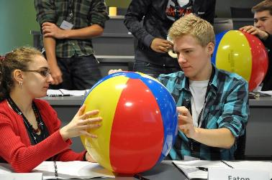

High School Student Programs
www.perimeterinstitute.ca/outreach/students
1-day workshops (online)
ISSYP
Notes:
Perimeter Institute offers a range of programming for high school students. Visit our website or email outreach@perimeterinstitute.ca for current programs.

Slide 6




INSPIRING THE NEXT GENERATION
10 MILLION⁺/year
40,000⁺
In-class resources
teachers trained
130 countries
100,000⁺ on site
2 MILLION online views
PUBLIC LECTURE SERIES
Notes:
Impact

Slide 7

https://resources.perimeterinstitute.ca/

Slide 8
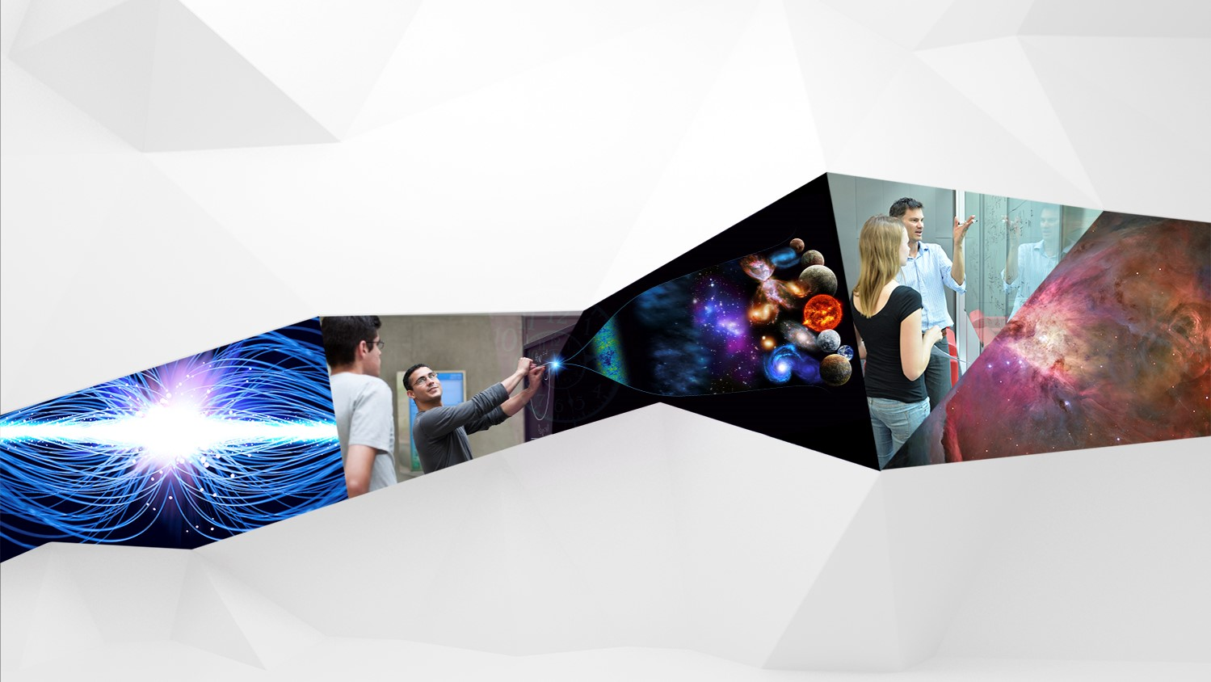

The Mystery of Dark Matter
Perimeter Explorations 01
CERN
Greek HST2022
Notes:
The main idea of this presentation is subversive physics. Many of these topics include connections to modern physics using classical activities.

Slide 9

Building and Revising Scientific Models
Notes:
(About 10-15 min) Using the Black Box:
-Demonstrate the box by pulling several strings
-Ask the participants to draw what they think is happening using their whiteboards
-Ask 3-4 people with different ideas to come up at the same time. Test their models, if they work, give their boards a checkmark
-Explain how nature can be described using models. We test these model/theories until they are proven wrong. At that point, they need to be thrown out or revised. Several, different models are capable of describing the same thing.
-Shake the Black Box. Show how some of the drawn models fail, while others survive.
-It is important to build vocabulary such as “predict, observe, model, etc.”

Slide 10
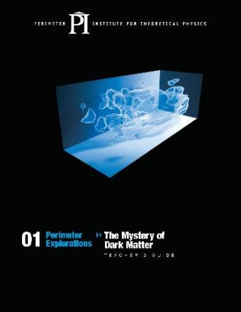
Activity 6: Dark Matter Lab
Curriculum Links:
  Circular Motion
  Netwonian Gravity
Notes:
Standard high school physics can be used to introduce one of the biggest topics in Physics today!

Slide 11
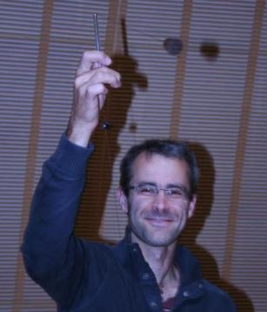
Uniform Circular Motion lab

Slide 12
Uniform Circular Motion
speed
Predict
Observe
Explain
How are mass and speed connected in circular motion?
mass
Notes:
Uniform Circular Motion (5-7 min)
-Begin by asking the participants to use their white boards to predict what happens to velocity as mass changes (PEOE). Ask them to explain their reasoning using diagrams, metaphors, etc.
-After the PEOE, get the students to complete the lab portion (18-20 min) of the activity. Make sure the participants get to the point where they must predict the weight of the unknown mass.
-Use some time at the end to explain the effectiveness of group work, and the ability to collaborate, communicate, and strategize.

Slide 13
Uniform Circular Motion
speed
Build a mathematical model to predict the relationship between mass and speed.
(Ignore the angle)
mass
Notes:
Give participants a minute or two to sketch out the forces and derive an expression.

Slide 14
F_{T}
Hanging mass is stationary
Forces are balanced (F_{net} = 0)
F_{T} = F_{g}
F_{g}
Rubber stopper is accelerating
Forces are NOT balanced
F_{net} = F_{T}
F_{T}

Slide 15
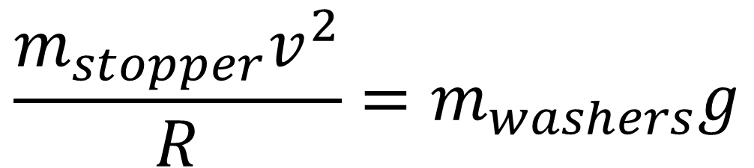
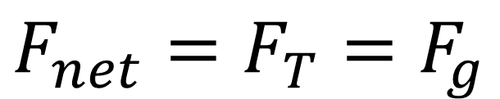
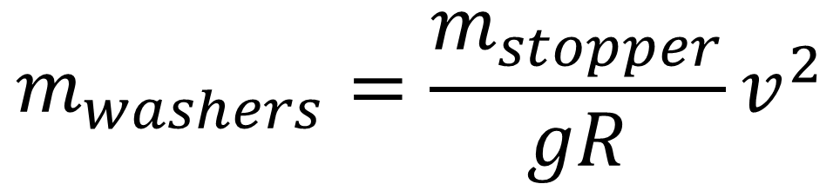
$$F_{net}=F_{T}=F_{g}$$
$$\frac{{m_{stopper}v}^{2}}{R}=m_{washers}g$$
$$m_{washers}=\frac{m_{stopper}}{gR}v^{2}$$

Slide 16
Circular Motion Lab
Set radius = 60 cm
Record period for 10 orbits for various masses.
Plot results

Slide 17
Circular Motion Lab Results
# of washers | 10 Orbits (s)
8 | 8.0
10 | 7.4
12 | 5.9
14 | 5.4
16 | 5.0
How is the orbital speed related to the mass of the washers?

Slide 18

Circular Motion Lab Results
$$\frac{m_{stopper}}{gR}$$
Notes:
What else could you do at this point?
Revisit model and identify variables in slope (solve for g?)
Interpolate or extrapolate to determine the mass of an unknown object.

Slide 19
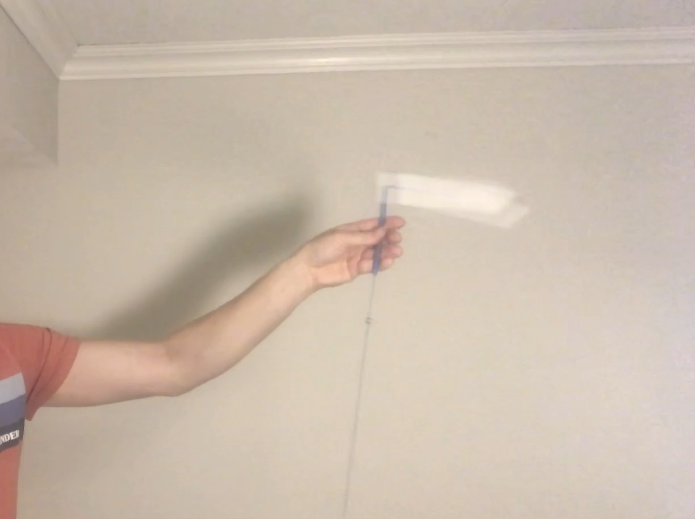
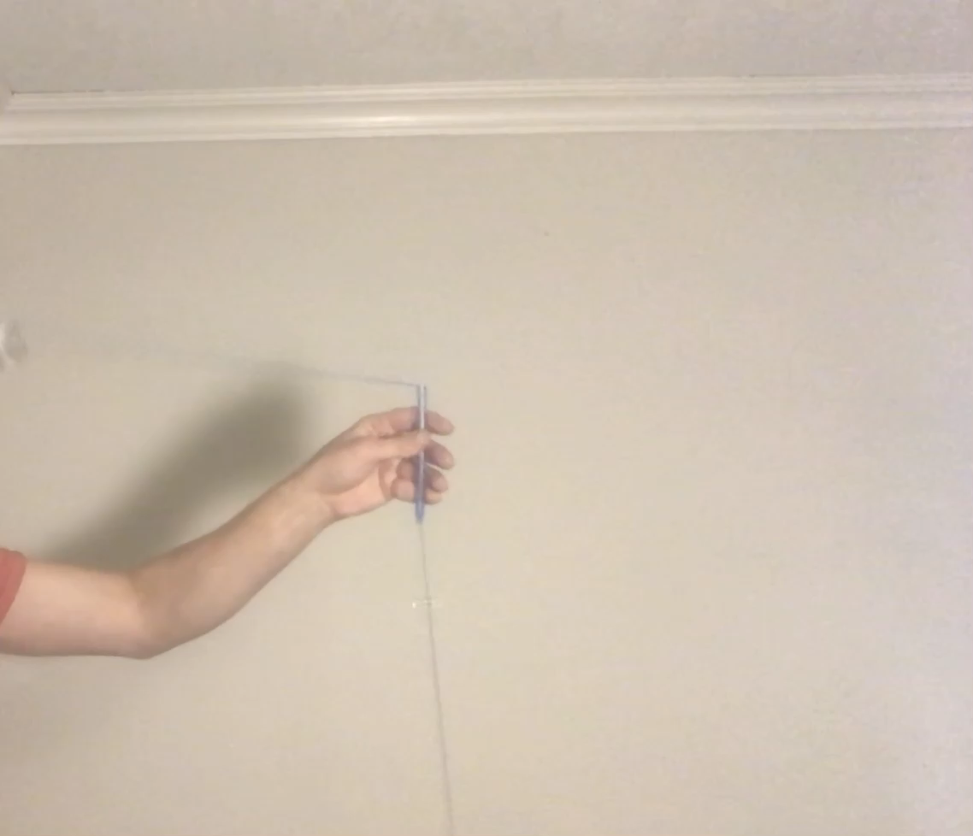
Which LED is connected to more mass?
.
.

Slide 20

Uniform Circular Motion → Dark Matter

Slide 21
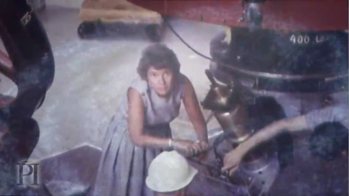
Vera Rubin’s
Discovery

Slide 22
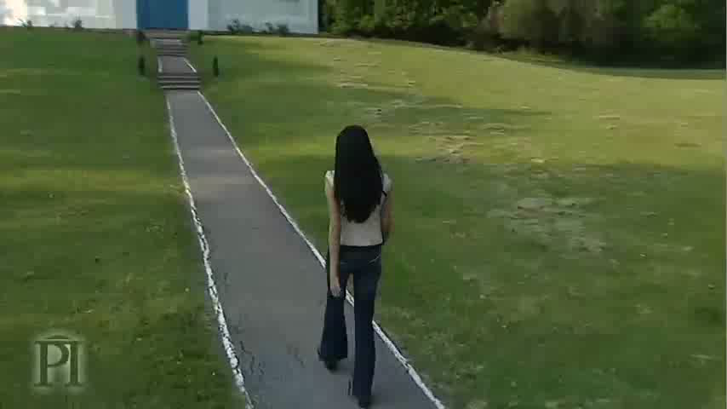
Uniform Circular Motion
Notes:
We’ll show you a clip from the video that highlights just what Rubin observed. She looked at Andromeda and saw stars moving

Slide 23
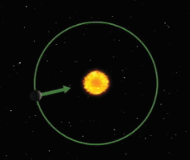
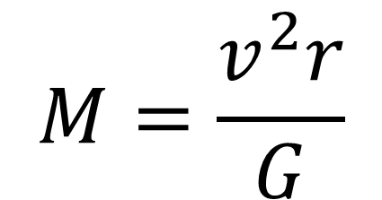
Uniform Circular Motion
Orbital Speed Depends on the Mass of the Central Object
$$M=\frac{v^{2}r}{G}$$
Notes:
We can scale up what we found with the circular motion apparatus to a galaxy. The principles are the same.

Slide 24
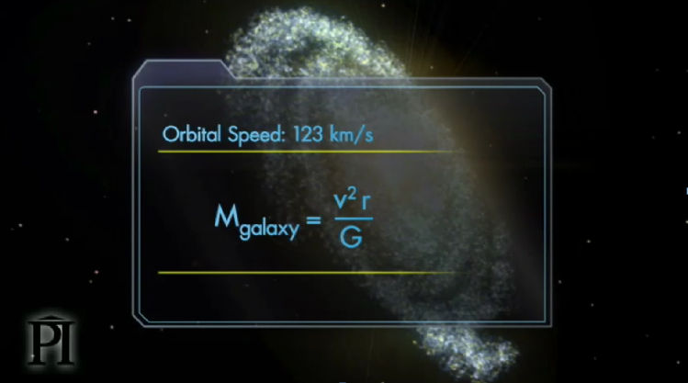
Extend this to galaxies

Slide 25
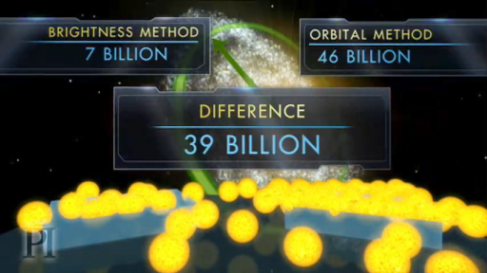
Triangulum is More Massive Than it Looks

Slide 26

What explanations might your students come up with?
Notes:
Act as your students. I’m not looking for the right answer. Just Exploring possibilities. ISLE. Write your ideas in the chat. Doesn’t matter if they’re correc or not. Just brainstorming.
Aside: This is what scientists do. What you did is exactly what professional scientists in the 1970s did.
Note: Don’t try to get it right the first time or not be wrong. Mention ISLE. Yes. Casually.
Do a casual teacher time out.
What is the rationale for casually positing explanations. Comes from research suggesting that students conceptions about the world are resistant to change. We’re trying to ease them into dark matter.

Slide 27
Some Possibilities
1. BRIGHTNESS METHOD IS FLAWED
Gas & dust between us & other galaxies make them appear dimmer
Assumptions about relationship between brightness & mass are wrong
There is a new kind of matter that we cannot see
2. ORBITAL METHOD IS FLAWED
Orbital radius measurements are inaccurate
Speed measurements are inaccurate
Newtonian gravity doesn’t hold on the scale of galaxies
There is some new physics that we don’t understand

Slide 28
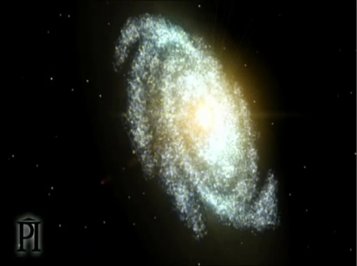
Old View

Slide 29
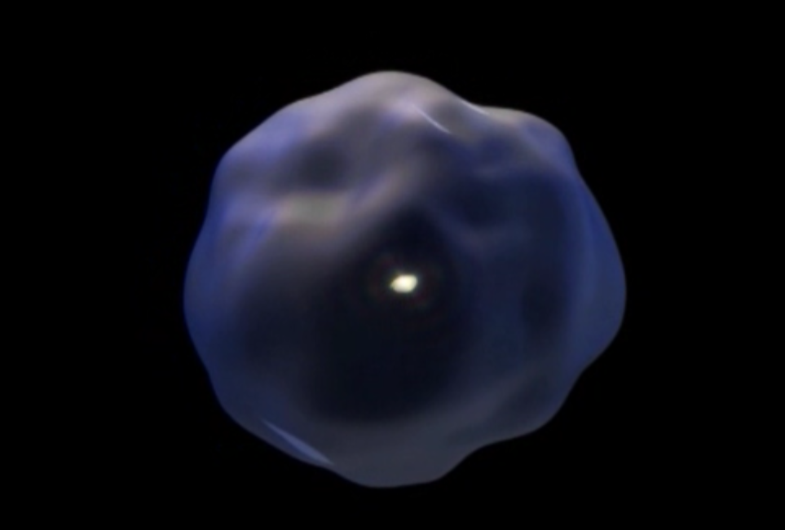
New View
Notes:
We now know that surrounding the stars in the centre of the galaxy is a blob of dark matter that extends ten times farther our & has 10 times more mass.
The stars are just the tip of the iceberg.
This is a radical change. On a par with realizing the Earth orbits around the Sun. Arguably, the greatest advance in our understanding of the universe in the last half a century.

Slide 30
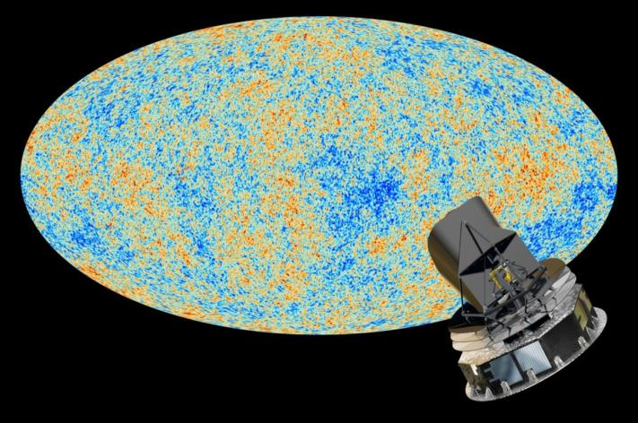
Notes:
Planck results from observations of the CMB (4-year survey fro 2009-2013)
Adds confidence to L-CDM model, from WMAP
Dark Energy Survey, started in 2012 and ending in 2018
Year 1, August 2017 results:
DES in the Chilean Andes to reduce precipitation, light pollution, and tau (optical density of the atmosphere)

Slide 31
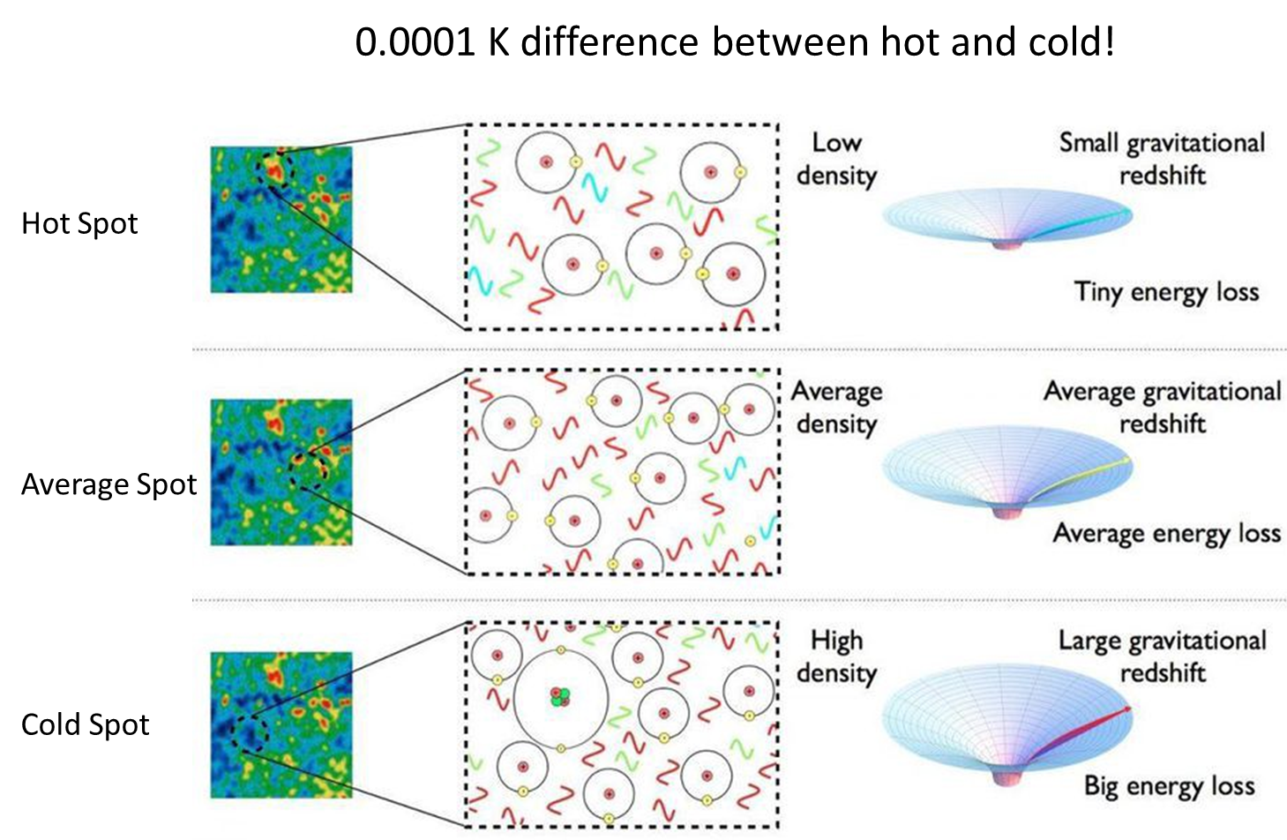

Slide 32
Dark Matter
26.8%
Dark Energy
68.3%
Normal Matter
4.9%
Notes:
Planck results from observations of the CMB (4-year survey fro 2009-2013)
Adds confidence to L-CDM model, from WMAP
Dark Energy Survey, started in 2012 and ending in 2018
Year 1, August 2017 results:
DES in the Chilean Andes to reduce precipitation, light pollution, and tau (optical density of the atmosphere)

Slide 33
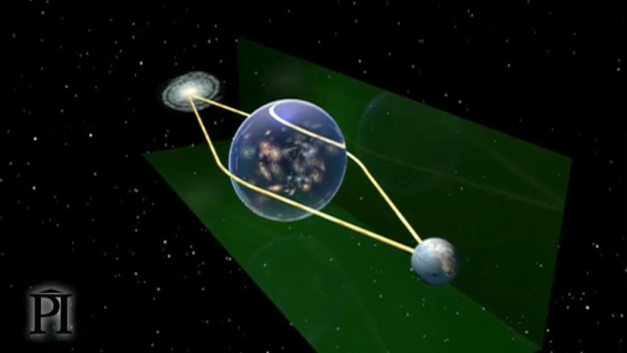
Gravitational Lensing
Notes:
Gravitational Lensing (About 10 min)
-Participants will complete the plate and wine glass activity from the teacher’s manual. This activity is also complemented with a video clip.

Slide 34

Bullet Cluster
Most of the baryonic matter
Mass map from lensing

Slide 35
Looking for Dark Matter particles
Cold Dark Matter
Fermions
Bosons
WIMPS
Axions
Electrons
Photons
Sterile neutrinos
Axion-like
Particle
Quarks

Slide 36
How to Look for Dark Matter Particles
Direct detection: wait for it to hit a detector
Indirect detection: look for other signatures
Particle colliders: make it

Slide 37
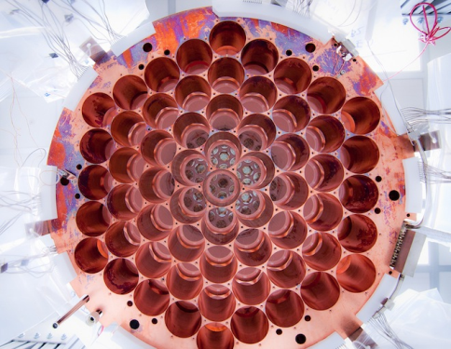
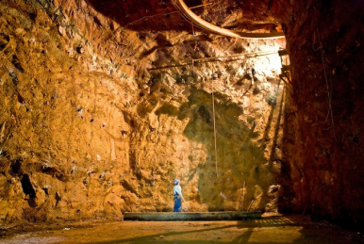
LUX- Large Underground Xenon Detector
Homestake Mine, South Dakota
Notes:
Homestake Mine in Lead South Dakota – first neutrinos from sun detected here
LUX, like most direct dark matter searching experiments, uses the wait-until-something-hits-me principle. The detector is composed of an extremely large number of atoms sitting around, increasing the probability that dark matter slams into them. In the case of LUX, these atoms are xenon, a very stable element that doesn’t undergo any pesky chemical reactions that could screw with results.
The idea is that a dark matter particle might whoosh by a xenon atom, knocking off an electron, which LUX would detect as an increase in charge. Alternatively, a dark matter particle could slam right into a xenon atom, kicking up one of its electrons to a higher orbit. When that electron returned to ground state, it would release a photon, creating a tiny flash of light that one of LUX’s 122 photomultiplier detectors could spot.
The LUX experiment was designed to look for weakly interacting massive particles, or WIMPs, the leading theoretical candidate for a dark matter particle. If the WIMP idea is correct, billions of these particles pass through your hand every second, and also through the Earth and everything on it. But LUX did not detect anything which rules out many theories of dm

Slide 38
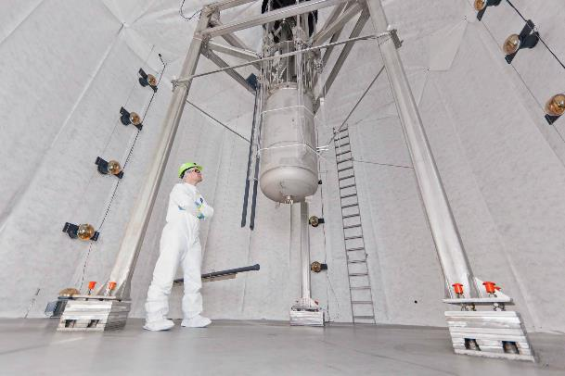
LUX update (2017)
With roughly fourfold improvement in sensitivity for high WIMP masses relative to our previous results, this search yields no evidence of WIMP nuclear recoils. arXiv:1608.07648v3
Notes:
The mass-dependent shape of the resulting limits can be explained by the effect of the mass on the detection probability. Lower mass particles will produce less of a signal in the detector due to their lower energy, making them harder to see. On the other hand, higher mass particles would have a lower flux through the detector since the observed gravitational physics of dark matter would require less of them.
Large underground Xenon dark matter experiment = LUX
370 kg of liquid xenon
Releases photons when WIMPs are incident on it.

Slide 39
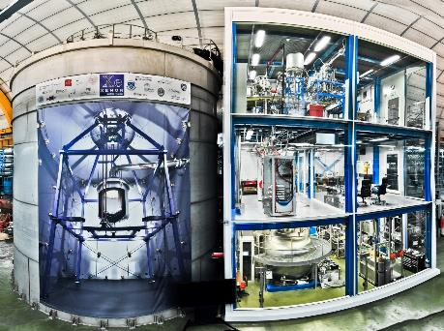
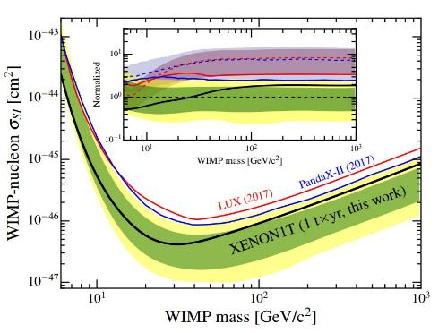
XENON1T most sensitive measurement yet
(2018)
No significant excess over background is found. arxiv.org/abs/1805.12562
Notes:
http://www.xenon1t.org/
XENON1T just released data further constraining WIMP window. No significant events were recorded over 279 days using an active target of 1300 kg of xenon.

Slide 40
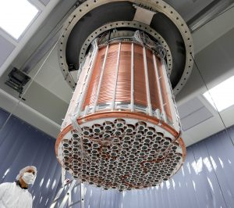
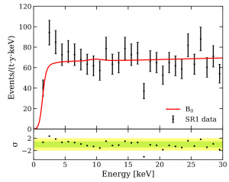
XENON1T – electronic recoil excess
(2020)
An excess is observed at low energies that is consistent with a solar axion signal, a bosonic dark matter signal with a mass of 2.3 keV/c2, a solar neutrino signal with enhanced magnetic moment, or a possible tritium background. arxiv.org/abs/2006.09721
Notes:
XENON1T observed more electron recoils than expected (283 instead of 230).
Could be solar axions!
More likely the result of trace tritium decays.
Only ~3.5sigma so still not a ‘discovery’

Slide 41
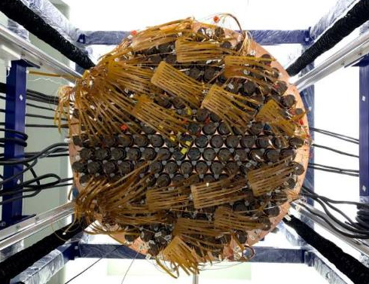
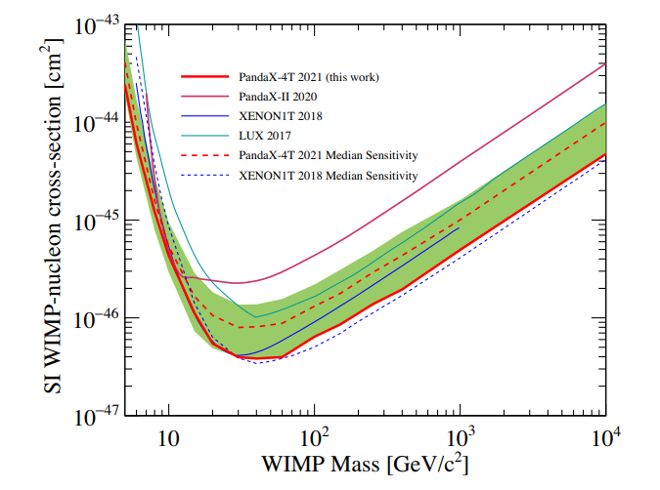
PANDAX-4T
(2021)
No dark matter candidates are identified above expected background. arxiv.org/abs/2107.13438

Slide 42
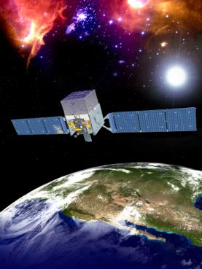
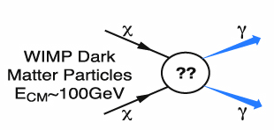
FERMI
Detects ɣ-rays
DM particle annihilation
Notes:
Dark matter candidates such as weakly interacting massive particles are predicted to annihilate or decay into Standard Model particles, leaving behind distinctive signatures in gamma rays, neutrinos, positrons, antiprotons, or even antinuclei. Indirect dark matter searches, and in particular those based on gamma-ray observations and cosmic-ray measurements, could detect such signatures.

Slide 43
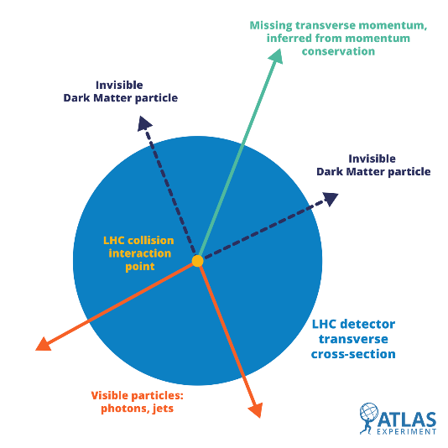
LHC
Notes:
ATLAS data (black points) are compared to the contribution expected from known particles (the filled histograms) in a number of control selections where no signal is expected (left of the dashed line) as well as in a number of selections where a supersymmetric signal, if it exists, would be enhanced (right of the dashed line). The statistical compatibility is reported on the lower panel, where a value above 5 in the signal selections would indicate a discovery.

Slide 44
Problems for Particle Dark Matter
We haven’t found anything yet
Missing Satellite galaxy problem
Not a great match in detail for galaxy rotation curves

Slide 45

Empty-Handed?

Slide 46
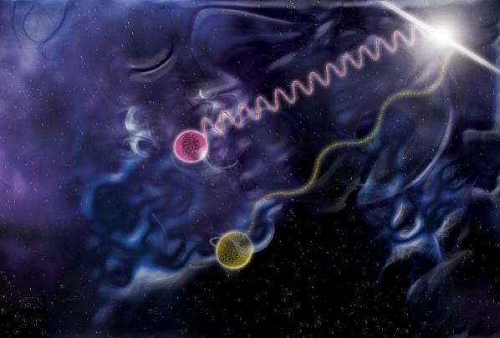
LIGO prefers a dark matter particle
Notes:
The Neutron Star merger places very strong constraints on theoretical models because it demonstrated that gravitational waves travel at speed of light.

Slide 47
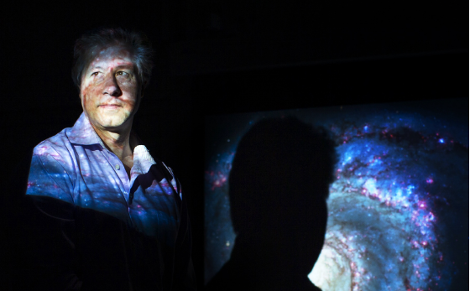
Modified Gravity Theories
Notes:
Could modified gravity be back on the table
Discuss verlinde and stacey mcgaugh work

Slide 48
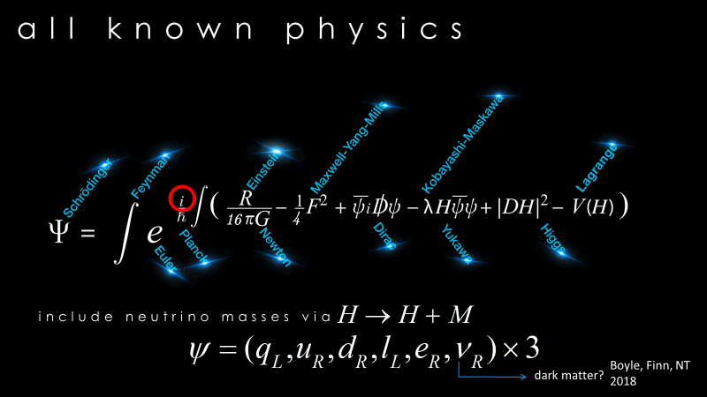
Maybe the particle has been here all along…
Notes:
Dark Matter has been in the model all along…neutrinos!

Slide 49
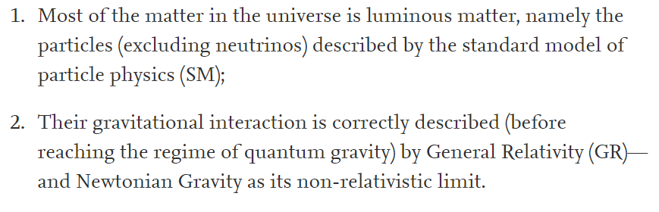
Moving beyond the
Dark Matter vs Modified Gravity debate
DM
MG
Notes:
Is it matter or spacetime?

Slide 50
Dark Matter
Works well on cosmological scales
Does not work well in detail for galaxy rotation curves (small scale problems)
We haven’t found it

Slide 51
Modified Gravity
Predicts galaxy rotation curves very well
Does not predict well or ignores the data from CMB or gravitational wave data

Slide 52
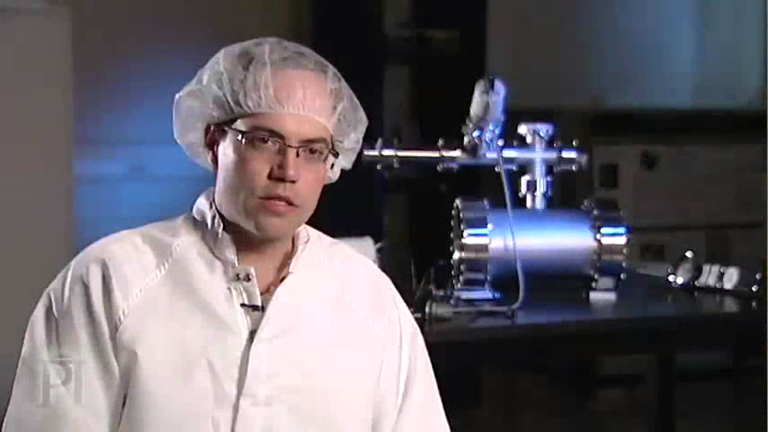
Competing Theories For Dark Matter
Notes:
Video

Slide 53
Competing Theories For Dark Matter
Notes:
Video

Slide 54
Evidence for Dark Matter on Mutiple Scales
Speeds of stars in galaxies
Speeds of galaxies in clusters
Gravitational lensing of clusters of galaxies
Web-like structure of large-scale universe
Cosmic Microwave Background

Slide 55
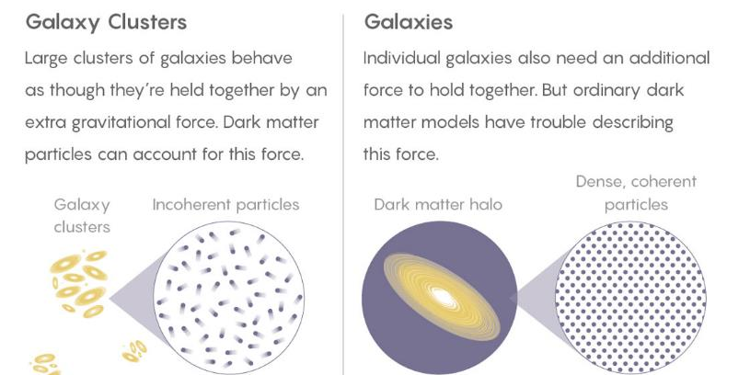
Superfluid Dark Matter?
Credit: Quanta Magazine

Slide 56

Free Resources for All Teachers
https://resources.perimeterinstitute.ca/

Slide 57

Thank You!
Dave Fish
dfish@perimeterinstitute.ca
Olga Michalopoulos
omichalopoulos@gmail.com
https://resources.perimeterinstitute.ca/

