Slide 1
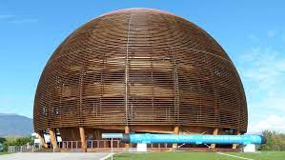
PTLTP21 Online
Leandro Donizete Moraes

Slide 2
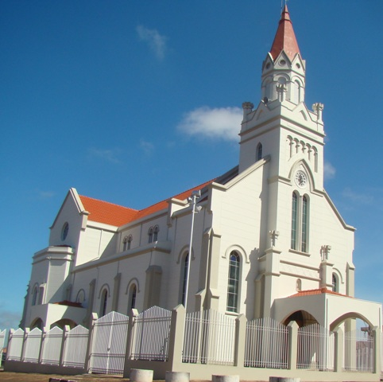
Live at:
São Tomás de Aquino – Minas Gerais
7,222 population
9,108.13 km away from CERN

Slide 3
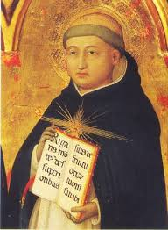
Live at:
São Tomás de Aquino – Minas Gerais
7,222 population
9,108.13 km away from CERN

Slide 4
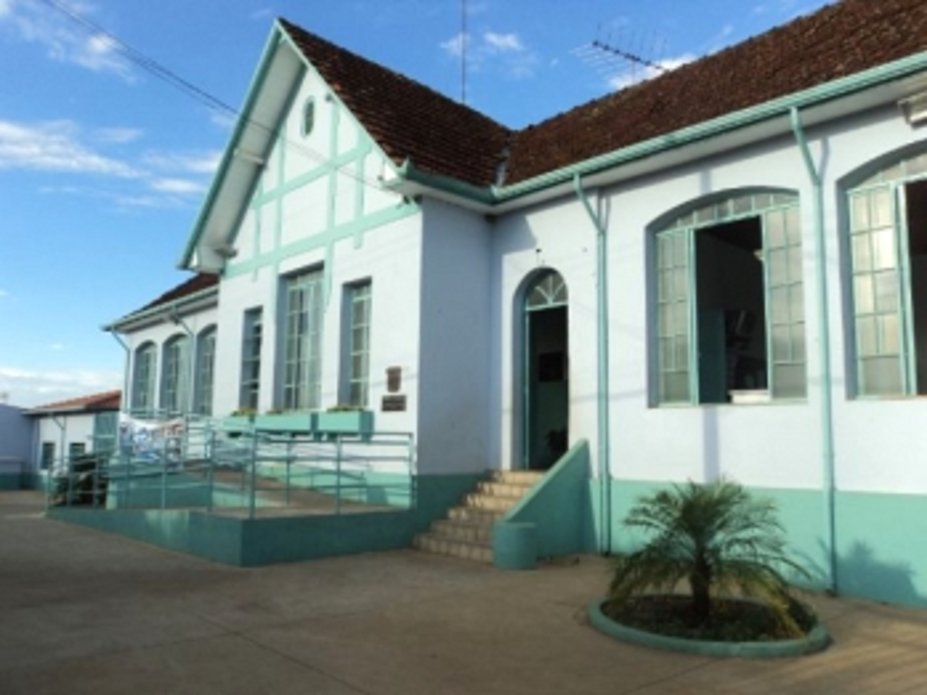
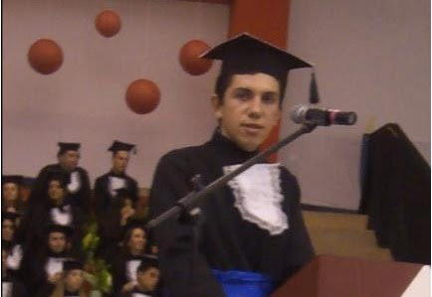
Public school Dr. Tancredo de Almeida Neves - Student, professor and currently deputy director and professor of Physics
Degree in Mathematics in 2011
Degree in Physics in 2014

Slide 5
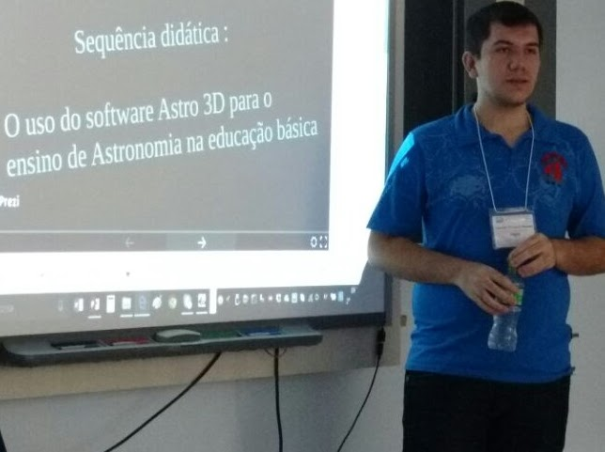
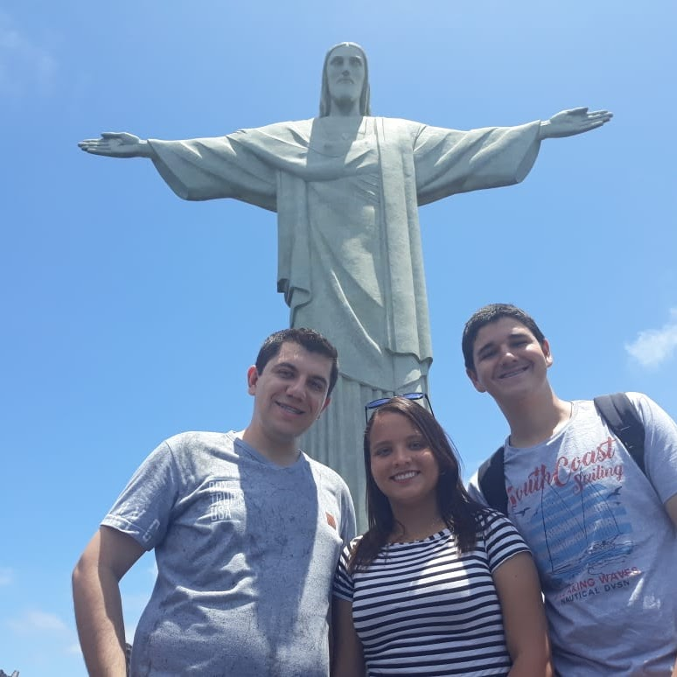
Master in Physics Teaching in 2016
Coordinator of several knowledge olympics: OBA (and MOBFOG), OBMEP, ONC, Rocket Journey in Rio de Janeiro, among other activities

Slide 8
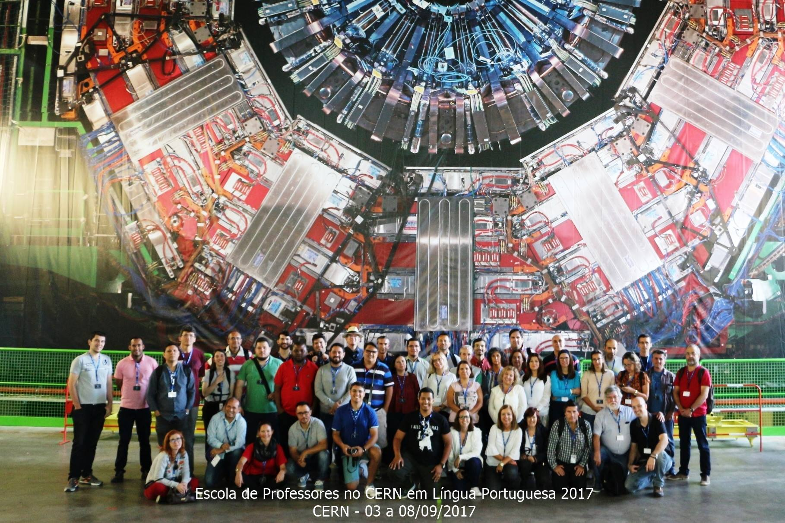

Slide 9
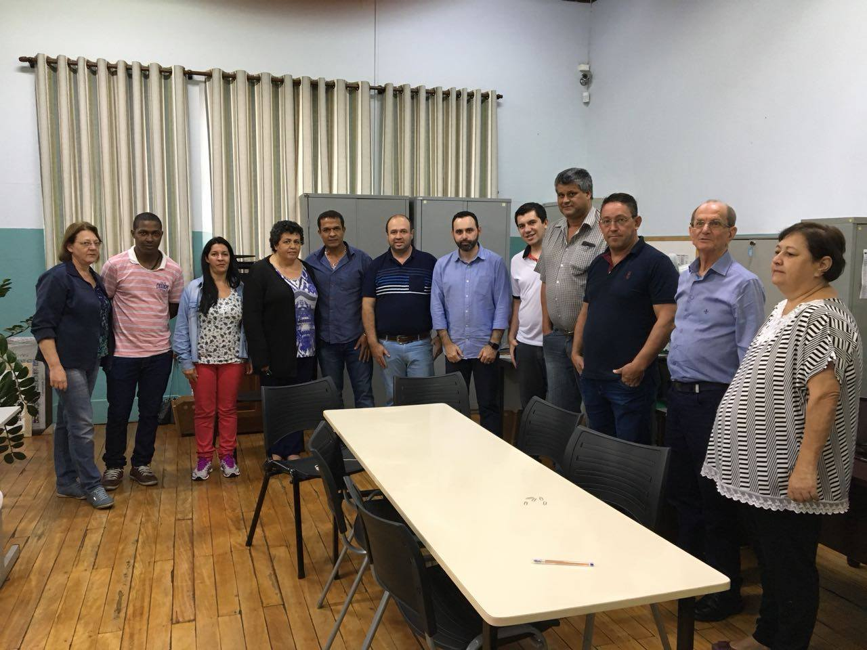
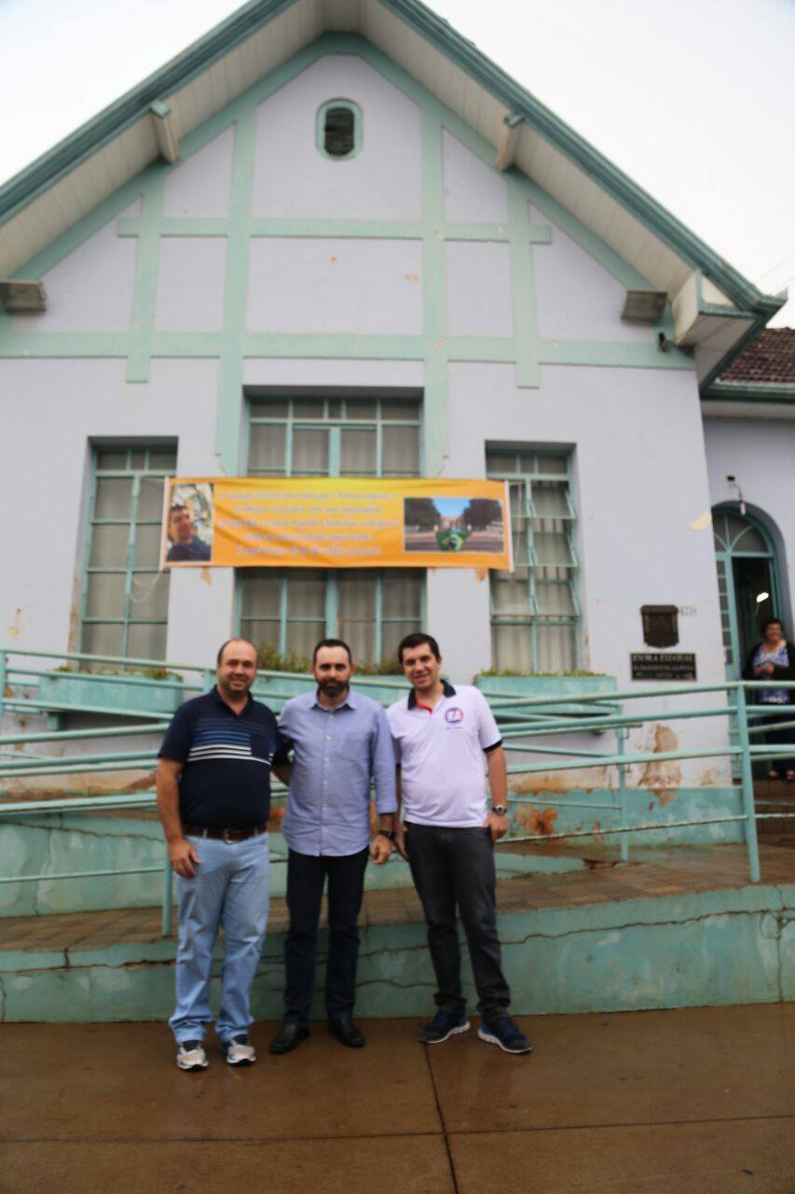
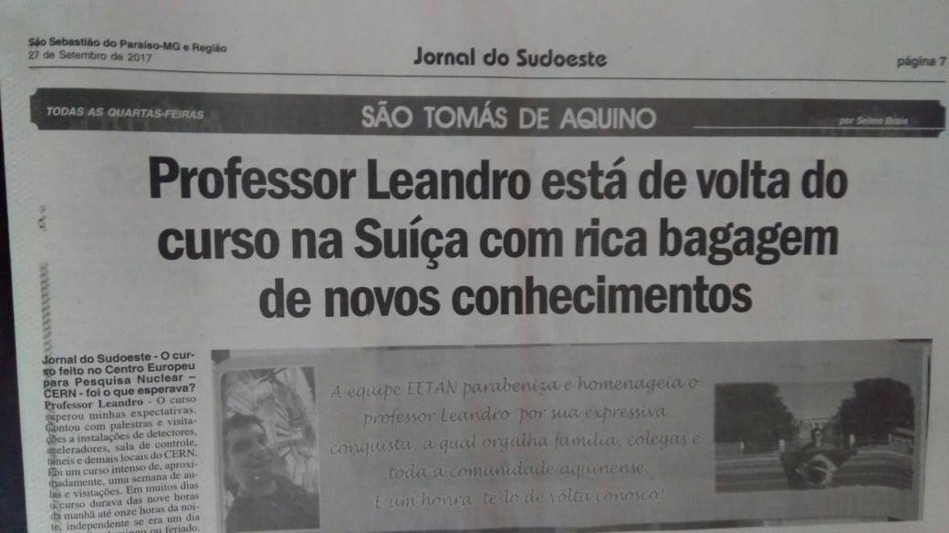
Several tributes were given in the city and region after
the return of the CERN School of Physics 2017.
Classes were also held on Particle Physics, CERN and
teacher training

Slide 10
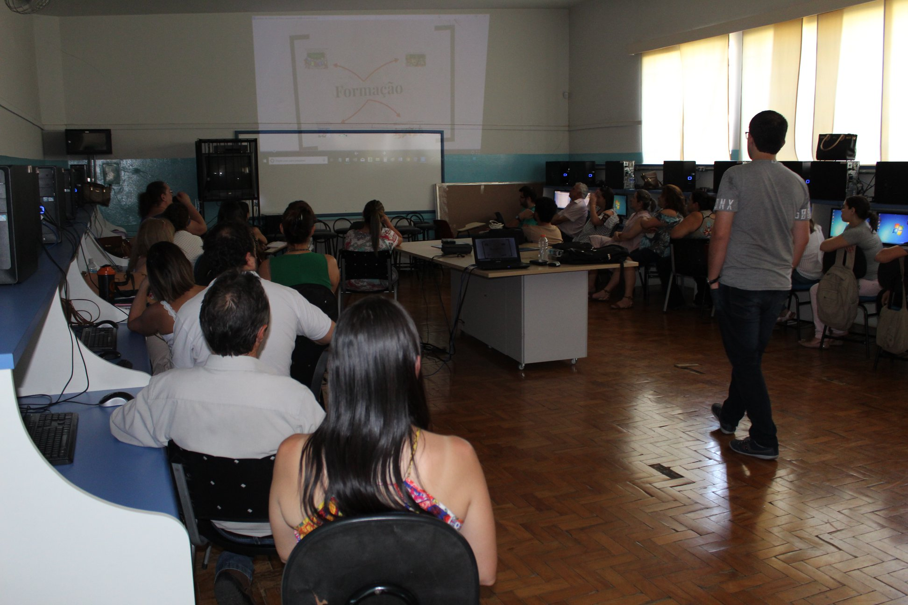

Slide 11
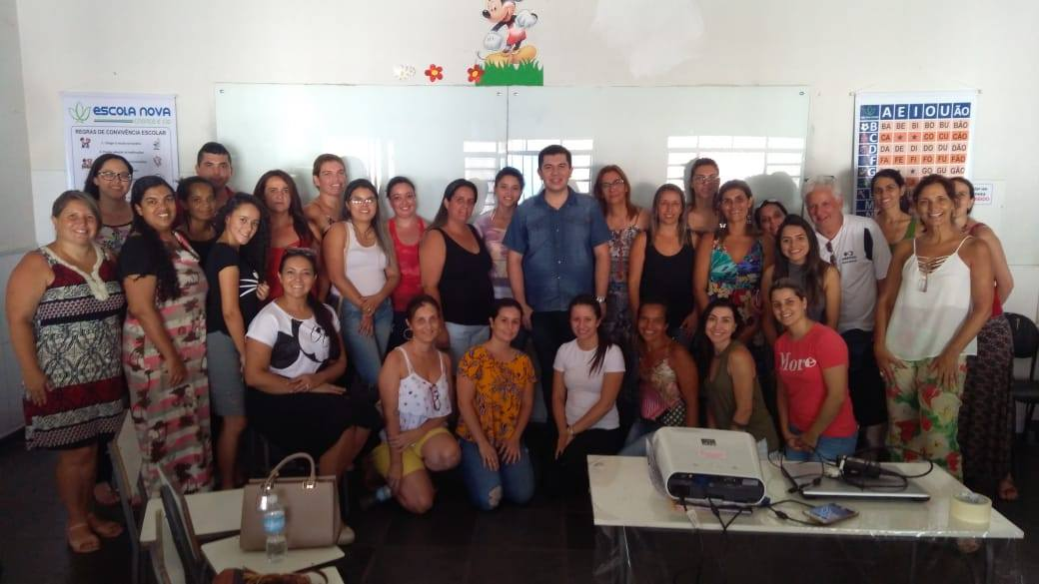

Slide 12
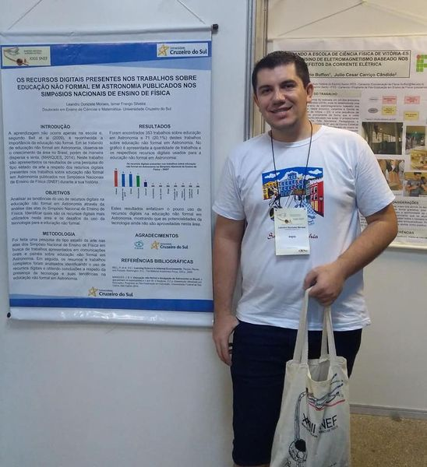
Participação em eventos, ensino de Física, em especial, de Física de Partículas e Astronomia

Slide 13
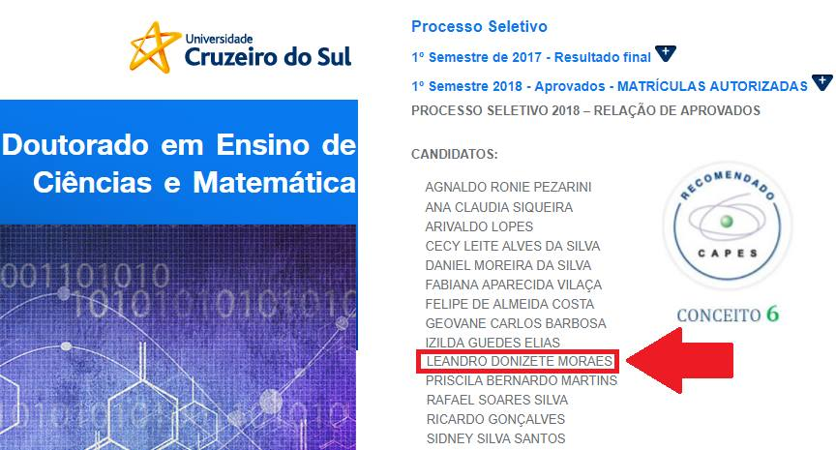
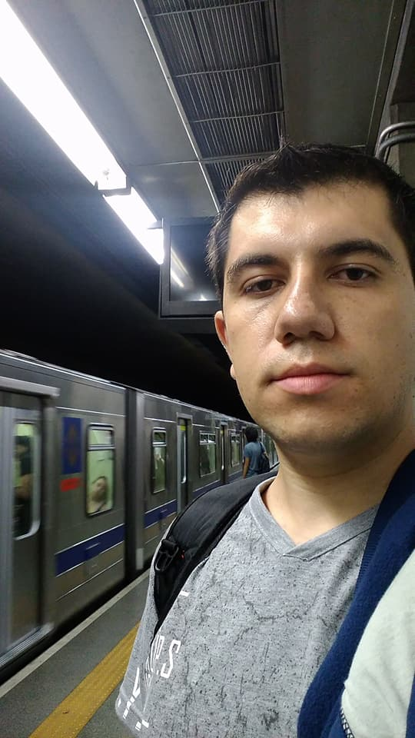
Thesis defended on 09/20/2021:
Production, application and analysis of a connectivist course for the
observational astronomy learning

Slide 14
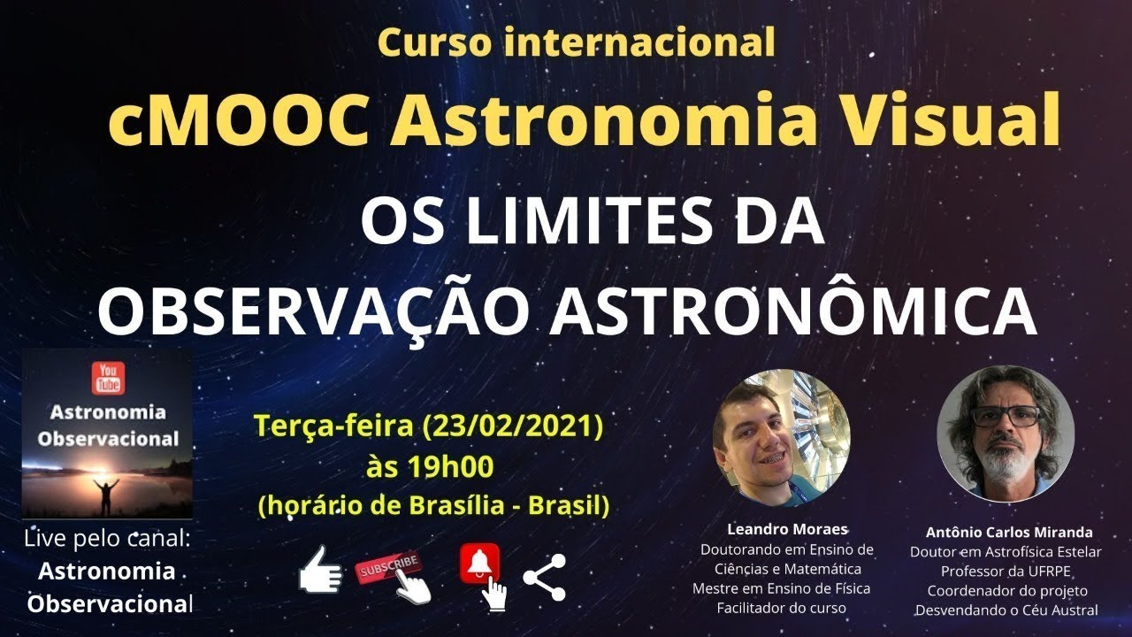

Slide 15

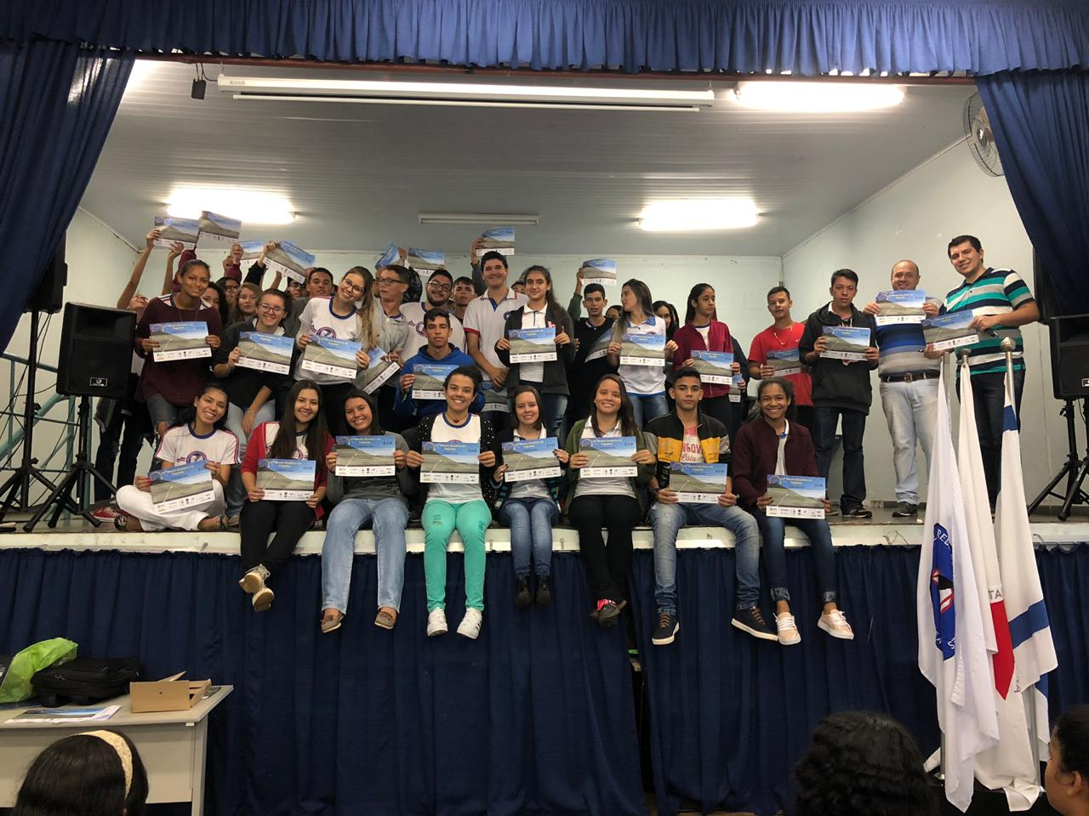
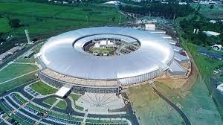
Participação em eventos, ensino de Física, em especial, de Física de Partículas e Astronomia

Slide 16
Professor Leandro's website: www.profleandromoraes.com.br

Slide 17
Thank you very much !!!
Teachers Nilson, Nelson and Pedro
Colleagues from CERN School 2017
PTLTP 2021 Colleagues
Everyone who believes in Science and Education

