Slide 1

The HEPiX IPv6 working group - an introduction
David Kelsey (STFC UKRI) HEPiX IPv6 WG meeting, virtual, 14-15 Oct 2021

Slide 2
On behalf of all co-authors in the HEPiX IPv6 working group
Active in HEPiX IPv6 Working Group – last 12 months
M Babik (CERN), M Bly (RAL), T Chown (Jisc), D Christidis (U Texas/ATLAS), J Chudoba (Prague), C Condurache (EGI.eu), J Flix (PIC), C Grigoras (CERN/ALICE), B Hoeft (KIT), D P Kelsey (RAL), E Martelli (CERN), S McKee (U Michigan), R Nandakumar (RAL/LHCb), K Ohrenberg (DESY), F Prelz (INFN), D Rand (Imperial), A Sciabà (CERN/CMS)
Many more in the past, and others join from time to time
and thanks also to WLCG operations, WLCG sites, LHC experiments, networking teams, monitoring groups, storage developers…

Slide 3
Outline
History (Phases 1 and 2)
Current status (see later agenda items for more details)
The future - Phase 3: IPv6-only networking
Summary

Slide 4
Worldwide LHC Computing Grid (WLCG)
The WLCG is a global collaboration
more than 170 computing centres in 42 countries
Its mission is to store, distribute and analyse the data generated by the LHC experiments
Sites hierarchically arranged with three tiers:
Tier-0 at CERN
13 Tier-1s (mainly national laboratories)
>150 Tier-2s (generally university physics laboratories)

Slide 5
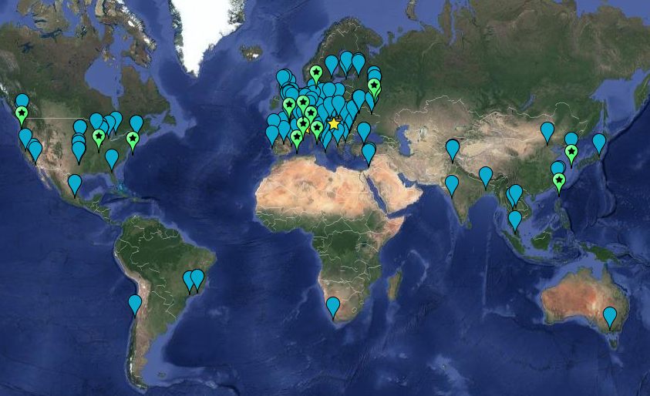

WLCG sites

Slide 6
Why should WLCG use IPv6?

Slide 7
Why IPv6?
Survey of 18 major HEP sites (Sep 2010) – IPv6 readiness
National NRENs ready, Universities and Labs not ready
Some reported lack of IPv4 address space, including CERN
HEPiX meeting – Cornell, Ithaca NY – Nov 2010
Projected IANA IPv4 address exhaustion
Sep 2010 – memo from US Federal CIO to all Exec depts (incl DOE)
Offers of opportunistic CPU resources which could be IPv6-only
Experiments want to be able to use them
Recognition that much of our middleware, software and technology was not yet IPv6 capable
HEPiX decided to create a working group (started April 2011)
No specific funding – but motivated, competent volunteers!

Slide 8
Phase 1: 2011-2016
Phase 1 – full analysis of work to be done
Applications, system and network tools, operational security
Create and operate a distributed test-bed
No interference with WLCG production data analysis!
Propose timetable and plan for transition
CERN announces shortages of routable IPv4 addresses
explosion of virtualisation
Active HEPiX IPv6 test-bed with ~ 12 sites
engagement of all 4 LHC experiments
Testing regular data transfers across the testbed
Testing dual-stack services (in production) at Imperial College London
Concluded not able to support IPv6-only clients until at least 2014

Slide 9
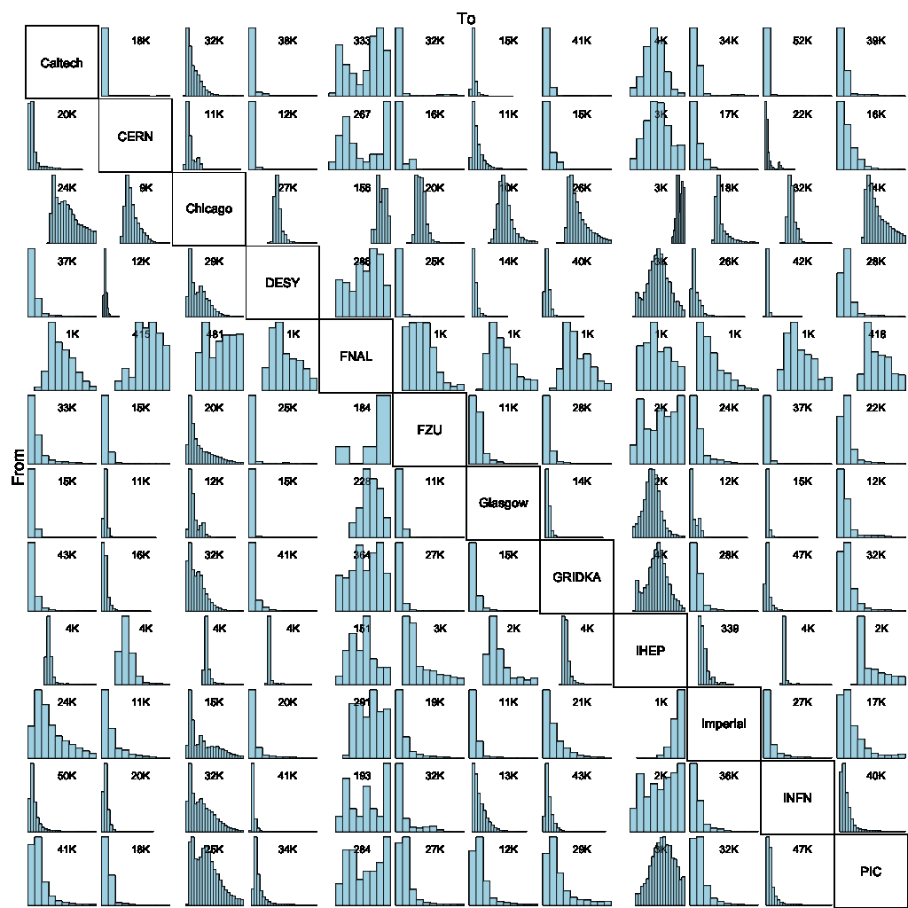
At CHEP2013 conference
> 2 PB data transferred over IPv6 in last 6 months
Success rate > 87%
Very High!
GridFTP IPv6 data transfer mesh

Slide 10
2013-14 Data Management
Testing the important data transfer protocols, technology and data storage/file systems
For IPv6-readiness
GridFTP, DPM, dCache, xRootD, OpenAFS, FTS, CASTOR
Found many problems needing work
Worked closely with developer community
Concluded IPv6 support will be much later than 2014!

Slide 11
Phase 2 – Dual-stack deployment – 2016-20
Most important IPv6 use case
Sites, Clouds providing CPU (virtual machines)
Opportunistic resources may be IPv6-only
Need dual-stack federated storage services
And dual-stack central WLCG and Experiment services
LHCOPN (Tier0-Tier1 private network)
Encourage IPv6 peering everywhere
perfSONAR – end to end network monitoring – dual-stack
Move central services and central monitoring to IPv4/IPv6
Wrote guidance on IPv6 security for WLCG sites
Deployment timetable approved by WLCG Management Board (Sep 2016)

Slide 12
WLCG – IPv6 deployment
Plan approved by WLCG Management Board
April 2017 – support for IPv6-only CPU starts
Tier-1s to provide dual-stack storage (in testbed)
April 2018
Tier-1 dual-stack storage in production mode
By end of LHC Run 2 (end 2018)
A large number of Tier-2s to migrate storage to IPv6
All requested to do this

Slide 13
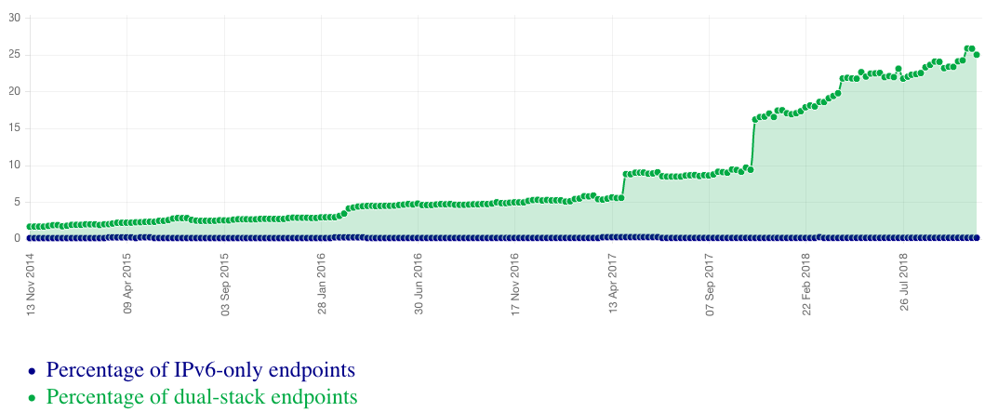
Growth of dual-stack hosts in the WLCG (Jan 2019)
~25%
All services, not just storage
Fraction of endpoints listed in the CERN central BDII (lcg-bdii.cern.ch) where the DNS returns a dual-stack IPv6-IPv4 (A+AAAA) resolution (green line) or an IPv6-only resolution (blue line). (http://orsone.mi.infn.it/~prelz/ipv6_bdii/).

Slide 14
Problems & lessons learned
Many blocking issues outside of our own control
Both software and site networking teams
Developers claim that software is fully IPv6-compliant!
Software/protocols fixed-size storage for IP addresses
Software/protocols assume single address (as in IPv4)
Performance differences between IPv4 & IPv6
IPv6 must perform at least as well
Have to understand cases where fraction of IPv6 is smaller than expected
Preference for IPv6 over IPv4 must be established
Can be lots of development effort and testing is not easy when no other positive change re functionality
Sys admins, operations staff, security team, developers
All need TRAINING and experience

Slide 15
IPv4/IPv6 and Tier-1 storage
Sep 2021 (GDB)
FTS servers at BNL, CERN, Fermilab and RAL all now work in dual stack
FTS transfers do happen via IPv6 at most Tier-1s (but not all transfers)
IPv6 transfers do not (yet) happen at RRC-KI but IPv6 is enabled
Experiment | Fraction of T1 storage accessible via IPv6
ALICE | 78%
ATLAS | 96%
CMS | 100%
LHCb | 94%
Overall | 96%

Slide 16
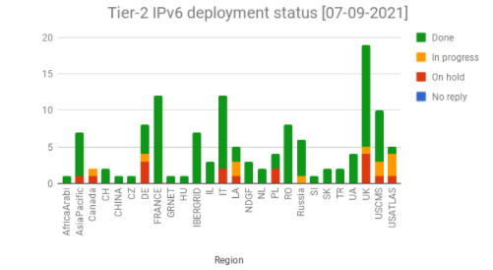
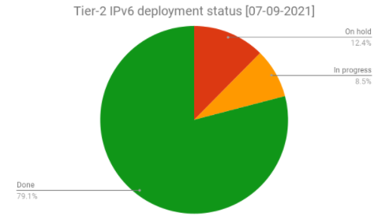
IPv4/IPv6 deployment at Tier-2 sites
The deployment campaign was launched in November 2017
Steady progress (status)
~79% of Tier-2 sites have storage on dual stack
Experiment | Fraction of T2 storage accessible via IPv6
ALICE | 87%
ATLAS | 62%
CMS | 94%
LHCb | 75%
Overall | 77%

Slide 17
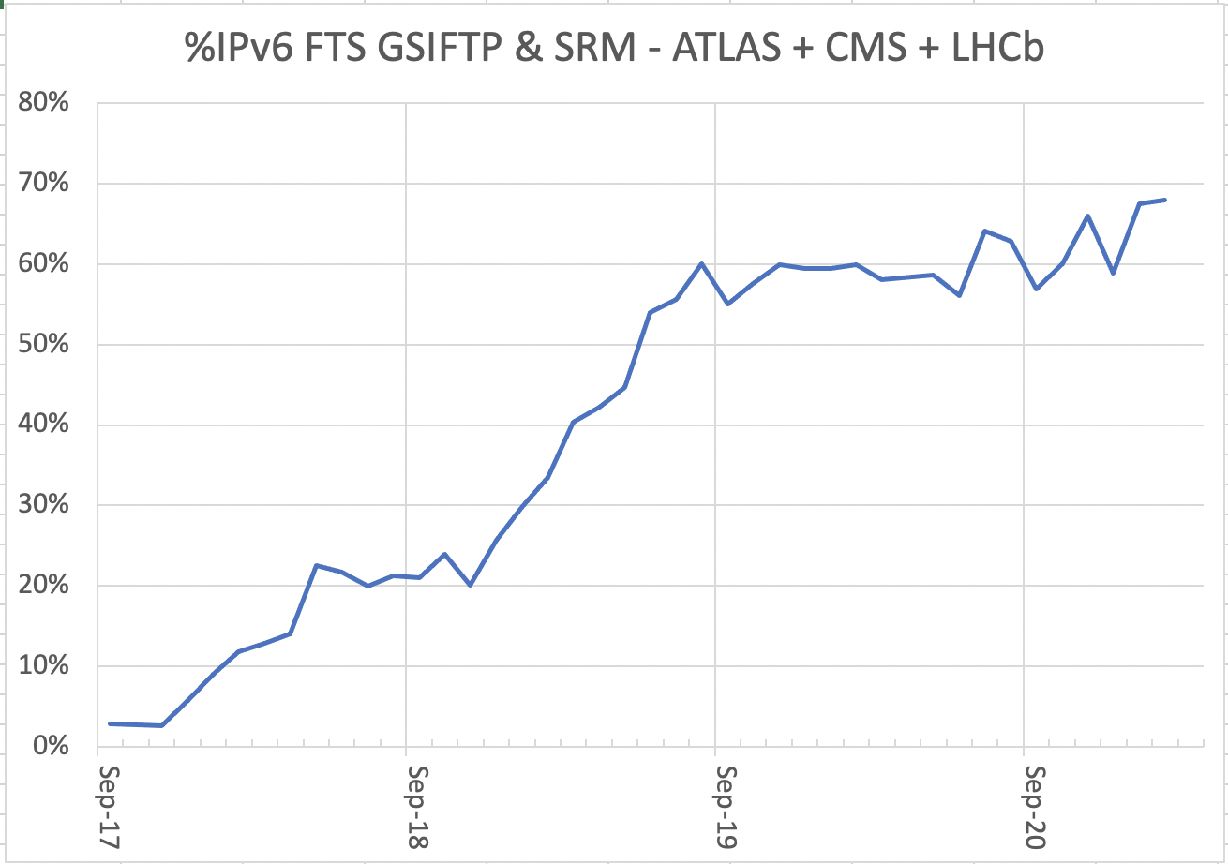
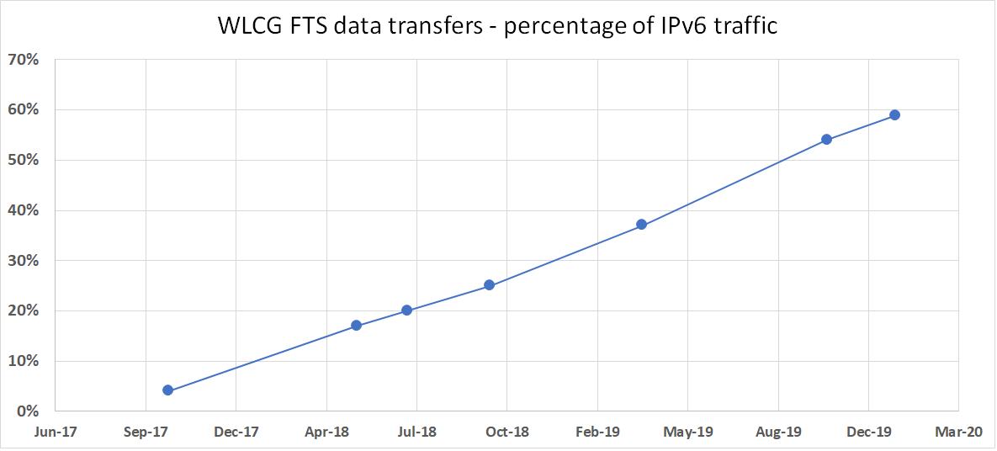
Fraction of SRM/GridFTP FTS traffic over IPv6
Some FTS protocols, e.g. DAVS, not yet instrumented to monitor IPv6
these are excluded from this plot

Slide 18
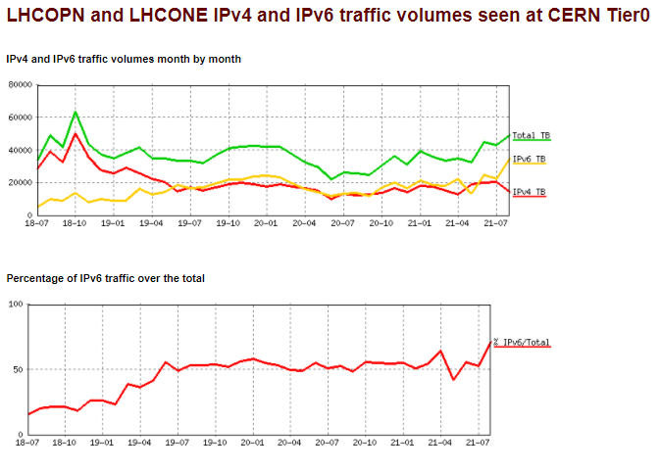
IPv6 traffic on LHCOPN/LHCONE at CERN
IPv6 traffic on LHCOPN/ONE as seen at CERN
~70% of all traffic is IPv6
> 50% from June 2019 onwards
LINK to these plots

Slide 19
IPv4 transfers on LHCOPN/ONE?
Tier1s are dual-stack, but IPv4 can still be used for transfers
Site/experiment issues - some storage end-points not yet dual-stack
Old software stacks (legacy deployments) are still deployed
both ends are dual-stack but configuration or request prefers IPv4
Investigation of ATLAS/CMS IPv6 traffic has been proposed in UK
transfers are to/from WN's and the WNs are still IPv4-only
Difficult to monitor WN IPv6 traffic centrally – can sites monitor?
encourage all sites to deploy all WNs and all services as dual-stack
encourage all sites and all experiments to "prefer" IPv6 transfers

Slide 20
IPv6 use cases
Main driver was and still is: “support IPv6-only CPU”
Ongoing concern of lack of IPv4 addresses (at some sites)
Other (more recent) drivers
Support packet marking in TCP for monitoring by RNTWG
Research Networking Technical Working Group
See WLCG GDB May 2021 – LHCOPN/ONE (E. Martelli) slide 15
And report today from Marian Babik
US Federal Government - 80% of services to be IPv6-only by 2025-26
See report today from Phil DeMar

Slide 21
Phase 3: From dual-stack to IPv6-only (CHEP2019) https://doi.org/10.1051/epjconf/202024507045
Planning for an IPv6-only WLCG
To simplify operations
dual-stack infrastructure is the most complex!
Large infrastructures (e.g. Facebook, EE/BT) use IPv6-only internally
The plan - the goal we are working towards
IPv6-only for the majority of WLCG services and clients
With ongoing support for IPv4-only clients where needed
e..g. via use of RFC 7755/7756
Stateless IP/ICMP Translation for IPv6-only Data Centres
Timetable to be defined

Slide 22
IPv6-only timetable
A possible first place to turn-off IPv4?
LHCOPN (Tier0 and all Tier1’s are all dual-stack)
When the amount of IPv4 traffic becomes very small
Can we make LHCOPN IPv6-only?
IPv4 traffic will flow via general internet links
WLCG Management Board (July 2021) – “must not happen too early”
WLCG IPv6-only plan - is during LS3 and before start of Run 4 possible?
MB still to agree date for end of “full support” for IPv4 on WLCG Clients
Core services at that point can become IPv6-only

Slide 23
WLCG MB Conclusions (July 2021)
Deployment of dual stack storage remains the priority
this is a prerequisite to fully supporting IPv6-only WNs
All sites and regions should plan accordingly and as soon as possible
The final goal is agreed to be IPv6-only
But the timetable to be agreed later!

Slide 24
Summary
WLCG is ready to support use of IPv6-only CPU resources
Good steady progress towards this goal!
Tier-1s should all have production storage accessible over IPv6
>96% of Tier-1 storage is available via IPv6
Tier-2s ~80% sites done
>75% of Tier-2 storage is dual-stack
WG Phase 3 - we are planning for move to IPv6-only services
message to new research communities - build on IPv6 from start

Slide 25
Questions, Discussion?

