Slide 1
SynRad+ in a nutshell
FCCee topical meeting on SR software
21 October 2021, Marton Ady

Slide 2
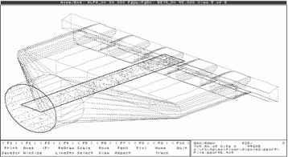
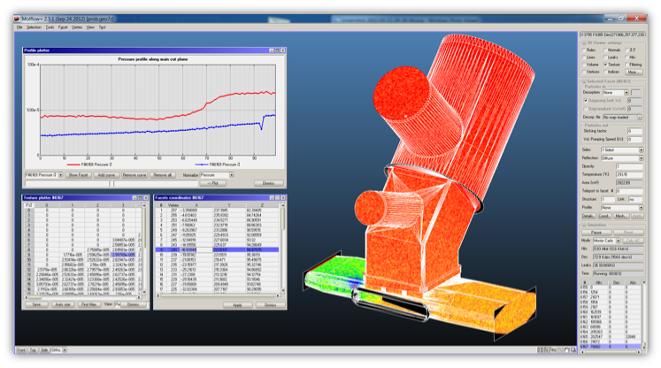
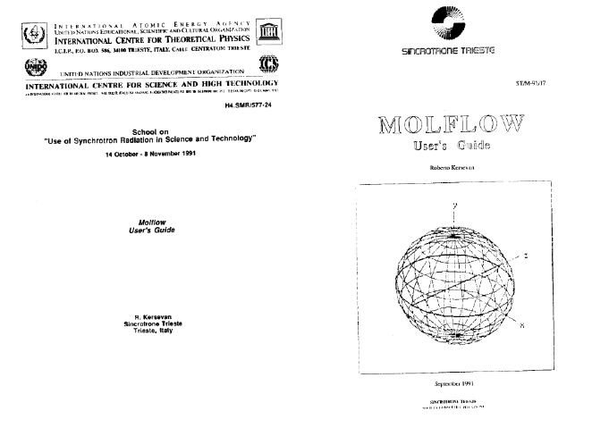
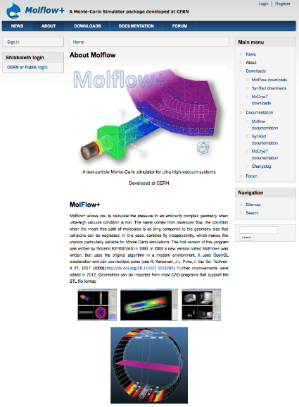
Molflow (1990)
Molflow+ (2008-)
R. Kersevan
R. Kersevan / J. L. Pons / M. Ady / P. Bahr

Slide 3
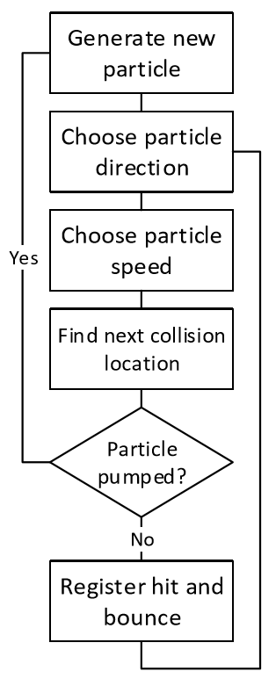
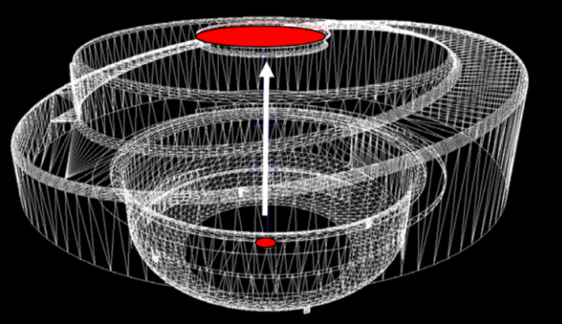
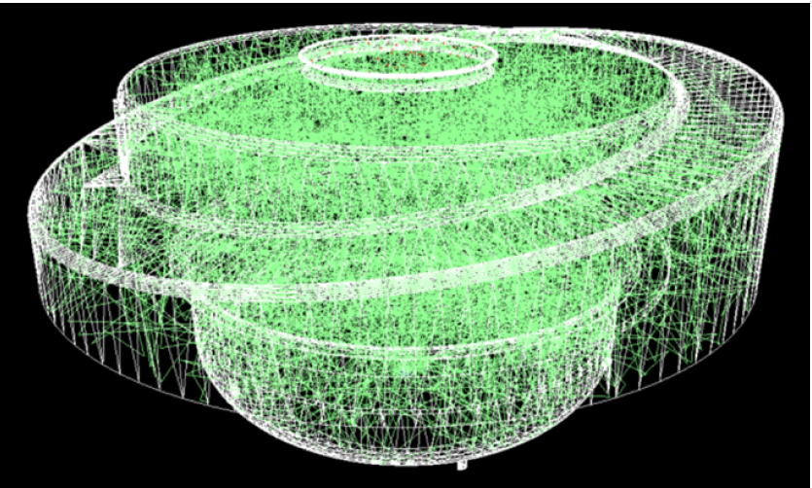
Monte Carlo vacuum simulations
Entrance
Exit

Slide 4
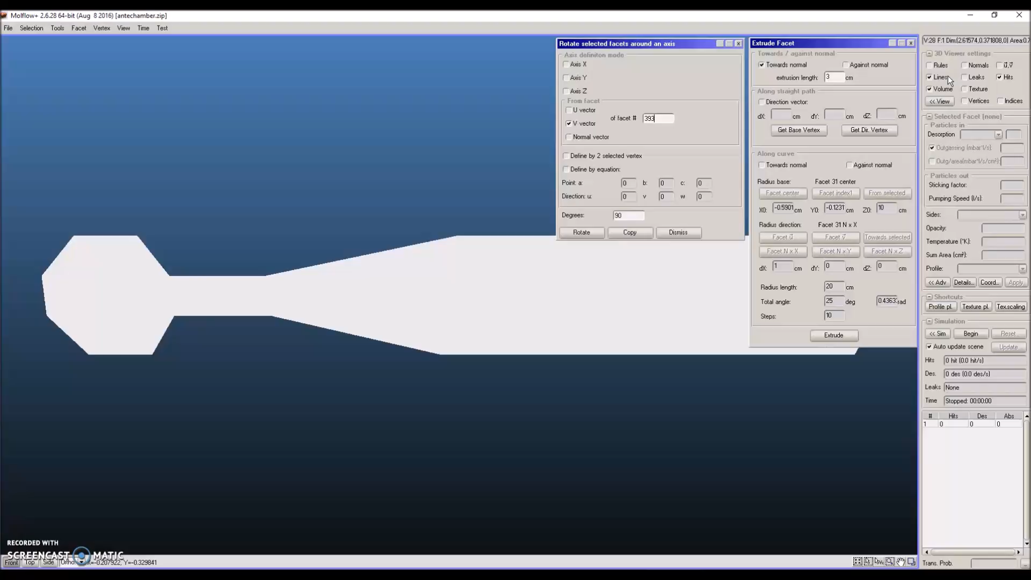

Slide 5
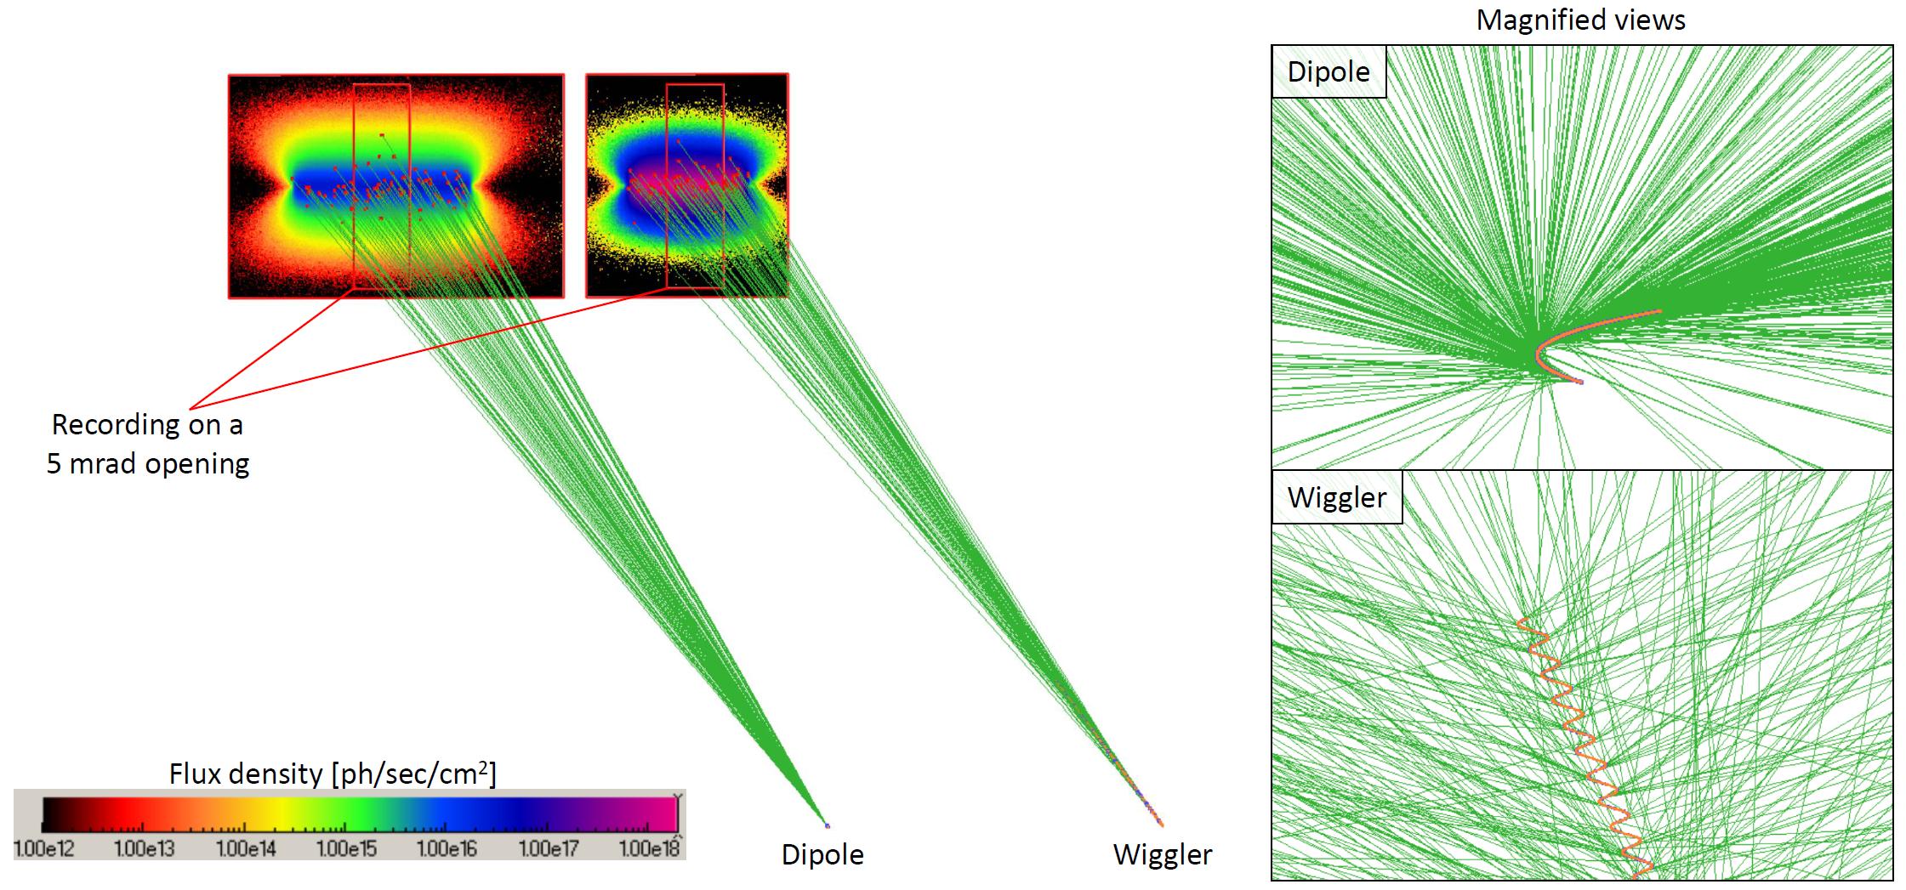
SynRad+
Dipole approximation
Dipole, Wiggler, Quadrupole (no Undulator)
Custom XYZ or X’Y’Z’ field, curved quadrupole

Slide 6
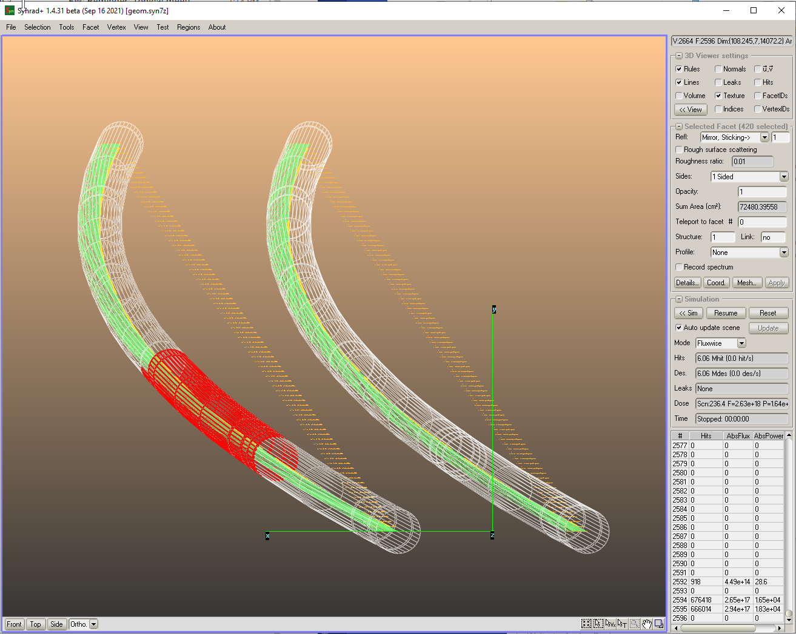
SynRad+ interface
Facet parameters
Results
Geometry, selection, camera

Slide 7
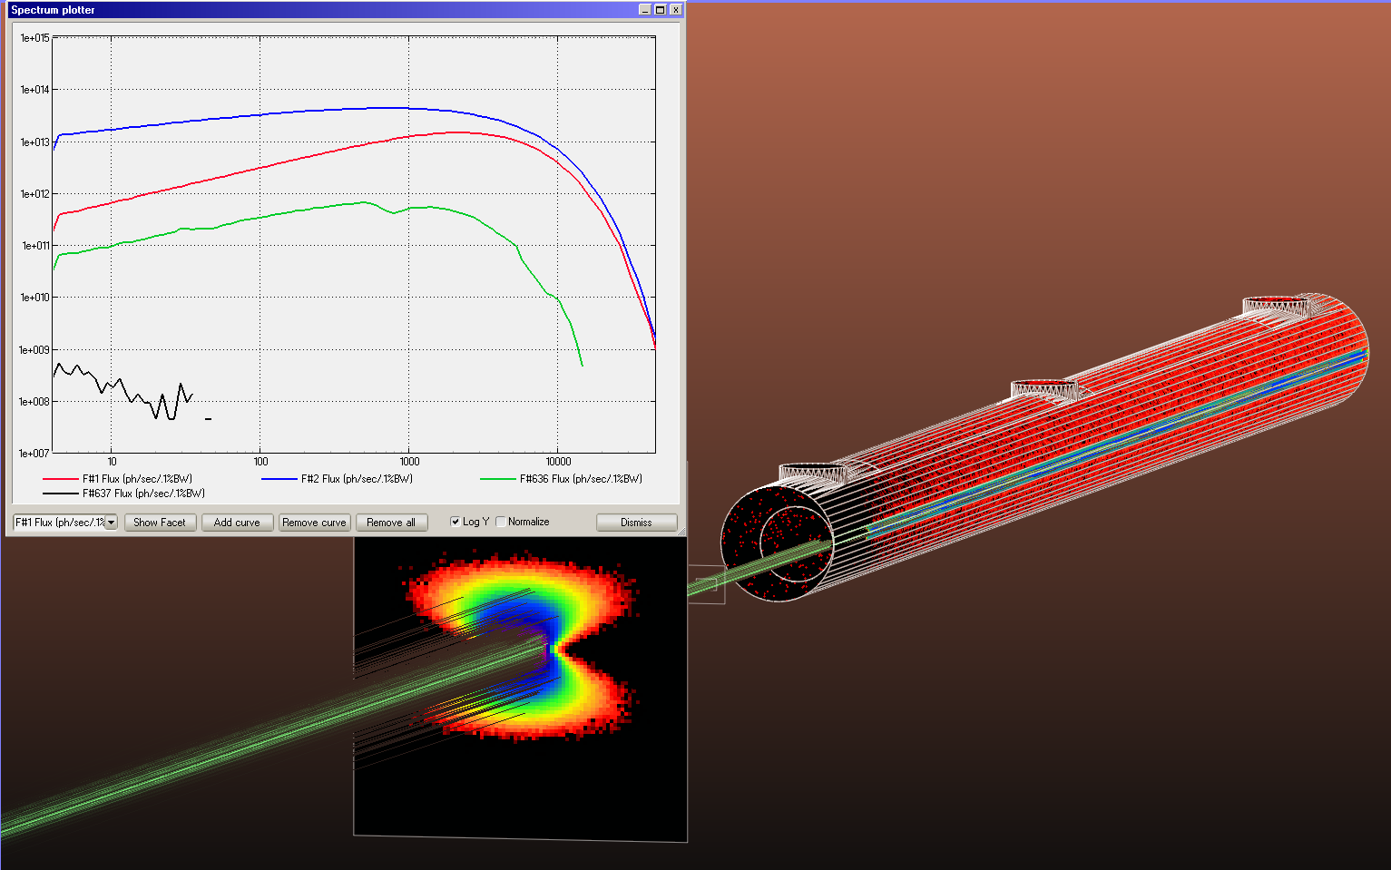
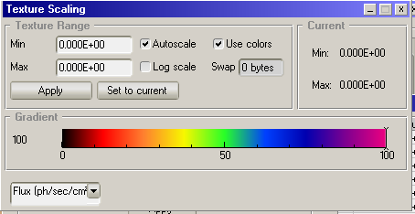
Built-in post-processing
Spectrum plotter
SR From dipole
Electrodes
First reflection
After collimator
Backscattered
(0.002%)
SR collimator
Primary incidence:
Sample wall
First reflection:
end flange
Dipole source
13m upstream
2.5GeV 450mA beam
0.9634T, e_crit=4keV
Textures
Textures

Slide 8
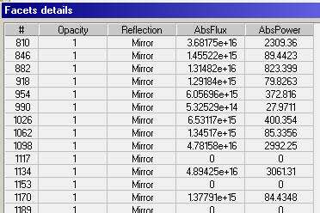
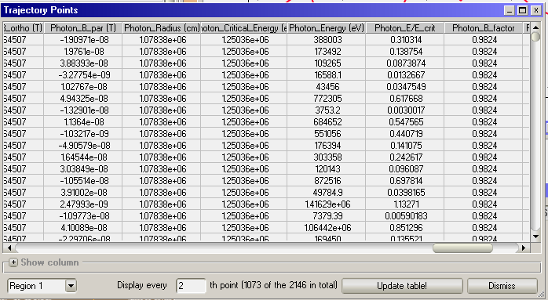
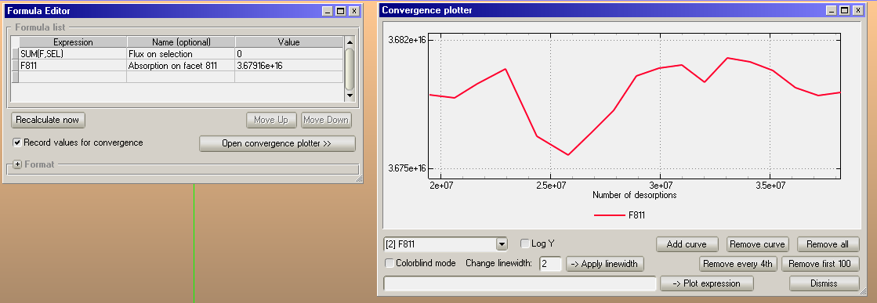
Built-in post-processing

Slide 9
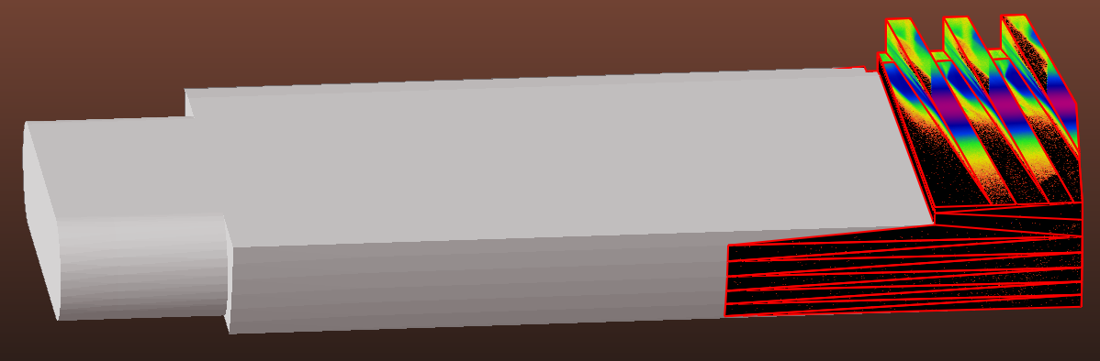
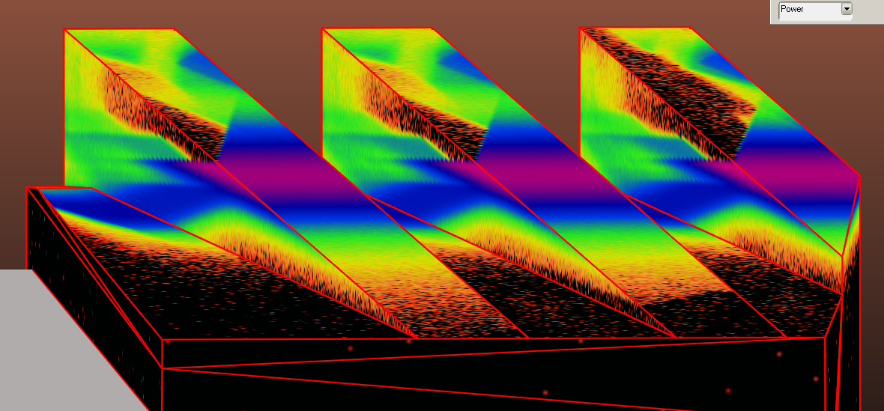

Working with SynRad+ and MolFlow+
1) Simulate SR
Power density [W/cm2]

Slide 10
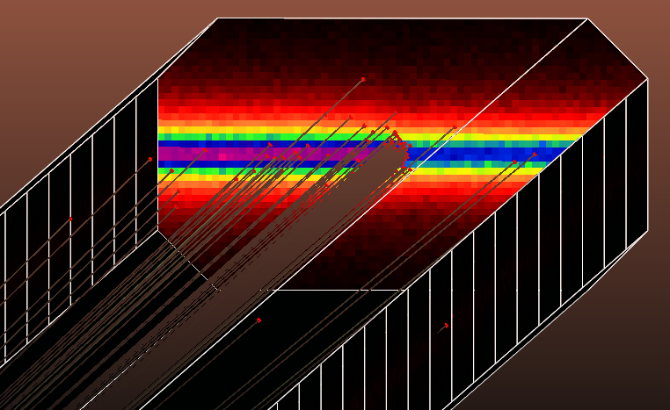
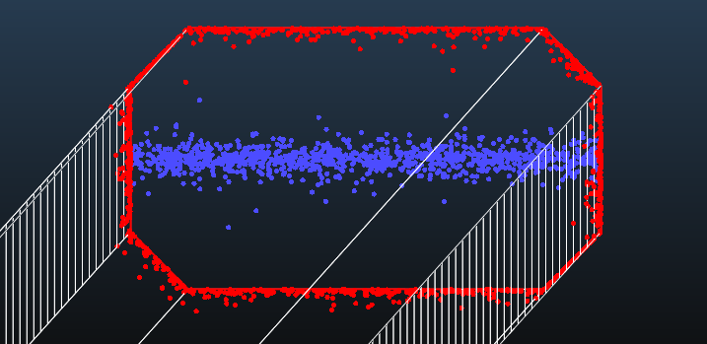
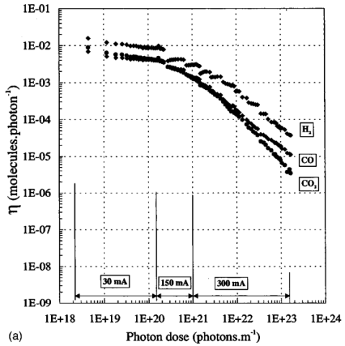
Photon stimulated desorption:
Working with SynRad+ and MolFlow+
2) Convert SR to dynamic outgassing
SynRad+
MolFlow+
Conversion

Slide 11
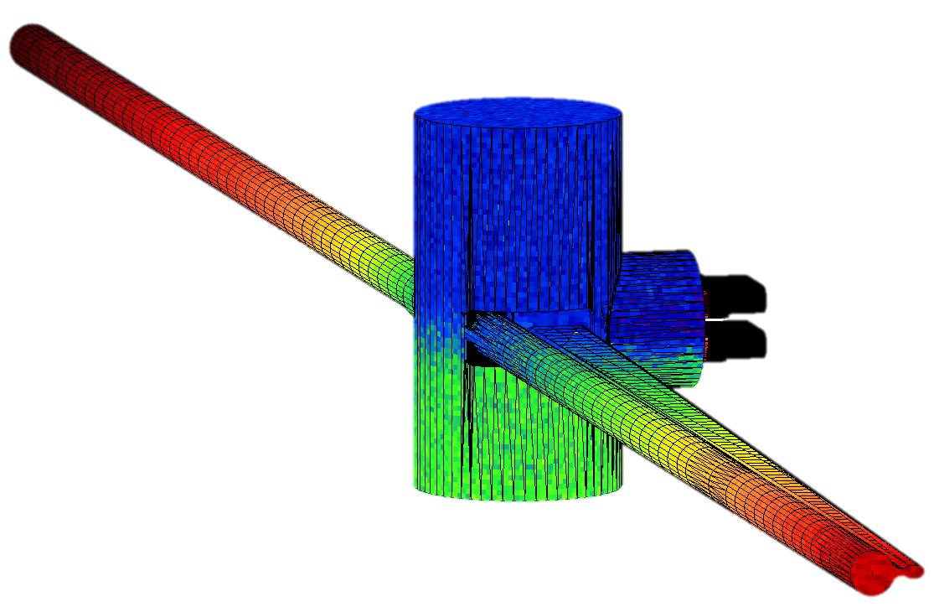

Working with SynRad+ and MolFlow+
3) Perform vacuum simulation
Pressure [mbar]

Slide 12
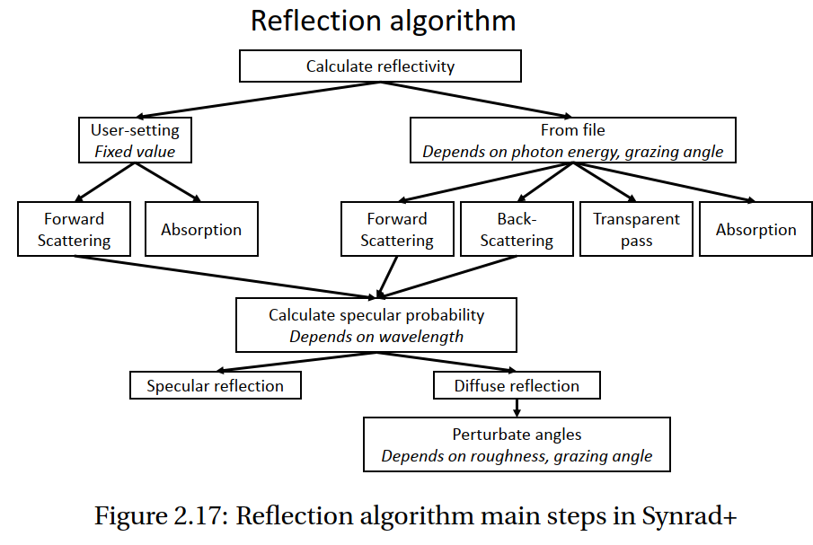
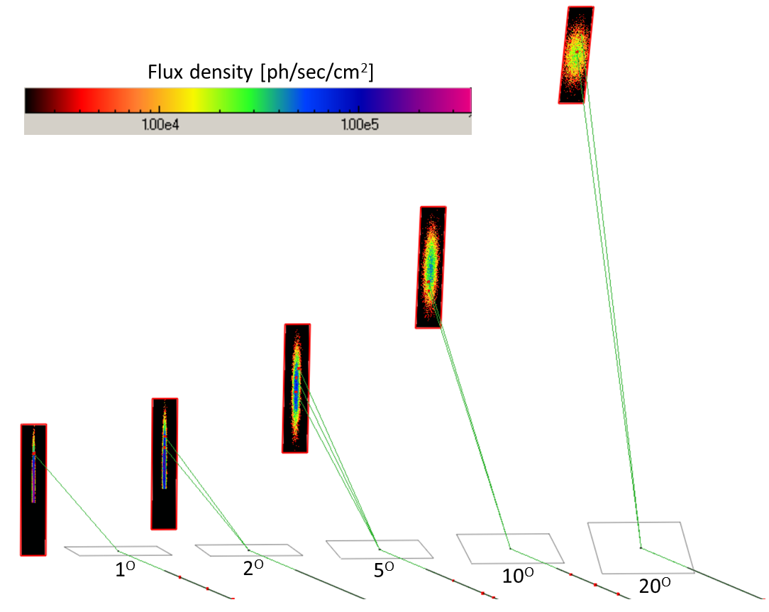
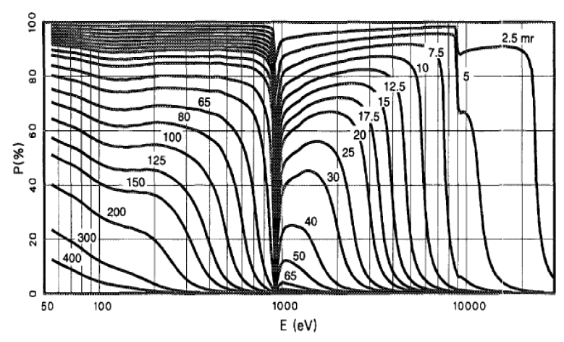
Details: rough surface scattering

Slide 13
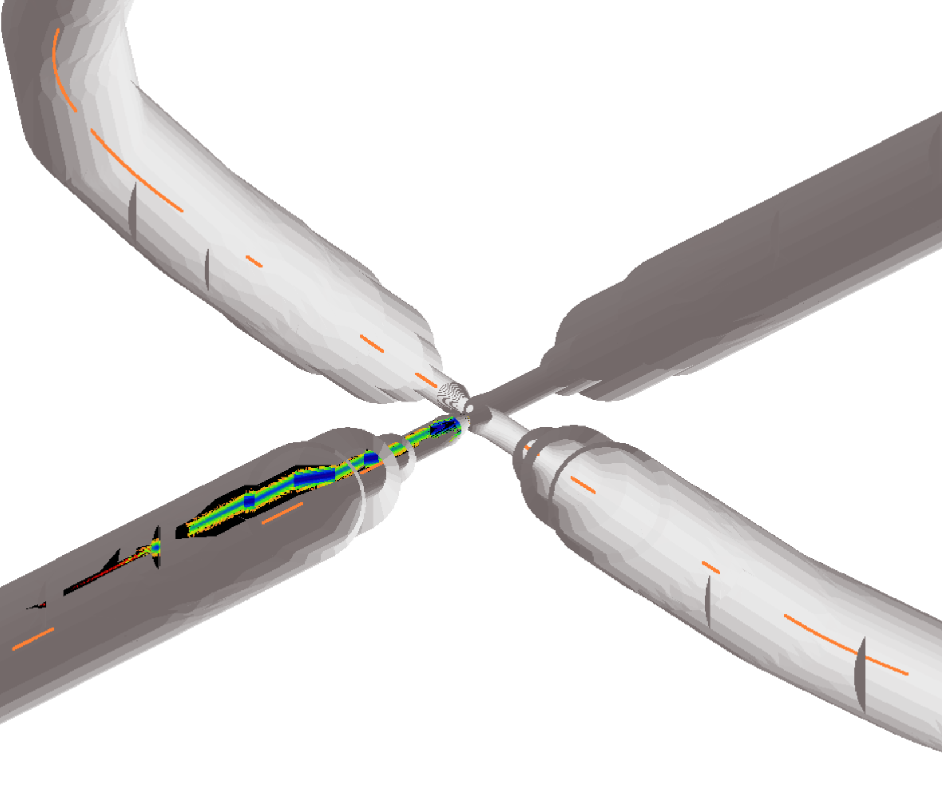
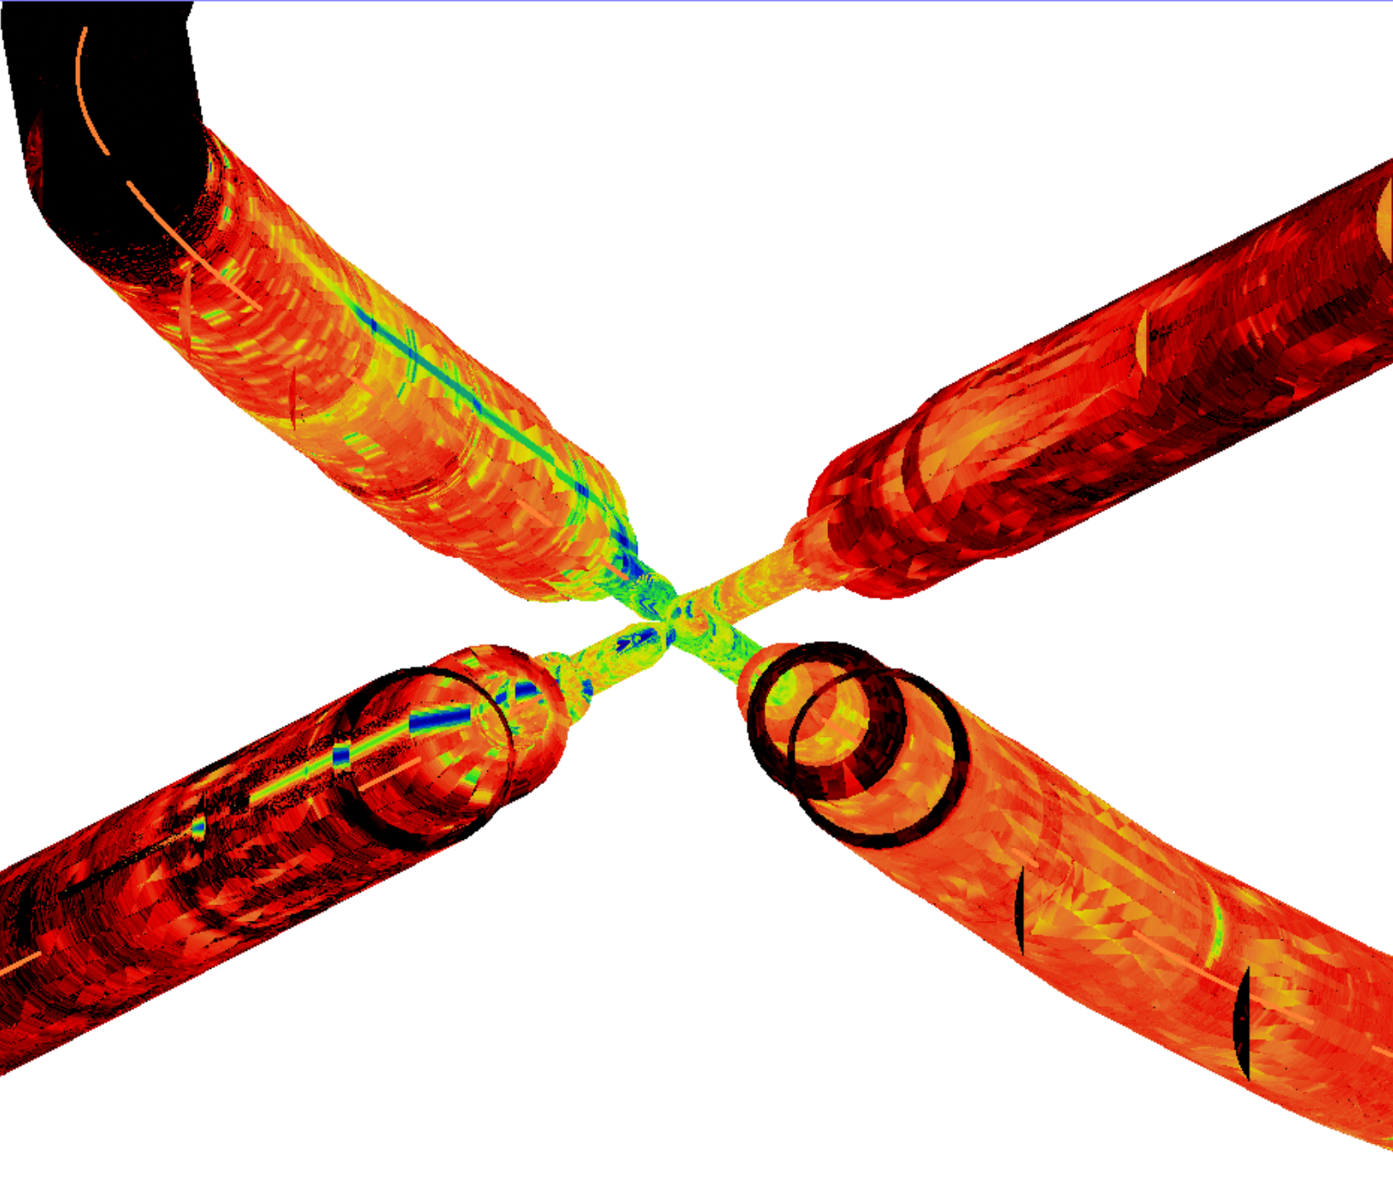
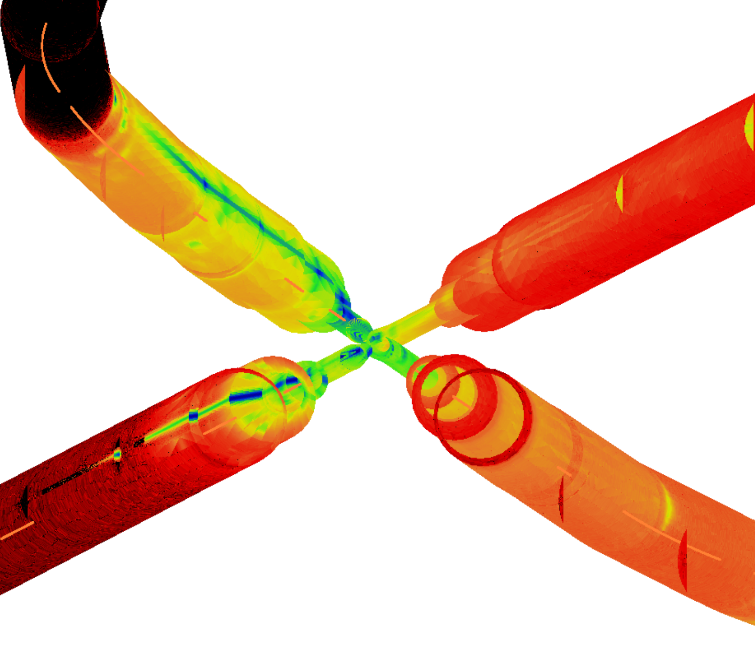

Details: rough surface scattering
no scattering
sigma=10 nm
sigma=400nm
reflected photons
e-
e+
direct incidence
Flux density [photons/sec/cm2]

Slide 14
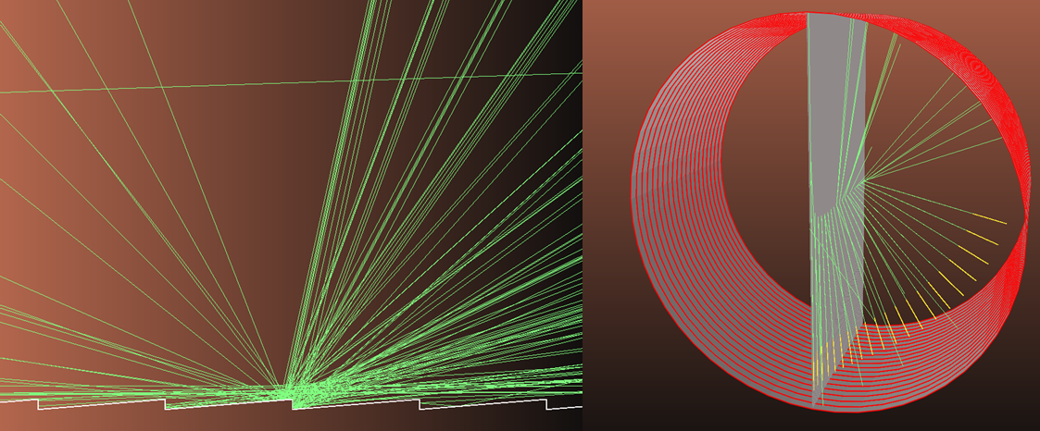
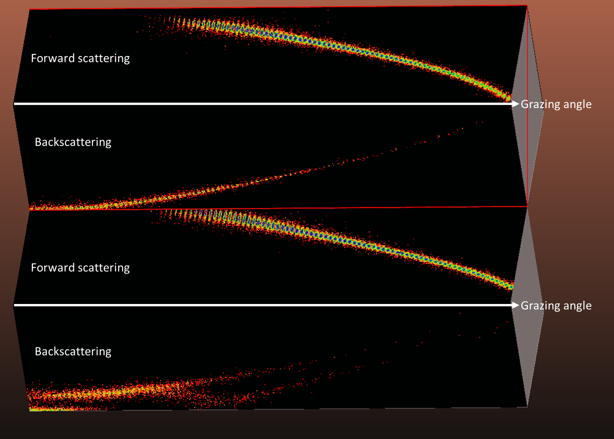
Details: sawtooth surfaces

Slide 15
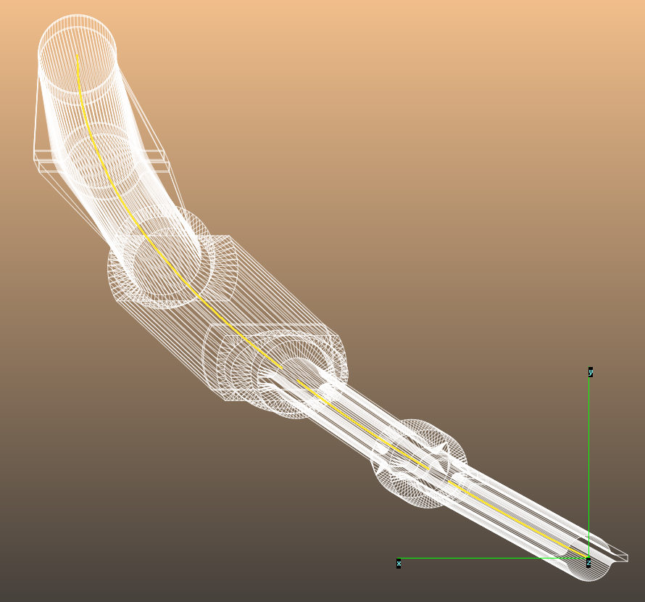
Synrad geometries: OpticsBuilder
Accelerator optics world: mainly Linux/Mac, command line tools
Accelerator as a sequence of apertures, S,θ,dX coordinates in XZ plane
Standard tools (MADX), standardized aperture description
Synrad+: individual regions, 3D geometry, XYZ absolute coordinates

Slide 16
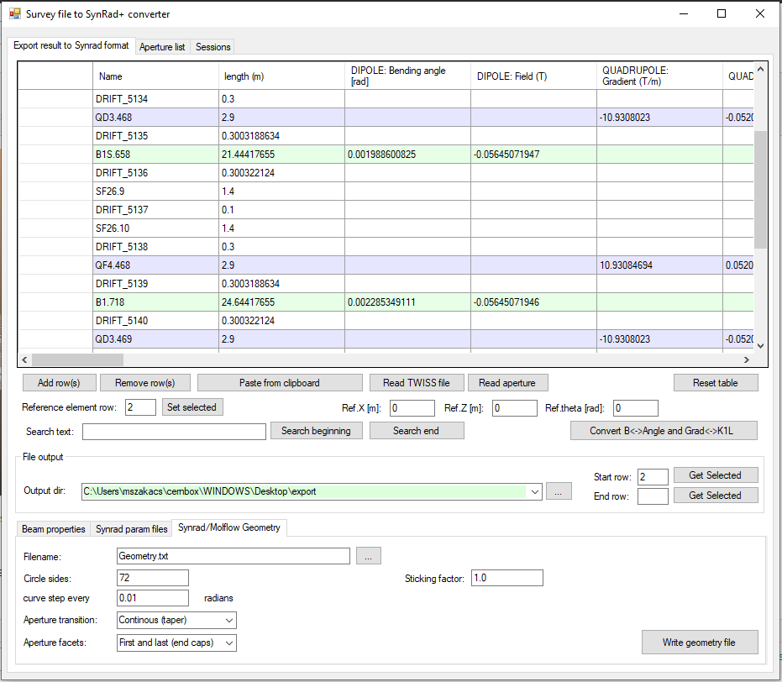
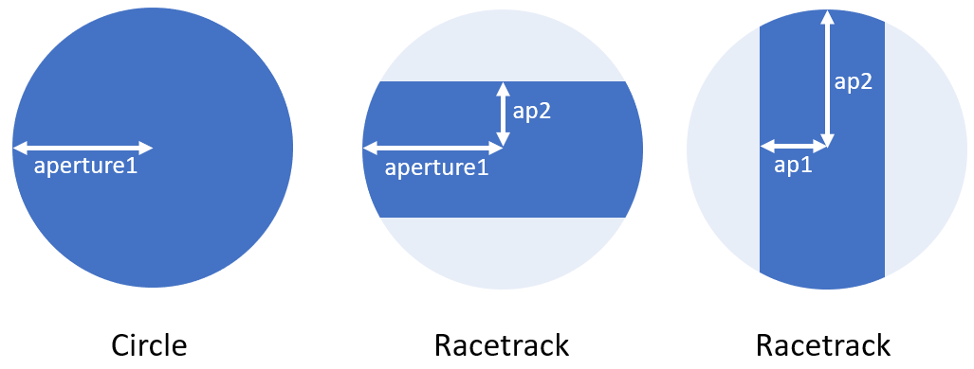

Slide 17
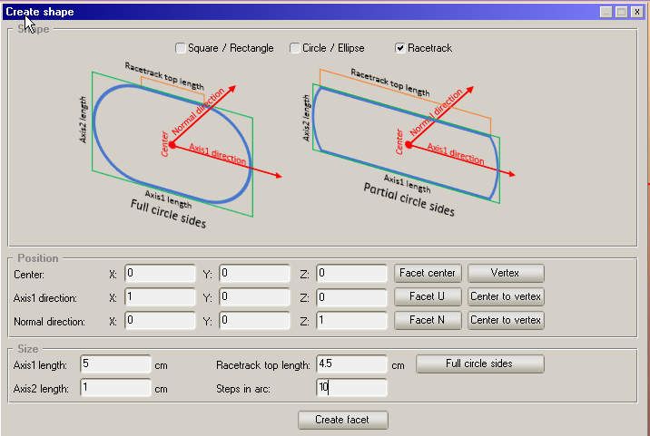
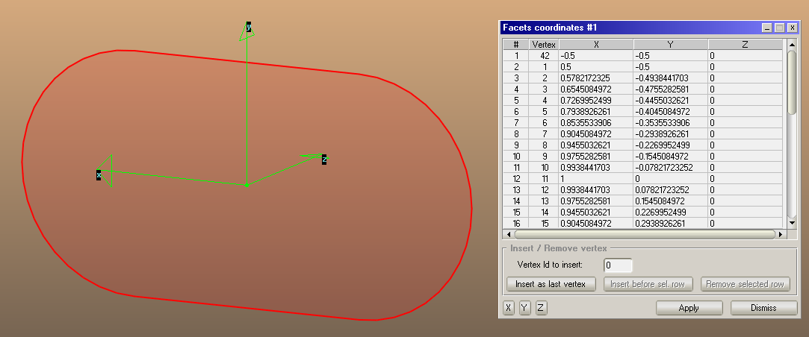
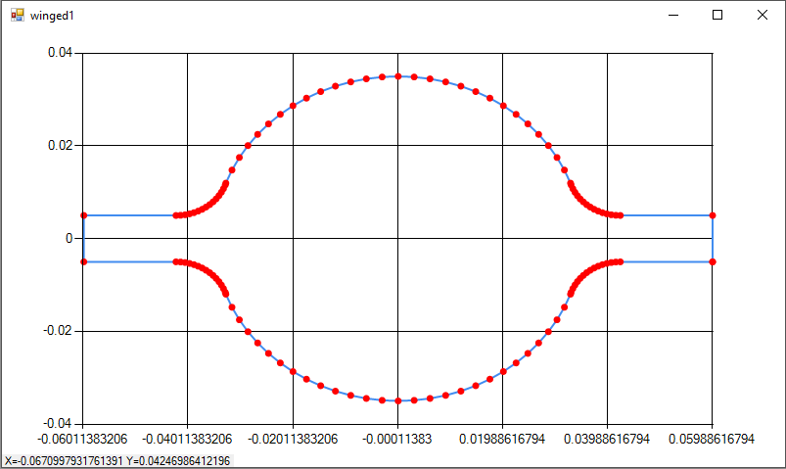
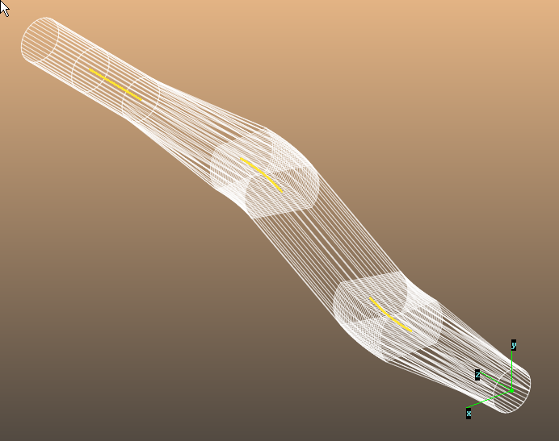
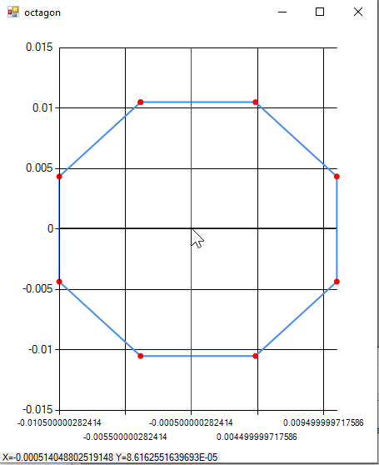

Slide 18
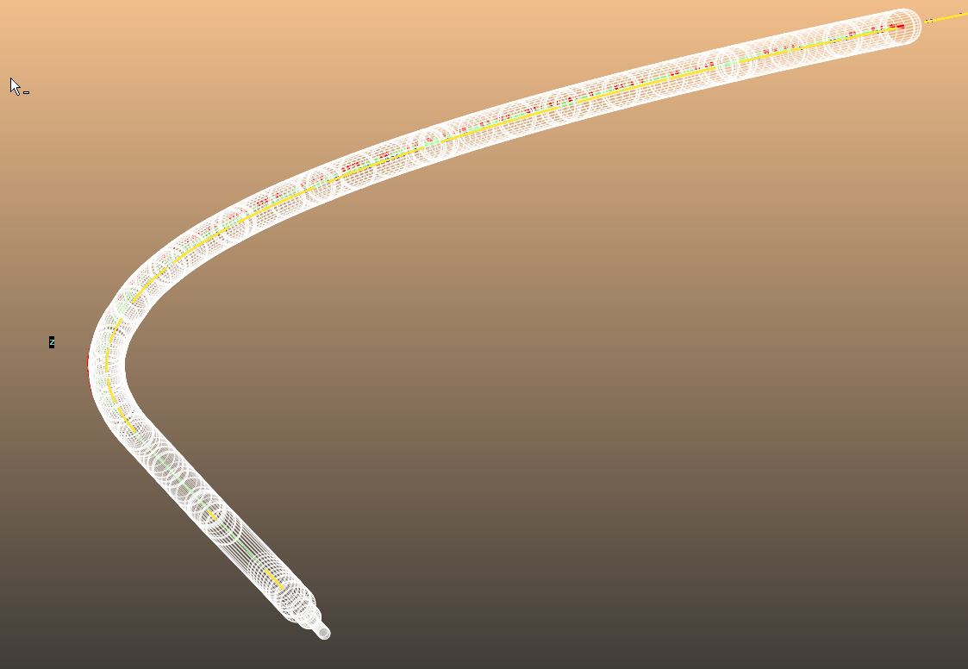
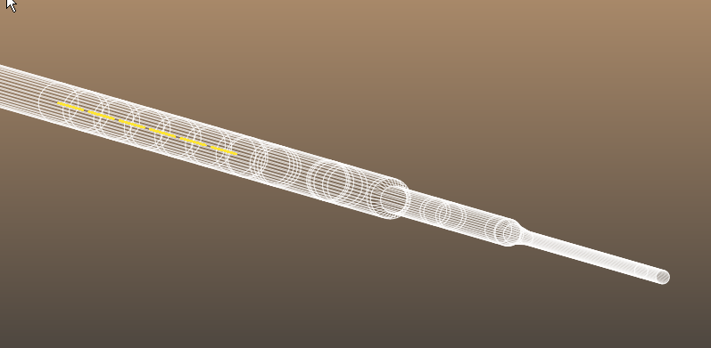
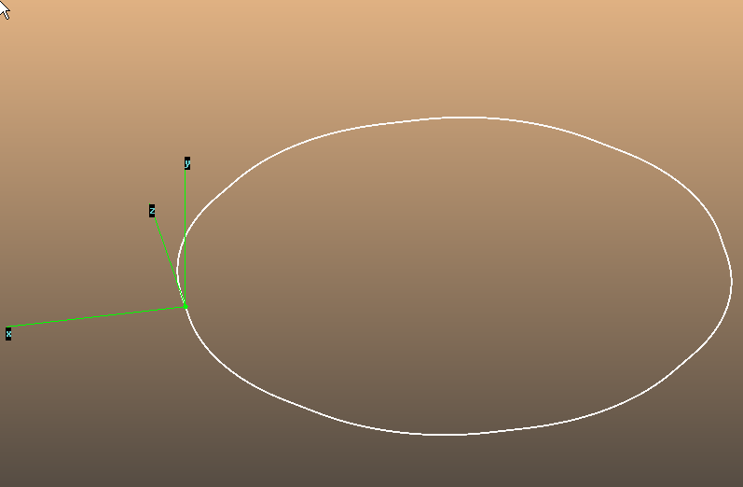
LHC LSS1 and arc
LHC inner triplet at IP1
Stress test: entire LHC

Slide 19
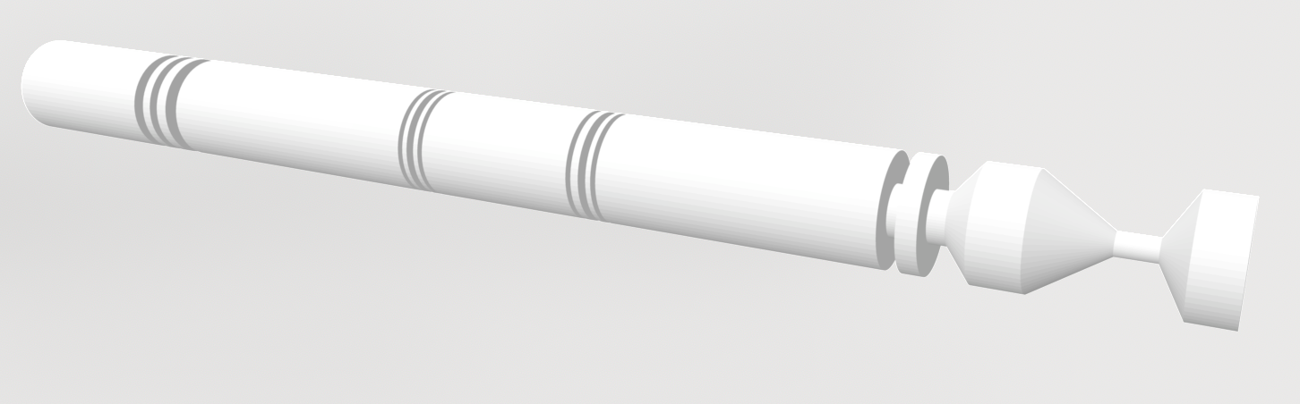
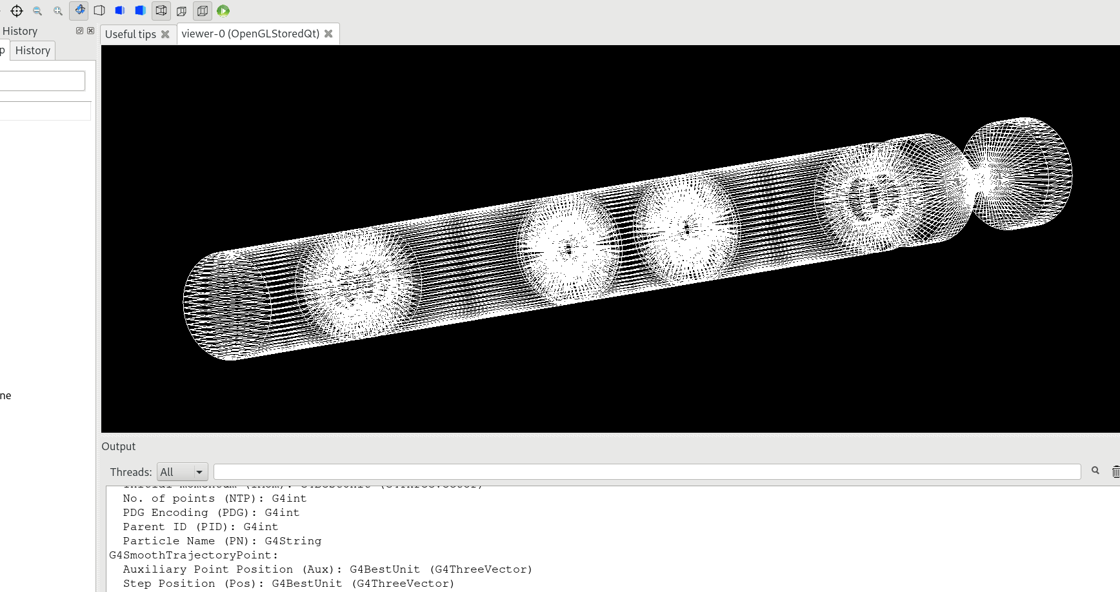
SynRad+ to GDML with tessellated bodies
https://github.com/tihonav/cad-to-geant4-converter

