Slide 1
The Programs
SYNC_BKG and MASKING
M. Sullivan
Synchrotron Code Workshop
Oct. 21, 2021

Slide 2
SYNC_BKG
Enhanced version of the original program QSRAD created by Al Clark of LBNL in the 1980s
  Language is FORTRAN
QSRAD was designed to calculate SR photon rates on beam pipe apertures from incoming final focus quadrupoles
  Simplifying assumptions in the program:
    Final focus quads are on beam axis
    Gaussian beam profile given by σ_{x} and σ_{y} at the outboard face of the first incoming final focus quadrupole
    Beam focuses to a point at the IP – this allows one to generate a simple transfer matrix

Slide 3
QSRAD – core of SYNC_BKG
Mainframe computers were 10⁵ to 10⁶ times slower than the laptops of today, so code was designed for speed
Program reads in an ASCII file deck that specifies the number of electrons per bunch, number of bunches and the ring frequency
Beam sigmas at the starting point – outside face of the FF quads
Magnet locations and strengths
Beam pipe transverse apertures
  Z location
  Three options
    Ellipses with axes (x1, y1)
    Vertical slits (+y1, -y2)
    Horizontal slits (+x1, -x2)

Slide 4
How it works
Grid map of weighted beam macro-particles
  Usually, ±15 σ_{x} and ±25 σ_{y}
  Step size 0.25 σ
  ~10000 traces
Calculates the magnetic field strength based on the trajectory position
Calculates the critical energy
Finds the starting and stopping trajectories for the SR fan
Traces the fan edges until a surface aperture is hit
Calculates the fraction of the fan that hits the aperture
Each aperture has a weighted histogram of the critical energies

Slide 5
How it works (2)
After the beam profile tracing is complete then the following calculations are done
For each aperture
  The energy spectrum is computed based on the weighted critical energy histogram
  The energy, power, and number of photons is printed out
  The collected information about the source location is printed out
  Each aperture information was originally printed to a single output page
  Currently we just print to an output FORTRAN file

Slide 6
SYNC_BKG enhancements
Some of these enhancements came from Stan Hertzbach and Bill Lockman and others
Non-gaussian beam tails
  Second gaussian with a lower, broader particle distribution
Bend magnets
  This complicates the setup but can be done and is generally important
  I have some auxiliary programs to assist me in getting the setup correctly done
Offset and rotated quadrupoles (small rotations)
Skew quads and sextupoles
Improved energy spectrum information
Ability to include non-zero emittances (seldom used)
Still fast on my laptop
  Couple of seconds to run 20,000 macro-particles through 44 magnet segments with 77 beam pipe apertures

Slide 7
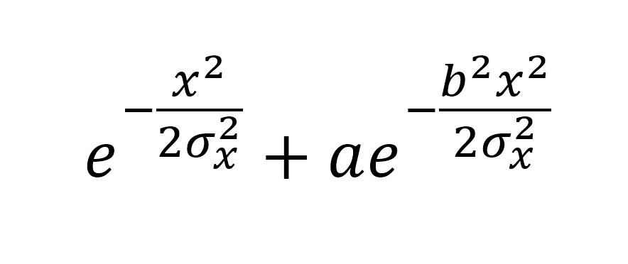
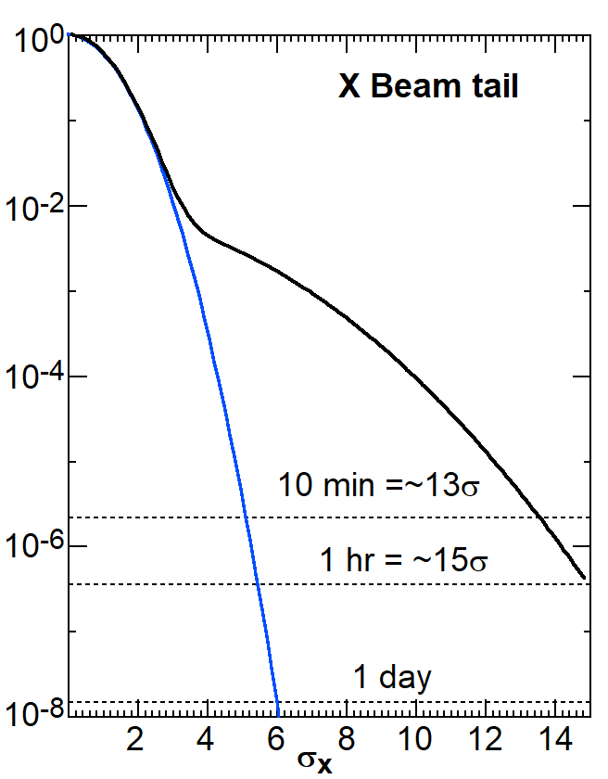
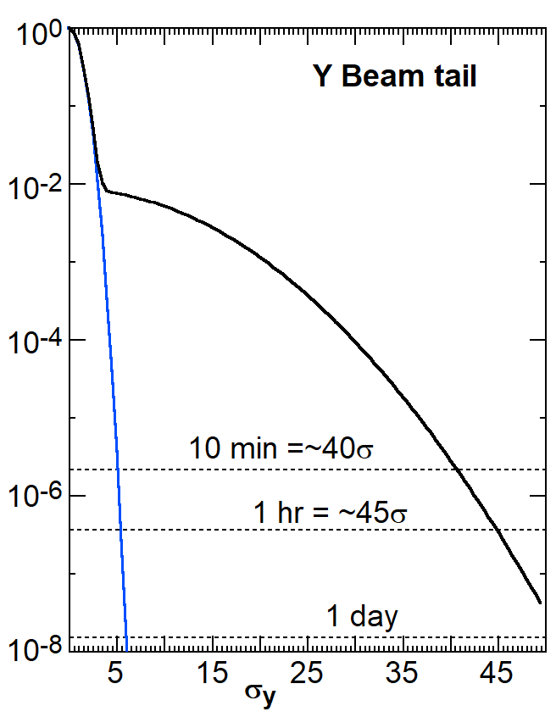
Beam profile
First term is the gaussian part of the beam
The second term is the lower, wider gaussian the simulates the non-gaussian beam tail part
The integral of the second term should not exceed about 5% of the integral of the first term
The coefficient in front (a) sets the height and the coefficient (b) sets the width in units of one over the gaussian σ
Example Beam transverse distribution

Slide 8
Second primary program – MASKING
I have a second package that uses the energy spectrum information and total number of photons striking an aperture from SYNG_BKG to calculate forward scattering, back-scattering, absorption and transmission of incident photons through simplified geometric surfaces
This is an EGS4 interface program with large flexibility in setting up the initial conditions
I use this to estimate photon scattering from a mask surface or mask tip that can strike a central beam pipe
It can also calculate the back-scatter rate from a downstream surface to a central beam pipe

Slide 9
MASKING (2)
The program uses the energy spectrum put out by SYNC_BKG to efficiently generate this energy spectrum of photons onto a surface
The incident angle is specified as well as the incident position (or area)
The scattered or transmitted photons can be saved in a file as 4-vectors
These files can be read in by GEANT4 (A. Kolano has made an interface) and propagated into a detector
MASKING can also read in these photon files and can use a file as the source of incident photons to a new surface (i.e. a central beam pipe) and calculate the transmission fraction of the photons incident on the inside of the central beam pipe – a two step operation for me

Slide 10
MASKING (3)
This program is a good first approximation of the result we should obtain from a full geometry simulation (GEANT4)
Uses EGS4 to transport photons through materials
Includes K-shell fluorescence
Includes Rayleigh scattering
Reasonably fast on my laptop
  23 min to do 2×10⁸ incident photons from a fairly hard energy spectrum ~50 keV critical energy equivalent with a high energy tail
  Softer energy spectra are faster

Slide 11
Disadvantages
MASKING setup is not automatic
  All setup parameters need to be specified by the user
  Many options gives one good flexibility, but the user has to answer many setup questions
Materials table is currently 21 elements and compounds
  Not sure I can add any more materials
1 keV is the lower energy limit
No L-shell fluorescence

Slide 12
Summary
I consider SYNC_BKG and MASKING good first approximation codes
They can also be used as a cross-check of other simulations
MASKING needs user setup and is flexible but can get complicated
SYNC_BKG is easier to setup but also needs some hand holding especially when bend magnets are involved
  Lattice information is important here to make sure one has properly set up SYNC_BKG
These programs were designed to work without much lattice information – length, strength, and z location of the FF quads is all that is needed to get a first look at some central beam pipe hit numbers

Slide 13
Conclusions
I am working on a writeup that describes the code and what it can do
I will include some simple examples showing input and output information
Thanks!

