Slide 1


Accounting
John Gordon (STFC)
APEL PT Leader

Slide 2
Outline
APEL in EGI
Task Force
CPU
Storage
Others
Talk about the issues and then how EMI is involved

Slide 3
APEL
APEL is the core of accounting in EGI
It receives accounting information for all EGI(*) VOs + WLCG from the rest of the world.
Data is published to the central repository by :
  Sites running glite-APEL (EMI)
  Grids running other accounting solutions
A third method is under development in EGI: Distributed APEL Repositories in NGIs
  gLite-APEL within the NGI and then the NGI repository publishes to the central on.
* - +/- ARC & Unicore

Slide 4
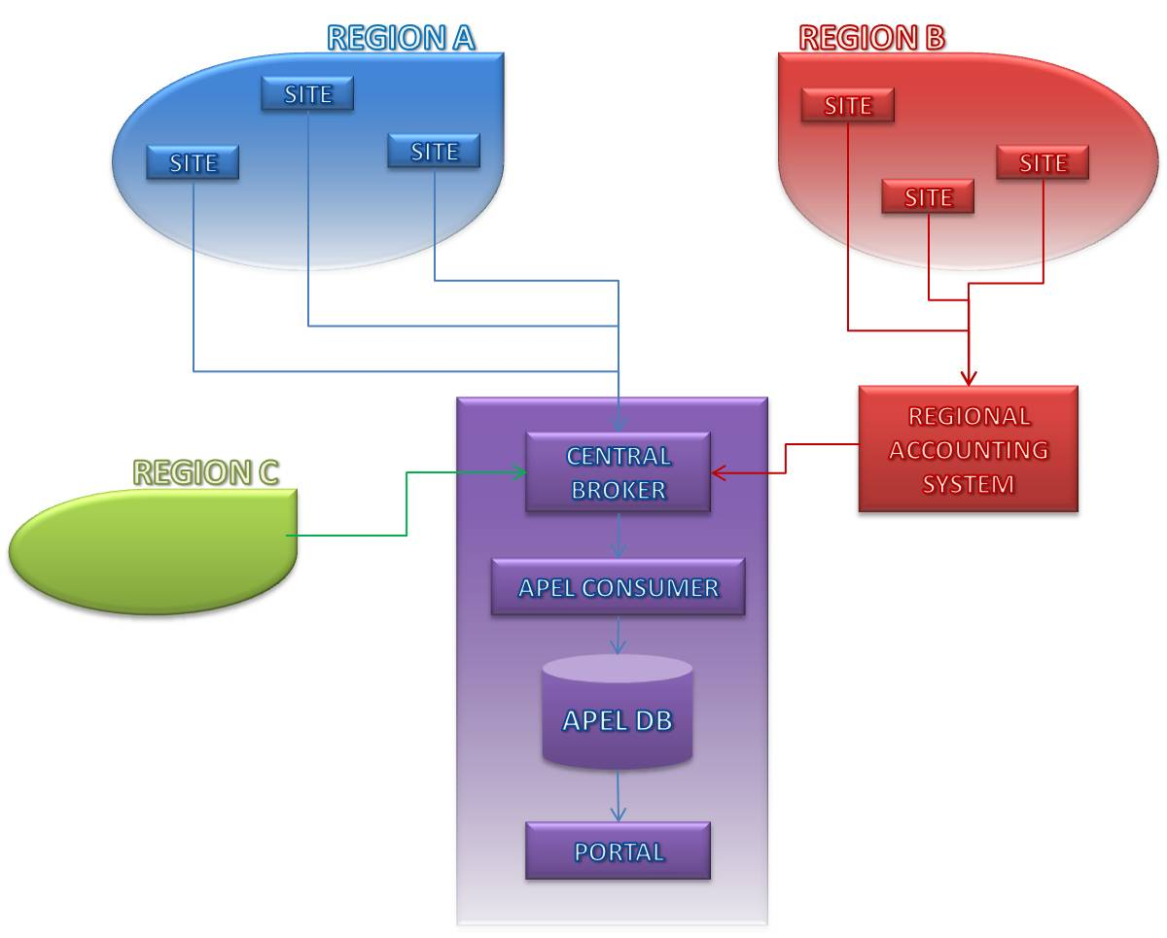

Slide 5
Task Force GAP Analysis
Although this task force is in EMI we intend to look at the coverage of accounting solutions by site/user community and not try to fill the matrix of possible middleware component interoperation.
glite sites – glite-APEL or replacements
ARC in NDGF – SGAS
ARC in other countries - ??
DEISA – own accounting
PRACE - ?
Unicore - (Poland has developed a solution which publishes to a central database)
Globus – discussing with IGE for them to support a RUS Client.

Slide 6
CPU Requirements
MPI the current cpu solution is based on a single batch job so in theory should deliver the correct cpu usage for batch MPI jobs.
However the wallclock needs agreement and the number of cpus/cores needs recording. Do all batch systems support this information?
Discussing with EGI MPI WG
May require a schema change

Slide 7
Storage
General VO requirement for grid-wide view of storage use by a VO.
Management requirement (eg WLCG and NGI) to see installed capacity at sites to evaluate compliance with MoUs and other commitments and agreements.
Most (all?) of the relevant information is published in a Glue1.3 profile defined by WLCG.
gstat gathers this and aggregates by site/VO but does not keep a persistent record
EMI Data Group looking at defining a Usage Record(UR) for storage use. EMI components would then implement this and APEL could collect the records.
Useful meeting of OGF-UR WG at OGF30 in October
  Agreed not to cut record/file; record snapshots valid at a point in time, not integrals

Slide 8
Clouds/Virtualisation
There are requirements to record the usage of virtual machines
  both as a record of user share of the physical resources
  and for the cloud-like deployment of images.
Be aware of double counting if the application running in the image is also accounted.
Discussing with Stratuslab

Slide 9
APEL usage collection
APEL collects data in 2 steps:
  Parses batch logs on CEs and publishes to a local database and then
  Collects records from local database and publishes them via AMQ to central repository
The central repository can handle multiple record types and process differently.
APEL is thus in a good position to receive other types of accounting record.
E.g. If the SE collects storage information and stores it locally then glite-APEL will only needs small changes to gather and publish these records as a different type in a different topic.
The central repository could either read all topics and process them differently or split the load between multiple instances reading different topics.

Slide 10
Thank you
EMI is partially funded by the European Commission under Grant Agreement INFSO-RI-261611

