Slide 1


Guidelines and SQA Process
Maria Alandes Pradillo (CERN)
SA2.2 Task Leader

Slide 2

Outline
Introduction
Status and Achievements
Issues and Concerns
Next steps

Slide 3
Introduction
SA2.2 is responsible for:
  Defining standards-compliant software engineering processes
  Monitoring the application of these processes within SA1 and JRA1
SA2.2 deliverables:
  Software Quality Assurance Plan
  Periodic QA reports

Slide 4
Status and Achievements (I)
Definition of the SQAP (03.09.2010)
  http://cdsweb.cern.ch/record/1277599?ln=en
  Contains the definition of the documentation, processes and responsibilities relevant to the SW lifecycle.
  A new version is in progress with the results of the reviews performed in October and November:
    https://twiki.cern.ch/twiki/bin/view/EMI/SQAPReview_Oct2010
    https://twiki.cern.ch/twiki/bin/view/EMI/SQAPReview_Nov2010
QA periodic report (18.10.2010)
  http://cdsweb.cern.ch/record/1277600?ln=en
  Reports about the status of the guidelines and the project documentation relevant to the SW lifecycle.

Slide 5
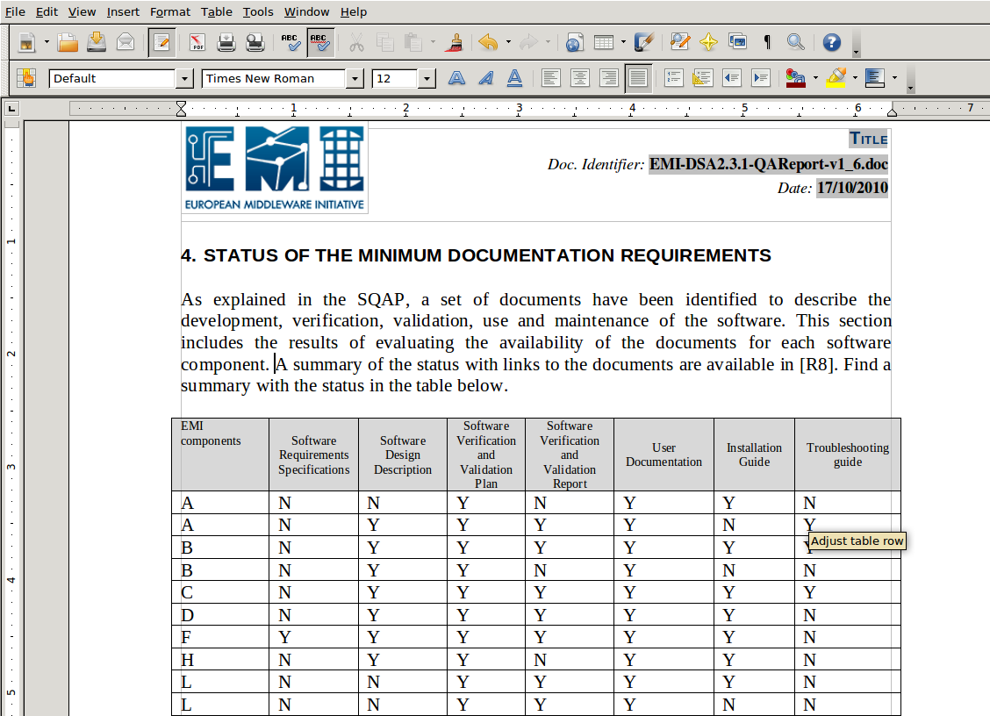
QA Reports

Slide 6
Status and Achievements (II)
Definition of Guidelines
  Guidelines to support JRA1 and SA1 in the different stages of the SW lifecycle have been defined.
  They are included as satellite documents of the SQAP and will be integrated in future versions of the SQAP:
    Configuration and Integration
    Packaging
    Releasing
    Change Management
    Metrics Generation
    Certification and Testing

Slide 7
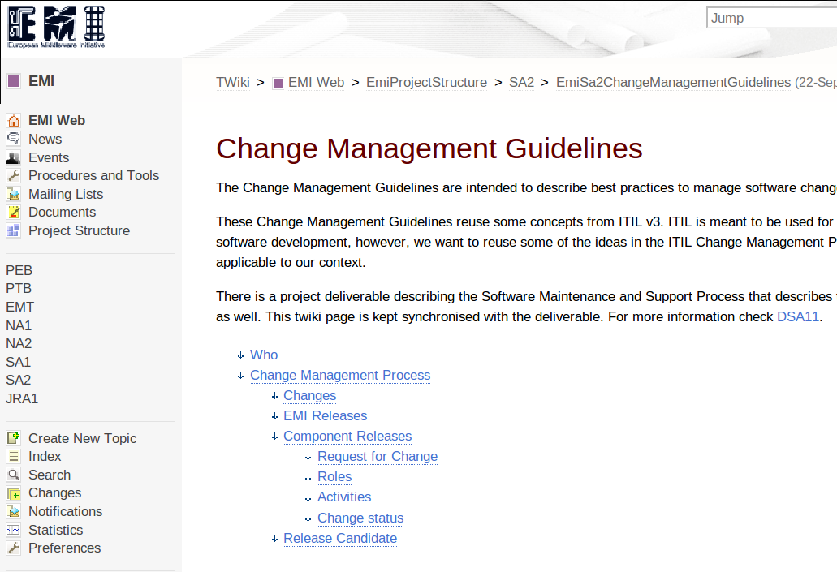
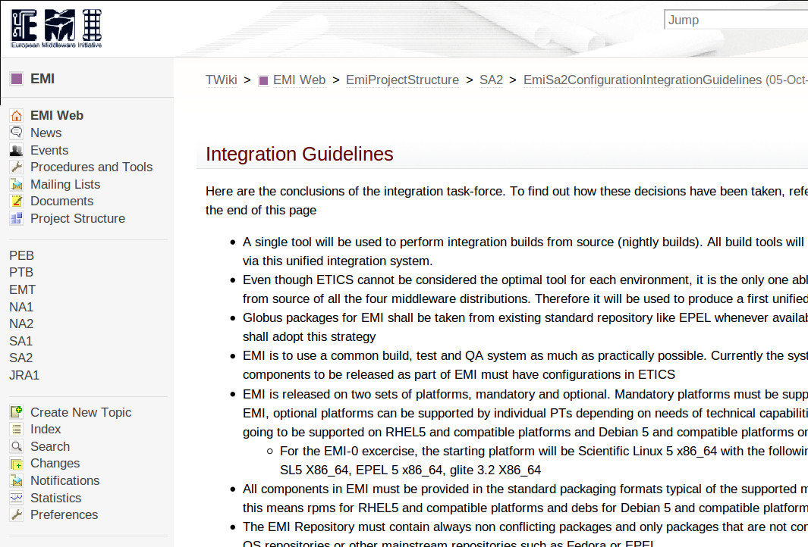
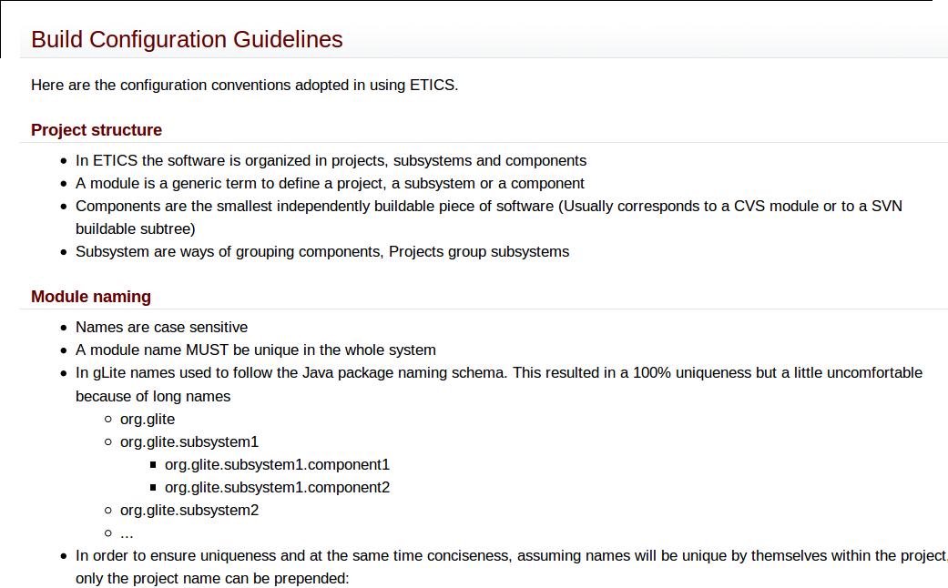
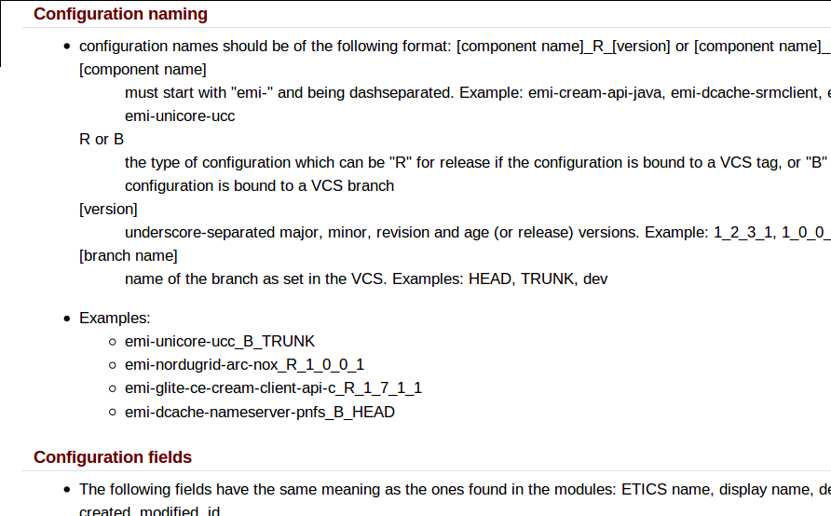
Guidelines

Slide 8
Status and Achievements (III)
Configuration and Integration (Finished)
  Definition of tools, repositories for external dependencies and build instructions.
  https://twiki.cern.ch/twiki/bin/view/EMI/EmiSa2ConfigurationIntegrationGuidelines
Packaging (Finished)
  Rules to properly create a package (name, version, license, dependencies, etc).
  https://twiki.cern.ch/twiki/bin/view/EMI/EmiSa2PackagingGuidelines
Releasing (In progress)
  Description of how to create EMI releases.
  https://twiki.cern.ch/twiki/bin/view/EMI/EmiSa2ReleasingGuidelines

Slide 9
Status and Achievements (IV)
Change Management (Finished)
  How to manage software changes in the EMI middleware.
    https://twiki.cern.ch/twiki/bin/view/EMI/EmiSa2ChangeManagementGuidelines
Metrics Generation (Finished)
  How to generate metrics.
    https://twiki.cern.ch/twiki/bin/view/EMI/EmiSa2MetricsGuidelines
Certification and Testing (Finished)
  Description of which tests need to be performed, how to certify a release candidate and how to write test plans and test reports.
    https://twiki.cern.ch/twiki/bin/view/EMI/EmiSa2CertTestGuidelines

Slide 10
Issues and Concerns
SA2.2 and QC tasks should work together to monitor documentation is up to date:
  Guidelines
    Are EMT meetings the right place to discuss guidelines and propose changes?
  Relevant deliverables
    Status of deliverables related to the SW lifecycle is presented every week at the SA2 meeting.
      Deliverables are all very late. Should deadlines be more realistic?
    Work Area plans
      Are the different milestones defined in the work area plans going to be tracked somewhere?
      https://savannah.cern.ch/projects/emi-req/?

Slide 11
Issues and Concerns
SA2.2, QC and EMT should work together to monitor the application of the defined sw processes:
  EMT should reject any component release not meeting the criteria defined in the guidelines.
  QC should inform in their reports about PTs not meeting the criteria defined in the guidelines.

Slide 12
Next Steps
Create a new version of the SQAP
Consolidate Monitoring activities by:
  Working more closely with QC and SA2.5
  Attending the EMT meetings regularly
Make sure documentation is up to date
Help PTs providing better documentation providing templates

Slide 13
Thank you
EMI is partially funded by the European Commission under Grant Agreement INFSO-RI-261611

