Slide 1


SA2.3 Metrics Report
Eamonn Kenny (TCD)
Gianni Pucciani (CERN)

Slide 2
Why collect Metrics?
For goodness sake! Not for statistics sake!
Governed by the end goals of the project
End-Goals
Suggests a Question
Leads to a Metric

Slide 3
Metrics Categories
Process Metrics (Bug-tracking related)
  Related to priority, severity, open/closed bugs
Quality in Use Metrics (Bug-tracking/EGI)
  3rd level GGUS related metrics (KPIs for SA1)
Product Metrics (Software related)
  Unit tests, supported platforms, bug density
Static Analysis Metrics (Static analysers)
  Cyclomatic Complexity, Code commenting, etc.
Optional Metrics (Valgrind/Helgrind)

Slide 4
Process/Bug-tracking related Metrics
Priority Bugs (closed), Open Priority Bugs
  Graphs of immediate and high priority bugs
Bug Severity Distribution
Failed Builds metric
Backlog Management Index
Integration test effectiveness metric
Up-to-date documentation metric
Delay on release schedule metric
Total user incident metric (KSA1.1)
Training and support incident metric
Average time to deal with an incident (KSA1.2)
User Support level ticket distribution

Slide 5
Product Team (PT) related Metrics
Unit test coverage metric
Number of supported Platforms
Total bug density
Bug density per release
Cyclomatic complexity
C/C++ metrics - cppcheck
Java metrics - FindBugs, PMD, Checkstyle
Python metrics - pylint
Code commenting metrics
Memory Leakage warnings (optional)
Open POSIX test suite metric (dismissed)

Slide 6
Metrics Description Layout
Metrics Id
  E.g: PriorityBugs
Name
Description
Measurement Calculation
  Complete formula
Input(s) & Units
  E.g: time range in days
Output(s) & Units
  E.g: Average time in hours
Scope
Thresholds/Target Value
Tools
Availability
  Per middleware availability
Goals
Quality factor
  Follows the McCall factors
Risks
Special Notes

Slide 7
Thresholds
Thresholds in many cases don’t make sense yet! Why?
We are not starting afresh to produce a middleware stack → Some product teams will have good/poor statistics starting off
Some programming languages strongly support static metrics
Some bug-trackers are full of features
Interoperation & reusability only beginning
We expect improving trends...

Slide 8
Metric Guidelines & Repository
Twiki Page
  https://twiki.cern.ch/twiki/bin/view/EMI/EmiSa2MetricsGuidelines
Subversion Repository
  https://svnweb.cern.ch/trac/emisa2/browser/metrics/trunk
    Internal metrics documentation directory
    XML schemas (XSDs) directory
    Per middleware Bug-Listing (in XML format)
    Per middleware Bug-Mapping (in XML format)
    Scripts to convert bug-tracking data into XML format, full validated by XML schemas

Slide 9
Why bug-tracking info in XML?
ARC
Bugzilla
Bug-Mapping XML
gLite
Savannah
Bug-Mapping XML
UNICORE
SourceForge
Bug-Mapping XML
dCache
RT/Review Board
Bug-Mapping XML
Exposed XML to
ETICS
(run anytime)
Middleware Bug-Mapping
(needs periodic intervention)
Middleware Bug-tracking
(Snapshot taken daily)
Visualisation
We want a tool that uses all bug-trackers
We need a common interface

Slide 10
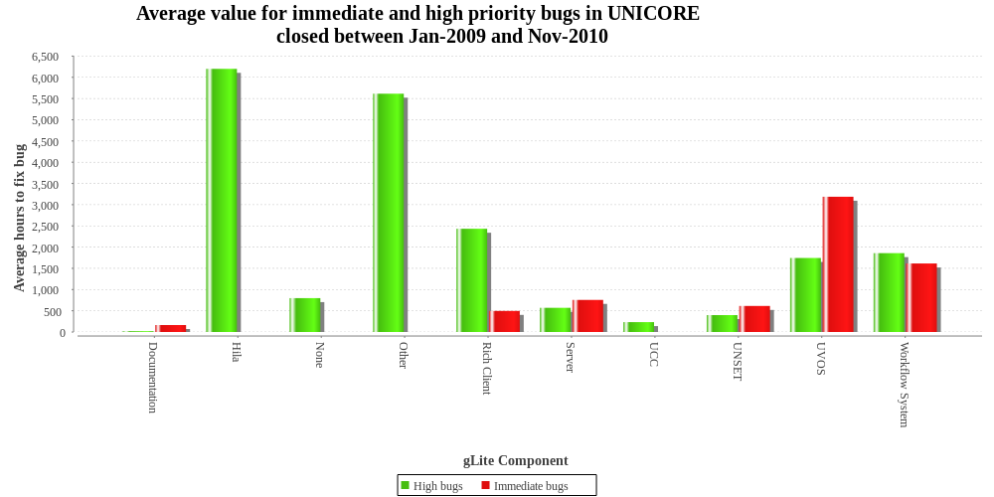
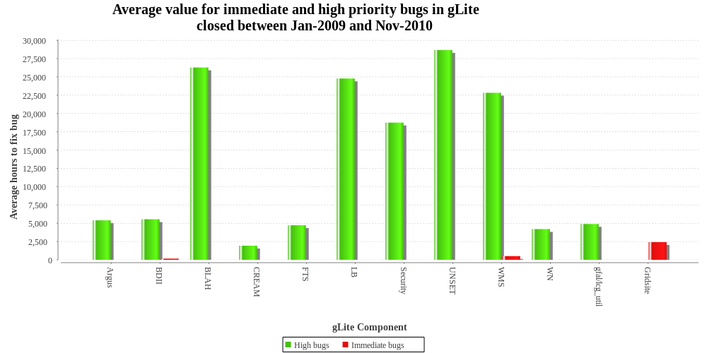
Sample Metric Plots of Priority Bugs

Slide 11
Achieved so far
Bug Listing XSD, Bug Mapping XSD, XML examples, python sample scripts defined for extracting bug-tracking data
Validated UNICORE and gLite XML listings
Prototype ETICS plots/statistics for process and static analyser metrics
Pseudo code made available to SA2.4 to produce metric calculations

Slide 12
Pending/Outstanding Issues
2 of 4, GGUS 3rd level user incident metric reports are still to be produced
Awaiting dCache-BugListing.xml and ARC-BugListing.xml for combined bug-tracking metrics
Metrics may need to evolve over time to track interoperation & reusability

Slide 13
Questions?

