Slide 1


EMI SA2 Report
Quality Assurance
Alberto Aimar (CERN)
SA2 WP Leader

Slide 2

Outline
Deliverables and Milestones
Overview of the SA2 tasks
Discussions on each task
  Guidelines and Process
  Metrics
  Tools and Reports
  Testbeds

Slide 3
SA2 Deliverables
Deliverable | Author | Reviewers | Status
DSA2.1 Quality Assurance Plan | M. Alandes (CERN) | G. Fiameni (SA1/CINECA) A. Ceccanti (JRA1/INFN) | Completed
DSA2.2 QA Tools Documentation | L. Dini (CERN) | R.Rocha (SA1/CERN) TBD | In Preparation
DSA2.3 Periodic QA Reports | M. Alandes (CERN) | C. Cacciari (SA1/CINECA) M. Riedel (JRA1/JUELICH) | Completed
DSA2.4 Continuous Integration and Certification Testbeds | D. Dongiovanni (INFN) | Morris Riedel (JRA1/JUELICH) Balazs Konya (TD/LU) Oliver Keeble (SA1/CERN) | Under Review

Slide 4
SA2 Milestones
Milestone | Author | Status
MSA2.1 - Software development tools and software repositories in place | L. Dini (CERN) | Completed
MSA2.2 - Continuous integration and certification testbeds in place | D. Dongiovanni (INFN) | Under Review
MSA2.3 - Large-scale acceptance certification testbeds are in place | D. Dongiovanni (INFN) | Under Review

Slide 5
EMI QA (SA2) Tasks and Objectives
TSA2.2 - Quality Assurance Process Definition and Monitoring
  Define standards-compliant software engineering process and guidelines
  Continual activity of monitoring its application
TSA2.3 - Metrics Definition and Reporting
  Definition, collection and reporting of software quality metrics
  Reports information on the status of the software to take corrective actions
TSA2.4 - Tools and Repositories, Maintenance and Integration
  Definition and maintenance of tools required to support QA process
  Supporting activity to software providers to integrate external tools
  Repositories for the EMI software packages, tests, build and reports
TSA2.5 - QA Implementation Review and Support
  Review activities of the QA, test and certification implementations.
  Sample review of test plans, compliance, porting guidelines, documentation, etc
  Supporting the Product Teams in implementation of tests and use of testing tools
TSA2.6 - Testbeds Setup, Maintenance and Coordination
  Setup and maintenance of distributed testbeds for continuous integration testing
  Coordination and provision of larger-scale testbeds from collaborating providers

Slide 6
Quality Assurance Process
TSA2.2 - Quality Assurance Process Definition and Monitoring
  Define standards-compliant software engineering process and guidelines
  Continual activity of monitoring its application
Software Quality Assurance Plan (SQAP)
  Main deliverable of TSA2.2 task
  Document that specifies the tasks needed to define and measure quality, responsibilities for quality monitoring, documentation required and procedures
  Plan that will be followed to manage the QA process
SQA tasks, roles and responsibilities
  EMI technical activities (SA1, SA2 and JRA1)
  EMI technical bodies (PTB and EMT)
  Even of specific individuals/roles in EMI
The SQAP covers documentation, reporting and reviewing tasks
  Describes the metrics that will be used for the QA reporting and reviews
Will be updated regularly, based on experience and real needs
Complemented by a set of guidelines (on dev and doc)

Slide 7
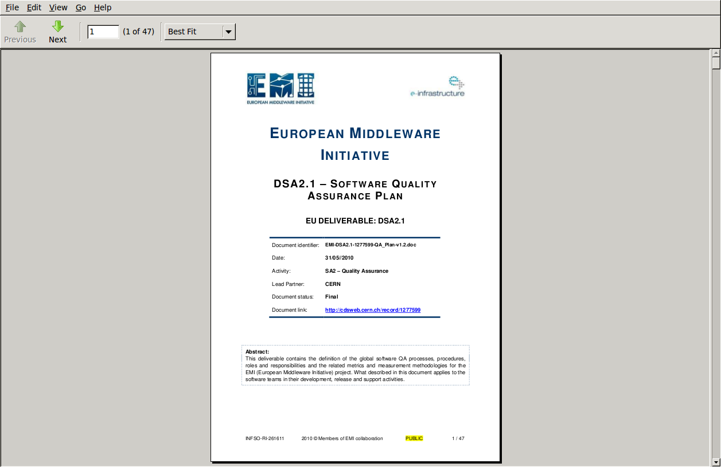
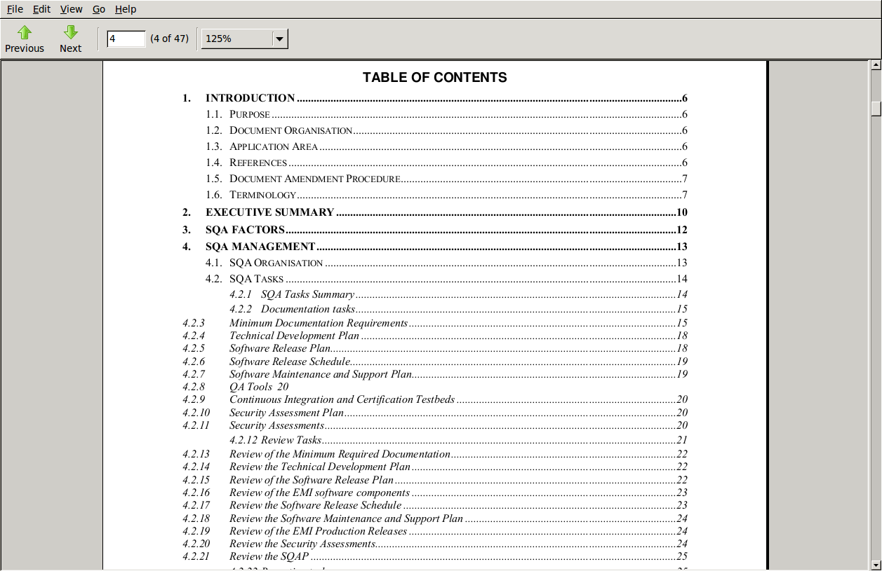
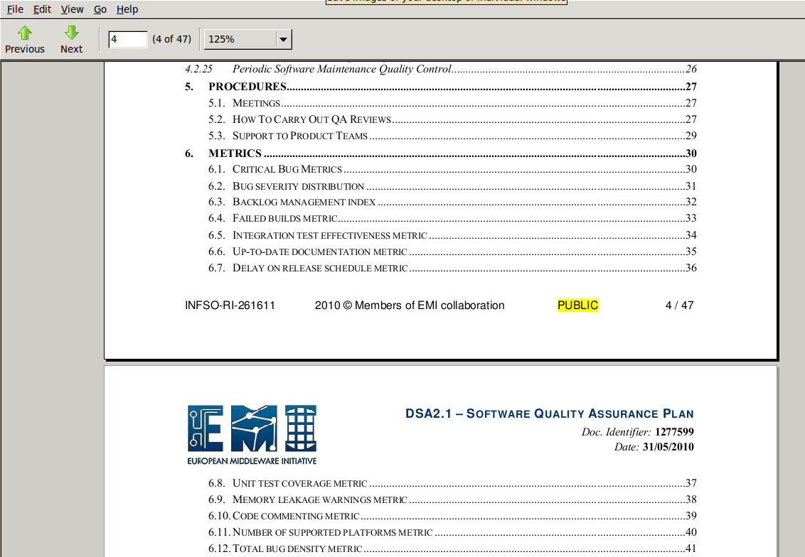
Software Quality Plan

Slide 8
Quality Assurance Process
Guidelines for QA and Software Development are available:
  Configuration and Integration
  Packaging and Releasing
  Change Management (bugs, patches, etc)
  Certification and Testing
  Metrics Generation
Move towards a uniform setup and common definitions and conventions in the project
  Releases, patches, versions
  Packaging, repositories, distributions
  User support, documentation
Advantages for e-infrastructures are obvious but they require some work and accepting some changes by the PTs in EMI
  The project was funded because the middleware agreed to converge

Slide 9
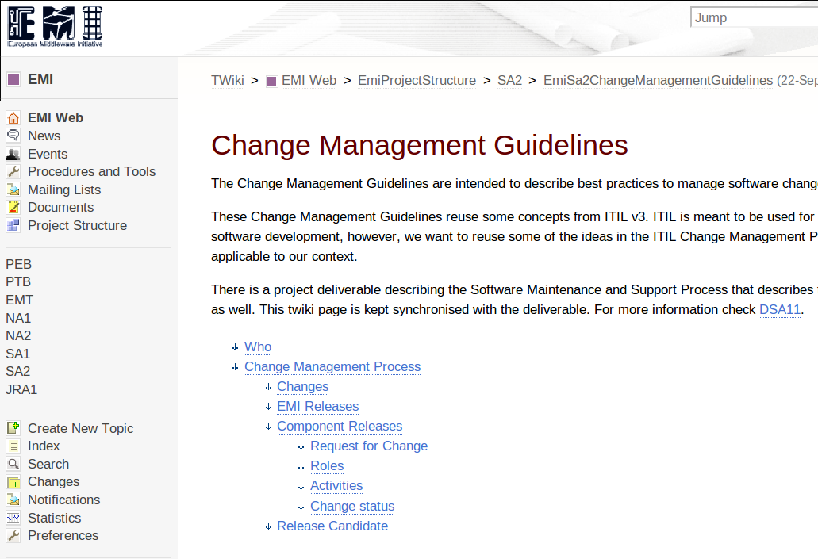
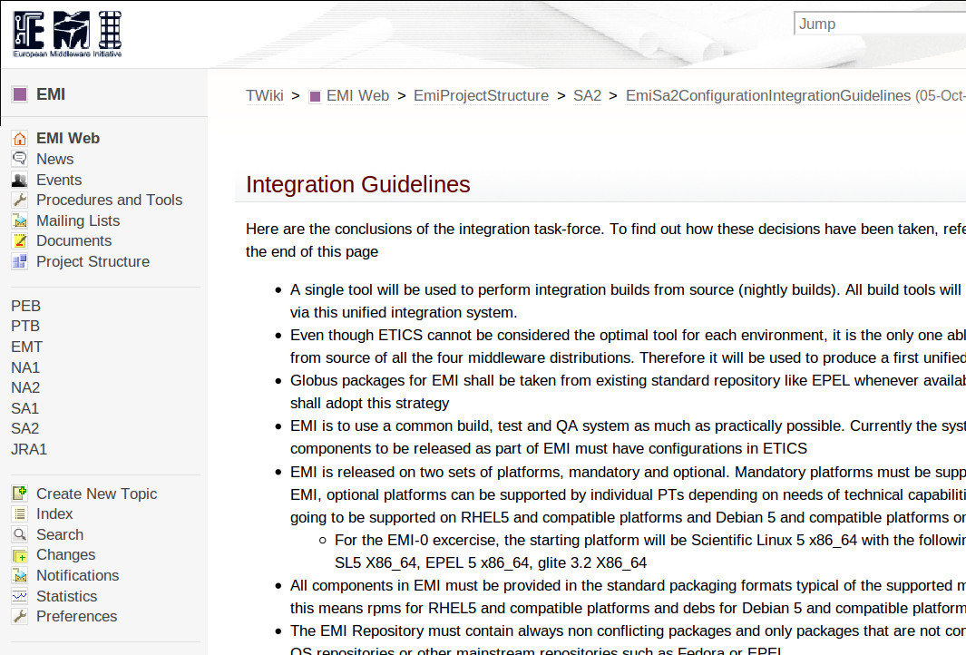
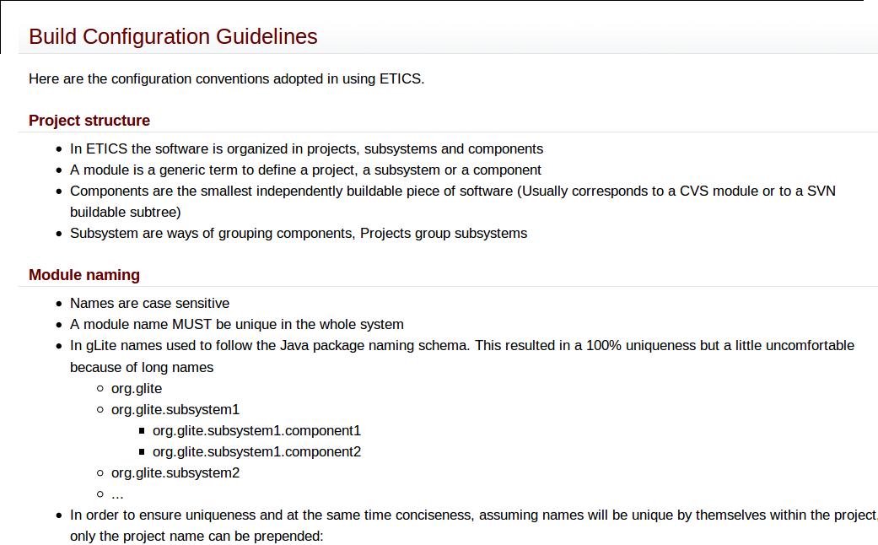
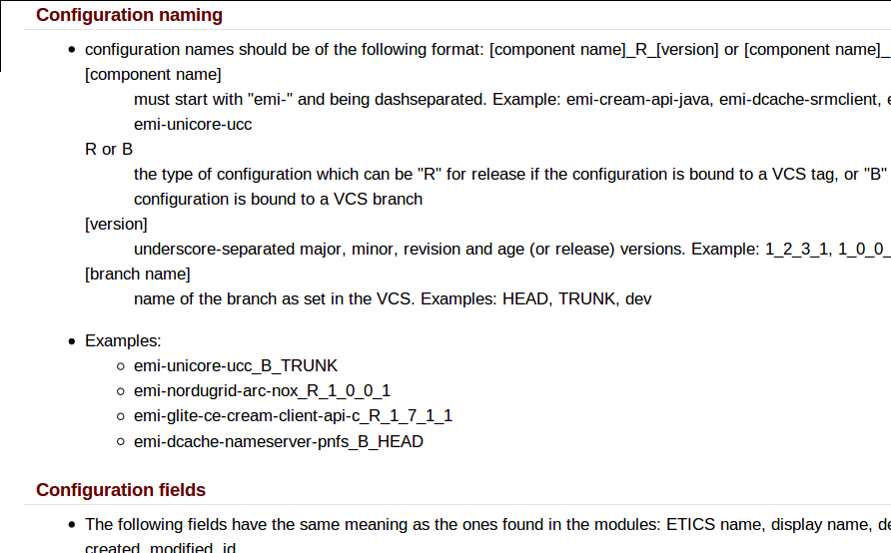
Development Guidelines

Slide 10
Quality Metrics
TSA2.3 - Metrics Definition and Reporting
  Definition, collection and reporting of software quality metrics
  Reports information on the status of the software to take corrective actions
Metrics are needed to quantify and qualify the status of the software components
  Use as much as possible numerical metrics
  All automated and extracted in the same exact way , by the same tool(s)
Starting with a selection of useful and simple metrics
  Tools available give a common environment to extract metrics and test
  Same metrics for all components, in order to have fair reports
Types of SQA metrics
  Metrics on code, process, support, documentation
  Internal & external metrics (code, process) language metrics (Java, C++, Python)
Examples of metrics
  Reaction time to critical bugs, delays in releases. Complexity, bug density, test cov.
We refer to QA standards, but use what is realistically applicable
  ISO /IEC 9126-1,-2,-3,-4 and ISO/IEC 25000

Slide 11
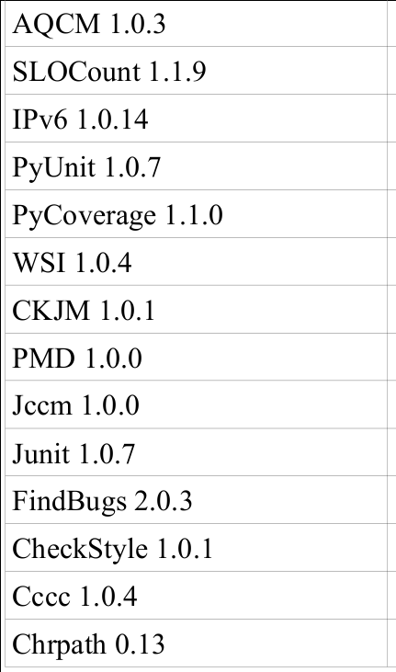
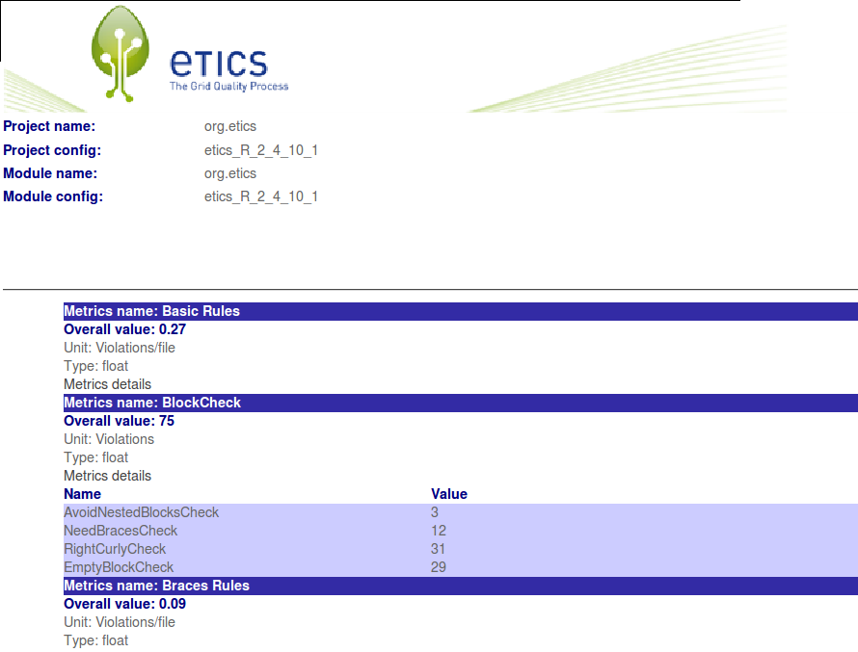
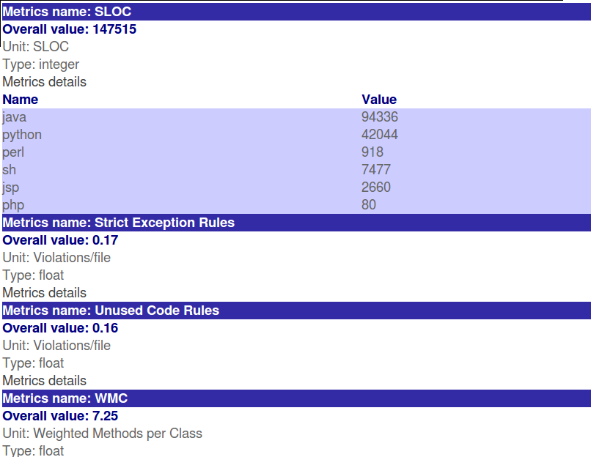
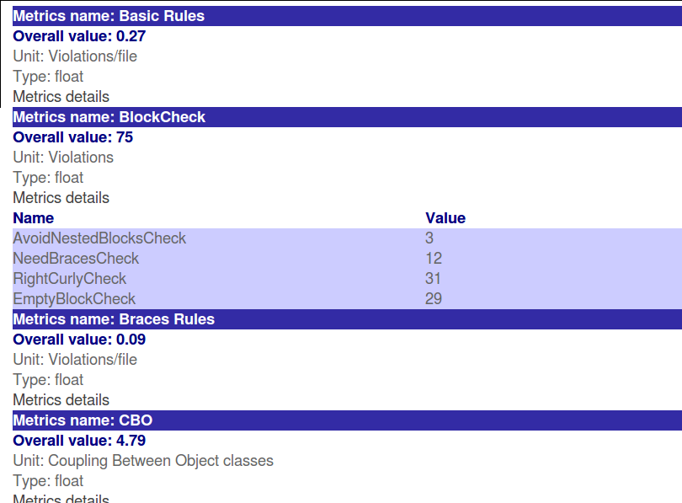
Quality Metrics

Slide 12
Tools
TSA2.4 - Tools and Repositories, Maintenance and Integration
  Definition and maintenance of tools required to support QA process
  Supporting activity to software providers to integrate external tools
  Repositories for the EMI software packages, tests, build and reports
Metric, Testing and Packaging Tools
  Compliance and interoperability of the software products. Integration builds.
  Same identical platforms for all builds, use standard packages on platforms
  Automatic deployment and distributed testing of software products
Integration of data coming from different sources and tools
  Common report of metrics from different static and dynamic software QA tools
  Collection of data from several req and bug trackers used by PTs
  Using same tool for packaging, testing, reporting or exchange formats
Support for repositories and distribution
  Common software repository for all EMI middleware
  Use the standard RHEL/SL and Debian repositories and formats
Generation of QA reports
  Metrics extraction, storage and archival
  Graphs and reports at all levels of detail. Comparison tables and plot trends

Slide 13
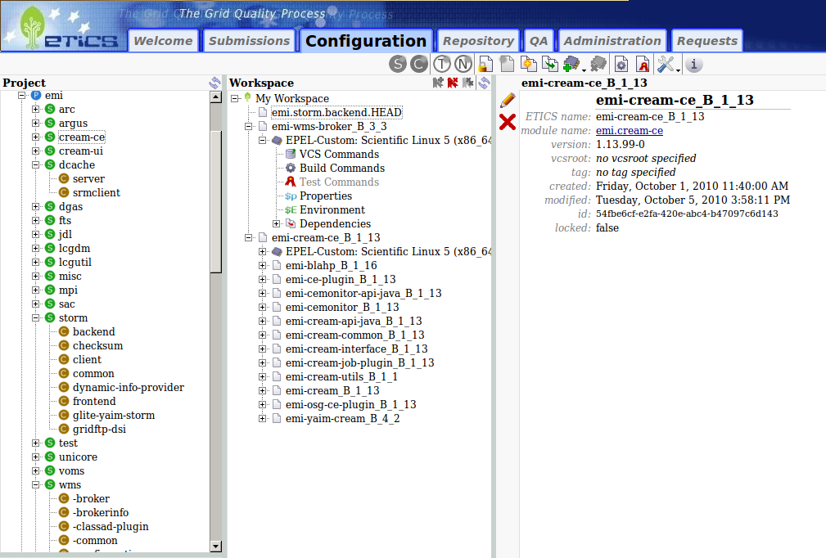
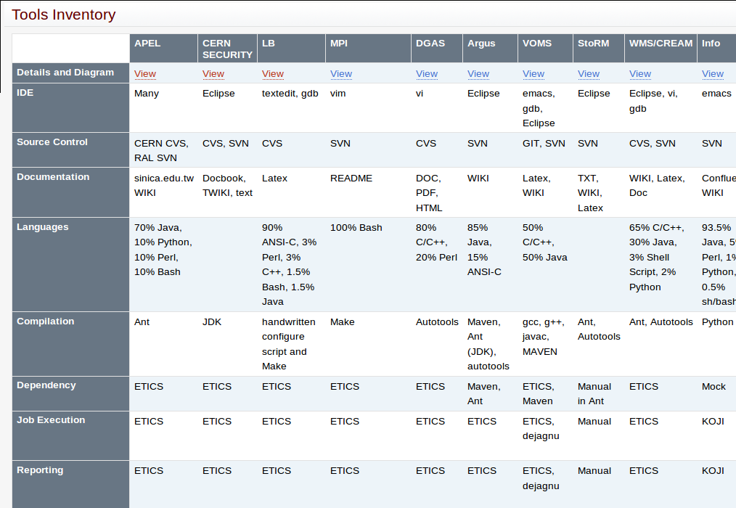
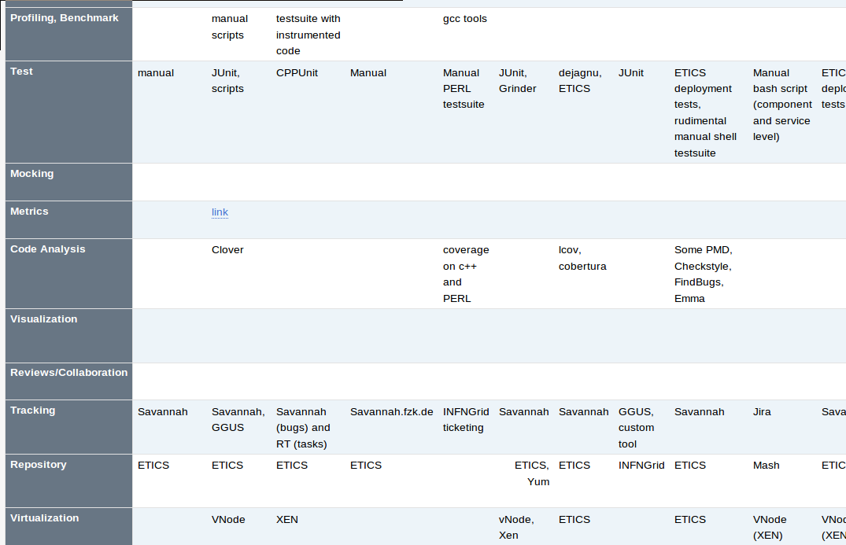
Tools

Slide 14
Testbeds
TSA2.6 - Testbeds Setup, Maintenance and Coordination
  Setup and maintenance of distributed testbeds for continuous integration testing
  Coordination and provision of larger-scale testbeds from collaborating providers
EMI SA2 provides a distributed testbed
  Real hw resources (+ using virtualization when possible)
  For integration testing in EMI project
  For the product teams testing
  Distributed over the sites of the middleware partners
Testbed available to Dev teams for testing their software
  The teams can easily test their components with what is in production or will soon be (RC)
  Production and RC installations available for all components, servers, etc
  And a Product Team can configure the services needed for its specific tests
Provide support for the typical scenarios
  Integration testing within a minor release and a major release
  Cross middlewares tests across the network
  Large-scale tests, with real usage scenarios

Slide 15
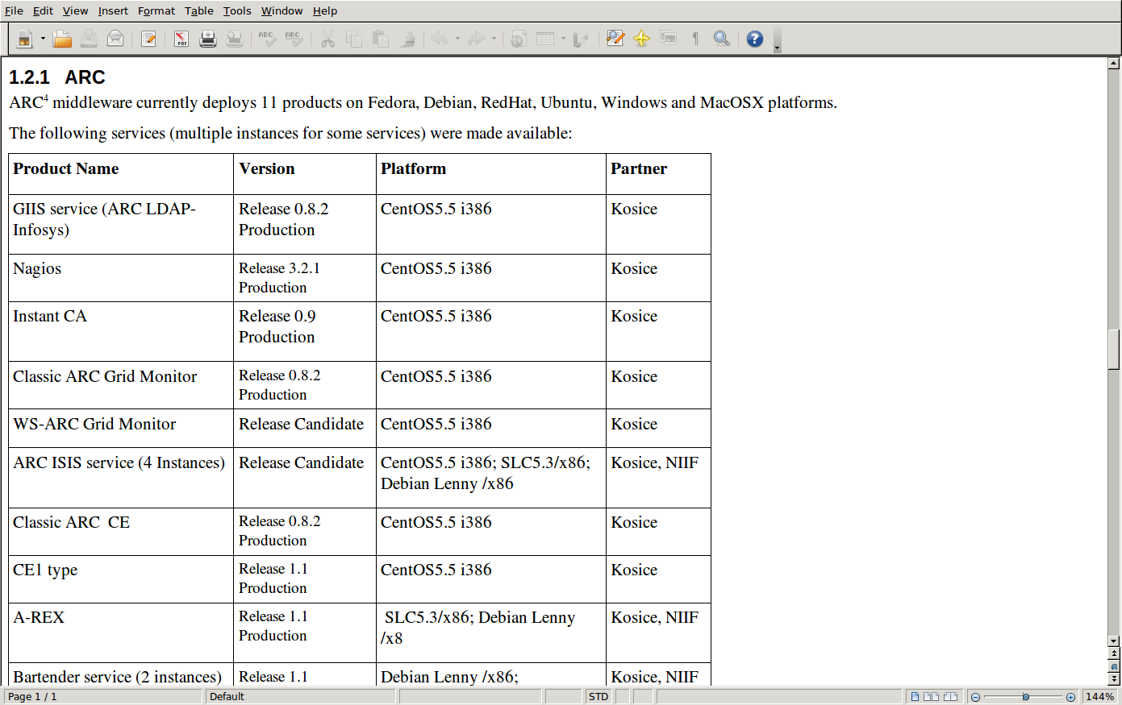
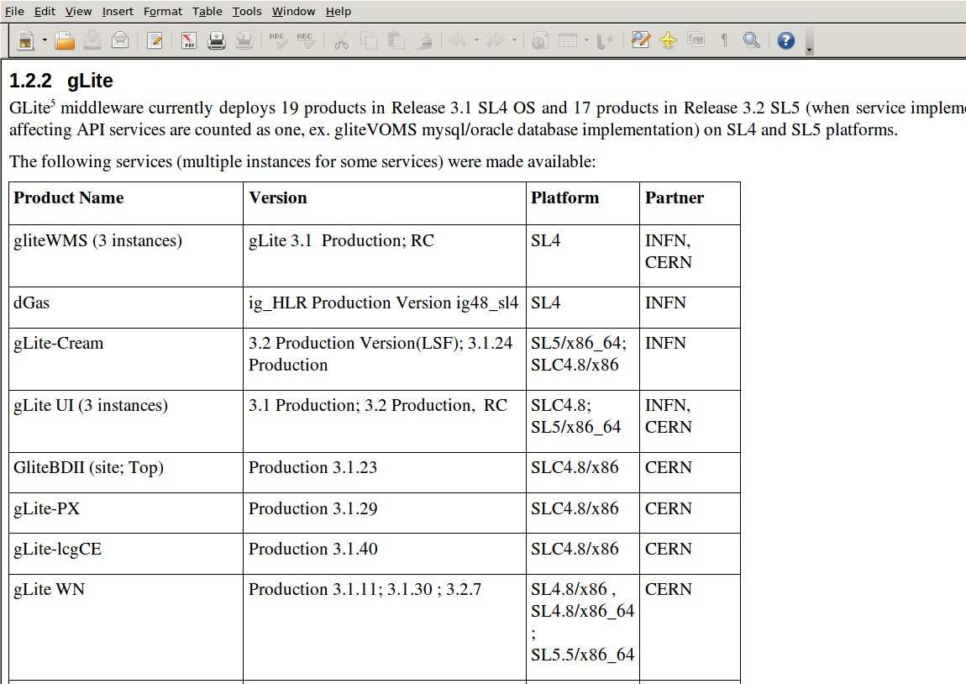
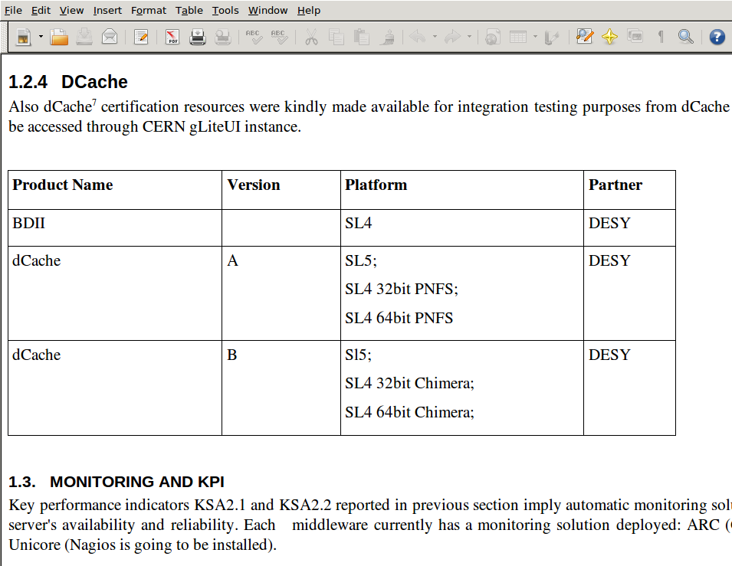
Testbeds

Slide 16
QA Reports and Reviews
TSA2.5 - QA Implementation Review and Support
  Review activities of the QA, test and certification implementations.
  Sample review of test plans, compliance, porting guidelines, documentation, etc
  Supporting the Product Teams in implementation of tests and use of testing tools
QA reports objectively describe the quality of the product
  Only numerical metrics are included, e.g. number of bugs/SLOC, reaction time, trends over time, successful/failed releases, etc
  Reports both on the product but also on how the team works
The same type report for all components
  Allows comparisons among components
  Trends over time of the same components
Fully automated. PTs will have their report weekly
  Will be able to see their score and execute corrective actions
SA2 reviews of the QA reports and supports the teams
  Provides the general reviewing every Month and formally every Quarter
  Reports to the EMI mgmt in case of issues
  Supports the PTs that need help with metrics, tools, testbeds

Slide 17
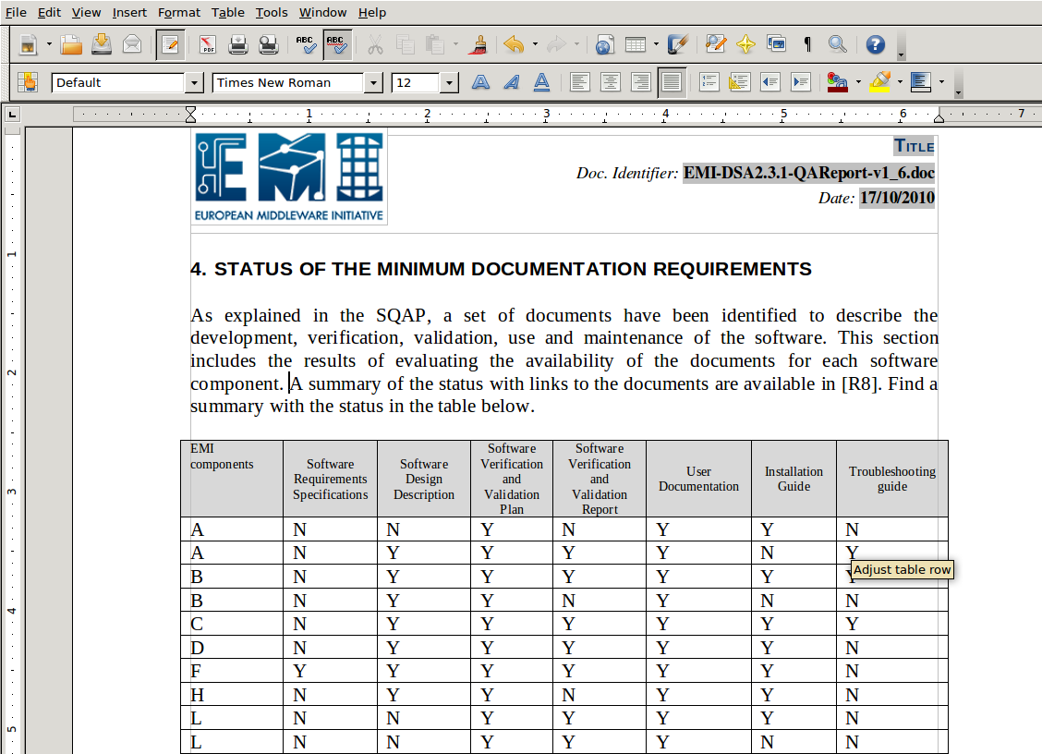
QA Reports

Slide 18
Conclusions
Dedicated QA is a useful activity in large projects but is complex when merging 4 different existing projects
Challenge of implementing QA in a distributed and heterogeneous environment
  Different kind of sw products, different tools, distributed teams, etc
Guidelines & procedures should not overload the developers
  But converging on common solution is what we got the EU funds for
SA2 does its best to collect experience from the developers in order to define realistic and shared solutions
SA2 focus on metrics and automated report generation
SA2 provides also practical services, not just procedures
  to developers: supported and automated tools, testbeds, packaging
  to e-infrastructures: verified and homogeneous sw, doc, repositories
https://twiki.cern.ch/twiki/bin/view/EMI/SA2

Slide 19
What’s Next
Discussions on each task
  Guidelines and Process → Maria
  Metrics → Eamonn
  Tools and Reports → Lorenzo
  Testbeds → Jozef (Danilo)

