Slide 1

Supersymmetry and dark matter extensions of Higgs-R2 model
Shuntaro Aoki (Chung-Ang University)
with Hyun Min Lee, Adriana G. Menkara, and Kimiko Yamashita
2108.00222, 2202.13063
SUSY 29/6/2022 @ Ioannina

Slide 2
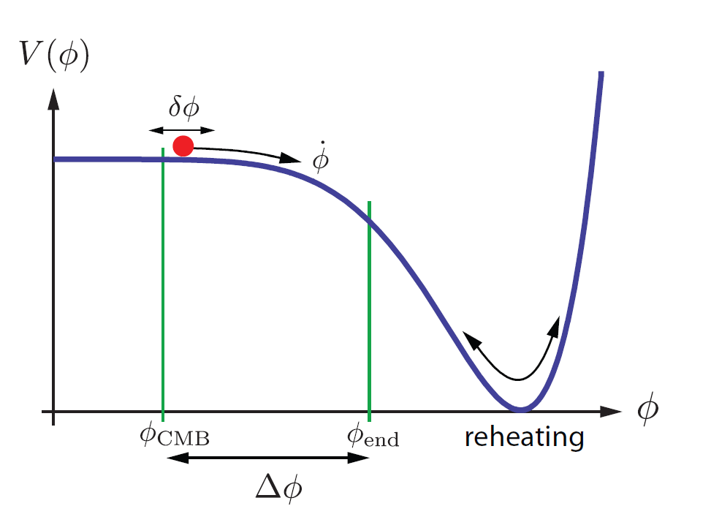
Introduction
Inflation
・Rapid expansion of early universe
・theoretically & observationally established
・Slow roll inflation (scalar field : inflaton)
arXiv:0907.5424

Slide 3
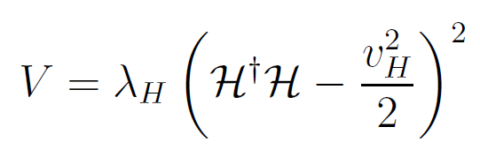
Introduction
Inflation
・Rapid expansion of early universe
・theoretically & observationally established
・Slow roll inflation (scalar field : inflaton)
Higgs inflation
arXiv:0907.5424
Natural idea : inflaton = SM Higgs boson
However, the original SM Higgs potential doesn’t work
: Not flat

Slide 4
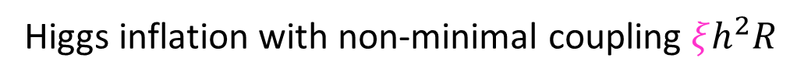
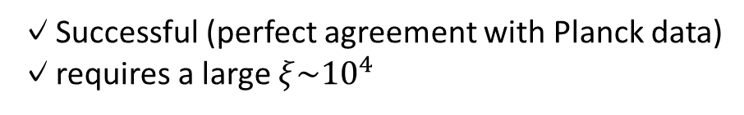
Introduction
Higgs inflation with non-minimal coupling $ξh^{2}R$
F. L. Bezrukov, M. Shaposhnikov, ‘08
✓Successful (perfect agreement with Planck data)
✓requires a large $ξ\sim {10}^{4}$

Slide 5

Introduction
Higgs inflation with non-minimal coupling $ξh^{2}R$
F. L. Bezrukov, M. Shaposhnikov, ‘08
✓Successful (perfect agreement with Planck data)
✓requires a large $ξ\sim {10}^{4}$
However, low cutoff scale$\sim M_{pl}/ξ$ ⇒ unitarity??
Burgess, Lee, Trott, ’09
Barbon, Espinosa, ‘09

Slide 6
Introduction
Higgs inflation with non-minimal coupling $ξh^{2}R$
F. L. Bezrukov, M. Shaposhnikov, ‘08
✓Successful (perfect agreement with Planck data)
✓requires a large $ξ\sim {10}^{4}$
However, low cutoff scale$\sim M_{pl}/ξ$ ⇒ unitarity??
Burgess, Lee, Trott, ’09
Barbon, Espinosa, ‘09
Solution
・introduce a new d.o.f (like Higgs in SM)
Giudice, Lee ’10
・Palatini, Einstein-Cartan, ...
F. Bauer, D. A. Demir, ’08
M. Shaposhnikov, A. Shkerin, I. Timiryasov, S. Zell’20
・Critical Higgs inflation
Y. Hamada, H. Kawai, K. y. Oda and S. C. Park ’14

Slide 7
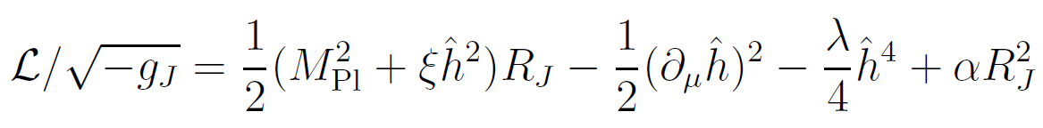
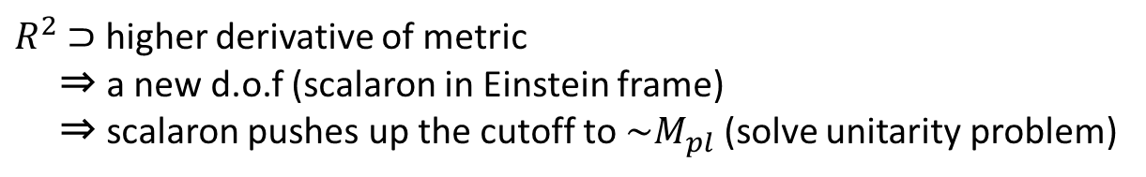
Higgs-R^2 inflation model
Salvio & Mazumdar ‘15, Ema ‘17, Gorbunov & Tokareva ‘18, Gundhi & Steinwachs ’18,
D. Y. Cheong & S. M. Lee & S. C. Park ’21, SA, H. M. Lee, A. G. Menkara,’21 …
$R^{2}$ $⊃$ higher derivative of metric
⇒ a new d.o.f (scalaron in Einstein frame)
⇒ scalaron pushes up the cutoff to $\sim M_{pl}$ (solve unitarity problem)

Slide 8
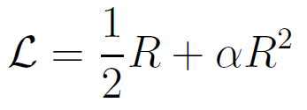
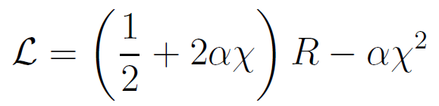



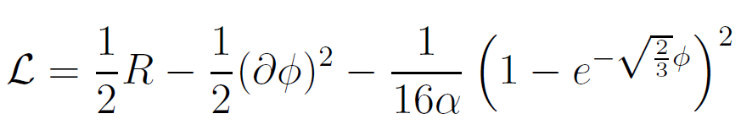

Higgs-R^2 inflation model
Salvio & Mazumdar ‘15, Ema ‘17, Gorbunov & Tokareva ‘18, Gundhi & Steinwachs ’18,
D. Y. Cheong & S. M. Lee & S. C. Park ’21, SA, H. M. Lee, A. G. Menkara,’21 …
$R^{2}$ $⊃$ higher derivative of metric
⇒ a new d.o.f (scalaron in Einstein frame)
⇒ scalaron pushes up the cutoff to $\sim M_{pl}$ (solve unitarity problem)
c.f. pure R^2 case
conformal trans.
$φ$ : scalaron

Slide 9
What to do next?
✓Further UV embedding = Supersymmetry
SA, H.M. Lee, A. G. Menkara
2108.00222
✓Study post inflationary dynamics
= Reheating & DM production
SA, H.M. Lee, A. G. Menkara, K.Yamashita
2202.13063

Slide 10
SUSY (SUGRA) embedding
SA, H.M. Lee, A. G. Menkara 2108.00222

Slide 11
Strategy
Higgs R^2 SUGRA =
Higgs inflation in SUGRA + R^2 SUGRA
MSSM embedding
→ instability
✓Constructed by S. Cecotti’ 87
✓Duality
✓NMSSM
R^2 sugra ⇔
two chiral superfields {𝑇, 𝐶}
(Non-SUSY : R^2 ⇔ scalaron)
Einhorn, Jones’ 10
H.M.Lee’ 10
Ferrara, Kallosh, Linde, Marrani, Van Proeyen’ 10

Slide 12
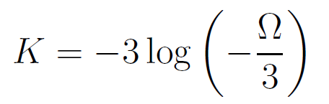
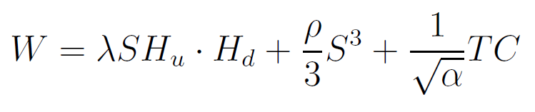
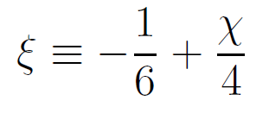
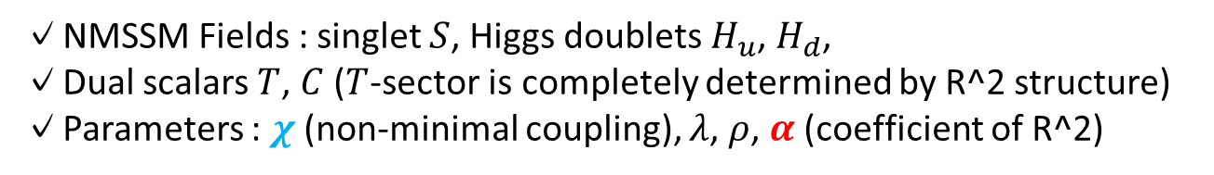
Supergravity embedding
NMSSM
R^2 SUGRA
✓NMSSM Fields : singlet $S$, Higgs doublets $H_{u}$, $H_{d}$,
✓Dual scalars $T$, $C$ ($T$-sector is completely determined by R^2 structure)
✓Parameters : $χ$ (non-minimal coupling), $λ$, $ρ$, $α$ (coefficient of R^2)

Slide 13
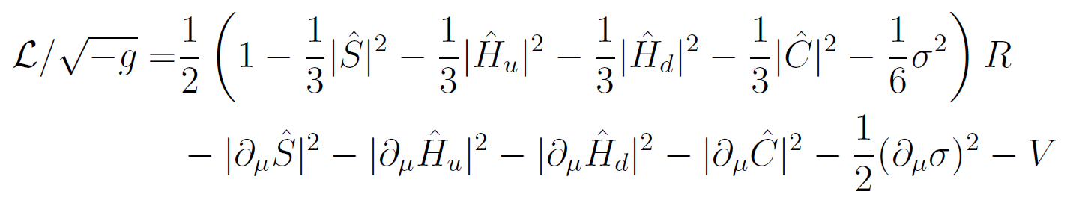
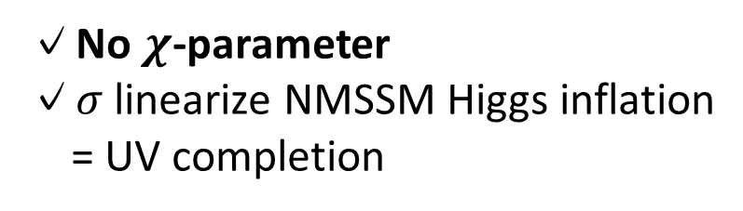

Unitarity ?? non-trivial after supersymmetrization…
Requires analysis of scattering amplitude,
but can be manifest by (specific) field redefinition & conformal transformation
Scalaron : Re$T$ → $σ$
conformal
canonical
✓No $χ$-parameter
✓$σ$ linearize NMSSM Higgs inflation
= UV completion

Slide 14
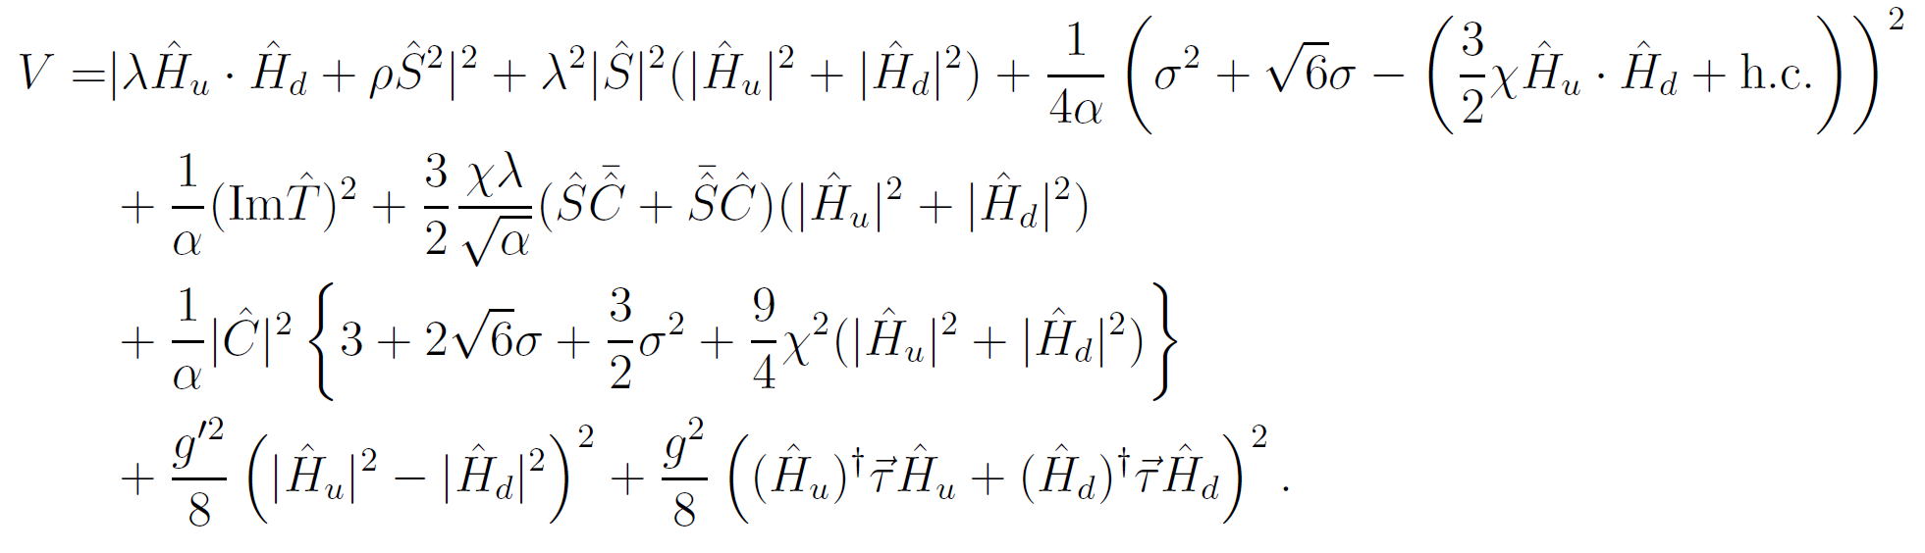

Unitarity ?? non-trivial after supersymmetrization…
Where $χ$ has gone?

Slide 15

Unitarity ?? non-trivial after supersymmetrization…
Where $χ$ has gone?
$$χ/\sqrt{α}$$
can be order one
No unitary violation up to Planck scale even after susy extension

Slide 16

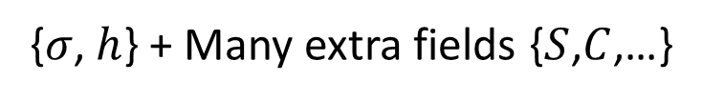
Comments on phenomenology
✓Successful inflation ??
{$σ$, $h$} + Many extra fields {$S$,$C$,…}
Same as non-susy
should be stabilized

Slide 17








Comments on phenomenology
✓Successful inflation ??
{$σ$, $h$} + Many extra fields {$S$,$C$,…}
Same as non-susy
should be stabilized
✓SUSY breaking ??
1. Minimal modification:
SUSY $\sim$
: High scale SUSY breaking
2. Introduce O'Raifeartaigh field $Φ$
SUSY $\sim$
: adjustable

Slide 18
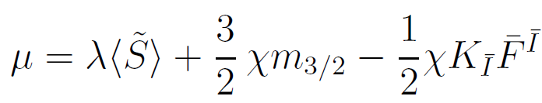
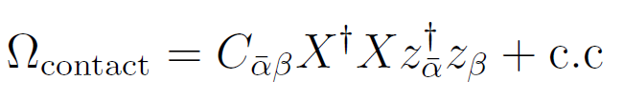


Comments on phenomenology
✓$μ$-term
NMSSM
Non-minimal coupling
Giudice-Masiero term
Lee’ 10
Giudice, Masiero’ 88
✓transmission to visible sector
Sequestered form
vanishing soft mass at tree level
anomaly mediation
tachyonic slepton

Slide 19
Reheating & DM production
SA, H.M. Lee, A. G. Menkara, K.Yamashita
2202.13063

Slide 20
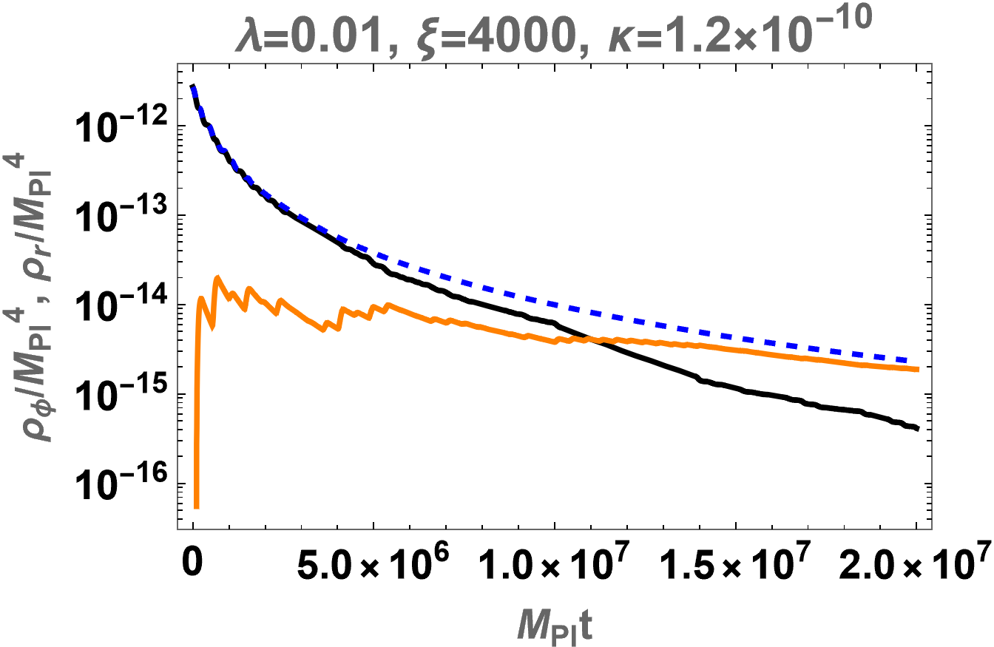
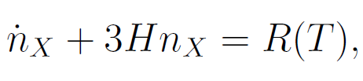



Short summary of reheating
・After inflation, $σ$ and $h$ start oscillation
F. Bezrukov, D. Gorbunov, C. Shepherd and A. Tokareva’19, M.He ’20, SA, H.M.Lee, A.Menkara, K.Yamashita’ 22
・dominant channel : $h$ → $t$ + $\overline{t}$ ⇒ $T_{reh}\sim {10}^{14}$ (GeV)
・Note: reheating is not instantaneous
⇒ affect DM production
During RH
After RH
RH complete

Slide 21
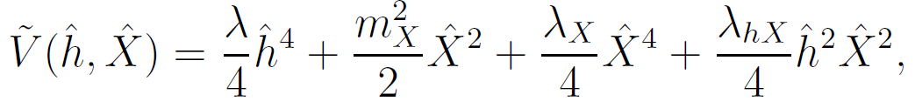
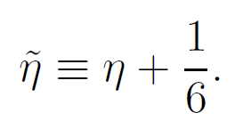


FIMP DM scenario
・FIMP = feebly interacting massive particle
・DM never thermalize
Introduce DM ($X$) as
・Many Planck suppressed interactions in E-frame
・$|\tilde{η}|$, $|λ_{hX}|\sim 0$ ⇒ FIMP

Slide 22





Production process
✓Thermal production
・from radiation (SM particles)
・Efficient both during and after RH
✓Non-thermal production
・from inflaton ($h$ and $σ$)
・Efficient during RH
✓Graviton exchange
S. Clery, Y. Mambrini, K. A. Olive, S. Verner’ 21
important for both thermal and non-thermal production

Slide 23
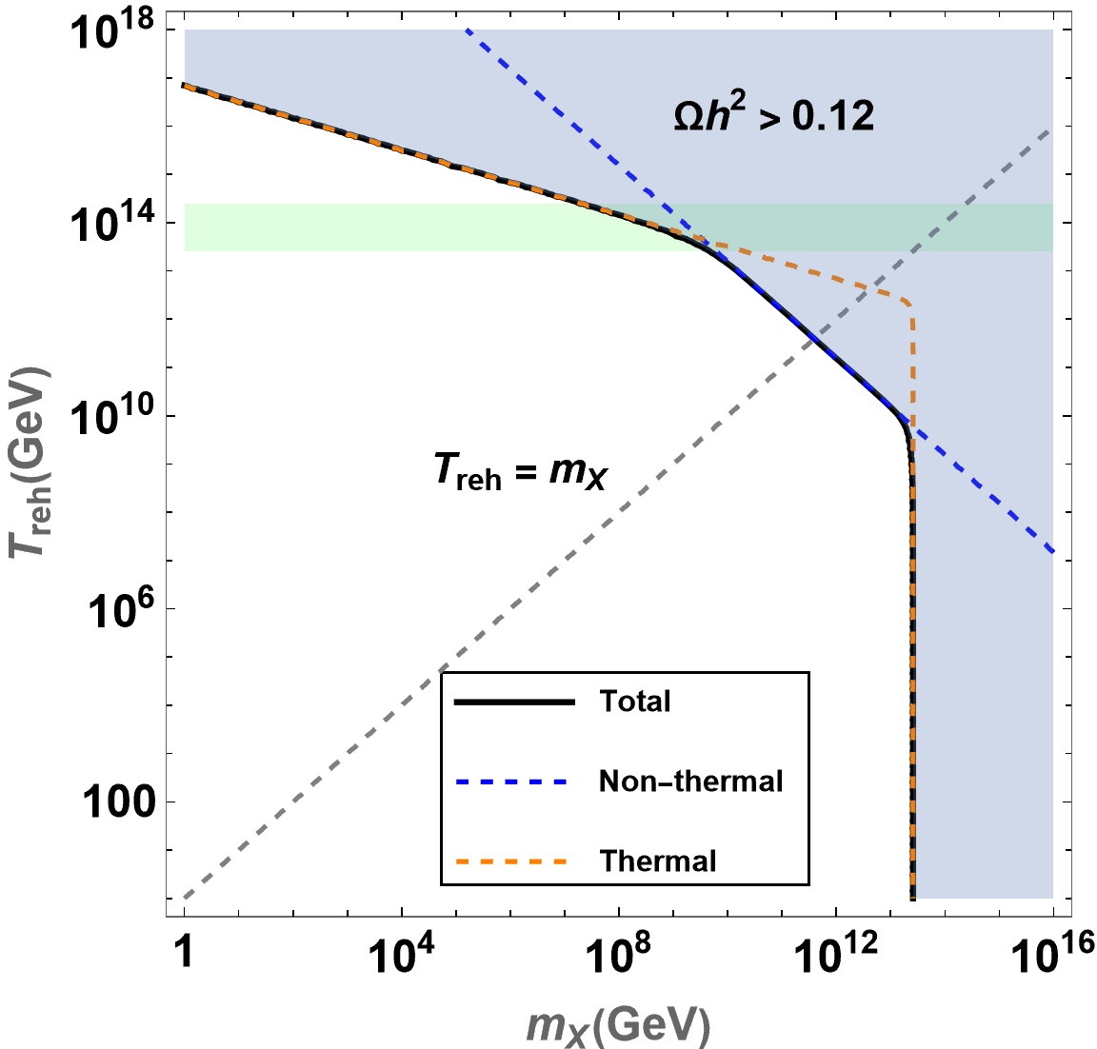
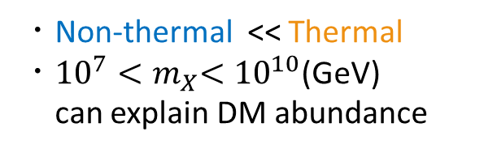
DM abundance
Green band
(predicted RH temp. in this model)
・Non-thermal << Thermal
・${10}^{7}{<m}_{X}<{10}^{10}$(GeV)
can explain DM abundance

Slide 24
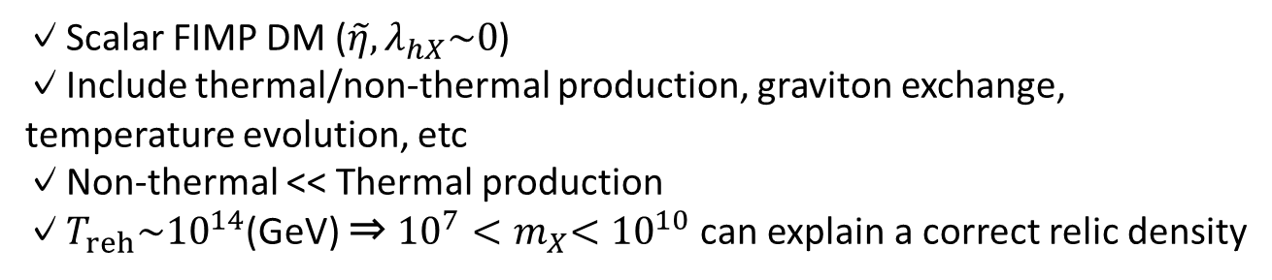
Summary
Higgs-R^2 = UV completion of Higgs inflation
SUGRA embedding of Higgs-R^2 model
✓no unitarity issue even after supersymmetrization
✓successful inflation with higher curvature modification
✓two SUSY breaking mechanisms & transmission to visible sector
Reheating & FIMP production
✓Scalar FIMP DM ($\tilde{η}, λ_{hX}\sim 0$)
✓Include thermal/non-thermal production, graviton exchange, temperature evolution, etc
✓Non-thermal << Thermal production
✓$T_{reh}\sim {10}^{14}$(GeV) ⇒ ${10}^{7}{<m}_{X}<{10}^{10}$can explain a correct relic density
Thank you !!

Slide 25
Backup

Slide 26
Higgs-R^2 inflation model
Salvio & Mazumdar ‘15, Ema ‘17, Gorbunov & Tokareva ‘18, Gundhi & Steinwachs ’18,
D. Y. Cheong & S. M. Lee & S. C. Park ’21, SA, H. M. Lee, A. G. Menkara,’21 …
In addition to the solution of unitarity issue,
・keep successful inflation (Higgs inflation + Starobinsky inflation)
・predictive
・Supported by RGE
・Solve vacuum instability problem

Slide 27
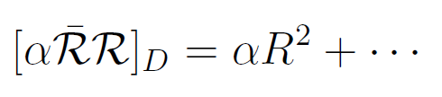

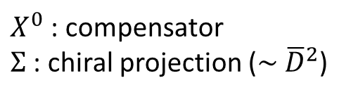
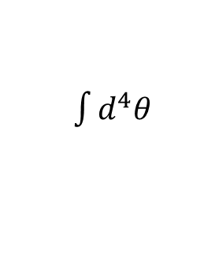
R^2 (Starobinsky) inflation in supergravity
$\int{d^{4}θ}$
: curvature superfield
S. Cecotti’ 87
$X^{0}$ : compensator
$Σ$ : chiral projection ($\sim {\overline{D}}^{2}$)

Slide 28

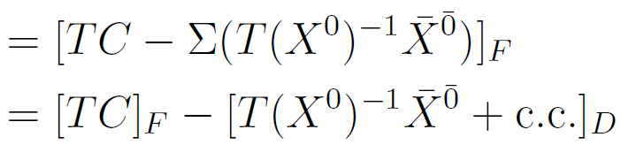



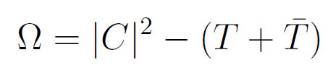
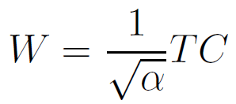

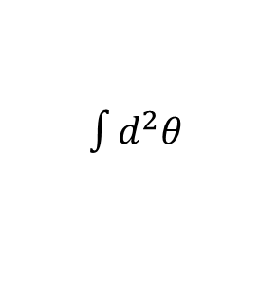
R^2 (Starobinsky) inflation in supergravity
Introduce auxiliary superfield $T$ and $C$
$\int{d^{2}θ}$
&
R^2 SUGRA = SUGRA + two chiral multiplets ($T, C$)

Slide 29
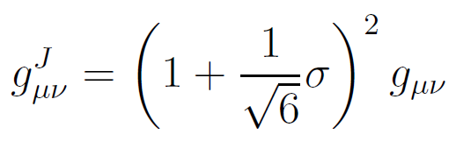
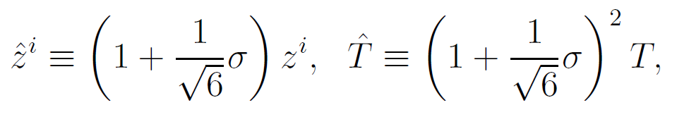

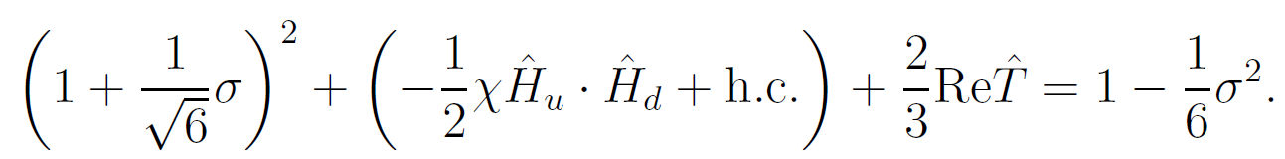

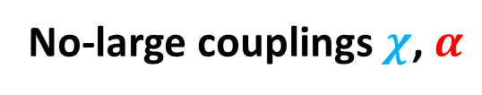

Linear Sigma frame
Conformal trans.
Field redef.
choose $σ$ s.t.
Convert Re$\hat{T}$ (scalaron) → $σ$
conformal
canonical
No-large couplings $χ$, $α$

Slide 30
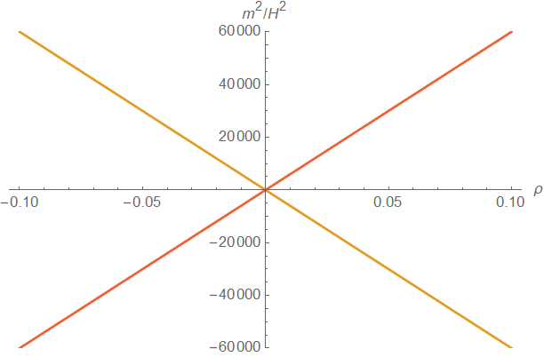
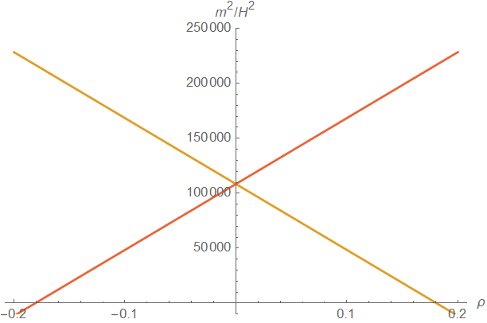






Stabilization of $S$ and $C$
$ρ$ : cubic coupling of $S$
Mass eigenvalues of $S$ and $C$
($ζ_{s}$, $ζ_{c}$)=($0$,$0$)
($ζ_{s}$, $ζ_{c}$)=($3$,$0.4$)

Slide 31


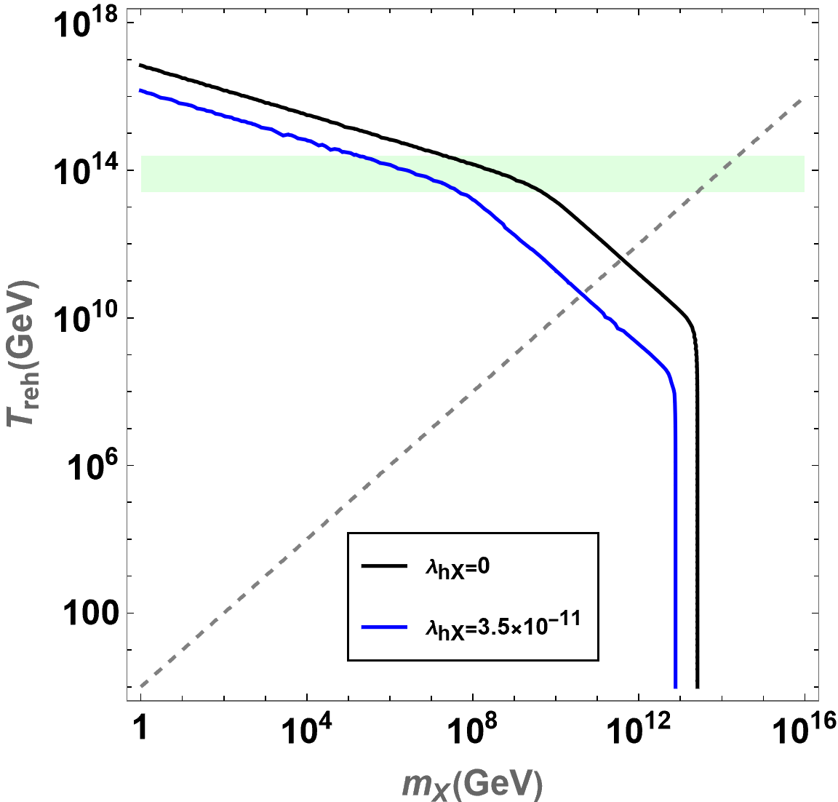

Effects of $\tilde{η}$ and $λ_{hX}$
To avoid overproduction ⇒
&
Smaller DM mass
for correct relic abundance

