Slide 1




SUSY 2022, University of Ioannina,
June 27-July 2, 2022
Gauge Group Topology and
Higher-Form Structures in
Consistent Quantum Gravity
Mirjam Cvetič

Slide 2
Motivation
Quantum field theories coupled to consistent quantum gravity
should be subject to additional constraints beyond standard QFT
consistency ones → Swampland Program [Vafa ‘06]
Globally consistent compactifications of String Theory → automatically include quantum gravity & constraints
emerge due to geometry of compactified space →
Does String Theory realize all consistent theories of
quantum gravity [String Universality]?
Focus on finding physical conditions, reflecting geometric constraints of consistent quantum gravity
(without reference to String Theory)
Long history: […Kumar, Taylor ’09; Adams, DeWolfe, Taylor ’10;…
García-Etxebarria, Hayashi, Ohmori, Tachikawa, Yonekura ’17;
Kim, Tarazi, Vafa ’19; M.C., Dierigl, Lin, Zhang ’20; Montero,Vafa ’20;
Hamada, Vafa ’21; Tarazi, Vafa ’21;…]

Slide 3
Highlight
Gauge symmetry topology for
N =1 Supergravity in 8D →
gauging of one-form symmetries
Top-down classification via string junctions →
all 8D (& 9D) N=1 string vacua
Guiding principles
Geometry: primarily F-theory compactification
Physics: global symmetries, including higher-form ones,
gauged or broken in consistent quantum gravity
[No Global Symmetry Hypothesis]
…[Harlow, Ooguri ’18]

Slide 4
Based on
• Gauge symmetry topology constraints in 8D
M.C., M.Dierigl, L.Lin and H.Y.Zhang,
``String Universality and Non-Simply-Connected Gauge Groups in 8d,’’
PRL, arXiv:2008.10605 [hep-th];
``Higher-form Symmetries and Their Anomalies in M-/F-theory Duality,’’
PRD, arXiv:2106.07654 [hep-th] - 8D/7D & 6D/5D
``Gauge group topology of 8D Chaudhuri-Hockney-Lykken vacua,’’
PRD, arXiv:2107.04031 [hep-th];
``One Loop to Rule Them All: Eight and Nine Dimensional String Vacua
from Junctions,’’ arXiv:2203.03644 [hep-th]– String junctions

Slide 5
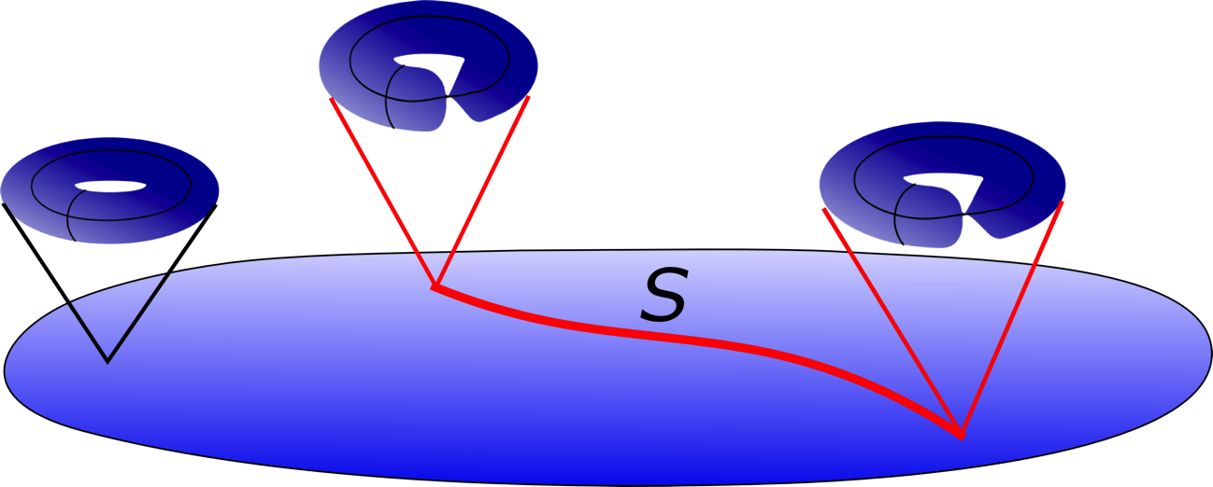
Digression:
[Vafa’96;Morrison,Vafa’96],…review [Weigand’18]
Key features of F-theory compactification
• F-theory, a powerful framework that geometrizes 𝜏 =axio-dilaton
as a modular parameter of T² (SL(2,Z) duality of Type IIB string)
• Compactification on
singular, elliptically fibered
Calabi-Yau fewfolds
• 7-brane non-Abelian gauge symmetries G, encoded in types of
singular T² fibration (ADE singularities)
• T² (elliptic curve) carries arithmetic structure: Mordell-Weil group of
rational points → U(1)’s [Morrison,Park’12;
M.C.,Klevers,Piragua’13; Borchmann, Mayrhofer,Palti,Weigand’13;…]
torsional points → gauge group topology Z→ G/Z [Aspinwall,Morrison’98; Mayrhofer,Morrison,Till,Weigand’14; M.C.,Lin’17]

Slide 6
F-theory compactification on elliptically fibered Calabi-Yau fourfolds led, for specific elliptic fibration
to D=4 N=1effective theory with
Standard Model gauge group SU(3) x SU(2) x U(1)
[M.C., Klevers, Peña, Oehlmann, Reuter ’15]
with gauge group topology
(geometric - encoded in Shioda Map of MW) [M.C.,Lin ’17]
toric geometry techniques
(toric bases B₃)
[M.C., Halverson, Lin, Liu, Tian ’19, PRL]
Quadrillion Standard Models (QSMs)
with 3-chiral families & gauge coupling unification
[gauge divisors – in class of anti-canonical divisor K]
Current efforts: determination the exact matter spectra
(including # of Higgs pairs) [Bies, M.C., Donagi,(Liu), Ong ’21,’22]

Slide 7
Bies, M.C., Donagi, Ong 2205.00008
Matter spectra specified by root bundles (K^{{frac no}}|_{curve})
on matter curves:
Identified O(10¹¹) F-theory QSM geometries without
vector-like matter exotics in the representations of Q_{L} , q_{R} , e_{R}
by studying [Caporaso,Casagrande, Cornalba ’04]
limit root bundles on nodal matter curves (deformed matter curves)
Develop algorithm to determine h⁰ for all limit root
bundles (w/ chirality: 𝝌 = h⁰ – h¹ =3)
For 𝝙₄ polytope (10¹¹ triangulations) 99.995% of root-bundles exactly h⁰ = 3 → ⁻no vector-like exotics
Statistical analysis for other polytopes → w/ h⁰ =3
by far most prevalent
→ Study of Higgs nodal curves [Bies, M.C., Liu, work in progress]

Slide 8
Back to the main topic:
I. Gauge group topology in 8D N=1 SG
a) Geometry - String compactification
G versus G/Z w/ Z ⊂ Z(G)-center
For simplicity: G = SU(n₁) × SU(n₂) × . . .
w/ Z(G) = ℤ_{n1} × ℤ_{n2} × . . .
Subgroup Z w/ generators represented as
(k₁, k₂, . . . ) ∈Π_{i} ℤ_{ni}
In F-theory compactification Z encoded in the geometry
(Mordell-Weil torsion)
F-theory on elliptically fibered K3 → 8D N=1 SG
→ Arithmetic constraint [Miranda, Persson’89]:
Σ_{i} k²_{i} (n_{i} − 1)/(2n_{i}) ∈ ℤ

Slide 9
b) Physics - constraints on higher-form symmetries
• G/Z has gauged 1-form symmetry[Gaiotto,Kapustin,Seiberg,Willet’14]
G/Z requires no obstruction to gauging the global 1-form!
• For G, instanton density fractional [’t Hooft ’81]
w/ 1-form symmetry background C₂ ( F/2π → F/2π + C₂):
Tr(F²)/8π² ≡ α_{G}𝒫(C₂) mod ℤ (``𝒫(C₂)-Pontryagin square’’)
w/ α_{G} fractional, e.g., α_{SU(n)} = (n − 1)/(2n)
• In 8D N=1 SG, instanton density couples to a tensor in the gravity
multiplet, B₄, w/ B₄ → B₄ + b₄ - U(1) large gauge symmetry:
ℒ ⊃ B₄ ∧ Tr(F²)/8π² [Awada,Townsend ’85]
• Shown [M.C., Dierigl, Lin, Zhang ’20]: fractional instantons lead
to mixed anomaly between global 1-form Z and gauge U(1):
𝒜 = Σ_{i} k²_{i} α_{Gi} = Σ_{i} k²_{i} (n_{i} − 1)/(2n_{i}) mod ℤ
Physics: No anomaly Geometry:Miranda-Persson constraint!
∈ ℤ

Slide 10
Classification of allowed gauge groups in 8D N=1 SG
• Anomalies of non-SU groups is integer sums of SU subgroups
[Cordova, Freed, Lam, Seiberg ’19]
• Solutions to Σ_{i} k²_{i} (n_{i} − 1)/(2n_{i}) ∈ ℤ , subject to Σ_{i} (n_{i} − 1) = 18
[Montero, Vafa ’20]
limited. E.g., G/ℤ_{ℓ} w/ ℓ > 8 no anomaly-free solution;
unique solutions ℓ = 7: SU(7)³/ℤ₇; ℓ = 8: [SU(8)²×SU(4)×SU(2)]/ℤ₈
• Also predictions for rank 10 and 2 theories.
Confirmed in compactifications of CHL string (rank 10)
[M.C., Dierigl, Lin, Zhang ’21]
• Independently quantified by advancing string junction techniques
including rank 2 [M.C., Dierigl, Lin, Zhang ’21 & ’22]
→ Long digression:

Slide 11
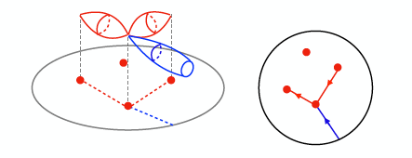


[M.C., Dierigl, Lin, Zhang 2203.03644]
String Junctions & All Gauge Groups in 8D String Theory
String junctions between (p,q) 7-branes geometry of 2-cycles
[Gaberdiel,Zwiebach ’97, DeWolfe,Zwiebach ’98]
in perpendicular
2d space
String junctions w/ prongs on stack ⇔ roots of gauge algebra lattice
String junctions w/ external (asymptotic) prongs ⇔ weights
[Magnetic ``junctions’’ → 5-branes wrapping the same 2-cycles; realizes ADE gauge algebras w/ weights = co-weights]
= Z(G) !
(magnetic) electric higher-form symmetries
[Morrison,Schäfer-NamekiWillett ’20,
Albertini,Del Zotto,García-Etxebarria,Hosseini ’20]

Slide 12



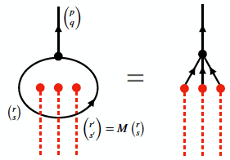
From local (non-compact) gauge group topology
“Fractionality” of encodes charge under Z(G) →
equivalently captured by extended weights
which are fractional loop junctions.
Non-root junctions carry non-zero asymptotic (p,q)-charge

Slide 13
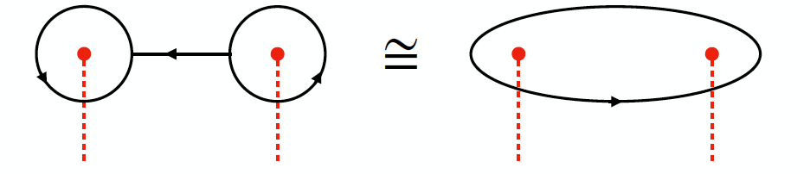
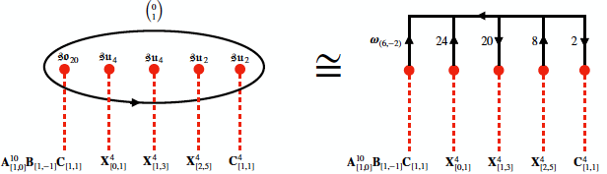
…to global compactification & gauge group topology there
→ no net asymptotic (p,q) charge
restricts allowed junctions in “gluing” local patches encoded in fractional null junctions of 5-branes (encode Z)
[Fukae,Yamada,Yang ’99, Guralnik ’01]
All rank 18 vacua → Example:
Also for all examples with U(1)’s

Slide 14
Junctions on O7⁺
• O7⁺ does not split into (p,q) 7-branes at finite g_{s} (unlike O7⁻)
• Same monodromy as 𝔰𝔬₁₆ - stack, but w/ “non-trivial flux”
that “freezes” singularity in M-/F-theory
[Witten ’97, de Boer et al ’01, Tachikawa ’15]
• Freezing - local: “replacing” one stack [two stacks]
with O7⁺ yields theories of rank 10 [rank 2]
[Hamada,Vafa ’21]
• Strings ending on O7⁺ must have even p and q charges
[Imamura ’99, Bergman,Gimon,Sugimoto ’01]
[5-brane prongs of any integer (p,q)]
Derived, if configs. with one O7⁺ are dual to CHL vacua
Analogous constructions w/global topology
w/ one O7⁺ → all rank 10 vacua
w/ two O7⁺→ all rank 2 vacua - first construction

Slide 15
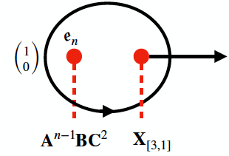
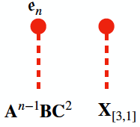
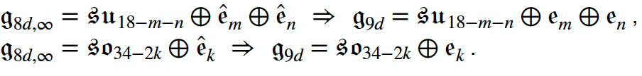
Junctions in 9D uplifts:
sharpens swampland distance conjecture
• Suitable infinite distance limits of F-theory in K3 moduli space
describe 9D N=1 theories of rank 17
[Lee, Lerche,Weigand ’21]
• Junctions characterized by appearance of singularities
associated with affine algebras ê_{n}:
Two series:
[Maximal non-Abelian enhancement in D=9 heterotic vacua
[Font, Fraiman,Grana,Parra de Freitas ‘20]]
Hyperbolic lattice [Lee,(Lerche),Weigand ’21]

Slide 16

9D uplifts with one O7⁺ → rank 9
• Start with configurations:
&“freeze” 𝔰𝔬₁₆, contained in 𝔰𝔬_{16+2n} or ê₈→freezing the latter
• Maximal enhancements:
[CHL: ]
[Mikhailov ’98, (Font), Fraiman, (Grana), Parra de Freitas ’21]
9D uplifts with two O7⁺ → rank 1
• Freezing’ of two ê₈:
(dual to M-theory on Klein-bottle)
• 9D, rank 1 has two disconnected moduli branches
[Aharony,Komargodski,Patir ’07]
• Shown to be connected through D=8
All 9D string vacua are “emergent” from 8D ones!

Slide 17
Back to physics comments:
Consequences of 1-form symmetry gauged or broken
G and G/Z have different charge lattices: G has states charged under Z
If anomaly present →Z is broken & gauge group is G.
A consistent quantum gravity theory should supply
the necessary states charged under Z
In 8D spectrum due to excitations on BPS 3-brane

Slide 18
Role of 1-form symmetry &
Mixed 1-form - gauge anomalies in D≤8
8D [Font, Graña ,Fraiman, Freitas ’21] – heterotic
[M.C., Dierigl, Lin, Zhang ’21, ’22] – string junctions
7D [M.C., Dierigl, Lin, Zhang ’21] – F/M-theory duality
(torsional boundary G₄)
6D [Apruzzi, Dierigl, Lin ’20] – excitations of BPS strings
5D [M.C., Dierigl, Lin, Zhang ’21] – F/M-theory duality
(torsional boundary G₄)
[Apruzzi, Bonetti, García-Etxebarria, Hosseini, Schäfer-Nameki ’22]…
Mixed higher-form - gauge anomalies
have important implications also for 6D and 5D SCFTs

Slide 19
Summary
Physics:
Employing higher-form symmetries to formulate
anomaly condition for gauge group topology
Gauged 1-form symmetry in 8D
Geometry:
F-theory/Heterotic string/CHL/string junctions
Full 8D string theory landscape
perfect agreement

Slide 20
Future Directions
• Focused on 8D N=1 and role of 1-form gauge
symmetry
• Higher-group structures in D≤6
0-form & 1-form symmetries → 2-group structures
- Within SCFT’s → geometric origin of higher group structures
[M. C., Heckman, Hübner , Torres ’22]
[Del Zotto, Etxebarria, Schafer-Nameki ‘22]
- Their role in in quantum gravity -
string theory on compact spaces
[M. C., Heckman,Hübner, E. Torres to appear]

Slide 21
Thank you!

Slide 22
Announcement
Geometry and Strings 2023
at UPenn
Date to be fixed

