Slide 1
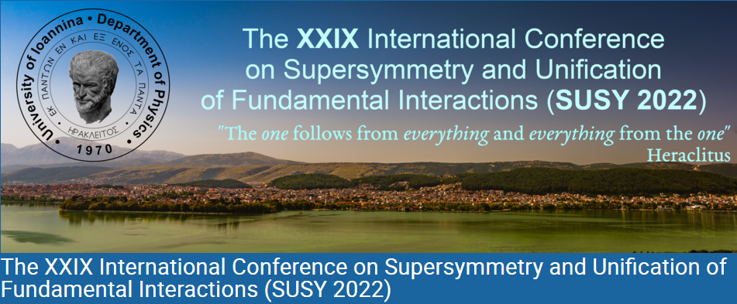


June 27, 2022 to July 2, 2022
University of Ioannina (GR)
Dimitri Nanopoulos

Slide 2
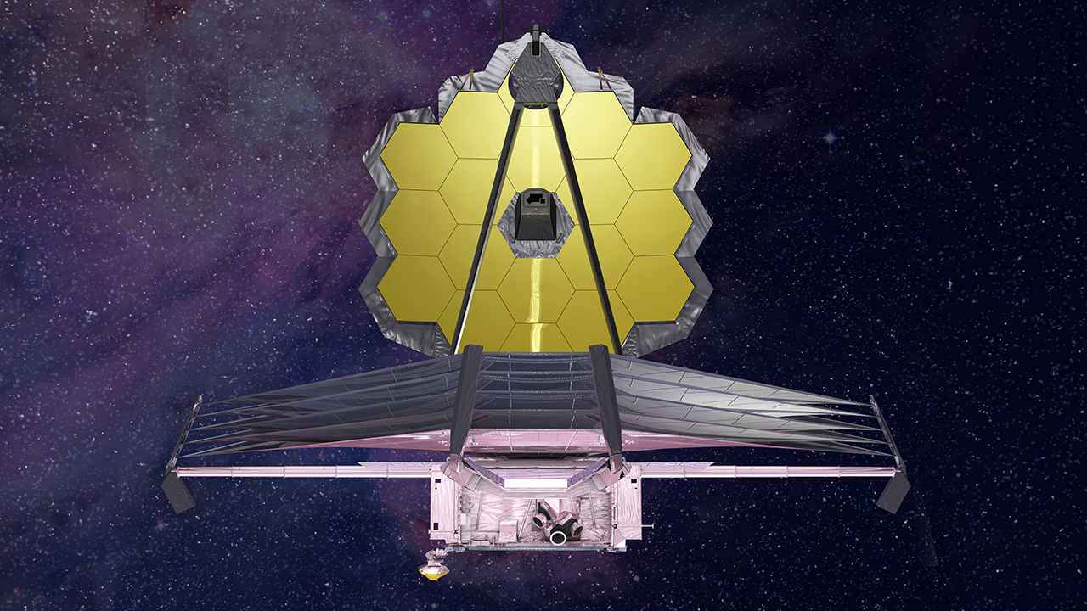
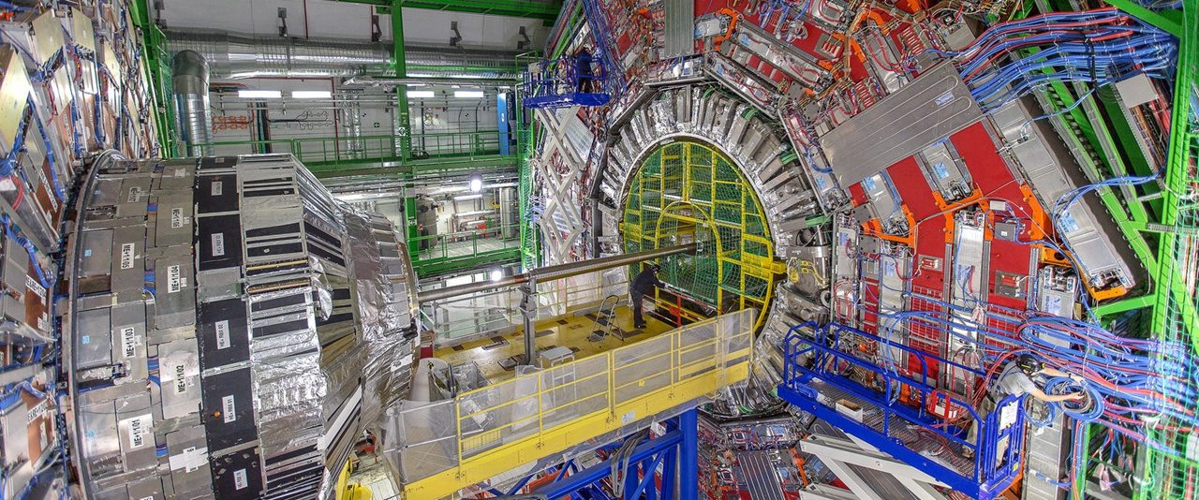
Cosmology and Phenomenology of the Superstring derived No-Scale Flipped SU(5)
James Webb Space Telescope
LHC
Dimitri Nanopoulos

Slide 3
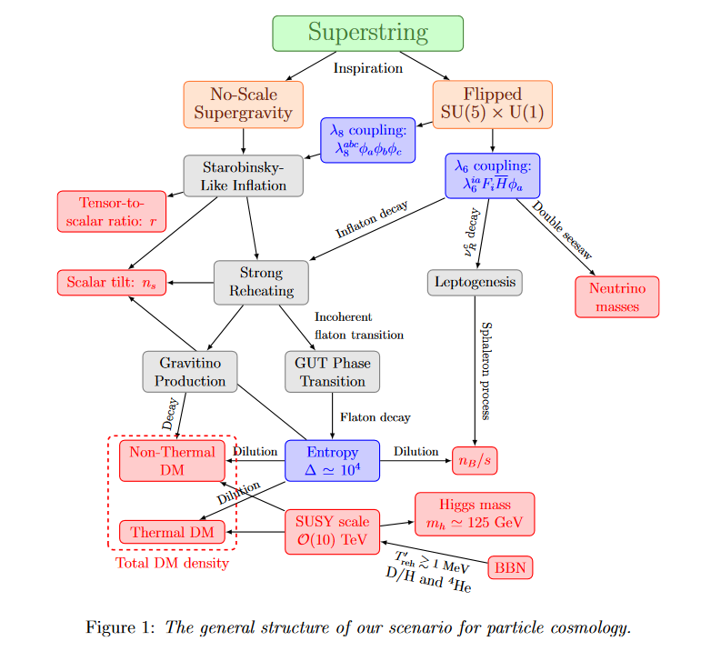
Quark, charged lepton masses

Slide 4
I.Antoniadis, D.V. Nanopoulos and J. Rizos
Inspired Derived
Superstring derived SUSY Flipped SU (5)
FULL CALCULABILITY OF THE EFFECTIVE NO- SCALE SUPERGRAVITY THEORY…!! *
Around the fermionic vacuum (all string moduli fixed).
*
I. Antoniadis, J.R. Ellis, E. Floratos, D.V. Nanopoulos and T. Tomaras, The Low-energy Effective Field Theory From Four-dimensional Superstrings, Phys. Lett. B 191 (1987) 96 [INSPIRE].
S. Kalara, J.L. Lopez, D.V. Nanopoulos, Nonrenormalizable terms in the free fermionic formulation of 4-D strings. Phys. Lett. B 245, 421–428 (1990). https://doi.org/10.1016/0370-2693(90)90668-V 46. S. Kalara, J.L. Lopez, D.V. Nanopoulos,
Calculable nonrenormalizable terms in string theory: a guide for the practitioner. Nucl. Phys. B 353, 650–682 (1991). https://doi.org/10.1016/ 0550-3213(91)90321-N

Slide 5

“REVAMPED” MODEL AEHN/1989
Very Successful Particle Physics Phenomenology

Slide 6
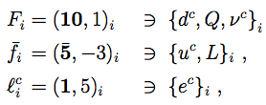
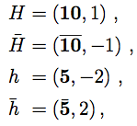



Flipped SU(5)×U(1) GUT Model
JE, Garcia, Nagata, Nanopoulos & Olive, arXiv:1704.07331
Fields:
  Matter: Higgs:
  Singlets:
Superpotential:
No-scale Kähler potential:
D-terms:
Symmetry breaking:
Proton lifetime:

Slide 7
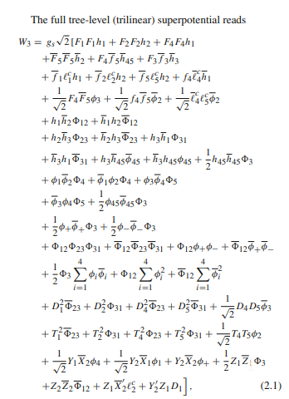

Particle physics and cosmology of the string derived no-scale flipped SU(5)
I. Antoniadis, D. V. Nanopoulos, J. Rizos, Eur. Phys. J. C (2022) 82:377

Slide 8




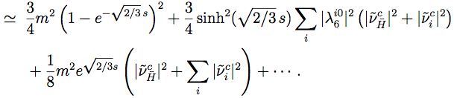
Starobinsky-Like Inflation
JE, Garcia, Nagata, Nanopoulos & Olive, arXiv:1704.07331
Need superpotential:
Identify inflaton S with some combination of Φ_{a}, consider 2 scenarios:
1) Hierarchy of scalars* with one light eigenstate Φ₀^{D}:
:
“Starobinsky” condition:
* Consider later scenario 2) no scalar mass hierarchy

Slide 9
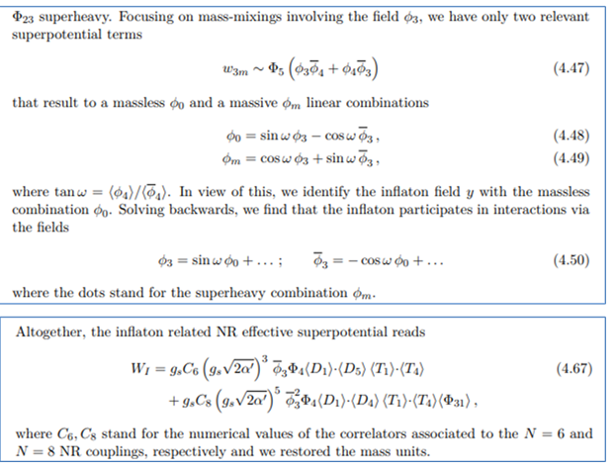

Cosmology of the string derived flipped SU(5)
I. Antoniadis, D.V. Nanopoulos and J. Rizos, JCAP03 (2021) 017
NEW!

Slide 10
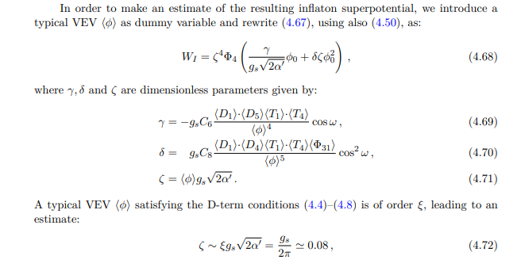

Cosmology of the string derived flipped SU(5)
I. Antoniadis, D.V. Nanopoulos and J. Rizos, JCAP03 (2021) 017

Slide 11
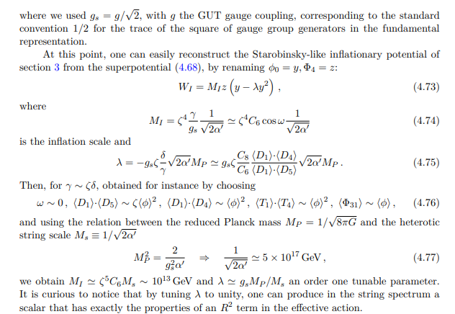
Cosmology of the string derived flipped SU(5)
I. Antoniadis, D.V. Nanopoulos and J. Rizos, JCAP03 (2021) 017

Slide 12
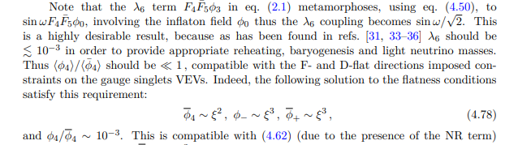

Slide 13



Neutrino Masses & Mixing
Consider 2 options:
(A) Inflaton decouples from neutrinos
  Inflaton decays to Higgs(inos): leptogenesis difficult
(B) Inflaton couples to neutrinos
Double seesaw mass matrix, 2 heavy states, couplings where
Constraints from neutrino data, easier leptogenesis

Slide 14




Neutrino Masses & Inflaton Coupling
JE, Garcia, Nagata, Nanopoulos & Olive, arXiv:1704.07331
To avoid overproduction of dark matter via gravitinos if no later entropy
With entropy factor Δ, if inflaton couples to neutrinos:
Normal neutrino mass hierarchy preferred
Weak or strong reheating? Much much extra entropy?

Slide 15


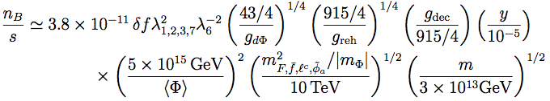
Entropy Release & Baryogenesis
JE, Garcia, Nagata, Nanopoulos & Olive, arXiv:1704.07331
Entropy release
Relaxes gravitino production constraint, little effect on number of inflationary e-folds:
Standard leptogenesis if inflaton couples to neutrinos:

Slide 16
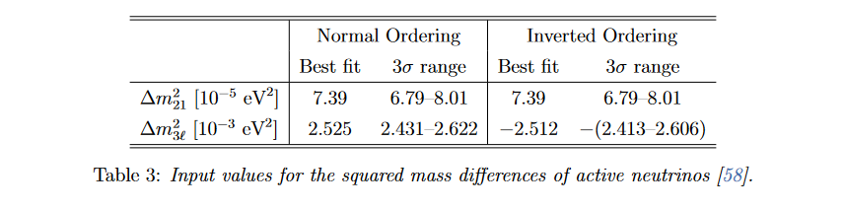

Slide 17
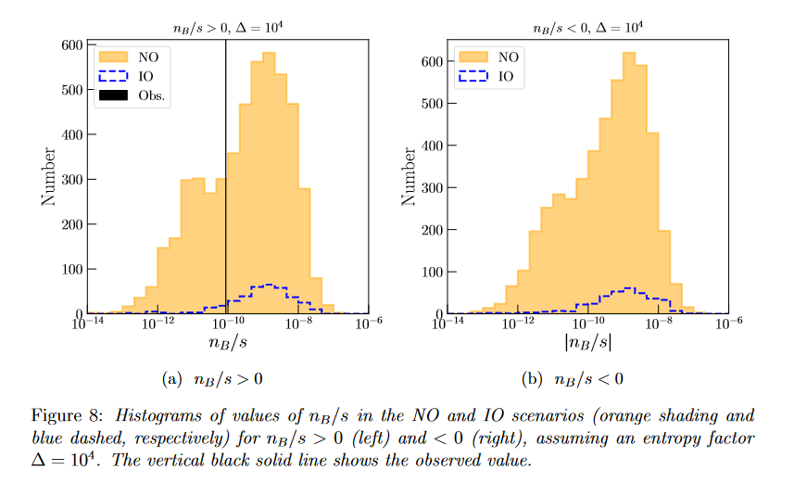

Slide 18
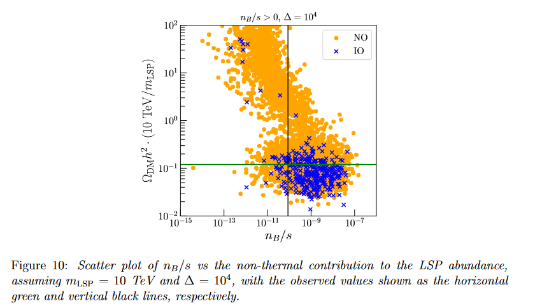

Slide 19
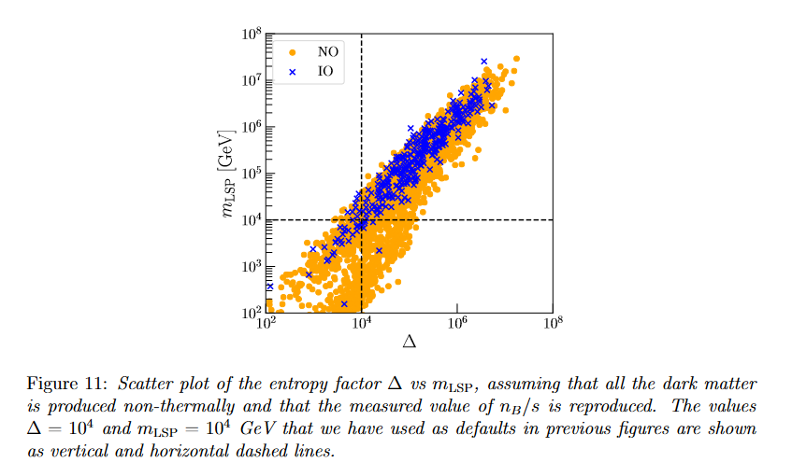

Slide 20
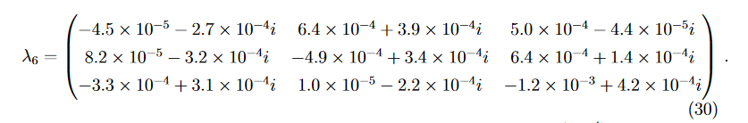

Slide 21
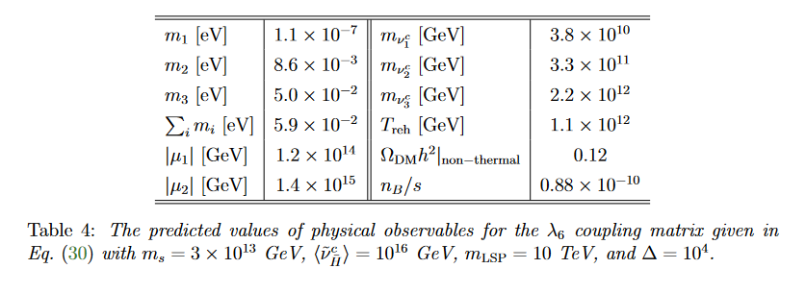

Slide 22
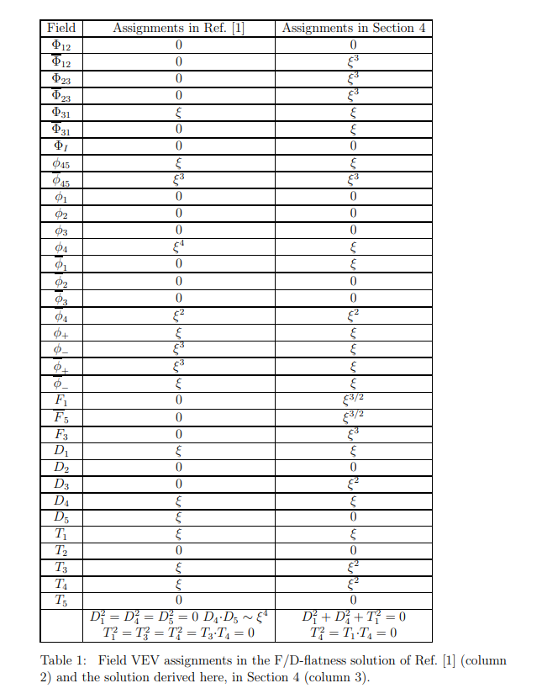

Slide 23
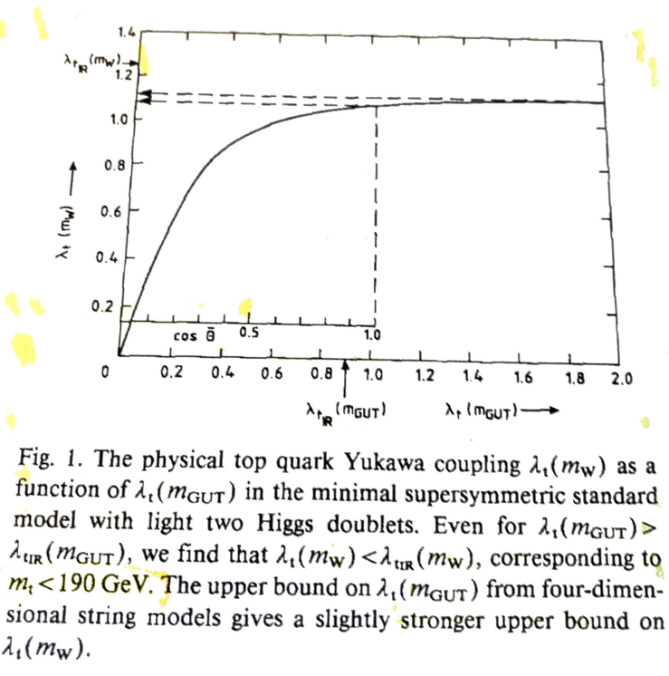


Fermion Masses
Particle physics and cosmology of the string derived no-scaleflipped SU(5)
I. Antoniadis, D.V. Nanopoulos and J. Rizos, JCAP03 (2021) 017
ΑΕΗΝ, Phys. B, 231 (1989)65

Slide 24
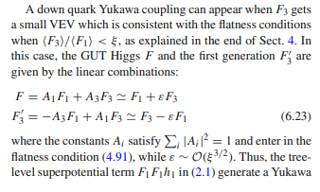

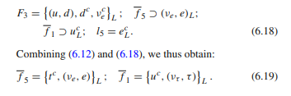
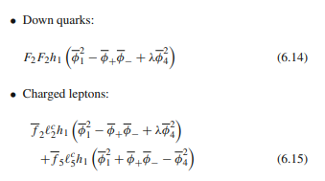

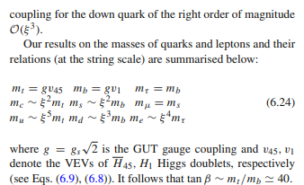
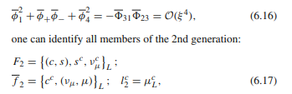

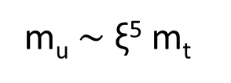
Fermion Masses
Particle physics and cosmology of the string derived no-scaleflipped SU(5)
I. Antoniadis, D.V. Nanopoulos and J. Rizos, JCAP03 (2021) 017
m_{u} $\sim$ξ⁵ m_{t}
0
3m_{s}
*

Slide 25

* $F=F_{1}+ξF_{2}+εF_{3}$
i)$F_{1}F_{1}h_{1}→ −ξF_{2}{ξF}_{2}h_{1}→ −{ξ^{2}F}_{2}F_{2}h_{1}$
Extra contribution to m_{s}, eq. (6.14): m_{s} $\sim \frac{m_{μ}}{3}$
ii) d-s mixing:
$F_{1}F_{1}h_{1}→εF_{3}{ξF}_{2}h_{1}→ {ξ^{\frac{5}{2}}F}_{3}F_{2}h_{1}$
$\left(\begin{aligned}ξ^{3 }{ ξ}^{\frac{5}{2}} \\ ξ^{\frac{5}{2}} ξ^{2 }\end{aligned}\right)→$ $\tan{θ_{c}}≈\frac{{ ξ}^{\frac{5}{2}}}{ ξ^{2 }} ≈{ ξ}^{\frac{1}{2}}$

Slide 26
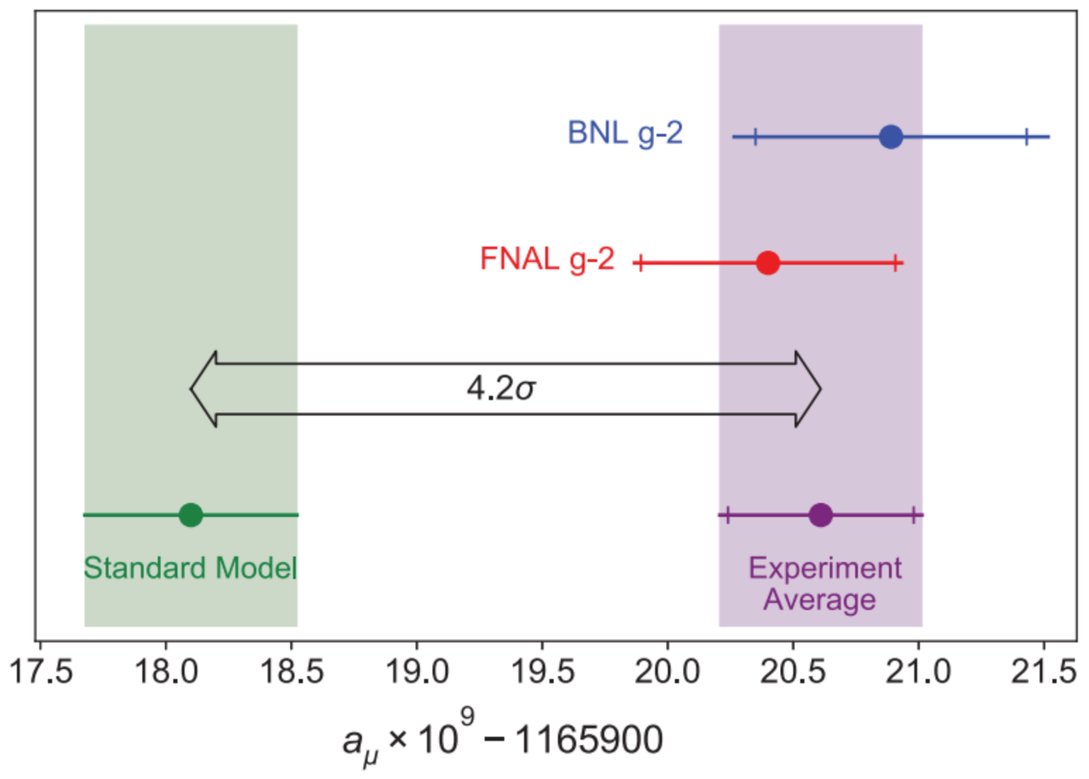
Fermilab Measurement
FNAL result:
Combined result:
Difference from Standard Model:
Abi et al, arXiv:2104.03281

Slide 27
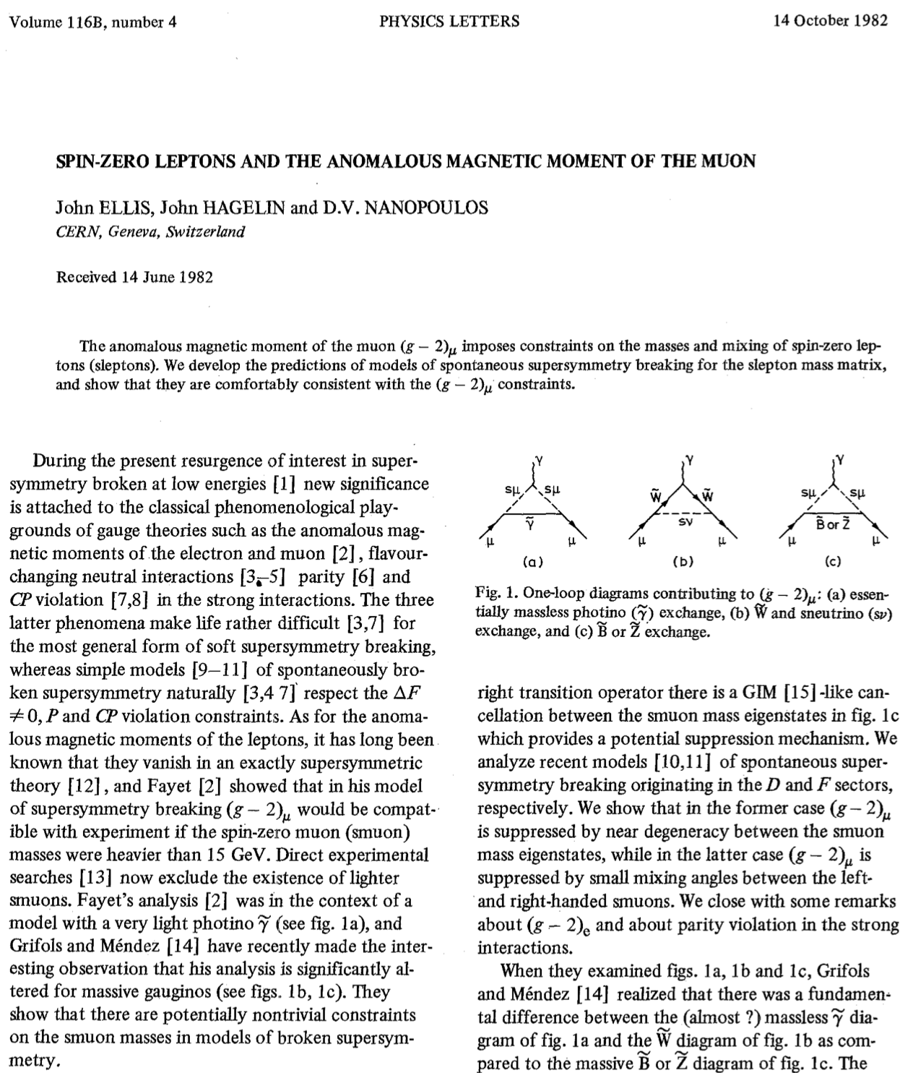
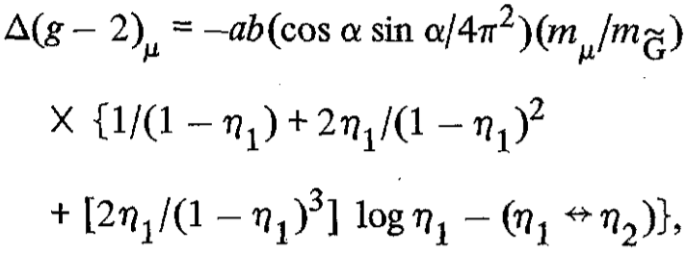




Supersymmetry,
$g_{μ}−2$ & I
go back a long way
(1982)
One-loop contribution from smuon/neutralino loop
where
and
Before idea of supersymmetric dark matter

Slide 28
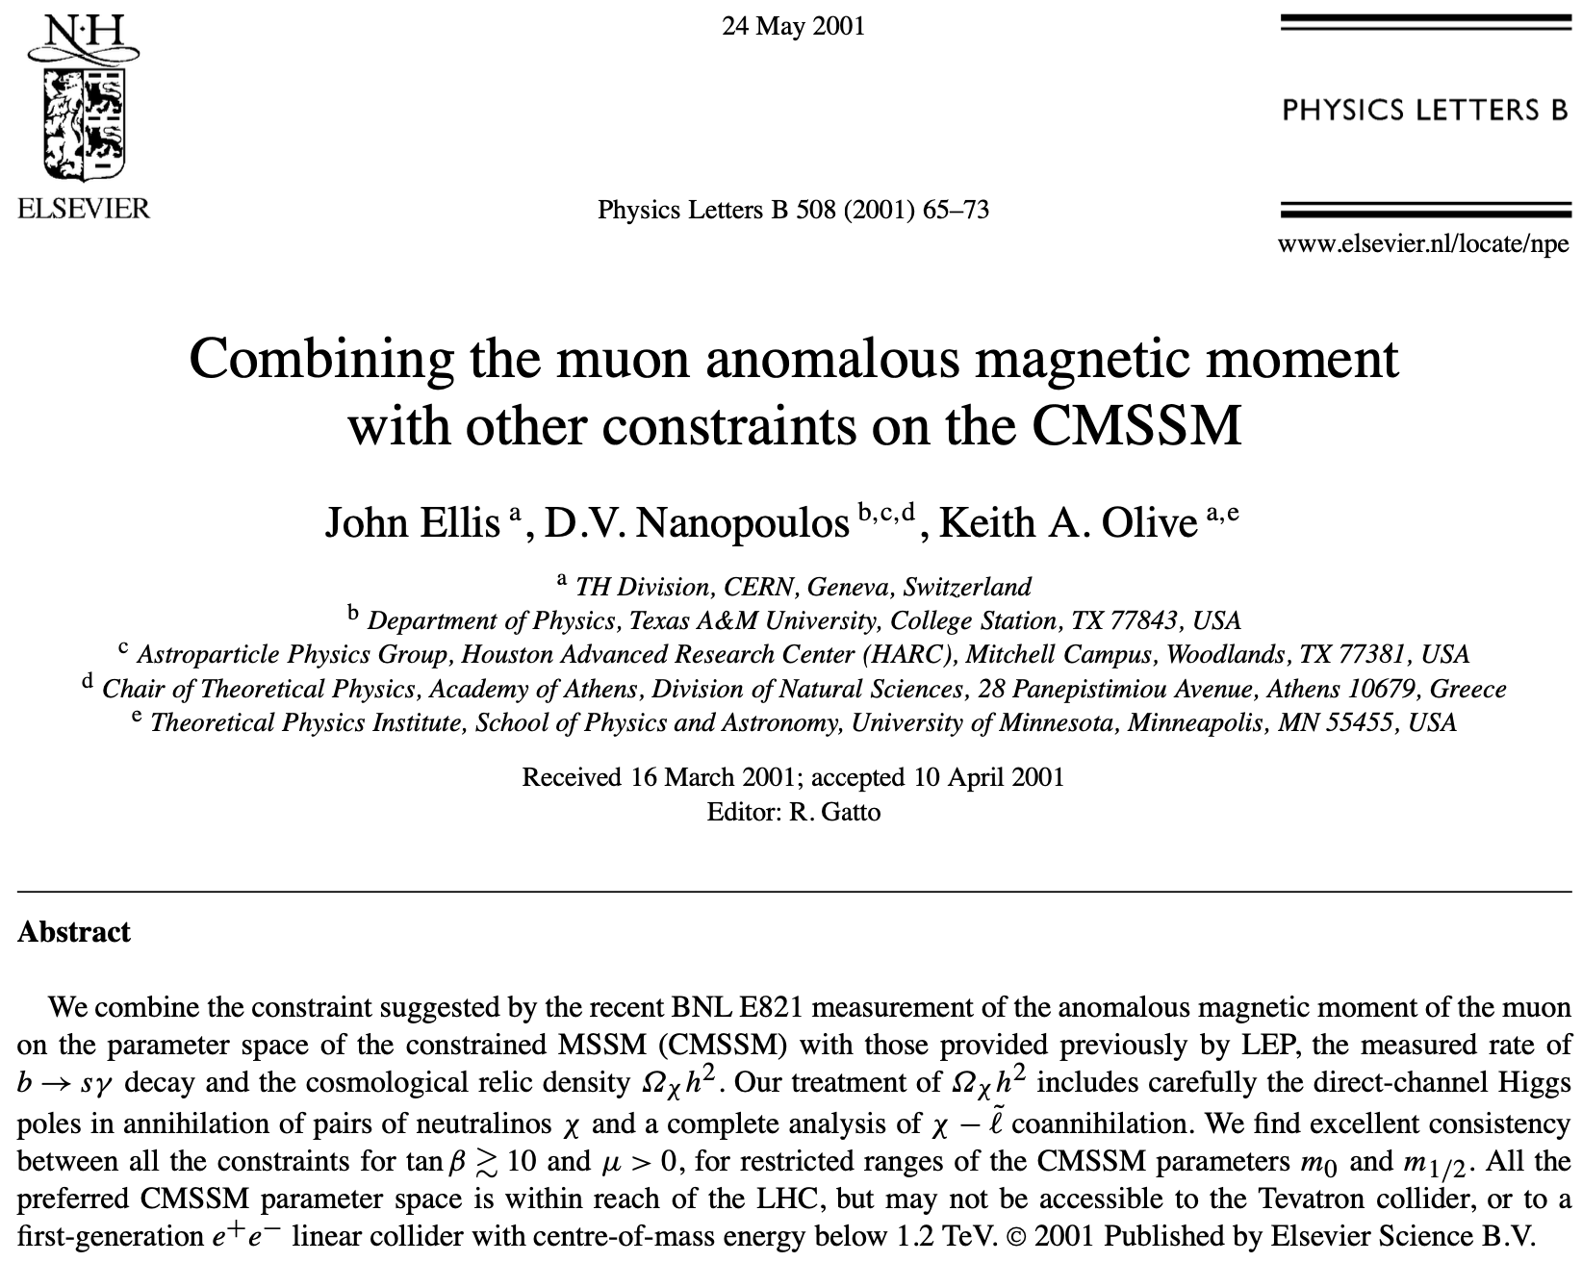
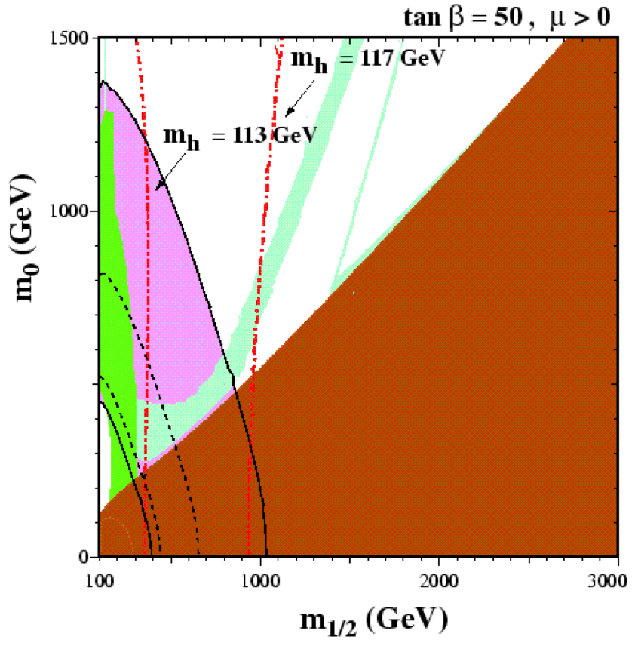
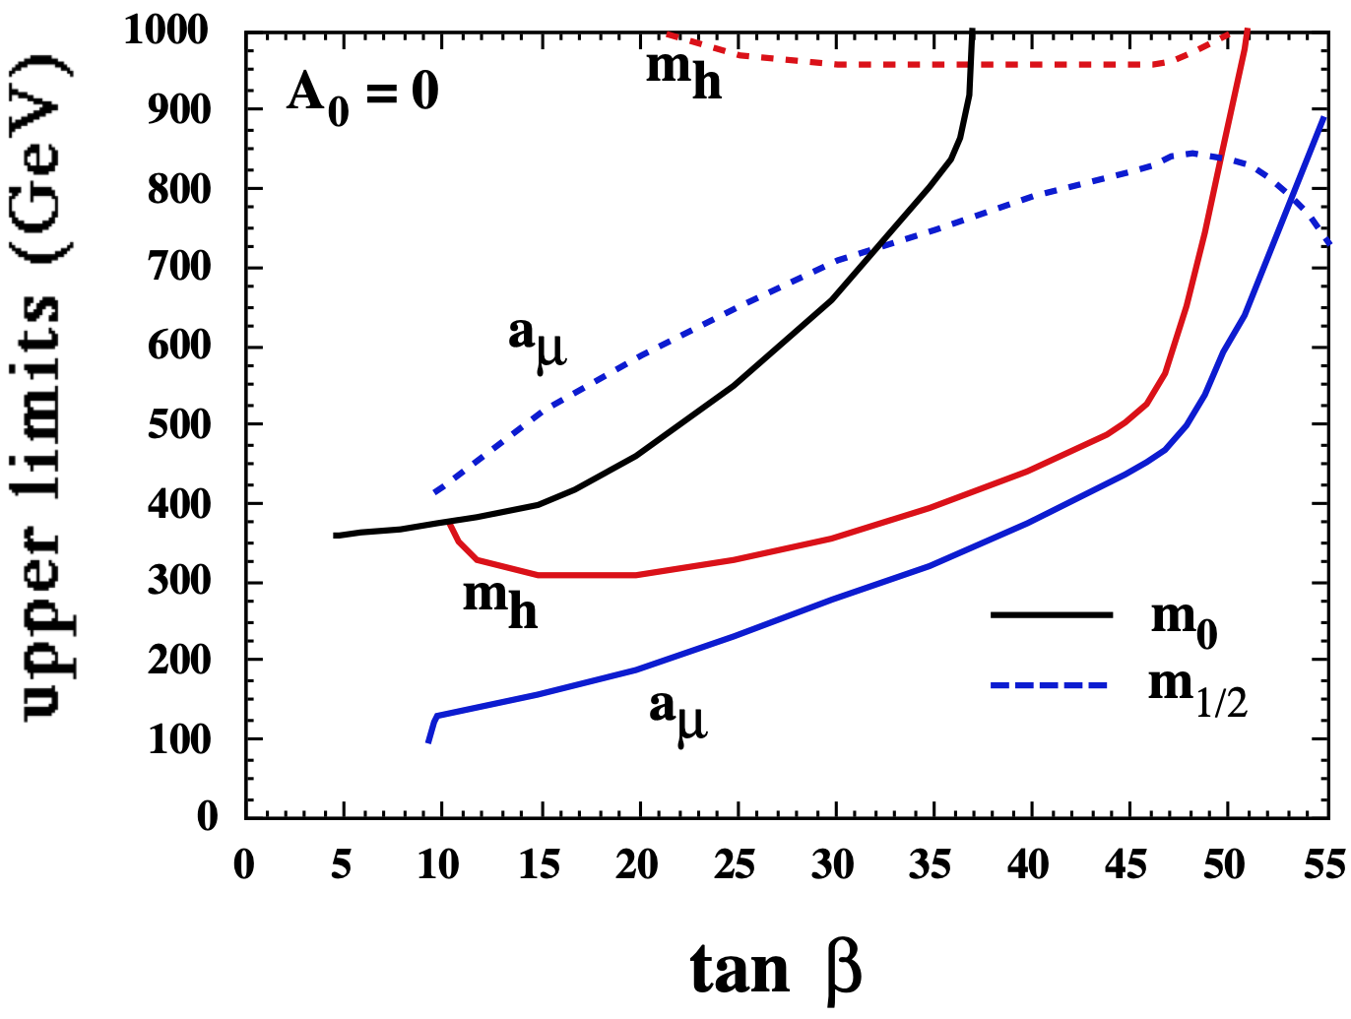
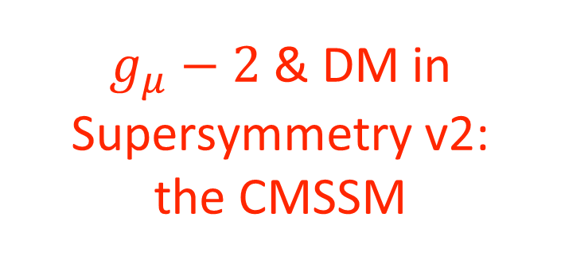
$g_{μ}−2$ & DM in Supersymmetry v2:
the CMSSM
Dark matter
density constraint
Sparticle masses a few hundred GeV
(2001)

Slide 29
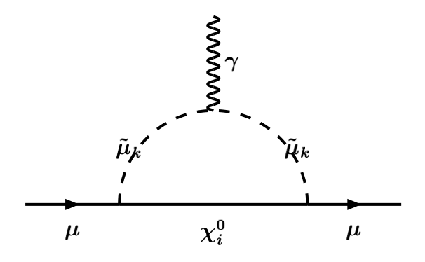
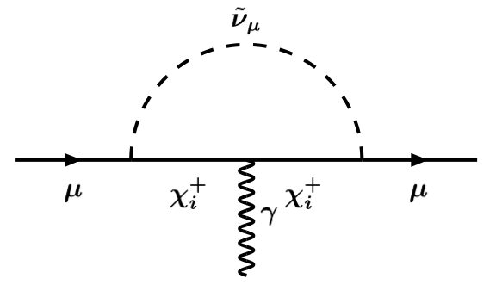
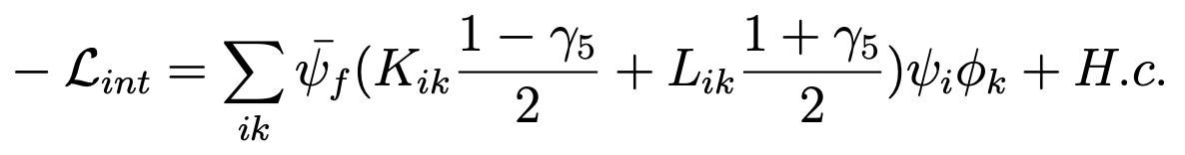
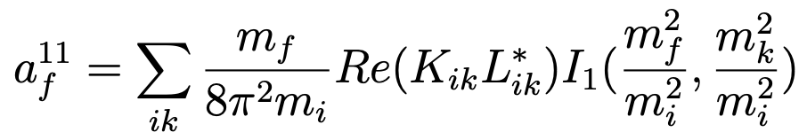
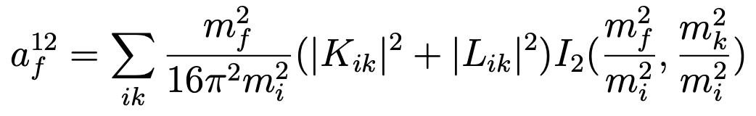


$g_{μ}−2$ in Supersymmetry
Muon $ψ_{f}$ , 4 neutralinos $ψ_{i}$ , 2 smuons $φ_{k}$ $({\overset{˜}{μ}}_{L,R})$
One-loop contributions from smuon/neutralino loops:
  Left-right mixing:
  Unmixed:

Slide 30
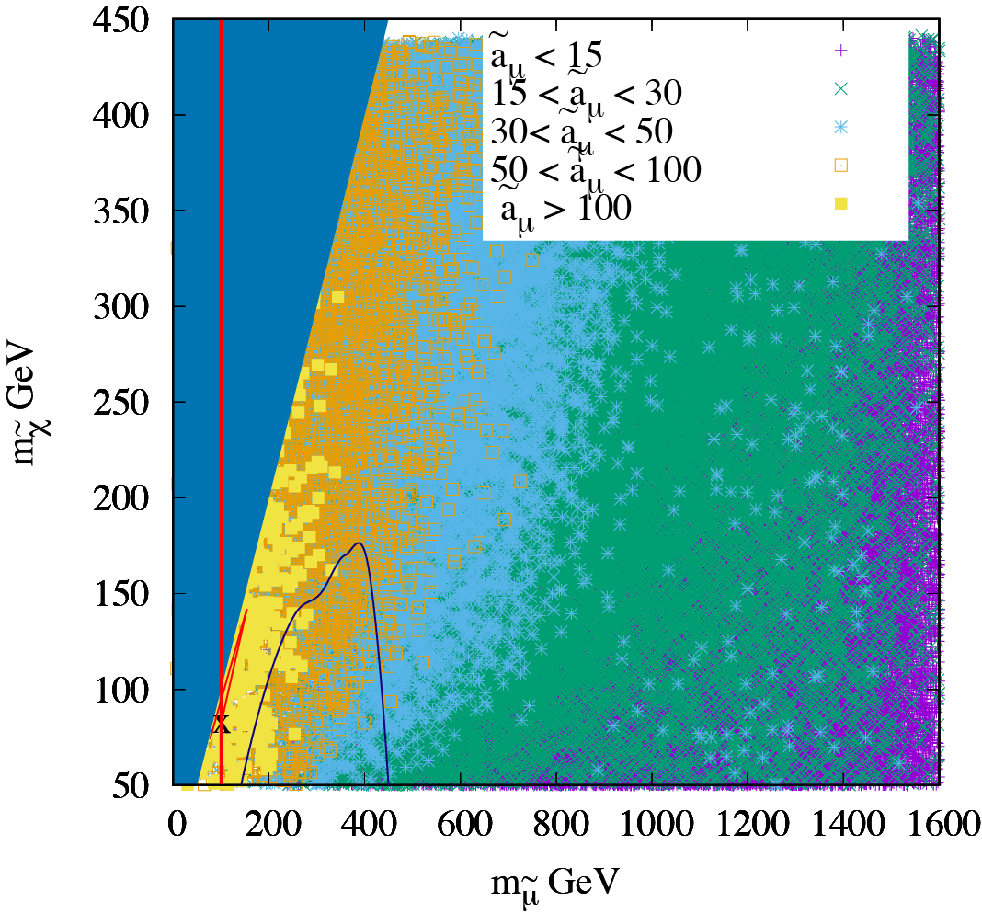

$g_{μ}−2$ in Flipped SU(5)
Scan free parameters of model:
Lightest supersymmetric particle charged
LEP lower limit
on slepton mass
LHC constraints
x = best-fit point
JE, Evans, Nagata, Nanopoulos & Olive, arXiv:2107.03025

Slide 31
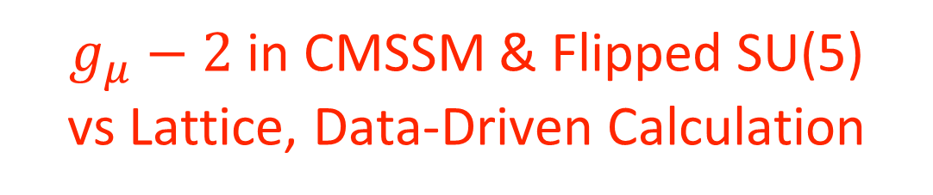
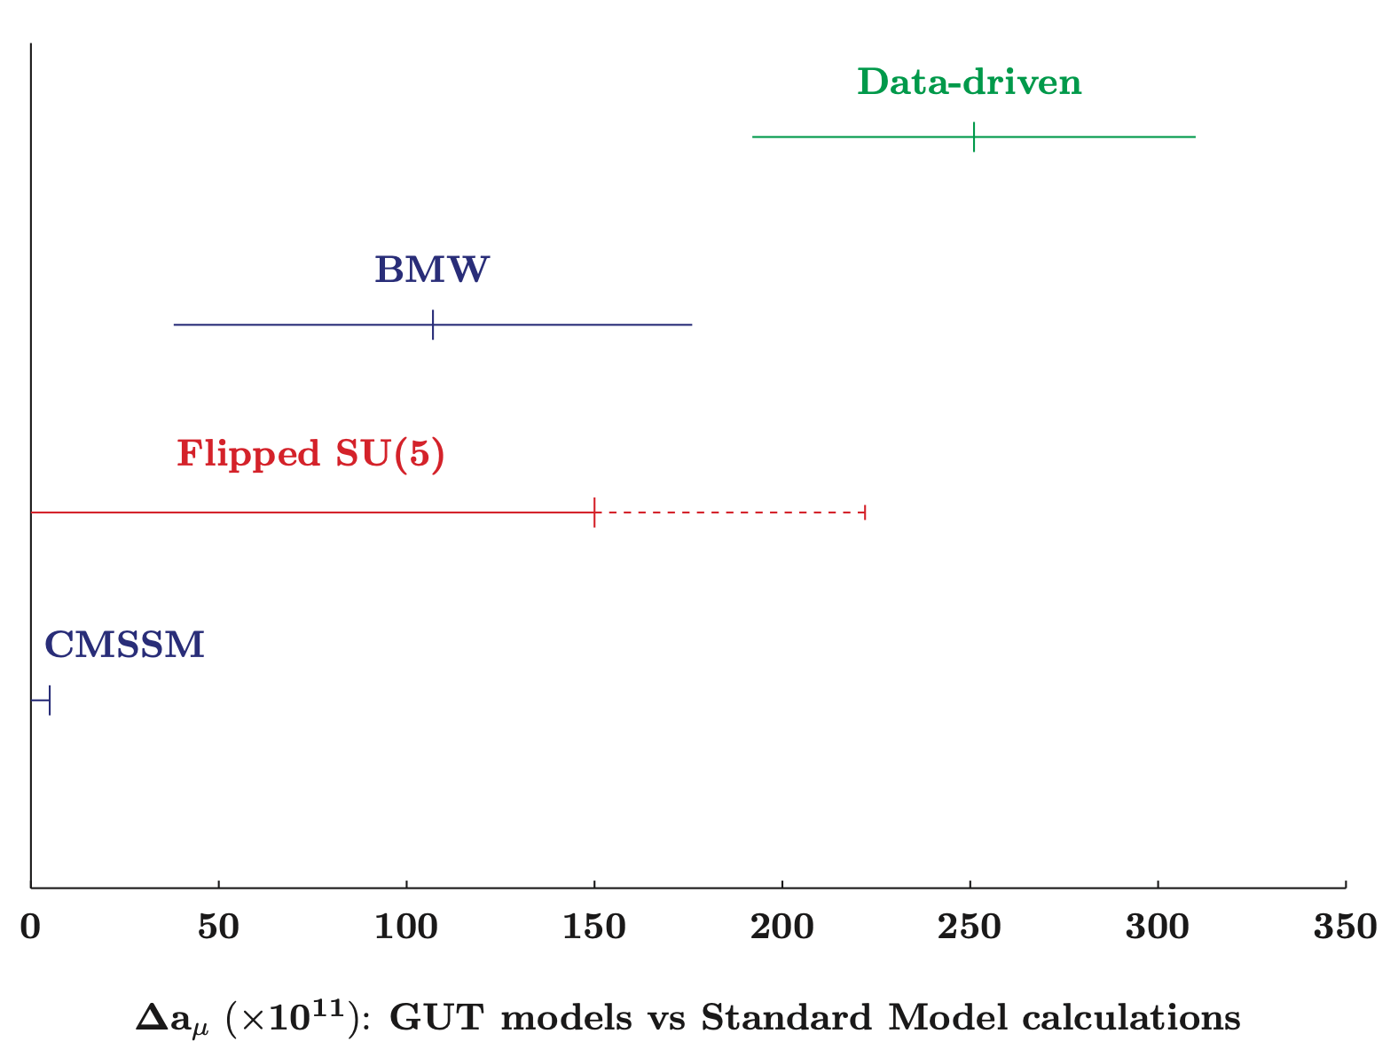

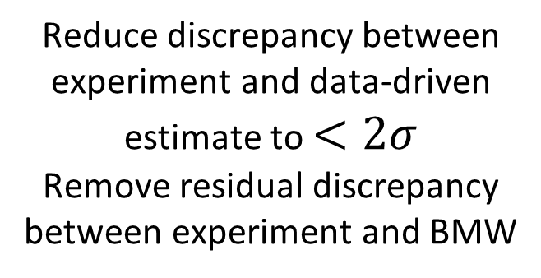
Scan of ${\overset{˜}{a}}_{μ}$ as function of Higgs mass, Higgs mixing
Reduce discrepancy between experiment and data-driven estimate to $<2σ$
Remove residual discrepancy between experiment and BMW
JE, Evans, Nagata, Nanopoulos & Olive, arXiv:2107.03025

Slide 32
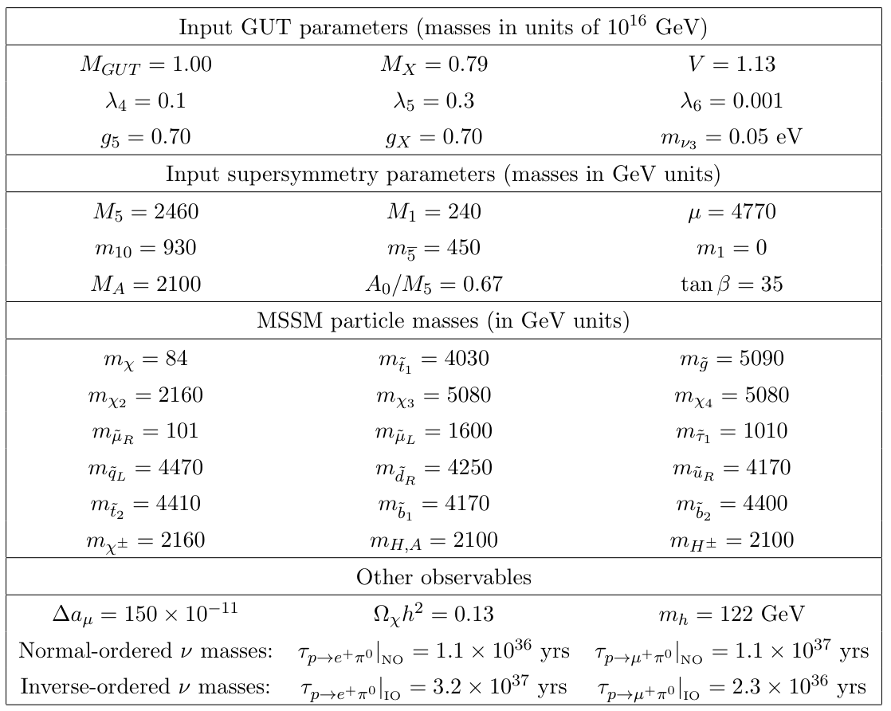

$g_{μ}−2$ in Flipped SU(5)
Parameters & predictions at best-fit point
Opportunities to search for light smuon, neutralino at LHC
Other sparticles too heavy?
Get good CDM density
without even trying!
JE, Evans, Nagata, Nanopoulos & Olive, arXiv:2107.03025

Slide 33
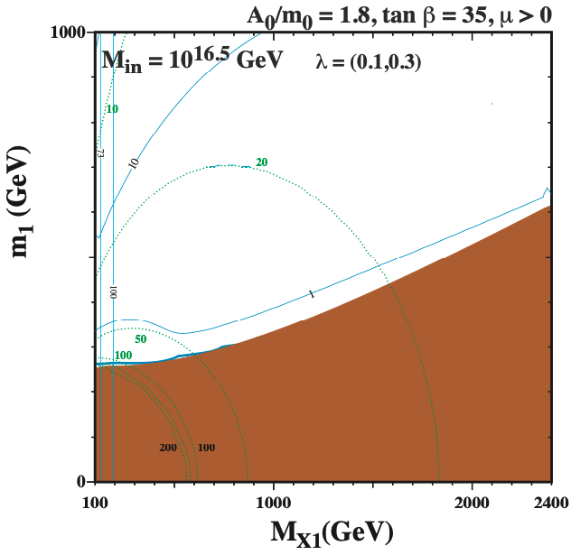
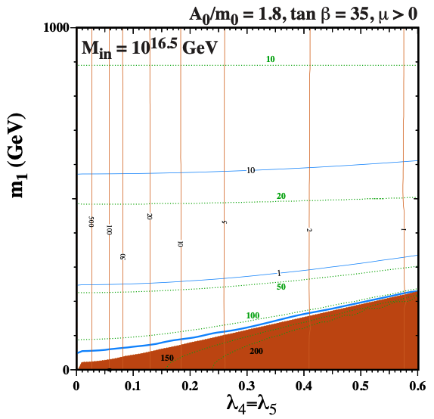
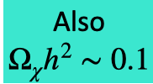

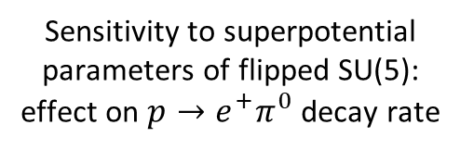


Flipped Supersymmetry, $g_{μ}−2$ & Dark Matter
Exploration of $g_{μ}−2$, dark matter and proton decay possibilities
Proton decay accessible to
Hyper-Kamiokande
Higgs mass
also OK
‘Quadrifecta’
region
Significant contribution
to $g_{μ}−2$
Soft supersymmetry-breaking
parameters specific
to flipped SU(5)
Sensitivity to superpotential
parameters of flipped SU(5):
effect on $p→e^{+}π^{0}$ decay rate
JE, Evans, Nagata, Nanopoulos & Olive, arXiv:2110.06833

Slide 34



Summary
Visible matter
Standard Model
$$g_{μ}−2$$
& DM:
SUSY?
https://www.youtube.com/watch?v=Ts6vS-qYuY4

Slide 35
FINALE
J.R. Ellis, J.L. Lopez, D.V. Nanopoulos, Phys. Lett. B 252, 53–58 (1990).
“We leave it to the reader to decide
how many more miracles she wants to see before abandoning her doubts
about flipped SU(5)”.

