Slide 1

Proposal for MCBXF acceptance criteria
E. Todesco, J. C. Perez, F. Toral, et al.
12 October 2021

Slide 2
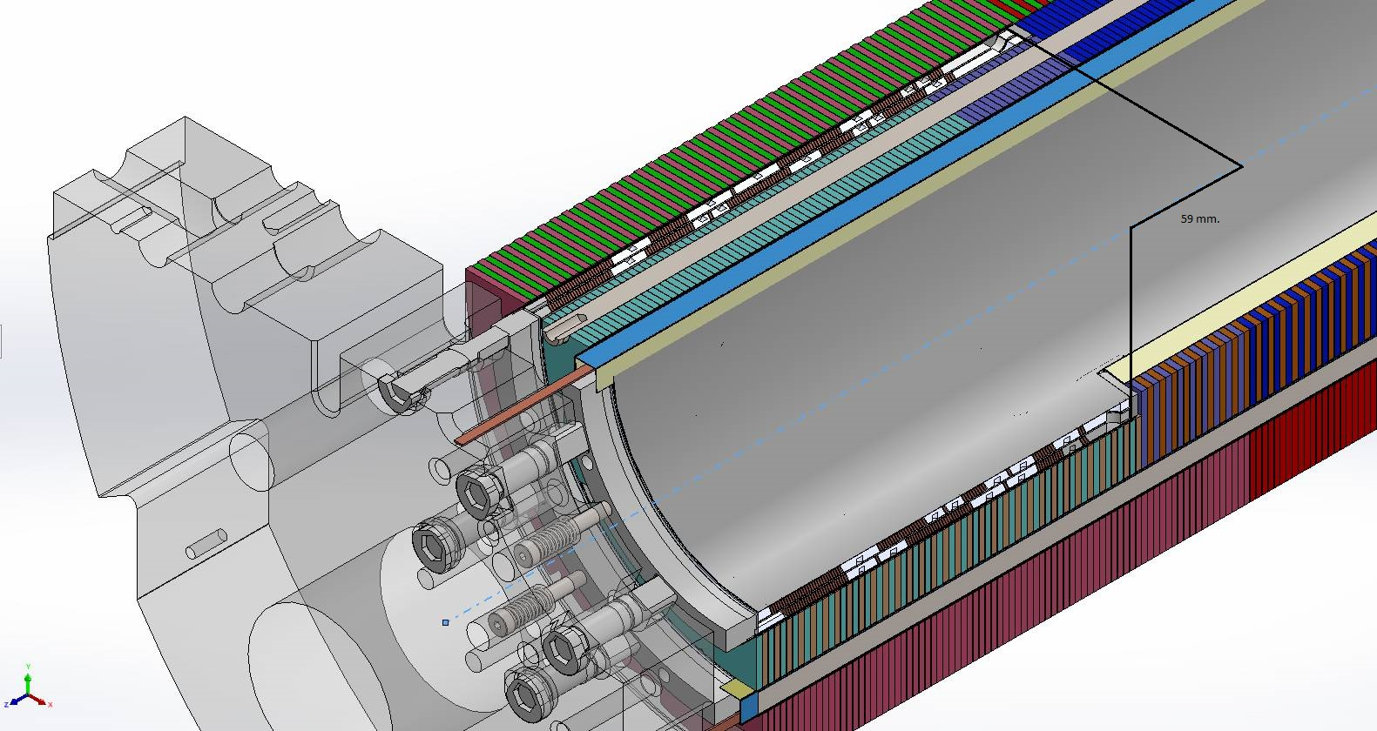
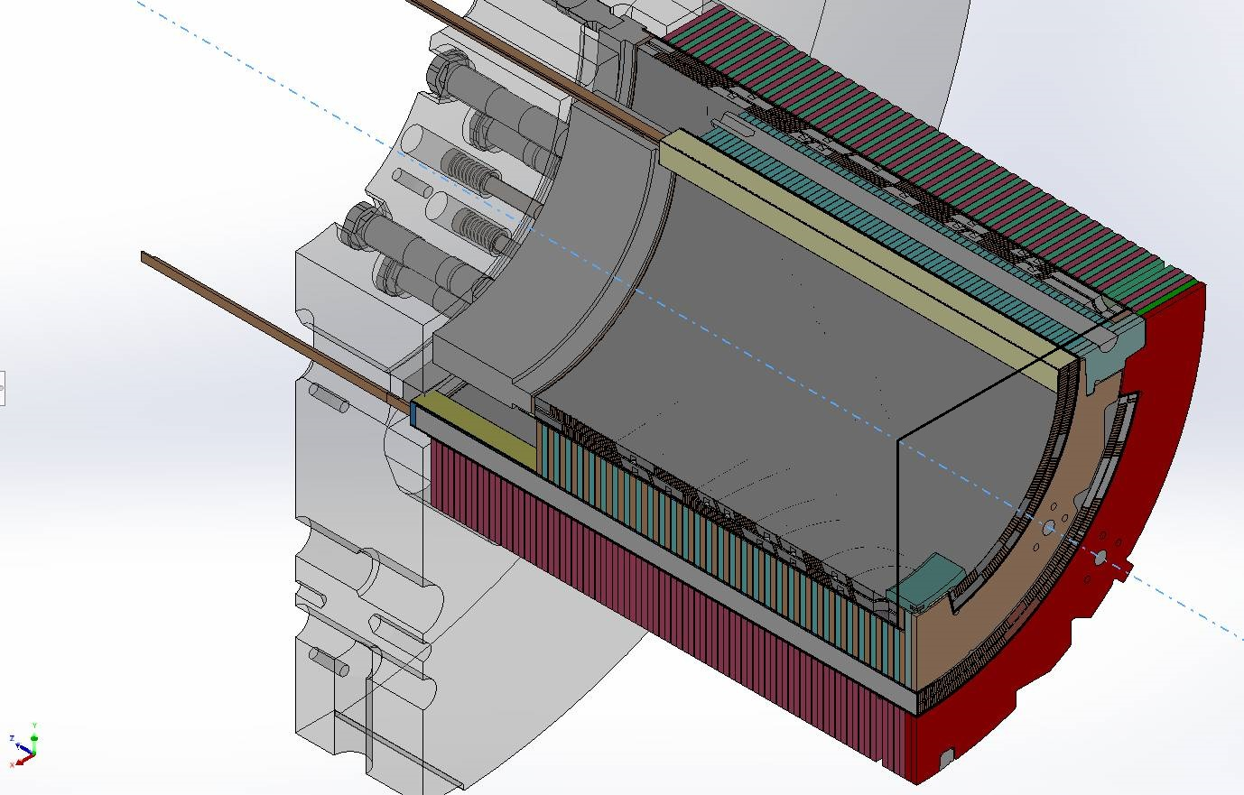
MCBXFB01 results
The third nested corrector MCBXFB01 has been tested in July-August 2021
This magnet had a design modification to improve the issue of retraining when changing the torque sign (see EDMS 2612566)
Baseline configuration of the coil end (top) and new configuration (bottom)
Baseline configuration of the end spacer (left) and new configuration (right)
[F. Toral, C. Martins Jardim, J. Garcia Matos, J. C. Perez, et al.]

Slide 3
MCBXFB01 results
Since the very beginning of the test, the improvement was clearly visible
First element (not critical for operation): virgin training
  The magnet reached nominal integrated field 2.5/2.5 T m in both dipoles with 3 quenches, compared to about 30 in MCBXFBP1 and MCBXFBP2
Test results of MCBXFB01 (left) and MCBXFBP2 (right)
[S. Ferradas Troitino, F. Toral, C. Martins Jardim, J. Garcia Matos, J. C. Perez, et al.]

Slide 4
MCBXFB01 results
Since the very beginning of the test, the improvement was clearly visible
Second element (critical for operation): change of torque
  After changing the torque sign, the magnet reached nominal integrated field 2.5/2.5 T m in both dipoles with 1 quench, compared to about 30 in MCBXFBP1 and MCBXFBP2
Test results of MCBXFB01 (left) and MCBXFBP2 (right)
[S. Ferradas Troitino, F. Toral, C. Martins Jardim, J. Garcia Matos, J. C. Perez, et al.]

Slide 5
MCBXFB01 results
Since the very beginning of the test, the improvement was clearly visible
Third element (critical for operation): memory
  After thermal cycle, the magnet reached nominal integrated field 2.5/2.5 T m in both dipoles with 2 quenches, and was able to operate in all sign configurations
Test results of MCBXFB01
[S. Ferradas Troitino, F. Toral, C. Martins Jardim, J. Garcia Matos, J. C. Perez, et al.]

Slide 6
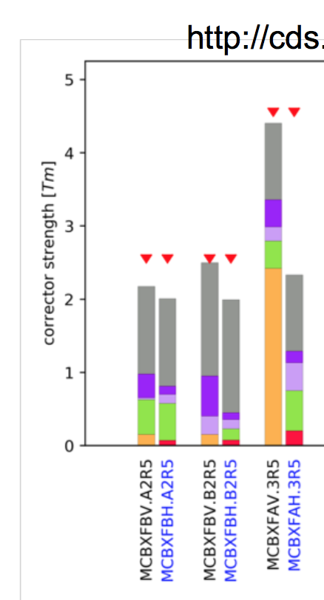
Proposal for requirements
The test of MCBXFB01 showed that few quenches occurr when the torque is larger than 90% of nominal torque
  And indeed the torque is the phyiscal phenomena limiting the magnet performance
We propose to go for a specification that
  Satisfies the WP2 requirements
  Accounts for this feature of the magnet
  Gives some margin and possibility of 7.5 TeV
MCBXFB: 2.0 T m inner, 2.5 T m outer
  … and viceversa
MCBXFA: 2.5 T m inner, 4.5 T m outer
  … and viceversa
MCBXF requirements
[R. de Maria, M. Giovannozzi, R. Tomas Garcia, et al.]

Slide 7
Test results for new requirements
In this configuration the MCBXFB01was tested
  It reached 2/2.5 T m and also 2.14/2.68 T m (7.5 TeV equivalent operation without quench
Test results of MCBXFB01 – the powering at 2/2.5 T m
[S. Ferradas Troitino, F. Toral, C. Martins Jardim, J. Garcia Matos, J. C. Perez, et al.]

Slide 8
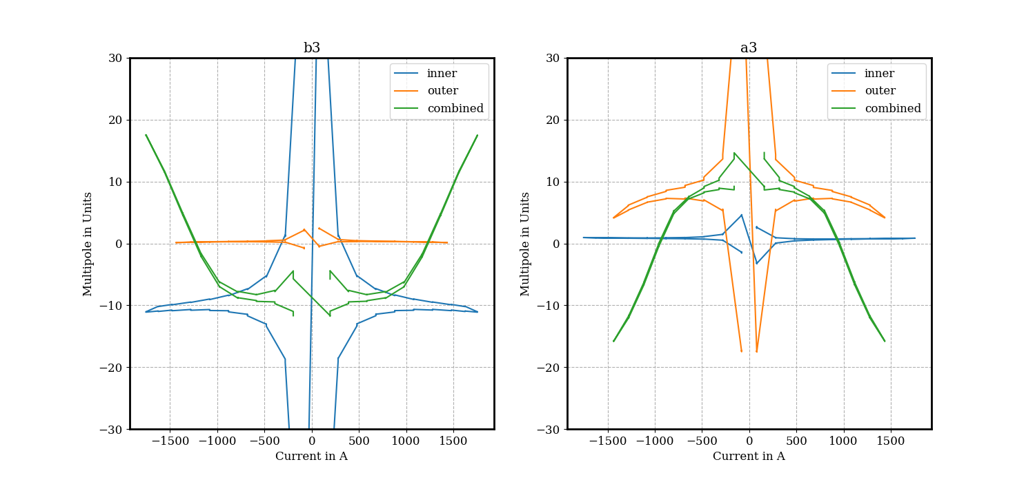
A word about field quality
Having the full 2.5 T m, the magnet can fit the 20 units range in b3 and a3
  This is intrinsic to the magnet design
  It is deterministic, and becomes relevant (above 10 units) only above 1.5 T m integrated field in each dipole
We are working on a 2D field model to account for this – not yet there
  Several data collected for MCBXFB01, analysis ongoing
Measured field quality in MCBXFB01, powering at 2.5/ 2.5 T in combined mode (green curve)
[M. Bonora, L. Fiscarelli, S. Ferradas Troitino, F. Toral,
C. Martins Jardim, J. Garcia Matos, J. C. Perez, et al.]

