Slide 1

HL-LHC motorized jacks
Clarification of requirements of engineering specification
Jaime Perez Espinos
TE-VSC
HL-LHC ad-hoc meeting – 16/06/21

Slide 2
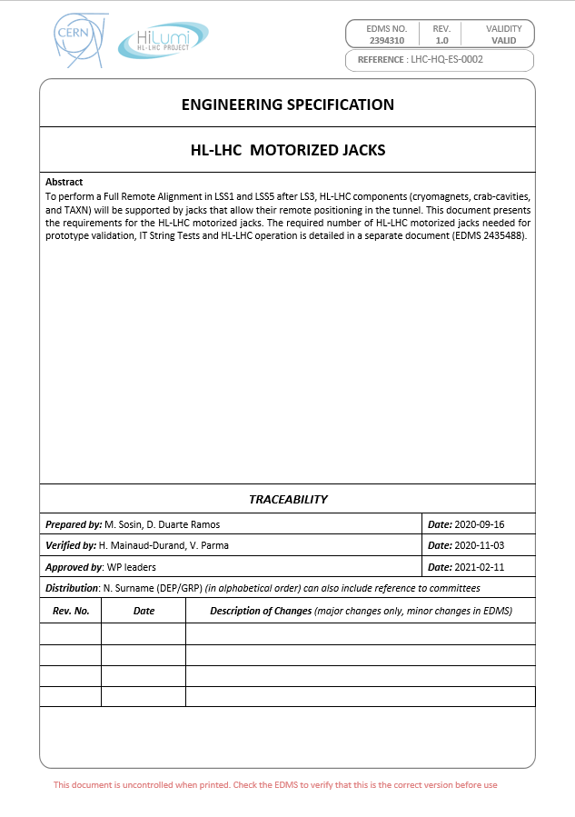
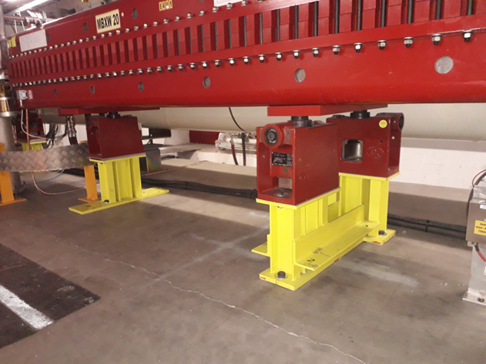
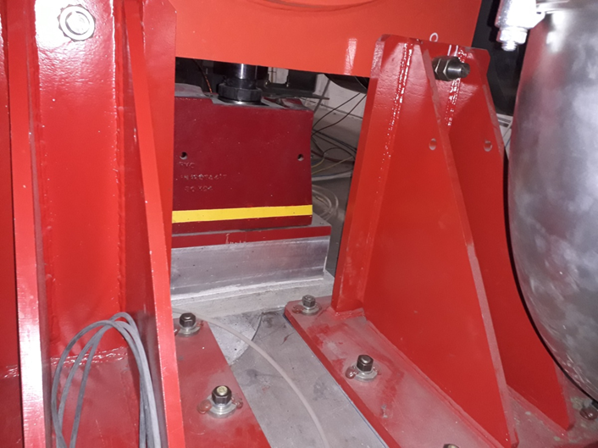
Outline
EDMS #2394310
Released status (v1)
Objective of the exercise: clarify open or undefined aspects for design finalization and manufacturing launch
Installation process, including shimming or grinding is not part of the exercise. However, available space wrt nominal position and for maintenance and/or alignment purposes must be validated

Slide 3
General
FRAS spec. contains a table of requirements for the jacks. Some of the figures are not equivalent to those included in doc. EDMS #2394310. The basis for the design is the specification EDMS #2394310, and not EDMS #2166298 (for the FRAS). Any comment?

Slide 4
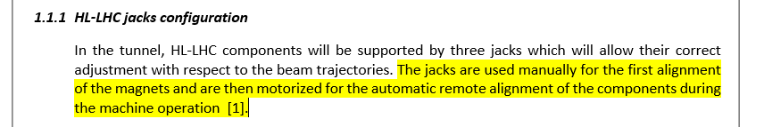
Section 1.1.1 (page 3) - #1
  Clarify if the interface for both manual and motorized alignment driving systems is the same [WP15 (SURVEY)]
  If so, details of the interface and the envelope taken by the tools themselves and for their assembly are necessary [WP15 (SURVEY)]

Slide 5
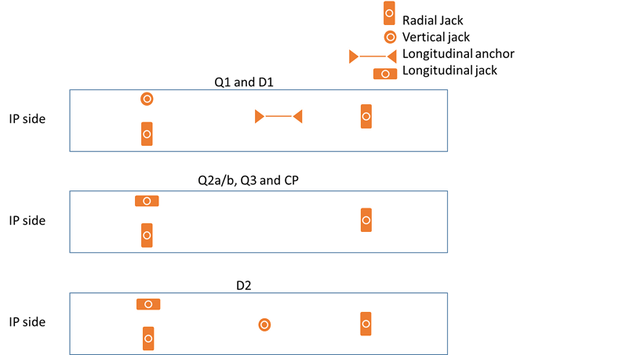
Section 1.1.1 (page 3) - #2
Clarify configuration at LEFT side: mirror symmetry? [WP15 (SURVEY), WP3]
180° rotation?
What about Q4 and Q5 support configuration? [WP15 (INTEGRATION), WP15 (SURVEY), WP3]

Slide 6
Section 1.1.1 (page 3) - #3
What about TAXN support configuration? [WP15 (INTEGRATION), WP15 (SURVEY), WP8]
What about CC support configuration? [WP15 (INTEGRATION), WP15 (SURVEY), WP4]

Slide 7
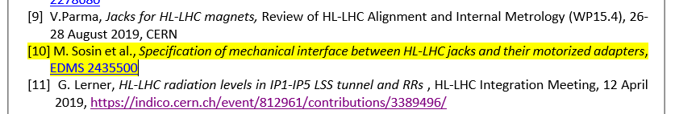
Section 2 (page 5)
Document is EMPTY!!! Needs to be created!!! [WP15 (INTEGRATION), WP15 (SURVEY), WP3, WP4, WP8]
  At least interfaces to:
    Floor [WP15 (INTEGRATION)]
    Motorization systems (2x) [WP15 (SURVEY)]
    Manual alignment tools [WP15 (SURVEY)]
    Load sensors (for vertical and horizontal movements) [WP15 (SURVEY)]
    Machine elements [WP3, WP4, WP8]
  At least envelopes for:
    Assembly/disassembly of manual alignment tools [WP15 (INTEGRATION), WP15 (SURVEY)]
    Assembly/disassembly of motorization systems [WP15 (INTEGRATION), WP15 (SURVEY)]

Slide 8
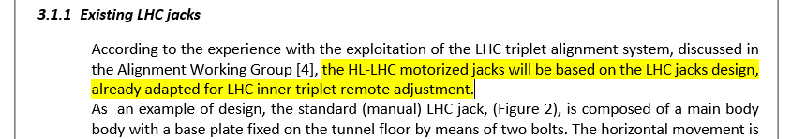
Section 3.1.1 (Page 5) - #1
Design stands on push/pull system for horizontal movement and push system for vertical movement
The push system for vertical movement involves that the reaction on a support due to the weight of the machine element and the supporting configuration must be ALWAYS higher than the sum of loads acting on the opposite sense (stiffness from compensators or jumpers, ΔP, etc.)
→
Confirmation that this will be the case [WP3, WP4, WP8]

Slide 9
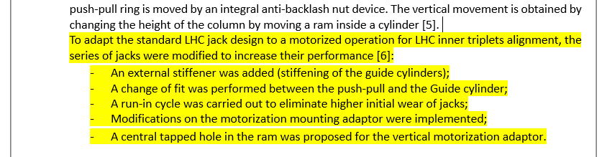
Section 3.1.1 (Page 5) - #2
  → The information in [6] is not fully tracked. Does anyone have all the details? [WP15 (SURVEY), WP3]

Slide 10
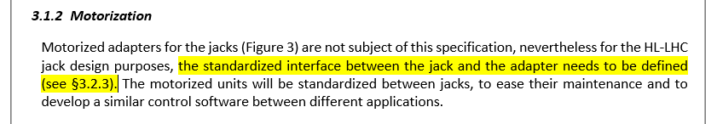
Section 3.1.2 (page 6)
(§3.2.3) does not exist. The interface must be detailed [WP15 (SURVEY)]

Slide 11
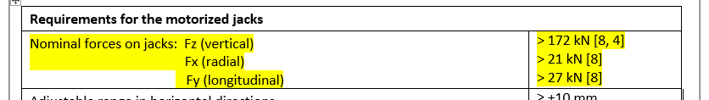
Section 3.2.1 (page 7) - #1
The requirement for nominal forces on jacks, as written, can be misleading.
To be clarified that the system can be submitted to the following maximum forces [WP3]
Push system

Slide 12
Section 3.2.1 (page 7) - #2
Maximum loading for jacks comes from magnets. TAXN and CCs are considered to be in the shade of those values.
  In vertical direction the maximum load comes basically from the weight and compensator forces: all rest of contributions are considered negligible. Do you confirm? [WP3]
  In horizontal direction (radial or longitudinal), the maximum load comes from compensator forces (transversal or axial, leaving apart the loads absorbed by the longitudinal anchoring). Do you confirm that other contributions like jumper, tunnel inclination (and subsequent horizontal component), internal busbars, load coupling effects, etc. are negligible wrt to requirements given? [WP3]

Slide 13
Section 3.2.1 (page 7) - #3
The adjustable range in horizontal direction and vertical directions is shared between manual and motorized movements, isn’t it? [WP15 (SURVEY)]
Is there any minimum free range at transversal direction to compensate pre-alignment process, coupling effects, etc.? [WP15 (SURVEY)]

Slide 14
Section 3.2.1 (page 7) - #4
Clarification of long term stability is required. [WP15 (SURVEY)]
  Does it apply to vertical and/or transversal movement? Or to a combination of both?
  How to discriminate the long term instability coming from other sources different to the jacks themselves (ie from the tunnel floor)?

Slide 15
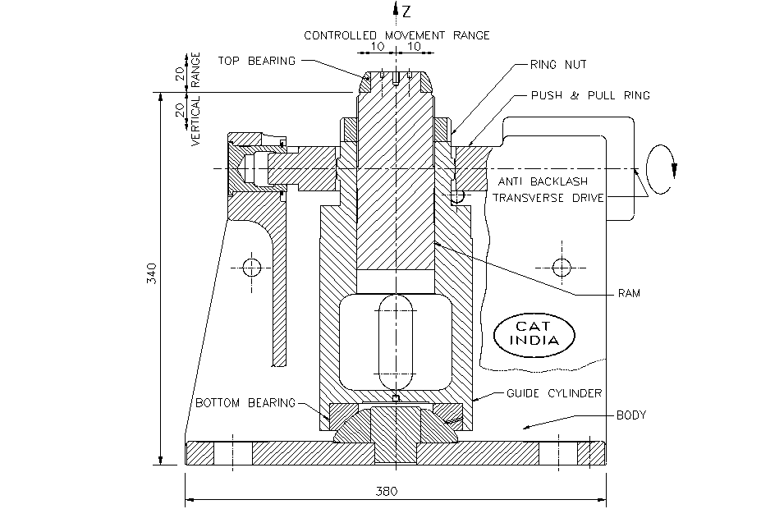
Section 3.2.1 (page 7) - #5
Minimum gap between cryostat and floor
(340 mm) → I understand the requirement as minimum “nominal” gap between floor and top bearing plain support surface→ the reality is that the gap is bigger. Do you confirm that this spec. is OK for all cases? [WP15 (INTEGRATION), WP3, WP4, WP8]

Slide 16
Section 3.2.1 (page 7) - #6
Why radiation hardness is 2 MGy? According to RP and FRAS spec, the most critical case is estimated to be <1 MGy at TAXN or D2 → could have an impact on the lubricant to be used [WP15 (SURVEY)]
Backlash in horizontal adjustment applies only to the horizontal mechanism moving the jack piston; it does not cover the driving system or the gearing system to have perpendicular adaptor. Is it confirmed? [WP15 (SURVEY)]
Only vertical (on all cases) and radial (on radial configuration) movements are motorized. Is it confirmed? [WP15 (SURVEY)]

Slide 17

Section 3.2.1 (page 7) - #7
Type and characteristics of load transducers for radial and vertical movements are necessary. Otherwise, agree space reservation and interface. [WP15 (SURVEY)]
No jack stiffness spec. is present. Not necessary? Impact or control in case of shimming? [WP15 (INTEGRATION), WP15 (SURVEY), WP3, WP4, WP8]
  → F. Micolon has created a draft doc. for this (EDMS #2581596)
No spec. in terms of load transmission to the floor. Any limitation? Same approach as in LHC? Torque applied through nuts? [WP15 (INTEGRATION), WP15 (SURVEY), WP3, WP4, WP8]
Current design assumes two attachment points to the floor. Maximum coupling from installation is limited to 25 mrad (⇒ 0.7 KN force). There’s another coupling or load source provoking a transversal load to be supported by the jack? No stiffness spec. on that direction? [WP15 (INTEGRATION), WP15 (SURVEY), WP3, WP4, WP8]

Slide 18

Section 3.2.2 (page 7)
Figures 4 and 5 involve the orientation of the motor adaptors towards the QXL. Any interference at magnets, CCs or TAXN? [WP15 (INTEGRATION)]
  Any installation difficulty wrt gutter (draining chanel)? [WP15 (INTEGRATION)]
Figures 6 and 7. Does it include the space required for assembly/disassembly? [WP15 (INTEGRATION), WP15 (SURVEY)]

Slide 19
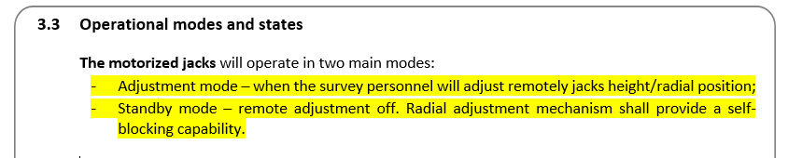
Section 3.3 (page 10)
I understand that both in adjustment mode and standby mode, the position in vertical direction is blocked by the driving system itself, isn’t it? No need then for blocking nut? [WP15 (SURVEY)]

Slide 20
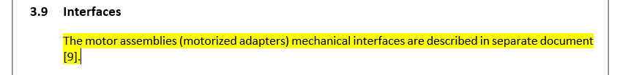
Section 3.9 (page 10)
Reference should be [10] instead of [9]. Likewise doc. is empty → CHECKED PREVIOUSLY

