Slide 1
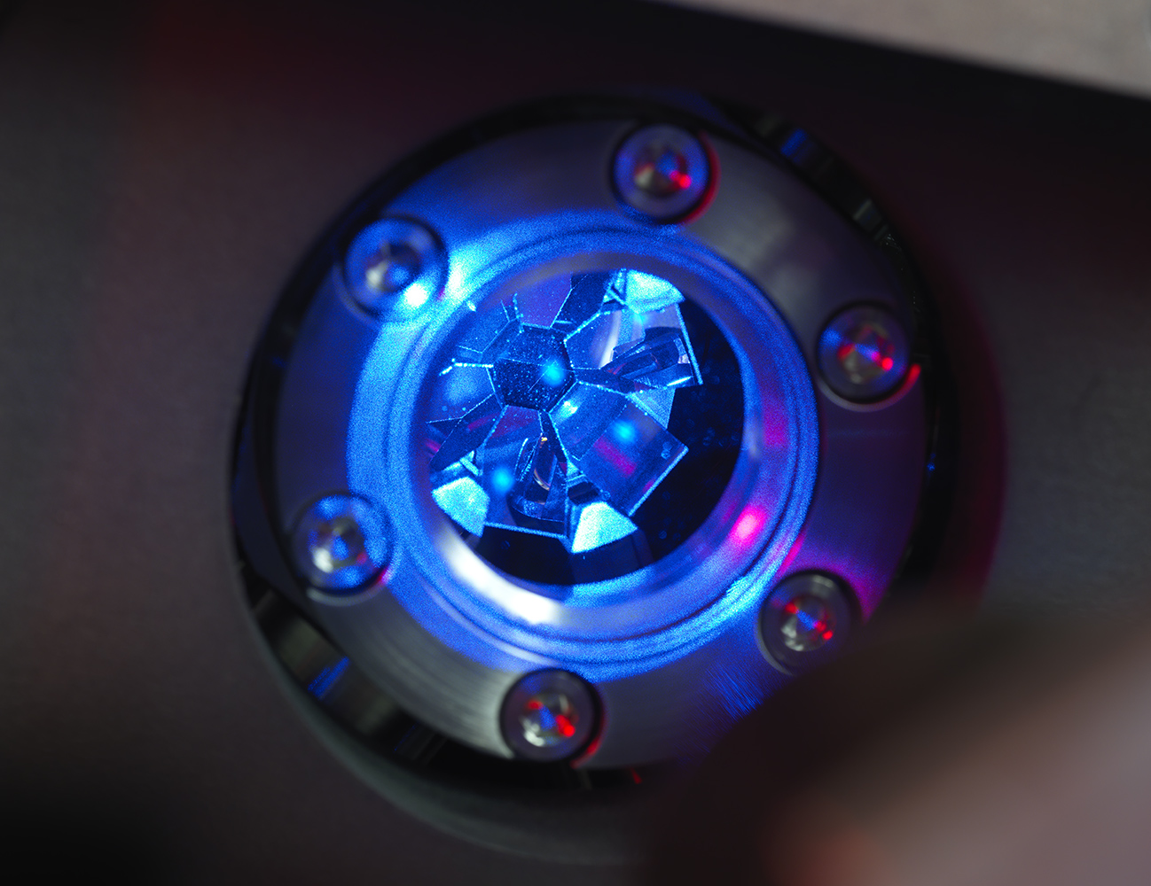
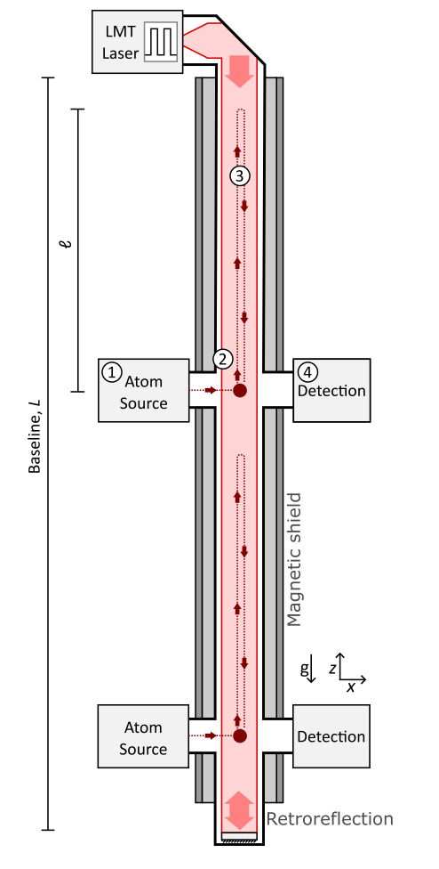
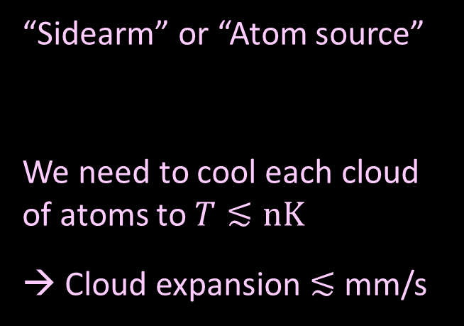
Strontium atoms in a MOT
“Sidearm” or “Atom source”
We need to cool each cloud of atoms to $T≲nK$
→ Cloud expansion $≲$ mm/s
Image: Sr atoms in an optical lattice clock at NPL, UK
W. Bowden et al. Scientific Reports 9, 11704 (2019)
1

Slide 2
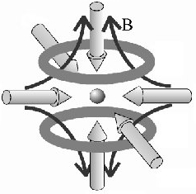
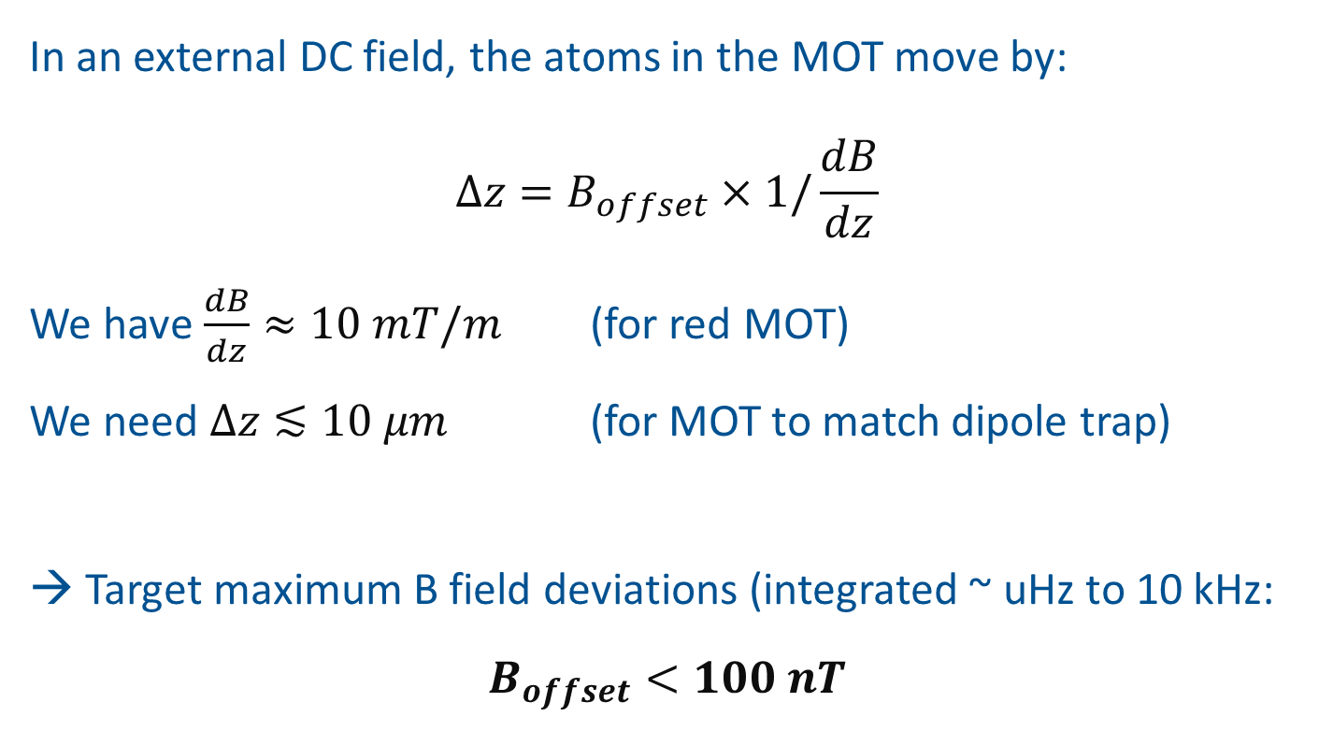
B field requirements
In an external DC field, the atoms in the MOT move by:
$$Δz=B_{offset}×1/\frac{dB}{dz}$$
We have $\frac{dB}{dz}≈10 mT/m$ (for red MOT)
We need $Δz≲10 μm$ (for MOT to match dipole trap)
→ Target maximum B field deviations (integrated ~ uHz to 10 kHz:
$$B_{offset}<100 nT$$

Slide 3
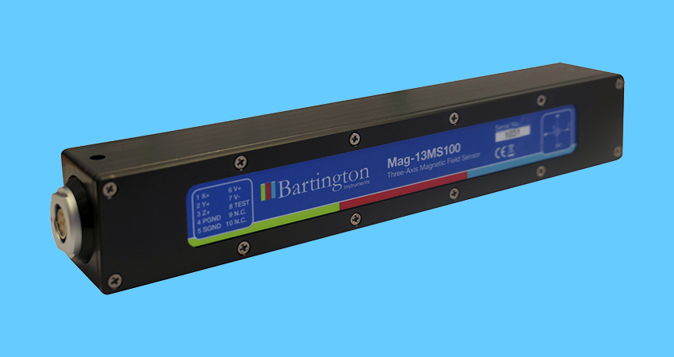
Suggested B field measurement
Use a few low-noise Hall probes at different locations in the shaft to measure B in the most relevant bandwidth: DC - a few kHz
Split into two datasets
Noise spectrum: mHz - 3 kHz
Long-term field: 1 Sa/s for a few weeks
Take measurements, then decide mitigation approach
Suitable 3-axis Hall probe, e.g. :
https://www.bartington.com/products/precision-magnetometers/mag-13-three-axis/

Slide 4
Other concerns
A couple of potentially concerning features pointed out in Daniel’s EM noise slides:
UPS switching currents (8, 16, 25 kHz) find their return paths through all interconnected structures
  What does this mean? Cold atom technology includes sensitive analog circuits for e.g. lasers and coils
  Possible mitigation: fancy UPS to supply all the cold atom equipment
Low frequency magnetic field
  E.g. 50 Hz + harmonics can be difficult to compensate or shield – could be a showstopper if these are too large. Another reason to measure with Hall probe…

