Slide 1
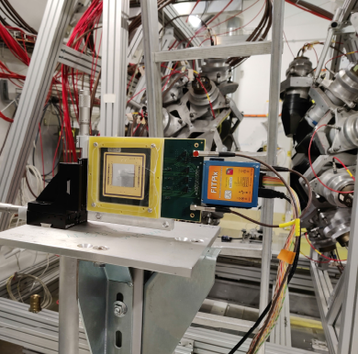
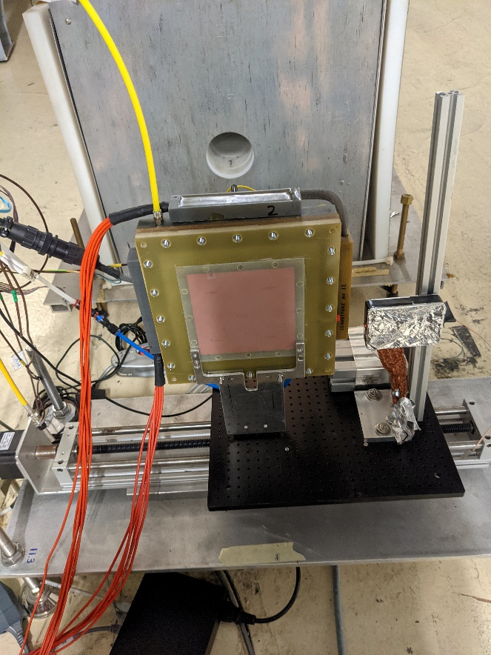
TIMEPIX for beams: Alignment & Profiles

Slide 2
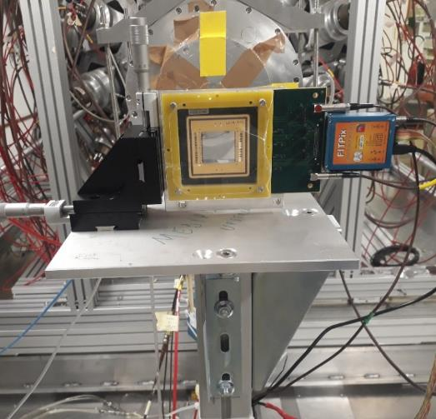
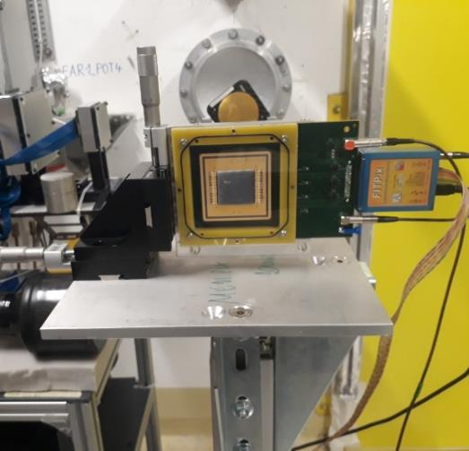
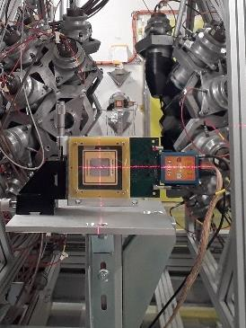
Timepix Installation in EAR1 for the beam/laser alignement
B04
B05
The two TimepixQuads already used in 2018 have been installed
on the usual aluminum column but this time with
two vernier calliper screws (horizontal and vertical)
allowing a fast alignment of the detector to the beam position

Slide 3
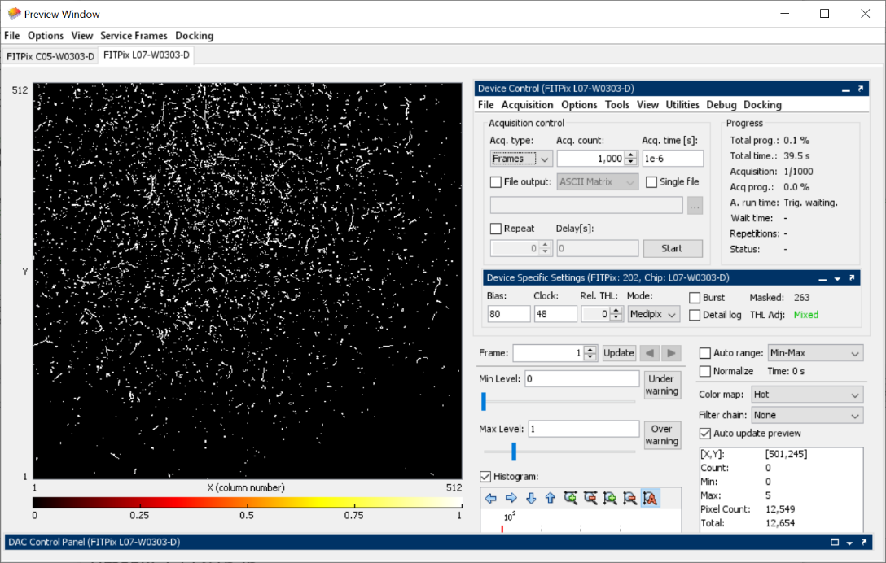
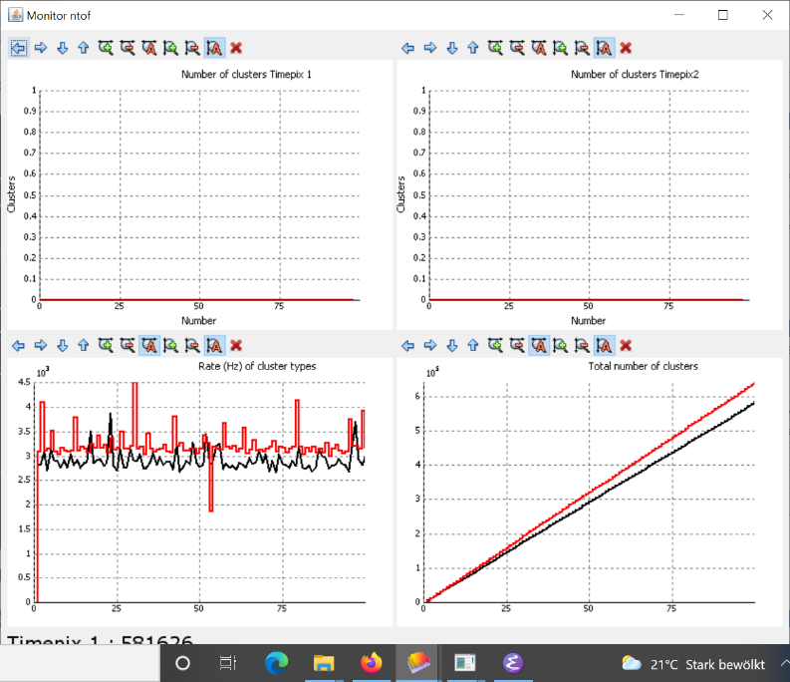
Online plots
The 4 Timepixes were acquired by the two Windows PC placed in EAR1 and EAR2
The data can be saved by a list of pixels or cluster produced by an online Cluster analysis

Slide 4
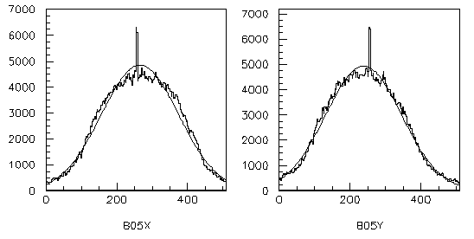
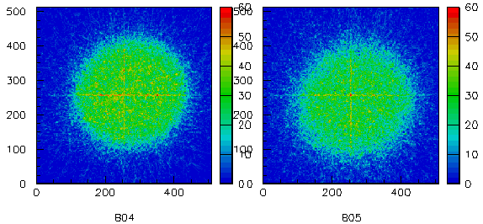
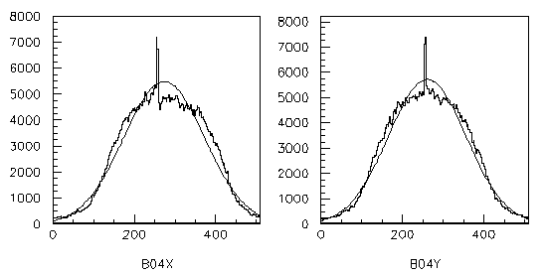
EAR1 beam position : 2D and projections
B05 X : 14.62 => 0.54 mm
B05 Y : 13.13 => - 0.94 mm
B04 X : 15.05 => 0.97 mm
B04 Y : 14.38 => 0.30 mm

Slide 5
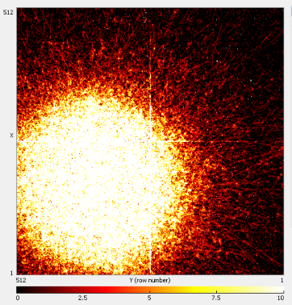
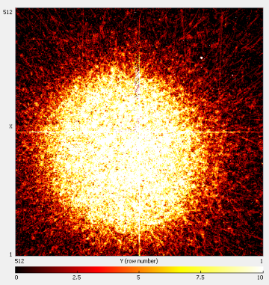
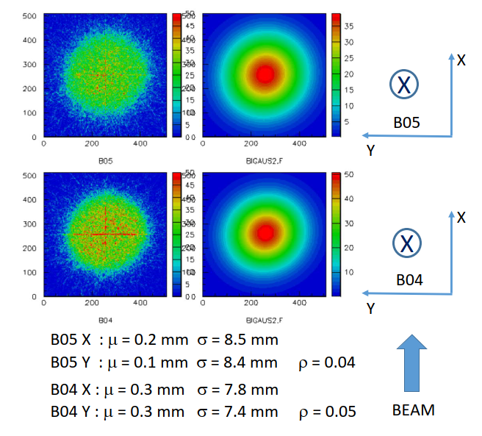
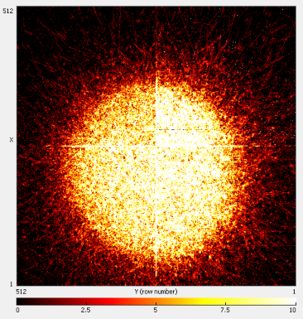
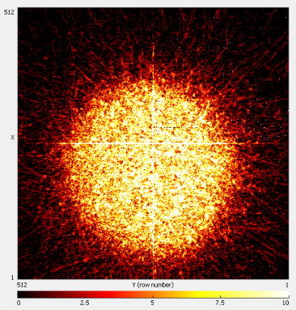
Alignment in EAR1 Timepix positions
First measurement
Second measurement
Final Position
B05
X
B04
X
EAR1
BEAM
EAR1
BEAM

Slide 6
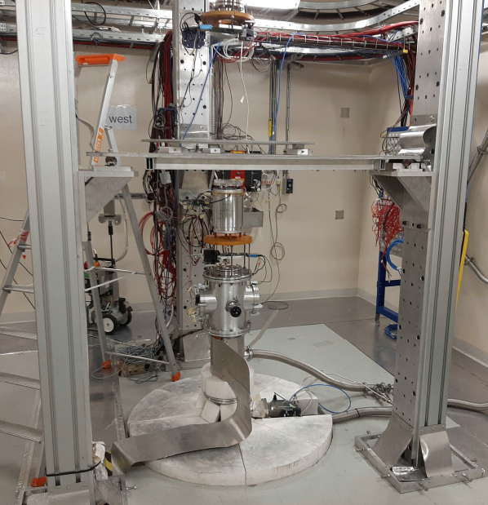
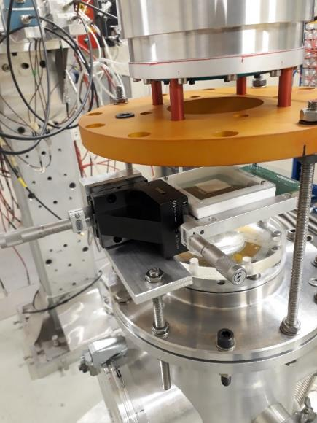
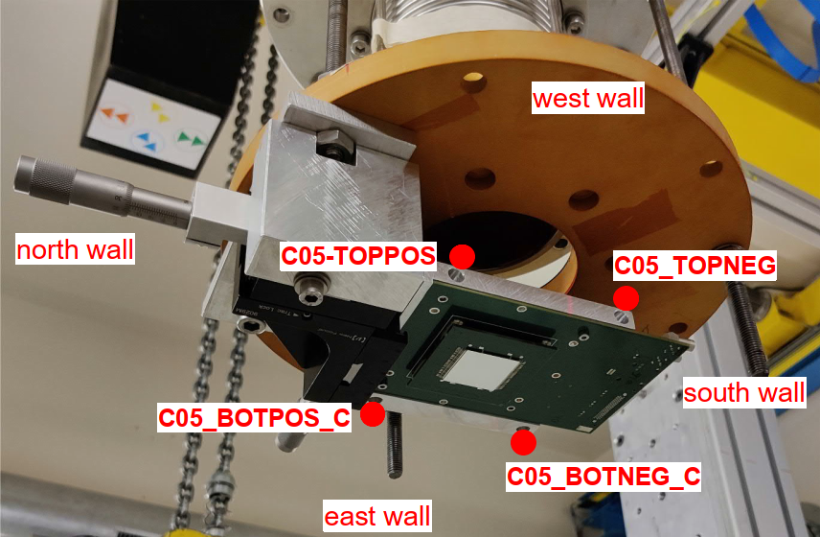
TimepixQuad Installation in EAR2 for the beam/laser alignment
L07
C05
Installation in EAR2 with the two Timpixquad bought in 2020 by INFN
In this case two special support have been built to hang the stages on the beam pipe

Slide 7
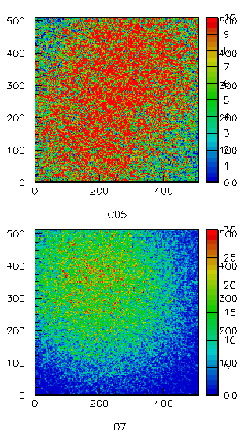
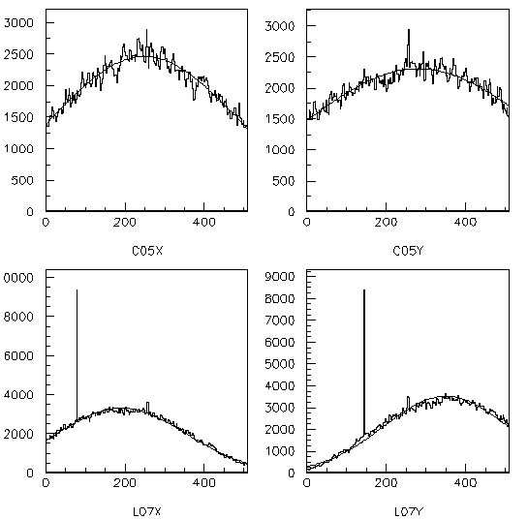
EAR2 beam position run001 E> 1MeV
C05 X : 13.70 => - 0.38 mm
C05 Y : 15.43 => 1.35 mm
L07 X : 10.52 => - 3.56 mm
L07 Y : 19.29 => 5.21 mm

Slide 8
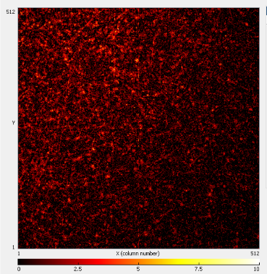
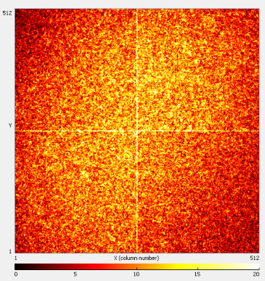
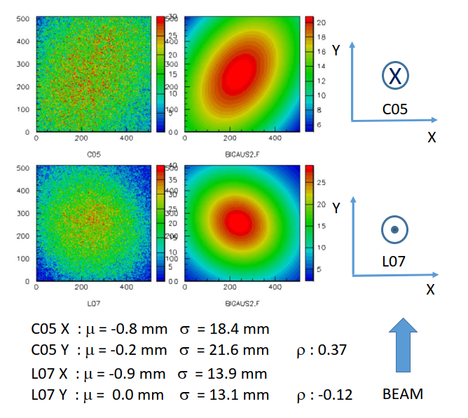
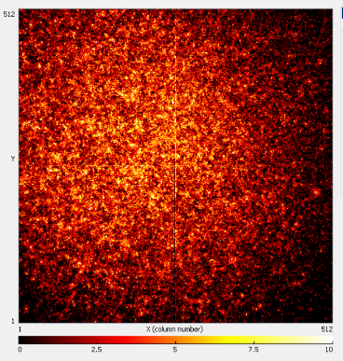
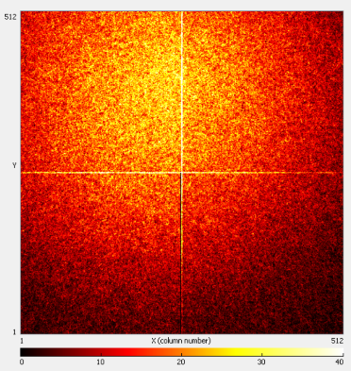
Timepix positions
First measurement
Second measurement
C05
X
L07
EAR2
BEAM
EAR2
BEAM

Slide 9
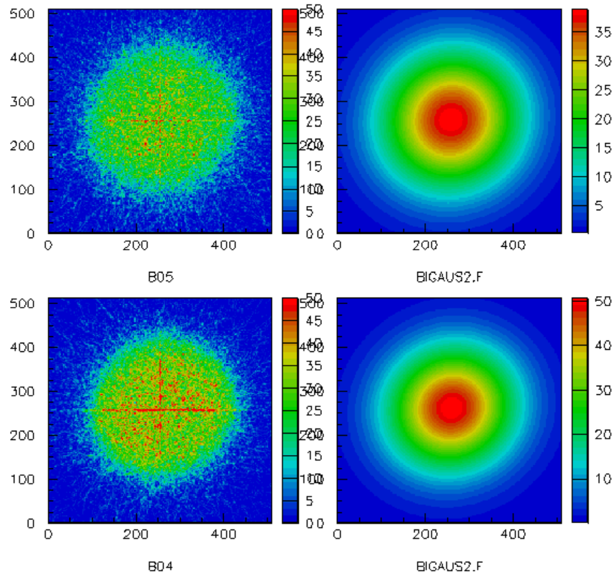
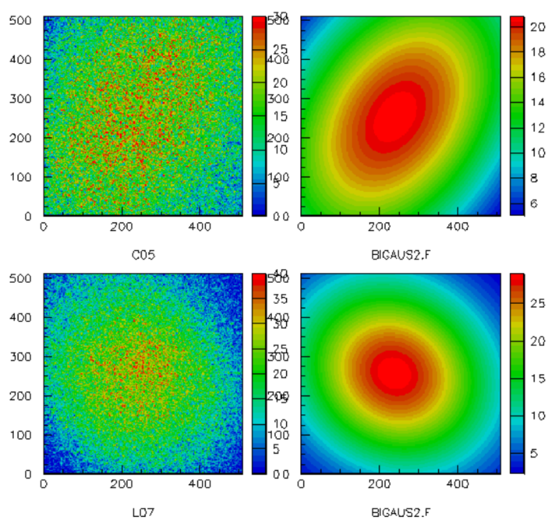
The 2D fast neutrons beam spot and fits
EAR1
EAR2
Proton direction
X
Y
X
X
B05
C05
Y
X
X
Y
X
B04
L07
Y
X
B05 X : μ = 0.2 mm σ = 8.5 mm
B05 Y : μ = 0.1 mm σ = 8.4 mm ρ = 0.04
C05 X : μ = -0.8 mm σ = 18.4 mm
C05 Y : μ = -0.2 mm σ = 21.6 mm ρ : 0.37
B04 X : μ = 0.3 mm σ = 7.8 mm
B04 Y : μ = 0.3 mm σ = 7.4 mm ρ = 0.05
L07 X : μ = -0.9 mm σ = 13.9 mm
L07 Y : μ = 0.0 mm σ = 13.1 mm ρ : -0.12
BEAM
BEAM

Slide 10
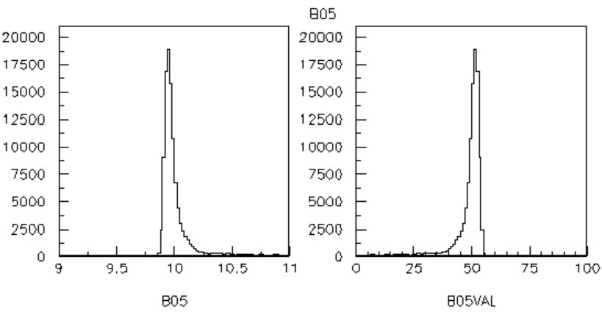
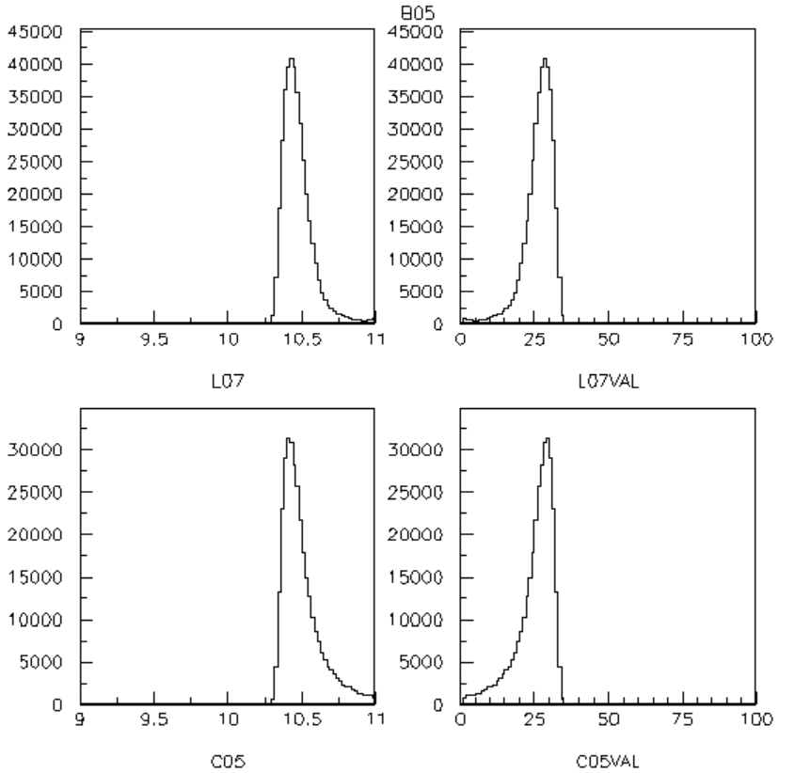
Gamma flash timing
EAR1
EAR2
Time ToA
Time ToA
μ 9.9 μs
σ = 34 ns
μ 10.4 μs
σ = 50 ns
FWHM
80 ns
FWHM
117 ns
Timepix clock 48 MHz
μ 10.4 μs
σ = 50 ns
Time (μm) = delay +( gate – ToA/48)

Slide 11
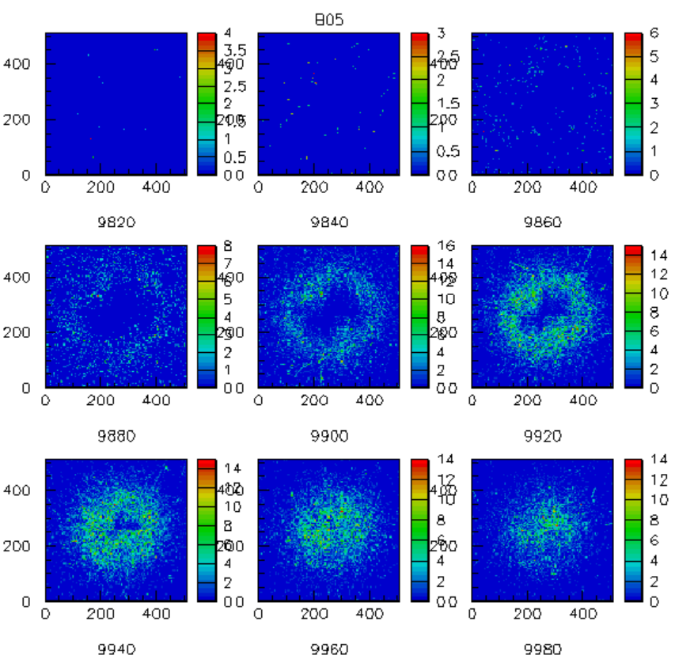
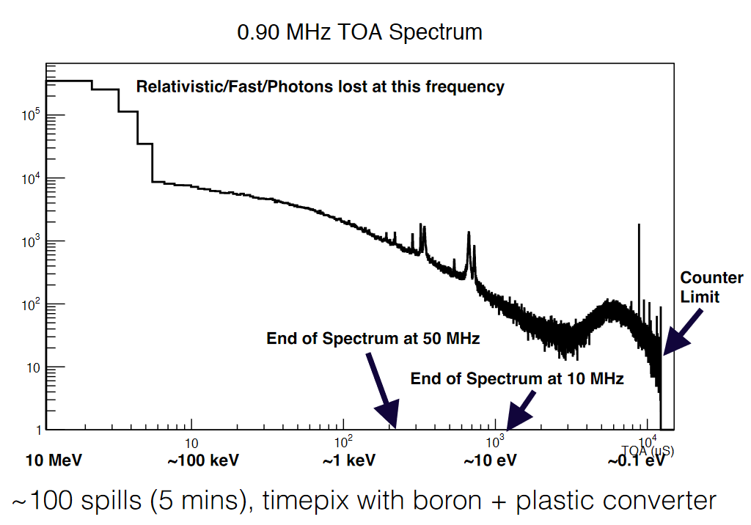
Gamma flash timing
Measurements by Stuart George in 2014
Some issue regarding the real image on gamma flash
due to high intensity
Next year we’ll have Timepix3 quad and this type of
meaasurements can be performed rapidly

Slide 12
Multi Boron GEM detector

Slide 13
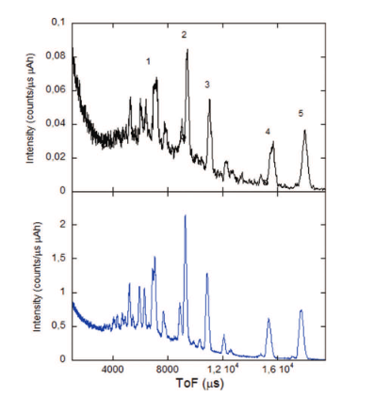
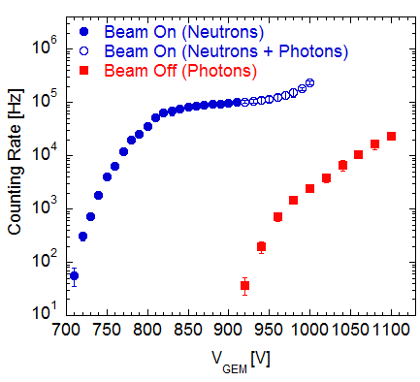
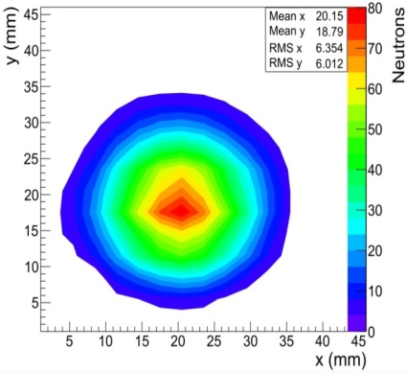
GEM detector for Neutrons
LNF has developed GEM detectors for thermal neutrons through conversion on Boron coated cathode ( good candidate for He³ detector replacement):
Imaging capability
good time resolution (5 ns),
high gamma rejection (>10⁵)
high rate capability O(10 MHz/cm²)
good spatial resolution O(mm)
Diffraction Measurement at ISIS
Gamma Neutron rejection
³He
Neutron beam spot
GEM

Slide 14
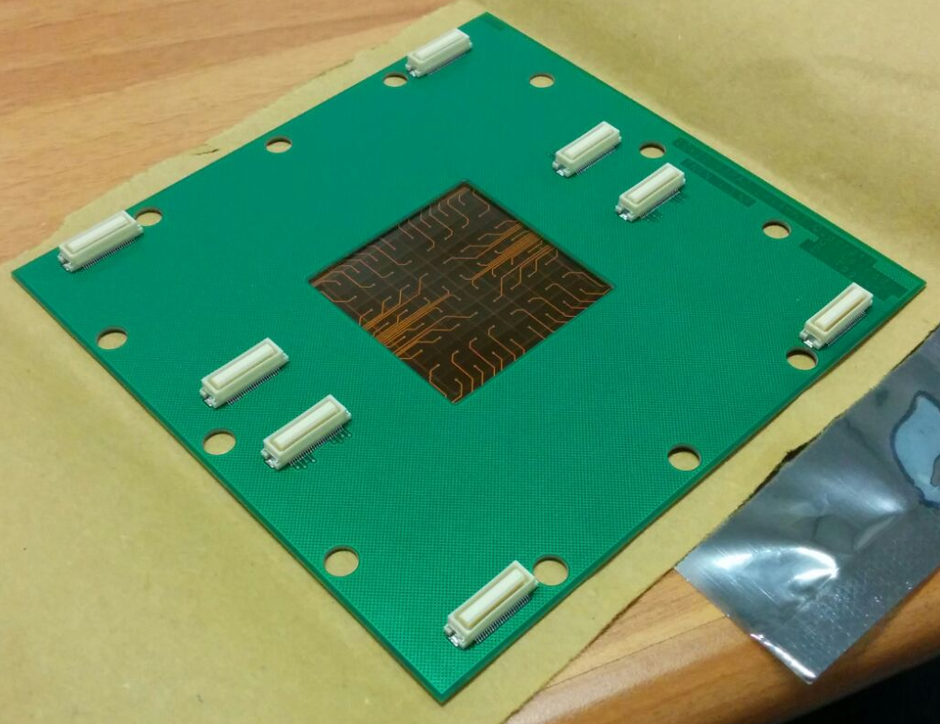
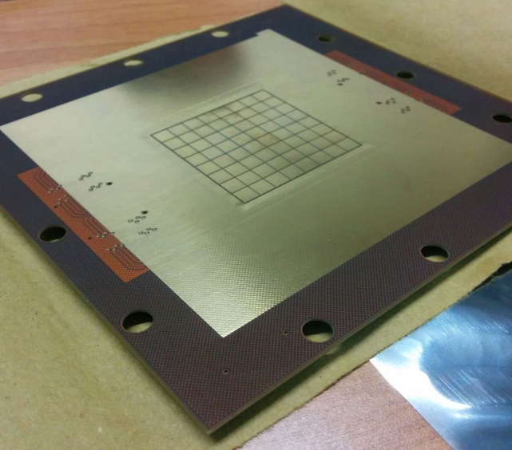
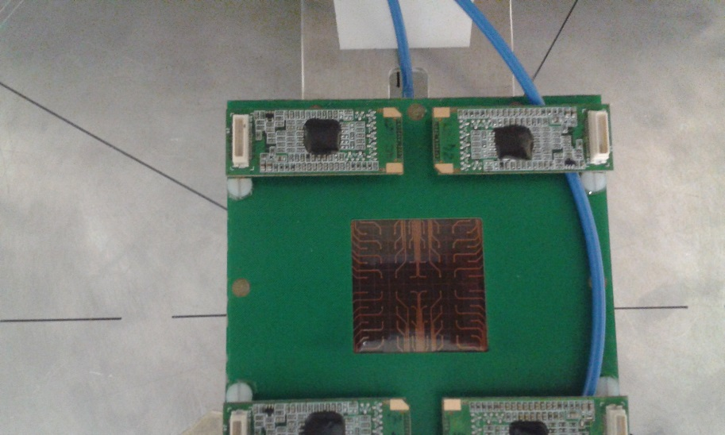
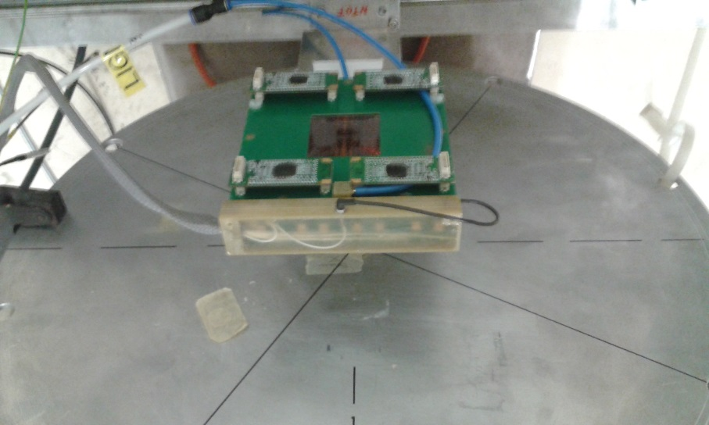
Beam Monitor already tested at nToF in 2017
GAIN
DRIFT
p
pads on kapton
Mylar 12 um
Triple GEM
3 mm
Low Material Budget !

Slide 15
Multi Boron GEM Detector Layout
3GEM
GAIN
DRIFT
α
Li
Thermal Neutron
12 layers of
1 um ¹⁰B₄C
pad readoout
pad readoout
α
Triple GEM
Multiborate
GEM cathode
Triple GEM
BGEMs
50 um

Slide 16
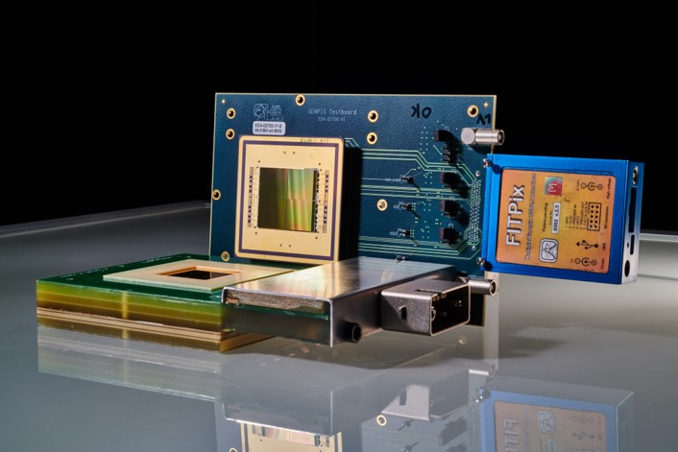
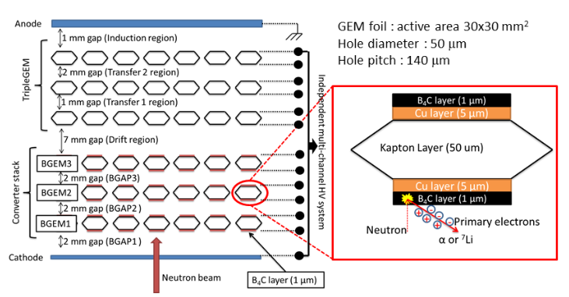
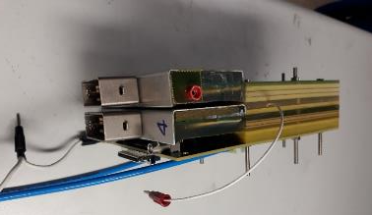
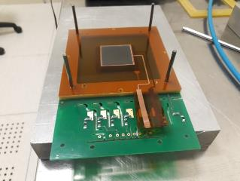
MBGEM Detector assembly
Assembling done in Frascati of
two detectors with 2 and 3 mm gap
between borated gem foils

Slide 17
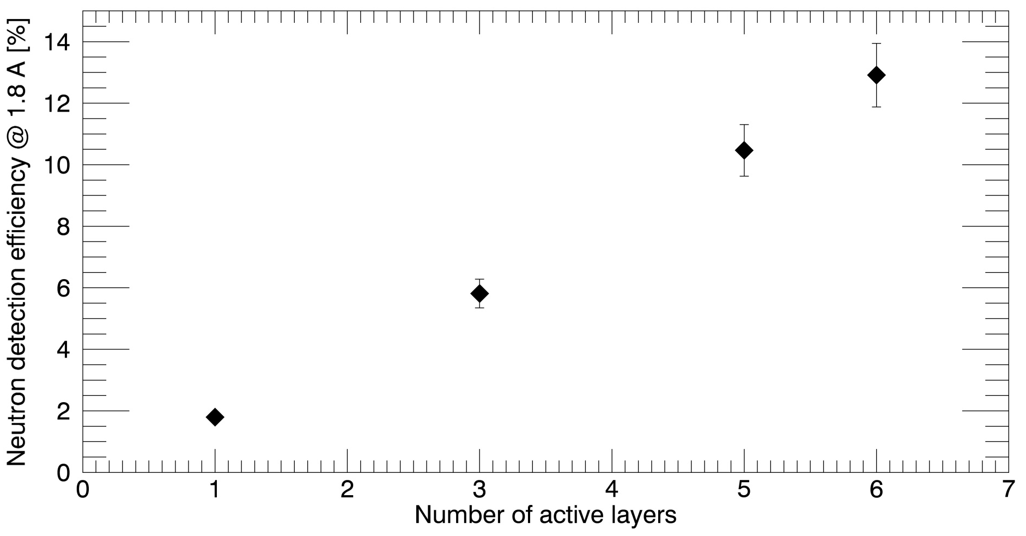
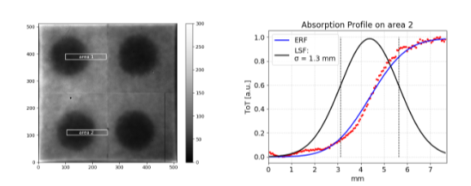
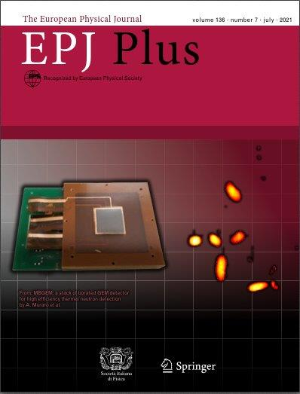
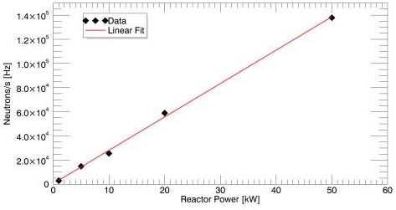
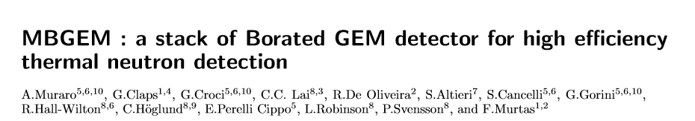
MBGEM characterization published on EPJ+
There is a clear evidence of the contribution of all 6 borated layers:
Final preliminary detector efficiency = 9%
Spatial resolution ranging between 2.0 to 2.6 mm.
Published on EPJ Plus : EPJP-D-21-01206R2 .
Good linearity up to 10⁵ neutrons/s

Slide 18
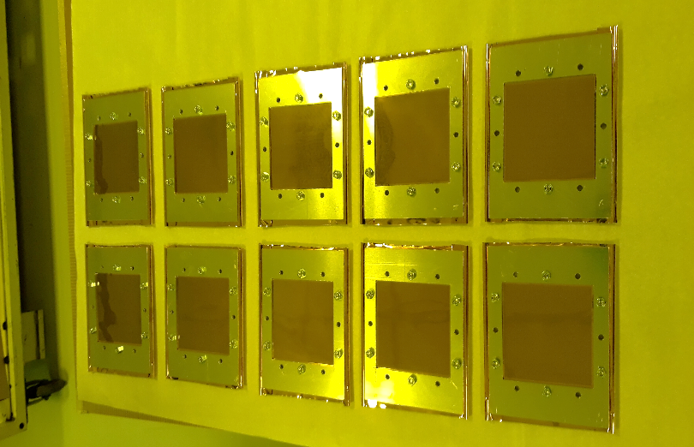
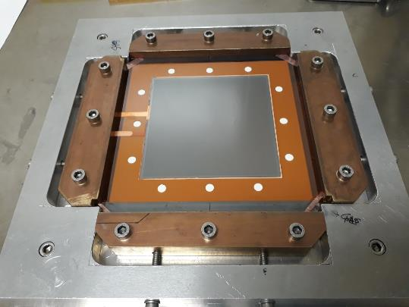
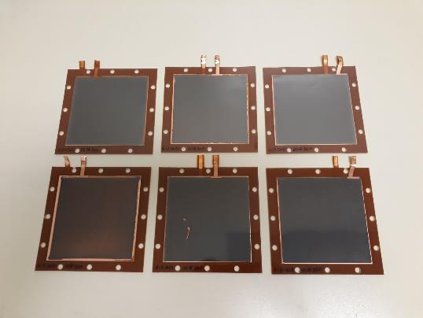



Big Area MBGEM (12 layers) preparation and test at nToF

Slide 19



MBGEM detector : neutron spectra and
Every Boron layer contribute to the
the detector efficiency
Active area 10x10 cm²
Fast
neutrons
Gammas
Fast
neutrons
Gammas
Fast
neutrons
Intermediate
Neutrons
Epitermic
Neutrons
Termal
Neutrons
Epitermic
Neutrons
Termal
Neutrons

Slide 20
Summary
We used few times during this year the 4 Timepixquad for the neutron beam position in EAR1 and EAR2
The systems appear to be solid and reliable
We are going to use for future studies the timepix3; With this readout we have less material budget, better time resolution and wide range of time readout
MBGEM reaches finally a good high efficiency on a wide area The BGEM are mechanically reliable and all the layer are contributing to the thermal neutron detection
Similar detector can now be realized for fast neutrons

